Slide 1
Automotive Technology Principles, Diagnosis, and Service
Sixth Edition
Chapter 89
Onboard Diagnosis
Copyright © 2018, 2015, 2011 Pearson Education, Inc. All Rights Reserved

Slide 2
LEARNING OBJECTIVES (1 of 2)
89.1 Explain the purpose and function of systems.
89.2 List the various continuous and non-continuous monitors.
89.3 Explain the numbering designation of OBD-II diagnostic trouble codes.

Slide 3
LEARNING OBJECTIVES (2 of 2)
89.4 Explain the information captured by freeze-frame and the criteria to enable an OBD monitor.
89.5 Describe PCM tests related to OBD systems.
89.6 List the operation modes of a global scan tool.

Slide 4
ON-BOARD DIAGNOSTICS GENERATION-II (OBD-II) SYSTEMS (1 OF 2)
Purpose and Function
All light-duty vehicles (less than 8,500 pounds) sold in North America since 1996, as well as medium-duty vehicles (8,500–14,000 pounds) beginning in 2005, and heavy-duty vehicles (greater than 14,000 pounds) beginning in 2010, are required to support OBD-II diagnostics, using a standardized data link connector.

Slide 5
ON-BOARD DIAGNOSTICS GENERATION-II (OBD-II) SYSTEMS (2 OF 2)
OBD-II Objectives
Detect component degradation or a faulty emission-related system that prevents compliance with federal emission standards.
Alert the driver of needed emission-related repair or maintenance.
Use standardized DTCs and accept a generic scan tool.

Slide 6
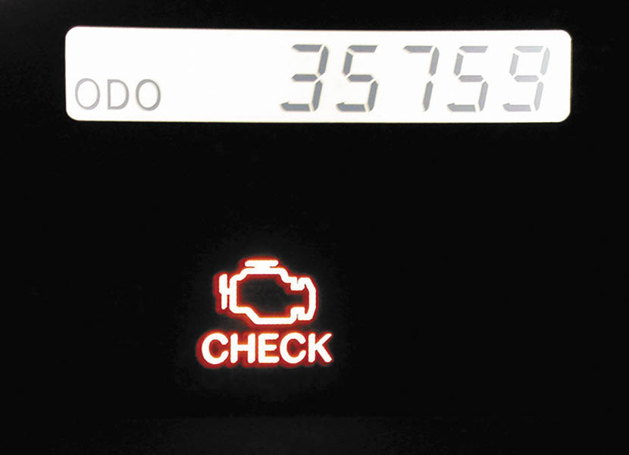
Figure 89.1 A typical malfunction indicator lamp (MIL) often labeled “check engine” or “service engine soon” (SES)

Slide 7
DIAGNOSTIC EXECUTIVE AND TASK MANAGER
This software program is designed to manage the operation of all OBD-II monitors by controlling the sequence of steps necessary to execute the diagnostic tests and monitors.
On Ford and GM systems, this software is called the diagnostic executive.
On Chrysler systems, it is called the task manager.

Slide 8
MONITORS (1 OF 2)
Purpose and Function
A monitor is an organized method of testing a specific part of the system.
Continuous Monitors
Comprehensive component monitor (CCM).
Misfire monitor.
Misfire type A.
Misfire type B.
Fuel trim monitor.

Slide 9
MONITORS (2 OF 2)
Non-continuous Monitors
O2S monitor
O2S heater monitor
Catalyst monitor
EGR monitor
EVAP monitor
Secondary AIR monitor
Transmission monitor
PCV system monitor
Thermostat monitor

Slide 10
OBD-II MONITOR INFORMATION (1 OF 2)
Comprehensive Component Monitor
Inputs and outputs are to be checked electrically.
Inputs to the PCM are tested for rationality.
Outputs from the PCM be tested for functionality
Monitor runs continuously
Continuous Running Monitors
Continuous monitors run continuously and only stop if they fail and include:
Fuel system: rich/lean
Misfire: catalyst damaging/FTP

Slide 11
OBD-II MONITOR INFORMATION (2 OF 2)
Once Per Trip Monitors
Monitor runs once per trip, pass or fail
O2 response, O2 heaters, EGR, purge flow EVAP leak, secondary air, catalyst
Exponentially Weighted Moving Average (EWMA) Monitors
A mathematical method used to determine performance.
Some Catalyst and EGR monitors

Slide 12
ENABLING CRITERIA (1 OF 3)
Purpose and Function
Each monitor has enabling criteria. These criteria are a set of conditions that must be met before the task manager gives the go-ahead for each monitor to run.
Trip
A trip is defined as a key-on condition that contains the necessary conditions for a particular test to be performed, followed by a key-off.

Slide 13
ENABLING CRITERIA (2 OF 3)
Warm-up Cycle
A warm-up cycle is defined as a trip with an engine temperature increase of at least 40°F and where engine temperature reaches at least 160°F (71°C).
MIL Condition: Off
This condition indicates that the PCM has not detected any faults in an emissions-related component or system, or that the MIL circuit is not working.

Slide 14
ENABLING CRITERIA (3 OF 3)
MIL Condition: On Steady
This condition indicates a fault in an emissions-related component or system that could affect the vehicle emission levels.
MIL Condition: Flashing
This condition indicates a misfire or fuel control system fault that could damage the catalytic converter.
MIL Off:
When the codes are cleared, the battery is connected on the monitor passes three consecutive trips.

Slide 15
OBD-II DTC NUMBERING DESIGNATION (1 OF 4)
The DTCs are grouped into major categories, depending on the location of the fault on the system involved.
Pxxx – powertrain DTCs
Bxxx – Body DTCs
Cxxx – Chassis DTCs
Uxxx – Network DTCs

Slide 16
OBD-II DTC NUMBERING DESIGNATION (2 OF 4)
DTC Numbering Explanation
P0100—Air metering and fuel system fault
P0200—Fuel system (fuel injector only) fault
P0300—Ignition system or misfire fault
P0400—Emission control system fault
P0500—Idle speed control, vehicle speed (VS) sensor fault
P0600—Computer output circuit (relay, solenoid, etc.) fault
P0700—Transaxle, transmission faults

Slide 17
OBD-II DTC NUMBERING DESIGNATION (3 OF 4)
Types of DTCs
TYPE A CODES. A type A DTC is emission-related and causes the MIL to be turned on the first trip if the computer has detected a problem.
TYPE B CODES. A type B code is stored and the MIL is turned on during the second consecutive trip, alerting the driver to the fact that a diagnostic test was performed and failed.
TYPE C AND D CODES. Type C and D codes are for use with non- emission-related diagnostic tests

Slide 18
OBD-II DTC NUMBERING DESIGNATION (4 OF 4)
Diagnostic Trouble Code Priority
CARB mandated that all diagnostic trouble codes (DTCs) Freeze Frame be stored according to individual priority.
Priority 0—Non-emission-related codes
Priority 1—One-trip failure of two-trip fault for non-fuel, non-misfire codes
Priority 2—One-trip failure of two-trip fault for fuel or misfire codes
Priority 3—Two-trip failure or matured fault of non-fuel, non-misfire codes
Priority 4—Two-trip failure or matured fault for fuel or misfire codes

Slide 19
Animation: Diagnostic Code, DTC (The animation will automatically start in a few seconds)

Slide 20
Animation: Retrieving Trouble Codes, Code Reader (The animation will automatically start in a few seconds)

Slide 21
QUESTION 1: ?
What is the difference between a Type A and a Type B DTC?

Slide 22
ANSWER 1:
A Type A DTC illuminates the MIL after one trip. A Type B DTC requires two trips to illuminate the MIL.

Slide 23
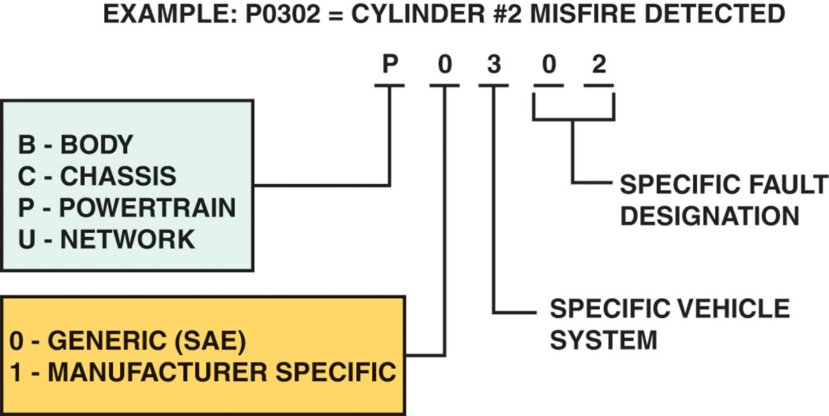
Figure 89.2 OBD-II DTC identification format

Slide 24
OBD-II FREEZE FRAME
Purpose and Function
To assist the service technician, OBD II requires the computer to take a “snapshot” or freeze-frame of all data at the instant an emission-related DTC is set.
Freeze-Frame Items Include:
Calculated load value, engine speed (RPM), short-term and long-term fuel trim percent, fuel system pressure (on some vehicles), vehicle speed (mph), engine coolant temperature, intake manifold pressure, closed-open-loop status, and the fault code that triggered the freeze-frame.

Slide 25
ENABLING CONDITIONS
Global Disable Conditions:
Pending: Under some situations, the PCM does not run a monitor if the MIL is illuminated and a fault is stored from another monitor.
Conflict: There are also situations when the PCM does not run a monitor if another monitor is in progress.
Suspend: Occasionally, the PCM may not allow a two-trip fault to mature.

Slide 26
PCM TESTS
Rationality Test
This means that the input signal is compared against other inputs and information to see if it makes sense under the current conditions.
Functionality Test
A functionality test refers to using PCM inputs checking the operation of the outputs.
Electrical Tests
Refers to the PCM check of both input and outputs for open circuits, shorts to ground and shorts to voltage.

Slide 27
GLOBAL OBD-II
All OBD-II vehicles must be able to display data on a global (also called generic) scan tool under nine different modes of operation.
Mode 1: Current powertrain data
Mode 2: Freeze-frame data
Mode 3: DTCs
Mode 4: Clear and reset DTCs
Mode 5: Oxygen sensor results
Mode 6: Once per trip monitor results
Mode 7: Continuous monitor results
Mode 8: Bidirectional control of onboard systems
Mode 9: Module Identification

Slide 28
DIAGNOSING PROBLEMS USING MODE SIX
Mode six information can be used to diagnose faults by following three steps:
Check the monitor status before starting repairs. This step shows how the system failed.
Look at the component or parameter that triggered the fault. This step helps pin down the root cause of the failure.
Look to the monitor enable criteria, which shows what it takes to fail or pass the monitor.

Slide 29
QUESTION 2: ?
What is a rationality test?

Slide 30
ANSWER 2:
A comparison of the input to other inputs to see if it makes sense under the current conditions.

Slide 31
Video Links (Internet Access Required)
OBD 1 (time 4:36)
PCM driver testing part 1 (time 3:11)
PCM driver testing part 2 (time 3:10)
Flash a PCM (time 1:56)
K Line OBD protocol (time 2:01)
ECM diagnosis (time 2:22)

Slide 32
Copyright

