Slide 1
Automotive Technology Principles, Diagnosis, and Service
Sixth Edition
Chapter 84
Vehicle Emissions Standards and Testing
Copyright © 2018, 2015, 2011 Pearson Education, Inc. All Rights Reserved

Slide 2
LEARNING OBJECTIVES (1 of 2)
84.1 Identify the reasons why excessive amounts of HC, CO, and NOx exhaust emissions are created.
84.2 Diagnose driveability and emissions problems resulting from malfunctions of interrelated systems.
84.3 Discuss emissions standards.

Slide 3
LEARNING OBJECTIVES (2 of 2)
84.4 Describe how to test for various emissions products.
84.5 This chapter will help prepare for ASE A8 certification test content area “D” (Emissions Control Systems Diagnosis and Repair) and ASE L1 certification test content area “F” (I/M Failure Diagnosis).

Slide 4
NORMAL ENGINE COMBUSTION
Entering the engine combustion chamber is fuel (HC) plus air (nitrogen N2 is 78% and oxygen O2 is 21% of the air).
During combustion, the HC combines with the air to form water (H2O) and carbon dioxide (CO2), plus nitrogen (N2) and some other non-desirable gases.
Carbon monoxide (CO)
Oxides of Nitrogen (NOx)
Unburned hydrocarbons (HC)

Slide 5
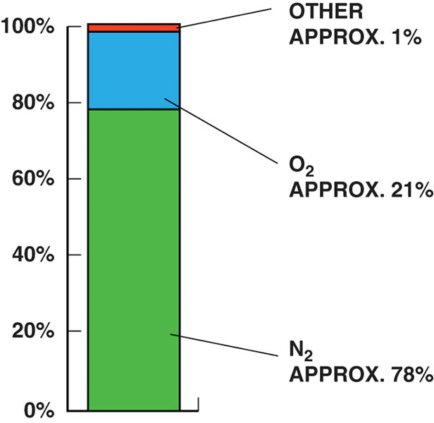
Figure 84.1 The air entering the engine consists of mostly nitrogen (78%) with about 21% oxygen and about 1% other gases.

Slide 6
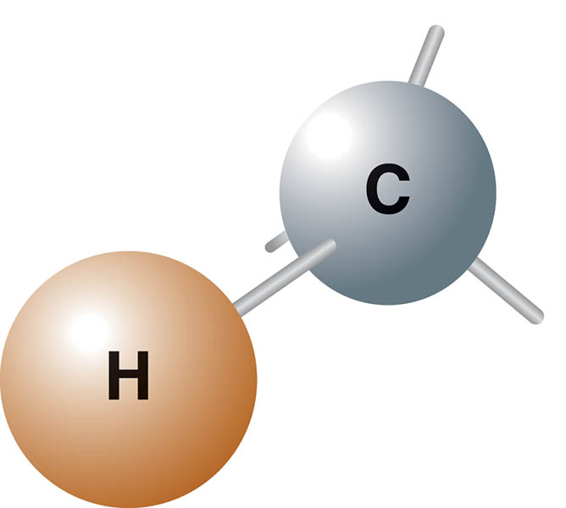
Figure 84.2 Hydrocarbons can include many combinations of hydrogen and carbon.

Slide 7
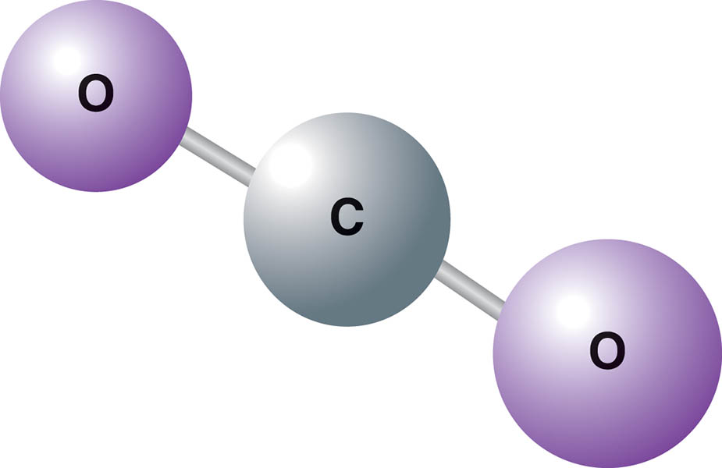
Figure 84.3 Carbon dioxide has two oxygen atoms attached to the one carbon atom and is a stable molecule.

Slide 8
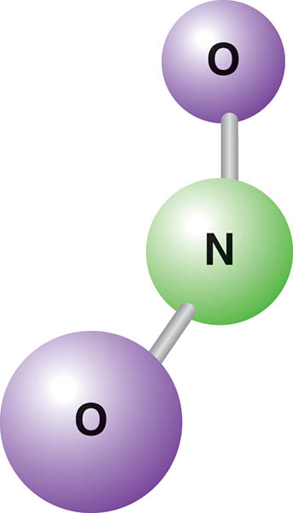
Figure 84.4 NO and NO₂ shown together are referred to as NO_{x}

Slide 9
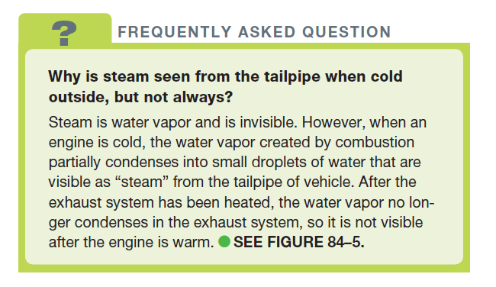
FREQUENTLY ASKED QUESTION

Slide 10
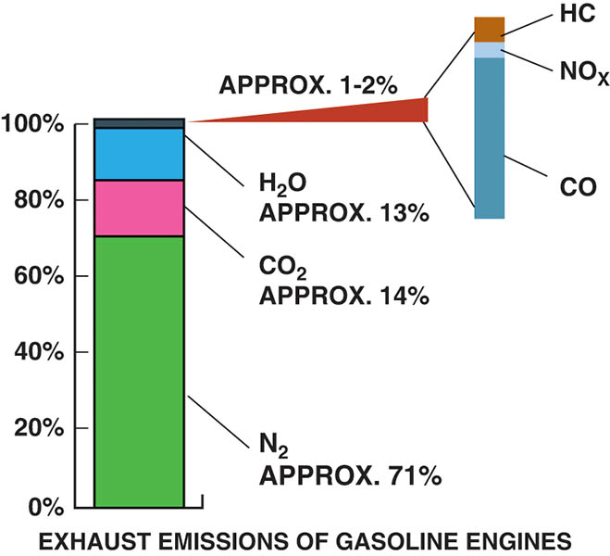
Figure 84.5 A chart showing that about 13% of the exhaust emissions is water (H₂O) in the form of steam

Slide 11
QUESTION 1: ?
What are the five exhaust gases?

Slide 12
ANSWER 1:
Oxygen, Carbon monoxide, carbon dioxide, hydrocarbons, and oxides of nitrogen.

Slide 13
EXHAUST ANALYSIS AND COMBUSTION EFFICIENCY (1 OF 2)
Hydrocarbons (HC)
Unburned gasoline that are measured in parts per million (ppm).
Carbon Monoxide (CO)
An unstable poisonous gas created by partially burned gasoline that easily combines with any oxygen.
Carbon Dioxide (CO2)
The result of oxygen in the engine combining with the carbon of the gasoline.

Slide 14
EXHAUST ANALYSIS AND COMBUSTION EFFICIENCY (2 OF 2)
Oxygen
There is about 21% oxygen in the atmosphere, and most of this oxygen should be “used up” during the combustion process.
Oxides of Nitrogen (NOx)
An oxide of nitrogen (NO) is a colorless, tasteless, odorless gas that mixes with oxygen to create NO2 is reddish-brown and has an acid and pungent smell.

Slide 15
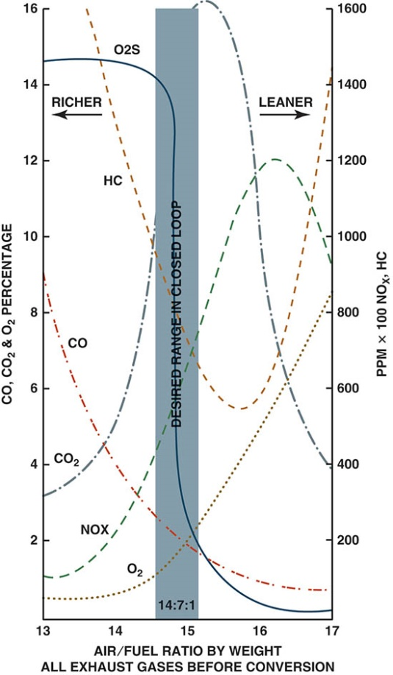
Figure 84.6 Exhaust emissions are very complex. When the air–fuel mixture becomes richer, some exhaust emissions are reduced, while others increase.

Slide 16
CATALYTIC CONVERTER
The catalytic converter is used to help reduce exhaust emissions by helping the oxygen in the exhaust to oxidize the HC and CO in the exhaust stream to form harmless water (H2O) and carbon dioxide (CO2).
It also is used to separate the nitrogen from the oxygen in NOx to produce just nitrogen (N2) and oxygen (O2).

Slide 17
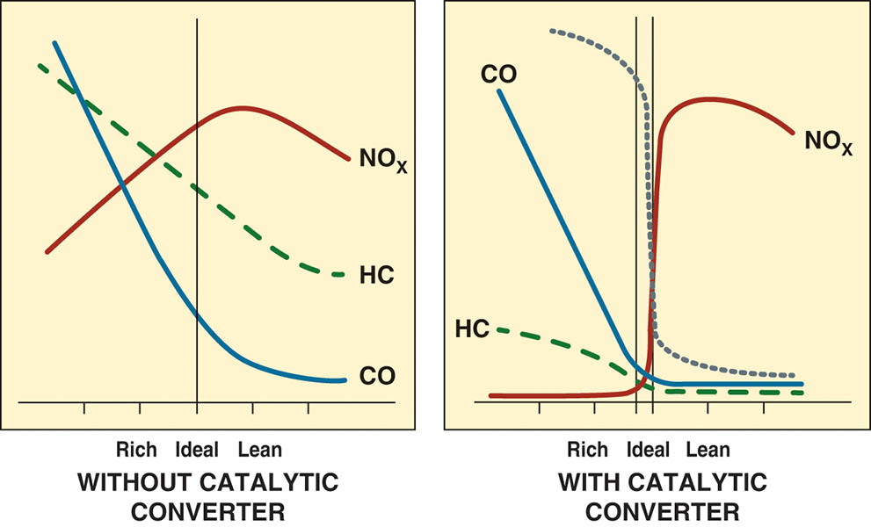
Figure 84.7 The image on the left shows exhaust gases existing in an engine without a catalytic converter with rich exhaust being toward the left of the vertical line and lean exhaust to the right of the line. The image on the right shows the exhaust after it has been treated by the catalytic converter.

Slide 18
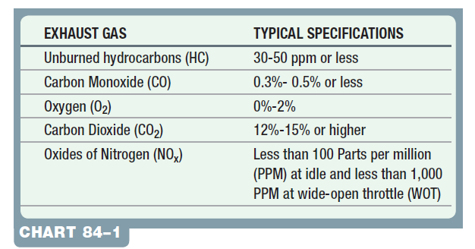
Chart 84-1. Typical specifications for gases with the vehicle equipped with a catalytic converter.

Slide 19
QUESTION 2: ?
What is the function of a catalytic converter?

Slide 20
ANSWER 2:
Oxidize hydrocarbons and carbon monoxide and reduce oxides of nitrogen.

Slide 21
EXHAUST ANALYSIS AS A DIAGNOSTIC TOOL
Rich or Lean Exhaust
If CO is high, the exhaust is rich, so CO is called the “rich indicator”
If O2 is high, the exhaust is lean, so O2 is called the “lean indicator”
Therefore, if the CO reading is the same as the O2 reading, then the engine is operating correctly.

Slide 22
Tech Tip

Slide 23
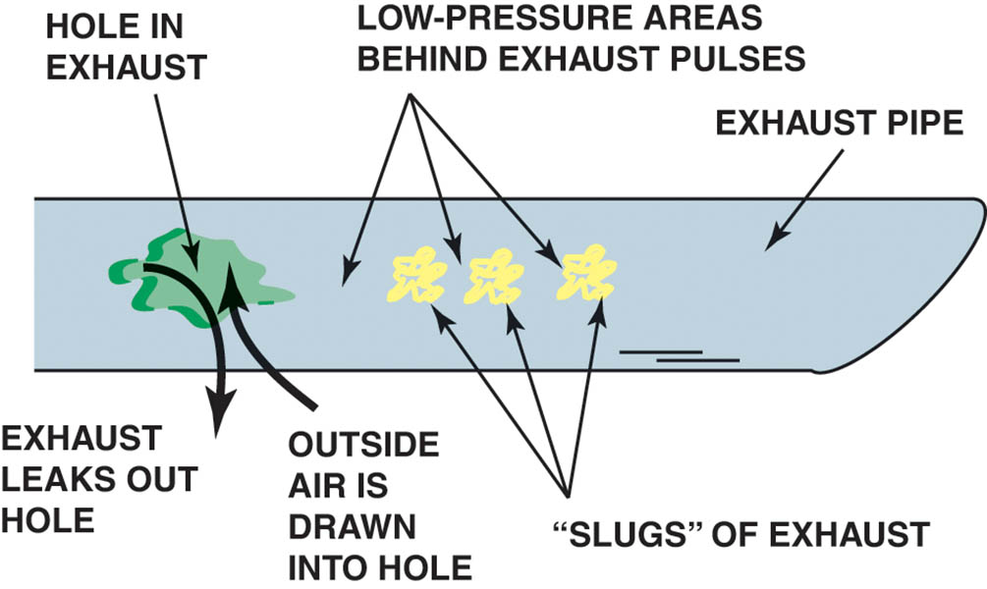
Figure 84.8 A hole in the exhaust system can cause outside air (containing O₂) to be drawn into the exhaust system. This extra O₂ can be confusing to a service technician because the extra O₂ in the exhaust stream could be misinterpreted as a too-lean air–fuel mixture.

Slide 24
ENGINE FAULT POSSIBILITIES (1 OF 2)
HC Too High
High HC exhaust emissions are usually caused by an engine misfire.
CO too High
Excessive carbon monoxide is an indication of too rich an air–fuel mixture.
Fuel pressure may be too high, injector may be malfunctioning, or the air intake is restricted.

Slide 25
ENGINE FAULT POSSIBILITIES (2 OF 2)
O2 and CO2 Relationships
The higher the O2 level, the leaner the exhaust. Oxygen, therefore, is the lean indicator. Acceptable levels of O2 are 0% to 2%.
CO2 is a measure of efficiency. The higher the level of CO2 in the exhaust stream, the more efficiently the engine is operating. Levels of 12% to 17% are considered to be acceptable.
SMOG and NOx
NOx contributes to the formation of photochemical smog when sunlight reacts chemically with NOx and unburned HC.

Slide 26
EMISSION STANDARDS (1 OF 2)
Tier 1 and Tier 2
All vehicles sold in the United States must meet Tier 1 standards that went into effect in 1994 and are the least stringent.
Tier 2 standards have been optional since 2001, and fully adopted by 2009.
Federal EPA Bin Number
Tier 2 only
The lower the bin number, the cleaner the vehicle.

Slide 27
EMISSION STANDARDS (2 OF 2)
SMOG Emission Information
New vehicles are equipped with a sticker that shows the relative level of smog causing emissions created by the vehicle compared to others on the market.
California Standards
The California Air Resources Board (CARB) standards since January 1, 2004 are known as LEVII.
Within that rating system there are three primary ratings: LEV, ULEV, and SULEV.
LEVIII
Includes maintaining the reduced emissions for 150,000 miles.

Slide 28
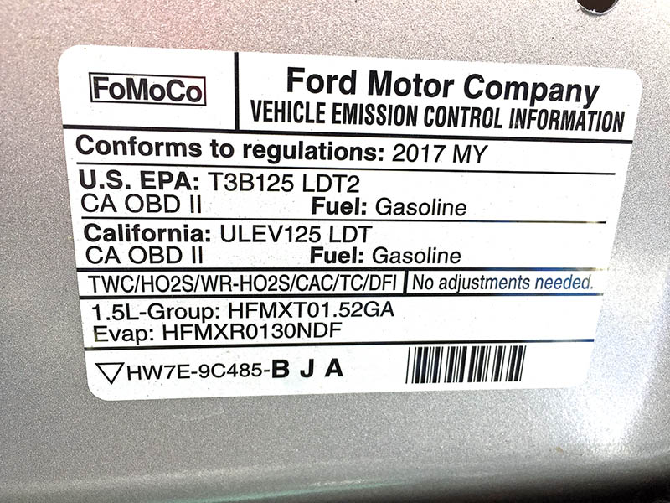
Figure 84.9 A vehicle emission control information (VECI) sticker for a vehicle showing that meets Tier 3, Bin 1 (T2B3) EPA rating and California ULEV125 standard.

Slide 29
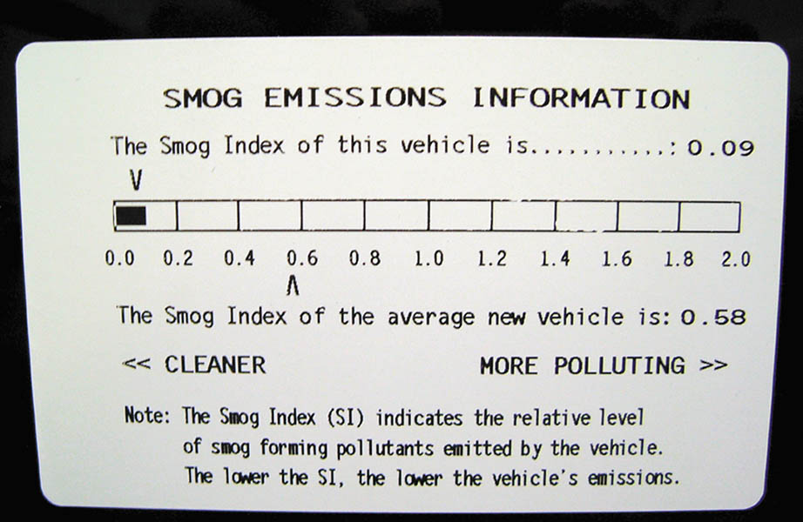
Figure 84.10 This label on a Toyota Camry hybrid shows the relative smog-producing emissions, but this does not include CO₂, which may increase global warming.

Slide 30
EUROPEAN STANDARDS
Exhaust emissions of NOx, total hydrocarbon (THC), non-methane hydrocarbons (NMHC), CO and PM are regulated for most vehicle types, including cars and trucks in the European Union (EU).
The EU also sets limits for CO2 emission in units of grams per kilometer.

Slide 31
VEHICLE EMISSION TESTING
OBD-II Testing
The OBD-II system is designed to illuminate the MIL and store trouble codes any time a malfunction exists that causes the vehicle emissions to exceed 1 1/2 times the Federal Test Procedure (FTP) limits.
Remote Sensing
In highly enhanced areas, states perform on-the-road testing of vehicle emissions.
Random Roadside Testing
Visual checks of the emission control devices to detect tampering.

Slide 32
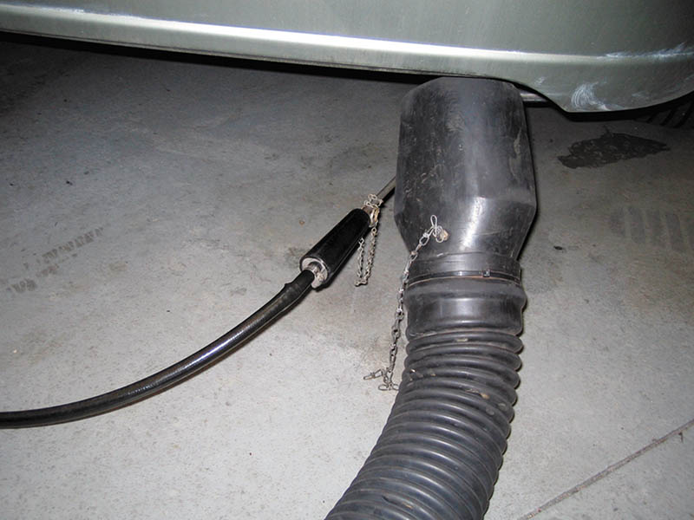
Figure 84.11 A partial stream sampling exhaust probe being used to measure exhaust gases in parts per million (PPM) or percent (%).

Slide 33
QUESTION 3: ?
What are three types of vehicle emission testing?

Slide 34
ANSWER 3:
OBD-II, remote sensing, and random roadside testing.

Slide 35
Video Links (Internet Access Required)
State emission test (time 2:03)
3 reasons why cars fail the emissions test (time 3:57)

Slide 36
Copyright

