Slide 1
Automotive Technology Principles, Diagnosis, and Service
Sixth Edition
Chapter 81
Gasoline Direct-Injection Systems
Copyright © 2018, 2015, 2011 Pearson Education, Inc. All Rights Reserved

Slide 2
LEARNING OBJECTIVES (1 of 2)
81.1 List the advantages and disadvantages of direct fuel injection.
81.2 Explain how a gasoline direct-injection system works.
81.3 List the various modes of operation of a gasoline direct-injection system.
81.4 Describe common piston top designs.

Slide 3
LEARNING OBJECTIVES (2 of 2)
81.5 Describe the differences between port fuel-injection and gasoline direct-injection systems.
81.6 Discuss how to troubleshoot a gasoline direct-injection system.
81.7 This chapter will help prepare for Engine Repair (A8) ASE certification test content area “C” (Fuel, Air Induction, and Exhaust Systems Diagnosis and Repair).

Slide 4
DIRECT FUEL INJECTION (1 OF 2)
Port Injection Vs. Direct Injection
In a gasoline direct injection (GDI) system the fuel is squirted directly into the combustion chamber.
Port Fuel Injection–constant fuel pressure but variable injector pulse-width.
GDI–almost constant injector pulse-width with varying fuel pressure.
Parts and Operation
A direct-injection system sprays high-pressure fuel, up to 2,900 PSI, into the combustion chamber.

Slide 5
DIRECT FUEL INJECTION (2 OF 2)
Advantages of Gasoline Direct Injection
Improved fuel economy and lower emissions
Higher compression ratio for higher engine efficiency
Use of lower-octane gasoline
Higher volumetric efficiency
Disadvantages of Gasoline Direct Injection
Higher cost due to high-pressure pump and injectors
More components compared with port fuel injection
Higher NOx emissions

Slide 6
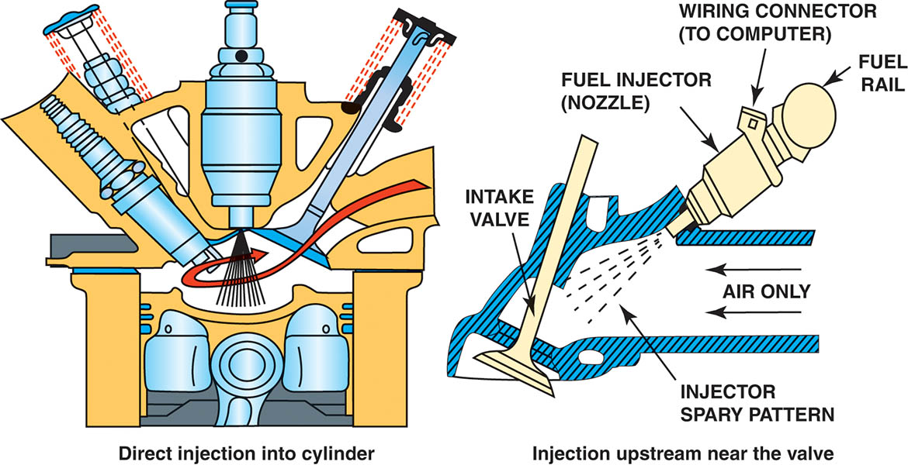
Figure 81.1 A comparison of a port fuel injection system (right) to a gasoline direct injection system on the left.

Slide 7
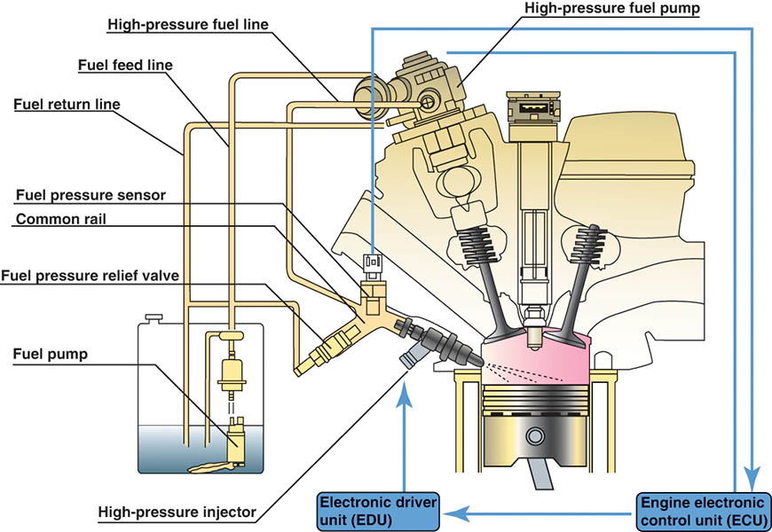
Figure 81.2 A gasoline direct-injection system injects fuel under high pressure directly into the combustion chamber.

Slide 8
QUESTION 1: ?
What are two advantages of gasoline direct injection compared
with port fuel injection?

Slide 9
ANSWER 1:
Better fuel economy and lower emissions.

Slide 10
DIRECT INJECTION FUEL DELIVERY SYSTEM (1 OF 2)
Low Pressure Supply Pump
The fuel pump in the fuel tank supplies fuel to the high-pressure fuel pump at a pressure of approximately 60 PSI.
High Pressure Pump
A typical GDI high-pressure pump has a range of between 500 PSI (3,440 kPa) and 2,900 PSI (15,200 kPa) during engine operation.

Slide 11
DIRECT INJECTION FUEL DELIVERY SYSTEM (2 OF 2)
Fuel Rail
The fuel rail stores the fuel from the high-pressure pump and stores high-pressure fuel for use to each injector.
Fuel Pressure Regulator
An electric pressure-control valve is installed between the pump inlet and outlet valves.

Slide 12
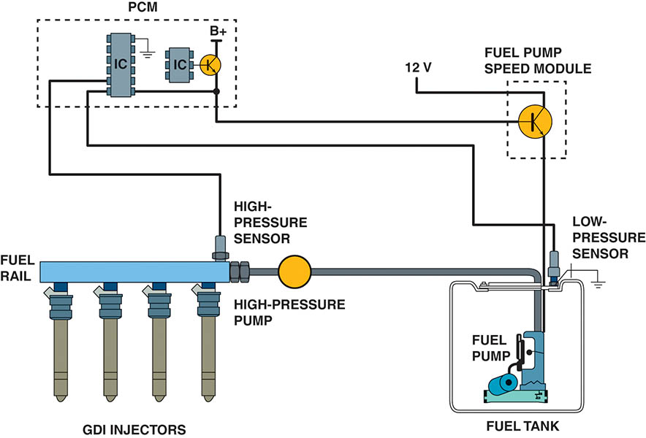
Figure 81.3 A GDI system uses a low-pressure pump in the gas tank similar to other types of fuel-injection systems. The PCM controls the pressure of the high-pressure pump using sensor inputs.

Slide 13
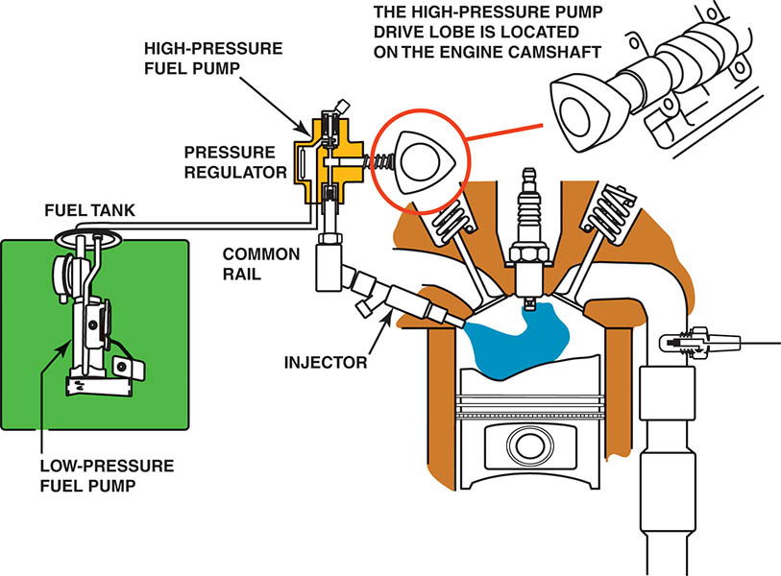
Figure 81.4 A typical direct-injection system uses two pumps—one low-pressure electric pump in the fuel tank and the other a high-pressure pump driven by the camshaft. The high pressure fuel system operates at a pressure as low as 500 PSI during light load conditions and as high as 2,900 PSI under heavy loads.

Slide 14
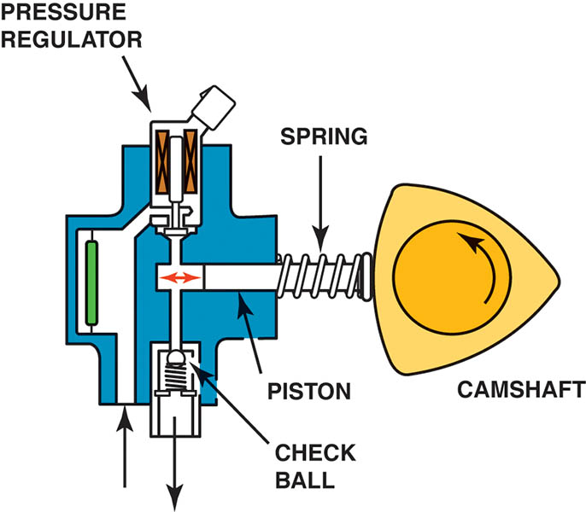
Figure 81.5 (a) A typical camshaft-driven high-pressure pump used to increase fuel pressure to 2,000 PSI or higher.

Slide 15
Animation: Direct Fuel Injection, Mechanical (The animation will automatically start in a few seconds)

Slide 16
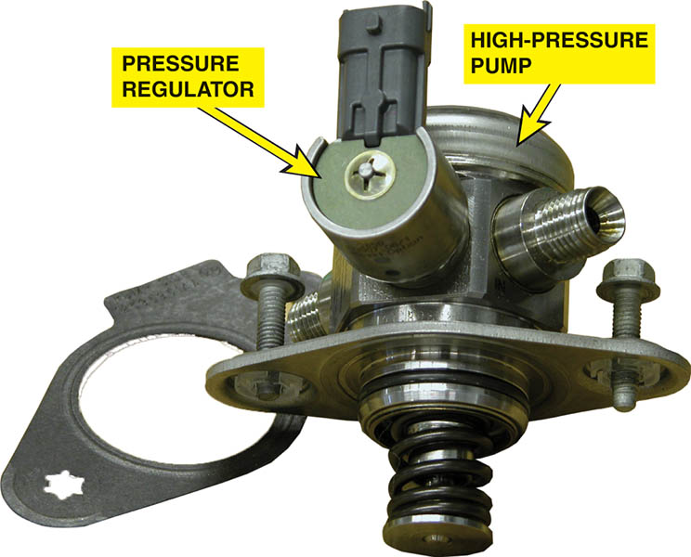
Figure 81.5 (b) The high pressure pump assembly removed from the engine. Many GDI engines use a roller where the high-pressure pump rides against the cam lobes to help reduce friction and wear.

Slide 17
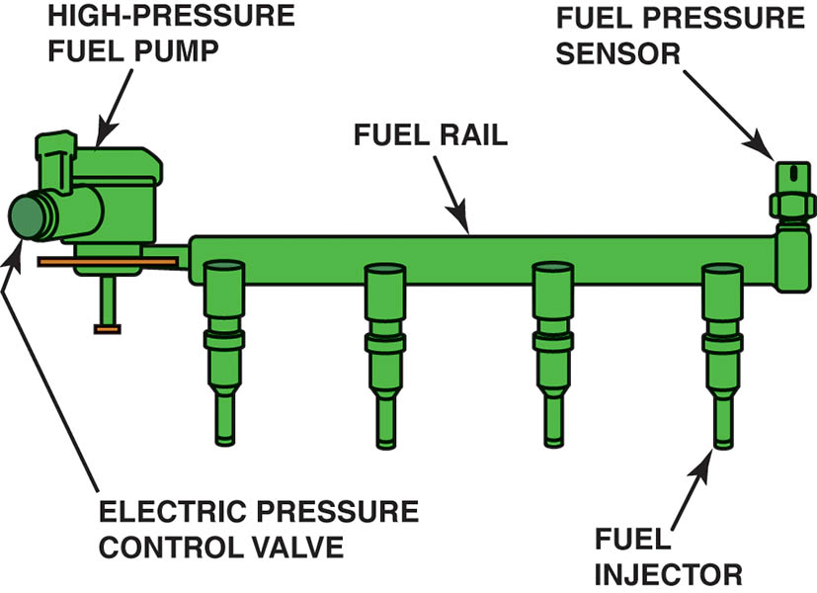
Figure 81.6 A gasoline direct-injection (GDI) fuel rail and pump assembly with the electric pressure control valve.

Slide 18
GASOLINE DIRECT-INJECTION FUEL INJECTORS
Each high-pressure fuel injector assembly is an electrically magnetic injector mounted in the cylinder head.
The PCM controls each fuel injector with 50 to 90 volts (usually 60 to 70 volts), depending on the system, which is created by a boost capacitor in the PCM.

Slide 19
MODES OF OPERATION (1 OF 2)
Stratified Mode
In this mode of operation, the air–fuel mixture is richer around the spark plug than it is in the rest of the cylinder.
Homogeneous Mode
In this mode of operation, the air–fuel mixture is the same throughout the cylinder.

Slide 20
MODES OF OPERATION (2 OF 2)
There are variations of these modes that can be used to fine-tune the air–fuel mixture inside the cylinder.
Homogeneous lean mode.
Homogeneous stratified mode.
Homogeneous knock-protection mode.
Stratified catalyst heating mode.

Slide 21
PISTON TOP DESIGNS
Three of the most commonly used designs include:
Spray-guided combustion.
Swirl combustion.
Tumble combustion.

Slide 22
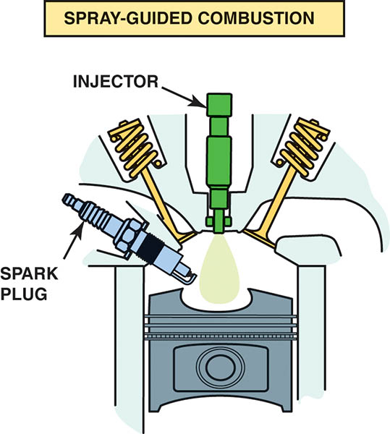
Figure 81.7 In this design, the fuel injector is at the top of the cylinder and sprays fuel into the cavity of the piston.

Slide 23
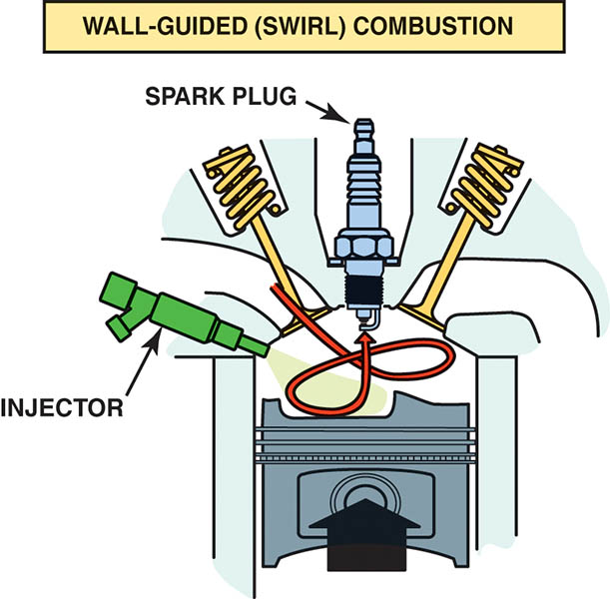
Figure 81.8 The side injector combines with the shape of the piston to create a swirl as the piston moves up on the compression stroke.

Slide 24
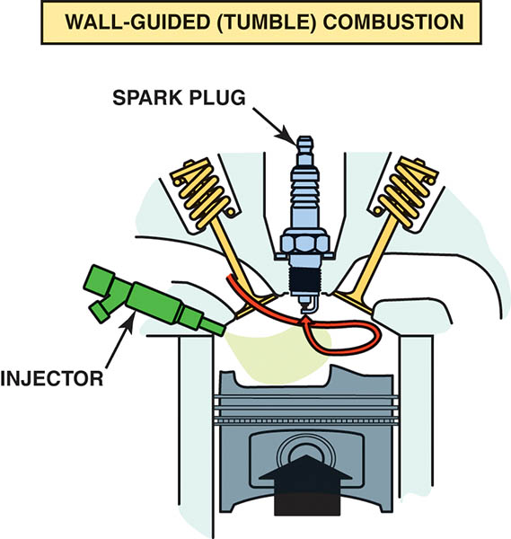
Figure 81.9 The piston creates a tumbling force as it moves upward.

Slide 25
QUESTION 2: ?
What are the two primary modes of operation?

Slide 26
ANSWER 2:
Stratified and homogeneous mode.

Slide 27
PORT AND DIRECT-INJECTION SYSTEMS
Overview
This system combines direct-injection injectors located in the combustion chamber with port fuel-injectors in the intake manifold near the intake valve.
Cold-Start Warm-Up
To help reduce exhaust emissions after a cold start, the fuel system uses a stratified change mode.
The catalytic converter rapidly reaches operating temperature, which reduces exhaust emissions.

Slide 28
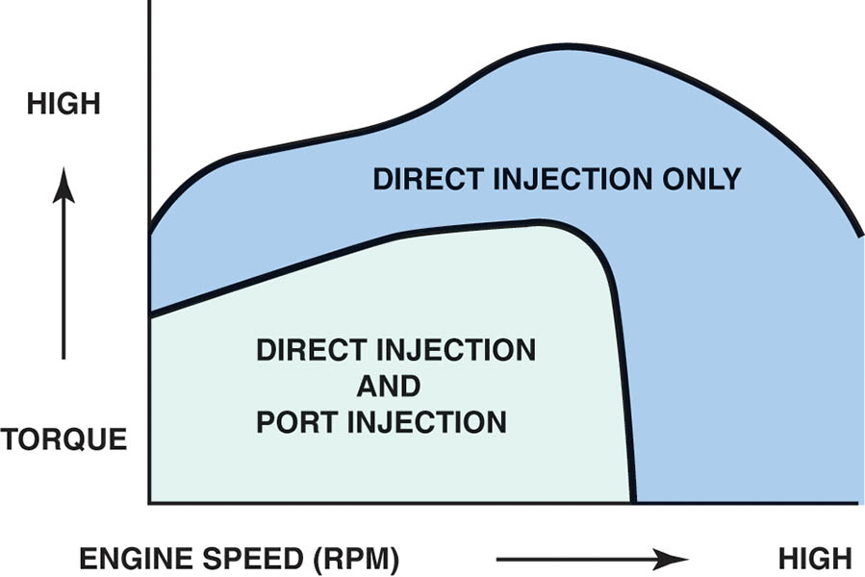
Figure 81.10 Notice that there are conditions when the port fuel-injector, located in the intake manifold, and the gasoline direct injector, located in the cylinder, both operate to provide the proper air-fuel mixture.

Slide 29
GASOLINE DIRECT-INJECTION ISSUES
Noise Issues
Injectors can often be heard with the engine running and the hood open. (Likely a normal condition)
Carbon Issues
Carbon can accumulate on the tip of the injector.
Carbon can accumulate on the back side of the intake valve.

Slide 30
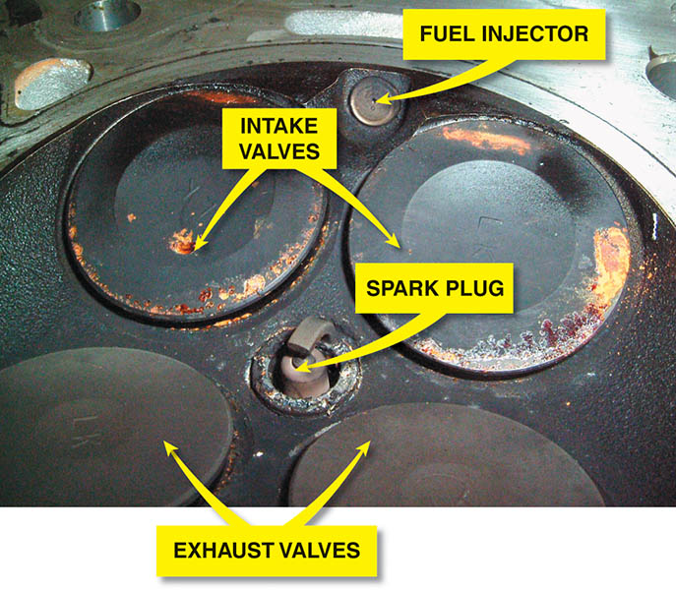
Figure 81.11 This may become a driveability issue because the gasoline direct-injection injector is exposed to combustion carbon and fuel residue.

Slide 31
GDI SERVICE
Carbon Prevention
The use of a dispersant every six months or every 6,000 miles has proven to help prevent injector and intake valve deposits.
Service Precautions
Don’t reuse high-pressure lines.
Always use a torque wrench when tightening fuel line fittings.
Do not loosen any fuel fittings with the engine cranking or running.
Always replace the Teflon seal whenever replacing or reinstalling an GDI injector.

Slide 32
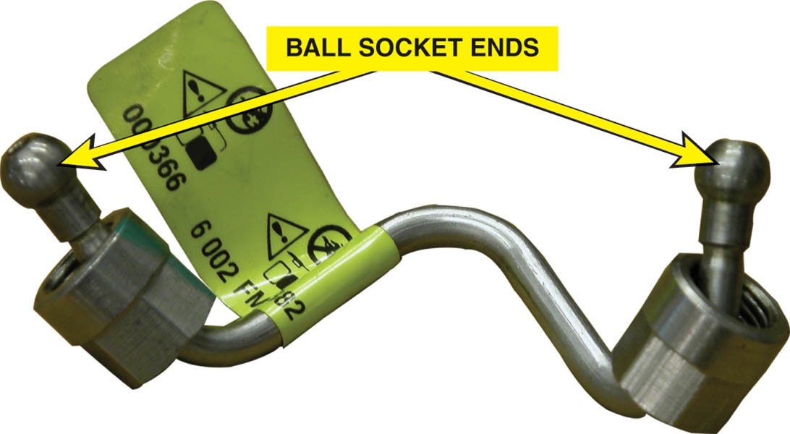
Figure 81.12 The high-pressure lines use a ball and socket connection. The ball end deforms when the line is tightened and must be replaced with a new part whenever it is removed.

Slide 33
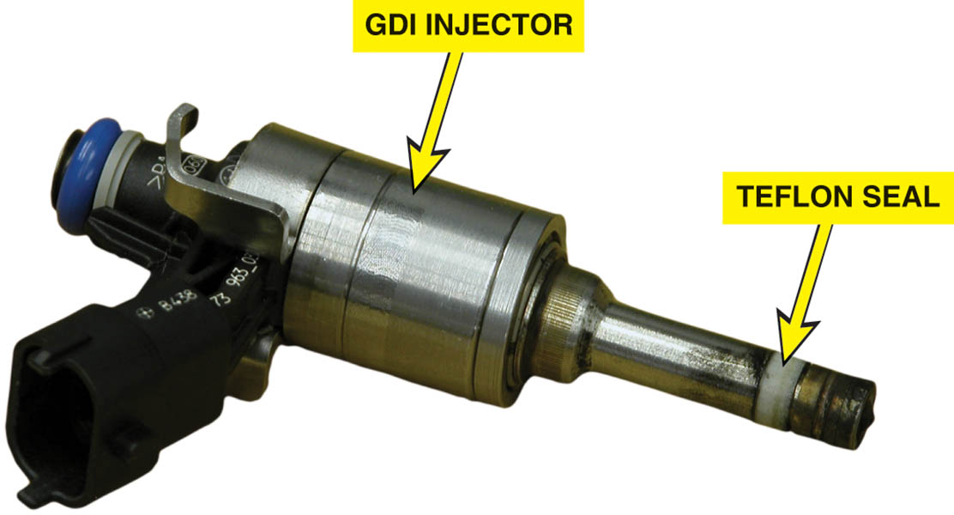
Figure 81.13 Whenever a GDI fuel injector is removed, a new Teflon seal must be installed to ensure a leak-free connection in the combustion chamber.

Slide 34
QUESTION 3: ?
What should be replaced any time a high pressure injector is serviced?

Slide 35
ANSWER 3:
The Teflon seal.

Slide 36
Video Links (Internet Access Required)
Gasoline direct injection (time 5:50)
Bosch gasoline direct injection system (time 6:20)
Accelerator pedal position sensor testing (time 3:22)
Accelerator pedal position sensor (time 5:35)
Electronic throttle (time 4:15)

Slide 37
Copyright

