Slide 1
Automotive Technology Principles, Diagnosis, and Service
Sixth Edition
Chapter 78
Oxygen Sensors
Copyright © 2018, 2015, 2011 Pearson Education, Inc. All Rights Reserved

Slide 2
LEARNING OBJECTIVES (1 of 2)
78.1 Discuss how O2S sensors work and describe the types of O2S sensors.
78.2 Discuss the PCM uses for the O2S sensor.
78.3 List the methods that can be used to test oxygen sensor.
78.4 Describe the symptoms of a failed O2S sensor.

Slide 3
LEARNING OBJECTIVES (2 of 2)
78.5 Describe testing on a post catalytic converter O2S sensor.
78.6 Explain the operation of wide-band oxygen sensors.
78.7 Compare dual cell wide-band sensors to single cell wide-band sensors.
78.8 Describe wide-band oxygen pattern failures.

Slide 4
OXYGEN SENSORS (1 OF 3)
Purpose and Function
Automotive computer systems use an oxygen sensor in the exhaust system to measure the oxygen content of the exhaust.
Narrow Band
A conventional zirconia oxygen sensor (O2S) is only able to detect if the exhaust is richer or leaner than 14.7:1.

Slide 5
OXYGEN SENSORS (2 OF 3)
Construction
A typical zirconia oxygen sensor has the sensing element in the shape of a thimble; therefore, it is often referred to as one of the following: Thimble design, cup design, or finger design.
Operation
When the concentration of oxygen on the exhaust side of the thimble is low, a high voltage (0.60 to 1.0 V) is generated between the electrodes. As the oxygen concentration on the exhaust side increases, the voltage generated drops low (0.0 to 0.3 V).

Slide 6
OXYGEN SENSORS (3 OF 3)
There are several different designs of oxygen sensors, including:
One-wire oxygen sensor
Two-wire oxygen sensor
Three-wire oxygen sensor
Four-wire oxygen sensor
Heater Circuits
Conventional O2 sensors requires 0.8 to 2.0 amperes at about 600°F (315°C).
Wide-band O2 sensors require 8 to 10 amperes at 1200° to 1400°F (650°-760° C).

Slide 7
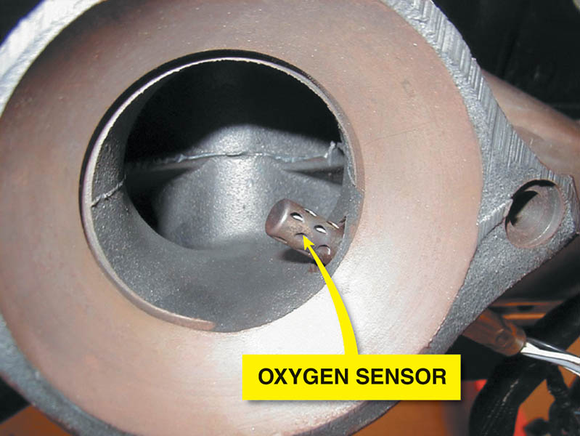
Figure 78.1 Many oxygen sensors are located in the exhaust manifold near its outlet so that the sensor can detect the air-fuel mixture in the exhaust stream for all cylinders that feed into the manifold.

Slide 8
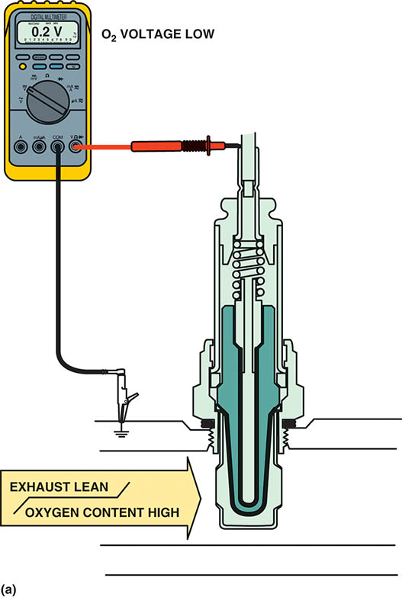
Figure 78.2 (a) When the exhaust is lean, the output of a zirconia oxygen sensor is below 450 mV.

Slide 9
Animation: O2 Sensor, Voltage Check (The animation will automatically start in a few seconds)

Slide 10
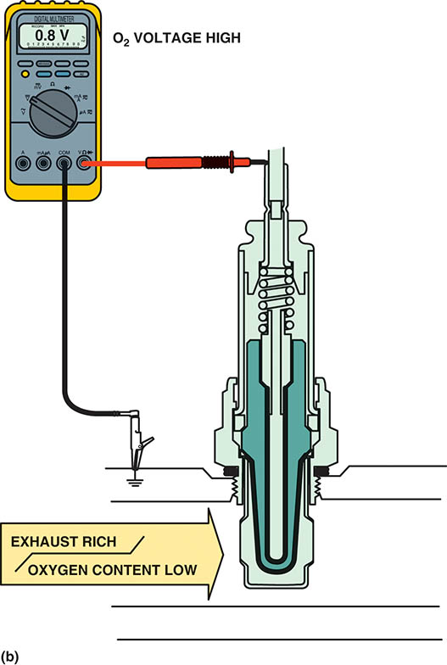
Figure 78.2 (b) When the exhaust is rich, the output of a zirconia oxygen sensor is above 450 mV.

Slide 11
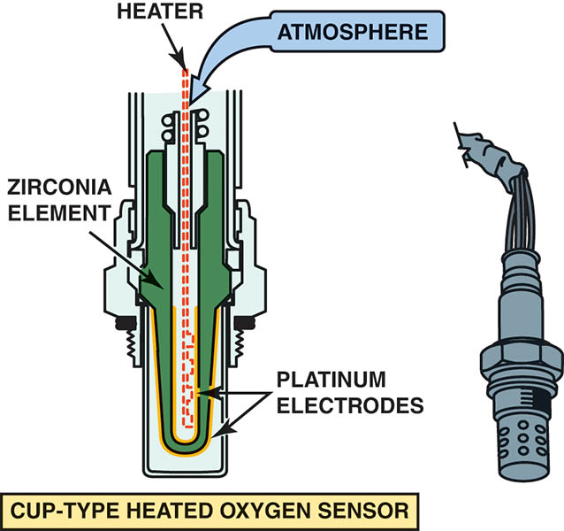
Figure 78.3 Most conventional zirconia oxygen sensors and some wide-band oxygen sensors use the cup (finger) type of design.

Slide 12
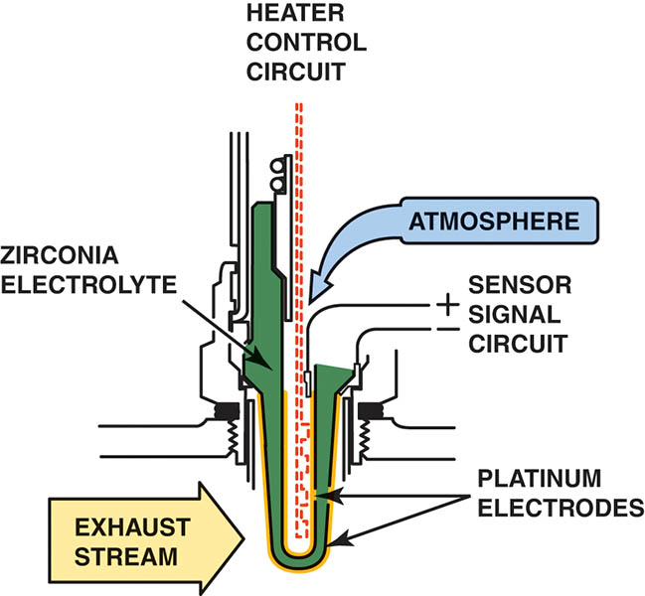
Figure 78.4 A typical heated zirconia oxygen sensor, showing the sensor signal circuit that uses the outer (exhaust) electrode as the negative and the ambient air side electrode as the positive.

Slide 13
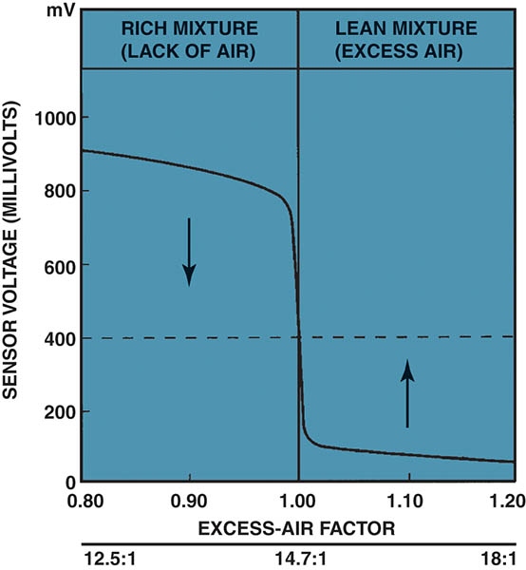
Figure 78.5 The oxygen sensor provides a quick response at the stoichiometric air-fuel ratio of 14.7:1.

Slide 14
QUESTION 1: ?
How does an oxygen sensor report the level of oxygen in the exhaust?

Slide 15
ANSWER 1:
When the oxygen level is low, the sensor generates a voltage above 450mV. When the oxygen level is high, the oxygen sensor generates a voltage below 450mV.

Slide 16
TITANIA OXYGEN SENSOR
The titania (titanium dioxide) oxygen sensor does not produce a voltage, but rather changes resistance due to the presence of oxygen in the exhaust.
As with a zirconia oxygen sensor, the voltage signal is above 450 mV when the exhaust is rich and low (below 450 mV) when the exhaust is lean.

Slide 17
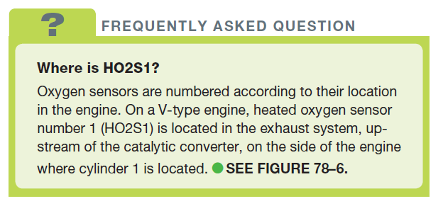
FREQUENTLY ASKED QUESTION

Slide 18
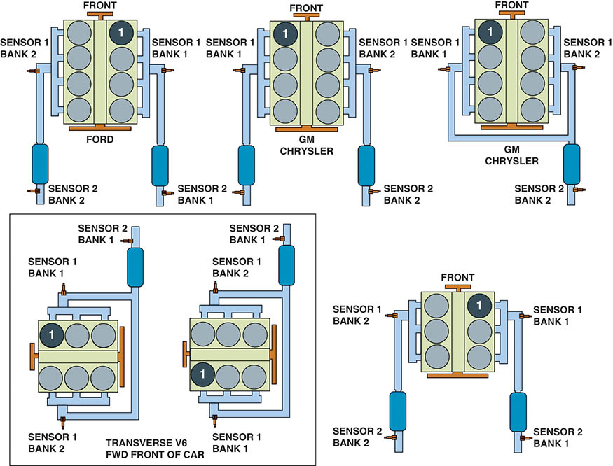
Figure 78.6 Number and label designations for oxygen sensors. Bank 1 is the bank where cylinder 1 is located.

Slide 19
PCM USES OF THE OXYGEN SENSOR
Fuel Control
The upstream oxygen sensors are among the high-authority sensors used for fuel control while operating in closed loop.
Fuel Trim
The fuel trim numbers are determined from the signals by the oxygen sensor(s).
Fuel trim can be negative (subtracting fuel) or positive (adding fuel).

Slide 20
OXYGEN SENSOR DIAGNOSIS (1 OF 2)
PCM System Tests
The PCM uses the oxygen sensor to test the EGR system, the catalytic converter, and the fuel system.
Visual Inspection
Black sooty deposits usually indicate a rich air-fuel mixture.
White chalky deposits are characteristic of silica contamination.
White sandy or gritty deposits are characteristic of antifreeze (ethylene glycol) contamination.

Slide 21
OXYGEN SENSOR DIAGNOSIS (2 OF 2)
Digital Voltmeter Testing
The oxygen sensor can be checked for proper operation using a digital high-impedance voltmeter.
Min/Max Testing
A digital meter set on DC volts can be used to record the minimum and maximum voltage with the engine running.
Scan Tool Testing
Using a scan tool, observe the oxygen sensor voltages.
Scope testing
The voltage signal of the sensor should be constantly changing.

Slide 22
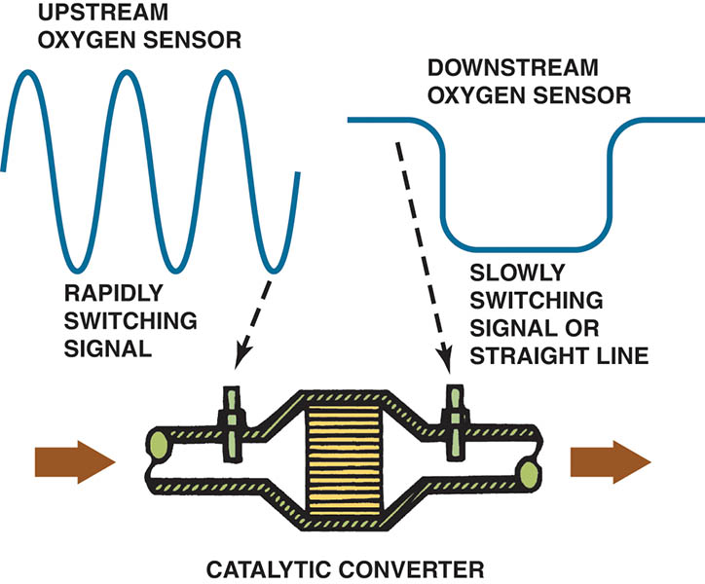
Figure 78.7 The OBD-II catalytic converter monitor compares the signals of the upstream and downstream oxygen sensor to determine converter efficiency.

Slide 23
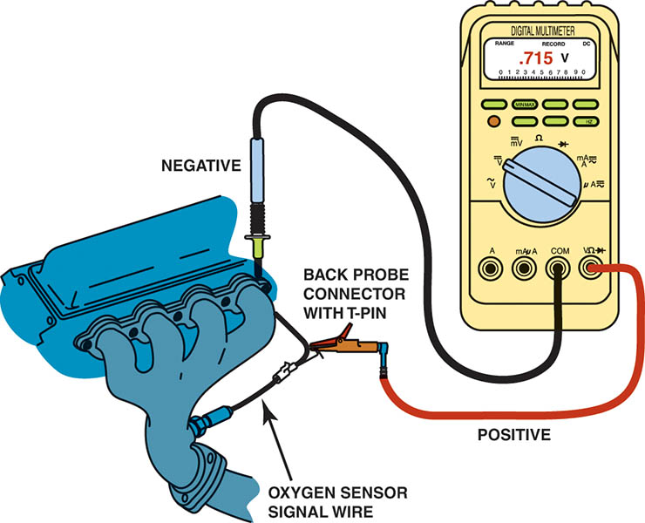
Figure 78.8 Testing an oxygen sensor using a DMM set on DC volts. With the engine operating in closed loop, the oxygen voltage should read over 800 mV and lower than 200 mV and be constantly fluctuating.

Slide 24
Animation: Testing an O2 Sensor (The animation will automatically start in a few seconds)

Slide 25
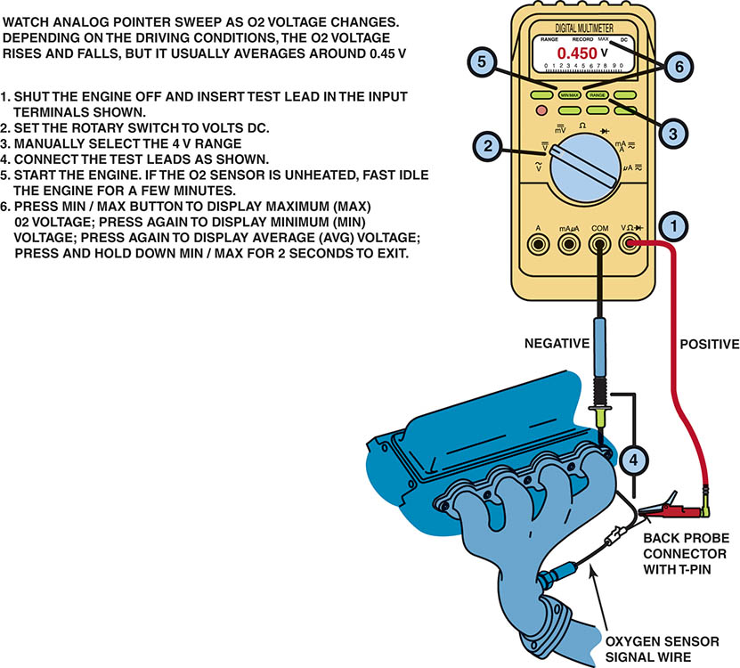
Figure 78.9 Using a digital multimeter to test an oxygen sensor using the MIN/MAX record function of the meter.

Slide 26
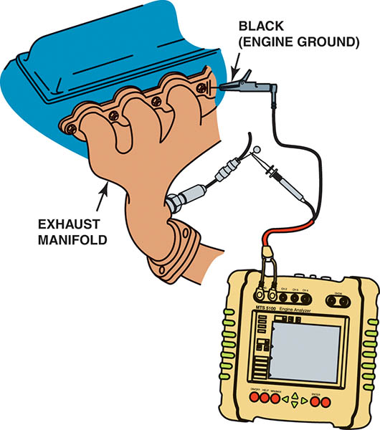
Figure 78.10 Connecting a handheld digital storage oscilloscope to an oxygen sensor signal wire. Check the instructions for the scope as some require the use of a filter to be installed in the test lead to reduce electromagnetic interference that can affect the oxygen sensor waveform.

Slide 27
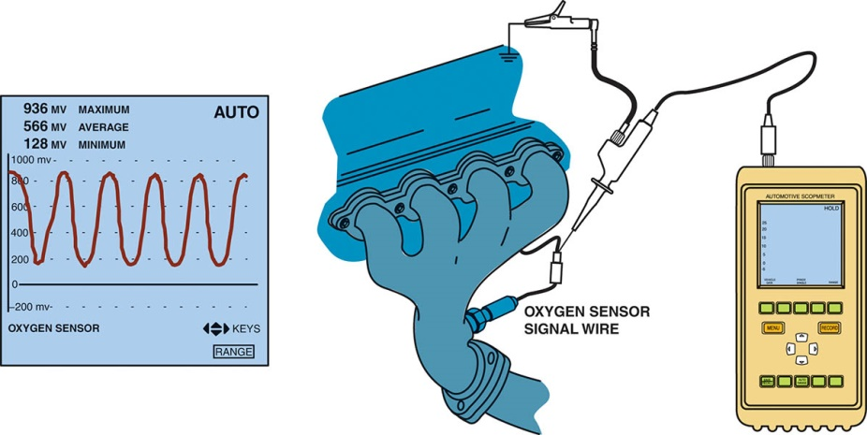
Figure 78.11 The waveform of a good oxygen sensor as displayed on a digital storage oscilloscope (DSO). Note that the maximum reading is above 800 mV and the minimum reading is less than 200 mV.

Slide 28
QUESTION 2: ?
What are the three ways to test an oxygen sensor?

Slide 29
ANSWER 2:
With a multimeter, a scan tool or an oscilloscope.

Slide 30
POST CATALYTIC CONVERTER OXYGEN SENSOR TESTING
The oxygen sensor located behind the catalytic converter is used on OBD-II vehicles to monitor converter efficiency.
If the converter is working correctly, the oxygen content after the converter should be fairly constant.
The post catalytic converter oxygen sensor also is used to modify the amount of fuel delivered to the engine to allow the converter to work efficiently.

Slide 31
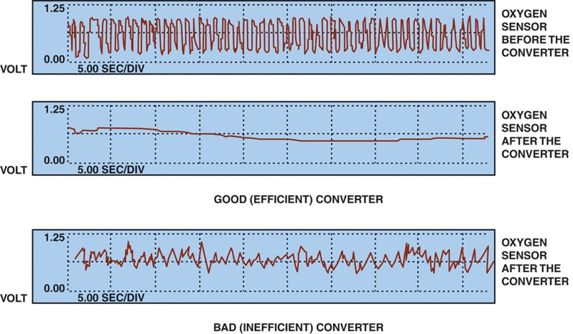
Figure 78.12 The post catalytic converter oxygen sensor should display very little activity if the catalytic converter is efficient.

Slide 32
WIDE-BAND OXYGEN SENSORS (1 OF 2)
Terminology
Wide-band oxygen sensors have various names, depending on the vehicle and/or oxygen sensor manufacturer, including: broadband, wide-band, air-fuel sensor, lean air-fuel sensor.
Introduction
The need for more stringent exhaust emission standards require more accurate fuel control than can be provided by a traditional oxygen sensor.

Slide 33
WIDE-BAND OXYGEN SENSORS (2 OF 2)
Purpose and Function
A wide-band oxygen sensor is capable of supplying air-fuel ratio information to the PCM over a much broader range.
Planar Design
A wide-band oxygen sensor that is flat and thin (1.5 mm or 0.006 inch).
The thin design makes it easier to heat and allows closed loop operation in less than 10 seconds.

Slide 34
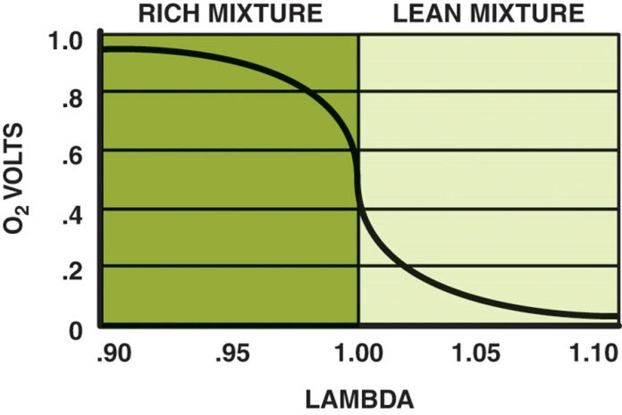
Figure 78.13 A conventional zirconia oxygen sensor can only reset to exhaust mixtures that are richer or leaner than14.7:1 (lambda 1.00).

Slide 35
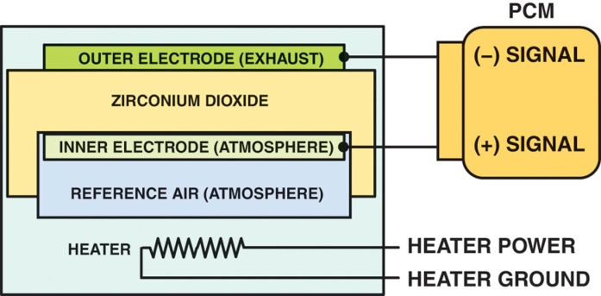
Figure 78.14 A planar design zirconia oxygen sensor places all of the elements together, which allows the sensor to reach operating temperature quickly.

Slide 36
DUAL-CELL PLANAR WIDE-BAND SENSOR OPERATION (1 OF 2)
Construction
A dual-cell, planar-type, wide-band oxygen sensor is made like a conventional planar O2S, or Nernst cell. Above the Nernst cell is another zirconia layer with two electrodes, called the pump cell.
Operation
Oxygen sensors do not measure the quantity of free oxygen in the exhaust. Instead, oxygen sensors produce a voltage that is based on the ion flow between the platinum electrodes of the sensor to maintain a stoichiometric balance.

Slide 37
DUAL-CELL PLANAR WIDE-BAND SENSOR OPERATION (2 OF 2)
Stoichiometric
When the exhaust is at stoichiometric (14.7:1 air-fuel ratio), the voltage of the Nernst cell is 450 mV (0.45 V).
The voltage between the diffusion chamber and the air reference chamber changes from 0.45 V. This voltage is:
Higher if the exhaust is rich
Lower if the exhaust is lean
The reference voltage remains constant, but varies by vehicle.

Slide 38
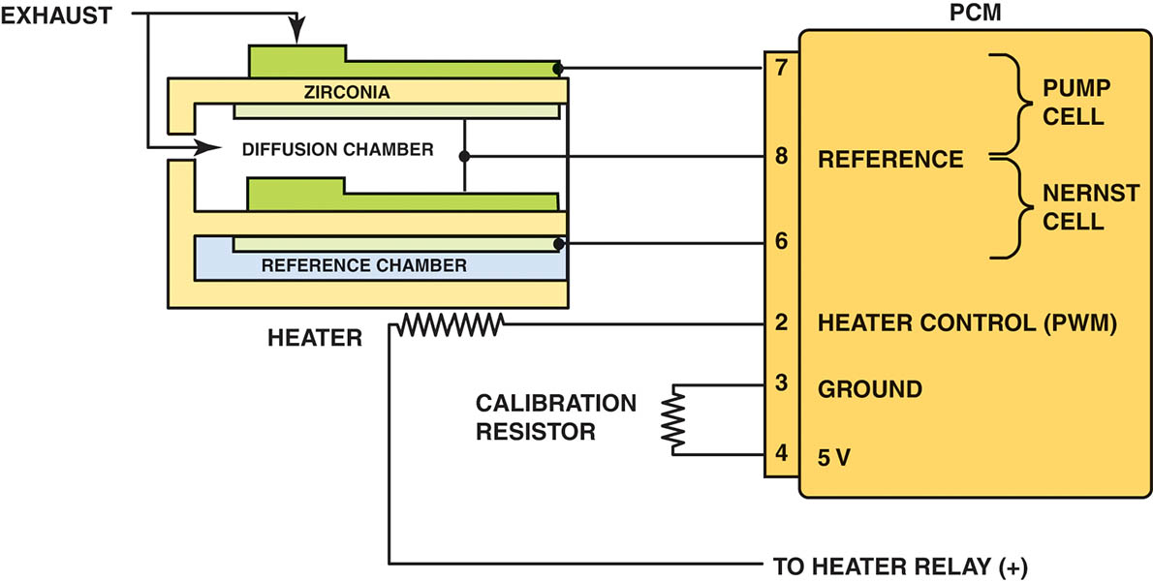
Figure 78.15 The reference electrodes are shared by the Nernst cell and the pump cell.

Slide 39
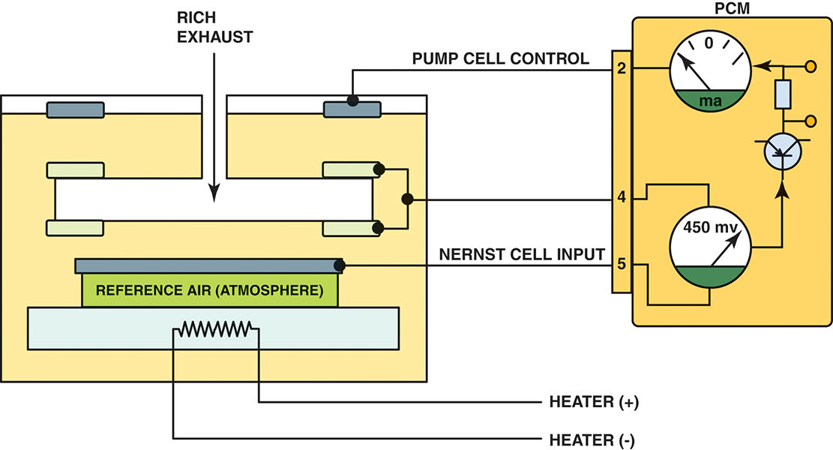
Figure 78.16 When the exhaust is rich, the PCM applies a negative current into the pump cell.

Slide 40
Figure 78.17 When the exhaust is lean, the PCM applies a positive current into the pump cell.

Slide 41
DUAL-CELL DIAGNOSIS
Scan Tool Diagnosis
Most service information specifies that a scan tool be used to check the wide-band oxygen sensor, because the PCM performs tests of the unit and can identify faults.
Digital Meter Testing
Check service information and determine the circuit and connector terminal identification.
Measure the calibration resistor for opens and shorts.

Slide 42
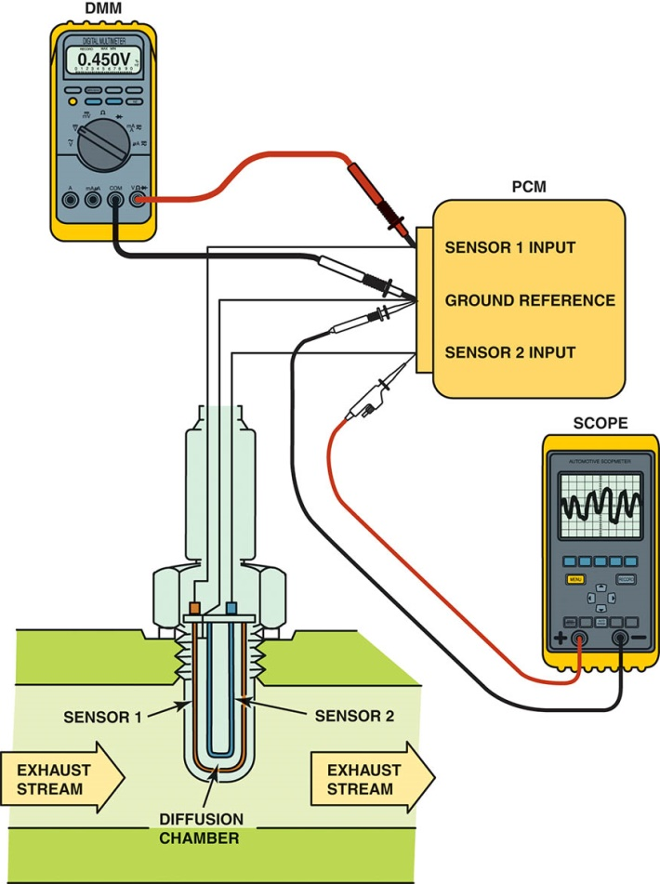
Figure 78.18 Testing a dual-cell, wide-band oxygen sensor can be done using a voltmeter or a scope. The meter reading is attached to the Nernst cell and should read stoichiometric (450 mV) at all times. The scope is showing activity to the pump cell with commands from the PCM to keep the Nernst cell at 14.7:1 air-fuel ratio.

Slide 43
Animation: Wide Band Oxygen Sensor Tests (The animation will automatically start in a few seconds)

Slide 44
SINGLE-CELL WIDE-BAND OXYGEN SENSORS
Construction
A typical single-cell wide-band oxygen sensor looks similar to a conventional four-wire zirconia oxygen sensor, and is referred to as an air-fuel sensor.
Milliammeter Testing
Zero (0 mA) represents lambda or stoichiometric air-fuel ratio of 14.7:1
+10 mA indicates a lean condition
–10 mA indicates a rich condition
Scan Tool Testing
The scan tool displays the voltage, but varies by vehicle.

Slide 45
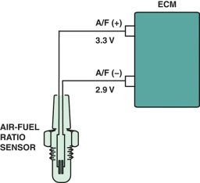
Figure 78.19 A single-cell, wide-band oxygen sensor has four wires with two for the heater and two for the sensor itself. The voltage applied to the sensor is 0.4 V (3.3−2.9 = 0.4) across the two leads of the sensor.

Slide 46
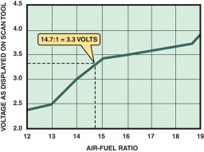
Figure 78.20 A scan tool can display various voltages, but often shows 3.3 V because the PCM is controlling the sensor through applying a low current to the sensor to achieve balance.

Slide 47
WIDE-BAND OXYGEN SENSOR PATTERN FAILURES
Most of the failures cause a DTC to set, usually causing the malfunction indicator (check engine) lamp to light.
However, one type of failure may not set a DTC, such as when the following occurs.
Voltage from the heater circuit bleeds into the Nernst cell.
This voltage causes the engine to operate extremely lean and may or may not set a DTC.

Slide 48
QUESTION 3: ?
How are diagnostics performed on a wide-band dual-cell oxygen sensor?

Slide 49
ANSWER 3:
Diagnostics are performed with a scan tool or a multimeter.

Slide 50
Video Links (Internet Access Required)
Oxygen sensors (time 0:39)
O2 sensor testing (time 6:56)
Oxygen sensor BMW Mini (time 4:16)
Front oxygen sensor removal (time 4:20)
Oxygen sensor bench test (time 5:35)
O2 sensor test (time 10:26)
Oxygen sensor testing (time 3:35)
GM oxygen sensor (time 1:43)
Oxygen sensor testing (time 5:55)
Bias voltage testing (time 12:06)

Slide 51
Video Links (Internet Access Required)
AFR sensor current pump signal circuit (time 1:52)
AFR sensor signal circuit (time 3:02)
AFR sensor ground circuit (time 1:26)
AFR sensor out put signal circuit (time 2:07)
O2 sensor heater circuit (time 1:34)
O2 sensor signal circuit (time 1:14)
Oxygen and ECM circuits (time 1:27)
Oxygen sensor (time 6:42)
Oxygen sensors (time 3:23)
Oxygen sensor troubleshooting part 1 (time 7:59)

Slide 52
Video Links (Internet Access Required)
O2 sensor diagnostics (time 3:10)
Oxygen sensors and wiring diagrams (time 2:52)
Oxygen sensor (time 4:50)
Sensor types (time 7:20)
Wide band air fuel sensor (time 2:48)
Wide band oxygen sensor circuit (time 1:45)

Slide 53
Copyright

