Slide 1
Automotive Technology Principles, Diagnosis, and Service
Sixth Edition
Chapter 77
Mass Air Flow Sensors
Copyright © 2018, 2015, 2011 Pearson Education, Inc. All Rights Reserved

Slide 2
LEARNING OBJECTIVES
77.1 Discuss how MAF sensors work and describe the types of MAF sensors.
77.2 Discuss the PCM uses for the MAF sensor.
77.3 List the methods that can be used to test MAF sensors.
77.4 This chapter will help prepare for Engine Repair (A8) ASE certification test content area “E” (Computerized Engine Controls Diagnosis and Repair).

Slide 3
MASS AIR FLOW SENSOR TYPES
Purpose and Function
The purpose and function of mass air flow sensors is to measure the amount of air entering the engine.
Hot Film Sensor
Uses a temperature sensing resistor (thermistor) to measure the temperature of the incoming air.
Hot Wire Sensor
Uses a hot wire to sense the mass airflow.

Slide 4
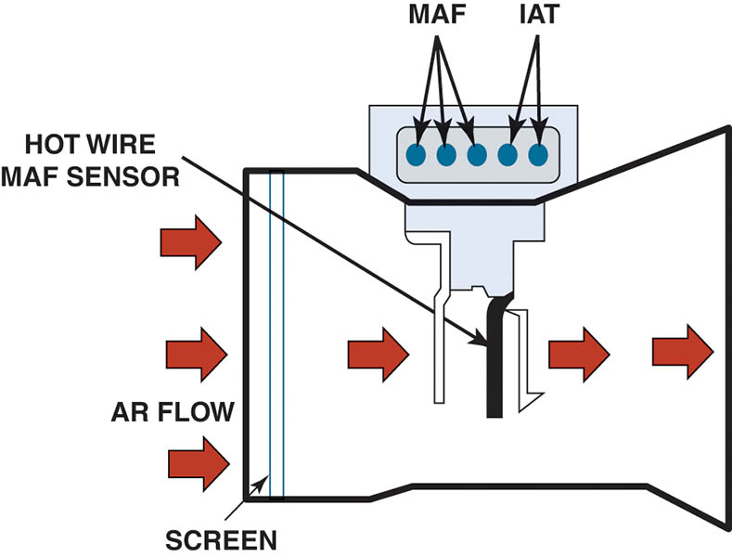
Figure 77.1 This five-wire mass air flow sensor consists of a metal foil sensing unit, an intake air temperature (IAT) sensor, and the electronic module.

Slide 5
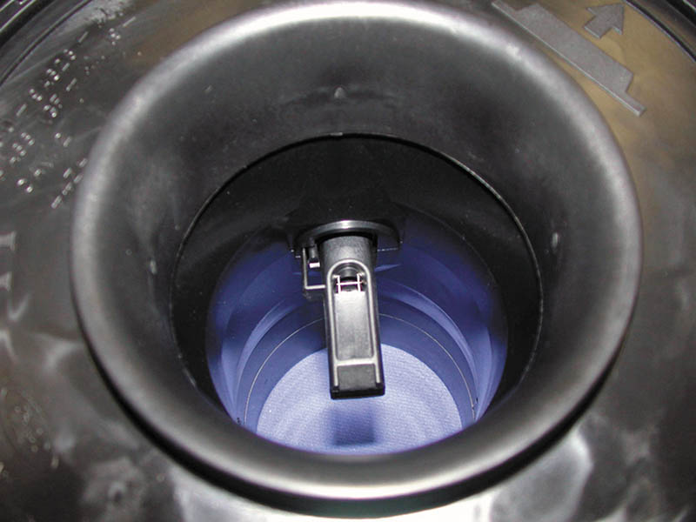
Figure 77.2 The sensing wire in a typical hot wire mass air flow sensor.

Slide 6
QUESTION 1: ?
What are the two most common types of mass air flow sensors?

Slide 7
ANSWER 1:
Hot wire and hot film.

Slide 8
KARMAN VORTEX SENSORS
There are two basic designs of Karman Vortex air flow sensors.
Ultrasonic. This type of sensor uses ultrasonic waves to detect the vortexes that are produced.
Pressure-type. Chrysler uses a pressure-type Karman Vortex sensor that uses a pressure sensor to detect the vortexes.

Slide 9
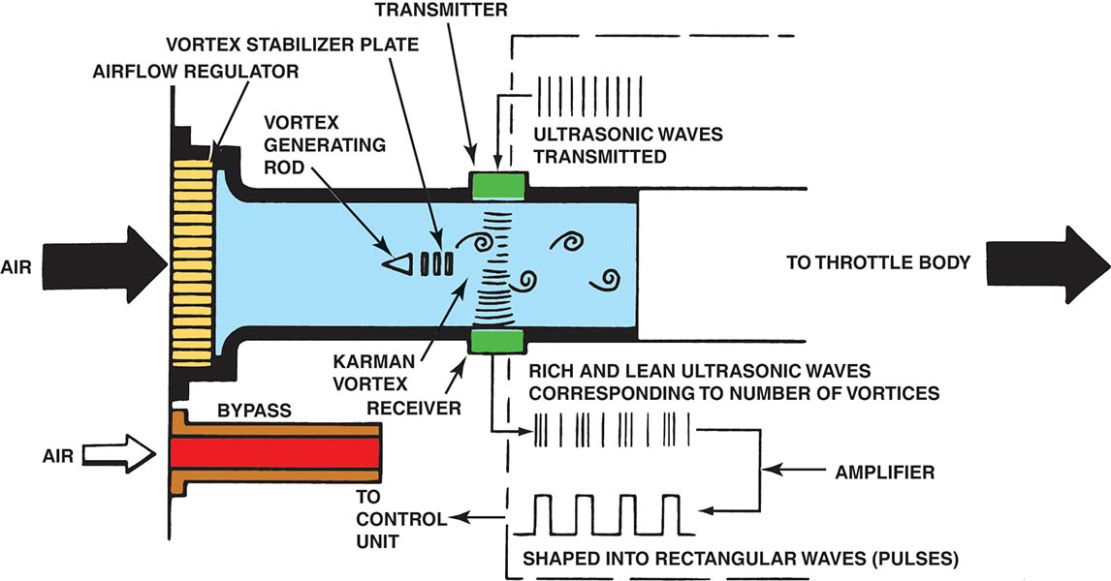
Figure 77.3 A Karman Vortex air flow sensor uses a triangle-shaped rod to create vortexes as the air flows through the sensor. The electronics in the sensor itself converts these vortexes to a digital square wave signal.

Slide 10
PCM USES FOR AIRFLOW SENSORS
The PCM uses the information from the airflow sensor for the following purposes:
Airflow sensors are used mostly to determine the amount of fuel needed and base pulse-width numbers.
Airflow sensors back up the TP sensor in the event of a loss of signal or an inaccurate throttle position sensor signal.

Slide 11
TESTING MASS AIR FLOW SENSORS
Visual Inspection
MAF Sensor Output Test
Tap Test
Digital Meter Test of a MAF Sensor

Slide 12
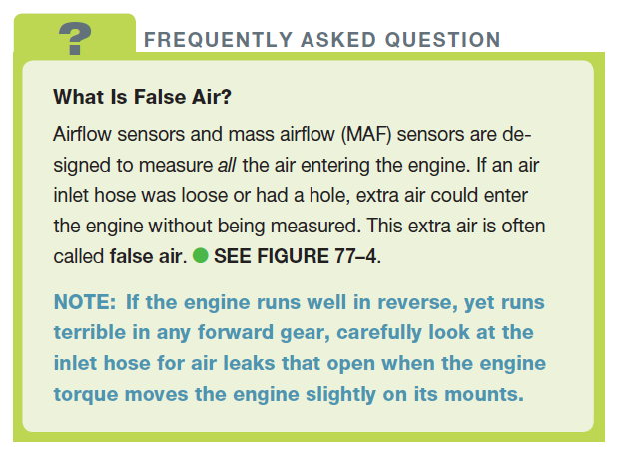
FREQUENTLY ASKED QUESTION

Slide 13
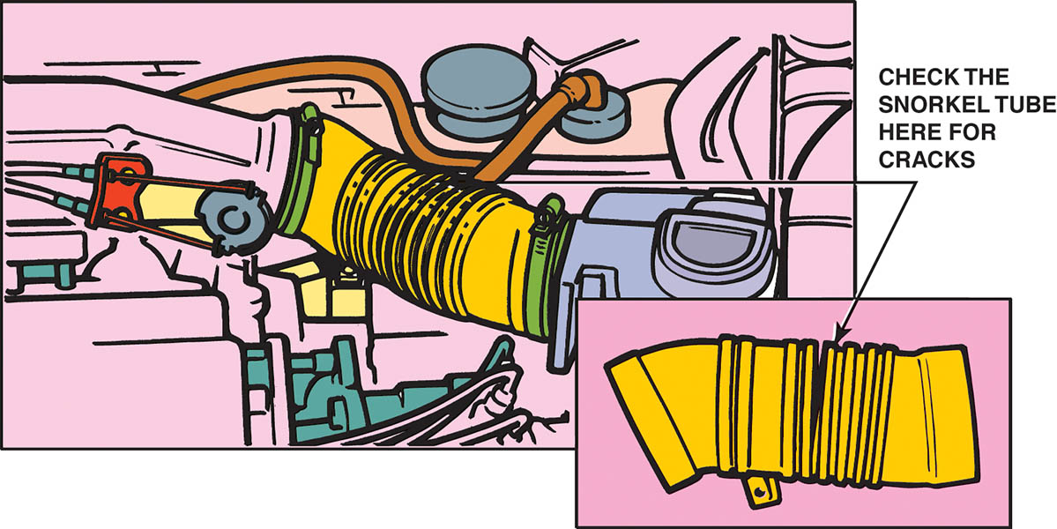
Figure 77.4 Carefully check the hose between the MAF sensor and the throttle plate for cracks or splits that could create extra (false) air into the engine that is not measured by the MAF sensor.

Slide 14
QUESTION 2: ?
What are four ways to test a MAF sensor?

Slide 15
ANSWER 2:
Visual inspection, MAF sensor output test, tap test, and a digital meter.

Slide 16
MAF SENSOR CONTAMINATION
Dirt, oil, silicon, or even spider webs can coat the sensing wire.
It tends to insulate the sensing wire at low airflow rates.
Creates an incorrect estimate of air entering the engine.

Slide 17
MAF SENSOR SCOPE TESTING
A digital storage oscilloscope (DSO) can be used to monitor the operation of a MAF sensor.
Connect the test leads to the signal wire and the sensor ground and, following the scope instructions.
Look for a consistent pattern that changes in frequency as the engine speed is increased.

Slide 18
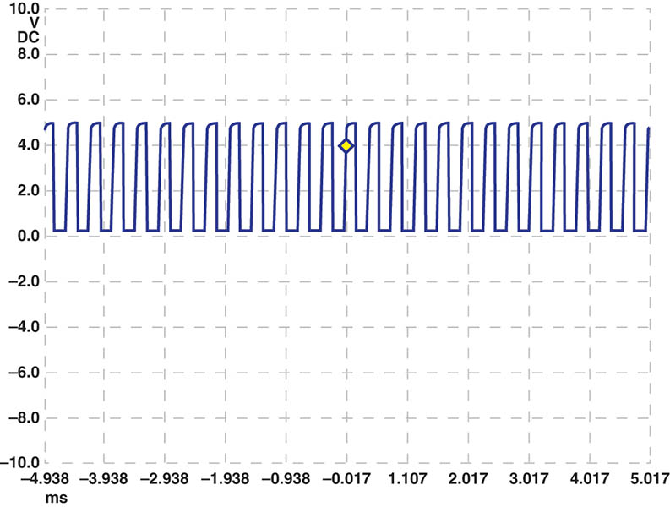
Figure 77.5 A scope display showing a normal Chevrolet Equinox MAF sensor at idle speed. the frequency is 2,600 Hertz (2.6kHz).

Slide 19
QUESTION 3: ?
What will be the result of a contaminated MAF sensor?

Slide 20
ANSWER 3:
An incorrect estimate of the air entering the engine.

Slide 21
Video Links (Internet Access Required)
MAF cleaning (time 2:26)
MAF testing part 1 (time 9:00)
MAF testing part 2 (time 10:59)
Dirty MAF sensor (time 14:51)
MAF testing (time 15:04)
MAF sensor (time 8:05)
Vane air sensor (time 3:51)
Ford MAF sensor testing (time 5:36)
Ford MAF sensor cleaning (time 3:37)
MAF sensor karman vortex signal circuit (time 2:15)

Slide 22
Video Links (Internet Access Required)
MAF IAT sensor signal circuit (time 1:47)
MAF hot film circuit (time 2:23)
MAF and ECM circuit (time 1:32)
MAF sensor (time 1:34)
MAF testing (time 1:29)
Digital MAF sensor diagnosis and repair (time 3:08)
Mass air flow sensor (time 0:37)
Vane air meter (time 6:14)
Cleaning a MAF sensor (time 2:57)
MAF sensor testing (time 1:27)

Slide 23
Video Links (Internet Access Required)
MAF sensor and wiring diagram (time 4:24)

Slide 24
Copyright

