Slide 1
Automotive Technology Principles, Diagnosis, and Service
Sixth Edition
Chapter 69
Alternative Fuels
Copyright © 2018, 2015, 2011 Pearson Education, Inc. All Rights Reserved

Slide 2
LEARNING OBJECTIVES
69.1 Describe the sources of ethanol and compare E85 with gasoline.
69.2 Discuss how alternative fuels affect driveability.
69.3 Discuss methanol, propane, natural gas, and synthetic fuel options.
69.4 Discuss safety precautions when working with alternative fuels.
This chapter will help prepare for Engine Repair (A8) ASE certification test content area “A” (General Engine Diagnosis).

Slide 3
ETHANOL
Ethanol Terminology
Ethanol is also called ethyl alcohol or grain alcohol, because it is usually made from grain.
Ethanol Production
Conventional ethanol is derived from grains, such as corn, wheat, or soybeans.
Ethanol can be made by the dry mill process in which the starch portion of the corn is fermented into sugar and then distilled into alcohol.

Slide 4
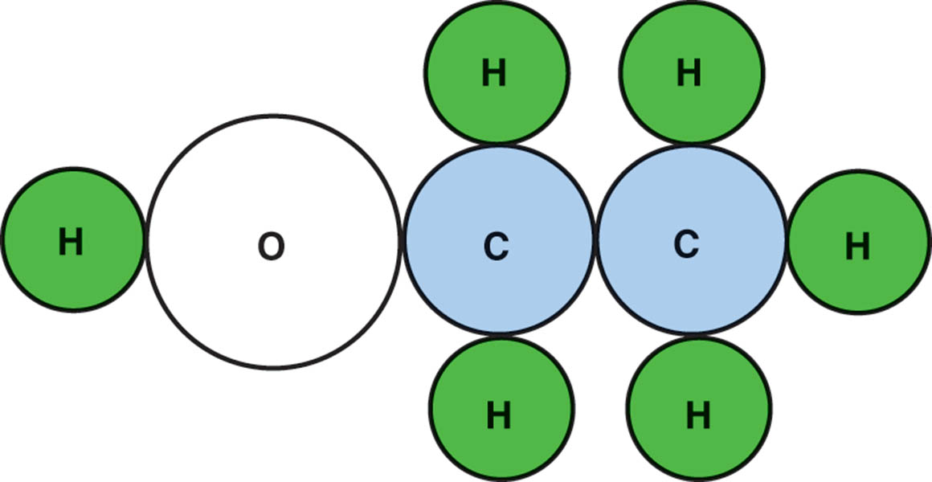
Figure 69.1 The ethanol molecule showing two carbon atoms, six hydrogen atoms, and one oxygen atom

Slide 5
CELLULOSE ETHANOL
Terminology
Cellulose ethanol can be produced from a wide variety of cellulose biomass feedstock, including:
Agricultural plant wastes (corn stalks, cereal straws)
Plant wastes from industrial processes (sawdust, paper pulp)
Energy crops grown specifically for fuel production
Refining Cellulose Biomass
Involves extracting fermentable sugars from the feedstock.

Slide 6
E85
What is E85?
E85 is composed of 85% ethanol and 15% gasoline.
E85 has an octane rating of about 100 to 105.
Heat Energy of E85
E85 has less heat energy than gasoline.
Gasoline = 114,000 BTUs per gallon
E85 = 87,000 BTUs per gallon

Slide 7
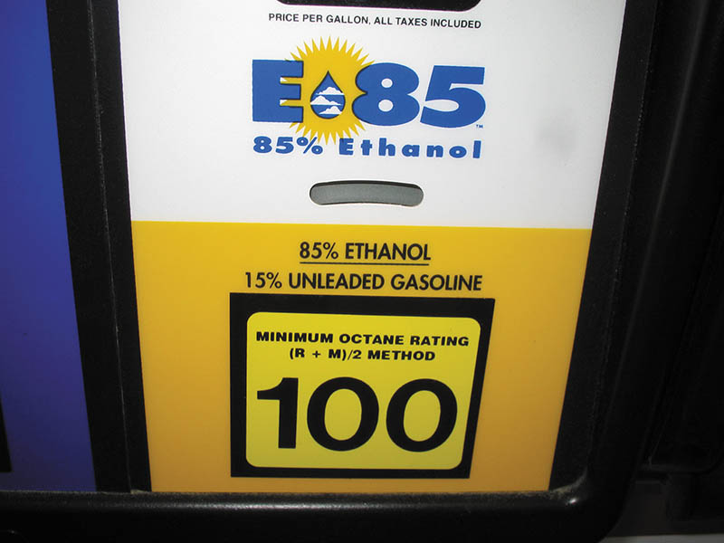
Figure 69.2 E85 has 85% ethanol mixed with 15% gasoline

Slide 8
QUESTION 1: ?
What is E85?

Slide 9
ANSWER 1:
85% gasoline and 15% ethanol.

Slide 10
ALTERNATIVE-FUEL VEHICLES (1 OF 2)
Vehicles equipped with this capability are commonly referred to as alternative-fuel vehicles (AFVs), Flex Fuels, and flexible fuel vehicles (FFVs).
E85 Fuel System Requirements
Fuel compensation sensor that measures both the percentage of ethanol blend and the temperature of the fuel.
Sensor-less flex-fuel systems rely on feedback from the oxygen sensor to detect lean condition.

Slide 11
ALTERNATIVE-FUEL VEHICLES (2 OF 2)
Flex-Fuel Vehicle Identification
Emblems on the side, front, and/or rear of the vehicle
Yellow fuel cap showing E85/gasoline
Vehicle emission control information (VECI) label under the hood
Vehicle identification number (VIN)

Slide 12
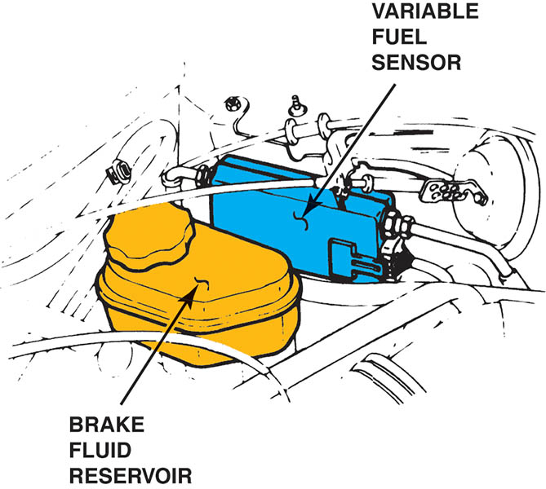
Figure 69.3 The location of the variable fuel sensor can vary, depending on the make and model of vehicle, but it is always in the fuel line between the fuel tank and the fuel injectors

Slide 13
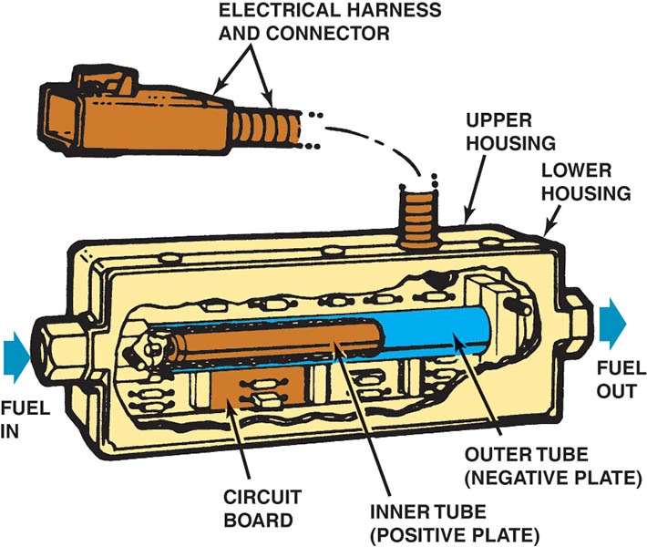
Figure 69.4 A cutaway view of a typical variable fuel sensor

Slide 14
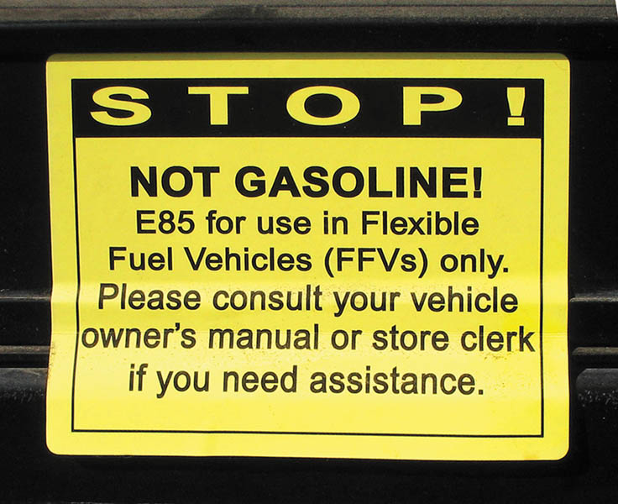
Figure 69.5 A warning sticker on an E85 pump warning to only use this fuel in vehicles designated as flexible fuel vehicles (FFV)

Slide 15
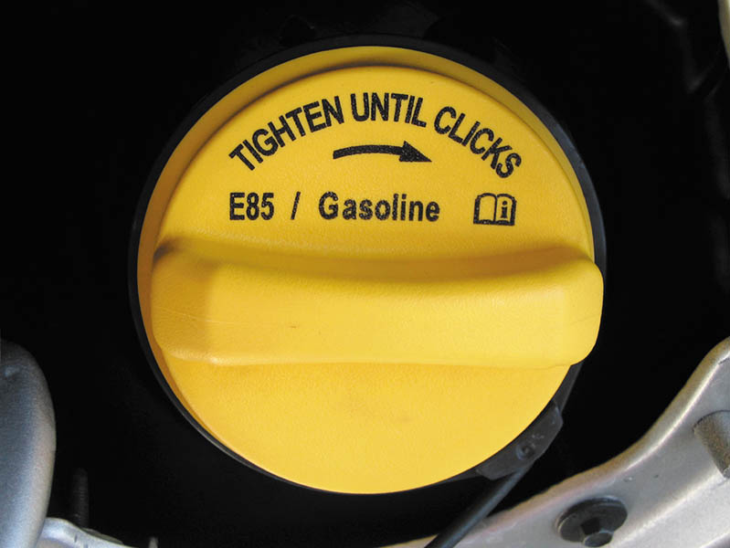
Figure 69.6 A flex-fuel vehicle often has a yellow gas cap, which is labeled “E85/gasoline”

Slide 16
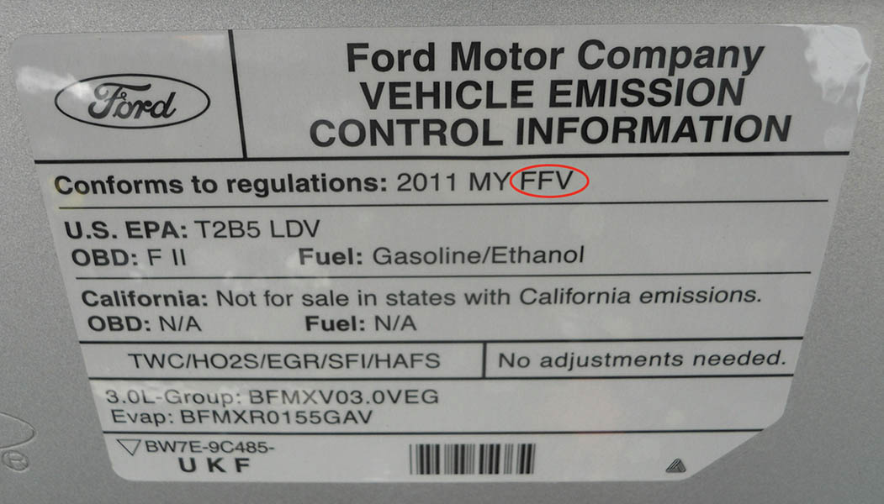
Figure 69.7 A vehicle emission control information (VECI) sticker on a flexible fuel vehicle

Slide 17
QUESTION 2: ?
How is a flexible fuel vehicle identified?

Slide 18
ANSWER 2:
The vehicle can be identified by the fuel cap, the VIN number, the emissions sticker, or the badging on the sides.

Slide 19
METHANOL
Methanol Terminology
Methanol, also known as methyl alcohol, wood alcohol, or methyl hydrate, is a chemical compound that includes one carbon atom, four hydrogen atoms, and one oxygen atom
Production of Methanol
The biggest source of methanol in the United States is coal. Using a simple reaction between coal and steam, a gas mixture called syn-gas (synthesis gas) is formed.
M85: 85% gasoline and 15% methanol

Slide 20
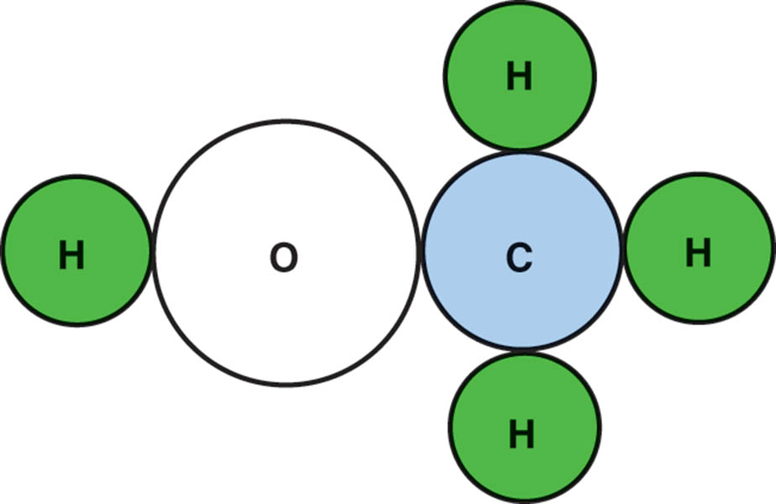
Figure 69.8 The molecular structure of methanol showing the one carbon atom, four hydrogen atoms, and one oxygen atom

Slide 21
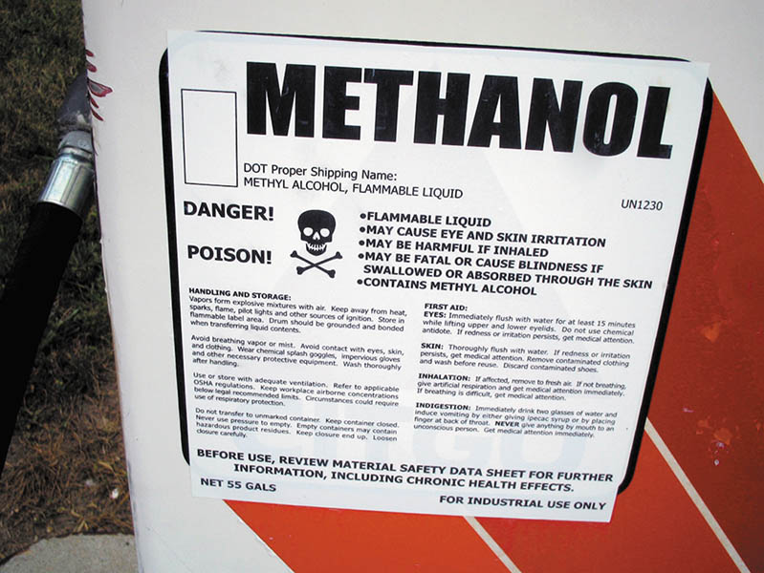
Figure 69.9 Sign on methanol pump shows that methyl alcohol is a poison and can cause skin irritation and other personal injury. Methanol is used in industry as well as being a fuel

Slide 22
PROPANE
When sold as a fuel, it is also known as liquefied petroleum gas (LPG) or LP-gas
Advantages of Propane
Reduced emissions, low cost, improved cold start ability, and lower maintenance costs
Disadvantages of Propane
Required space for storage tanks, fewer BTUs per gallon than gasoline, higher initial costs, and limited refueling stations.

Slide 23
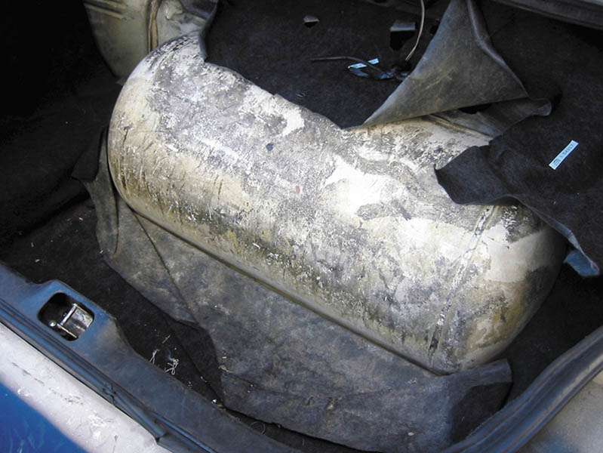
Figure 69.10 Propane fuel storage tank in the trunk of a Ford taxi

Slide 24
COMPRESSED NATURAL GAS (CNG) (1 OF 2)
CNG Vehicle Design
Vehicles using this fuel are often referred to as natural gas vehicles (NGVs).
Natural gas has to be compressed to about 3,000 PSI (20,000 kPa).
The weight and the cost of the storage container is a major factor when it comes to preparing a vehicle to run on CNG.

Slide 25
COMPRESSED NATURAL GAS (CNG) (2 OF 2)
CNG Composition
Compressed natural gas is made of methane, propane, ethane, n-butane, carbon dioxide, and nitrogen.
Once it is processed, it is at least 93% methane.
CNG Fuel Systems
The CNG tank has 3,600 PSI of pressure in the tank.
The high-pressure regulator reduces the high-pressure CNG to approximately 170 PSI.
A two-stage regulator that first reduces the pressure to approximately 4 to 6 PSI in the first stage and then to 4.5 to 7 inches of water in the second stage.

Slide 26
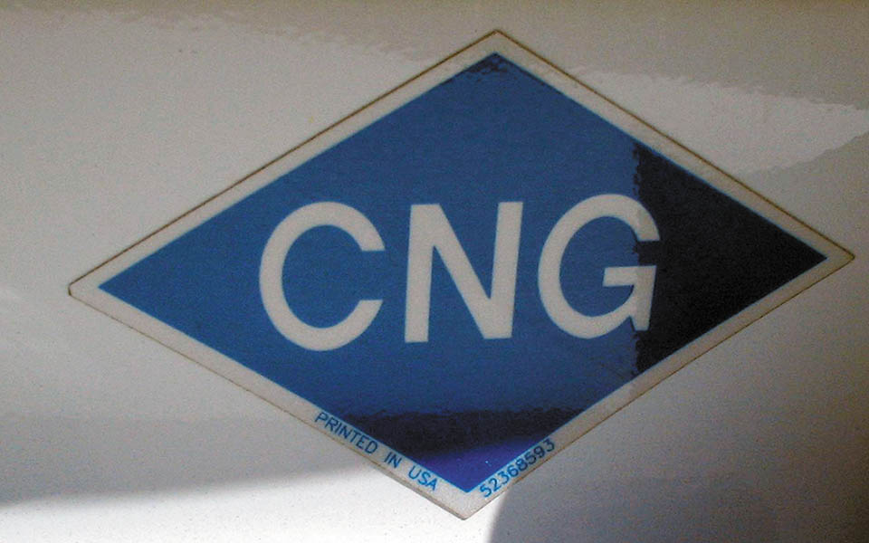
Figure 69.11 The blue sticker on the rear of this vehicle indicates that it is designed to use compressed natural gas

Slide 27
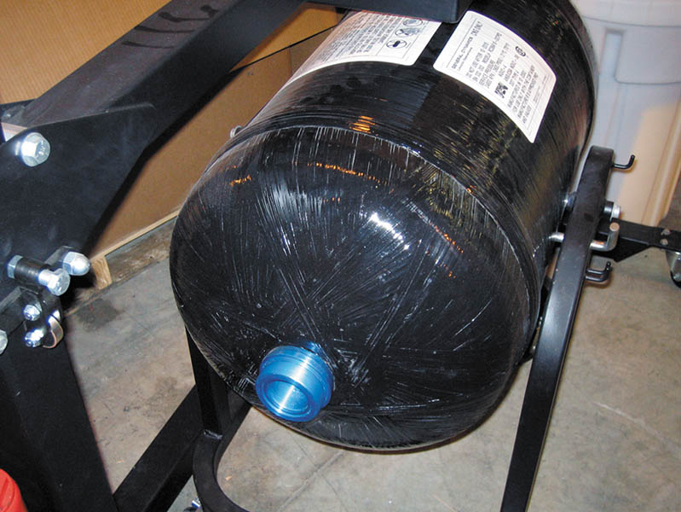
Figure 69.12 A CNG storage tank from a Honda Civic GX shown with the fixture used to support it while it is being removed or installed in the vehicle.

Slide 28
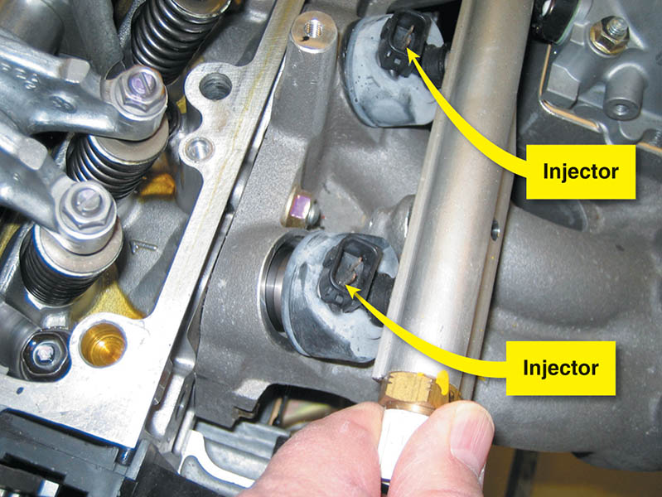
Figure 69.13 The fuel injectors used on this Honda Civic GX CNG engine are designed to flow gaseous fuel instead of liquid fuel and cannot be interchanged with any other type of injector

Slide 29
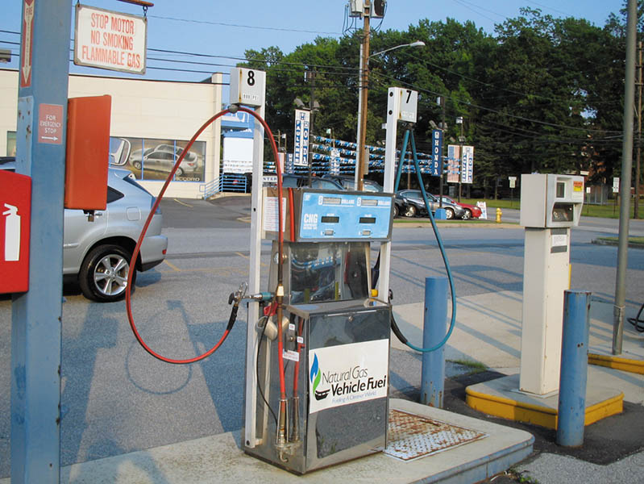
Figure 69.14 This CNG pump is capable of supplying compressed natural gas at either 3,000 PSI or 3,600 PSI. The price per gallon is higher for the higher pressure

Slide 30
LIQUEFIED NATURAL GAS (LNG)
Natural gas can be turned into a liquid if cooled to below −260°F (−162°C).
The natural gas condenses into a liquid at normal atmospheric pressure and the volume is reduced by about 600 times.
Practical for use in short-haul trucks where they can be refueled from a central location.

Slide 31
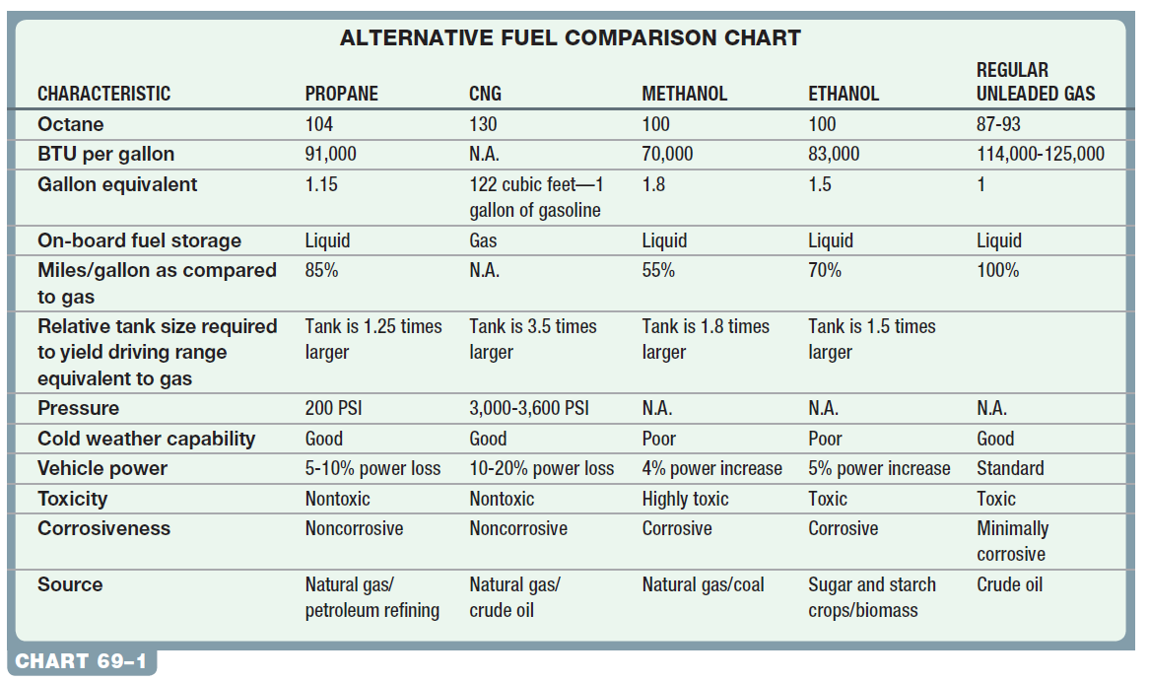
Chart 69-1 The characteristics of alternative fuels compared to regular unleaded gasoline shows that all have advantages and disadvantages.

Slide 32
SYNTHETIC FUELS (1 OF 2)
Fischer-Tropsch
The Fischer-Tropsch method uses carbon monoxide and hydrogen (the same synthesis gas used to produce hydrogen fuel) to convert coal and other hydrocarbons to liquid fuels in a process similar to hydrogenation, another method for hydrocarbon conversion.
Coal To Liquid (CTL)
Two procedures can be used: Direct and Indirect
Very expensive and generates high CO2 emissions.
Currently not in use in the United States.

Slide 33
SYNTHETIC FUELS (2 OF 2)
Methanol to Gasoline
A process for converting methanol (methyl alcohol) into gasoline in a process called methanol-to-gasoline (MTG).
Future of Synthetic Fuels
A very expensive process to produce synthetic fuels.
May become more common as costs of refining from crude oil increase.

Slide 34
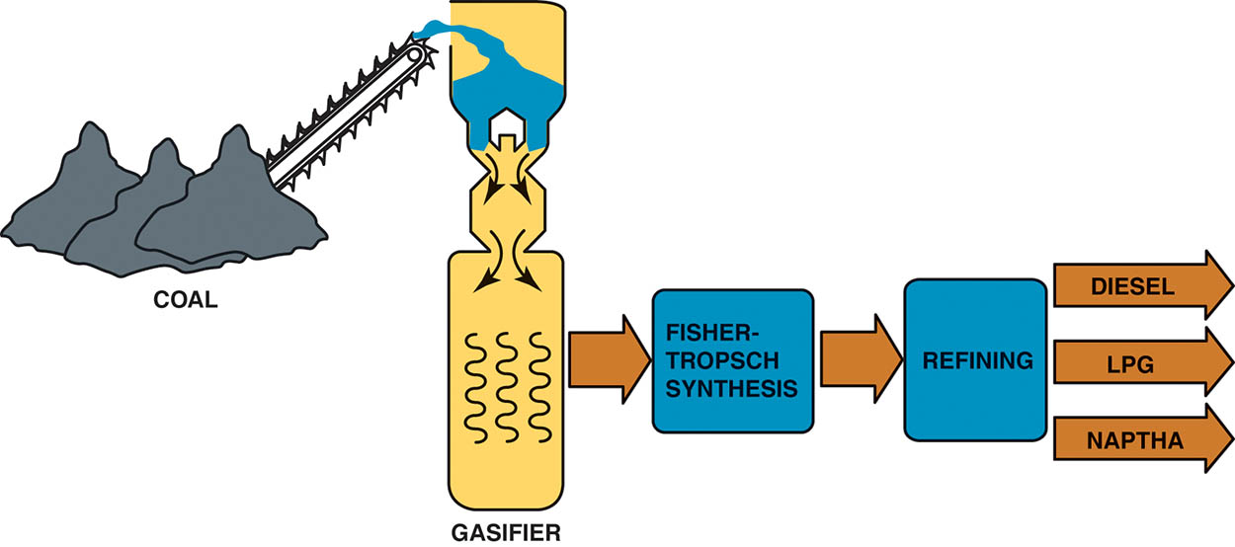
Figure 69.15 A Fischer-Tropsch processing plant is able to produce a variety of fuels from coal

Slide 35
SAFETY PROCEDURES WHEN WORKING WITH ALTERNATIVE FUELS
Safety glasses and/or face shield
Protective gloves
Long-sleeved shirt and pants
If any fuel gets on the skin, the area should be washed immediately.
If fuel spills on clothing, change into clean clothing as soon as possible.
If fuel spills on a painted surface, flush the surface with water and air dry.
Always vent the exhaust to the outside.

Slide 36
QUESTION 3: ?
What is the Fischer-Tropsch method?

Slide 37
ANSWER 3:
A process of converting coal into liquid fuels.

Slide 38
Video Links (Internet Access Required)
Alternative fuel: water powered cars part 1 (time 10:25)
Alternative fuel: water powered cars part 2 (time 3:42)
Alternative fuel vehicles (time 2:55)

Slide 39
Copyright

