Slide 1

Automotive Technology Principles, Diagnosis, and Service
Sixth Edition
Chapter 65
Automatic Air-Conditioning System Operation
Copyright © 2018, 2015, 2011 Pearson Education, Inc. All Rights Reserved

Slide 2
LEARNING OBJECTIVES
65.1 Explain airflow management and the sensors and actuators used in automatic air conditioning.
65.2 Discuss the filters and controls used in automatic air conditioning.
65.3 Explain dual-zone climate controls, rear air-conditioning system operation, and recirculation operation.
65.4 Describe how hybrid electrical vehicle heating and cooling systems are different from conventional systems.

Slide 3
AIRFLOW MANAGEMENT
All automatic heating, ventilation, and air-conditioning (HVAC) systems use a combination of the following components to control airflow into the passenger compartment:
  Vents
  Ducts
  Air Doors (also flap doors or valves)
The use of these components allows the system to provide airflow under the following conditions:
  Fresh air, heat, air conditioning, and defrost

Slide 4
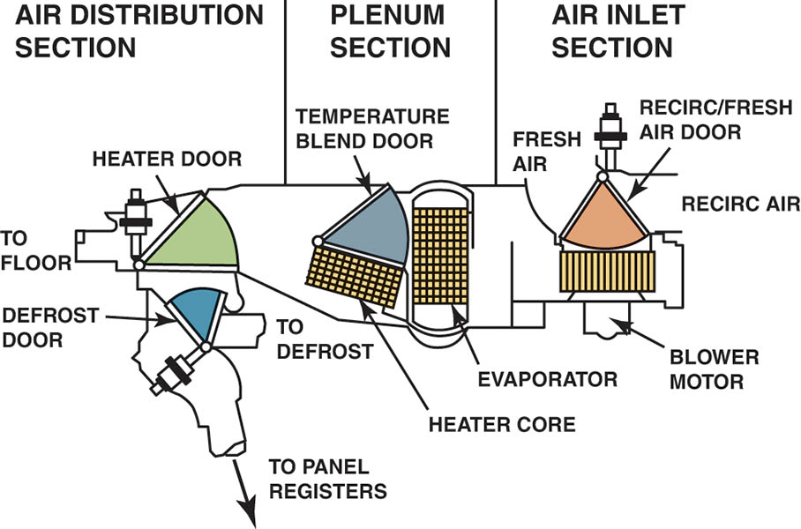
Figure 65.1 The three major portions of the A/C and heat system are air inlet, plenum, and air distribution. The shaded portions show the paths of the four control doors

Slide 5
AUTOMATIC AIR CONDITIONING (1 OF 3)
Automatic air-conditioning systems are usually called automatic temperature control (ATC) systems.
Additional sensors are needed to automate the system.
Outside Air Temperature (OAT) Sensor
  Usually located behind the grille, in front of the radiator.
  Also called the ambient temperature sensor.
  Used to supply information for the driver display and the ATC system.

Slide 6
AUTOMATIC AIR CONDITIONING (2 OF 3)
Inside Vehicle Temperature Sensor
  The temperature sensor is located behind the instrument panel.
  Air to the sensor is forced to flow past the sensor by using an aspirator tube, which is connected to the blower motor case.
Discharge Air Temperature Sensor
  The sensor is located in the outlet ducts.
  Provides the controller with the actual discharge temperature.

Slide 7
AUTOMATIC AIR CONDITIONING (3 OF 3)
Evaporator Outlet Temperature Sensor
  The sensor is used to control the AC compressor to keep the evaporative temperature within the specified temperature range for most efficient operation.
Sunload Sensor
  Mounted on the top of the dash.
  Uses a photo diode to measure increased heat load from window glass.
  Outlet temperature and fan speed are adjusted based on input.

Slide 8
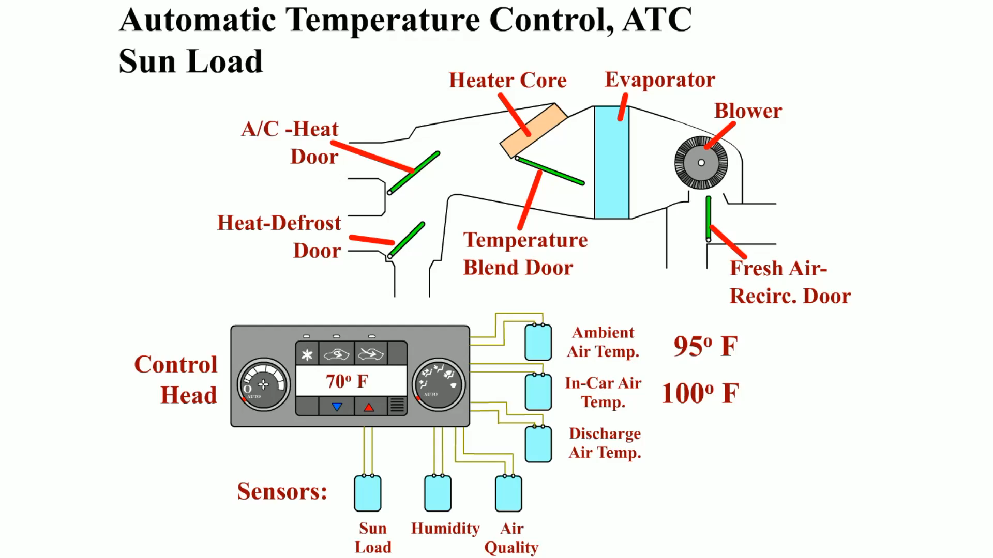
Animation:
Automatic Control, ATC Sun Load
(The animation will automatically start in a few seconds)

Slide 9
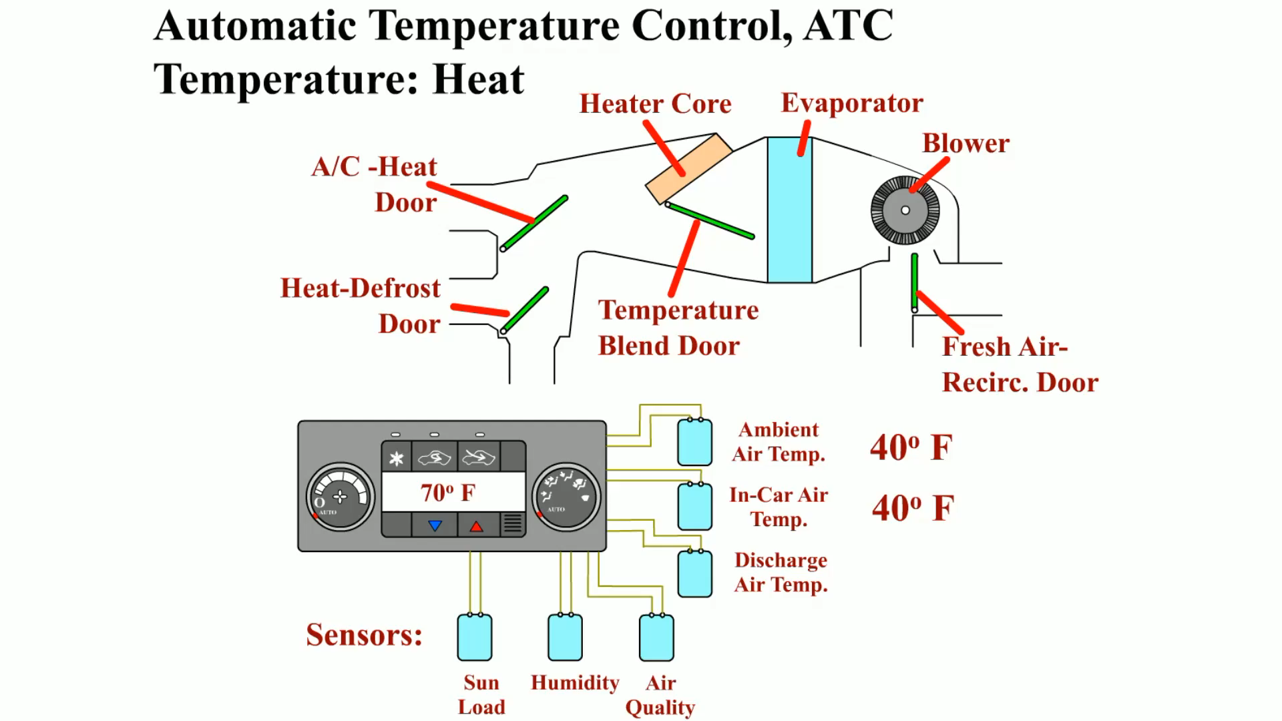
Animation: Automatic Temperature Control, ATC Temperature Heat
(The animation will automatically start in a few seconds)

Slide 10
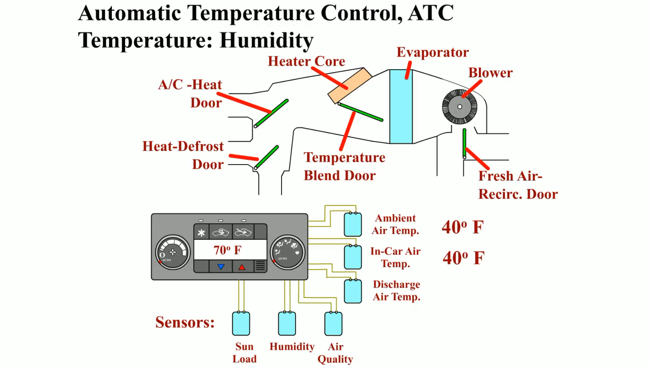
Animation: Automatic Temperature Control, ATC Temperature: Humidity
(The animation will automatically start in a few seconds)

Slide 11
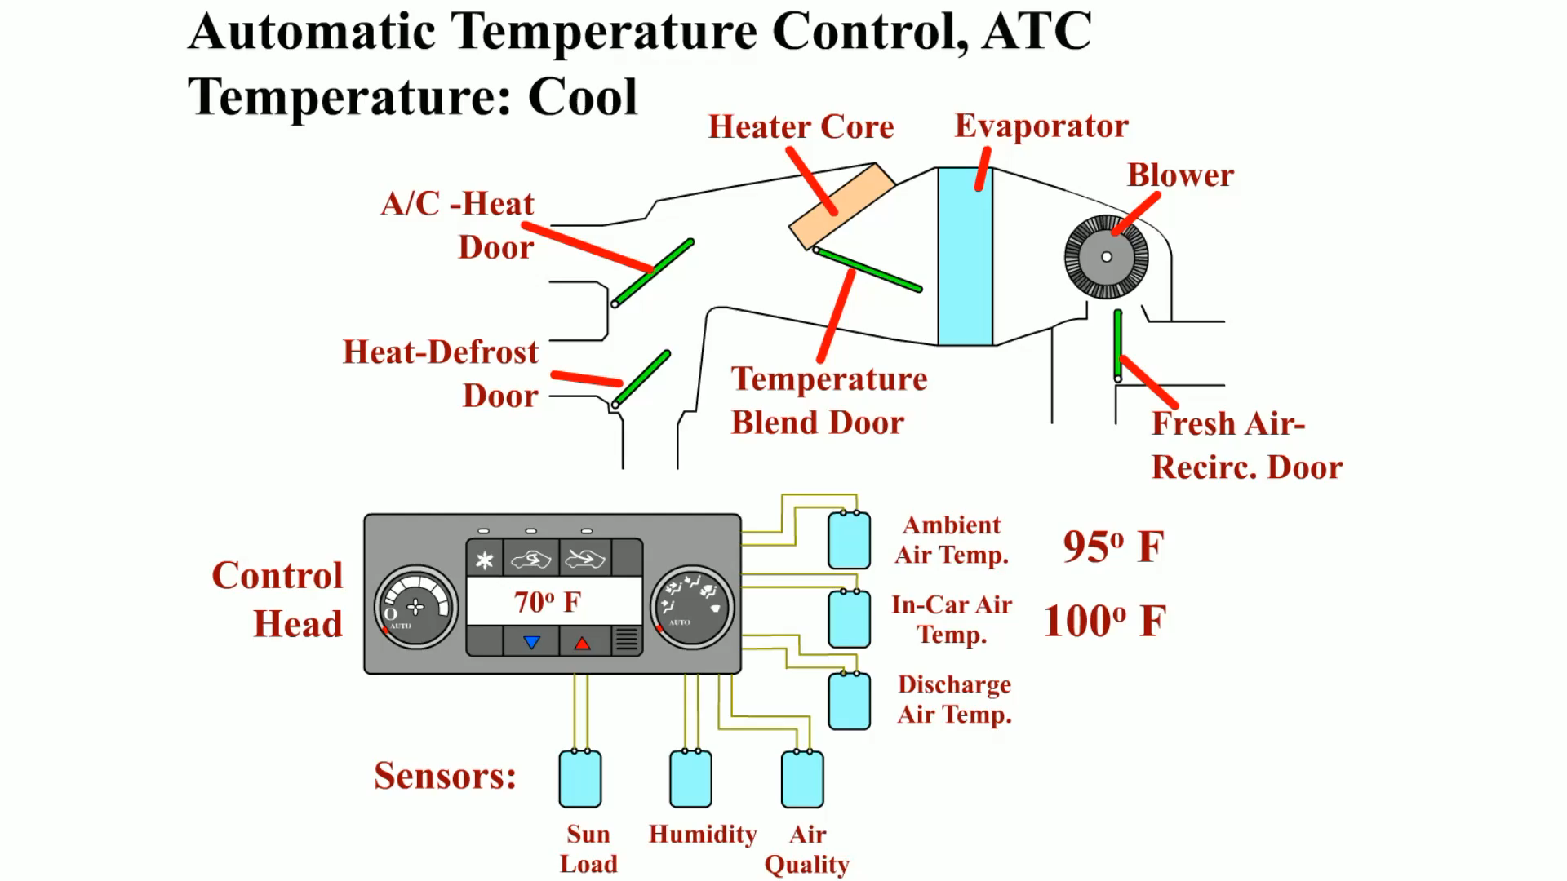
Animation: Automatic Temperature Control, ATC Temperature: Cool
(The animation will automatically start in a few seconds)

Slide 12
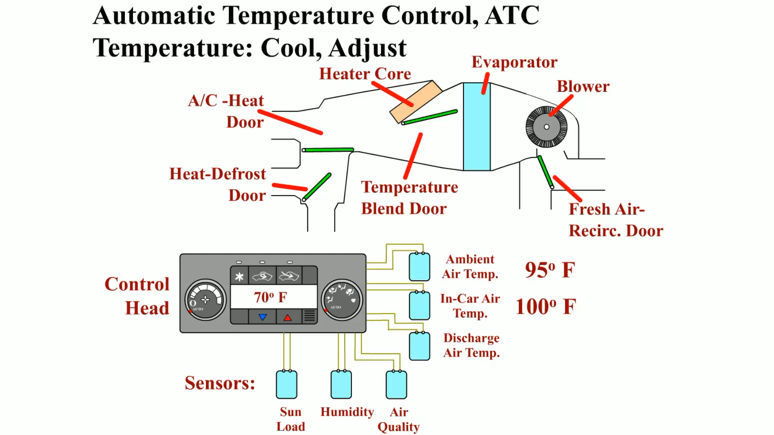
Animation: Automatic Temperature Control, ATC Temperature Cool, Adjust
(The animation will automatically start in a few seconds)

Slide 13
QUESTION 1: ?
Automatic air-conditioning systems include which sensors?

Slide 14
ANSWER 1:
Outside air temperature sensor, Inside vehicle temperature sensor, Discharge air temperature sensor, Evaporator outlet temperature sensor and Sunload sensor.

Slide 15
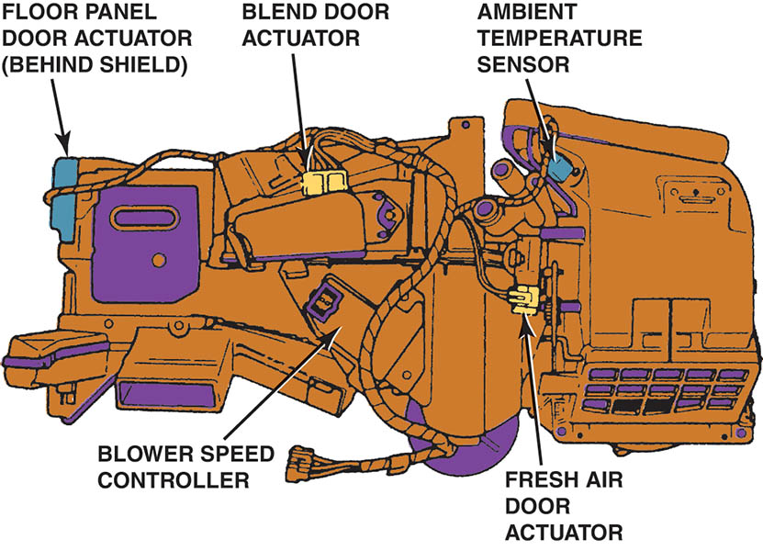
Figure 65.2 The ambient temperature sensor in this system is located in the fresh air intake duct for the HVAC systems

Slide 16
ACTUATORS
Dual-Position Actuator
  Able to move either open or closed. A recirculation door is an example.
Three-Position Actuator
  Able to provide three air door positions, such as the bi-level door, which could allow defrost only, floor only, or a mixture of the two.
Variable-Position Actuator
  Capable of multiple positions. May use a potentiometer to provide feedback of actual door position.

Slide 17
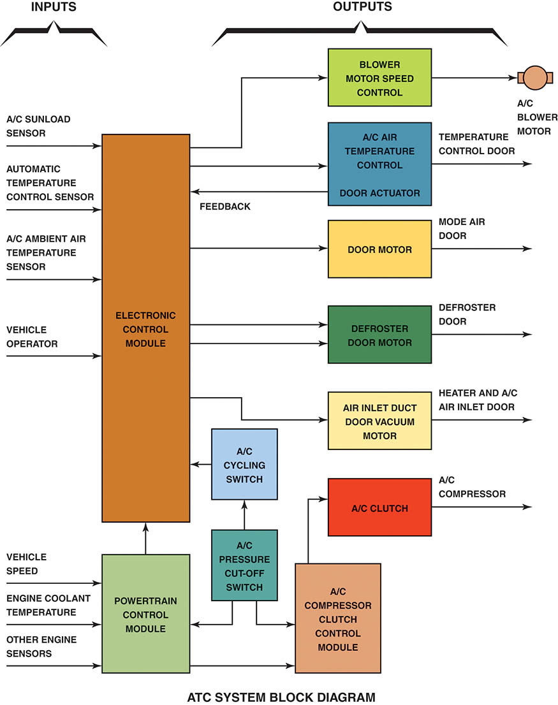
Figure 65.3 A block diagram showing the inputs to the electronic control assembly and the outputs; note that some of the outputs have feedback to the ECM

Slide 18
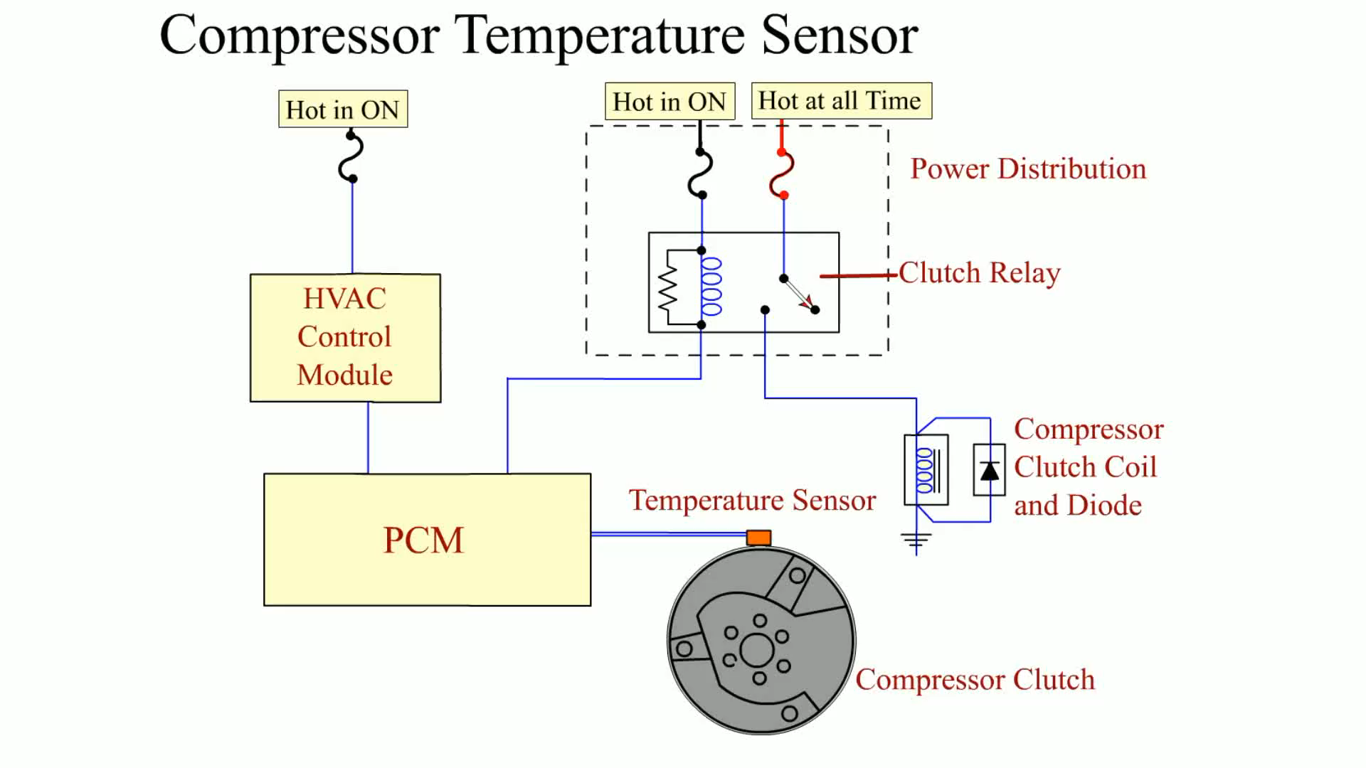
Animation:
Compressor Temperature Sensor
(The animation will automatically start in a few seconds)

Slide 19
QUESTION 2: ?
Why is a feedback potentiometer used on an electric actuator?

Slide 20
ANSWER 2:
To provide feedback of the actual position of the door.

Slide 21
CABIN FILTERS
An air filter in the outside air inlet
The purpose is to filter dirt and dust from the air before it enters the interior of the vehicle.
It is accessed either in the dash, usually behind the glove box, or from under the hood.
Cabin air filters should be replaced regularly.

Slide 22
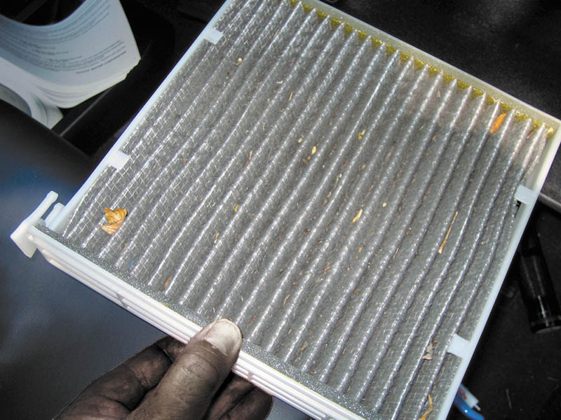
Figure 65.4 A typical cabin filter being removed from behind the glove compartment

Slide 23
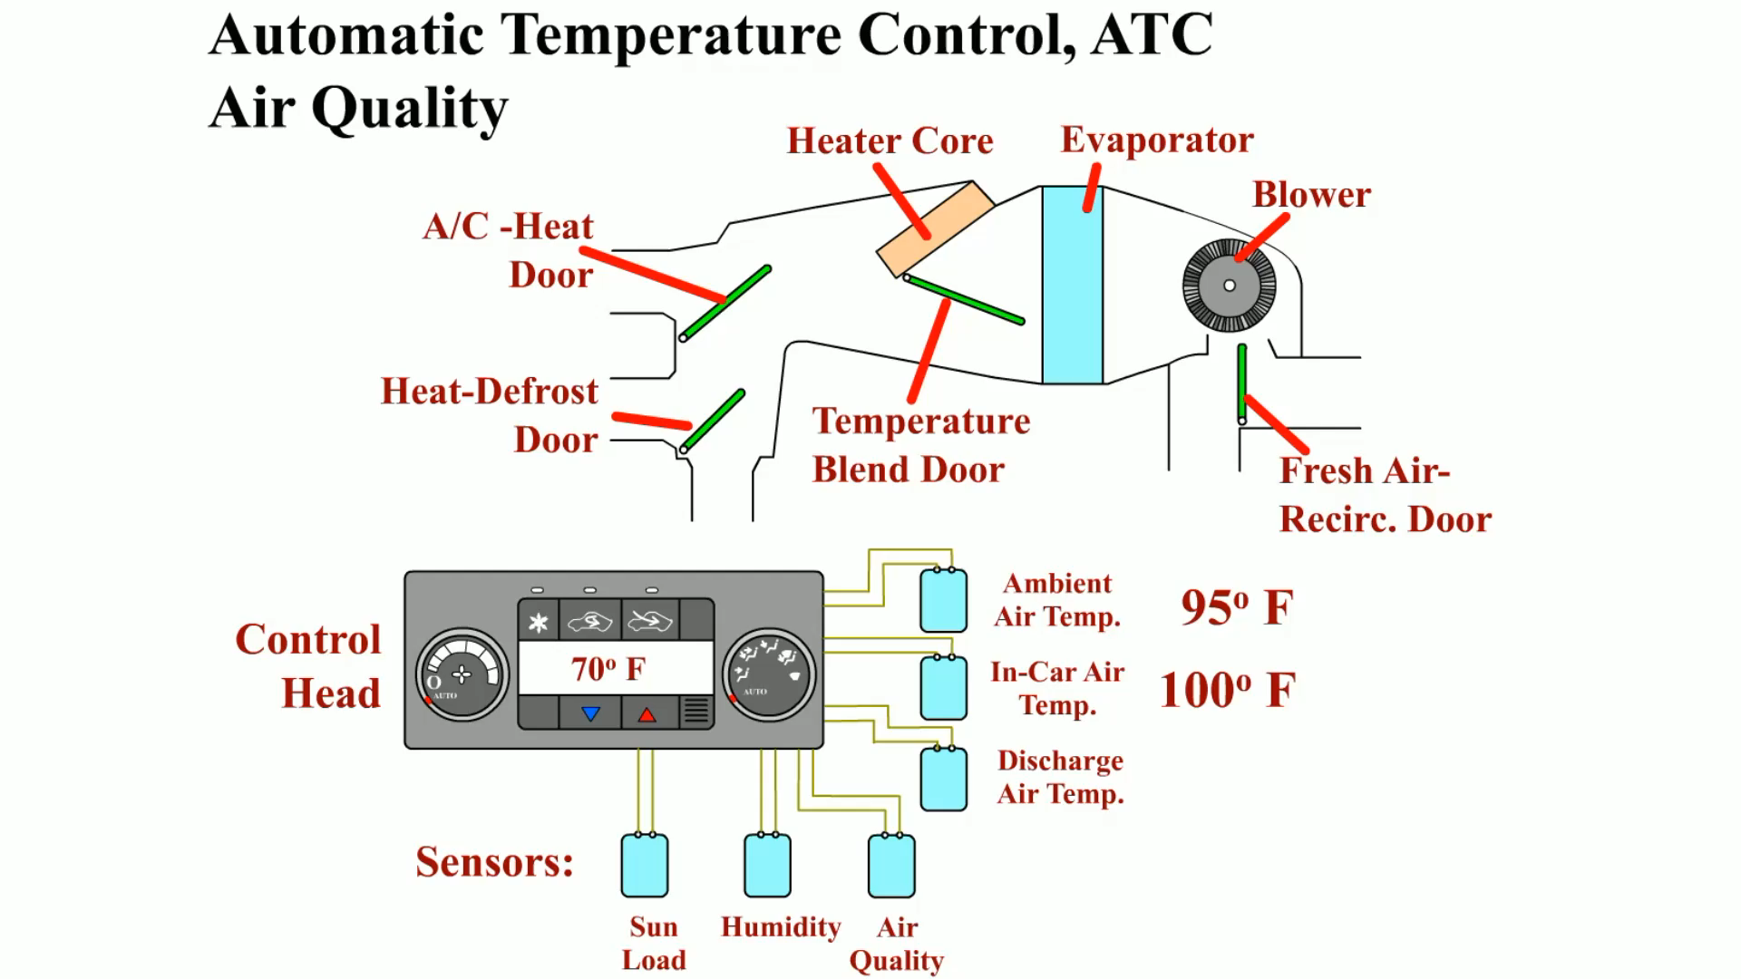
Animation: Automatic Temperature Control, ATC Air Quality
(The animation will automatically start in a few seconds)

Slide 24
VACUUM CONTROL CIRCUITS
Vacuum control circuits use vacuum created in the intake manifold of the engine.
Vacuum actuators are used to control door position.
A vacuum accumulator is used to store vacuum during the short periods of acceleration.

Slide 25
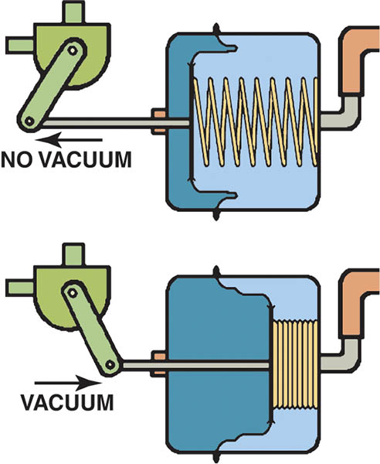
Figure 65.5 With no vacuum signal, the spring extends the actuator shaft to place the door in a certain position (top). A vacuum signal pulls the shaft inward and moves the door to the other position (bottom)

Slide 26
ELECTRIC SERVOMOTOR CIRCUITS
Most HVAC systems use electric motors to move valves and doors.
Each servomotor contains a feedback potentiometer, which is used by the air-conditioning control unit to indicate the actual position of the valve or door.
Most systems are designed to store a diagnostic trouble code indicating which door is out of calibration.

Slide 27
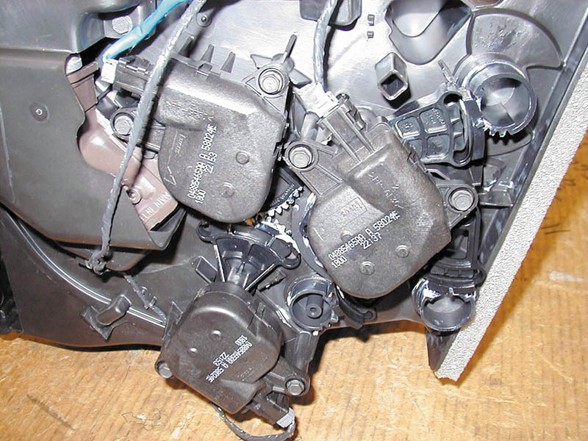
Figure 65.6 Three electric actuators can be easily seen on this demonstration unit. However, accessing these actuators in a vehicle can be difficult

Slide 28
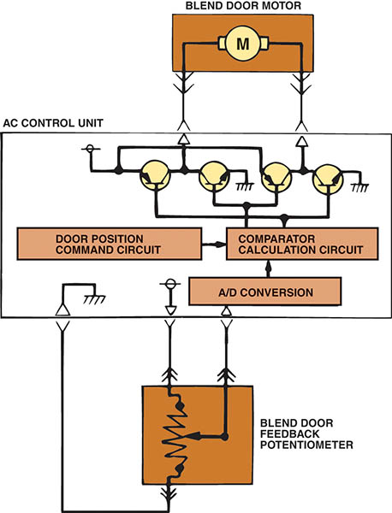
Figure 65.7 The feedback circuit signals the A/C control unit with the blend door position

Slide 29
BLOWER MOTOR CONTROL
Blower motors are used to move air.
The system uses resistors to control the speed of the motor.
The resistor lowers the voltage and the current to the motor.
The blower motor resistor is always located in the plenum near the blower motor so that airflow past the resistor can help keep it cool.

Slide 30
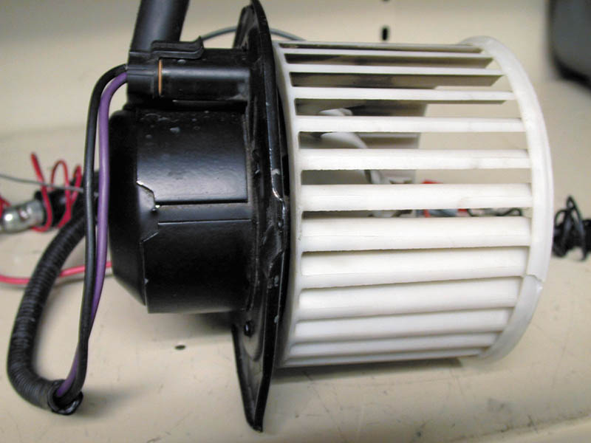
Figure 65.8 A typical blower motor assembly with attached squirrel cage blower. A replacement motor does not include the squirrel cage blower, so it needs to be switched to the replacement motor

Slide 31
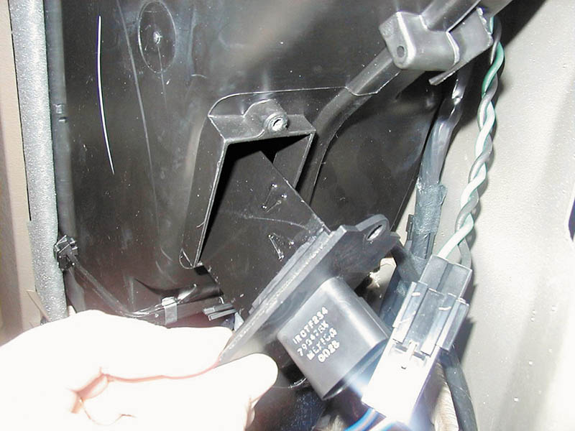
Figure 65.9 A “credit card” resistor used in the rear blower assembly in a Dodge minivan

Slide 32
DUAL-ZONE CLIMATE CONTROLS
Dual-zone climate controls allow the driver and the passenger to select different temperatures, as much as a 30°F (17°C) difference.
Two air mix (blend air) doors are used, with each door being controlled by its own actuator.

Slide 33
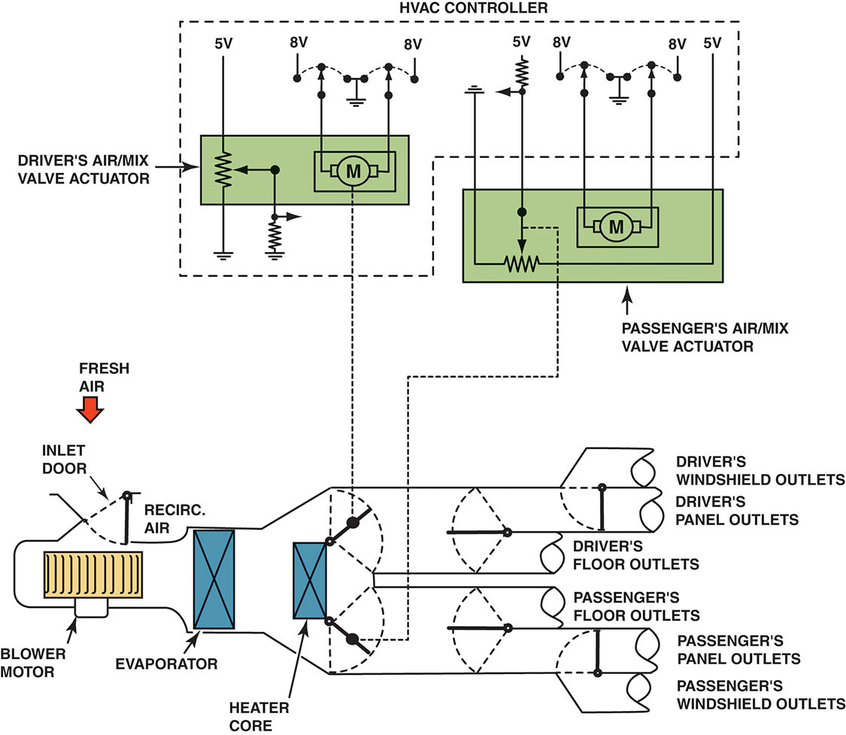
Figure 65.10 A dual-zone climate control system showing the airflow and how it splits

Slide 34
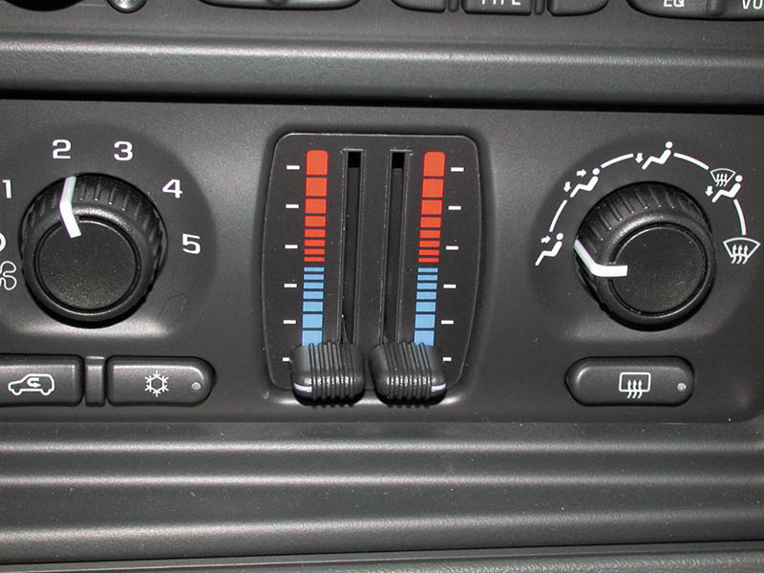
Figure 65.11 A typical dual-zone climate control panel showing left and right side temperature control levers

Slide 35
QUESTION 3: ?
How does a dual-zone climate control system work?

Slide 36
ANSWER 3:
Two air mix (blend air) doors are used, each with its own actuator .

Slide 37
REAR AIR-CONDITIONING SYSTEM
Most rear HVAC systems include the following components:
  A larger capacity air-conditioning compressor
  A second evaporator located at the rear of the vehicle
  A second heater core located at the rear of the vehicle
  A second blower motor and blower motor control at the rear of the vehicle
  Lines and fittings connecting the front heater and air- conditioning components to the rear system
  Rear controls for speed and temperature on some models

Slide 38
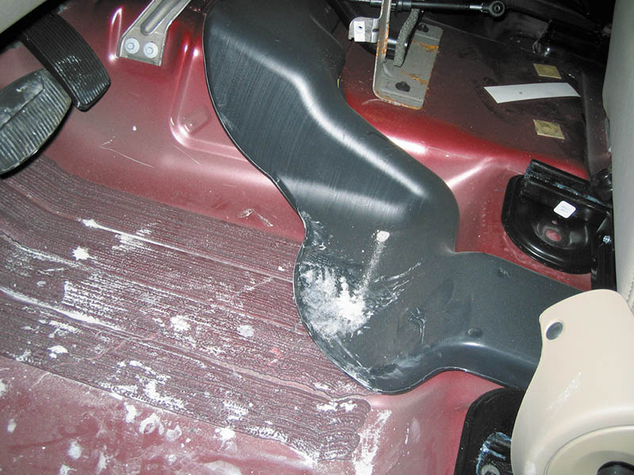
Figure 65.12 Heated or cooled air is supplied to the rear seat passengers of most vehicles through ducts that run under the front seats

Slide 39
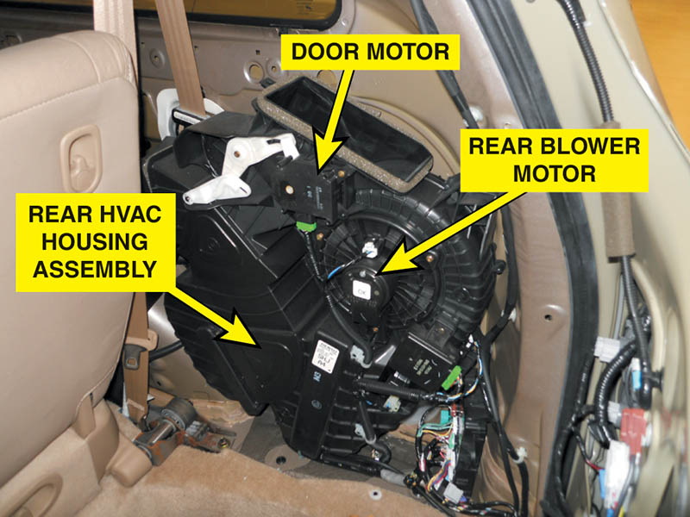
Figure 65.13 A rear heat and air-conditioning system on a Honda Odyssey minivan

Slide 40
RECIRCULATION OPERATION
The purpose is to speed up the cooling of the inside of the vehicle.
The body control module may also select recirculation operation if the high-side air-conditioning system pressures exceed 320 PSI (2,200 kPa)
  To help lower the high-side pressure using cooler inside air through the evaporator
  Customer may notice change in air noise.

Slide 41
HYBRID ELECTRIC VEHICLE HEATING AND COOLING SYSTEMS
Hybrid electric vehicle (HEV) systems need to be different than conventional systems.
  Provide heat and cooling during engine off periods.
These methods include:
  Idle-stop mode is disabled if max cooling is selected.
  Hybrid compressor that is both belt and electronically operated.
  High voltage electric compressor.

Slide 42
Video Links (Internet Access Required)
Audi A8 Automatic Climate Control (time 5:02)

Slide 43

Copyright

