Slide 1
Automotive Technology Principles, Diagnosis, and Service
Sixth Edition
Chapter 61
Autonomous Vehicles
Copyright © 2018, 2015, 2011 Pearson Education, Inc. All Rights Reserved

Slide 2
LEARNING OBJECTIVES (1 of 2)
61.1 Outline the benefits and concerns regarding autonomous vehicles.
61.2 Discuss the levels of autonomous vehicle automation and the computer power needed.
61.3 Explain the different types of sensors used in autonomous vehicles.

Slide 3
LEARNING OBJECTIVES (2 of 2)
61.4 Discuss the importance having communications between vehicles and from vehicles to the infrastructure.
61.5 Explain how cameras can be used in autonomous vehicles.
61.6 Explain the purpose of the multi-domain controller and describe how it works.

Slide 4
THE NEED FOR AUTOMATION
Purpose
Lane Keep Assist
Emergency Braking
Connected Vehicle Applications
Safety
Traffic Updates
Convenience

Slide 5
INTRODUCTION TO AUTONOMOUS VEHICLES (1 OF 2)
What is an Autonomous Vehicle?
A vehicle that uses an automated driving system that monitors the driving environment and makes navigation decisions without driver input.
History
Finds its roots in da Vinci’s Self-Propelled Cart of the 1500s.

Slide 6
INTRODUCTION TO AUTONOMOUS VEHICLES (2 OF 2)
Benefits
Fewer traffic collisions
Increased roadway capacity
Increased speed limits and occupant productivity
Concerns
Resistance of drivers to accept
Hardware function in poor driving conditions
Cybersecurity and the loss of privacy
Managing the transition to full automation

Slide 7
LEVELS OF VEHICLE AUTOMATION
SAE Definitions
Level 0: No assistance systems
Level 1: Cruise Control
Level 2: Adaptive Cruise Control, Blind-Spot Warning, Lane-Departure Warning, Forward Collision Warning, Automatic Emergency Braking, Self-Parking
Level 3,4, 5: Equipped with radar, Lidar, and cameras to detect objects surrounding the vehicle. Also able to communicate with other vehicles.

Slide 8
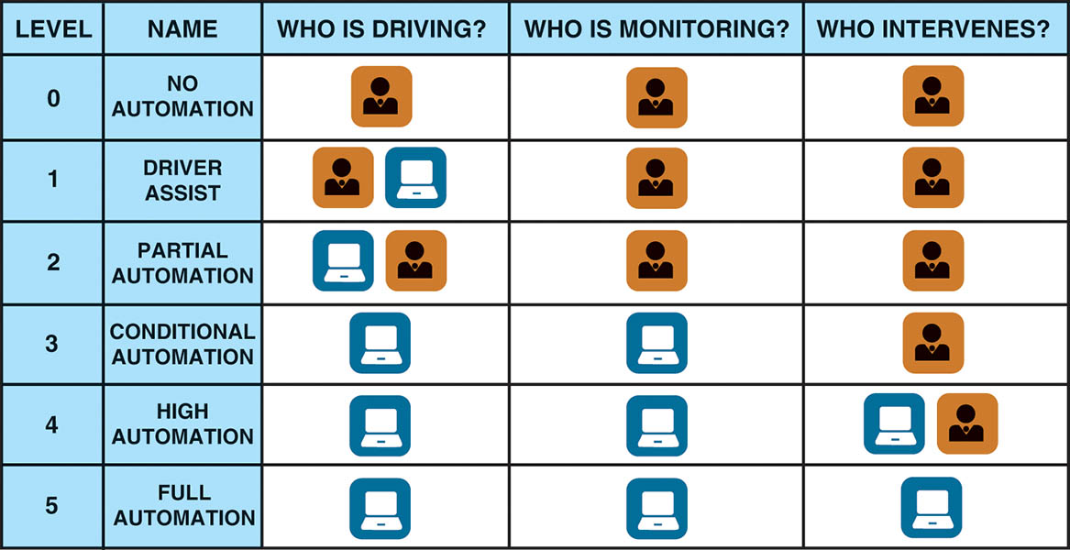
Figure 61.1 A graphic example of who is driving and monitoring the conditions, and who can intervene if a situation requires evasive action.

Slide 9
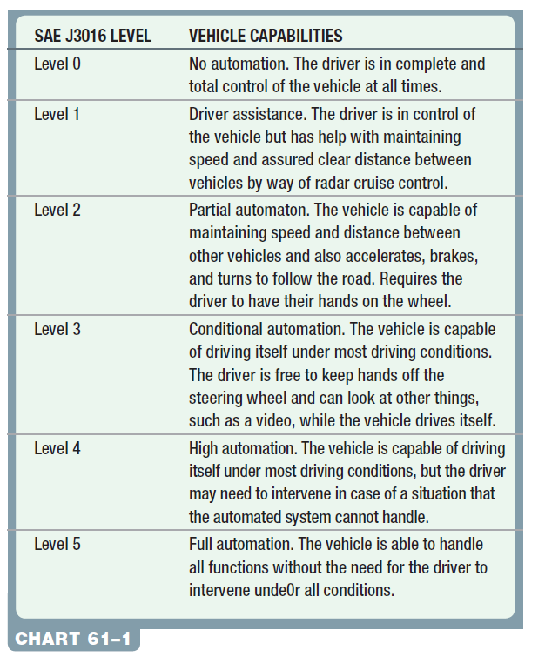
Chart 61-1 The SAE J3016 levels of automated vehicle capabilities.

Slide 10
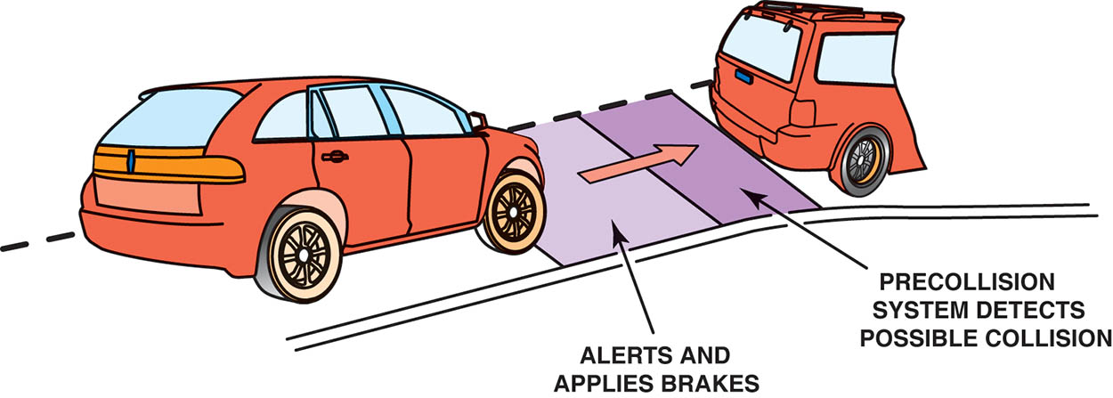
Figure 61.2 A pre-collision system is designed to prevent a collision first, and then interacts to prepare for a collision, if needed

Slide 11
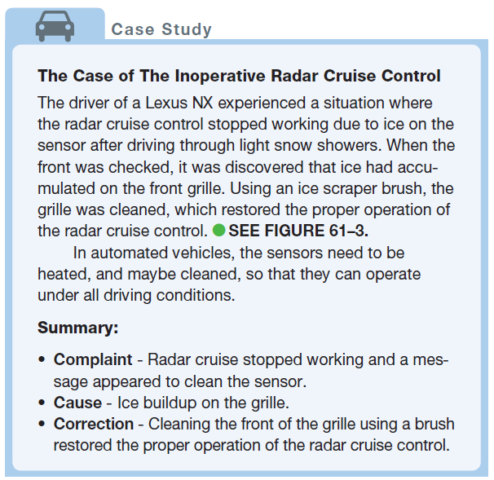
CASE STUDY

Slide 12
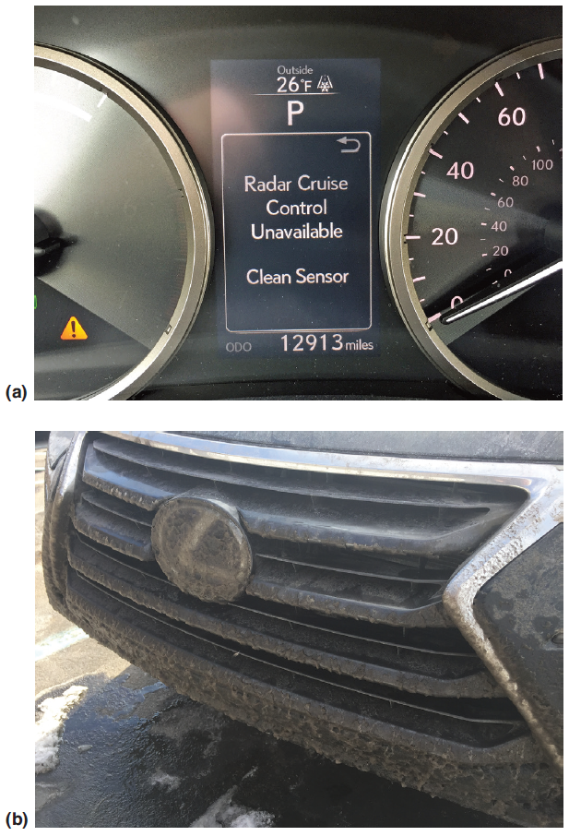
Figure 61.3 (a) The dash warning message that appeared when the cruise control stopped working (b) The front of a Lexus shows some ice build-up that was enough to block the radar signals needed for the radar cruise control to work

Slide 13
COMPUTER POWER NEEDED
Purpose
Data processing needs increase exponentially in self-driving level 5 autonomous vehicles.
Artificial Intelligence (AI)
Artificial intelligence is machine learning accomplished through programming and training that allows the computer to react much like a human.

Slide 14
Figure 61.4 Artificial intelligence includes the hardware and the software needed to make judgments based on the input from sensors and knowledge of the surrounding environment

Slide 15
RADAR SYSTEMS (1 OF 2)
Purpose and Function
Radio Detection and Ranging (Radar) emits radio waves that bounce off objects and return for interpretation.
Parts and Operation
Radar transmits a radio wave at specific frequency.
The radio wave bounces off of that object and returns to the radar.
The Doppler Effect is used to calculate position and speed of another object.

Slide 16
RADAR SYSTEMS (2 OF 2)
Diagnosis and Calibration
The diagnosis of the radar system begins with checking for diagnostic trouble codes (DTCs).
Check the technical service bulletins (TSBs) for a software update.
Calibration of the radar is required anytime the unit is replaced or reinstalled.
The calibration process may be static (in shop), or dynamic (on road), or a combination of the two.

Slide 17
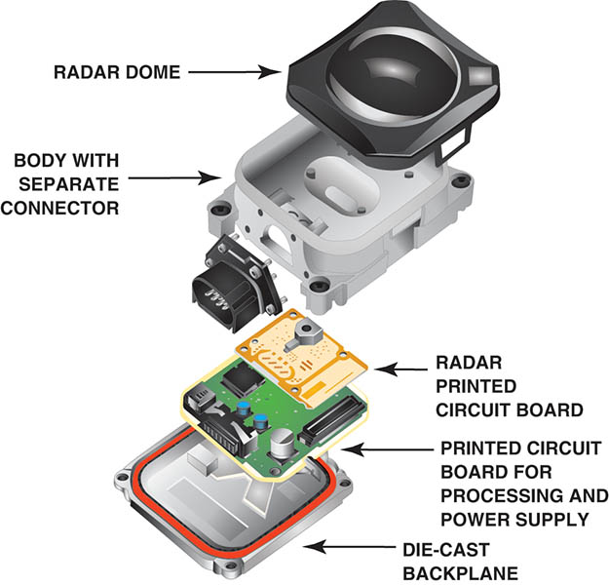
Figure 61.5 An exploded view of a typical radar assembly located at the front of the vehicle

Slide 18
QUESTION 1: ?
How does radar operate?

Slide 19
ANSWER 1:
Emits radio waves that bounce off objects and return for interpretation.

Slide 20
CAMERAS (1 OF 2)
Purpose and Function
Cameras are used to replace the human eye.
Parts and Operation
The light that reflects off an object in front of the lens passes through the lens and is collected at a focal point. The light then passes to a Charge-Coupled Device (CCD). A CCD is a device for the movement of electrical charge, for conversion into a digital value.

Slide 21
CAMERAS (2 OF 2)
Diagnosis and Calibration
The diagnosis of the camera system begins by reading the DTCs.
Verify the lens of the camera is free of anything that obstructs its view.
Calibration of the camera is required when one or more cameras are replaced or a mounting component, such as a windshield, bumper cover, mirror, or door, is replaced.

Slide 22
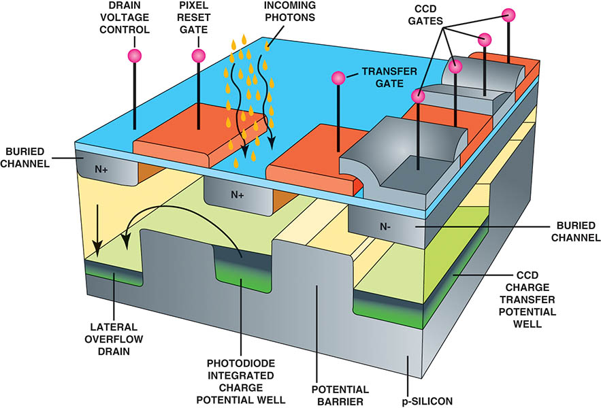
Figure 61.6 A charge coupled device (CCD) is an integrated circuit on a silicon surface forming light-sensitive elements called pixels. The light photons generate a charge that can be used by electronics and turned into a digital copy of the image on the device

Slide 23
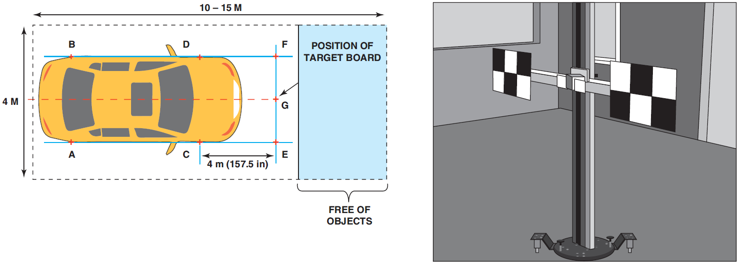
The calibration is an in-shop static process. Large patterned mats are placed around the vehicle at specific locations and the scan tool is used to initiate the process.

Slide 24
LIDAR SYSTEMS (1 OF 2)
Purpose and Function
Lidar means Light Detection and Ranging or Light Imaging, Detection, And Ranging.
Lidar systems are able to create 3-D images at 300 yards (300 m), which is a lot further than a camera is able to detect objects.
Parts and Operation
The laser light from the sensor can view all objects surrounding the vehicle.

Slide 25
LIDAR SYSTEMS (2 OF 2)
Diagnosis and Calibration
Begin diagnosis by checking for trouble codes.
Calibration is performed in a static manner using targets that are positioned according to manufacturers specifications.

Slide 26
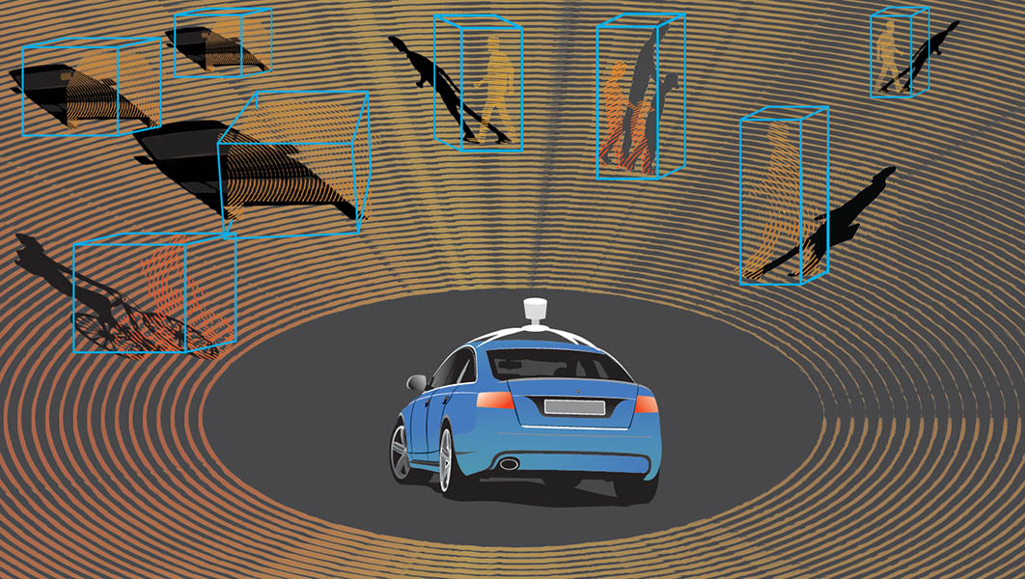
Figure 61.7 Lidar is a detection system that uses light from a laser to create a picture of the surrounding area

Slide 27
QUESTION 2: ?
Why does Lidar work poorly in foul weather?

Slide 28
ANSWER 2:
Like the human eye, it does not see well.

Slide 29
ULTRASOUND
Purpose and Function
Ultrasound is used in the parking assistance applications.
It has an effective operating range of approximately 2 to 4 yards (2 to 4 m), and is installed so that it can detect obstacles on all four sides of the vehicle.

Slide 30
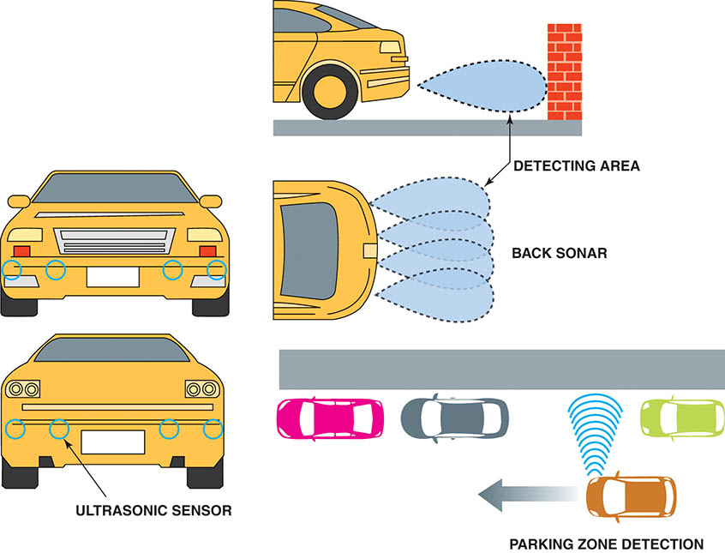
Figure 61.8 Ultrasound sensors are used at the front and rear of many vehicles and are used for detection of objects that are close to the vehicle

Slide 31
DEDICATED SHORT-RANGE COMMUNICATION (DSRC)
Purpose and Function
Is used for vehicle-to-vehicle communication, as well as the vehicle to the infrastructure communication.
It uses a 5.9 GHz frequency and 75 MHz bandwidth to transmit critical information like speed, location, direction, and traffic.
Diagnosis and Calibration
The signal strength is measured with specific equipment designed to measure the frequency of DSRC devices.

Slide 32
QUESTION 3: ?
What is the purpose of dedicated short-range communications?

Slide 33
ANSWER 3:
Vehicle to vehicle and Vehicle to Everything Communication.

Slide 34
MULTI-DOMAIN CONTROLLER
Purpose and Function
The multi-domain controller receives the inputs from the many different operating systems, adds mapping information, and makes the necessary navigation decisions.
It is anticipated that a multi-domain controller needs to process about 4,000 GB of information per day.

Slide 35
ACTUATORS
Purpose and Function
Used to control the vehicle through actuators in the engine, transmission, steering, brakes, human-machine interface (HMI), and vehicle-to- everything (V2X) systems.
These systems are commonly referred to as control “by wire.”

Slide 36
PUTTING IT ALL TOGETHER
Sensors and Communication
The advanced architectures needed for self-driving vehicles rely on real-time communications and data from all of the sensors.
The images and data are then combined with data from the communications, from other vehicles, and from the environment to make the necessary decisions regarding how to proceed.
AI is needed to process all of the data and images to create what is needed to achieve level 5 autonomy.

Slide 37
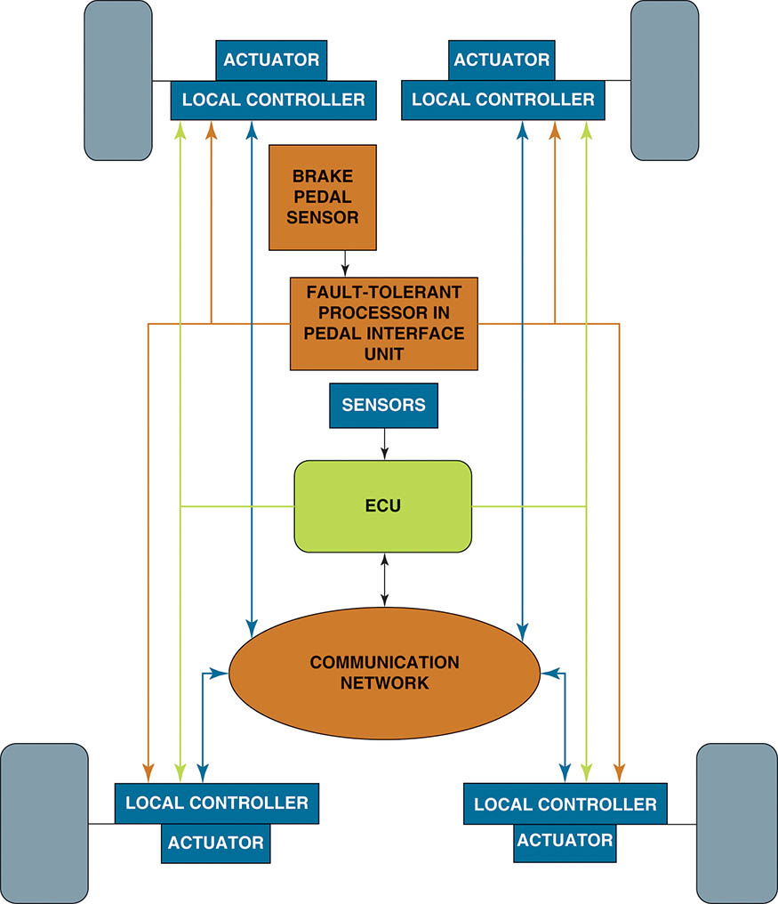
Figure 61.9 A brake-by-wire system using all electronic controls can eventually replace the hydraulic-based systems used on vehicles

Slide 38
Video Links (Internet Access Required)
Self driving car how it works Tech 10 Systems (time 1:14)
How is LiDAR remote sensing used for autonomous vehicles? (time 3:01)
Qamcom autonomous drive using radar, camera and lidar (time 1:57)
Autonomous car/self-driving car – how it works! Animation (time 3:11)

Slide 39
Copyright

