Slide 1
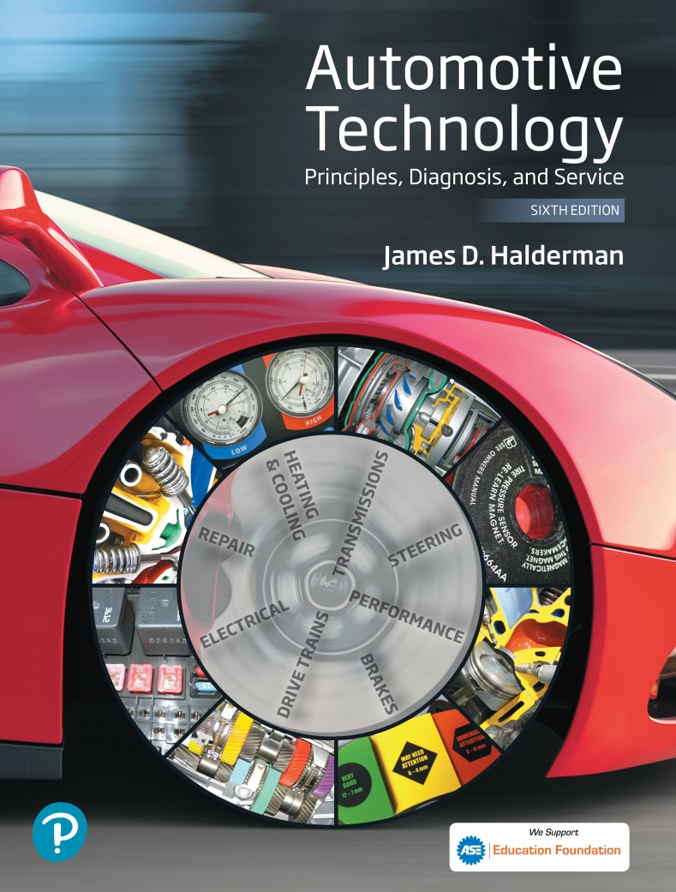
Automotive Technology Principles, Diagnosis, and Service
Sixth Edition
Chapter 5
Technician Certification
Copyright © 2018, 2015, 2011 Pearson Education, Inc. All Rights Reserved

Slide 2
LEARNING OBJECTIVES (1 of 2)
5.1 Describe the automotive certifications offered by the ASE tests.
5.2 Explain how to qualify and register for register the ASE certification tests.
5.3 Describe the type of test questions asked on the certification tests.
5.4 Explain how to prepare to take the ASE certification tests.

Slide 3
LEARNING OBJECTIVES (2 of 2)
5.5 Describe Canada’s apprenticeship and certification requirements.
5.6 Describe vehicle manufacturer certification requirements.
5.7 Explain why re-certification is necessary and how technicians can obtain it.

Slide 4
AUTOMOBILE TECHNICIAN CERTIFICATION TESTS
National Institute of Automotive Service Excellence (ASE)
A1 Engine Repair
A2 Automatic Transmission
A3 Manual Drive Train & Axles
A4 Suspension & Steering
A5 Brakes
A6 Electrical/Electronics
A7 Air Conditioning
A8 Engine Performance

Slide 5
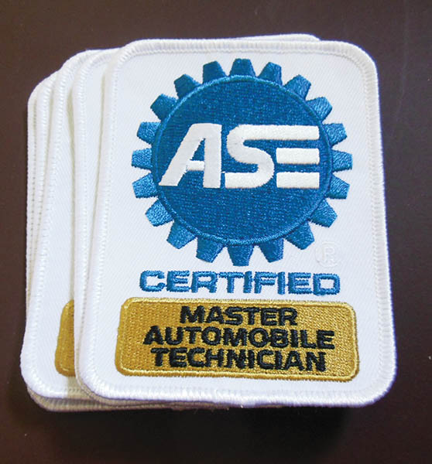
Figure 5.1 A stack of ASE certification patches usually sewn on the sleeves of a work shirts

Slide 6
QUALIFYING AND REGISTERING FOR THE ASE TESTS
Contact
ASE: 1-877-ASE-TECH or www.ase.com
Test times and locations
Throughout the year at multiple online test sites
Registration
Create an account at www.ase.com
Work experience
Two or more years of work experience. Some credit for school.
Types of questions
Objective multiple choice questions

Slide 7
QUESTION 1: ?
What are the eight ASE test areas?

Slide 8
ANSWER 1:
A1 Engine Repair
A2 Automatic Transmission
A3 Manual Drive Train & Axles
A4 Suspension & Steering
A5 Brakes
A6 Electrical/Electronics
A7 Air Conditioning
A8 Engine Performance

Slide 9
TAKING THE ASE TESTS
Key and Distractor
The key is the correct answer
The distractors are the incorrect answers
Types of Questions
Multiple Choice
Technician A and Technician B
Most likely type questions
Except type questions
Least likely type questions

Slide 10
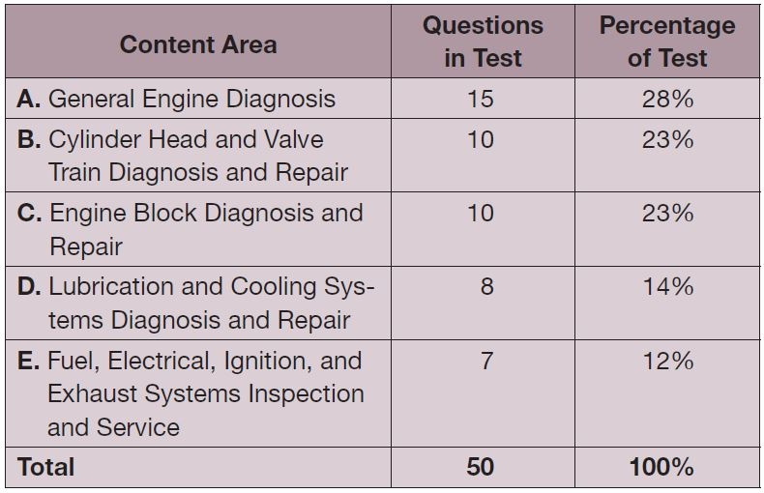
Engine Repair (A1) ASE Task List

Slide 11
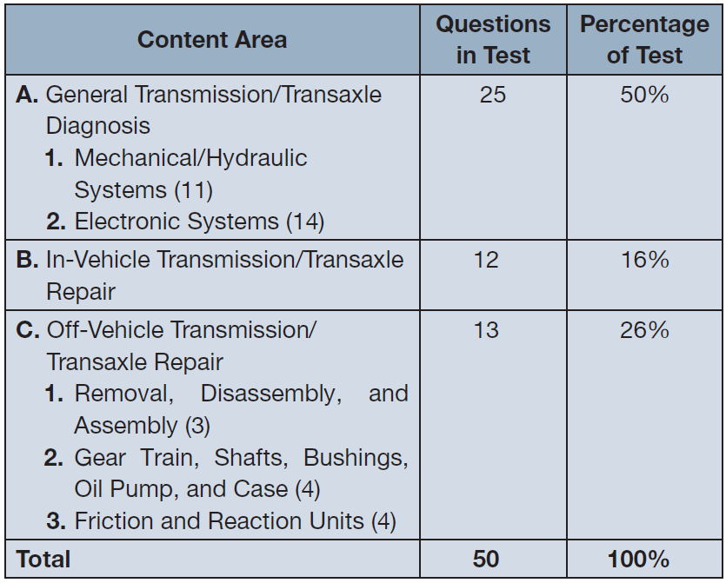
Automatic Transmission/Transaxles (A2) ASE Task List

Slide 12
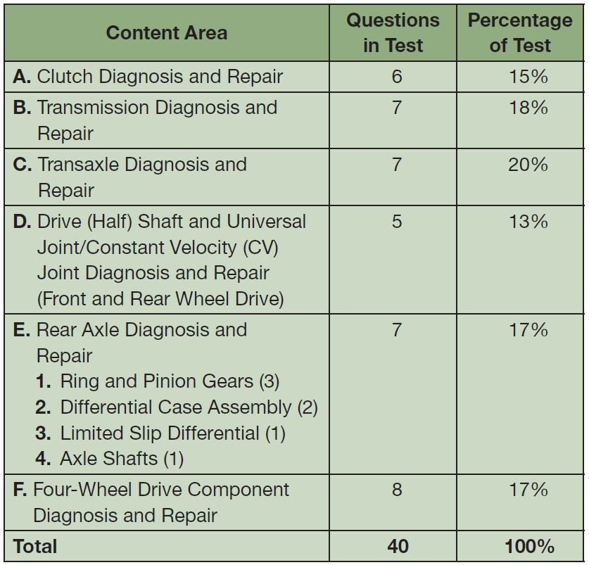
Manual Drive Train and Axles (A3) ASE Task List

Slide 13
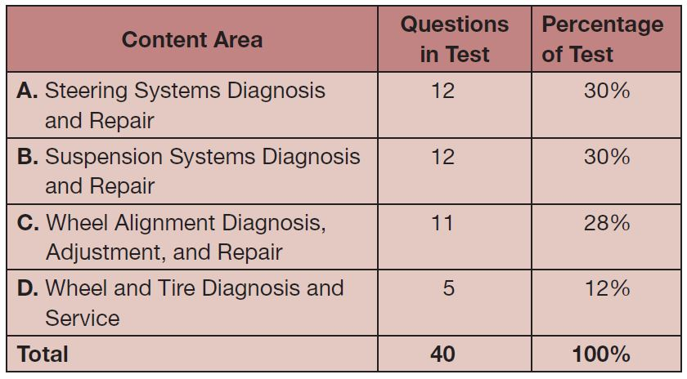
Suspension and Steering (A4) ASE Task List

Slide 14
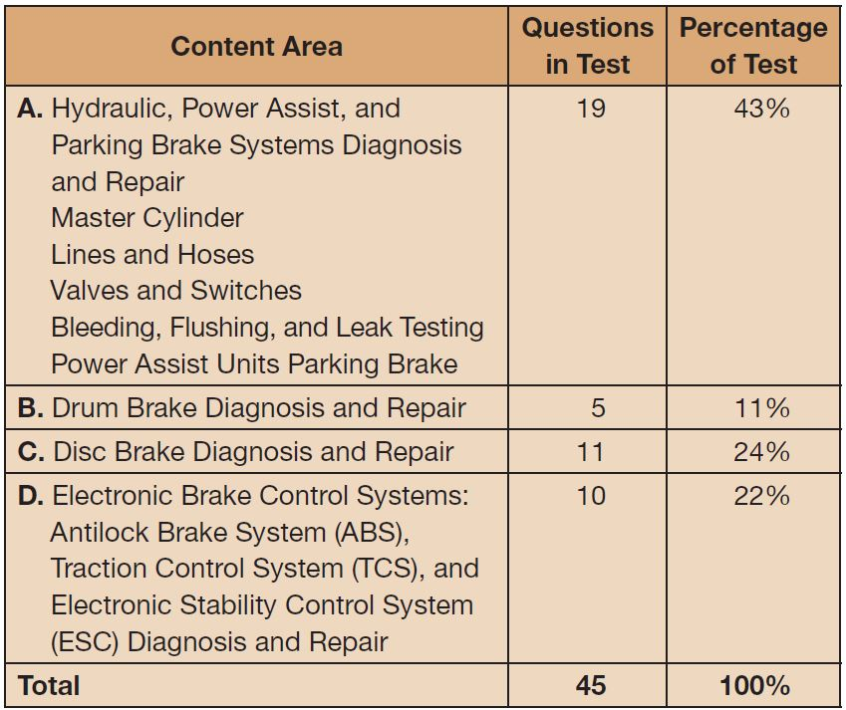
Brakes (A5) ASE Task List

Slide 15
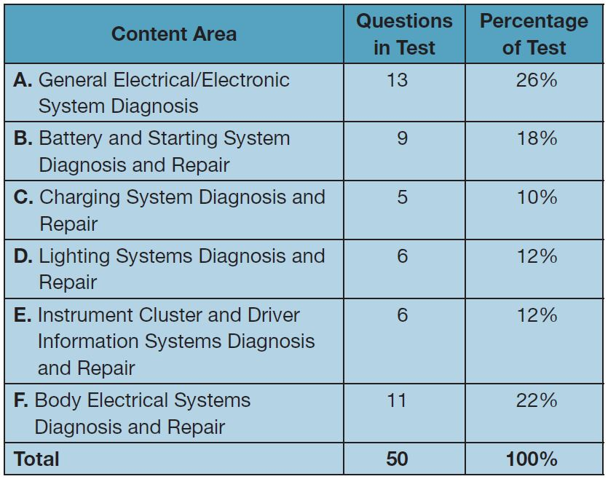
Electrical Systems (A6) ASE Task List

Slide 16
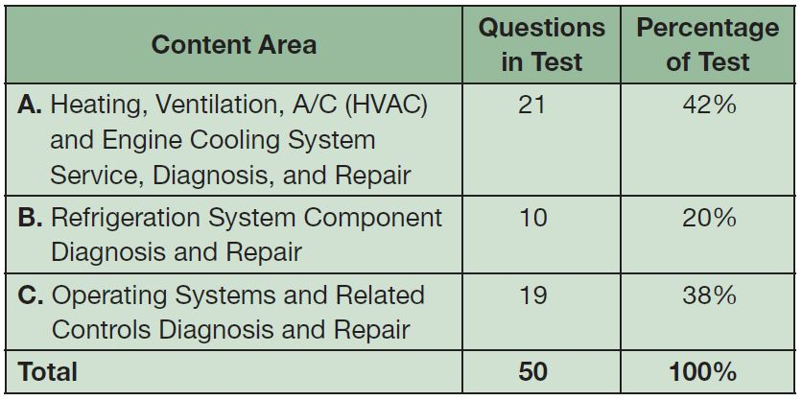
Heating and Air Conditioning (A7) ASE Task List

Slide 17
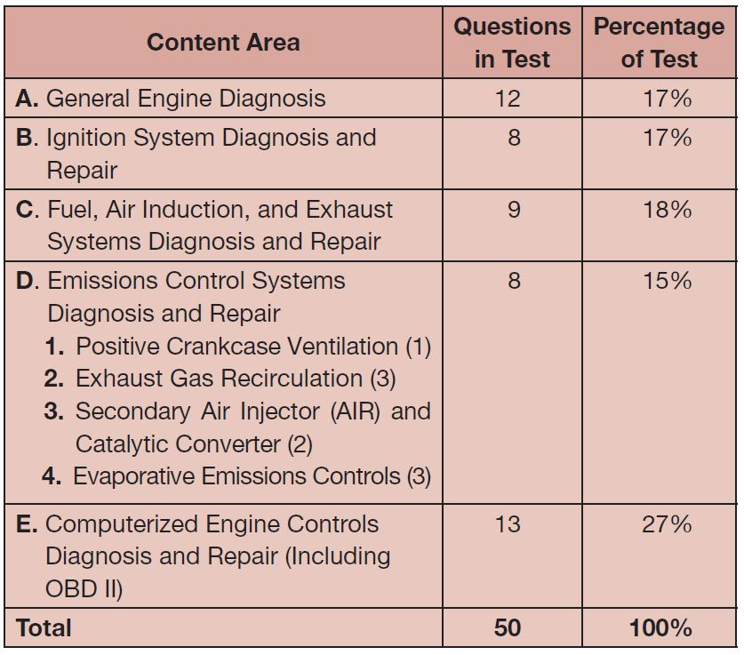
Engine Performance (A8) ASE Task List

Slide 18
QUESTIONS OFTEN ASKED (1 of 3)
Should I guess?
Yes, you are scored on the number of questions you get correct.
Is the test the same each time?
No, the questions are generated by a test bank.
Can I skip questions?
Yes, as long as you return to answer before the end.
How much time is allowed?
Between one and two hours per test.

Slide 19
QUESTIONS OFTEN ASKED (2 of 3)
Can I take a break?
You may use the restroom after receiving permission from the proctor.
Will I have to know specifications?
Yes, you will have to know normal operating ranges.
Can I leave early?
Yes, you may leave as soon as you complete the test.
What percentage do I need to pass?
The percentage varies from 61% to 69%.

Slide 20
QUESTIONS OFTEN ASKED (3 of 3)
What happens if I don’t pass?
You may take the test again during the next test cycle
Do I have to pay another registration fee?
Yes, a registration fee is due at every test session
Will I receive notice as to what questions I missed?
You will receive a summary that shows the number missed in each section of the test.
Will ASE send me the correct answers?
No, ASE will not send you the correct answers

Slide 21
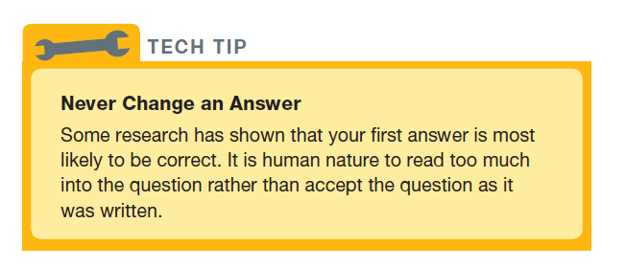
Tech Tip

Slide 22
PREPARING FOR THE ASE TESTS
Start now
Allocate time each day for study
Practice is important
ASE practice tests are widely available.
Keys too success
Carefully read each question
Read all the answers
Pick the best answer

Slide 23
CANADA’S AUTOMOTIVE APPRENTICESHIP PROGRAM (RED SEAL)
A four year program
Combination of school and shop time
Proficiency and demonstrated knowledge required in eight blocks
Successful completion of a national exam.

Slide 24
VEHICLE MANUFACTURER CERTIFICATION
Technician performing warranty work must be certified in that area.
Without certification, the dealership may not get paid for the warranty repair.
Certification may or may not include ASE certifications.

Slide 25
RE-CERTIFICATION
ASE certifications expire after 5 years
40 hours of additional training recommended every year.
Training available from many sources
Parts stores and distributors
State or regional associations
Local colleges or training companies

Slide 26
QUESTION 2: ?
What types of questions are asked on the ASE certification
tests?

Slide 27
ANSWER 2:
Multiple Choice Questions.

Slide 28
Video Links (Internet Access Required)
ASE Explained (time 7:28)

Slide 29
COPYRIGHT

