Slide 1

Automotive Technology Principles, Diagnosis, and Service
Sixth Edition
Chapter 45
Wiring Schematics and Circuit Testing
Copyright © 2018, 2015, 2011 Pearson Education, Inc. All Rights Reserved

Slide 2
LEARNING OBJECTIVES (1 of 2)
45.1 Interpret wiring schematics and explain the procedure to identify relay terminals.
45.2 Locate shorts, grounds, opens, and resistance problems in electrical circuits, and determine necessary action.
45.3 Explain the different methods to locate a short circuit, and the procedure to troubleshoot an electrical problem.

Slide 3
LEARNING OBJECTIVES (2 of 2)
45.4 This chapter will help you prepare for the ASE Electrical/Electronic Systems (A6) certification test content area “A” (General Electrical/Electronic System Diagnosis).

Slide 4
WIRING SCHEMATICS AND SYMBOLS (1 OF 2)
Terminology
  A wiring schematic, sometimes called a diagram, shows electrical components and wiring using symbols and lines to represent components and wires.
All circuit schematics or diagrams include:
  Power-side of wiring, splices, connectors, wire size, wire color, trace color, circuit number, electrical components, ground path returns, fuses and switches

Slide 5
WIRING SCHEMATICS AND SYMBOLS (2 OF 2)
Circuit Information
  The first color or color abbreviation is the color of the wire insulation.
  The second color (if mentioned) is the color of the stripe or tracer on the base color.
Wire Size
  Wire size is shown on all schematics.
  Metric wire gauge size in square millimeters (mm2)
  Standard wire using the AWG standard

Slide 6
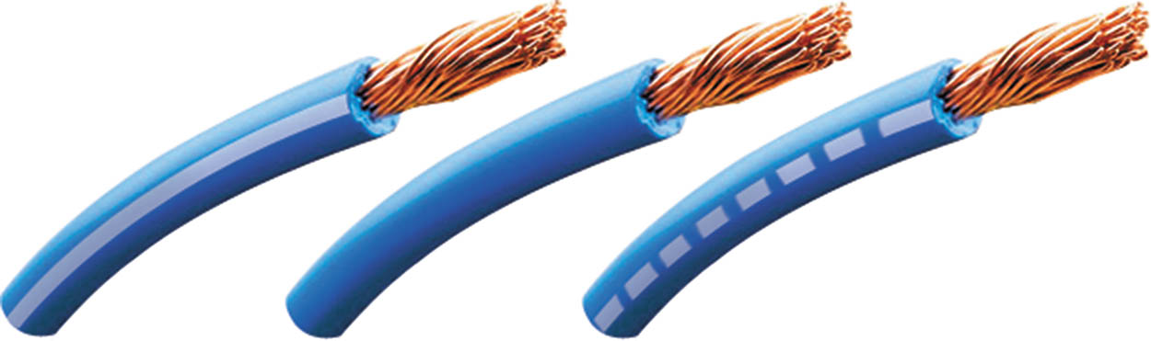
Figure 45.1 The center wire is a solid color wire, meaning that the wire has no other identifying tracer or stripe color. The two end wires could be labeled “BLU/WHT,” indicating a blue wire with a white tracer or stripe

Slide 7
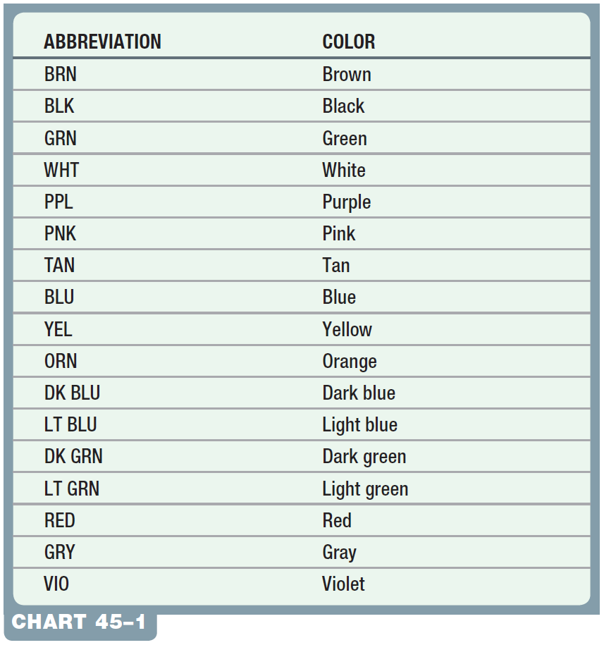
Chart 45-1 Typical abbreviations used on schematics to show wire color. Some vehicle manufacturers use two letters to represent a wire color. Check service information for the color abbreviations used.

Slide 8
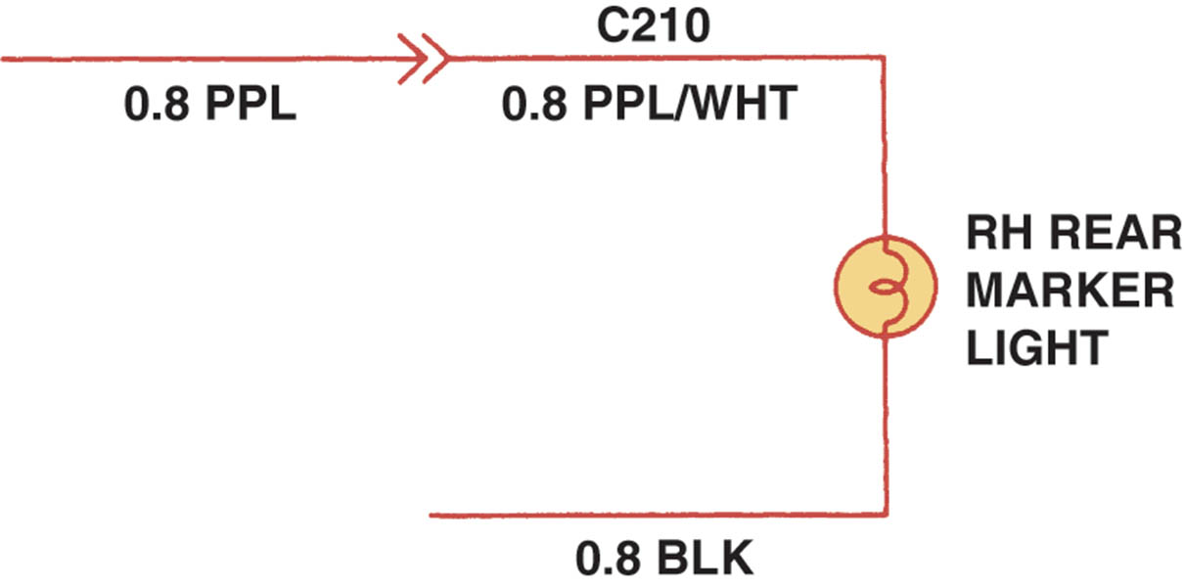
Figure 45.2 Typical section of a wiring diagram. Notice that the wire color changes at connection C210. The “0.8” represents the metric wire size in square millimeters

Slide 9
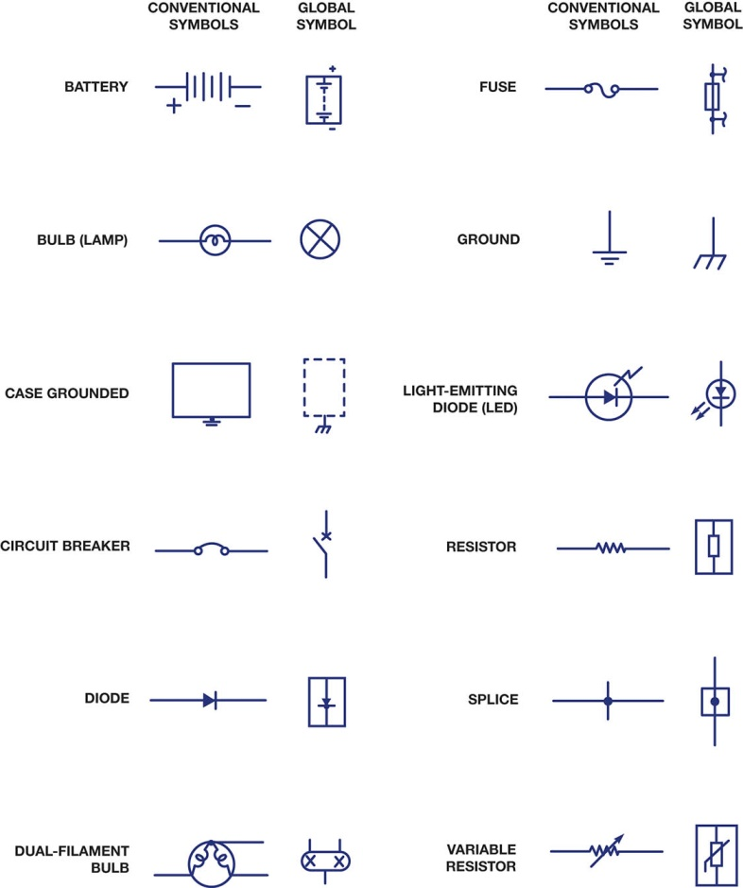
Figure 45.3 Typical electrical and electronic symbols used in automotive wiring and circuit diagrams. Both the conventional and the global symbols are shown side-by-side to make reading schematics easier.

Slide 10
QUESTION 1: ?
What are the two ways the wire size may be displayed on the schematic?

Slide 11
ANSWER 1:
mm2 or AWG Standard.

Slide 12
SCHEMATIC SYMBOLS (1 OF 4)
Battery
  The plates of a battery are represented by long and short lines.
Wiring
  Electrical wiring is shown as straight lines and with a few numbers and/or letters to indicate the wire size, circuit number, wire color, splices, connectors and location.

Slide 13
SCHEMATIC SYMBOLS (2 OF 4)
Electrical Components
  Most electrical components have their own unique symbol that shows the basic function or parts.
Electric Motors
  An electric motor symbol shows a circle with the letter M in the center and two electrical connections, one at the top and the other at the bottom.

Slide 14
SCHEMATIC SYMBOLS (3 OF 4)
Resistors
  A resistor symbol is a jagged line representing resistance to current flow.
Capacitors
  If one of the lines is curved, this indicates that the capacitor being used has a polarity.
Electrically Heated Unit
  The grid-like symbol represents an electrically heated element.

Slide 15
SCHEMATIC SYMBOLS (4 OF 4)
Boxed Components
  A solid line, the box is the entire component.
  Dashed lines, it represents part of a component.
Switches
  Normally open
  Normally closed
  Momentary contact

Slide 16
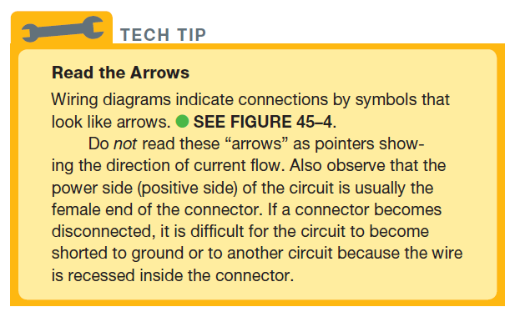
Tech Tip

Slide 17
Figure 45.4 In this typical connector, note that the positive terminal is usually a female connector

Slide 18

Figure 45.5 The symbol for a battery. The positive plate of a battery is represented by the longer line and the negative plate by the shorter line.

Slide 19

Figure 45.6 The ground symbol on the left represents an earth ground. The ground symbol on the right represents a chassis ground

Slide 20
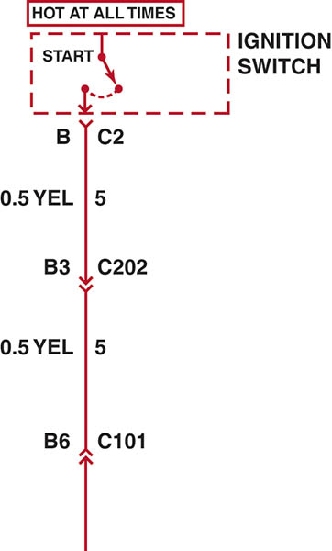
Figure 45.7 Starting at the top, the wire from the ignition switch is attached to terminal B of connector C2, the wire is 0.5 mm² (20- gauge AWG), and is yellow. The circuit number is 5. The wire enters connector C202 at terminal B3

Slide 21

Figure 45.8 The electrical terminals are usually labeled with a letter or number

Slide 22

Figure 45.9 Two wires that cross at the dot indicate that the two are electrically connected

Slide 23
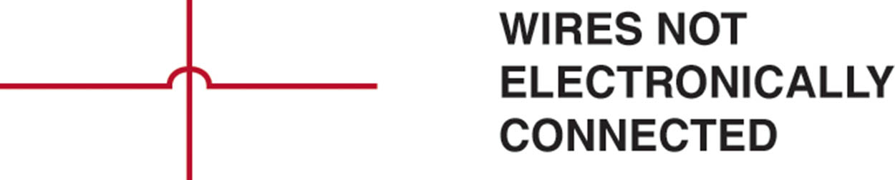
Figure 45.10 Wires that cross, but do not electrically contact each other, are shown with one wire bridging over the other

Slide 24
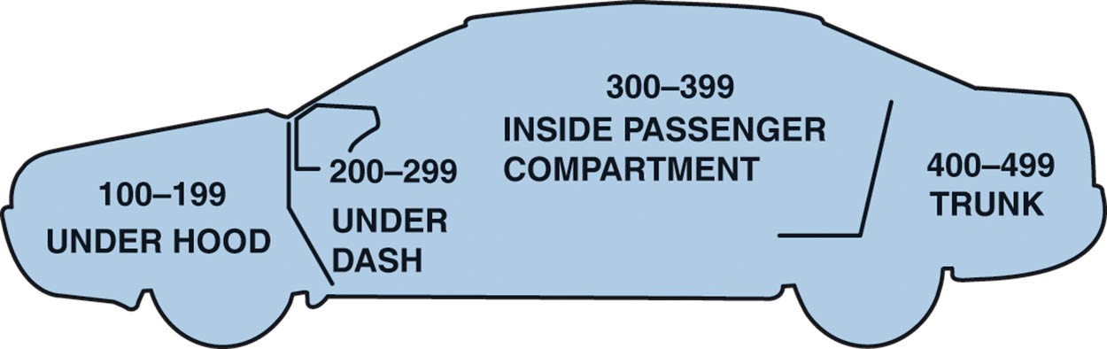
Figure 45.11 Connectors (C), grounds (G), and splices (S) are followed by a number, generally indicating the location in the vehicle. G209 is under the dash.

Slide 25
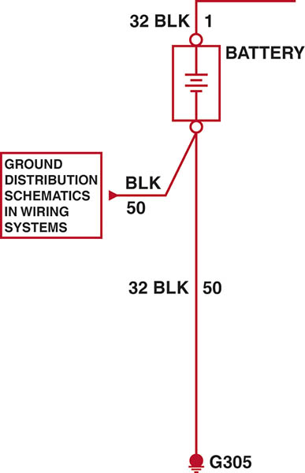
Figure 45.12 The ground for the battery is labeled G305, indicating the ground connector is located in the passenger compartment of the vehicle.

Slide 26
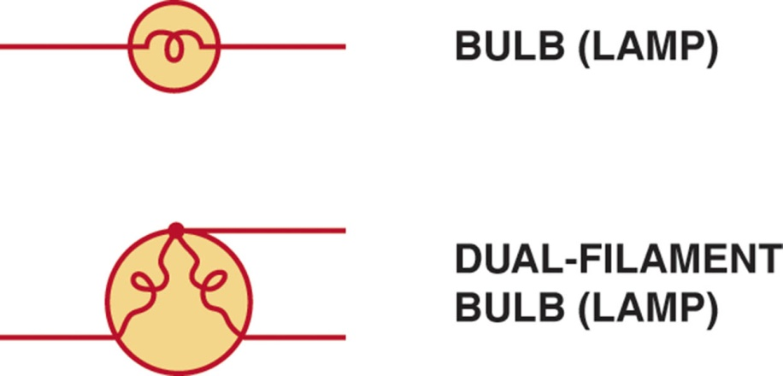
Figure 45.13 The symbol for lightbulbs shows the filament inside a circle, which represents the glass ampoule of the bulb

Slide 27

Figure 45.14 An electric motor symbol shows a circle with the letter M in the center and two black sections that represent the brushes of the motor.

Slide 28
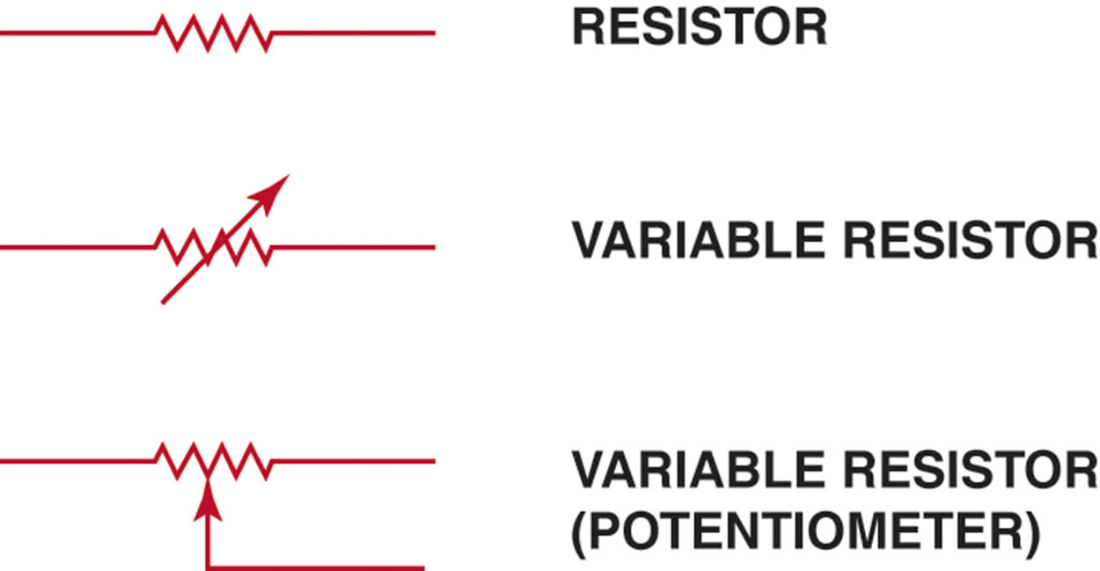
Figure 45.15 Resistor symbols vary, depending on the type of resistor

Slide 29

Figure 45.16 A rheostat uses only two wires—one is connected to a voltage source and the other is attached to the movable arm

Slide 30
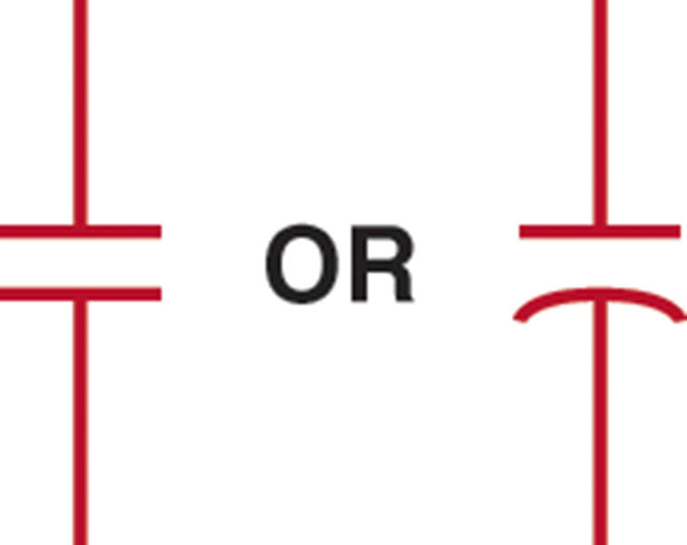
Figure 45.17 Symbols used to represent capacitors. If one of the lines is curved, this indicates that the capacitor being used has a polarity.

Slide 31
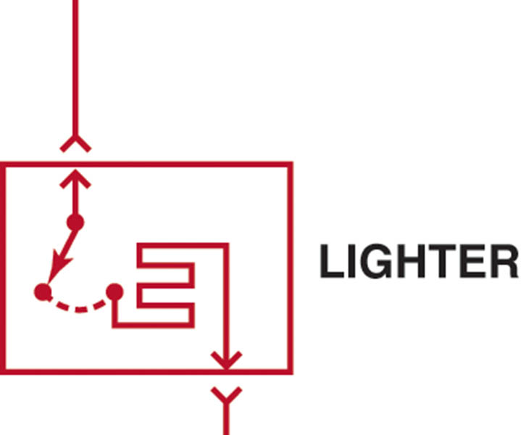
Figure 45.18 The grid-like symbol represents an electrically heated element

Slide 32

Figure 45.19 A dashed outline represents a portion (part) of a component

Slide 33

Figure 45.20 A solid box represents an entire component

Slide 34
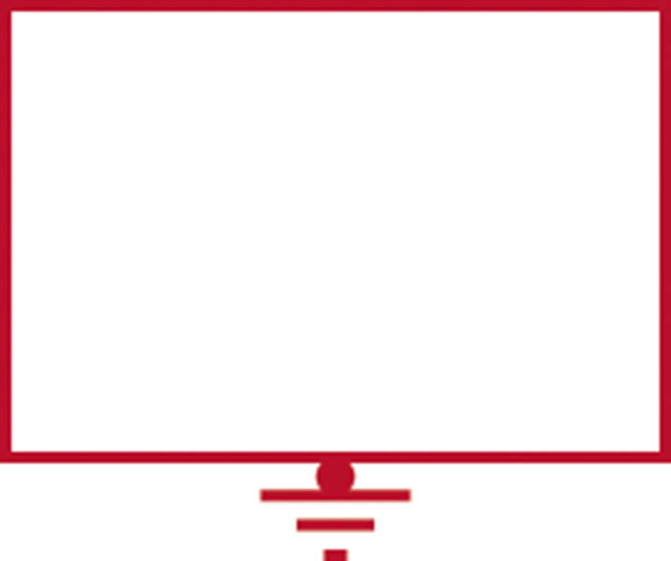
Figure 45.21 This symbol represents a component that is case grounded

Slide 35
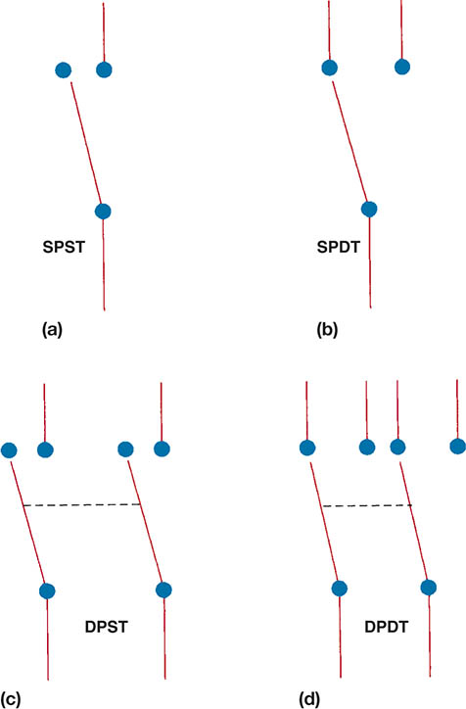
Figure 45.22 (a) A symbol for a single-pole, single-throw (SPST) switch. This type of switch is normally open (N.O.) because nothing is connected to the terminal that the switch is contacting in its normal position. (b) A single-pole, double-throw (SPDT) switch has three terminals.

Slide 36
Figure 45.22(c) A double-pole, single-throw (DPST) switch has two positions (off and on) and can control two separate circuits. (d) A double-pole, double-throw (DPDT) switch has six terminals—three for each pole.

Slide 37
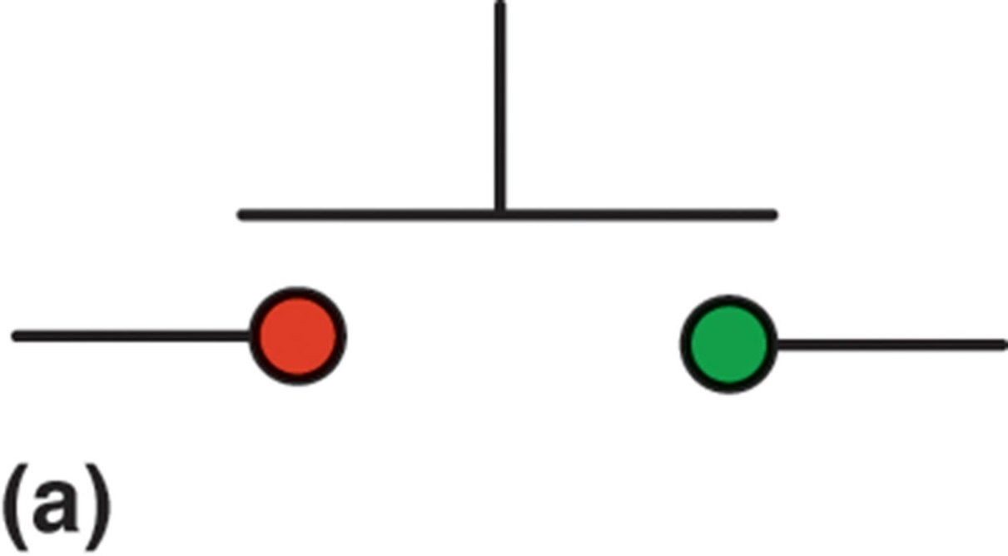
Figure 45.23 (a) A symbol for a normally open (N.O.) momentary switch

Slide 38
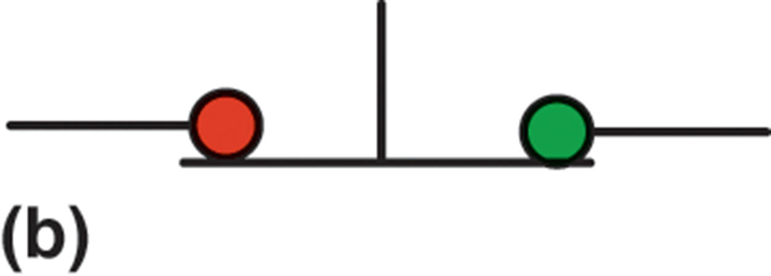
Figure 45.23 (b) A symbol for a normally closed (N.C.) momentary switch

Slide 39
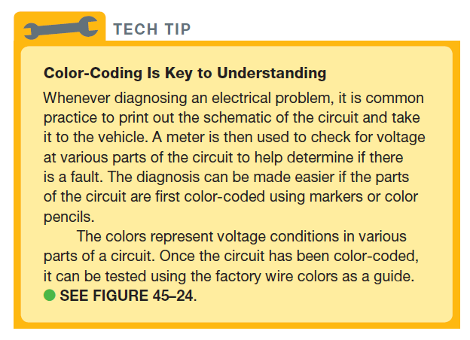
TECH TIP

Slide 40
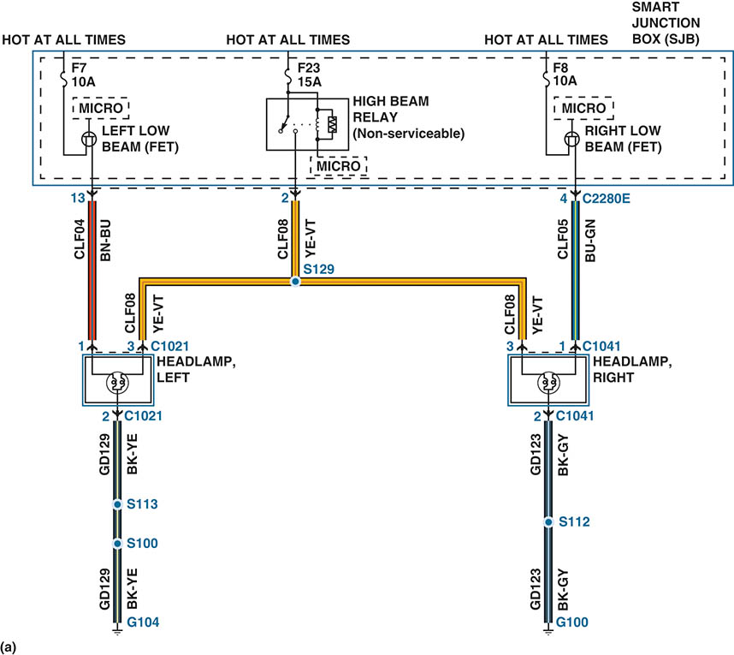
Figure 45.24 (a) A typical headlight circuit showing the colors of the wires

Slide 41
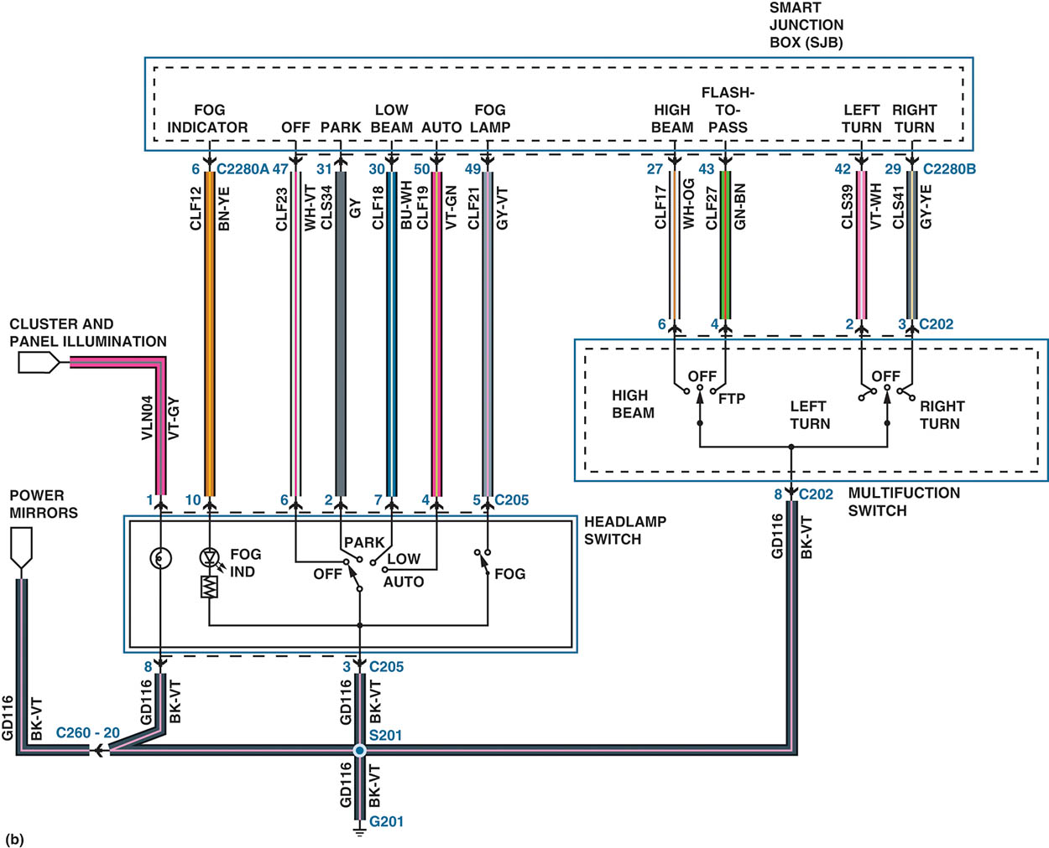
Figure 45.24 (b) A more complex circuit using colored pencils to indicate where there is voltage in the circuit will help diagnosis the system if there is a fault

Slide 42
QUESTION 2: ?
How is an electrical motor identified on a schematic?

Slide 43
ANSWER 2:
An electric motor symbol shows a circle with the letter M in the center and two black sections that represent the brushes of the motor.

Slide 44
RELAY TERMINAL IDENTIFICATION
A relay is a magnetic switch that uses a movable armature to control a high-amperage circuit by using a low amperage electrical switch.
ISO Relay Terminal Identification
  Coil (Terminals 85 and 86)
  Load (Terminals 30, 87 and 87a)
Relay Spike Control
  To reduce the induced voltage, some relays contain a diode connected across the coil.

Slide 45
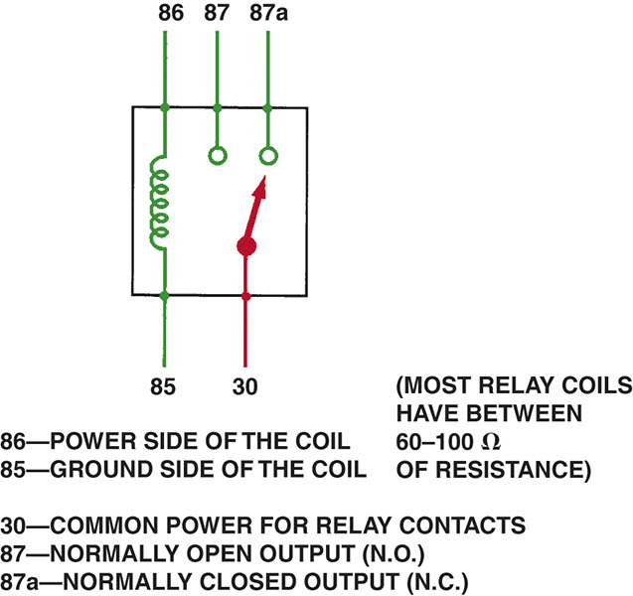
Figure 45.25 A relay uses a movable arm to complete a circuit whenever there is a power at terminal 86 and a ground at terminal 85.

Slide 46
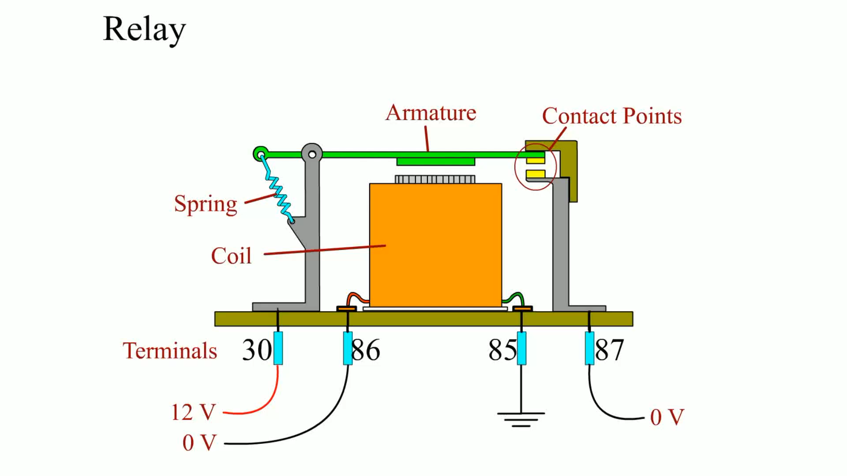
Animation: Relay
(The animation will automatically start in a few seconds)

Slide 47
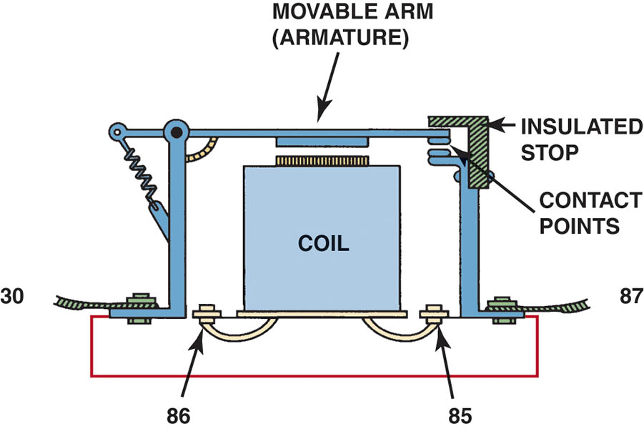
Figure 45.26 A cross-sectional view of a typical four-terminal relay. Current flowing through the coil (terminals 86 and 85) causes the movable arm (called the armature) to be drawn toward the coil magnet.

Slide 48
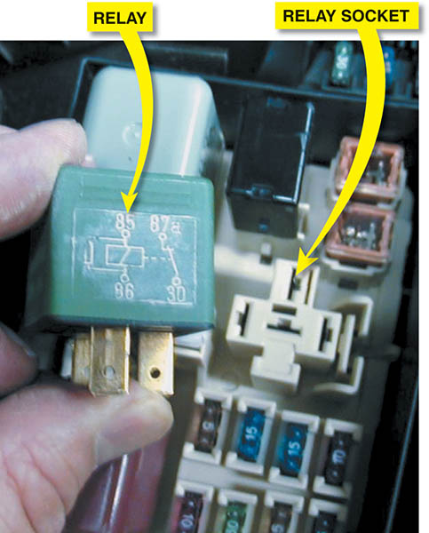
Figure 45.27 A typical relay showing the schematic of the wiring in the relay

Slide 49
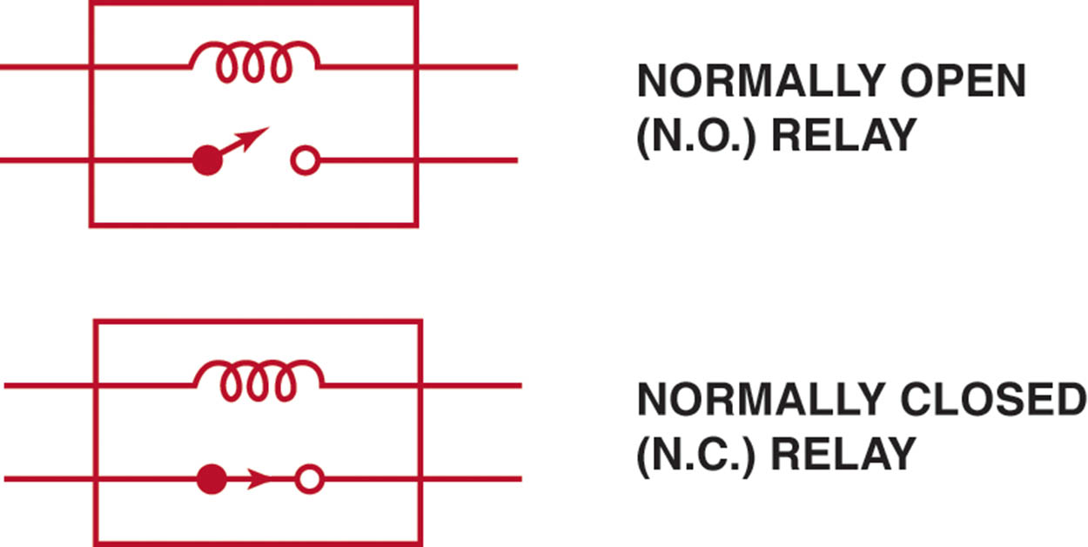
Figure 45.28 All schematics are shown in their normal, non-energized position

Slide 50
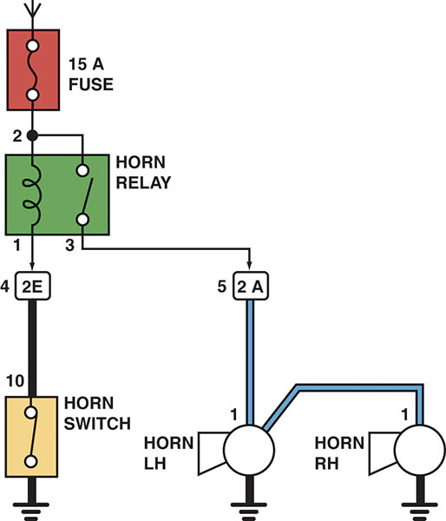
Figure 45.29 A horn circuit. Note that the relay contacts supply the heavy current to operate the horn when the horn switch simply completes a low-current circuit to ground, causing the relay contacts to close.

Slide 51
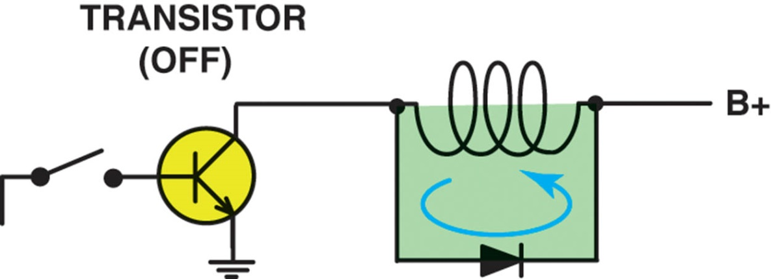
Figure 45.30 When the relay or solenoid coil current is turned off, the stored energy in the coil flows through the clamping diode and effectively reduces voltage spike.

Slide 52
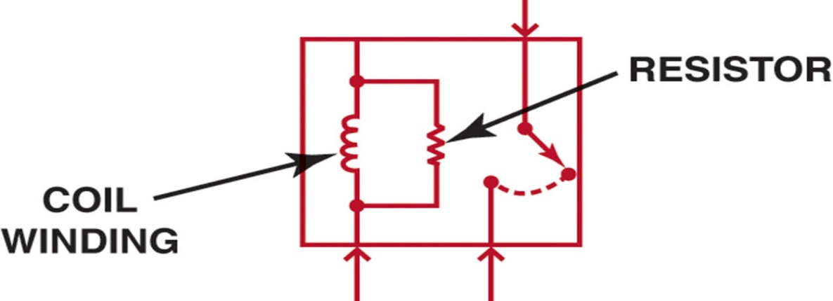
Figure 45.31 A resistor used in parallel with the coil windings is a common spike reduction method used in many relays

Slide 53
LOCATING AN OPEN CIRCUIT
The typical procedure for locating an open circuit involves the following steps.
  Perform a thorough visual inspection.
  Print out the schematic.
  Check everything that does and does not work.
  Check for voltage.

Slide 54
COMMON POWER OR GROUND
When diagnosing an electrical problem that affects more than one component or system, check the electrical schematic for a common power source or a common ground.
Example:
  Under-hood light
  Inside lighted mirrors
  Dome light
  Left-side courtesy light
  Right-side courtesy light

Slide 55
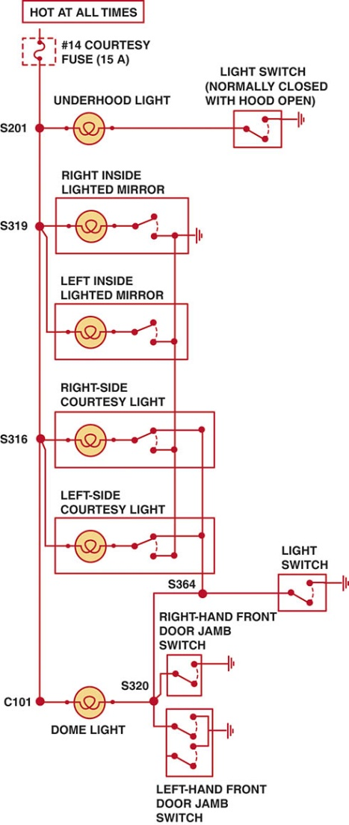
Figure 45.32 A typical wiring diagram showing multiple switches and bulbs powered by one fuse

Slide 56
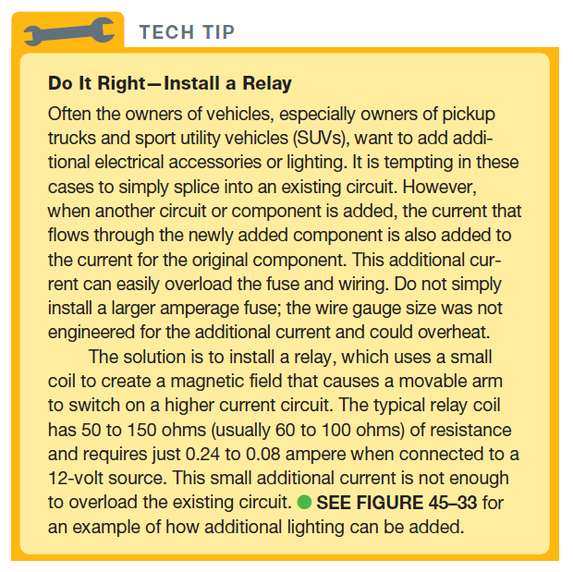
TECH TIP

Slide 57
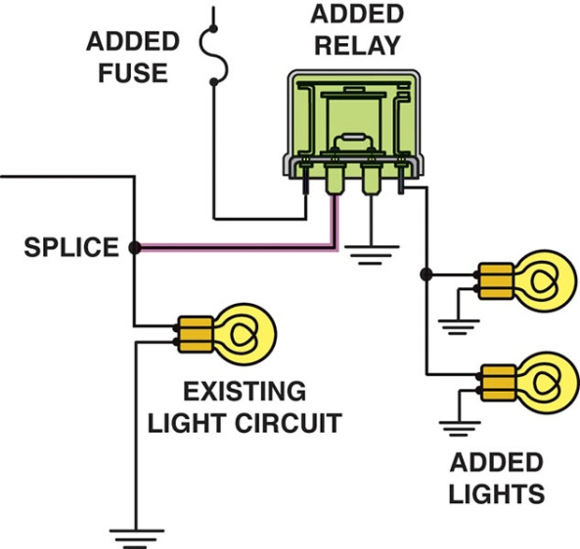
Figure 45.33 To add additional lighting, simply tap into an existing light wire and connect a relay. Whenever the existing light is turned on, the coil of the relay is energized.

Slide 58
CIRCUIT TROUBLESHOOTING PROCEDURE
Example: Backup lights are inoperative
  Verify the malfunction
  Check for everything else that does not operate correctly
  Check fuse for backup lights
  Check for voltage at the backup light socket

Slide 59
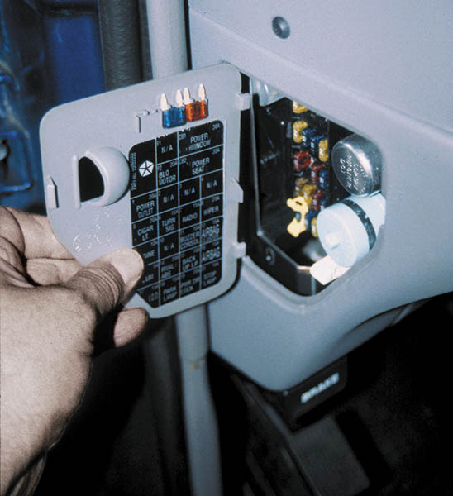
Figure 45.34 Always check the simple things first. Check the fuse for the circuit you are testing.

Slide 60
LOCATING A SHORT CIRCUIT (1 OF 3)
Definition
  A short circuit is an electrical connection to another wire or to ground before the current flows through some or all of the resistance in the circuit.
Fuse Replacement Method
  Disconnect one component at a time and then replace the fuse. Not the preferred method.
Circuit Breaker Method
  The circuit breaker alternately opens and closes the circuit, protecting the wiring from overheating.

Slide 61
LOCATING A SHORT CIRCUIT (2 OF 3)
Test Light Method
  Remove the blown fuse and connect a test light to the terminals of the fuse holder (polarity does not matter).
Buzzer Method
  The buzzer method is similar to the test light method, but uses a buzzer to replace a fuse and act as an electrical load.
Ohmmeter Method
  Remove power from the circuit and measure continuity to ground.

Slide 62
LOCATING A SHORT CIRCUIT (3 OF 3)
Gauss Method
  A Gauss gauge is a handheld meter that responds to weak magnetic fields.
Circuit Tracer
  The tone is generated as long as there is a continuous electrical path along the circuit.

Slide 63
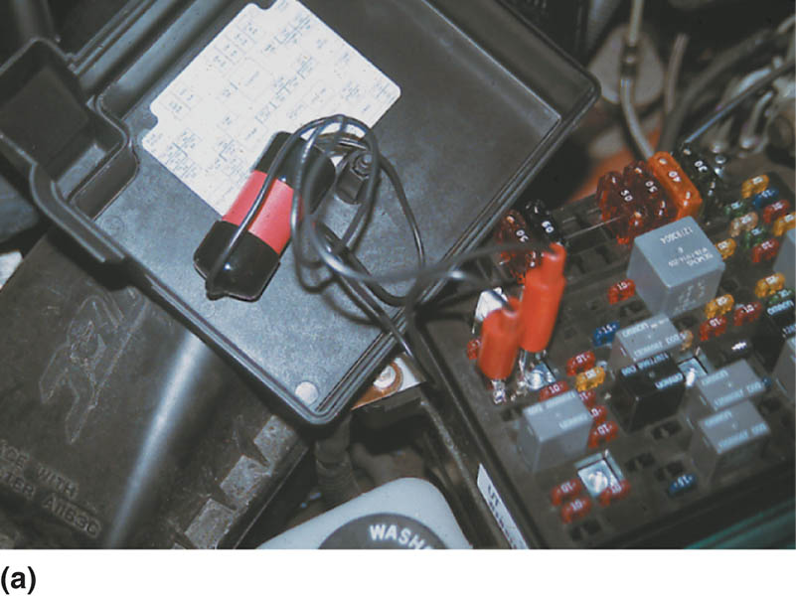
Figure 45.35 (a) After removing the blown fuse, a pulsing circuit breaker is connected to the terminals of the fuse

Slide 64
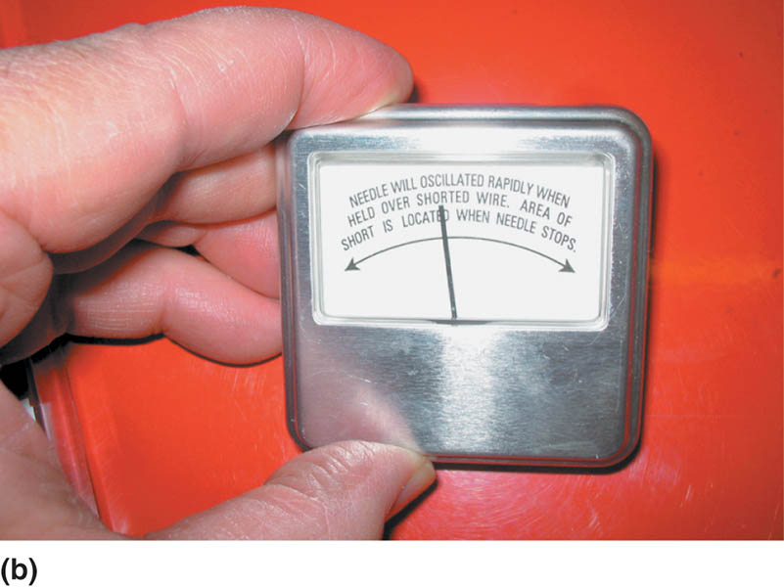
Figure 45.35 (b) The circuit breaker causes current to flow, then stop, then flow again, through the circuit up to the point of the short-to-ground.

Slide 65
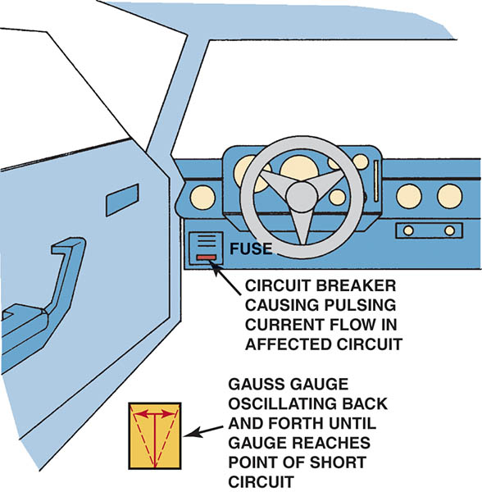
Figure 45.36 A Gauss gauge can be used to determine the location of a short circuit even behind a metal panel

Slide 66
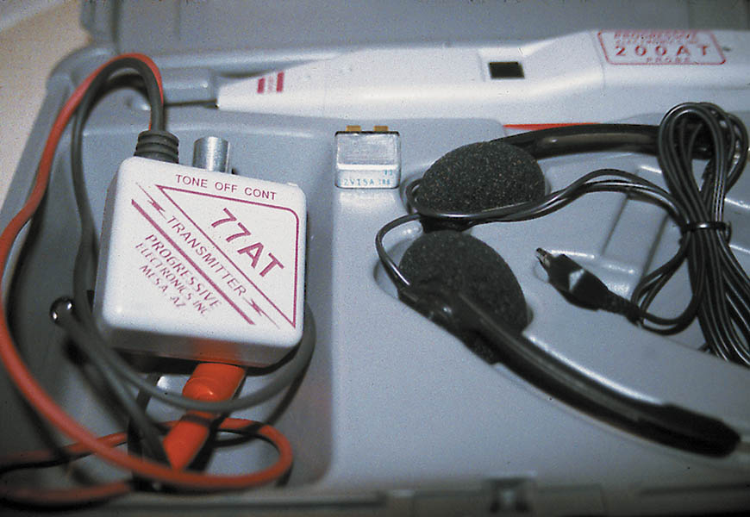
Figure 45.37 A tone generator–type tester used to locate open circuits and circuits that are shorted-to-ground.

Slide 67
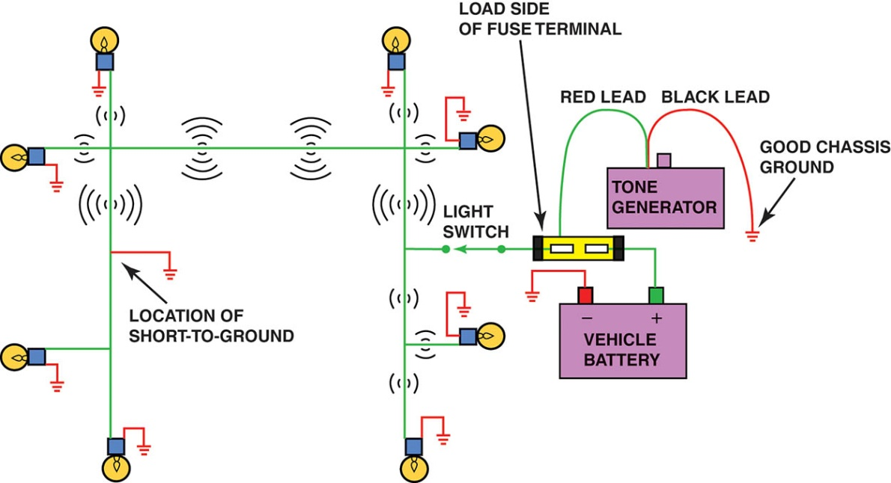
Figure 45.38 To check for a short-to-ground using a tone generator, connect the black transmitter lead to a good chassis ground and the red lead to the load side of the fuse terminal.

Slide 68
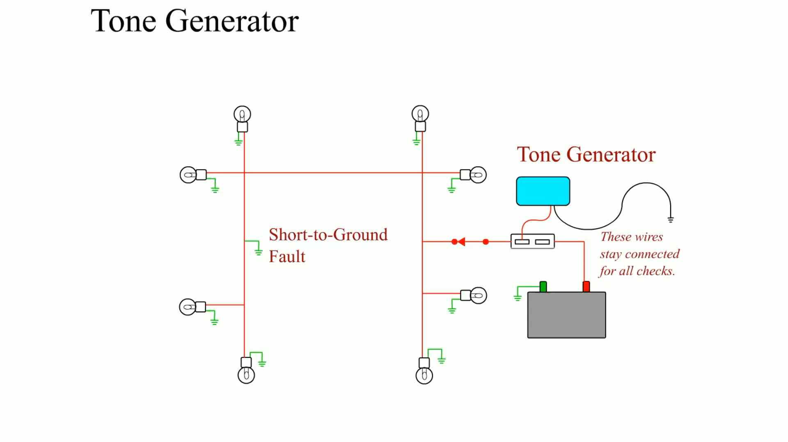
Animation: Tone Generator
(The animation will automatically start in a few seconds)

Slide 69
QUESTION 3: ?
How can a tone generator be used to locate a short circuit?

Slide 70
ANSWER 3:
When the circuit is shorted the generator will emit a tone.

Slide 71
ELECTRICAL TROUBLESHOOTING GUIDE
When troubleshooting any electrical component, remember the following hints to identify the problem faster and more easily.
  For a device to work, it must have power and ground.
  If there is no power to a device, an open power side (blown fuse, etc.) is indicated.
  If there is power on both sides of a device, an open ground is indicated.
  If a fuse blows immediately, a grounded power-side wire is indicated.

Slide 72
STEP-BY-STEP TROUBLESHOOTING
Determine the customer concern
Verify the customer’s concern
Perform a thorough visual inspection
Check for technical service bulletins (TSBs)
Locate the wiring schematic
Check the factory service information
Determine the root cause and repair the vehicle
Verify the repair

Slide 73
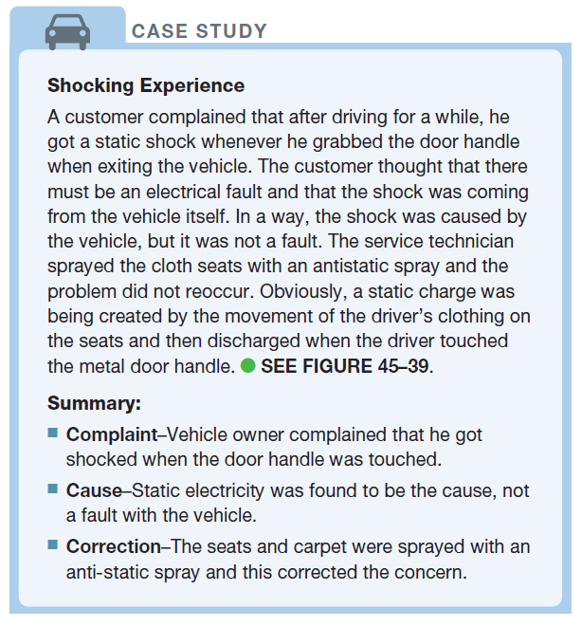
CASE STUDY

Slide 74
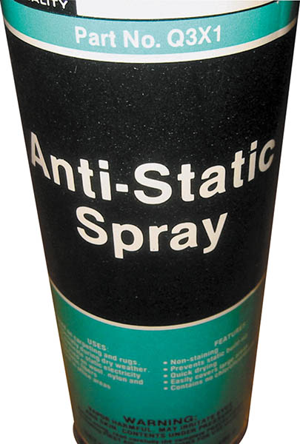
Figure 45.39 Anti-static spray can be used by customers to prevent being shocked when they touch a metal object like the door handle

Slide 75
Additional Animations
The following slides will provide additional animations.

Slide 76
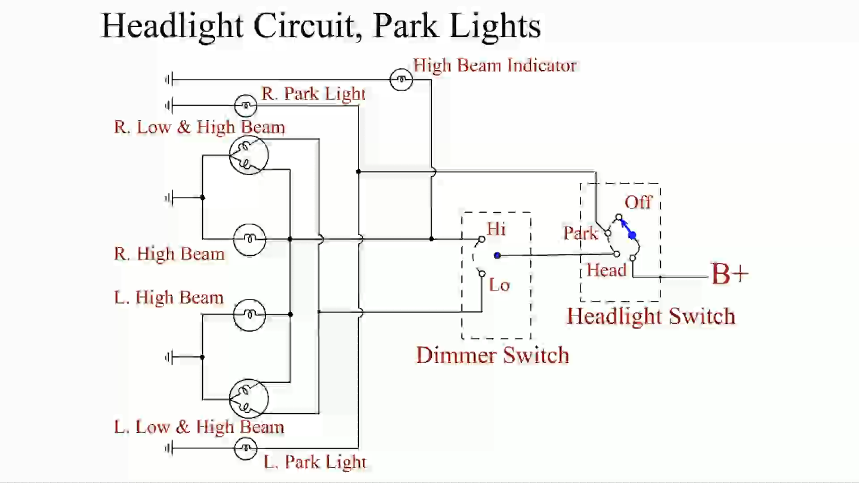
Animation: Headlight Circuit, Park Lights
(The animation will automatically start in a few seconds)

Slide 77
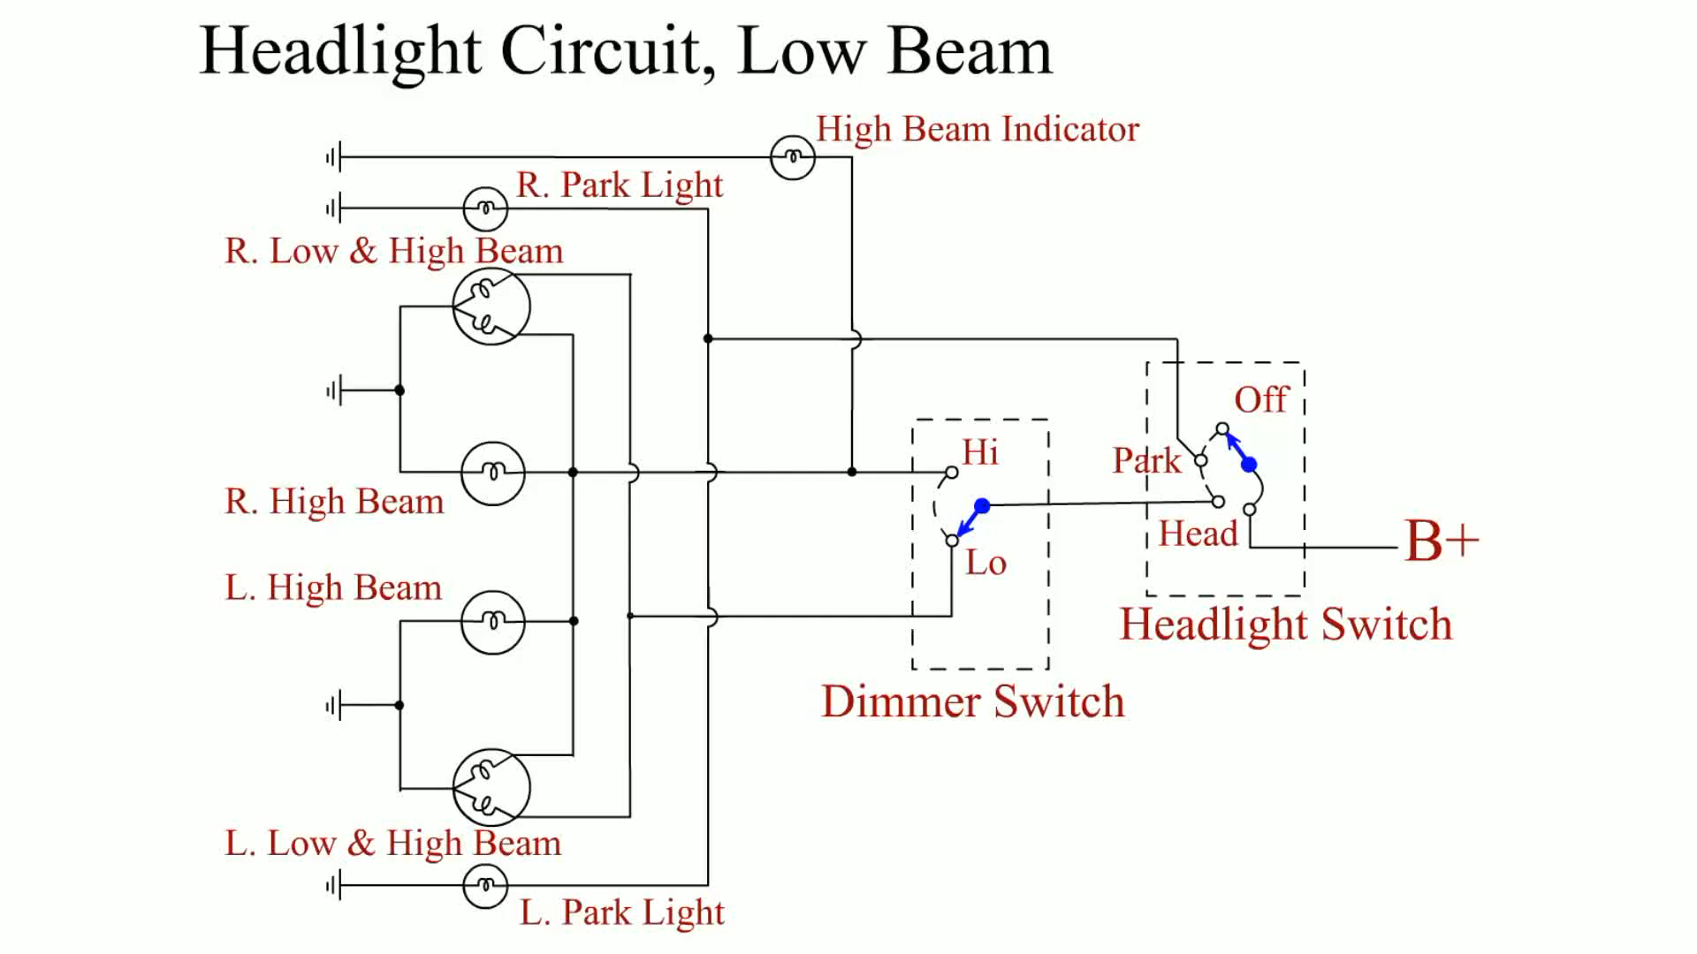
Animation: Headlight Circuit, Low Beam
(The animation will automatically start in a few seconds)

Slide 78
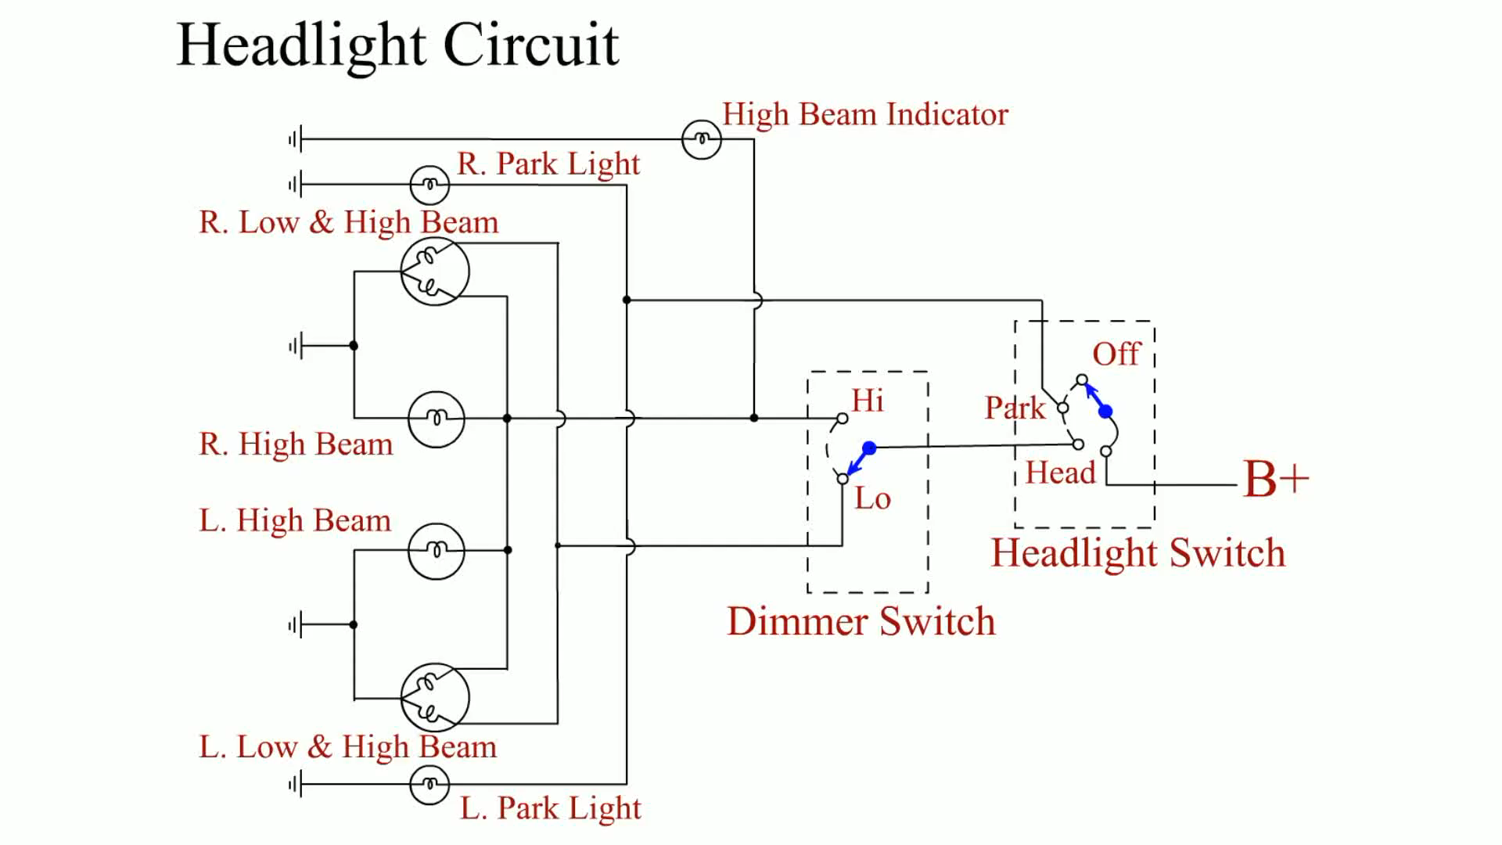
Animation: Headlight Circuit, High Beam
(The animation will automatically start in a few seconds)

Slide 79
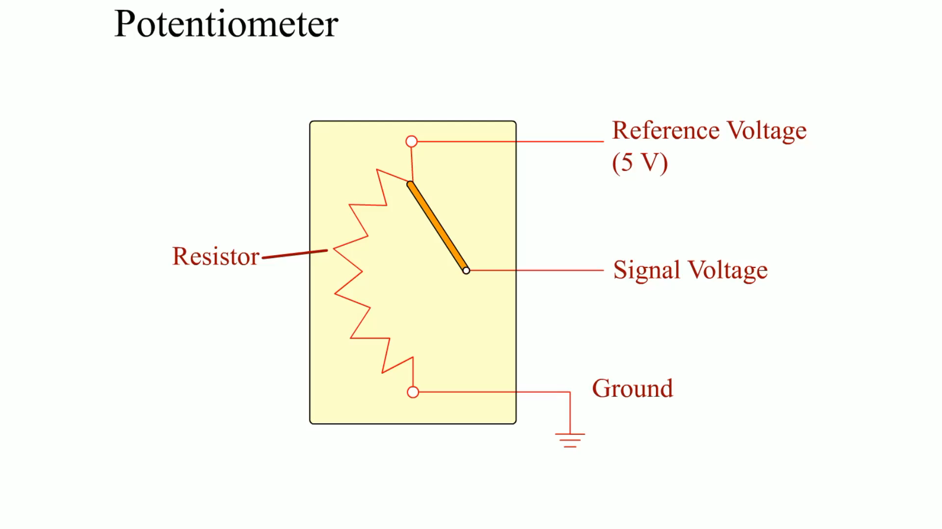
Animation: Potentiometer
(The animation will automatically start in a few seconds)

Slide 80
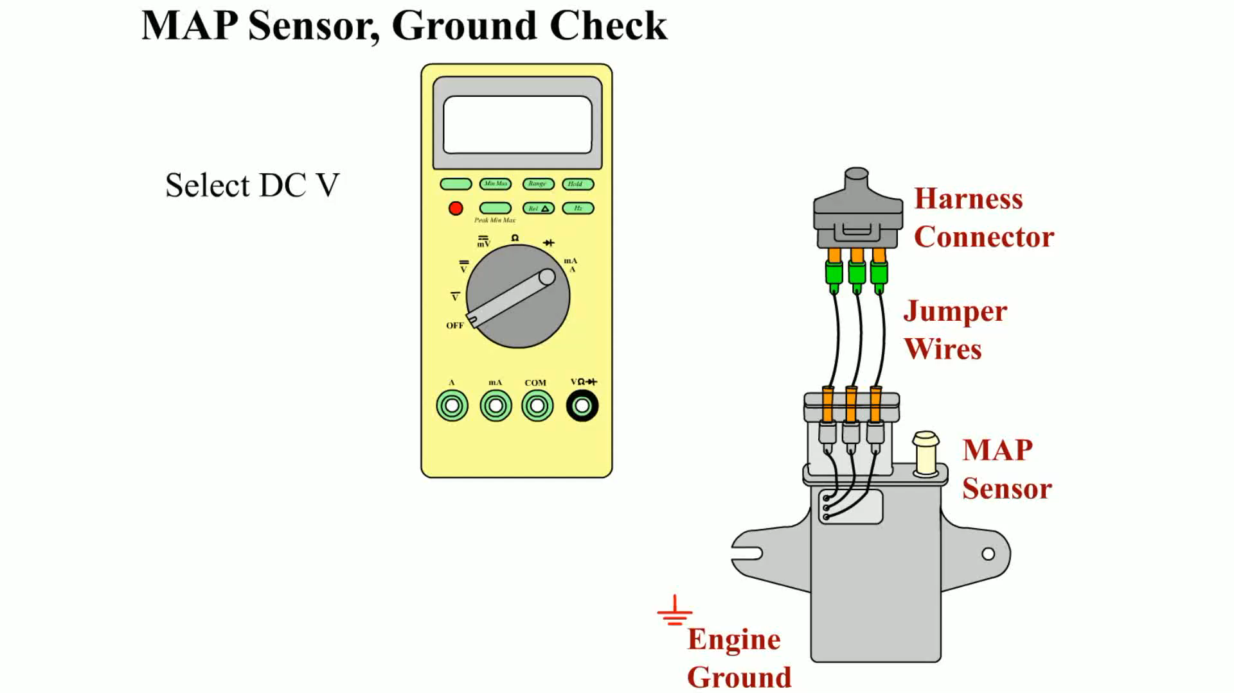
Animation: MAP Sensor, Ground Check
(The animation will automatically start in a few seconds)

Slide 81
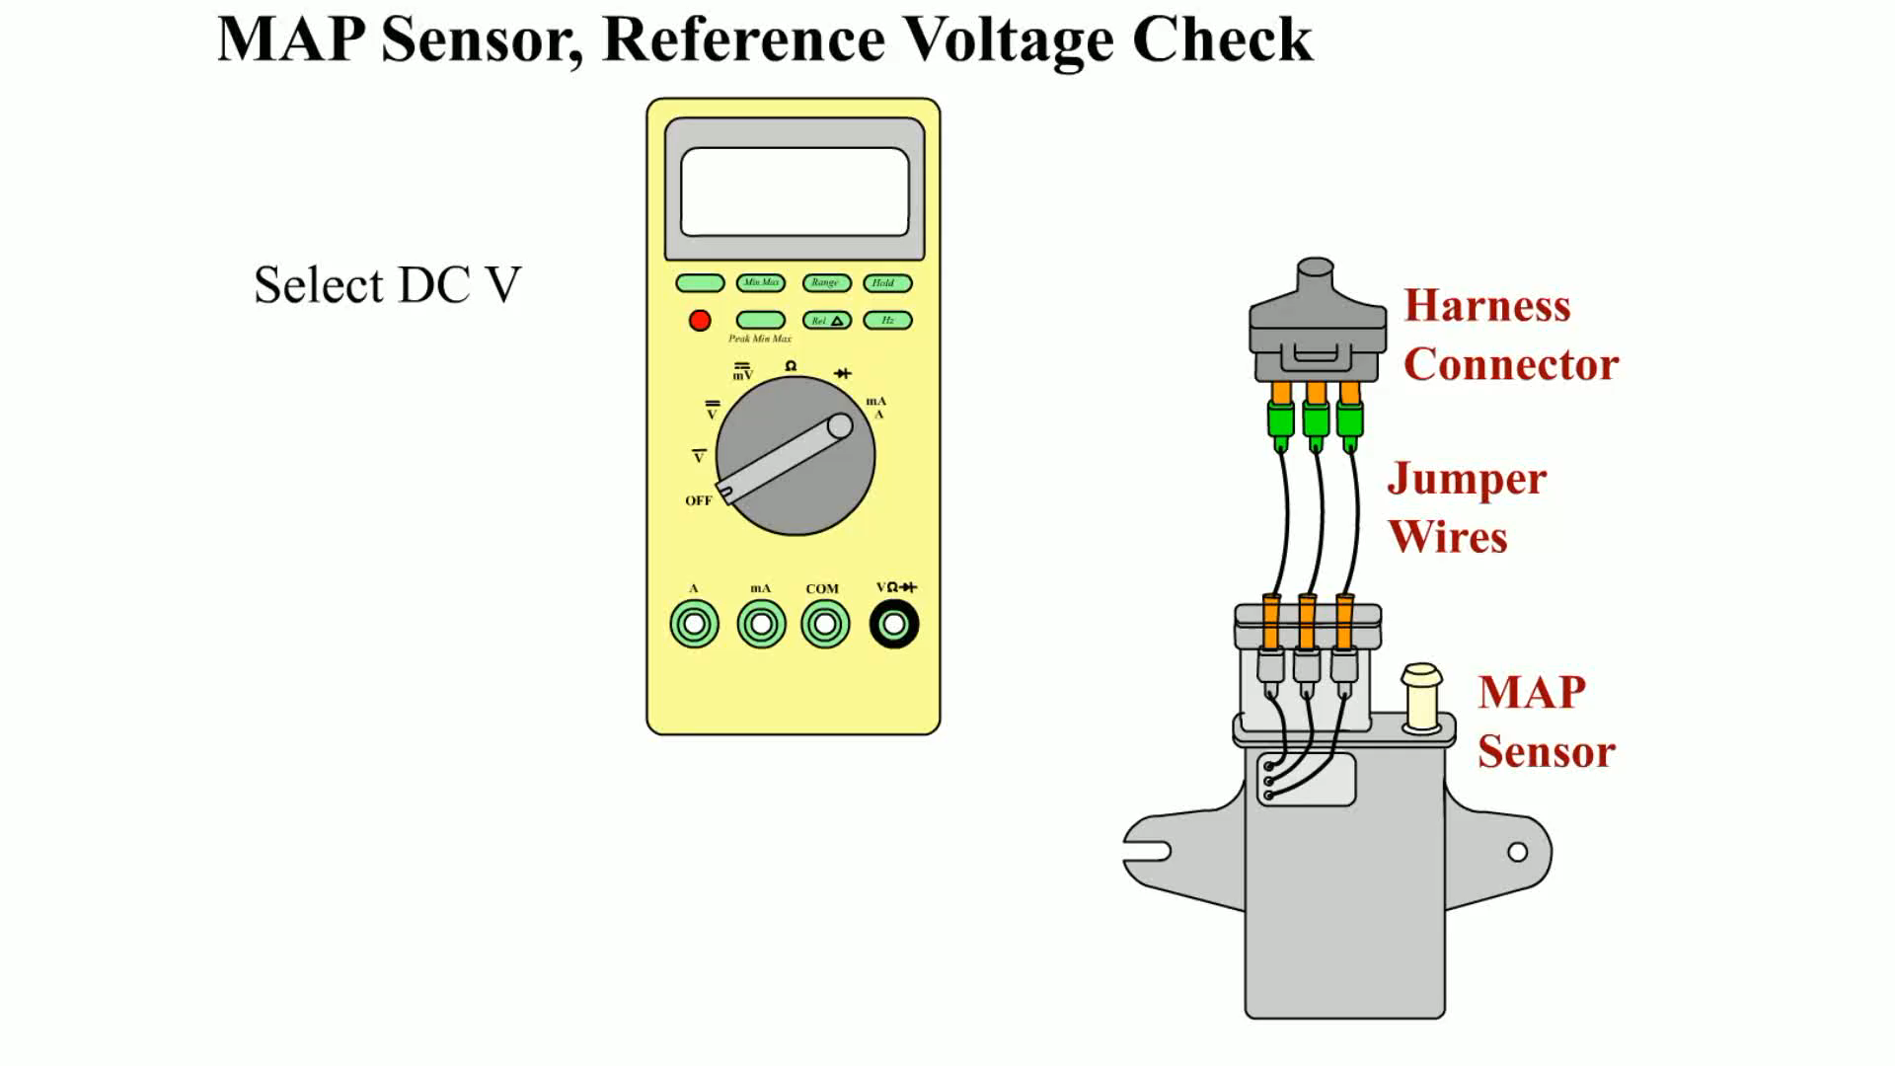
Animation:
MAP Sensor, Reference Voltage Check
(The animation will automatically start in a few seconds)

Slide 82
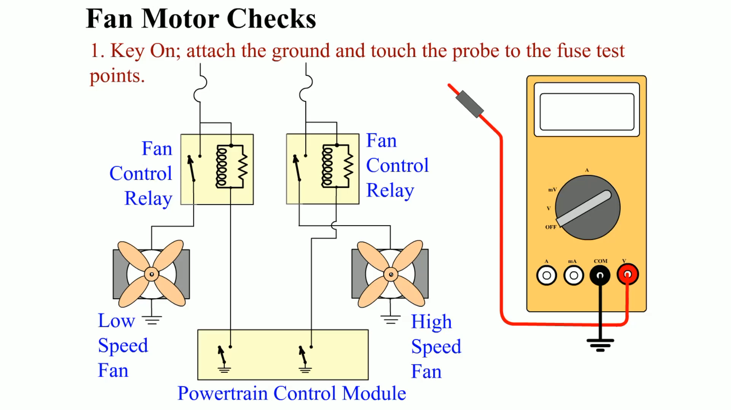
Animation: Fan Motor Checks
(The animation will automatically start in a few seconds)

Slide 83
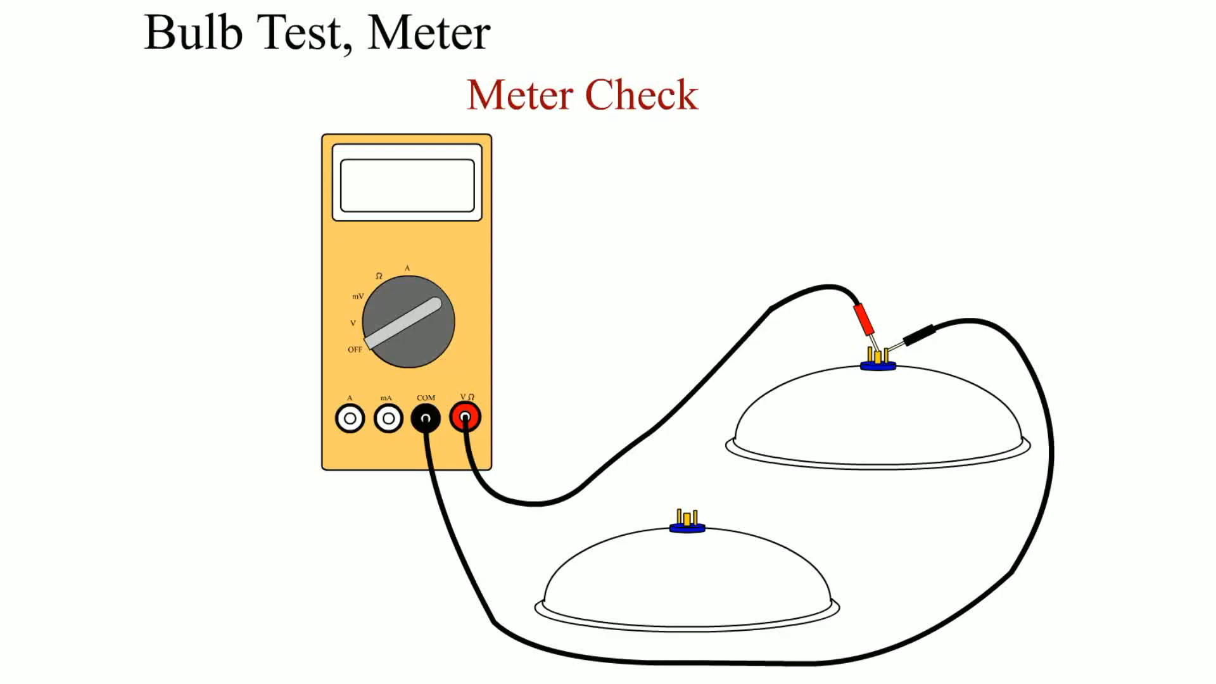
Animation: Bulb Test, Meter
(The animation will automatically start in a few seconds)

Slide 84
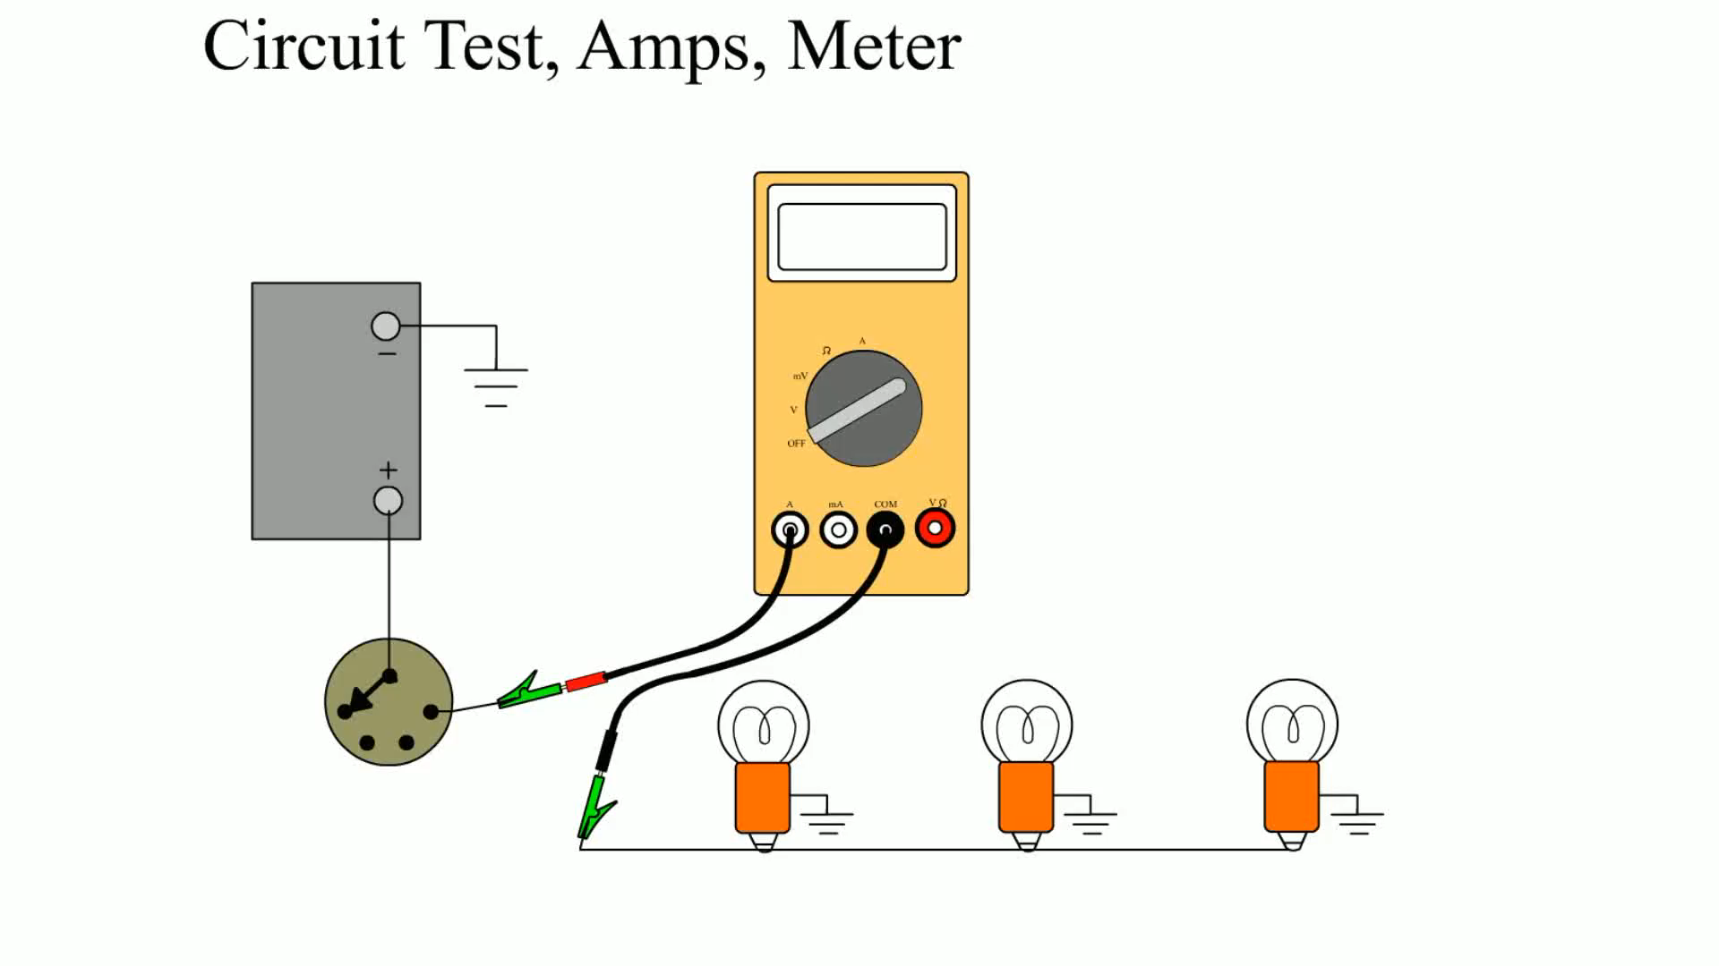
Animation: Circuit Test, Amps, Meter
(The animation will automatically start in a few seconds)

Slide 85
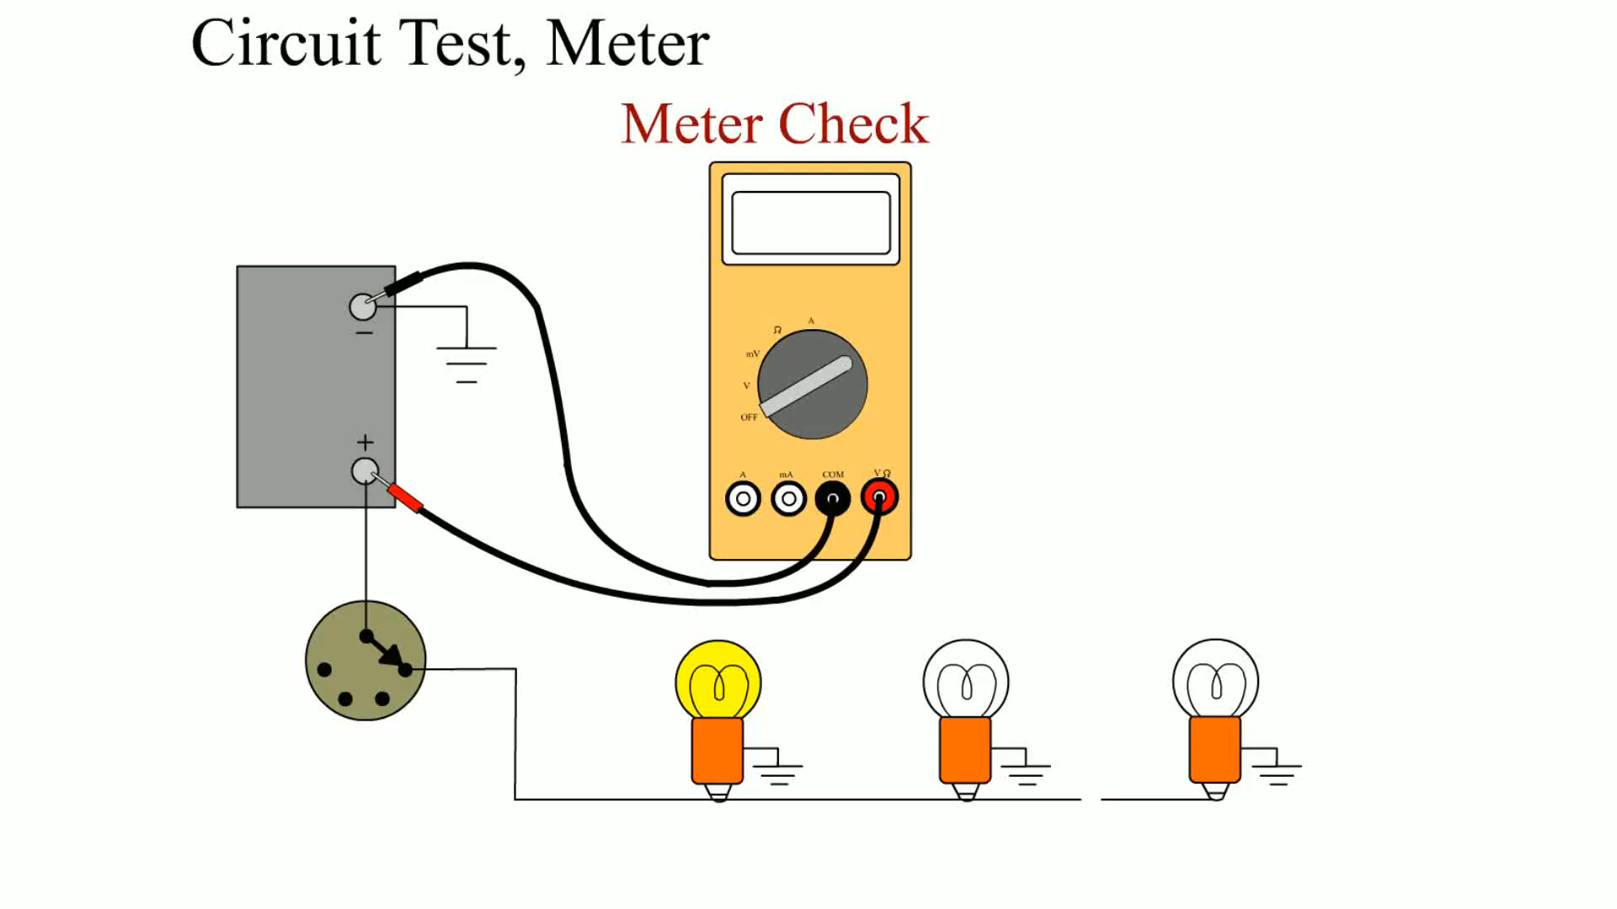
Animation: Circuit Test, Meter
(The animation will automatically start in a few seconds)

Slide 86
Video Links (Internet Access Required)
Cruise control and wiring diagram (time 3:33)
Power locks and wiring diagrams (time 3:47)
Power windows and wiring diagrams part 1 (time 6:47)
Power windows and wiring diagrams part 2 (time 6:01)
Wiring diagram analysis (time 6:25)
Ohms law and wiring diagrams (time 5:01)
Negative or positive trigger wiring diagrams (time 1:35)
Current induction and wiring diagrams (time 4:37)
Capacitors and wiring diagrams (time 6:09)
Short circuit detection part 1 (time 5:05)

Slide 87
Video Links (Internet Access Required)
Short circuit detection part 2 (time 4:50)
Open circuit detection part 1 (time 7:07)
Open circuit detection part 2 (time 7:25)
Module circuits (time 5:32)
High resistance detection (time 3:34)
Electric motors and wiring diagrams (time 6:16)
Basic sensor and wiring diagrams (time 2:29)
Power, ground and wiring diagrams (time 4:31)
Charging system and wiring diagram (time 4:03)
Voltage drop part 1 (time 2:01)

Slide 88
Video Links (Internet Access Required)
Voltage drop part 2 (time 2:25)
Voltage drop part 3 (time 3:16)
Voltage drop part 4 (time 2:23)
Relay diagnosis (time 3:53)
Solenoid testing (time 6:59)
Ampere draw (time 1:42)
Checking circuits for continuity (time 2:1)
Switches relays and wiring part 1 (time 5:34)
Switches relays and wiring part 2 (time 5:22)
Resistors and wiring diagrams (time 7:20)

Slide 89
Video Links (Internet Access Required)
Relay current flow (time 11:58)
Pressure sensor wiring diagram (time 1:46)
Duty cycle and wiring diagrams (time 3:57)
Blower motor ampere draw (time 7:16)
Electric fuel pump testing (time 13:54)
Finding an electrical short (time 21:29)
Electrical short (time 8:41)
Network circuits (time 8:09)
Alternator voltage drop (time 7:48)
Solenoid wiring diagrams (time 3:06)

Slide 90
Video Links (Internet Access Required)
Starter system voltage drop (time 1:55)
Voltage drop part 1 (time 3:41)
Voltage drop part 2 (time 9:29)
Voltage drop part 3 (time 9:42)
Voltage drop part 4 (time 9:39)
Clutch switch (time 5:10)
Electrical shorts (time 2:44)
Electrical diagnosis (time 3:37)
Relays (time 8:13)
Relays (time 1:32)

Slide 91
Video Links (Internet Access Required)
Relays (time 1:27)
Wiper repair (time 11:34)
Horns and wiring diagrams (time 3:33)
Horn troubleshooting (time 3:39)
Repairing wipers (time 4:03)
How to test a wiper motor (time 3:04)
Wiper motor diagnosis (time 9:05)
Windshield washer pump (time 3:52)
Wiper motor (time 1:15)
Horn repair (time 1:17)

Slide 92
Video Links (Internet Access Required)
Horn contact repair (time 5:16)
Horn diagnosis (time 5:13)
Wiper diagnosis (time 3:04)
Wiper motor replacement (time 5:30)
Wiper motor replacement (time 7:38)
Washer repair (time 1:42)
Volvo wipers (time 27:34)
Wiper motor (time 3:21)
Wiper and washer repair (time 3:42)
Wiper motor repair (time 2:22)

Slide 93
Video Links (Internet Access Required)
Wiper switch (time 1:27)
Wiper linkage (time 12:11)
Wiper switch (time 4:41)
Windshield Wiper Motor Replacement (time 2:35)

Slide 94

Copyright

