Slide 1

Automotive Technology Principles, Diagnosis, and Service
Sixth Edition
Chapter 41
Series, Parallel, and Series-Parallel Circuits
Copyright © 2018, 2015, 2011 Pearson Education, Inc. All Rights Reserved

Slide 2
LEARNING OBJECTIVES (1 of 2)
41.1 Identify a series circuit.
41.2 State Kirchhoff’s voltage law and calculate voltage drops in a series circuit.
41.3 Explain series circuit laws.
41.4 Identify a parallel circuit.
41.5 State Kirchhoff’s current law.

Slide 3
LEARNING OBJECTIVES (2 of 2)
41.6 Calculate the total resistance in a parallel circuit.
41.7 Identify a series-parallel circuit.
41.8 Calculate the total resistance of a series-parallel circuit.
41.9 Prepare for ASE Electrical/Electronic Systems (A6) certification test content area “A” (General Electrical/Electronic System Diagnosis).

Slide 4
SERIES CIRCUIT
A series circuit is a complete circuit that has more than one electrical load where all of the current has only one path to flow through all of the loads.
The circuit must be continuous or have continuity in order for current to flow through the circuit.

Slide 5
OHM’S LAW AND SERIES CIRCUITS
Because all current flows through all resistances, the total resistance is the sum (addition) of all resistances.
Ohm’s law can be used to calculate the value of one unknown (voltage, resistance, or amperes) if the other two values are known.

Slide 6
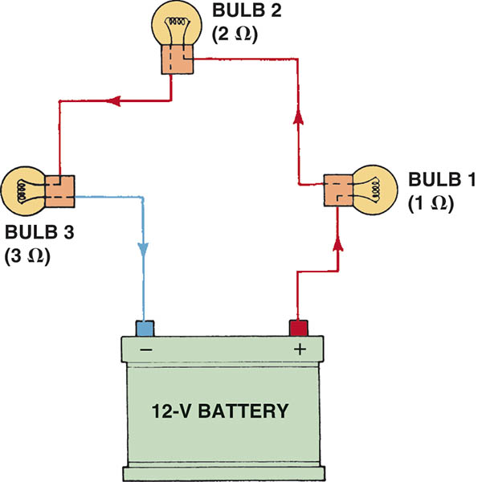
Figure 41.1 A series circuit with three bulbs. All current flows through all resistances (bulbs). The total resistance of the circuit is the sum of the total resistance of the bulbs.

Slide 7
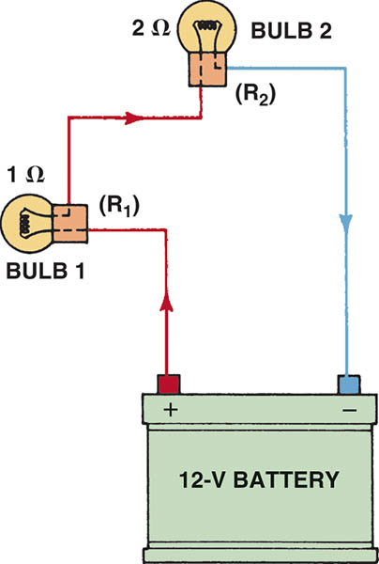
Figure 41.2 A series circuit with two bulbs

Slide 8
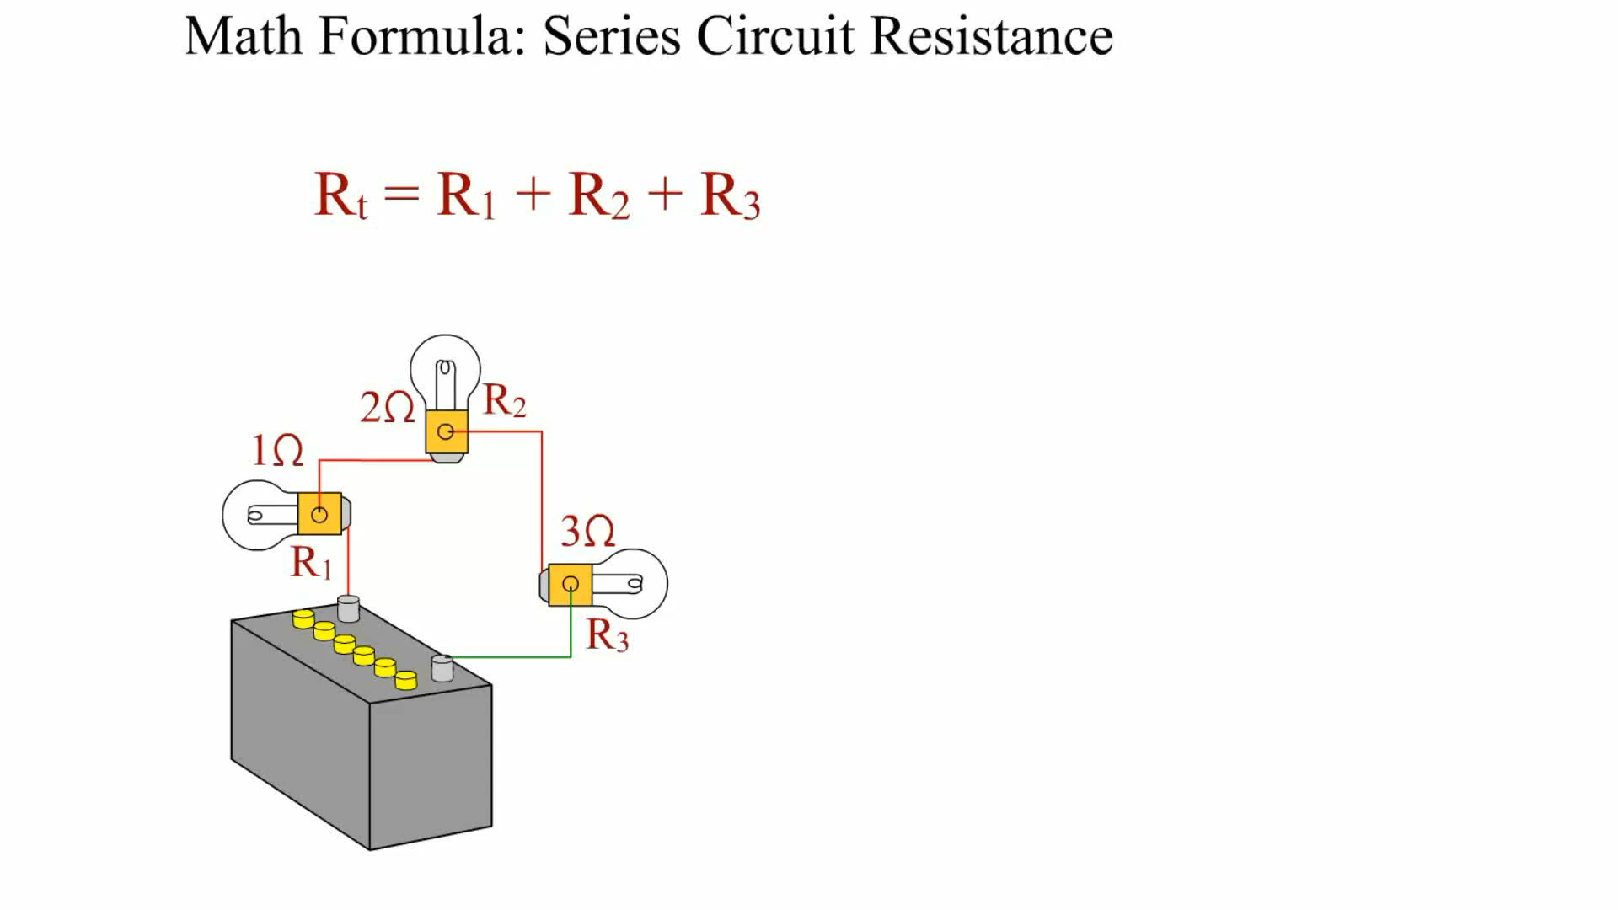
Animation:
Math Formula Circuit Resistance
(The animation will automatically start in a few seconds)

Slide 9
KIRCHHOFF’S VOLTAGE LAW
Kirchhoff’s Second Law
  The voltage around any closed circuit is equal to the sum (total) of the voltage drops across the resistances.
Applying Kirchhoff’s Law
  The voltage drop can be determined by using Ohm’s law and calculating for voltage (E) using the value of each resistance individually:

Slide 10
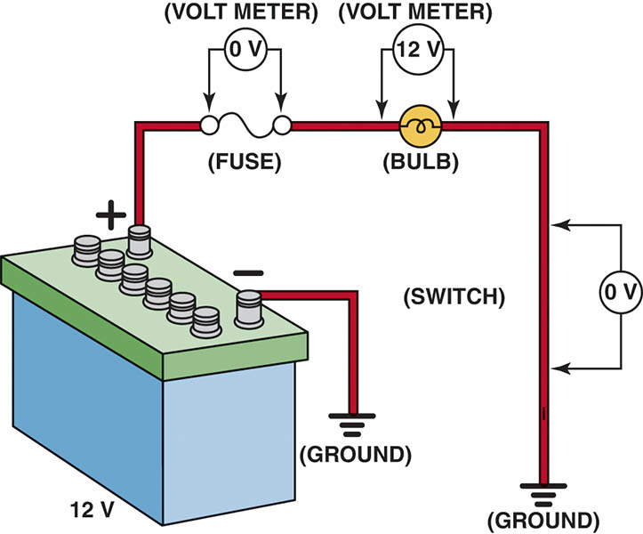
Figure 41.3 As current flows through a circuit, the voltage drops in proportion to the amount of resistance in the circuit. Most, if not all, of the resistance should occur across the load, such as the bulb in this circuit.

Slide 11
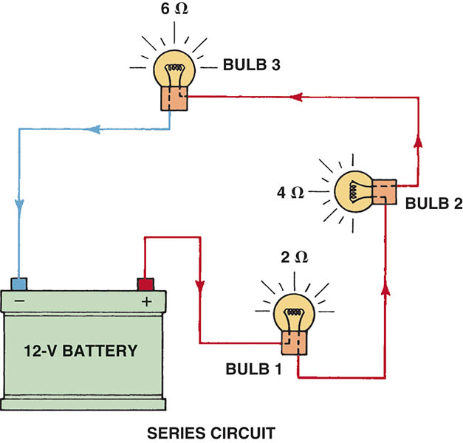
Figure 41.4 In a series circuit, the voltage is dropped or lowered by each resistance in the circuit. The higher the resistance, the greater the drop in voltage

Slide 12
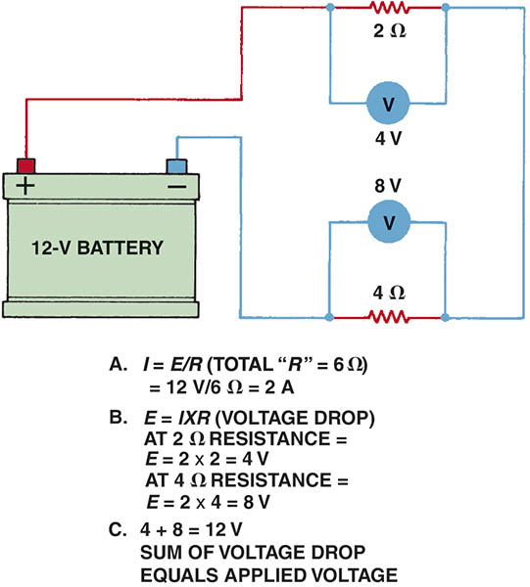
Figure 41.5 A voltmeter reads the differences of voltage between the test leads. The voltage read across a resistance is the voltage drop that occurs when current flows through a resistance.

Slide 13
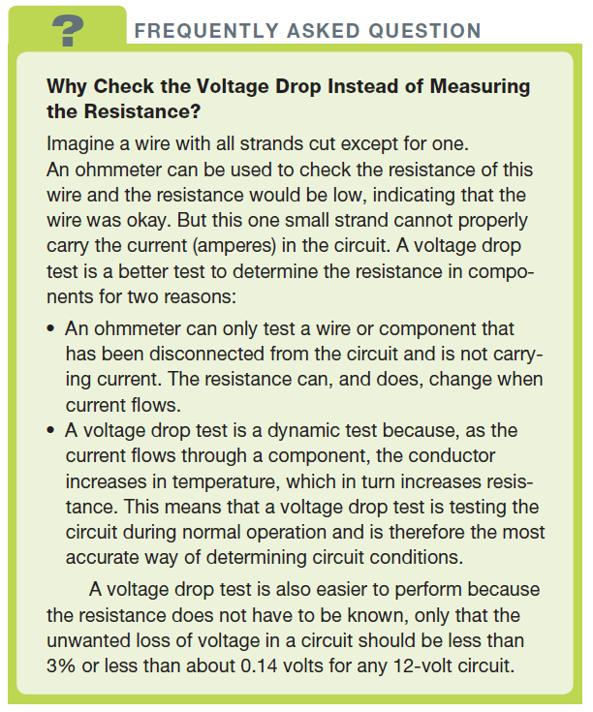
FREQUENTLY ASKED QUESTION

Slide 14
QUESTION 1: ?
What is Kirchhoff’s voltage law?

Slide 15
ANSWER 1:
  The voltage around any closed circuit is equal to the sum (total) of the voltage drops across the resistances.

Slide 16
SERIES CIRCUIT LAWS
Law 1
  The total resistance in a series circuit is the sum total of the individual resistances.
Law 2
  The current is constant throughout the entire circuit.
Law 3
  Although the current is constant, the voltage drops across each resistance in the circuit. The voltage drop across each load is proportional to the value of the resistance compared to the total resistance.

Slide 17
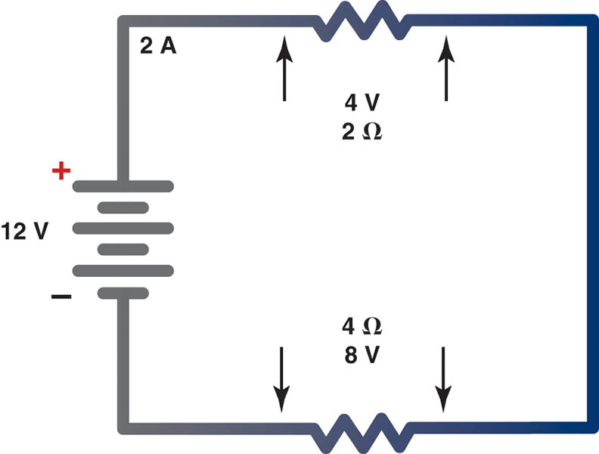
Figure 41.6 In this series circuit with a 2-ohm resistor and a 4-ohm resistor, current (2 amperes) is the same throughout, even though the voltage drops across each resistor

Slide 18
SERIES CIRCUIT EXAMPLES
Each of the four examples discussed includes solving for the following:
  Total resistance in the circuit
  Current flow (amperes) through the circuit
  Voltage drop across each resistance

Slide 19
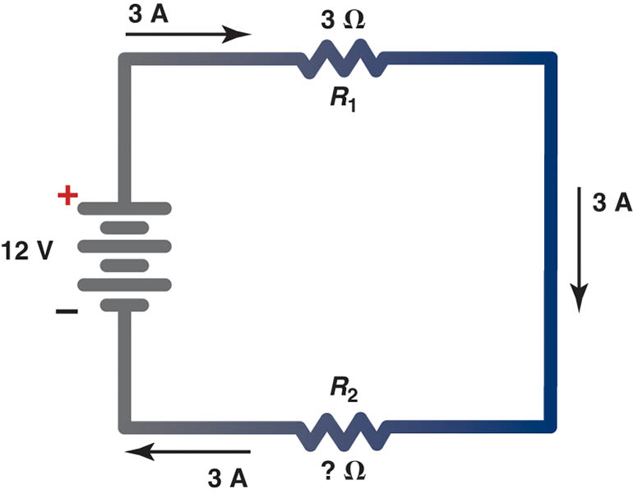
Figure 41.7 Example 1

Slide 20
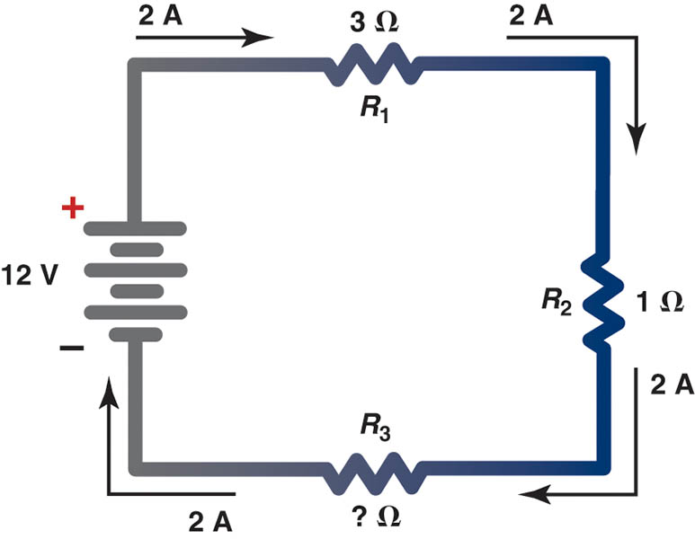
Figure 41.8 Example 2

Slide 21
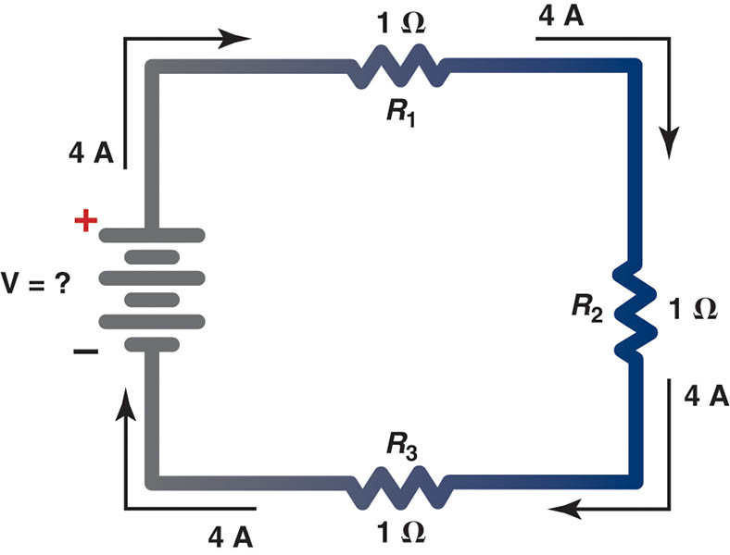
Figure 41.9 Example 3

Slide 22
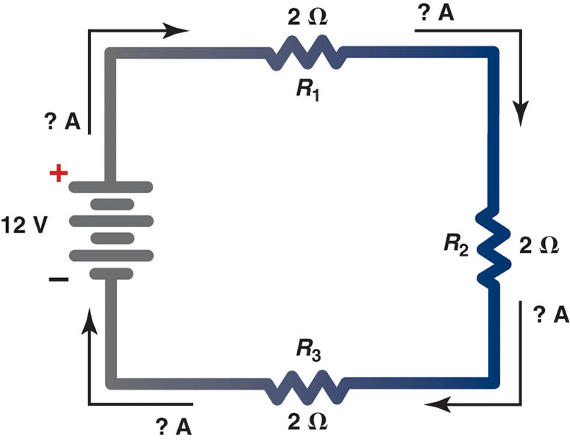
Figure 41.10 Example 4

Slide 23
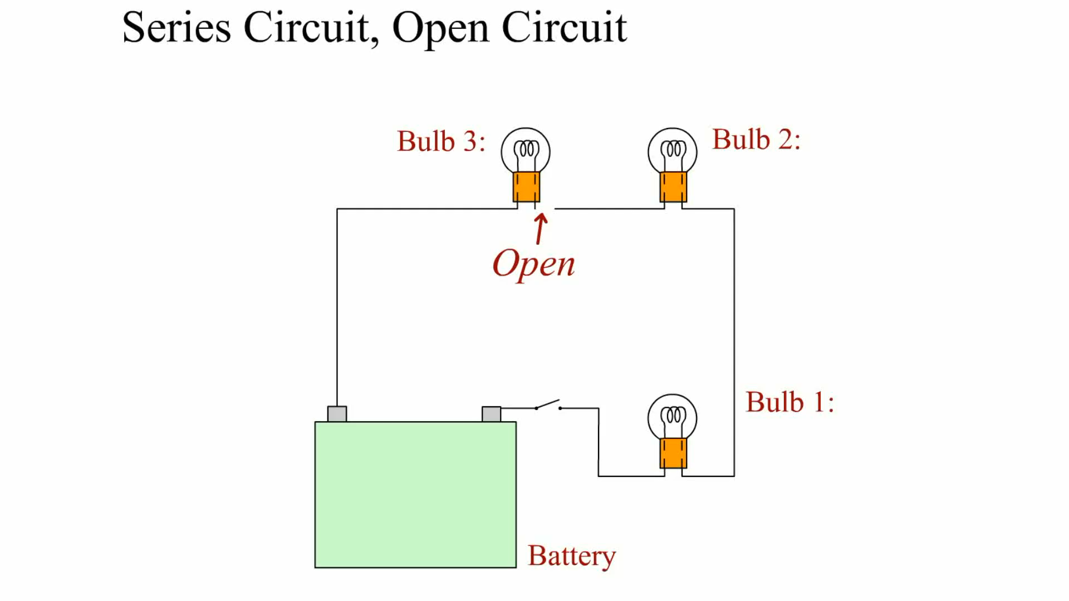
Animation: Series Circuit, Open
(The animation will automatically start in a few seconds)

Slide 24
PARALLEL CIRCUITS
A parallel circuit is a complete circuit that has more than one path for the current.
The separate paths that split and meet at junction points are called branches, legs, or shunts.
The current flow through each branch or leg varies, depending on the resistance in that branch.

Slide 25
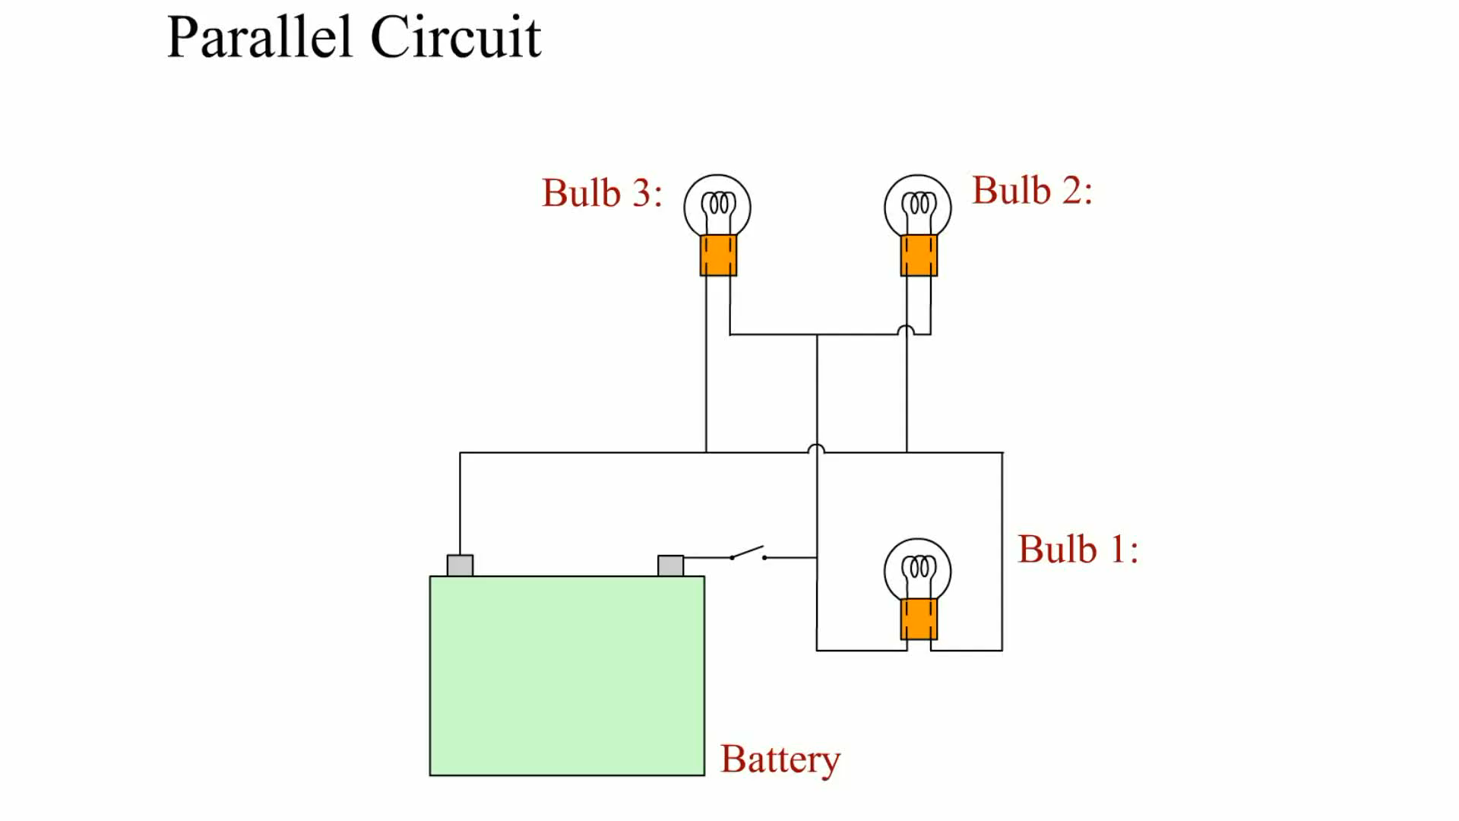
Animation: Parallel Circuit
(The animation will automatically start in a few seconds)

Slide 26
KIRCHHOFF’S CURRENT LAW
Kirchhoff’s Current Law
  The current flowing into any junction of an electrical circuit is equal to the current flowing out of that junction.

Slide 27
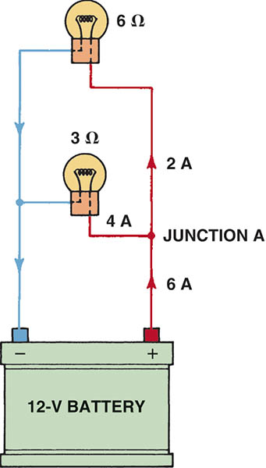
Figure 41.11 The amount of current flowing into junction point A equals the total amount of current flowing out of the junction

Slide 28
PARALELL CIRCUIT LAWS
Law 1
  The total resistance of a parallel circuit is always less than that of the smallest-resistance leg.
Law 2
  The voltage is the same for each leg of a parallel circuit.
Law 3
  The sum of the individual currents in each leg equals the total current.

Slide 29
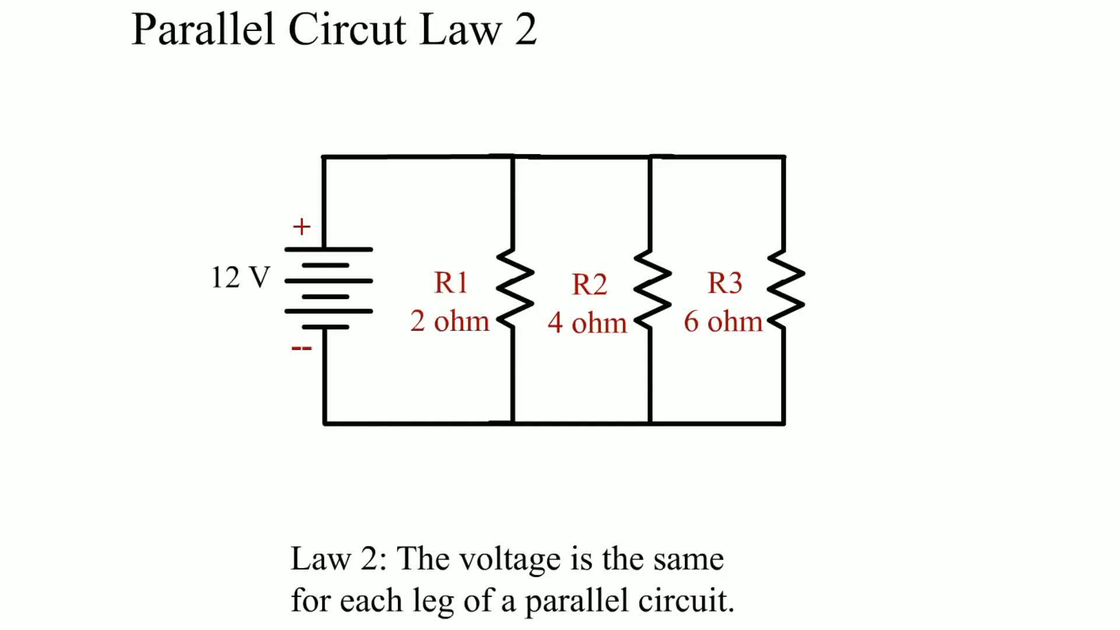
Animation: Parallel Circuit Law 2
(The animation will automatically start in a few seconds)

Slide 30
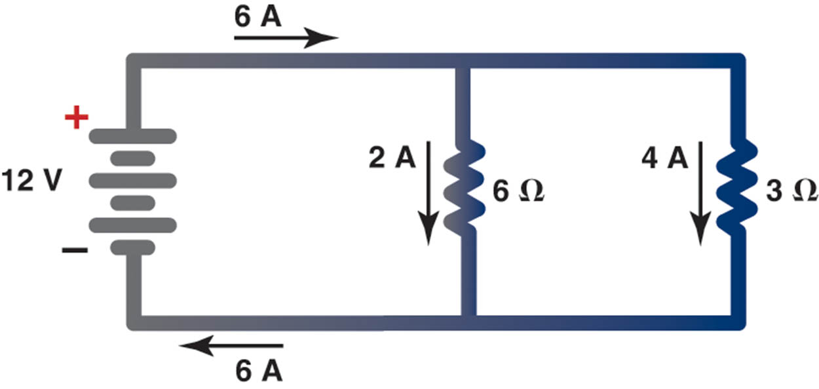
Figure 41.12 The current in a parallel circuit splits (divides) according to the resistance in each branch

Slide 31
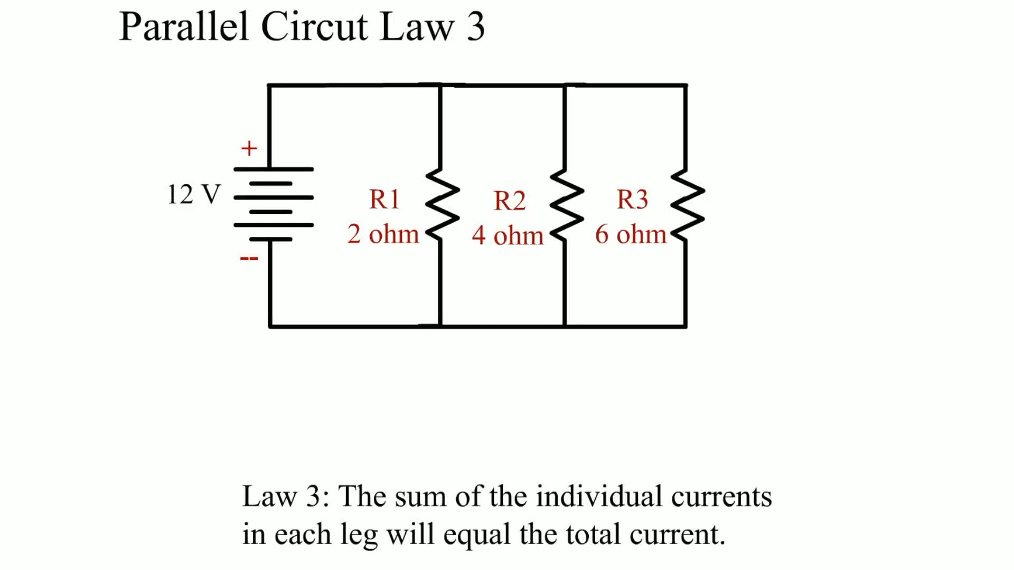
Animation: Parallel Circuit Law 3
(The animation will automatically start in a few seconds)

Slide 32
DETERMINING TOTAL RESISTANCE IN A PARALLEL CIRCUIT (1 OF 2)
Method 1
  The total current (in amperes) can be calculated first by treating each leg of the parallel circuit as a simple circuit.
Method 2
  If only two resistors are connected in parallel, the total resistance (RT) can be found using the formula RT = (R1 *R2)/(R1 + R2).

Slide 33
DETERMINING TOTAL RESISTANCE IN A PARALLEL CIRCUIT (2 OF 2)
Method 3
  A formula that can be used to find the total resistance for any number of resistances in parallel is 1/RT = 1/R1 +1/R2 + 1/R3 + . . .
Method 4
  This method uses an electronic calculator, commonly available at very low cost.
Method 5
  This method can be easily used whenever two or more resistances connected in parallel are of the same value.

Slide 34
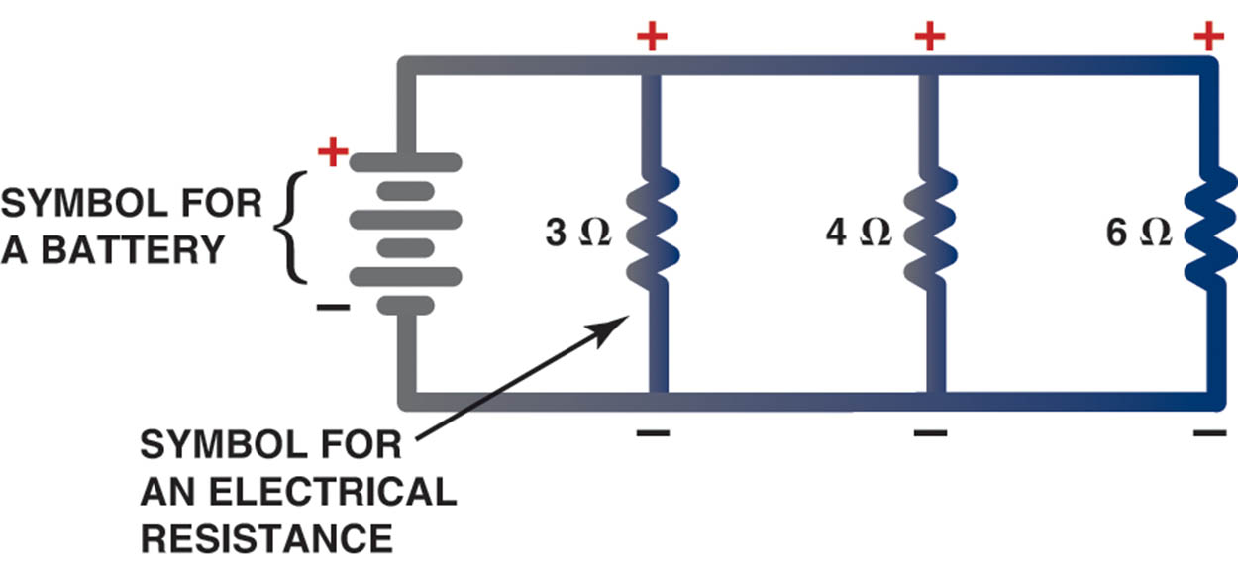
Figure 41.13 In a typical parallel circuit, each resistance has power and ground, and each leg operates independently of the other legs of the circuit

Slide 35
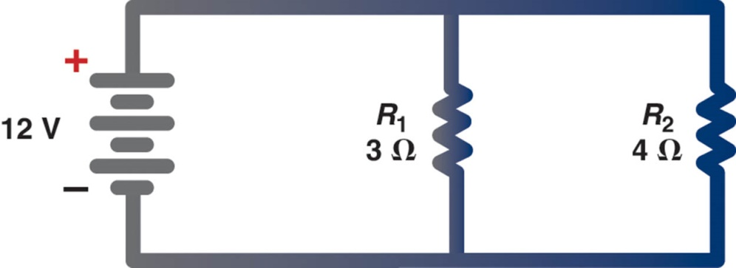
Figure 41.14 A schematic showing two resistors in parallel connected to a 12-volt battery

Slide 36
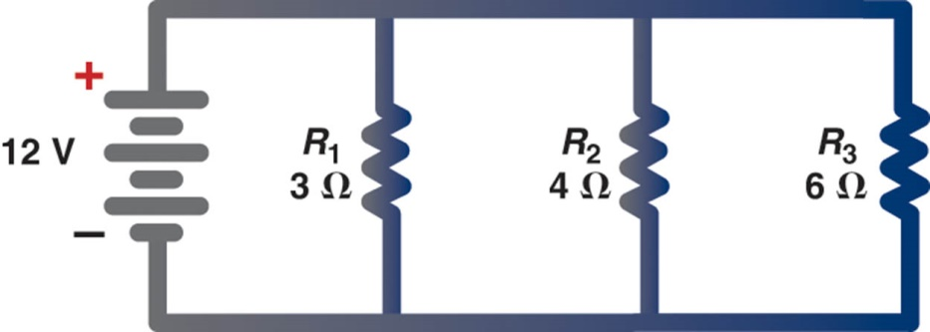
Figure 41.15 A parallel circuit with three resistors connected to a 12-volt battery

Slide 37
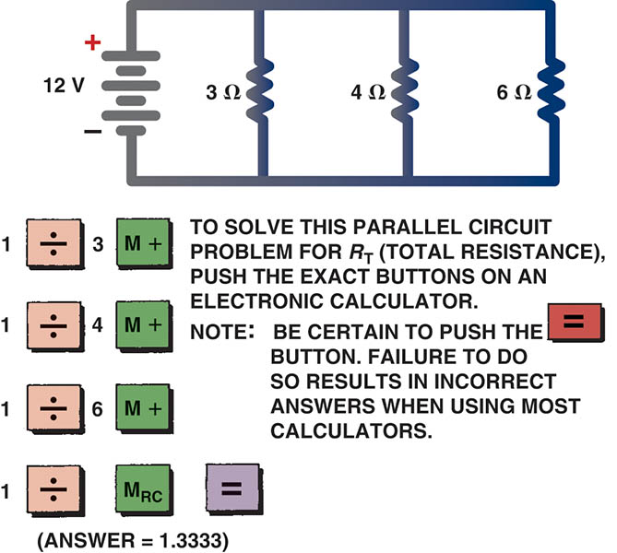
Figure 41.16 Using an electronic calculator to determine the total resistance of a parallel circuit

Slide 38
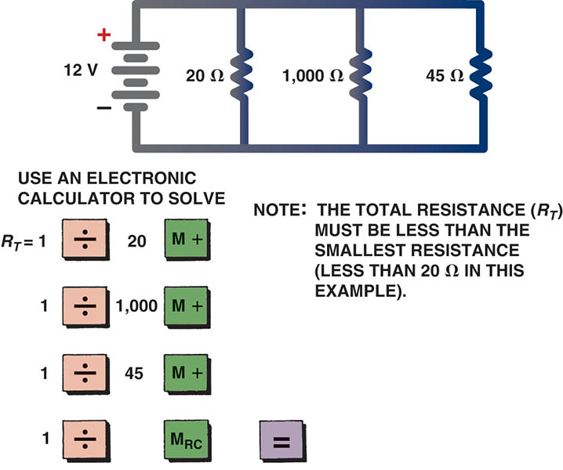
Figure 41.17 Another example of how to use an electronic calculator to determine the total resistance of a parallel circuit. The answer is 13.45 ohms.

Slide 39
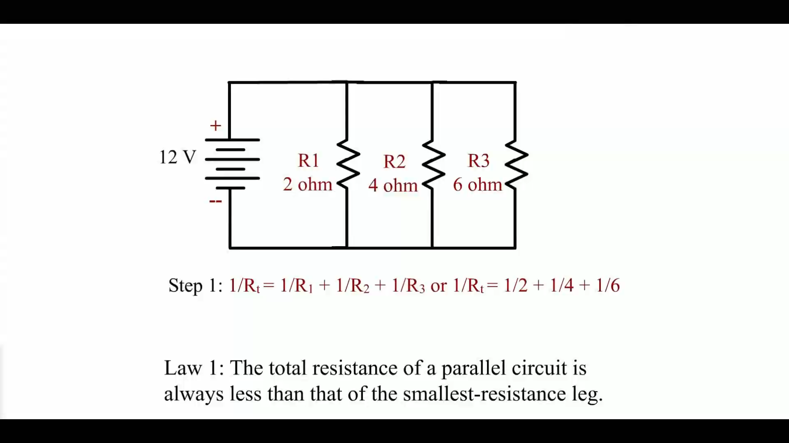
Animation: Parallel Circuit Law 1
(The animation will automatically start in a few seconds)

Slide 40
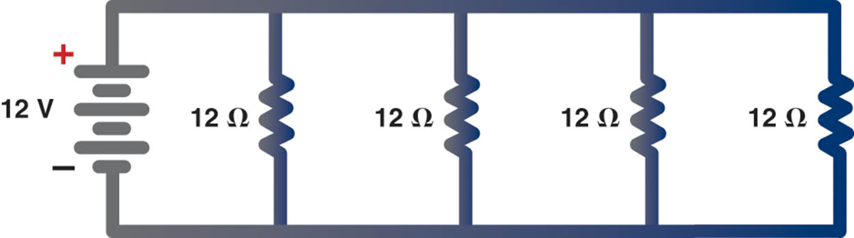
Figure 41.18 When a circuit has more than one resistor of equal value, the total resistance can be determined by simply dividing the value of the resistance (12 ohms in this example) by the number of equal-value resistors (4 in this example) to get 3 ohms

Slide 41
PARALLEL CIRCUIT EXAMPLES
Each of the four examples discussed includes solving for the following:
  Total resistance
  Current flow (amperes) through each branch, as well as total current flow
  Voltage drop across each resistance

Slide 42
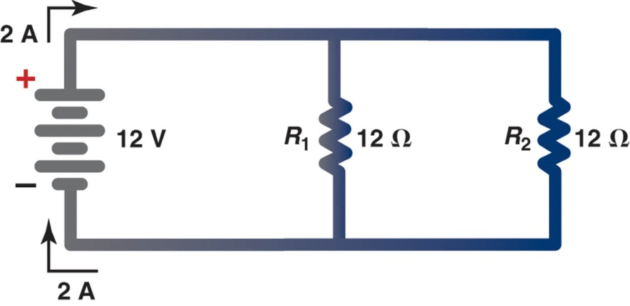
Figure 41.19 Example 1

Slide 43
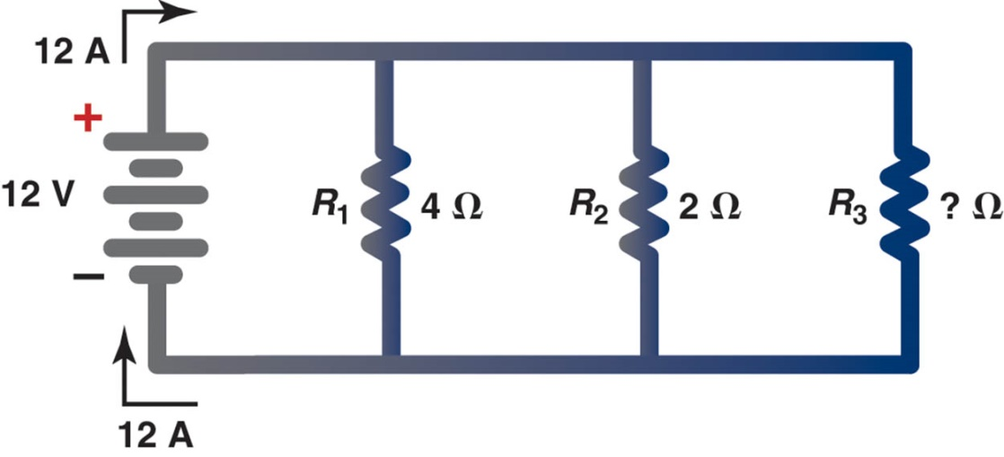
Figure 41.20 Example 2

Slide 44
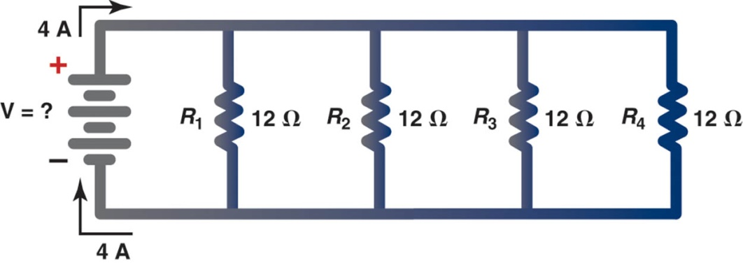
Figure 41.21 Example 3

Slide 45
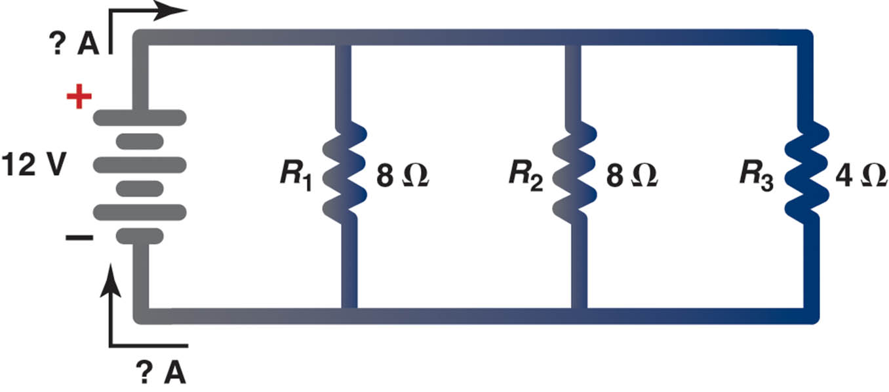
Figure 41.22 Example 4

Slide 46
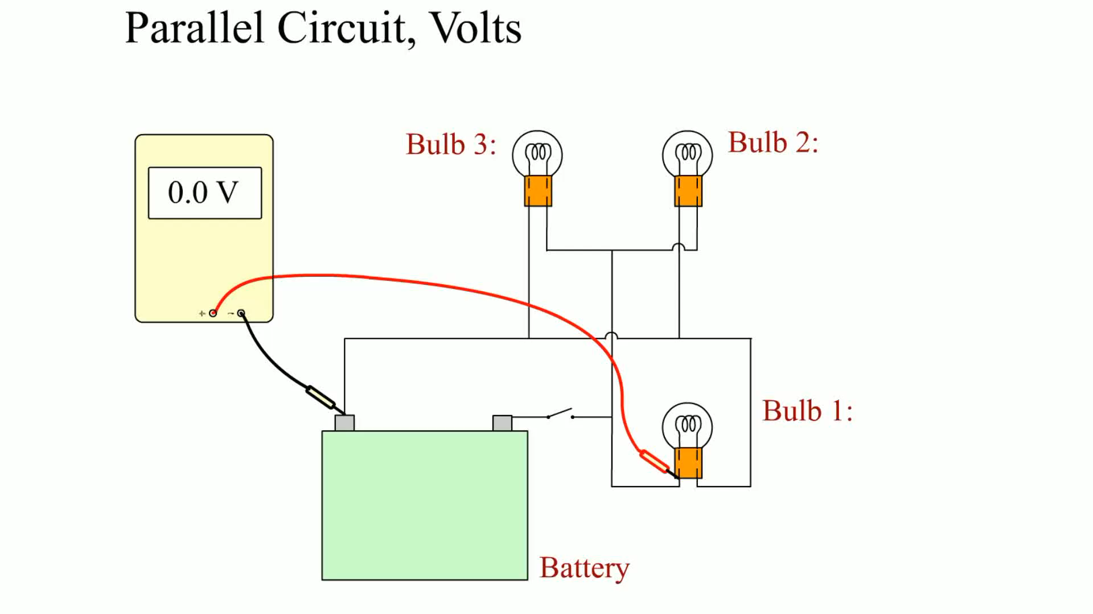
Animation: Parallel Circuit, Volts
(The animation will automatically start in a few seconds)

Slide 47
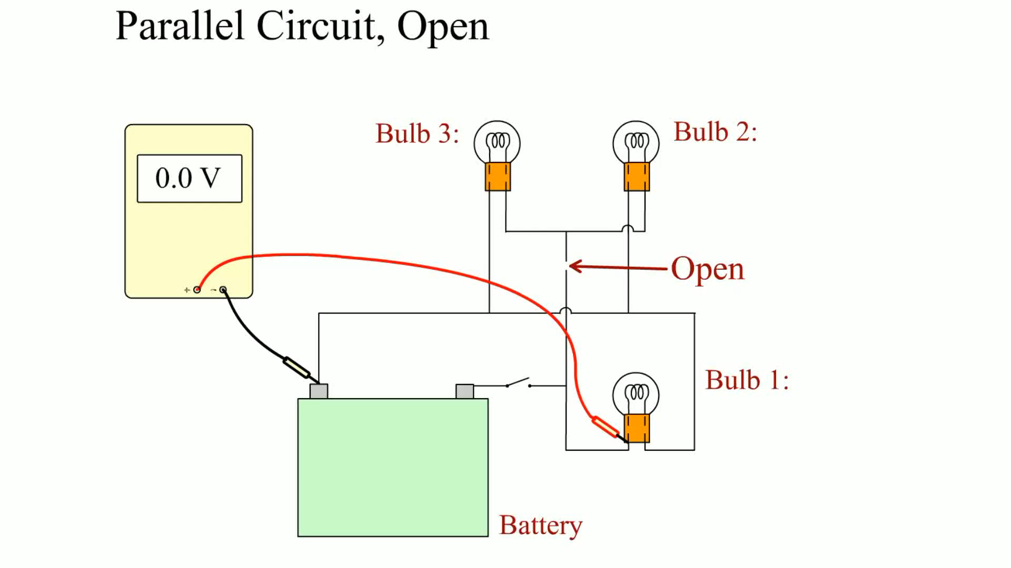
Animation: Parallel Circuit, Open
(The animation will automatically start in a few seconds)

Slide 48
QUESTION 2: ?
Why is the total resistance of a parallel circuit less than the
smallest resistance?

Slide 49
ANSWER 2:
With many branches, more current can flow from the battery

Slide 50
SERIES-PARALLEL CIRCUITS
Series-parallel circuits are a combination of series and parallel segments in one complex circuit.
There are two basic types of series-parallel circuits.
  A circuit where the load is in series with other loads in parallel.
  A circuit where a parallel circuit contains resistors or loads that are in series with one or more branches.

Slide 51
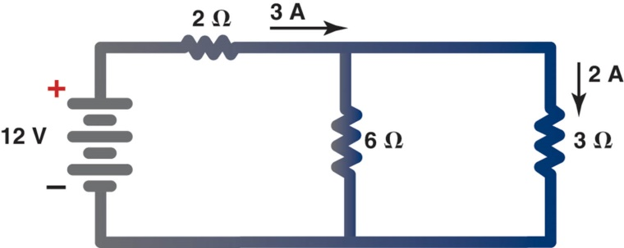
Figure 41.23 A series-parallel circuit

Slide 52
SOLVING SERIES-PARALLEL CIRCUIT PROBLEMS
The key to solving series-parallel circuit problems is to combine or simplify as much as possible.
For example, if there are two loads or resistances in series within a parallel branch or leg, then the circuit can be made simpler if the two are first added together before attempting to solve the parallel section.

Slide 53
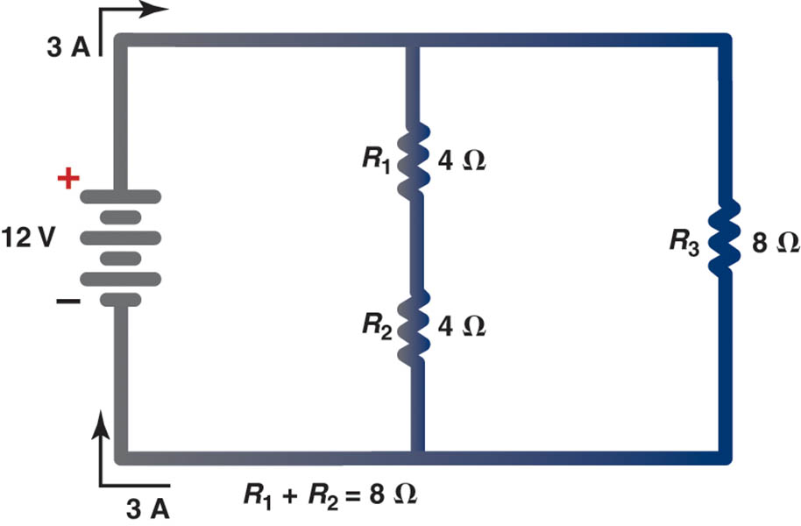
Figure 41.24 Solving a series-parallel circuit problem

Slide 54
SERIES-PARALLEL CIRCUIT EXAMPLES
Each of the four examples discussed includes solving for the following:
  Total resistance
  Current flow (amperes) through each branch, as well as total current flow
  Voltage drop across each resistance

Slide 55
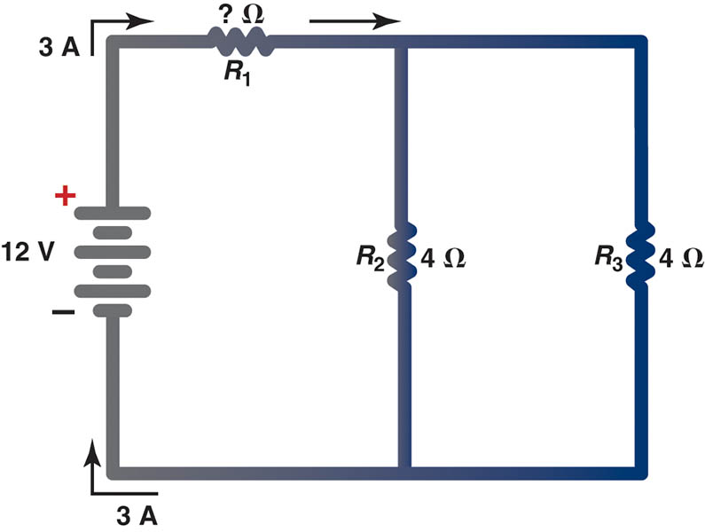
Figure 41.25 Example 1

Slide 56
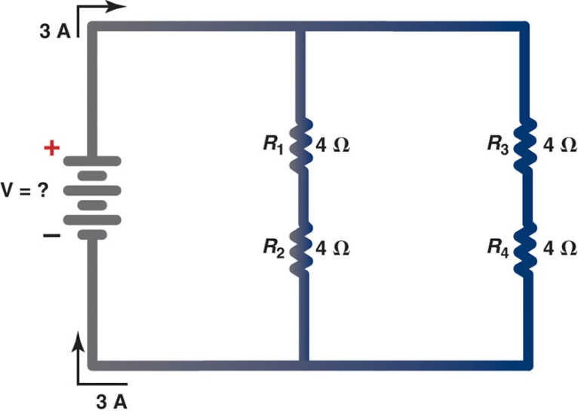
Figure 41.26 Example 2

Slide 57
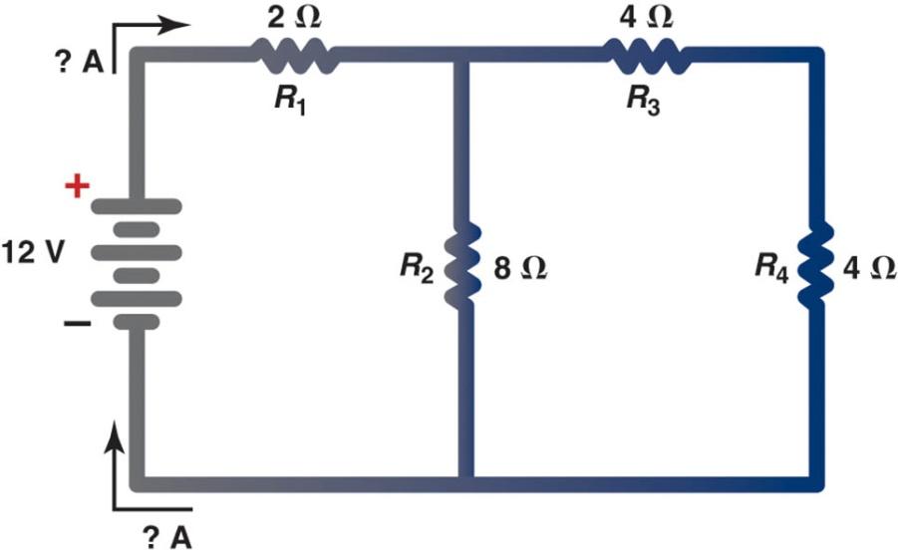
Figure 41.27 Example 3

Slide 58
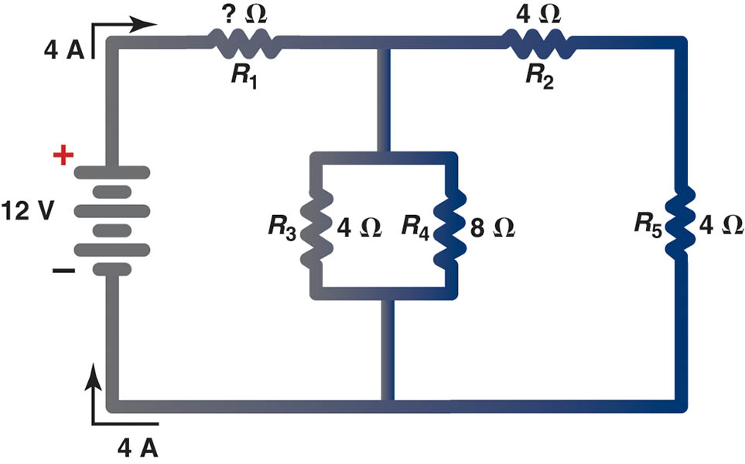
Figure 41.28 Example 4

Slide 59
QUESTION 3: ?
What would be the effect of an open circuit in a series portion
of a series-parallel circuit?

Slide 60
ANSWER 3:
It would affect the entire circuit.

Slide 61
Video Links (Internet Access Required)
Series Circuits (time 7:11)
Intro the Parallel Circuits (time 5:43)
Calculating Current in a Parallel Circuit (time 11:00)
Solving Series-Parallel Circuits (time 8:03)
Series-Parallel Circuits (time 2:42)

Slide 62

Copyright

