Slide 1
Automotive Technology Principles, Diagnosis, and Service
Sixth Edition
Chapter 37
Engine Assembly and Dynamometer Testing
Copyright © 2018, 2015, 2011 Pearson Education, Inc. All Rights Reserved

Slide 2
LEARNING OBJECTIVES (1 of 2)
37.1 Explain short block preparation and cylinder head preparation.
37.2 Discuss trial assembly and final short block assembly.
37.3 Describe camshaft installation and piston/rod installation.
37.4 Explain the cylinder head installation procedure.

Slide 3
LEARNING OBJECTIVES (2 of 2)
37.5 Discuss torque-to-yield head bolts.
37.6 Explain valve train assembly and final assembly of an engine.
37.7 Explain dynamometer testing.

Slide 4
DETAILS, DETAILS, DETAILS
Successful engine assembly depends on getting all of the details right.
Read. Read all instructions that are included with all new parts and gaskets.
Understand. Be sure to fully understand everything that is stated in the instructions.
Follow. Be sure to follow all of the instructions.

Slide 5
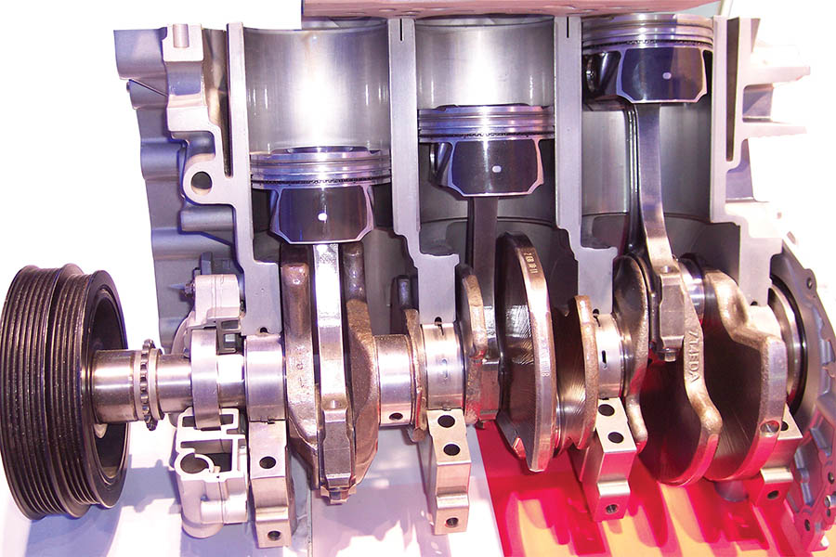
Figure 37.1 A Ford 1.0 liter 3-cylinder engine is different than many small engines and may require detailed service information for proper assembly

Slide 6
SHORT BLOCK PREPARATION (1 OF 3)
Items to Check
All passages should be clean and free of rust and debris.
All gasket surfaces are properly cleaned and checked for burrs and scratches.
All cups and plugs should be installed.
The final bore dimension is correct for the piston.
The surface finish of the cylinder bore matches with the specified finish required for the piston rings that are going to be used.
All sharp edges and burrs have been removed.

Slide 7
SHORT BLOCK PREPARATION (2 OF 3)
Surface Finish
Surface finish is measured in micro-inches.
The higher the micro-inch finish, the rougher the surface.
The lower the micro-inch finish, the smoother the surface.
Check Surfaces Before Assembly
All surfaces of an engine should be clean and straight and have the specified surface finish and flatness.

Slide 8
SHORT BLOCK PREPARATION (3 OF 3)
Preparing the Block for Studs
Using studs instead of head bolts for cylinder heads is recommended for all high performance applications.
Studs provide for more accurate and consistent torque loading and clamping force.
The use of studs for the main bearing saddles helps main cap alignment.
Preparing the Thread Holes
All threads in the block should be thoroughly cleaned and free of any liquid.

Slide 9
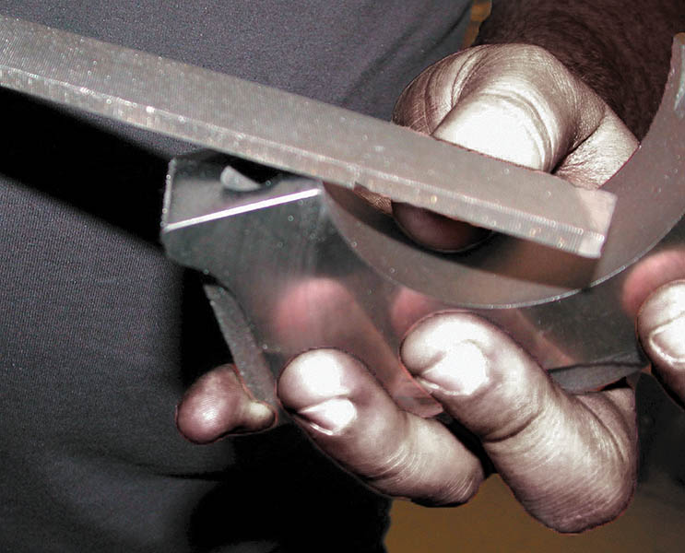
Figure 37.2 Deburring all sharp edges is an important step to achieve proper engine assembly

Slide 10
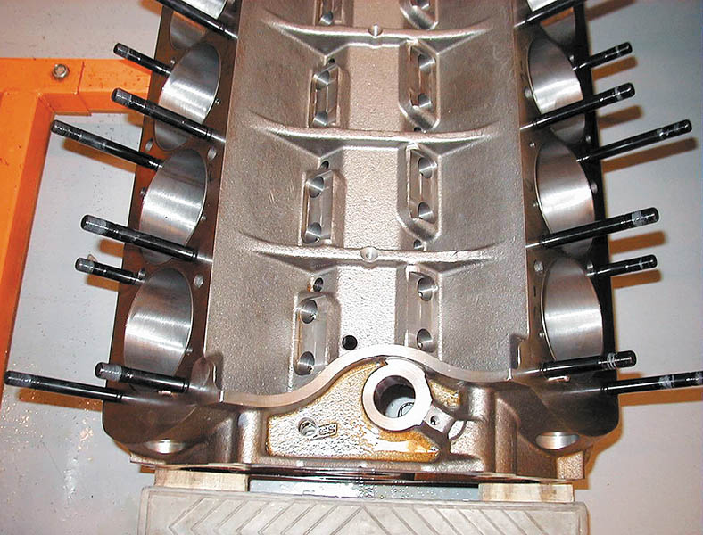
Figure 37.3 Studs installed in the block, replacing head bolts

Slide 11
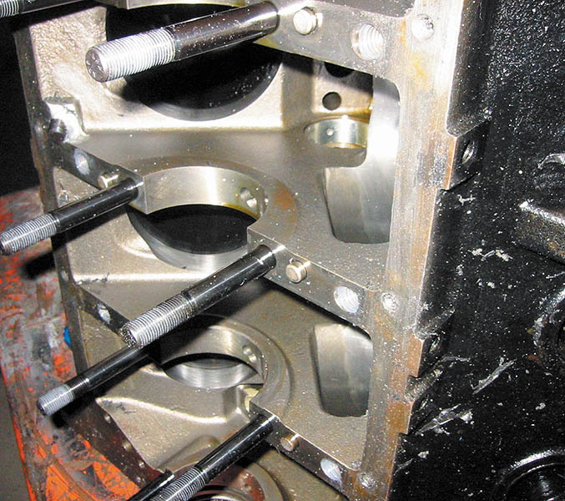
Figure 37.4 Main bearing studs installed on a V-8 block

Slide 12
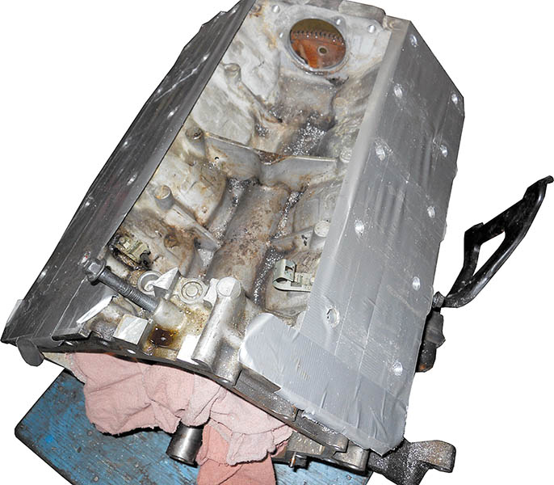
Figure 37.5 A Cadillac Northstar engine being rebuilt. The shop doing the work is installing Heli-coils® in all threaded cylinder head bolt holes as a precaution.

Slide 13
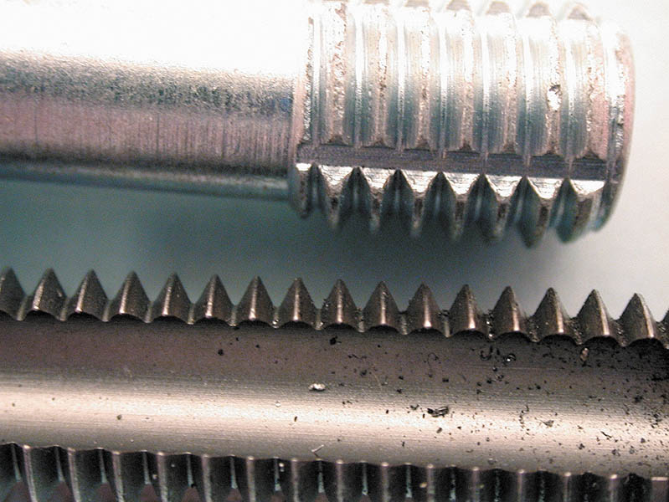
Figure 37.6 A thread chaser (top) is the preferred tool to clean threaded holes because it cleans without removing metal, compared to a tap (bottom)

Slide 14
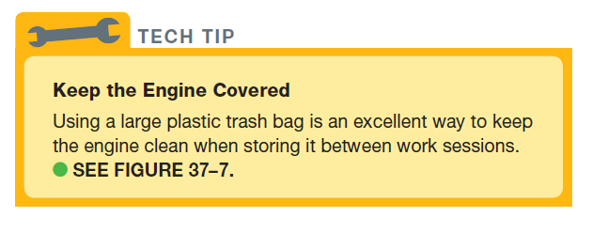
Tech Tip

Slide 15
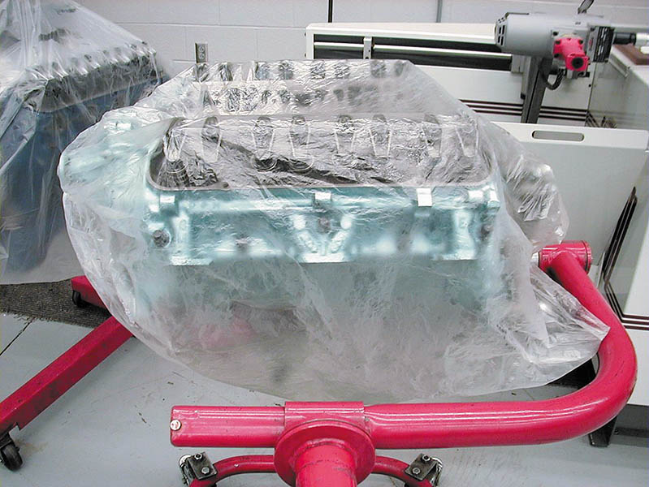
Figure 37.7 Using a plastic trash bag is an excellent way to keep the engine clean during all stages of assembly

Slide 16
CYLINDER HEAD PREPARATION
Check the following details on the cylinder head(s).
The surface finish of the fire deck is as specified.
All valves should be checked for leakage.
All valve springs should be checked for even spring pressure and installed height.
Check for proper pushrod length.
If replacement rocker arms are used, be sure that the geometry
and total lift is okay.

Slide 17
TRIAL ASSEMBLY
Short Block
Before performing final engine assembly, the wise technician checks that all parts fit and work.
Valve Train
Some timing chain mechanisms require more space than the stock component, so some machining may be needed.
Check the Angle Between the Heads
Use a gauge to check the angle to ensure proper intake manifold gasket sealing.

Slide 18
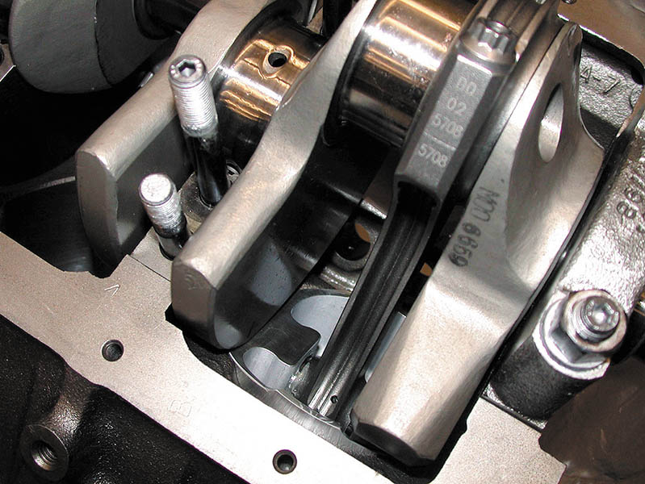
Figure 37.8 A trial assembly showed that some grinding of the block is needed to provide clearance for the counterweight of the crankshaft.

Slide 19
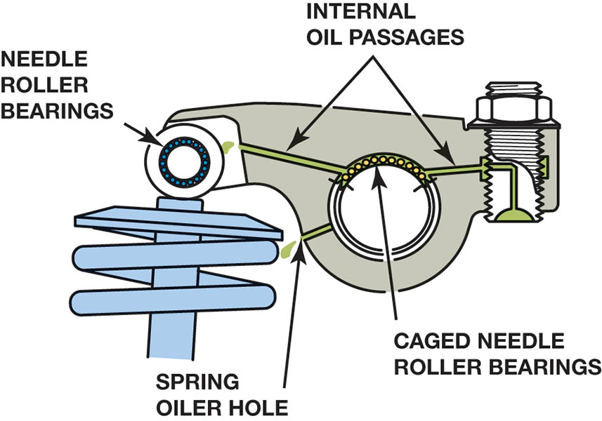
Figure 37.9 A typical high-performance aftermarket rocker arm that is equipped with needle roller bearings at the valve stem end.

Slide 20
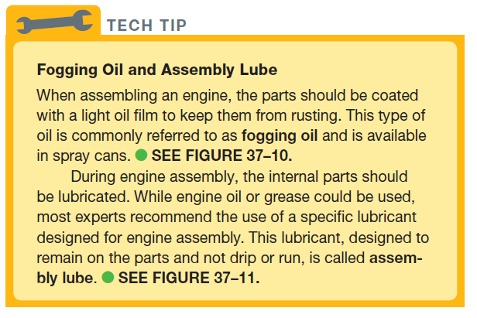
TECH TIP

Slide 21
Figure 37.10 Fogging oil is used to cover bare metal parts when the engine is being stored to prevent corrosion

Slide 22
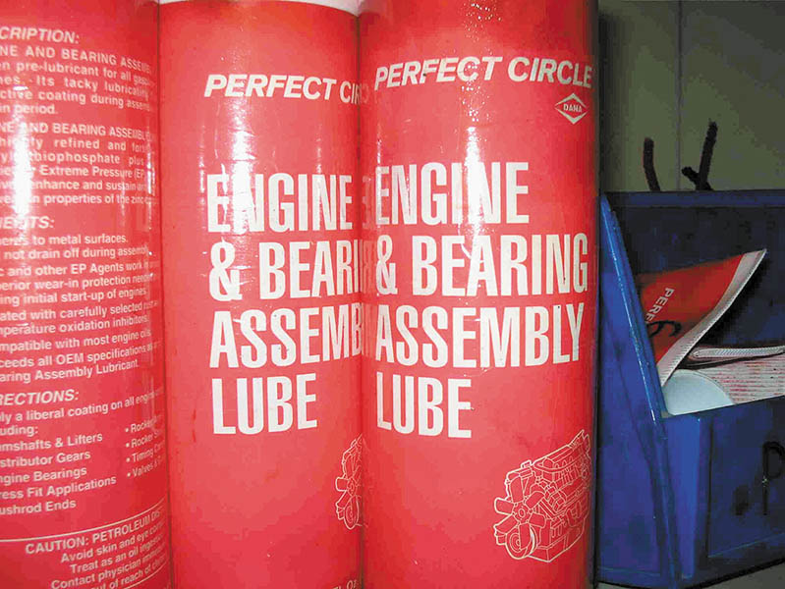
Figure 37.11 Engine assembly lube is recommended to be used on engine parts during assembly

Slide 23
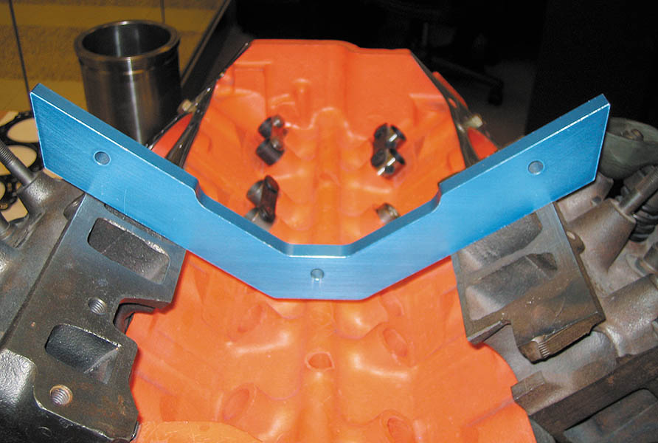
Figure 37.12 An angle gauge being used to check the angle between the cylinder heads on this small block Chevrolet V-8 engine

Slide 24
FINAL SHORT BLOCK ASSEMBLY (1 OF 5)
Block Preparation
The block, including the oil gallery passages, should be thoroughly cleaned.
All threaded bolt holes should be chamfered.
All threaded holes should be cleaned with a thread chaser before final assembly.
Installing Cups and Plugs
Oil gallery plugs should be installed using sealant on the threads.
Core holes left in the external block wall are machined and sealed with soft core plugs or expansion plugs (also called freeze plugs or Welsh plugs).

Slide 25
FINAL SHORT BLOCK ASSEMBLY (2 OF 5)
Cam Bearings
A cam bearing installing tool is required to insert the new cam bearing without damaging the bearing.
The installed bearing must be checked to ensure that it has the correct depth and that the oil hole is indexed with the oil passage in the block.
Measuring Main Bearing Clearance
The oil clearance of both main and connecting rod bearings is set by selectively fitting the bearings. In this way, the oil clearance can be adjusted to within 0.0005 inch of the desired clearance.

Slide 26
FINAL SHORT BLOCK ASSEMBLY (3 OF 5)
Correcting Bearing Clearance
The oil clearance can be reduced by 0.001 inch by replacing both bearing shells with bearing shells that are 0.001 inch undersize.
The clearance can be reduced by 0.0005 inch by replacing only one of the bearing shells with a bearing shell that is 0.001 inch smaller.
Lip Seal Installation
The lip of the seal should be well lubricated before the shaft and cap are installed.
Check manufacturers recommendations on sealant.

Slide 27
FINAL SHORT BLOCK ASSEMBLY (4 OF 5)
Rope Seal Installation
Rope-type oil seals must be compressed tightly into the groove so that no oil can leak behind them.
Special care must be used when trimming excess rope from the seal.
Crankshaft Installation
The crankshaft should be carefully placed in the bearings to avoid damage to the thrust bearing surfaces.
The main bearing cap bolts are tightened finger tight, and the crankshaft is rotated. It should rotate freely.

Slide 28
FINAL SHORT BLOCK ASSEMBLY (5 OF 5)
Thrust Bearing Clearance
Pry the crankshaft forward and rearward to align the cap half of the thrust bearing with the block saddle half.
The clearance can be measured with a dial indicator or a feeler gauge.
Main Bearing Tightening Sequence
Tighten the main bearing caps to the specified assembly torque, and in the specified sequence.

Slide 29
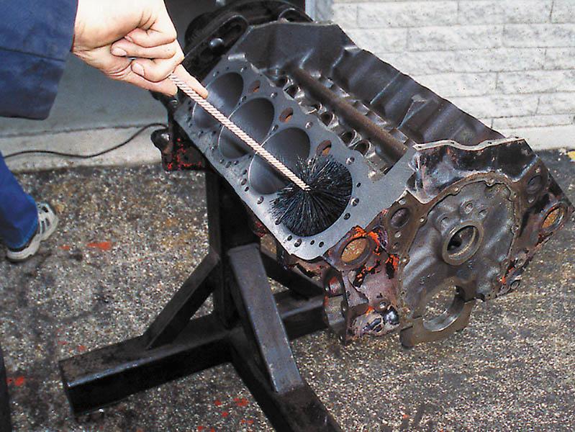
Figure 37.13 The best way to thoroughly clean cylinders is to use soap (detergent), water, and a large washing brush. This method floats the machining particles out of the block and washes them away

Slide 30
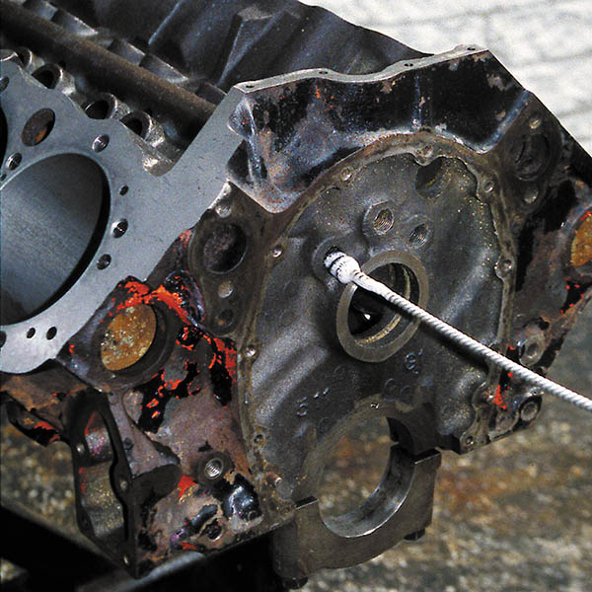
Figure 37.14 All oil galleries should be cleaned using soap (detergent), water, and a long oil gallery cleaning brush

Slide 31
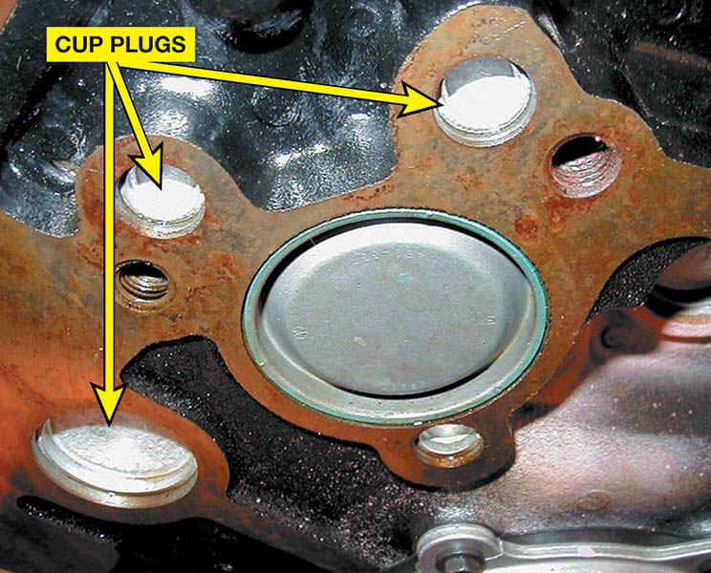
Figure 37.15 This engine uses many cup plugs to block off coolant and oil passages, as well as a large plug over the end of the camshaft bore

Slide 32
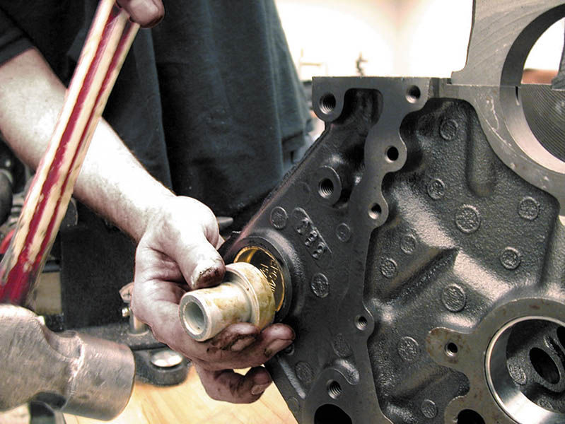
Figure 37.16 Sealer should be applied to the cup plug before being driven into the block

Slide 33
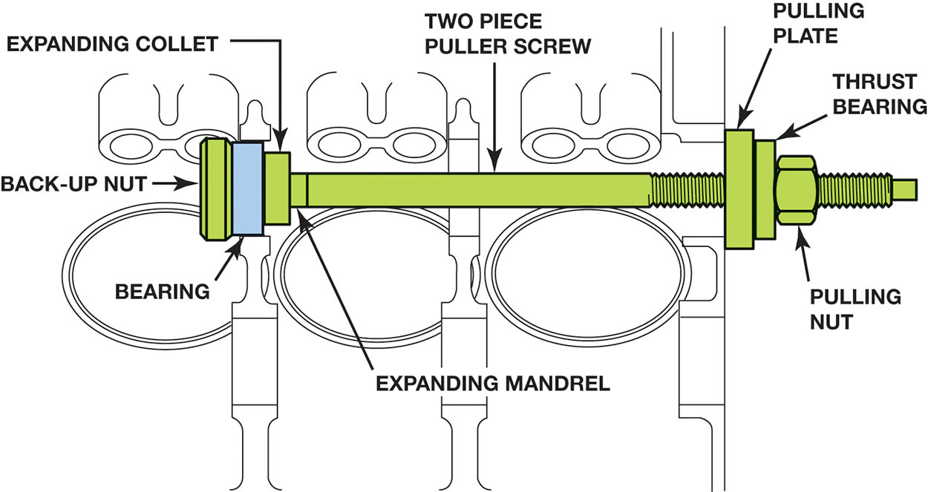
Figure 37.17 Screw-type puller being used to install a new cam bearing. Most cam bearings are crush fit. The full round bearing is forced into the cam bearing bore.

Slide 34
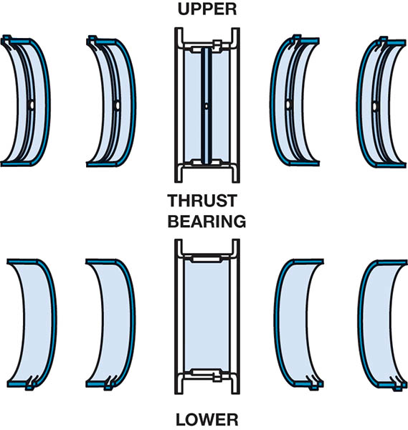
Figure 37.18 Typical main bearing set. Note that the upper halves are grooved for better oil flow and the lower halves are plain for better load support. This bearing set uses the center main bearing for thrust control.

Slide 35
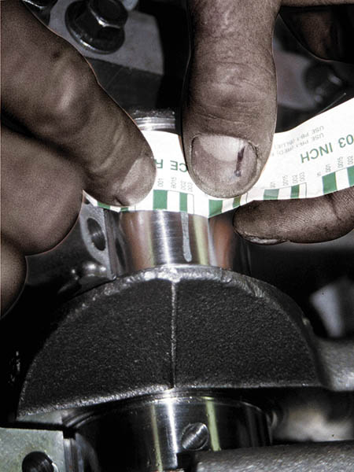
Figure 37.19 The width of the plastic gauging strip determines the oil clearance of the main bearing.

Slide 36
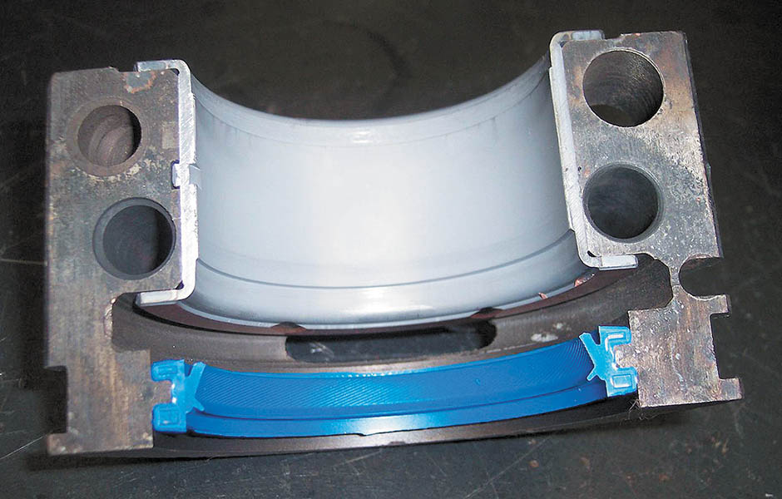
Figure 37.20 Lip-type rear main bearing seal in place in the rear main bearing cap. The lip should always be pointing toward the inside of the engine

Slide 37
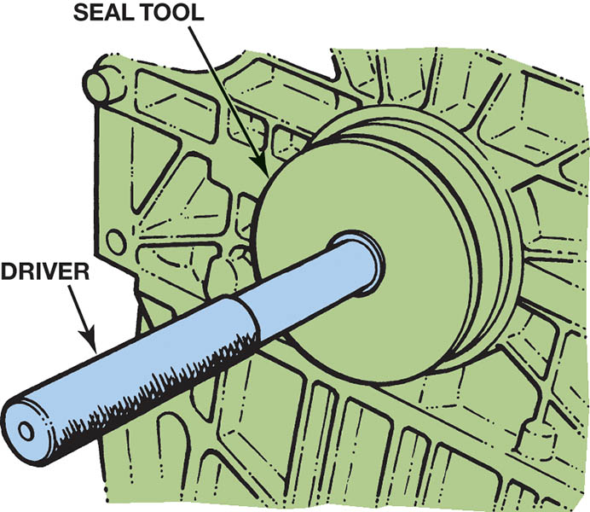
Figure 37.21 Always use the proper driver to install a main seal. Never pound directly on the seal

Slide 38
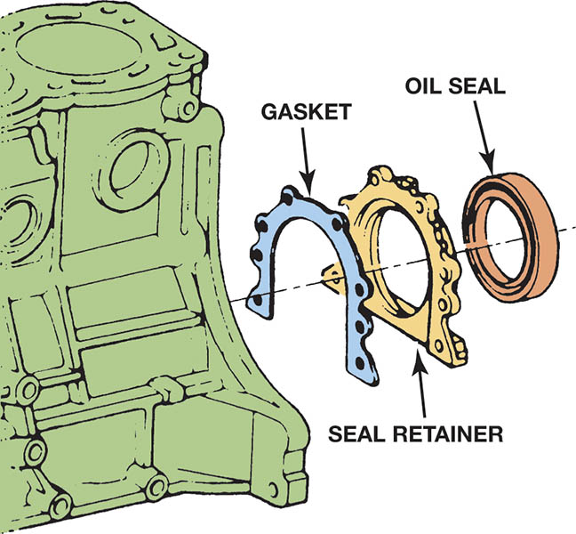
Figure 37.22 The rear seal for this engine mounts to a retainer plate. The retainer is then bolted to the engine block

Slide 39
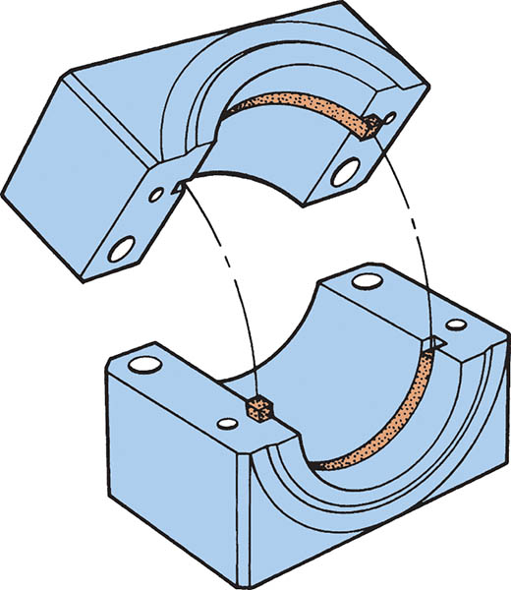
Figure 37.23 Many engine builders prefer to stagger the parting lines of a rope-type seal

Slide 40
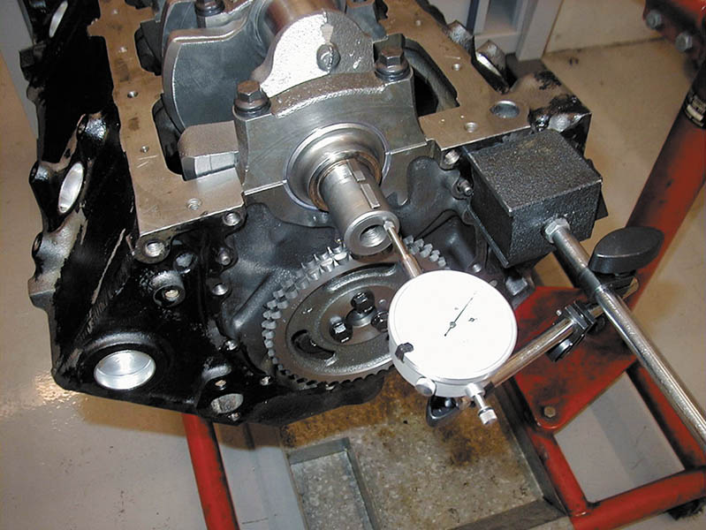
Figure 37.24 A dial indicator is being used to check the crankshaft end play, known as thrust bearing clearance.

Slide 41
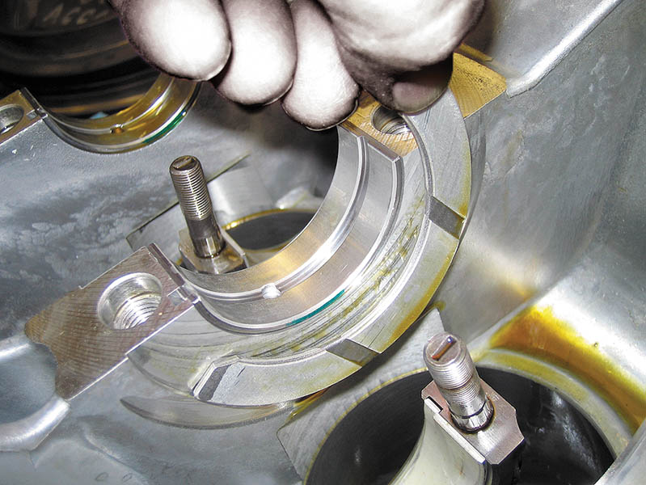
Figure 37.25 A thrust bearing insert being installed before the crankshaft is installed

Slide 42
INSTALLING THE CAMSHAFT
Pre-lubrication
When the camshaft is installed, the lobes must be coated with a special lubricant that contains molydisulfide.
Camshaft Precautions
When installing a new camshaft, always install new valve lifters (tappets).
Never use a hydraulic lifter camshaft with solid lifters or hydraulic lifters with a solid lifter camshaft.

Slide 43
TECH TIP

Slide 44
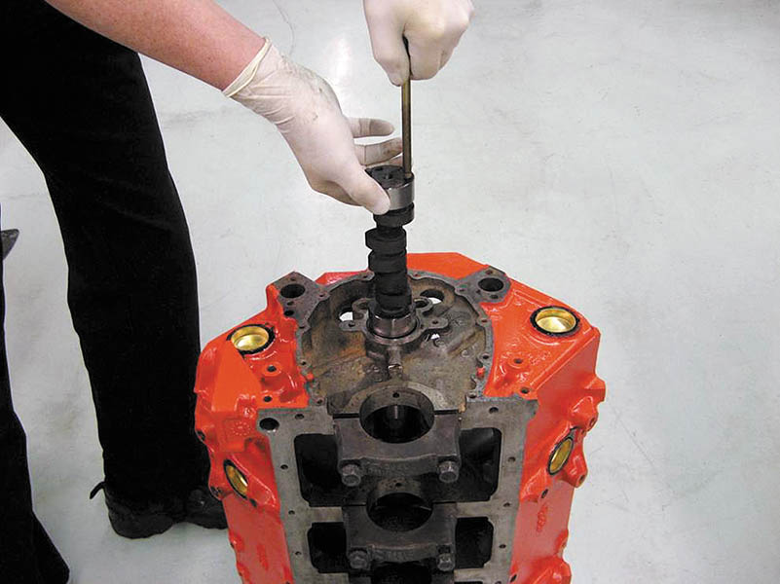
Figure 37.26 Installing a camshaft is easier if the engine is vertical so gravity can help, and this method reduces the possibility of damaging the cam bearings

Slide 45
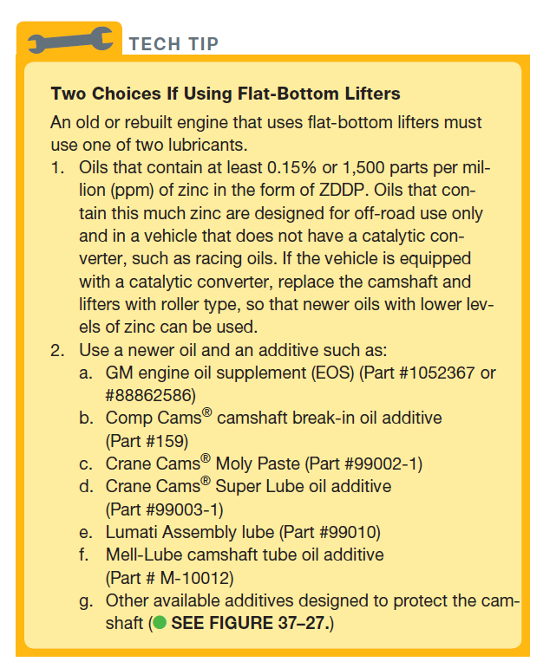
TECH TIP

Slide 46
Figure 37.27 A commercial additive designed to protect a flat bottom lifter camshaft used in older vehicles when using newer oils that do not have enough ZDDP to protect the camshaft and lifters

Slide 47
PISTON/ ROD INSTALLATION (1 OF 4)
Checking Piston Rings
Before installing the piston assemblies, all piston rings should be checked for proper side clearance and ring gap.

Slide 48
PISTON/ ROD INSTALLATION (2 OF 4)
Piston Markings
Care must be taken to ensure that the pistons and rods are in the correct cylinder and facing the correct direction.
Connecting Rod Bearing Clearance
Use Plastigage® following the same procedure discussed for main bearing clearance.

Slide 49
PISTON/ ROD INSTALLATION (3 OF 4)
Piston Installation
Apply a coating of clean engine oil to the cylinder walls.
Apply oil or assembly lube to the rod bearings.
Align the piston ring gaps (ring gap stagger) to the locations specified in service information.
Using a squirt-type oil can, squirt oil over the rings and the skirt of the piston.
Install the ring compressor.
Install protectors over rod bolts.
Carefully install the piston into the cylinder until the rod bearing is fully seated on the journal.

Slide 50
PISTON/ ROD INSTALLATION (4 OF 4)
Connecting Rod Side Clearance
This is measured by fitting the correct thickness of feeler gauge between the connecting rod and the crankshaft cheek of the bearing journal.
If the side clearance is too great, excessive amounts of oil may escape that can cause lower-than-normal oil pressure.
If the side clearance is too small, there may not be enough room for heat expansion.

Slide 51
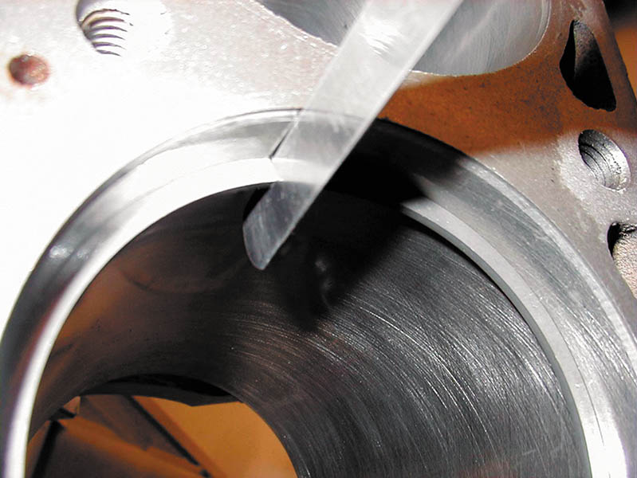
Figure 37.28 A feeler gauge is used to check piston ring gap

Slide 52
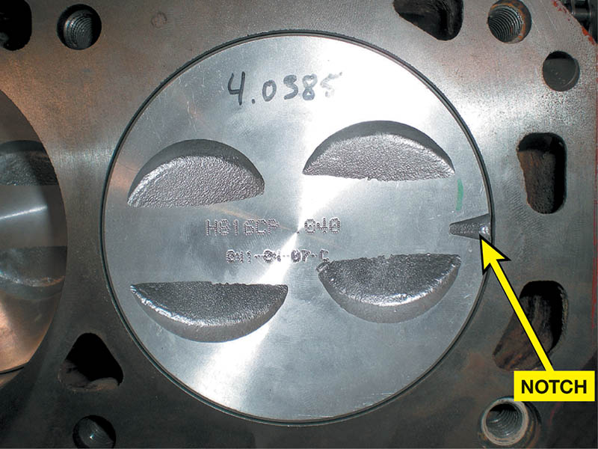
Figure 37.29 The notch on a piston should always face toward the front of the engine

Slide 53
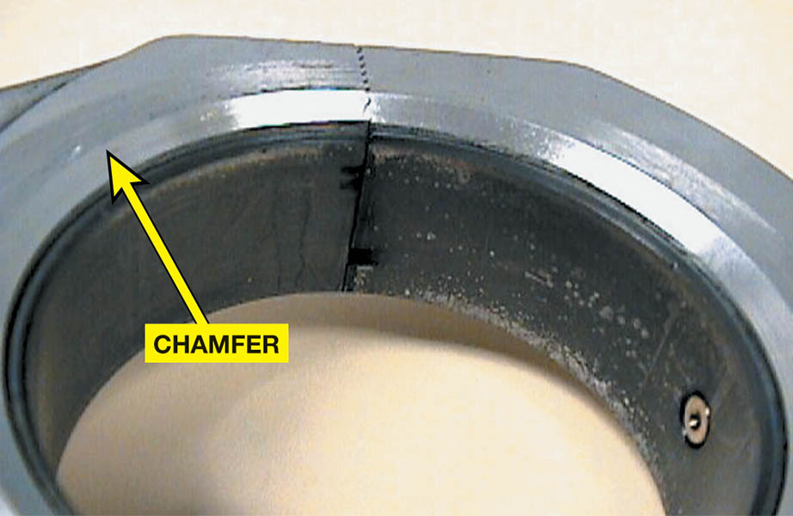
Figure 37.30 On V-type engines that use paired rod journals, the side of the rod with the large chamfer should face toward the crank throw (outward)

Slide 54
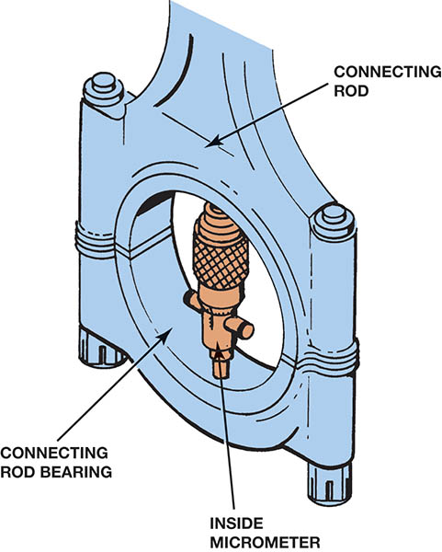
Figure 37.31 An inside micrometer can be used to measure the inside diameter of the big end of the connecting rod with the bearings installed.

Slide 55
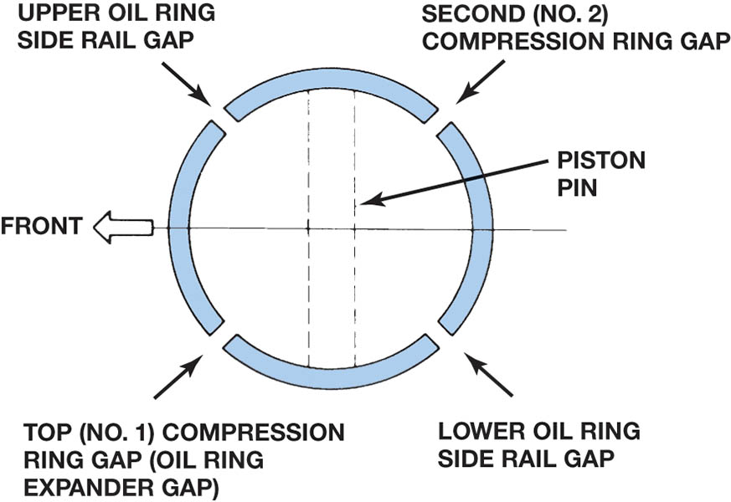
Figure 37.32 One method of piston ring installation showing the location of ring gaps. Always follow the manufacturer’s recommended method for the location of ring gaps and for ring gap spacing.

Slide 56
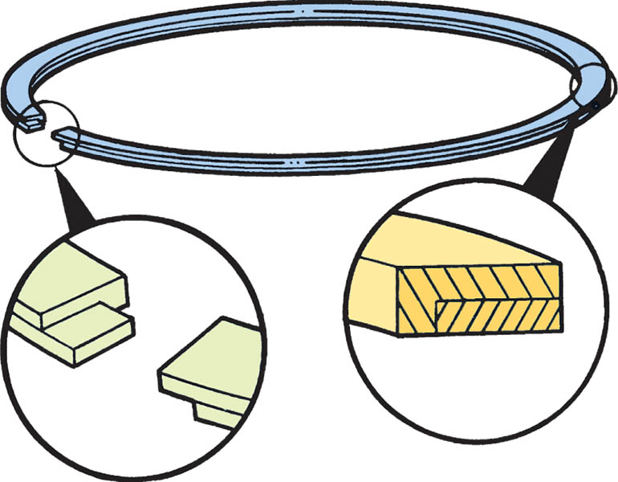
Figure 37.33 A gapless ring is made in two pieces that overlap

Slide 57
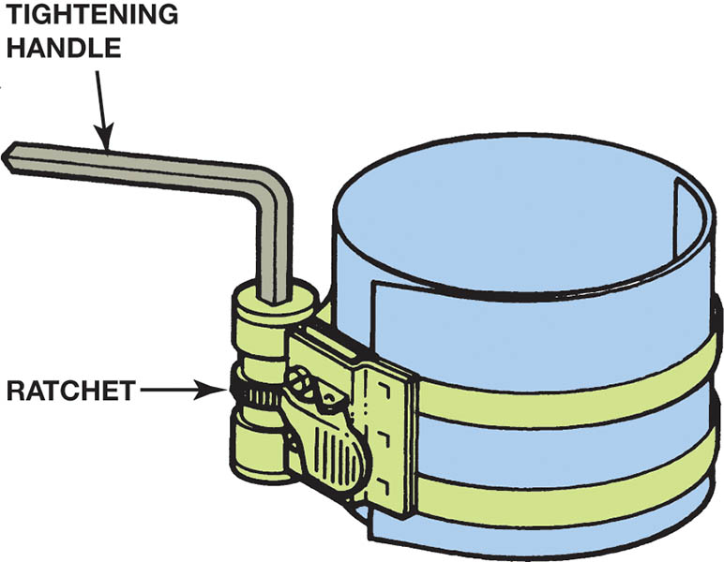
Figure 37.34 This style of ring compressor uses a ratchet to contract the spring band and compress the rings into their grooves

Slide 58
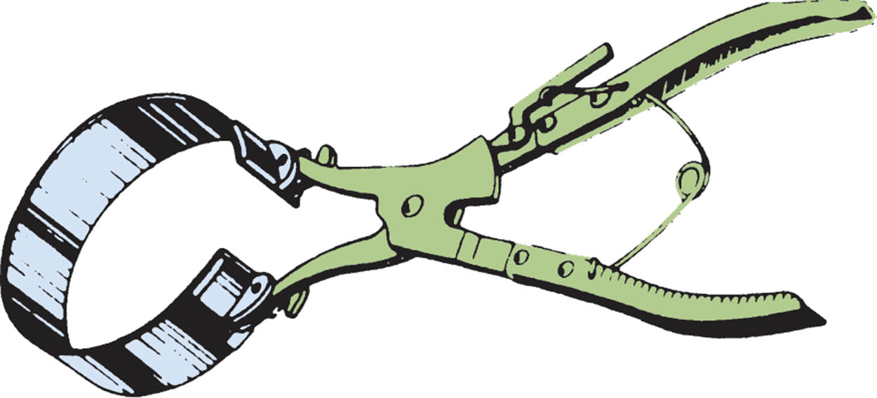
Figure 37.35 This pliers-like tool is used to close the metal band around the piston to compress the rings. An assortment of bands is available to service different size pistons

Slide 59
Figure 37.36 When threaded onto the rod bolts, these guides not only help align the rod, but also protect the threads and hold the bearing shell in place. The soft ends do not damage the crankshaft journals

Slide 60
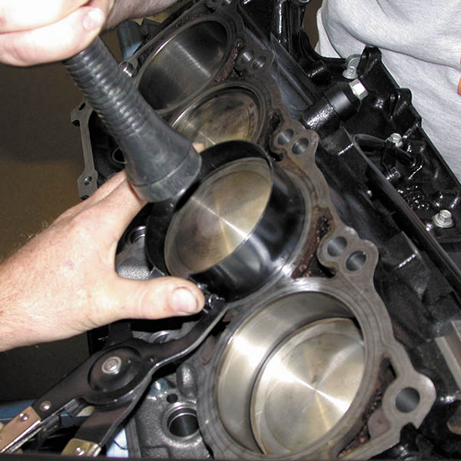
Figure 37.37 Installing a piston using a ring compressor to hold the rings into the ring grooves of the piston, and then using a hammer handle to drive the piston into the bore.

Slide 61
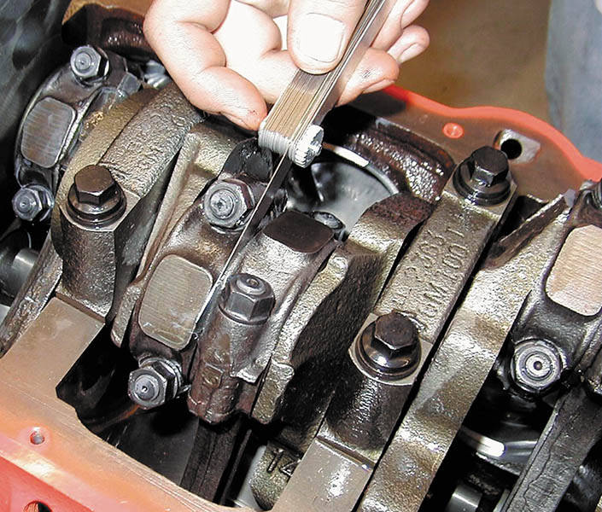
Figure 37.38 The connecting rod side clearance is measured with a feeler gauge

Slide 62
CYLINDER HEAD INSTALLATION (1 OF 3)
Installing the Camshaft for OHC Engines
On some overhead camshaft engines, the camshaft is installed before the head is fastened to the block deck.
The cam bearings on these engines can be either one piece or split.
The cam bearing caps must be tightened evenly to avoid bending the camshaft.
Some engines use shims under a follower disk.

Slide 63
CYLINDER HEAD INSTALLATION (2 OF 3)
Head Bolt Torque Sequence
In general, the head bolts are tightened in a specified torque sequence in three steps.
The procedure starts with the head bolts in the center and then moves to those farther and farther from the center.
By tightening the head bolts in three steps, the head gasket has time to compress and conform to the block deck and cylinder head gasket surfaces.

Slide 64
CYLINDER HEAD INSTALLATION (3 OF 3)
Clamping Force
Clamping force is the amount of force exerted on a gasket.
Fastener Consideration
Clean the threads of all fasteners before using.
Check service information for the specified thread lubricant.
Thread Lubricant
Follow the manufacturer’s recommendations.

Slide 65
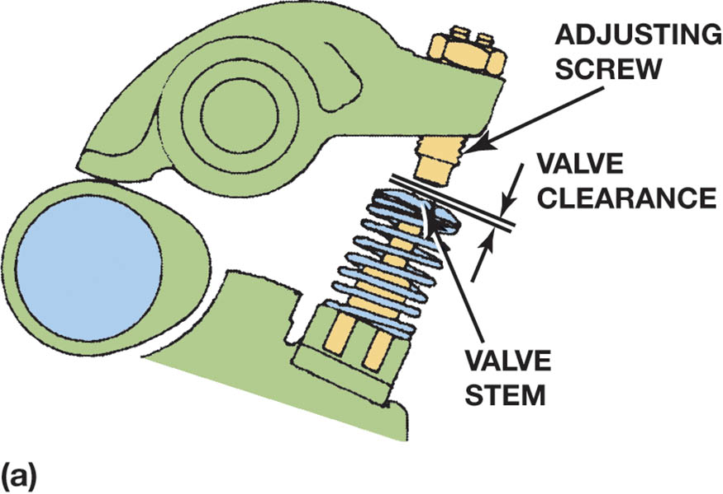
Figure 37.39 Valve clearance allows the metal parts to expand and maintain proper operation, both when the engine is cold and at normal operating temperature. (a) Adjustment is achieved by turning the adjusting screw

Slide 66
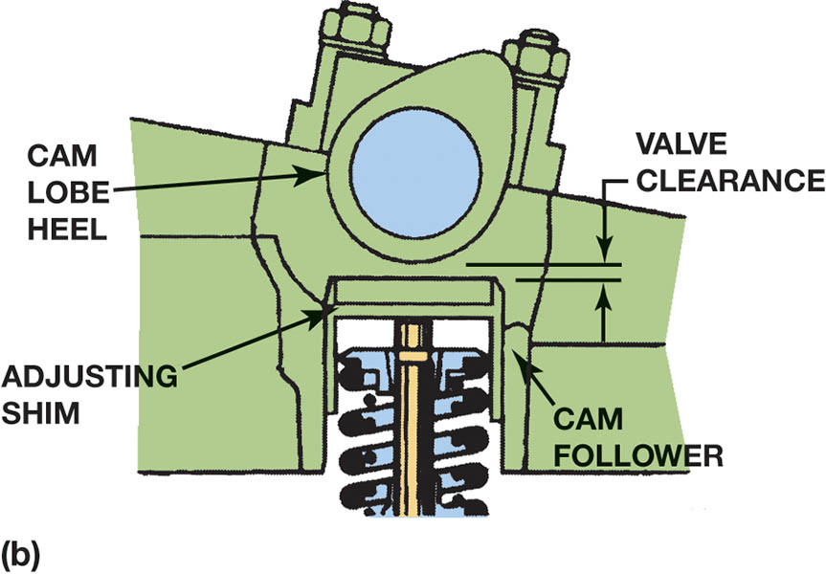
Figure 37.39 (b) Adjustment is achieved by changing the thickness of the adjusting shim

Slide 67
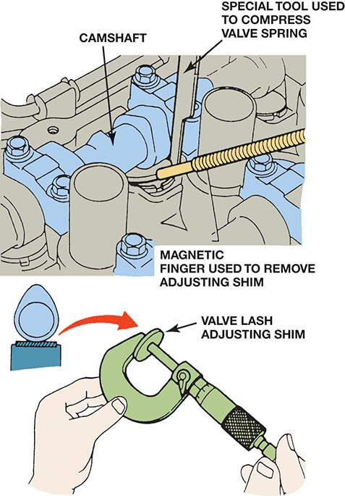
Figure 37.40 Some overhead camshaft engines use valve lash adjusting shims to adjust the valve lash. A special tool is usually required to compress the valve spring so that a magnet can remove the shim

Slide 68
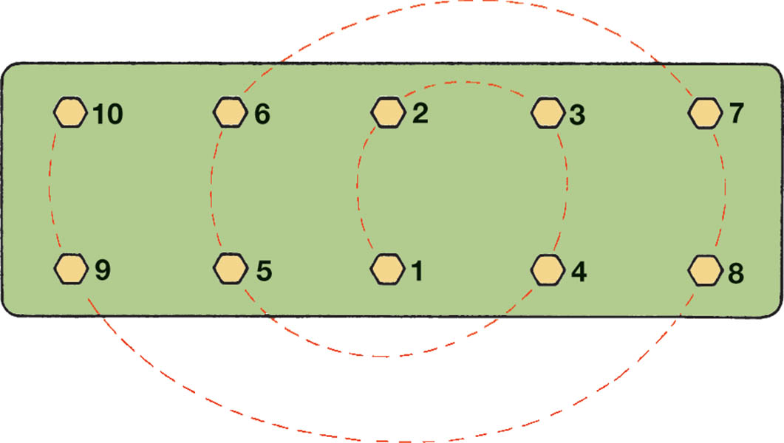
Figure 37.41 Typical cylinder head tightening sequence

Slide 69
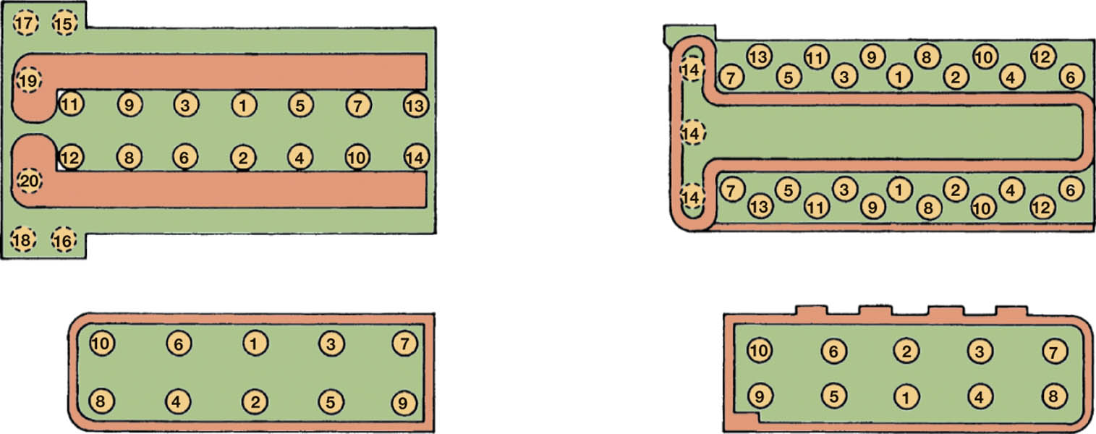
Figure 37.42 Examples of cylinder head bolt torqueing sequences

Slide 70
FREQUENTLY ASKED QUESTION

Slide 71
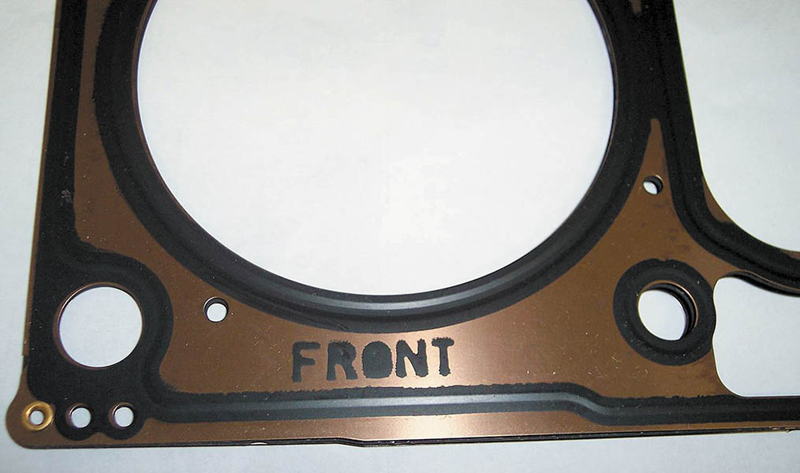
Figure 37.43 Typical head gasket markings. The front means that the gasket should be at the accessory drive belt end of the block

Slide 72
TORQUE-TO-YIELD HEAD BOLTS (1 OF 2)
Definition and Terminology
The purpose of the TTY procedure is to have a more constant clamping load from bolt to bolt.
Bolt Construction
Many torque-to-yield head bolts are made with a narrow section between the head and threads.
As a result, many engine manufacturers specify new head bolts each time the head is installed.

Slide 73
TORQUE-TO-YIELD HEAD BOLTS (2 OF 2)
Torque-To-Yield Procedure
Torque-to-yield bolts are tightened to a specific initial torque, from 18 to 50 pound-feet (25 to 68 N-m). The bolts are tightened an additional specified number of degrees, following the tightening sequence.
Torque Angle Method
Some engine specifications call for a beginning torque and then a specified angle, but the fastener is not designed to yield. These head bolts can often be reused.

Slide 74
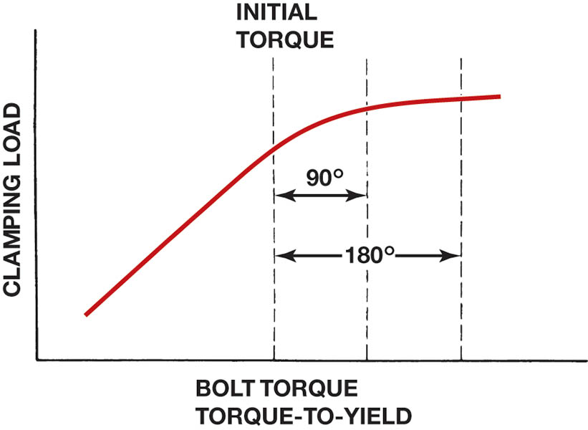
Figure 37.44 Due to variations in clamping force with turning force (torque) of head bolts, some engines specify the torque-to-yield procedure.

Slide 75
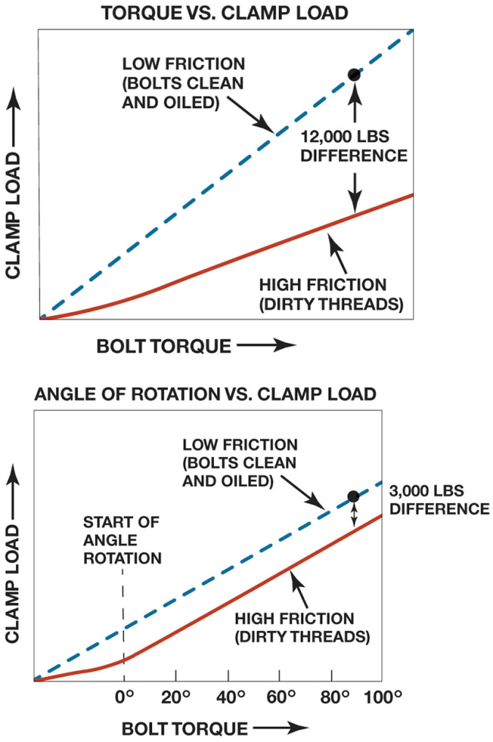
Figure 37.45 To ensure consistent clamp force (load), many manufacturers are recommending the torque-angle or torque-to-yield method of tightening head bolts.

Slide 76
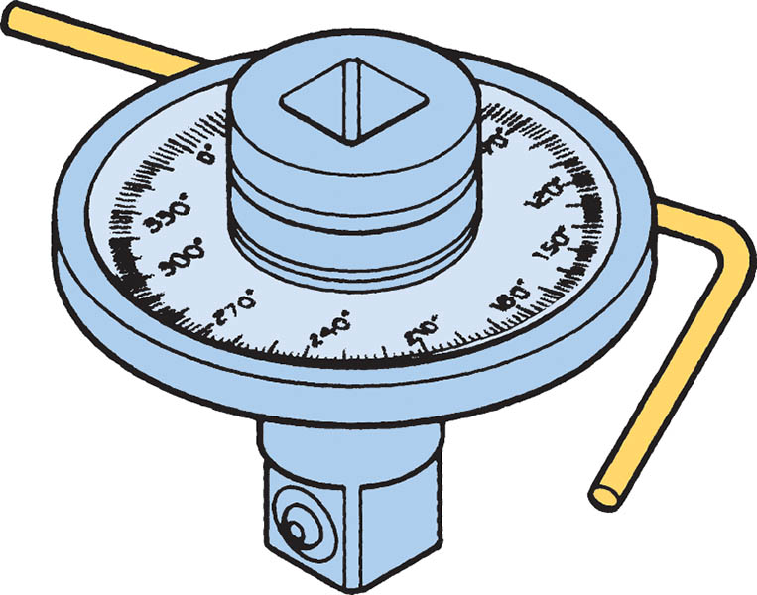
Figure 37.46 Torque angle can be measured using a special adaptor

Slide 77
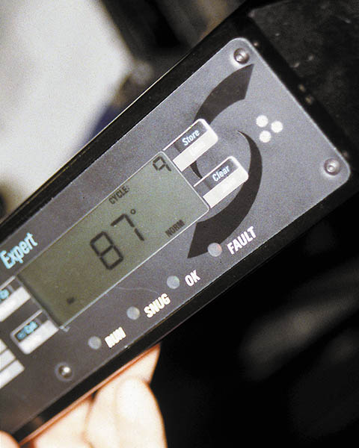
Figure 37.47 An electronic torque wrench showing the number of degrees of rotation. These very accurate and expensive torque wrenches can be programmed to display torque or number of degrees of rotation

Slide 78
VALVE TRAIN ASSEMBLY (1 OF 4)
Timing Chains for OHC Engines
Align the timing marks of the crankshaft and camshaft drive sprockets with their respective timing marks.
The tensioner may be on either or both sides of the timing belt or chain.
Hydraulic Valve Lifter Installation
Most vehicle manufacturers recommend installing lifters without filling or pumping the lifter full of oil.
Flat lifters require that engine assembly lube or extreme pressure (EP) grease be applied to the base.

Slide 79
VALVE TRAIN ASSEMBLY (2 OF 4)
Bleeding Hydraulic Lifters
Air trapped inside a hydraulic valve lifter can be easily bled by simply operating the engine at a fast idle (2,500 RPM).
Some engines require a special procedure at installation.
Timing Chains and Gears Installation
On cam-in-block (OHV) engines, the timing gears or chain and sprocket can be installed after the crankshaft and camshaft.

Slide 80
VALVE TRAIN ASSEMBLY (3 OF 4)
OHV Engine Lifter and Pushrod Installation
The outside of the lifters and the lifter bores in the block should be cleaned and coated with assembly lubricant.
Make sure that the pushrods are installed in the proper location.
Rocker arm shafts should have their retaining bolts tightened a little at a time, alternating between the retaining bolts.

Slide 81
VALVE TRAIN ASSEMBLY (4 OF 4)
Hydraulic Lifter Adjustment
The retaining nut on some rocker arms mounted on studs can be tightened to a specified torque.
Other types of rocker arms require tightening the nut to a position that centers the hydraulic lifter.
Solid Lifter Adjustment
The valve clearance or lash must be set on a solid lifter engine, so that the valves can positively seat.

Slide 82
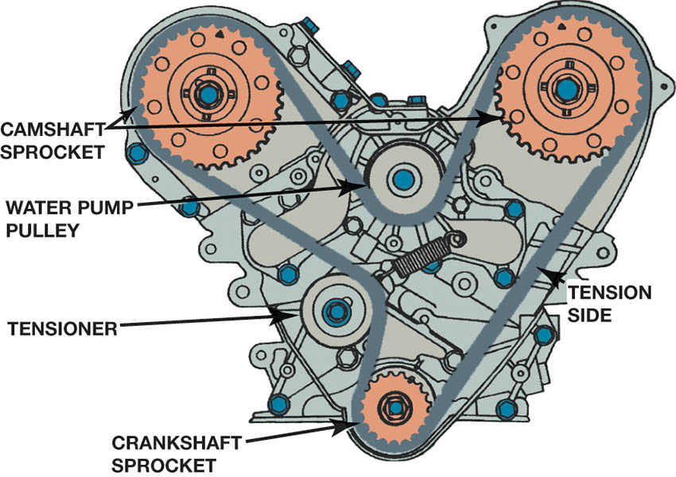
Figure 37.48 Both camshafts have to be timed on this engine, and the timing belt also drives the water pump

Slide 83
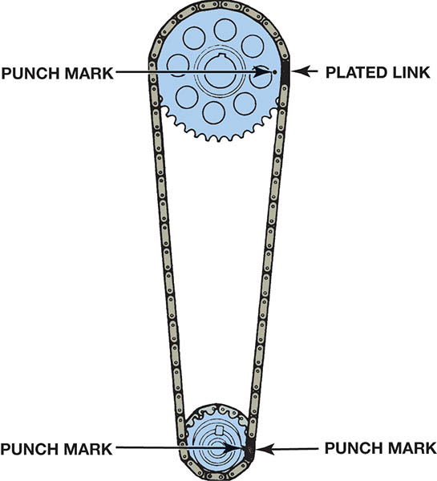
Figure 37.49 Some timing chains have plated links that are used to correctly position the chain on the sprockets

Slide 84
Figure 37.50 A special tool may be needed to bleed air from the hydraulic lash adjusters (HLA) through the bleed hole.

Slide 85
Figure 37.51 Timing chain and gears can be installed after the crankshaft and camshaft have been installed and the timing marks are aligned with cylinder 1 at top dead center (TDC)

Slide 86
Figure 37.52 With the lifter resting on the base circle of the cam, zero lash is achieved by tightening the rocker arm lock nut until the pushrod no longer rotates freely

Slide 87
Figure 37.53 Most adjustable valves use a nut to keep the adjustment from changing. Therefore, to adjust the valves, the nut has to be loosened and the screw rotated until the proper valve clearance is achieved.

Slide 88
FINAL ASSEMBLY (1 OF 3)
Manifold Installation
The intake manifold gasket for a V-type engine may be a one-piece gasket or it may have several pieces.
Inline engines usually have a one-piece intake manifold gasket.
Only some exhaust manifolds use gaskets.
Timing Cover Installation
The timing cover with seal installed and the gasket are placed over the timing gears and/or chain and sprockets.
Some timing covers use RTV instead of a gasket.

Slide 89
FINAL ASSEMBLY (2 OF 3)
Vibration Damper Installation
The damper is either bolted or pressed into position.
Oil Pump Installation
When an engine is rebuilt, the oil pump should be replaced with a new pump and oil pickup screen.
Oil pump gears should be coated with assembly lubricant before the cover is put on the pump.
Oil Pan Installation
The oil pan should be checked and straightened as necessary. The bolts should be torqued to specification.

Slide 90
FINAL ASSEMBLY (3 OF 3)
Water Pump Installation
A reconditioned, rebuilt, or new water pump should be used.
A new thermostat should be installed.
Engine Painting
Painting an engine helps prevent rust and corrosion and makes the engine look new.
Pre-lubricating the Engine
Oil pressure should be established before the engine is started.

Slide 91
Figure 37.54 This intake manifold gasket includes end seals and a full shield cover for the valley to keep hot engine oil from heating the intake manifold

Slide 92
Figure 37.55 An exhaust manifold gasket is used on some engines. It seals the exhaust manifold to the cylinder head

Slide 93
Figure 37.56 A 1/8 to 3/16 inch (3 to 5 mm) bead of RTV silicon on a parting surface with silicon going around the bolt hole

Slide 94
Figure 37.57 A beam-type torque wrench being used to tighten the oil pump pickup assembly to factory specification

Slide 95
TECH TIP

Slide 96
Figure 37.58 Using clay to determine the oil pan to oil pickup clearance, which should be about 1/4 inch

Slide 97
Figure 37.59 Using a hammer to straighten the gasket rail surface of the oil pan before installing a new gasket. When the retaining bolts are tightened, some distortion of sheet metal covers occurs. If the area around the bolt holes is not straightened, leaks can occur with the new gasket

Slide 98
FREQUENTLY ASKED QUESTION

Slide 99
Figure 37.60 Torque paint applied to the head of the fastener indicates that it has been properly torqued to factory specification

Slide 100
Figure 37.61 Oil should be seen flowing to each rocker arm as shown

Slide 101
TECH TIP

Slide 102
Figure 37.62 Heat tabs can be purchased from engine supply companies

Slide 103
DYNAMOMETER TESTING (1 OF 3)
Purposes
Allows the completed engine to be started and run to operating temperature.
Permits checking for possible problems or leaks before the engine is installed in a vehicle.
Allows the piston rings to seat and the engine to be partially broken-in, before being installed in a vehicle.
Permits the technician to determine the output of the engine.

Slide 104
DYNAMOMETER TESTING (2 OF 3)
Types of Dynamometers
A brake type, where a variable load is applied to the engine.
An inertia type, which measures engine power by using the engine to accelerate a known mass load.
Terminology
Numbers allow values to be assigned to virtually everything being measured or tested.
Measured values
Calculated values

Slide 105
DYNAMOMETER TESTING (3 OF 3)
Measured Valves
Measured units are those that are obtained directly from sensors.
Calculated Numbers
Calculated numbers are those that are obtained by using the measured values and processing them through software.
Standards
For best results, perform testing on nice days with low relative humidity and high atmospheric pressure.

Slide 106
Figure 37.63 A dynamometer measures engine torque by applying a resistive force to the engine and measuring the force applied. Water is being used as the resistive load on this dynamometer

Slide 107
Figure 37.64 A chassis dynamometer is used to measure torque at the drive wheels. There is a power loss through the drive train, so the measured values are about 20% less than when measuring engine output at the flywheel, using an engine dynamometer

Slide 108
Figure 37.65 A magnetic pickup being used to monitor engine speed when the vehicle is being tested on a chassis dynamometer

Slide 109
TECH TIP

Slide 110
Figure 37.66 Because horsepower is calculated from measured torque, the horsepower and torque curves should always cross at exactly 5,252 RPM

Slide 111
PLASTIGAGE

Slide 112
1. Clean the main bearing journal and then place a strip of Plastigage material across the entire width of the journal.

Slide 113
2. Carefully install the main bearing cap with the bearing installed.

Slide 114
3. Torque main bearing cap bolts to factory specifications.

Slide 115
4. Carefully remove the bearing cap and, using the package that contained the Plastigage strips, measure the width of the compressed material. The gauge is calibrated in thousandths of the inch. Repeat for each main bearing.

Slide 116
5. To measure rod bearing oil clearance, start by removing the rod cap.

Slide 117
6. Clean the rod bearing journal and then place a strip of Plastigage across the entire width of the journal.

Slide 118
7. Torque the rod bearing cap nuts to factory specifications.

Slide 119
8. Remove the rod cap and measure the oil clearance using the markings on the Plastigage package. The wider the compressed gauge material is, the narrower the bearing oil clearance. Repeat for all rod bearings.

Slide 120
Video Links (Internet Access Required)
Timing gears part 1 (time 4:46)
Timing gears part 2 (time 6:39)
Timing gears part 3 (time 9:14)
Using plastigauge (time 3:49)
How to find TDC (time 1:14)
Rear main seal (time 7:38)
Motor mount (time 6:22)
SBC top end (time 23:45)
SBC lower end (time 23:41)
Crankshaft balancing (time 1:37)

Slide 121
Video Links (Internet Access Required)
Plasti gauge (time 10:18)
Rod bearing install (time 1:52)
Thrust bearing (time 6:04)
Radius and fillet (time 2:32)
End play check (time 4:23)
Motor mount (time 4:38)
Checking valve to piston clearance part 1 (time 2:53)
Checking valve to piston clearance part 2 (time 4:01)
Rear main seal check (time 1:53)
Motor mounts (time 10:54)

Slide 122
Video Links (Internet Access Required)
Motor mount (time 1:21)
King engine baring & crankshaft installation guide (time 10:20)
How to install a harmonic balancer (time 5:10)
Honda crank bolt & harmonic balancer removal DIY (time 4:03)
Install piston rings (time 2:14)
Front seal replacement (time 6:27)
How to remove / install freeze plugs (time 12:49)
Valve adjustment (time 3:05)
Valve adjustment (time 1:39)
Camshaft installation (time 1:37)

Slide 123
Video Links (Internet Access Required)
Torque a cylinder head (time 25:08)
Replace freeze plugs (time 3:43)

Slide 124
Copyright

