Slide 1
Automotive Technology Principles, Diagnosis, and Service
Sixth Edition
Chapter 30
Cylinder Head and Valve Guide Service
Copyright © 2018, 2015, 2011 Pearson Education, Inc. All Rights Reserved

Slide 2
LEARNING OBJECTIVES (1 of 2)
30.1 Explain the design and construction of cylinder heads.
30.2 Discuss intake and exhaust ports.
30.3 Discuss cylinder head passages and cylinder head servicing.

Slide 3
LEARNING OBJECTIVES (2 of 2)
30.4 Explain aluminum cylinder head straightening, cylinder head resurfacing, and intake manifold alignment.
30.5 Explain valve guides and the procedure for valve guide replacement.

Slide 4
CYLINDER HEADS (1 OF 4)
Construction
Cylinder heads support the valves and valve train, and contain passages for the flow of intake, exhaust gases, coolant, and sometimes engine oil.
Design Features
Squish Area
This is an area of the combustion chamber where the piston nearly contacts the cylinder head.
Quench Area
The squish area can also be the quench area where the air-fuel mixture is cooled by the cylinder head.

Slide 5
CYLINDER HEADS (2 OF 4)
Design Features
Spark Plug Placement
The best spark plug placement is at the center of the combustion chamber.
Surface-to-Volume Ratio
The ratio is determined by the surface area of the combustion chamber divided by the volume
Valve Shrouding
The valve is kept close to the walls of the combustion chamber to help increase mixture turbulence.
Crossflow Placement
The valve arrangement allows for flow across the head.

Slide 6
CYLINDER HEADS (3 OF 4)
Combustion Chamber Design
Wedge
Pentroof
Hemi
Four-Valve Cylinder Heads
Adding more than two valves per cylinder permits more air to flow into and out of the engine with greater velocity without excessive valve duration.

Slide 7
CYLINDER HEADS (4 OF 4)
Valve Size and Lift
The maximum amount of gas moving through the opening area of a valve depends on the distance around the valve and the degree to which it lifts open.

Slide 8
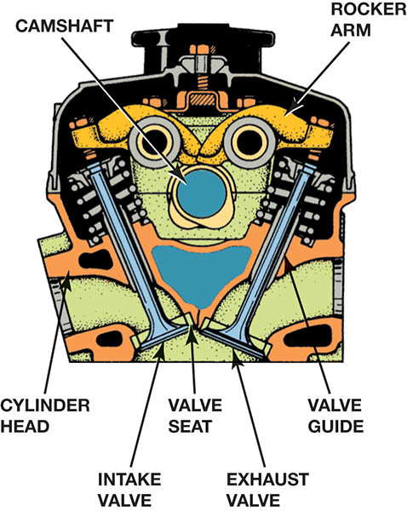
Figure 30.1 The seats and guides for the valves are in the cylinder head, as well as the camshaft and the entire valve train if it is an overhead camshaft design

Slide 9
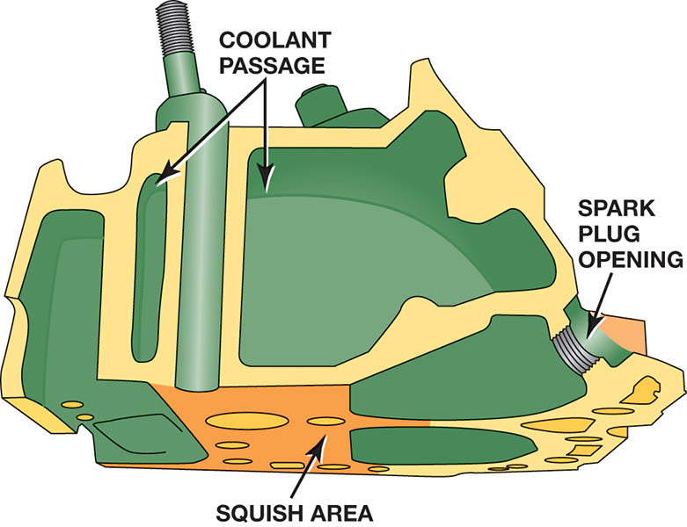
Figure 30.2 A wedge-shaped combustion chamber showing the squish area where the air-fuel mixture is squeezed, causing turbulence that pushes the mixture toward the spark plug

Slide 10
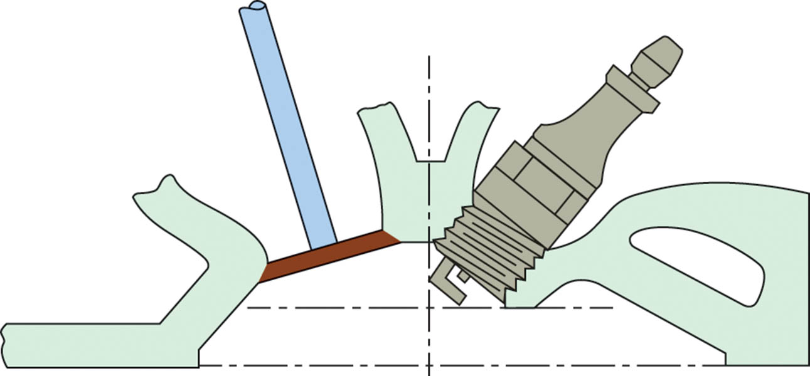
Figure 30.3 Locating the spark plug in the center of the combustion chamber reduces the distance the flame front must travel

Slide 11
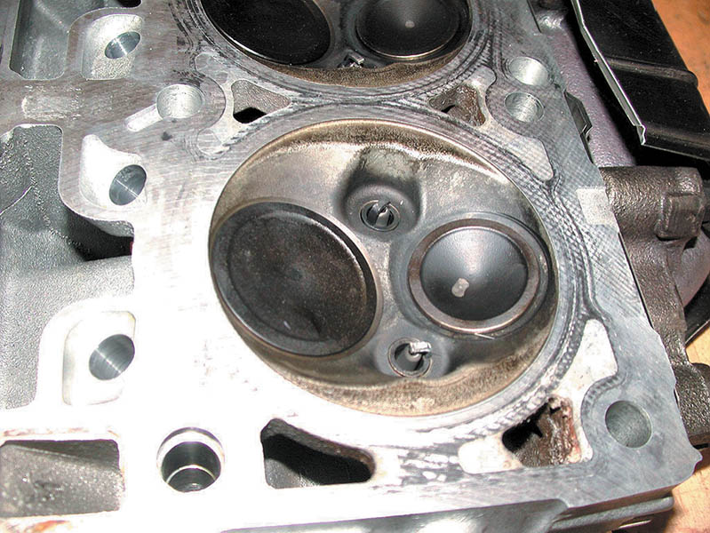
Figure 30.4 The combustion chamber of the 5.7 liter Chrysler Hemi cylinder head shows the two spark plugs used to ensure rapid burn for best power and economy with the lowest possible exhaust emissions

Slide 12
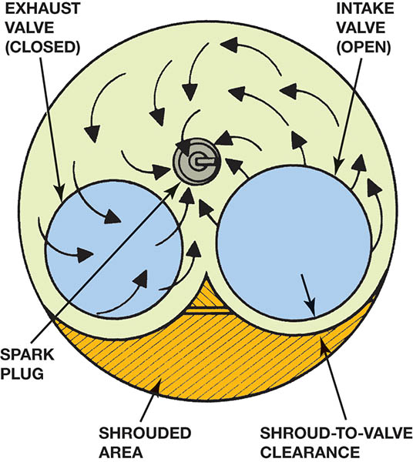
Figure 30.5 The shrouded area around the intake valve causes the intake mixture to swirl as it enters the combustion chamber

Slide 13
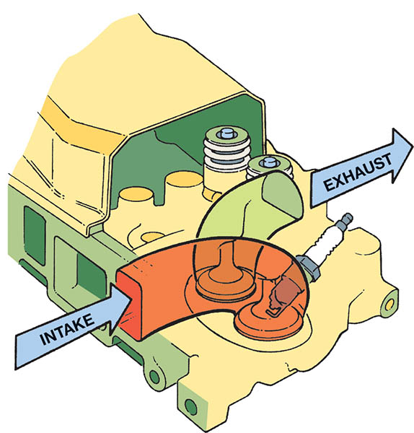
Figure 30.6 A typical crossflow cylinder head design, where the flow into and out of the combustion chamber is from opposite sides of the cylinder head

Slide 14
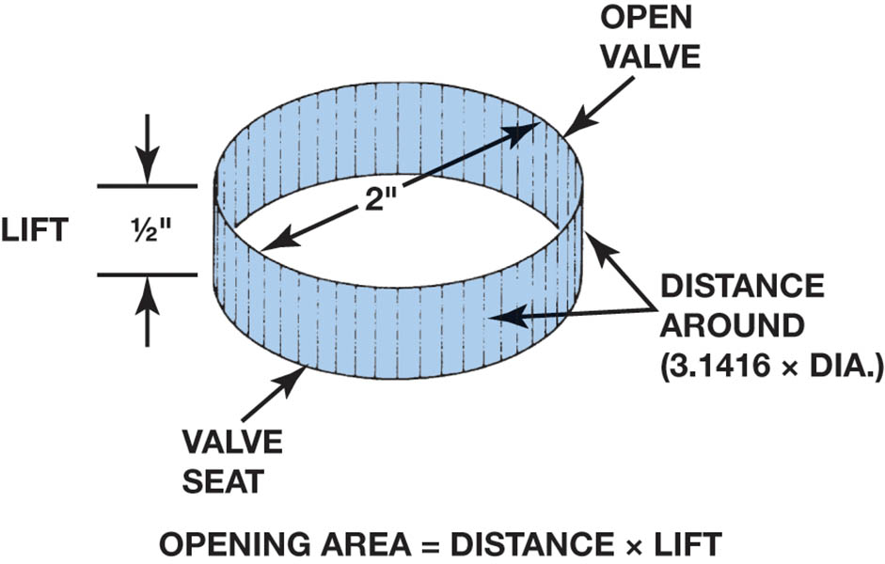
Figure 30.7 Method for measuring the valve opening space

Slide 15
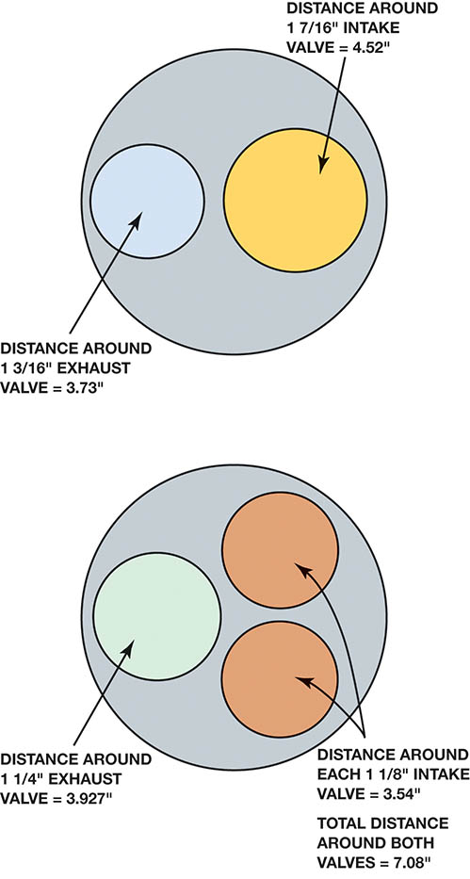
Figure 30.8 Comparing the valve opening areas between a two- and three-valve combustion chamber when the valves are open

Slide 16
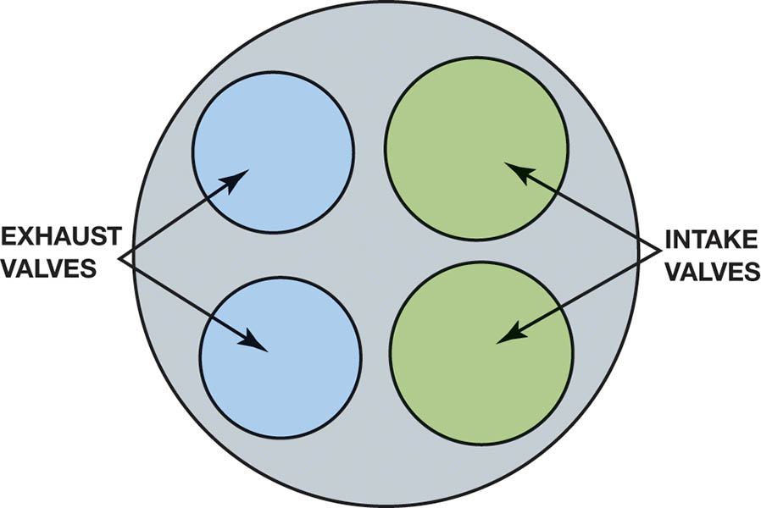
Figure 30.9 Typical four-valve head. The total area of opening of two small intake valves and two smaller exhaust valves is greater than the area of a two-valve head using much larger valves.

Slide 17
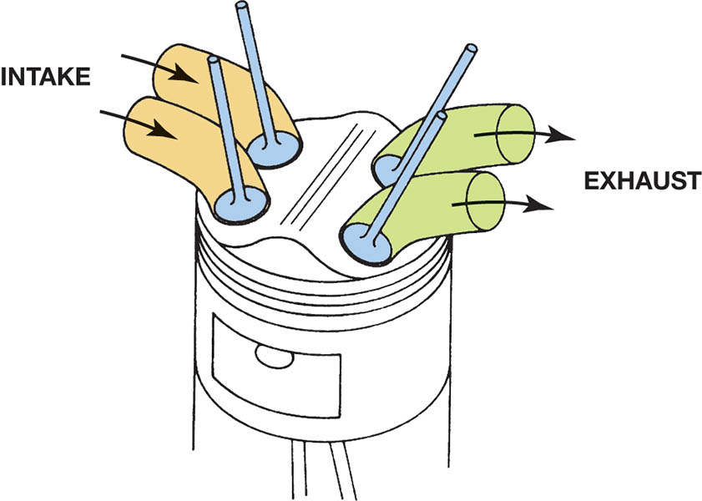
Figure 30.10 Four valves in a pentroof combustion chamber

Slide 18
QUESTION 1: ?
What is meant by the term crossflow head?

Slide 19
ANSWER 1:
The flow into and out of the combustion chamber is from opposite sides of the cylinder head.

Slide 20
INTAKE AND EXHAUST PORTS
Purpose and Function
The part of the intake or exhaust system passage that is cast in the cylinder head is called a port.
Intake Ports
The length and design are designed to promote swirl into the combustion chamber.
Exhaust Ports
Designed to allow for the free flow of exhaust gasses from the engine without transferring the heat to the coolant.

Slide 21
Tech Tip

Slide 22
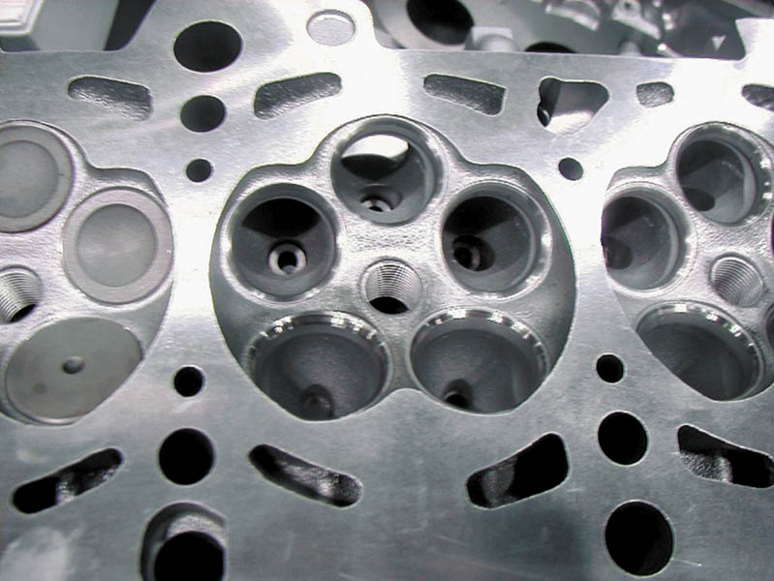
Figure 30.11 An Audi five-valve cylinder head, which uses three intake valves and two exhaust valves

Slide 23
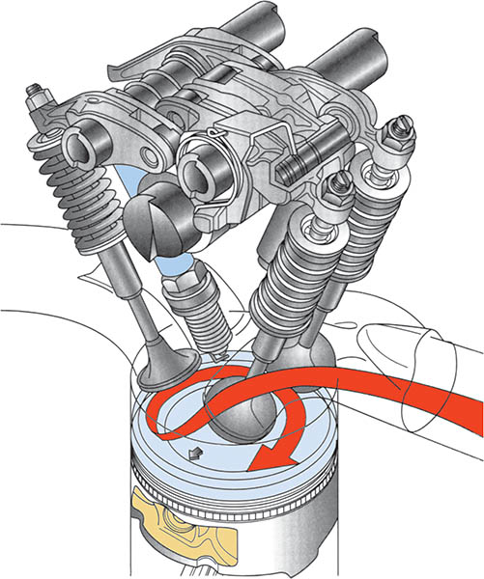
Figure 30.12 The intake manifold design and combustion chamber design both work together to cause the air-fuel mixture to swirl as it enters the combustion chamber

Slide 24
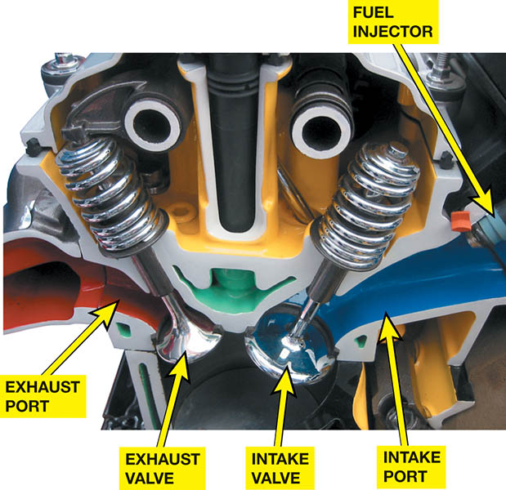
Figure 30.13 A port-injected engine showing the straight free flowing intake and exhaust ports

Slide 25
CYLINDER HEAD PASSAGES
Coolant Flow Passages
The engine is designed so that coolant will flow from the coolest portion of the engine to the warmest portion.
Head Gasket Holes
These holes correct the coolant flow rate at each opening.
Lubricating Oil Passages
Lubricating oil is delivered to the overhead valve mechanism, either through the valve pushrods or through drilled passages in the head and block casting.

Slide 26
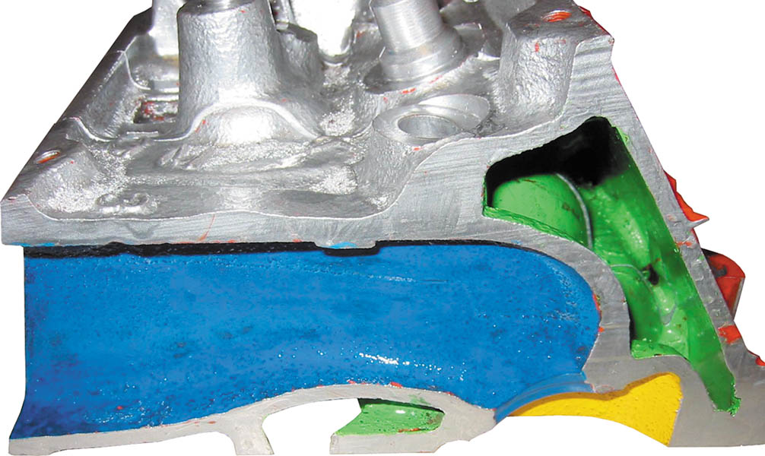
Figure 30.14 A cutaway head showing the coolant passages in green

Slide 27
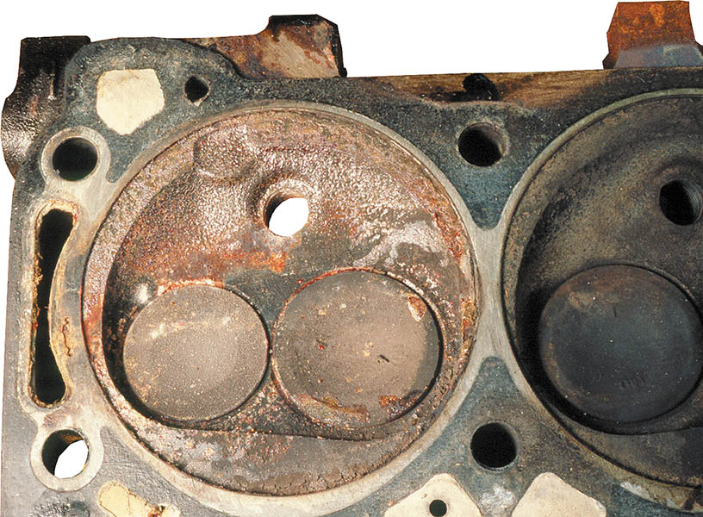
Figure 30.15 Coolant flows through the cylinder head, and the passages are sealed by the head gasket. In this case the head gasket has failed, allowing coolant to enter the cylinder on the left.

Slide 28
QUESTION 2: ?
Why is the hole in the head gasket cooling passage a different size than the block and the cylinder head?

Slide 29
ANSWER 2:
To correct the coolant flow rate to remove the most heat.

Slide 30
CYLINDER HEAD SERVICING (1 OF 2)
Cylinder Head Serving Sequence
Disassemble and clean cylinder head.
Check for cracks and repair as needed.
Check the surfaces for needed machining.
Check valves and service as needed.
Grinding valves and reinstall with new seals.

Slide 31
CYLINDER HEAD SERVICING ( 2 OF 2)
Disassembling Overhead Camshaft Head
Remove the camshaft following service procedures.
Valve Train Disassembly
Keep pushrods and rockers together
Do not mix intake and exhaust springs as they may be different.
Cylinder Head Inspection
Check for warpage, distortion, bend and twist.

Slide 32
Figure 30.16 Overhead camshafts may be (a) held in place with bearing caps, (b) supported by towers, or (c) fitted into bearing bores machined directly into the head

Slide 33
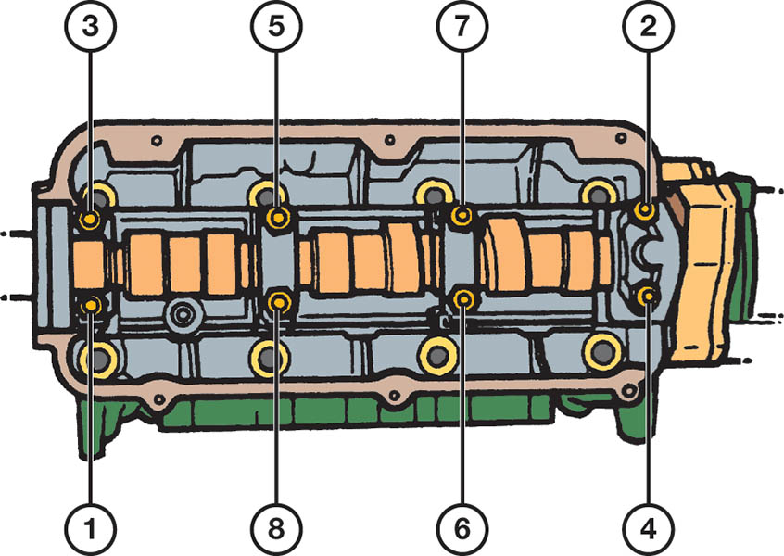
Figure 30.17 Always follow the specified loosening sequence to prevent valve spring tension from bending the camshaft

Slide 34
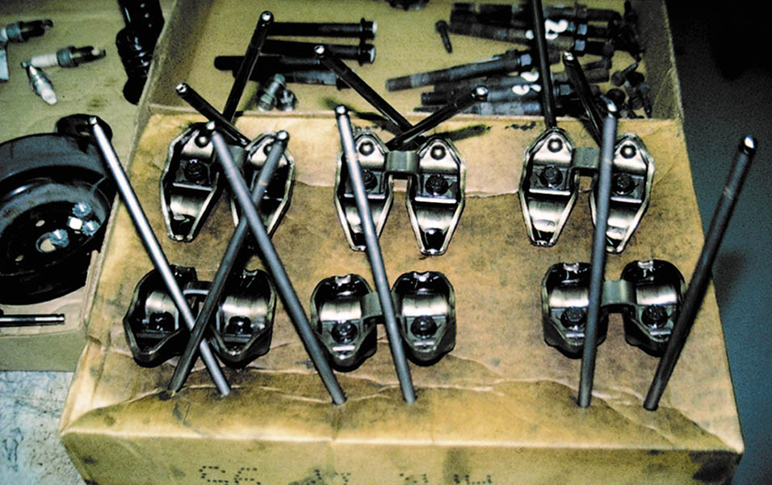
Figure 30.18 Pushrods can be kept labeled if stuck through a cardboard box. Individual parts become worn together. An effective method to keep all valve train parts together and labeled exactly as they came from the engine.

Slide 35
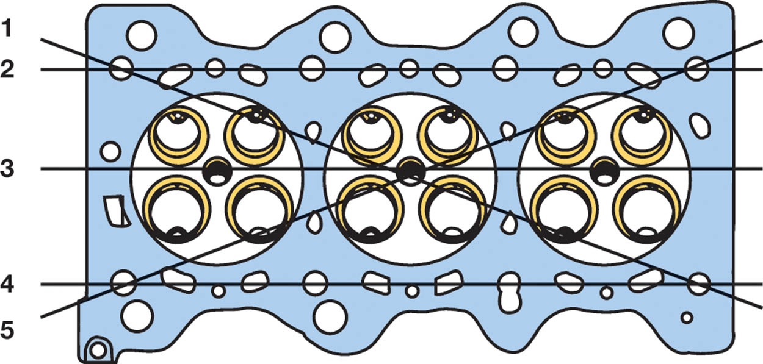
Figure 30.19 Cylinder heads should be checked in five planes for warpage, distortion, bend, and twist

Slide 36
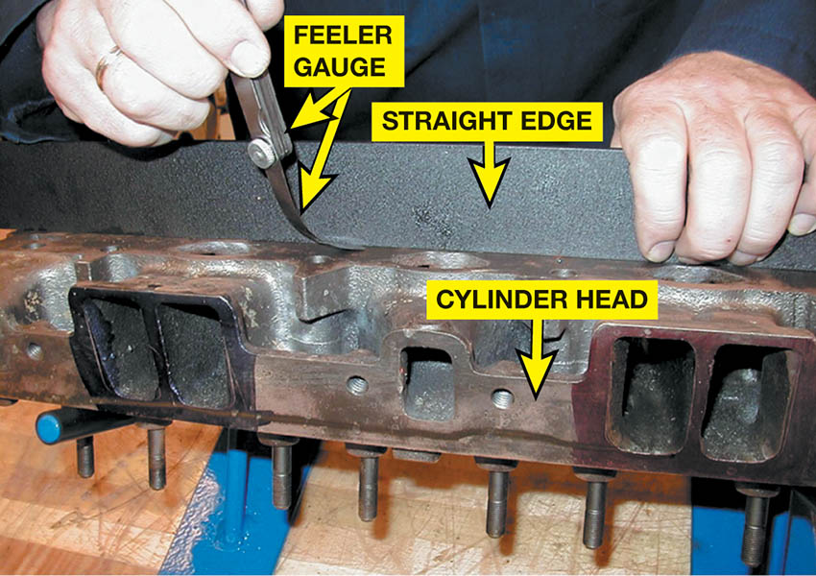
Figure 30.20 A precision ground straightedge and a feeler gauge are used to check the cylinder head for flatness

Slide 37
ALUMINUM CYLNDER HEAD STRAIGHTENING
Step 1
Determine the amount of warpage with a straightedge and thickness (feeler) gauge.
Step 2
Tighten the center of the cylinder head down on a strong, flat base.
Step 3
Place the head and base in an oven for 5 hours at 500°F (260°C). Turn the oven off and leave the assembly in the oven.

Slide 38
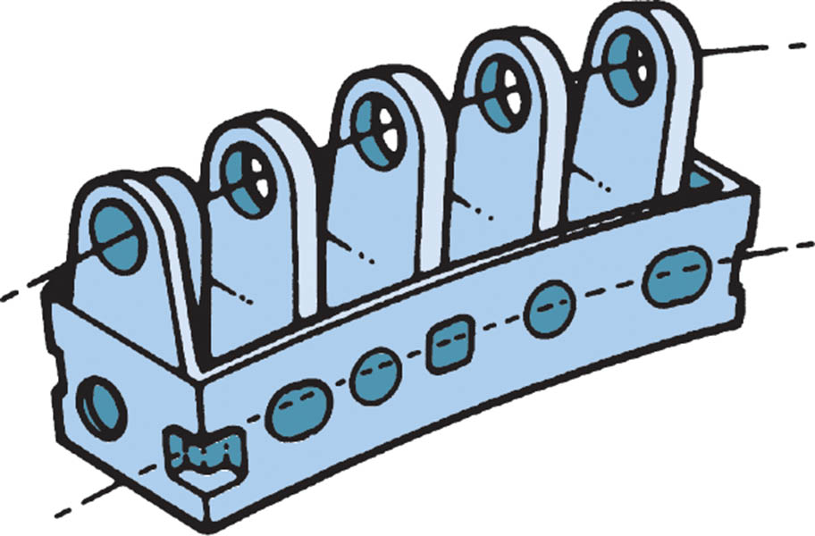
Figure 30.21 Warped overhead camshaft cylinder head. If the gasket surface is machined to be flat, the camshaft bearings will still not be in proper alignment. The solution is to straighten the cylinder head or to align bore the cam tunnel

Slide 39
CYLINDER HEAD RESURFACING
Refinishing Methods
Milling or Broaching
A milling type of resurfacer uses metal-cutting tool bits fastened in a disc. This type is also called a broach. The disc is the rotating workhead of the mill.
Grinding
The surface grinder type uses a large-diameter abrasive wheel.
Surface Finish
The usual method of expressing surface finish is by the arithmetic average roughness height (RA)
.

Slide 40
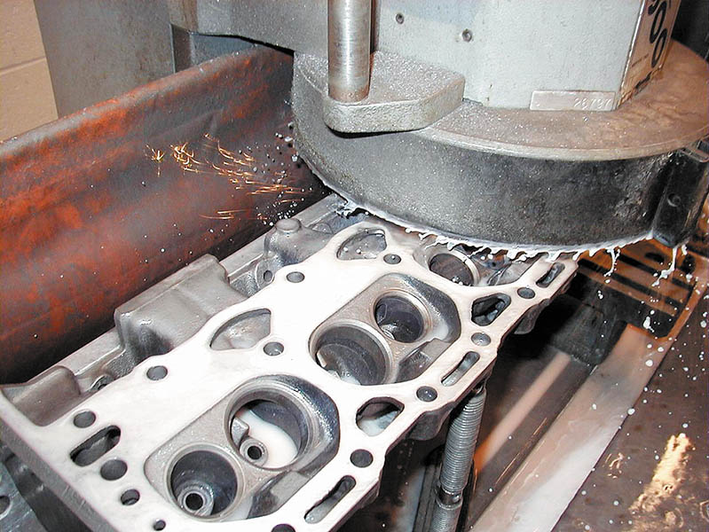
Figure 30.22 A cast-iron cylinder head being resurfaced using a surface grinder

Slide 41
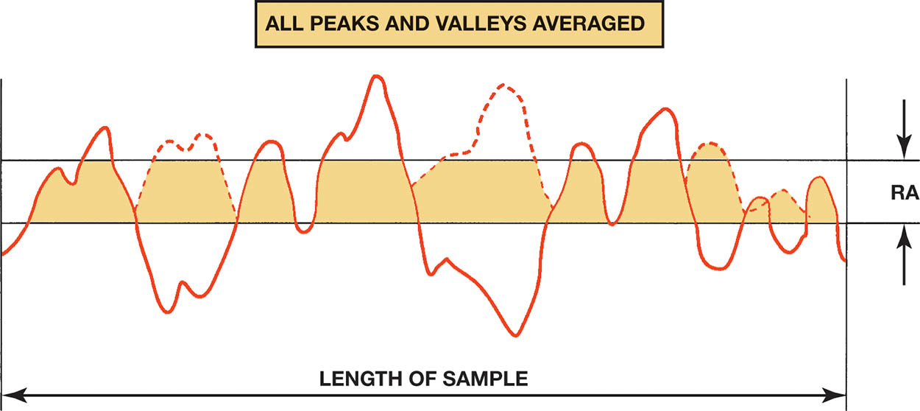
Figure 30.23 A graph showing a typical rough surface as would be viewed through a magnifying glass. RA is an abbreviation indicating the average height of all peaks and valleys

Slide 42
INTAKE MANIFOLD ALIGNMENT
Purpose
The intake manifold surface must be resurfaced to remove enough metal to rematch the ports and bolt holes after the cylinder head has been serviced.
Procedure
Automotive machine shops that perform head resurfacing have tables that specify the exact amount of metal to be removed.

Slide 43
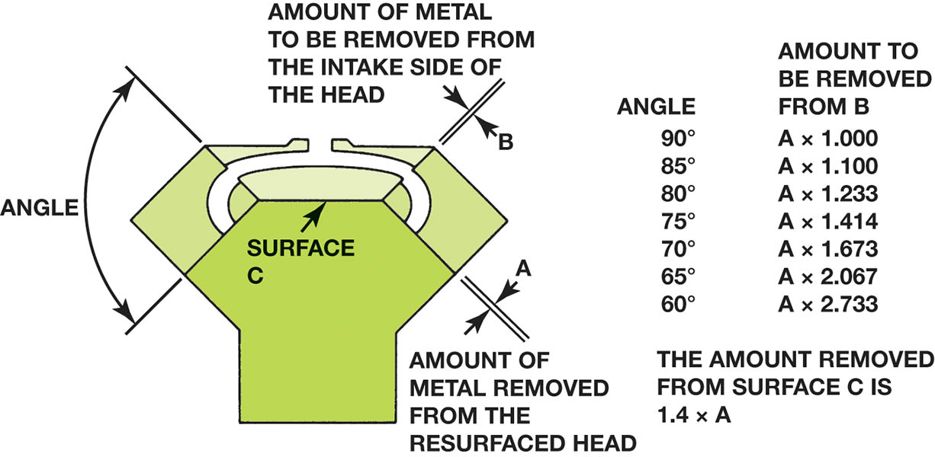
Figure 30.24 The material that must be removed for a good manifold fit

Slide 44
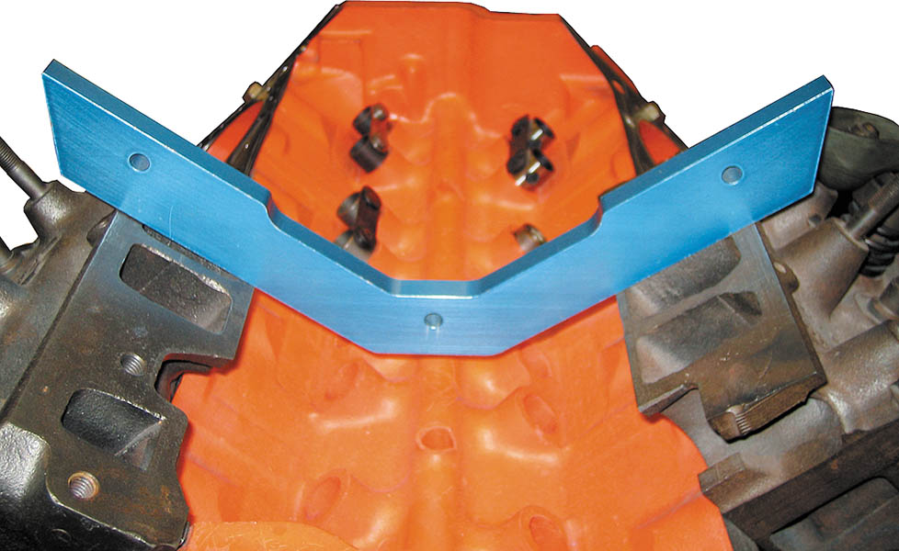
Figure 30.25 Using an intake manifold template to check for the proper angles after the cylinder heads have been machined

Slide 45
VALVE GUIDES (1 OF 2)
Types
Integral: Part of cast-iron cylinder heads.
Removable or Pressed-in: Associated with aluminum cylinder heads.
Valve to Stem Guide Clearance
Intake valve: 0.001 to 0.003 inch (0.025 to 0.076 mm)
Exhaust valve: 0.002 to 0.004 inch (0.05 to 0.1 mm)

Slide 46
VALVE GUIDES (2OF 2)
Measuring Valve Guides
The valve guide is first measured in the middle with a small-hole gauge. Then it is measured at both ends.
Oversize Stem Valves
Oversize stem valves are used when the guide is reamed or honed. The resulting clearance is the same as the original.

Slide 47
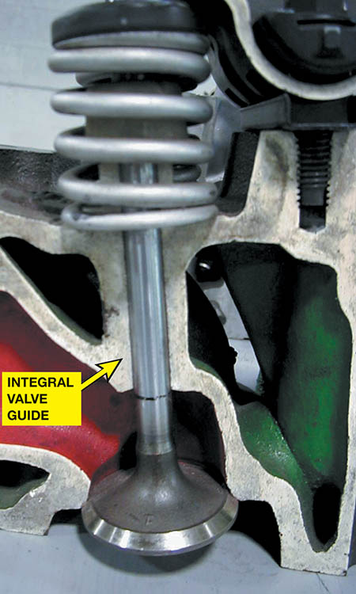
Figure 30.26 An integral valve guide is simply a guide that has been drilled into the cast-iron cylinder head

Slide 48
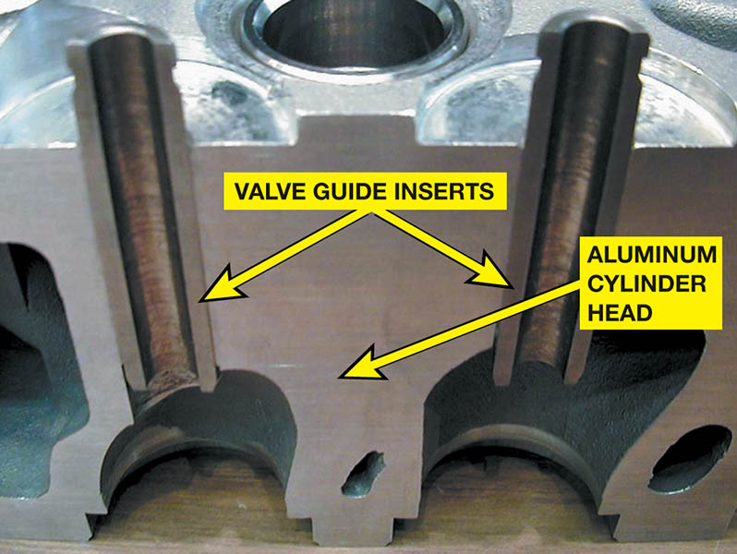
Figure 30.27 All aluminum cylinder heads use valve guide inserts

Slide 49
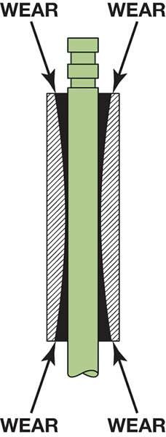
Figure 30.28 Valve guides often wear to a bell-mouth shape to both ends due to the forces exerted on the valve by the valve train components

Slide 50
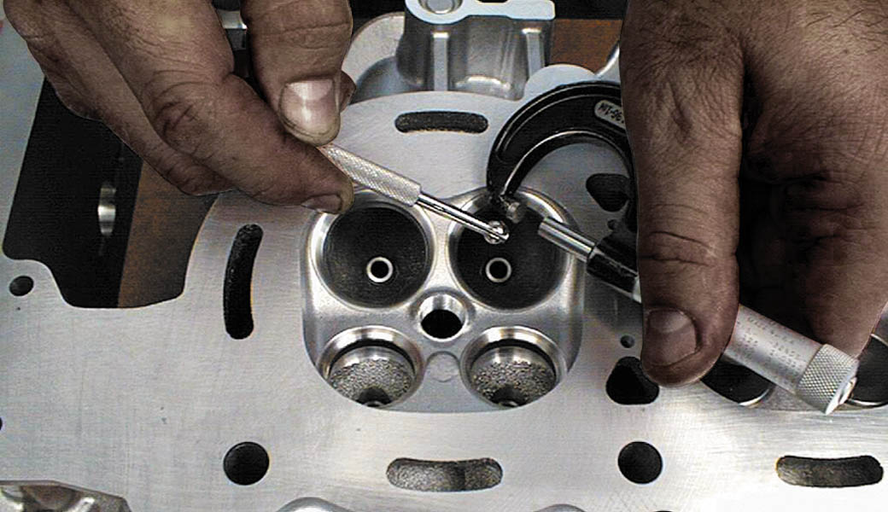
Figure 30.29 A small-hole gauge and a micrometer are being used to measure the valve guide. The guide should be measured in three places: at the top, middle, and bottom

Slide 51
Animation: Check Valve Guide Wear (The animation will automatically start in a few seconds)

Slide 52
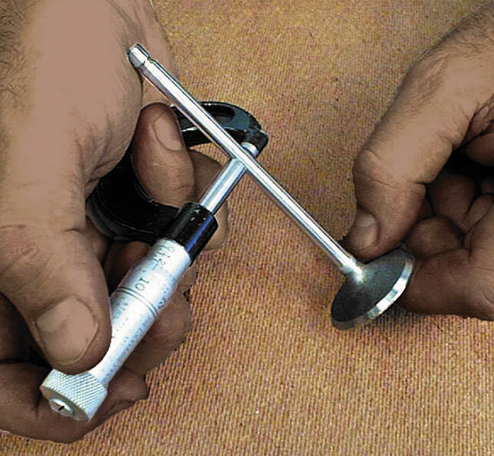
Figure 30.30 The diameter of the valve stem is being measured using a micrometer. The difference between the inside diameter of the valve guide and the diameter of the valve stem is the valve guide-to-stem clearance

Slide 53
Animation: Check Valve Stem Clearance (The animation will automatically start in a few seconds)

Slide 54
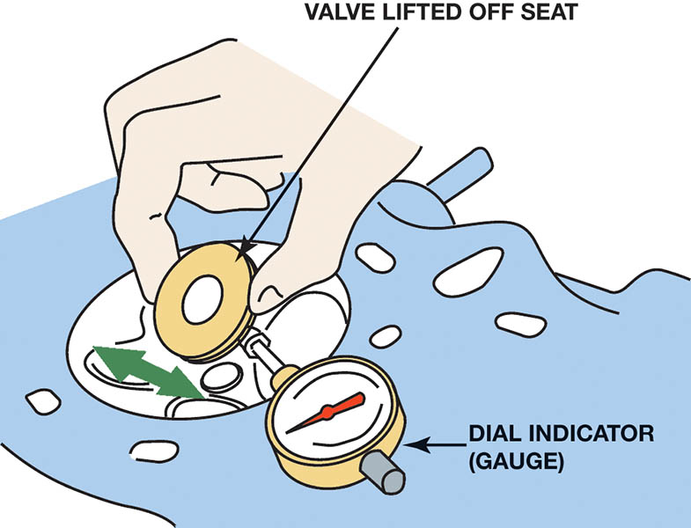
Figure 30.31 Measuring valve guide-to-stem clearance with a dial indicator while rocking the stem in the direction of normal thrust.

Slide 55
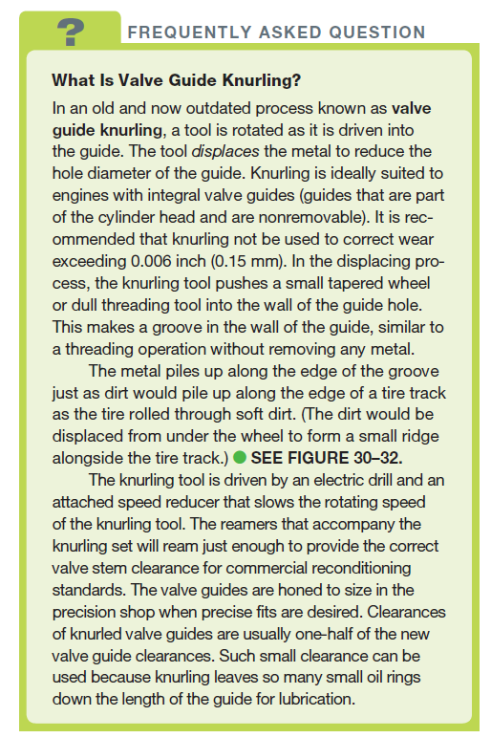
FREQUENTLY ASKED QUESTION

Slide 56
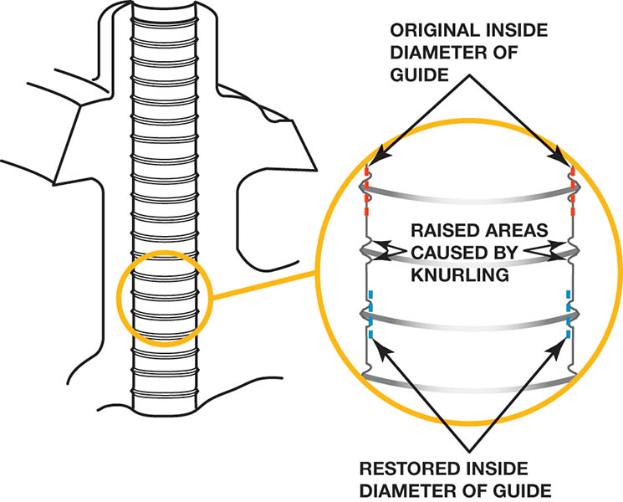
Figure 30.32 Sectional view of a knurled valve guide

Slide 57
VALVE GUIDE REPLACEMENT (1 OF 2)
Purpose
When an engine is designed with replaceable valve guides, their replacement is always recommended when the valve assembly is being reconditioned.
Valve Guide Sizes
5/16 or 0.313 inch
11/32 or 0.343 inch
3/8 or 0.375 inch

Slide 58
VALVE GUIDE REPLACEMENT (2 OF 2)
Valve Guide Inserts
Thin-walled bronze alloy sleeve bushing
Spiral bronze alloy bushing
Different tools and processes are used depending on the type of replacement used.

Slide 59
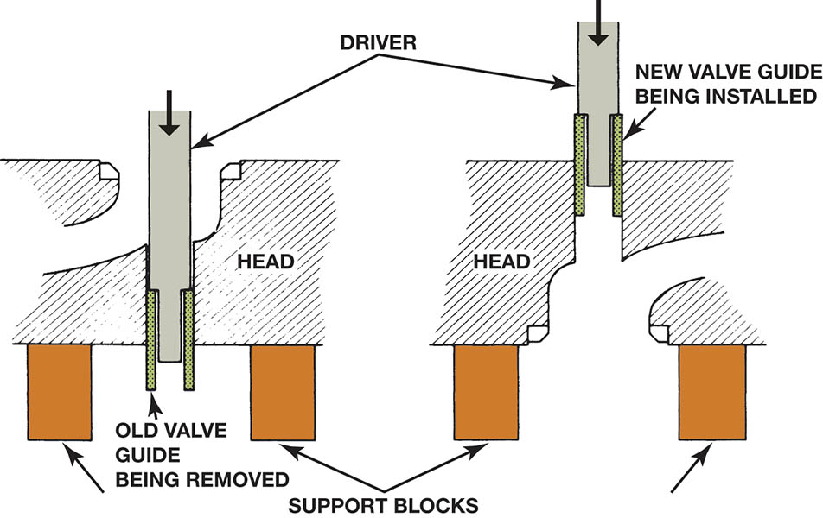
Figure 30.33 Valve guide replacement procedure

Slide 60
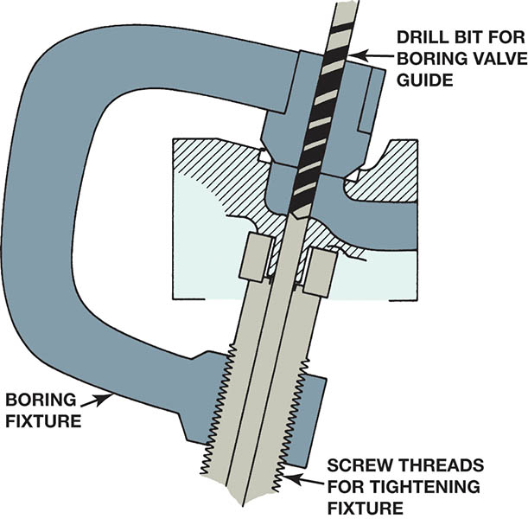
Figure 30.34 A type of fixture required to bore the valve guide to accept a thin-walled insert sleeve

Slide 61
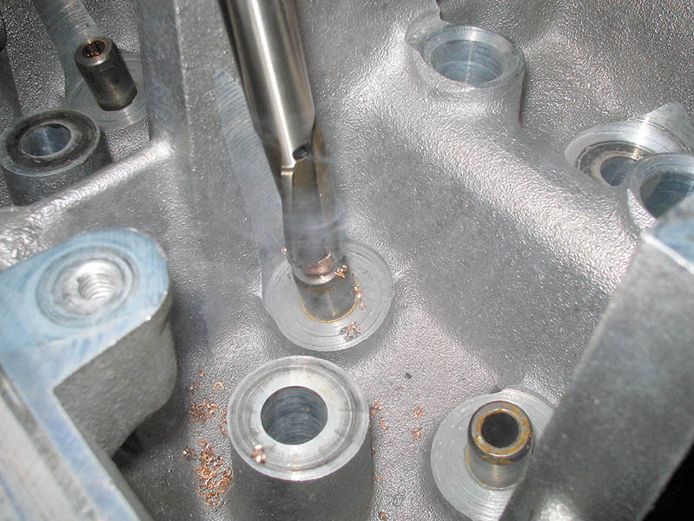
Figure 30.35 Trimming the top of the thin-walled insert

Slide 62
Figure 30.36 Installed spiral bronze insert bushing

Slide 63
QUESTION 3: ?
How is valve stem-to-guide clearance measured?

Slide 64
ANSWER 3:
Measuring valve guide-to-stem clearance with a dial indicator while rocking the stem in the direction of normal thrust.

Slide 65
Video Links (Internet Access Required)
Valve lash adjustment (time 3:04)
Checking cylinder head warpage (time 1:39)
How to torque cylinder head bolts (time 25:08)
Cylinder head repair after valve and seat damage (time 2:41)
Cylinder head for flatness / warpage (time 2:51)
Fitting new valve guides (time 3:30)

Slide 66
Copyright

