Slide 1
Automotive Technology Principles, Diagnosis, and Service
Sixth Edition
Chapter 22
Engine Oil
Copyright © 2018, 2015, 2011 Pearson Education, Inc. All Rights Reserved

Slide 2
LEARNING OBJECTIVES (1 of 2)
22.1 Explain the purpose of engine oil and engine oil additives.
22.2 Discuss the properties of engine oil.
22.3 Discuss SAE rating, API rating, ILSAC oil rating, and European oil rating system.

Slide 3
LEARNING OBJECTIVES (2 of 2)
22.4 Discuss synthetic oil and high mileage oils.
22.5 Discuss vehicle-specific specifications and brand compatibility of oil.
22.6 Discuss the purpose and function of oil filters.
22.7 Describe the oil change procedure.

Slide 4
PURPOSE AND FUNCTION OF ENGINE OIL
Lubricate moving parts.
Help cool engine parts.
Seal piston rings.
Neutralize acids formed by the combustion process.
Reduce friction in the engine.
Reduce rust and corrosion.
Act as a hydraulic fluid for lifters and tensioners.

Slide 5
ENGINE OIL ADDITIVES
Viscosity Index (VI) Improvers
Pour Point Depressant
Antioxidants
Oxidants
Total Base Number (TBN)
Rust and Corrosion Inhibitors
Anti-wear additive
Extreme Pressure Additive

Slide 6
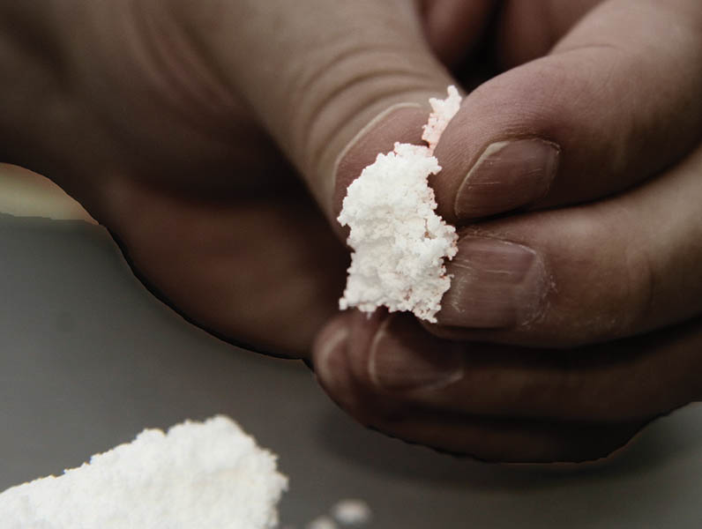
Figure 22.1 Viscosity index (VI) improver is a polymer and feels like finely ground foam rubber. When dissolved in the oil, it expands when hot to keep the oil from thinning

Slide 7
PROPERTIES OF ENGINE OIL
As oil gets cooler, it gets thicker.
As oil gets hotter, it get thinner.
The viscosity index is the change of viscosity between hot and cold extremes.
The lowest temperature an oil will pour is the pour point.
Oils must be miscible, meaning they have the ability to mix with other oils.

Slide 8
SAE RATING
Society of Automotive Engineers (SAE)
SAE grade number determines the viscosity range.
Oil tested only at 212°F (100°C) have no letter in the grade (example SAE 30).
Oils tested at 0°F (-18°C) and 212°F (100°C) are considered multi-grade oils and have the letter “W” in the grade (Example SAE 0W-20).

Slide 9
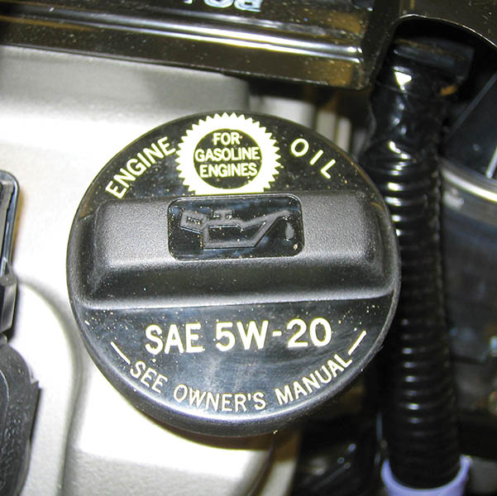
Figure 22.2 The SAE viscosity rating required is often printed on the engine oil filler cap. Most hybrid electric vehicles specify either SAE 0W-20 or SAE 5W-20 engine oil

Slide 10
API RATING
American Petroleum Institute (API)
Worked with manufacturers to develop engine oil performance classifications.
Oils are tested and rated in production automotive engines.
Gasoline engine ratings begin with the letter “S”.
Diesel engine ratings begin with the letter “C”.

Slide 11
Figure 22.3 API doughnut for a SAE 5W-30, SM engine oil. When compared to a reference oil, the “energy conserving” designation indicates a 1.1% better fuel economy for SAE 10W-30 oils and 0.5% better fuel economy for SAE 5W-30 oils

Slide 12
QUESTION 1: ?
What property of oil does the SAE ratings reflect?

Slide 13
ANSWER 1:
It indicates the viscosity range
into which the oil fits.

Slide 14
ILSAC OIL RATING
International Lubricant Standardization and Approval Committee (ILSAC).
Developed an oil rating that consolidates the SAE viscosity rating and the API quality rating.
If an engine oil meets the standards, a “starburst” symbol is displayed on the front of the oil container.
Rating begin with the letters “GF” (Example GF-6).
.

Slide 15
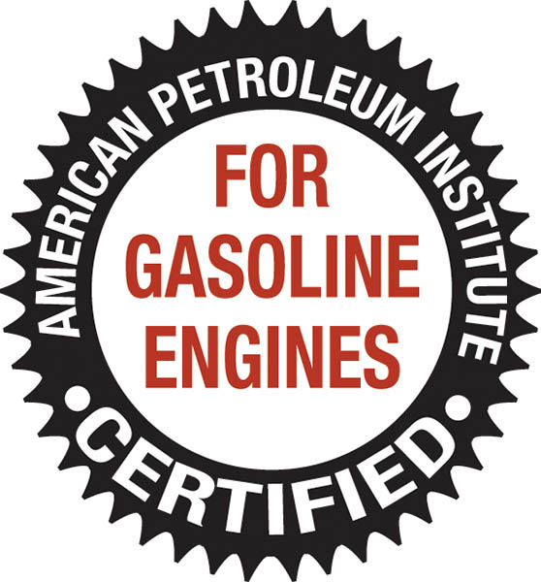
Figure 22.4 The International Lubricant Standardization and Approval Committee (ILSAC) starburst symbol. If this symbol is on the front of the container of oil, then it is acceptable for use in almost any gasoline engine

Slide 16
EUROPEAN OIL RATING SYSTEM
The Association des Constructeurs Européens d’Automobiles (ACEA)
Gasoline oil ratings: ACEA-A
Diesel oil ratings: ACEA-B
Combined gasoline and diesel rating: ACEA-C
The A,B, or C rating is followed by a number that represents the specific rating (example: ACEA-A4)

Slide 17
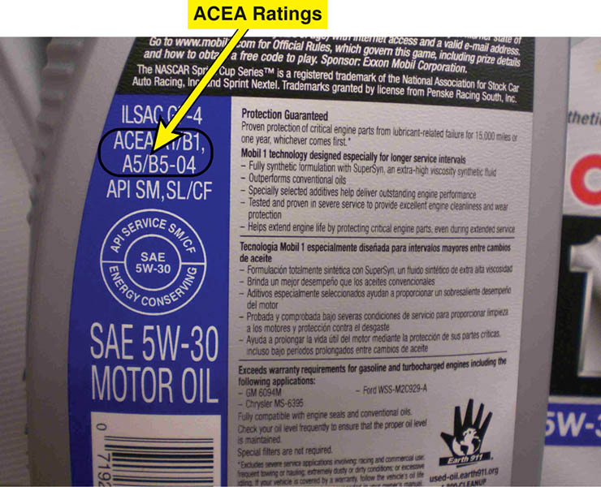
Figure 22.5 ACEA ratings are included on the back of the oil container if it meets any of the standards

Slide 18
SYNTHETIC OIL
The term synthetic means that it is a manufactured product and not refined from a naturally occurring substance.
The American Petroleum Institute classifies oil into groups.
Group IV: Synthetic oils made from mineral oil and monomolecular oil called polyalpholefin (POA); includes Mobil 1.

Slide 19
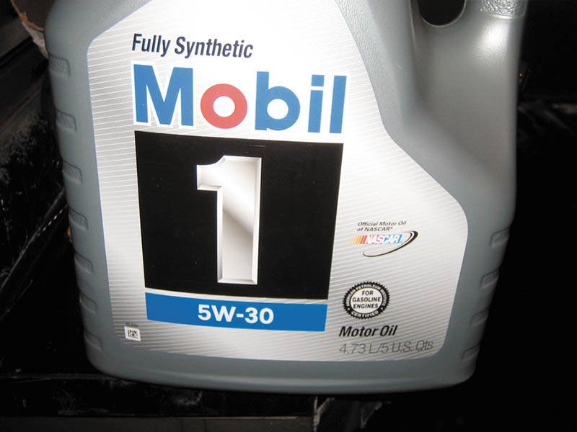
Figure 22.6 Mobil 1 synthetic engine oil is used by several vehicle manufacturers in new engines

Slide 20
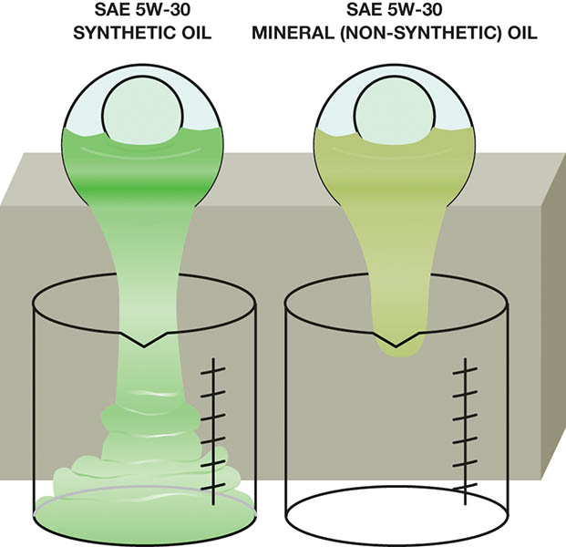
Figure 22.7 Both oils have been cooled to -20°F (-29°C). Notice that the synthetic oil on the left flows more freely than the mineral oil on the right, even though both are SAE 5W-30

Slide 21
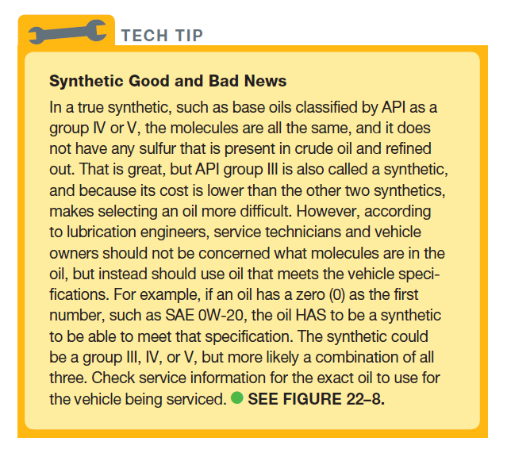
Tech Tip

Slide 22
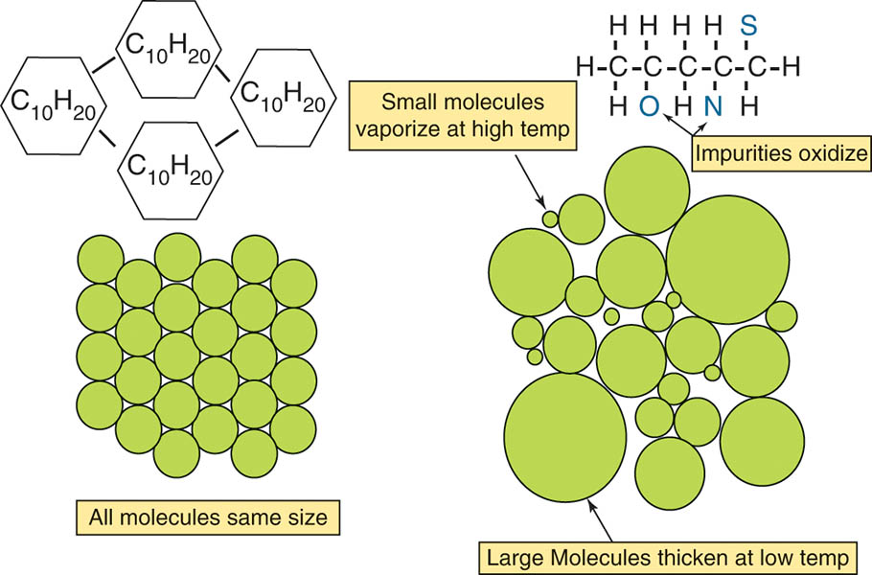
Figure 22.8 A true synthetic is made of a stable molecule that does not vary compared to mineral oils. However, regardless of the molecules, always use an oil that meets the vehicle manufacturer’s specifications

Slide 23
QUESTION 2: ?
What is meant by the term synthetic oil?

Slide 24
ANSWER 2:
The term synthetic means that it is a manufactured product and not refined from a naturally occurring substance.

Slide 25
HIGH MILEAGE OILS
A “high mileage oil” is sold for use in vehicles that have over 75,000 miles and are, therefore, nearing the eight-year, 80,000-mile catalytic converter warranty period.
Esters are added to swell oil seals (main and valve-stem seals).
The oil usually does not have the energy rating of conventional oils.

Slide 26
VEHICLE-SPECIFIC SPECIFICATIONS
Many manufacturers specify engine that meets their own test standards.
Examples:
General Motors: Dexos 1 and Dexos 2
Ford: WSS-M2C931-A and WSS-M2C934-A
Chrysler: MS-6395 and MS- 10725
Volkswagen: 502.00 and 505.00

Slide 27
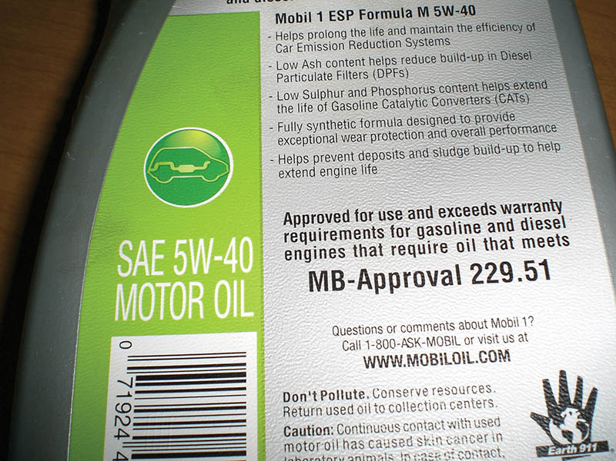
Figure 22.9 European vehicle manufacturers usually specify engine oil with a broad viscosity range, such as SAE 5W-40, and their own unique standards, such as the Mercedes specification 229.51

Slide 28
OIL BRAND COMPATABILITY
According to SAE standard J-357, all engine oils must be miscible (compatible) with all other brands of engine oil.
Any brand of engine oil can be used as long as it meets the viscosity and API standards recommended by the vehicle manufacturer.
Most experts agree that the oil changes are the most important regularly scheduled maintenance for an engine.

Slide 29
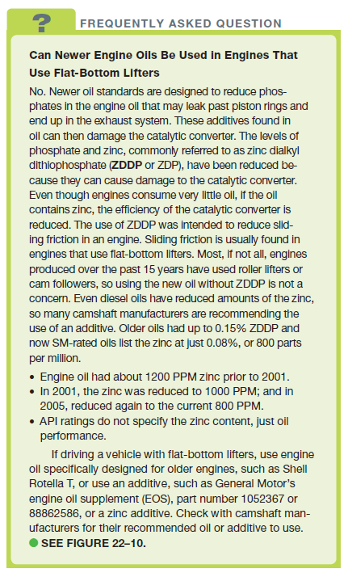
FREQUENTLY ASKED QUESTION

Slide 30
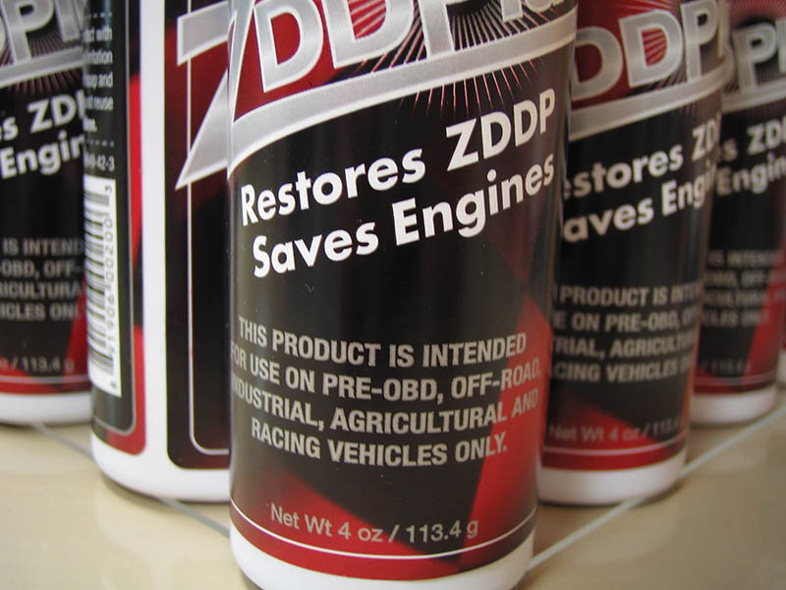
Figure 22.10 Using a zinc additive is important when using SM-rated oil in an engine equipped with a flat-bottom lifter, especially during the break-in period

Slide 31
OIL FILTERS
Large particles are trapped in the filter material.
The antidrainback valve prevents oil from draining out of the filter when the vehicle is shut off.
The bypass valve will allow the oil to bypass the filter if it becomes clogged.
Used filters should be drained/crushed before disposing according to state and local regulations.

Slide 32
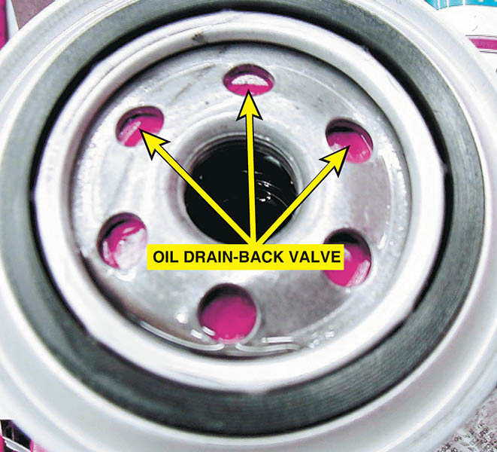
Figure 22.11 A rubber diaphragm acts as an antidrainback valve to keep the oil in the filter when the engine is stopped and the oil pressure drops to zero

Slide 33
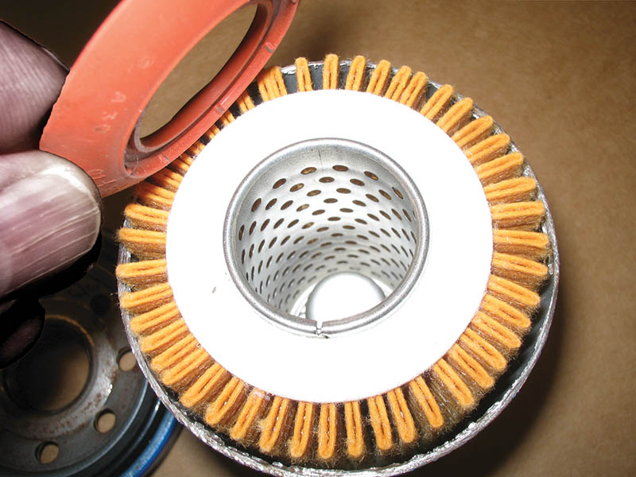
Figure 22.12 A cutaway of a typical spin-on oil filter.

Slide 34
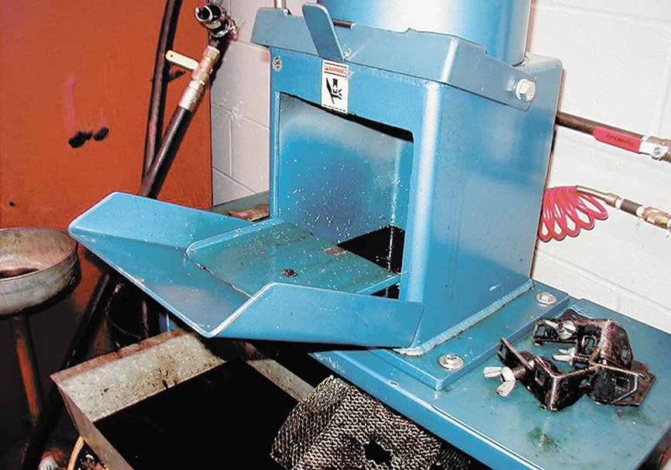
Figure 22.13 A typical filter crusher. The hydraulic ram forces out most of the oil from the filter. The oil is trapped underneath the crusher and is recycled

Slide 35
OIL CHANGE
All vehicle and engine manufacturers recommend a maximum oil change interval.
The maximum oil change interval is shortened when the vehicle is operated in severe use conditions.
Oil life monitors alert the driver when service is required.
Mileage based reminder systems
Algorithm based reminder systems

Slide 36
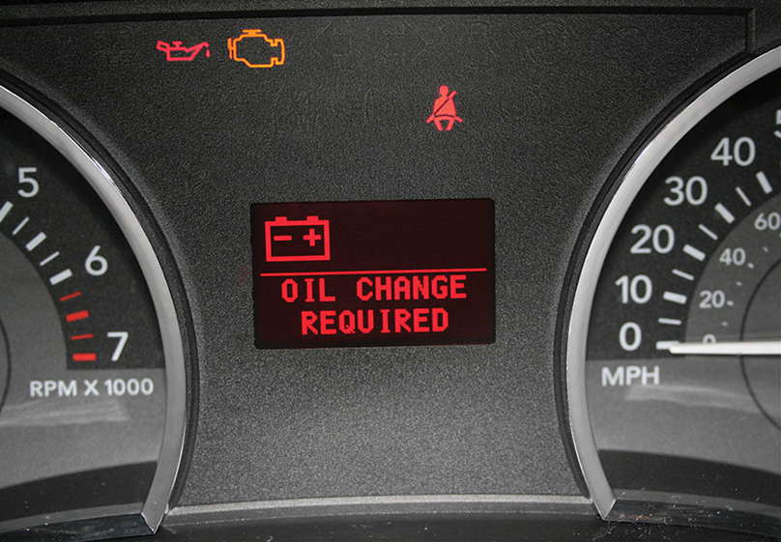
Figure 22.14 Many vehicle manufacturers can display the percentage of oil life remaining, whereas others simply turn on a warning lamp when it has been determined that an oil change is required

Slide 37
Animation: Engine Oil Level & Quality Sensor (The animation will automatically start in a few seconds)

Slide 38
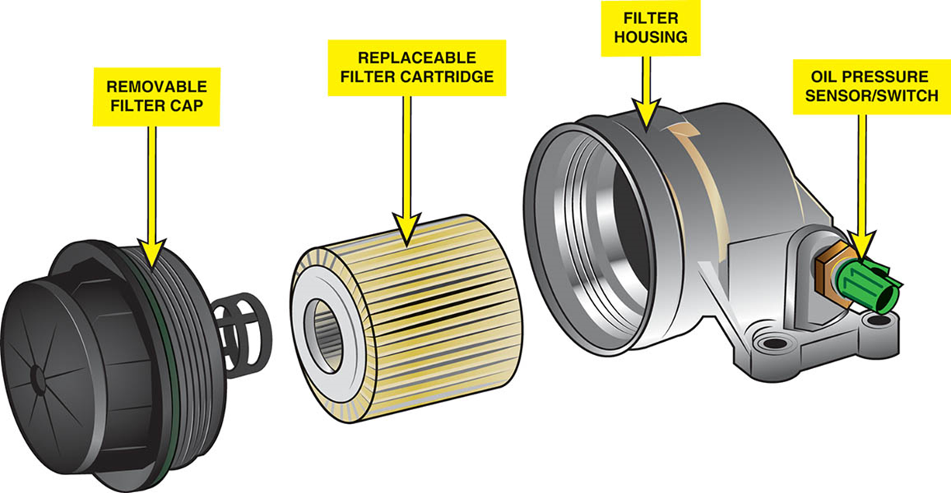
Figure 22.15 If replacing a cartridge-type oil filter, be sure to use the proper size wrench on the filter cap and tighten to factory specifications

Slide 39
QUESTION 3: ?
What are the two types of oil change reminder systems?

Slide 40
ANSWER 3:
Mileage based and algorithm based systems.

Slide 41
OIL CHANGE PHOTO SEQUENCE

Slide 42
1. Before entering the customer’s car for the first time, be sure to install a seat cover as well as a steering wheel cover to protect the vehicle’s interior.

Slide 43
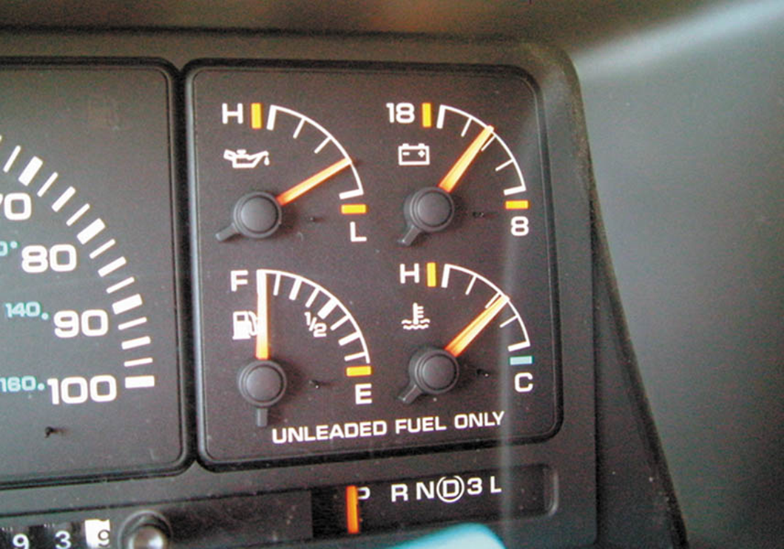
2. Run the engine until it is close to operating temperature. This will help the used oil drain more quickly and thoroughly.

Slide 44
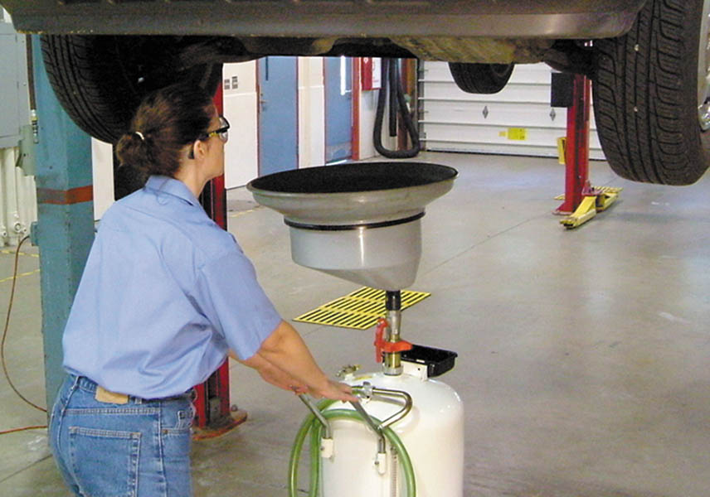
3. Raise the vehicle on a hoist, and place the oil drain container in position under the oil drain plug. Be sure to wear protective gloves.

Slide 45
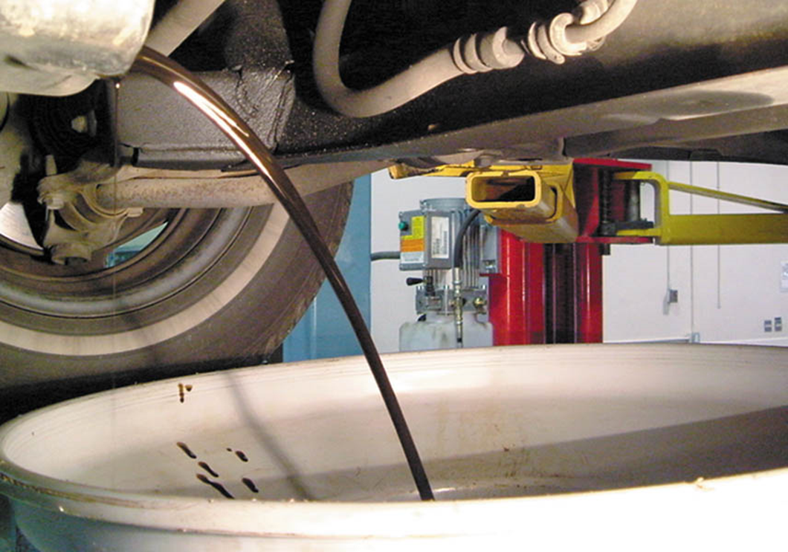
4. Remove the plug and allow the hot oil to drain from the engine. Use caution during this step as hot oil can cause painful burns!

Slide 46
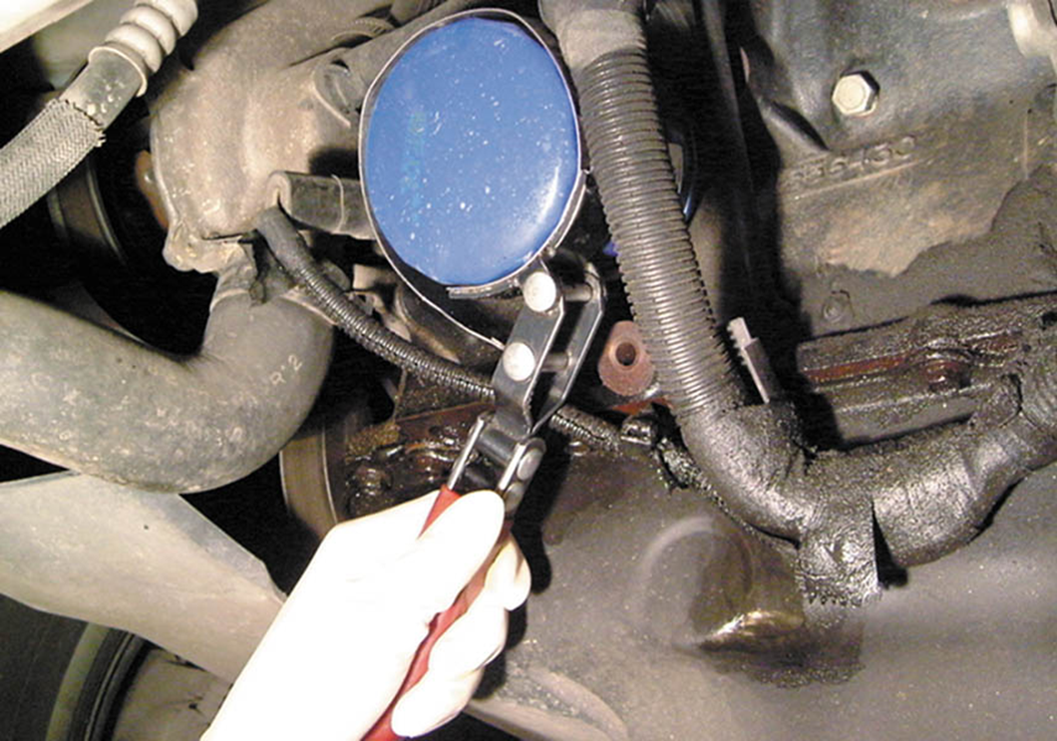
5. While the engine oil continues to drain, remove the engine oil filter using a filter wrench. Some oil will drain from the filter, so be sure to have the oil drain container underneath when removing it.

Slide 47
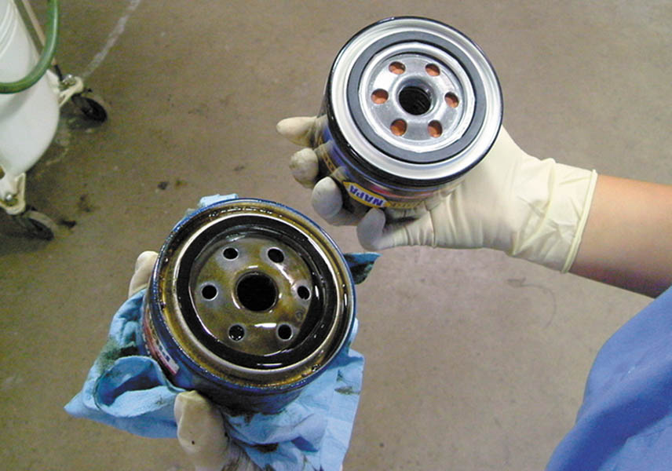
6. Compare the new oil filter with the old one to be sure that it is the correct replacement.

Slide 48
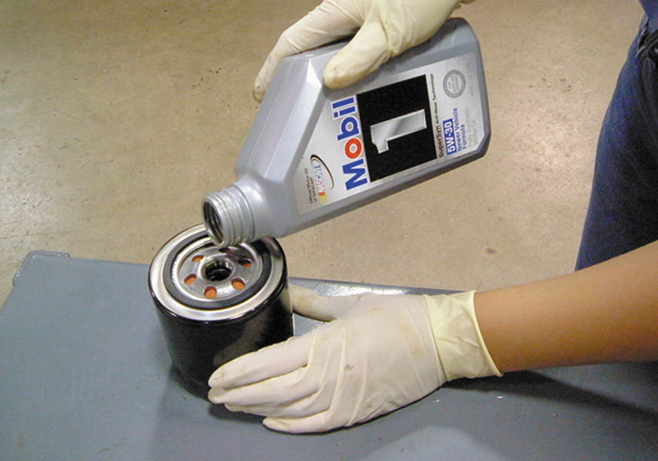
7. The wise service technician adds oil to the oil filter whenever possible. This provides faster filling of the filter during start-up and a reduced amount of time that the engine does not have oil pressure.

Slide 49
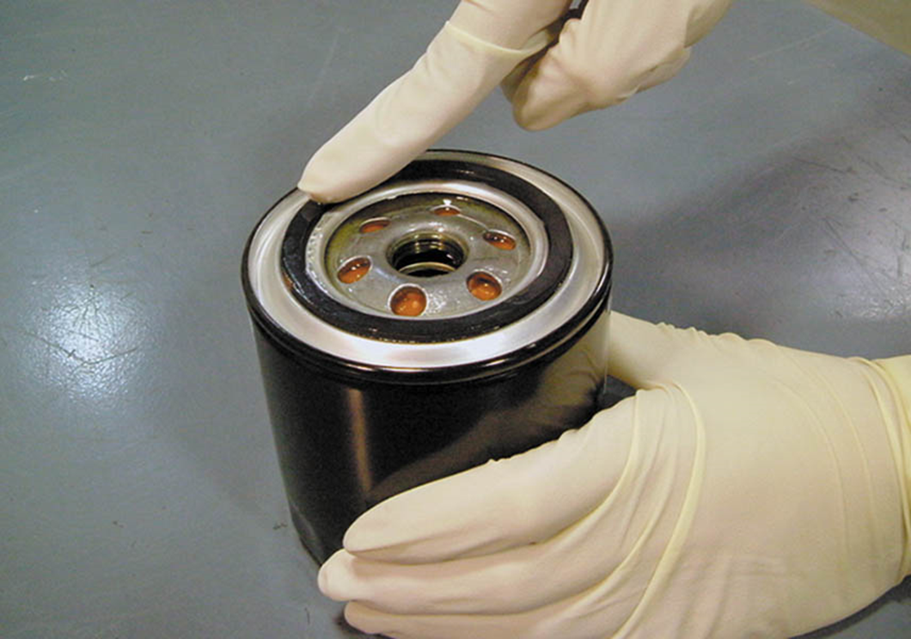
8. Apply a thin layer of clean engine oil to the gasket of the new filter. This oil film will allow the rubber gasket to slide and compress as the oil filter is being tightened.

Slide 50
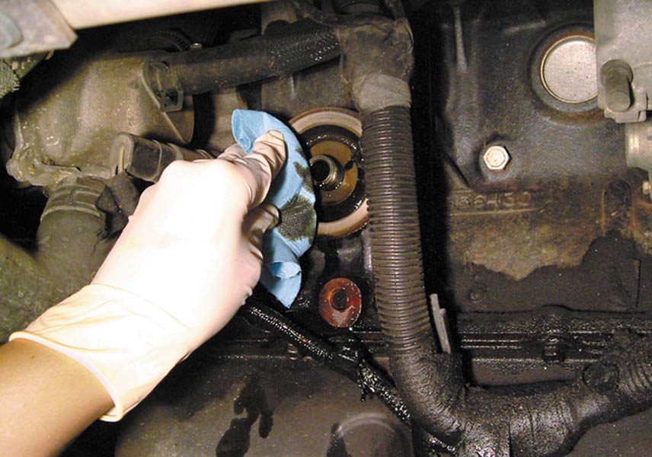
9. Clean the area where the oil filter gasket seats to be sure that no part of the gasket remains that could cause an oil leak.

Slide 51
10. Install the new oil filter and tighten it by hand. Do not use an oil filter wrench to tighten the filter! Most filters should be tightened 3/4 of a turn after the gasket contacts the engine.

Slide 52
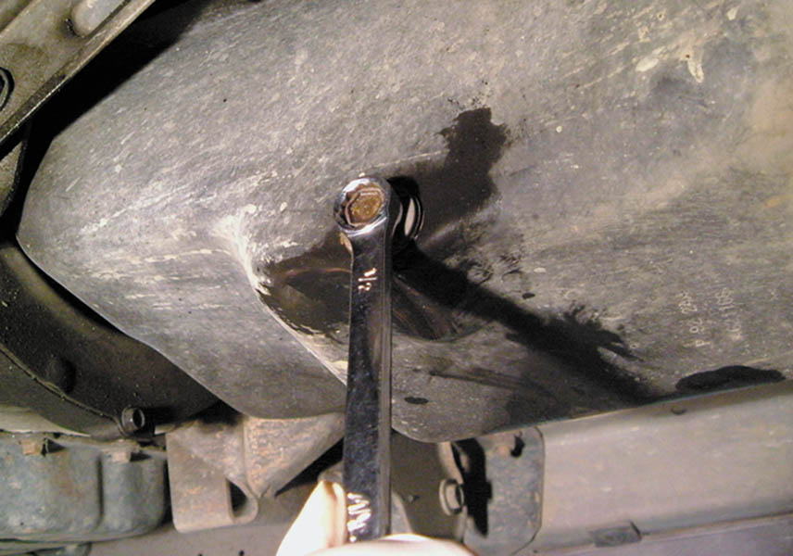
11. Carefully inspect the oil drain plug and gasket. Replace the gasket as needed. Install the drain plug and tighten firmly, but do not overtighten!

Slide 53
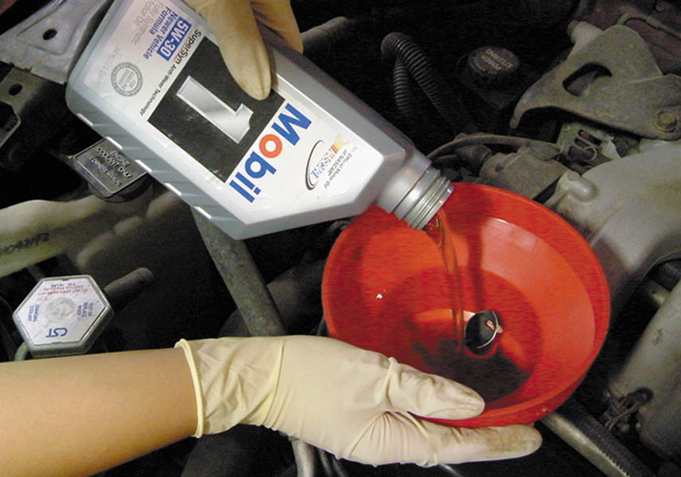
12. Use a funnel to add the specified amount of oil to the engine at the oil fill opening. When finished, replace the oil fill cap.

Slide 54
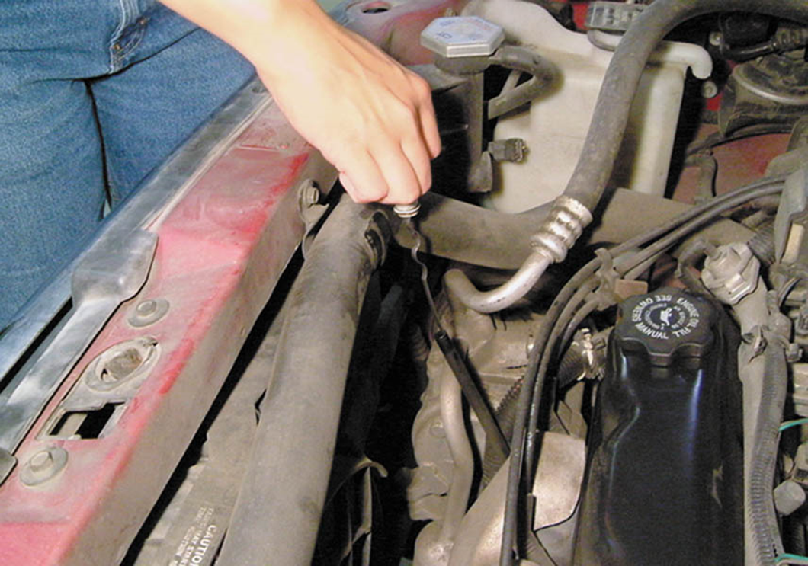
13. Remove the oil-level dipstick and wipe it clean with a shop cloth. Reinstall the oil-level dipstick. Remove the dipstick a second time and read the oil level.

Slide 55
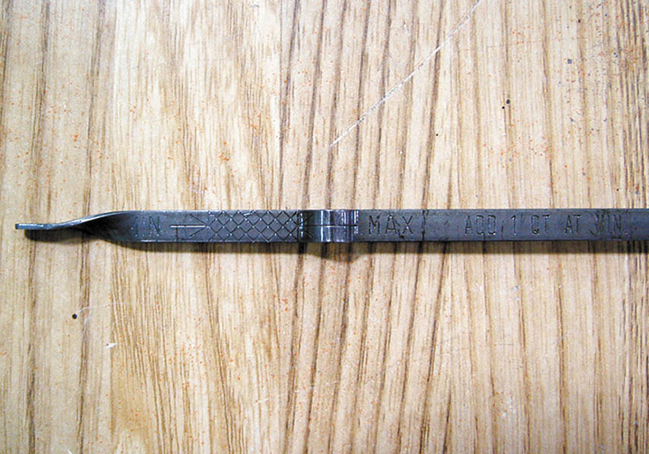
14. The oil level should be between the MIN and the MAX lines. In this case, the oil level should be somewhere in the cross-hatched area of the dipstick.

Slide 56
Video Links (Internet Access Required)
How engine lubrication system works (time 3:26)
What is an indication of bad engine oil? (time 2:14)

Slide 57
Copyright

