Slide 1
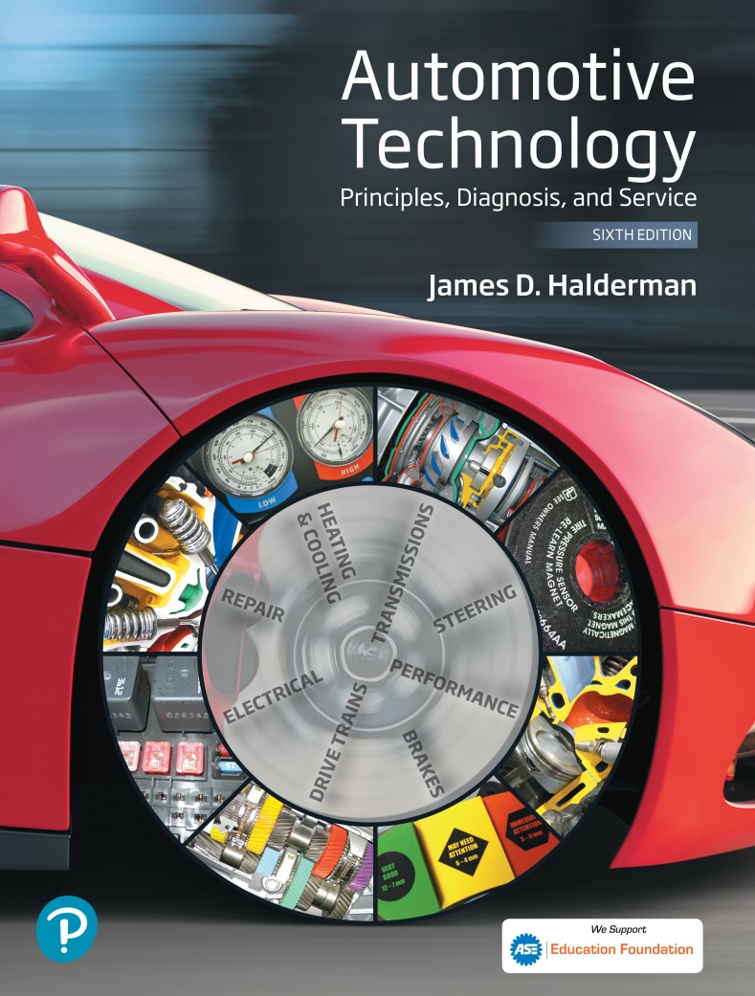
Automotive Technology Principles, Diagnosis, and Service
Sixth Edition
Chapter 20
Coolant
Copyright © 2018, 2015, 2011 Pearson Education, Inc. All Rights Reserved

Slide 2
LEARNING OBJECTIVES
20.1 Discuss coolant fundamentals.
20.2 Compare the different types of coolant.
20.3 Discuss coolant freezing/boiling temperatures and water as coolant.
20.4 Discuss coolant testing and coolant replacement issues.

Slide 3
COOLANT FUNDAMENTALS
Purpose of Coolant: Transfer heat, protect against corrosion, and protect against freezing.
Freezing/Boiling Temperatures: Normal mixture is 50% coolant and 50% water.
Coolant Composition:
47% Ethylene glycol
50% Water
3% Additives

Slide 4
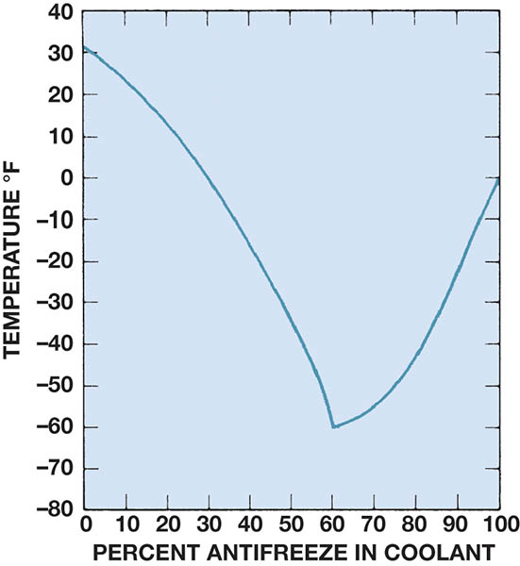
Figure 20.1 Graph showing the relationship of the freezing point of the coolant to the percentage of antifreeze used in the coolant

Slide 5
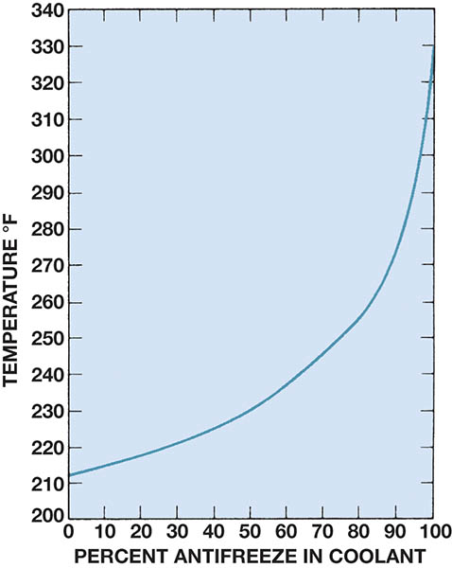
Figure 20.2 Graph showing how the boiling point of the coolant increases as the percentage of antifreeze in the coolant increases

Slide 6
TYPES OF COOLANT
Inorganic Acid Technology: Contains silicates, phosphates, and borates
Organic Acid Technology: Does not contain silicates or phosphates.
Hybrid Organic Acid Technology: Uses carboxylates that are not abrasive to the water pump.
Phosphate Hybrid Organic Acid Technology: Used in Mazda based Fords, similar to Mazda FL-22.
Universal Coolant: Usually a hybrid organic acid technology.

Slide 7
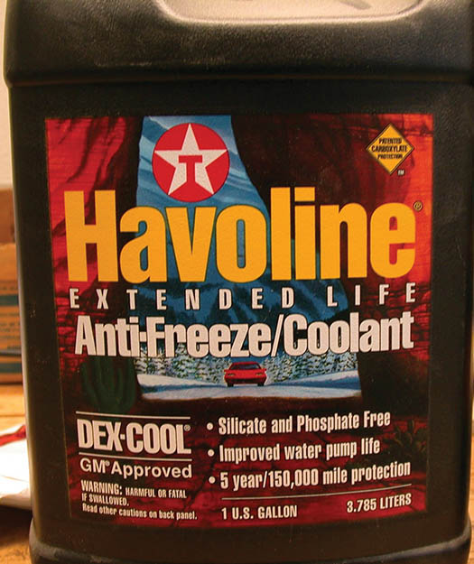
Figure 20.3 Havoline was the first company to make and market OAT coolant. General Motors uses the term DEX-COOL

Slide 8
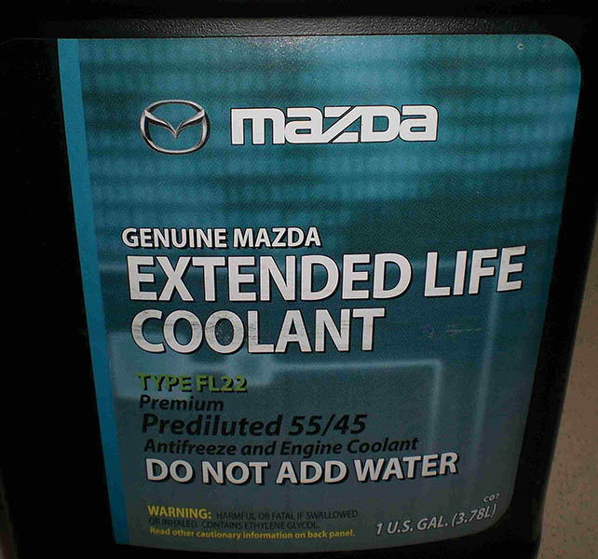
Figure 20.4 Coolant used in Fords that use Mazda engines and in Mazda vehicles. It requires the use of a PHOAT coolant, which is dark green

Slide 9
FREQUENTLY ASKED QUESTION

Slide 10
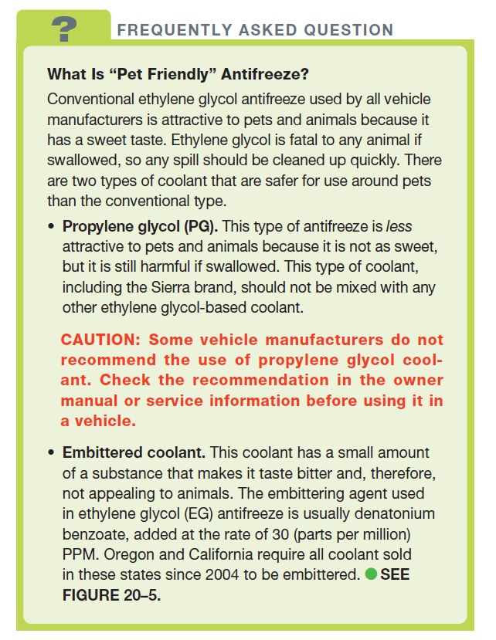
FREQUENTLY ASKED QUESTION

Slide 11
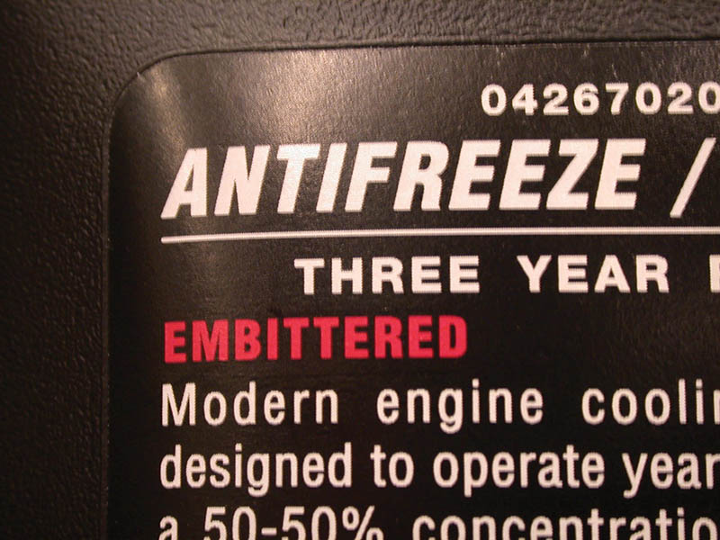
Figure 20.5 Not all embittered coolant is labelled embittered

Slide 12
QUESTION 1: ?
What types of coolant are used in vehicles?

Slide 13
ANSWER 1:
Inorganic acid technology, organic acid technology, hybrid organic acid technology, phosphate hybrid organic acid technology.

Slide 14
WATER
Efficient heat exchange fluid.
It is inexpensive.
Water quality can affect coolant protection.
Many coolants sold as premix solutions to avoid water quality concerns.

Slide 15
Tech Tip

Slide 16
COOLANT FREEZING/BOILING TEMPERATURES
Freezing Point:
Pure water 32° F (0° C)
Pure Coolant 0° F (-18° C)
50/50 Mixture -34° F (-37° C)
70% antifreeze/ 30% water -84° F (-64° C)
Boiling Point:
Pure Water 212° F (100° C)
50/50 Mixture 218° F (103° C)
70/30 Mixture 225°F (107° C)
Pressure Cap will raise boiling point
.

Slide 17
COOLANT TESTING
Hydrometer: Measures the density of the coolant.
Refractometer: Tests coolant on a prism surface.
PH: The measure of acidity or alkalinity of the coolant.
Galvanic Activity: The flow of electrical current as a result of two different metals in a liquid.
Electrolysis: Current flow in coolant caused by an external voltage source.

Slide 18
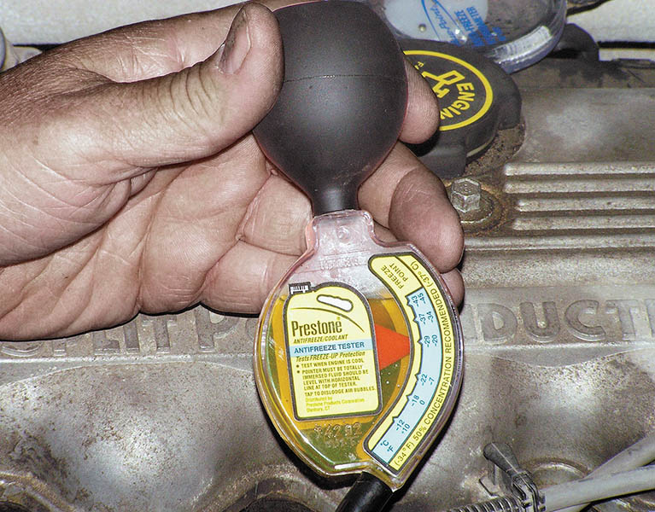
Figure 20.6 Checking the freezing temperature of the coolant using a hydrometer

Slide 19
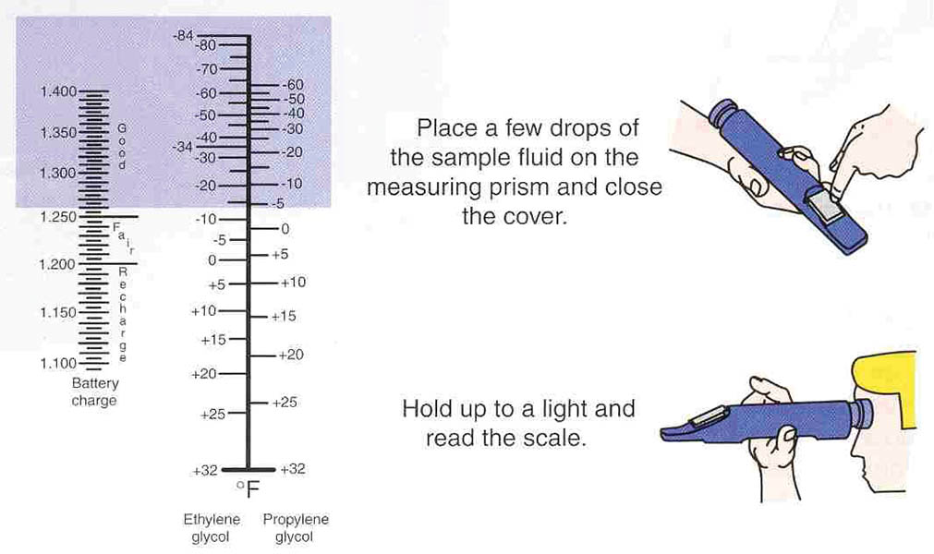
Figure 20.7 Using a refractometer is an accurate method to check the freezing point of coolant

Slide 20
Animation: Coolant Refractometer (The animation will automatically start in a few seconds)

Slide 21
Figure 20.8 A meter that measures the actual pH of the coolant can be used for all coolants, unlike many test strips that cannot be used to test the pH of red or orange coolants

Slide 22
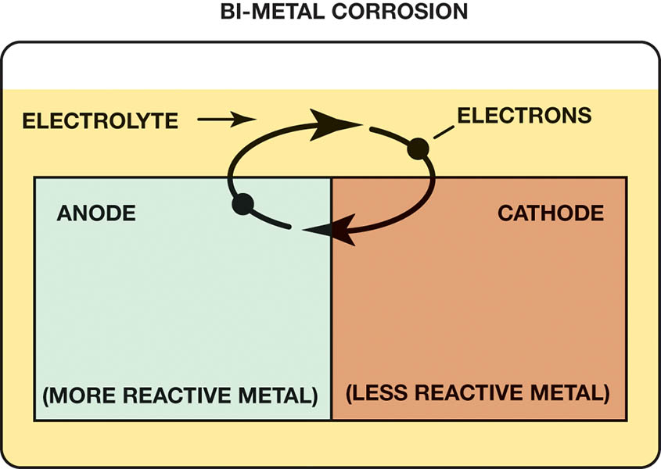
Figure 20.9 Galvanic activity is created by two dissimilar metals in contact with a liquid, in this case coolant

Slide 23
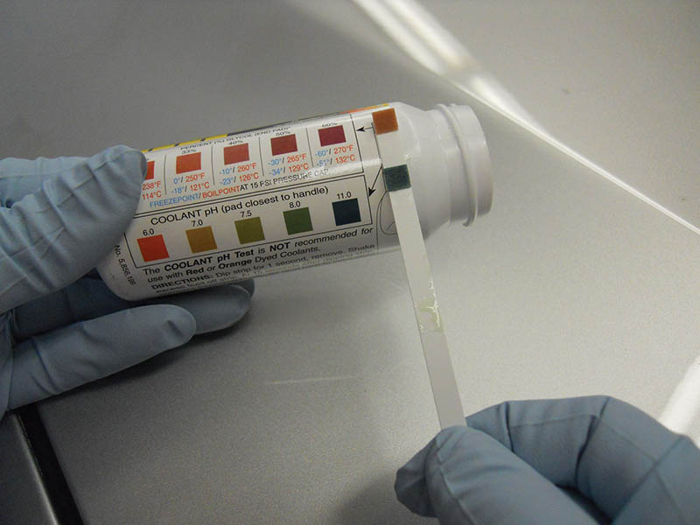
Figure 20.10 A test strip can be used to determine the pH and percentage of glycol of the coolant. The percentage of glycol determines the freezing and boiling temperatures, as shown on the bottle that contains the test strips

Slide 24
QUESTION 2: ?
What is the difference between galvanic activity and electrolysis?

Slide 25
ANSWER 2:
Electrolysis requires an external voltage source.

Slide 26
COOLANT REPLACEMENT ISSUES
Service Intervals:
Most OAT and HOAT coolants every 5 years or 150,000 miles.
Asian vehicles every 3 year or 36,000 miles.
Conventional coolant every 2 years or 24,000 miles.
Passivation: Chemical reaction between the coolant and the metal.
Recycling Coolant: Removes metals and dirt, then replenishes the depleted acids.

Slide 27
Video Links (Internet Access Required)
When will your coolant freeze? (time 5:00)
Antifreeze coolant checking with a multimeter (time 2:11)

Slide 28
Copyright

