Slide 1

Automotive Technology Principles, Diagnosis, and Service
Sixth Edition
Chapter 15
Service Information and Work Orders
Copyright © 2018, 2015, 2011 Pearson Education, Inc. All Rights Reserved

Slide 2
LEARNING OBJECTIVES (1 of 2)
15.1 Discuss the importance of vehicle, owner’s manuals, service records, and service information.
15.2 Explain the different types of service information.
15.3 Discuss the importance of the work order.

Slide 3
LEARNING OBJECTIVES (2 of 2)
15.4 Describe vehicle recalls and campaigns.
15.5 Explain why service records are important.
15.6 Explain hotline services, specialty repair manuals, and aftermarket supplies guides and catalogs.

Slide 4
OWNERS MANUALS
Most owners manuals contain all or most of the following information.
  Meaning of dash symbols
  How to rest the maintenance reminder light
  Specifications of fluids
  Tire pressures
  Maintenance schedules
  Operation of specific features
  Tire rotation and TPMS

Slide 5
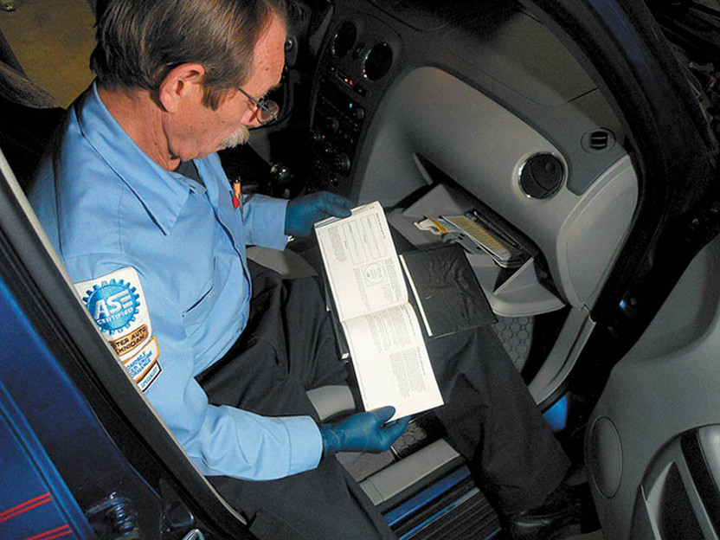
Figure 15.1 The owner’s manual has a lot of information pertaining to the operation, as well as the maintenance and resetting procedures, that technicians often need

Slide 6
SERVICE INFORMATION
Contains all of the specifications, as well as the specified procedures to follow when servicing or repairing a vehicle.
Factory Service Information: The most comprehensive and accurate service information.
Aftermarket Service Information: Subscription services that include service information for many vehicles.

Slide 7
SERVICE INFORMATION CONTENT
  General Information
  Maintenance and Lubrication
  Engines
  Automatic Transmissions
  Manual Transmissions and Axles
  Suspension and Steering
  Brakes
  Electrical/Electronics
  Heating, Ventilation and Air Conditioning
  Engine Performance

Slide 8
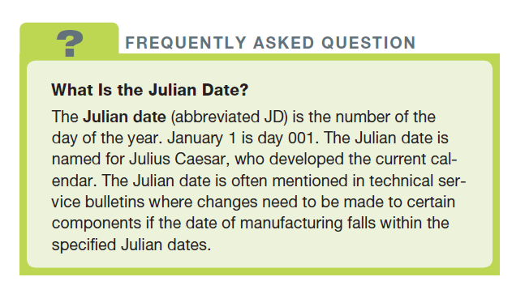
FREQUENTLY ASKED QUESTION

Slide 9
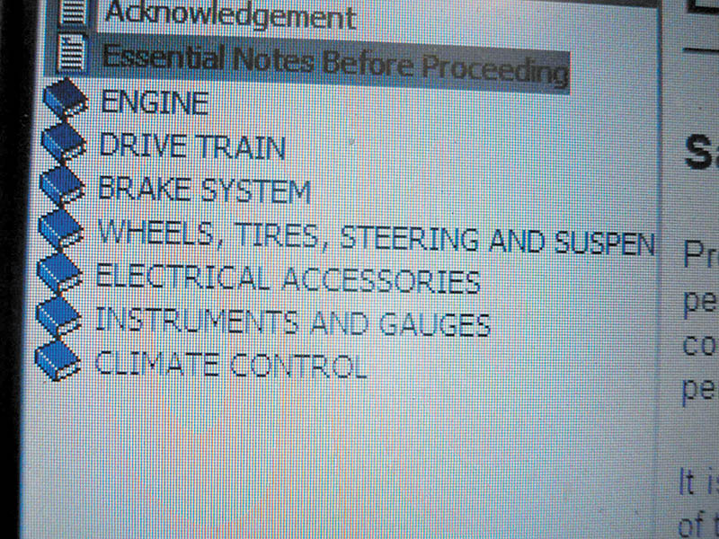
Figure 15.2 A main menu showing the major systems of the vehicle. Clicking on one of these major topics opens up another menu showing more detailed information

Slide 10
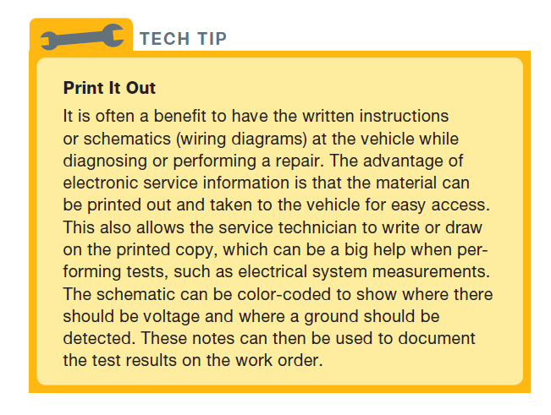
Tech Tip

Slide 11
QUESTION 1: ?
What is included in the vehicle owner’s manual that could be
helpful for a service technician?

Slide 12
ANSWER 1:
Maintenance and resetting procedures.

Slide 13
TECHNICAL SERVICE BULLITENS
A technical Service Bulletin (TSB) is issued by the vehicle manufacturer to notify service technicians of a potential problem or other critical information.
TSBs are not an authorization for repair or a guarantee to correct a concern.
TSBs are designed for dealership technicians, but are republished by aftermarket companies and made available to others.

Slide 14
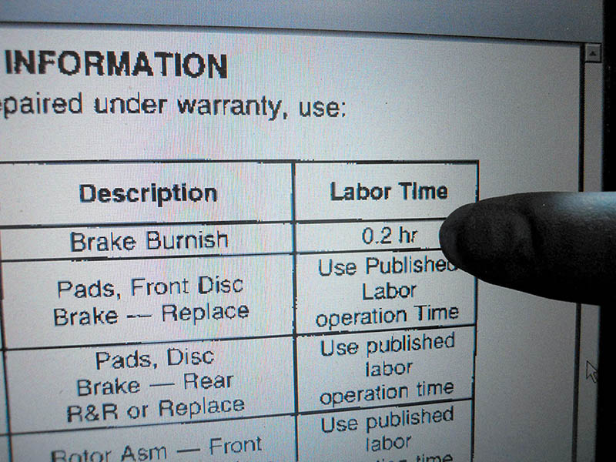
Figure 15.4 Some technical service bulletins also include the designated flat-rate time when specifying a repair procedure

Slide 15
RECALLS AND CAMPAIGNS
A recall can occur when either the manufacturer or the National Highway Traffic Safety Administration (NHTSA) determines there is a safety or emissions concern.
A campaign is typically issued when a manufacturer wants to improve a product’s performance or increase the customer’s satisfaction.

Slide 16
WORK ORDERS
Work orders contain the following:
  Service advisor documentation
  Service technician documentation
  Parts documentation
  Labor time documentation
Work orders serve as service records to provide a history of the service work performed.

Slide 17
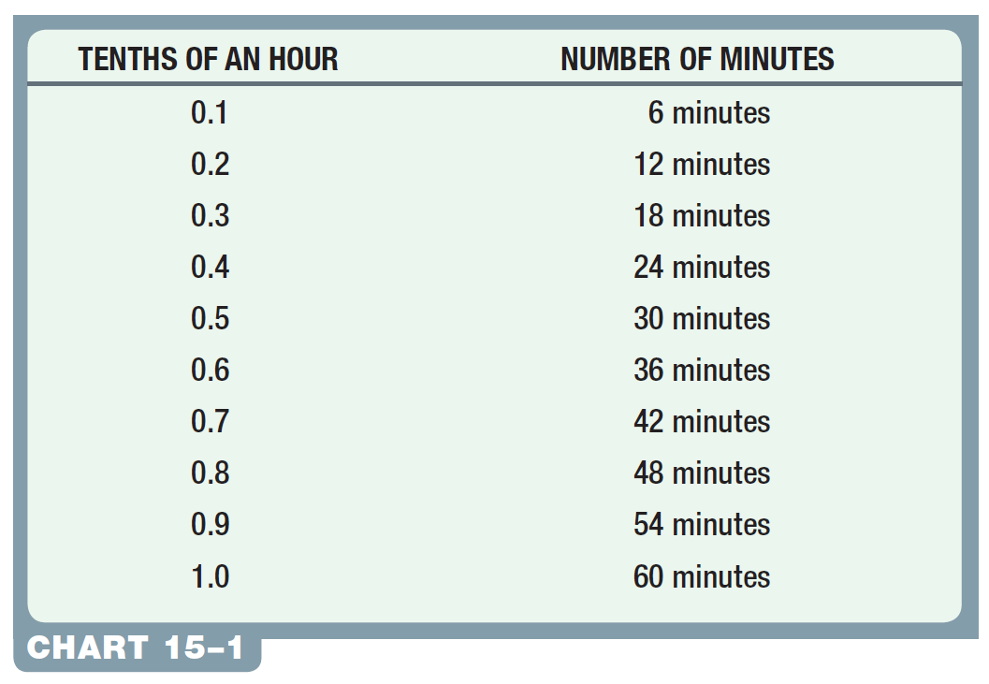
Labor Time Documentation

Slide 18
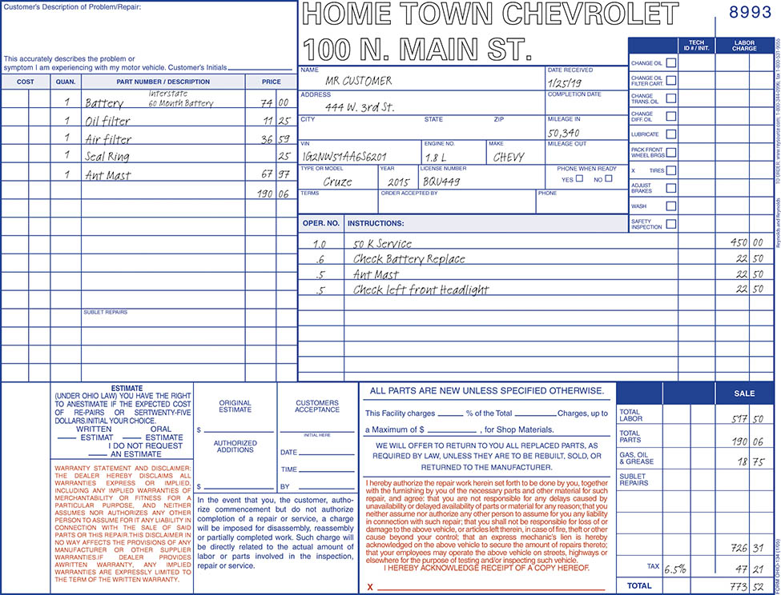
Figure 15.3 A typical work order showing the customer concern and what was done to correct the issue. Electronic work orders include all of the same required information. This included a stored diagnostic trouble code and what was found to be wrong and what was done to complete the repair

Slide 19
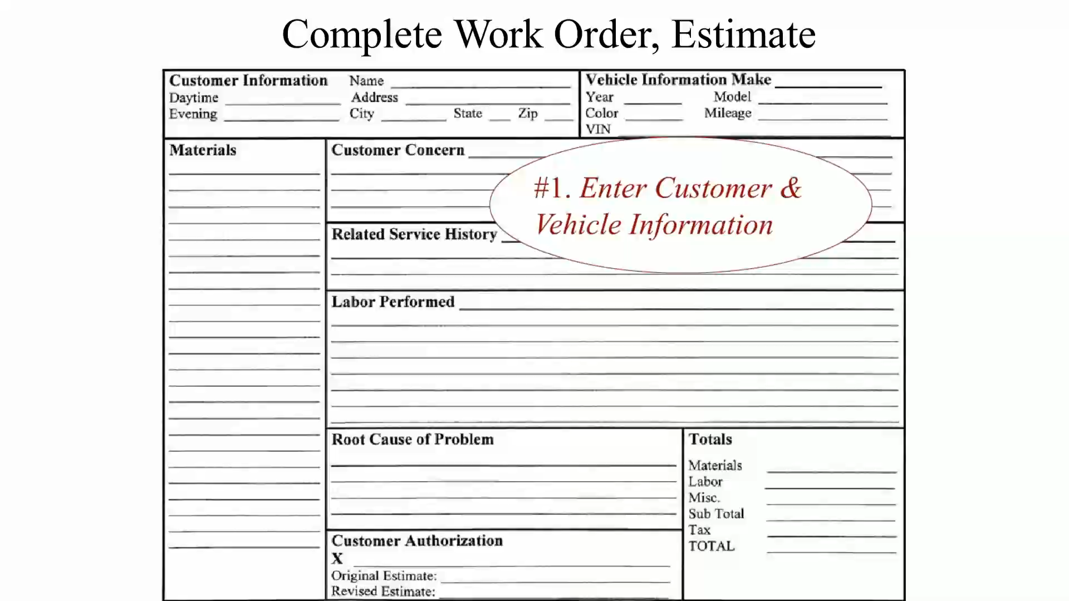
Animation:
Complete Work Order, Estimate
(The animation will automatically start in a few seconds)

Slide 20
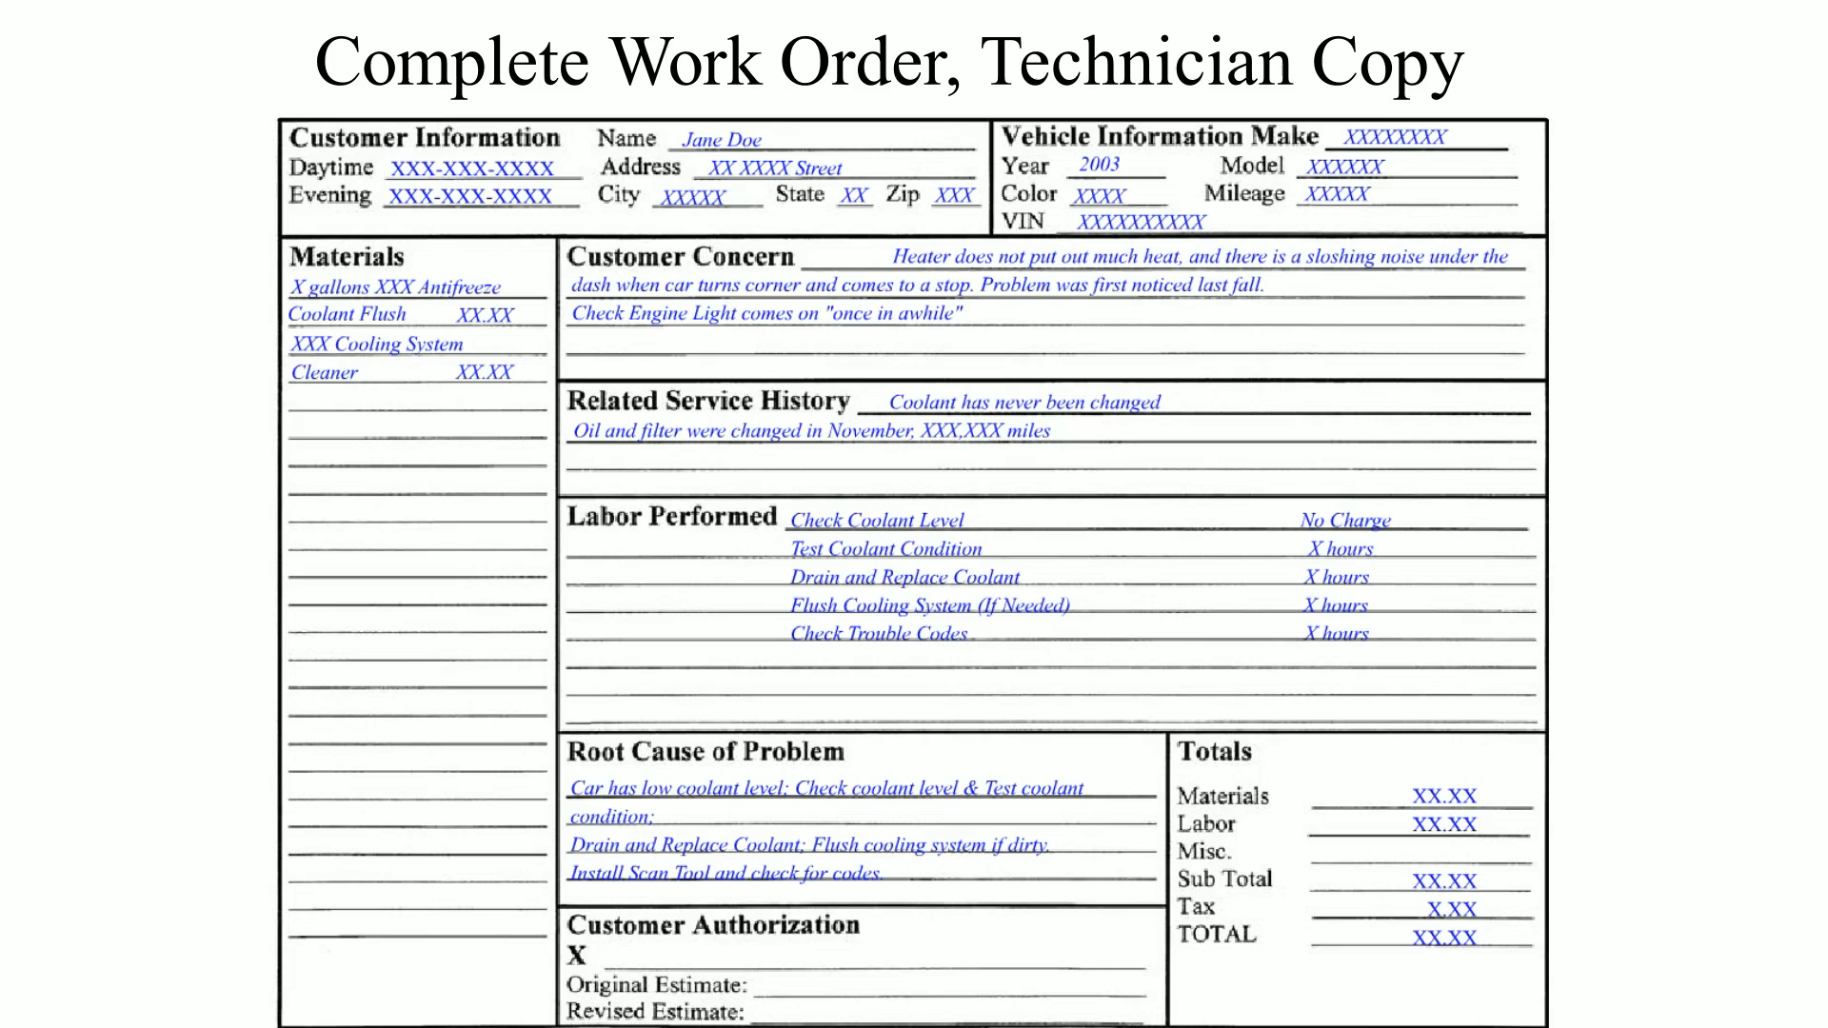
Animation:
Complete Work Order, Technician Copy
(The animation will automatically start in a few seconds)

Slide 21
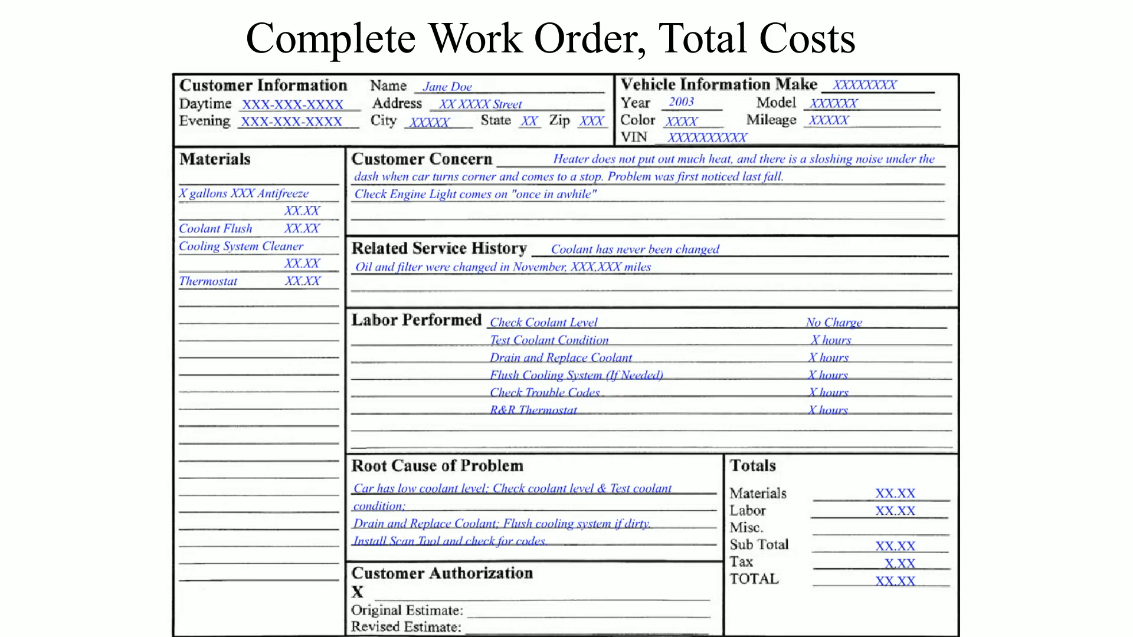
Animation:
Complete Work Order, Total Costs
(The animation will automatically start in a few seconds)

Slide 22
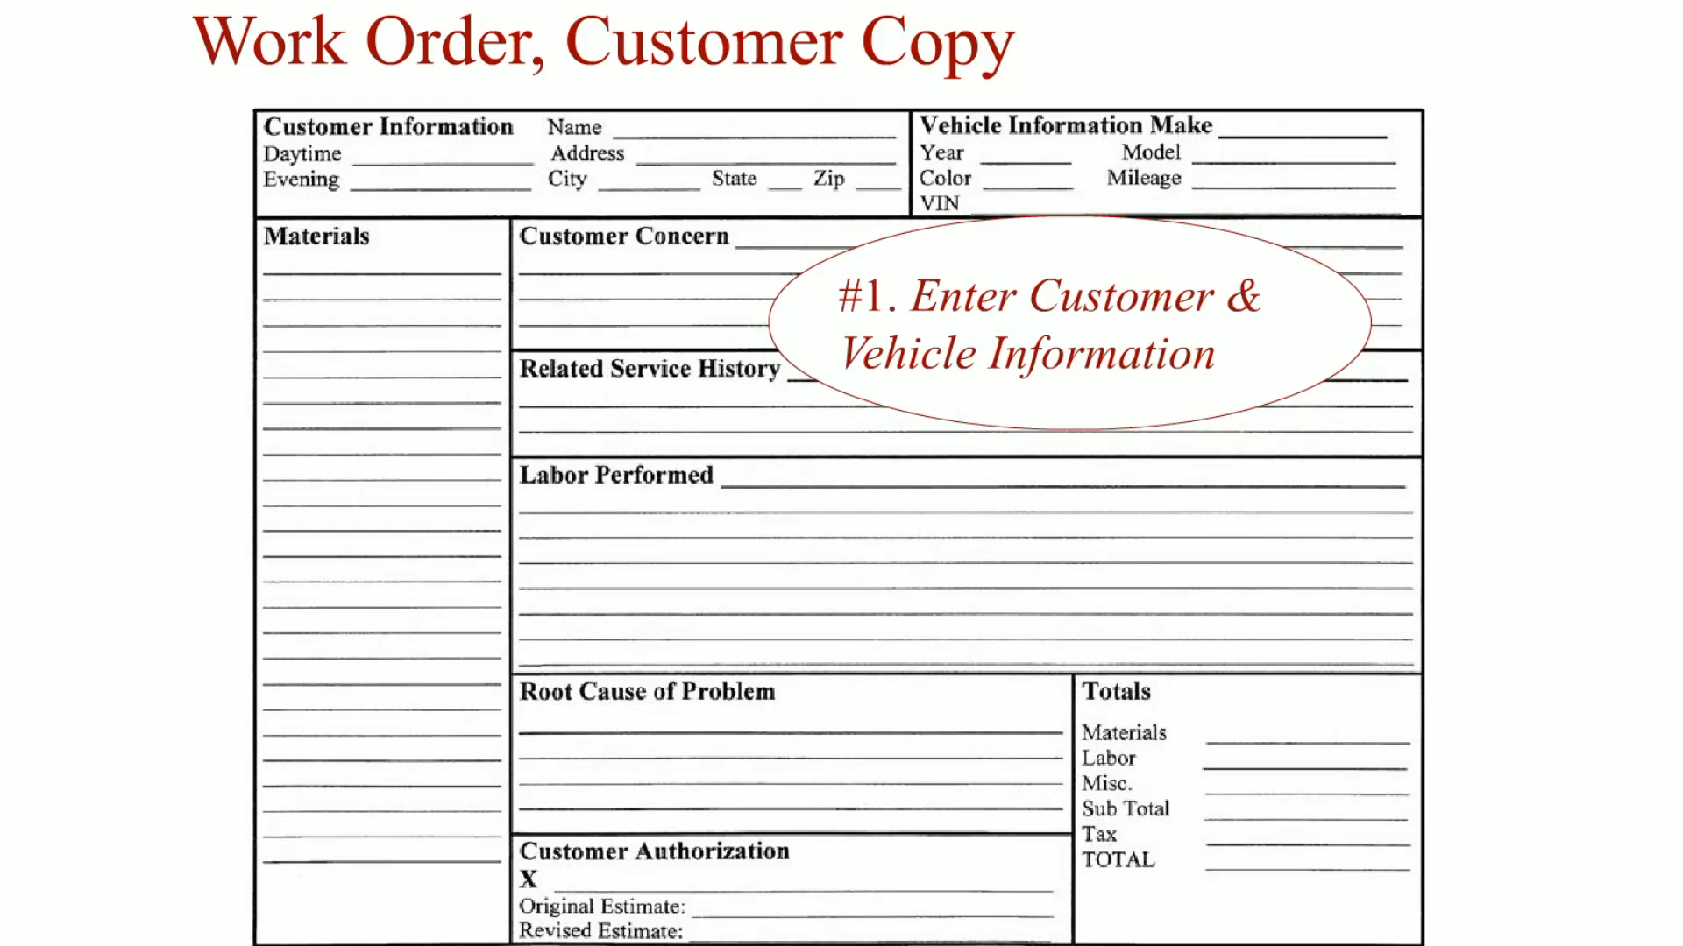
Animation:
Work Order, Customer Copy
(The animation will automatically start in a few seconds)

Slide 23
QUESTION 2: ?
What customer information needs to be included on a repair order (RO)?

Slide 24
ANSWER 2:
The name and address of the owner with contact information, such as the cell phone number and email address.

Slide 25
HOTLINE SERVICES
A subscription-based helpline to assist service technicians solve technical problems.
Hotline services are an efficient way to get information on an as-needed basis.

Slide 26
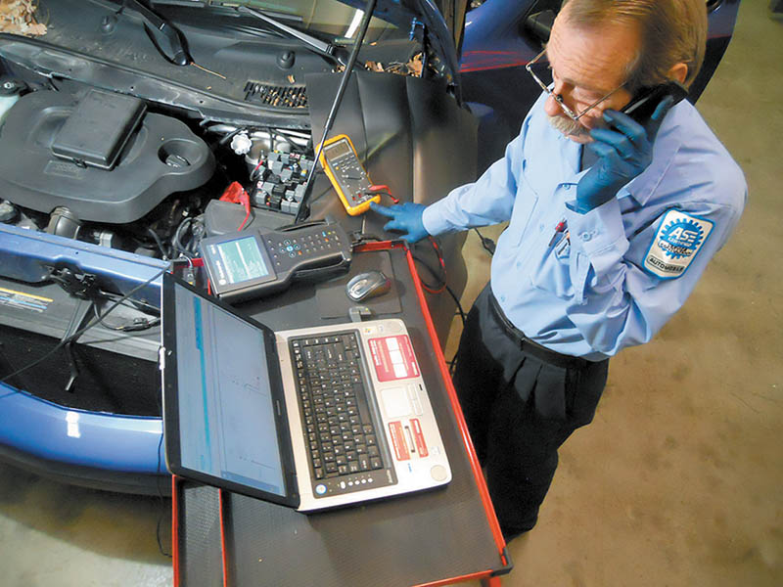
Figure 15.5 Whenever calling a hot line service, be sure that you have all of the vehicle information ready and are prepared to give answers regarding voltage readings or scan tool data when talking to the vehicle specialist

Slide 27
QUESTION 3: ?
How do hotline services and Internet sites assist service technicians?

Slide 28
ANSWER 3:
Hotline services and the Internet are an efficient way to get information on an as-needed basis.

Slide 29
SPECIAL SERVICE TOOLS
Tool rooms typically house all the special tools.
Tools are recommended by the factory.
Tools are sorted by content area and numbered.
More likely to be in a dealership.
Also available to the aftermarket.

Slide 30
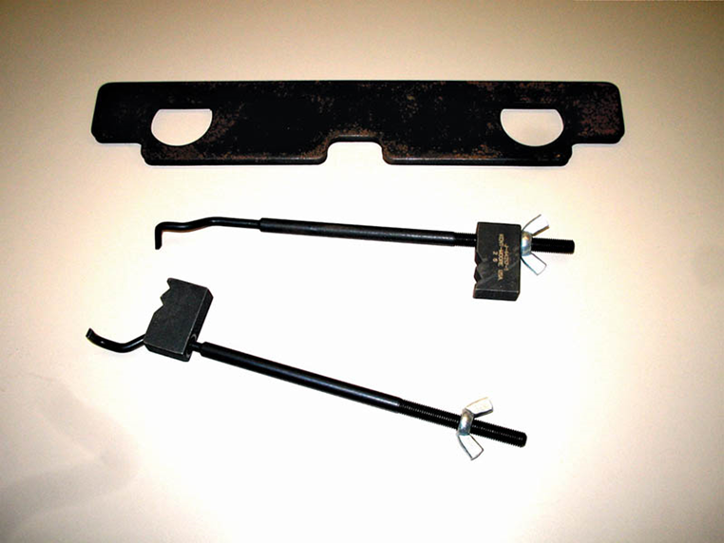
Figure 15.6 The special tool number is printed or stamped on the tool for easy identification. The Kent-Moore part number J- 44217 indicates a tool used to hold a timing chain

Slide 31
Video Links (Internet Access Required)
Writing effective repair orders (time 1:25)
Online service manual (time 4:22)

Slide 32
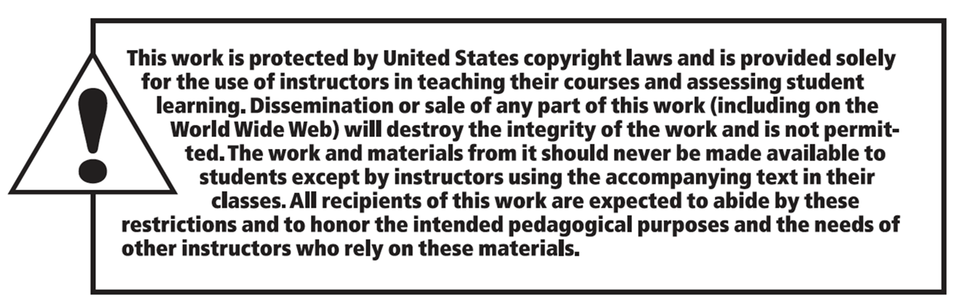
Copyright

