Slide 1
Automotive Technology Principles, Diagnosis, and Service
Sixth Edition
Chapter 13
Scientific Principles and Materials
Copyright © 2018, 2015, 2011 Pearson Education, Inc. All Rights Reserved

Slide 2
LEARNING OBJECTIVES (1 of 2)
13.1 Discuss the use of scientific methods and energy principles in solving problems.
13.2 Explain the relationship between torque, work, power, and horsepower.
13.3 Explain the importance of Newton’s laws of motion, kinetic energy, inertia, and mechanical principles in brake design.

Slide 3
LEARNING OBJECTIVES (2 of 2)
13.4 Discuss the concepts of heat, temperature, pH scale, gas laws, and acoustics.
13.5 Describe the types of plastics, iron, steel, and aluminum alloys.

Slide 4
SCIENTIFIC METHOD
A series of steps taken to solve a problem.
Used to determine the root cause of a failure.
Sometimes referred too as the “5 whys”
The root cause of the problem is typically found by the fifth time the question is asked.

Slide 5
ENERGY PRINCIPLES
Energy is the ability or capacity to do work.
Many forms of energy:
Chemical
Mechanical
Electrical
Kinetic energy is energy in the form of a moving object.
Potential energy is energy that is capable of being changed to useful energy.

Slide 6
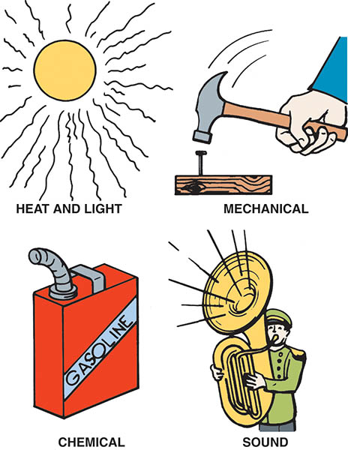
Figure 13.1 Energy, which is the ability to perform work, exists in many forms

Slide 7
QUESTION 1: ?
What is kinetic energy?

Slide 8
ANSWER 1:
Energy in the form of a moving object.

Slide 9
TORQUE
A term used to describe a rotating force that may or may not result in motion.
Measured as the amount of force multiplied by the length of the lever on which it acts.
Typically measured in:
Newton-meters
Pound-foot

Slide 10
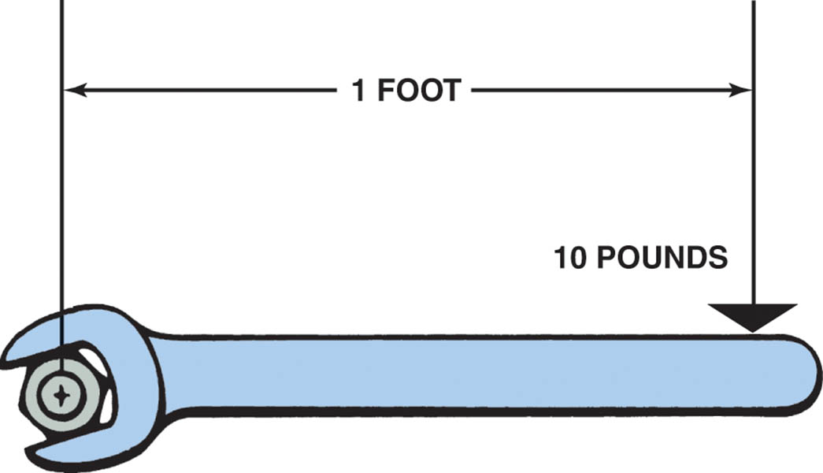
Figure 13.2 Torque is a twisting force equal to the distance from the pivot point times the force applied expressed in units called pound-feet (lb-ft) or Newton-meters (N-m)

Slide 11
Animation: Math Formula Ib in to Lb ft, Torque (The animation will automatically start in a few seconds)

Slide 12
WORK
Work is defined as actually accomplishing movement when force (torque) is applied to an object.
Work is calculated by multiplying the applied force by the distance the object moves.

Slide 13
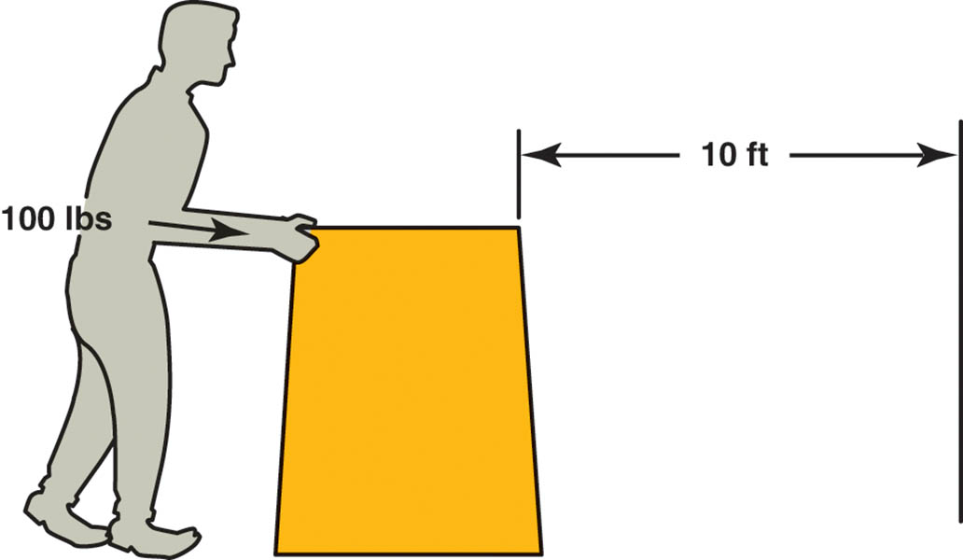
Figure 13.3 Work is calculated by multiplying force times distance. If you push 100 pounds 10 feet, you have done 1,000 foot-pounds of work

Slide 14
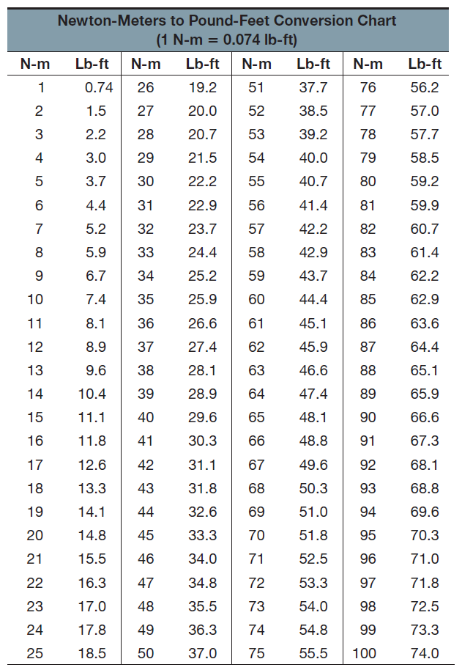
Newton-Meters to Pound-Feet Conversion Chart

Slide 15
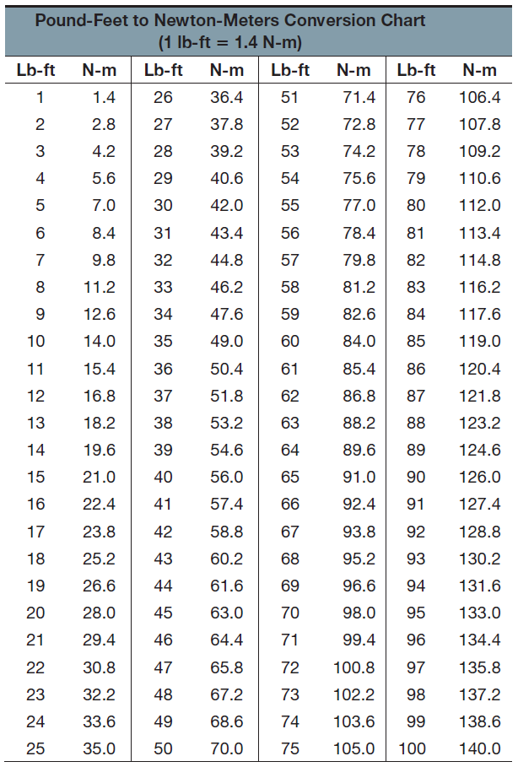
Pound-Feet to Newton-Meters Conversion Chart

Slide 16
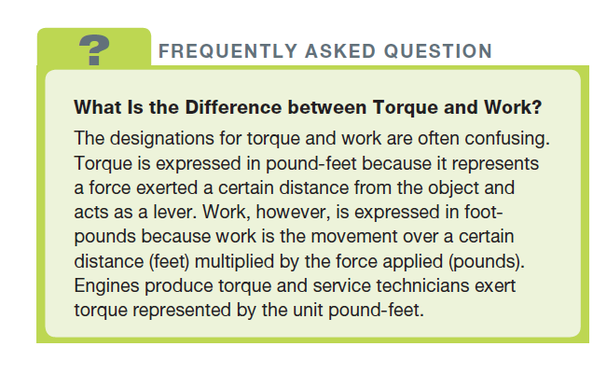
FREQUENTLY ASKED QUESTION

Slide 17
POWER AND HORSEPOWER
Power means the rate of doing work.
Typically expressed in foot-pound per minute
Horsepower is defined as the power needed to move 550 pounds one foot in one second.
Engine horsepower often is measured by a dynamometer.

Slide 18
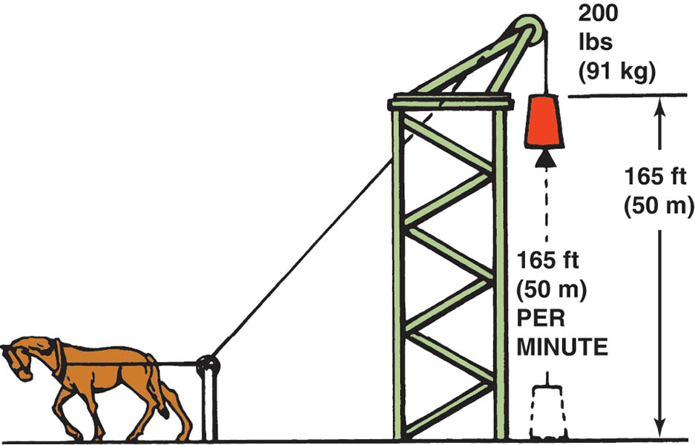
Figure 13.4 One horsepower is equal to 33,000 foot-pounds (200 lbs × 165 ft) of work per minute

Slide 19
Animation: Math Formula: Horsepower (The animation will automatically start in a few seconds)

Slide 20
QUESTION 2: ?
What is the difference between torque and power?

Slide 21
ANSWER 2:
Torque is a force and power is the rate of doing work.

Slide 22
NEWTON’S LAWS OF MOTION
1. Newton’s first law of motion states that an object at rest tends to stay at rest and an object in motion tends to stay in motion unless acted on by an outside force.
2. Newton’s second law of motion states that the force needed to move an object is proportional to the mass of the object multiplied by the acceleration rate of the object.
3. Newton’s third law of motion states that for every action, there is an opposite and equal reaction.
.

Slide 23
KINETIC ENERGY
The energy of mass in motion.
Every moving object possesses kinetic energy.
The amount of energy is determined by the speed and mass of the object.
The greater the mass or the faster the speed, the more kinetic energy.

Slide 24
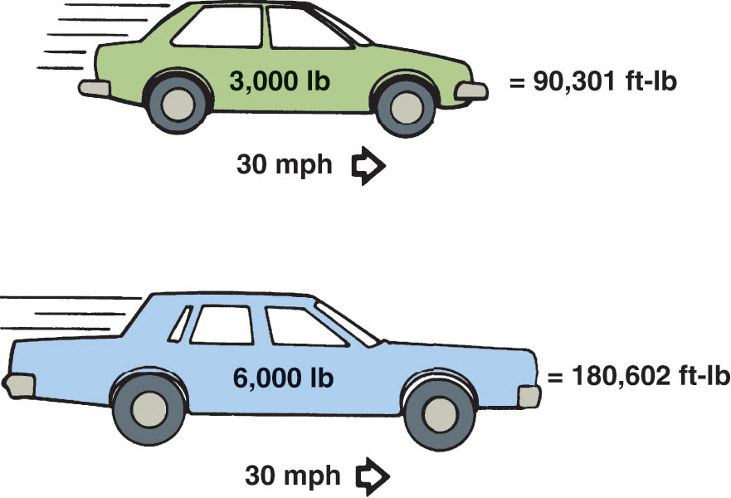
Figure 13.5 Kinetic energy increases in direct proportion to the weight of the vehicle

Slide 25
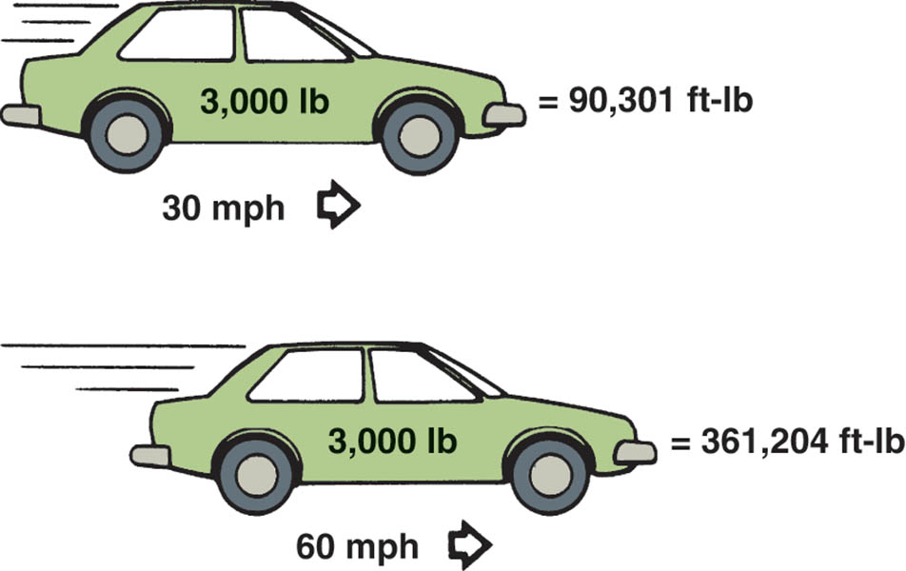
Figure 13.6 Kinetic energy increases as the square of any increase in vehicle speed

Slide 26
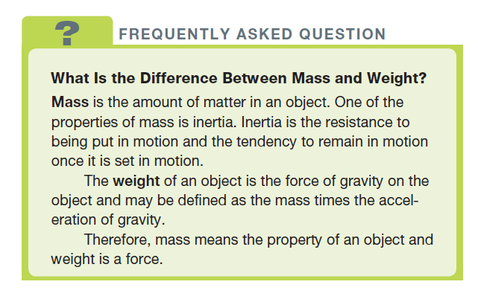
FREQUENTLY ASKED QUESTION

Slide 27
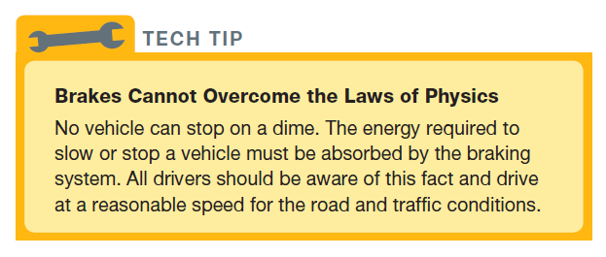
TECH TIP

Slide 28
MECHANICAL PRINCIPLES
Leverage: Used to increase application force.
Fulcrum: A fixed point that is used for a pivot.
Three basic types of levers.
All change a quantity of energy into a useful form.

Slide 29
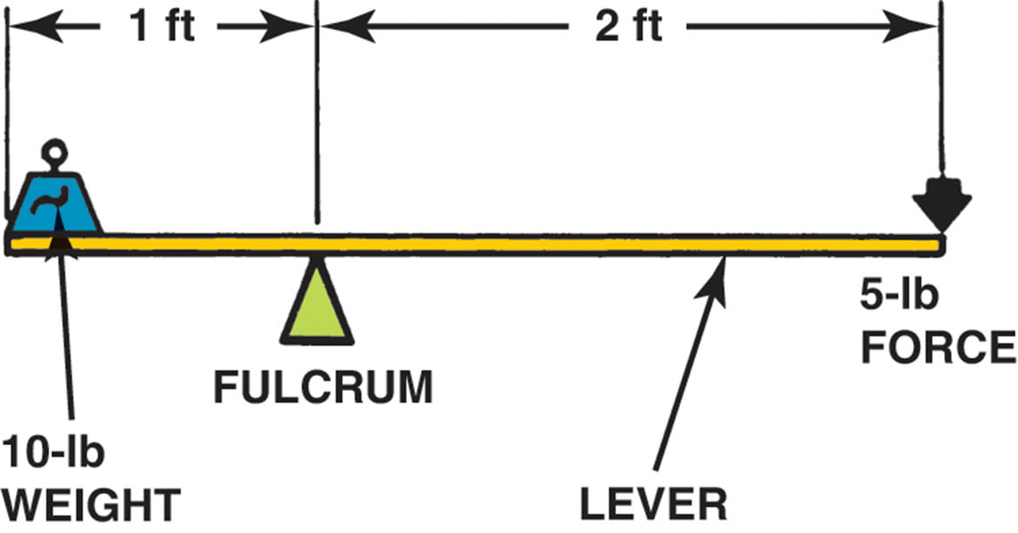
Figure 13.7 A first-class lever increases force and changes the direction of the force

Slide 30
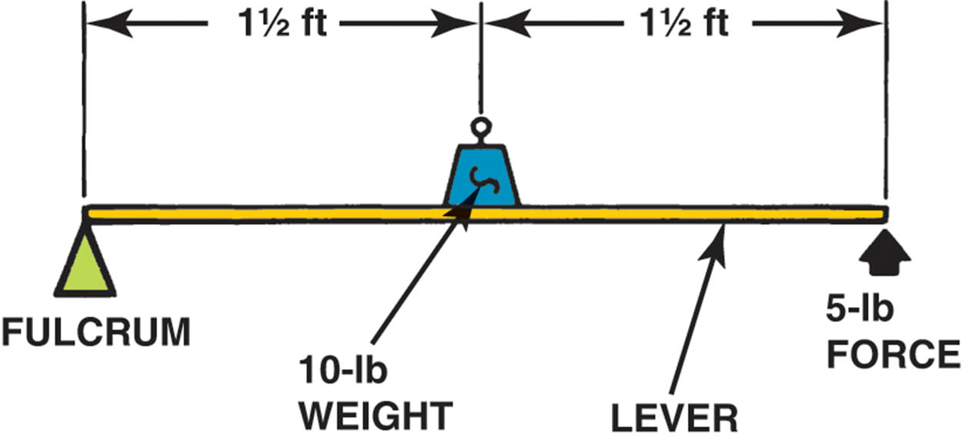
Figure 13.8 A second-class lever increases force in the same direction as it is applied

Slide 31
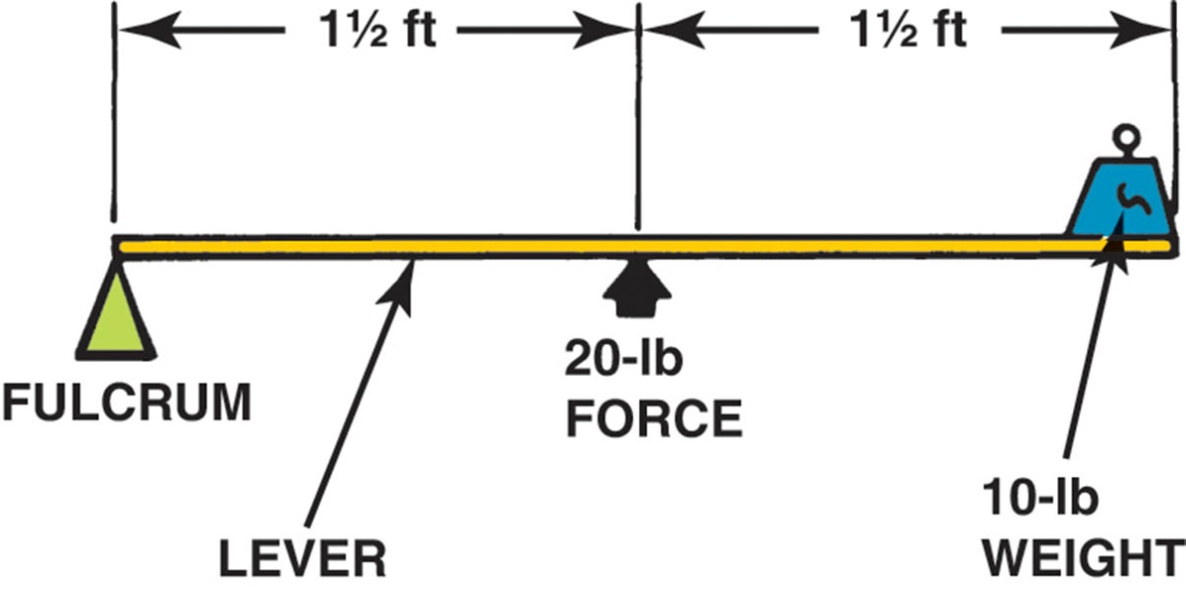
Figure 13.9 A third-class lever reduces force but increases the speed and travel of the resulting work

Slide 32
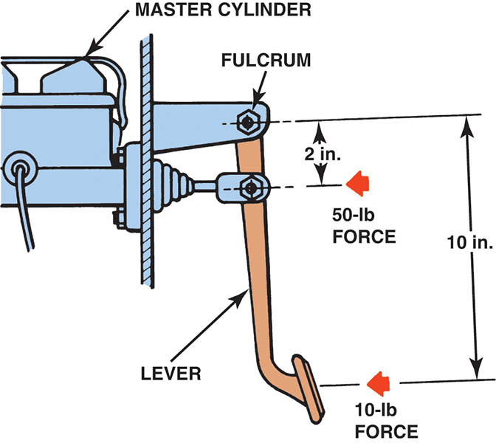
Figure 13.10 This brake pedal assembly provides a 5:1 mechanical advantage because a 10-lb force input results in a 50-lb force into the master cylinder

Slide 33
HEAT AND TEMPERATURE
Heat is measured in British Thermal Units (BTUs)
One BTU is the amount of heat needed to the temperature of one pound of water one degree Fahrenheit.
Heat transferred three ways:
Conduction
Convection
Radiation
Temperature is the measurement of the ability to give up or absorb heat.
Measured in Celsius or Fahrenheit

Slide 34
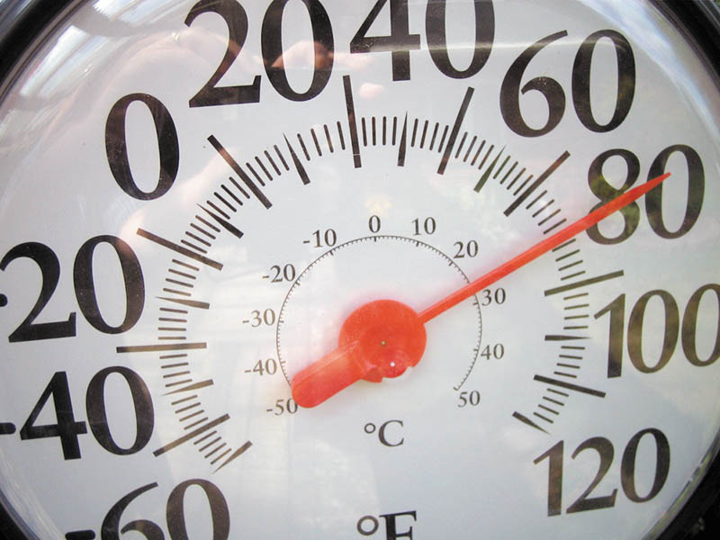
Figure 13.11 A typical outdoor thermometer which is used to measure temperature, not heat

Slide 35
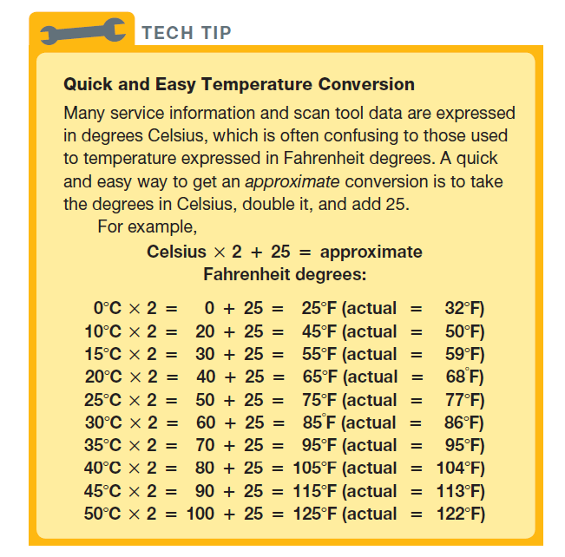
Tech Tip

Slide 36
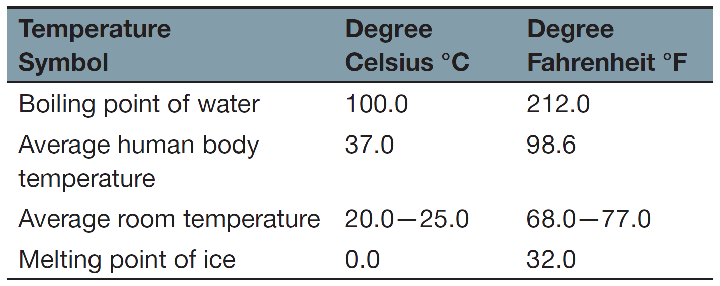
Temperature

Slide 37
Animation: Math Formula Metric-English Conversion: Temperature (The animation will automatically start in a few seconds)

Slide 38
ACIDS AND BASES
Acids: Substances that can corrode metal or cause severe skin burns. Include hydrochloric acid, nitric acid, and battery acid.
Bases: An alkaline that if strong enough can burn skin. Include: lye, bleach, drain cleaner.
pH Scale: On a scale of 1-14; used to indicate the amount of chemical activity in a substance.

Slide 39
GAS LAWS
Boyle’s Law: The volume of a gas varies inversely (opposite) with the pressure exerted against it in a closed container.
Charles's Law: When the temperature of a gas increases, the volume increases. When the temperature of a gas decreases, the volume decreases.

Slide 40
Animation: Math Formula English to Metric, Pressure (The animation will automatically start in a few seconds)

Slide 41
Animation: Math Formula Metric to English, Pressure (The animation will automatically start in a few seconds)

Slide 42
SOUND AND ACOUSTICS
Sound: The movement of air that the ear interprets.
Sound has two properties:
Frequency: cycles per second
Intensity: The loudness of the sound
Acoustics: The study of how sound is generated and transmitted.
Used to reduce noise that is transmitted to passenger compartment.

Slide 43
PLASTICS
Thermoset Plastic: This type of plastic is changed chemically when cured and shaped and cannot be reheated or reformed.
Thermoplastic: This type of plastic is flexible at room temperature.
Plastic Identification: Most large plastic pieces are labeled on the inside with letters, such as PP or PE.
A burn test can be used to identify plastic type if no labeling is present.

Slide 44
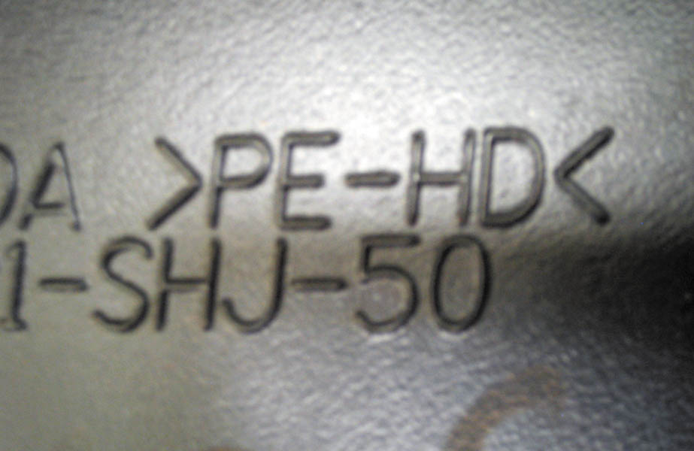
Figure 13.12 This interior plastic part is labeled PE-HD, which means polyethylene-high density

Slide 45
QUESTION 3: ?
How can a burn test help identify the type of plastic used?

Slide 46
ANSWER 3:
No visible smoke means that the plastic is polypropylene. Visible black smoke means that the plastic is ABS.

Slide 47
IRON AND STEEL
Cast Iron: Cast iron contains 2% to 4% carbon and this carbon is usually in the shape of flakes of graphite 0.001 to 0.004 inches long.
Ductile Cast Iron: The carbon in the alloy with silicon are small ball-shapes called spherloidols.
Grey Cast Iron: Gray cast iron is cast iron that has another element, silicon, in the alloy, giving the metal a gray color.

Slide 48
SAE STEEL DESIGNATIONS
Mild (low carbon) steel: Has less than 20 points of carbon (0.02%).
Medium carbon steel: Usually has between 25 and 50 points of carbon (0.25% and 0.50%).
High carbon steel: Usually has between 60 and 100 points (0.60% and 1.00%) of carbon and is very strong.

Slide 49
ALUMINIUM AND ALUMINIUM ALLOYS
Lightweight material
Most always combined with small quantities of other metals to form an alloy.
Alloys are identified with a four-digit number and a letter to identify heat treating.

Slide 50
Video Links (Internet Access Required)
The Scientific Method (time 10:39)
Work and work energy principles (time 5:47)
Torque (time 9:56)
Newton’s First Law of Motion (time 9:32)
Potential and Kinetic Energy (time 6:06)
Mass and Inertia (time 6:08)
SAE Steel Grades (time 9:49)

Slide 51
Copyright

