Slide 1
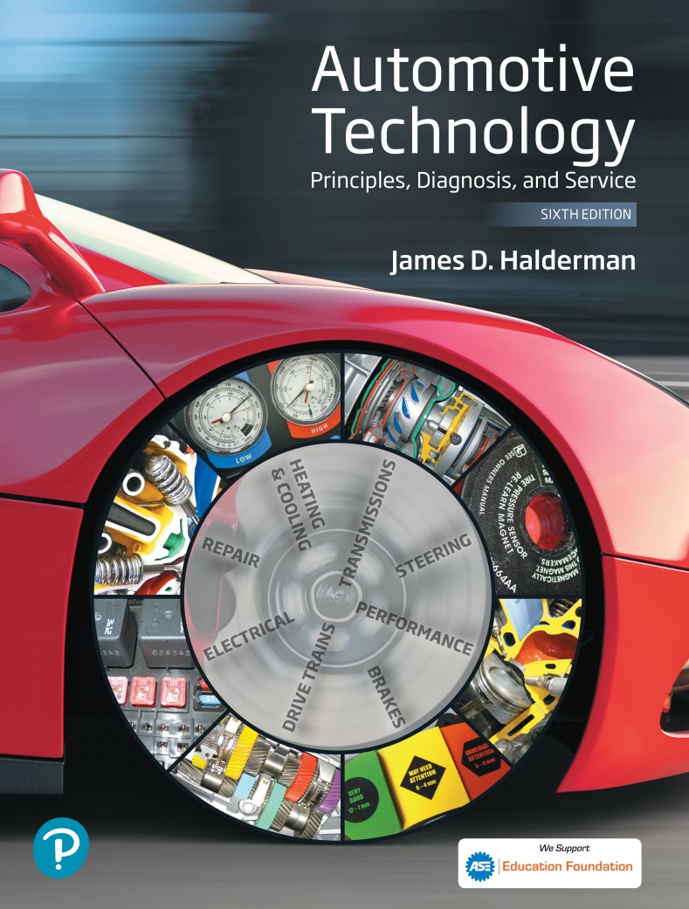
Automotive Technology Principles, Diagnosis, and Service
Sixth Edition
Chapter 127
Manual Transmissions/ Transaxles
Copyright © 2018, 2015, 2011 Pearson Education, Inc. All Rights Reserved

Slide 2
LEARNING OBJECTIVES (1 of 2)
127.1 Discuss the need for a transmission.
127.2 Explain the different types of gears and gear ratios.
127.3 Describe the relationship between torque, speed, and power.
127.4 Describe the construction of a transmission.
127.5 Describe the torque flow through a manual transmission.

Slide 3
LEARNING OBJECTIVES (2 of 2)
127.6 Describe speed gears.
127.7 Explain the construction and operation of a synchronizer.
127.8 Describe the torque flow through a five-speed manual transmission.
127.9 Describe the procedure to diagnose, remove, disassemble, and install manual transmission/transaxle.

Slide 4
THE NEED FOR A TRANSMISSION
A vehicle requires a lot of torque to start off and to climb hills, yet it does not require as much torque to move on level ground.
Using gears allows the engine speed to increase at low vehicle speeds yet still permits the engine speed to drop at higher speeds to save fuel and reduce exhaust emissions.

Slide 5
GEAR TYPES (1 OF 2)
Spur Gear
A spur gear consists of a gear blank with straight-cut teeth around its entire circumference.
Helical Gear
A helical gear, although similar to a spur gear, has its teeth cut at an angle to the axis of the gear.
External Gears
Gear teeth on their outside circumference

Slide 6
GEAR TYPES (2 OF 2)
Internal Ring Gears
Gears having teeth along the inside circumference.
Bevel Gears
The teeth of a bevel gear are cut at an angle to the outside gear surface.
Hypoid Gears
Hypoid gear sets have gear teeth that are curved much like the teeth of a spiral bevel gear.

Slide 7
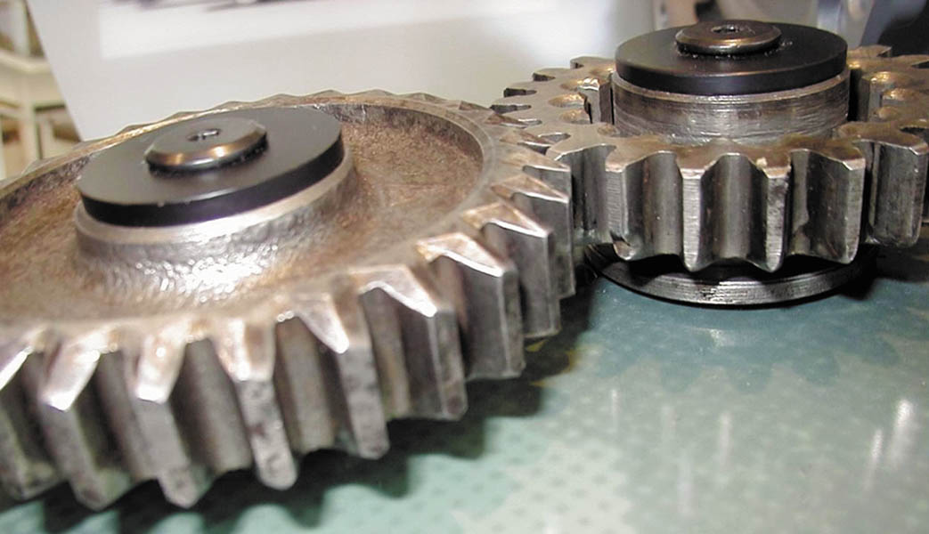
Figure 127.1 Spur gears have straight-cut teeth

Slide 8
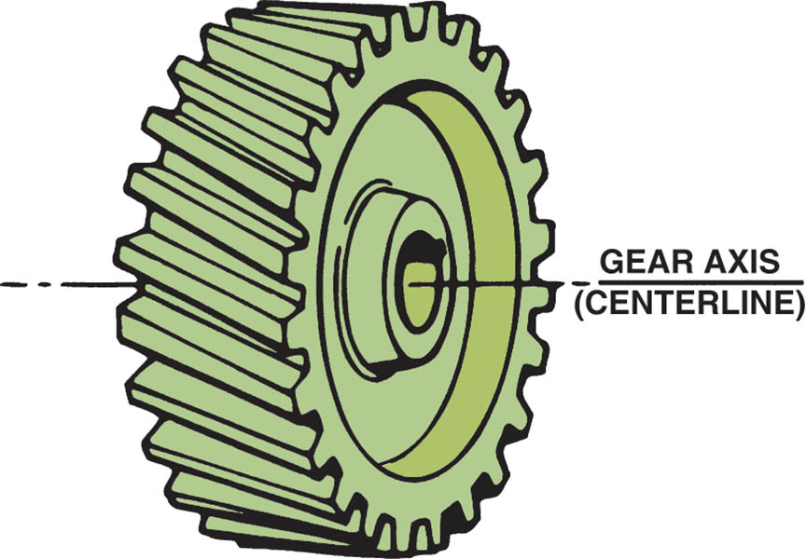
Figure 127.2 The teeth of a helical gear are cut at an angle to the gear axis

Slide 9
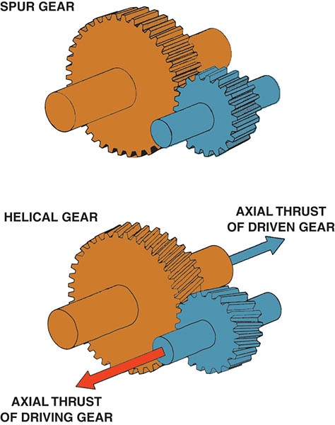
Figure 127.3 A spur gear has straight-cut teeth. This design is very strong and is used where strength is important. Spur gears are noisy during operation. Helical-cut gears, on the other hand, operate quietly but create a force in line with the axis of the gears due to the angle of the gear teeth

Slide 10
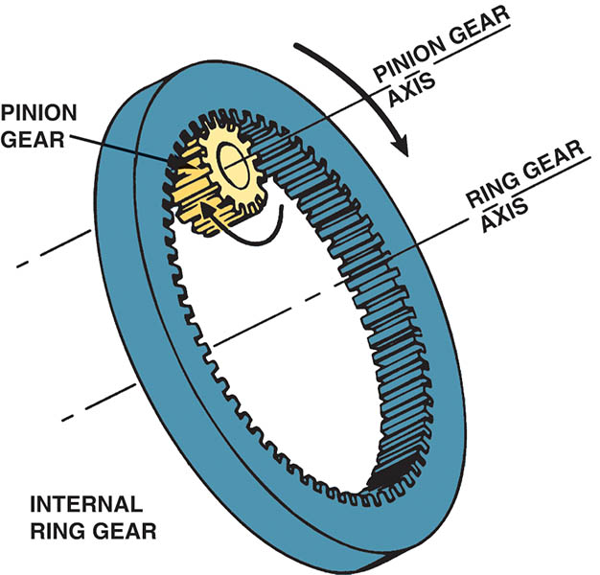
Figure 127.4 A pinion gear meshed with an internal ring gear rotates in the same direction around a parallel axis of rotation

Slide 11
Animation: Internal & External Gear (The animation will automatically start in a few seconds)

Slide 12
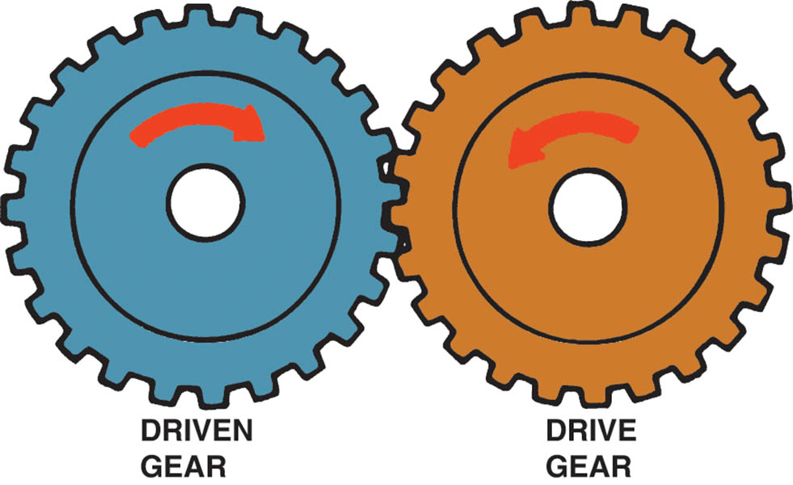
Figure 127.5 When two external gears mesh, they rotate in opposite directions

Slide 13
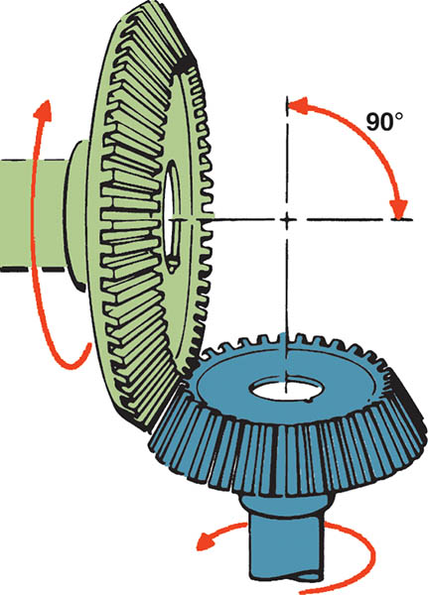
Figure 127.6 Bevel gears are often used to change the direction of rotation and are typically used in differentials

Slide 14
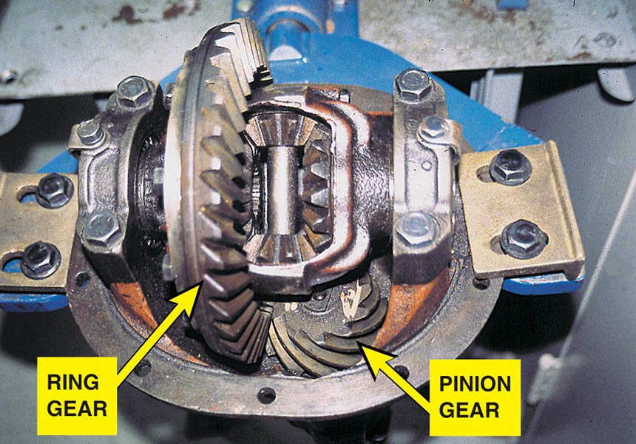
Figure 127.7 A differential uses a hypoid gear set to provide a change in the direction of torque and for gear reduction (torque increases) to the drive wheels

Slide 15
GEAR RATIOS (1 OF 3)
Gear ratio is expressed as the number of rotations the drive gear must make in order to rotate the driven gear through one revolution.
Gear ratios, which are expressed relative to the number one, fall into three categories:
Direct drive
Gear reduction
Overdrive

Slide 16
GEAR RATIOS (2 OF 3)
Direct Drive
If two meshed gears are the same size and have the same number of teeth, they will turn at the same speed.
Gear Reduction
If one gear drives a second gear that has three times the number of teeth, the smaller drive gear must travel three complete revolutions in order to drive the larger gear through one rotation.

Slide 17
GEAR RATIOS (3 OF 3)
Overdrive
Overdrive is the opposite of a gear reduction condition and occurs when a driven gear turns faster than its drive gear.
Idler Gears
A gear that operates between the drive and driven gears is called a floating gear, or idler gear.
Idler gears affect direction of rotation not the speed of the gear.

Slide 18
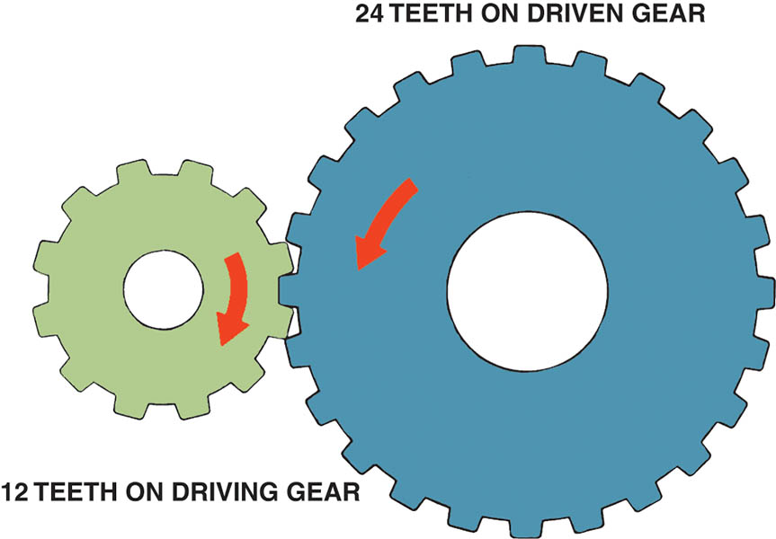
Figure 127.8 Gear ratio is determined by dividing the number of teeth of the driven (output) gear (24 teeth) by the number of teeth on the driving (input) gear (12 teeth). The ratio illustrated is 2:1

Slide 19
Animation: External Gears: 2:1 (The animation will automatically start in a few seconds)

Slide 20
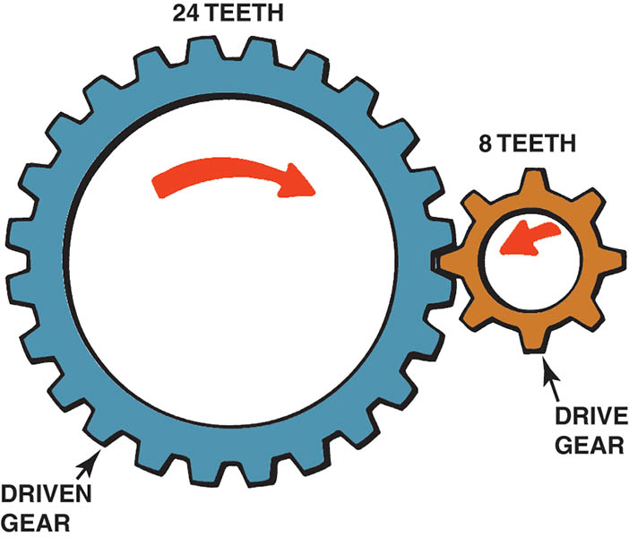
Figure 127.9 This gear combination provides a gear reduction of 3:1

Slide 21
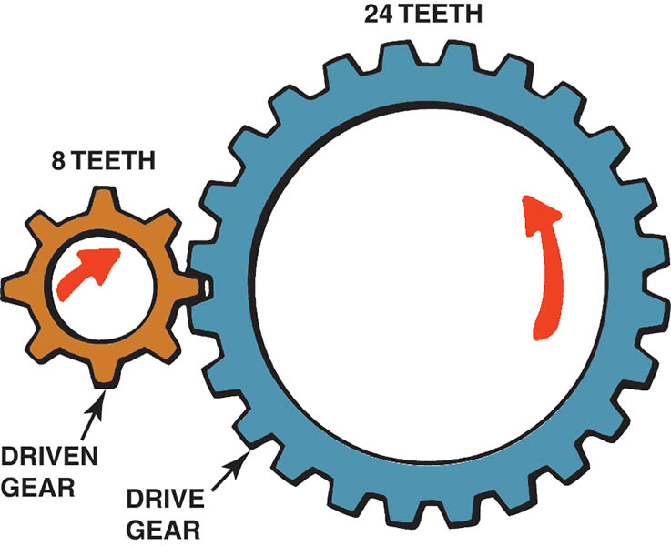
Figure 127.10 This gear combination provides an overdrive ratio of 0.33:1

Slide 22
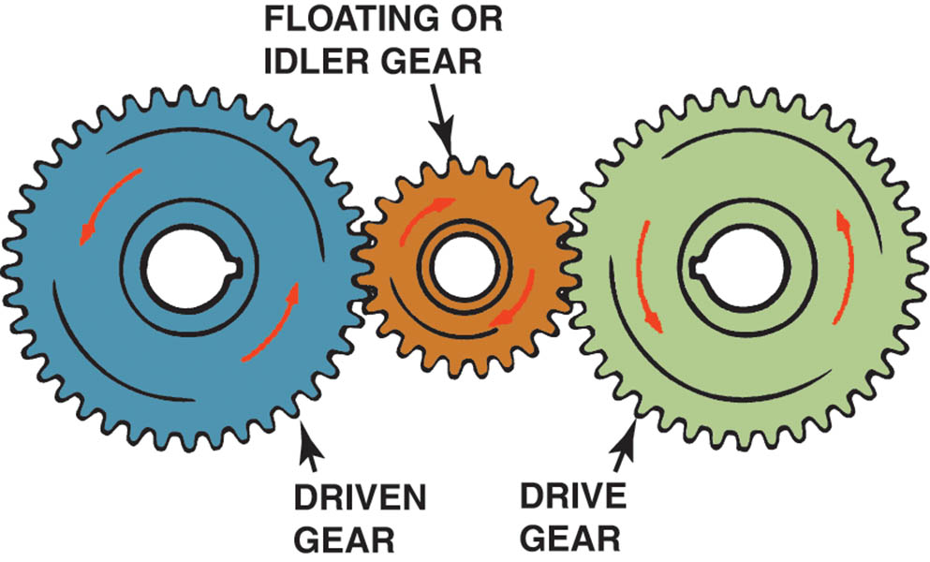
Figure 127.11 Idler gears affect the direction of rotation in a gear train, but not the final drive ratio

Slide 23
Animation: External Gears with Idler (The animation will automatically start in a few seconds)

Slide 24
QUESTION 1: ?
In an overdrive gear ratio what is the relationship between the drive and driven gear?

Slide 25
ANSWER 1:
The driven gear turns faster than its drive gear.

Slide 26
TOEQUE, SPEED, AND POWER
Gears apply torque much like a wrench does; each tooth of a gear is actually a lever.
Torque and Speed Relationship
Torque and speed have an inverse relationship: as one goes up, the other goes down.
Torque Multiplication
Levers can be used to increase or multiply torque.
Either distance or speed must always be given up in order to increase, or multiply, torque.

Slide 27
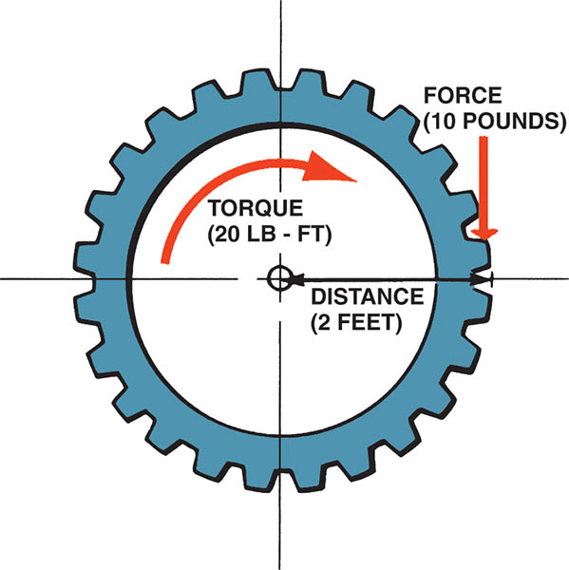
Figure 127.12 Gears apply torque in the same way a wrench applies torque—the force applied multiplied by the distance from the center of the gear equals the torque

Slide 28
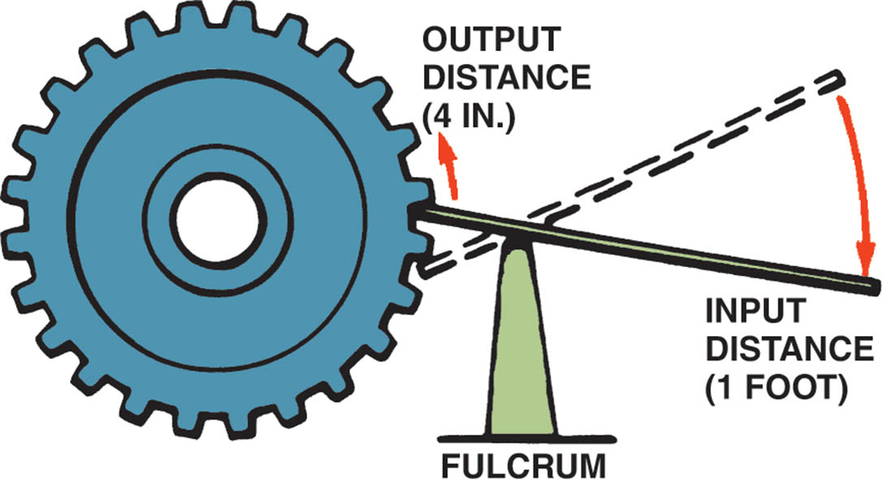
Figure 127.13 A lever can be used to multiply torque, but it does so at the expense of distance or speed

Slide 29
TRANSMISSION CONSTRUCTION (1 OF 2)
A transmission is usually constructed of cast aluminum.
The front of the transmission attaches to a separate bell housing.
At the front of the transmission (toward the engine) is the front bearing retainer.
The rear of the transmission usually includes a separate casting called the extension housing.

Slide 30
TRANSMISSION CONSTRUCTION (2 OF 2)
The center housing is usually referred to as the transmission case.
The input shaft is splined to the clutch disc and is also referred to as the main gear, clutch gear, or main drive pinion assembly.
The main shaft, also called the output shaft.
All manual transmissions/transaxles use a countershaft.

Slide 31
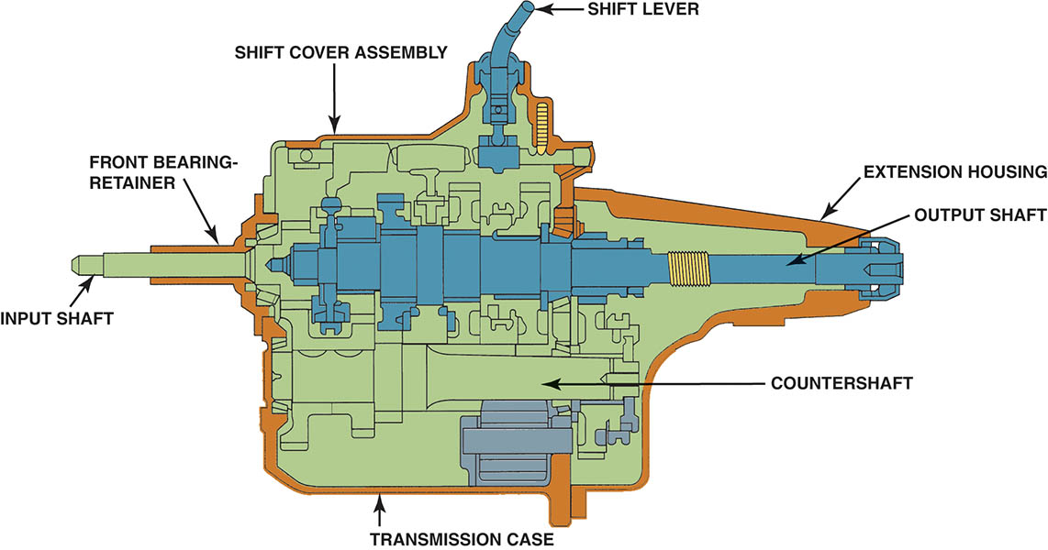
Figure 127.14 Cross section of a five-speed manual transmission showing the main parts

Slide 32
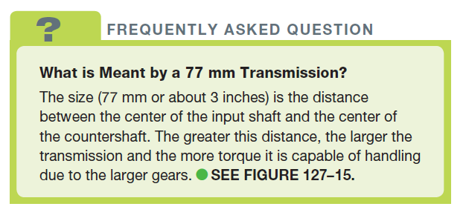
FREQUENTLY ASKED QUESTION

Slide 33
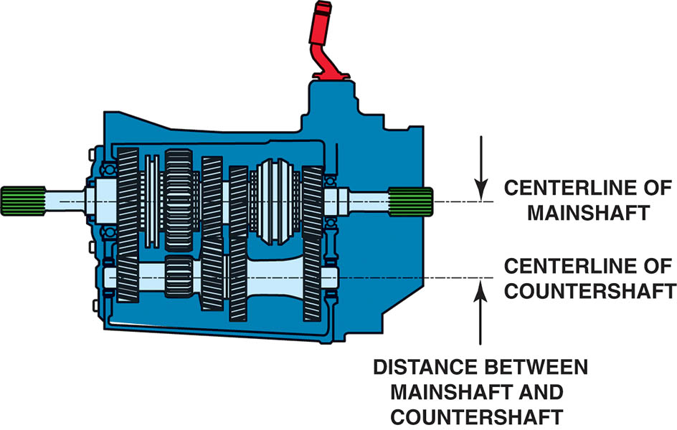
Figure 127.15 The torque capacity of a transmission is determined by the size of the gear and bearings used. The greater the distance, usually measured in millimeters such as 77 mm, between the main shaft and the countershaft, the greater the torque capacity

Slide 34
Animation: Transmission Power Flow (The animation will automatically start in a few seconds)

Slide 35
TORQUE FLOW THROUGH A MANUAL TRANSMISSION
The engine torque is applied to the input shaft when the clutch is engaged (clutch pedal up).
This torque is applied to the main gear.
The engine torque is multiplied by the ratio difference between the main gear and the cluster gear.
The engine torque then is applied to the drive wheels through the driveshaft, differential, and drive axles.

Slide 36
SPEED GEARS
The gears on the main shaft are free to move on the shaft and are connected to the main shaft through the synchronizer hub when a shift is made.
The gears that rotate on the main shaft are called speed gears and are free to rotate on a film of oil or on bearings.

Slide 37
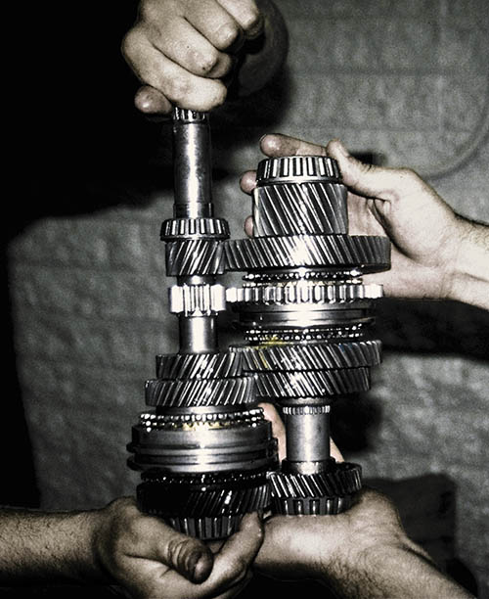
Figure 127.16 Notice that the countershaft and the main shaft both use gears of increasing size that mesh together

Slide 38
SYNCHRONIZER PARTS AND OPERATION (1 OF 2)
Interlocks either in the shifter linkage itself or inside the transmission/transaxle prevent selecting two gears at the same time.
Synchronizers are used in manual transmissions/transaxles to make shifting easier.
To synchronize means to make two or more events occur at the same time.
The synchronizer ensures the two gears to be meshed must be rotating at the same speed.

Slide 39
SYNCHRONIZER PARTS AND OPERATION (2 OF 2)
Synchronizer Construction
Although there are a number of design variations, all are similar and include a hub, a sliding sleeve, a blocker ring, (or stop ring or synchronizer ring), keys, and springs.
Synchronizer Operation
When a force on the sleeve that moves it toward the speed gear. The sleeve and the inserts contact the stop ring (blocking ring). The synchronizer ring (stop ring) engages the cone on the speed gear, causing both assemblies to reach the same speed.

Slide 40
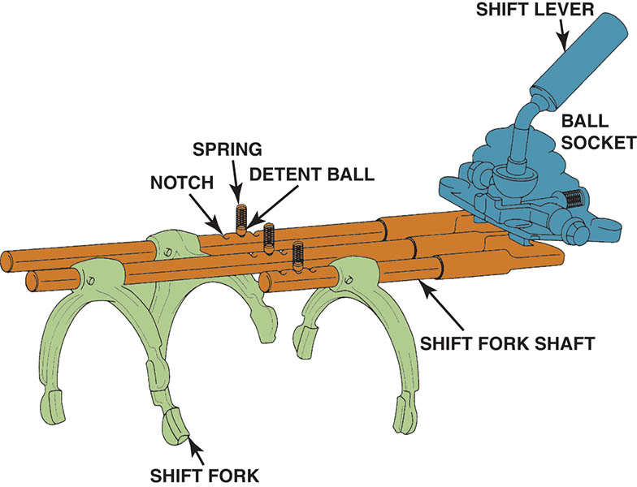
Figure 127.17 A typical shift mechanism is designed to not only give the driver a solid feel when shifting, but also prevents shifting into reverse except from the neutral position

Slide 41
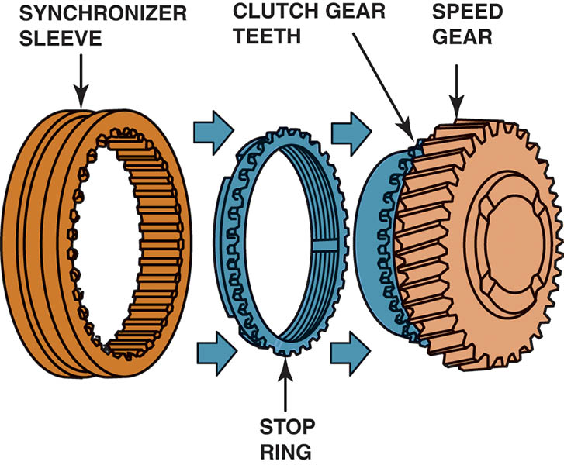
Figure 127.18 When a shift is made, the sleeve is moved toward the speed gear. The sleeve presses the stop ring against the cone area of the speed gear. The friction between the stop ring and the speed gear causes the speed of the two to become equal, permitting the sleeve to engage the gear clutch teeth of the speed gear.

Slide 42
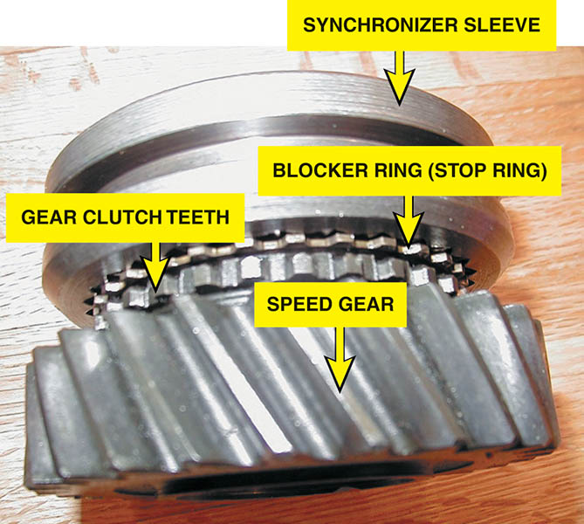
Figure 127.19 Typical synchronizer assembly

Slide 43
Animation: Check Blocker Ring Clearance (The animation will automatically start in a few seconds)

Slide 44
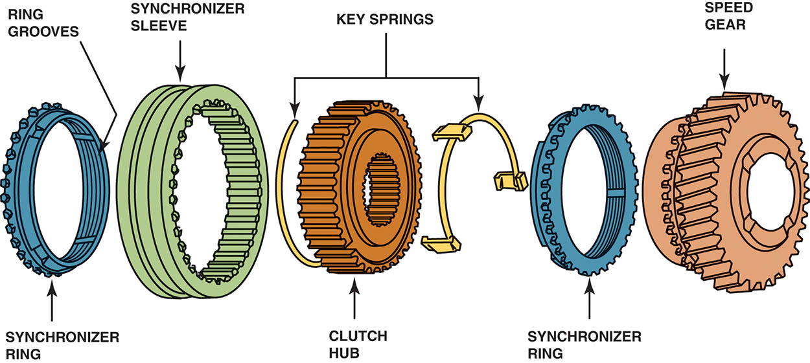
Figure 127.20 Synchronizer keys are attached to the clutch hub and push against the synchronizer ring when the sleeve is being moved during a shift. Notice the grooves on the synchronizer ring. These grooves prevent lubricating oil from becoming trapped between the ring and the cone surface of the speed gear.

Slide 45
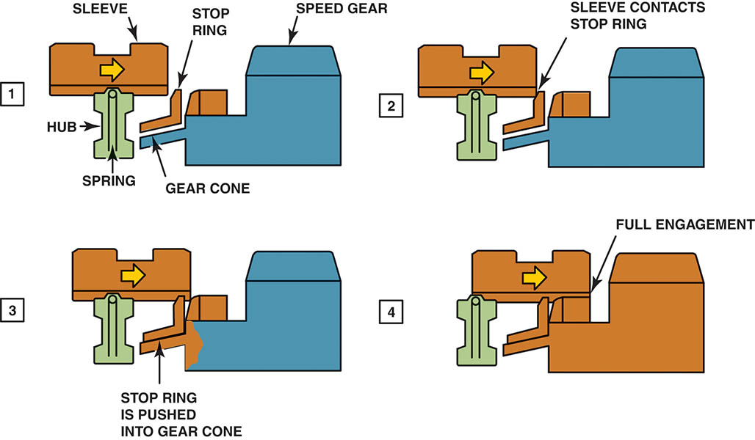
Figure 127.21 A shift sequence starts when the shift fork applies a force on the sleeve that moves it toward the speed gear. (2) The sleeve and the inserts contact the stop ring. (3) The synchronizer ring engages the cone on the speed gear, causing both assemblies to reach the same speed. (4)

Slide 46
Animation: Synchronizer Operation (The animation will automatically start in a few seconds)

Slide 47
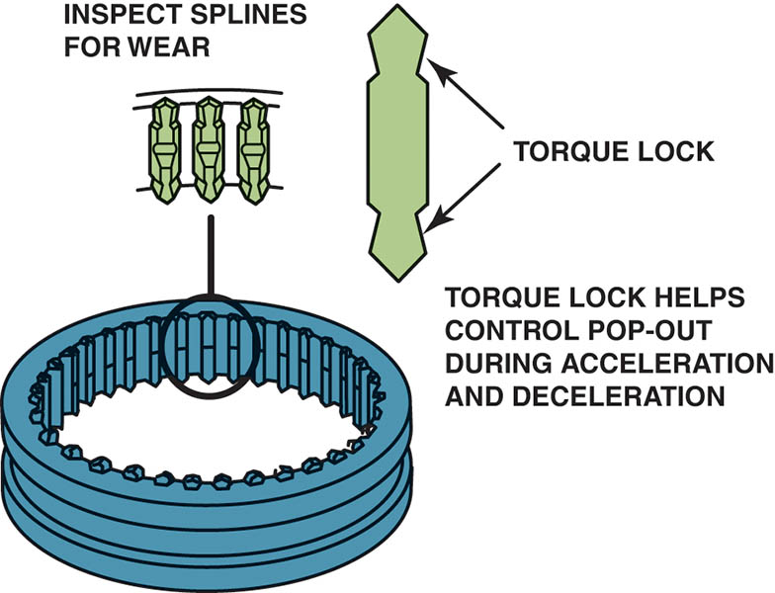
Figure 127.22 Before reassembling the transmission/transaxle, carefully inspect the splines on the synchronizer sleeves for wear. The shape of the splines helps prevent the transmission/transaxle from jumping out of gear during acceleration and deceleration

Slide 48
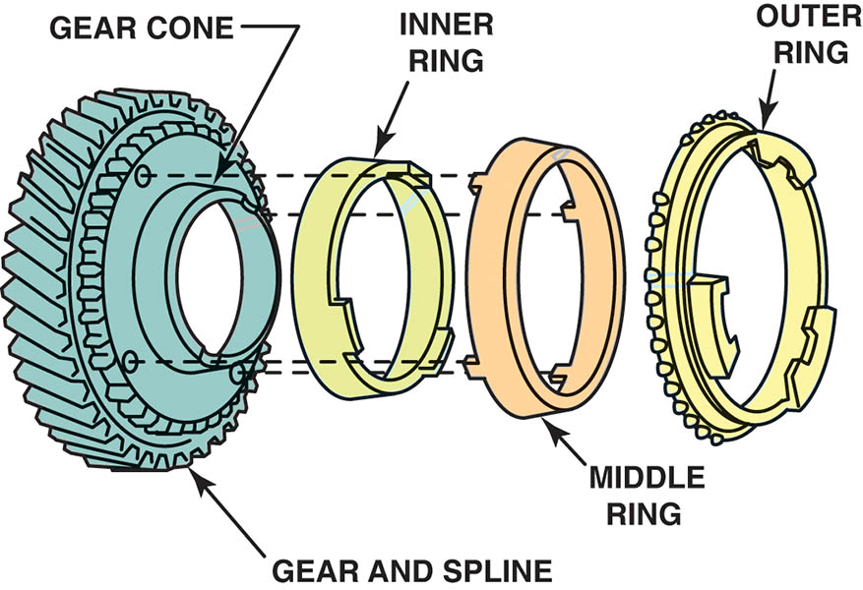
Figure 127.23 Exploded view of a triple-cone synchronizer. The inner and outer rings rotate with the synchronizer sleeve while the middle ring rotates with the speed gear

Slide 49
QUESTION 2: ?
What is the purpose of the synchronizer?

Slide 50
ANSWER 2:
The synchronizer ensures the two gears to be meshed must be rotating at the same speed.

Slide 51
FIVE SPEED TRANSMISSION TORQUE FLOW (1 OF 3)
Neutral
All of the synchronizer sleeves are centered on their hubs.
First Gear
In first gear, the shift linkage slides the 1–2 synchronizer sleeve rearward toward the first speed gear.
Second Gear
In second gear, the shift linkage slides the 1–2 synchronizer sleeve forward, away from the first speed gear and toward the second speed gear.

Slide 52
FIVE SPEED TRANSMISSION TORQUE FLOW (2 OF 3)
Third Gear
In third gear, the shift linkage centers the 1–2 synchronizer sleeve and moves the 3–4 synchronizer sleeve back toward the third speed gear.
Fourth Gear
In fourth gear, the shift linkage moves the 3–4 synchronizer sleeve forward, away from the third speed gear and toward the input shaft drive gear.

Slide 53
FIVE SPEED TRANSMISSION TORQUE FLOW (3 OF 3)
Fifth Gear
In fifth gear, the shift linkage centers the 3–4 synchronizer sleeve and moves the fifth synchronizer sleeve toward the fifth speed gear.
Reverse
There are two common reverse gear designs used on transmissions:
Sliding gear
Constant-mesh gear

Slide 54
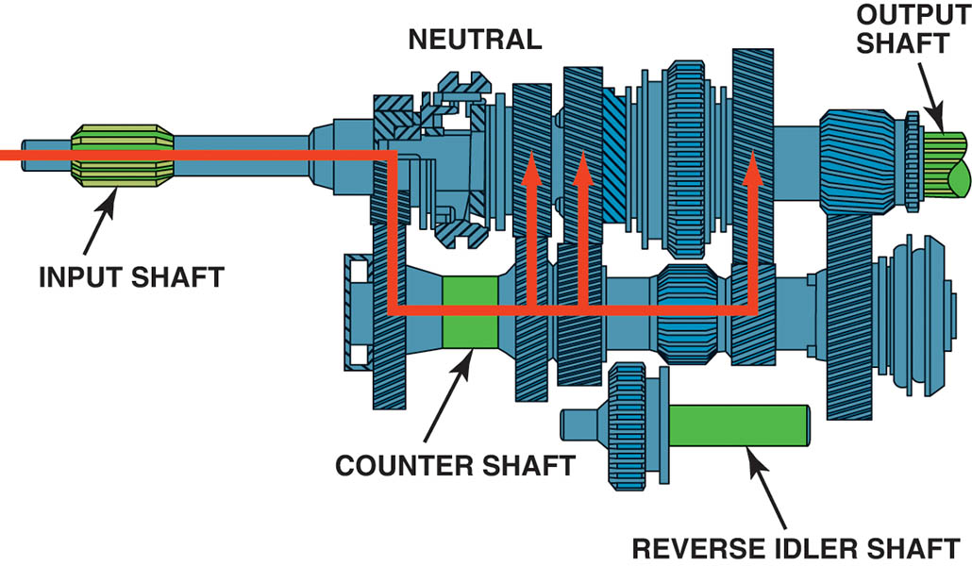
Figure 127.24 In neutral, the input shaft and the countershaft are rotating if the clutch is engaged (clutch pedal up), but no torque is being transmitted through the transmission

Slide 55
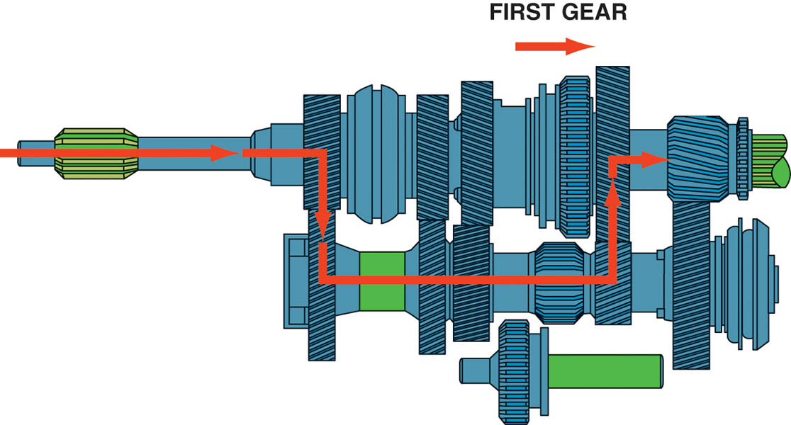
Figure 127.25 In first gear, the 1–2 synchronizer sleeve is moved rearward, locking the first speed gear to the output shaft. Torque is transmitted from the input shaft to the countershaft and then to the output shaft

Slide 56
Animation: 5-Speed Transmission, 1st Gear (The animation will automatically start in a few seconds)

Slide 57
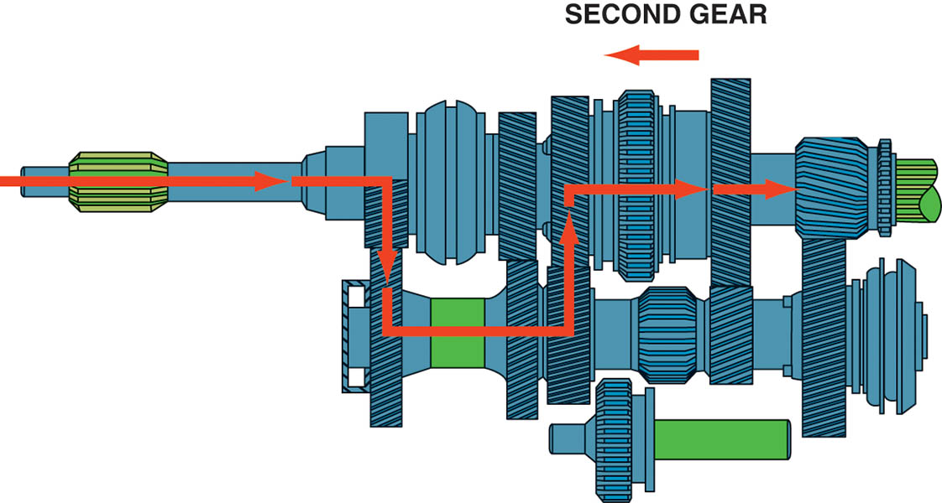
Figure 127.26 In second gear, the 1–2 synchronizer sleeve is moved forward, which locks the second speed gear to the output shaft

Slide 58
Animation: 5-Speed Transmission, 2nd Gear (The animation will automatically start in a few seconds)

Slide 59
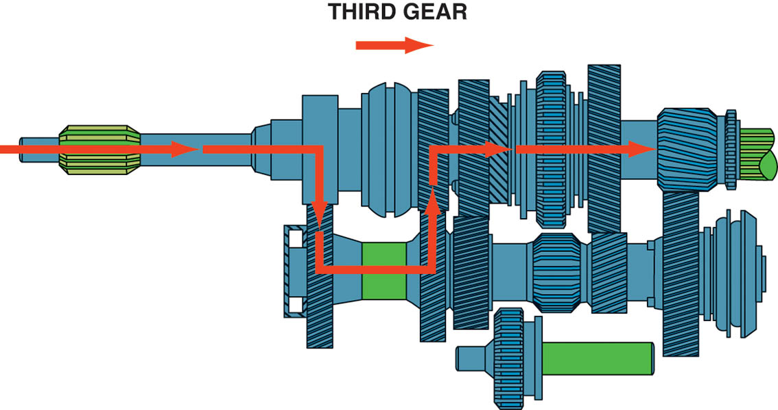
Figure 127.27 To achieve third gear, the shaft linkage first centers the 1–2 synchronizer sleeve and then moves the 3–4 synchronizer sleeve rearward, locking third speed gear to the output shaft

Slide 60
Animation: 5-Speed Transmission, 3rd Gear (The animation will automatically start in a few seconds)

Slide 61
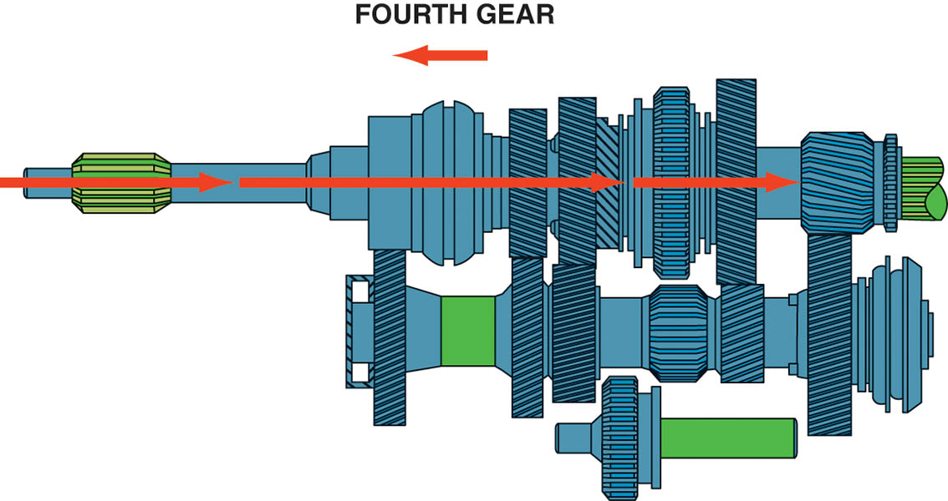
Figure 127.28 In fourth gear, the 3–4 synchronizer sleeve is moved forward, which locks the fourth speed gear to the output shaft

Slide 62
Animation: 5-Speed Transmission, 4th Gear (The animation will automatically start in a few seconds)

Slide 63
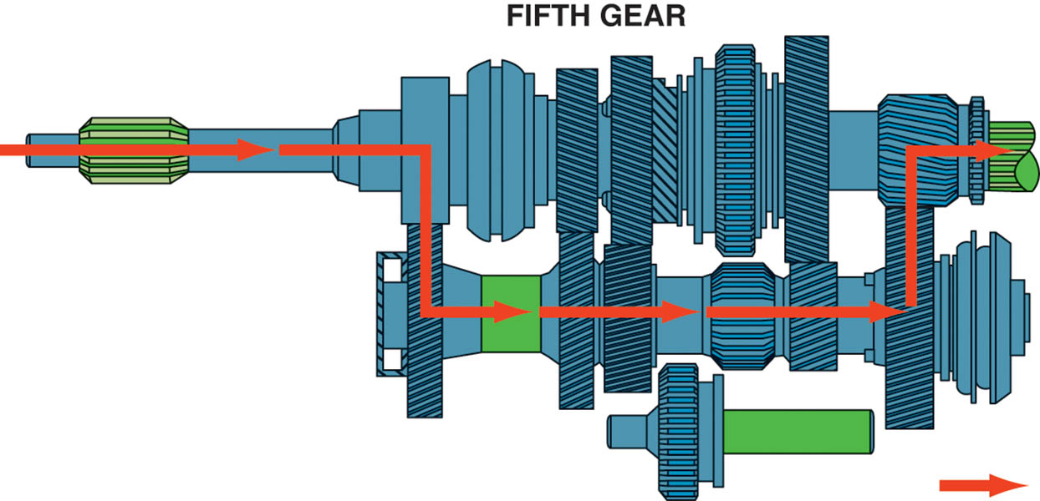
Figure 127.29 To achieve fifth gear, the shift linkage first centers the 3–4 synchronizer sleeve and then moves the fifth synchronizer sleeve toward the fifth speed gear, locking it to the output shaft

Slide 64
Animation: 5-speed Transmission: 5th Gear (The animation will automatically start in a few seconds)

Slide 65
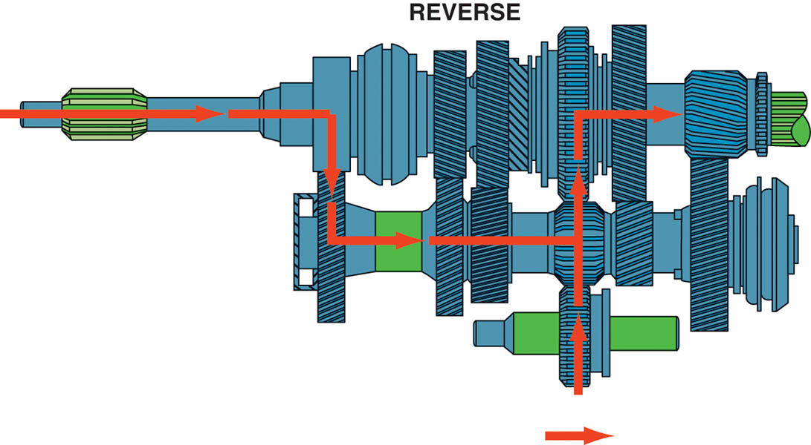
Figure 127.30 Torque flows through the transmission in reverse gear. Note that the idler gear drives the 1–2 synchronizer sleeve gear, which is splined to the output shaft

Slide 66
Animation: Transmission: Reverse (The animation will automatically start in a few seconds)

Slide 67
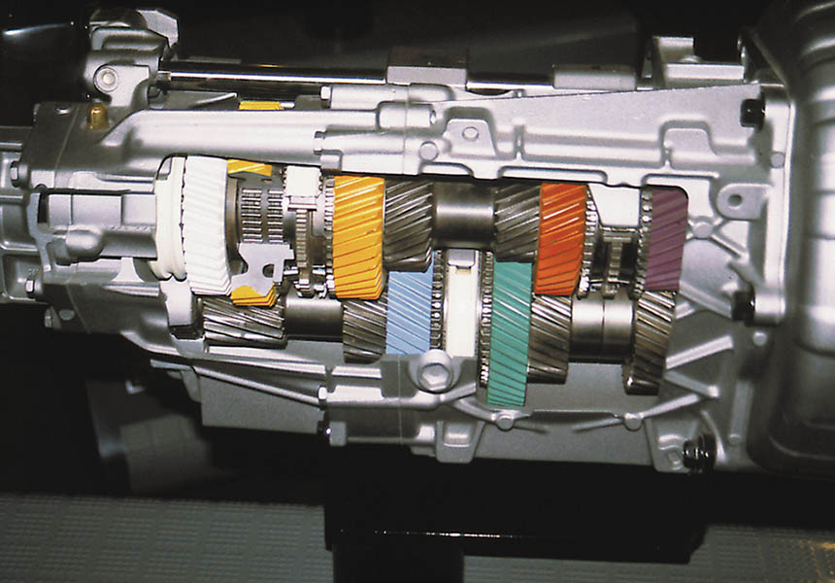
Figure 127.31 Cutaway of a T56 six-speed transmission showing all of its internal parts

Slide 68
Animation: 6-Speed Transaxle Operation (The animation will automatically start in a few seconds)

Slide 69
MANUAL TRANSAXLE CONSTRUCTION
Most transaxles use speed gears and synchronizers on both the input and output shafts.
The differential assembly, also called a final drive assembly, attaches to the output shaft and splits the torque to both front drive axles.

Slide 70
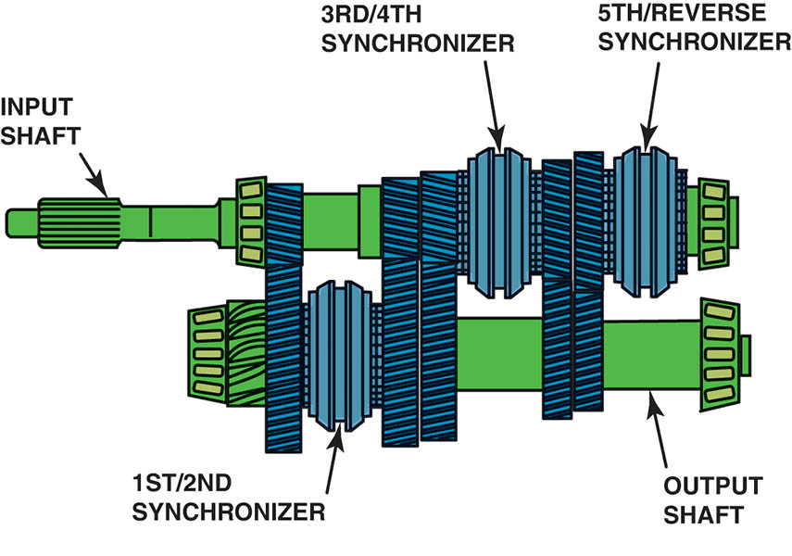
Figure 127.32 Notice that this five-speed transaxle from a Dodge/Plymouth Neon uses synchronizers on both the input and output shafts

Slide 71
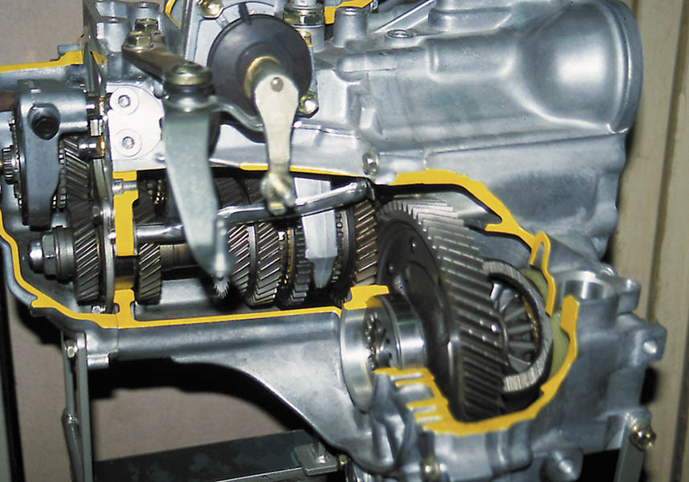
Figure 127.33 Cutaway of a typical manual transaxle showing all of its internal parts including the final drive assembly

Slide 72
Animation: Power Transfer Unit (The animation will automatically start in a few seconds)

Slide 73
Animation: Transaxle Power Flow (The animation will automatically start in a few seconds)

Slide 74
Animation: Transaxle: 1st Gear (The animation will automatically start in a few seconds)

Slide 75
Animation: Transaxle, 2nd Gear (The animation will automatically start in a few seconds)

Slide 76
Animation: Transaxle, 3rd Gear (The animation will automatically start in a few seconds)

Slide 77
Animation: Transaxle, 4th Gear (The animation will automatically start in a few seconds)

Slide 78
Animation: Transaxle, 5th Gear (The animation will automatically start in a few seconds)

Slide 79
Animation: Transaxle, Final Drive (The animation will automatically start in a few seconds)

Slide 80
Animation: Transaxle, Reverse (The animation will automatically start in a few seconds)

Slide 81
TRANSMISSION/ TRANSAXLE REMOVAL
Disconnecting the negative battery cable.
Safely hoisting and supporting the vehicle.
Supporting the engine with a holding fixture or other support (front-wheel-drive).
Remove the drive axle shafts or drive shaft (rear-wheel-drive).
Remove the clutch linkage and shift linkage.
Disconnect the vehicle speed sensor and reverse (backup) light connectors.
Remove the attaching bolts/nuts from the engine and transmission/transaxle mounts and then removing the unit from the vehicle.

Slide 82
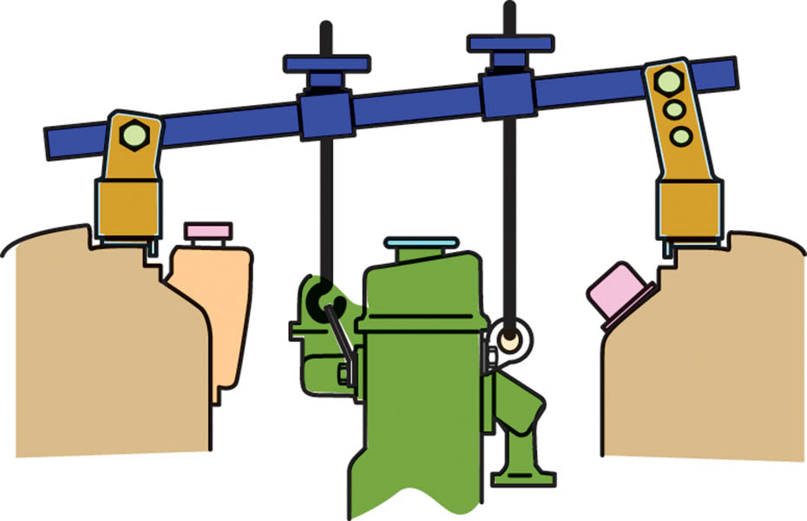
Figure 127.34 Most front-wheel-drive (FWD) vehicles require the use of a fixture to support the engine before removing the transaxle

Slide 83
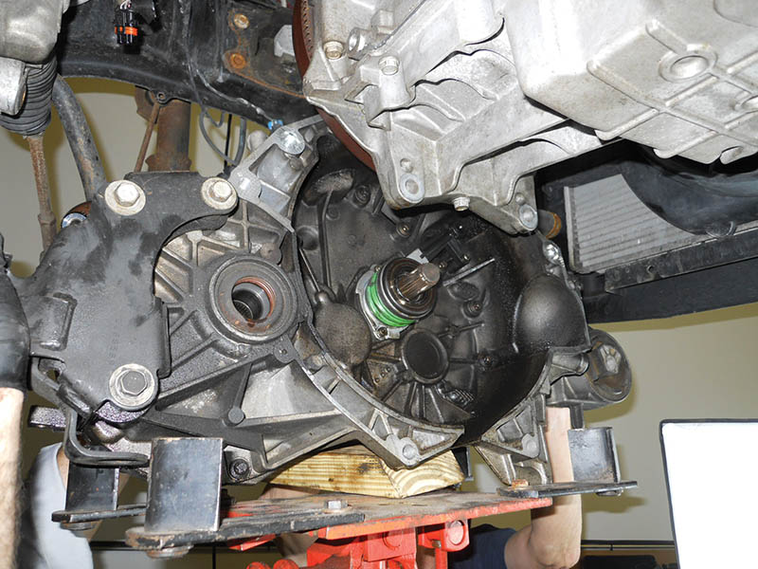
Figure 127.35 A transaxle being removed from underneath a vehicle and being supported by a transmission jack

Slide 84
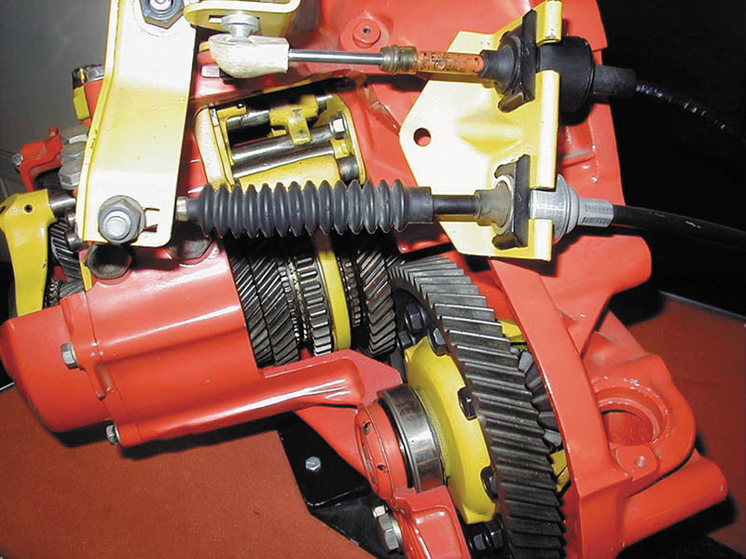
Figure 127.36 Typical cable-operated shift linkage used on a front-wheel-drive transaxle

Slide 85
TRANSMISSION/ TRANSAXLE DISASSEMBLY
Before disassembling the transmission/transaxle, drain any remaining gear lubricant from the unit and dispose of it properly.
Mount the transmission/transaxle on a holding fixture or place it on a large, clean work surface.
Check the service manual for the exact disassembly procedures to follow for the unit being serviced.

Slide 86
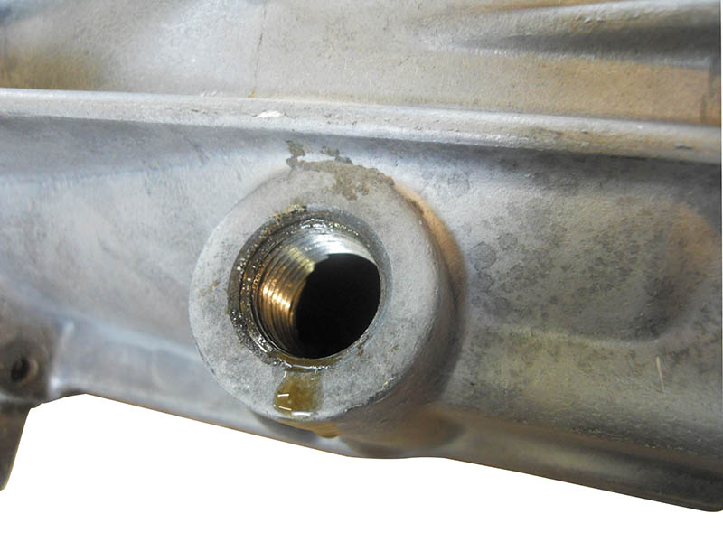
Figure 127.37 Drain the fluid into a suitable container and dispose of the old fluid according to local, state, and federal regulations

Slide 87
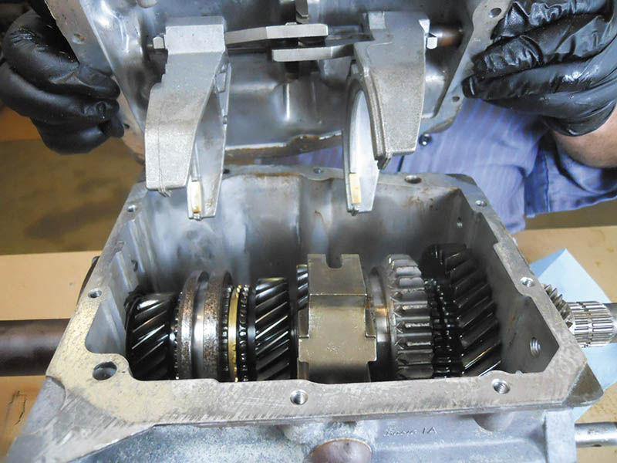
Figure 127.38 A Borg-Warner T5 five-speed transmission shown with the shifter cover removed

Slide 88
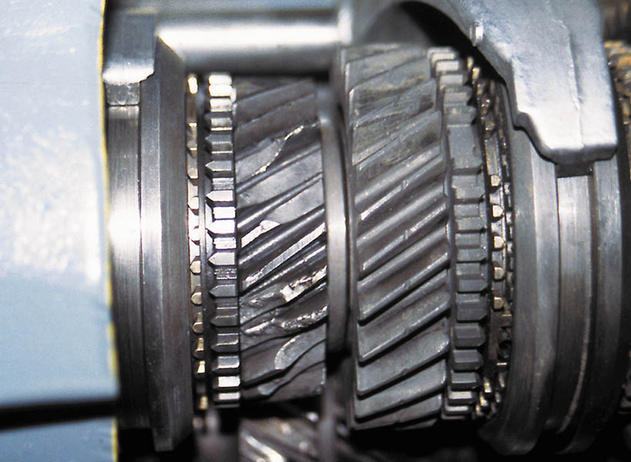
Figure 127.39 The cost to replace these gears may exceed the cost of a replacement transmission

Slide 89
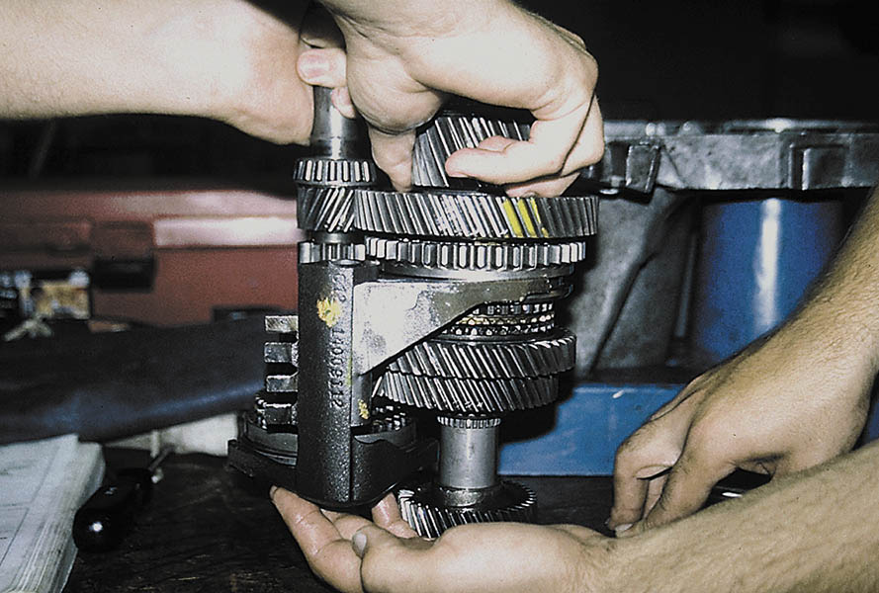
Figure 127.40 It often requires two people to assemble a transaxle because the shaft with the shifter forks needs to be placed into the case as an assembly, as on this unit

Slide 90
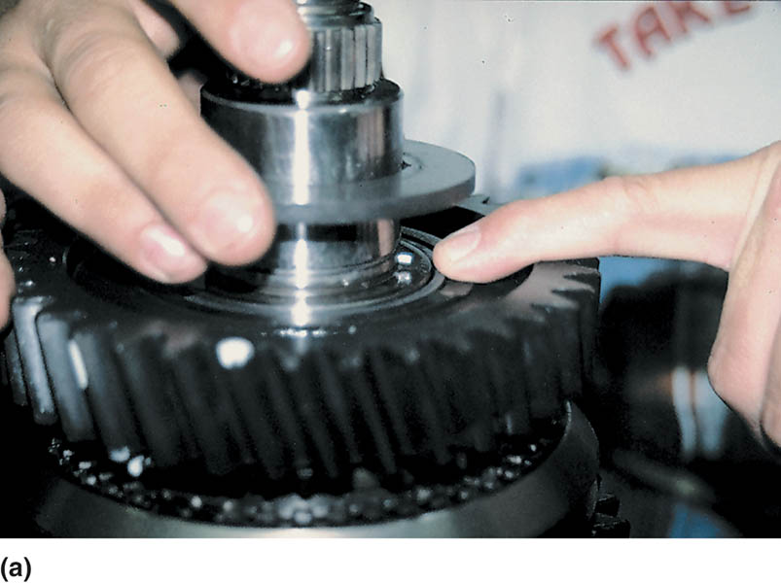
Figure 127.41 (a) During the disassembly of any manual transmission/transaxle, carefully check for the location of the snap rings. Often they are hidden. Consult the factory service manual or unit repair manual for information and procedures for the unit being serviced

Slide 91
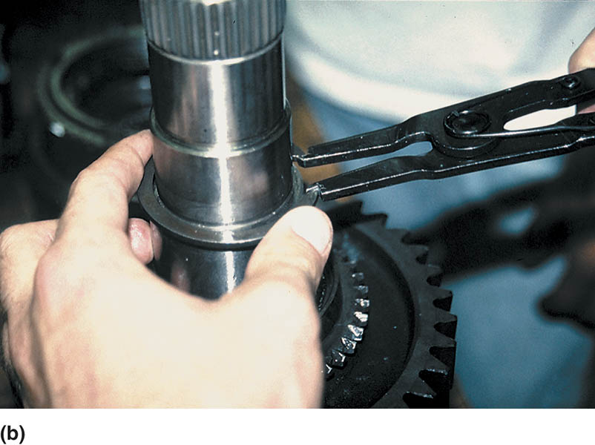
Figure 127.41 (b) Using snap-ring pliers to remove a snap ring. Many snap rings have an “up” side. Be sure to reinstall any snap rings in the correct direction

Slide 92
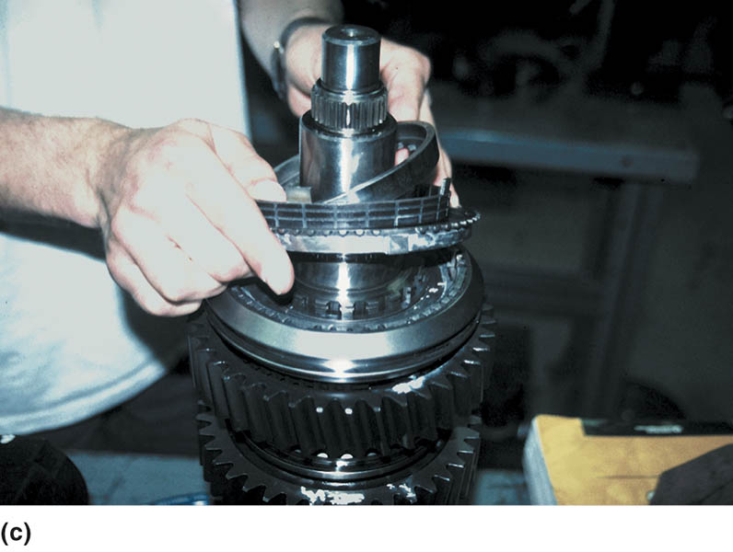
Figure 127.41 (c) After the snap ring is removed, some components can be simply lifted off the main shaft, while other gears may require the use of a press

Slide 93
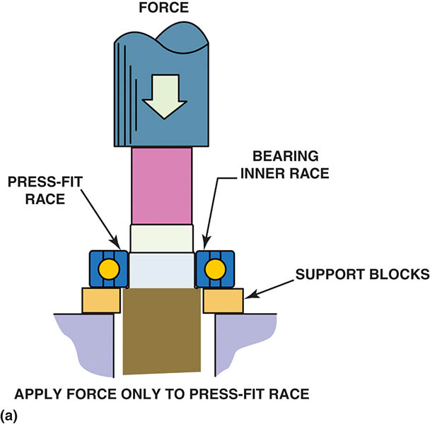
Figure 127.42 (a) When a ball bearing is pressed off a shaft, the bearing should be supported by the inner race (if possible) so the force is not exerted on the outer race by the balls

Slide 94
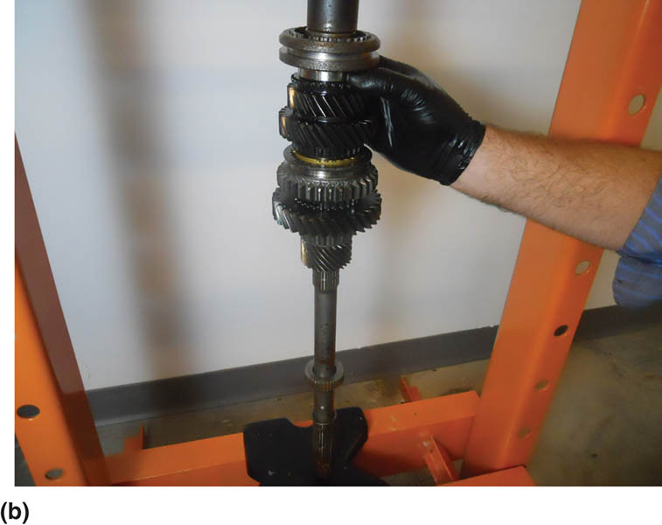
Figure 127.42 (b) Use caution when pressing parts onto the main shaft. Always follow the specified assembly procedures as found in service information

Slide 95
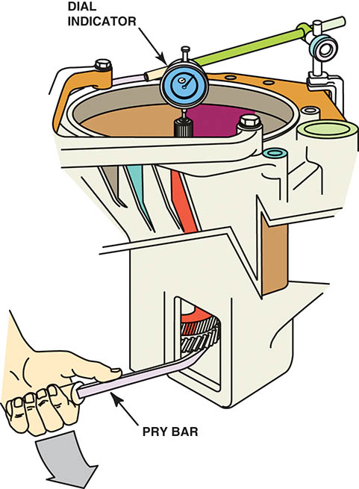
Figure 127.43 The dial indicator is set up to measure input shaft endplay as it is lifted and dropped using the pry bar

Slide 96
HARD-TO-SHIFT PROBLEM DIAGNOSIS
Several items that could be worn or defective can cause a manual transmission/transaxle to be difficult to shift, including:
Clutch not fully disengaging.
Worn synchronizer.
Worn, cracked, or loose shift forks.
Excessive input- or main-shaft end play.
Improper lubrication.

Slide 97
GEAR LUBRICATION
After the installation of the transmission/transaxle, the unit should be filled with the correct lubricant.
SAE 80W-90 (GL-4) gear lube
STF (synchromesh transmission fluid), but with friction characteristics designed for manual transmissions.
ATF (automatic transmission fluid)
Engine oil (usually SAE 5W-30)

Slide 98
Figure 127.44 Some manual transmissions/transaxles require synchromesh transmission fluid

Slide 99
NV 1500 MANUAL TRANSMISSION SERVICE

Slide 100
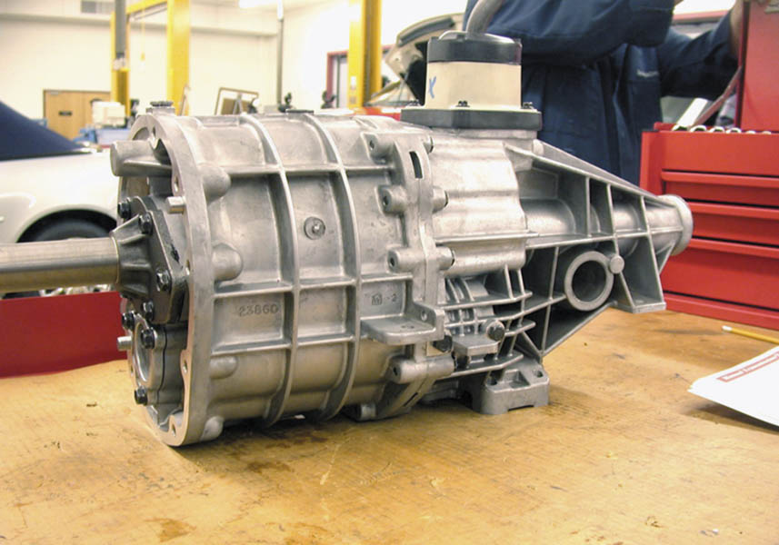
1 A NV-1500 five-speed manual transmission is used in two-wheel drive applications only.

Slide 101
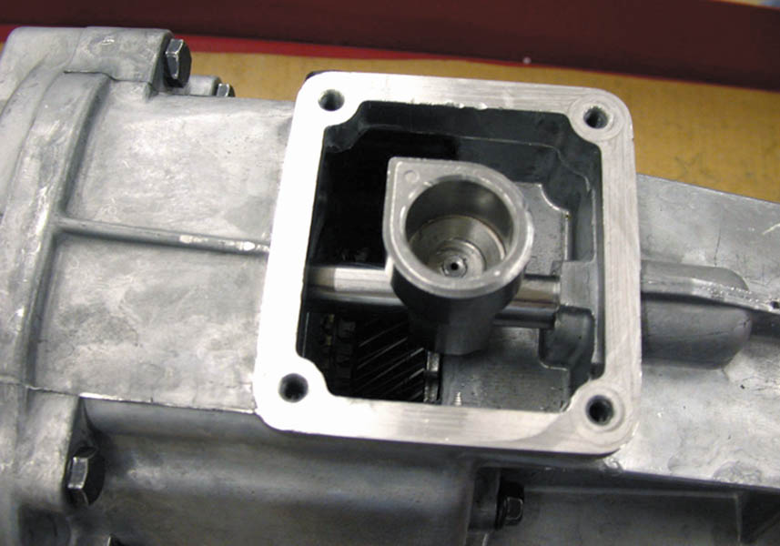
2 The shifter assembly has been removed. Note the roll pin in the center of the shift lever socket.

Slide 102
3 Snap-ring pliers are being used to remove the snap ring retaining the input shaft bearing.

Slide 103
4 The upside down case is being separated showing the countershaft (top) and shift forks.

Slide 104
5 Before further disassembly can be accomplished, the shift lever socket roll pin must be driven out using a punch and a hammer.

Slide 105
6 The shift shaft and forks can now be removed.

Slide 106
7 The reverse idle gear is unbolted from the case and removed.

Slide 107
8 The output shaft assembly fifth gear (far left) and the synchronizer assemblies.

Slide 108
9 The bearing is being removed using a bearing splitter and a hydraulic press.

Slide 109
10 A speed gear (bottom) along with the double row needle bearing used between the shaft and the speed gear. The hub (center) is splined and rotates with the output shaft.

Slide 110
11 A synchronizer assembly being reassembled. It often takes several hands to hold the hub (center) and the sleeve (outer ring).

Slide 111
12 A hydraulic press is used to reassemble output shaft and bearing.

Slide 112
13 The assembled output shaft is held against the counter shaft to double check that all of the gears have been correctly assembled.

Slide 113
14 The assembled output shaft and counter shaft are being reinstalled in the transmission case.

Slide 114
15 The case halves are bolted together.

Slide 115
16 The last step is to assembly the shift lever and check for proper operation in all gear positions.

Slide 116
NV-350 TRANSAXLE SERVICE

Slide 117
1 After the transaxle has been removed from the vehicle and the fluid drained, place the transaxle on a work surface.

Slide 118
2 The bell housing case half containing the large output shaft front bearing (center) and the input shaft front bearing (smaller bearing on the left).

Slide 119
3 The differential assembly is simply lifted out of half of the case.

Slide 120
4 The input and output shafts are a press fit into the bearings and are also retained with a snap ring, which must be removed.

Slide 121
5 Using a special tool, the input and output shafts are pressed out of the housing using a hydraulic press.

Slide 122
6 The input shaft can be disassembled using a bearing splitter and a press, or two screwdrivers to pry the gears off the shaft.

Slide 123
7 This transaxle uses both brass and powdered metal synchronizer rings with a fiber (paper) inner cone surface.

Slide 124
8 Synchronizer ring gaps are being measured using a feeler (thickness) gauge. The factory specifications are usually 0.040 to 0.069 inches.

Slide 125
9 The gear clutch teeth should be inspected for wear.

Slide 126
10 An assembled synchronizer assembly containing a sleeve, keys, springs, and detent.

Slide 127
11 The input shaft (left) and the output shaft (right) are checked for proper assembly before being installed into the case.

Slide 128
12 The differential bearing preload is determined by measuring for zero end play; then adding the thickness shim under the bearing cup.

Slide 129
13 The bearing cup is being installed using an installation tool and a hammer.

Slide 130
14 All of the shift forks and shift arms must be aligned properly before installing the components into the case.

Slide 131
15 All of the components, including the differential (right), the output shaft (center), and the input shaft (left), plus the shift linkage are installed and checked for proper positioning.

Slide 132
16 The case halves being reinstalled. The bearings (top) must be pressed back onto the input and output shafts using a press.

Slide 133
17 The bell housing case being reattached.

Slide 134
18 The completed assembly. Notice the bearing cover (top) has already been installed.

Slide 135
Video Links (Internet Access Required)
How synchronizers work (time 13:11)
Clutch and trans operation (time 3:30)
Manual trans operation (time 0:43)
Manual trans power flow (time 0:13)
Trans operation (time 7:59)
Trans operation (time 2:19)
Manual trans animation (time 0:43)
Manual overdrive transmission (time 2:40)
Electronic manual transmission (time 0:49)
Overdrive transmission old British car (time 1:34)

Slide 136
Video Links (Internet Access Required)
AX-15 teardown part 1 (time 13:57)
AX-15 assembly part 2 (time 10:43)
AX-15 rebuild part 3 (time 19:46)
AX-15 rebuild part 4 (time 13:32)
AX-15 rebuild part 5 (time 25:27)
AX-15 rebuild part 6 (time 22:14)
AX-15 rebuild part 7 (time 9:28)
Shifter bushing repair (time 3:23)
Gearshift knob removal (time 1:23)
Transmission noise (time 3:04)

Slide 137
Video Links (Internet Access Required)
Transaxle noise (time 1:15)
Drivetrain diagnosis (time 1:11)
Honda manual transmission fluid change (time 10:20)

Slide 138
Copyright

