Slide 1
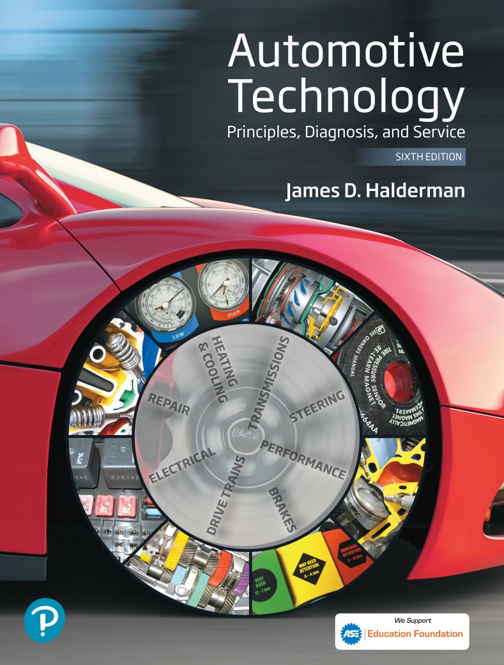
Automotive Technology Principles, Diagnosis, and Service
Sixth Edition
Chapter 108
Machining Brake Drums and Rotors
Copyright © 2018, 2015, 2011 Pearson Education, Inc. All Rights Reserved

Slide 2
LEARNING OBJECTIVES (1 of 2)
108.1 Describe the types of brake drums.
108.2 Explain the factors that cause rotor damage.
108.3 Discuss brake drum distortion and removal.
108.4 Explain how to machine a brake drum and when a brake drum should be discarded.
108.5 Explain the procedure for machining disc brake rotor.

Slide 3
LEARNING OBJECTIVES (2 of 2)
108.6 Discuss disc brake rotors and causes of rotor distortion.
108.7 Explain when to machine a disk brake rotor, and discuss rotor thickness and finish.
108.8 Explain the procedure for qualifying a brake lathe.
108.9 This chapter will help prepare for the Brakes (A5) ASE certification test content area “C” (Drum Brake Diagnosis and Repair) and “D” (Disc Brake Diagnosis and Repair).

Slide 4
BRAKE DRUMS
Cast-Iron Drums
Cast iron contains approximately 3% carbon, which makes the drum hard, yet brittle.
The 3% carbon content of the cast iron also acts as a lubricant, which prevents noise during braking.
Aluminum Drums
Aluminum brake save weight, and transfer heat to the surrounding air faster than cast iron or steel.
Aluminum brake drums use cast iron for the friction surface area.

Slide 5
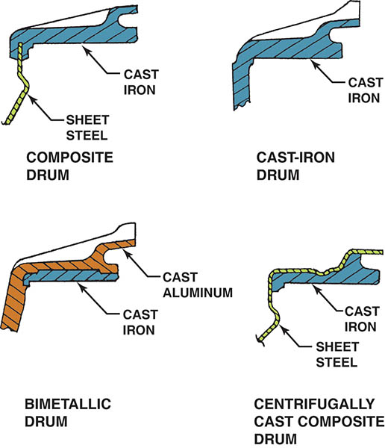
Figure 108.1 Types of brake drums. Regardless of the design, all types use cast iron as a friction surface

Slide 6
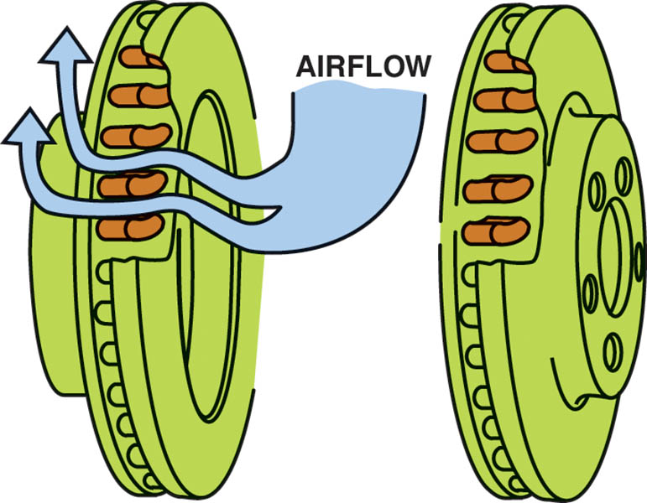
Figure 108.2 The airflow through cooling vents helps brakes from overheating

Slide 7
BRAKE DRUM AND ROTOR DAMAGE (1 OF 2)
Scoring
Scoring is an extreme form of drum and rotor wear consisting of scratches, deep grooves, and a generally rough finish on the friction surface.
Cracking
Cracks in a brake drum or rotor are caused by the stress of severe braking or an impact during an accident.

Slide 8
BRAKE DRUM AND ROTOR DAMAGE (2 OF 2)
Heat Checking
Heat checking consists of many small, interlaced cracks on the friction surface.
Hard or Chill Spots
Hard or chill spots are an altering the structure of the metal caused by heat.

Slide 9
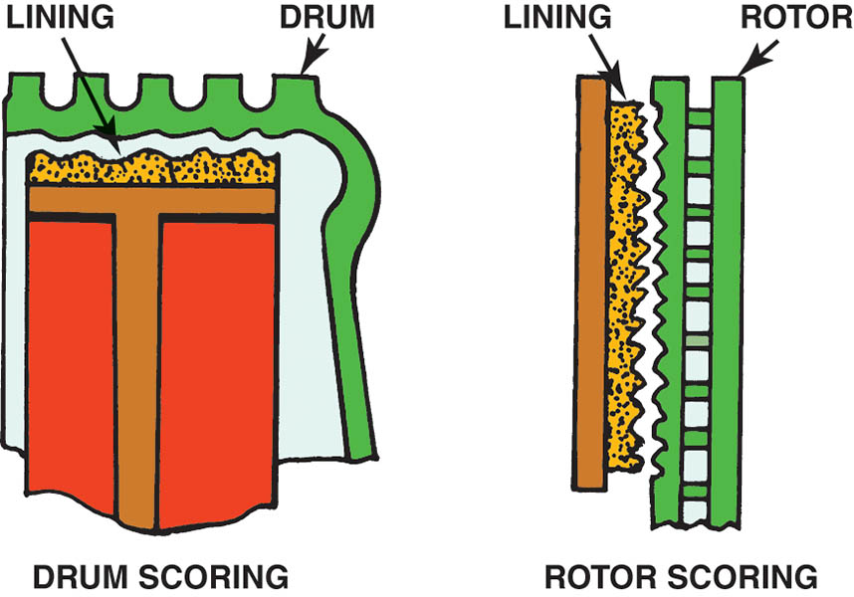
Figure 108.3 Scored drums and rotors often result in metal-to-metal contact

Slide 10
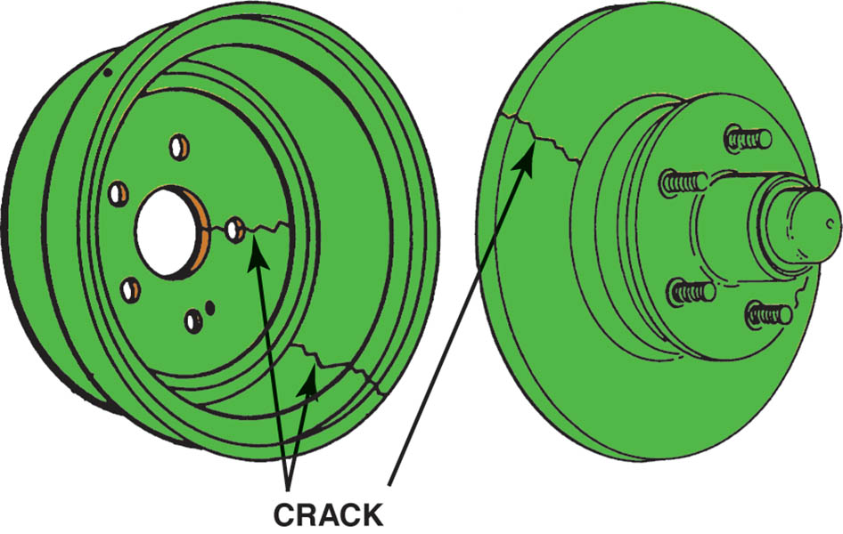
Figure 108.4 Cracked drums or rotors must be replaced

Slide 11
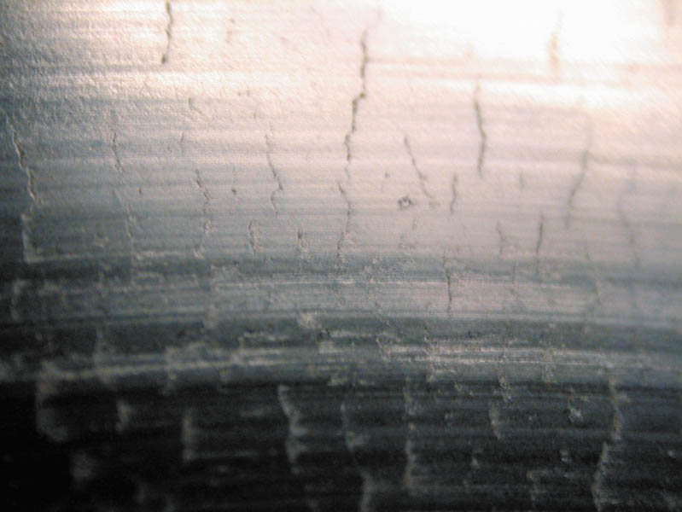
Figure 108.5 A heat-checked surface of a disc brake rotor

Slide 12
QUESTION 1: ?
What are the four types of rotor damage?

Slide 13
ANSWER 1:
Scoring, cracking, heat checking and hard spots.

Slide 14
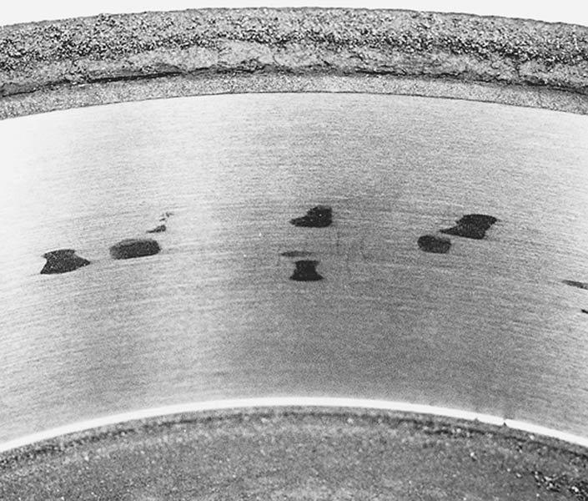
Figure 108.6 These dark hard spots are created by heat that actually changes the metallurgy of the cast-iron drum. Most experts recommend replacement of any brake drum that has these hard spots

Slide 15
BRAKE DRUM DISTORTION (1 OF 2)
Drum Distortion
Drum distortion occurs when the friction surface does not return to its proper shape, is no longer parallel to the axle
Bellmouth Drums
Occurs when an open edge of a brake drum friction surface has a larger diameter than the closed edge.

Slide 16
BRAKE DRUM DISTORTION (2 OF 2)
Out-Of-Round Drums
A distortion in which the drum radius varies when measured at different points around its circumference.
Eccentric Drums
Eccentric distortion exists when the geometric center of the circle described by the brake drum friction surface is other than the center of the axle or the bolt circle of the drum web.

Slide 17
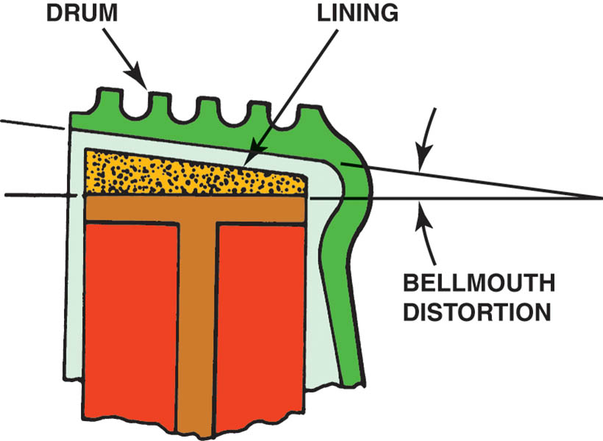
Figure 108.7 Bellmouth brake drum distortion

Slide 18
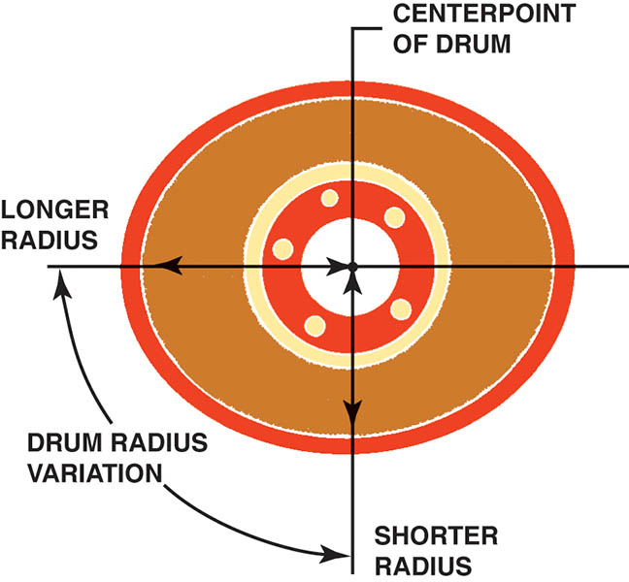
Figure 108.8 Out-of-round brake drum distortion

Slide 19
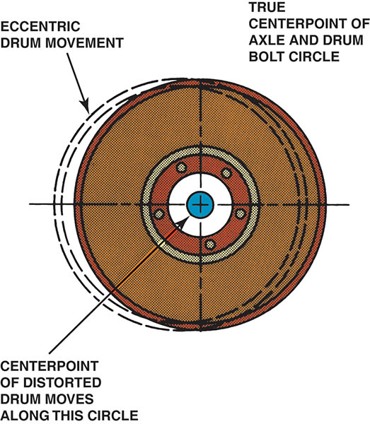
Figure 108.9 Eccentric brake drum distortion

Slide 20
REMOVING DRUMS
The first inspection step after removing a brake drum is to check it for warpage using a straightedge.
A warped drum is often a source of vibration.
A brake drum that is out-of-round can cause a brake pedal pulsation during braking.

Slide 21
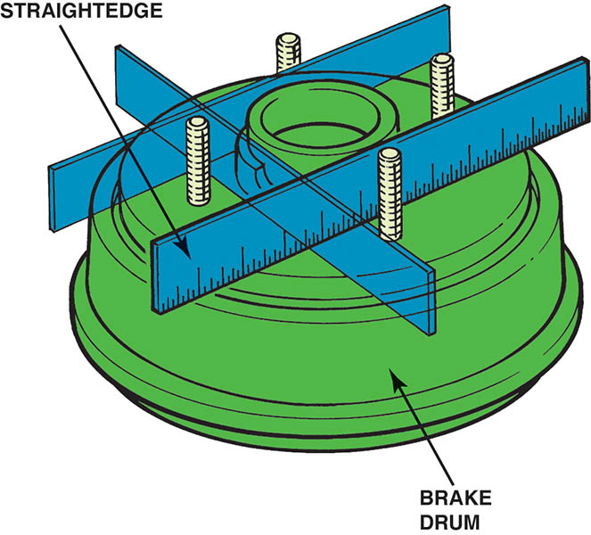
Figure 108.10 A straightedge can be used to check for brake drum warpage

Slide 22
“MACHINE TO” VERSUS “DISCARD”
Brake drums can usually be machined a maximum of 0.060 inch (1.5 mm) oversize unless otherwise stamped on the drum.
Most brake experts recommend that both drums on the same axle be within 0.010 inch (0.25 mm) of each other.
Always leave at least 0.015 inch (0.4 mm) after machining (resurfacing) for wear. Many manufacturers recommend that 0.030 inch (0.8 mm) be left for wear.

Slide 23
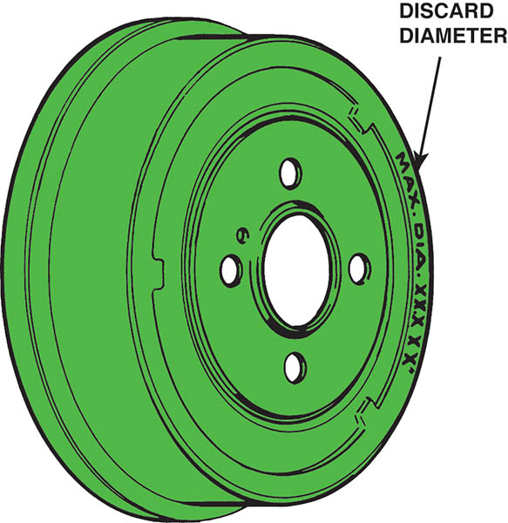
Figure 108.11 Discard diameter and maximum diameter are brake drum machining and wear limits

Slide 24
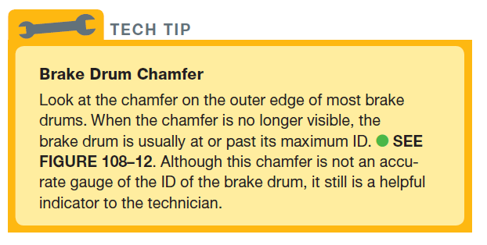
Tech Tip

Slide 25
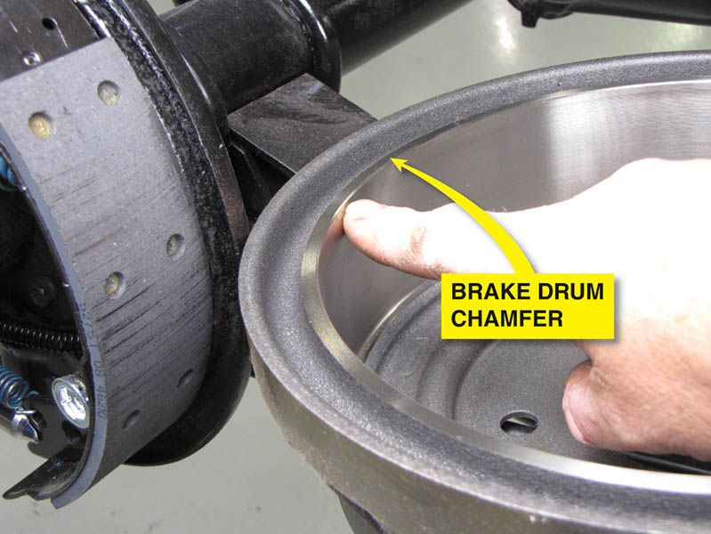
Figure 108.12 Most brake drums have a chamfer around the edge. If the chamfer is no longer visible, the drum is usually worn (or machined) to its maximum allowable ID

Slide 26
MACHINING BRAKE DRUMS
Measuring a Drum
Brake drums are usually measured using a micrometer especially designed for brake drums.
Compare the micrometer reading to the discard diameter.
Machining a Drum Procedure
Follow the machine specific procedures to ensure the drum is properly mounted with a silencer band.
Perform a scratch cut to confirm the mounting position.
Start the lathe and set the depth of cut.

Slide 27
Animation: Micrometer, Metric (The animation will automatically start in a few seconds)

Slide 28
Animation: Brake Drum Micrometer (The animation will automatically start in a few seconds)

Slide 29
Animation: Rotor Thickness Measurements (The animation will automatically start in a few seconds)

Slide 30
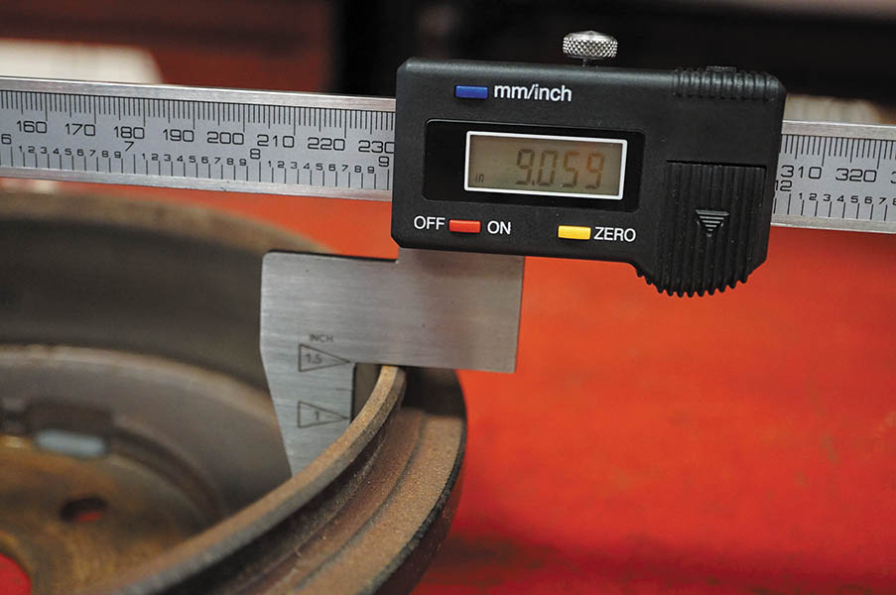
Figure 108.13 A digital drum micrometer makes measuring brake drums easily and accurately

Slide 31
Figure 108.14 (a) A rotor or brake drum with a bearing hub should be installed on a brake lathe using the appropriate size collet that fits the bearing cups (races)

Slide 32
Figure 108.14 (b) A hubless rotor or brake drum requires a spring and a tapered centering cone. A faceplate should be used on both sides of the rotor or drum to provide support

Slide 33
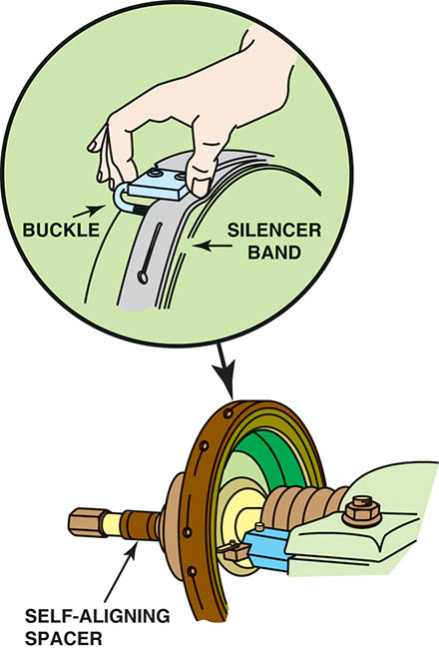
Figure 108.15 A self-aligning spacer (SAS) should always be used between the drum or rotor and the spindle retaining nut to help ensure an even clamping force and to prevent the adapters and cone from getting into a bind. A silence band should always be installed to prevent turning-tool chatter and to ensure a smooth surface finish

Slide 34
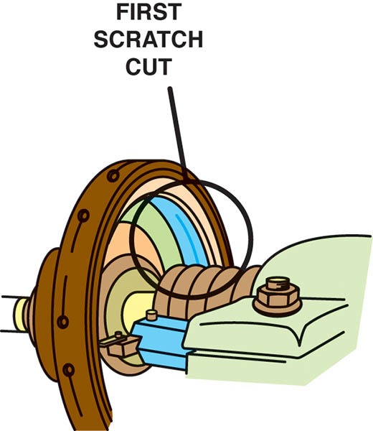
Figure 108.16 After installing a brake drum on the lathe, turn the cutting tool outward until the tool just touches the drum. This is called a scratch cut

Slide 35
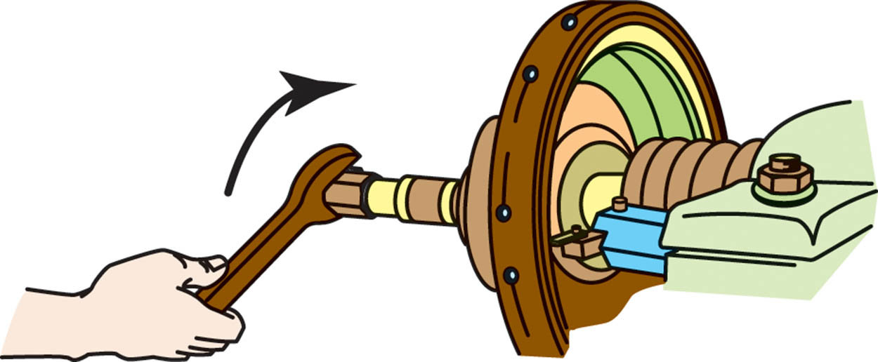
Figure 108.17 After making a scratch cut, loosen the retaining nut, rotate the drum on the lathe, and make another scratch cut. If both cuts are in the same location, the drum is installed correctly on the lathe and drum machining can begin

Slide 36
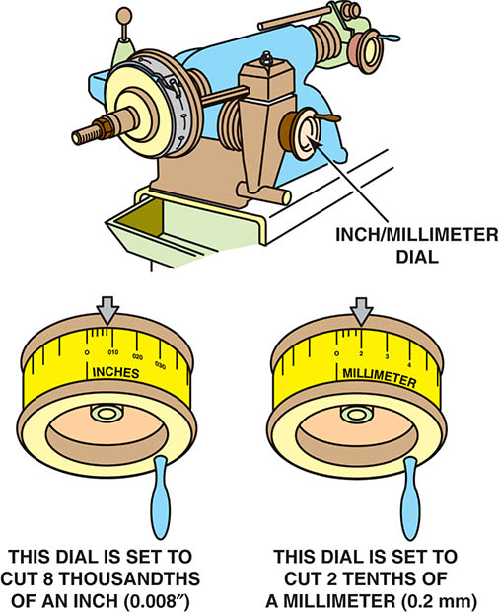
Figure 108.18 Set the depth of the cut indicator to zero just as the turning tool touches the drum

Slide 37
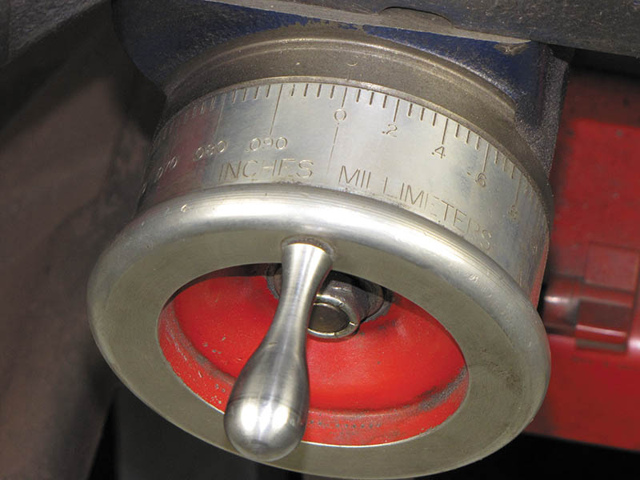
Figure 108.19 This lathe has a dial that is “diameter graduated.” This means that a reading of 0.030 inch indicates a 0.015 inch cut that increases the inside diameter of the brake drum by 0.030 inch

Slide 38
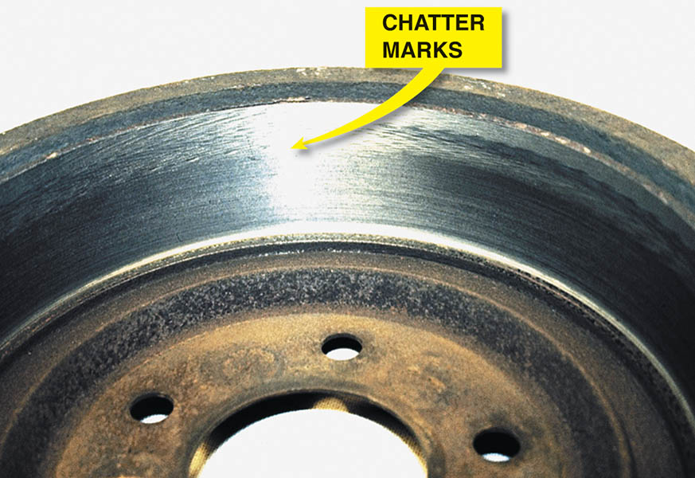
Figure 108.20 Notice the chatter marks at the edge of the friction-area surface of the brake drum. These marks were caused by vibration of the drum because the technician failed to wrap the dampening strap (silencer band) over the friction-surface portion of the brake drum

Slide 39
DISC BRAKE ROTORS
Disc brake rotors use cast gray iron at the area that contacts the friction pad.
Styles of Rotors
Solid
Vented
Composite Rotors
Composite rotors use a steel center section with a cast-iron wear surface.
Aluminum Metal Matrix Composite Rotors
Manufactured from an aluminum metal matrix composite alloy reinforced with 20% silicon carbide particulate.

Slide 40
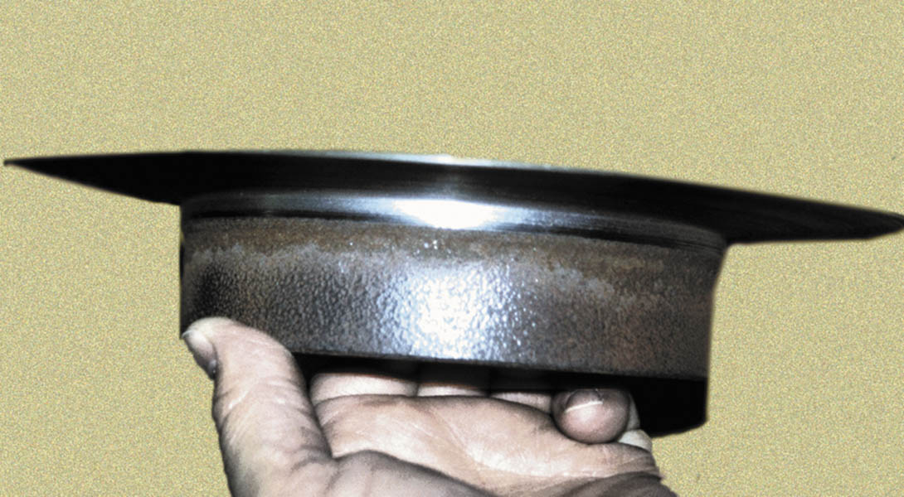
Figure 108.21 This excessively worn (thin) rotor was removed from the vehicle in this condition. It is amazing that the vehicle was able to stop with such a thin rotor.

Slide 41
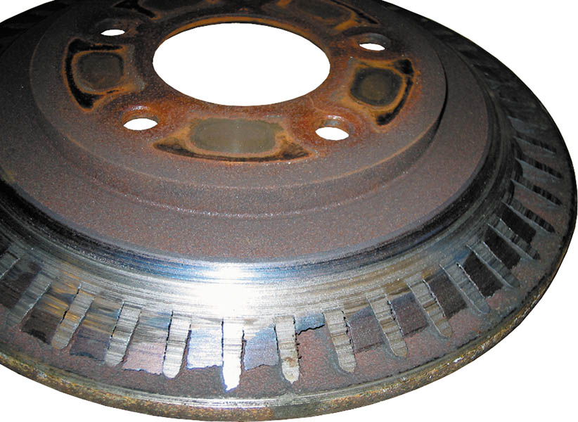
Figure 108.22 Severely worn vented disc brake rotor. The braking surface has been entirely worn away exposing the cooling fins. The owner brought the vehicle to a repair shop because of a “little noise in the front.”

Slide 42
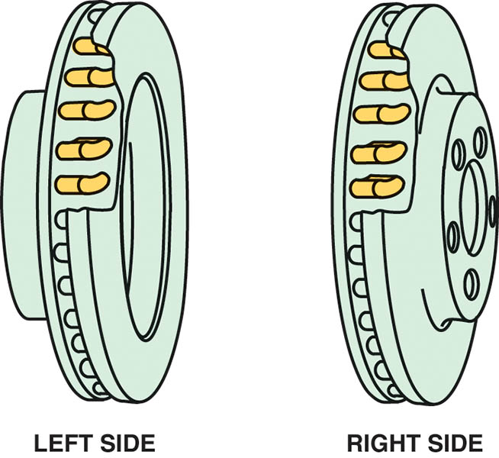
Figure 108.23 Directional vane vented disc brake rotors. Note that the fins angle toward the rear of the vehicle. It is important that this type of rotor be reinstalled on the correct side of the vehicle.

Slide 43
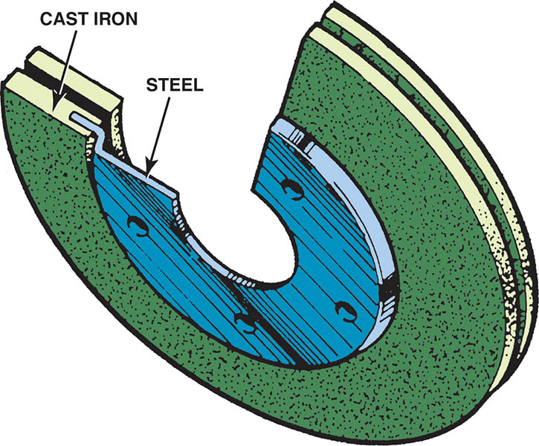
Figure 108.24 Typical composite rotor that uses cast-iron friction surfaces and a steel center section.

Slide 44
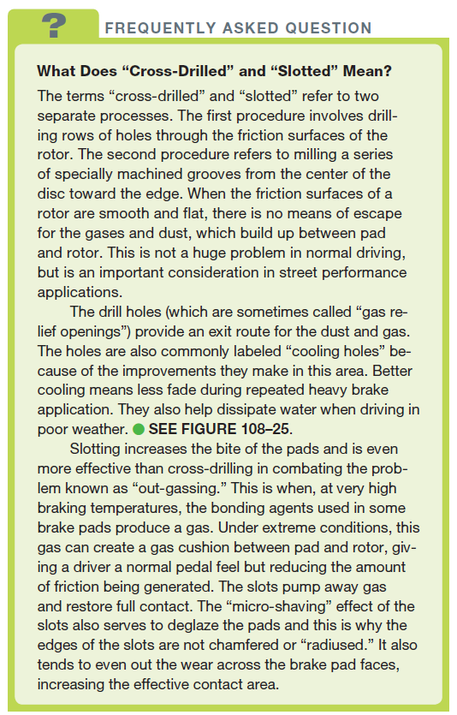
FREQUENTLY ASKED QUESTION

Slide 45
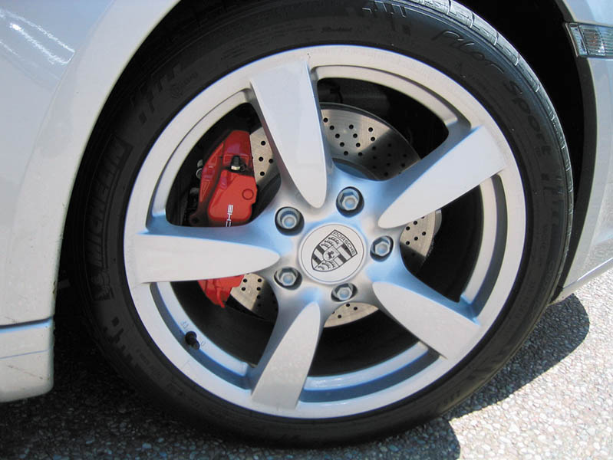
Figure 108.25 This Porsche is equipped with high performance brakes including cross-drilled brake rotors

Slide 46
DISC BRAKE ROTOR DISTORTION
Causes of Rotor Distribution
The most common cause of distortion is when there is a problem with the friction assembly, such as a frozen caliper piston that creates unequal application force on the two sides of the rotor.
Rotor Lateral Runout
A side-to-side wobble of the rotor as it rotates on the spindle.
Rotor Lack of Parallelism
A variation in the thickness of the rotor

Slide 47
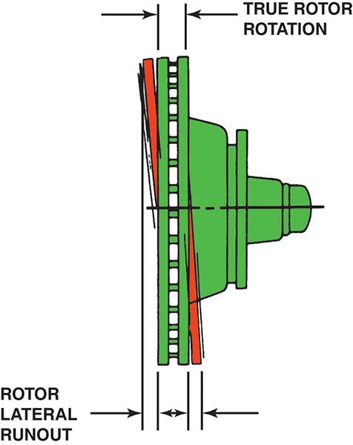
Figure 108.26 Brake rotor lateral runout distortion

Slide 48
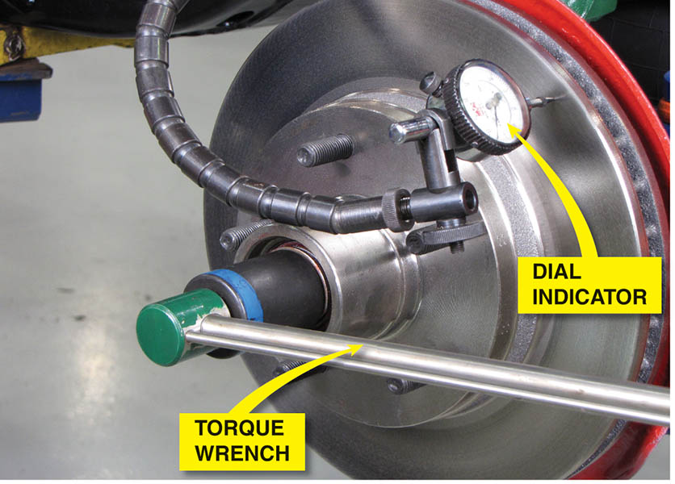
Figure 108.27 Before measuring lateral runout with a dial indicator (gauge), remove any wheel bearing end play by tightening the spindle nut to 10 to 20 ft lb with a torque wrench. This step helps prevent an inaccurate reading.

Slide 49
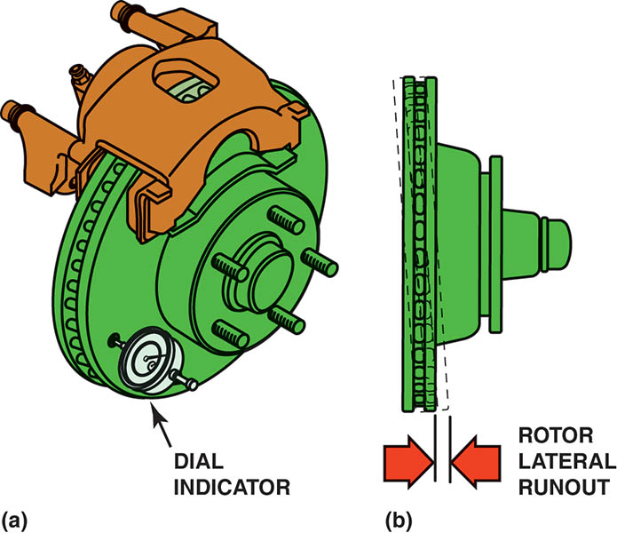
Figure 108.28 (a) Rotate the disc brake rotor one complete revolution while observing the dial indicator (gauge)

Slide 50
Figure 108.28 (b) Most vehicle manufacturers specify a maximum runout of about 0.003 inch (0.08 mm)

Slide 51
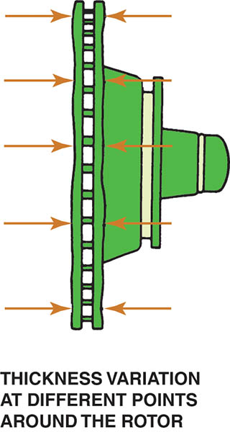
Figure 108.29 Brake rotor lack-of-parallelism distortion

Slide 52
Figure 108.30 (a) Disc brake rotor thickness variation (parallelism)

Slide 53
Figure 108.30 (b) The rotor should be measured with a micrometer at four or more equally spaced locations around the rotor

Slide 54
Animation: Rotor Parallelism Measurements (The animation will automatically start in a few seconds)

Slide 55
QUESTION 2: ?
What is the most common cause of rotor distortion?

Slide 56
ANSWER 2:
A frozen caliper piston that creates unequal application force to each side of the rotor.

Slide 57
CARBON-CERAMIC ROTORS
Description
Carbon-ceramic brake (CCB) rotors are used on some high-performance vehicles and are very expensive.
Construction
Carbon-ceramic brake rotors are made of a carbon-fiber-reinforced ceramic silicon carbide material.
Advantages
Low weight and corrosion and weather resistant.
Service Procedures
Cannot be serviced or machined, it must be replaced.

Slide 58
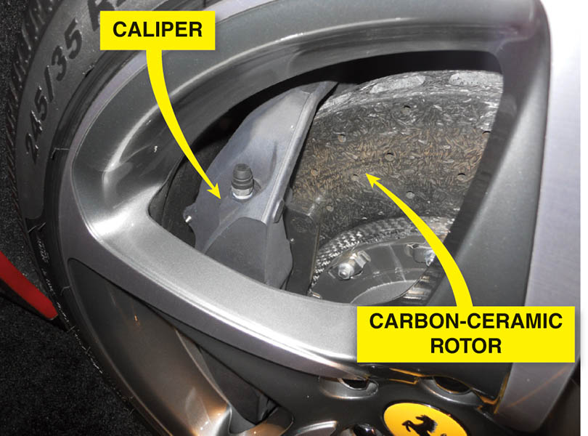
Figure 108.31 A carbon-ceramic brake (CCB) rotor on a Ferrari

Slide 59
DISC BRAKE ROTOR THICKNESS
Most rotors have a minimum thickness cast or stamped into the rotor.
At least 0.015 inch (0.4 mm) to 0.030 inch (0.8 mm) must remain after machining to allow for wear.
Whenever machining (resurfacing) a rotor, an equal amount of material must be removed from each side.

Slide 60
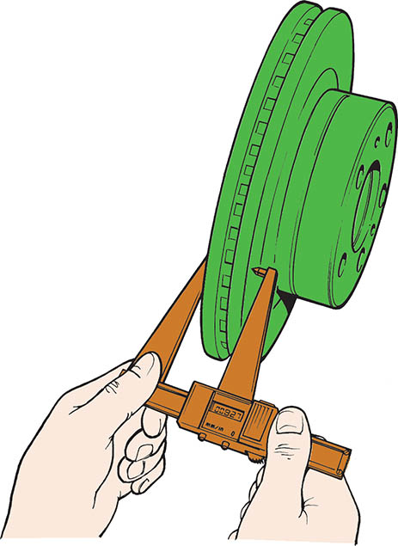
Figure 108.32 A digital readout rotor micrometer is an accurate tool to use when measuring a rotor. Both fractional inches and metric millimeters are generally available

Slide 61
WHEN THE ROTORS SHOULD BE MACHINED
Grooves deeper than 0.060 inch (1.5 mm). This is the approximate thickness of a nickel.
Thickness variation exceeding specifications and a brake pedal pulsation complaint.
Heavy rust that has corroded the friction surface of the rotor.

Slide 62
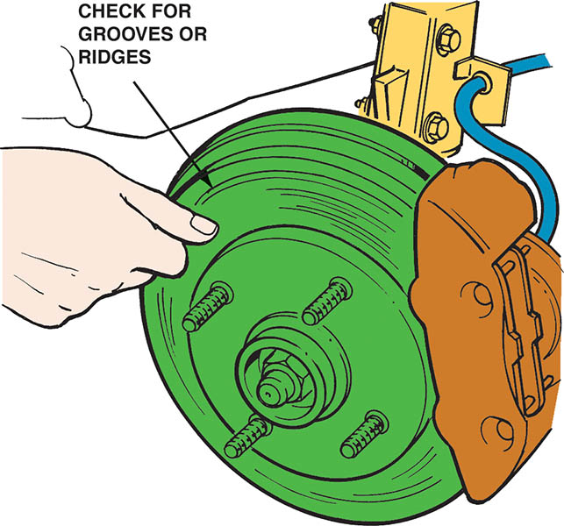
Figure 108.33 If a fingernail catches on a groove in the rotor, the rotor should be machined

Slide 63
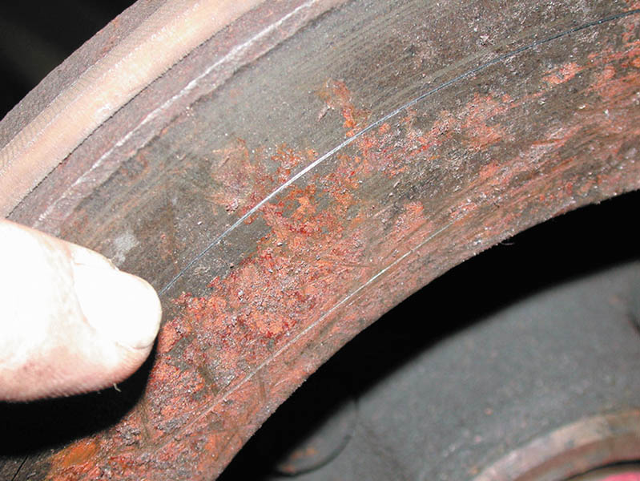
Figure 108.34 This rusted rotor should be machined

Slide 64
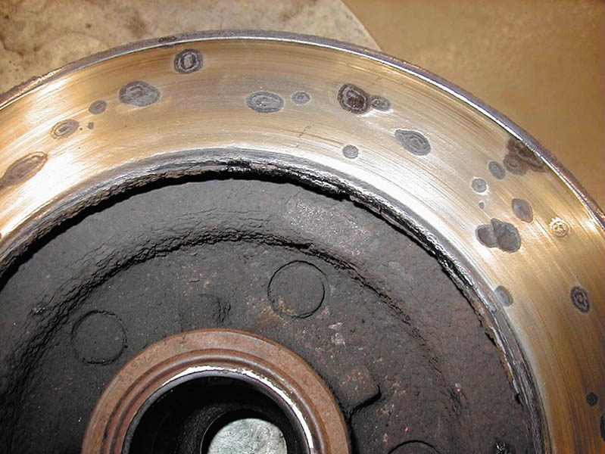
Figure 108.35 Rotors that have deep rust pockets usually cannot be machined

Slide 65
QUESTION 3: ?
When should a rotor be machined?

Slide 66
ANSWER 3:
When deep grooves, excessive thickness variation or heavy rust exist on the friction surface.

Slide 67
ROTOR FINISH
Surface finish is measured in units called microinches, abbreviated μin..
The usual method of expressing surface finish is the arithmetic average roughness height, abbreviated Ra, which is the average of all peaks and valleys from the mean (average) line.
Most new rotors have a surface finish of 45 to 60 μin. Ra.

Slide 68
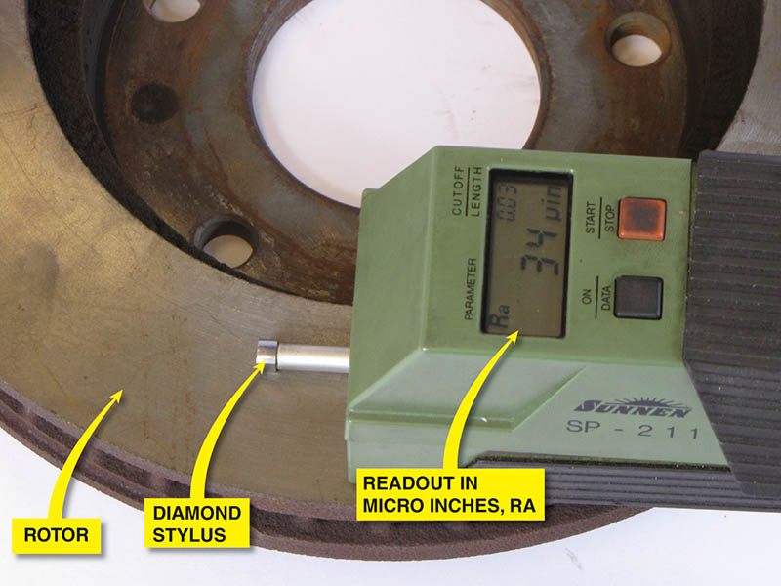
Figure 108.36 Electronic surface finish machine. The reading shows about 34 μin. This is a very smooth rotor and is suitable for use with any brake pad

Slide 69
QUALIFYING A BRAKE LATHE
Purpose of Qualifying a Brake Lathe
To make sure the lathe is in good condition and are capable of machining brake drums and rotors accurately.
Qualifying Procedure
Ensure the machine is clean and fully operational.
Check all adapters and mounting surface for nicks and contamination.
Follow the manufactures specific operating and machining instructions.

Slide 70
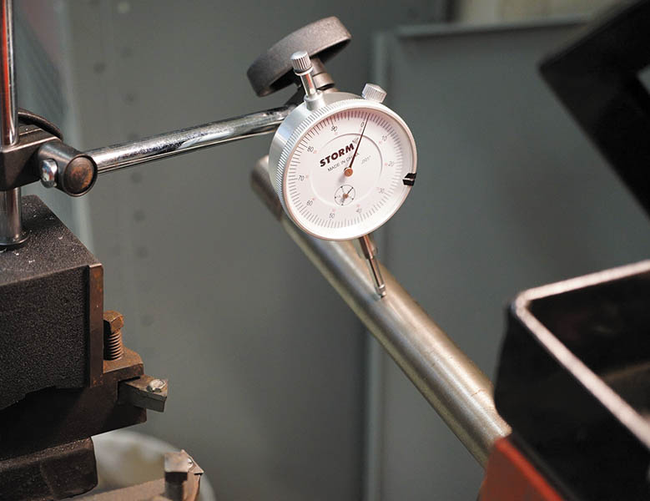
Figure 108.37 A dial indicator being used to check the arbor for total indicator runout (TIR). brake lathe

Slide 71
MACHINING A DISC BRAKE ROTOR (1 OF 2)
Mount the disc brake rotor
Install a rotor damper
Make a scratch cut on the rotor face
Turn the rotor one-half turn (180°), and retighten the nut. Make another scratch cut.
Verify rotor mounting
Machine the rotor following the manufacturer's guidelines.

Slide 72
MACHINING A DISC BRAKE ROTOR (2 OF 2)
Rough Cut
A rough cut on a lathe involves cutting 0.005 inch per side with a feed of 0.008 inch per revolution.
Finish Cut
A finish cut means removing 0.002 inch per side with a feed of 0.002 inch per revolution.
Non-directional Finish
A non-directional finish is used to help prevent the grooves machined into the rotor from acting like record grooves that can force the pads to move outward while the rotor rotates.

Slide 73
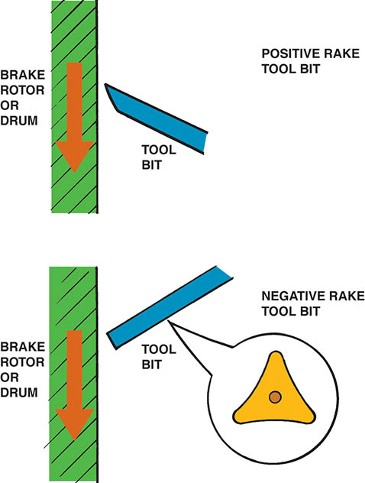
Figure 108.38 Most positive rake brake lathes can cut any depth in one pass, thereby saving time. A typical negative rake lathe uses a three-sided turning tool that can be flipped over, thereby giving six cutting edges

Slide 74
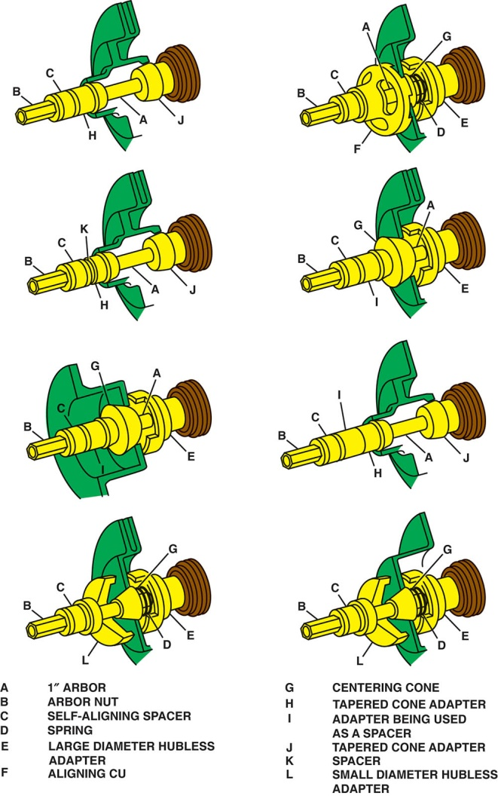
Figure 108.39 Recommended adapters and location for machining hubbed and hubless rotors

Slide 75
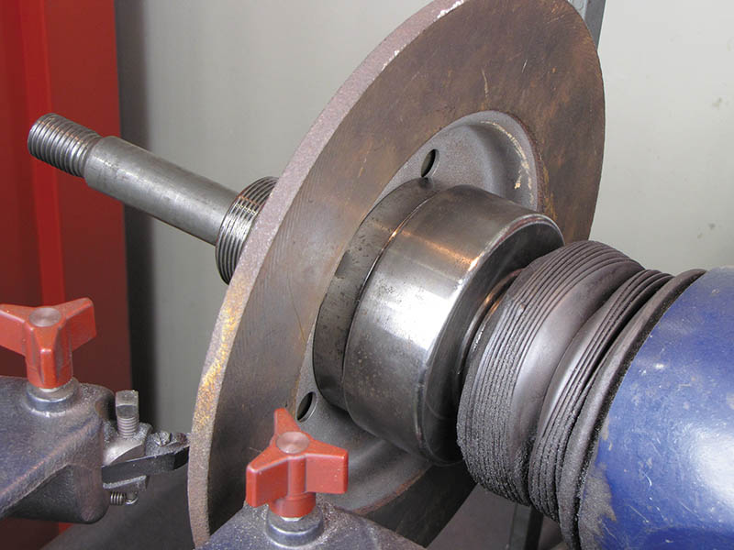
Figure 108.40 A composite rotor properly mounted on a brake lathe

Slide 76
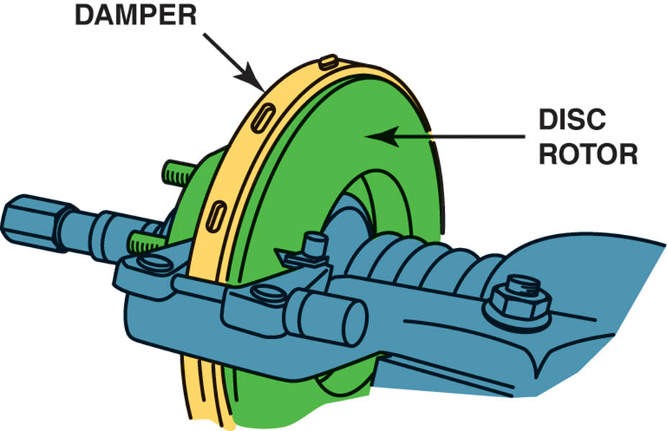
Figure 108.41 A damper is necessary to reduce cutting-tool vibrations that can cause a rough surface finish

Slide 77
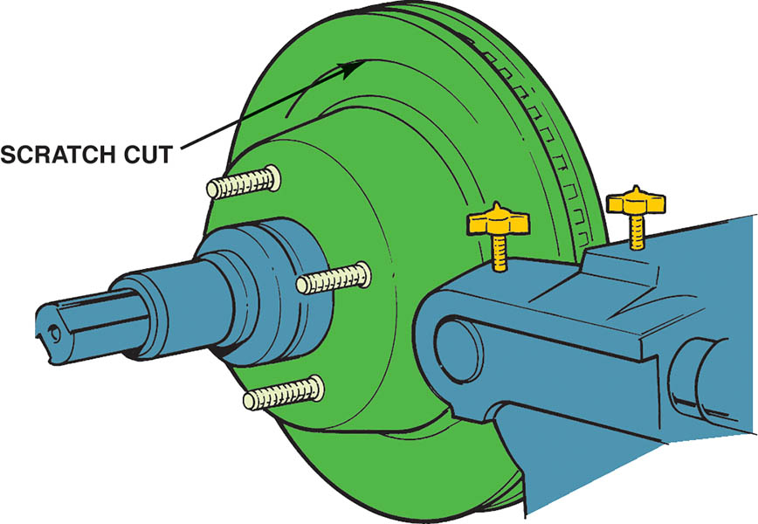
Figure 108.42 After installing the rotor on the brake lathe, turn the cutting tool in just enough to make a scratch cut

Slide 78
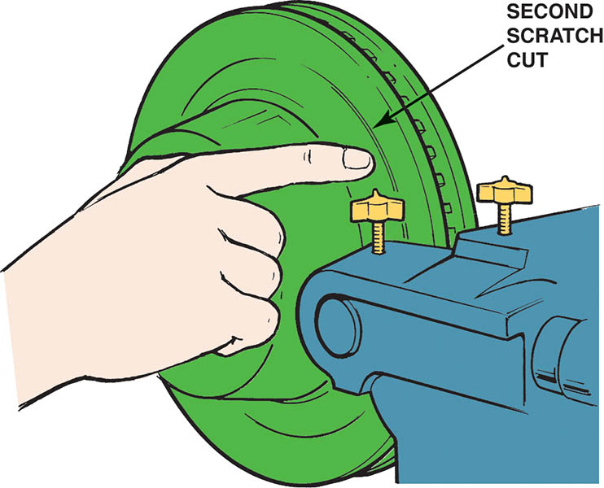
Figure 108.43 After making a scratch cut, loosen the retaining nut and rotate the rotor on the spindle of the lathe one-half turn. Tighten the nut and make a second scratch cut. The second scratch cut should be side-by-side with the first scratch if the rotor is installed correctly on the brake lathe

Slide 79
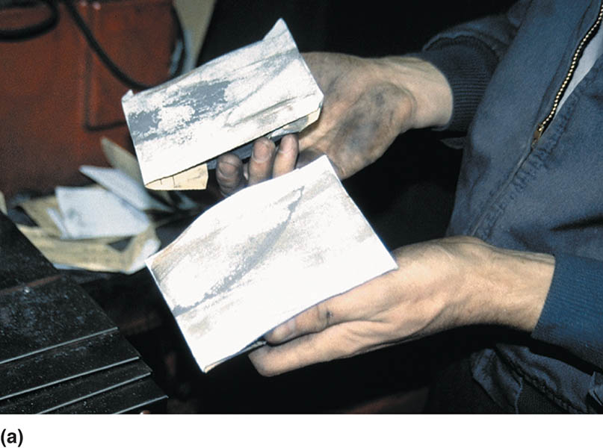
Figure 108.44 (a) This technician uses two sanding blocks each equipped with 150-grit aluminum-oxide sandpaper

Slide 80
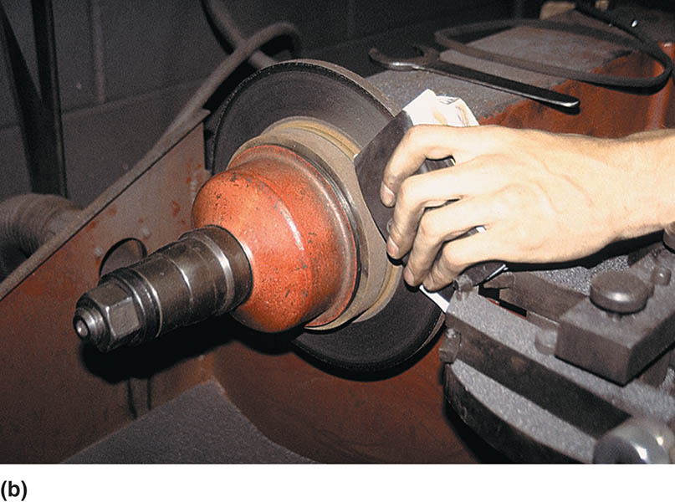
Figure 108.44 (b) With the lathe turned on, the technician presses the two sanding blocks against the surface of the rotor after the rotor has been machined to achieve a smooth microinch surface finish.

Slide 81
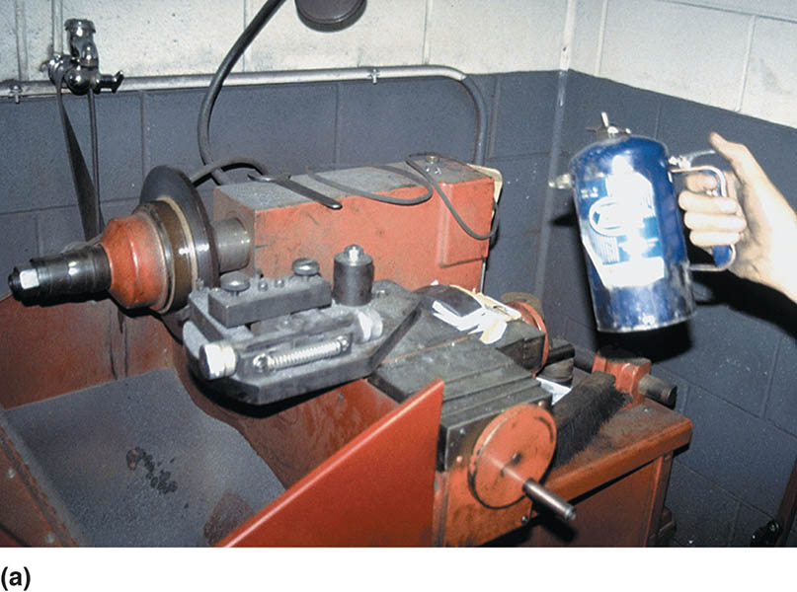
Figure 108.45 (a) After machining and sanding the rotor, it should be cleaned. In this case, brake cleaner from an air pressurized spray can is used

Slide 82
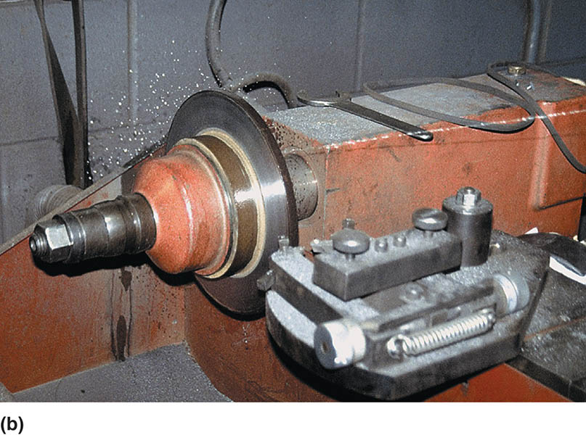
Figure 108.45 (b) With the lathe turning, the technician stands back away from the rotor and sprays both sides of the rotor to clean it of any remaining grit from the sanding process. This last step ensures a clean, smooth surface for the disc brake pads and a quality brake repair.

Slide 83
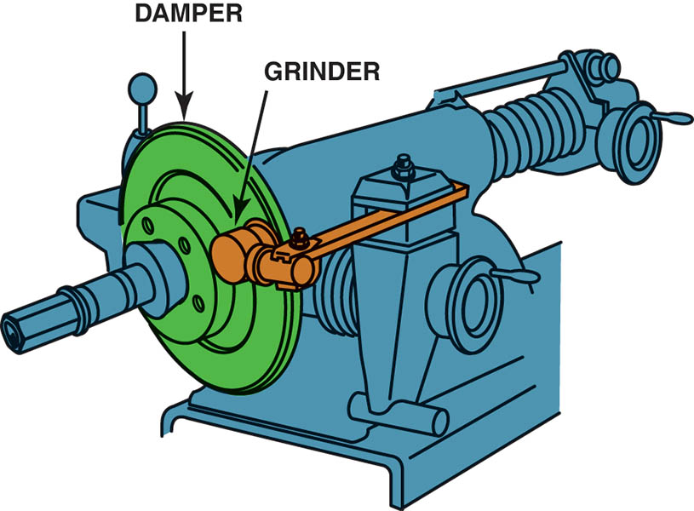
Figure 108.46 A grinder with sandpaper can be used to give a smooth nondirectional surface finish to the disc brake rotor

Slide 84
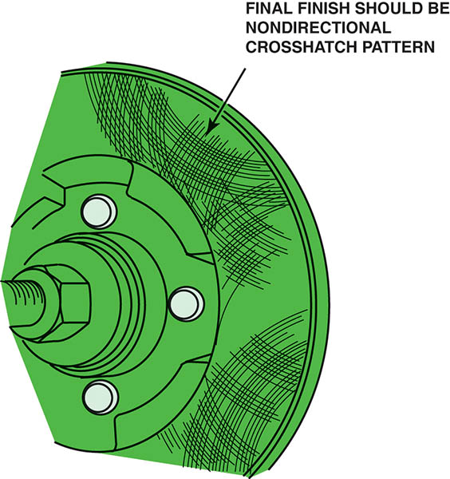
Figure 108.47 The correct final surface finish should be smooth and non-directional

Slide 85
Figure 108.48 Rust should always be cleaned from both the rotor and the hub whenever the rotors are machined or replaced. An air-powered die grinder with a sanding disc makes quick work of cleaning this hub

Slide 86
ON-THE-VEHICLE ROTOR MACHINING
Many vehicle manufacturers recommend on-the-vehicle machining for rotors if the disc brake rotor must be machined.
Follow the manufacturer specific instructions for the on-car lathe that is being used.

Slide 87
Figure 108.49 A typical hub-mount on-the-vehicle lathe. This particular lathe oscillates while machining the rotor, thereby providing a smooth and non-directional finish at the same time

Slide 88
TECH TIP

Slide 89
Figure 108.50 A wheel stud was replaced on the rotor hub assembly when it was discovered to be stripped

Slide 90
DRUM MACHINING

Slide 91
1. Before starting to machine a brake drum, check the drum for any obvious damage such as heat cracks or hard spots.

Slide 92
2. Lightly tap the drum. It should ring like a bell. If a dull thud is heard, the drum may be cracked and should be discarded.

Slide 93
3. Use a drum micrometer to measure the inside diameter of the drum and compare this measurement to specifications to be sure that the drum can be safely machined.

Slide 94
4. Most brake drums have the maximum inside diameter cast into the drum as shown.

Slide 95
5. Thoroughly clean the outside and inside of the drum.

Slide 96
6. Be sure the center hole in the drum is clean and free from any burrs that could prevent the drum from being properly centered on the shaft of the brake lathe.

Slide 97
7. A typical brake lathe used to machine drums.

Slide 98
8. Locate a tapered, centering cone that best fits inside the hole of the brake drum.

Slide 99
9. Slide the large face plate over the shaft of the brake lathe.

Slide 100
10. Slide the tapered centering cone onto the shaft with the spring between the face plate and the centering cone.

Slide 101
11. Slide the other face plate onto the shaft.

Slide 102
12. Install the self-aligning spacer (SAS) and left hand- thread spindle nut.

Slide 103
13. Tighten the spindle nut.

Slide 104
14. Loosen the turning bar retainer.

Slide 105
15. Carefully check the cutting bits and either rotate the bit to a new cutting point or replace it with a new part as necessary.

Slide 106
16. Turn the spindle control knob until the spindle is as short as possible (i.e., the drum as close to the machine as possible) to help reduce vibration as much as possible.

Slide 107
17. Position the cutting bar so that the cutting bit is located at the back surface of the drum.

Slide 108
18. Install the silencer band (vibration dampener strap).

Slide 109
19. Be sure the tool bit and clothing are away from the drum and turn the brake lathe on.

Slide 110
20. Center the bit in the center of the brake surface of the drum and rotate the control knob that moves the bit into contact with the drum friction surface. This should produce a light scratch cut.

Slide 111
21. Turn the lathe off.

Slide 112
22. Observe the scratch cut.

Slide 113
23. Loosen the spindle nut.

Slide 114
24. Rotate the drum 180° (one-half turn) on the spindle.

Slide 115
25. Tighten the spindle nut.

Slide 116
26. Turn the lathe on, rotate the control knob, and run the cutter into the drum for another scratch cut.

Slide 117
27. Observe the scratch cut. If the second scratch cut is in the same place as the first scratch cut or extends all the way around the drum, the drum is correctly mounted on the lathe.

Slide 118
28. Adjust the depth gauge to zero when the cutter just touches the drum.

Slide 119
29. Run the cutter all the way to the back surface of the drum.

Slide 120
30. Adjust the depth of the cut and lock it in position by turning the lock knob. Most vehicle manufacturers recommend a rough cut depth should be 0.005–0.010 inch and a finish cut of 0.002 inch.

Slide 121
31. Select a fast-feed rate if performing a rough cut (0.006–0.016 inch per revolution) or 0.002 inch per revolution for a finish cut.

Slide 122
32. Turn the lock knob to keep the feed adjustment from changing.

Slide 123
33. Engage the automatic feed.

Slide 124
34. The drum will automatically move as the tool remains stationary to make the cut.

Slide 125
35. Turn the lathe off.

Slide 126
36. If additional material must be removed, proceed with the finish cut. Clean thoroughly before installing on a vehicle.

Slide 127
ROTOR MACHINING

Slide 128
1. Before machining any rotor, use a micrometer and measure the thickness of the rotor.

Slide 129
2. Check the specifications for the minimum allowable thickness.

Slide 130
3. Visually check the rotor for evidence of heat cracks or hard spots that would require replacement (rather than machining) of the rotor.

Slide 131
4. After removing the grease seal and bearings, remove the grease from the bearing races.

Slide 132
5. Clean and inspect the brake lathe spindle for damage or burrs that could affect its accuracy.

Slide 133
6. Select a tapered cone adapter that fits the inner bearing race.

Slide 134
7. Slide the cone adapter onto the brake lathe spindle.

Slide 135
8. Select the proper size cone adapter for the smaller outer wheel bearing race.

Slide 136
9. Place the rotor onto the large cone adapter and then slide the small cone adapter into the outer wheel bearing race.

Slide 137
10. Install the self-aligning spacer (SAS) and spindle nut.

Slide 138
11. Tighten the spindle nut (usually left-hand threads).

Slide 139
12. If a hubless rotor is being machined, be sure to thoroughly clean the inside surface.

Slide 140
13. Also remove all rust from the other side of the hubless rotor.

Slide 141
14. Select the proper centering cone for the hole in the center of the hub.

Slide 142
15. Select the proper size cone-shaped hubless adapter and the tapered centering cone with a spring in between.

Slide 143
16. After sliding the rotor over the centering cone, install the matching hubless adapter.

Slide 144
17. Install the self-aligning spacer (SAS) and spindle nut.

Slide 145
18. After the rotor has been secured to the brake lathe spindle, install the noise silencer band (dampener).

Slide 146
19. Carefully inspect the cutting bits and replace, if necessary.

Slide 147
20. Loosen the tool holder arm.

Slide 148
21. Adjust the twin cutter arm until the rotor is centered between the two cutting bits.

Slide 149
22. Turn the lathe on.

Slide 150
23. Move the cutter arm toward the center of the rotor, placing the cutting bits in about the center of the friction surface.

Slide 151
24. Turn one cutting bit into the surface of the rotor to make a scratch cut. This step checks the lathe setup for accuracy.

Slide 152
25. Turn the lathe off.

Slide 153
26. Observe the first scratch cut.

Slide 154
27. Loosen the spindle retaining nut.

Slide 155
28. Rotate the rotor 180° (one-half turn) on the spindle of the brake lathe.

Slide 156
29. Tighten the spindle nut.

Slide 157
30. Turn the lathe back on and turn the cutting bit slightly into the rotor until a second scratch cut is made.

Slide 158
31. If the second scratch cut is in the same location as the first scratch cut or extends all around the surface of the rotor, then the rotor is properly installed on the lathe.

Slide 159
32. Start the machining process by moving the twin cutters to about the center of the rotor friction surface.

Slide 160
33. Turn the cutting bits inward until they touch the rotor and zero the depth adjustment.

Slide 161
34. Adjust the twin cutters, then dial in the amount of depth (0.005–0.010 inch per side for a rough cut or 0.002 inch for a finish cut) and lock the adjustment so that vibration will not change the setting.

Slide 162
35. Turn the feed control knob until the desired feed rate is achieved for the first or rough cut (0.006– 0.010 inch per revolution) or finish cut (0.002 inch per revolution).

Slide 163
36. Engage the automatic feed.

Slide 164
37. Observe the machining operation.

Slide 165
38. After the cutting bits have cleared the edge of the rotor, turn the lathe off and measure the thickness of the rotor.

Slide 166
39. Readjust the feed control to a slow rate (0.002 inch per revolution or less) for the finish cut.

Slide 167
40. Reposition the cutting bits for the finish cut.

Slide 168
41. Loosen the adjustment locks.

Slide 169
42. Turn the depth of the cut for the finish cut (0.002 inch maximum).

Slide 170
43. Lock the adjustment.

Slide 171
44. Engage the automatic feed.

Slide 172
45. Use 150-grit aluminum-oxide sandpaper on a block of wood for 60 seconds per side on a grinder to give a non-directional and smooth surface to both sides of the rotor.

Slide 173
46. After the sanding or grinding operation, thoroughly clean the machined surface of the rotor to remove any and all particles of grit that could affect the operation and life of the disc brake pads.

Slide 174
47. Remove the silencer band.

Slide 175
48. Loosen the spindle retaining nut and remove the rotor.

Slide 176
ON-THE-VEHICLE LATHE

Slide 177
1. Prepare to machine a disc brake rotor using an on-the-vehicle lathe by properly positioning the vehicle in the stall and hoisting the vehicle to a good working height.

Slide 178
2. Remove the wheels and place them out of the way.

Slide 179
3. Remove the disc brake caliper and use a wire to support the caliper out of the way of the rotor.

Slide 180
4. Measure the rotor thickness and compare it with factory specifications before machining. If a discard thickness is specified, be sure to allow an additional 0.015 inch for wear.

Slide 181
5. Install the hub adapter onto the hub and secure it using the wheel lug nuts.

Slide 182
6. Engage the drive unit by aligning the hole in the drive plate with the raised button on the adapter.

Slide 183
7. Use the thumb wheel to tighten the drive unit to the adapter.

Slide 184
8. Attach a dial indicator to a secure part on the vehicle and position the dial indicator on a flat portion of the lathe to measure the lathe runout.

Slide 185
9. Rotate the wheel or turn the lathe motor on and measure the amount of runout.

Slide 186
10. Use a wrench to adjust the runout using the four numbers stamped on the edge of the drive flange as a guide.

Slide 187
11. After the hub runout is adjusted to 0.005 inch or less, remove the dial indicator from the vehicle.

Slide 188
12. Using a T-handle Allen wrench, adjust the cutter arms until they are centered on the disc brake rotor.

Slide 189
13. Move the cutters to the center of the rotor.

Slide 190
14. Adjust the cutter depth until each cutter barely touches the rotor.

Slide 191
15. Position the cutters to the inside edge of the rotor surface and adjust the cutters to the desired depth of cut.

Slide 192
16. Adjust the automatic shut-off so the lathe will turn itself off at the end of the cut.

Slide 193
17. Turn the lathe on by depressing the start button.

Slide 194
18. Monitor the machining operations as the lathe automatically moves the cutters from the center toward the outside edge of the rotor.

Slide 195
19. After the lathe reaches the outside edge of the rotor, the drive motor should stop.

Slide 196
20. Measure the thickness of the rotor after machining to be certain that the rotor thickness is within service limits.

Slide 197
21. The technician is using 150-grit aluminum-oxide sandpaper and a wood block for 60 seconds on each side of the rotor to provide a smooth surface finish.

Slide 198
22. After completing the machining and resurfacing of the rotor, unclamp the drive unit from the hub adapter and clean the rotor.

Slide 199
23. After the drive unit has been removed, remove the lug nuts holding the adapter to the rotor hub.

Slide 200
24. After removing the hub adapter, the caliper can be reinstalled.

Slide 201
25. Be sure to torque the caliper retaining bolts to factory specifications.

Slide 202
26. Install the wheel and wheel cover. On this vehicle, the wheel cover must be installed before the lug nuts because the lug nuts hold the wheel cover on the wheel.

Slide 203
27. Always use a torque wrench or a torque-limiting adapter with an air impact wrench as shown here when tightening lug nuts.

Slide 204
28. Pump the brake pedal several times to restore proper brake pedal height. Check and add brake fluid as necessary before moving the vehicle.

Slide 205
Video Links (Internet Access Required)
On car brake machining (time 19:13)
Tapered wheel bearing rotors (time 33:08)
Replace a wheel stud (time 2:09)
Turn a rotor (time 7:14)
Machine a brake rotor (time 4:52)
On car brake lathe (time 3:04)
Rotor machining (time 9:19)
Rotor machining (time 7:49)
On car brake lathe (time 15:18)
Machining a brake drum (time 21:54)
Brake drum measurement (time 5:20)

Slide 206
Copyright

