Slide 2
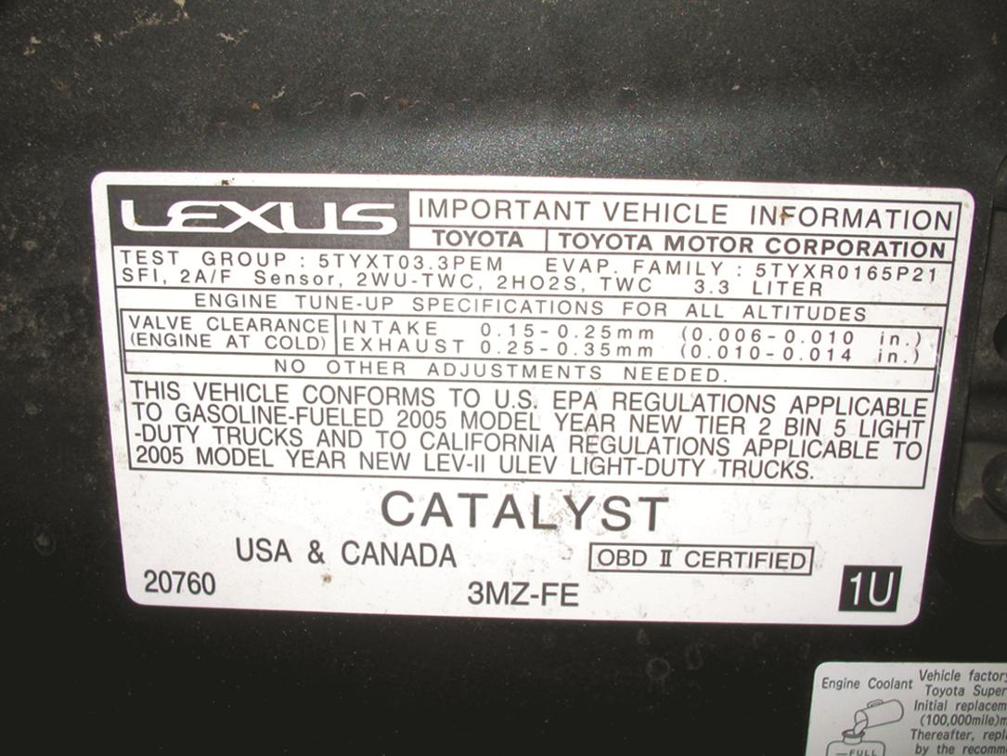
FIGURE 31.1 The underhood decal showing that this Lexus RX-330 meets both national (Tier 2; BIN 5) and California LEV-II (ULEV) regulation standards.

Slide 3
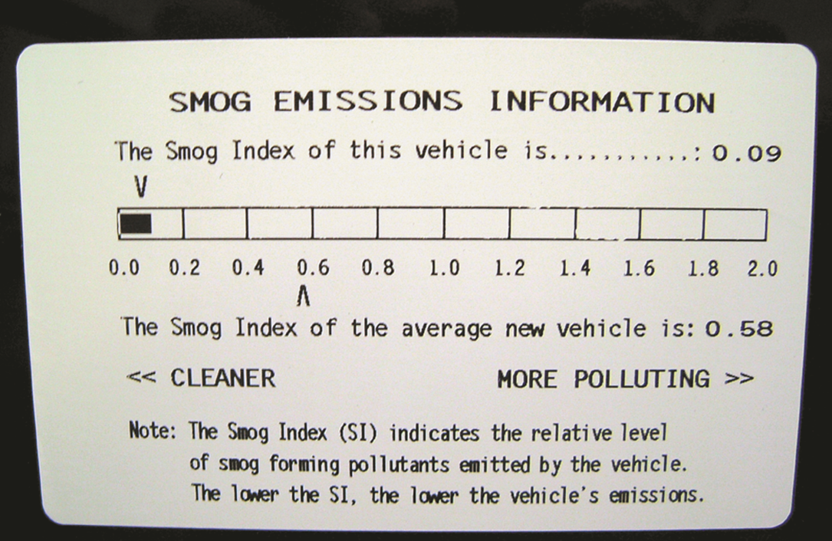
FIGURE 31.2 This label on a Toyota Camry hybrid shows the relative smog-producing emissions, but this does not include carbon dioxide (CO₂), which may increase global warming.

Slide 4
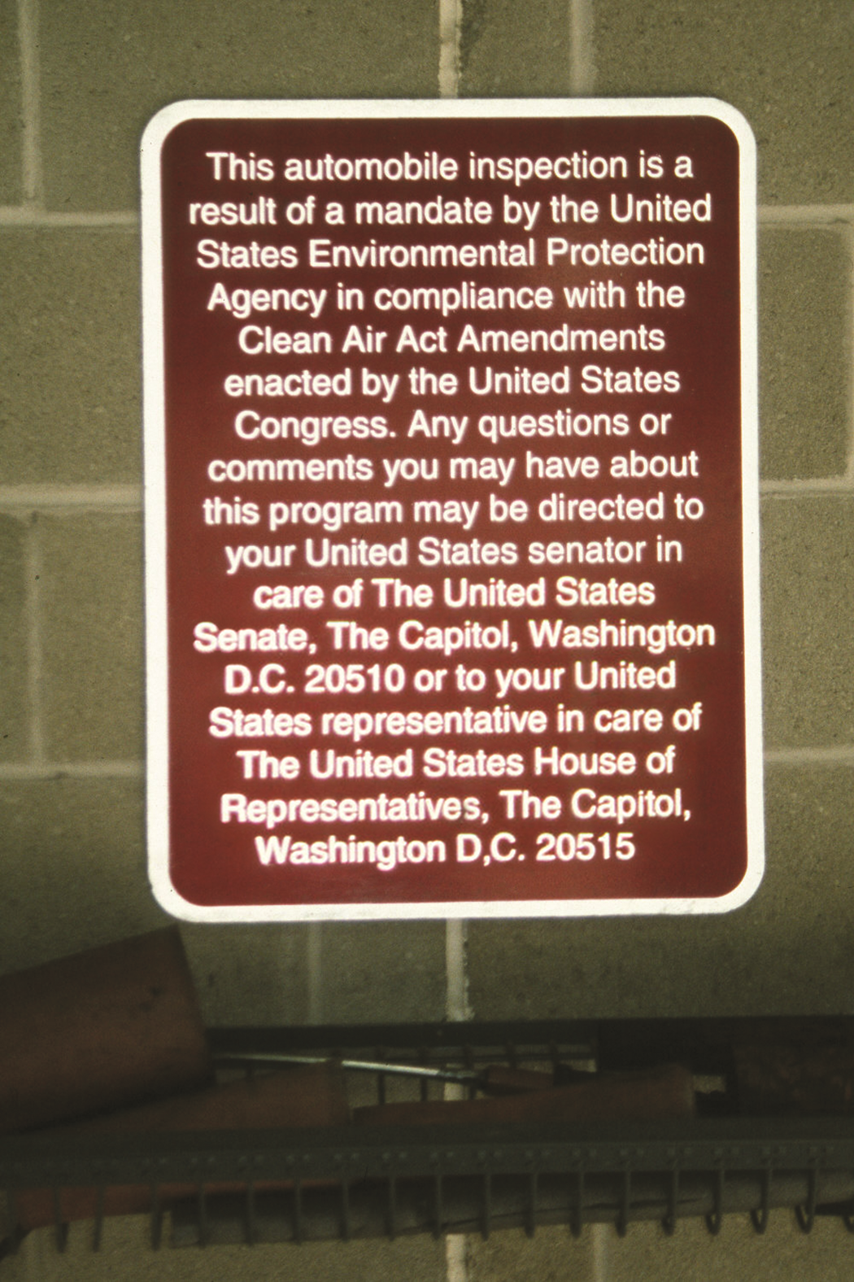
FIGURE 31.3 Photo of a sign taken at an emissions test facility.

Slide 5
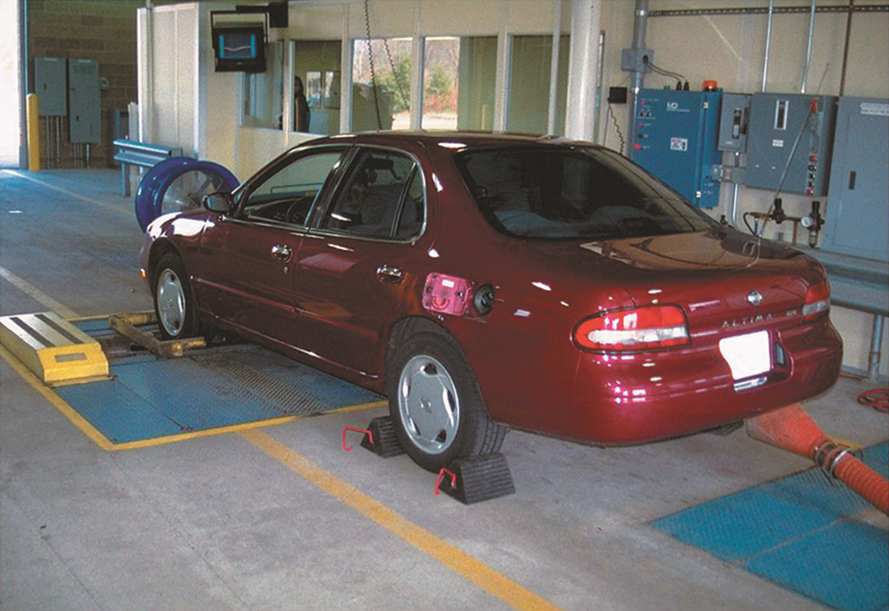
FIGURE 31.4 A vehicle being tested during an enhanced emissions test.

Slide 6
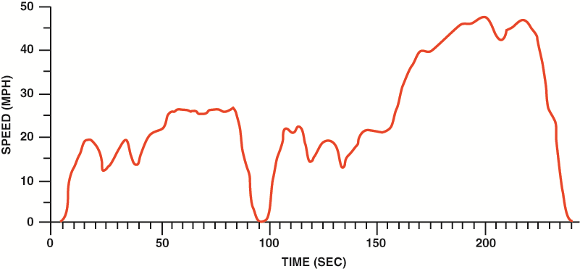
FIGURE 31.5 Trace showing the Inspection/Maintenance 240 test. The test duplicates an urban test loop around Los Angeles, California. The first “hump” in the curve represents the vehicle being accelerated to about 20 mph, then driving up a small hill to about 30 mph and coming to a stop. At about 94 seconds, the vehicle stops and again accelerates while climbing a hill and speeding up to about 50 mph during this second phase of the test.

Slide 7
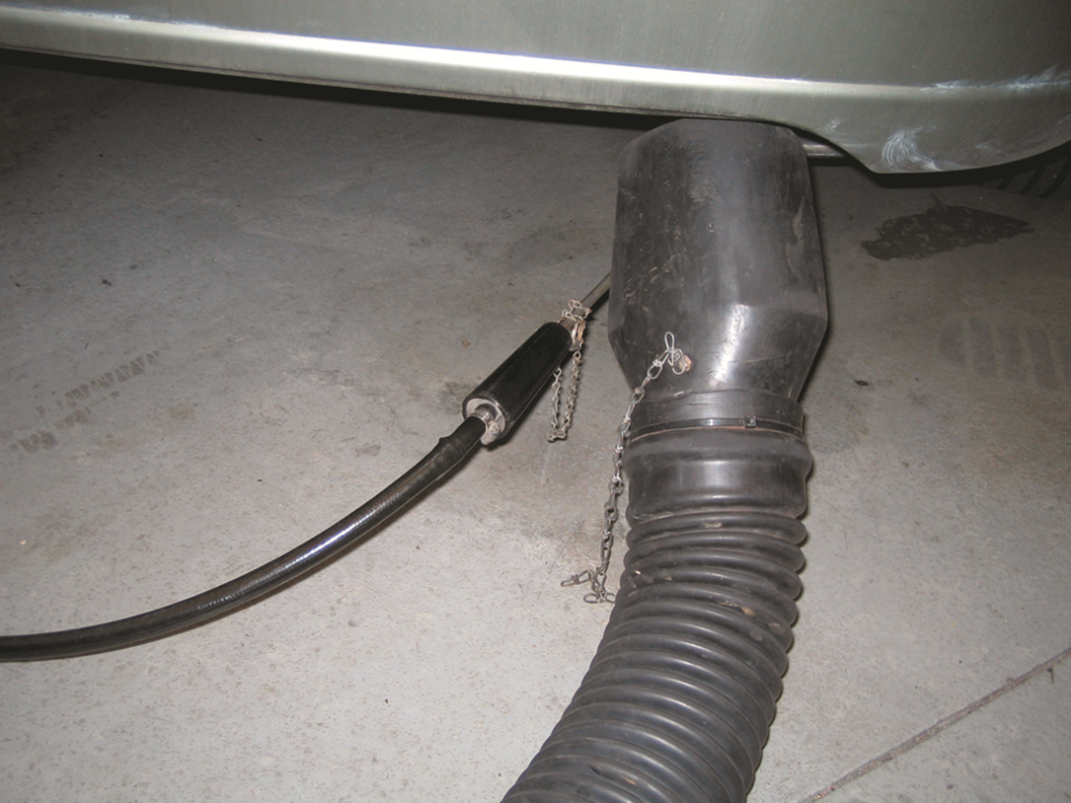
FIGURE 31.6 A partial stream sampling exhaust probe being used to measure exhaust gases in parts per million (PPM) or percent (%).

Slide 8
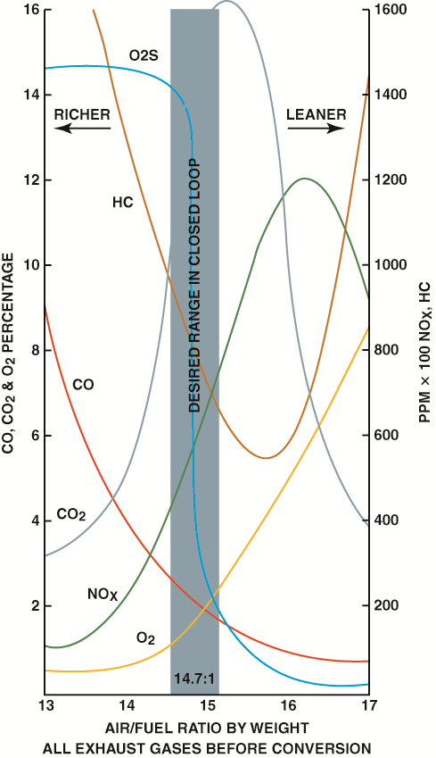
FIGURE 31.7 Exhaust emissions are very complex. When the air–fuel mixture becomes richer, some exhaust emissions are reduced, while others increase.

Slide 9
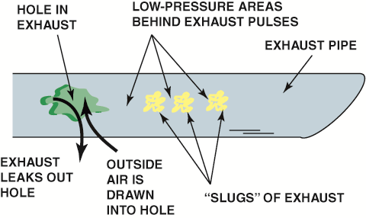
FIGURE 31.8 A hole in the exhaust system can cause outside air (containing oxygen) to be drawn into the exhaust system. This extra oxygen can be confusing to a service technician because the extra O₂ in the exhaust stream could be misinterpreted as a too-lean air–fuel mixture.

Slide 10
Video Links (Internet Access Required)
State Emission Test (time 2:03)
Emission Testing in Automotive Engines (time 1:00:29)
Secondary air injection (time 4:23)
PCV valve (time 1:45)
PCV valve (time 2:37)
Secondary Air Injection system (time 1:11)

