Slide 2
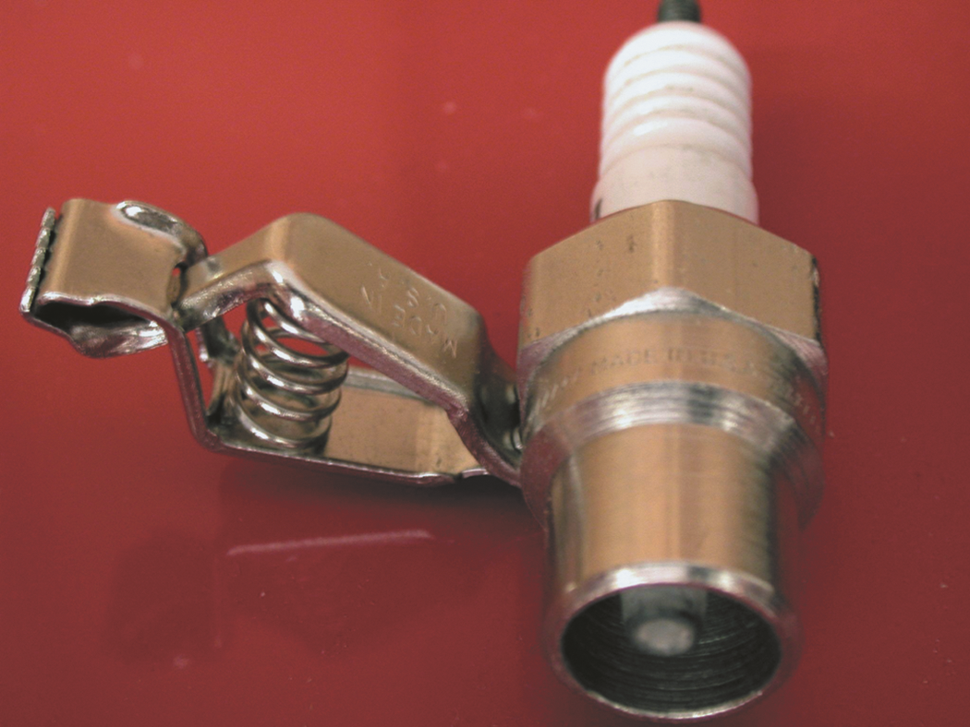
FIGURE 17.1 A spark tester looks like a regular spark plug with an alligator clip attached to the shell. This tester has a specified gap that requires at least
25,000 volts (25 kV) to fire.

Slide 3
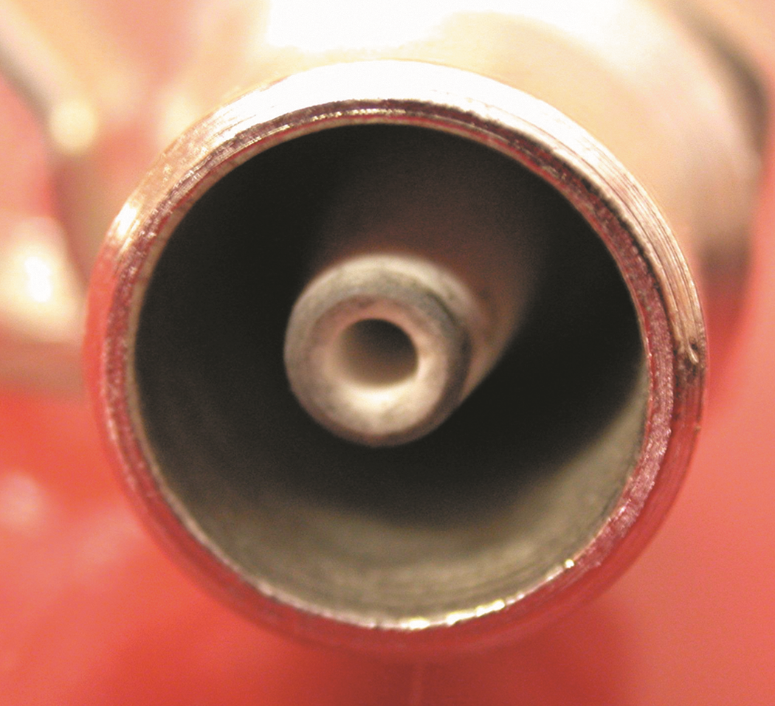
FIGURE 17.2 A close-up showing the recessed center electrode on a spark tester. It is recessed
3/8 inch into the shell and the spark must then jump another 3/8 inch to the shell for a total gap of 3/4 inch.

Slide 4
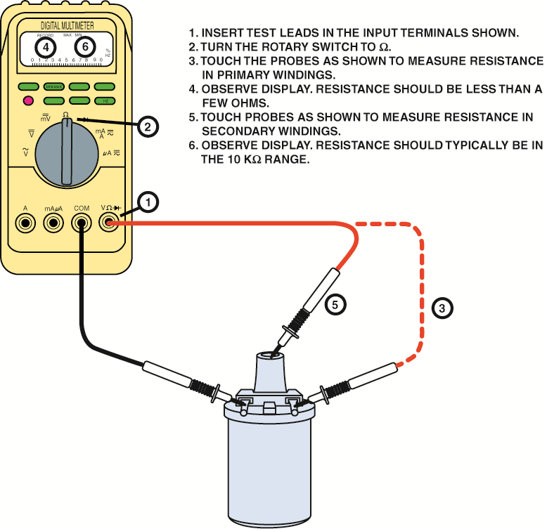
FIGURE 17.3 Checking an ignition coil using a multimeter set to read ohms.

Slide 5
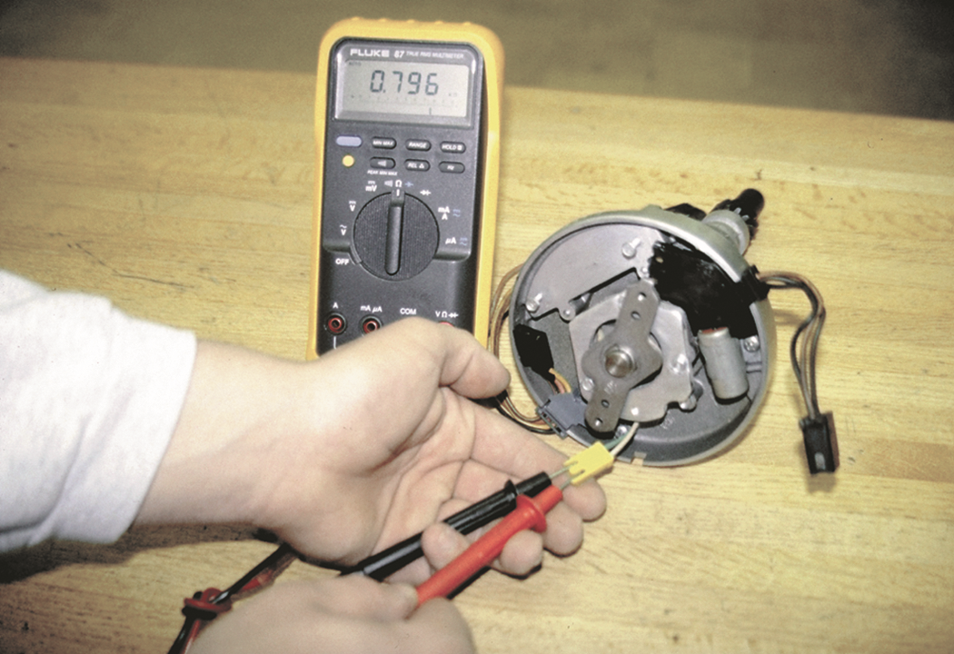
FIGURE 17.4 Measuring the resistance of an HEI pickup coil using a digital multimeter set to the ohms position.

Slide 6
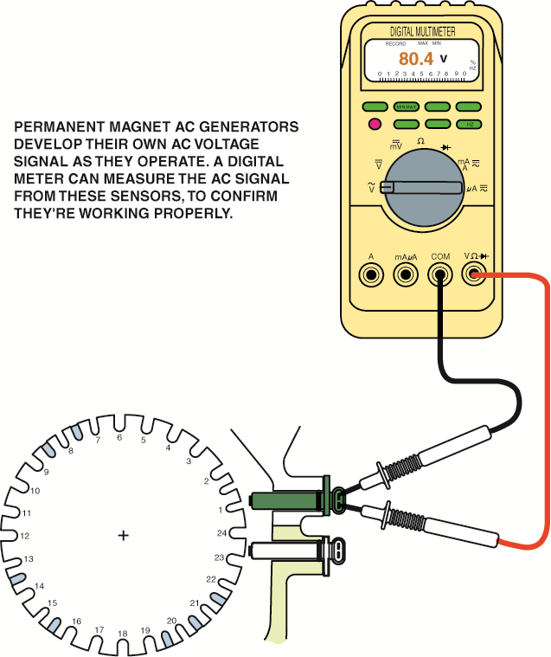
FIGURE 17.5 An AC voltage is produced by a magnetic sensor. Most sensors should produce at least 0.1 volt AC while the engine is cranking and can exceed 100 volts with the engine running if the pickup wheel has many teeth.

Slide 7
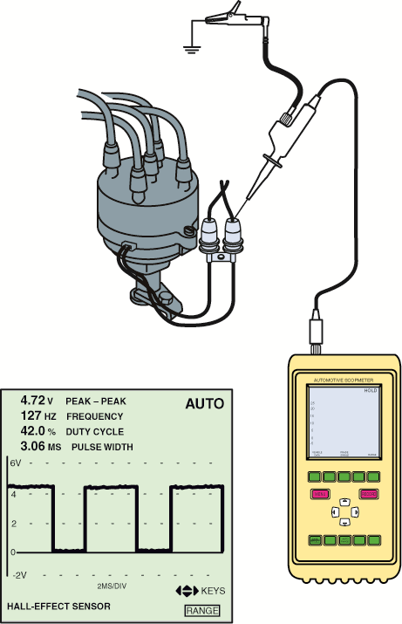
FIGURE 17.6 (a) The connection required to test a Halleffect sensor. (b) A typical waveform from a
Hall-effect sensor.

Slide 8
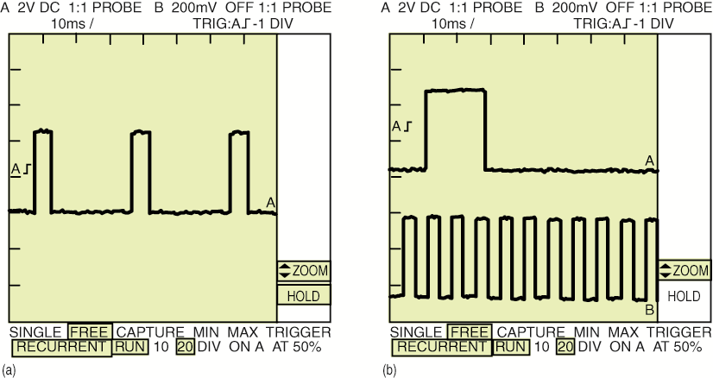
FIGURE 17.7 (a) The low-resolution signal has the same number of pulses as the engine has cylinders.
(b) A dual trace pattern showing both the low-resolution signal and the high-resolution signals that usually represent 1 degree of rotation.

Slide 9
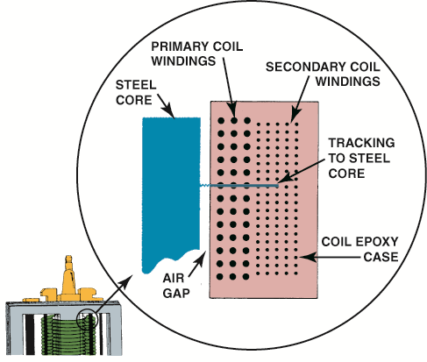
FIGURE 17.8 A track inside an ignition coil is not a short, but rather it is a low-resistance path or hole that has been burned through from the secondary wiring to the steel core.

Slide 10
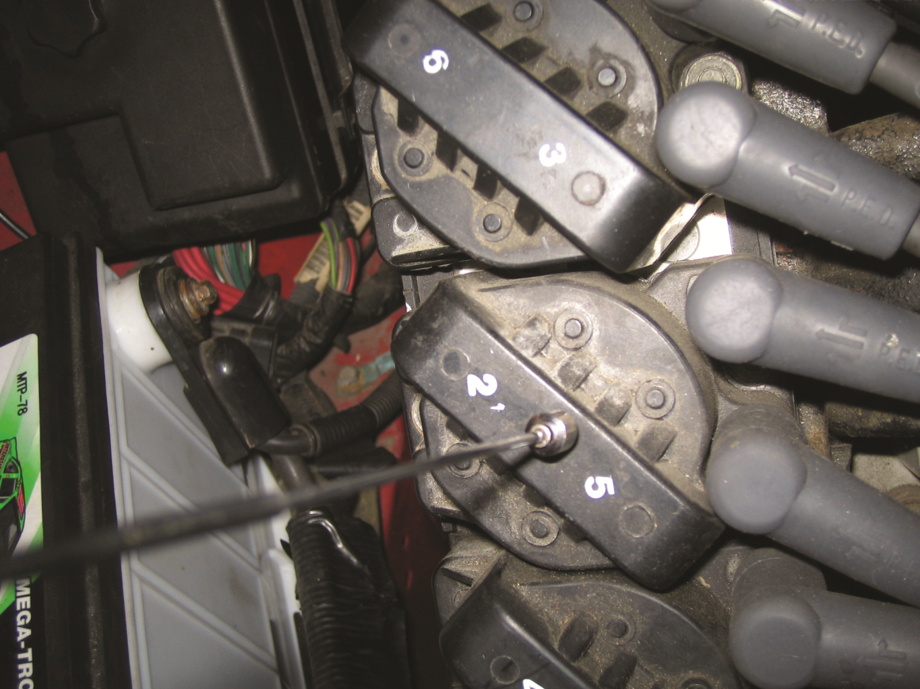
FIGURE 17.9 If the coil is working, the end of the magnetic pickup tool will move with the changes in the magnetic field around the coil.

Slide 11
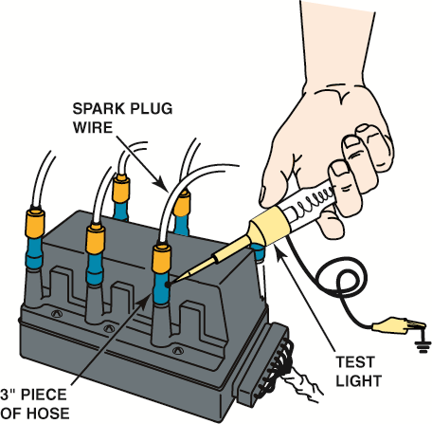
FIGURE 17.10 Using a vacuum hose and a grounded test light to ground one cylinder at a time on a DIS.
This works on all types of ignition systems and provides a method for grounding out one cylinder at a time without fear of damaging any component.

Slide 12
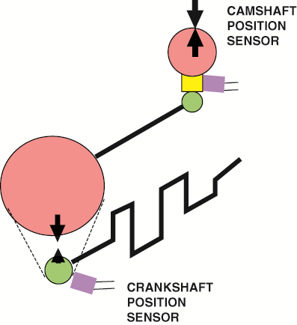
FIGURE 17.11 The relationship between the crankshaft position (CKP) sensor and the camshaft position (CMP) sensor is affected by wear in the timing gear and/or chain.

Slide 13
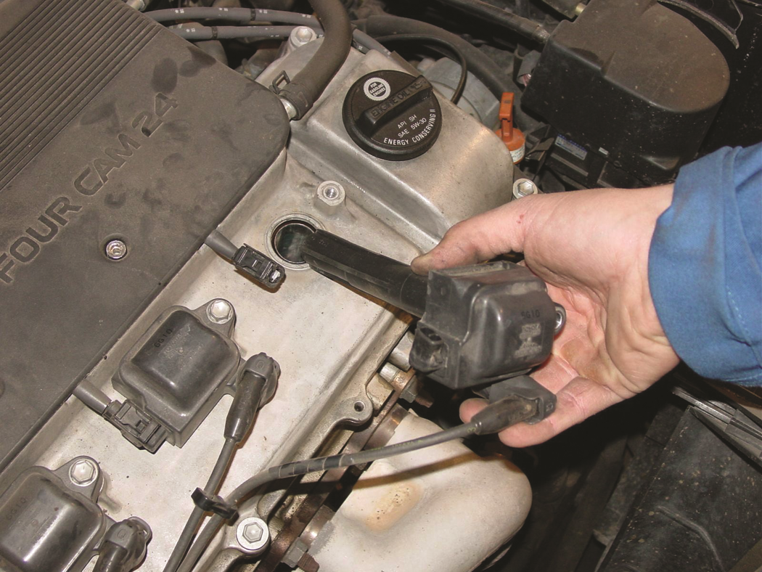
FIGURE 17.12 When checking a coil-on-plug (COP) assembly, check that the primary and secondary wiring looks normal and that the coil is not discolored from arcing or corrosion.

Slide 14
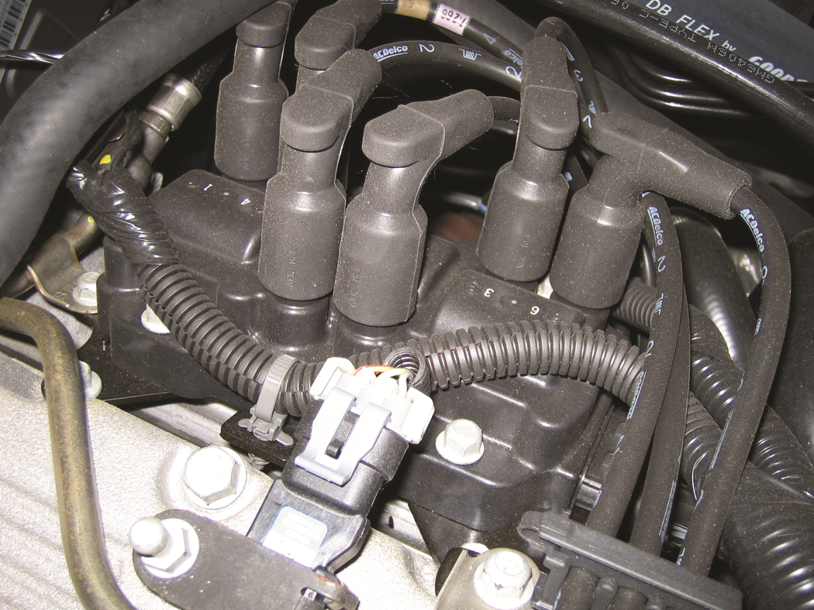
FIGURE 17.13 When checking a waste spark-type ignition system, check that the secondary wires are attached to the correct coil terminal and that the wiring is correctly routed to help avoid cross-fire.

Slide 15
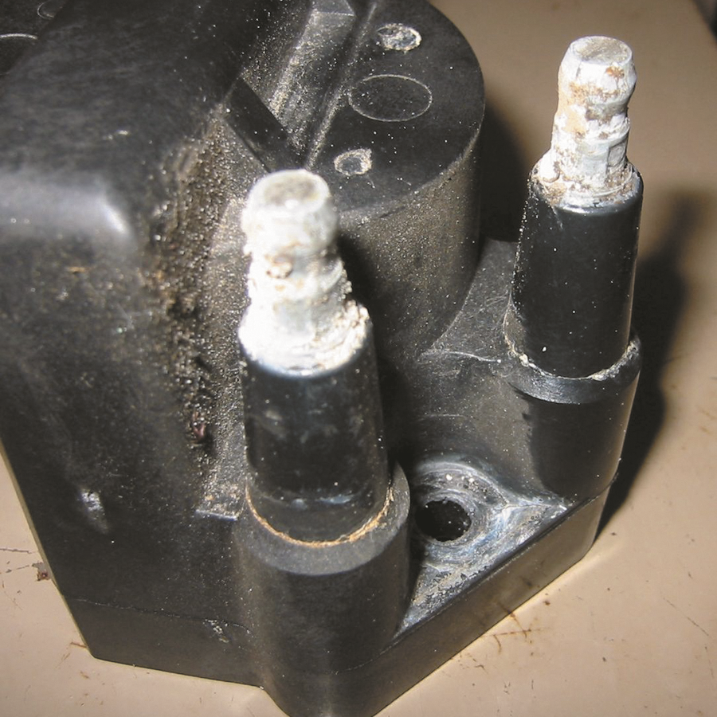
FIGURE 17.14 Corroded terminals on a waste-spark coil can cause misfire diagnostic trouble codes to be set.

Slide 16
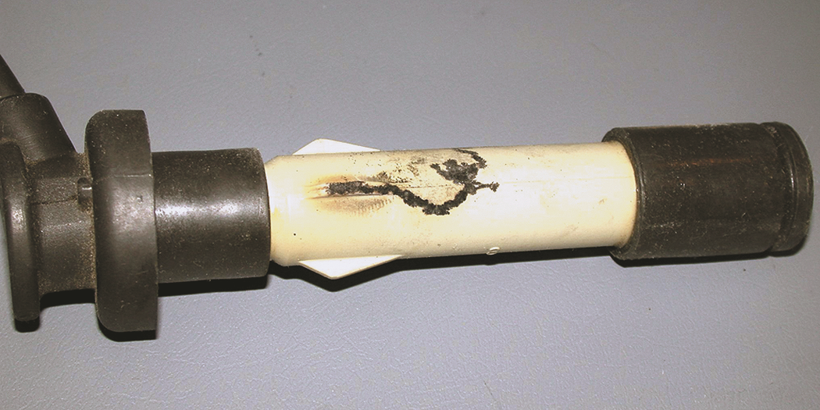
FIGURE 17.15 This spark plug boot on an overhead camshaft engine has been arcing to the valve cover causing a misfire to occur.

Slide 17
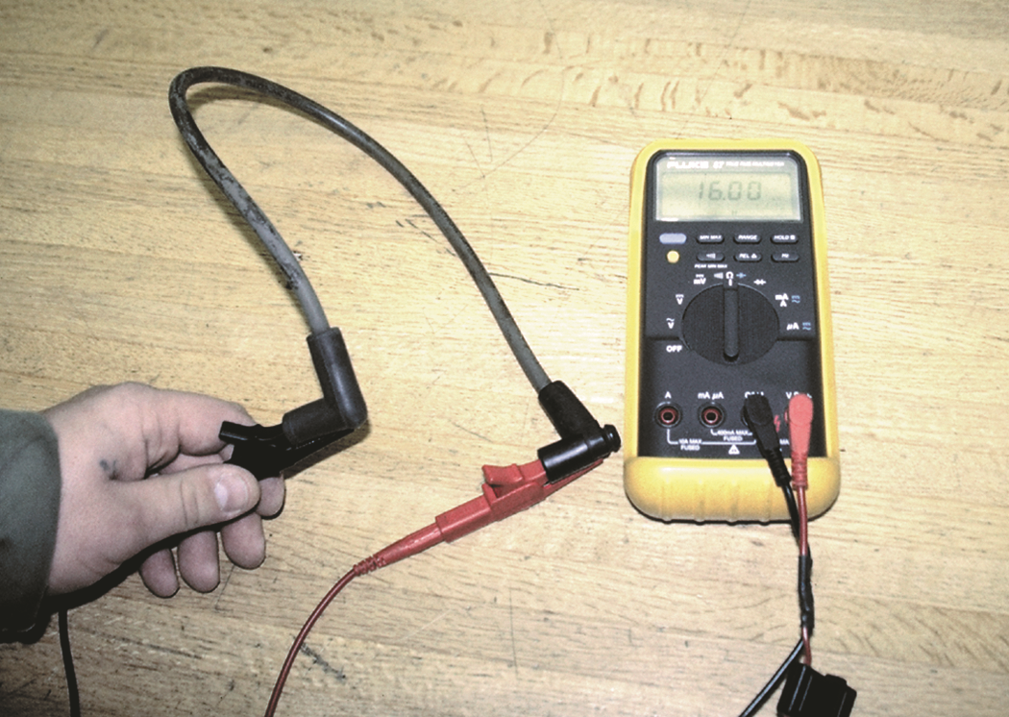
FIGURE 17.16 Measuring the resistance of a spark plug wire with a multimeter set to the ohms position.
The reading of 16.03 kO (16.030 ohms) is okay because the wire is about 2 feet long.

Slide 18
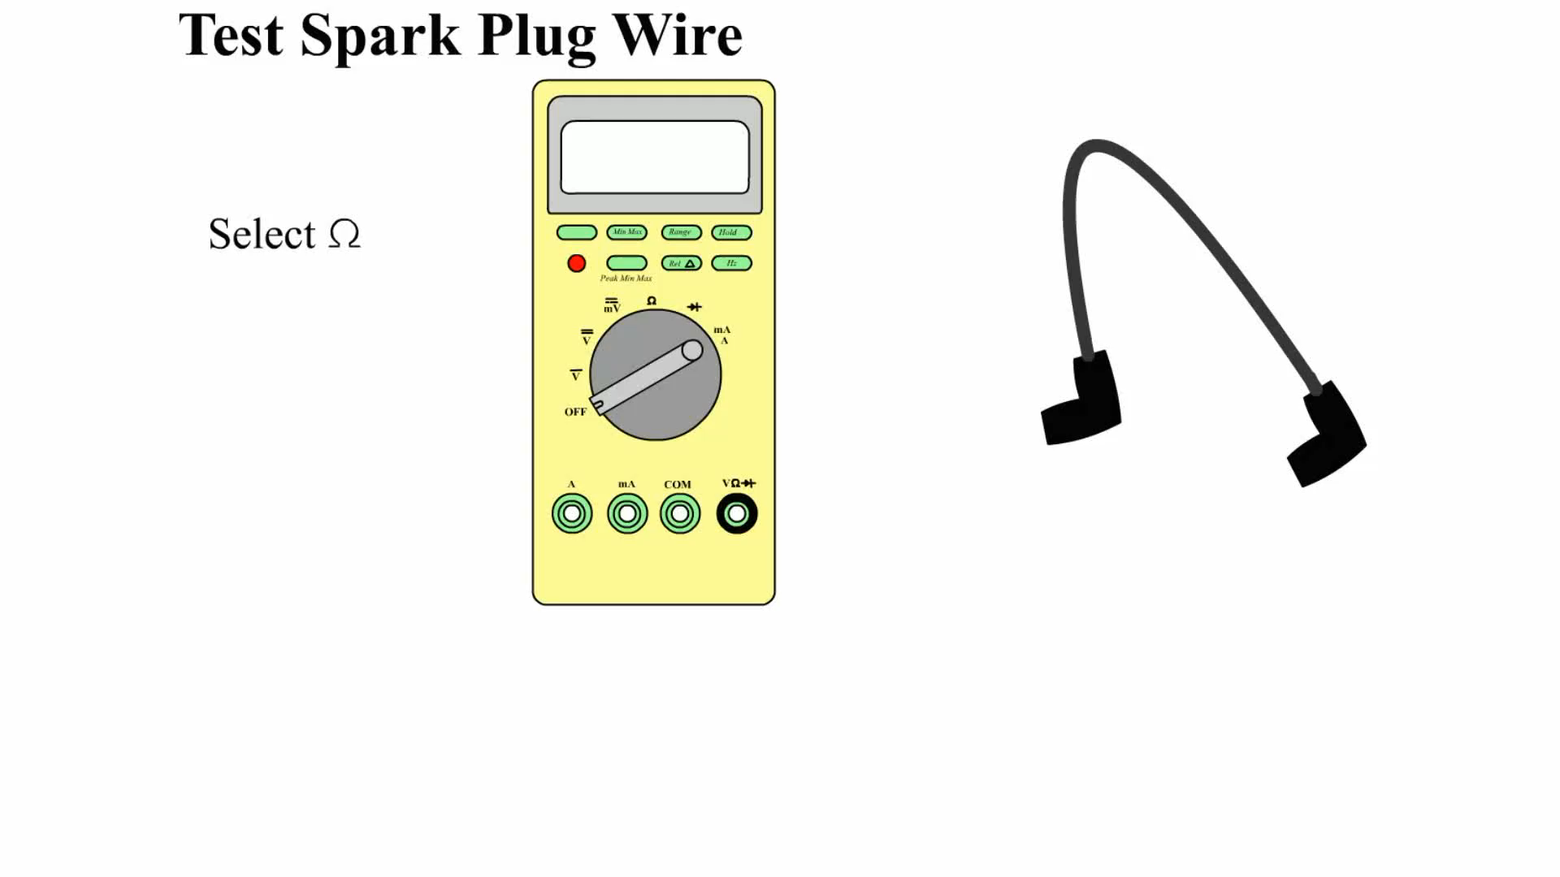
Animation: Test Spark Plug Wire
(The animation will automatically start in a few seconds)

Slide 19
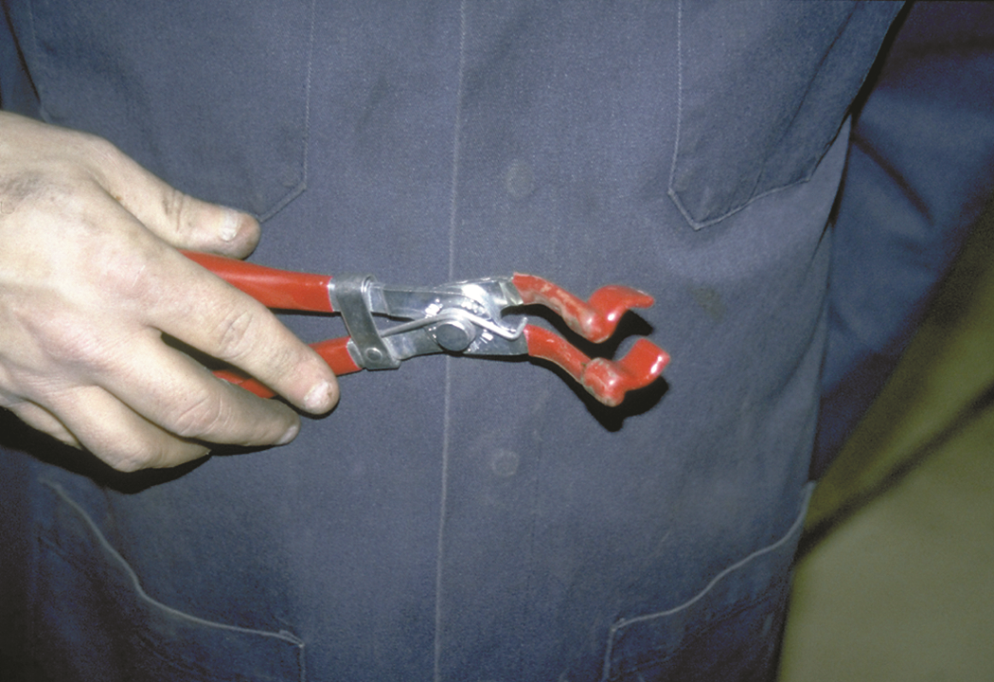
FIGURE 17.17 Spark plug wire boot pliers is a handy addition to any tool box.

Slide 20
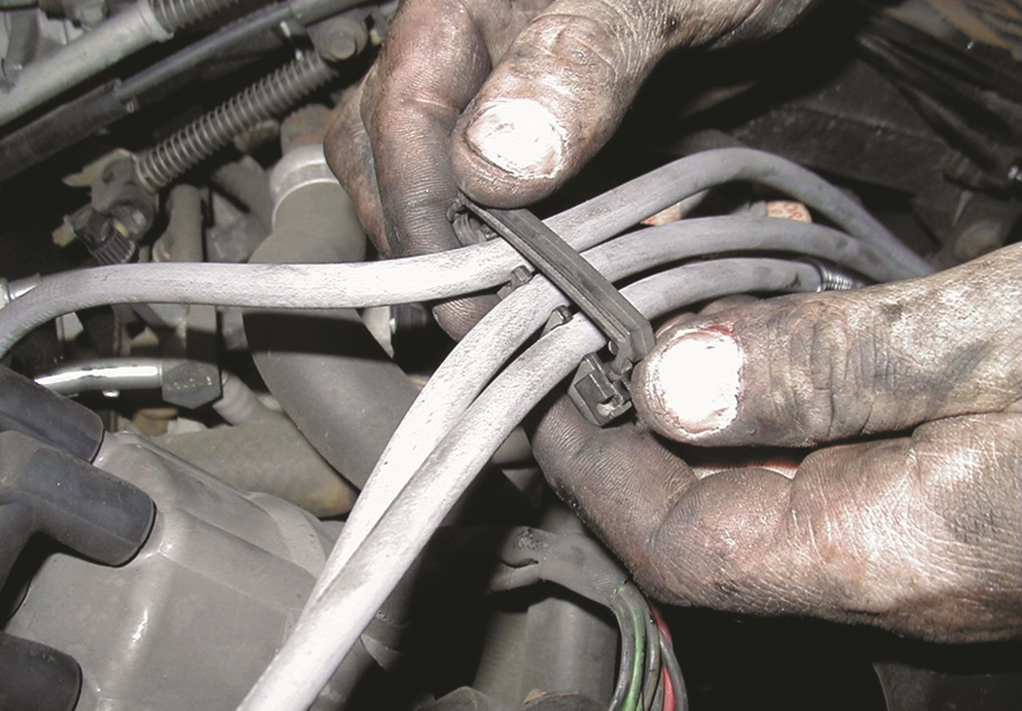
FIGURE 17.18 Always take the time to install spark plug wires back into the original holding brackets (wiring combs).

Slide 21
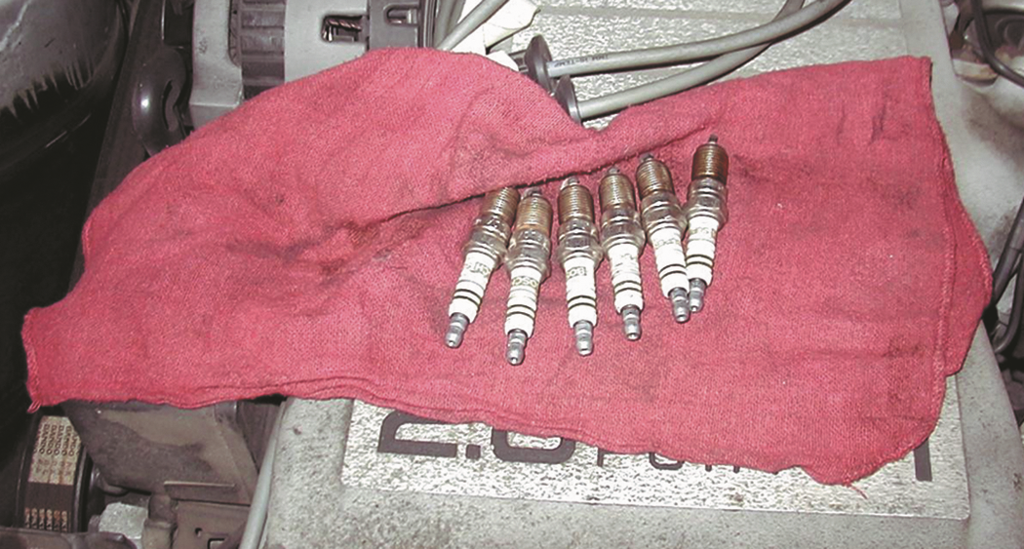
FIGURE 17.19 When removing spark plugs, it is wise to arrange them so that they can be compared and any problem can be identified with a particular cylinder.

Slide 22
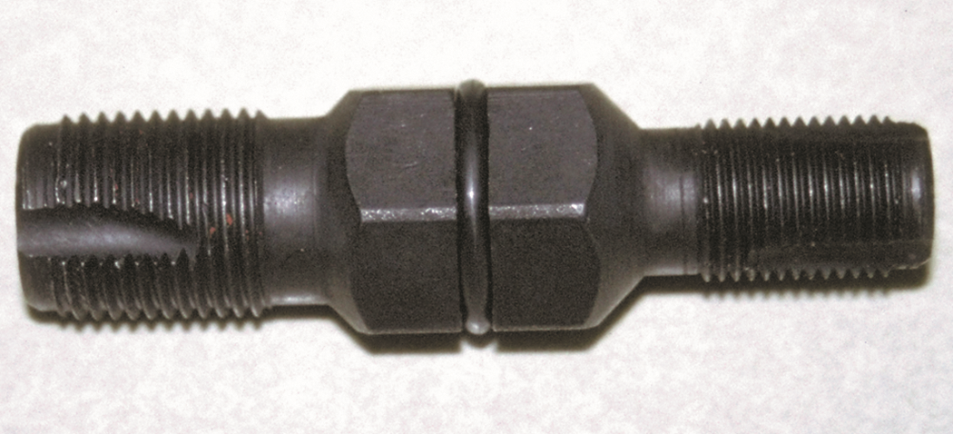
FIGURE 17.20 A spark plug thread chaser is a low-cost tool that hopefully will not be used often, but is necessary to use to clean the threads before new spark plugs are installed.

Slide 23
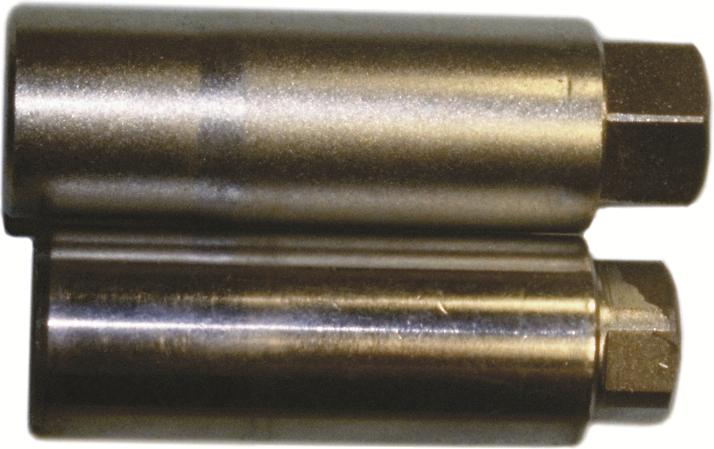
FIGURE 17.21 Since 1991, General Motors engines have been equipped with slightly (1/8 inch or 3 mm) longer spark plugs.

Slide 24
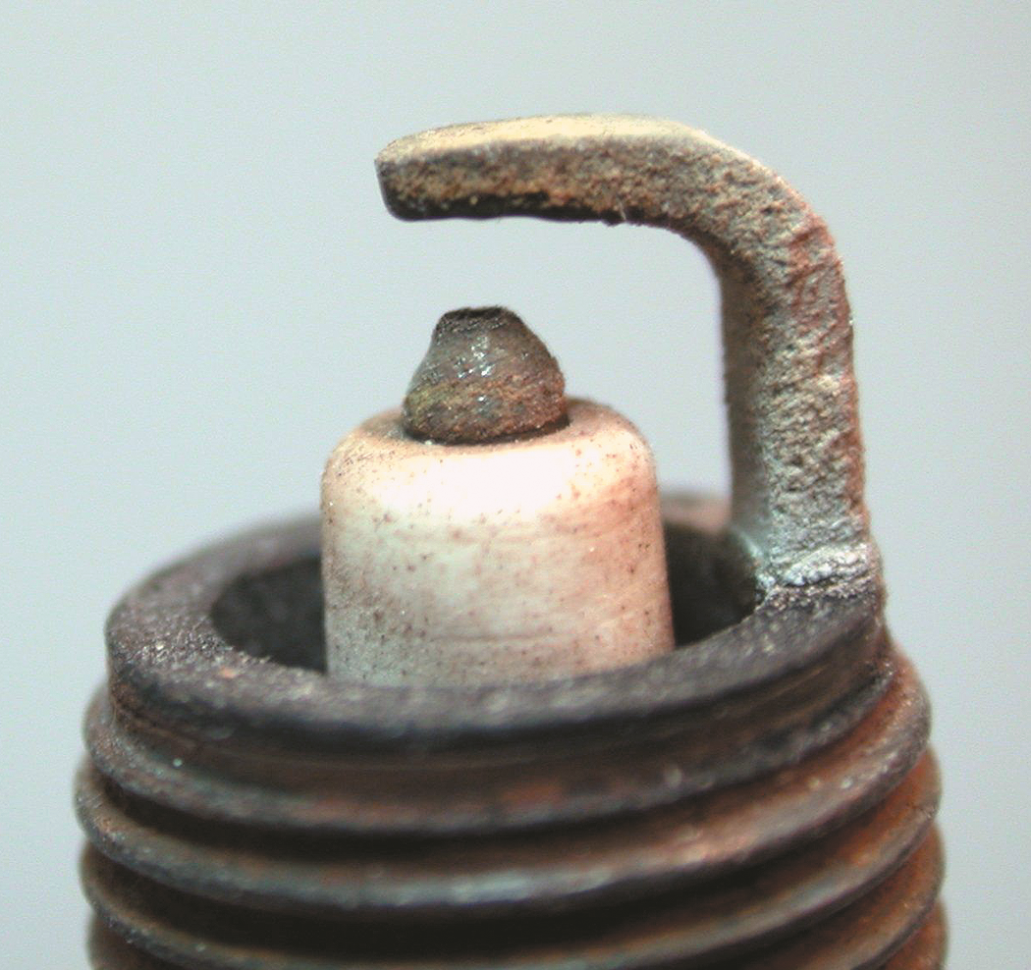
FIGURE 17.22 A normally worn spark plug that has a tapered platinum-tipped center electrode.

Slide 25
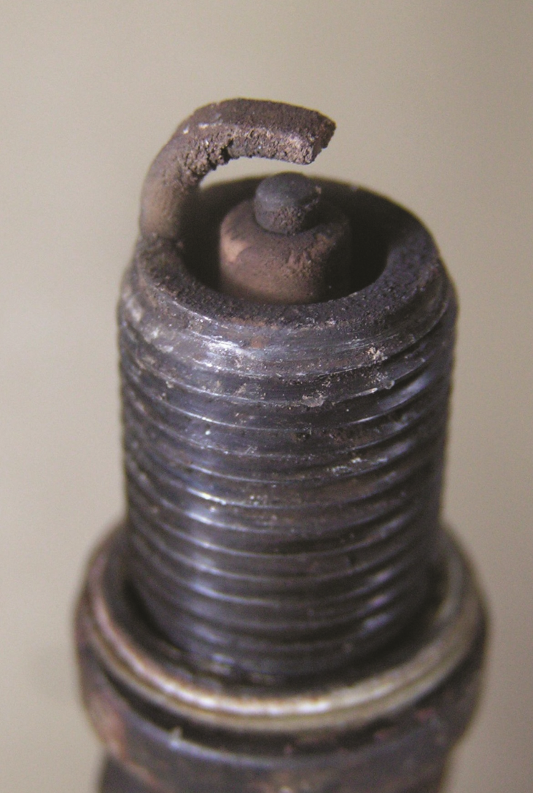
FIGURE 17.23 A worn spark plug showing fuel and/or oil deposits.

Slide 26
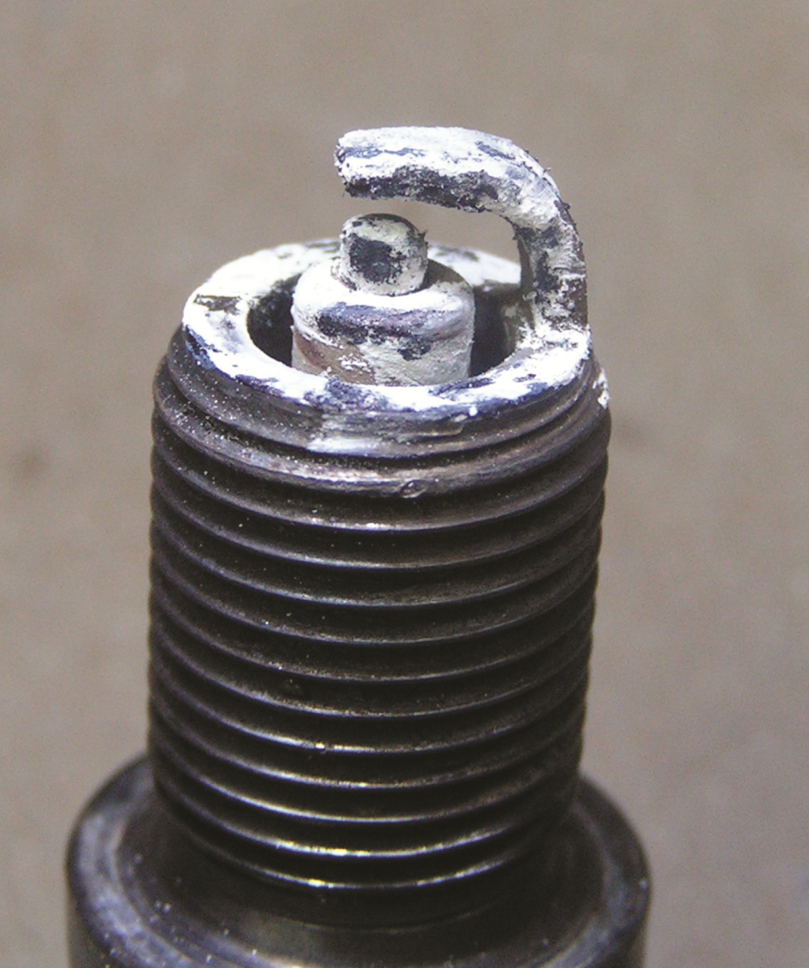
FIGURE 17.24 A spark plug from an engine that had a blown head gasket. The white deposits could be from the additives in the coolant.

Slide 27
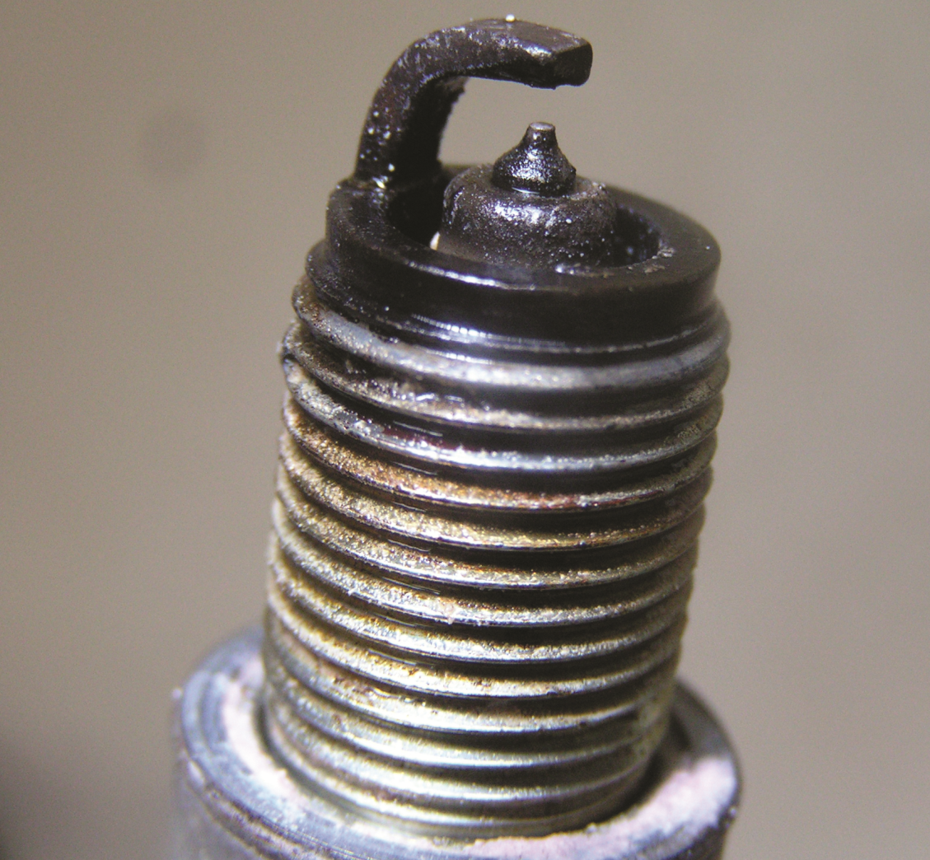
FIGURE 17.25 A platinum tipped spark plug that is fuel soaked indicating a fault with the fuel system or the ignition system causing the spark plug to not fire.

Slide 28
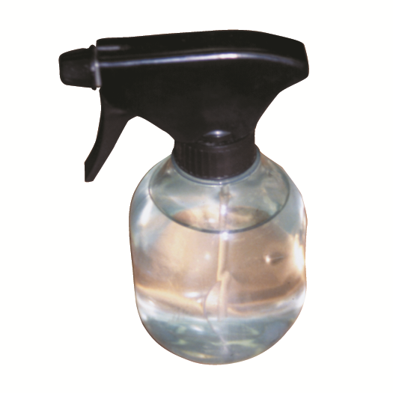
FIGURE 17.26 A water spray bottle is an excellent diagnostic tool to help find an intermittent engine misfire caused by a break in a secondary ignition circuit component.

Slide 29
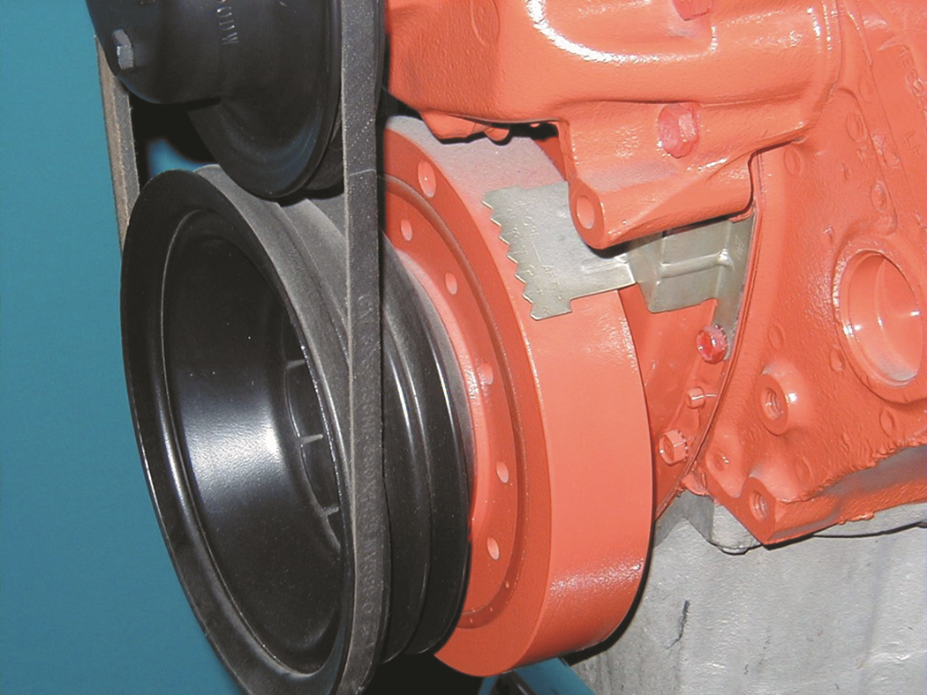
FIGURE 17.27 Typical timing marks. The numbers of the degrees are on the stationary plate and the notch is on the harmonic balancer.

Slide 30
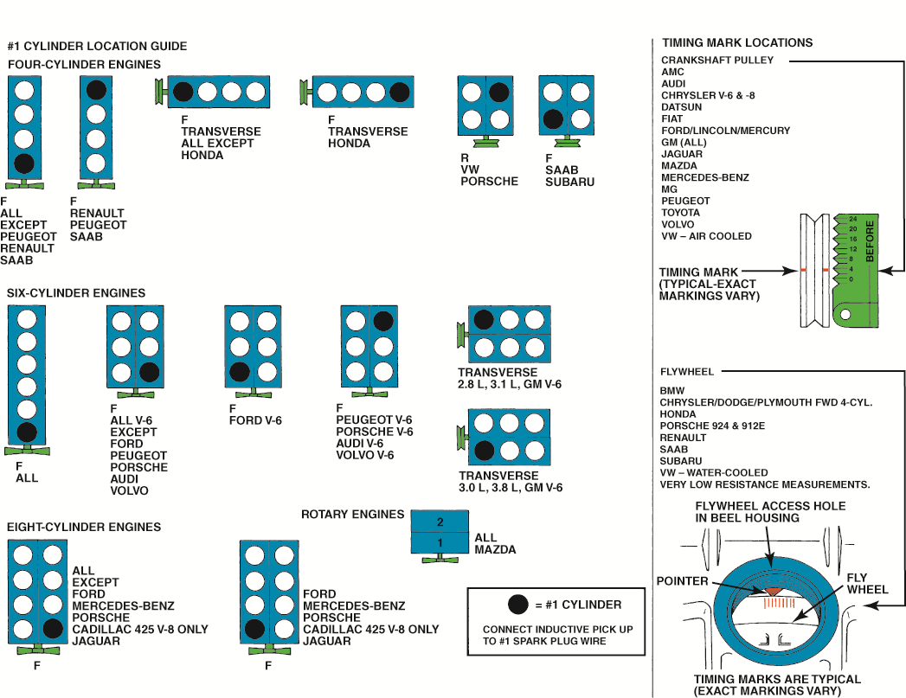
FIGURE 17.28 Cylinder 1 and timing mark location guide.

Slide 31
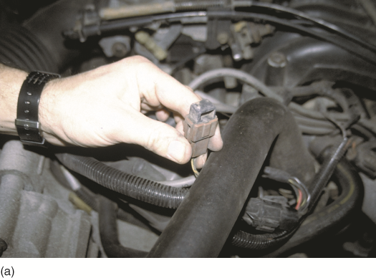
FIGURE 17.29A Typical SPOUT connector as used on many Ford engines equipped with distributor ignition (DI).

Slide 32
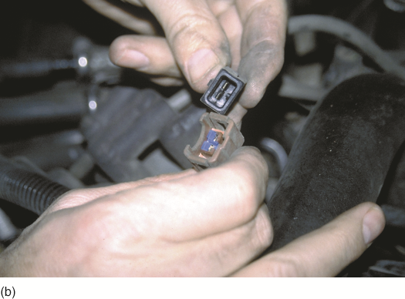
FIGURE 17.29B The connector must be opened (disconnected) to check and/or adjust the ignition timing. On DIS/EDIS systems, the connector is called SPOUT/SAW (spark output/spark angle word).

Slide 33
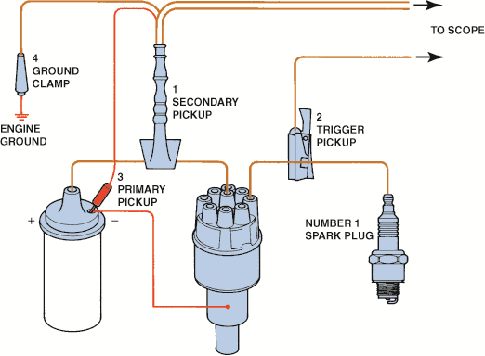
FIGURE 17.30 Typical engine analyzer hookup that includes a scope display. (1) Coil wire on top of the distributor cap if integral type of coil; (2) number 1 spark plug connection; (3) negative side of the ignition coil; (4) ground (negative) connection of the battery.

Slide 34
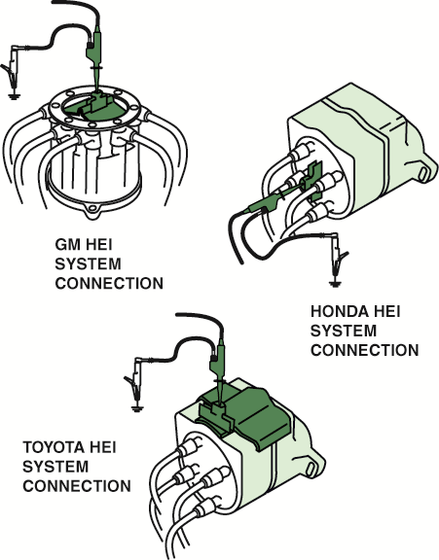
FIGURE 17.31 Clip-on adapters are used with an ignition system that uses an integral ignition coil.

Slide 35
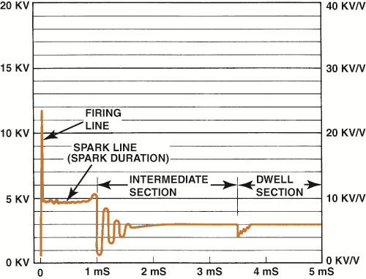
FIGURE 17.32 Typical secondary ignition oscilloscope pattern.

Slide 36
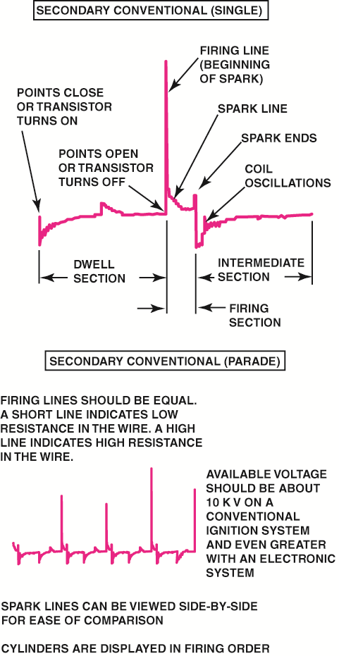
FIGURE 17.33 A single cylinder is shown at the top and a four-cylinder engine at the bottom.

Slide 37
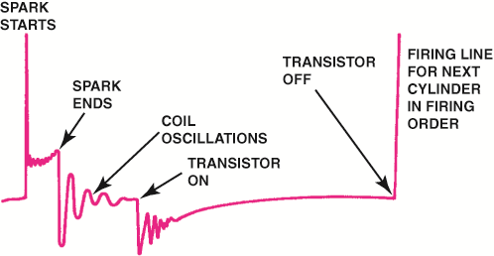
FIGURE 17.34 Drawing shows what is occurring electrically at each part of the scope pattern.

Slide 38
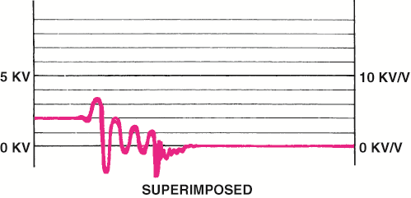
FIGURE 17.35 Typical secondary ignition pattern.
Note the lack of firing lines on superimposed pattern.

Slide 39
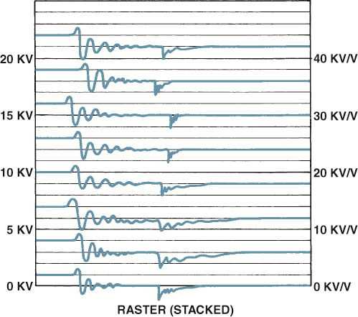
FIGURE 17.36 Raster is the best scope position to view the spark lines of all the cylinders to check for differences. Most scopes display the cylinder 1 at the bottom.

Slide 40
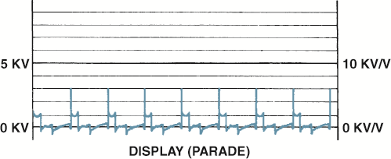
FIGURE 17.37 Display is the only position to view the firing lines of all cylinders. Cylinder 1 is displayed on the left (except for its firing line, which is shown on the right).

Slide 41
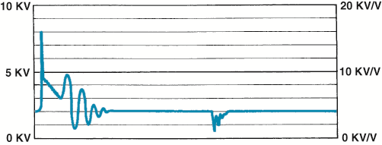
FIGURE 17.38 A downward-sloping spark line usually indicates high secondary ignition system resistance or an excessively rich air–fuel mixture.

Slide 42
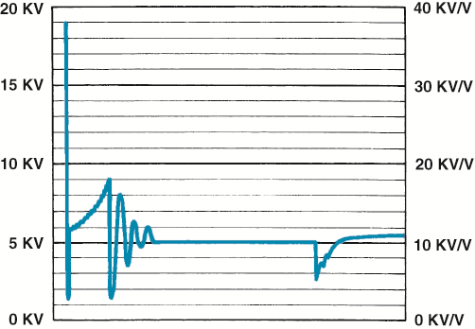
FIGURE 17.39 An upward-sloping spark line usually indicates a mechanical engine problem or a lean air–fuel mixture.

Slide 43
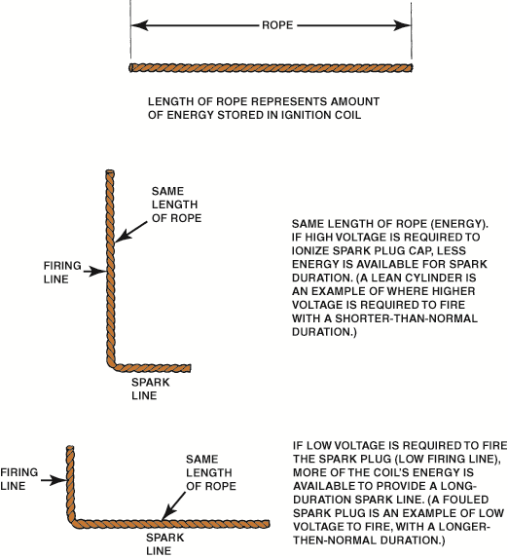
FIGURE 17.40 The relationship between the height of the firing line and length of the spark line can be illustrated using a rope.

Slide 44
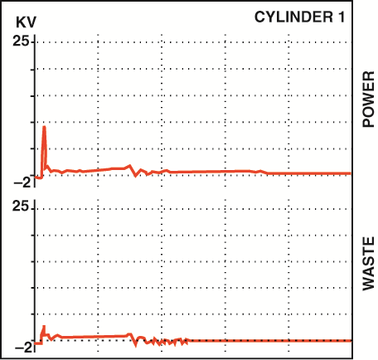
FIGURE 17.41 A dual-trace scope pattern showing both the power and the waste spark from the same coil (cylinders 1 and 6).

Slide 45
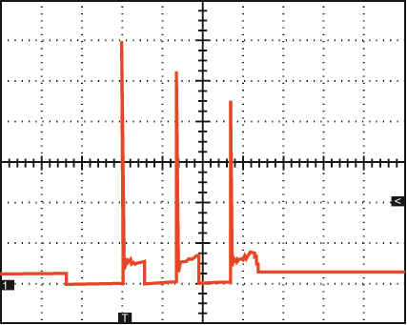
FIGURE 17.42 A secondary waveform of a Ford
4.6 liter V-8, showing three sparks occurring at idle speed.

Slide 46
Video Links
(Internet Access Required)
NGC ignition codes (time 4:21)
Crank no start (time 6:15)
Distributor installation (time 2:34)
Coil testing (time 14:39)
COP misfire diagnosis (time 11:01)
Spark plug thread repair (time 6:55)
Ignition fault codes (time 10:00)
Check for spark (time 1:58)
Distributor cap and rotor (time 2:57)
Spark plugs (time 3:25)

Slide 47
Video Links
(Internet Access Required)
Ignition coil (time 3:40)
Setting ignition timing (time 1:44)
Spark plug tube repair (time 7:08)
Finding an ignition voltage leak (time 6:28)
Misfire diagnosis (time 8:12)
Subaru no spark (time 13:25)
Ignition system primary testing (time 5:04)
Scanning to detect misfires (time 5:03)
Spark plugs (time 6:56)
Spark plug replacement (time 3:11)

Slide 48
Video Links
(Internet Access Required)
Ignition coil (time 0:53)
Crankshaft position sensor (time 3:55)
Crankshaft position sensor (time 4:07)
P0340 and P0341 (time 3:44)
Crankshaft position sensor (time 3:32)
Crankshaft sensor (time 9:57)
Nissan cam sensor fault (time 4:16)
Crankshaft sensor (time 5:12)
Scope testing a crankshaft sensor (time 6:47)
Cam sensor circuit test (time 1:02)

Slide 49
Video Links
(Internet Access Required)
Chrysler hall effect sensor testing part 1 (time 14:55)
Chrysler hall effect sensor testing part 2 (time 6:10)
Knock sensor testing (time 16:09)
Camshaft sensor (time 6:59)
VRS bypass testing (time 6:15)
Testing crankshaft sensors (time 4:39)
Testing crankshaft sensors (time 5:00)
Camshaft position sensor testing (time 2:43)
Cam sensor (time 8:57)
Camshaft timing (time 4:09)

Slide 50
Video Links
(Internet Access Required)
COP ignition system (time 3:00)
Misfire diagnosis (time 11:38)
How To Change Spark Plugs And Ignition Coil (time 13:37)
Replacing a Distributor Cap (time 2:11)
Basic Tune Up For A Car or Truck (time 23:09)
How to find a misfire when a scanner isn’t any help (time 2:41)
How to Check Ignition Spark (time 2:23)

