Slide 2
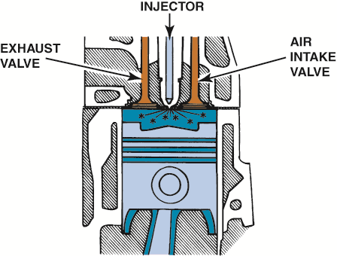
FIGURE 4.1 Diesel combustion occurs when fuel is injected into the hot, highly compressed air in the cylinder.

Slide 3
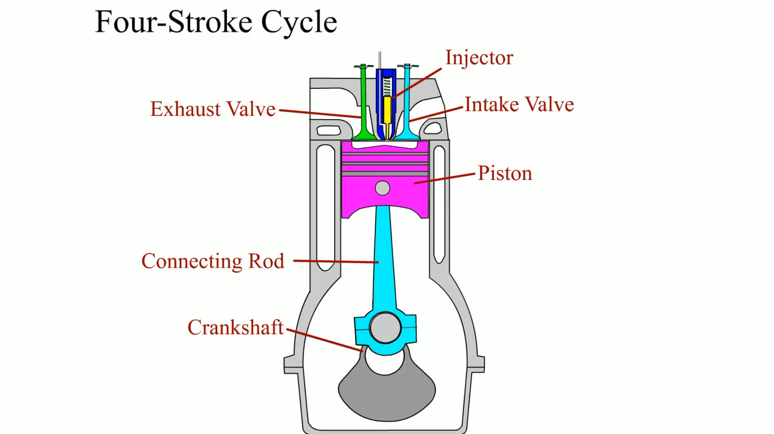
Animation: Four-Stroke Cycle
(The animation will automatically start in a few seconds)

Slide 4
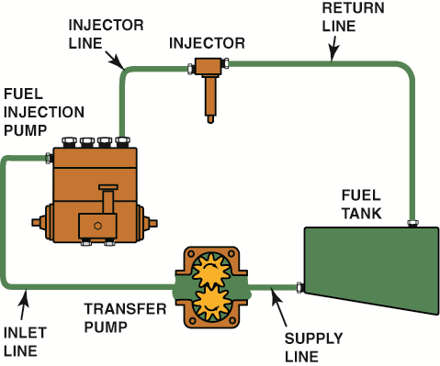
FIGURE 4.2 A typical injector-pump-type automotive diesel fuel injection system.

Slide 5
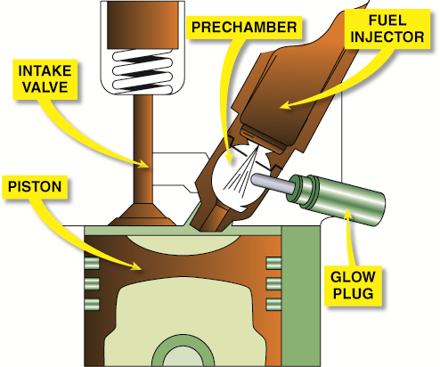
FIGURE 4.3 An indirect injection diesel engine uses a prechamber and a glow plug.

Slide 6
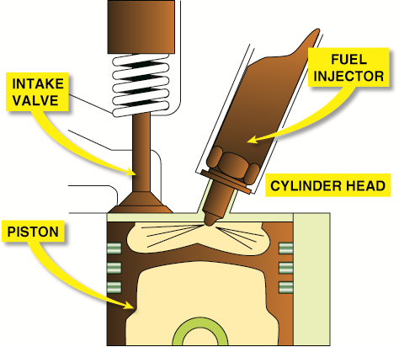
FIGURE 4.4 A direct injection diesel engine injects the fuel directly into the combustion chamber. Many designs do not use a glow plug.

Slide 7
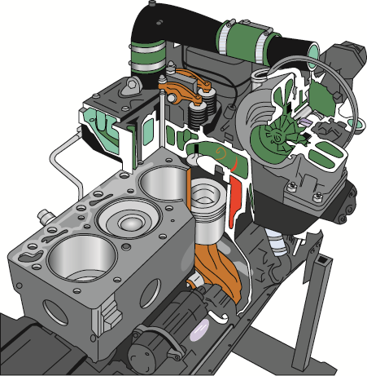
FIGURE 4.5 The common rail on a Cummins diesel engine. A high-pressure pump (up to 30,000 PSI) is used to supply diesel fuel to this common rail, which has cubes running to each injector.

Slide 8
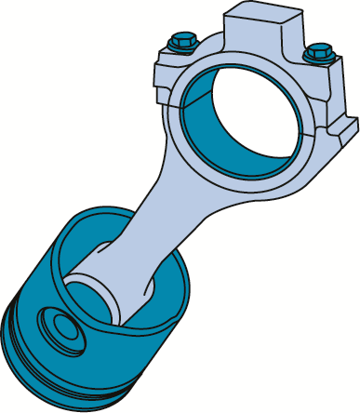
FIGURE 4.6 A rod/piston assembly from a 5.9 liter Cummins diesel engine used in a Dodge pickup truck.

Slide 9
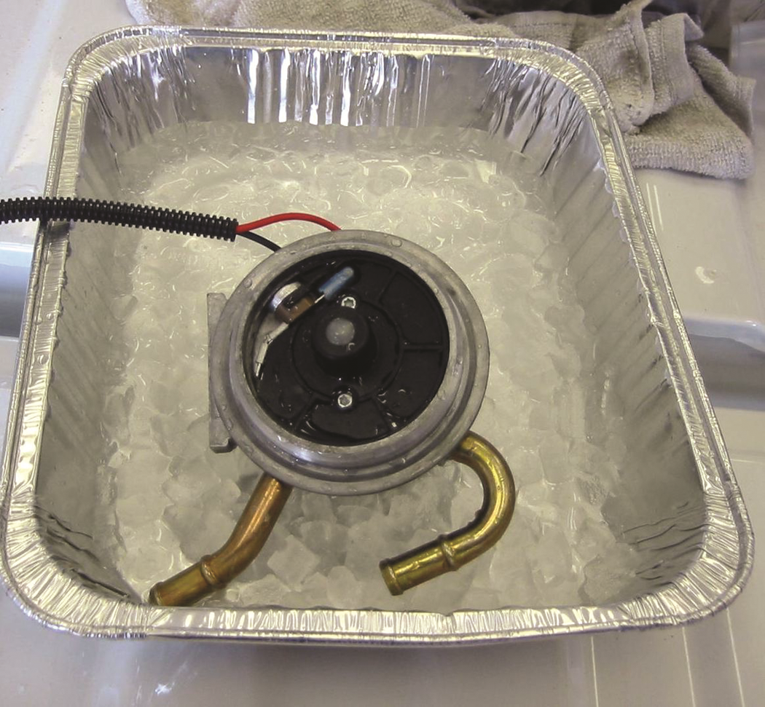
FIGURE 4.7 Using an ice bath to test the fuel temperature sensor.

Slide 10
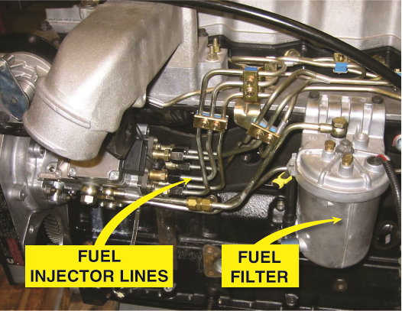
FIGURE 4.8 A typical distributor-type diesel injection pump showing the pump, lines, and fuel filter.

Slide 11
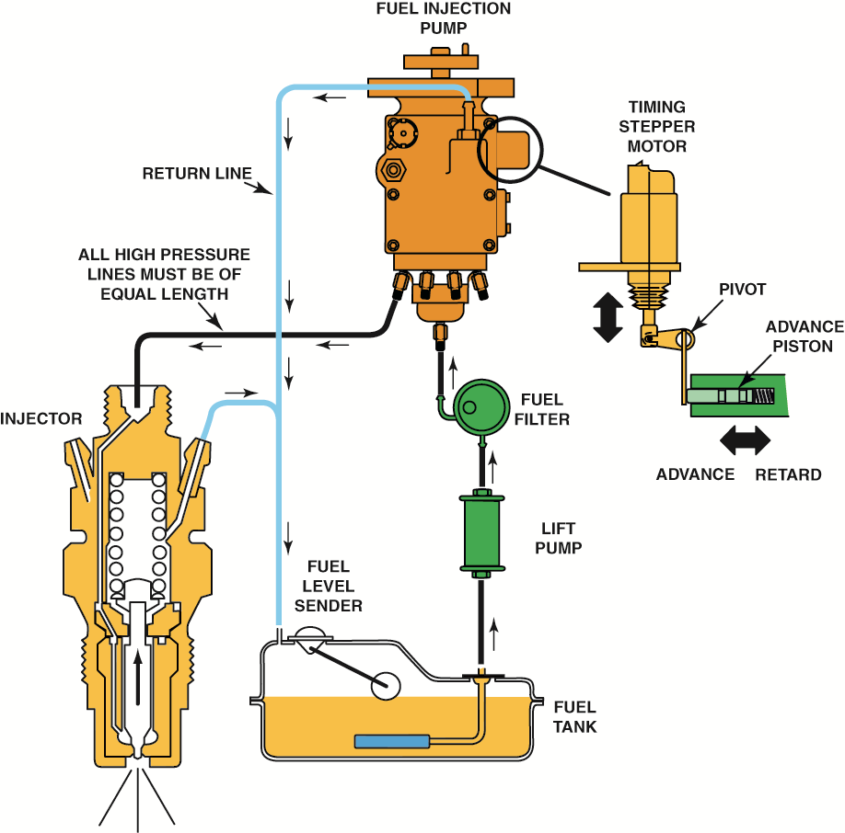
FIGURE 4.9 A schematic of a Stanadyne diesel fuel injection pump assembly showing all of the related components.

Slide 12
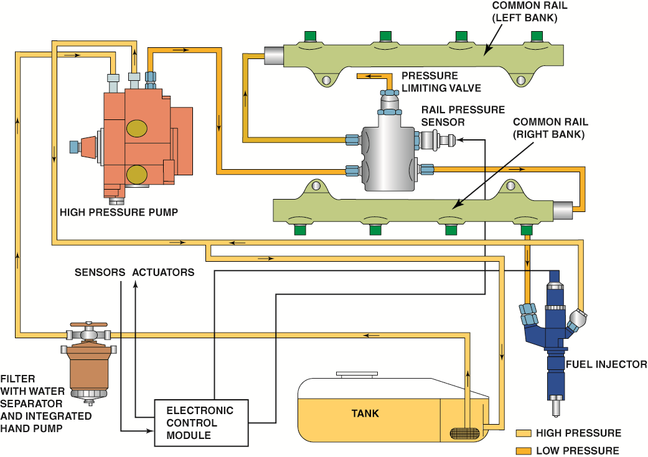
FIGURE 4.10 Overview of a computer-controlled high-pressure common rail V-8 diesel engine.

Slide 13
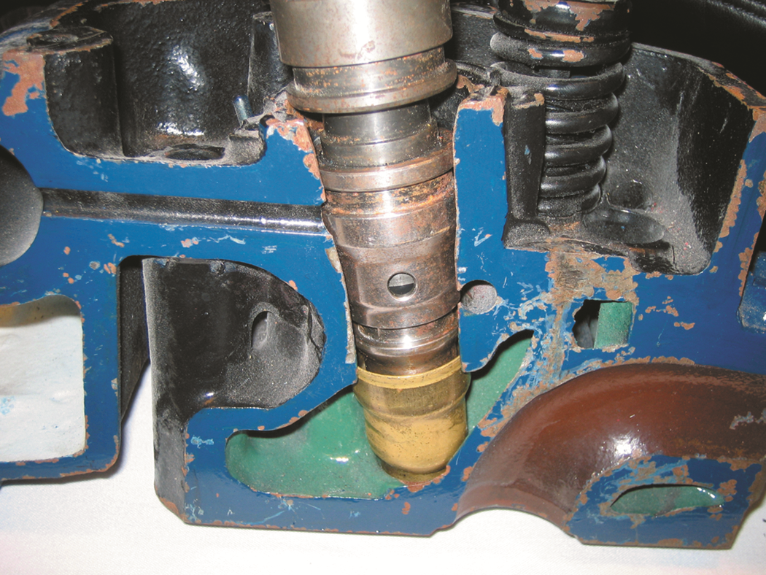
FIGURE 4.11 A HEUI injector from a Ford
PowerStroke diesel engine. The grooves indicate the location of the O-rings.

Slide 14
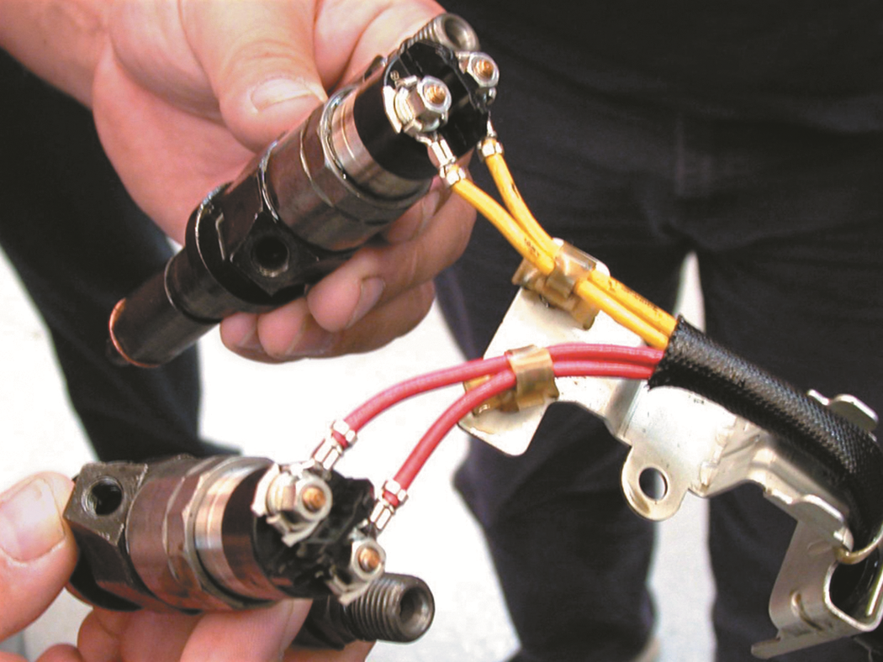
FIGURE 4.12 Typical computer-controlled diesel engine fuel injectors.

Slide 15
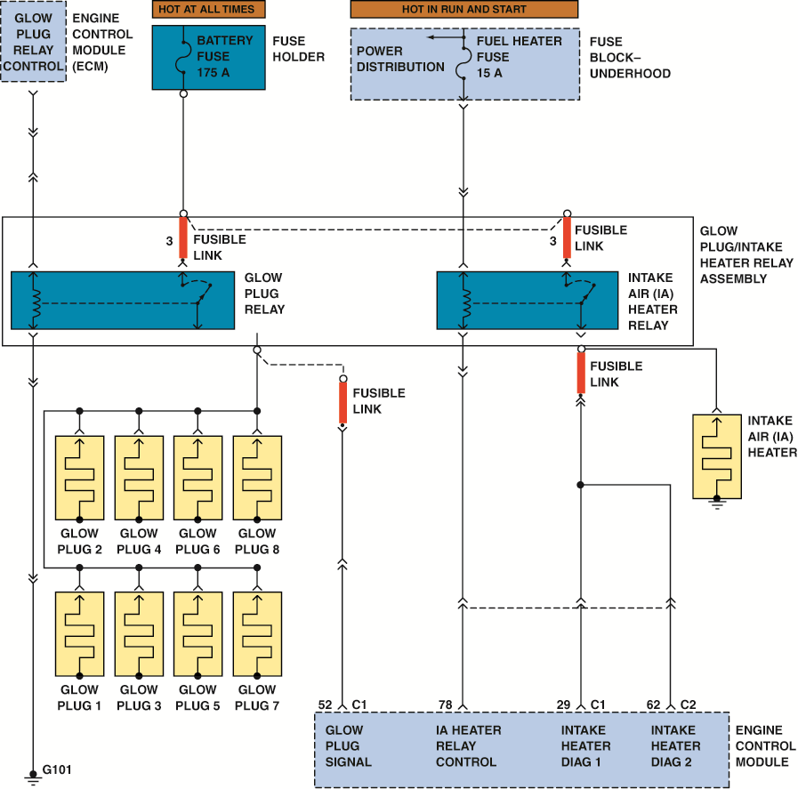
FIGURE 4.13 A schematic of a typical glow plug circuit. Notice that the relay for the glow plug and intake air heater relay are both computer controlled.

Slide 16
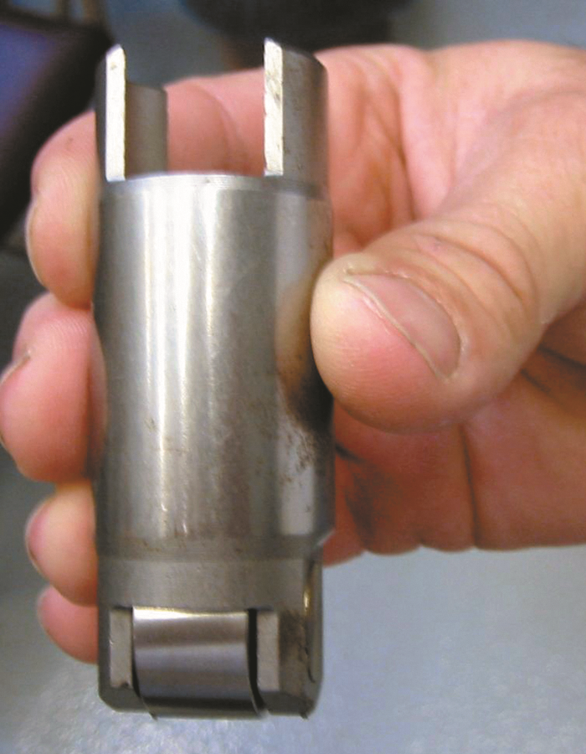
FIGURE 4.14 Roller lifter from a GM Duramax 6.6 liter V-8 diesel engine. Notice the size of this lifter compared to a roller lifter used in a gasoline engine.

Slide 17
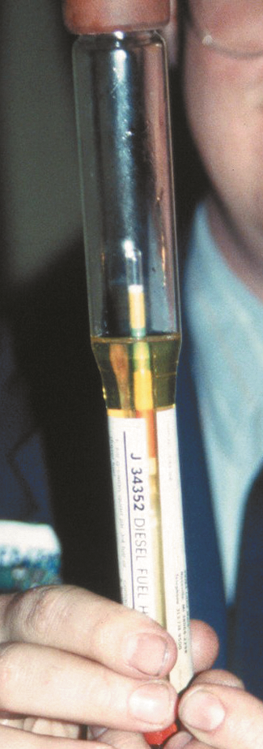
FIGURE 4.15 A hydrometer is used to measure the American Petroleum Institute (API) specific gravity of diesel fuel. The unit of measure is usually the API scale.

Slide 18
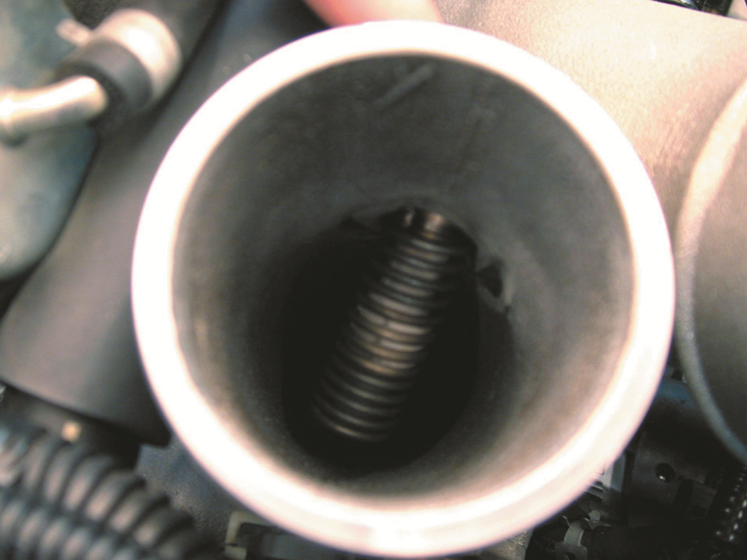
FIGURE 4.16 A wire wound electrical heater is used to warm the intake air on some diesel engines.

Slide 19
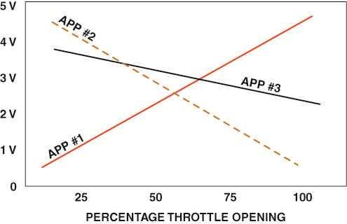
FIGURE 4.17 A typical accelerator pedal position (APP) sensor uses three different sensors in one package with each creating a different voltage as the accelerator is moved.

Slide 20
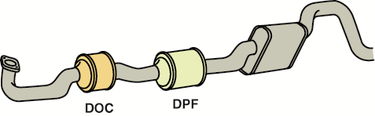
FIGURE 4.18 After treatment of diesel exhaust is handled by the DOC and DPF.

Slide 21
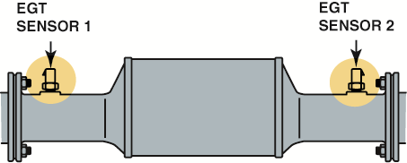
FIGURE 4.19 EGT 1 and EGT 2 are used by the
PCM to help control after treatment.

Slide 22
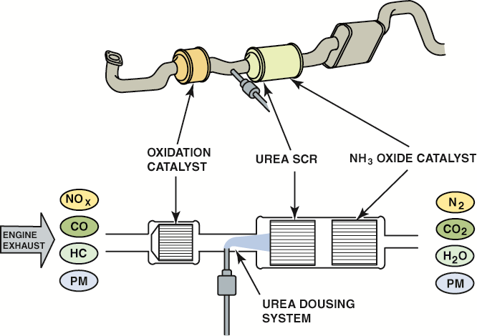
FIGURE 4.20 Urea (diesel exhaust fluid) injection is used to reduce NO_{x} exhaust emissions. It is injected after the diesel oxidation catalyst (DOC) and before the diesel particulate filter (DPF).

Slide 23
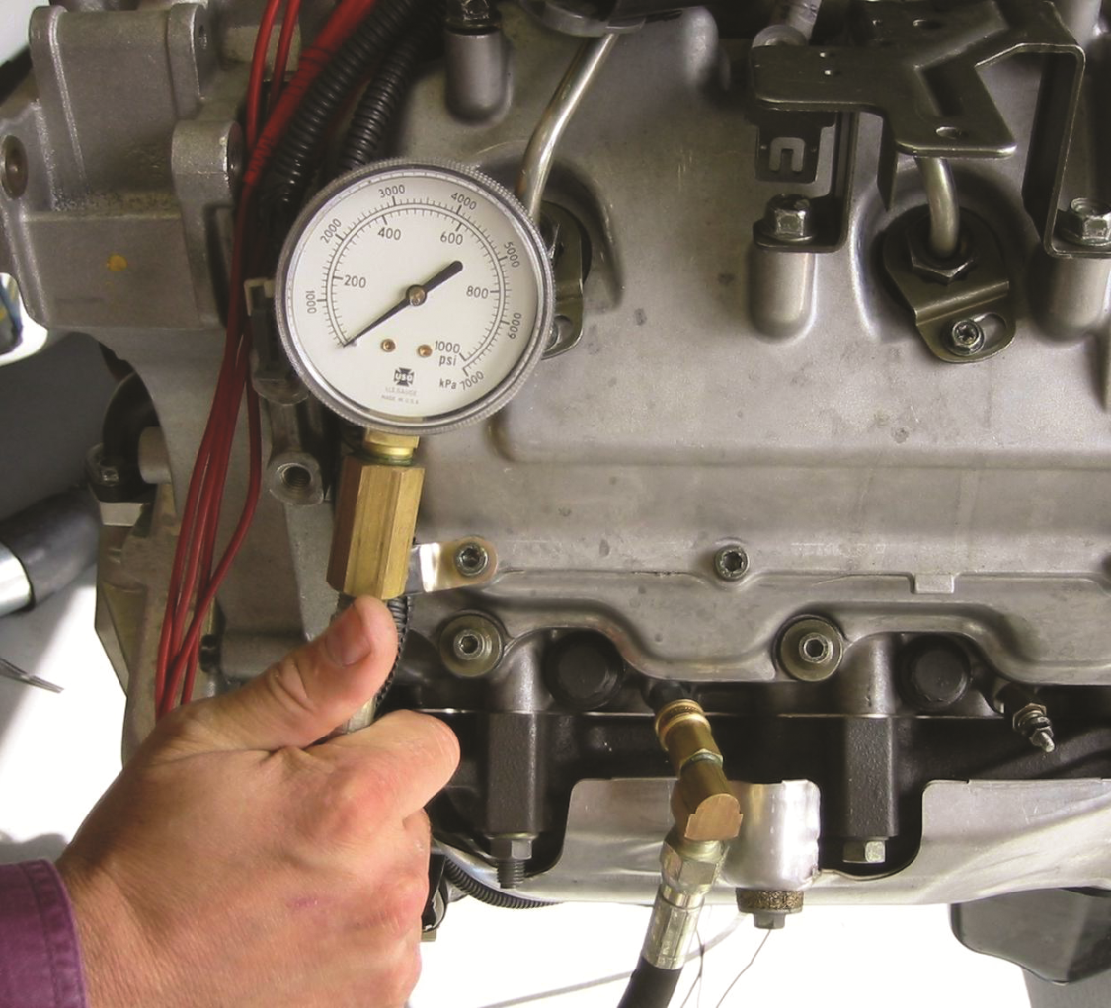
FIGURE 4.21 A compression gauge designed for the higher compression rate of a diesel engine should be used when checking the compression.

Slide 24
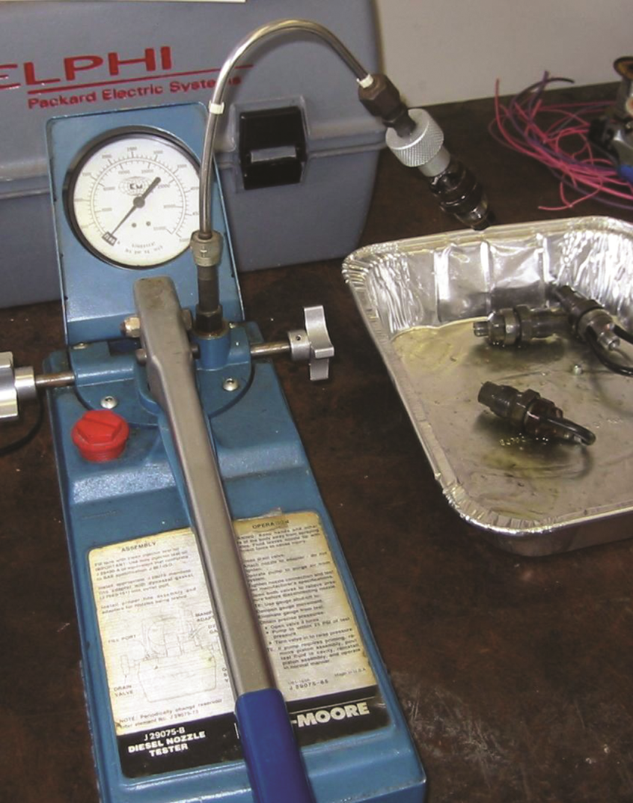
FIGURE 4.22 A typical pop tester used to check the spray pattern of a diesel engine injector.

Slide 25
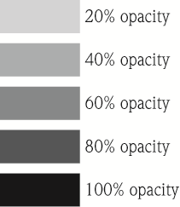
Diesel Emission Testing - Opacity Test.

Slide 26
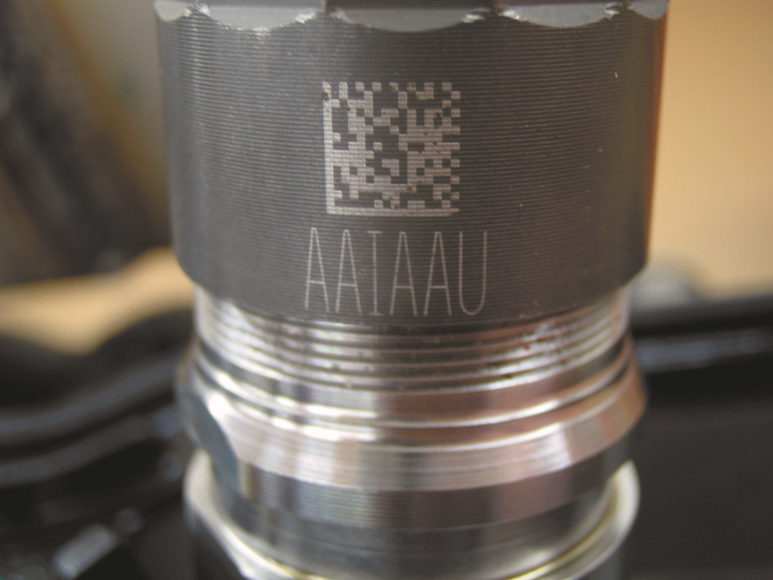
FIGURE 4.23 The letters on the side of this injector on a Cummins 6.7 liter diesel indicate the calibration number for the injector.

Slide 27
Video Links
(Internet Access Required)
How Diesel Engines Work Part 1 (time 4:13)
How Diesel Engines Work Part 2 (time 2:02)
How Diesel Engines Work Part 3 (time 2:32)
How Diesel Engines Work! (time 2:23)

