Slide 1
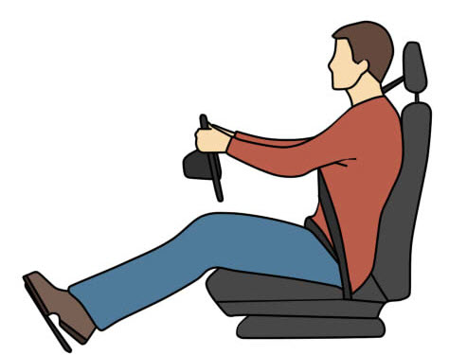
Diagnosis from the Driver’s Seat
Jim Halderman

Slide 2
Introduction
Jim Halderman
Former flat-rate technician.
Author and former automotive instructor

Slide 3
Power Point Available at www.jameshalderman.com

Slide 4
Select “Downloads”

Slide 5
Topics to be Discussed
Diagnosis of the battery, starting and charging systems from the driver's seat.
Using an OBD II breakout box (BOB).
How to check DTCs, monitor status and scan tool data all from the driver’s seat.
Test drive.

Slide 6
Diagnosing a Vehicle (Old school)

Slide 7
Today All or Mostly Electrical
What do you think could be checked from the driver's seat?
Oil level?
Battery voltage?
Starter/ alternator issues?
Air conditioning condition?
Diagnosis ?

Slide 8
Verify Customer Concern
Customer stated that he had to pound on dash to get the car to start.
Yep. the customer pounded on the dash,
So hard that the needles fell off.

Slide 9
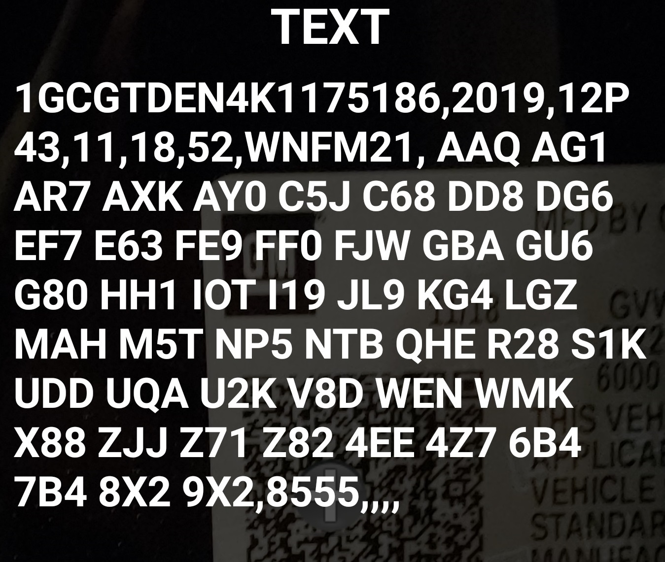
Service Information GM RPO Codes
2018+ GM use a QR code on the “B” pillar.
When using a QR reader on a smartphone or scan tool camera, shows the VIN and the “Regular Production Option” (RPO) codes. (2016-2017 VIN only)
Needed for the right parts and diagnosis.

Slide 10
Where to Start?
Check everything that does and does not work, including:
Test the brake pedal feel.
Check for proper engagement into drive and reverse
If the vehicle moves forward and back, but does not shift, it is usually the valve body.
If the vehicle does not move, usually the unit needs to be removed.

Slide 11
Visual Inspection
Check the following:
Lights, turn signal, and horn
Windshield wipers and washers
All accessories
Use mirrors in the shop to see the lights.

Slide 12
My Shop Mirror

Slide 13
TECH TIP
If the cruise control is inoperative,
Could be due to inoperative brake lights or CHMSL.
Check them by looking through the rear view mirror, using the mirrors in the shop.

Slide 14
Surround Cameras

Slide 15
Any Dash Warning Lights On?

Slide 16
Dash Symbol Chart
On Halderman website
under “Downloads.”
Look under “Favorites” for
122 symbols.
Green = Information
Amber = Caution
Red = Warning

Slide 17
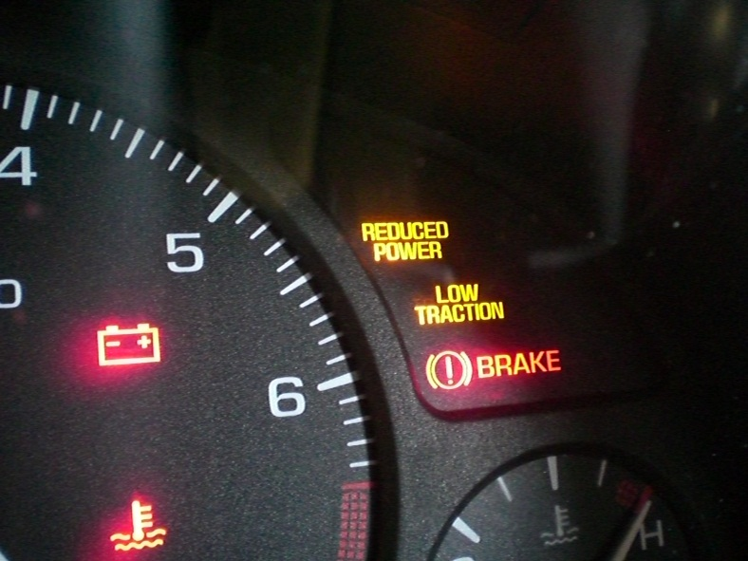
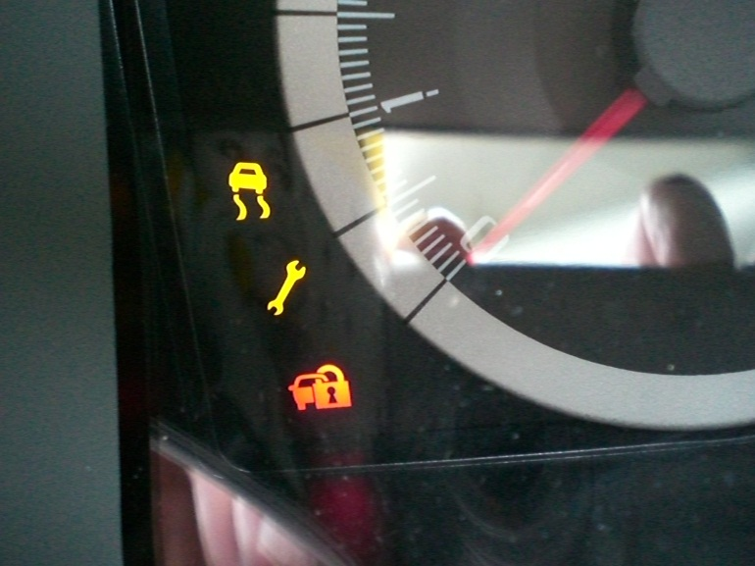
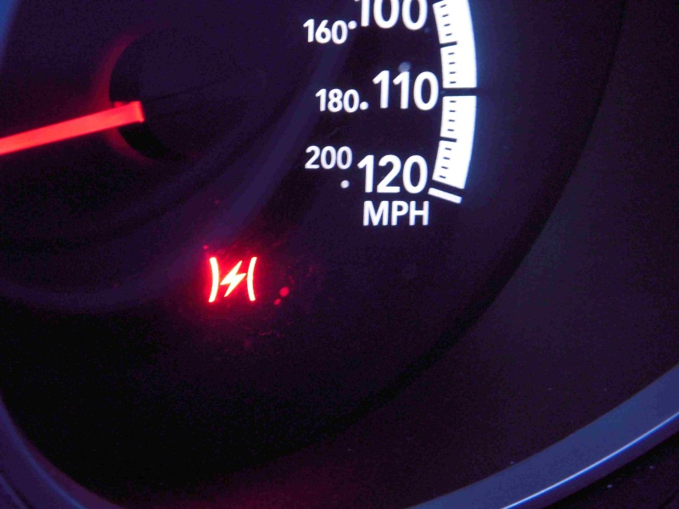
Dash Warning Lights Mean? (Electronic throttle control fault detected)

Slide 18
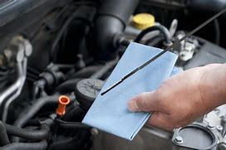
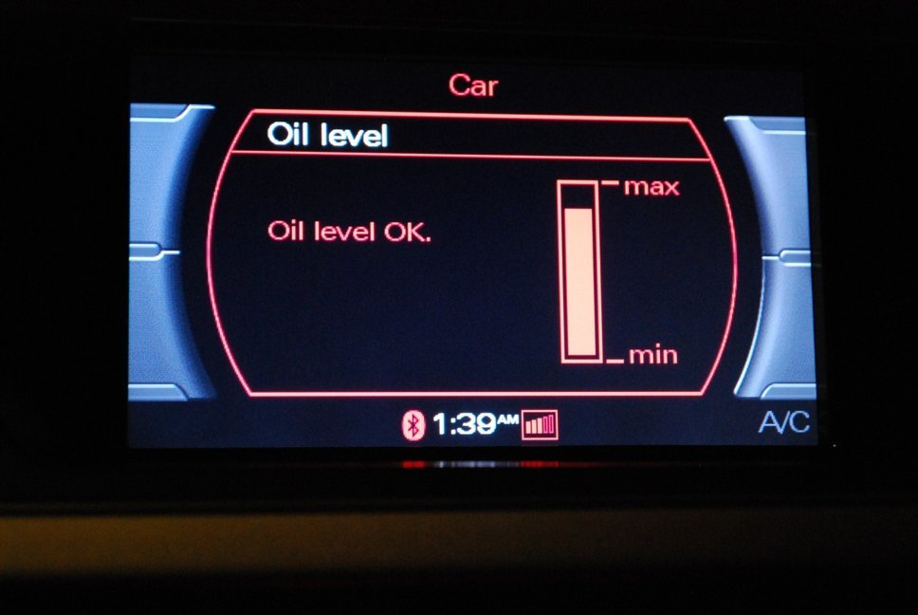
Checking Oil Level
Old school - Under the hood
New school - From the driver’s seat

Slide 19
Ultrasonic Oil Level Sensor
Since 2010, Jaguar uses an ultrasonic oil level sensor.
It uses sound waves that bounce off the oil surface and then displays the oil level.
Scroll through trip settings, using the trip button on the end of the turn signal stalk.

Slide 20
Oil Level Dash Displays
Oil level displayed on the dash is mostly on European vehicles at this this time, including:
Jaguar
BMW
Mercedes
Audi- Audi A8 shown

Slide 21
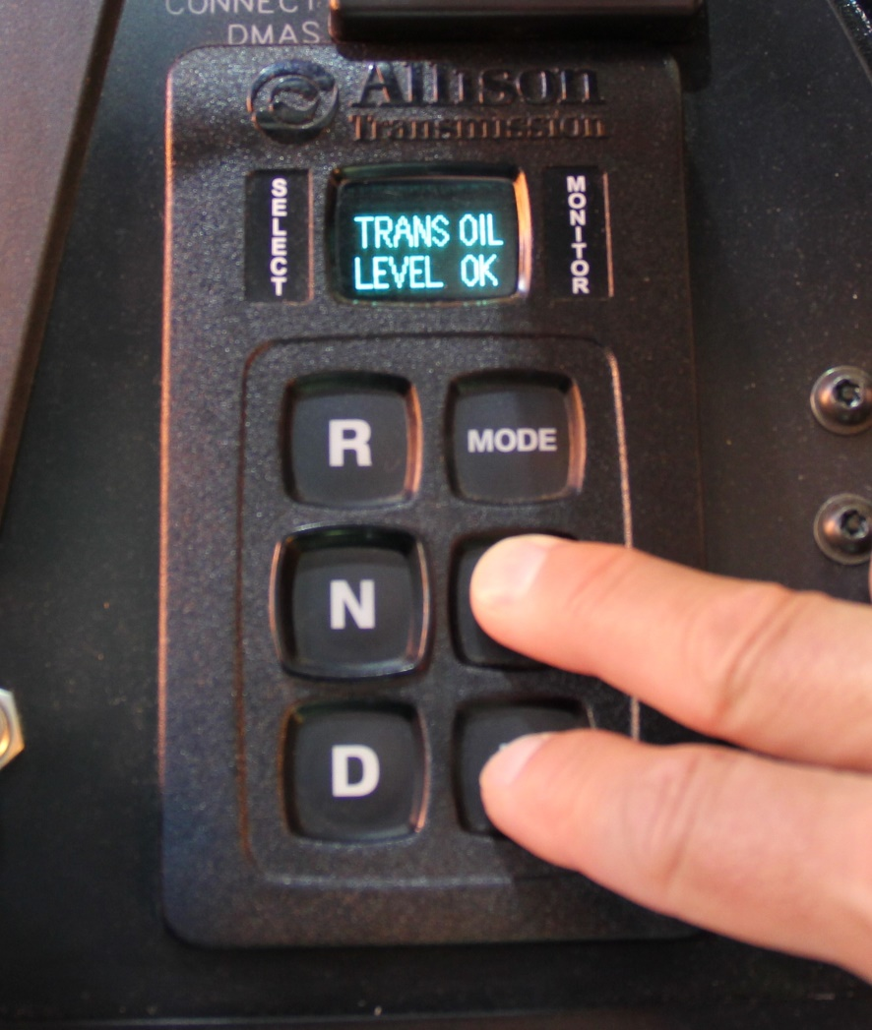
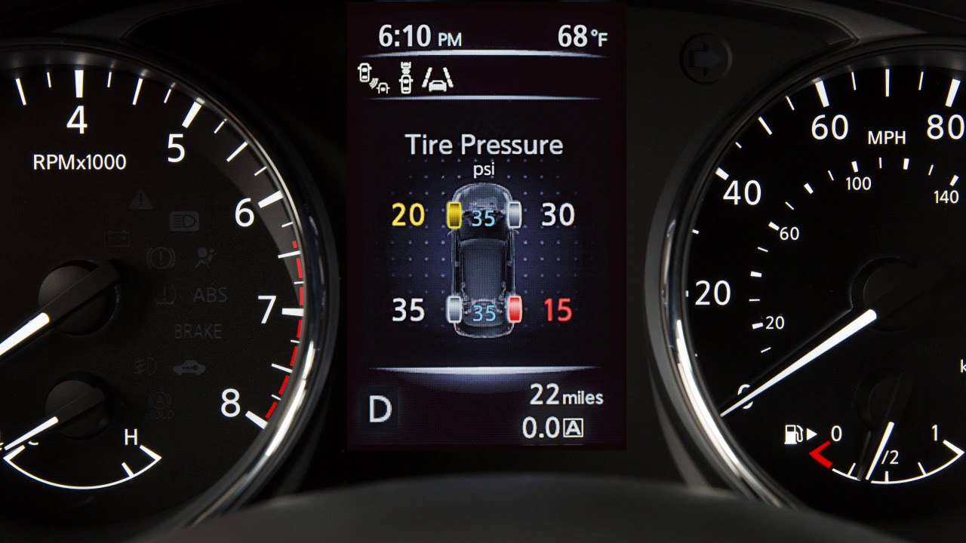
What else can be measured from the driver’s seat?
ATF? Some vehicles
Tire Pressure? Most vehicles

Slide 22
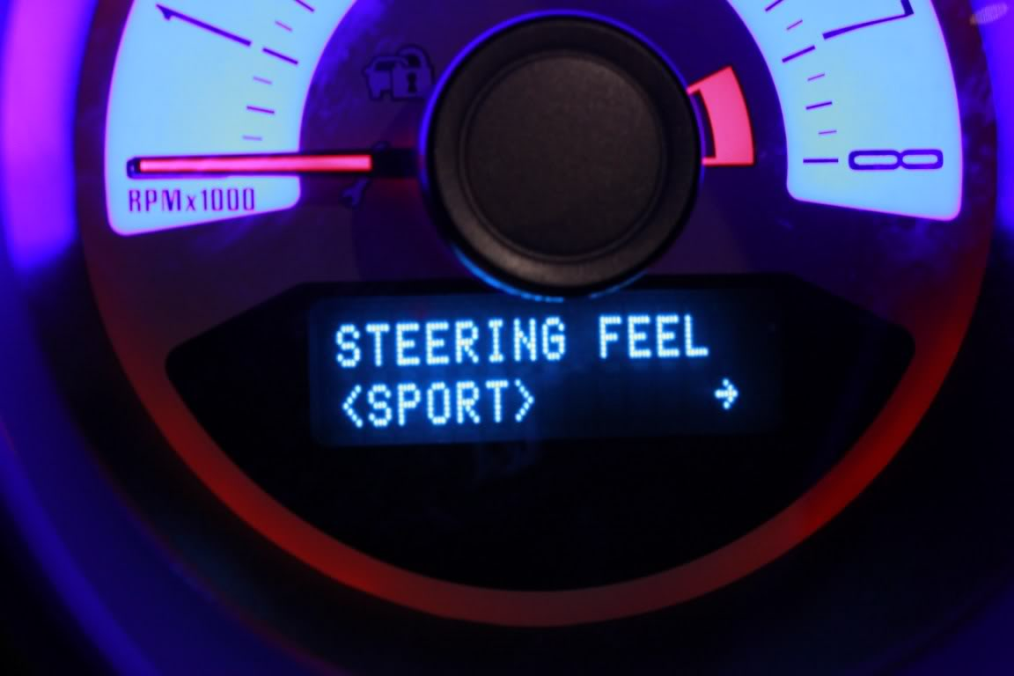
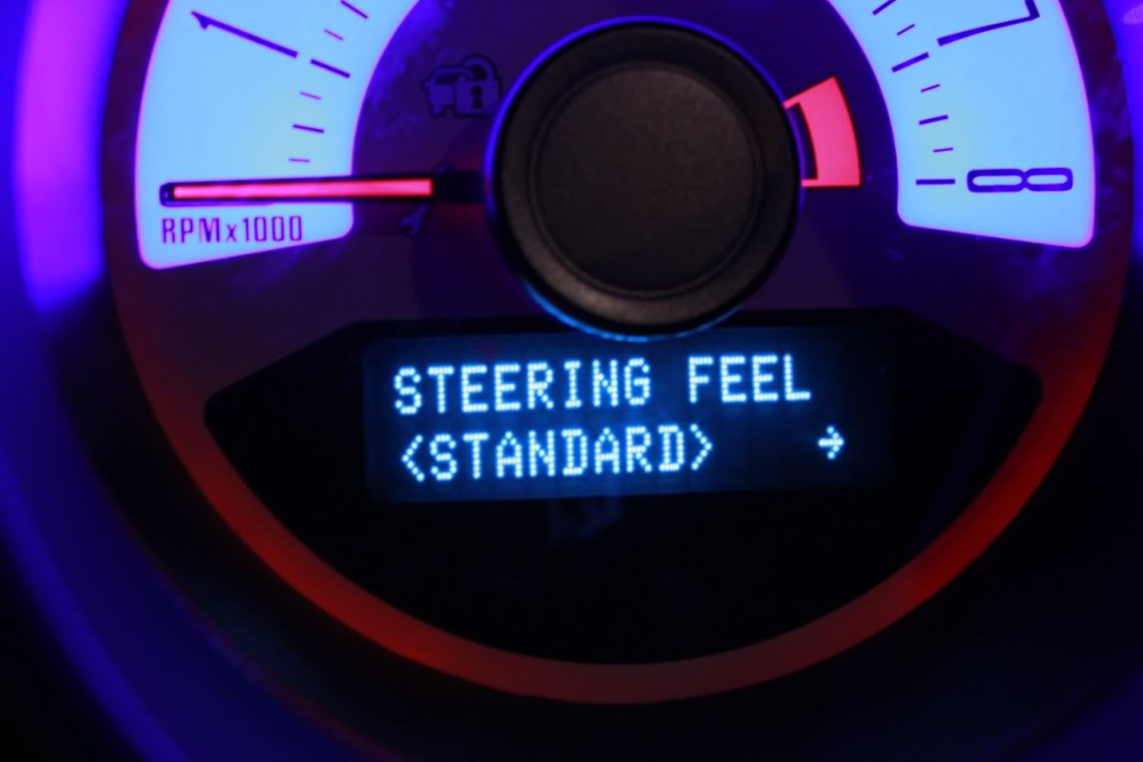
Ford Mustang Variable Effort Steering (Changeable from the driver’s seat)

Slide 23
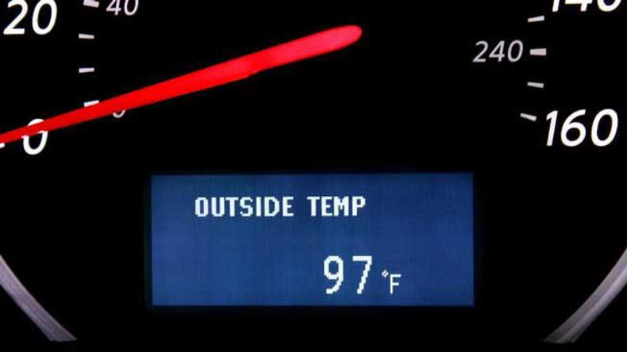
A/C Diagnosis from the Driver’s Seat
Is the air conditioning working as designed?
Measure vent temperature and look at outside temperature.

Slide 24
Airflow Check

Slide 25
Sample ASE-Type Question
Customer states that the air conditioning is not cooling enough and that it is cooler on the passenger side than on the driver's side. What is the most likely cause?
Over-charged refrigerant
Under-charged refrigerant
Stuck or broken blend door
Clogged cabin filter

Slide 26
Sample ASE-Type Question
Customer states that the air conditioning is not cooling enough and that it is cooler on the passenger side than on the driver's side. What is the most likely cause?
Over-charged refrigerant
Under-charged refrigerant X
Stuck or broken blend door
Clogged cabin filter

Slide 27
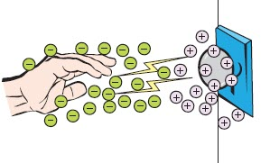
CASE Study
Complaint - There is an “electrical short” because the driver gets shocked when touching the door handle when leaving the car.
Cause - Driver’s movement on the upholstery caused a static charge buildup.
Correction - Used static guard spray on the seats.

Slide 28
CASE STUDY
Buick LaCrosse 3.8 L
Customer states that the battery goes dead overnight.
Customer says that a “humming” sound is heard from under the dash.

Slide 29
CASE STUDY - Solution
Used a thermal image camera to locate which module was powered up all the time.
The HVAC module was not shutting down.
It was controlled by the BCM.
Replaced BCM and programmed the unit.

Slide 30
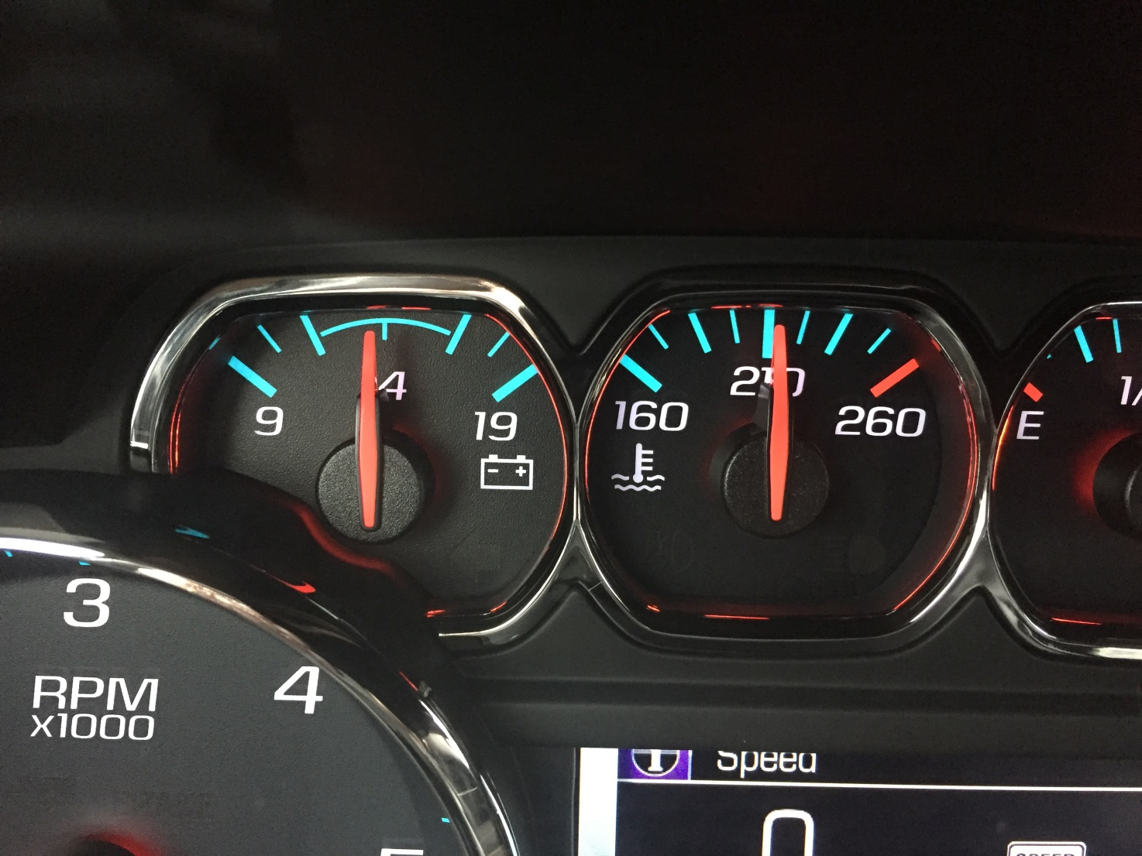
Voltage Display

Slide 31
Electrical Measurements from the Driver’s Seat
DC voltage (cranking and charging voltage)
AC voltage (AC ripple voltage)
Used to determine the condition of the following:
Battery SOC
Starter
Alternator

Slide 32
If The Battery Is Not Happy, The Vehicle Is Not Happy
Check battery voltage from the driver’s seat.
Using a power (lighter) plug, use a double banana plug to connect to the meter.

Slide 33
Where to Get Double Banana Plugs

Slide 34
Where is the DLC?

Slide 35
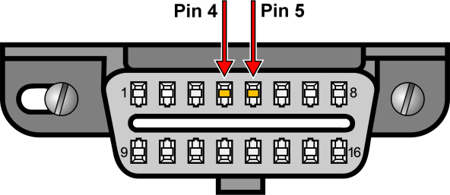
OBD II Connector
OBD II Plug - Pins #4 and #5 are longer.
Why?

Slide 36
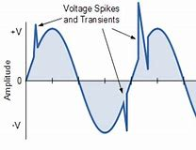
OBD II Connector
Because the ground touches first when making the connection.
Helps prevent voltage spikes.

Slide 37
OBD-II DLC

Slide 38
Case Study
Compliant-On a 2004 Chevrolet Avalanche, the scan tool would not power up.
Cause- No 12 volts at pin #16 of the DLC. Found a blown fuse for the lighter (power socket).
(Customer remembered hearing a “pop” when he plugged in a device to the power outlet.)
Correction- Replaced the that fuse feeds pin #16 of the DLC.

Slide 39
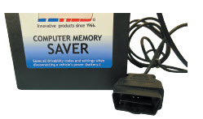
OBD II DLC Memory Saver
Use OBD II male connector…Pin #4 (-) and #16 (+) go to power plug and to a jump box.

Slide 40
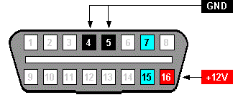
Checking Voltage at the DLC
Use a break-out box (BOB) and a DMM.
Connect the Meter to the Terminals 4 and 16 of the DLC

Slide 41
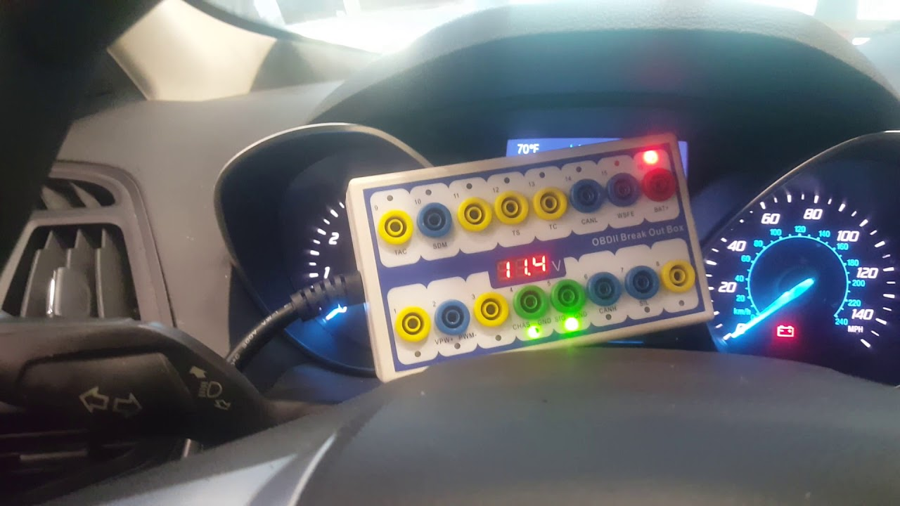
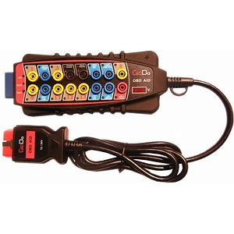
OBD II Break-Out Box (BOB)

Slide 42
LEDs on the OBD II BOB
Pin 16: Red LED lights up when there is power.
Pins 4 and 5: Green LED's on each pin light up when ground is good.
Pins 2, 6, 7, 10: Yellow LED's on each pin light up to identify vehicle data OBD-II protocol and activity.

Slide 43
Where to Purchase a Break-Out-Box (BOB)

Slide 44
Tech Tip
Add a breakout box or a DLC extension harness to every vehicle.
Protects the DLC from damage from students trying to plug in a scan tool.
A breakout box makes it easy to check for voltages without doing any harm to the vehicle.

Slide 45
Battery Voltage
Battery Testing-
Connect and watch the voltmeter and turn on high beam headlights.
Watch voltage drop.
After it stabilizes, turn off the lights.
Watch how fast the voltage increases.
The final voltage is the SOC.

Slide 46
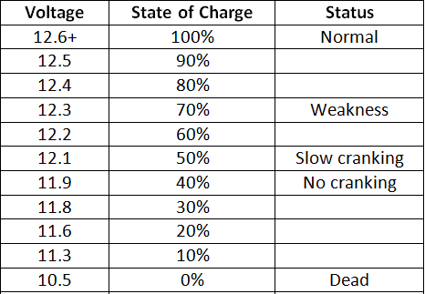
Battery Condition Test
Battery voltage should be 12.6 V or higher.

Slide 47
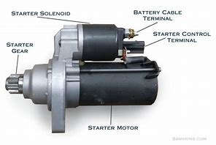
Cranking System Voltage
Cranking voltage -
Crank the engine.
Observe the battery voltage.
It should be above 9.6 Volts during cranking.

Slide 48
CASE STUDY
Complaint – 2016 Chevy Equinox infotainment system rebooting on occasion when starting the engine.
Cause – Voltage briefly dropping too low while cranking.
Captured by Fluke 87 using the peak min/max feature (250 µSec capture rate).
Correction – Replacing the battery corrected the problem.

Slide 49
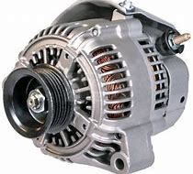
Charging System Voltage
Charging Voltage -
Start the engine and observe the voltmeter.
It should be 13.5-15.0 Volts.

Slide 50
CASE STUDY
Complaint - Ford F-150 speedometer needle went up and down with engine speed, rather than vehicle speed.
Cause - Excessive AC Ripple voltage (over 1 volt AC) at the battery.
Correction - Replacing the alternator restored the proper operation of the speedometer.

Slide 51
CASE STUDY
Complaint - The owner of a Chevrolet Silverado (6.6L diesel V8) stated that the battery warning light would come on when accelerating hard. Retrieved a C0800 DTC (system voltage is greater than 16 volts).
Cause - The charging voltage was measured at 17.7 volts.
Correction - The alternator was replaced, the DTC was cleared, and the vehicle returned to the customer.

Slide 52
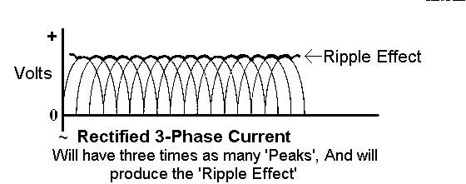
Ripple Voltage Testing
AC Ripple Voltage –
Start the engine.
Turn on the headlights to provide an electrical load.
Switch the meter to read AC volts.
Meter should read less than 0.5 Volt.

Slide 53
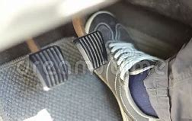
Relative Power Balance Test
Connect scope leads to terminals #4 and #16 at the DLC.
Hold the accelerator pedal to the floor to enter “clear flood” mode.
Crank the engine and observe the waveform.

Slide 54
Anything already plugged into the DLC?

Slide 55
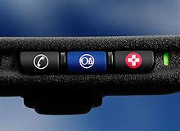
Insurance Telematics
Because the device is plugged into the DLC, it has power (#16) and ground (#4) at all times.
Can cause some driveability issues and false DTCs.
Can result in no savings. (Driving late at night because of a flight from the west coast, for example.)

Slide 56
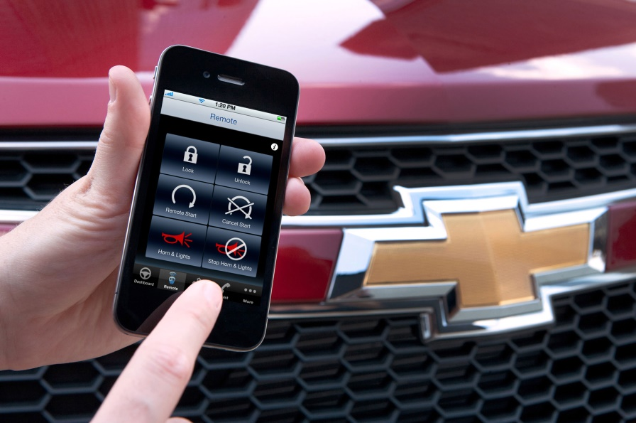
Diagnosis Telematics
The PCM, of course, monitors all functions.
Can transmit “state of health” messages to the vehicle manufacturer (i.e. On Star).

Slide 57
Smart Phone Interface (Chevrolet Volt)

Slide 58
OBD DLC Wiring

Slide 59
CAN Terminating Resistors

Slide 60
Terminating Resistance Testing (Two 120 ohm in parallel = 60 Ohms)

Slide 61
CASE Study
2013 Ford Focus S 2.0L
Complaint: The windshield wipers will sometimes stop in the middle of the sweep.
Cause: The motors have a fail-safe overload protection built in. If the BCM detects too much current, it will shut the motors down to protect them.
The motors communicate over a LIN network with each other.
The wiper blades are causing too much friction on the glass.
Correction: Replace the blades with OEM.

Slide 62
Stop-Start Systems

Slide 63
Check Engine Light On?
This means that a DTC has been stored.
Check for stored DTCs.
Then check TSBs.
Follow service information.

Slide 64
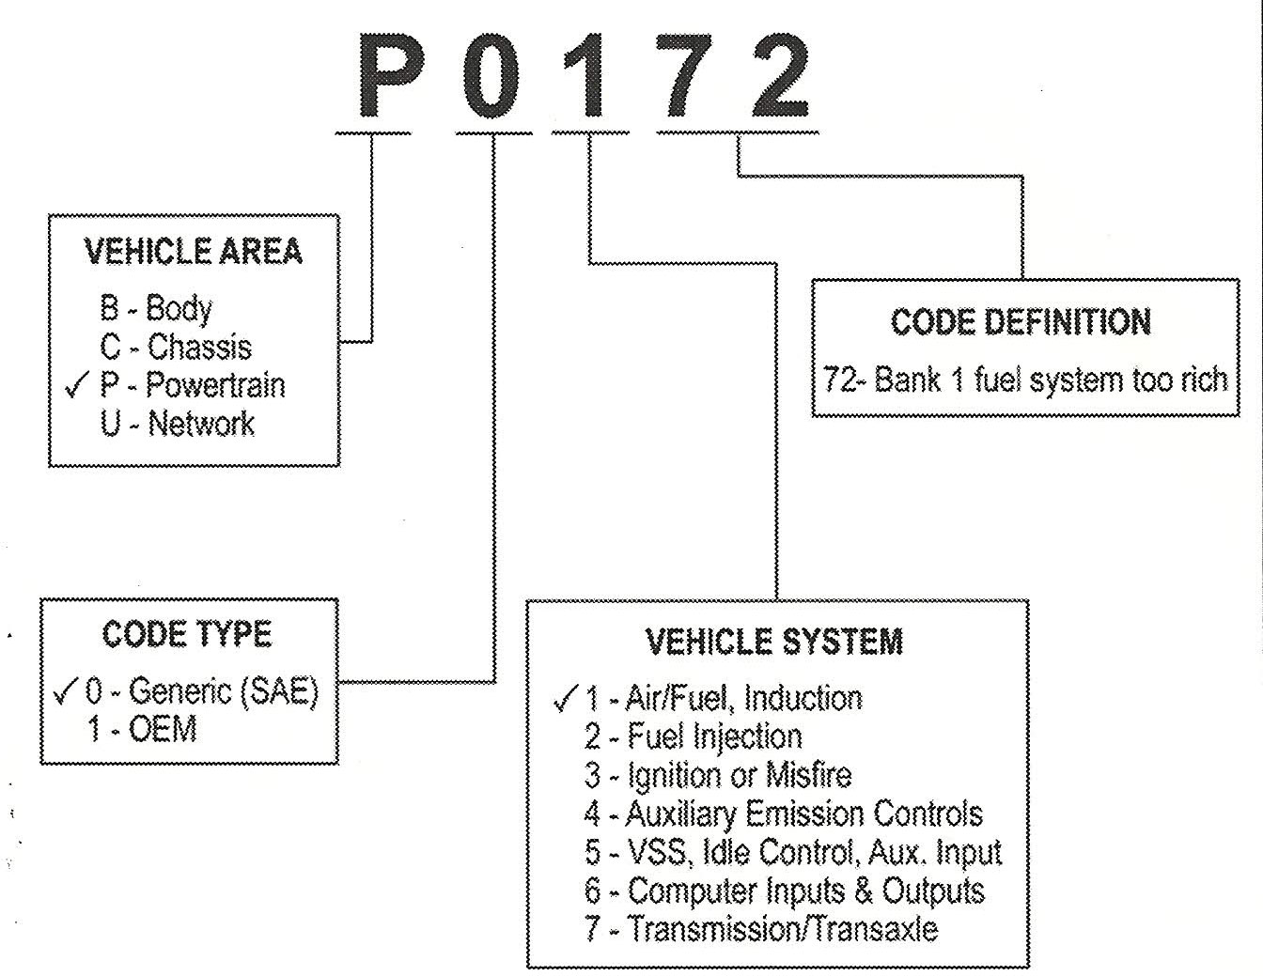
Diagnosing OBD II DTCs
Check DTCs

Slide 65
CASE STUDY
2010 Cadillac CTS
Complaint: Check engine light on and stumble on acceleration at times.
Cause: Code P0101 Check PIDs with an Autolink scanner. (Mass air flow sensor out of range.)
Correction - Replaced MAF.

Slide 66
Scan Tool
Before starting the engine, connect the scan tool.
Four types of scan tools:
Code readers
OBD II global (generic)
Factory scan tool
Enhanced aftermarket scan tool.

Slide 67
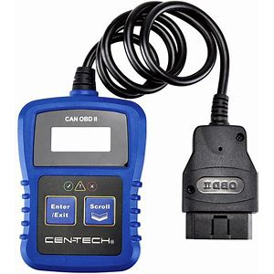
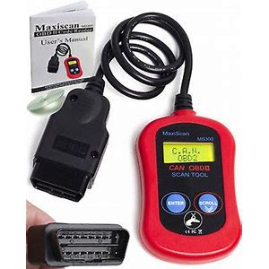
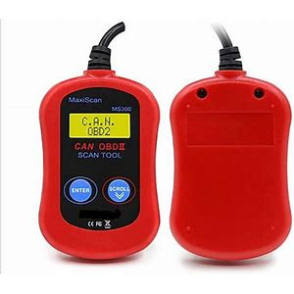
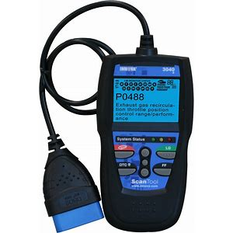
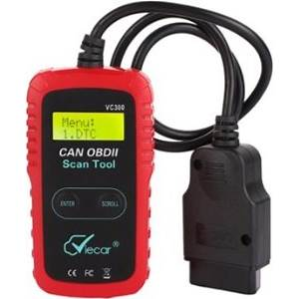
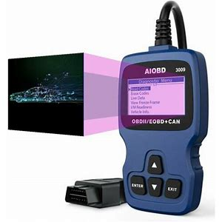
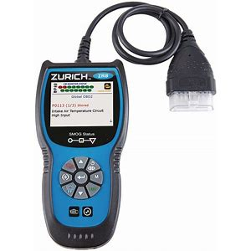
Code Readers (Usually cost less than $100)

Slide 68
Smart Phone Scan Tool
Uses a smart phone Bluetooth adapter (usually less than $20).
Purchase a phone app (about $5.00).
IOS: OBD Car Doctor, E OBD2
Android: OBD Car Doctor, Torque, EOBD2, Dash Command
Third-party apps may need to
pay to get full function.

Slide 69
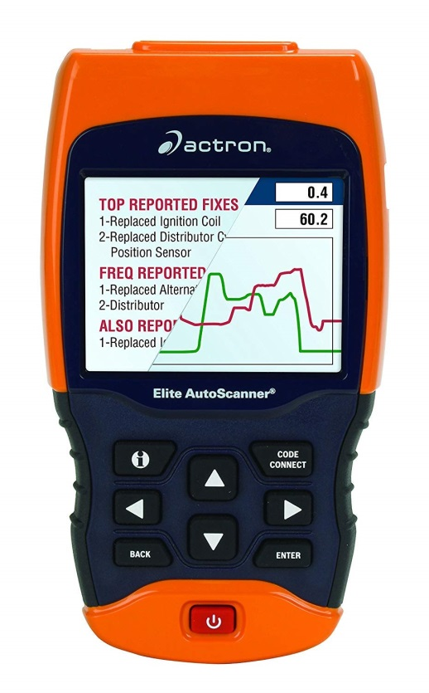
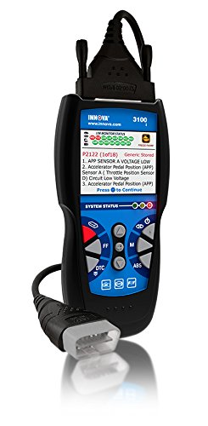
OBD II Global (Generic) Scan Tools

Slide 70
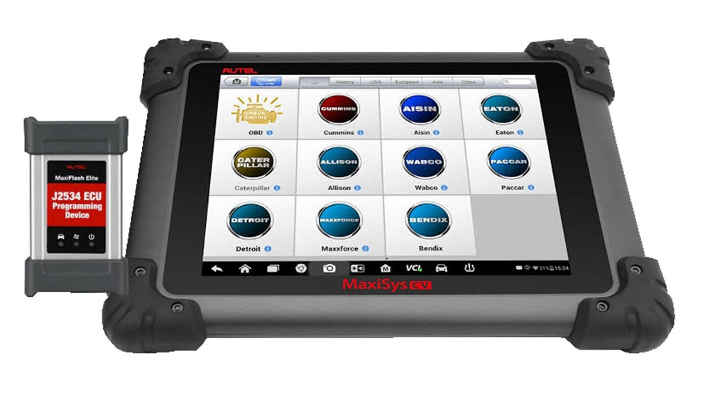
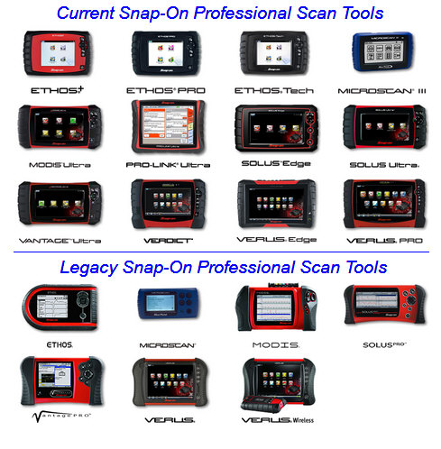
Enhanced Aftermarket Scan Tools

Slide 71
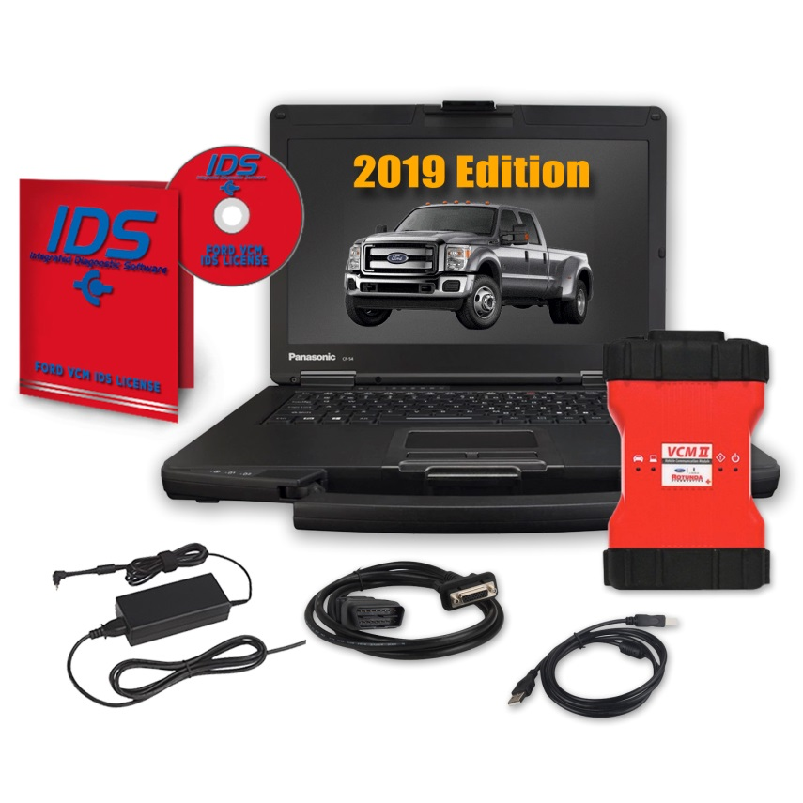
Factory Scan Tools

Slide 72
2016+ Hyundai Genesis
Some scan tool technology is built into the vehicle.
Cars like the Hyundai Genesis include a “System Check” visual that pops up in the center of the gauge cluster at start-up.

Slide 73
Scan Tool Data (PIDs) Perform all Module Scan

Slide 74
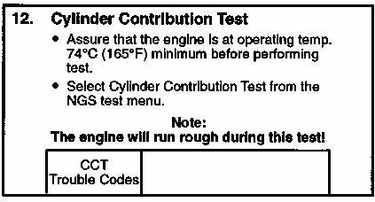
Cylinder Contribution Test
Such as provided by the Ford IDS scan tool.

Slide 75
P0300 Random Misfire DTC
P0300 etc.
Use the scan tool to do the hard work from the driver’s seat.
Look at the misfire data.

Slide 76
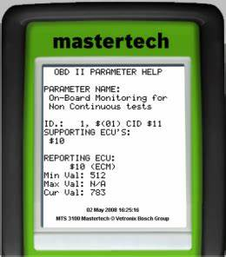
Misfire Data
Some scan tools can show misfire data or use Mode $06.

Slide 77
Mode $06
Global OBD II was designed for engineers to check the operation of non-continuously monitored systems.
It was not intended to be used by service technicians.
Mode $06 is used by service technicians to monitor the PCM test results of various systems.
Mode $06 is used to maintain all noncontinuous monitors and pending DTCs.

Slide 78
Check Monitor Status

Slide 79
CASE Study (1997 Chevy Truck 350 V8)
Rough Idle
Surge
No Codes
What data PID indicates
the problem?

Slide 80
CASE Study (1997 Chevy Truck 350 V8)
Rough Idle
Surge
No Codes
What data PID indicates
the problem?

Slide 81
Camshaft Wear Causing the CMP Retard (-6 degrees)

Slide 82
Bi-Directional Control
A factory or an enhanced aftermarket scan tool allows the technician to:
Turn on individual lights
Operate individual power windows and other accessories that are connected to the BUS system.

Slide 83
High Authority Inputs
The engine RPM signal comes from the CPK sensor.
As the number goes up, the engine is going faster.
This is usually the most important input.

Slide 84
Look Carefully at All PIDs

Slide 85
ECT = IAT
On a cold engine -
Key on/Engine off (KOEO) and look at the values for ECT (engine coolant temperature) and IAT (intake air temperature).
Basically, the same sensor and the two temperatures should agree.

Slide 86
ECT = IAT (continued)
The ECT sensor has a higher authority than the IAT and is therefore more likely to be the cause of a starting or cold running problem.
The ECT is the only sensor used by the PCM when the ignition key is first turned from on to start.

Slide 87
MAP = BARO
A MAP sensor is a high-authority sensor, especially on speed density-controlled engines.
The MAP reading at KOEO should be atmospheric pressure (about 29.50 in. Hg.), depending on altitude and weather conditions.
An easier value to remember is that it should be about 4.6- 4.8 volts.

Slide 88
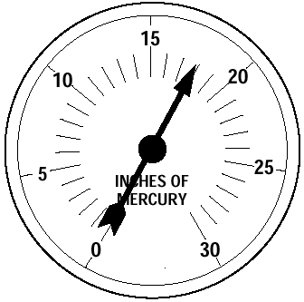
MAP vs. Vacuum
The MAP sensor is basically a vacuum gauge connected to the intake manifold.
Can be used to monitor basic engine health such as:
Retarded cam timing (low steady vacuum)
Restricted exhaust (vacuum drops at higher engine speeds)

Slide 89
CASE STUDY
2007 Pontiac Vibe 1.8 L -
Complaint: Rough idle and charging voltage drops from 12.4v to 11.8v the longer it runs.
Cause: Intake manifold gaskets vacuum leak causing low idle (too low to charge battery). Used MAP sensor PID to determine the low vacuum.
Correction: Replaced the leaking intake manifold gasket.

Slide 90
Long Term/Short Term Fuel Trim
Long-term fuel trim (LTFT) can add or subtract more fuel than STFT.
LTFT is slower than STFT.
The purpose of LTFT is to keep STFT within plus or minus 10%.

Slide 91
LTFT and STFT Diagnosis
I suggest that you ignore STFT.
STFT is what is happening this instant.
LTFT gives a history of the exhaust mixture and is more helpful when it comes to a diagnosis.
Add the two together to get the total amount of added or subtracted fuel.
LTFT = +8%, STFT = -3%, total = +5%.

Slide 92
+LTFT Too High
Look for a vacuum leak.
Look for a cracked exhaust manifold.

Slide 93
Fuel Trim Example
LTFT = +12%
STFT = +2%
How is the engine
running now?

Slide 94
Fuel Trim Example
Answer:
The engine is operating normally now because the PCM has compensated for a slightly lean air-fuel mixture by increasing the injector pulse-width.
Look for a vacuum leak or low fuel pressure.

Slide 95
Test Drive The Vehicle

Slide 96
Public Service Announcement (PSA) (Avoid software problem)

Slide 97
VOLUMETRIC EFFICIENCY
Volumetric efficiency (VE) is the percentage of air entering the engine compared to the theoretical airflow.
Typical normally aspirated engines will test having a VE of 75% to 90%.
Older two-valve cylinder head engines will test lower than newer engines equipped with four valves per cylinder.
Percentages above 100% are possible on supercharged or turbocharged engines.

Slide 98
Volumetric Efficiency Calculator
A VE calculator can be downloaded from:
www.jameshalderman.com
Click on “Downloads” and then “Service Information.”
“Volumetric Efficiency Calculator for Windows.”

Slide 99
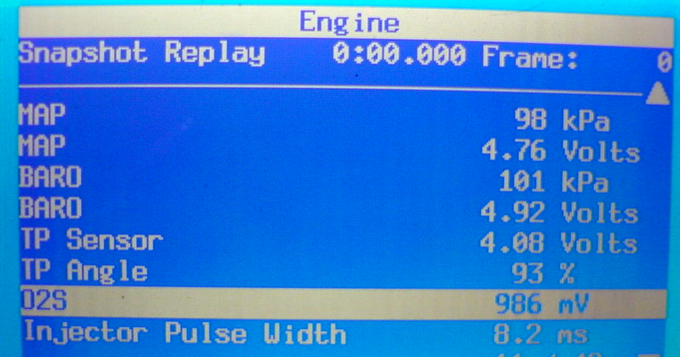
Must maintain at least 850mV

Slide 100
Power Test Drive
Accelerate -
If O₂ goes low, the fuel system is lean.
Check for MAF reporting error,
clogged fuel filter, or weak fuel
pump.
If O₂ goes high, something is
restricted.
Check intake and exhaust.

Slide 101
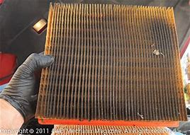
Test Drive- Continued
O₂ High -
BARO PID stays steady. Exhaust system is restricted.
O₂ High -
BARO PID ratchets down. Intake is restricted.

Slide 102
Module Programming
An everyday repair.
Most replacement modules require programming.
Current hardware and subscription access is a must.
Advantages to both generic and manufacturer specific J2534 pass through devices.

Slide 103
Summary Chart
Item | Yes | No | Maybe
Warning lights | X
A/C Vent temperature | X
Tire pressure | X (most vehicles)
Steering wheel effort | X (some vehicles)
Battery testing | X
Oil level |  |  | X
Starter Amp testing |  | X
Starting/charging testing | X (several tests)
DLC protocol activity | X
CAN Resistance | X
Head and brake lights | X
Scan tool data | X
Diagnose restricted intake | X
Diagnose restricted exhaust | X

Slide 104
Cars in The Future?

Slide 105
Summary
There are many systems that can be checked and diagnosed from the driver’s seat.
Think easy.
Think flat-rate.
Think fast diagnosis.
Get to the root cause quickly.
Fix the car right the first time.
Customer satisfaction

Slide 106
Contact Information
Jim Halderman
jim@jameshalderman.com

