Slide 1

Automotive Technology Principles, Diagnosis, and Service
Sixth Edition
Chapter 122
Hydraulic Power Steering Systems
Copyright © 2018, 2015, 2011 Pearson Education, Inc. All Rights Reserved

Slide 2
LEARNING OBJECTIVES (1 of 2)
122.1 Describe the operation of hydraulic power steering hydraulic systems.
122.2 Discuss the components and operation of power steering pumps.
122.3 Explain the purpose and function of integral power steering.
122.4 Discuss the purpose and function of variable effort steering systems.

Slide 3
LEARNING OBJECTIVES (2 of 2)
122.5 Discuss power steering diagnosis and troubleshooting.
122.6 Describe service of power steering components and fluid.
122.7 This chapter will help prepare for Suspension and Steering (A4) ASE certification test content area “A” (Steering Systems Diagnosis and Repair).

Slide 4
HYDRAULIC POWER STEERING SYSTEMS (1 OF 2)
Purpose and Function
Power-assisted steering hydraulically boosts the mechanical steering gear operation so the driver can turn the steering wheel with less effort for the same response.
Fundamentals
Force is a push or pull acting on an object and is usually measured in pounds of force or Newtons.
Pressure is measured in force per unit of area, such as pounds per square inch (PSI), or kilopascals (kPa).

Slide 5
HYDRAULIC POWER STEERING SYSTEMS (2 OF 2)
Pascal’s Law
When force is applied to a liquid confined in a container or an enclosure, the pressure is transmitted equally and undiminished in every direction.
The advantage of a liquid over a mechanical lever is that a liquid has volume but does not have a fixed shape.

Slide 6
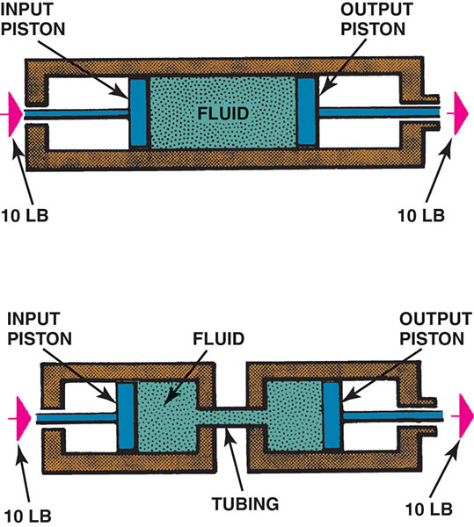
Figure 122.1 Hydraulic fluid transmits the same force whether it passes through a single chamber or two chambers connected by a narrow passage

Slide 7
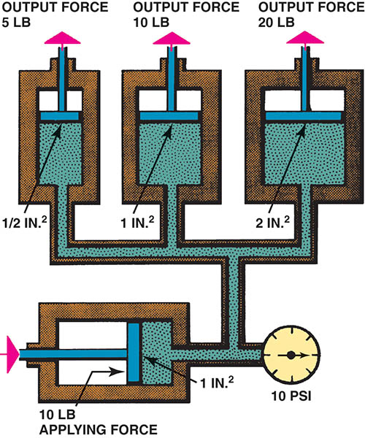
Figure 122.2 A fluid applies a force equal to the applied force on a surface that is equal in size to the applying surface. If the surface is half the size, then the fluid exerts half the force; if the surface is twice as large, the fluid exerts twice the force

Slide 8
QUESTION 1: ?
What is the purpose of a power steering system?

Slide 9
ANSWER 1:
Boost the mechanical steering unit so the driver can turn the wheel with less effort and get the same response.

Slide 10
POWER STEERING PUMP AND RESERVOIR (1 OF 4)
Parts and Operation
The power steering pump draws fluid from the reservoir, pressurizes it, and delivers it to the power steering system.
Remote Reservoir
The remote reservoir allows for a smaller, more compact pump assembly that is better suited to the cramped engine compartment of a modern vehicle.

Slide 11
POWER STEERING PUMP AND RESERVOIR (2 OF 4)
Forces and Pressures Involved
A typical power steering system requires only 2 to 3.5 lb (0.9 to 1.6 kg) of driver effort to turn the steering wheel.
Typical pressures generated by a power steering system include the following:
Straight ahead less than 150 PSI (1,400 kPa)
Cornering about 450 PSI (3,100 kPa)
Parking (maximum) 750–1,400 PSI (5,200–10,000 kPa)

Slide 12
POWER STEERING PUMP AND RESERVOIR (3 OF 4)
Vane Pump Operation
The drive belt rotates the power steering pump pulley and the rotor assembly inside the power steering pump.
Centrifugal force and hydraulic pressure push the vanes of the rotor outward into contact with the pump ring.
The shape of the pump ring causes a change in the volume of fluid between the vanes.

Slide 13
POWER STEERING PUMP AND RESERVOIR (4 OF 4)
Control Valve
The modulator valve (also called a control valve) is a spring-loaded pressure-relief device that bleeds off excess pressure to prevent system damage.

Slide 14
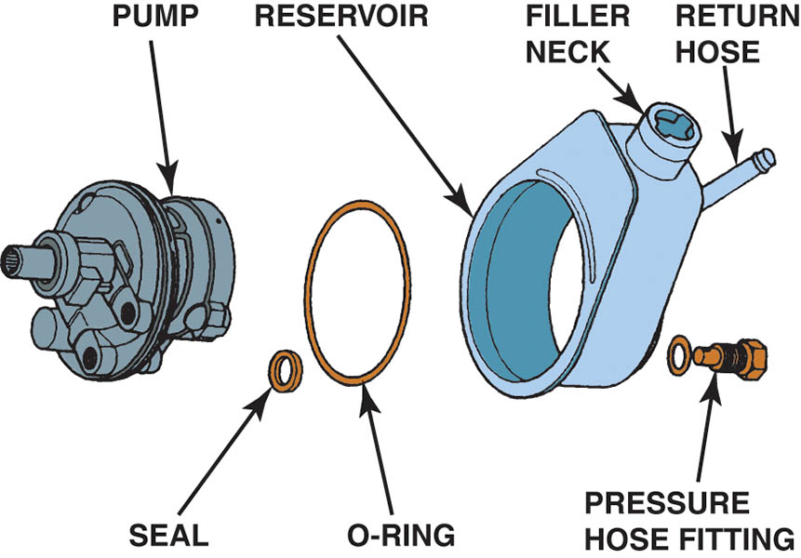
Figure 122.3 A typical integral power steering pump when the pump is mounted inside the reservoir

Slide 15
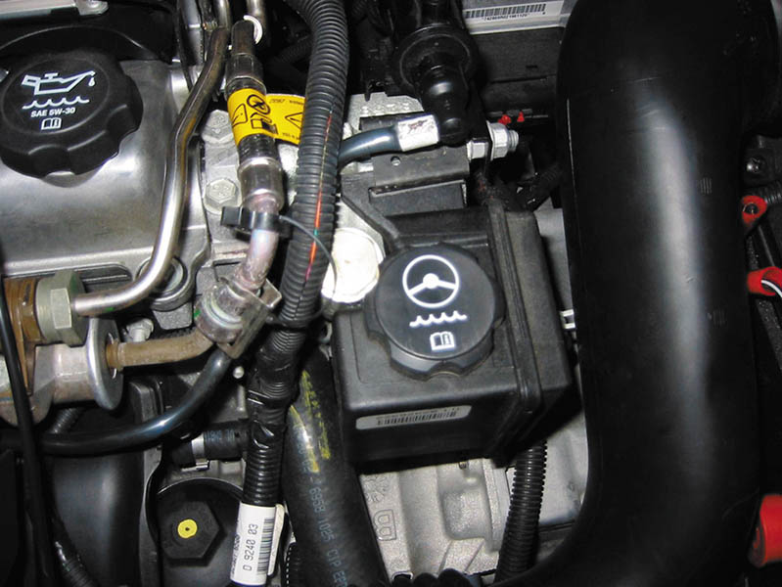
Figure 122.4 Typical remote reservoir

Slide 16
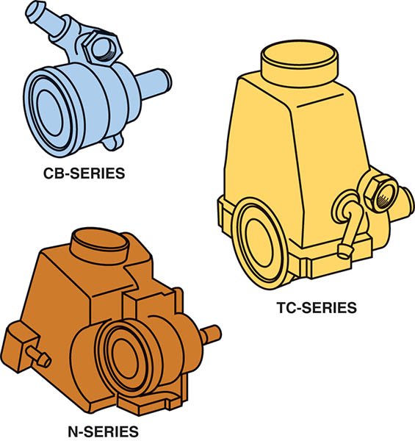
Figure 122.5 Typical power steering pump assemblies

Slide 17
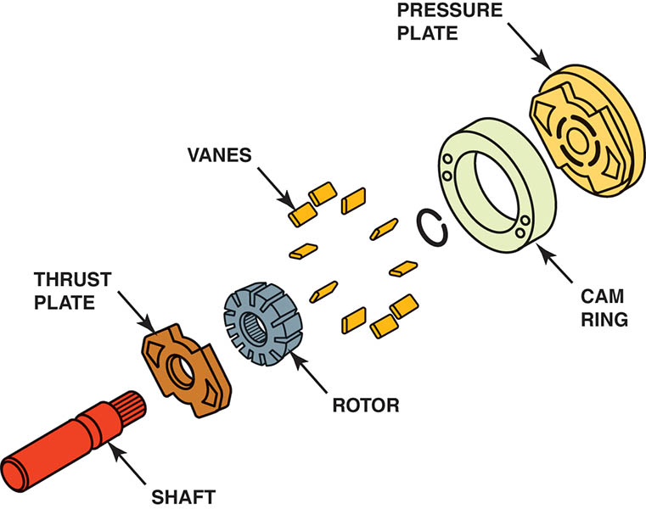
Figure 122.6 General Motors vane-type pump

Slide 18
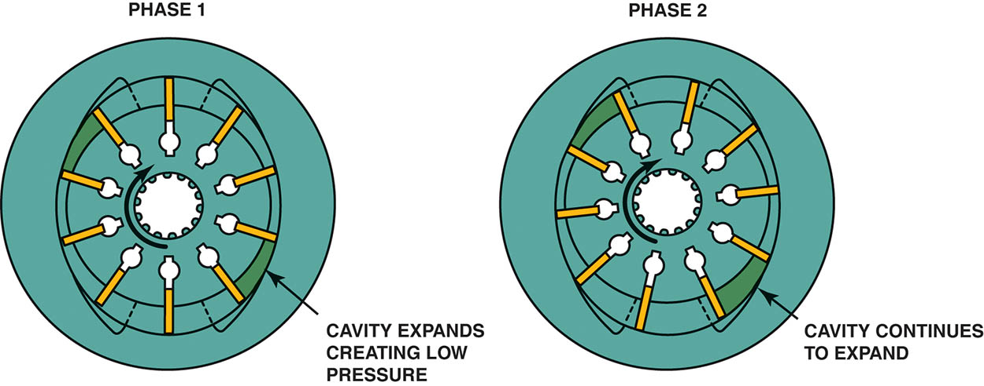
Figure 122.7 Vane pump operation. In phase 1, the rotor moves past the opposed suction ports, and the vanes move out to maintain contact with the ring. As the rotor continues to move during phase 2, the vanes follow the contour of the ring. The contour of the ring forms a larger cavity between the vanes.

Slide 19
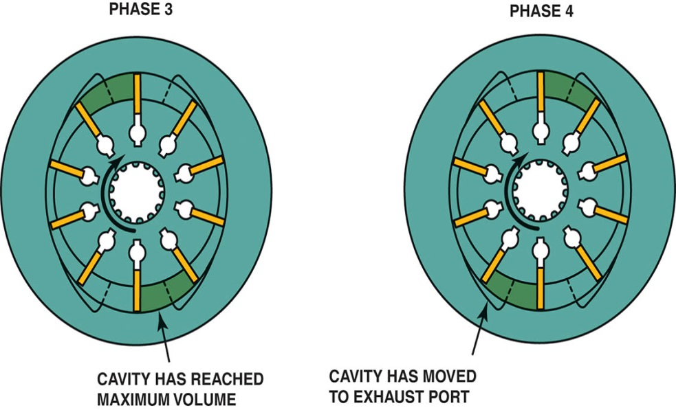
Figure 122.8 Vane pump operation—continued. At phase 3, the vanes are at the end of the intake port of the pump and the cavity has reached its maximum volume. In phase 4, the rotor moves into alignment with the opposed discharge ports

Slide 20
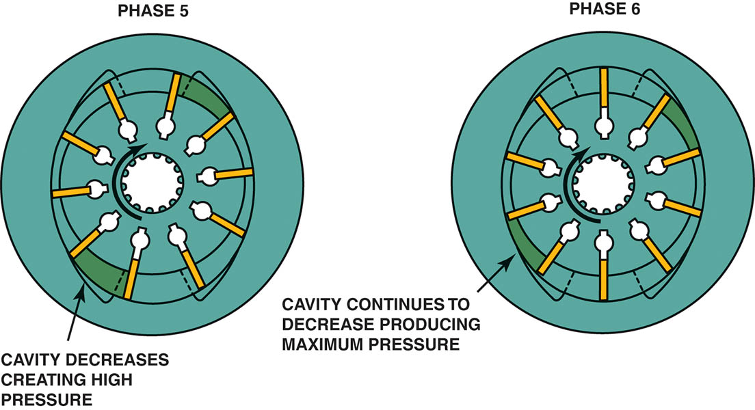
Figure 122.9 Vane pump operation—continued. As the rotor continues to move during phase 5, the volume of the cavity decreases, which increases the discharge pressure. At phase 6, the last phase, the contour of the ring results in the minimum cavity volume, and the discharge of fluid is completed

Slide 21
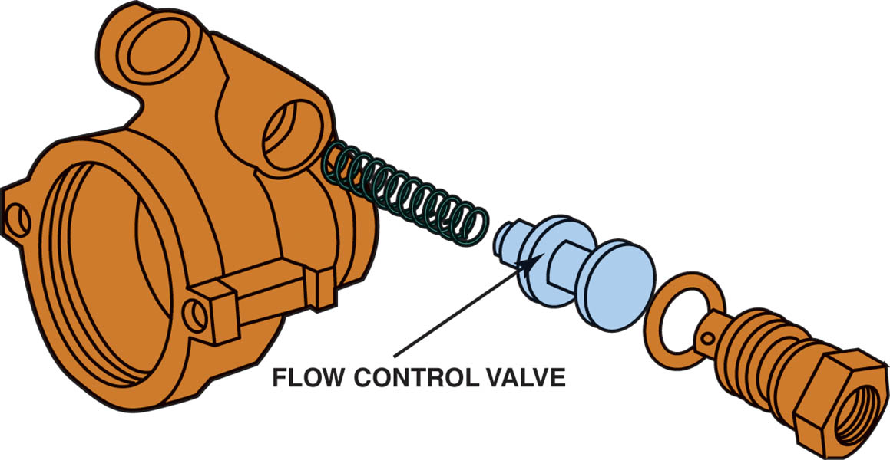
Figure 122.10 Flow control valve

Slide 22
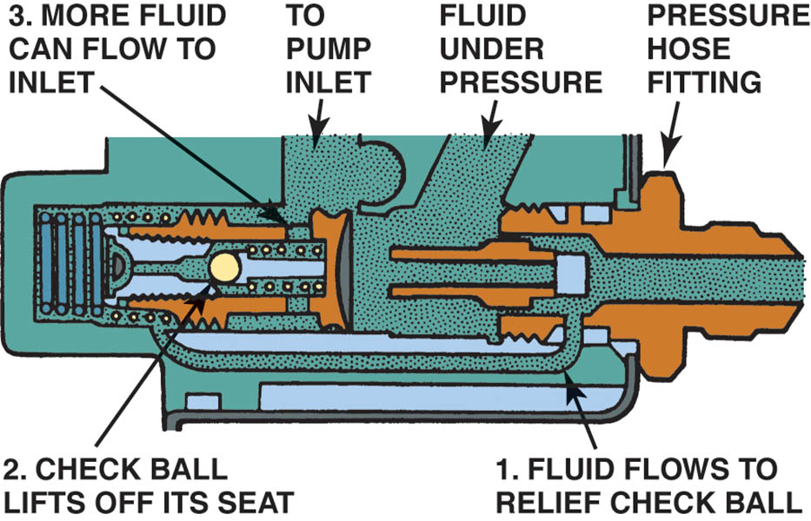
Figure 122.11 The pressure-relief check ball unseats, allowing fluid to flow back into the pump inlet if the pressure rises above a certain limit

Slide 23
QUESTION 2: ?
How does a vane-type power steering pump operate?

Slide 24
ANSWER 2:
Centrifugal force and hydraulic pressure push the vanes of the rotor outward into contact with the pump ring.

Slide 25
POWER STEERING HOSES
The pressure hose is connected to the flow control/relief valve. This hose supplies pressurized fluid to the steering gear.
The second hose is called the return hose and it returns the fluid from the steering gear back to the pump.
Some vehicles will use a cooler in the return path to the pump. The cooler is used to reduce the temperature of the fluid before it enters the pump.

Slide 26
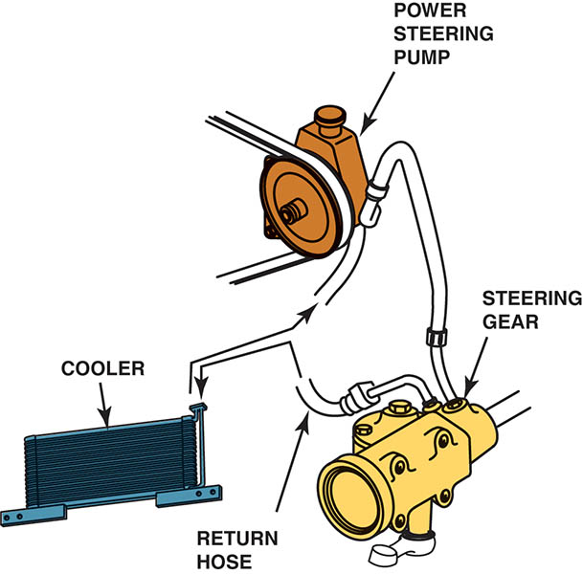
Figure 122.12 The power steering fluid cooler, if used, is located in the return hose. Often the “cooler” is simply a length of return metal line that is arranged in a loop and routed near the front of the vehicle. The airflow past the return line helps reduce the temperature of the fluid

Slide 27
INTEGRAL POWER STEERING (1 OF 2)
Purpose and Function
In an integral power steering system, the control valve and a power piston which applies force to the pitman arm are incorporated into the steering gear construction.
Integral Standard Steering Gear
Most standard steering gears with power assist are the recirculating-ball type, and the ball nut functions as the power piston.

Slide 28
INTEGRAL POWER STEERING (2 OF 2)
Rotary Control Valve
The rotary valve applies force to the power piston and reduces the effort needed to turn the steering linkage.
The rotary control valve consists of two cylindrical elements:
Inner valve element
Outer valve element
The inner valve element is secured to the steering gear input shaft and the torsion bar.
The outer valve element is also the steering worm gear.

Slide 29
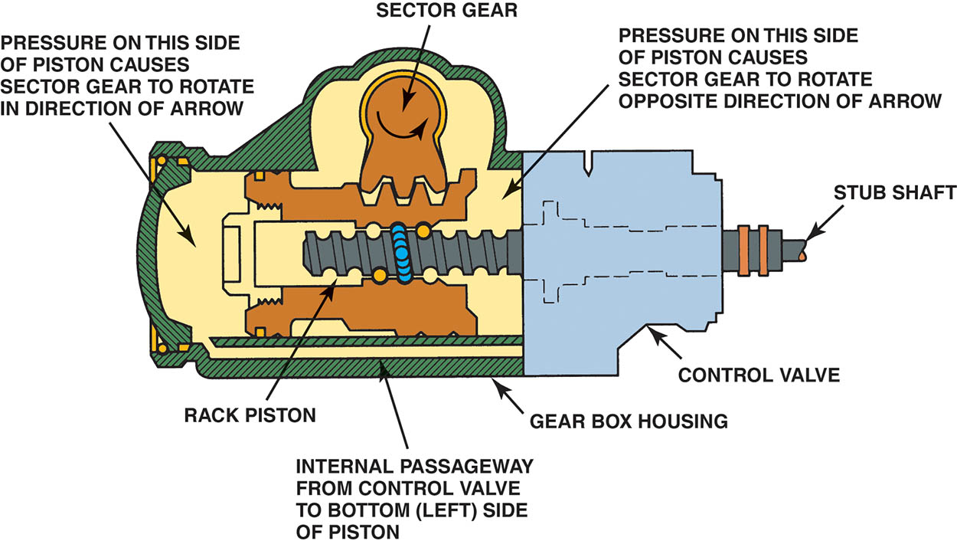
Figure 122.13 Forces acting on the rack piston of an integral power steering gear

Slide 30
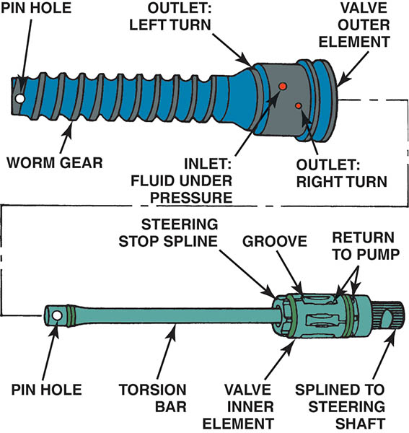
Figure 122.14 The rotary valve consists of inner and outer elements. The worm gear is part of the outer element and the torsion bar is part of the inner element. A pin attaches the worm gear to the bottom of the torsion bar to join the two elements together

Slide 31
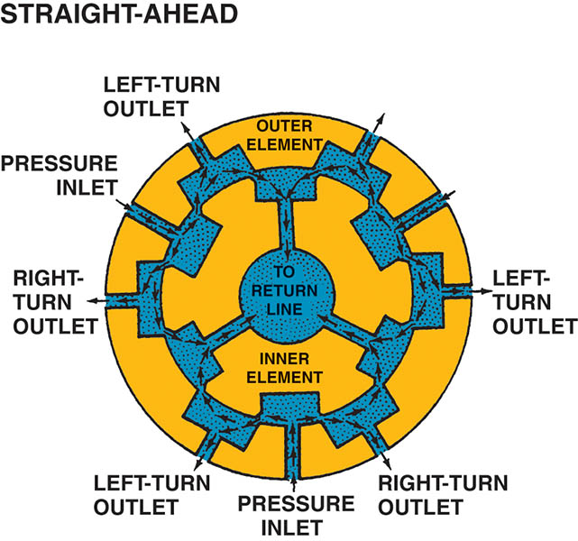
Figure 122.15 When the steering wheel is in the straight-ahead position, all of the ports in a rotary valve are open equally to the pressure and return circuits

Slide 32
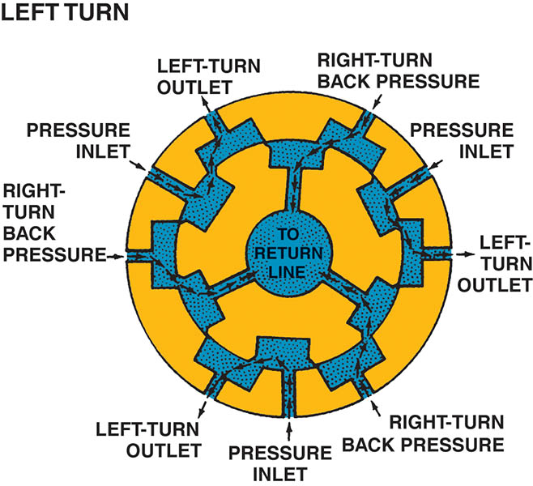
Figure 122.16 During a left turn, the inner element turns so that the left-turn circuits are open to pressure and the right-turn circuits are open to the return circuit

Slide 33
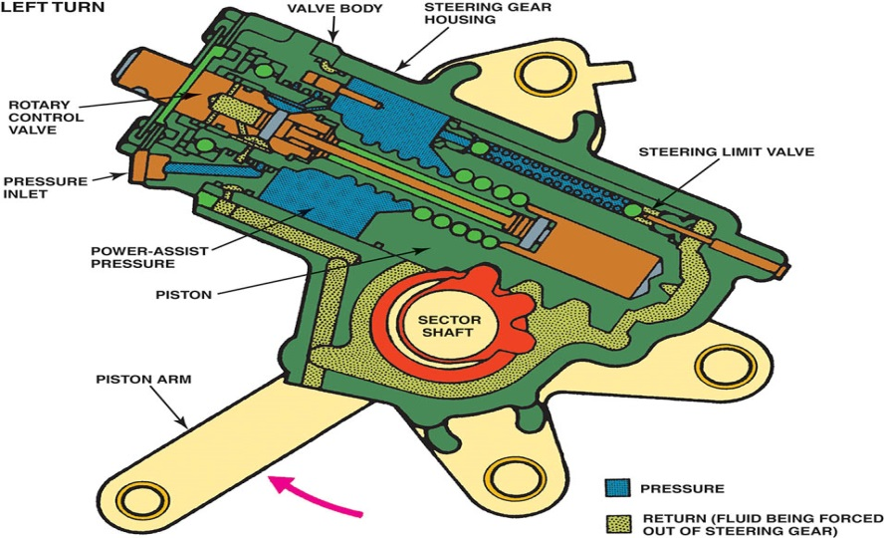
Figure 122.17 During a left turn, the high-pressure fluid helps push the piston along the worm gear, thereby reducing the steering effort from the driver

Slide 34
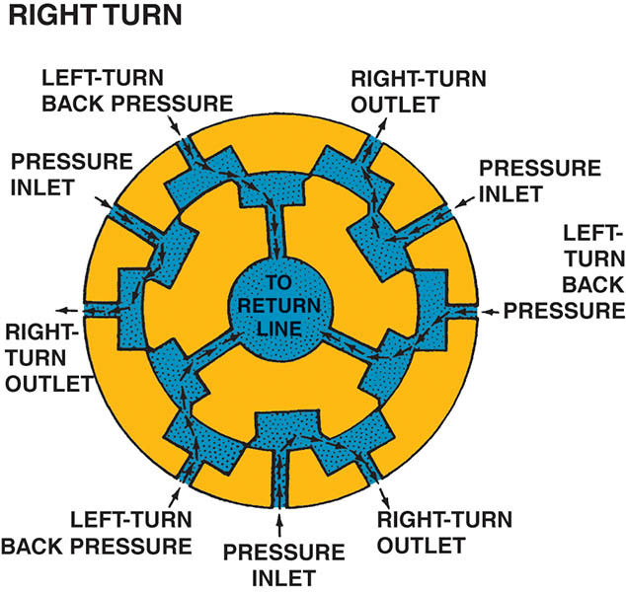
Figure 122.18 During a right turn, the inner element turns so that the right-turn outlets are open to pressure and the left-turn outlets are open to the return circuit

Slide 35
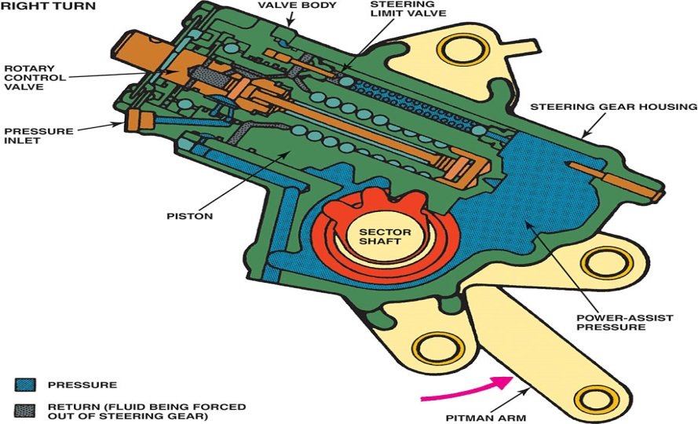
Figure 122.19 During a right turn, high-pressure fluid pushes the piston up the worm gear, moving the sector shaft and pitman arm to provide assist during a right turn

Slide 36
POWER RACK AND PINION STEERING
The rotary control valve on a power rack-and-pinion steering gear is located between the steering gear input shaft and the pinion gear.
Fluid discharged by the valve travels through external steel lines to either side of the power piston located in the rack housing.

Slide 37
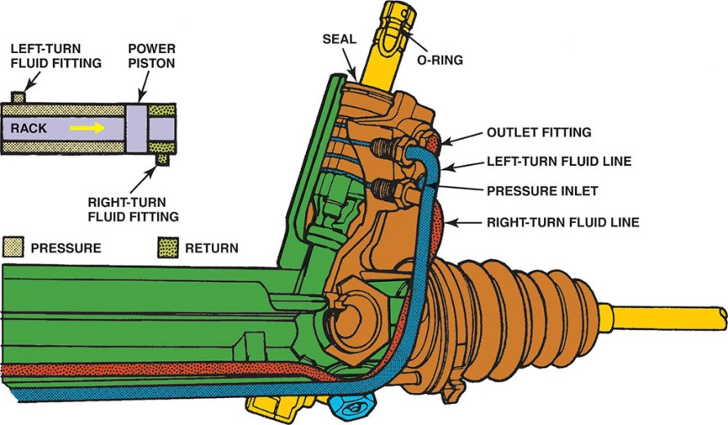
Figure 122.20 During a left turn, the control valve directs pressure into the left-turn fluid line and the rack moves left (see inset). Fluid pushed out of the right-turn fluid chamber travels back through the right-turn fluid line and control valve to the return circuit

Slide 38
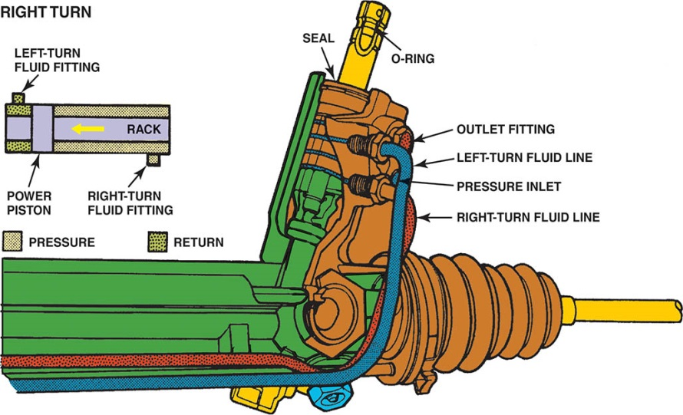
Figure 122.21 The control valve routes high-pressure fluid to the left-hand side of the power piston, which pushes the piston and assists in moving the rack toward the right when the steering wheel is turned right

Slide 39
FLOW CONTROL VALVE OPERATION
The operation of the flow control valve includes the following stages:
When the power steering pump begins operation, the fluid from the output of the pump flows into the control valve.
The fluid then flows through the orifice, where a pressure differential is formed. The pressure differential results in a higher pressure on the pump side than on the system side.
As the pump speed continues to increase, the valve moves more to compensate for the higher pressure and flow.

Slide 40
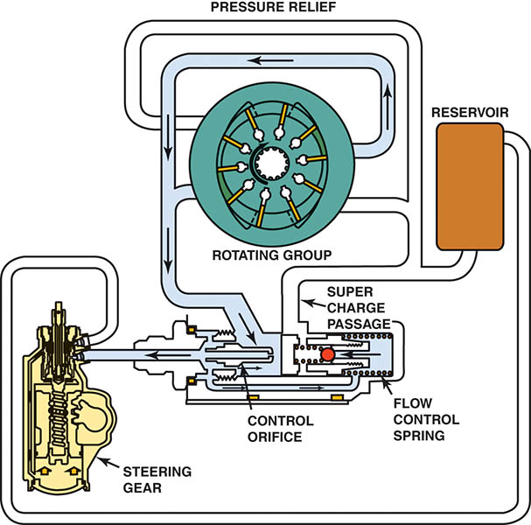
Figure 122.22 Low-speed flow control

Slide 41

Figure 122.23 High-speed flow control operation

Slide 42
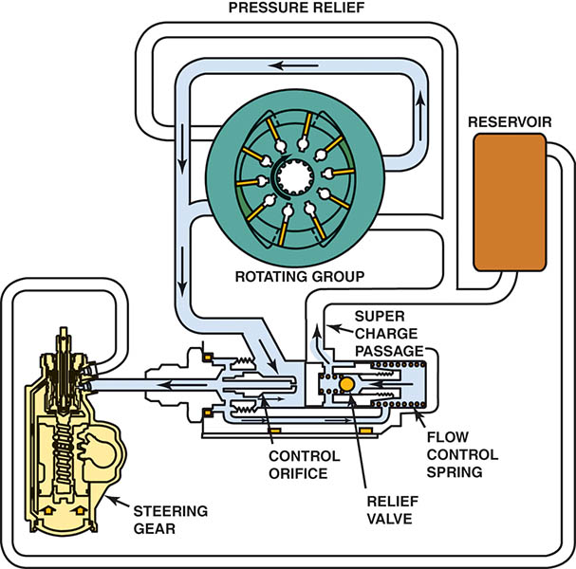
Figure 122.24 Pressure-relief mode. In this mode, the steering gear has blocked the flow of fluid from the pump and the pressure rises, which unseats the pressure-relief valve. Now, fluid flows back to the inlet through the pressure-relief orifice and passage

Slide 43
VARIABLE-EFFORT STEERING (VES) (1 OF 5)
Purpose and Function
Increases assist at lower vehicle speeds to aid parking maneuvers.
Decreases assist at higher speeds for greater road feel.
As examples, General Motors uses four different VES systems including:
Electronic Variable Orifice (EVO)
Two-Flow Electronic (TFE)
Speed Sensitive Steering (SSS)
Magnasteer®

Slide 44
VARIABLE-EFFORT STEERING (VES) (2 OF 5)
Electronic Variable Orifice (EVO) System
As the vehicle speed increases, the control module provides a higher current flow and the solenoid positions the pintle to change the size of the orifice.
This increased speed results in a reduced amount of hydraulic flow and provides less hydraulic pressure to the steering gear.

Slide 45
VARIABLE-EFFORT STEERING (VES) (3 OF 5)
Two-Flow Electronic (TFE) System
The TFE actuator is a solenoid-operated pintle valve. The pintle valve has only two positions:
Maximum assist
Reduced assist
The solenoid is energized whenever the vehicle speed is approximately 20 mph (32 km/h) or lower resulting in maximum assist.
When the vehicle speed is higher than 20 mph (32 km/h), the solenoid is de-energized resulting in reduced assist.

Slide 46
VARIABLE-EFFORT STEERING (VES) (4 OF 5)
Speed Sensitive Steering (SSS) System
The actuator is a solenoid-operated valve that controls the flow of fluid into the chambers of the steering gear valve.
The amperage has a direct effect on steering effort and the hydraulic flow rate into the chambers of the spool shaft.
The steering effort adjustment begins at a vehicle speed of 20 mph (32 km/h).

Slide 47
VARIABLE-EFFORT STEERING (VES) (5 OF 5)
Magnasteer®
This system uses a variable bidirectional magnetic rotary actuator built into the steering rack.
The electromagnet acts in parallel with the input shaft from the steering wheel to open or close the spool valve.
With vehicle speeds below 45 mph, increased current provides increased steering assist.
With vehicle speeds above 45 mph, decreased current flow provides decreased steering assist.

Slide 48
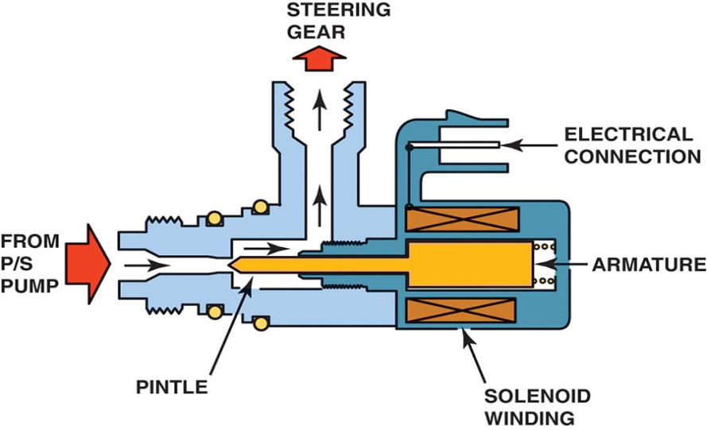
Figure 122.25 EVO actuator assembly

Slide 49
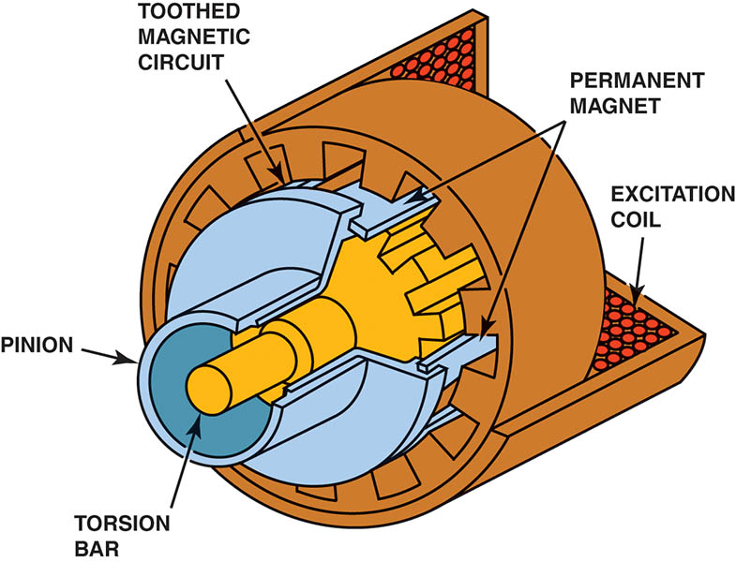
Figure 122.26 Integrated with the pinion shaft is a spool valve that senses the level of torque in the shaft and applies hydraulic pressure to the steering rack whenever assistance is needed. The electromagnet acts in parallel with the input shaft from the steering wheel to open or close the spool valve. The electromagnet generates variable torque, which can either increase or decrease the amount of steering torque that is needed to open the spool valve

Slide 50
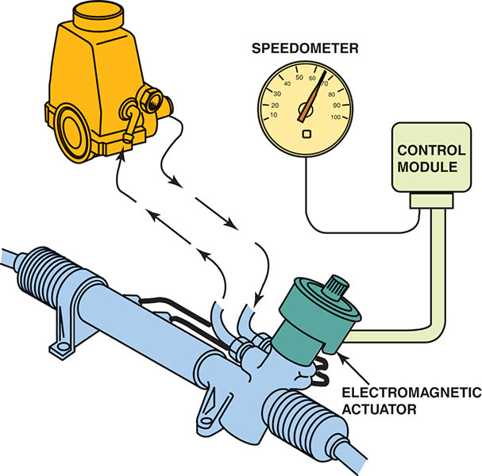
Figure 122.27 Magnasteer® system

Slide 51
QUESTION 3: ?
What is the purpose of variable assist steering systems?

Slide 52
ANSWER 3:
To improve steering assist at low speeds and to provide a more stable driving feel at higher speeds.

Slide 53
POWER STEERING DIAGNOSIS
Items to Check:
A loose, worn, or defective power steering pump drive belt.
A bent or misaligned drive pulley.
Low or contaminated power steering fluid.
Broken or loose power steering pump mounting brackets.
Underinflated tires.
Internal steering gear mechanical binding.
A defective power steering pressure switch.
Engine idle speed below specifications.

Slide 54
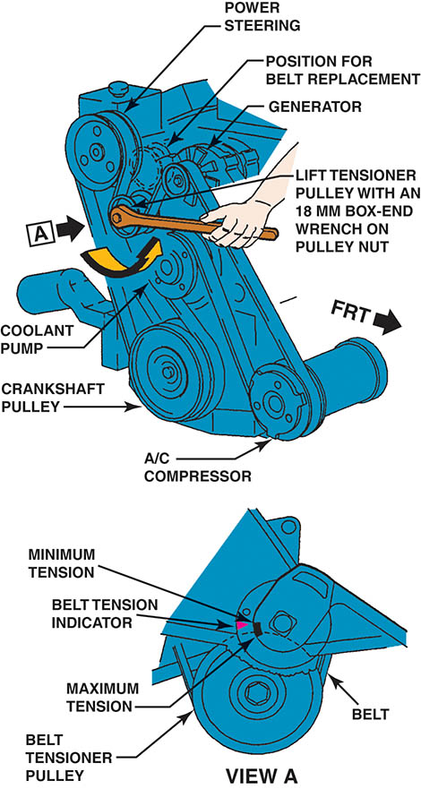
Figure 122.28 A typical service manual illustration showing the method to use to properly tension the accessory drive belt

Slide 55
POWER STEERING FLUID (1 OF 3)
The correct power steering (PS) fluid is critical to the operation and service life of the power steering system.
Whenever there is any power steering service performed, such as replacement of a defective pump or steering gear or rack-and-pinion unit, the entire system should be flushed.

Slide 56
POWER STEERING FLUID (2 OF 3)
Bleeding Air Out of the System
Lift the vehicle off the ground, then rotate the steering wheel.
Some systems require the reservoir to be placed in a vacuum to remove the air from the system.
Hose Inspection
Both high-pressure supply and low-pressure return hoses should be inspected as part of any thorough vehicle inspection.

Slide 57
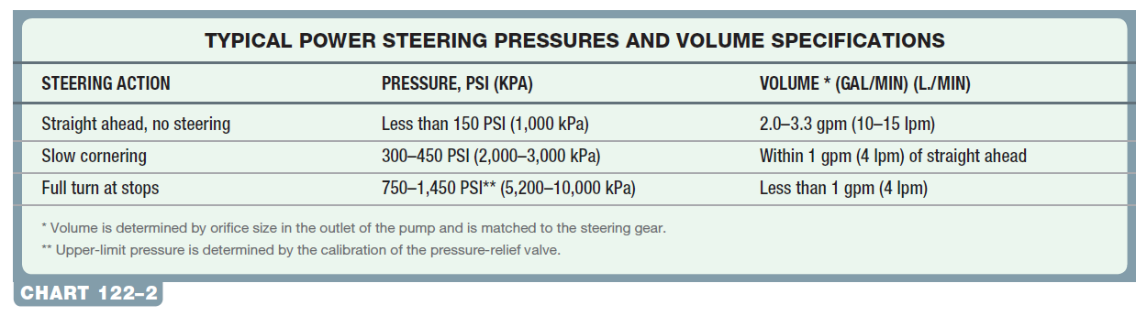
POWER STEERING FLUID (3 OF 3)
Pressure Testing
A power steering analyzer is used to pressure test the system.

Slide 58
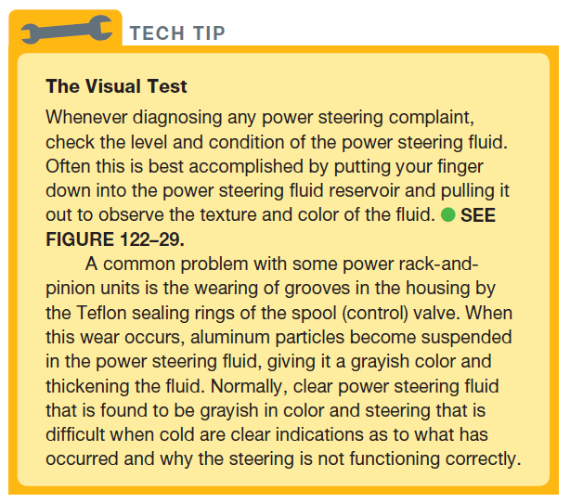
Tech Tip

Slide 59
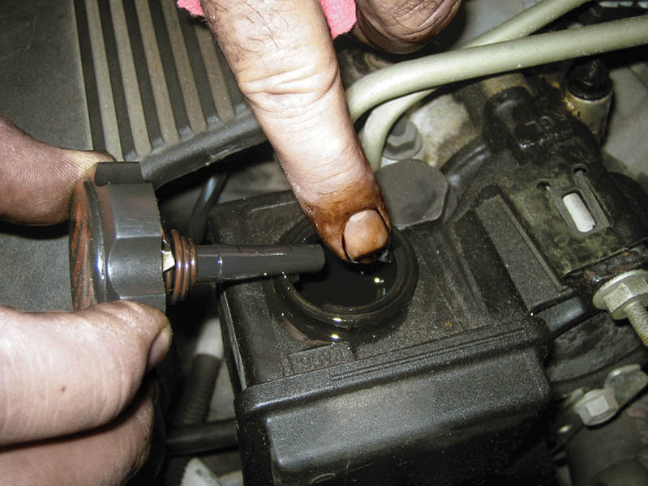
Figure 122.29 A check of the power steering fluid should include inspecting not only the level but the condition and color of the fluid, which could indicate a possible problem with other components in the steering system

Slide 60
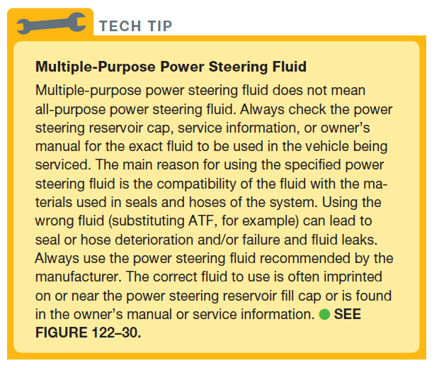
TECH TIP

Slide 61
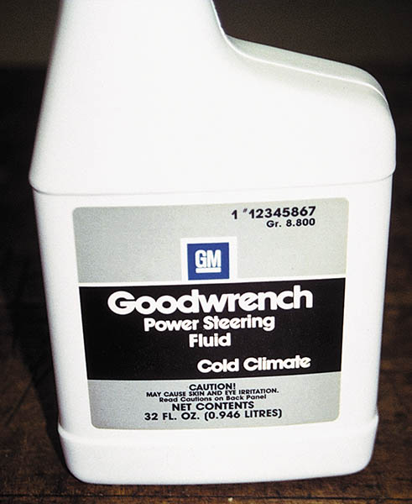
Figure 122.30 Some power steering fluid is unique to the climate, such as this cold climate fluid recommended for use in General Motors vehicles when temperatures are low

Slide 62
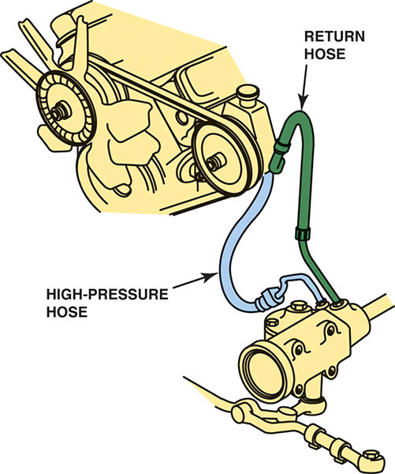
Figure 122.31 Inspect both high-pressure and return power steering hoses. Make sure the hoses are routed correctly and not touching sections of the body to prevent power steering noise from being transferred to the passenger compartment

Slide 63
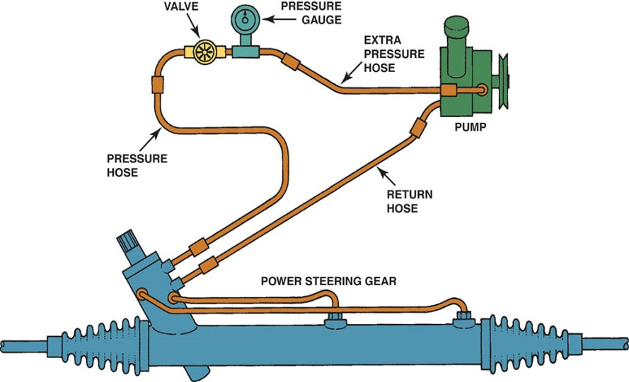
Figure 122.32 A drawing showing how to connect a power steering analyzer to the system

Slide 64
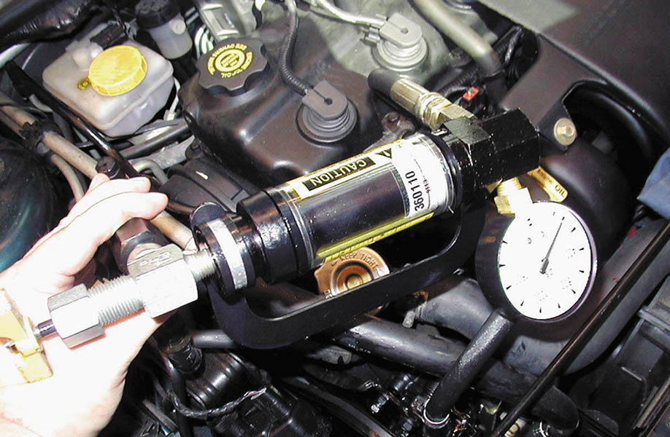
Figure 122.33 A power steering analyzer that measures both pressure and volume. The shut-off valve is used to test the maximum pressure of the pump

Slide 65
PUMP SERVICE (1 OF 2)
Some power steering pump service can usually be performed without removing the pump, including the following:
Replacing the high-pressure and return hoses.
Removing and cleaning the flow control valve assembly.
Most power steering pump service requires the removal of the pump from the engine mounting and/or removal of the drive pulley.

Slide 66
PUMP SERVICE (2 OF 2)
Most pumps are not repairable and must be replaced.
For pumps that are repairable:
After removing the pump from the vehicle and removing the drive pulley, disassemble the pump according to the manufacturer’s recommended procedure.

Slide 67
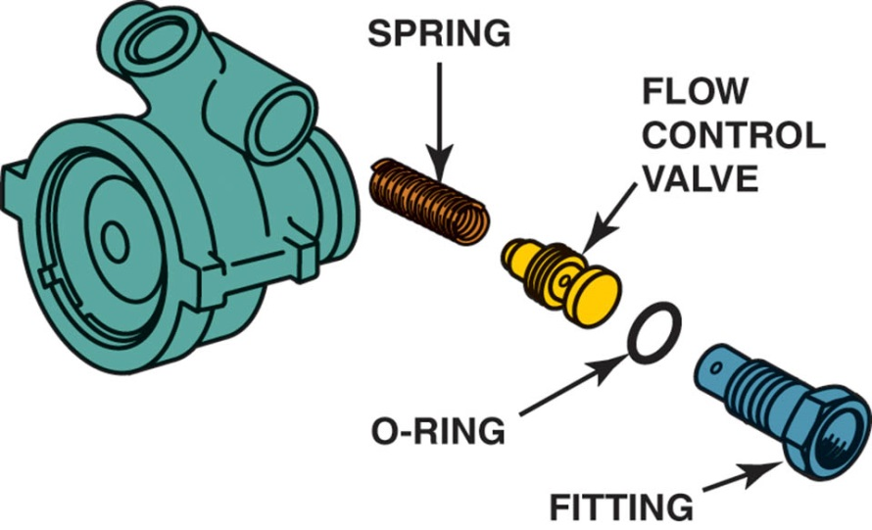
Figure 122.34 Typical power steering pump showing the order of assembly. The high-pressure (outlet) hose attaches to the fitting (#16). The flow control valve can be removed from the pump by removing the fitting

Slide 68
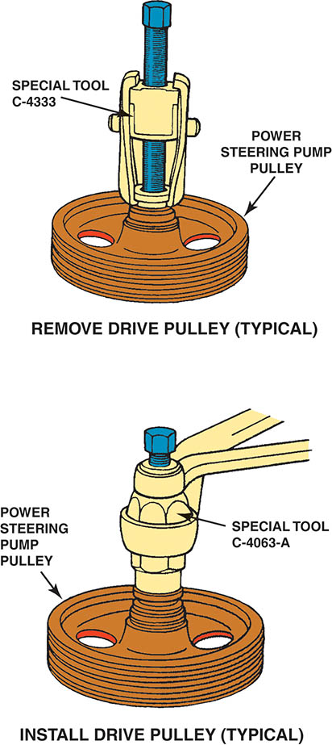
Figure 122.35 Typical tools required to remove and install a drive pulley on a power steering pump. Often these tools can be purchased at a relatively low cost from automotive parts stores and will work on many different makes of vehicles

Slide 69
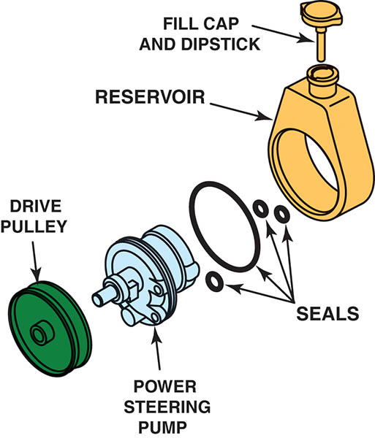
Figure 122.36 A typical submerged-type power steering pump. The pump is housed inside the fluid reservoir

Slide 70
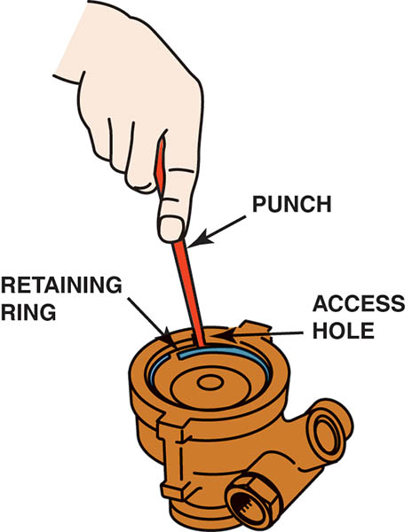
Figure 122.37 A punch is used to dislodge the retaining ring

Slide 71
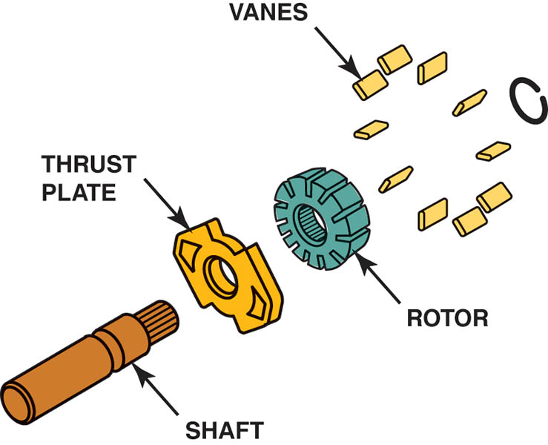
Figure 122.38 The driveshaft attaches to the drive pulley at one end and is splined to the pump rotor at the other end. The vanes are placed in the slots of the rotor

Slide 72
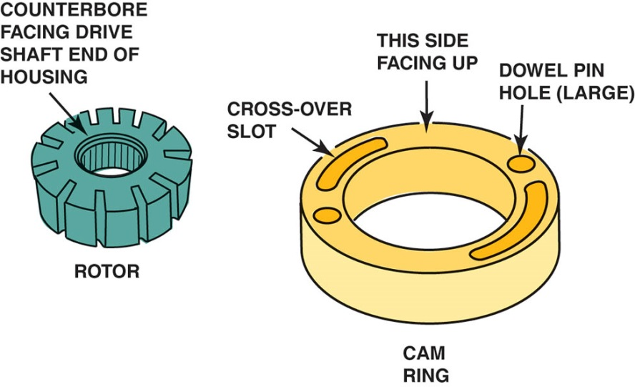
Figure 122.39 The pump ring must be installed correctly. If it is installed upside down, the internal passages will not line up and the pump will have no output

Slide 73
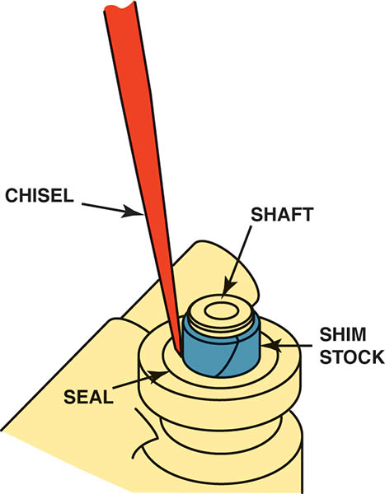
Figure 122.40 The shaft seal must be chiseled out. A thin metal shim stock should be used to protect the shaft from damage. Some technicians drill a small hole in the seal, then thread in a self-tapping sheet metal screw. Then pliers are used to pull out the old seal

Slide 74
STEERING RACK REMOVAL AND INSTALLATION

Slide 75
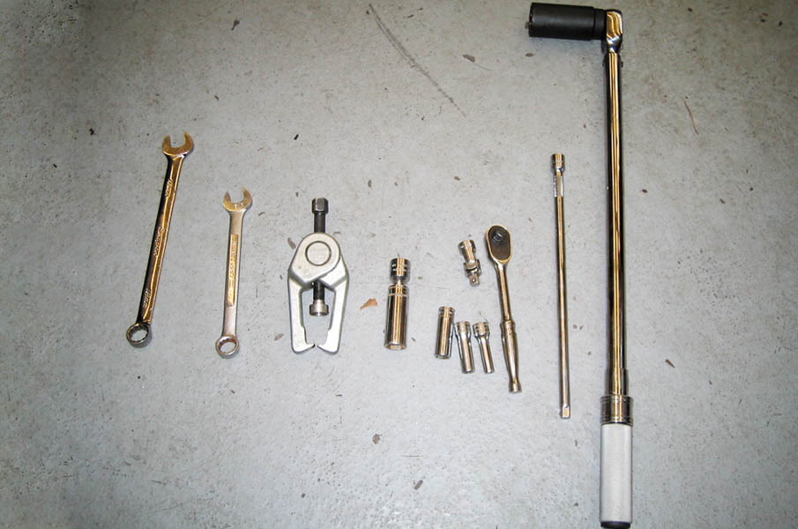
1. The tools required include a tie rod end puller and basic hand tools.

Slide 76
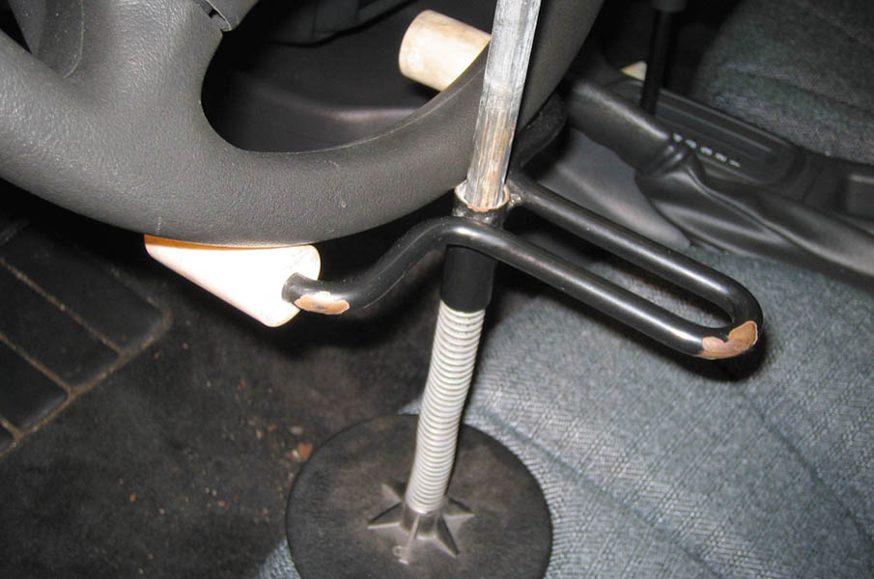
2. To help keep the steering wheel from rotating when the steering rack assembly is removed, a steering wheel lock is being used.

Slide 77
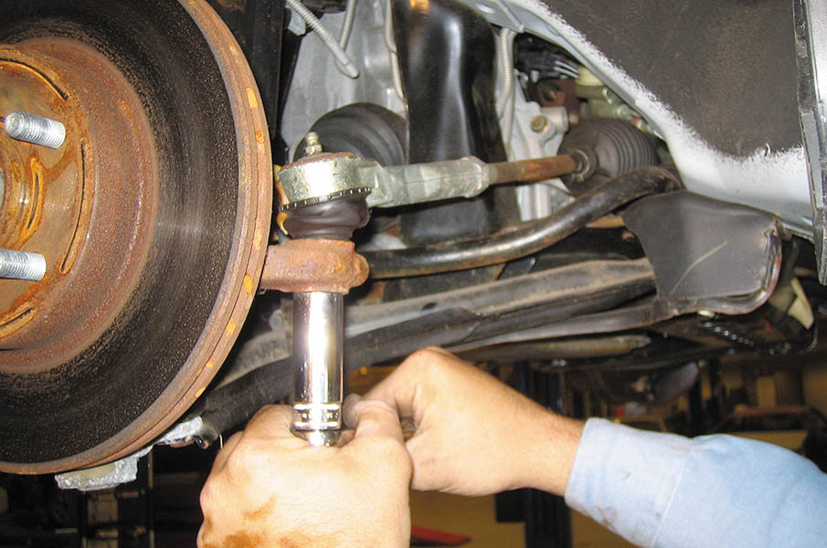
3. After safely hoisting the vehicle and removing the front wheels, the outer tie rod end retaining nuts are removed.

Slide 78
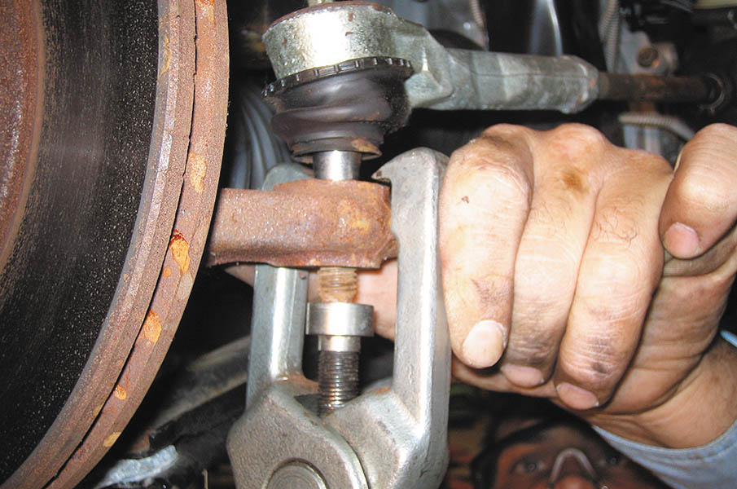
4. Use a tie rod taper breaker to separate the outer tie rods from the steering knuckle without harming the rubber grease boots.

Slide 79
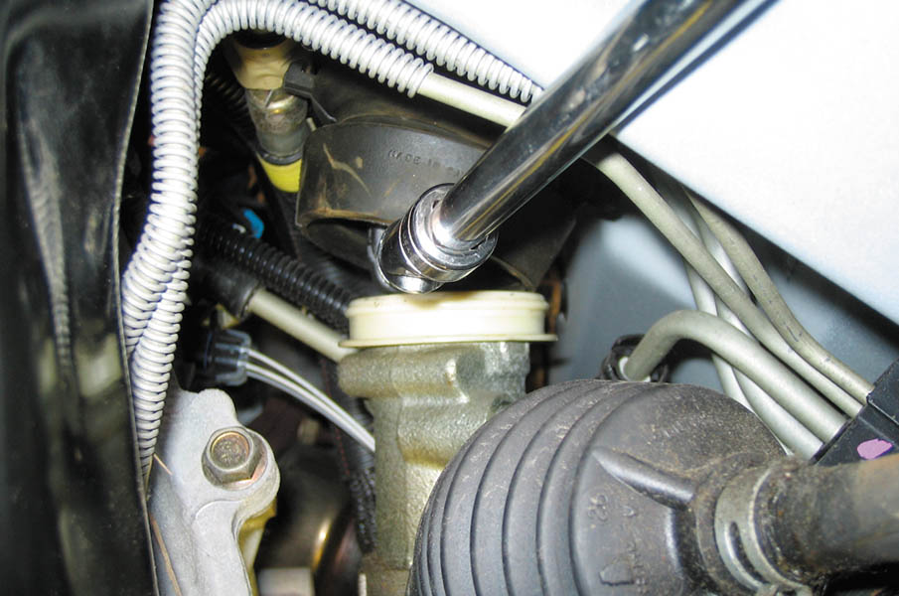
5. After moving the protective cover aside, the bolt used to retain the intermediate shaft to the steering gear stub shaft is removed.

Slide 80
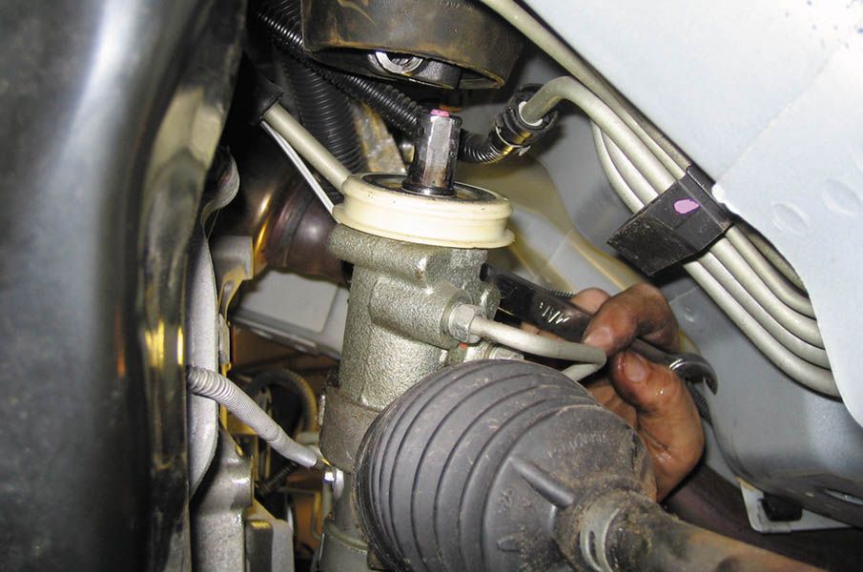
6. The hydraulic lines attached to the steering rack to the power steering rack assembly are removed using a line wrench.

Slide 81
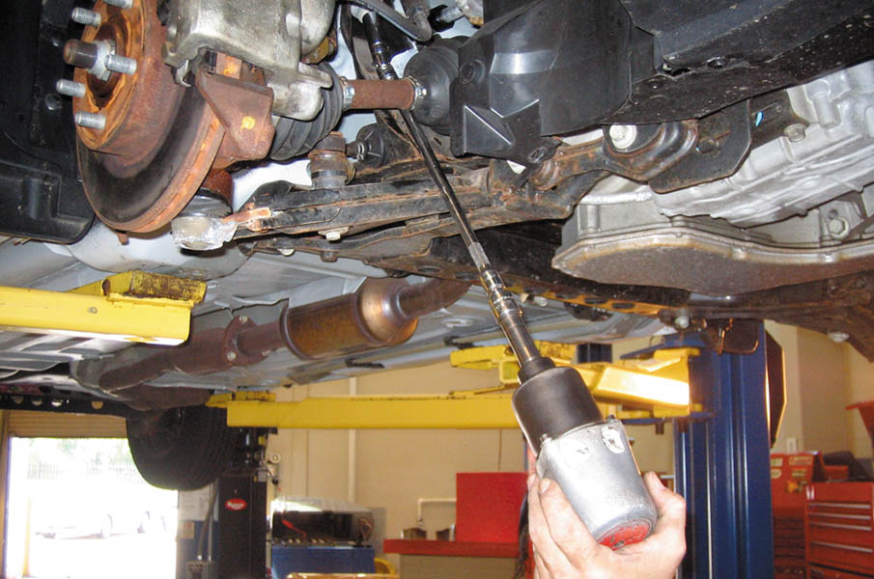
7. After supporting the engine cradle using a tall safety stand, an air impact wrench with a long extension is used to remove the engine cradle bolts.

Slide 82
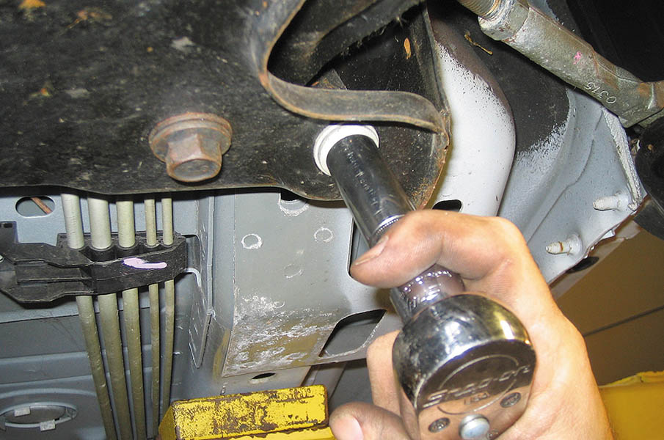
8. Removing the lower engine cradle bolts. This will allow the cradle to be lowered to gain access to the steering rack assembly.

Slide 83

9. The screw jack on the tall safety stands is rotated allowing the engine cradle to be lowered.

Slide 84

10. Removing the steering rack attachment bolts.

Slide 85

11. The steering rack assembly can be lifted out of the support brackets.

Slide 86

12. On this General Motors vehicle, the steering rack assembly is removed from the driver’s side.

Slide 87

13. Before reinstalling the steering gear assembly, note the notch on the stub shaft. This notch has to be aligned with the intermediate shaft retaining bolt when it is placed back into the vehicle.

Slide 88

14. Installation is the reverse of removal. Be sure that the rack is centered and check that the through-bolt is properly aligned with the notch in the steering rack stub shaft.

Slide 89

15. While using a tall safety stand to support the engine cradle, the retaining bolts are installed.

Slide 90

16. A socket is being used to keep the tapered tie rod end from rotating while the retaining nut is tightened with a wrench.

Slide 91

17. After the hydraulic lines and retaining bolts have been installed, the power steering pump reservoir is filled using the specified fluid.

Slide 92

18. To bleed the trapped air out of the system, the steering wheel is rotated lock to lock with engine off and the wheels off the ground. Check for leaks then perform a test-drive to verify a proper repair.

Slide 93

Copyright

