Slide 1

Automotive Technology Principles, Diagnosis, and Service
Sixth Edition
Chapter 98
Brake Hydraulic Systems
Copyright © 2018, 2015, 2011 Pearson Education, Inc. All Rights Reserved

Slide 2
LEARNING OBJECTIVES (1 of 2)
98.1 Explain how the non-compressibility of liquids is used in brake systems.
98.2 State Pascal’s law.
98.3 Describe the function, purpose, operation, and types of master cylinders.

Slide 3
LEARNING OBJECTIVES (2 of 2)
98.4 Describe the process of diagnosing and troubleshooting master cylinders.
98.5 This chapter will help prepare for the Brakes (A5) ASE certification test content area “A” (Hydraulic, Power Assist, and Parking Brake Systems Diagnosis and Repair).

Slide 4
HYDRAULIC PRINCIPLES
Need for Hydraulics
  All vehicles use hydraulic pressure to help increase brake application force.
Non-compressibility of Liquids
  No matter how much pressure or force is placed on a quantity of liquid, its volume remains the same.
  This fact enables liquids in a closed system to transmit motion.

Slide 5
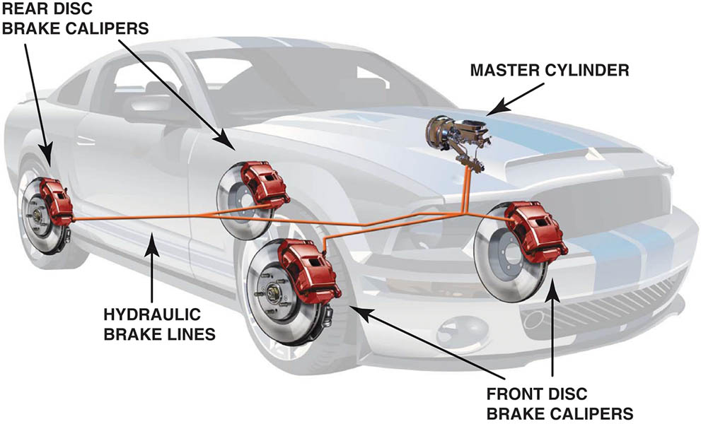
Figure 98.1 Hydraulic brake lines transfer the brake effort to each brake assembly attached to all four wheels

Slide 6
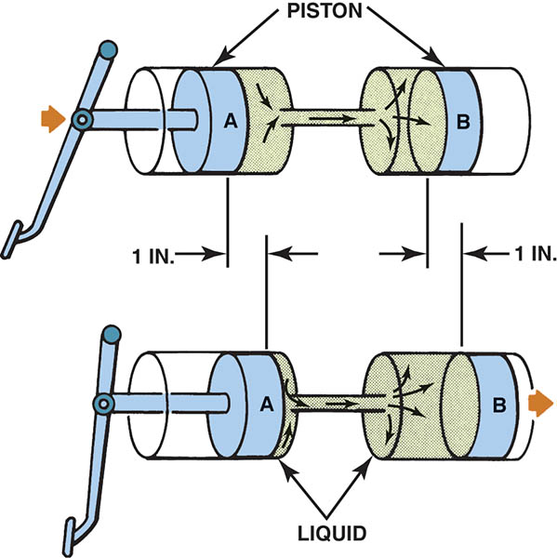
Figure 98.2 Because liquids cannot be compressed, they are able to transmit motion in a closed system.

Slide 7
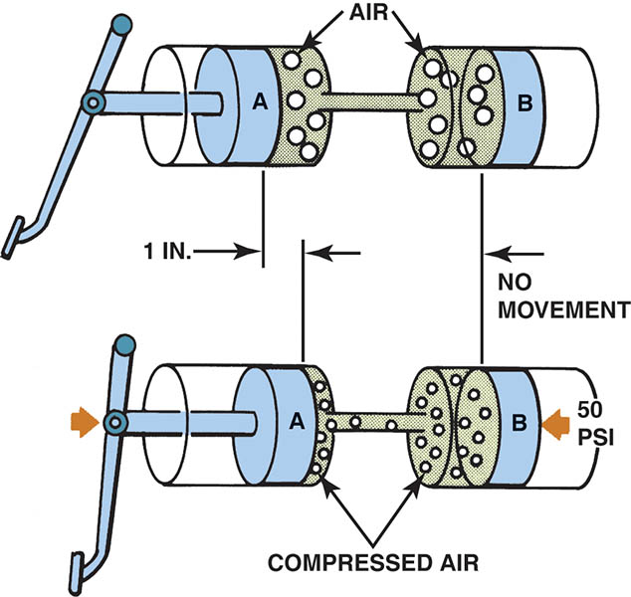
Figure 98.3 Hydraulic system must be free of air to operate properly. If air is in the system, the air is compressed when the brake pedal is depressed and the brake fluid does not transmit the force to the wheel brakes.

Slide 8
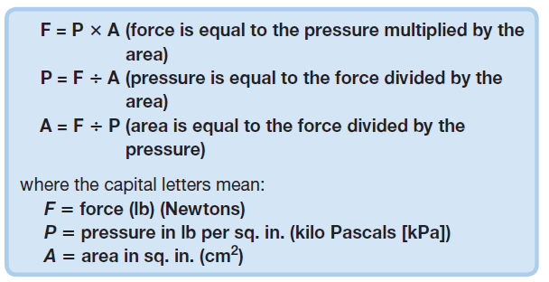
PASCAL’S LAW (1 OF 4)
Definition
  When force is applied to a liquid confined in a container or an enclosure, the pressure is transmitted equally and undiminished in every direction.
Example of Pascal’s Law

Slide 9
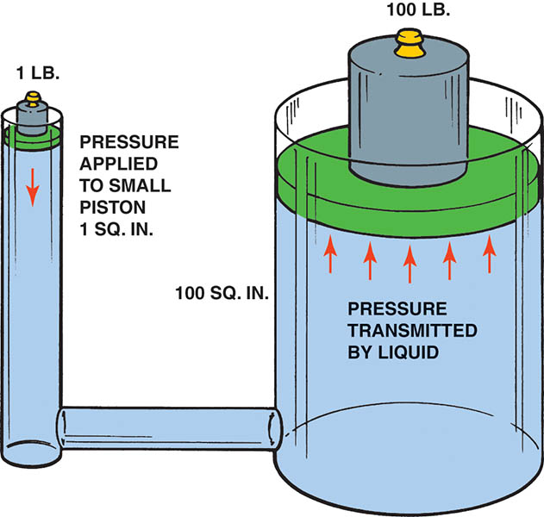
Figure 98.4 A one-pound force exerted on a small piston in a sealed system transfers the pressure to each square inch throughout the system. In this example, the 1-lb force is able to lift a 100-lb weight because it is supported by a piston that is 100 times larger in area than the small piston.

Slide 10
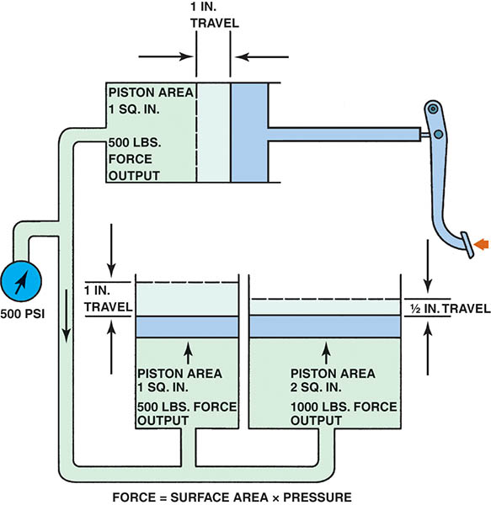
Figure 98.5 The amount of force (F) on the piston is the result of pressure (P) multiplied by the surface area (A)

Slide 11
PASCAL’S LAW (2 OF 4)
Brake Hydraulic Forces
  The real “magic” of a hydraulic brake system is the fact that different forces can be created at different wheel cylinders.
  Larger (area) pistons are used in brake calipers on the front wheels to increase the force used to apply the front brakes.
  On a typical vehicle, a driver-input force of 150 lb (660 Newton’s) is boosted both mechanically (through the brake pedal linkage) and by the power booster to a fluid pressure of about 1,700 PSI (11,700 kPa).

Slide 12
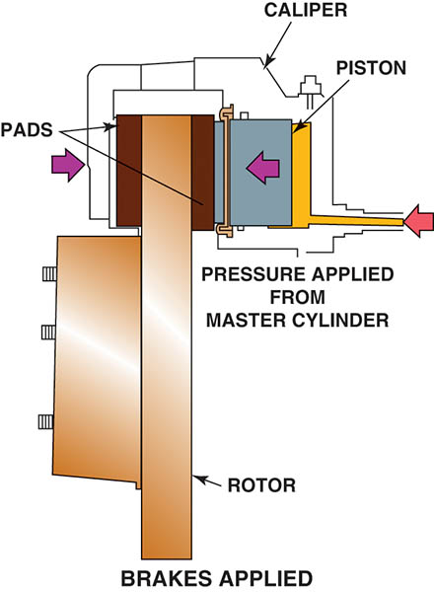
Figure 98.6 The brake pad (friction material) is pressed on both sides of the rotating rotor by the hydraulic pressure of the caliper

Slide 13
PASCAL’S LAW (3 OF 4)
Hydraulic Pressure and Piston Size
  If a mechanical force of 100 lb is exerted by the brake pedal pushrod onto a master cylinder piston with 1 sq. in. of surface area, the result is 100 PSI of brake system hydraulic pressure.
  However, if the same 100 lb force is applied to a master cylinder piston with twice the area (2 sq. in.), it cuts the hydraulic system pressure in half.
  Conversely, if the same 100 lb force is applied to a master cylinder piston with only half the area (0.5 or 1/2 sq. in.), the system pressure is doubled.

Slide 14
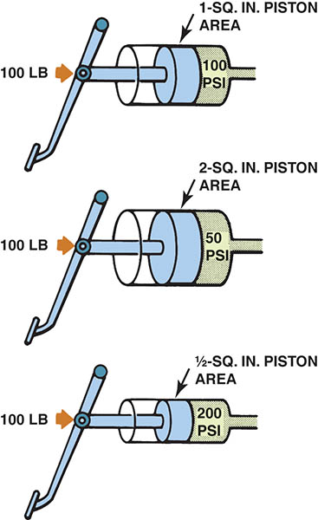
Figure 98.7 Mechanical force and the master cylinder piston area determine the hydraulic pressure in the brake system

Slide 15
PASCAL’S LAW (4 OF 4)
Application Force and Piston Size
  When equal pressure acts on unequal areas, as with different sized pistons, the brake application force differs as well.
  Larger pistons increase application force.
  Smaller pistons decrease application force.
Piston Size Versus Piston Travel
  The larger caliper piston with the greater force does not move as far as the smaller master cylinder piston.

Slide 16
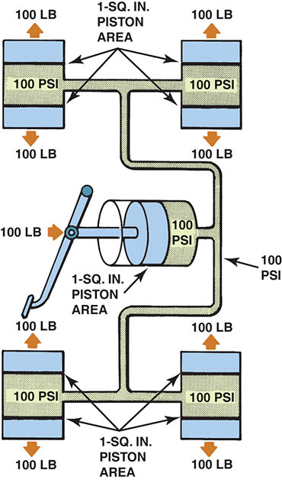
Figure 98.8 Hydraulic pressure is the same throughout a closed system and acts with equal force on equal areas

Slide 17
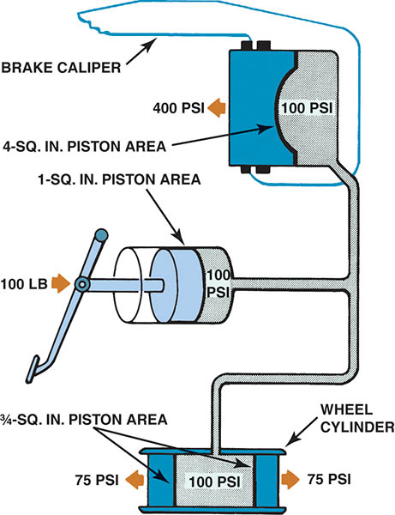
Figure 98.9 Differences in brake caliper and wheel cylinder piston area have a major effect on brake application force

Slide 18
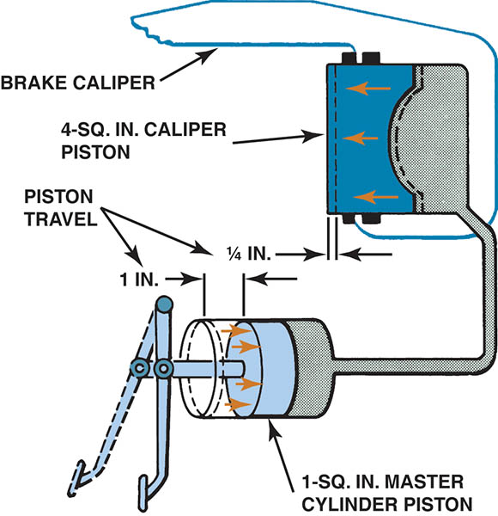
Figure 98.10 The increase in application force created by the large brake caliper piston is offset by a decrease in piston travel

Slide 19
QUESTION 1: ?
What is the definition of Pascal’s Law?

Slide 20
ANSWER 1:
  When force is applied to a liquid confined in a container or an enclosure, the pressure is transmitted equally and undiminished in every direction.

Slide 21
MASTER CYLINDERS (1 OF 7)
Purpose and Function
  The brake pedal linkage is used to apply the force of the driver’s foot into a closed hydraulic system at the master cylinder.
Master Cylinder Reservoirs
  Opaque reservoir allows for visual inspection without removing cap.
  Enough fluid reserve to allow the brakes to wear out and still have enough fluid for safe operation.

Slide 22
MASTER CYLINDERS (2 OF 7)
Master Cylinder Reservoir Diaphragm
  To help reduce the moisture from getting in contact with the brake fluid, master cylinders use a rubber diaphragm or floating disc to help seal outside air from direct contact with brake fluid.
Master Cylinder Operation
  The master cylinder is also separated into two pressure-building chambers (or circuits).
  The primary piston (chamber) is closest to the booster.
  The secondary piston (chamber) is farthest away.

Slide 23
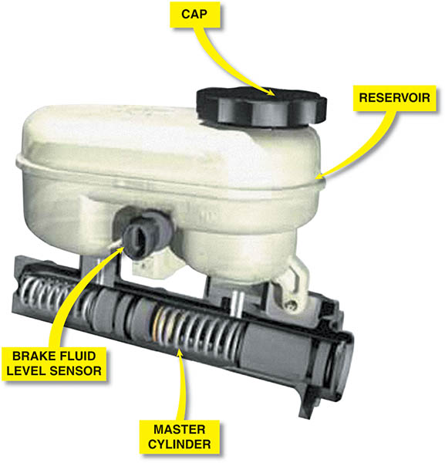
Figure 98.11 A master cylinder showing the see-through reservoir and the location of the brake fluid level sensor with a cutaway showing the internal pistons

Slide 24
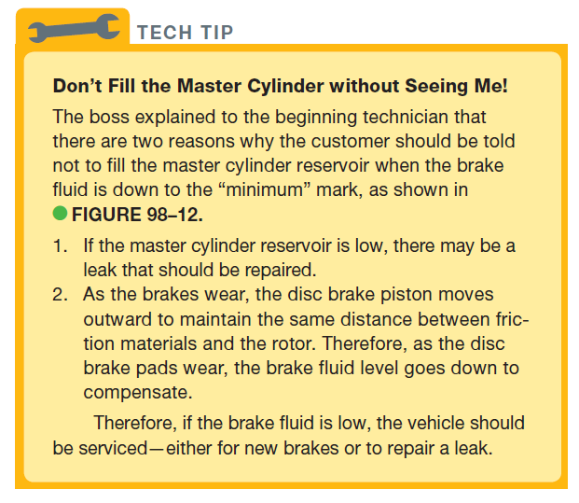
Tech Tip

Slide 25
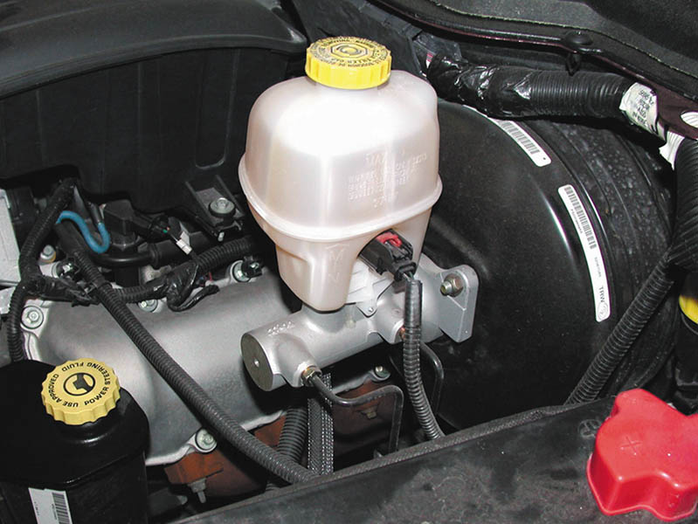
Figure 98.12 Master cylinder with brake fluid level at the “max” (maximum) line

Slide 26
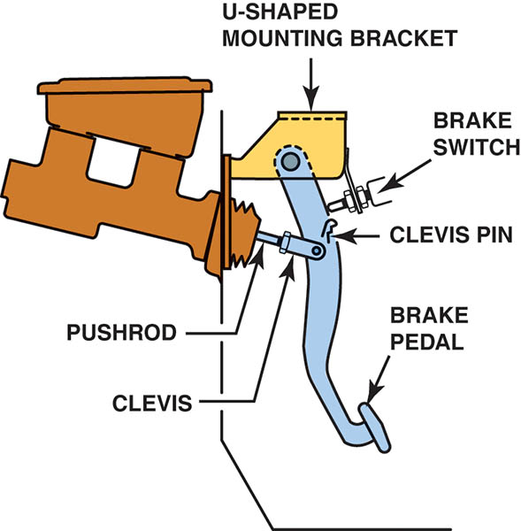
Figure 98.13 The typical brake pedal is supported by a mount and attached to the pushrod by a U-shaped bracket. The pin used to retain the clevis to the brake pedal is usually called a clevis pin.

Slide 27
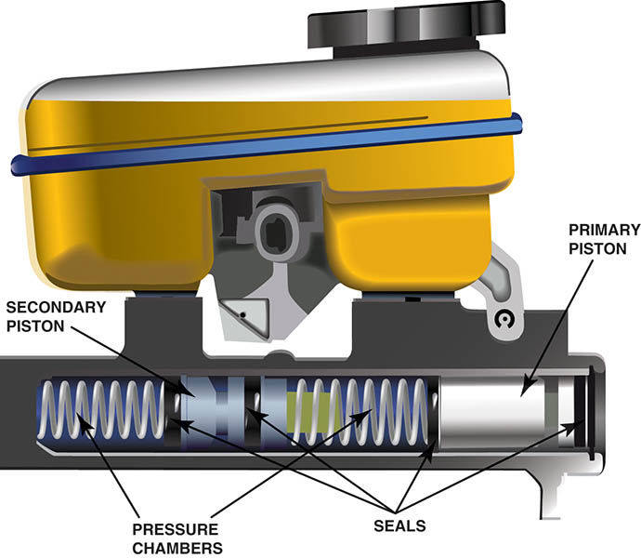
Figure 98.14 A cutaway of a master cylinder. The reservoir feeds both chambers and uses a fluid level switch that activates the red brake warning lamp if the brake fluid level drops too low.

Slide 28
MASTER CYLINDERS (3 OF 7)
Both pressure-building sections of the master cylinder contain two holes from the reservoir. According to the Society of Automotive Engineers (SAE), the terms used include:
  The forward (tapered) high pressure hole is the vent port, also called the compensating port.
  The rearward straight drilled low pressure hole is called the replenishing port, also called the inlet port, bypass port, filler port, or the breather port.

Slide 29
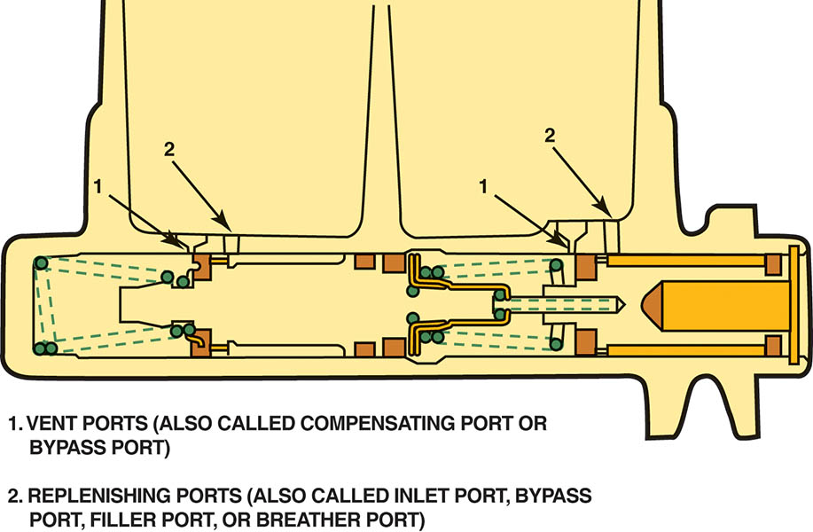
Figure 98.15 Note the various names for the vent port (front port) and the replenishing port (rear port). Names vary by vehicle and brake component manufacturer. Vent port and replenishing port are the terms recommended by the Society of Automotive Engineers (SAE).

Slide 30
MASTER CYLINDERS (4 OF 7)
At-Rest Position
  The primary sealing cups are between the compensating port hole and the inlet port hole.
Applied Position
  As the piston moves forward, the primary sealing cup covers and blocks off the vent port (compensating port).
  Hydraulic pressure builds in front of the primary seal as the pushrod moves forward.
  The secondary piston is moved forward as pressure is exerted by the primary piston.

Slide 31
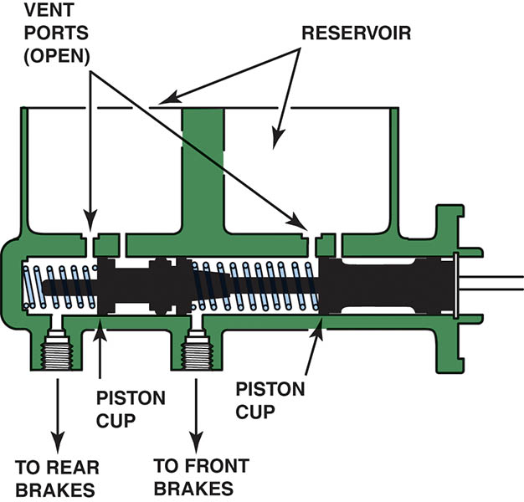
Figure 98.16 The vent ports must remain open to allow brake fluid to expand when heated by the friction material and transferred to the caliper and/or wheel cylinder. As the brake fluid increases in temperature, it expands. The heated brake fluid can expand and flow back into the reservoir through the vent ports.

Slide 32
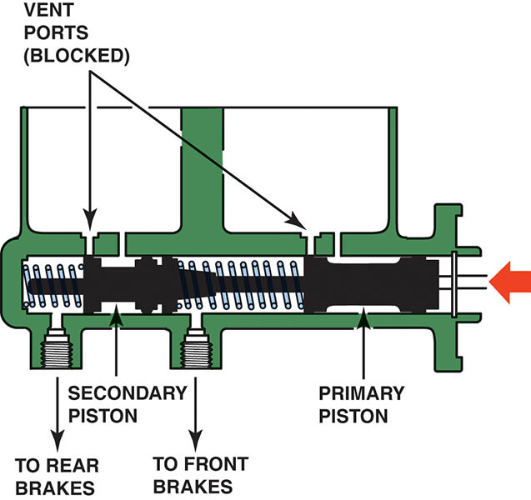
Figure 98.17 As the brake pedal is depressed, the pushrod moves the primary piston forward, closing off the vent port. As soon as the port is blocked, pressure builds in front of the primary sealing cup, which pushes on the secondary piston. The secondary piston moves forward, blocking the secondary vent port and building pressure in front of the sealing cup.

Slide 33
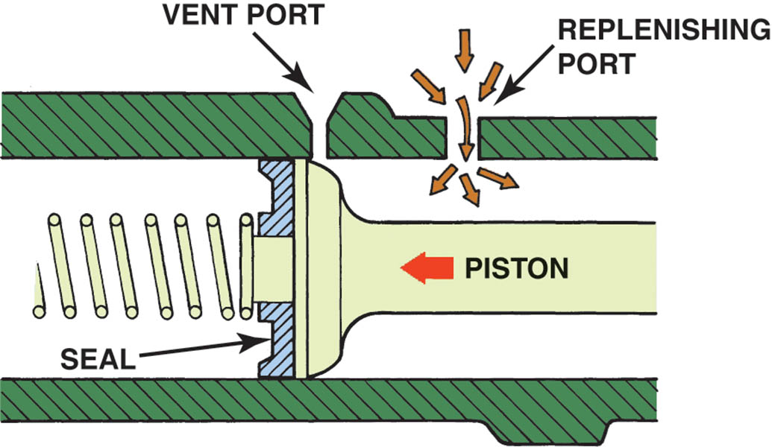
Figure 98.18 The purpose of the replenishing port is to keep the volume behind the primary piston filled with brake fluid from the reservoir as the piston moves forward during a brake application.

Slide 34
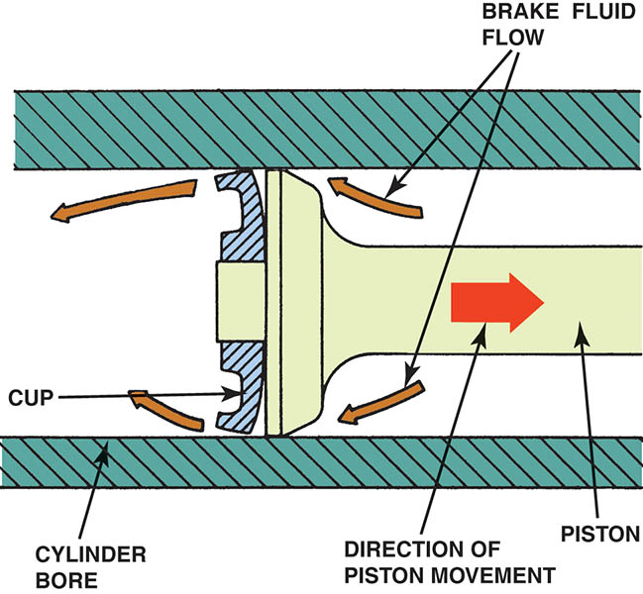
Figure 98.19 When the brake pedal is released, the master cylinder piston moves rearward. Some of the brake fluid is pushed back up through the replenishing port, but most of the fluid flows past the sealing cup. Therefore, when the driver pumps the brake pedal, the additional fluid in front of the pressure-building sealing cup is available quickly.

Slide 35
MASTER CYLINDERS (5 OF 7)
Front/Rear Split Master Cylinders
  Front/rear split master cylinders use two separate pressure-building sections.
  The nose end of the master cylinder is the closed end toward the front of the vehicle.
  In the event of a hydraulic failure in either section, the mechanical operation of the piston will create the needed pressure in the section without the failure.

Slide 36
MASTER CYLINDERS (6 OF 7)
Diagonal Split Master Cylinders
  With front-wheel drive vehicles, the weight of the entire power train is on the front wheels and 80% to 90% of the braking force is achieved by the front brakes.
  If the front brakes fail, the rear brakes alone can not provide adequate braking force.
  The solution is the use of a diagonal split master cylinder.

Slide 37
MASTER CYLINDERS (7 OF 7)
Quick Take-up Master Cylinders
  Some vehicles use low-drag disc brake calipers to increase fuel economy.
  Excessive brake pedal travel is required before the pads touched the rotor.
  The design of a quick take-up master cylinder includes a larger diameter primary piston (low-pressure chamber) and a quick take-up valve.
  The extra volume of brake fluid “takes up” the extra clearance of the front disc brake calipers without increasing the brake pedal travel distance.

Slide 38
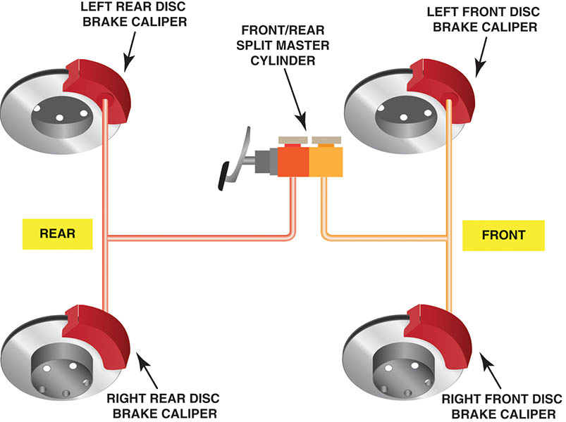
Figure 98.20 Rear-wheel-drive vehicles use a dual split master cylinder

Slide 39
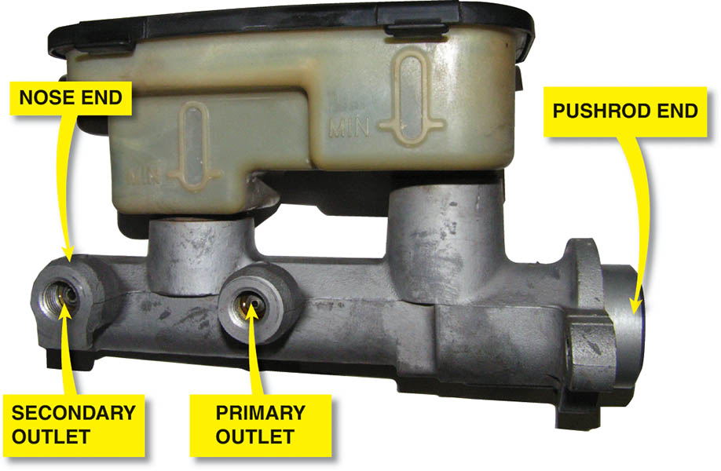
Figure 98.21 The primary outlet is closest to the pushrod end of the master cylinder and the secondary outlet is closest to the nose end of the master cylinder.

Slide 40
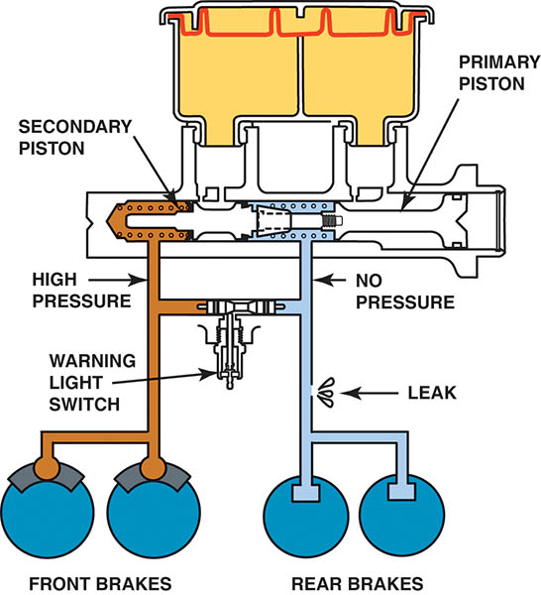
Figure 98.22 In the event of a primary system failure, no hydraulic pressure is available to push the second piston forward. As a result, the primary piston extension contacts the secondary piston and pushes on the secondary piston mechanically, rather than hydraulically.

Slide 41
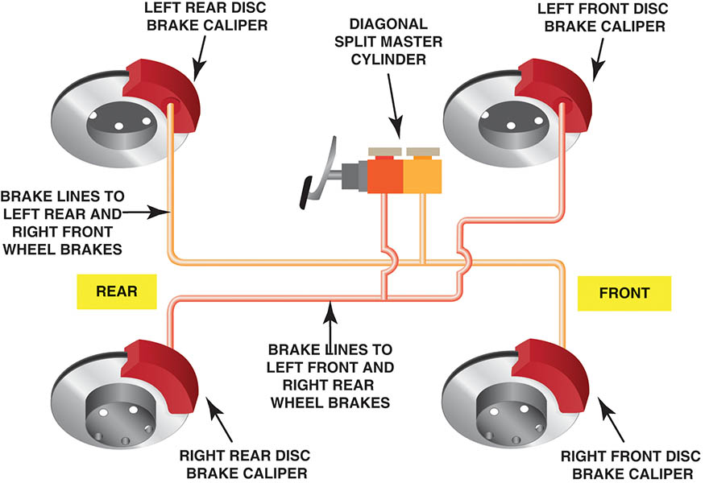
Figure 98.23 Front-wheel-drive vehicles use a diagonal split master cylinder. In this design, one section of the master cylinder operates the right front and the left rear brake and the other section operates the left front and right rear.

Slide 42
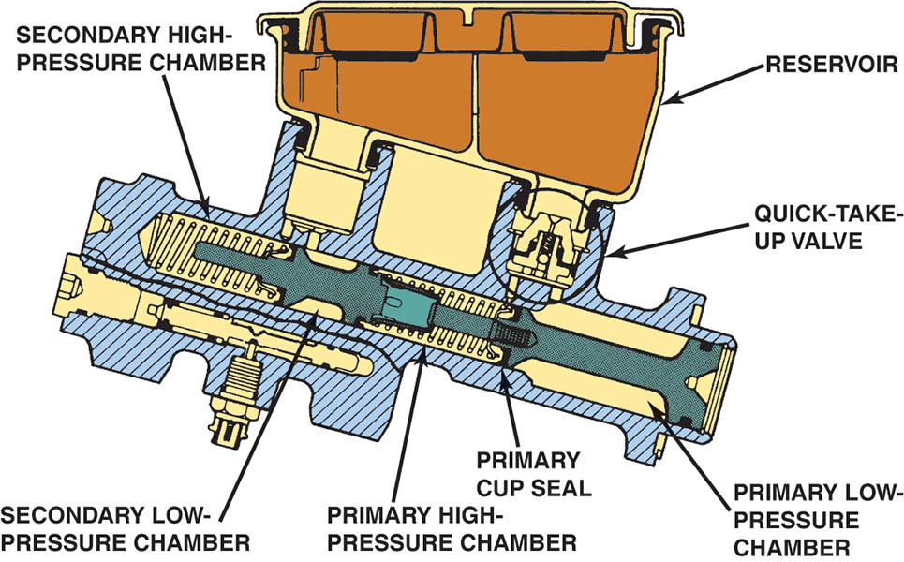
Figure 98.24 Quick take-up master cylinder can be identified by the oversize primary low-pressure chamber.

Slide 43
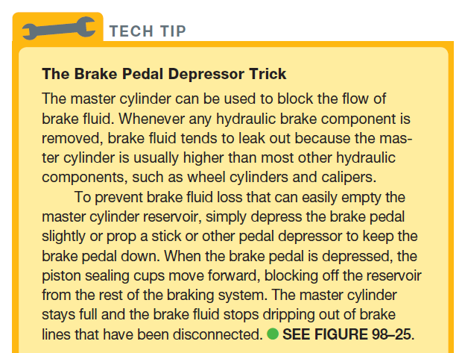
TECH TIP

Slide 44
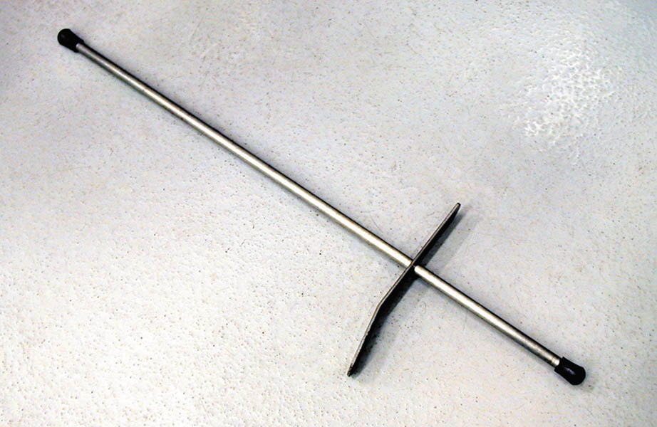
Figure 98.25 A brake pedal depressor like this can be used during brake service to block the flow of brake fluid from the master cylinder during service work on the hydraulic system

Slide 45
QUESTION 2: ?
What is the purpose of a diagonal split hydraulic system?

Slide 46
ANSWER 2:
To provide enough hydraulic pressure to stop the vehicle if there is a failure in the system.

Slide 47
DIAGNOSING MASTER CYLINDERS (1 OF 4)
Visual Inspection
  Check the brake fluid for proper level and condition.
  Check that the vent holes in the reservoir cover are open and clean.
  Check that the reservoir cover diaphragm is not torn or enlarged.
  Check for any external leaks at the lines or at the pushrod area.

Slide 48
DIAGNOSING MASTER CYLINDERS (2 OF 4)
Brake Pedal Height
  Proper brake pedal height is important for the proper operation of the stop (brake) light switch.
  If the pedal is not correct, master cylinder operation may be affected.
Brake Pedal Free Play
  Most vehicles require brake pedal free play between 1/8 and 1 1/2 inch (3 to 38 mm).

Slide 49
DIAGNOSING MASTER CYLINDERS (3 OF 4)
Brake Pedal Travel
  Measure and record the distance from the brake pedal to the lower rim of the steering wheel.
  While holding the pedal with 100 pounds of force, measure and record the distance from the pedal to the lower rim of the steering wheel.
  Subtract the applied measurement from the unapplied measurement to get the total travel.
  Compare the pedal travel with the specification found in service information.

Slide 50
DIAGNOSING MASTER CYLINDERS (4 OF 4)
Master Cylinder Symptoms
  Spongy brake pedal
  Lower then normal brake pedal
  Sinking brake pedal

Slide 51
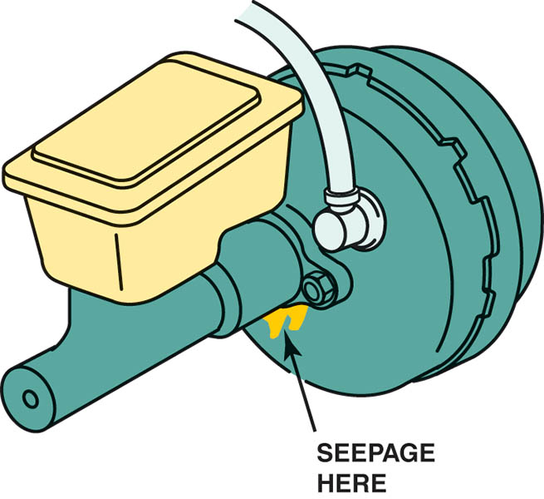
Figure 98.26 Seepage at the booster indicates a leaking secondary (end) seal

Slide 52
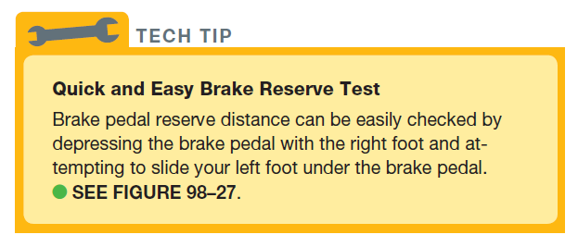
TECH TIP

Slide 53
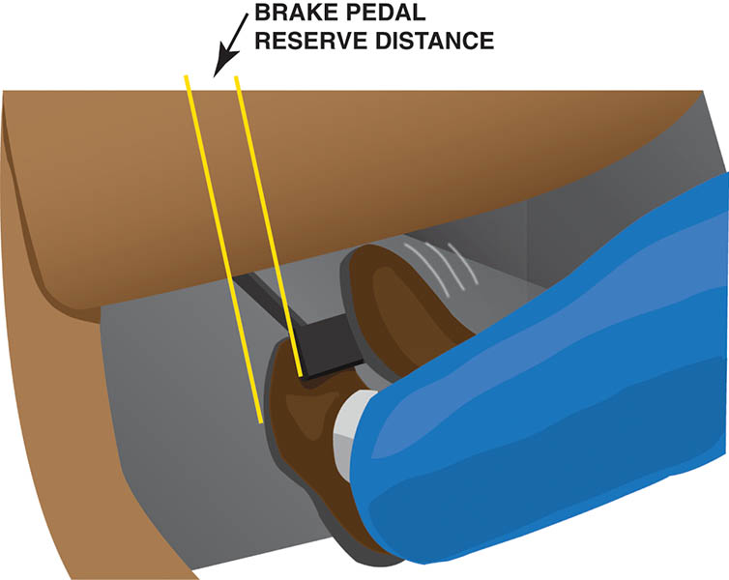
Figure 98.27 Pedal height is usually measured from the floor to the top of the brake pedal. Always follow the manufacturer’s recommended procedures and measurements

Slide 54
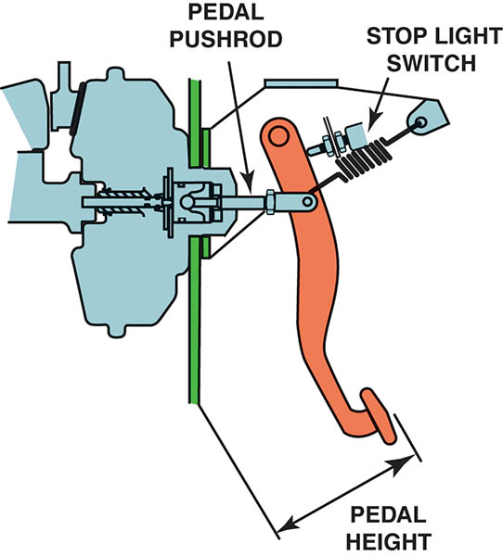
Figure 98.28 Pedal height is usually measured from the floor to the top of the brake pedal. Always follow the manufacturer’s recommended procedures and measurements

Slide 55
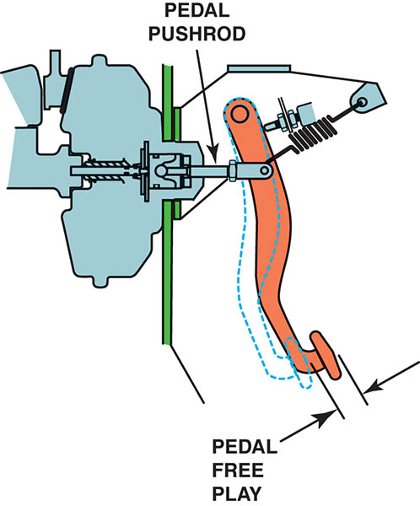
Figure 98.29 Brake pedal free play is the distance between the brake pedal fully released and the position of the brake pedal when braking resistance is felt

Slide 56
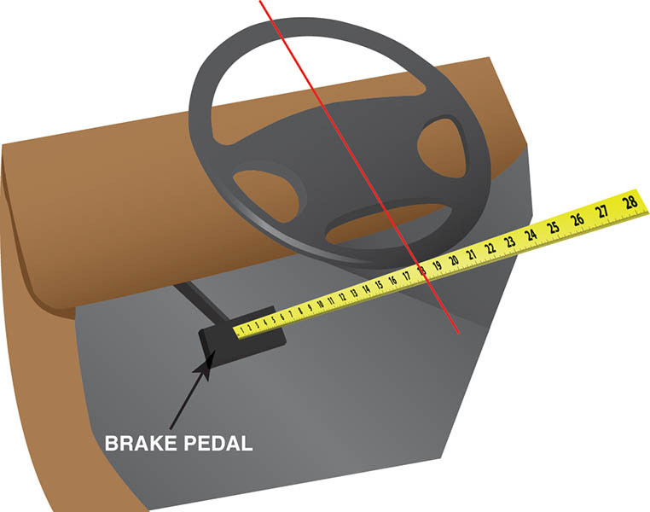
Figure 98.30 Measure the unapplied distance between the brake pedal and the steering wheel

Slide 57
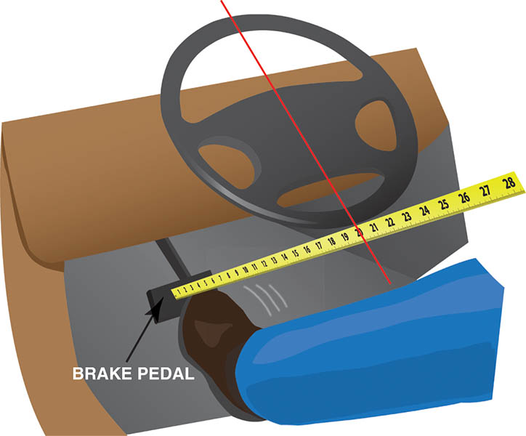
Figure 98.31 Apply the brakes and measure the distance again

Slide 58
QUESTION 3: ?
What are the most common master cylinder fault symptoms?

Slide 59
ANSWER 3:
  Spongy brake pedal, lower then normal brake pedal, sinking brake pedal.

Slide 60
MASTER CYLINDER SERVICE (1 OF 2)
Purpose for Service
  Many master cylinders can be disassembled, cleaned, and restored to service.
Disassembly Procedure
  Remove the mater cylinder from the vehicle and remove the reservoir.
  Remove the retaining bolt holding the secondary piston.
  Remove the snap ring at the push-rod end and remove primary and secondary pistons.

Slide 61
MASTER CYLINDER SERVICE (2 OF 2)
Inspection of the Master Cylinder
  Inspect the master cylinder bore for pitting, corrosion, or wear.
Reassembly of the Master Cylinder
  Install the secondary piston and then the primary piston.
  Install the snap ring and then the secondary piston retaining bolt.
  Install the reservoir and bench bleed the system.
  Reinstall on the vehicle according to specifications.

Slide 62
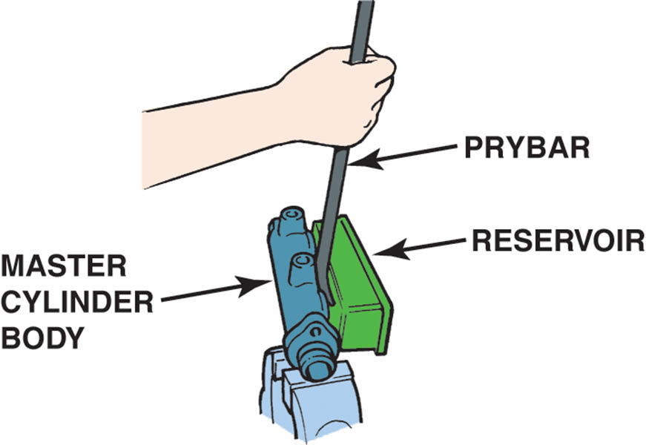
Figure 98.32 Use a pry bar to carefully remove the reservoir from the master cylinder

Slide 63
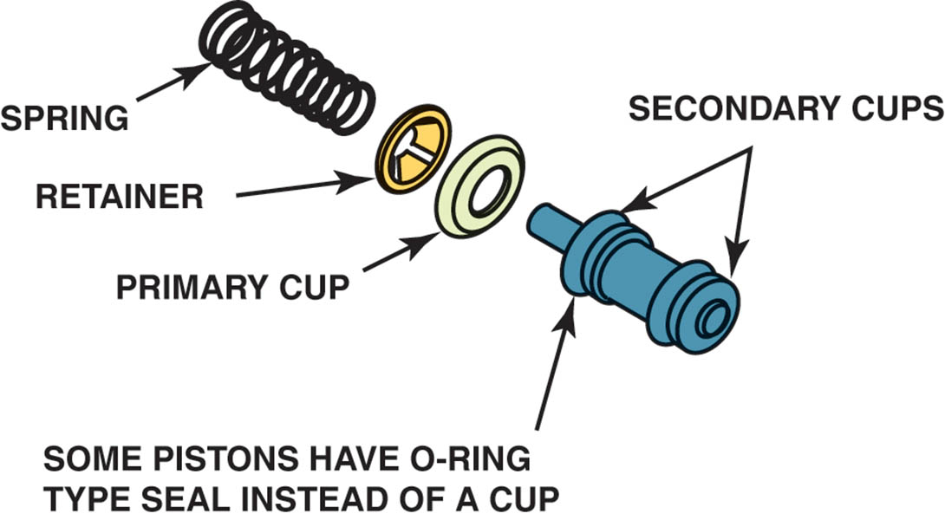
Figure 98.33 Piston assembly

Slide 64
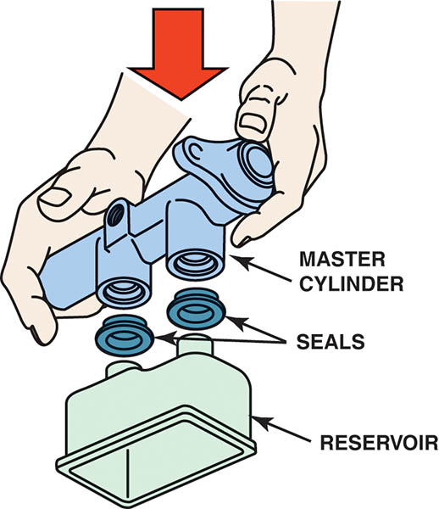
Figure 98.34 To reinstall the reservoir onto a master cylinder, place the reservoir on a clean flat surface and push the housing down onto the reservoir, after coating the rubber seals with brake fluid

Slide 65
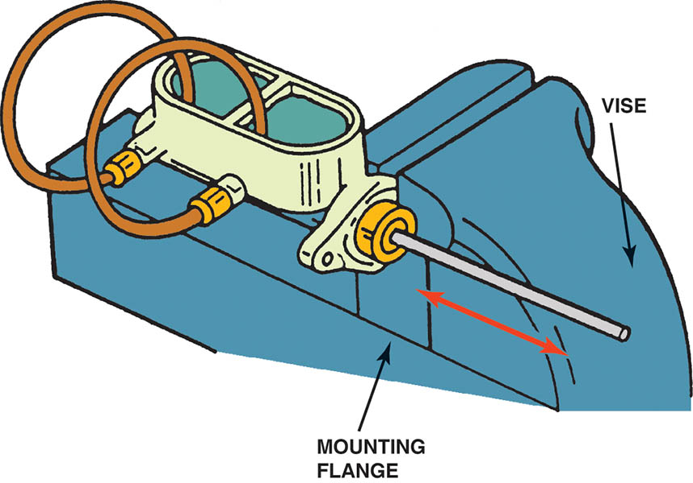
Figure 98.35 Bleeding a master cylinder before installing it on the vehicle. The master cylinder is clamped into a bench vise while using a rounded end of a dowel rod to push on the pushrod end with bleeder tubes down into the brake fluid. Master cylinders should be clamped on the mounting flange, as shown, to prevent distorting the master cylinder bore

Slide 66
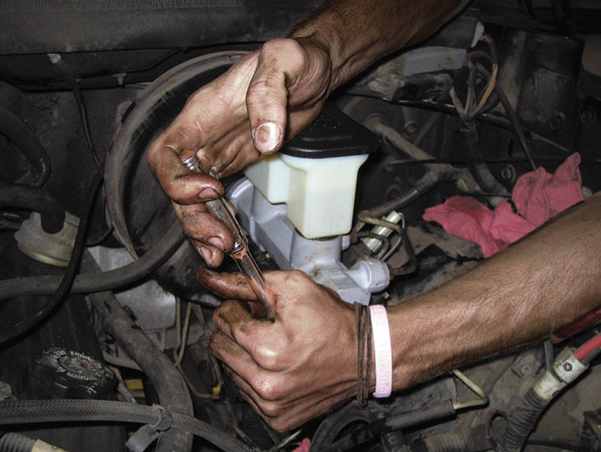
Figure 98.36 Installing a master cylinder. Always tighten the retaining fasteners and brake lines to factory specifications

Slide 67

Copyright

