Slide 1
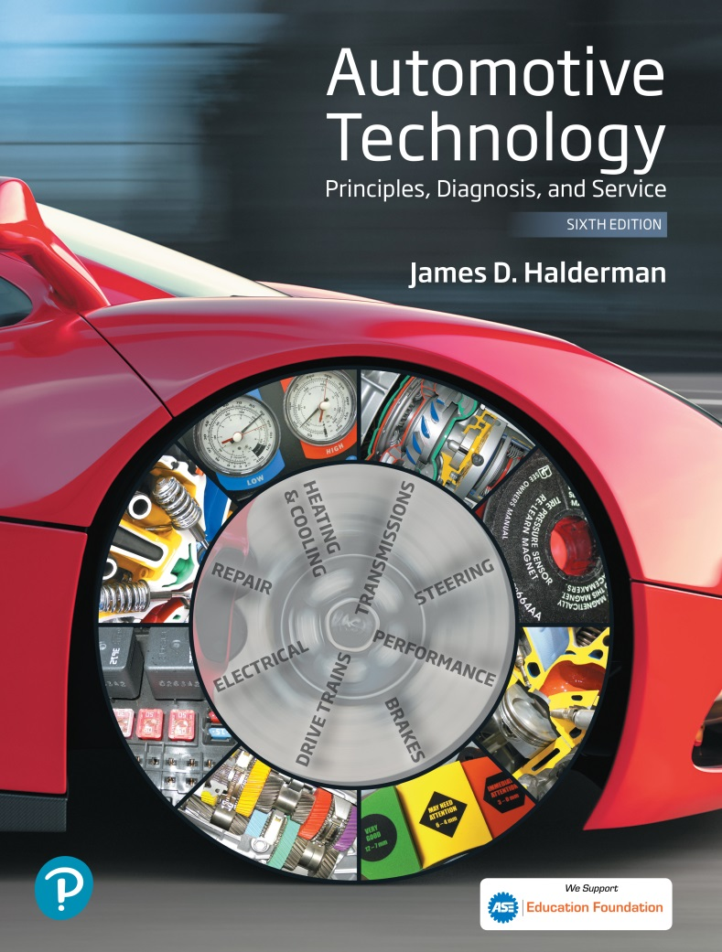
Automotive Technology Principles, Diagnosis, and Service
Sixth Edition
Chapter 97
Brake Principles and Friction Materials
Copyright © 2018, 2015, 2011 Pearson Education, Inc. All Rights Reserved

Slide 2
LEARNING OBJECTIVES
97.1 Discuss the energy principles that apply to brakes.
97.2 Discuss the friction principles that apply to brakes.
97.3 Describe how brakes can fade due to excessive heat.
97.4 Describe how deceleration rates are measured.
97.5 Discuss friction materials used in brake systems.

Slide 3
ENERGY AND WORK
Energy
Energy is the ability to do work.
Work
Work is the transfer of energy from one physical system to another.
Kinetic Energy
Is the energy of mass in motion.

Slide 4
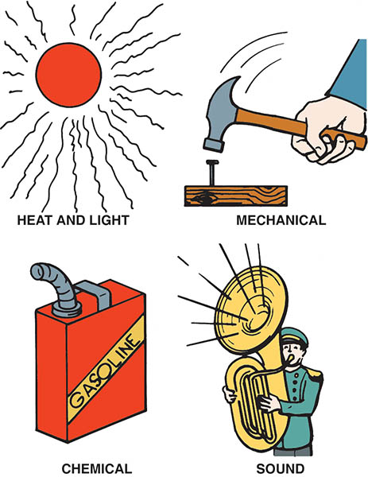
Figure 97.1 Energy, which is the ability to perform work, exists in many forms

Slide 5
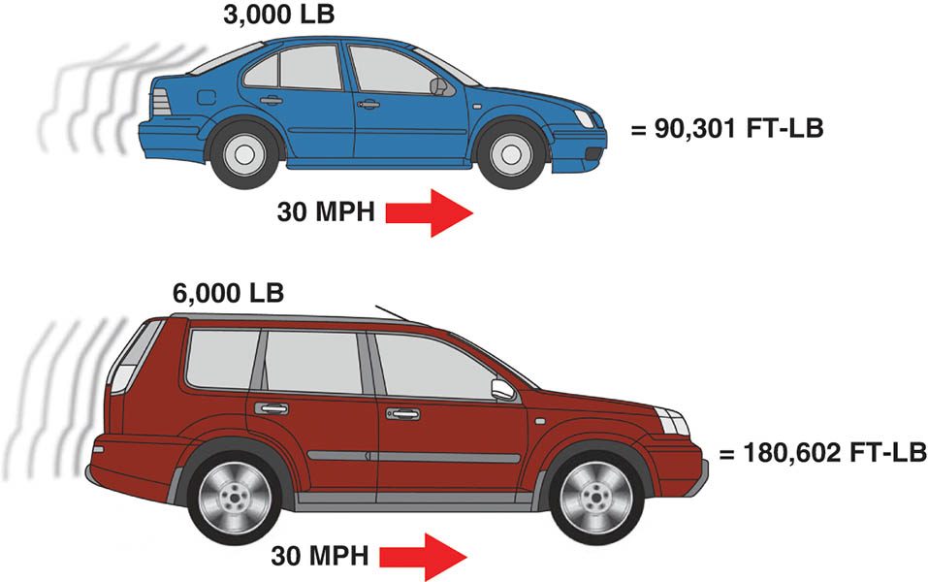
Figure 97.2 Kinetic energy increases in direct proportion to the weight of the vehicle

Slide 6
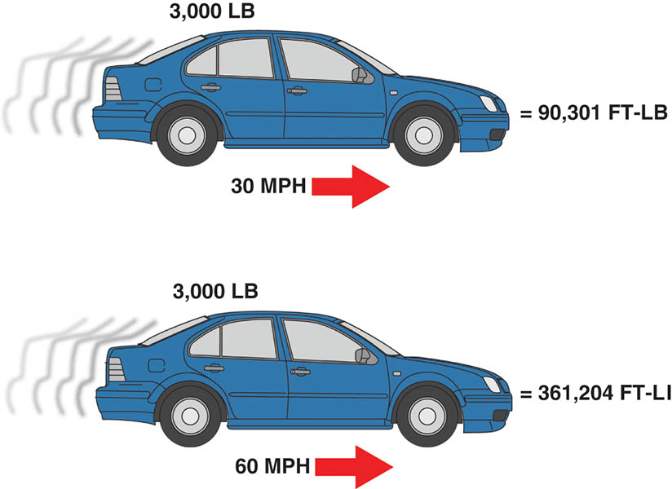
Figure 97.3 Kinetic energy increases as the square of any increase in vehicle speed

Slide 7
QUESTION 1: ?
What is kinetic energy?

Slide 8
ANSWER 1:
The energy of a mass in motion.

Slide 9
INERTIA (1 OF 2)
Definition
Inertia is a body at rest tends to remain at rest, and a body in motion tends to remain in motion in a straight line unless acted upon by an outside force.
Weight Transfer
When the brakes are applied at the wheel friction assemblies, only the wheels and tires begin to slow immediately.
The rest of the vehicle, all of the weight carried by the suspension, attempts to remain in forward motion.

Slide 10
INERTIA (2 OF 2)
Weight Bias
The total weight of the vehicle does not change during a brake application, only the amount supported by each axle.
Front-wheel-drive (FWD) vehicles, in particular, have a forward weight bias.
To deal with the extra load, the front brakes are much more powerful than the rear brakes.

Slide 11
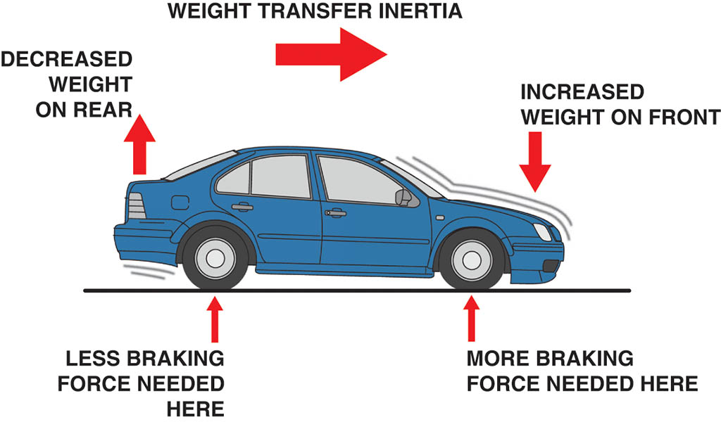
Figure 97.4 Inertia creates weight transfer that requires the front brakes to provide most of the braking force

Slide 12
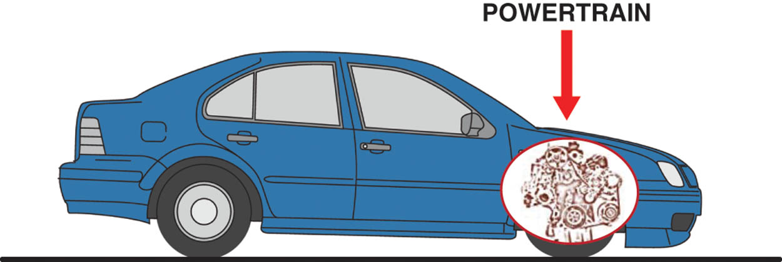
Figure 97.5 Front-wheel-drive vehicles have most of their weight over the front wheels

Slide 13
COEFFICIENT OF FRICTION
Definition
The amount of friction between two objects or surfaces is commonly expressed as a value called the coefficient of friction.
Static and Kinetic Friction
The static value is the coefficient of friction with the two friction surfaces at rest.
The kinetic value is the coefficient of friction while the two surfaces are sliding against one another.

Slide 14
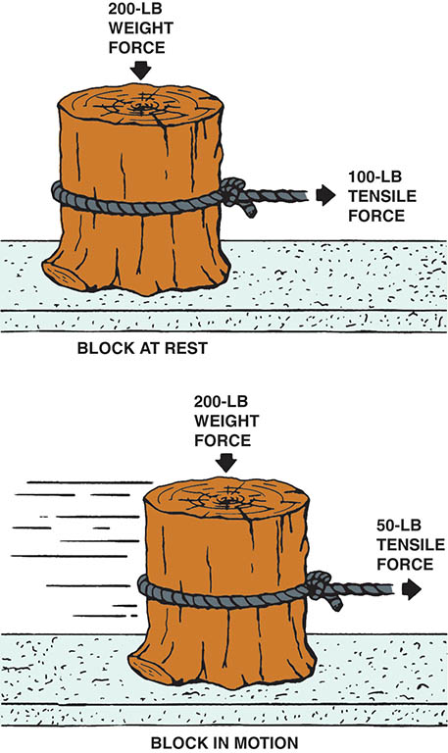
Figure 97.6 The static coefficient of friction of an object at rest is higher than the kinetic (dynamic) friction coefficient once in motion

Slide 15
QUESTION 2: ?
What is coefficient of friction?

Slide 16
ANSWER 2:
The amount of friction between two surfaces.

Slide 17
BRAKE FADE (1 OF 2)
Definition
If repeated hard stops are performed, the brake system components can overheat and lose effectiveness, or possibly fail altogether.
Mechanical Fade
Mechanical fade occurs when a brake drum overheats and expands away from the brake lining.
Lining Fade
The friction material overheats to the point where its coefficient of friction drops off.

Slide 18
BRAKE FADE (2 OF 2)
Gas Fade
Under very hard braking when a thin layer of hot gases and dust particles builds up between the brake drum or rotor and linings.
Water Fade
Occurs when water gets between the brake drum and the linings.

Slide 19
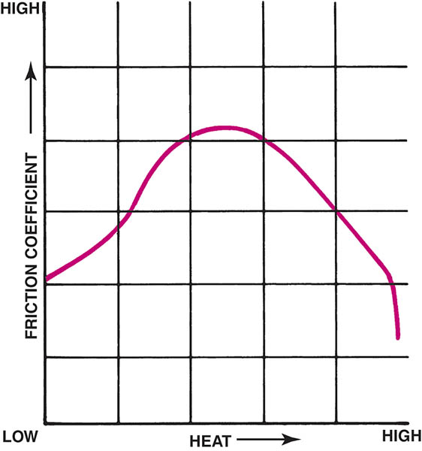
Figure 97.7 Some heat increases the coefficient of friction, but too much heat can cause it to drop off sharply

Slide 20
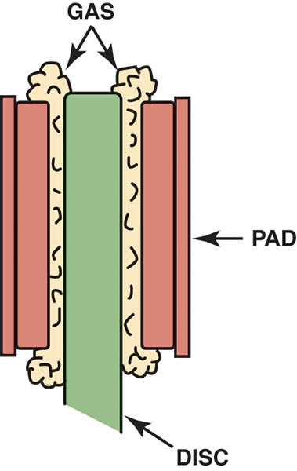
Figure 97.8 One cause of brake fade occurs when the phenolic resin, a part of the friction material, gets so hot that it vaporizes. The vaporized gas from the disc brake pads gets between the rotor (disc) and the friction pad. Because the friction pad is no longer in contact with the rotor, no additional braking force is possible

Slide 21
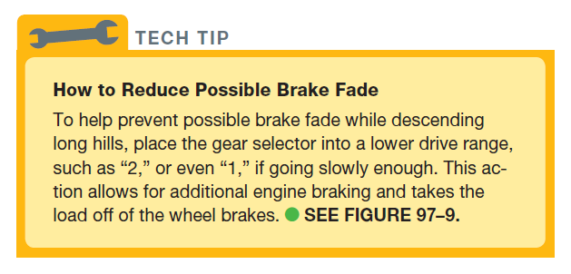
Tech Tip

Slide 22
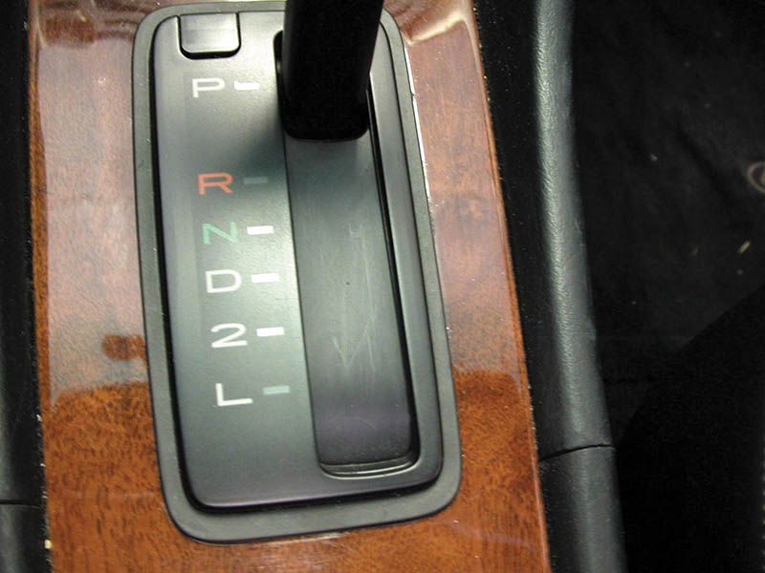
Figure 97.9 The gear selector is often called the “PRNDL,” pronounced “prindle,” regardless of the actual letters or numbers used

Slide 23
DECELERATION RATES
Terminology
Deceleration rates are measured in units of “feet per second per second”.
Typical Deceleration Rates
Comfortable deceleration is about 8.5 ft/sec2 (3 m/sec2).
Loose items in the vehicle “fly” above 11 ft/sec2 (3.5 m/sec2).
Brake temperature
1,300°F (700°C) or higher during normal driving

Slide 24
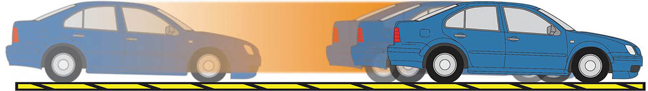
Figure 97.10 Rapid braking causes the brake friction material to wear more compared to gentle, less aggressive, braking

Slide 25
BRAKE FRICTION MATERIALS
Brake friction materials are composed of relatively soft, but tough, and heat-resistant material to provide the friction between the moveable part of the braking system (drum or rotor) and the stationary part of the braking system.

Slide 26
ASBESTOS (1 OF 2)
Definition
Asbestos is the term used to describe naturally occurring silicate minerals that consist of long fibers.
Asbestos Hazards
Asbestos exposure can cause scar tissue to form in the lungs. This condition is called asbestosis.

Slide 27
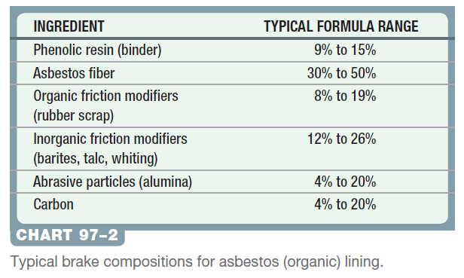
ASBESTOS (2 OF 2)
The use of asbestos for brake linings was never abandoned completely.

Slide 28
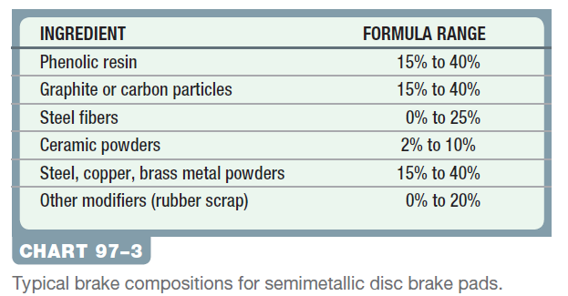
SEMI-METALIC FRICTION MATERIALS
Definition
The term semi-metallic refers to brake lining material that uses metal, rather than asbestos, in its formulation.

Slide 29
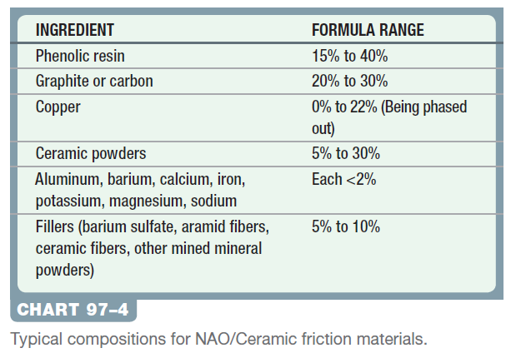
NON-ASBESTOS/CERAMIC FRICTION MATERIALS
Terminology
Brake pads and linings that use synthetic material, such as aramid fibers, instead of steel.

Slide 30
CARBON FIBER FRICTION MATERIALS
Terminology
Carbon fiber material is often called CFRC (carbon fiber-reinforced carbon). It is composed of a carbon mix into which reinforcing carbon fibers are embedded.
CFRC brakes provide constant friction coefficient whether cold or hot, low wear rates, and low noise development.

Slide 31
BRAKE PADS AND ENVIRONMENTAL CONCERNS
Copper is used in brake pads for heat transfer, strength, and to reduce fade.
Copper is considered a pollutant.
Legislation to reduce/eliminate copper in various states.
Washington State legislation mandates that all brake pads and shoes manufactured after January 1, 2015, are required to have a leaf mark icon indicating the level of compliance with state friction material content legislation.

Slide 32
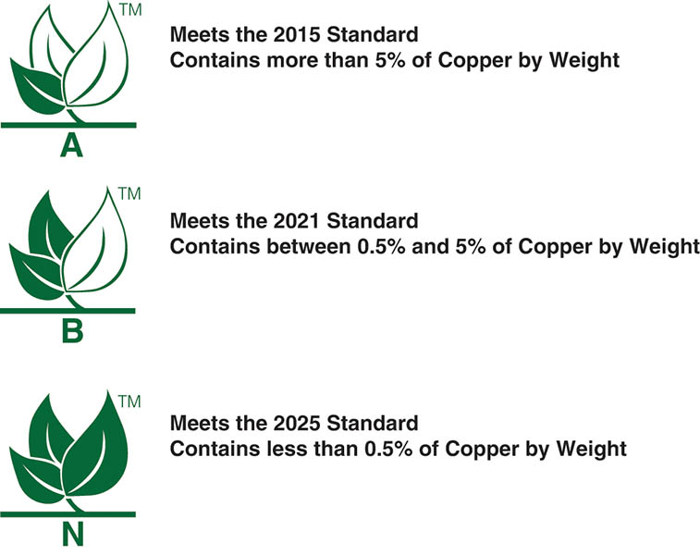
Figure 97.11 All boxes of brake linings and pads should be labeled with the leaf mark, which gives a visual clue as to the standard under which the brake friction materials meet certain state laws regarding the amount of copper

Slide 33
QUESTION 3: ?
Why is copper being removed from brake pads?

Slide 34
ANSWER 3:
It is considered a pollutant.

Slide 35
EDGE CODES (1 OF 2)
Purpose
Starting in 1964, brake linings have been using a standardized way to identify the brake lining materials.
Edge Code Information
Company code
Pad number
Formulation code
Vendor number
Friction code
Week number that the brakes were made
Environmental code (A, B, or N)
Year of manufacture

Slide 36
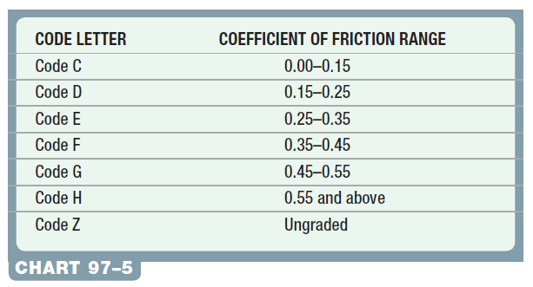
EDGE CODES (2 OF 2)
Coefficient of Friction Edge Code

Slide 37
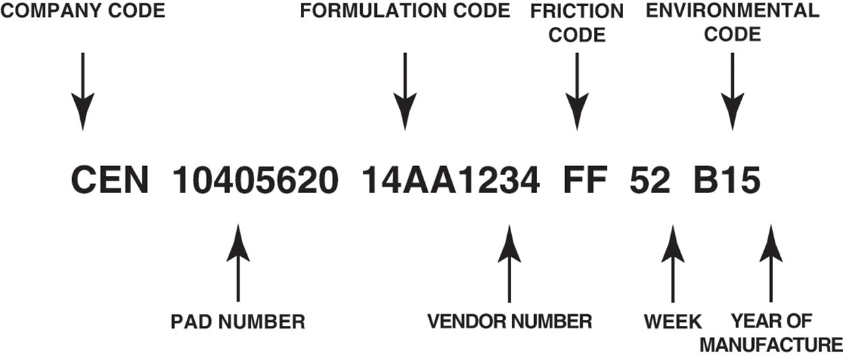
Figure 97.12 The edge codes include a lot of information about the brake friction material

Slide 38
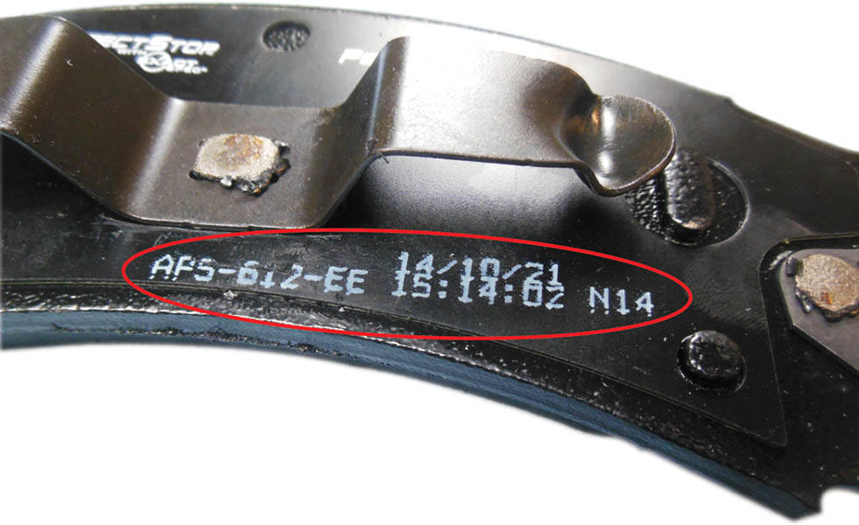
Figure 97.13 The “edge codes” are now printed on the backing of the brake pad because there is so much required information that it often does not fit on the edge of the brake pad or shoe

Slide 39
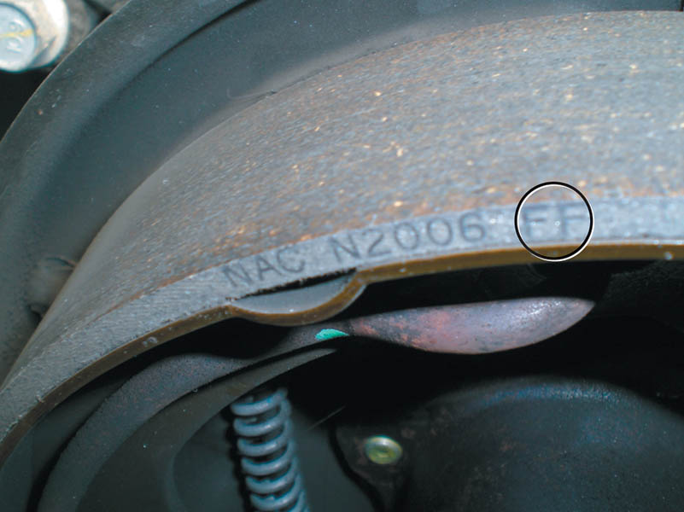
Figure 97.14 Typical drum brake lining edge codes, showing the coefficient of friction codes for cold and hot circled

Slide 40

Copyright

