Slide 1
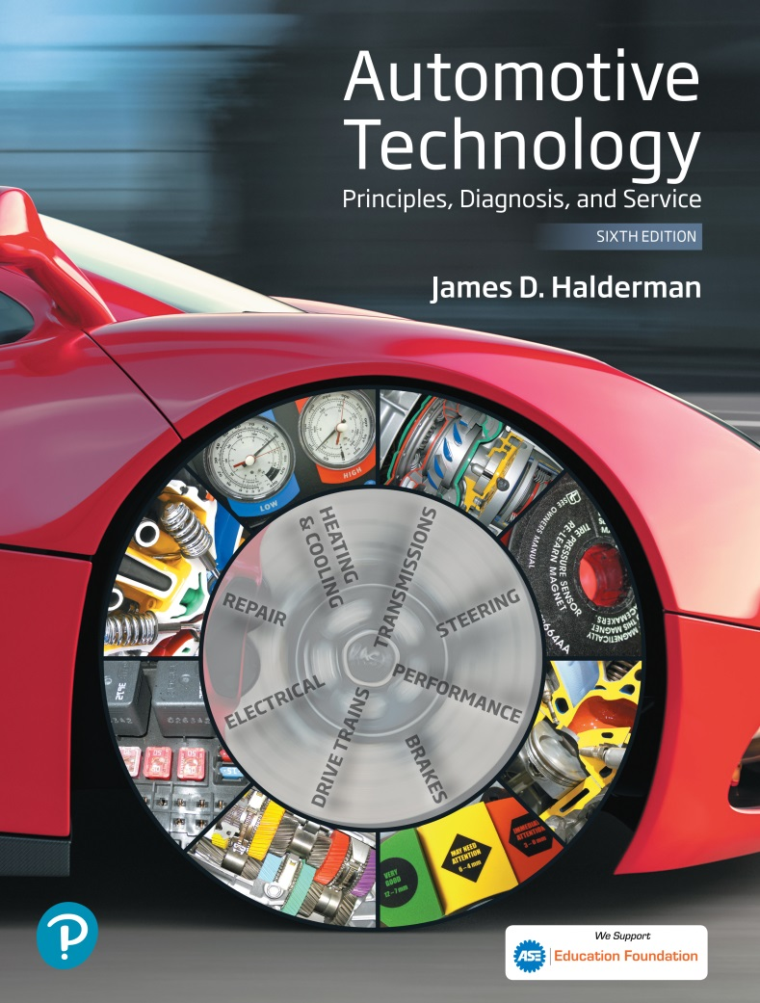
Automotive Technology Principles, Diagnosis, and Service
Sixth Edition
Chapter 96
Brake System Components and Performance Standards
Copyright © 2018, 2015, 2011 Pearson Education, Inc. All Rights Reserved

Slide 2
LEARNING OBJECTIVES (1 of 2)
96.1 Describe the fundamentals of brake systems.
96.2 Describe brake design requirements.
96.3 List the six brake system categories.

Slide 3
LEARNING OBJECTIVES (2 of 2)
96.4 State the purpose of an antilock brake system.
94.5 Discuss federal brake standards and legal aspects of brake repair.
94.6 This chapter will help prepare for the Brakes (A5) ASE certification test.

Slide 4
FUNDAMENTALS OF BRAKE SYSTEMS
Brakes are an energy-absorbing mechanism that converts vehicle movement into heat while stopping the rotation of the wheels.
Hydraulic pressure to each wheel cylinder or caliper is used to force friction materials against the brake drum or rotor.
The friction between the stationary friction material and the rotating drum or rotor (disc) causes the rotating part to slow and eventually stop.

Slide 5
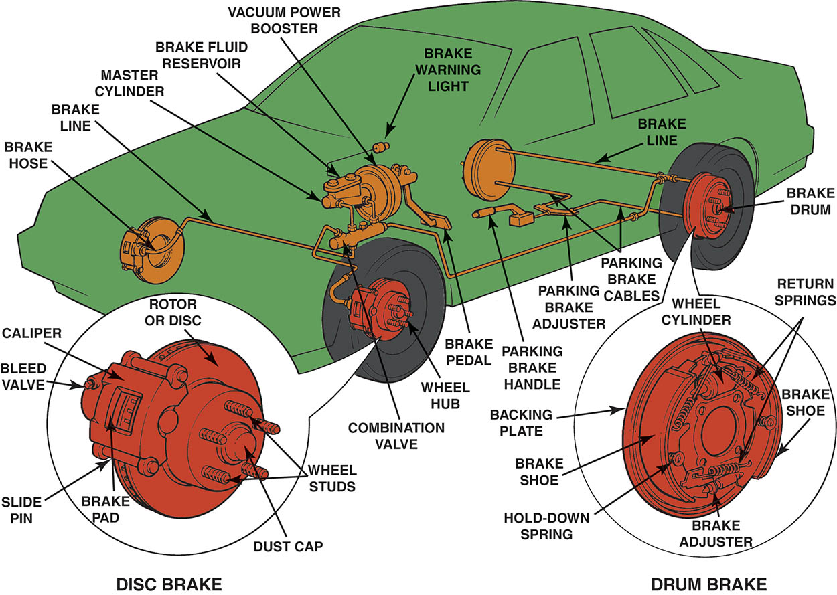
Figure 96.1 Typical vehicle brake system showing all typical components

Slide 6
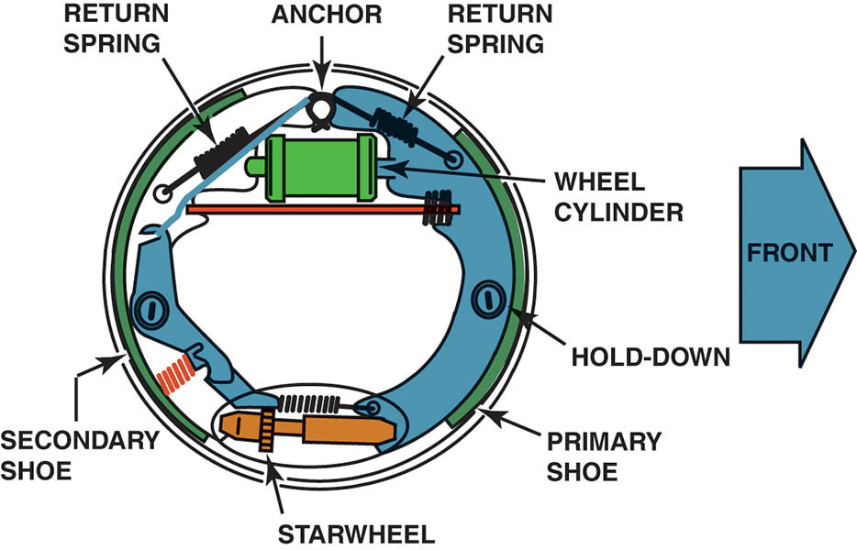
Figure 96.2 Typical drum brake assembly

Slide 7
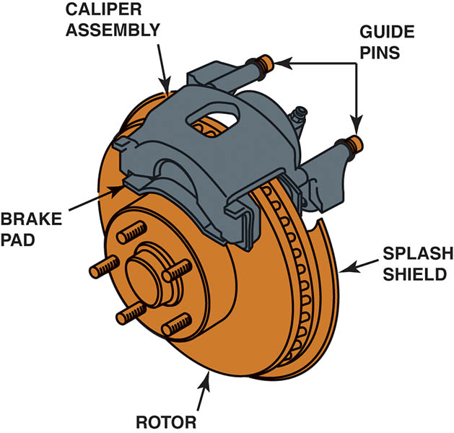
Figure 96.3 Typical disc brake assembly

Slide 8
BRAKE DESIGN REQUIREMENTS (1 OF 2)
All braking forces must provide for the following:
  Equal forces must be applied to both the left and right sides of the vehicle to assure straight stops.
  Hydraulic systems must be properly engineered and serviced to provide for changes as vehicle weight shifts forward during braking.
  The hydraulic system must use a fluid that does not evaporate or freeze.
  The friction material (brake lining or brake pads) must be designed to provide adequate friction between the stationary axles and the rotating drum or rotor.

Slide 9
BRAKE DESIGN REQUIREMENTS (2 OF 2)
All braking forces must provide for the following:
  The design of the braking system should secure the brake lining solidly to prevent the movement of the friction material during braking.
  Most braking systems incorporate a power assist unit that reduces the driver’s effort, but does not reduce stopping distance.

Slide 10
BRAKE SYSTEM CATEGORIES
Brake system components can be classified and placed into six subsystem categories, depending on their function.
  Apply system
  Boost System
  Hydraulic System
  Wheel Brakes
  Brake Balance Control Systems
  Brake Warning Lights

Slide 11
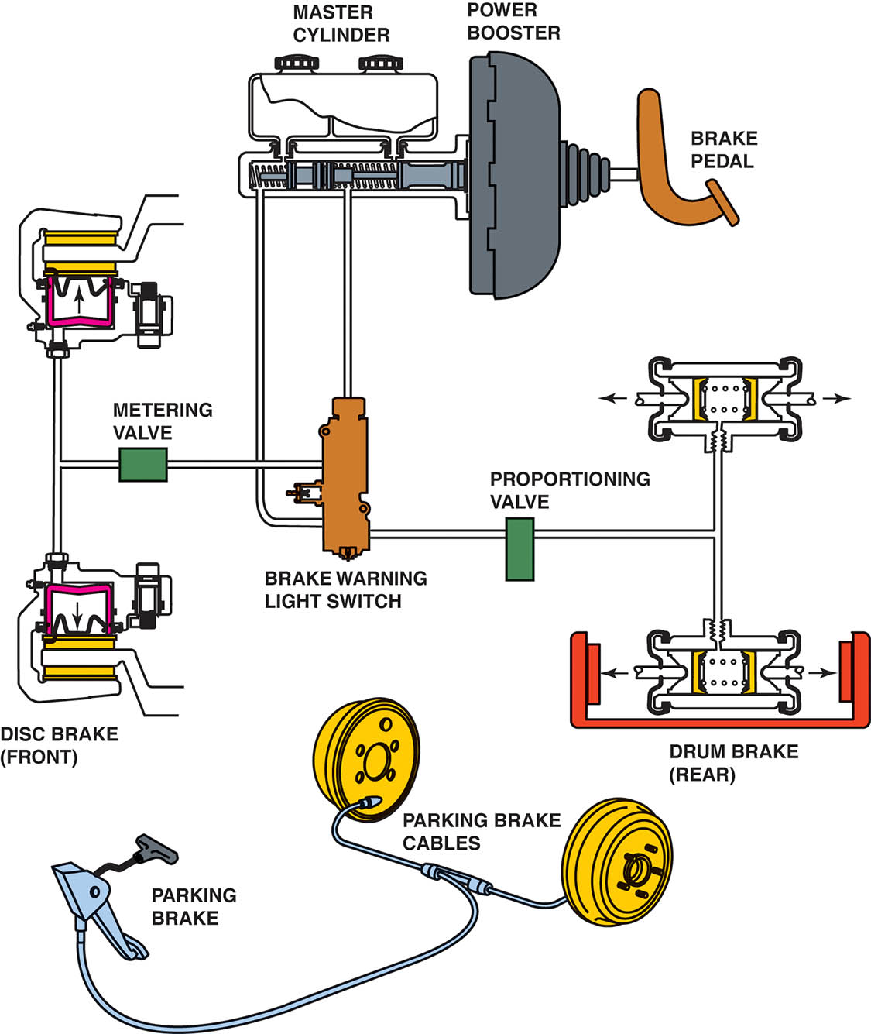
Figure 96.4 Typical brake system components

Slide 12
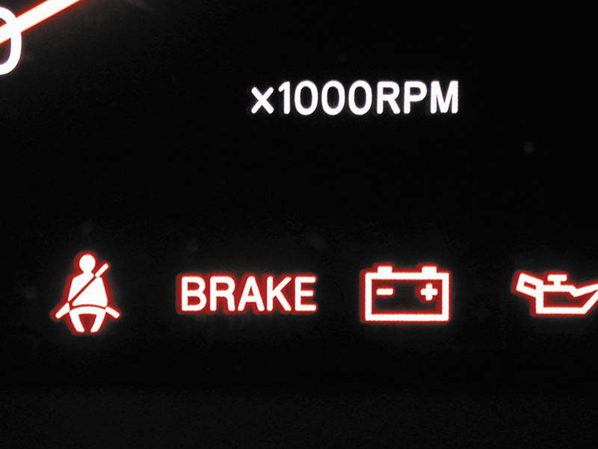
Figure 96.5 The red brake warning light remains on after a bulb test if there is a fault with the hydraulic part of the brake system or low brake fluid level has been detected

Slide 13

Figure 96.6 The ABS warning light is amber

Slide 14
QUESTION 1: ?
What are the six brake subsystem categories?

Slide 15
ANSWER 1:
  Apply system
  Boost System
  Hydraulic System
  Wheel Brakes
  Brake Balance Control Systems
  Brake Warning Lights

Slide 16
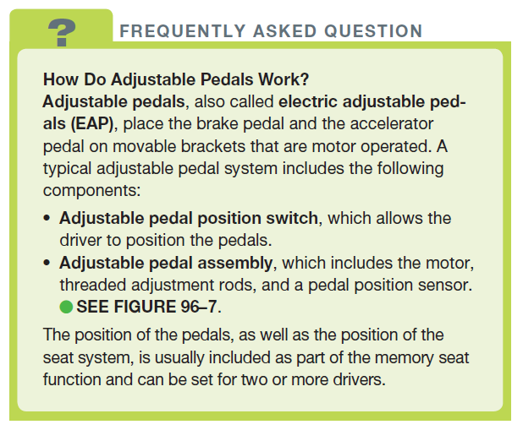
FREQUENTLY ASKED QUESTION

Slide 17
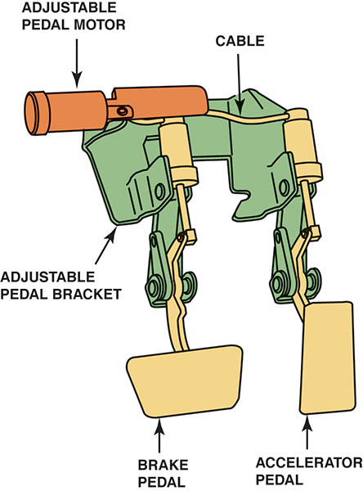
Figure 96.7 A typical adjustable pedal assembly. Both the accelerator and the brake pedal can be moved forward and rearward by using the adjustable pedal position switch

Slide 18
ANTILOCK BRAKE SYSTEM OVERVIEW
The purpose of an antilock brake system (ABS) is to prevent the wheels from locking during braking, especially on low-friction surfaces, such as wet, icy, or snowy roads.
ABS uses sensors at the wheels to measure the wheel speed.
The purpose of the ABS is to pulse the brakes on and off to maintain directional stability with maximum braking force.

Slide 19
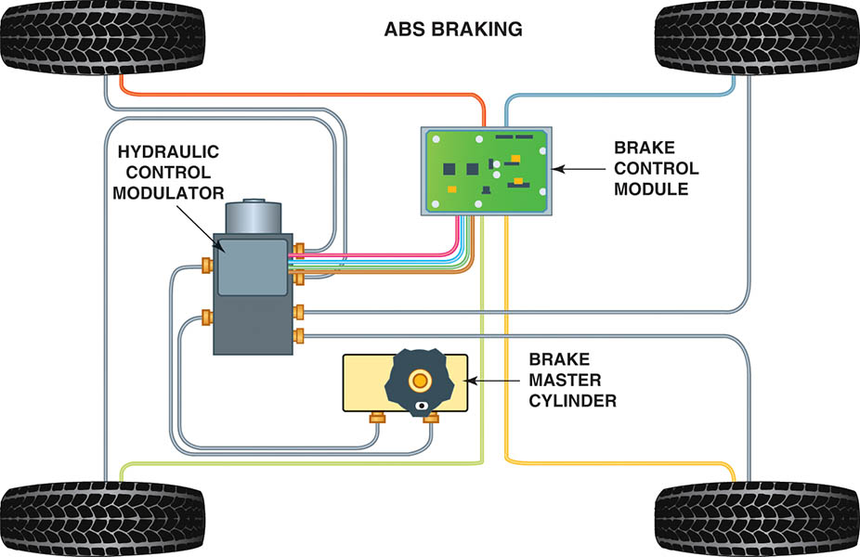
Figure 96.8 Typical components of an antilock brake system (ABS) used on a rear wheel- drive vehicle

Slide 20
FEDERAL BRAKE STANDARDS
The statutes pertaining to automotive brake systems are part of the Federal Motor Vehicle Safety Standards (FMVSS) established by the United States Department of Transportation (DOT).
FMVSS 135 Brake Test
  The overall FMVSS 135 brake test procedure consists of up to 24 steps, depending on the vehicle’s configuration and braking system.
  The test is a minimum standard of performance.

Slide 21
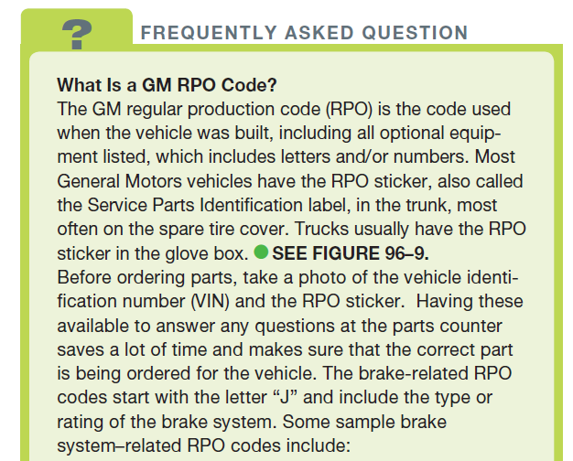
FREQUENTLY ASKED QUESTION

Slide 22
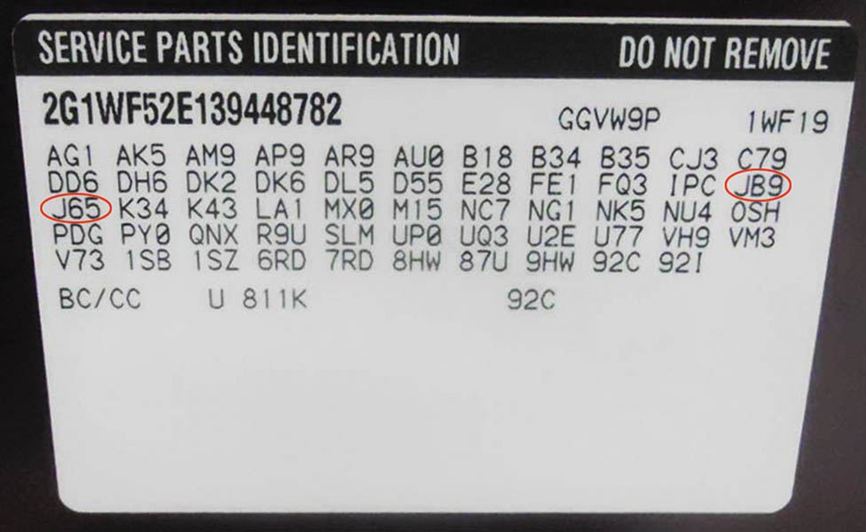
Figure 96.9 A typical Service Parts Identification (RPO) sticker is located on the inside of the trunk lid of a GM vehicle

Slide 23
BRAKE REPAIR AND THE LAW
The responsibility for maintaining the designed-in level of braking performance falls on the owner of the vehicle.
A technician is always liable for damage or injuries resulting from repairs performed in an unprofessional or un-workman-like manner.
The purpose of any repair is to restore like-new performance.

Slide 24
QUESTION 2: ?
What is the purpose of a brake repair?

Slide 25
ANSWER 2:
To restore like-new performance.

Slide 26
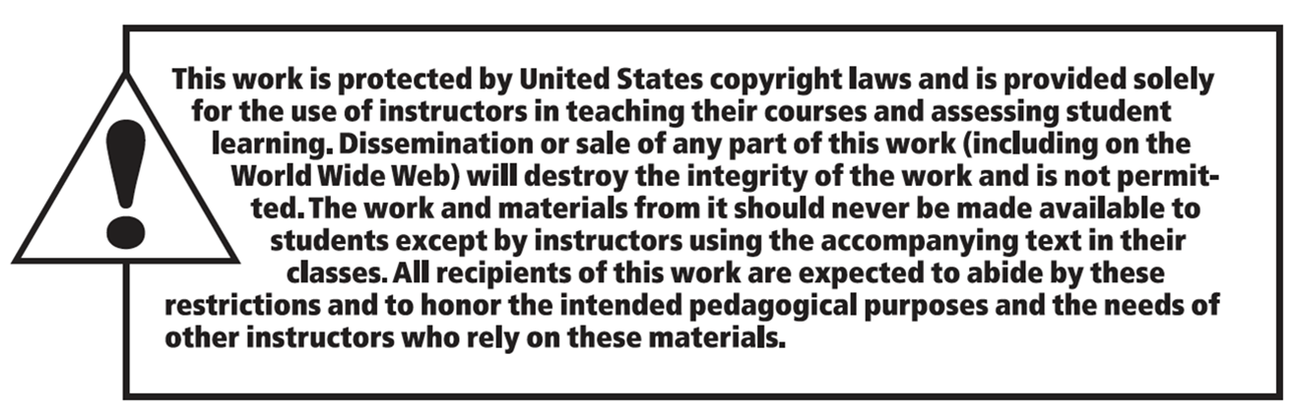
Copyright

