Slide 1

Automotive Technology Principles, Diagnosis, and Service
Sixth Edition
Chapter 95
Fuel Cells and Advanced Technologies
Copyright © 2018, 2015, 2011 Pearson Education, Inc. All Rights Reserved

Slide 2
LEARNING OBJECTIVES (1 of 2)
95.1 Explain how a fuel cell generates electricity and list advantages and disadvantages of fuel cells.
95.2 List the types of fuel cells and vehicle systems that use them.
95.3 Explain how ultracapacitors and transaxle work in fuel-cell hybrid vehicles.

Slide 3
LEARNING OBJECTIVES (2 of 2)
95.4 Discuss the use of hydraulic pressure as an energy source.
95.5 Describe the HCCI combustion process.
95.6 Discuss alternative electricity sources.

Slide 4
FUEL CELL TECHNOLOGY (1 OF 5)
Background
A fuel cell is an electrochemical device in which the chemical energy of hydrogen and oxygen is converted into electrical energy.
Parts and Operation
The chemical reaction in a fuel cell is the opposite of electrolysis.
Hydrogen and oxygen to reunite in a fuel cell to create electricity.

Slide 5
FUEL CELL TECHNOLOGY (2 OF 5)
Hydrogen-Powered Battery
A fuel cell is a hydrogen-powered battery.
Hydrogen Sources
Hydrogen is a low-carbon, non-toxic fuel that is domestically produced from local resources.
Hydrogen is also found in many other compounds, such as natural gas or crude oil.

Slide 6
FUEL CELL TECHNOLOGY (3 OF 5)
Advantages of a Fuel Cell
The only emissions are water vapor and heat.
More energy-efficient than a typical internal combustion engine (ICE).
Fuel cells have very few moving parts and have the potential to be very reliable.
Disadvantages of a Fuel Cell
High cost
Lack of refueling infrastructure
Safety perception
Insufficient vehicle range

Slide 7
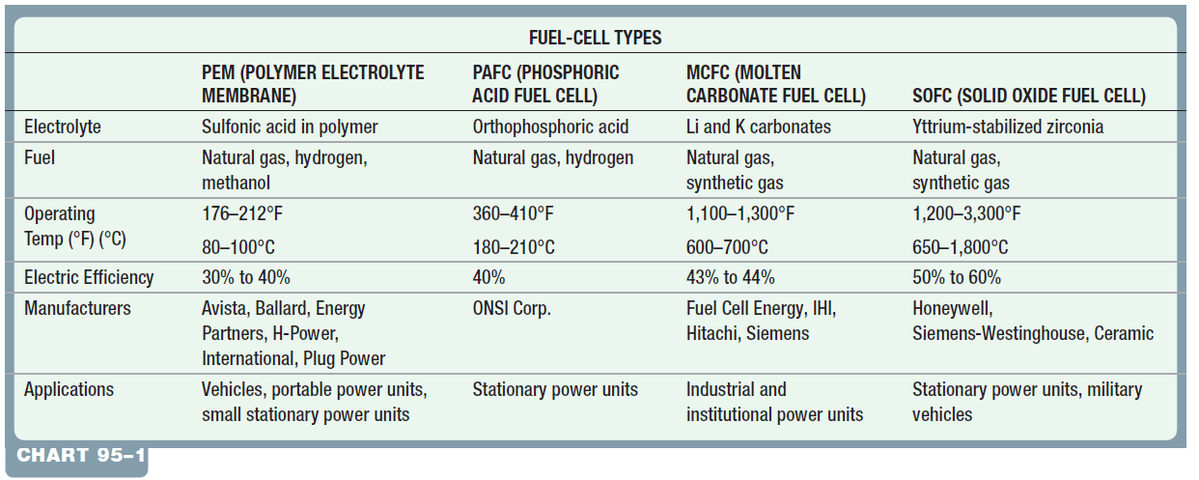
FUEL CELL TECHNOLOGY (4 OF 5)
Fuel Cell Types
The fuel-cell design that is best suited for automotive applications is the Proton Exchange Membrane (PEM).

Slide 8
FUEL CELL TECHNOLOGY (5 OF 5)
PEM Fuel Cell Operation
The PEM is a simple design based on a membrane that is coated on both sides with a catalyst, such as platinum or palladium.
There are two electrodes, one located on each side of the membrane.
These are responsible for distributing hydrogen and oxygen over the membrane surface, removing waste heat, and providing a path for electrical current flow.

Slide 9
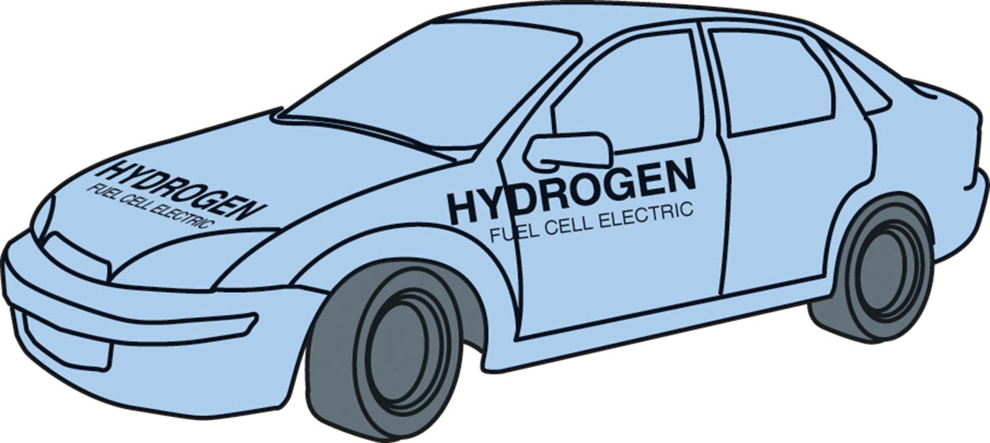
Figure 95.1 Ford Motor Company has produced a number of demonstration fuel-cell vehicles based on the Ford Focus

Slide 10
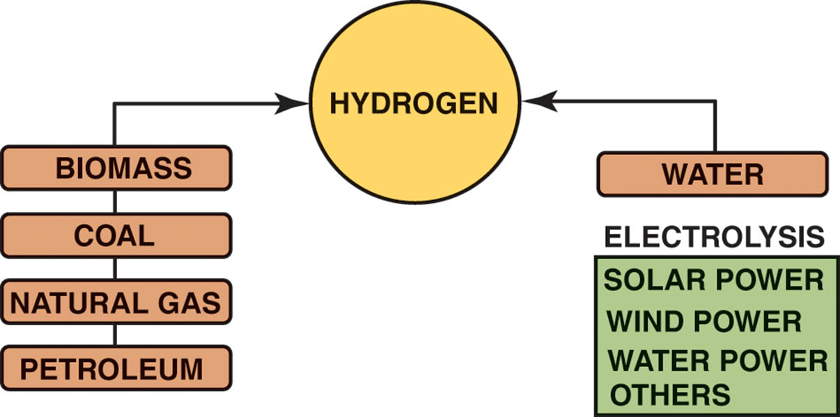
Figure 95.2 Hydrogen does not exist by itself in nature. Energy must be expended to separate it from other, more complex materials

Slide 11

Figure 95.3 The Mercedes-Benz B-Class fuel-cell car was introduced in 2005

Slide 12
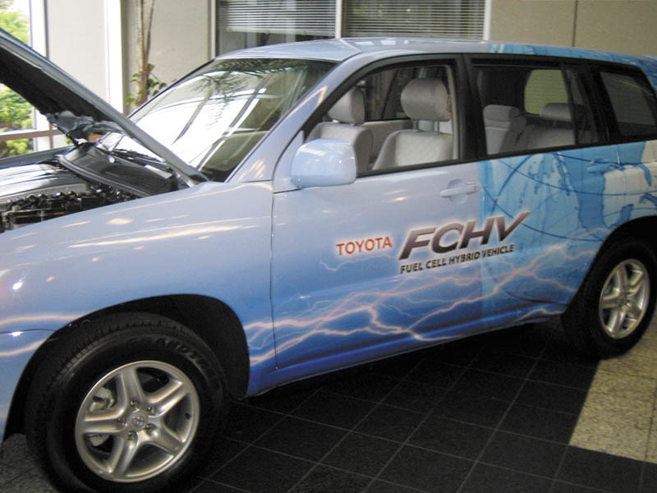
Figure 95.4 The Toyota FCHV is based on the Highlander platform and uses much of Toyota Hybrid Synergy Drive (HSD) technology in its design

Slide 13
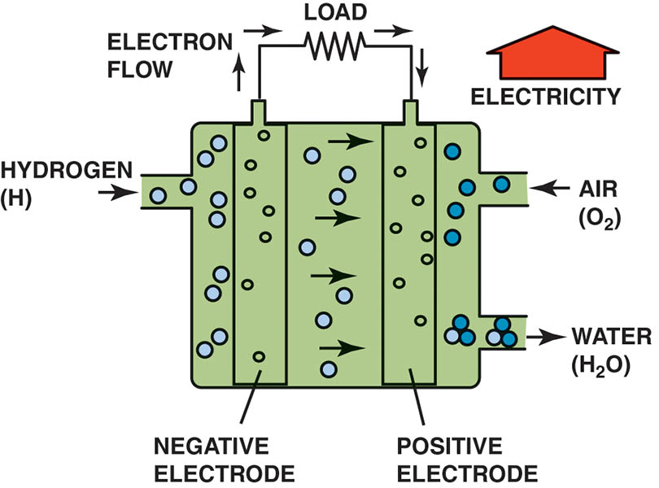
Figure 95.5 The polymer electrolyte membrane only allows H+ ions (protons) to pass through it. This means that electrons must follow the external circuit and pass through the load to perform work

Slide 14
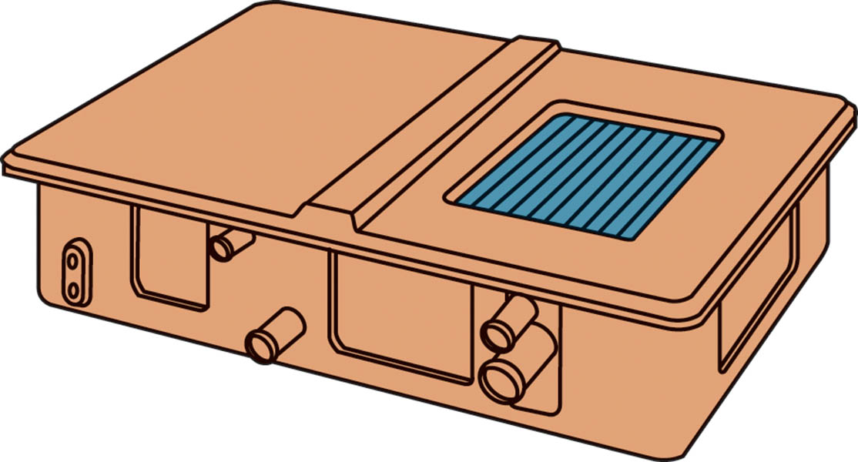
Figure 95.6 A fuel-cell stack is made up of hundreds of individual cells connected in series

Slide 15
QUESTION 1: ?
What are the advantages of a fuel cell?

Slide 16
ANSWER 1:
The only emissions are water vapor and heat.
More energy-efficient than a typical internal combustion engine (ICE).
Fuel cells have very few moving parts and have the potential to be very reliable.

Slide 17
REFUELING WITH HYDROGEN (1 OF 2)
Fueling Procedure
Hydrogen is a compressed gas that is stored aboveground at the station.
Filling a vehicle takes just minutes and, to obtain extended driving ranges in fuel-cell electric vehicles (FCEVs), the hydrogen needs to be filled at high pressures.
Filling up with hydrogen is very similar to putting propane in a barbeque tank.

Slide 18
REFUELING WITH HYDROGEN (2 OF 2)
Pressures Used
The two most commonly used pressures at hydrogen filling stations include:
H35 = 35 MPa (5,000 PSI)
H70 = 70 MPa (10,000 PSI)
SAE J2601
SAE International-created standard J2601 is the standard for hydrogen-fueling protocol of hydrogen fuel-cell electric vehicles (FCEVs).

Slide 19
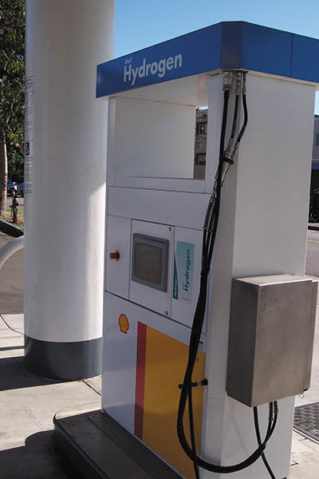
Figure 95.7 (a) A hydrogen fueling station located at a Shell gasoline station in Los Angeles, CA

Slide 20
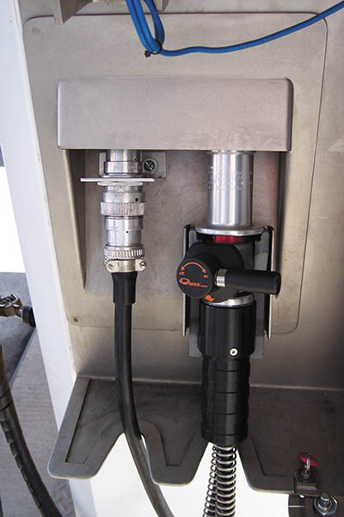
Figure 95.7 (b) The door on the side is opened to show the fill nozzle with shut-off valve. The hydrogen at this station is made on the roof of the dispenser using water and electricity. An electrical current separates the hydrogen from the oxygen in the water, then compresses the hydrogen, which is then sent to a storage tank, also on the roof

Slide 21
DIRECT METHANOL FUEL CELLS
Operation
Methanol has a higher-energy density than gaseous hydrogen because it exists in a liquid state at normal temperatures, and is easier to handle since no compressor or other high-pressure equipment is needed.
Disadvantages
Highly corrosive
No current infrastructure
High cost

Slide 22
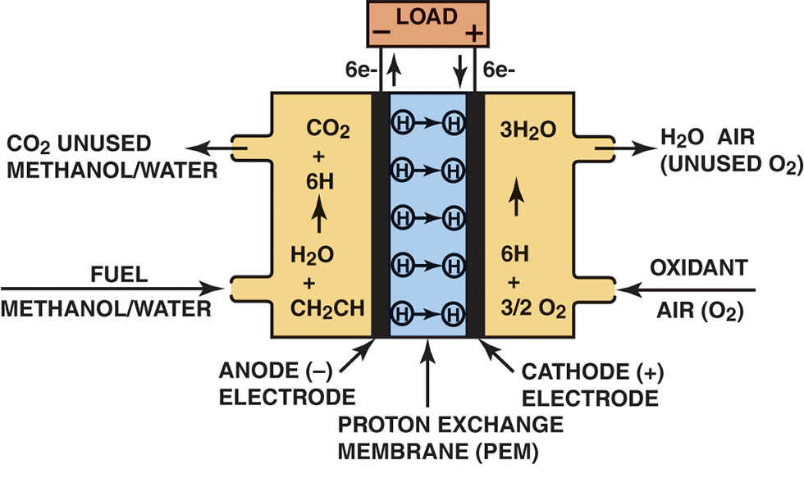
Figure 95.8 A direct methanol fuel cell uses a methanol/water solution for fuel instead of hydrogen gas

Slide 23
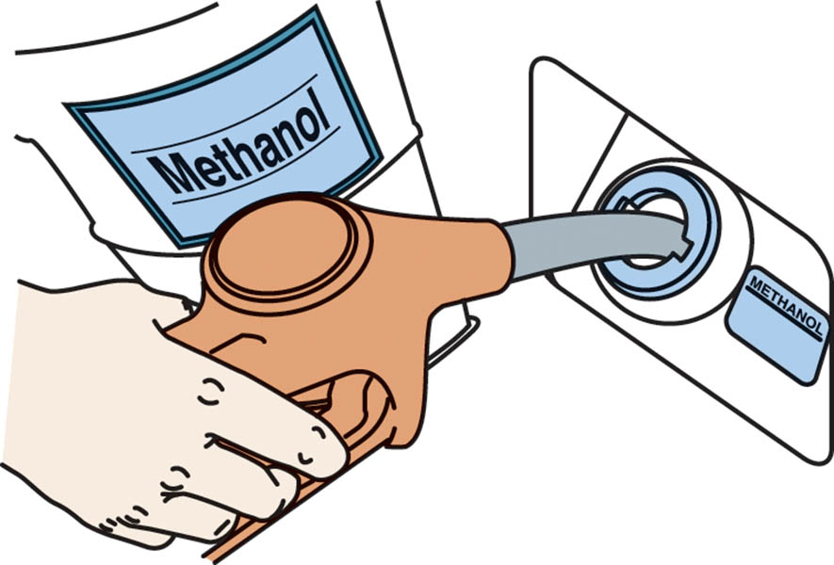
Figure 95.9 A direct methanol fuel cell can be refueled similar to a gasoline-powered vehicle.

Slide 24
FUEL-CELL VEHICLE SYSTEMS (1 OF 2)
Fuel-Cell Humidifiers
The role of the humidifier is to achieve a balance of moisture to the fuel cell. It is provides sufficient moisture to the fuel cell by recycling water that is evaporating at the cathode. The humidifier is located in the air line leading to the cathode of the fuel-cell stack.
Fuel-Cell Cooling Systems
Low-grade heat is generated during normal operation.
Large surface heat exchangers are required to cool the system.
Electric water pumps and fans support the cooling systems.

Slide 25
FUEL-CELL VEHICLE SYSTEMS (2 OF 2)
Air Supply Pumps
Air must be supplied to the fuel-cell stack at the proper pressure and flow rate to enable proper performance under all driving conditions.
This function is performed by an onboard air supply pump that compresses atmospheric air and supplies it to the fuel-cell positive electrode (cathode).

Slide 26
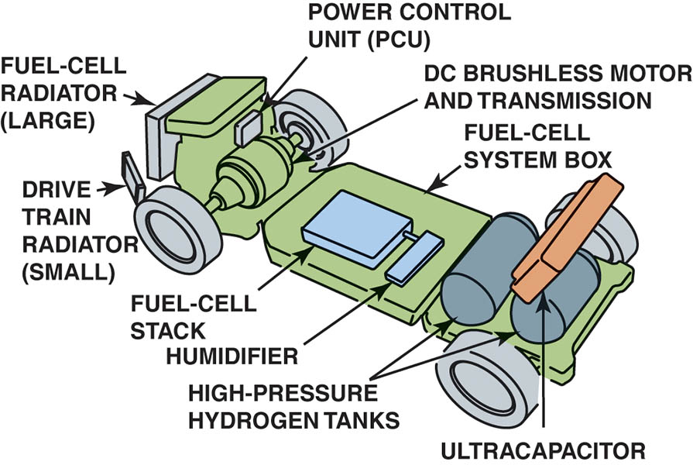
Figure 95.10 Powertrain layout in a Honda FCX fuel-cell vehicle. Note the use of a humidifier behind the fuel-cell stack to maintain moisture levels in the membrane electrode assemblies

Slide 27
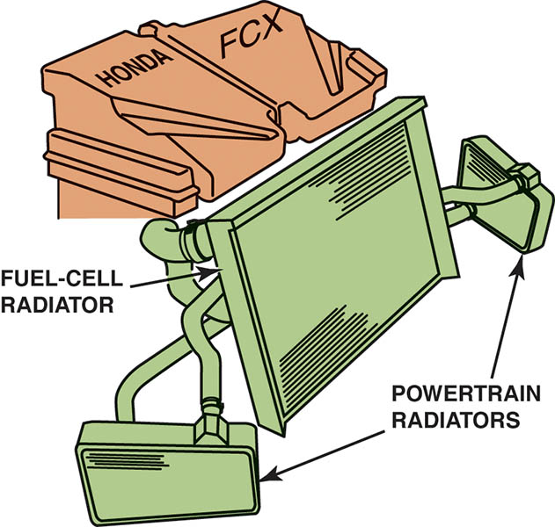
Figure 95.11 The Honda FCX uses one large radiator for cooling the fuel cell, and two smaller ones on either side for cooling drivetrain components

Slide 28
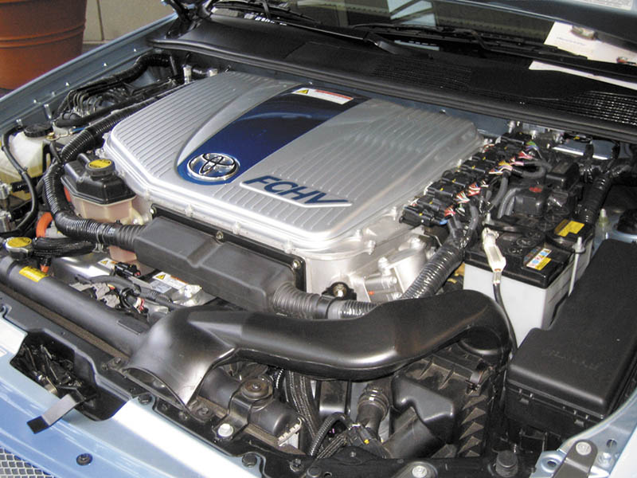
Figure 95.12 Space is limited at the front of the Toyota FCHV engine compartment, so an auxiliary heat exchanger is located under the vehicle to help cool the fuel-cell stack

Slide 29
FUEL-CELL HYBRID VEHICLES
Purpose and Function
The fuel-cell hybrid vehicle relies on both the fuel cell and an electrical storage device for motive power.
Secondary Batteries
In most FCHV designs, a high-voltage nickel-metal hydride (NiMH) battery pack is used as a secondary battery.

Slide 30
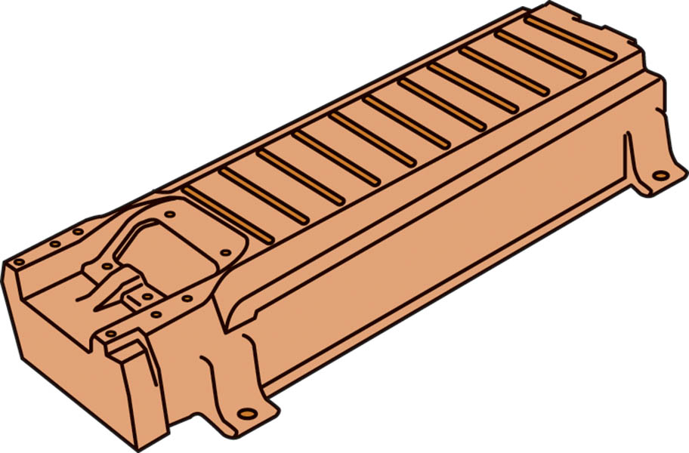
Figure 95.13 The secondary battery in a fuel-cell hybrid vehicle is made up of many individual cells connected in series, much like a fuel-cell stack

Slide 31
HYDROGEN STORAGE (1 OF 2)
Purpose and Function
Hydrogen has very high energy content on a pound-for-pound basis, but its energy density is less than that of conventional liquid fuels.
Efficient hydrogen storage is one of the technical issues that must be solved in order for fuel cells to be adopted for vehicle applications.
High-Pressure Compressed Gas
Most current fuel-cell hybrid vehicles use compressed hydrogen that is stored in tanks as a high-pressure gas.

Slide 32
HYDROGEN STORAGE (2 OF 2)
Liquid Hydrogen
Hydrogen can be liquefied in an effort to increase its energy density, but this requires that it be stored in cryogenic tanks at -423°F (-253°C).
Solid Storage of Hydrogen
One method discovered to store hydrogen in solid form is as a metal hydride, similar to how a NiMH battery works.

Slide 33
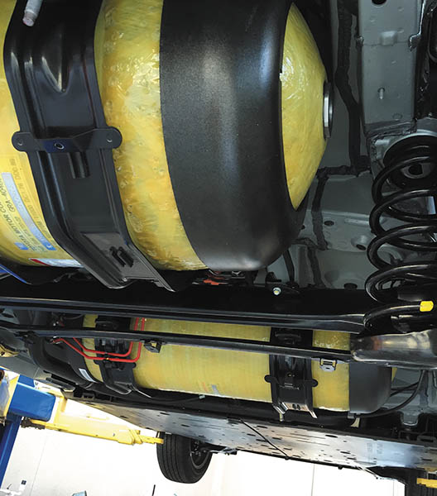
Figure 95.14 A photo showing the hydrogen storage tanks underneath a Toyota Mirai fuel cell vehicle. This vehicle uses two carbon-fiber-reinforced fuel tanks tanks

Slide 34
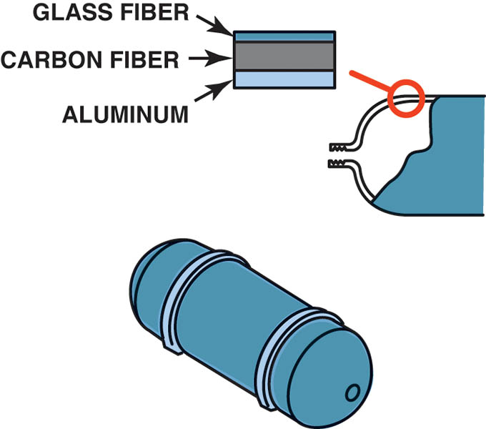
Figure 95.15 The Toyota FCHV uses high-pressure storage tanks that are rated at 350 bar. This is the equivalent of 5,000 pounds per square inch

Slide 35
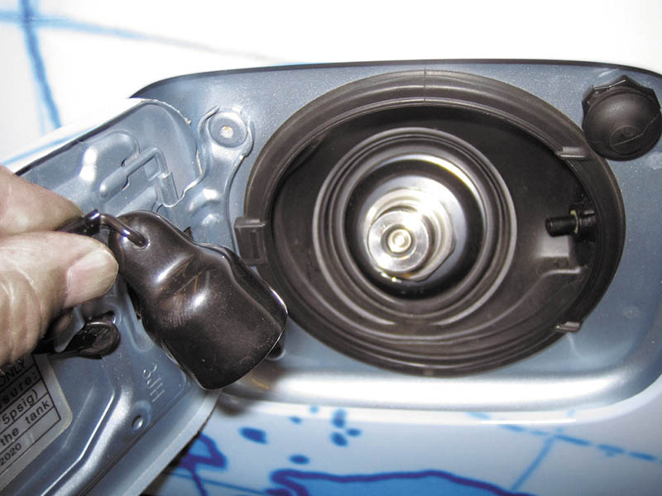
Figure 95.16 The high-pressure fitting used to refuel a fuel-cell hybrid vehicle

Slide 36
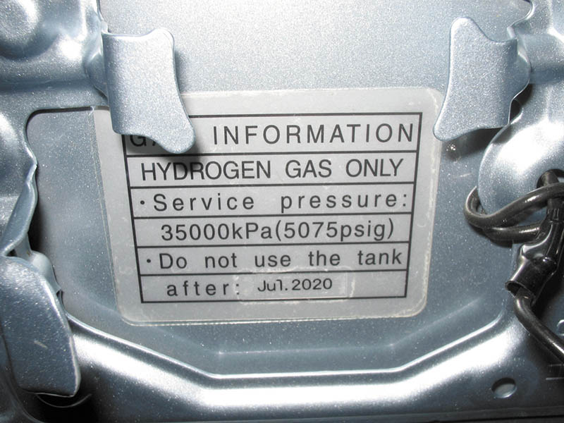
Figure 95.17 Note that high-pressure hydrogen storage tanks must be replaced in 2020

Slide 37
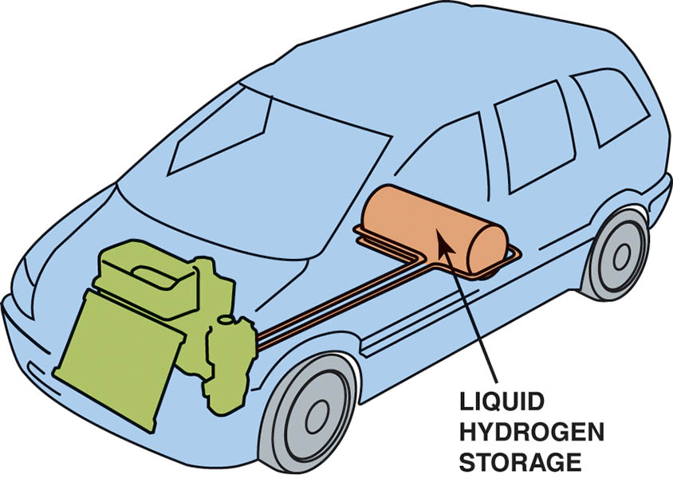
Figure 95.18 The GM Hydrogen3 has a range of 249 miles when using liquid hydrogen

Slide 38
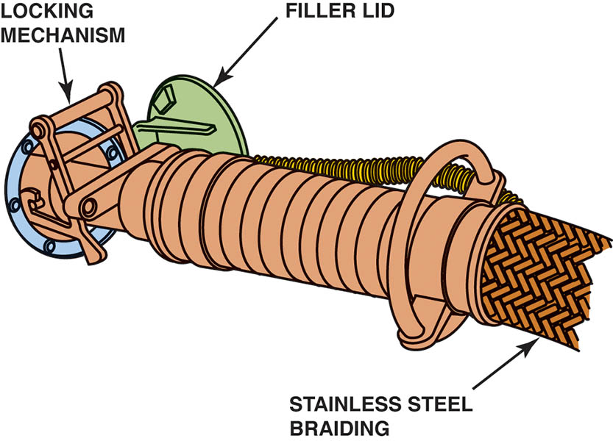
Figure 95.19 Refueling a vehicle with liquid hydrogen

Slide 39
QUESTION 2: ?
What are the three ways to store hydrogen?

Slide 40
ANSWER 2:
High pressure gas, liquid, and solid.

Slide 41
ULTRACAPACITORS (1 OF 2)
Purpose and Function
An alternative to storing electrical energy in batteries is to use ultracapacitors.
Parts and Operation
Ultracapacitor cells are based on double-layer technology, in which two activated carbon electrodes are immersed in an organic electrolyte.
Charging and discharging occurs as ions move within the electrolyte, but no chemical reaction takes place.

Slide 42
ULTRACAPACITORS (2 OF 2)
Advantages
Ultracapacitors have excellent cycle life, meaning that they can be fully charged and discharged many times without degrading their performance.
Disadvantages
The one major downside of ultracapacitors is a lack of specific energy, which means that they are best suited for sudden bursts of energy, as opposed to prolonged discharge cycles.

Slide 43
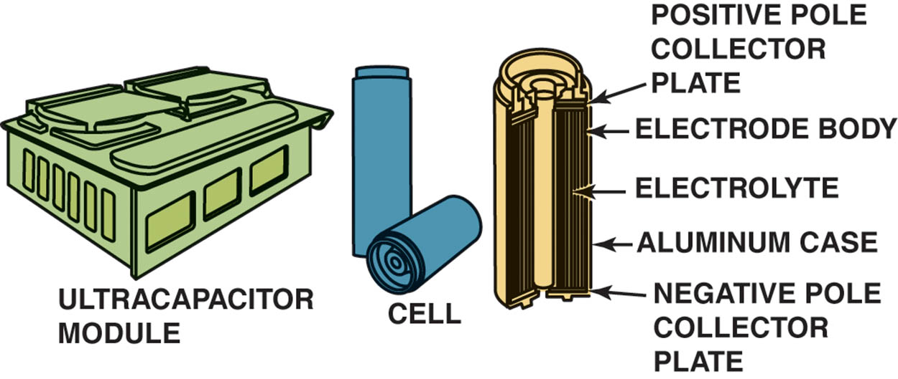
Figure 95.20 The Honda ultracapacitor module and construction of the individual cells

Slide 44
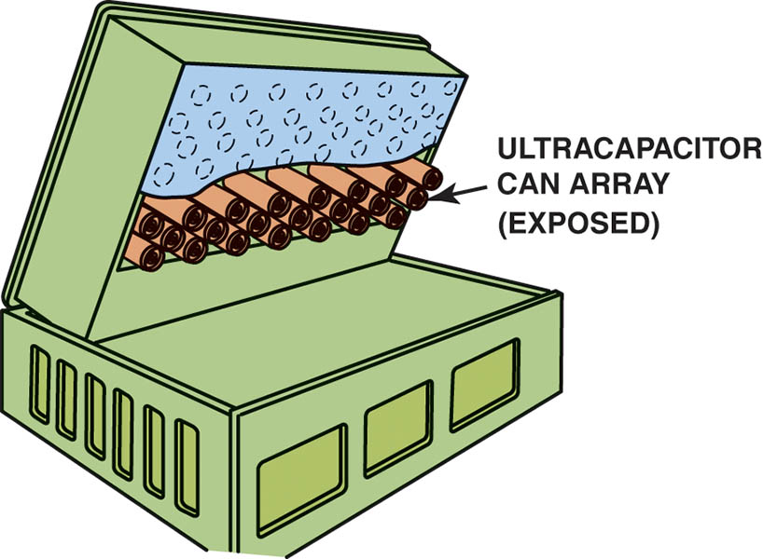
Figure 95.21 An ultracapacitor can be used in place of a high-voltage battery in a hybrid electric vehicle. This example is from the Honda FCX fuel-cell hybrid vehicle

Slide 45
FUEL-CELL VEHICLE TRANSAXLES (1 OF 2)
Purpose and Function
Some fuel-cell hybrid vehicles use a single electric drive motor and a transaxle to direct power to the vehicle.
It is also possible to use wheel motors to drive individual wheels.
Fuel-Cell Traction Motors
The typical drive motor is based on an AC synchronous design, which is sometimes referred to as a DC brushless motor.

Slide 46
FUEL-CELL VEHICLE TRANSAXLES (2 OF 2)
Fuel-Cell Power Control Units
One of the functions of the PCU is to act as an inverter, which changes direct current from the fuel-cell stack into three-phase alternating current for use in the vehicle drive motor(s).
A DC-to-DC converter is used in hybrid electric vehicles for converting the high voltage from the secondary battery pack into the 12 volts required for the remainder of the vehicle electrical system.

Slide 47
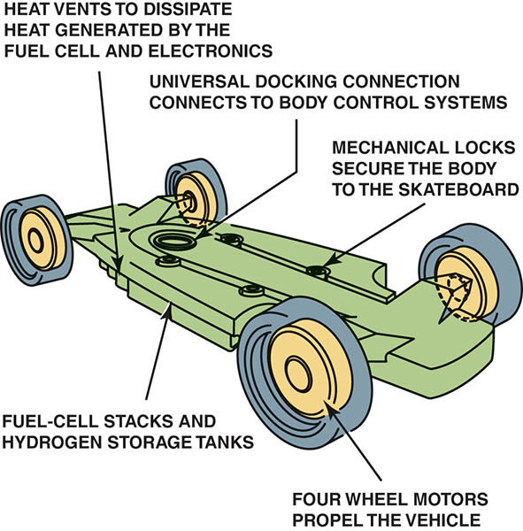
Figure 95.22 The General Motors “Skateboard” concept uses a fuel-cell populsion system with wheel motors at all four corners

Slide 48
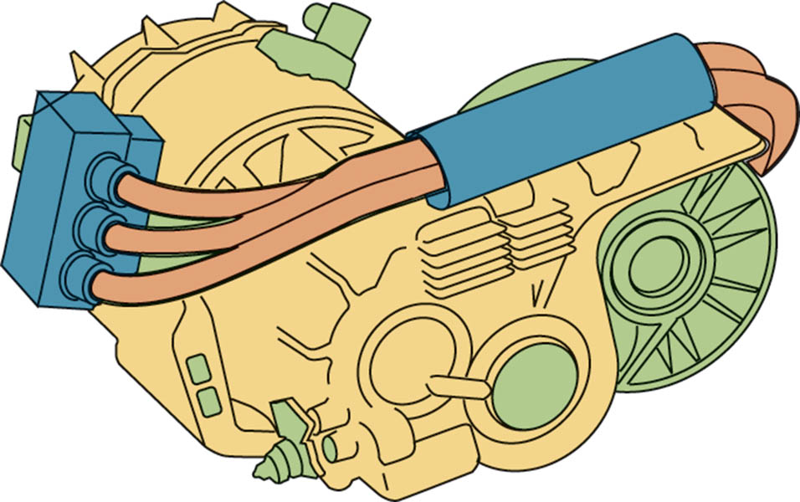
Figure 95.23 The electric drive motor and transaxle assembly from a Toyota FCHV. Note the three orange cables, indicating that this motor is powered by high-voltage three-phase alternating current

Slide 49
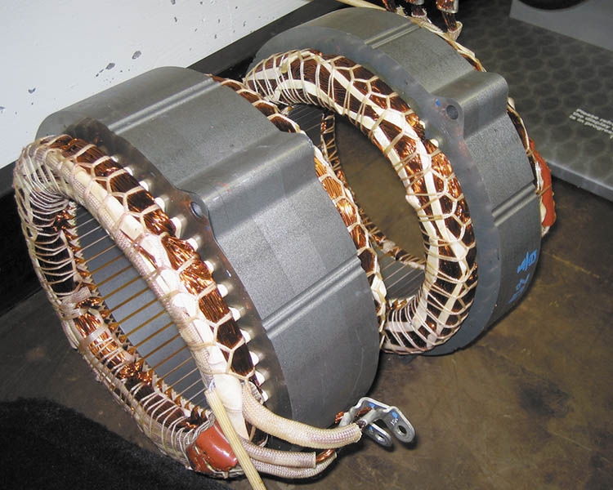
Figure 95.24 Drive motors in fuel-cell hybrid vehicles often use stator assemblies similar to ones found in Toyota hybrid electric vehicles. The rotor turns inside the stator and has permanent magnets on its outer circumference

Slide 50
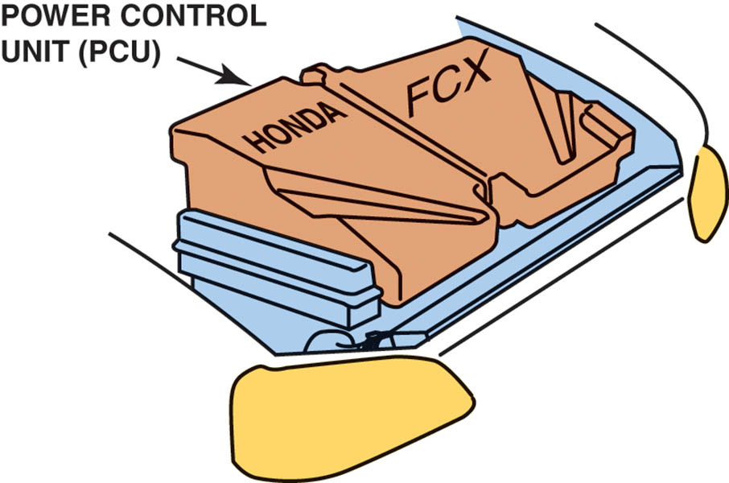
Figure 95.25 The power control unit (PCU) on a Honda FCX fuel-cell hybrid vehicle is located under the hood

Slide 51
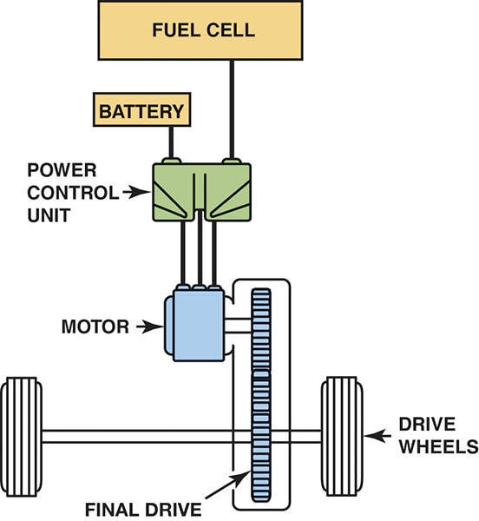
Figure 95.26 Toyota’s FCHV uses a power control unit that directs electrical energy flow between the fuel cell, battery, and drive motor

Slide 52
QUESTION 3: ?
What type of traction motor is used in a fuel cell transaxle?

Slide 53
ANSWER 3:
A DC brushless motor.

Slide 54
HYDRAULIC HYBRID STORAGE SYSTEM
Technology
Ford Motor Co. is experimenting with a system it calls Hydraulic Power Assist (HPA).
This system converts kinetic energy to hydraulic pressure, and then uses that pressure to help accelerate the vehicle.

Slide 55
HCCI
Terminology
Homogeneous Charge Compression Ignition (HCCI) is a combustion process.
It is a low-temperature, chemically controlled (flameless) combustion process
Future of HCCI
Additional research and development needs to be performed using this combustion process to make the process viable under all operating conditions.

Slide 56
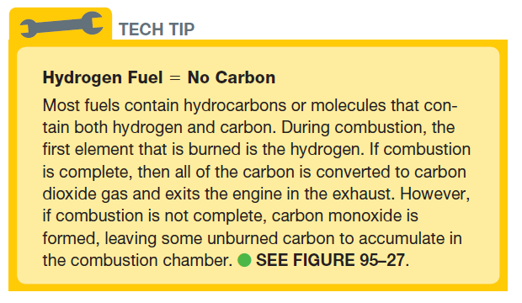
Tech Tip

Slide 57
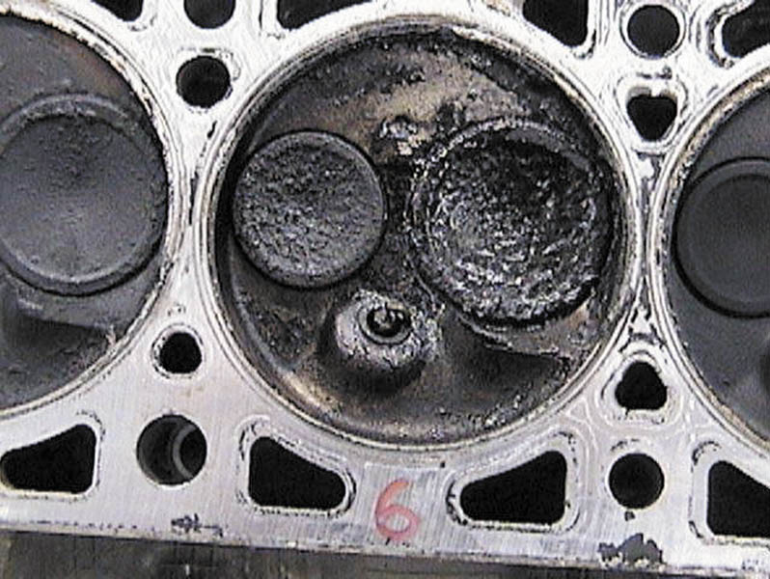
Figure 95.27 Carbon deposits, such as these, are created by incomplete combustion of a hydrocarbon fuel

Slide 58
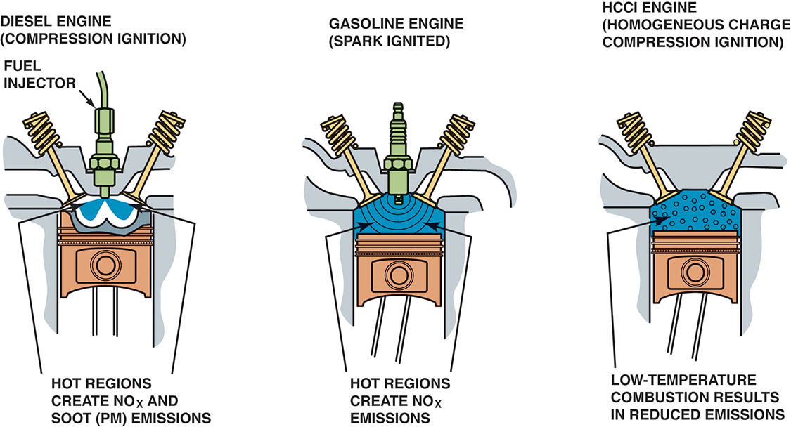
Figure 95.28 Both diesel and conventional gasoline engines create exhaust emissions due to high peak temperatures created in the combustion chamber. The lower combustion temperatures during HCCI operation result in high efficiency with reduced emissions

Slide 59
WIND POWER
Advantages
Because AC electricity cannot be stored, this energy source is best used to reduce the use of natural gas and coal to help reduce CO2 emissions.
Disadvantages
A lack of locations with consistent wind above 8 miles per hour reduces the ability to produce wind power.

Slide 60
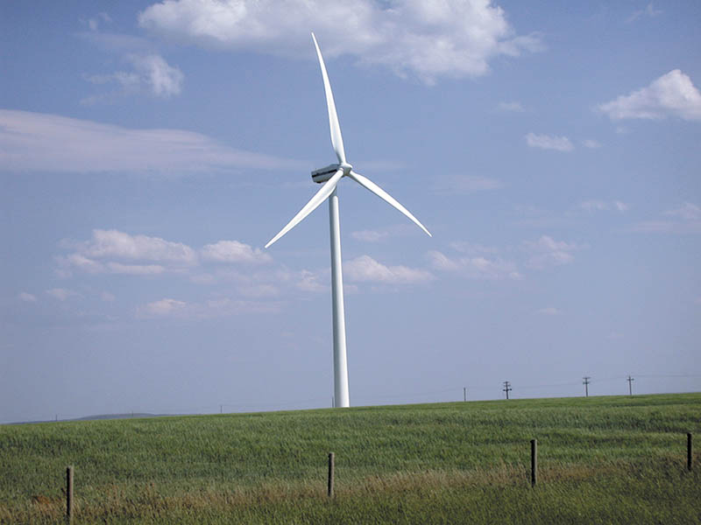
Figure 95.29 A typical wind generator that is used to generate electricity

Slide 61
HYDROELECTRIC POWER
Hydroelectric power is limited to locations where there are dammed rivers and hydroelectric plants.
Electrical power from hydroelectric sources can be used to charge plug-in hybrid electric vehicles, thereby reducing emissions that are normally created by burning coal or natural gas to create electricity.

Slide 62

Figure 95.30 The Hoover Dam in Nevada/Arizona is used to create electricity for use in the southwest United States

Slide 63

Copyright

