Slide 1

Automotive Technology Principles, Diagnosis, and Service
Sixth Edition
Chapter 94
Hybrid Safety and Service Procedures
Copyright © 2018, 2015, 2011 Pearson Education, Inc. All Rights Reserved

Slide 2
LEARNING OBJECTIVES (1 of 2)
94.1 Correctly use appropriate personal protective equipment (PPE).
94.2 Discuss the safety interlock system and loss of insulation in a hybrid electric vehicle.
94.3 Safely de-power a hybrid electric vehicle.

Slide 3
LEARNING OBJECTIVES (2 of 2)
94.4 Explain hazards while driving, moving, and hoisting a hybrid electric vehicle.
94.5 Perform routine vehicle service procedure on a hybrid electric vehicle and understand the HEV's unique service requirements.

Slide 4
HIGH-VOLTAGE SAFETY
Need For Caution
  Hybrid electric vehicles and all electric vehicles use high-voltage (HV) circuits that, if touched with an unprotected hand, could cause serious burns, or even death.
Identifying High-Voltage Circuits
  Blue or yellow. 42 volts (not a shock hazard but an arc is maintained if a circuit is opened)
  Orange. 60 to 600 volts or higher

Slide 5
HIGH VOLTAGE-SAFETY EQUIPMENT (1 OF 2)
Rubber Gloves
  Be sure that the gloves are rated for at least 1,000 volts and class “0” by ANSI/ASTM.
  Before using the rubber gloves, they should be tested for leaks.
CAT-III Rated Multimeter
  A CAT III-certified digital multimeter (DMM) is required for making measurements on these high-voltage systems.

Slide 6
HIGH VOLTAGE-SAFETY EQUIPMENT (2 OF 2)
Eye Protection
  Eye protection should be worn when testing for HV, which is considered by many experts to be over 60 volts.
Safety Cones
  Ford requires that cones be placed at the four corners of any hybrid electric vehicle when service work on the HV system is being performed.
Fiberglass Pole
  A ten-foot insulated pole used to rescue a shock victim.

Slide 7
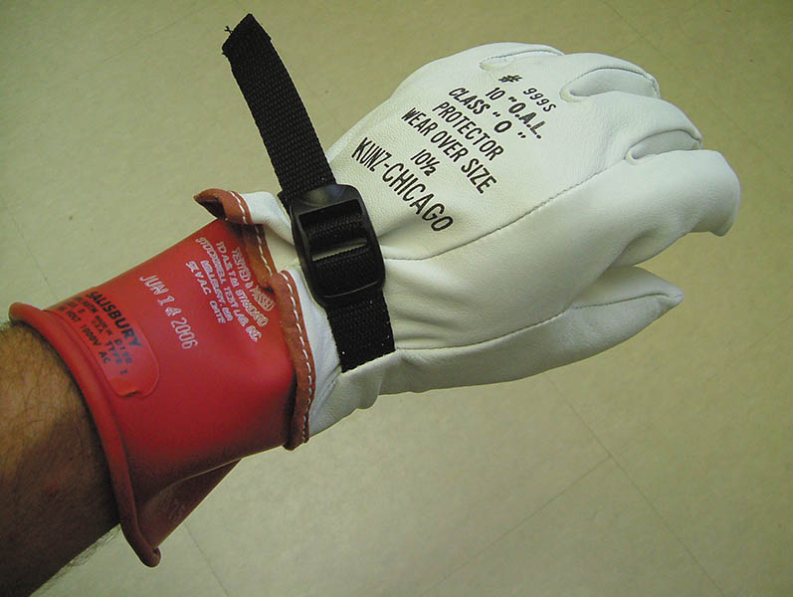
Figure 94.1 Appropriate personal protective equipment (PPE) must be worn whenever working on or around a hybrid vehicle high-voltage system, including high-voltage gloves with protective leather gloves to protect the rubber from being cut or pierced

Slide 8
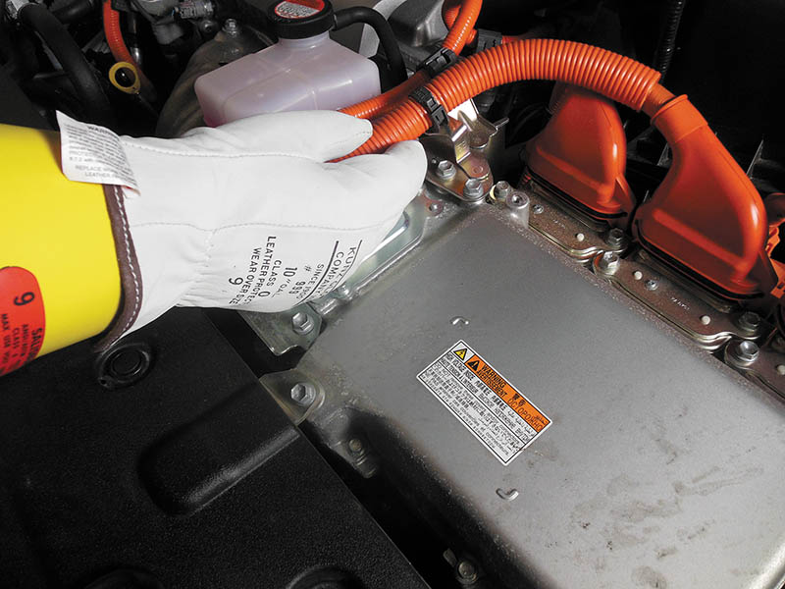
Figure 94.2 Whenever working around the high-voltage circuit, it is recommended that one hand be kept in a pocket to prevent the possibility of a high-voltage shock passing through the body

Slide 9
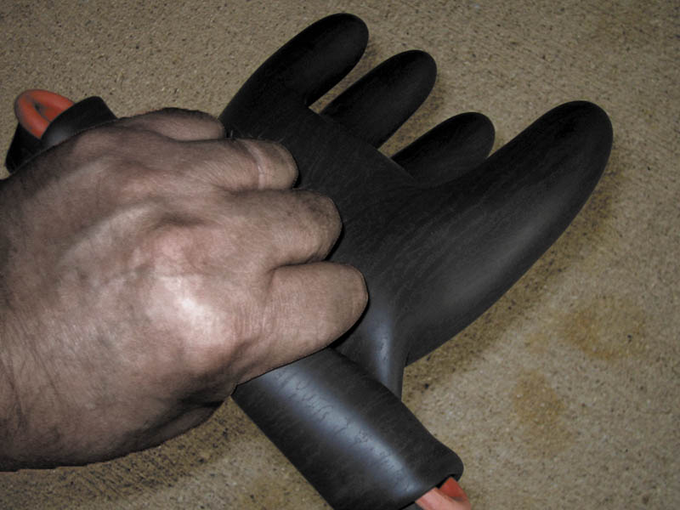
Figure 94.3 Checking rubber lineman’s gloves for pinhole leaks

Slide 10
QUESTION 1: ?
What should be the rating of the rubber gloves?

Slide 11
ANSWER 1:
Class “0” and 1000 Volts.

Slide 12
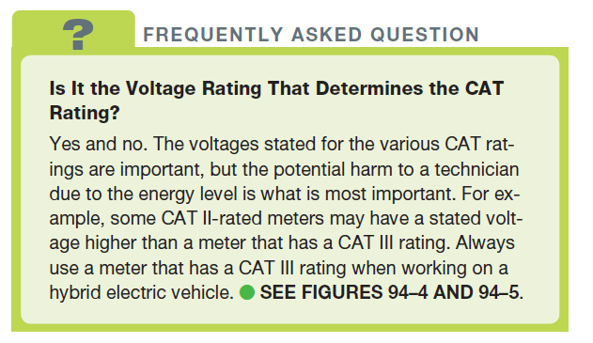
FREQUENTLY ASKED QUESTION

Slide 13
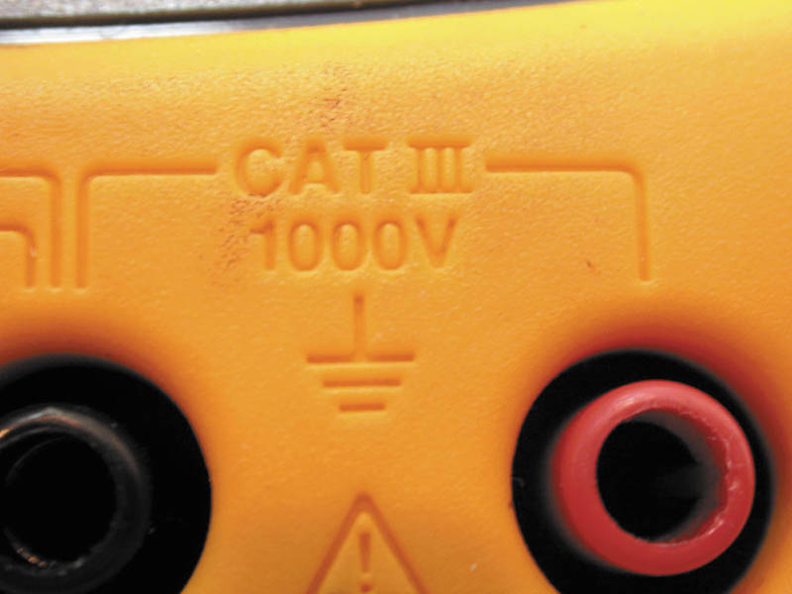
Figure 94.4 Be sure to only use a meter that is CAT III-rated when taking electrical voltage measurements on a hybrid electric or electric vehicle.

Slide 14
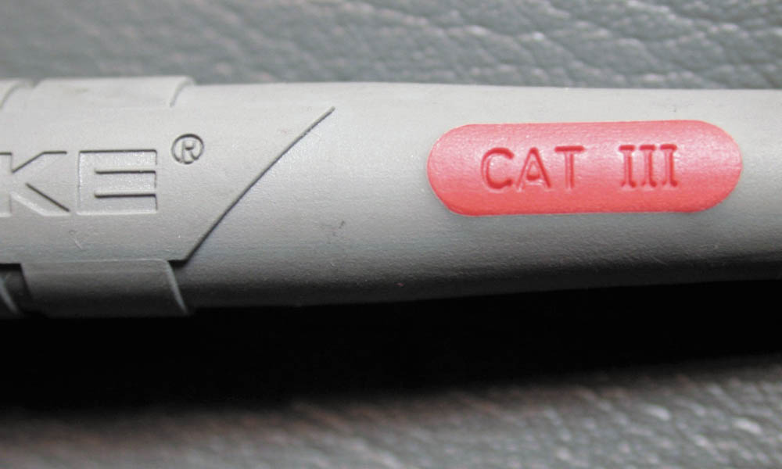
Figure 94.5 The meter leads should also be CAT III-rated when checking voltages on a hybrid electric vehicle

Slide 15
SAFETY INTERLOCK SYSTEM
Purpose and Function
  This is a safety system that keeps the power relays from closing.
  With an open detected, the hybrid controller set fault codes and shutdown the ICE in an orderly manner to keep the vehicle safe.
Local Interlock
  Separate switches on high voltage components and circuits used to detect open circuits.

Slide 16
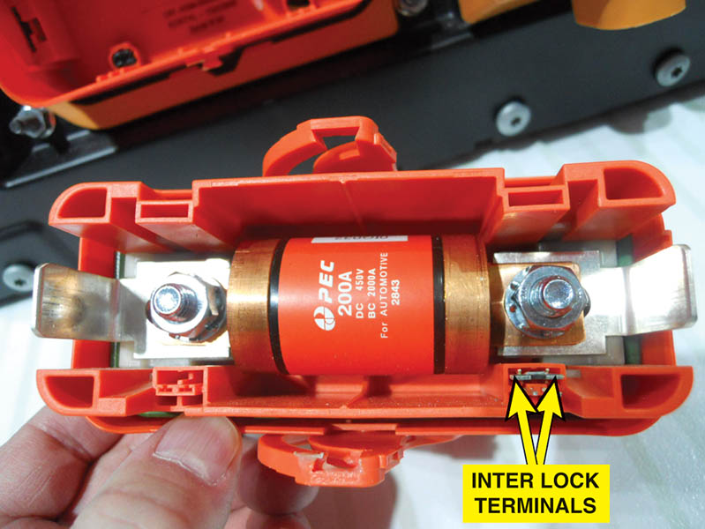
Figure 94.6 The HV disconnect plug has two small terminals used to signal the HV controller that the safety/service plug has been removed.

Slide 17
LOSS OF ISOLATION TEST
Purpose
  The HV circuits do not use a common ground.
  When the ground fault system detects HV leaking to ground, it sets a DTC that includes the location of the fault.
Test Procedure
  Disable the HV system
  Use DTCs and schematics to identify problem areas
  Connect the isolation tester to the circuit, perform the test and record the results.

Slide 18
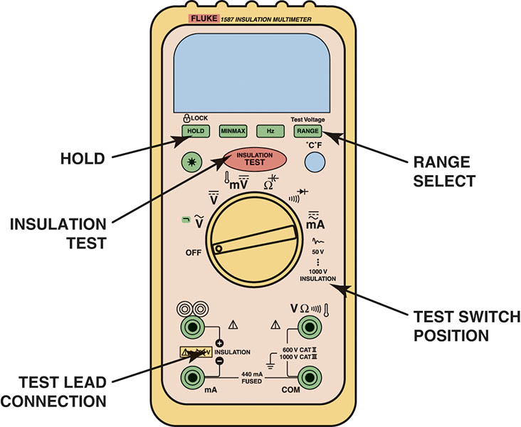
Figure 94.7 An insulation tester showing where the meter leads should be attached and where to select the voltage level to be used to test the insulation (usually 1,000 volts). The resistance between the insulated HV circuit and ground should be higher than one million ohms (1.0 to 2.2 MΩ)

Slide 19
QUESTION 2: ?
What is the purpose of the Loss of Isolation Test?

Slide 20
ANSWER 2:
The cylinder head did not contain the valves.

Slide 21
ELECTRIC SHOCK POTENTIAL
Locations Where Shock Can Occur
  Contact with the battery module
  Contact with the electric motor
  The HV cables
  The system main relays (SMRs)

Slide 22
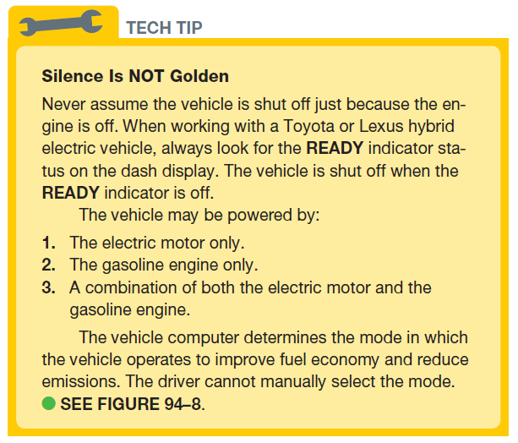
Tech Tip

Slide 23
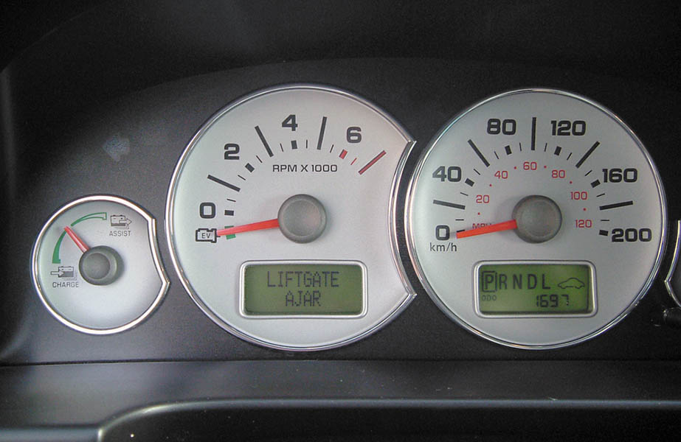
Figure 94.8 The Ford Escape Hybrid instrument panel showing the vehicle in park and the tachometer on “EV” instead of 0 RPM. This means that the gasoline engine could start at any time, depending on the state of charge of the high-voltage batteries and other factors

Slide 24
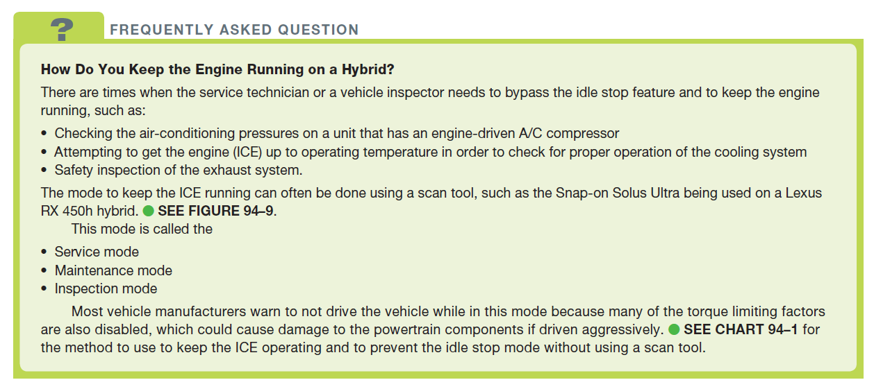
FREQUENTLY ASKED QUESTION

Slide 25
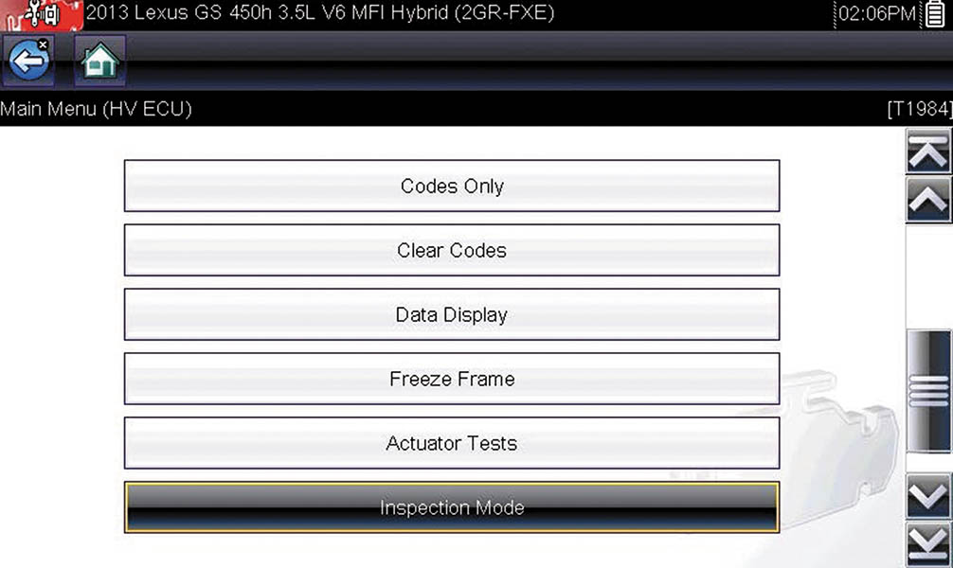
Figure 94.9 To enter the inspection mode, select this feature on a scan tool and follow the on-screen procedure

Slide 26
DE-POWERING THE HIGH-VOLTAGE SYSTEM
The Need to De-power the High-Voltage System
  Work is going to be performed on any of the following components:
  The high-voltage (HV) battery pack
  Any of the electronic controllers that use orange cables, such as the inverter and converters
  The air-conditioning compressor if electrically driven and has orange cables attached.
To safely de-power the vehicle, always follow the instructions found in service information for the exact vehicle being serviced.

Slide 27
COLLISION AND REPAIR INDUSTRY ISSUES
Jump Starting
  The 12-volt auxiliary battery may be jump started if the vehicle does not start.
  The high voltage battery cannot be jump started on most vehicles.

Slide 28
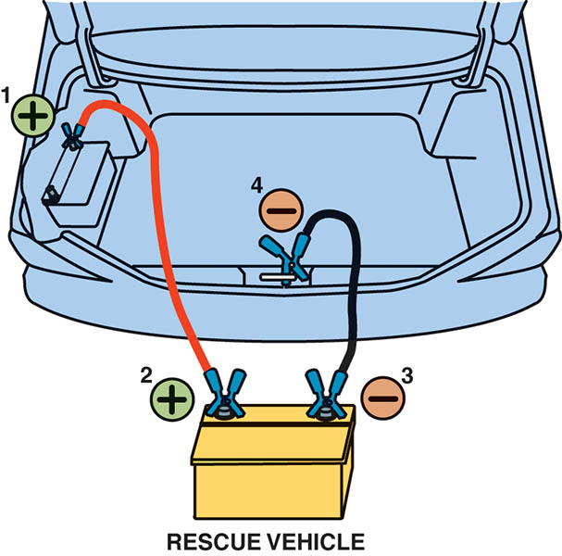
Figure 94.10 Jump starting a 2001–2003 Toyota Prius using a 12-volt supply to boost the 12-volt auxiliary battery in the trunk

Slide 29
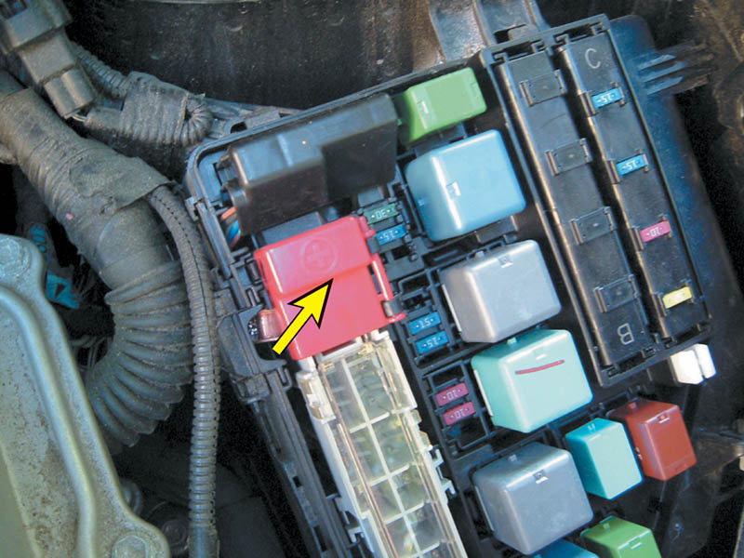
Figure 94.11 The underhood 12-volt jump-start terminal on this 2014 Toyota Prius has a red plastic cover with a “+” sign. The positive booster cable clamp attaches directly to the vertical metal bracket.

Slide 30
MOVING AND TOWING A HYBRID
Towing
  To transport a vehicle a flat-bed truck should be used.
Moving the Hybrid Vehicle in the Shop
  Make sure to tape any orange cable ends that were disconnected during the repair procedure.
  It is possible that a high-voltage arc could occur as the wheels turn and produce voltage.

Slide 31
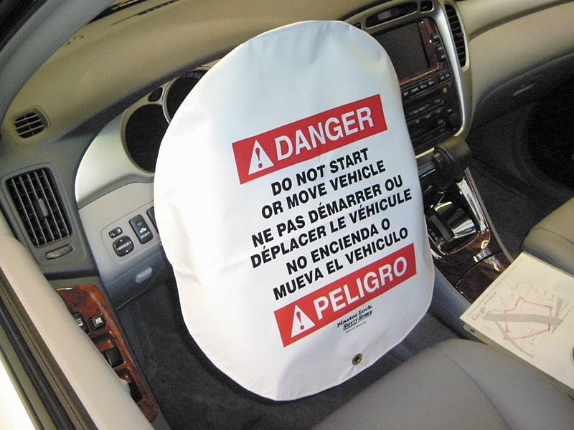
Figure 94.12 Using a warning cover over the steering wheel helps others realize that work is being performed on the high-voltage system and that no one is to attempt to start or move the vehicle.

Slide 32
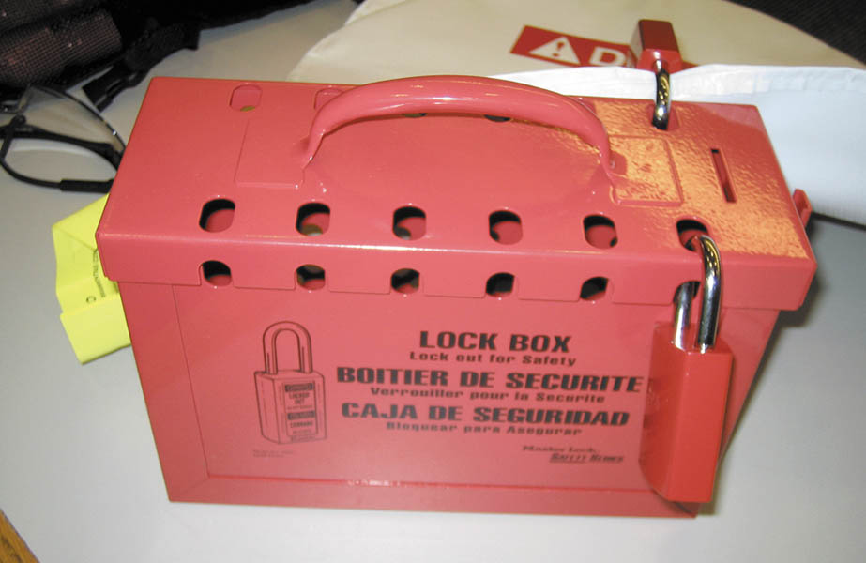
Figure 94.13 A lock box is a safe location to keep the ignition keys of a hybrid electric vehicle while it is being serviced.

Slide 33
REMOVING THE HIGH-VOLTAGE BATTERY
Precautions
  The HV battery box should always be removed as an assembly, placed on a rubber-covered work bench.
Storing the High-Voltage Battery
  If a hybrid is to be stored for any length of time, the state of charge of the HV must be maintained.
Hoisting a Hybrid Vehicle
  When hoisting or using a floor jack, pay attention to the lift points. Orange cables run under the vehicle just inside the frame rails on most hybrids.

Slide 34
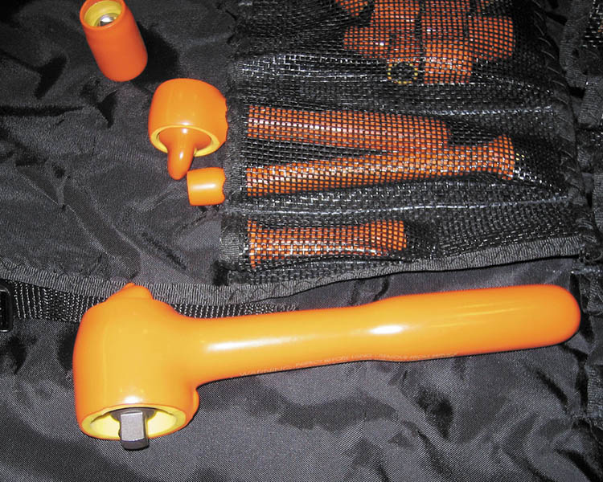
Figure 94.14 Insulated tools, such as this socket set, provide an additional margin of safety to the service technician when working around high-voltage components and systems.

Slide 35
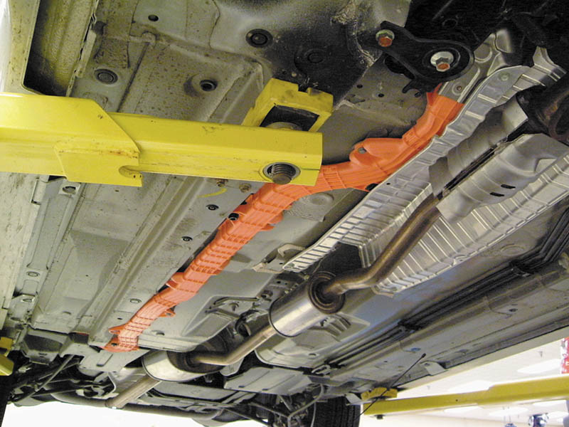
Figure 94.15 The high-voltage wiring on this Honda hybrid is colored orange for easy identification

Slide 36
QUESTION 3: ?
What precautions should be taken when lifting a HEV?

Slide 37
ANSWER 3:
Lift the vehicle in the proper location and note the location of the orange HV cables.

Slide 38
ROUTINE SERVICE PROCEDURES (1 OF 4)
Diagnostic Procedure
  Verify the customer concern.
  Check for diagnostic trouble codes (DTCs).
  Perform a thorough visual inspection.
  Check for technical service bulletins (TSBs)
  Follow service information specified steps and procedures.
  Determine and repair the root cause of the problem.
  Verify the repair

Slide 39
ROUTINE SERVICE PROCEDURES (2 OF 4)
Oil Change
  An oil change is similar to changing oil in any vehicle equipped with an internal combustion engine.
Cooling System Service
  Multiple cooling systems are serviced using the specific coolant mixture at the correct mileage interval.
Air Filter Service
  Similar to performing this service in any vehicle equipped with an internal combustion engine.

Slide 40
ROUTINE SERVICE PROCEDURES (3 OF 4)
Air-Conditioning Service
  Many HEVs use an air-conditioning compressor that uses high voltage from the HV battery pack
  Special refrigerant oil is used that is nonconductive.
Steering System Service
  Most HEVs use an electric power steering system that operates at 12 or 42 volts.
Braking System Service
  More frequent cleaning and lubrication due to regenerative braking.

Slide 41
ROUTINE SERVICE PROCEDURES (4 OF 4)
Tires
  Many HEVs have special “green” tires. Refer to the service information for correct replacement tires.
Auxiliary Battery Testing and Service
  Auxiliary batteries may be the flooded type or absorbed glass mat type. Refer to the service information for the correct service procedure.

Slide 42
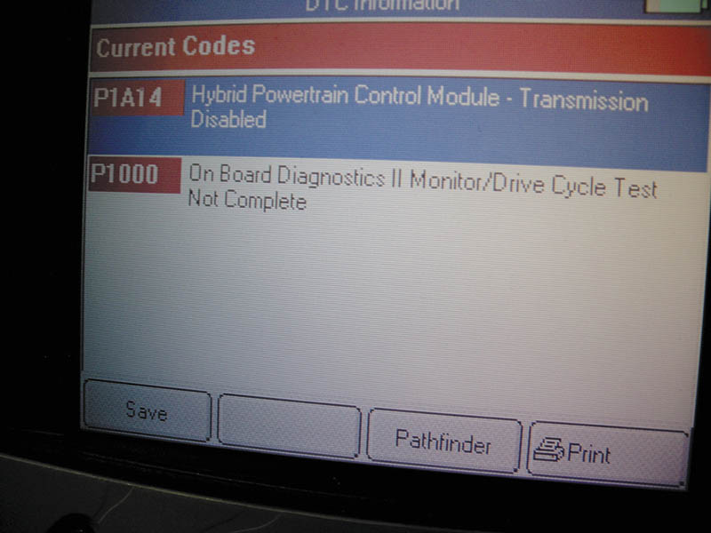
Figure 94.16 A scan tool display showing two hybrid-related faults in this Ford Escape hybrid

Slide 43
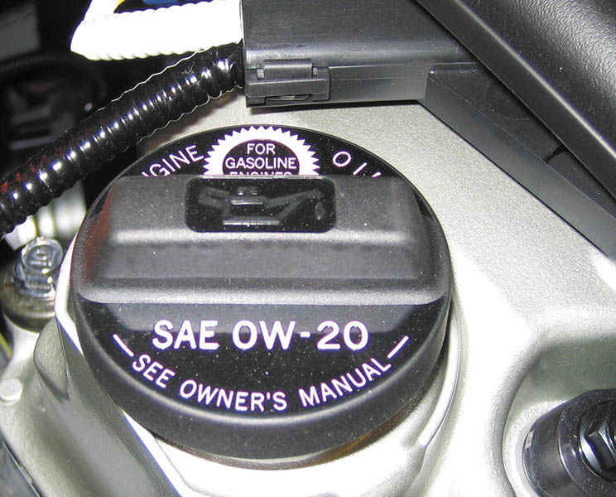
Figure 94.17 Always use the specified viscosity of oil in a hybrid electric vehicle, not only for best fuel economy, but also because of the need for fast lubrication because of the engine (idle) stop feature

Slide 44
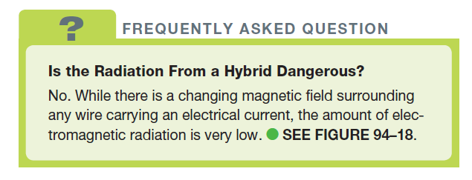
FREQUENTLY ASKED QUESTION

Slide 45
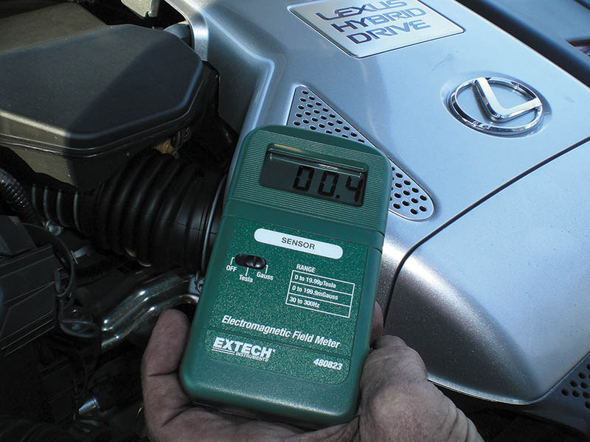
Figure 94.18 The radiation emitted from a hybrid electric vehicle is very low, as shown being measured in units of milligauss

Slide 46
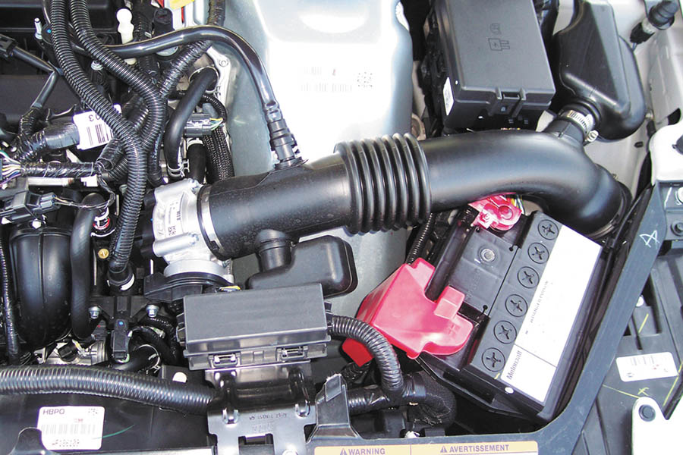
Figure 94.19 This 12-volt battery under the hood on a Ford Fusion hybrid is a flooded-cell-type auxiliary battery

Slide 47
HV GLOVE USE

Slide 48
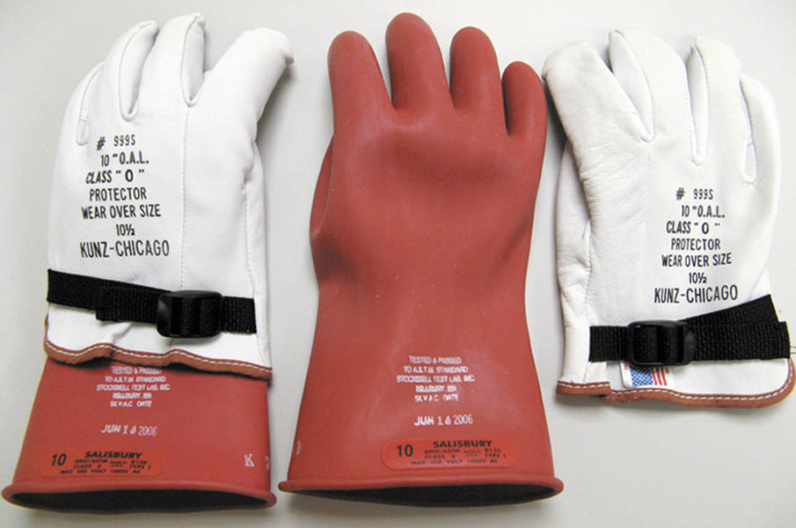
1. The cuff of the rubber glove should extend at least ½ inch beyond the cuff of the leather protector.

Slide 49
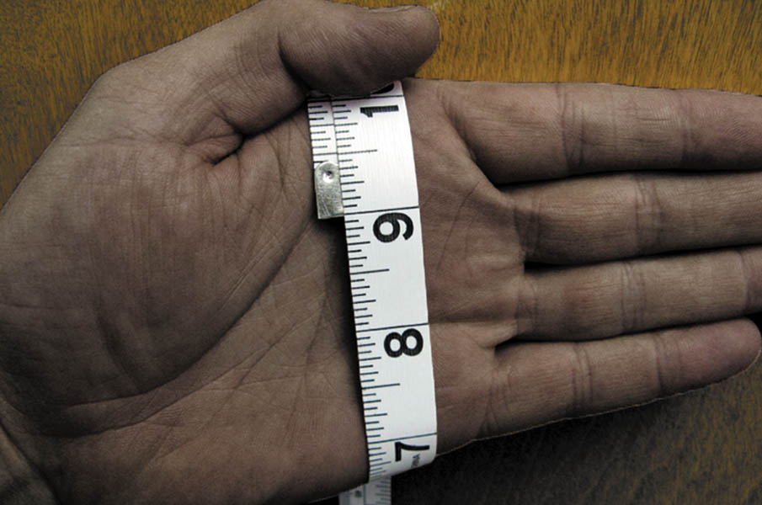
2. To determine correct glove size, use a soft tape to measure around the palm of the hand. A measurement of 9 inches corresponds with a glove size of 9.

Slide 50
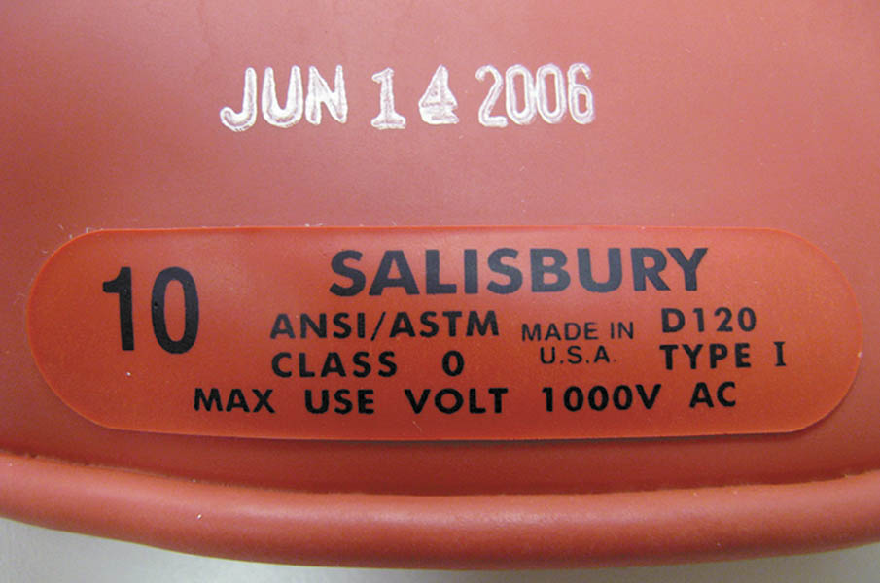
3. The glove rating and the date of the last test should be stamped on the glove cuff.

Slide 51
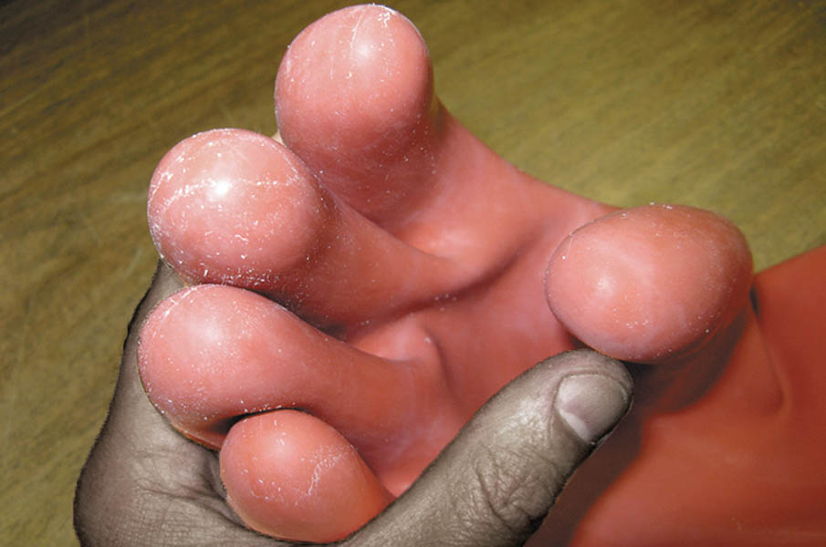
4. Start with a visual inspection of the glove fingertips, making sure that no cuts or other damage is present.

Slide 52
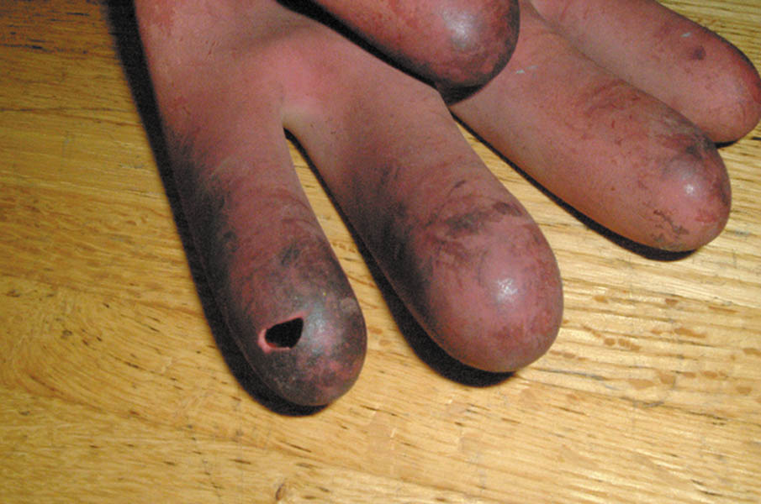
5. The damage on this glove was easily detected with a simple visual inspection. Note that the rubber glove material can be damaged by petroleum products, detergents, certain hand soaps, and talcum powder.

Slide 53

6. Manually inflate the glove to inspect for pinhole leaks. Starting at the cuff, roll up the glove and trap air at the finger end. Listen and watch carefully for deflation of the glove. If a leak is detected, the glove must be discarded.

Slide 54
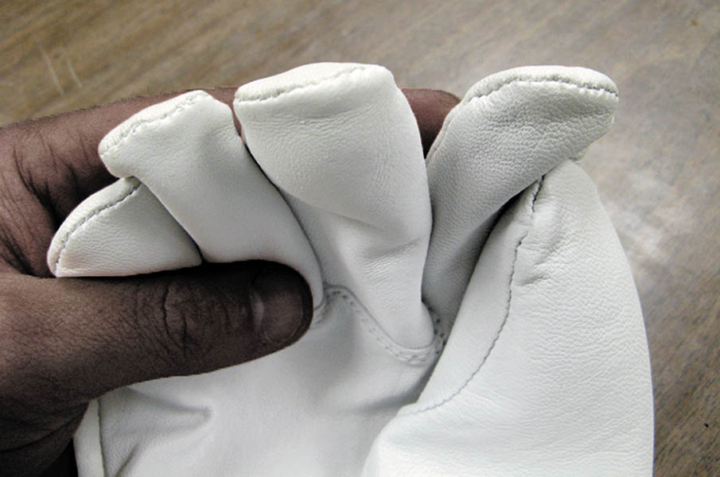
7. Petroleum on the leather protector’s surfaces damages the rubber glove underneath.

Slide 55
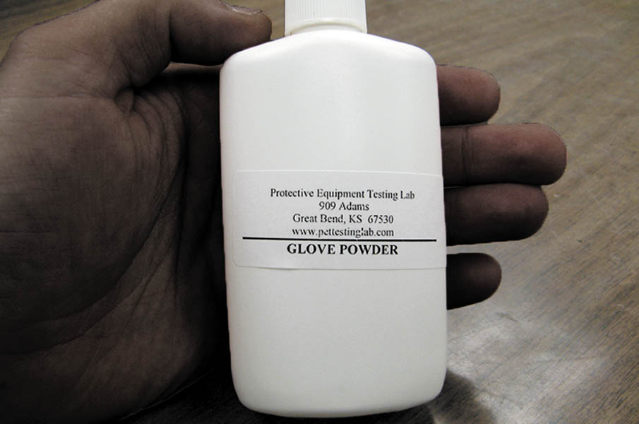
8. Glove powder (glove dust) should be used to absorb moisture and reduce friction.

Slide 56
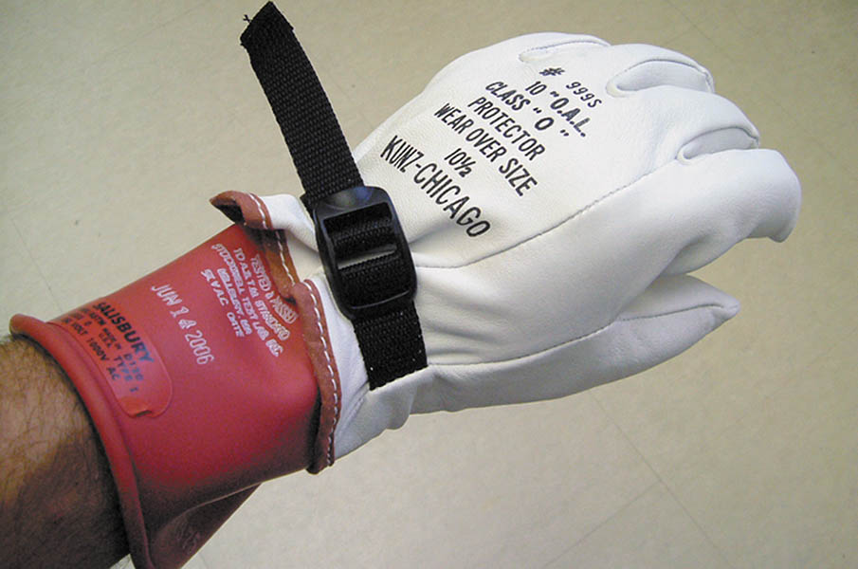
9. Put on the gloves and tighten the straps on the back of the leather protectors.

Slide 57
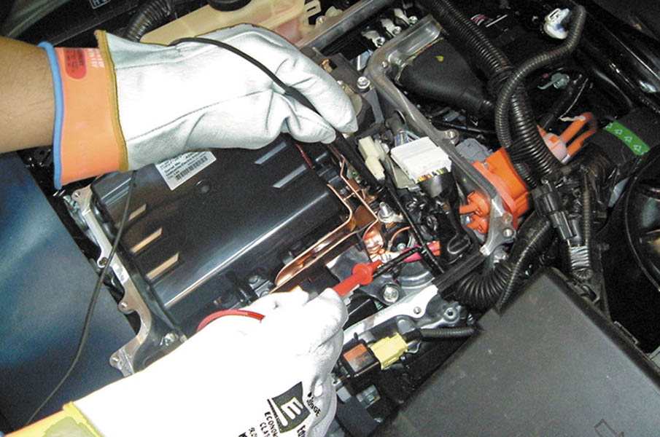
10. Technicians MUST wear HV gloves and leather protectors whenever working around the high-voltage areas of a hybrid electric vehicle.

Slide 58

11. HV gloves and leather protectors should be placed in a canvas storage bag when not in use. Note the ventilation hole at the bottom of this bag.

Slide 59
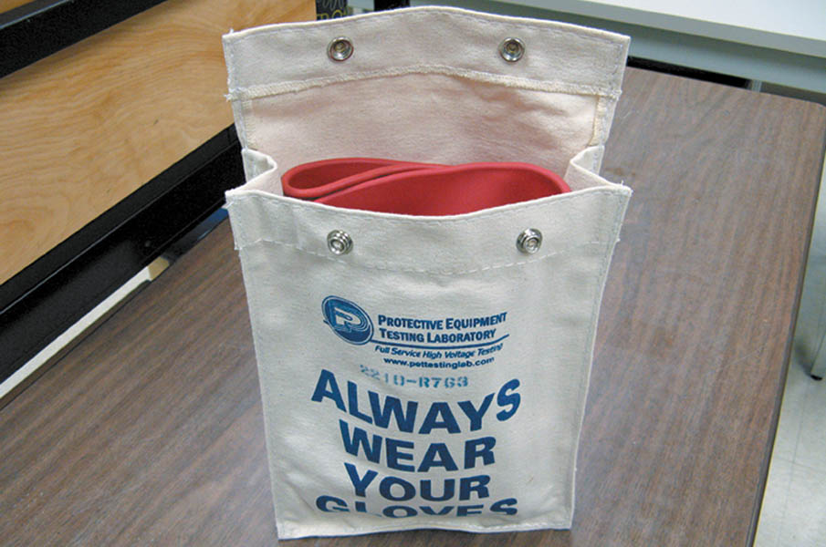
12. Make sure that the rubber gloves are not folded when placed in the canvas bag. Folding increases mechanical stress on the rubber and can lead to premature failure of the glove material.

Slide 60

Copyright

