Slide 1

Automotive Technology Principles, Diagnosis, and Service
Sixth Edition
Chapter 92
Hybrid High-Voltage Batteries
Copyright © 2018, 2015, 2011 Pearson Education, Inc. All Rights Reserved

Slide 2
LEARNING OBJECTIVES
92.1 State the purpose of the auxiliary battery in a hybrid vehicle.
92.2 Explain the types of high-voltage batteries used in most hybrid electric vehicles.
92.3 Describe the purpose of the high-voltage battery monitor.
92.4 List the steps for servicing a high-voltage battery.
92.5 Discuss high-voltage battery charging and safety precautions.

Slide 3
HYBRID AUXILIARY BATTERIES
Purpose and Function
In a hybrid electric vehicle (HEV), the 12-volt auxiliary battery is used to:
Power all of the 12-volt accessories
Power the electronic controller for the high-voltage system
The battery must be in good (serviceable) condition to assure correct hybrid vehicle operation.

Slide 4
HYBRID AND ELECTRIC VEHICLE HIGH-VOLTAGE BATTERIES
Purpose and Function
The high-voltage (HV) system is used to power the electric drive (traction) motor, while a conventional 12-volt system is used to power all other aspects of vehicle operation.
Electric Motor Requirements
HEVs use high-output electric motors to drive and assist vehicle movement. These motors are rated anywhere from 10 to 50 kW. The HV battery provides the voltage that keeps the current flow at a lower level.

Slide 5
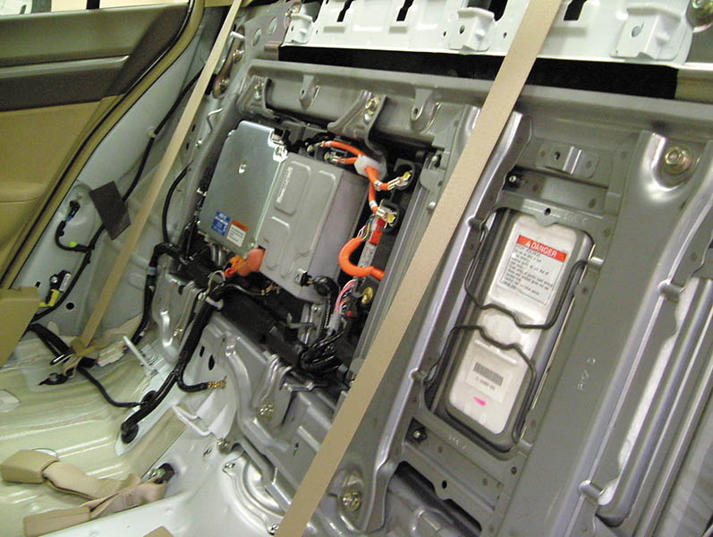
Figure 92.1 The high-voltage battery and motor controls are located behind the rear passenger’s seat in a Honda Civic

Slide 6
NICKEL-METAL HYDRIDE BATTERIES ( 1 OF 5)
Uses
Most current production HEVs use nickel-metal hydride (NiMH) battery technology for the high-voltage battery.
Description and Operation
NiMH uses a positive electrode made of nickel hydroxide and potassium hydroxide electrolyte.
The negative electrode is unique, however, in that it is a hydrogen-absorbing alloy, also known as a metal hydride.

Slide 7
NICKEL-METAL HYDRIDE BATTERIES (2 OF 5)
Electrolyte
NiMH batteries are known as alkaline batteries due to the alkaline (pH greater than 7) nature of the electrolyte
The electrolyte is aqueous potassium hydroxide.
Operation During Charging
Hydrogen ions (protons) travel from the positive electrode to the negative electrode, where they are absorbed into the metal-hydride material.

Slide 8
NICKEL-METAL HYDRIDE BATTERIES (3 OF 5)
Operation During Discharging
The hydrogen ions (protons) travel from the negative electrode back to the positive electrode.
Advantages
High specific energy.
The electrolyte does not react with steel.
The materials used in NiMH batteries are environmentally friendly.
Excellent cycle life.
Durable and safe.

Slide 9
NICKEL-METAL HYDRIDE BATTERIES (4 OF 5)
Disadvantages
High rate of self-discharge, especially at elevated temperatures.
Moderate levels of memory effect, although this seems to be less prominent in newer designs.
Moderate to high cost.
NiMH Battery Design
Cylindrical type
Prismatic type

Slide 10
NICKEL-METAL HYDRIDE BATTERIES (5 OF 5)
Battery Cells are Connected in Series
Each cell of an NiMH battery produces only 1.2 volts. In order to create a battery pack that is capable of producing high voltage, many individual NiMH cells must be connected in series.
High-Voltage Battery Cooling
All current production HEVs use air cooling to control HV battery pack temperature.
Temperature sensors (thermistors) are mounted in various locations in the battery pack housing.

Slide 11
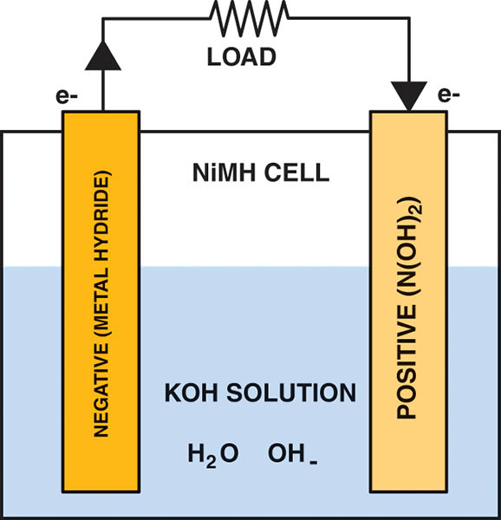
Figure 92.2 A NiMH cell. The unique element in a nickel-metal hydride cell is the negative electrode, which is a hydrogen-absorbing alloy. The positive electrode is nickel hydroxide. The electrolyte does not enter into the chemical reaction and is able to maintain a constant conductivity, regardless of the state of charge of the cell

Slide 12
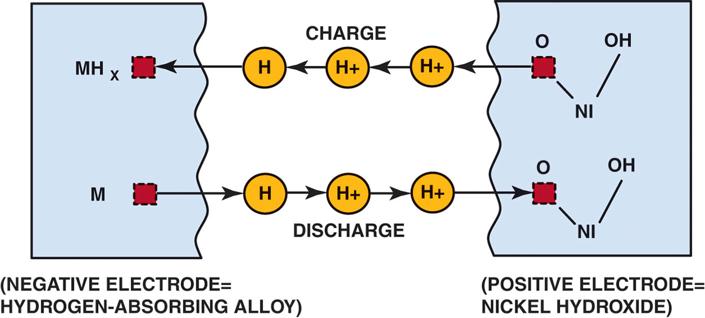
Figure 92.3 Chemical reactions inside an NiMH cell. Charging and discharging both involve an exchange of hydrogen ions (protons) between the two electrodes

Slide 13
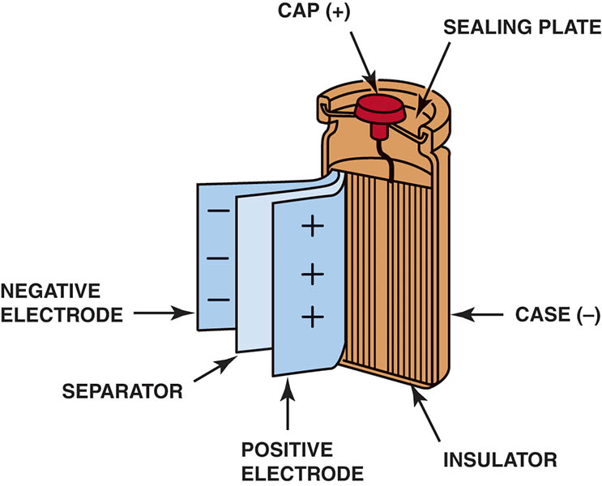
Figure 92.4 Cylindrical-type NiMH batteries are made with stainless steel housing

Slide 14
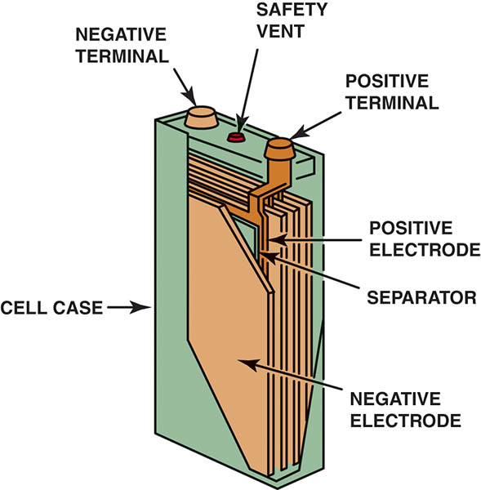
Figure 92.5 A prismatic NiMH cell. Prismatic cells are built with flat plates and separators similar to conventional lead–acid batteries

Slide 15
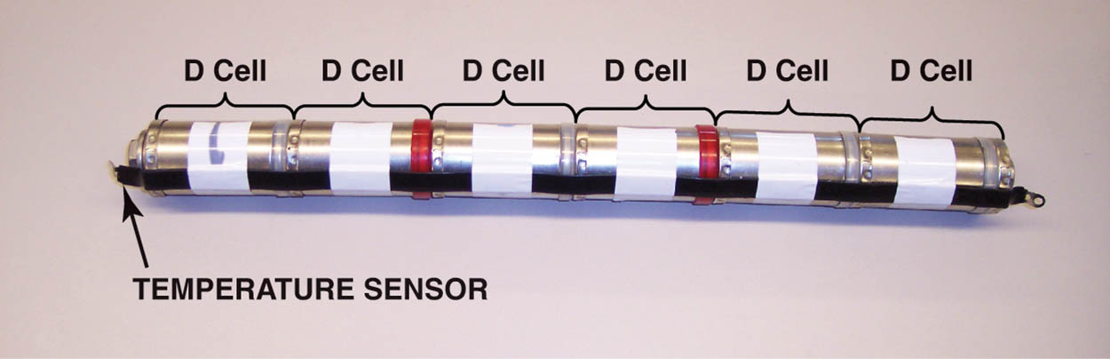
Figure 92.6 Each cell has 1.25 volts and a group of six, as shown, has 7.5 volts. These sections are then connected to other sections to create the high-voltage battery pack

Slide 16
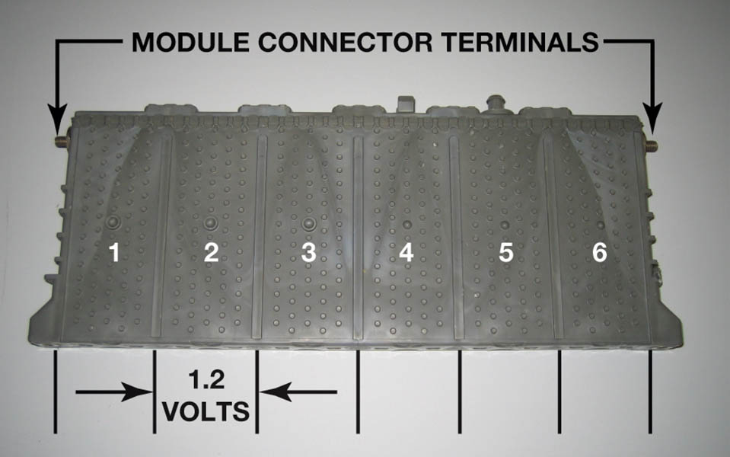
Figure 92.7 A prismatic NiMH module from a Toyota Prius HV battery pack. The battery posts are located on the left and right sides of the module. A self-resealing vent is located on the top right for venting hydrogen gas if the module overheats

Slide 17
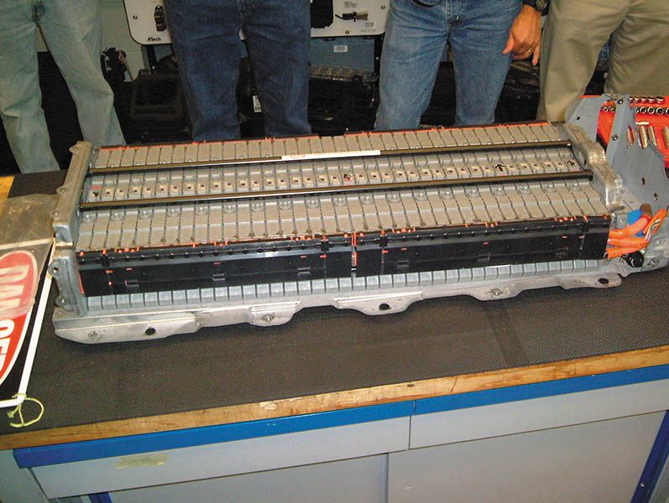
Figure 92.8 A Toyota Camry Hybrid high-voltage battery pack with modules connected in series

Slide 18
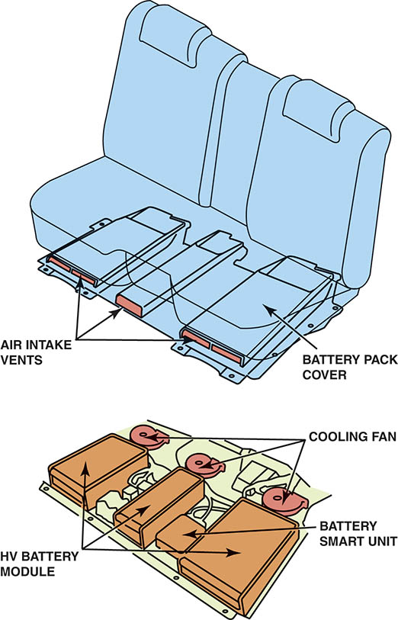
Figure 92.9 The battery cooling system for a Toyota hybrid SUV. All production hybrid HV battery packs are air cooled. Note the air intake vents located under the seats

Slide 19
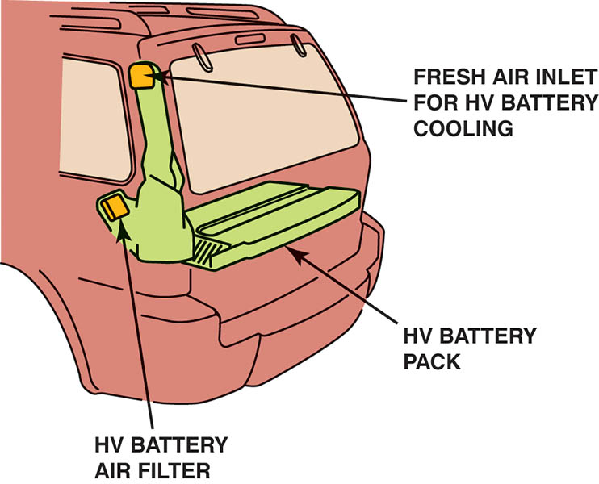
Figure 92.10 The HV battery cooling system from a Ford Escape Hybrid. Ford uses outside air to cool the battery pack, then increases cooling with a separate zone in the A/C system, when necessary

Slide 20
LITHIUM-ION HIGH-VOLTAGE BATTERIES (1 OF 4)
Use
A battery design that shows a great deal of promise for EVs and HEVs applications is lithium-ion (Li-ion) technology.
Currently used in vehicles that plug-in to the grid to recharge the battery.
Description
A lithium-ion cell is so-named because, during battery cycling, lithium ions move back and forth between the positive and negative electrodes.

Slide 21
LITHIUM-ION HIGH-VOLTAGE BATTERIES (2 OF 4)
Construction
The positive electrode in a conventional lithium-ion battery has lithium cobalt oxide as its main ingredient.
The negative electrode being made from a specialty carbon.
The electrolyte is an organic solvent.
Operation
During battery discharge, lithium ions leave the anode (negative electrode) and enter the cathode (positive electrode).
The process is reversed during charging.

Slide 22
LITHIUM-ION HIGH-VOLTAGE BATTERIES (3 OF 4)
Advantages
High specific energy
Good high-temperature performance
Low self-discharge
Minimal memory effect
High nominal cell voltage
Disadvantages
High cost
Issues related to overheating

Slide 23
LITHIUM-ION HIGH-VOLTAGE BATTERIES (4 OF 4)
State of Charge Management
The battery can overheat under the following conditions:
The battery state of charge rises above 80%.
The battery is placed under a load when its SOC is below 20%.
In most HEV applications, a target SOC of 60% is used, and the battery is then cycled so its SOC varies no more than 20% higher or lower than the target.

Slide 24
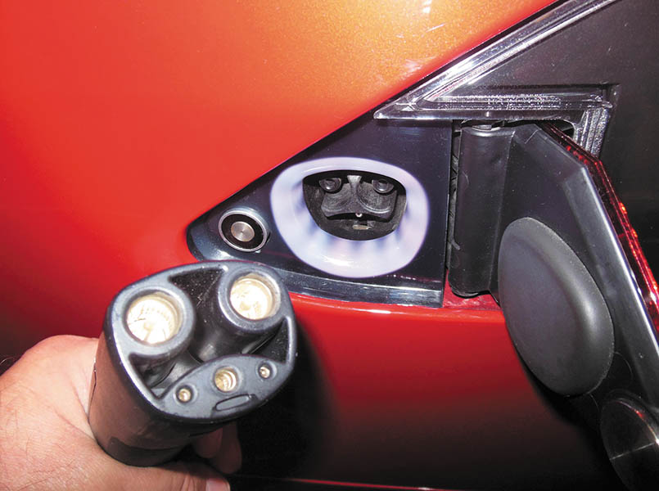
Figure 92.11 A Tesla Model S charge port is located at the left rear behind a door and uses a unique plug that is only used by Tesla

Slide 25
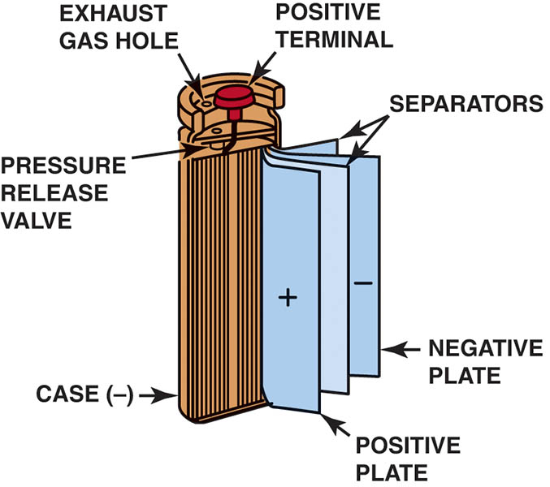
Figure 92.12 Construction of a cylindrical lithium-ion cell. Note the pressure relief valve and exhaust gas hole that relieves internal battery pressure if it gets too hot

Slide 26
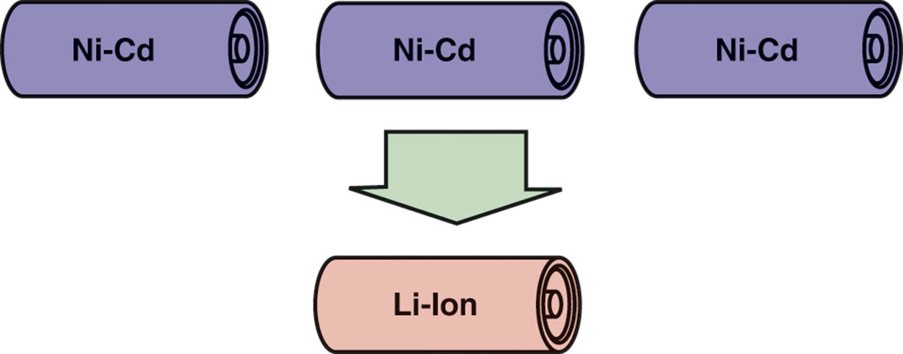
Figure 92.13 One advantage of a lithium-ion cell is that it produces 3.6 volts, whereas an NiMH cell produces only 1.2 volts

Slide 27
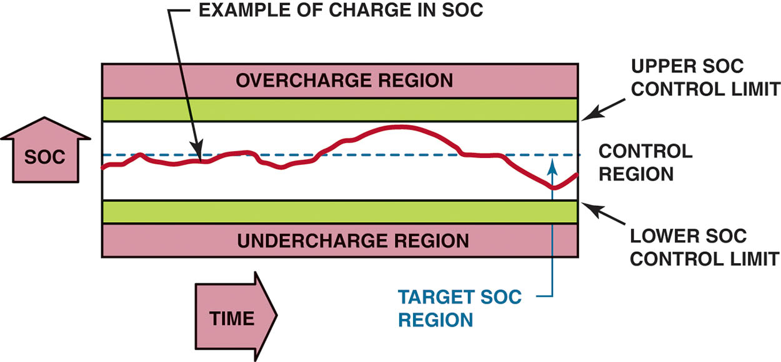
Figure 92.14 The HV battery pack SOC is maintained in a relatively narrow range to prevent overheating and maximize service life

Slide 28
QUESTION 1: ?
What are the two types of Batteries used in most hybrid and electric vehicles today?

Slide 29
ANSWER 1:
Nickel Metal Hydride and Lithium-ion.

Slide 30
HIGH-VOLTAGE BATTERY DISCONNECT LOCATION
Purpose and Function
Most HEVs are equipped with a high-voltage disconnect switch or connector that is used to cut off high voltage from the rest of the system beyond the battery pack.
Battery Type and Safety Switch/Plug Location
See service information for the location and type of batteries used for the high-voltage system and the location of the high-voltage disconnect switch.

Slide 31
OTHER HIGH-VOLTAGE BATTERY TYPES
Nickel Cadmium
Lithium Polymer
Zink-Air
Zebra Battery

Slide 32
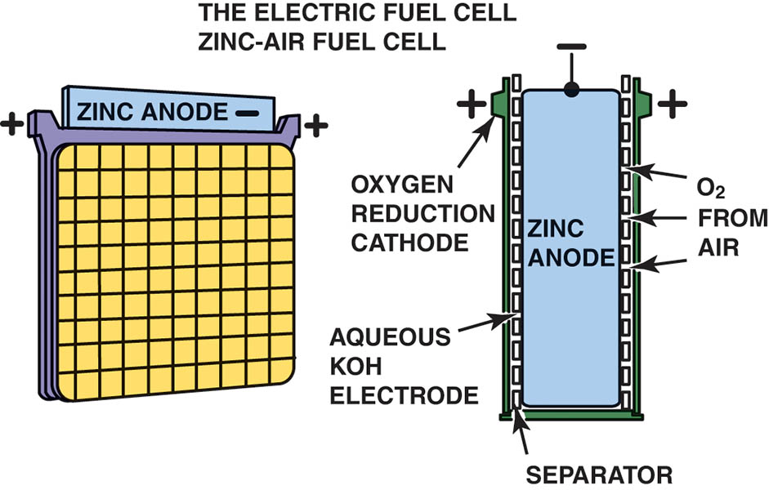
Figure 92.15 Zinc-air batteries are recharged by replacing the zinc anodes. These batteries are also considered to be a type of fuel cell, because the positive electrode is oxygen taken from atmospheric air

Slide 33
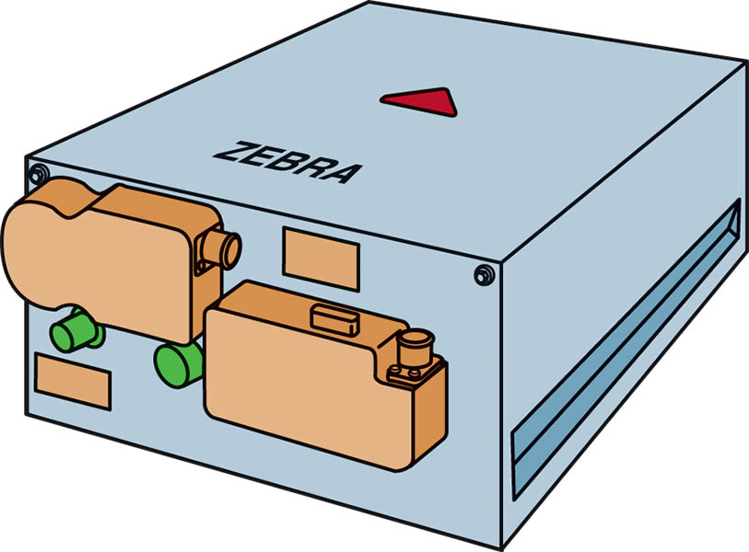
Figure 92.16 Sodium-metal-chloride batteries are also known as ZEBRA batteries. These batteries are lightweight (40% of the weight of lead–acid) and have a high energy density

Slide 34
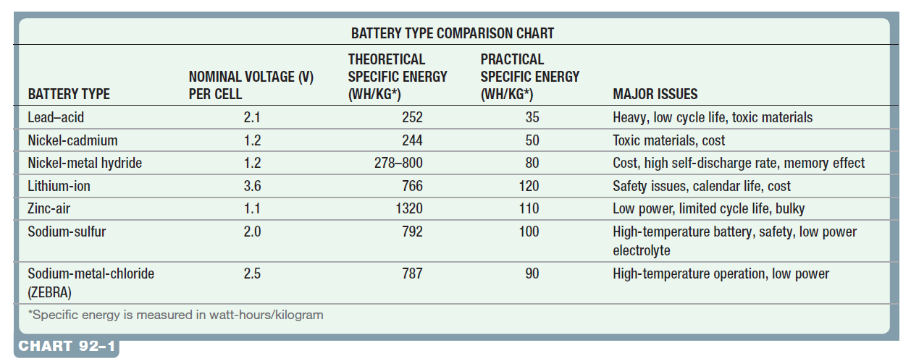
BATTERY COMPARISON

Slide 35
HIGH-VOLTAGE BATTERY MONITOR
State of Charge
Normal operating HV battery SOC range for most hybrid electric vehicles is within 52% to 68%.
Scan Data Test Procedure
Battery temperature
Battery voltage
State of charge
Battery current draw
Battery block internal resistance

Slide 36
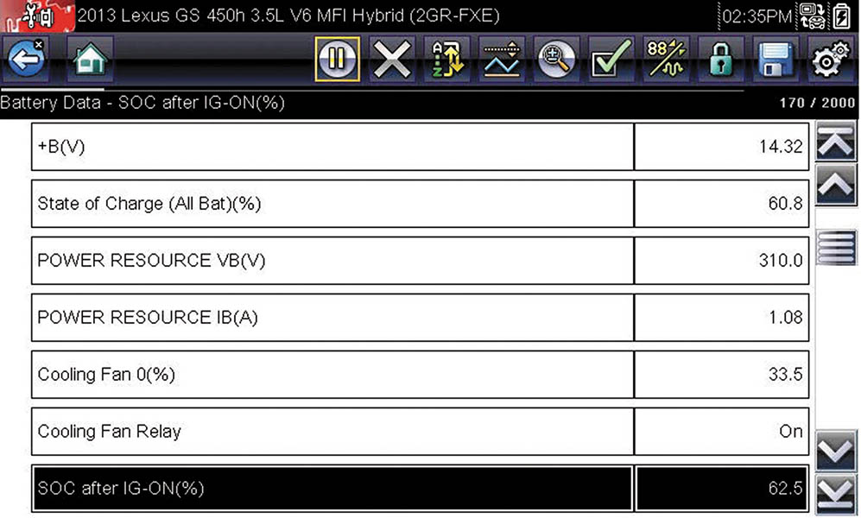
Figure 92.17 A Snap-on Solus scan tool displays the state of charge of the high-voltage battery under the heading of “HV ECM.”

Slide 37
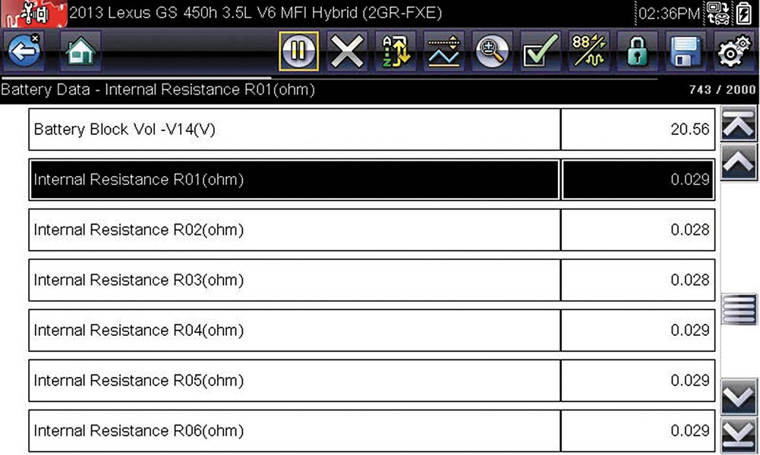
Figure 92.18 The internal resistance of the battery blocks are available on the data stream, as shown, using an aftermarket scan tool. The internal resistance should be between 15 and 40 milliohms (0.015 to 0.040 Ohms)

Slide 38
QUESTION 2: ?
What is the normal SOC range for most hybrid electric vehicles?

Slide 39
ANSWER 2:
The normal SOC is 52%-68%.

Slide 40
OUT-OF-VEHICLE HV BATTERY SERVICE
Procedure
Follow the manufacturer’s recommended service procedures and safety instructions when disassembling a HV battery.
Determine Internal Resistance
To determine the internal resistance of a battery block (two modules), compare the unloaded voltage to the voltage of the block under the load that was applied by the resistor, which is called the delta (Δ) or the change in the voltage.
Match State of Charge
Connecting batteries in series requires the batteries be close to the same voltage.

Slide 41
HIGH VOLTAGE BATTERY CHARGING
If the HV battery in an HEV becomes discharged, the first step should be getting the vehicle started to recharge the battery pack.
The procedure varies, depending on the model in question.
Always follow the manufacturer’s specified procedures when starting a disabled hybrid vehicle.

Slide 42
HIGH-VOLTAGE BATTERY SAFETY PRECAUTIONS
Do not work on the vehicle if moisture is present.
If service must be performed on the hybrid system, be sure to disconnect the HV battery and allow enough time for system capacitors to discharge before proceeding.
If an electrical fire occurs, do not attempt to extinguish it using water. Use an ABC fire extinguisher or wait for firefighters to deal with it.
ALWAYS refer to the service manual for approved safety procedures when handling the HV battery pack.
Read all warning labels and always follow the vehicle manufacturer’s instructions.

Slide 43
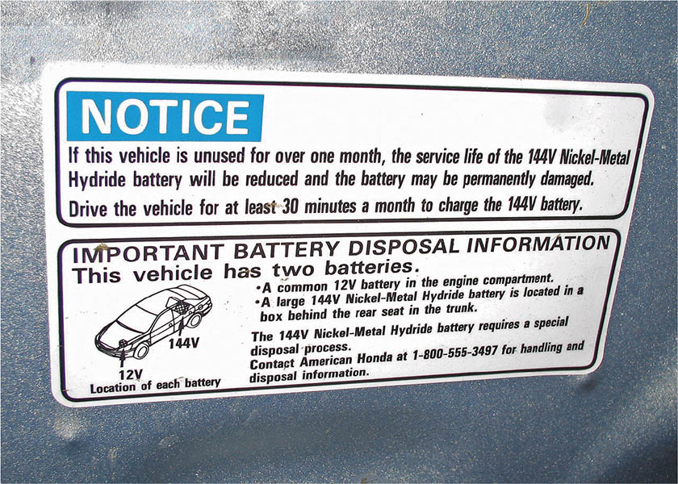
Figure 92.19 A battery service warning label from a Honda hybrid electric

Slide 44
HV BATTERY PACK SERVICE

Slide 45
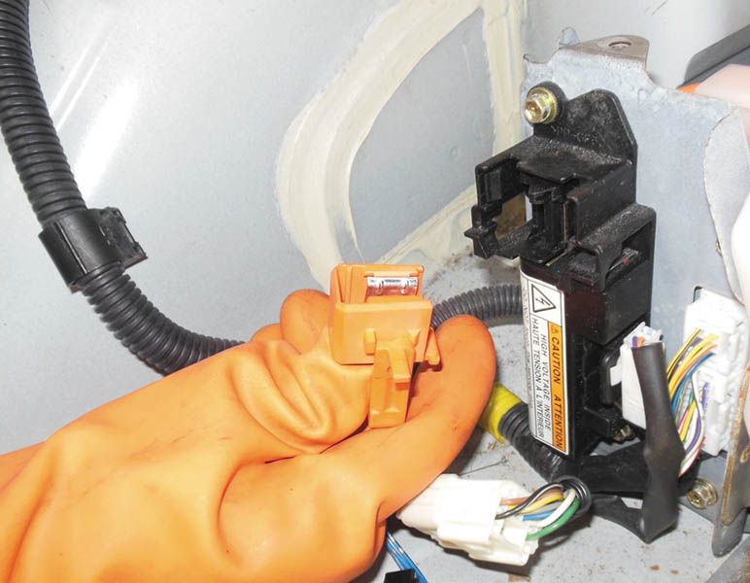
1. To depower the high-voltage system, the ignition is off and the negative battery cable is disconnected from the 12-volt auxiliary battery, then the HV battery safety plug is removed.

Slide 46
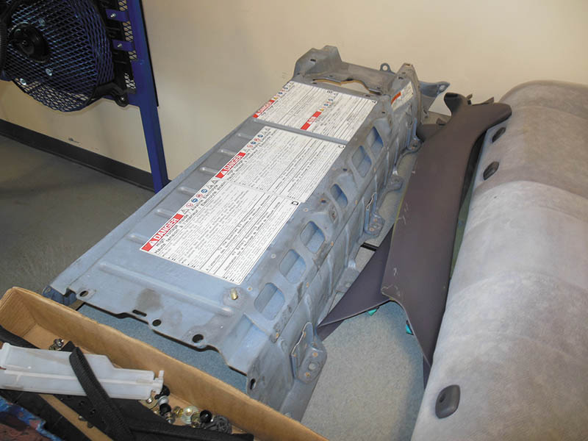
2. After checking that the voltage level is safe, the rear seat and HV battery cover are removed. Always follow the safety procedures specified by the manufacturer for the vehicle being serviced and adhere to all safety warnings and precautions.

Slide 47
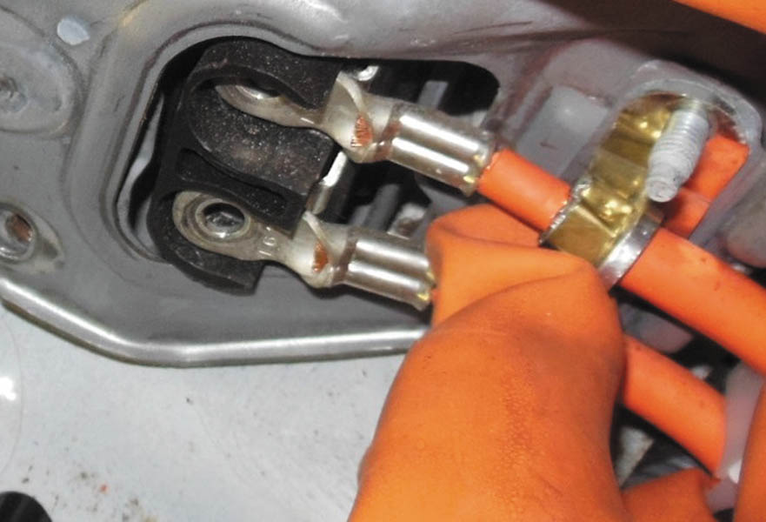
3. The high-voltage wires are removed from the battery pack while wearing HV gloves.

Slide 48
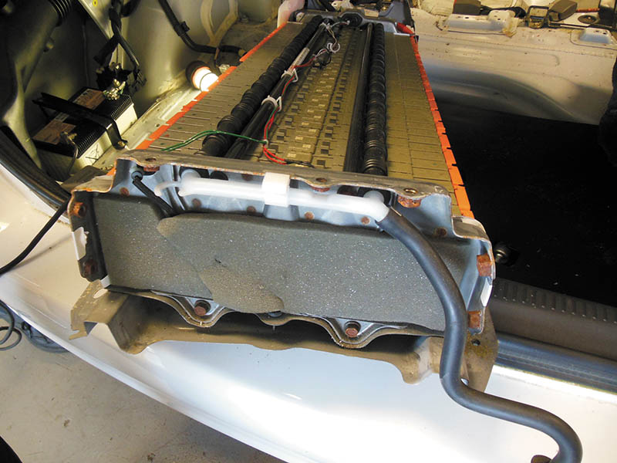
4. The HV battery pack is being removed through the rear of the vehicle.

Slide 49
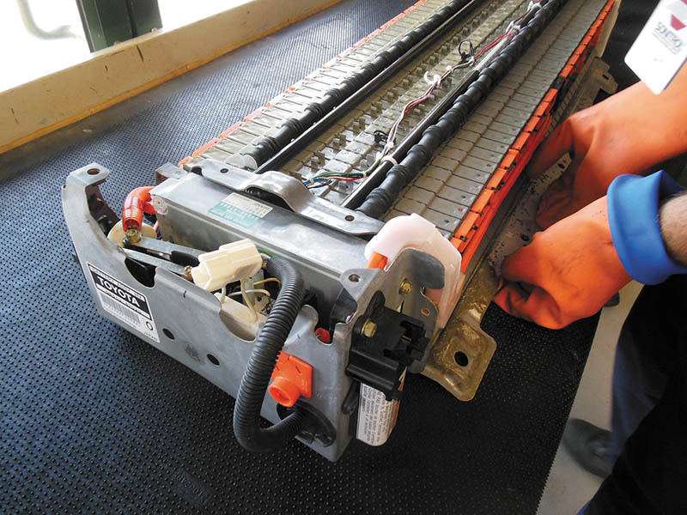
5. The HV battery pack is placed on a workbench that is covered with a thick rubber (insulating) mat. A wood top bench can also be used.

Slide 50
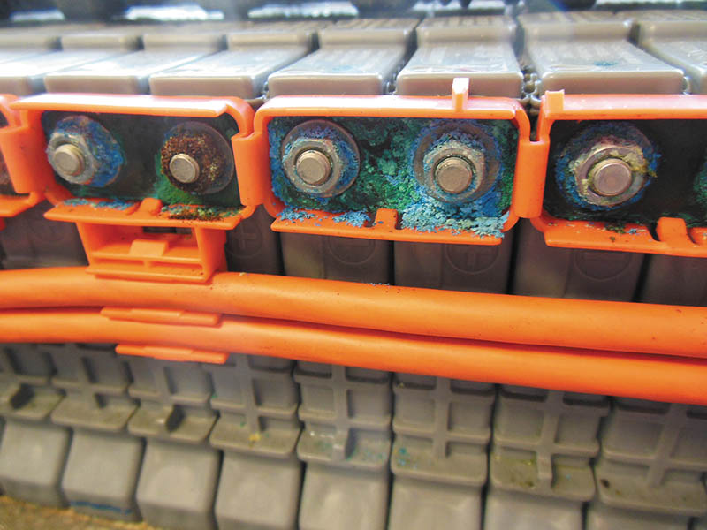
6. A visual inspection shows that many electrical connections between battery modules are corroded.

Slide 51
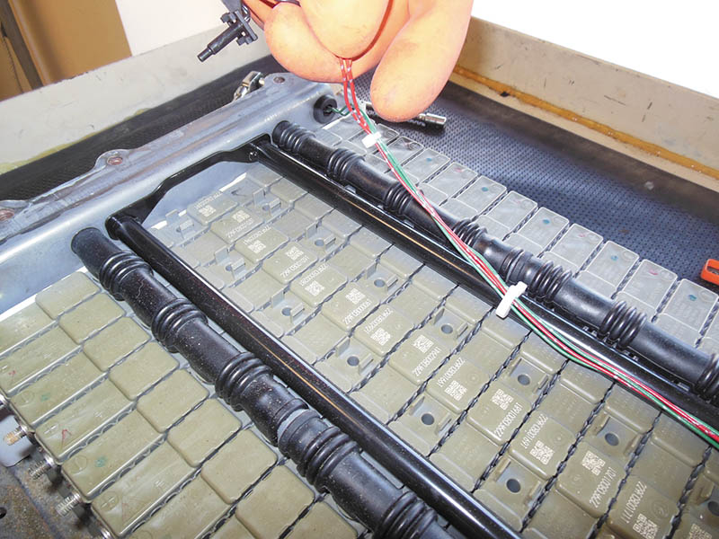
7. The HV battery pack temperature sensors are removed.

Slide 52
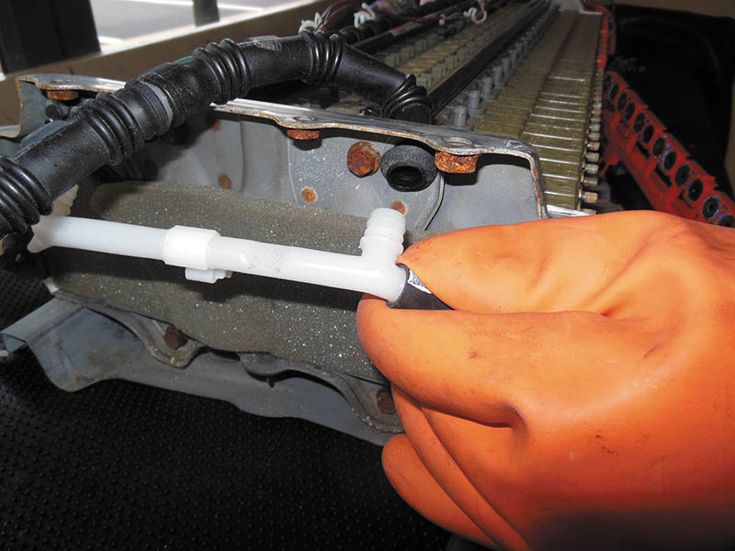
8. The HV battery vent tubes are removed from the battery pack.

Slide 53
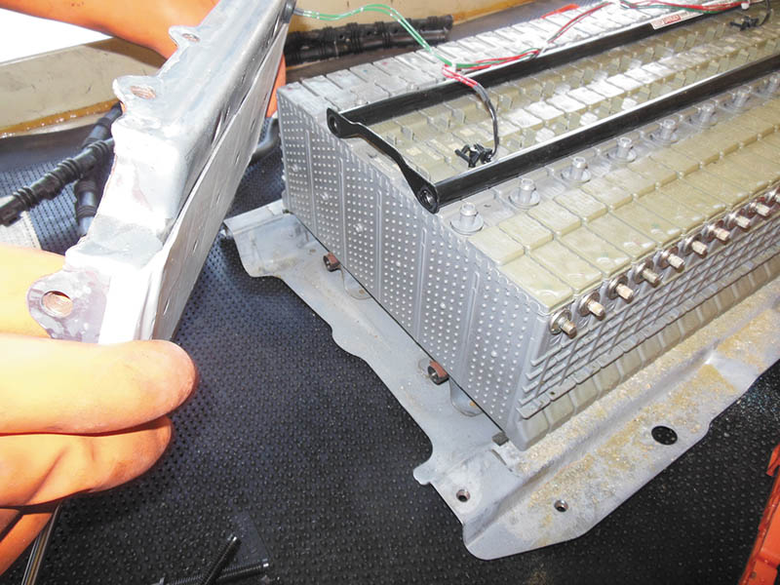
9. The end caps are removed from the battery pack.

Slide 54
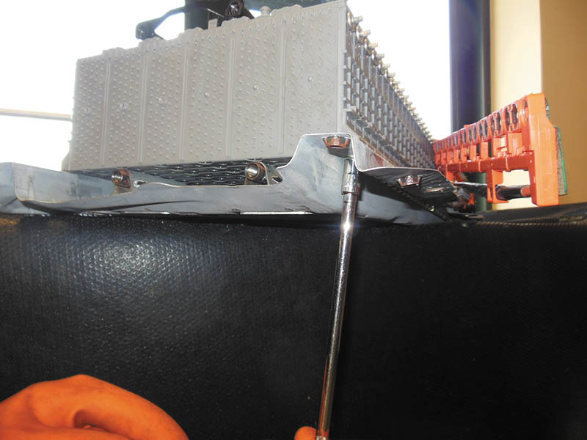
10. The fasteners that hold the battery modules to the base of the battery pack are removed.

Slide 55
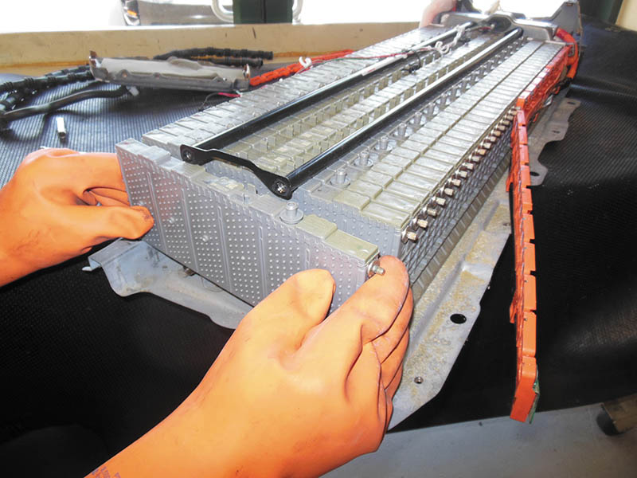
11. The end module is being removed from the battery pack.

Slide 56
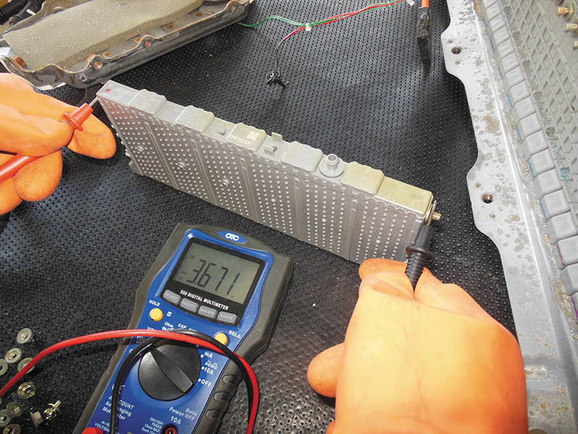
12. The individual modules are measured using a voltmeter and most modules are found to be about 3.6 volts, which is far below the minimum of 5.4 volts that most experts think can be restored by charging.

Slide 57

Copyright

