Slide 1
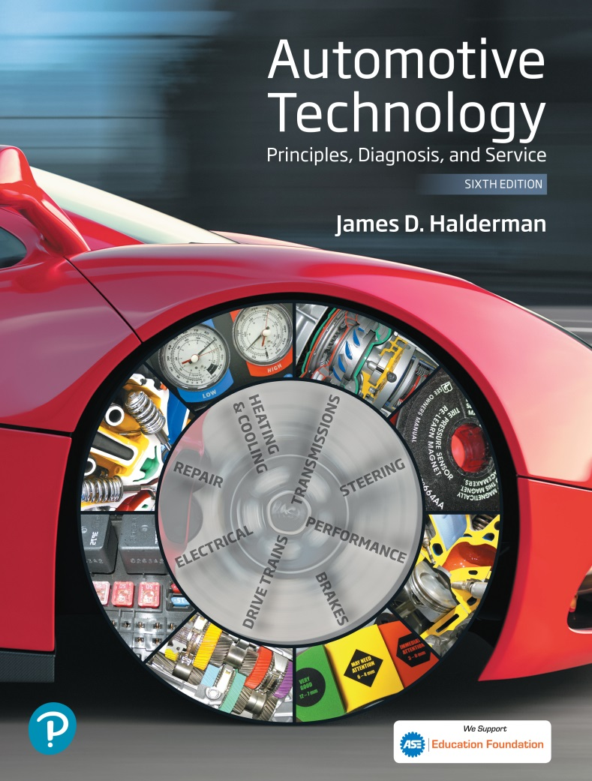
Automotive Technology Principles, Diagnosis, and Service
Sixth Edition
Chapter 91
Introduction to Hybrid Vehicles
Copyright © 2018, 2015, 2011 Pearson Education, Inc. All Rights Reserved

Slide 2
LEARNING OBJECTIVES (1 of 2)
91.1 Discuss the evolution of electric and hybrid vehicles.
91.2 Describe how owning a hybrid electric vehicle is different from a conventional vehicle.
91.3 Explain the classifications of hybrid electric vehicles.

Slide 3
LEARNING OBJECTIVES (2 of 2)
91.4 Explain the operation of belt-alternator-starter (BAS) systems.
91.5 Discuss the common features of most hybrids and the levels of hybrid vehicle.

Slide 4
HYBRID VEHICLE
Definition of Terms
  A hybrid vehicle is one that uses two different methods to propel the vehicle.
  Most hybrid vehicles use a high-voltage battery pack and a combination electric motor and generator to help or assist a gasoline engine.
  In some designs, is capable of propelling the vehicle alone without having to start the internal combustion engine.

Slide 5
ELECTRIC VEHICLES (1 OF 2)
Early Electric Vehicles
  The controller was operated by the driver and allowed different voltages to be applied to the electric motor, depending on the needs of the driver.
  Early electric vehicles did not have a long range and needed to have the batteries charged regularly, which meant that electric vehicles could only be used for short distances.

Slide 6
ELECTRIC VEHICLES (2 OF 2)
Newer Electric Vehicles
  In the late 1990s, several vehicle manufacturers produced electric vehicles, using electronic controllers to meet the demands for zero emission vehicles.
  By 2010, there were several electric vehicles for sale, although often in limited parts of the country and in limited numbers.

Slide 7
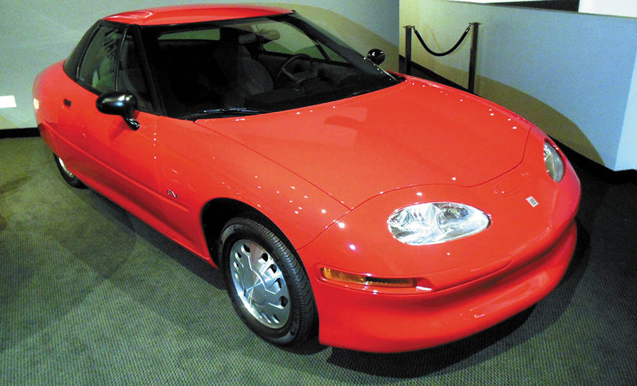
Figure 91.1 One of the last remaining General Motor’s EV1 on display at the Peterson Museum in Los Angles, California

Slide 8
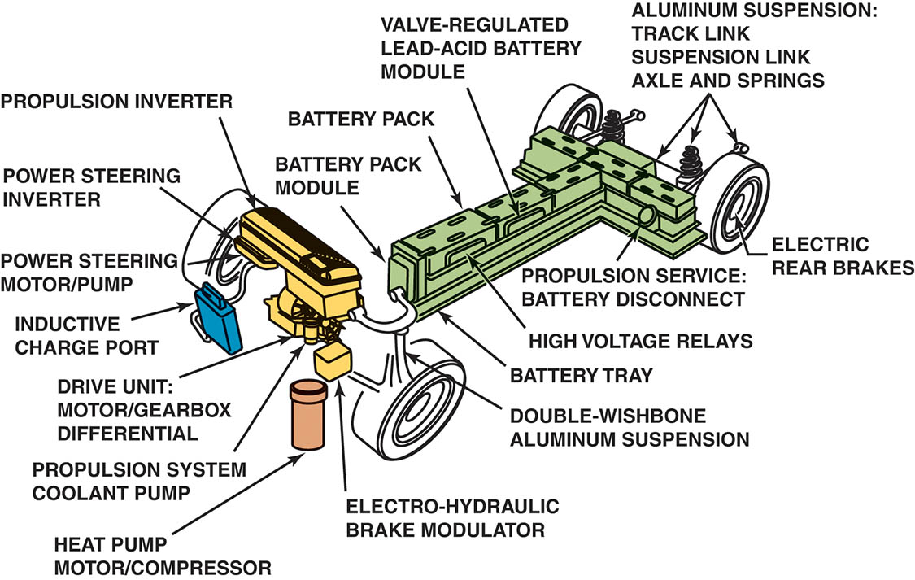
Figure 91.2 General Motors EVI shown without the body. Many of the features of this vehicle, such as regenerative braking, currently used on hybrid vehicles were first put into production on this vehicle

Slide 9
DRIVING AND OWNING A HYBRID ELECTRIC VEHICLE (1 OF 2)
Driving a Hybrid Vehicle
  Some unique characteristics that the driver may or may not notice include:
  The engine stops when the vehicle slows down and stops.
  The brake pedal may feel different, especially at slow speeds of about 5 mph and 15 mph when slowing to a stop.
  Some hybrid electric vehicles are able to propel the vehicle using the electric motor alone

Slide 10
DRIVING AND OWNING A HYBRID ELECTRIC VEHICLE (2 OF 2)
Owning a Hybrid Electric Vehicle
  The fuel economy is higher compared to a similar-type vehicle.
  A hybrid electric vehicle costs and weighs more than a conventional vehicle.

Slide 11
CLASSIFICATIONS OF HYBRID ELECTRIC VEHICLES
Series Hybrid
  In a series-hybrid design, sole propulsion is by a battery-powered electric motor
  The electric energy for the batteries comes from another on-board energy source, such as an internal combustion engine.
  The engine is only operated to keep the batteries charged

Slide 12
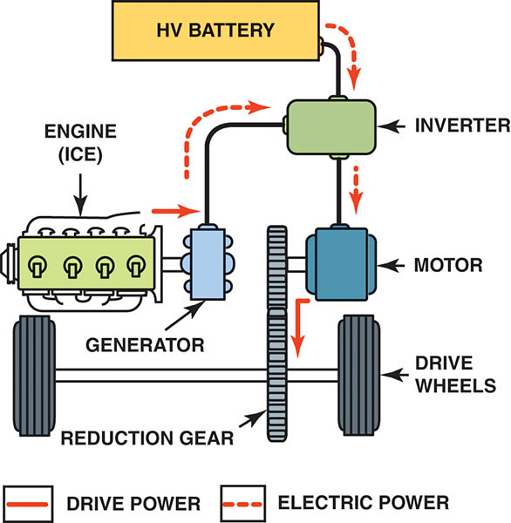
Figure 91.3 A drawing of the power flow in a typical series-hybrid vehicle

Slide 13
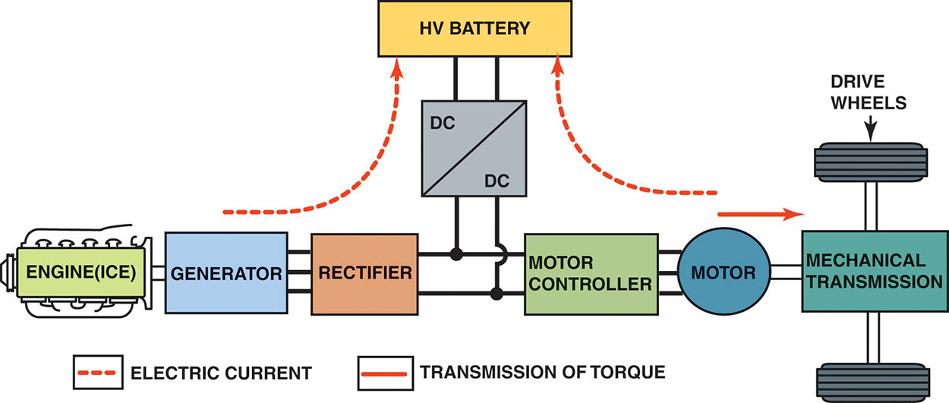
Figure 91.4 This diagram shows the components included in a typical series-hybrid design. The solid-line arrow indicates the transmission of torque to the drive wheels. The dotted-line arrows indicate the flow of electrical current

Slide 14
CLASSIFICATIONS OF HYBRID ELECTRIC VEHICLES
Parallel Hybrid
  The vehicle using a parallel-hybrid design can be powered by the internal combustion engine alone, by the electric motor alone (full hybrids only), or by a combination of engine and electric motor propulsion.
  One of the advantages of using a parallel hybrid design is that by using an electric motor or motors to assist the internal combustion engine, the engine itself can be smaller than would normally be needed.

Slide 15
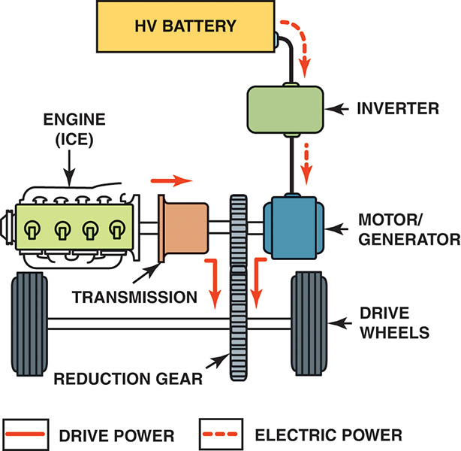
Figure 91.5 The power flow in a typical parallel-hybrid vehicle

Slide 16
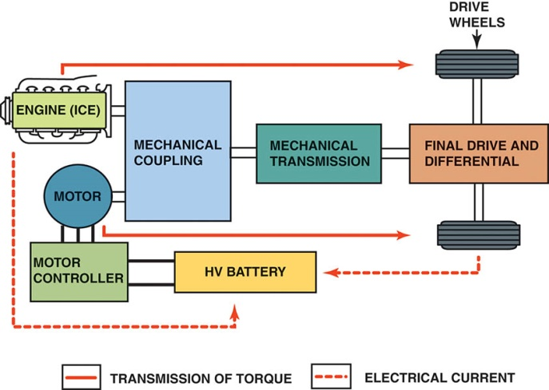
Figure 91.6 Diagram showing the components involved in a typical parallel-hybrid vehicle. The solid-line arrows indicate the transmission of torque to the drive wheels, and the dotted-line arrows indicate the flow of electrical current

Slide 17
CLASSIFICATIONS OF HYBRID ELECTRIC VEHICLES
Series-Parallel Design
  Series-parallel hybrids combine the functions of both a series and a parallel design.
  The vehicle operates using electric motor power alone or with the assist of the ICE.
  The internal combustion engine may be operating, even though the vehicle is stopped if the batteries need to be charged.

Slide 18
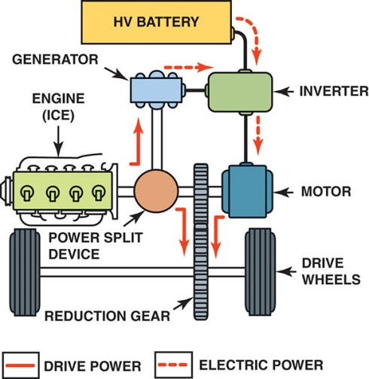
Figure 91.7 A series-parallel hybrid design allows the vehicle to operate in electric motor mode only or in combination with the internal combustion engine

Slide 19
QUESTION 1: ?
What are the three classifications of hybrid powertrain?

Slide 20
ANSWER 1:
Series, parallel, and series-parallel.

Slide 21
BELT ALTERNATOR STARTER SYSTEMS
Parts and Operation
  The BAS concept is to replace the belt-driven alternator with an electric motor that serves as a generator and a motor.
  When the engine is running, the BAS system acts as a generator, it charges a separate 36-volt battery (42-volt charging voltage).
  The engine stops at idle.
  The BAS motor is used to crank the engine by taking electrical power from the 36-volt battery pack and applies its torque via the accessory belt, and cranks the engine instead of using the starter motor.

Slide 22
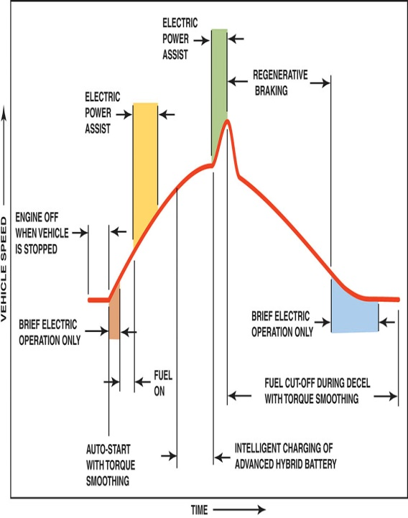
Figure 91.8 This chart shows what is occurring during various driving conditions in a BAS-type hybrid

Slide 23
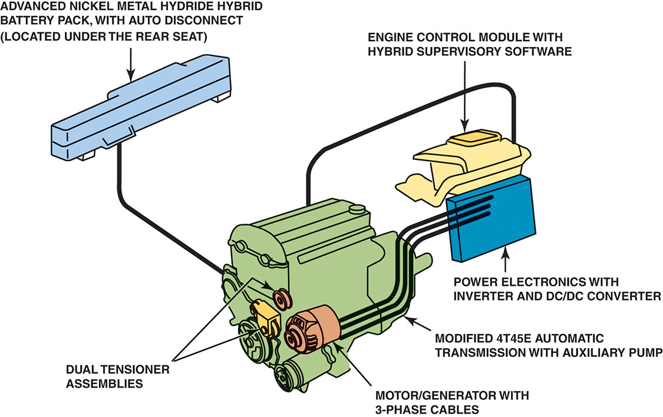
Figure 91.9 The components of a typical belt alternator-starter (BAS) system

Slide 24
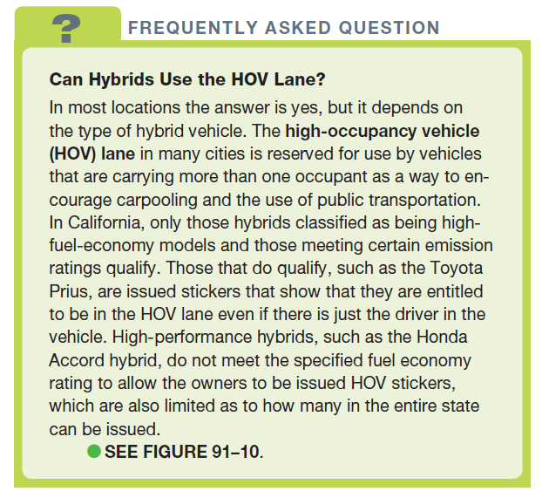
FREQUENTLY ASKED QUESTION

Slide 25

Figure 91.10 This sticker on a hybrid vehicle allows the driver to use the high-occupancy vehicle (HOV) lanes, even if there is only one person in the vehicle, as a way to increase demand for hybrid vehicles in California

Slide 26
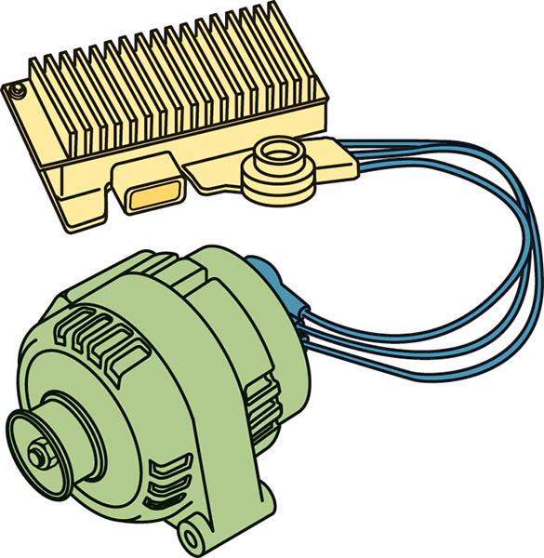
Figure 91.11 A combination starter/alternator is used to provide idle stop function to conventional vehicles. This very limited and low-cost system is called a micro-hybrid drive

Slide 27
QUESTION 2: ?
What is the main advantage of BAS system?

Slide 28
ANSWER 2:
Low cost hybrid features.

Slide 29
MODES OF OPERATION
The following are the most common features of hybrids that improve fuel economy:
  Idle stop. The idle stop mode turns off the engine when the vehicle is stopped
  Regenerative braking. When decelerating, the braking system captures the energy from the vehicle’s inertia and charges the battery.
  Power assist. The electric motor assists the internal combustion engine during acceleration.
  Engine-off drive-electric vehicle mode. The electric motor propels the vehicle at lower speeds.

Slide 30
LEVELS OF HYBRID VEHICLES
Mild Hybrid
  A mild hybrid incorporates idle stop and regenerative braking, but is not capable of using the electric motor to propel the vehicle on its own
Medium Hybrid
  A medium hybrid uses 144- to 158-volt batteries that provide for engine stop/start, regenerative braking, and power assist.
Full Hybrid
  A full hybrid, also called a strong hybrid, uses idle stop regenerative braking, and is able to propel the vehicle using the electric motor(s) alone.

Slide 31
QUESTION 3: ?
What are the three levels of hybrid vehicles?

Slide 32
ANSWER 3:
Mild, medium and full hybrids.

Slide 33

Copyright

