Slide 1

Automotive Technology Principles, Diagnosis, and Service
Sixth Edition
Chapter 90
Scan Tools and Engine Performance Diagnosis
Copyright © 2018, 2015, 2011 Pearson Education, Inc. All Rights Reserved

Slide 2
LEARNING OBJECTIVES (1 of 2)
90.1 List the steps of the diagnostic process.
90.2 Discuss the types of scan tools that are used to assess vehicle components.
90.3 List the steps for retrieving diagnostic information from the PCM.
90.4 Explain the troubleshooting procedures to follow if a diagnostic trouble code has been set.

Slide 3
LEARNING OBJECTIVES (2 of 2)
90.5 Describe the methods for reprogramming (reflashing) a vehicle computer and performing a drive cycle.
90.6 This chapter will help you prepare for the ASE computerized engine controls diagnosis (A8) certification test content area “E.”

Slide 4
THE EIGHT-STEP DIAGNOSTIC PROCEDURE
Step 1 Verify the Problem (Concern)
Before a minute is spent on diagnosis, be certain that a problem exists.
Step 2 Perform a Thorough Visual Inspection and Basic Tests
Check for obvious problems (basics, basics, basics).
Check everything that does and does not work.
Look for evidence of previous repairs.
Check oil level and condition.
Check coolant level and condition.

Slide 5
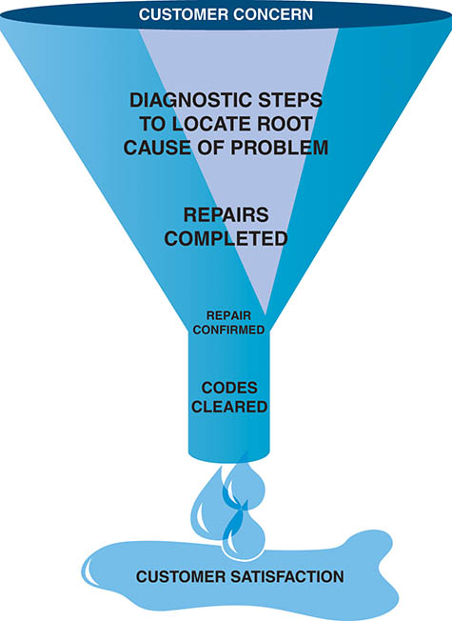
Figure 90.1 A funnel is one way to visualize the diagnostic process. The purpose is to narrow the possible causes of a concern until the root cause is determined and corrected

Slide 6
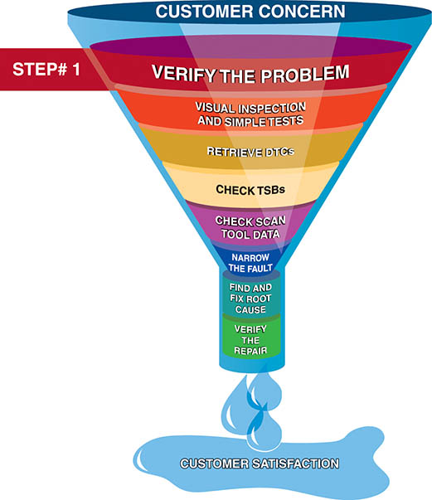
Figure 90.2 Step 1 is to verify the customer concern or problem. If the problem cannot be verified, then the repair cannot be performed

Slide 7
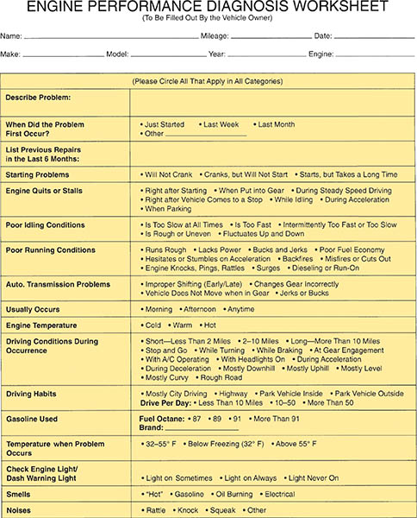
Figure 90.3 A form that the customer should fill out if there is a driveablilty concern to help the service technician more quickly find the root cause

Slide 8
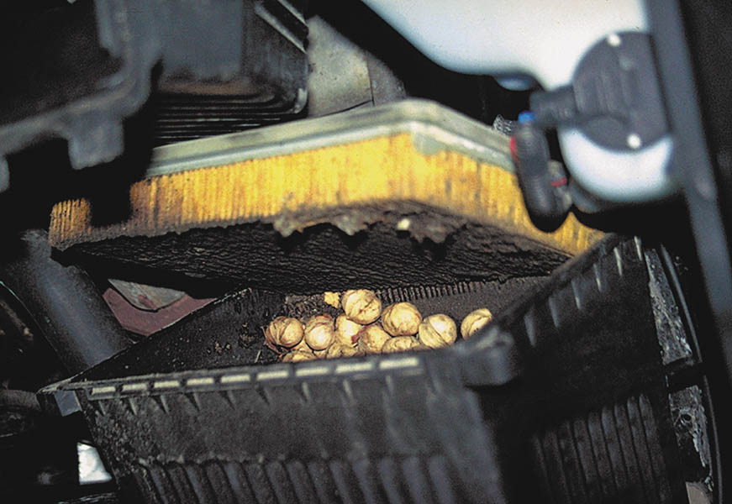
Figure 90.4 This is what was found when removing an air filter from a vehicle that had a lack-of-power concern. Obviously, the nuts were deposited by squirrels or some other animal, blocking a lot of the airflow into the engine

Slide 9
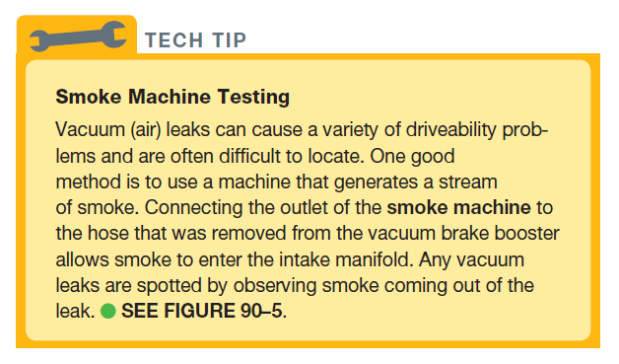
Tech Tip

Slide 10
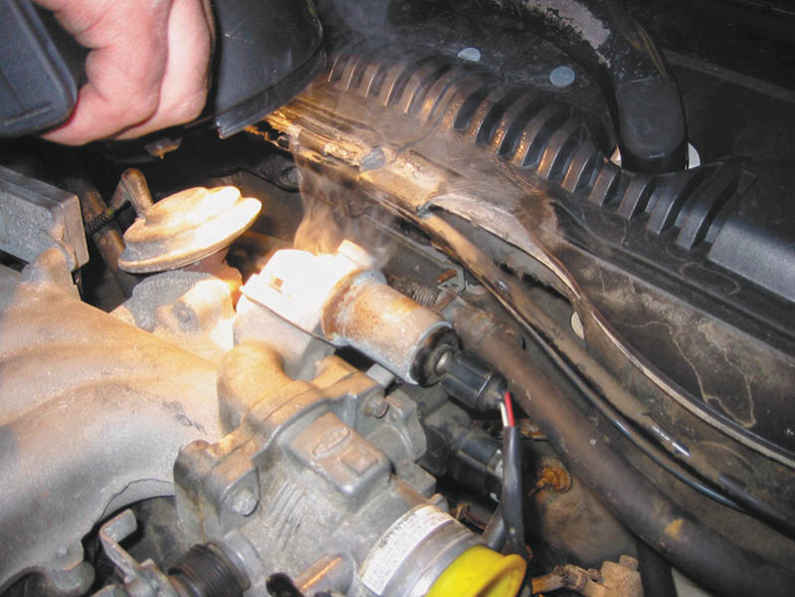
Figure 90.5 Using a bright light makes seeing where the smoke is coming from easier. In this case, smoke was added to the intake manifold with the inlet blocked with a yellow plastic cap and smoke was seen escaping past a gasket at the idle air control

Slide 11
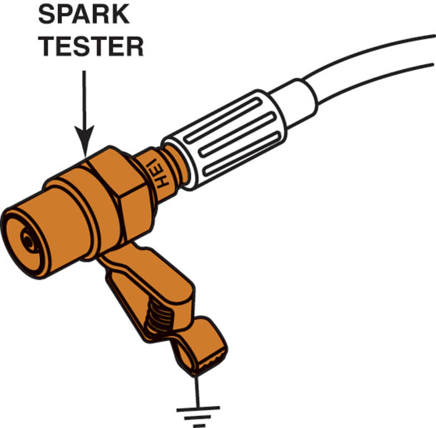
Figure 90.6 A spark tester connected to a spark plug wire or coil output. A typical spark tester fires only if at least 25,000 volts is available from the coil, making a spark tester a useful tool. Do not use one that just lights when a spark is present, because it does not require more than about 2,000 volts to light

Slide 12
THE EIGHT-STEP DIAGNOSTIC PROCEDURE
Step 3 Retrieve the Diagnostic Trouble Codes (DTCs)
If a diagnostic trouble code (DTC) is present in the computer memory, it may be signaled by illuminating a malfunction indicator lamp (MIL), commonly labeled “check engine” or “service engine soon.”

Slide 13
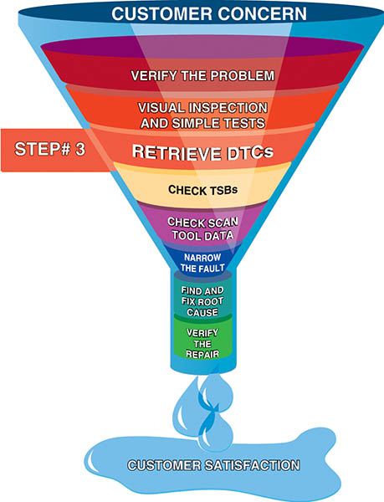
Figure 90.7 Step 3 in the diagnostic process is to retrieve any stored diagnostic trouble codes

Slide 14
THE EIGHT-STEP DIAGNOSTIC PROCEDURE
Step 4 Check For Technical Service Bulletins
Check for corrections in technical service bulletins (TSBs) that match the symptoms.
As many as 30% of vehicles can be repaired following the information, suggestions, or replacement parts found in a service bulletin.

Slide 15
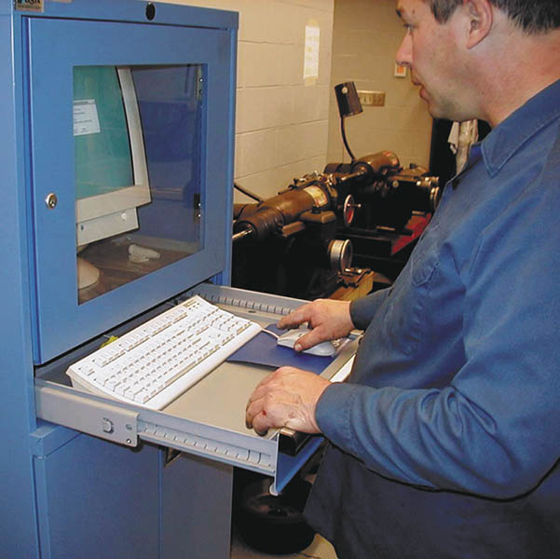
Figure 90.8 After checking for stored diagnostic trouble codes (DTCs), the wise technician checks service information for any technical service bulletins (TSBs) that may relate to the vehicle being serviced

Slide 16
THE EIGHT-STEP DIAGNOSTIC PROCEDURE
Step 5 Look Carefully at Scan Tool Data
Vehicle manufacturers have been giving the technician more and more data on a scan tool connected to the data link connector (DLC).
The best way to look at scan data is in a definite sequence and with specific, selected bits of data that can tell the most about the operation of the engine

Slide 17
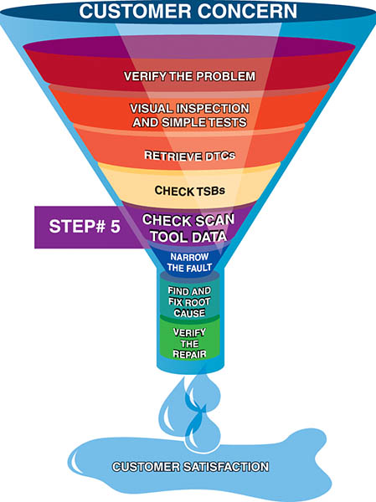
Figure 90.9 Looking carefully at the scan tool data is very helpful in locating the source of a problem

Slide 18
THE EIGHT-STEP DIAGNOSTIC PROCEDURE
Step 6 Narrow the Problem to a System or Cylinder
Narrowing the focus to a system or individual cylinder is the hardest part of the entire diagnostic process.
Perform specific tests such as a power balance test, a compression test, or a cylinder leakage test.
Step 7 Repair the Problem and Determine the Root Cause
The repair or part replacement must be performed following vehicle manufacturer’s recommendations.

Slide 19
THE EIGHT-STEP DIAGNOSTIC PROCEDURE
Step 8 Verify the Repair and Clear any Stored DTCs
Test-drive to verify that the original problem (concern) is fixed.
Verify that no additional problems have occurred during the repair process.
Check for and then clear all DTCs.

Slide 20
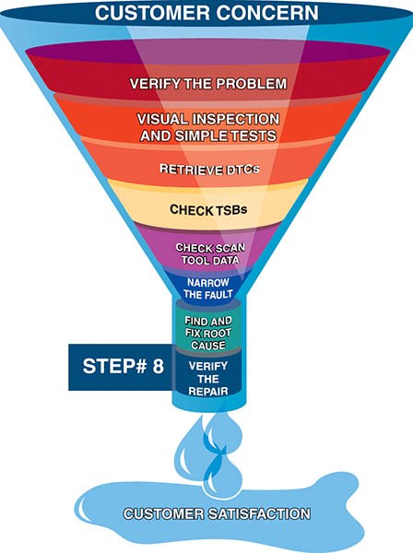
Figure 90.10 Step 8 is very important. Be sure that the customer’s concern has been corrected

Slide 21
QUESTION 1: ?
What is the purpose of the eight step diagnostic process?

Slide 22
ANSWER 1:
To ensure the concern is properly identified and fixed correctly on the first visit.

Slide 23
SCAN TOOLS
Scan tools can be divided into two basic groups:
Factory Scan Tools
Factory scan tools are designed to provide bidirectional capability
Factory scan tools are capable of displaying all factory parameters.
Aftermarket Scan Tools
While many aftermarket scan tools can display most, if not all, of the parameters of the factory scan tool, there can be a difference when trying to troubleshoot some faults

Slide 24
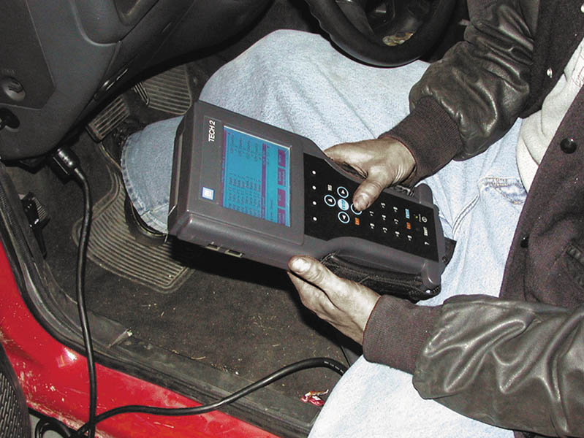
Figure 90.11 A TECH 2 scan tool is the factory scan tool used on General Motors vehicles

Slide 25
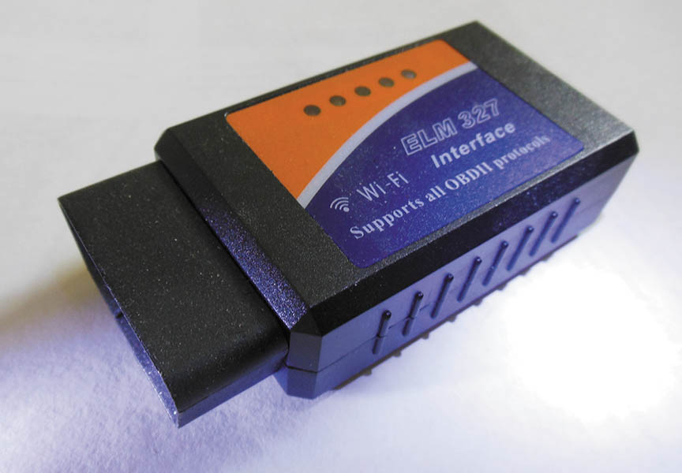
Figure 90.12 A Bluetooth adapter that plugs into the DLC and transmits global OBD-II information to a smart phone that has a scan tool app installed

Slide 26
QUESTION 2: ?
What is the difference between a factory level and an aftermarket scan tool?

Slide 27
ANSWER 2:
The factory scan tool supports a specific brand, an aftermarket scan tool support many brands.

Slide 28
RETRIEVAL OF DIAGNOSTIC INFORMATION
Locate and gain access to the data link connector (DLC).
Connect the scan tool to the DLC and establish communication.
Follow the on-screen instructions of the scan tool.
Observe the scan data, as well as any DTCs.
Follow vehicle manufacturer’s instructions if any DTCs are stored.

Slide 29
TROUBLESHOOTING USING DIAGNOSTIC TROUBLE CODES
Pinning down causes of the actual problem can be accomplished by trying to set the opposite code.
If the opposite code sets, this indicates that the wiring and connector for the sensor is okay and the sensor itself is defective (open).
If the same code sets, this indicates that the wiring or electrical connection is open (has high resistance) and is the cause of the setting of the DTC.
Methods for Clearing Diagnostic Trouble Codes
Scan tool, remove power from computer, or disconnect the vehicle battery.

Slide 30
RETRIEVING CODES PRIOR TO 1996
Flash Codes
Most vehicles from the early 1980s through 1995 used some method to retrieve DTCs.
Scan Tool
Special Tester
Fused jumper wire
Test light

Slide 31
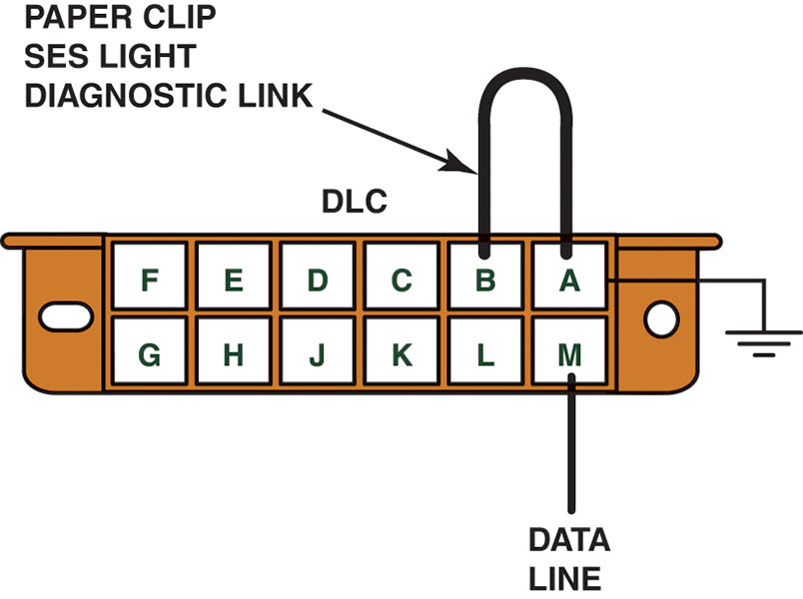
Figure 90.13 To retrieve flash codes from an OBD-I General Motors vehicle, connect terminals A and B with the ignition on– engine off. The M terminal is used to retrieve data from the sensors to a scan tool

Slide 32
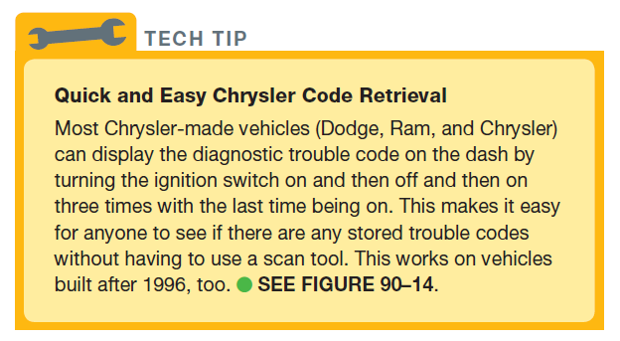
TECH TIP

Slide 33
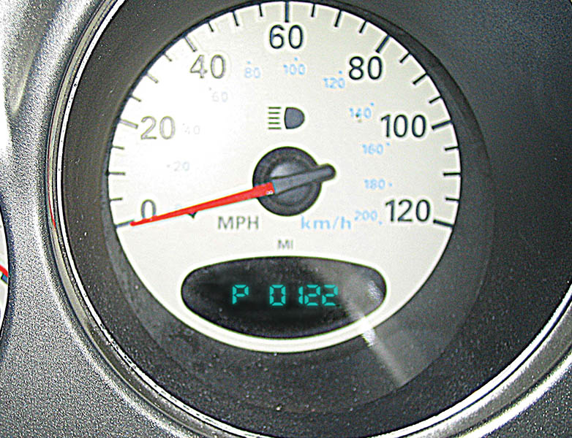
Figure 90.14 Diagnostic trouble codes (DTCs) from Chrysler and Dodge vehicles can be retrieved by turning the ignition switch to on and then off three times

Slide 34
DLC LOCATIONS
The data link connector (DLC) is a standardized 16-cavity connector to which a scan tool can be connected to retrieve diagnostic information from the vehicle’s computers
The normal location is under the dash on the driver’s side of the vehicle.

Slide 35
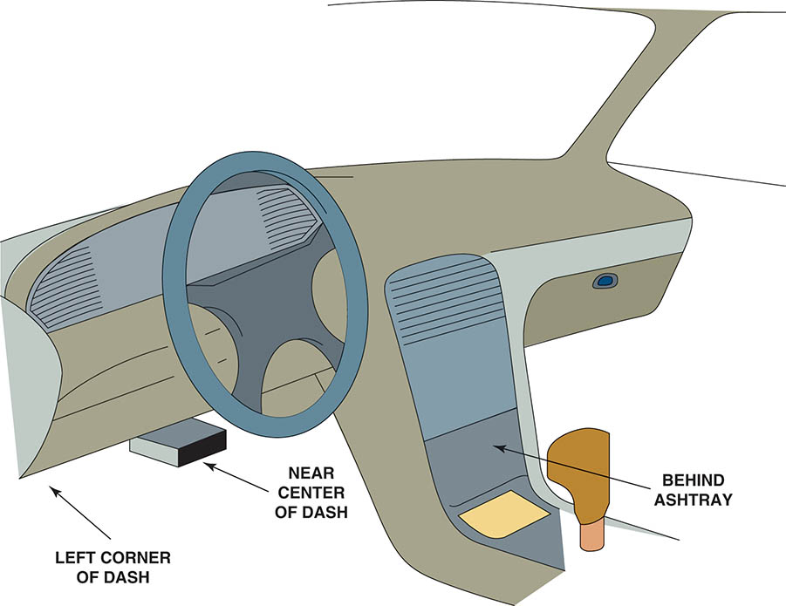
Figure 90.15 The data link connector (DLC) can be located in various locations

Slide 36
OBD-II DIAGNOSIS
Starting with the 1996 model year, all vehicles sold in the United States must use the same type of 16-pin DLC and must monitor emissions-related components.
Retrieving OBD-II Codes
A scan tool is required to retrieve diagnostic trouble codes from most OBD-II vehicles.
Every OBD-II scan tool will be able to read all generic Society of Automotive Engineers (SAE) DTCs from any vehicle.

Slide 37
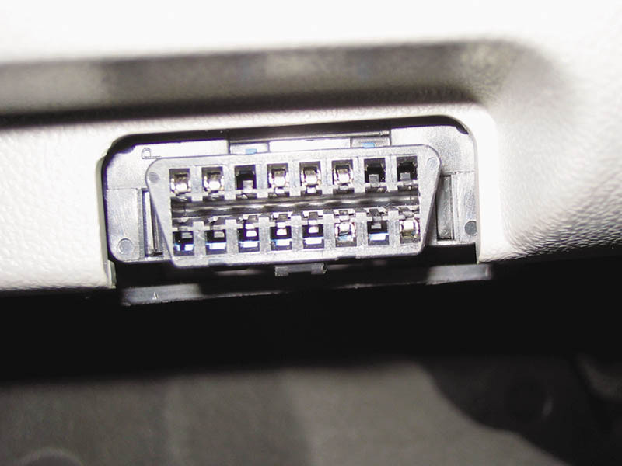
Figure 90.16 A typical OBD-II DLC. The location varies with make and model and may even be covered, but a tool is not needed to gain access. Check service information for the exact location, if needed

Slide 38
OBD-II ACTIVE TESTS (1 OF 2)
OBD-II Drive Cycle
The vehicle must be driven under a variety of operating conditions for all active tests to be performed.
Types of OBD-II Codes
TYPE A CODES. A type A diagnostic trouble code is emissions related and causes the MIL to be turned on at the first trip if the computer has detected a problem.
TYPE B CODES. A type B code is stored and the MIL is turned on during the second consecutive trip, alerting the driver to the fact that a diagnostic test was performed and failed.

Slide 39
OBD-II ACTIVE TESTS (2 OF 2)
TYPE C AND D CODES. Type C and type D codes are for use with non-emissions-related diagnostic tests.
OBD-II Freeze Frame
OBD II requires the computer to take a “snapshot” or freeze-frame of all data at the instant an emissions-related DTC is set.
Diagnosing Intermittent Malfunctions
Determine the conditions when the malfunction occurs, and then try to duplicate those conditions.

Slide 40
SERVICE/FLASH REPROGRAMMING
Reprogramming consists of downloading new calibration files from a scan tool, personal computer, or modem into the PCM’s electronically erasable programmable read-only memory (EEPROM).
Reprogramming can be performed using three different processes.
Direct programming
Off-board programming
Remote programming

Slide 41
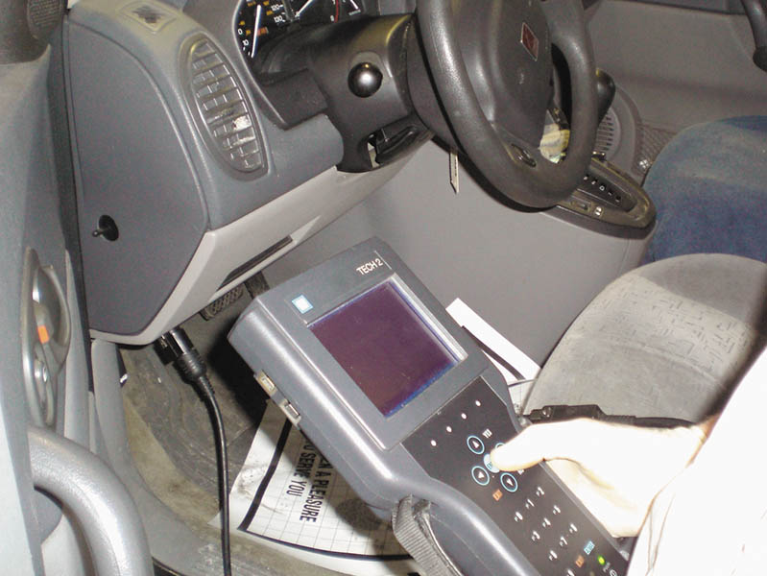
Figure 90.17 The first step in the reprogramming procedure is to determine the current software installed using a scan tool. Not all scan tools can be used. In most cases, using the factory scan tool is needed for reprogramming, unless the scan tool is equipped to handle reprogramming

Slide 42
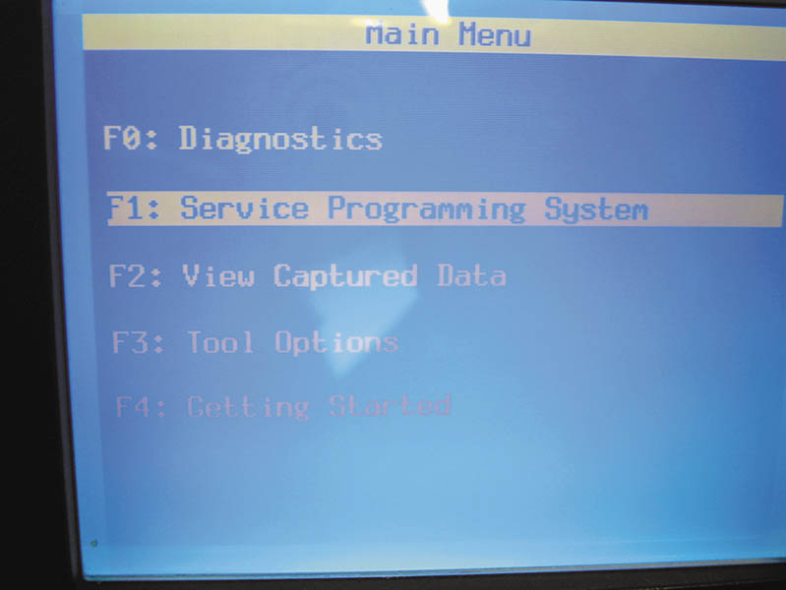
Figure 90.18 Follow the on-screen instructions

Slide 43
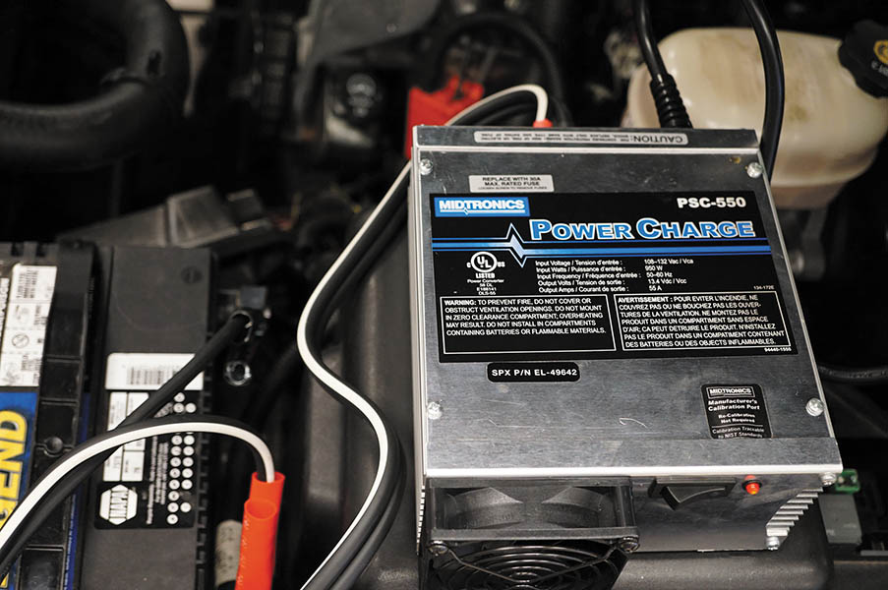
Figure 90.20 A battery charger that does not introduce any alternating current (AC) when charging the the battery is extremely important when programming a PCM

Slide 44
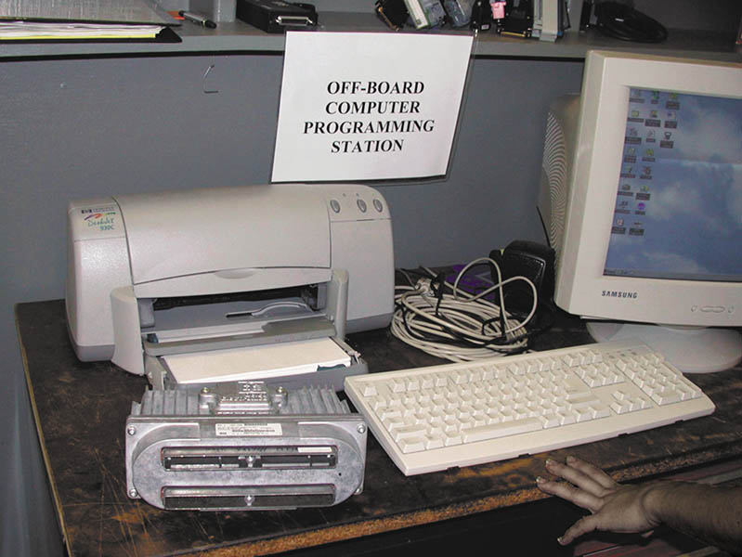
Figure 90.21 Connecting cables and a computer to perform off-board programming

Slide 45
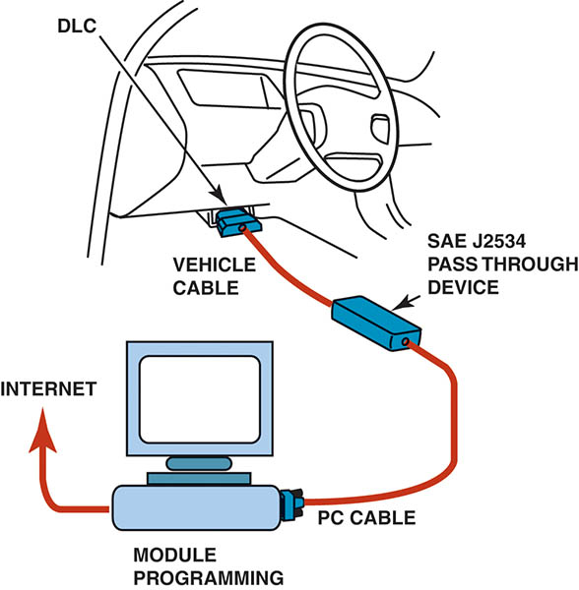
Figure 90.22 The J2534 pass-through reprogramming system does not need a scan tool to reflash the PCM on most 2004 and newer vehicles

Slide 46
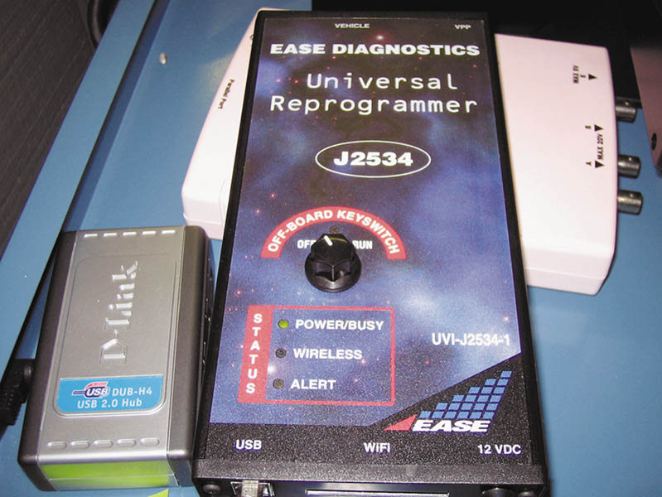
Figure 90.23 A typical J2534 universal reprogrammer that uses the J2534 standards

Slide 47
QUESTION 3: ?
What the three methods of flash/reprogramming a computer?

Slide 48
ANSWER 3:
Direct, off-board and Remote.

Slide 49
ROAD TEST (DRIVE CYCLE)
The vehicle may have to be driven under conditions that allow the PCM to conduct monitor tests. This drive pattern is called a drive cycle.
The drive cycle is different for each vehicle manufacturer, but a universal drive cycle may work. In many cases, performing a universal drive cycle resets most monitors in most vehicles.

Slide 50

Copyright

