Slide 1

Automotive Technology Principles, Diagnosis, and Service
Sixth Edition
Chapter 9
Hand Tools
Copyright © 2018, 2015, 2011 Pearson Education, Inc. All Rights Reserved

Slide 2
LEARNING OBJECTIVES (1 of 2)
9.1 Compare the different types of wrenches.
9.2 Discuss the purpose of ratchets, sockets, and extensions, and screwdrivers.
9.3 Discuss the purpose of hammers, mallets, and pliers.
9.4 Explain the characteristics of cutters, punches, chisels, removers, and hacksaws.

Slide 3
LEARNING OBJECTIVES (2 of 2)
9.5 List the basic tools a service technician should possess.
9.6 Describe the purpose of specialty tools such as seal pullers, seal drivers, and electrical hand tools.
9.7 Discuss the safety tips for using hand tools and hand tool maintenance.

Slide 4
WRENCHES
Most common hand tool used by service technicians.
Many types of wrenches:
Open-end wrench
Box-end wrench
Combination wrench
Adjustable wrench
Line wrench

Slide 5
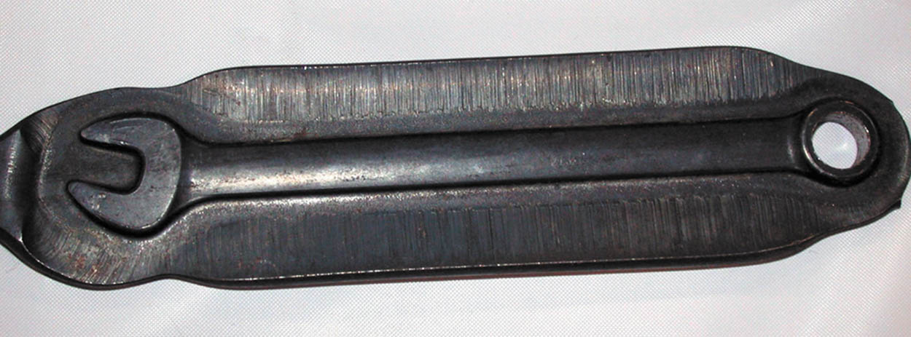
Figure 9.1 A forged wrench after it has been forged but before the flashing, extra material around the wrench, has been removed

Slide 6
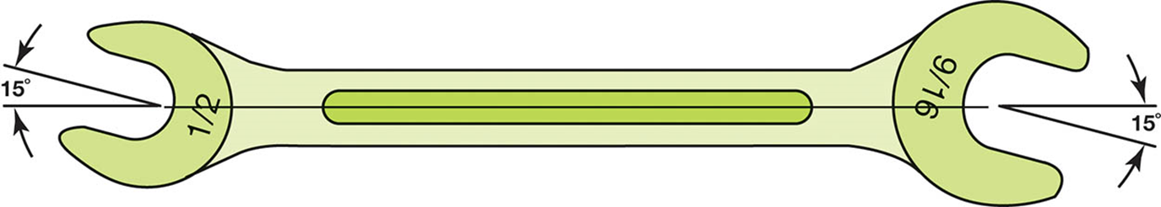
Figure 9.2 A typical open-end wrench. The size is different on each end and notice that the head is angled 15 degrees at each end

Slide 7
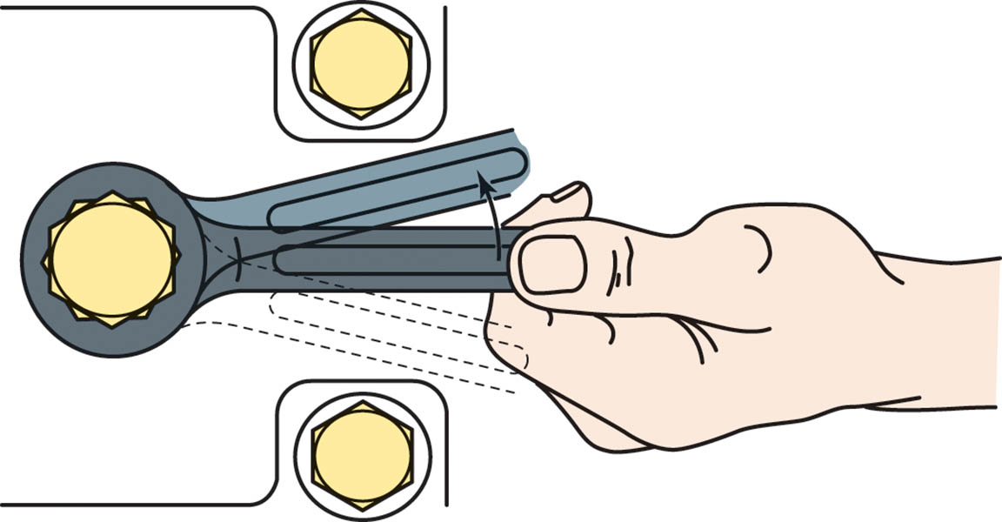
Figure 9.3 A typical box-end wrench is able to grip the bolt or nut at points completely around the fastener. Each end is a different size

Slide 8
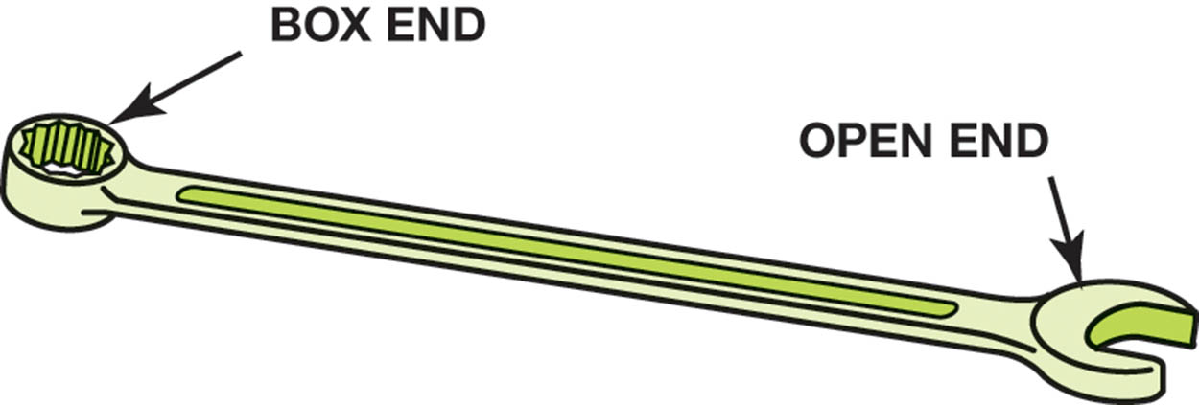
Figure 9.5 A combination wrench has an open end at one end and a box end at the other with the same size at each end

Slide 9
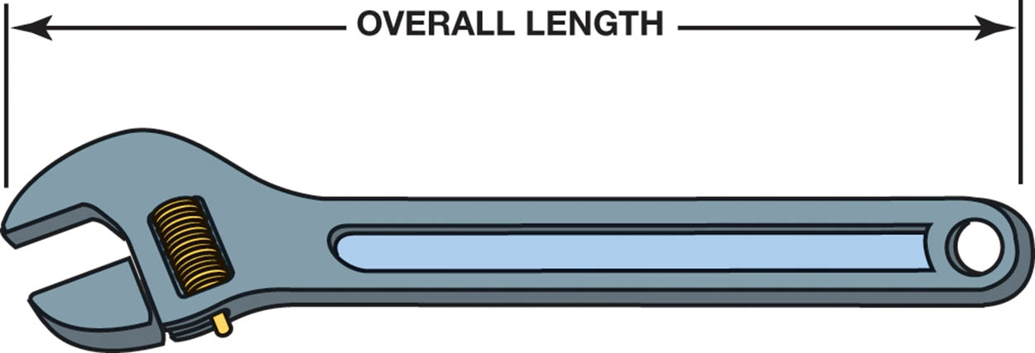
Figure 9.6 An adjustable wrench. Adjustable wrenches are sized by the overall length of the wrench and not by how far the jaws open. Common sizes of adjustable wrenches include 8, 10, and 12 inch

Slide 10
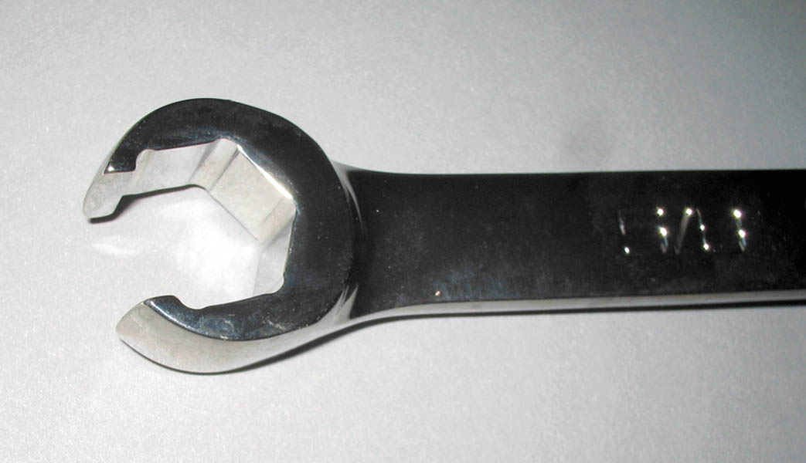
Figure 9.7 The end of a typical line wrench, which shows that it is capable of grasping most of the head of the fitting

Slide 11
RATCHETS, SOCKETS, AND EXTENSIONS
Ratchets: Turns the socket in only one direction and allows the rotating of the ratchet handle back and forth in a narrow space.
Sockets: Fits over the fastener and grips the points and/or flats of the bolt or nut.
Extensions: Used with sockets to allow access to fasteners in restricted locations.

Slide 12
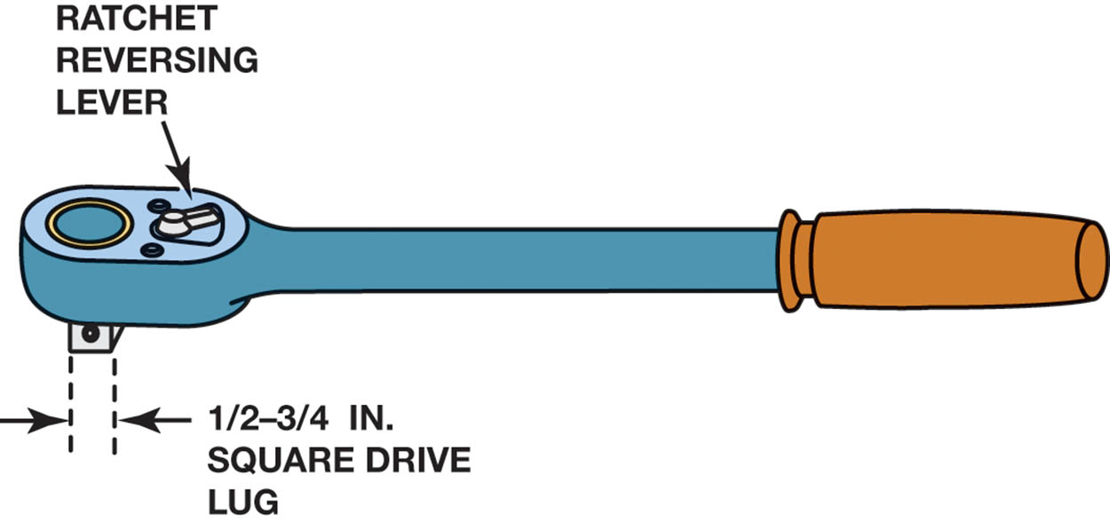
Figure 9.8 A typical ratchet used to rotate a socket. A ratchet makes a ratcheting noise when it is being rotated in the opposite direction from loosening or tightening. A knob or lever on the ratchet allows the user to switch directions

Slide 13
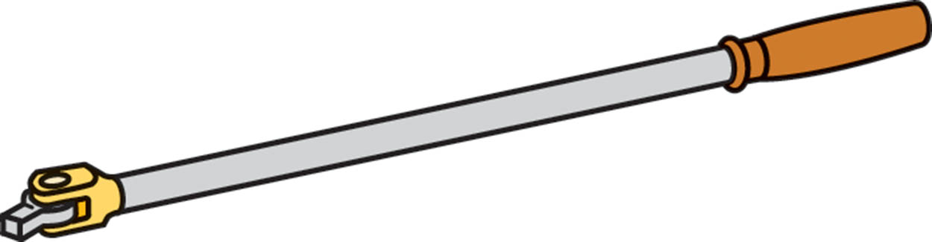
Figure 9.9 A typical flex handle used to rotate a socket, also called a breaker bar because it usually has a longer handle than a ratchet and, therefore, can be used to apply more torque to a fastener than a ratchet

Slide 14
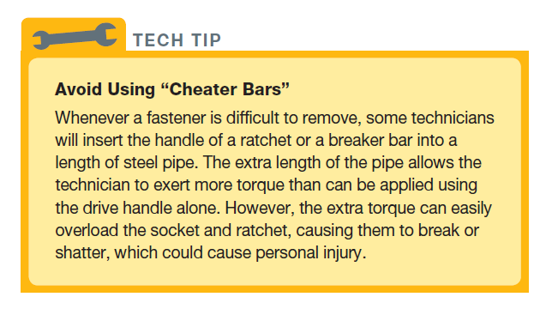
Tech Tip

Slide 15
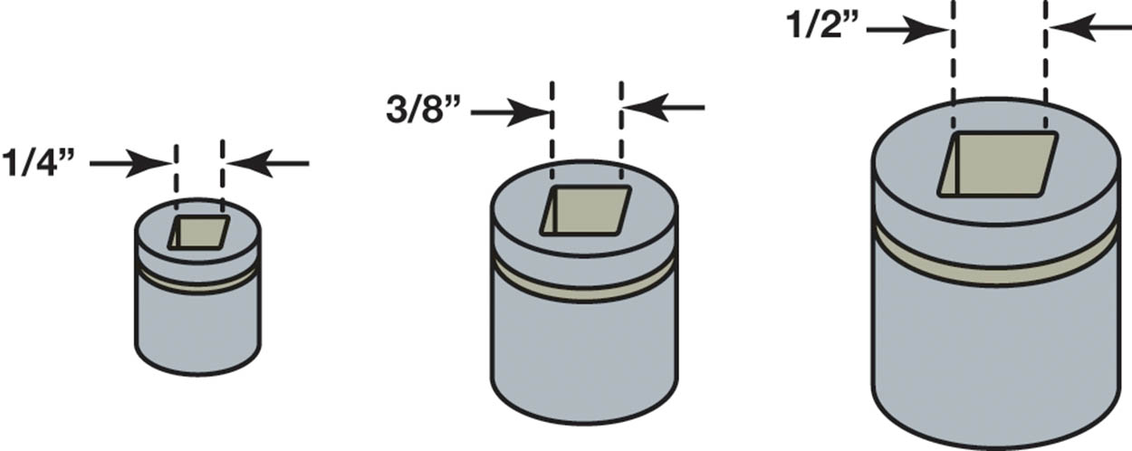
Figure 9.10 The most commonly used socket drive sizes include 1/4 inch, 3/8 inch, and 1/2 inch drive

Slide 16
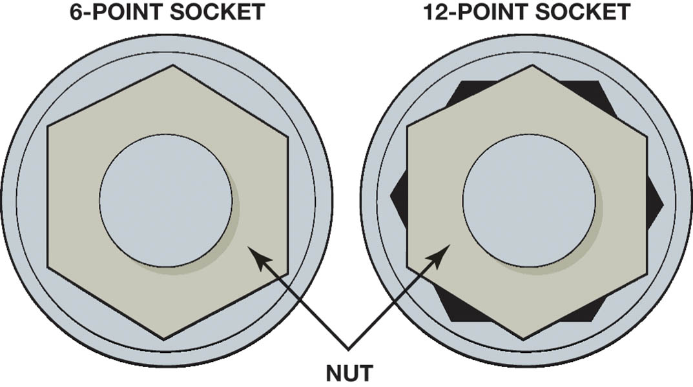
Figure 9.11 A 6-point socket fits the head of the bolt or nut on all sides. A 12-point socket can round off the head of a bolt or nut if a lot of force is applied

Slide 17
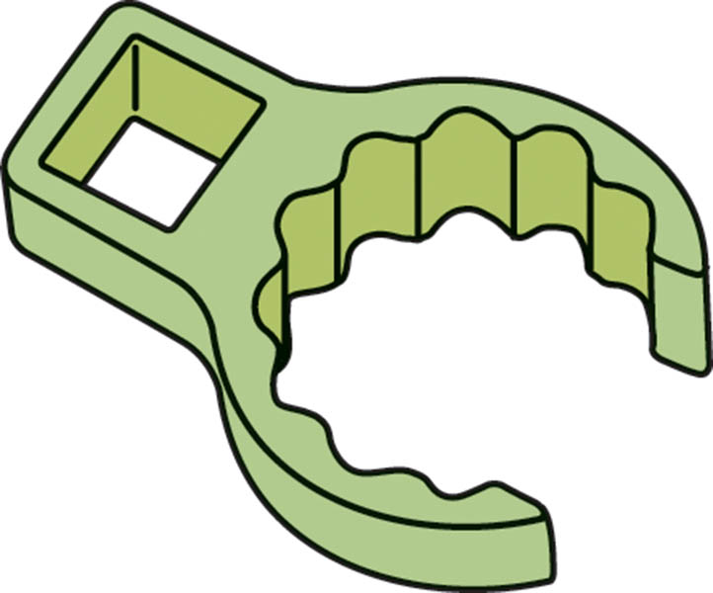
Figure 9.12 A crowfoot socket is designed to reach fasteners using a ratchet or breaker bar with an extension

Slide 18
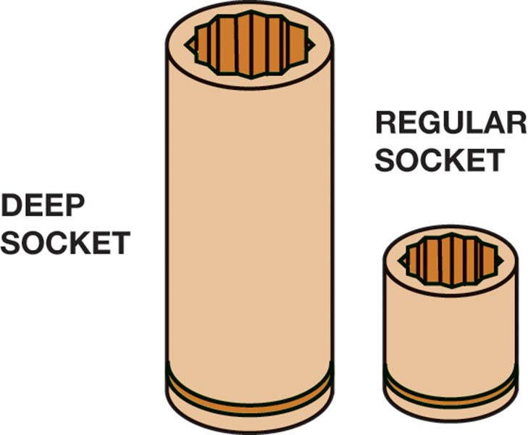
Figure 9.16 Deep sockets allow access to the nut that has a stud plus other locations needing great depth, such as spark plugs

Slide 19
TORQUE WRENCHES
Socket turning handles that are designed to apply a known amount of force to the fastener.
Types of torque wrenches:
Clicker type
Beam type
Dial type

Slide 20
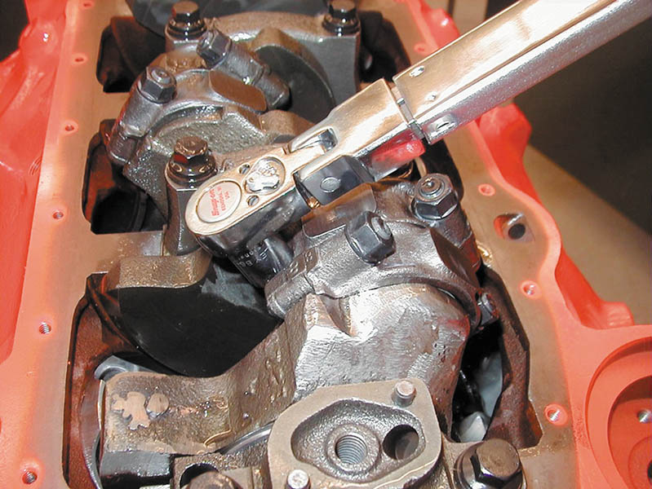
Figure 9.13 Using a torque wench to tighten connecting rod nuts on an engine

Slide 21
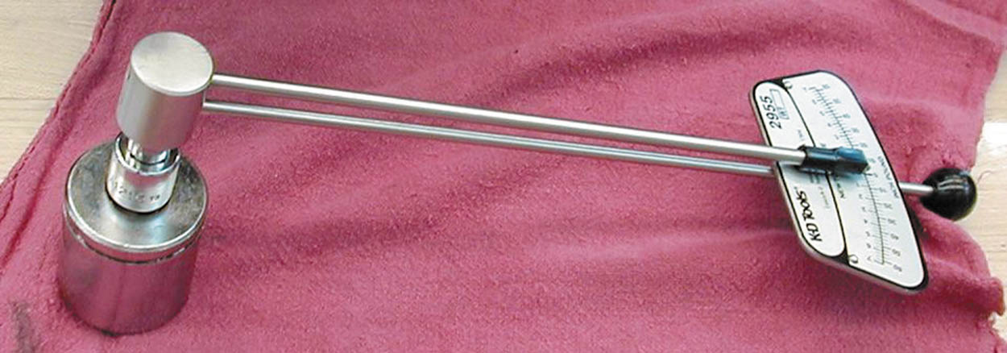
Figure 9.14 A beam-type torque wrench that displays the torque reading on the face of the dial. The beam display is read as the beam deflects, which is in proportion to the amount of torque applied to the fastener

Slide 22
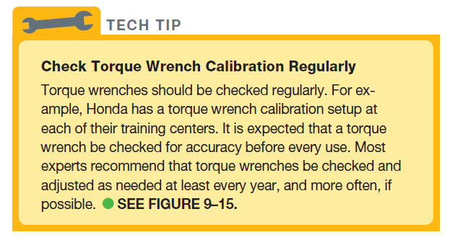
Tech Tip

Slide 23
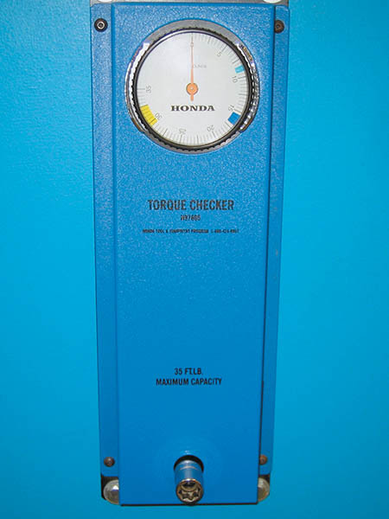
Figure 9.15 Torque wrench calibration checker

Slide 24
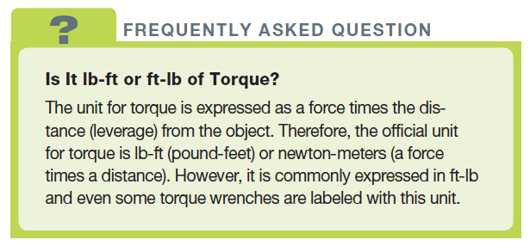
FREQUENTLY ASKED QUESTION

Slide 25
QUESTION 1: ?
What are the standard automotive drive sizes for sockets?

Slide 26
ANSWER 1:
1/4 , 3/8 , 1/2 .

Slide 27
SCREWDRIVERS
Used to remove and install many types of small fasteners.
Types of screwdrivers:
Flat tip (straight blade)
Phillips
Offset
Torx
Impact

Slide 28
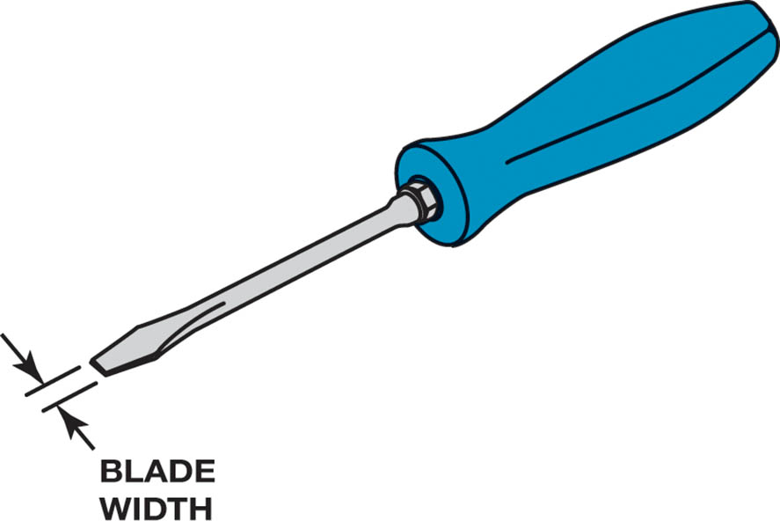
Figure 9.17 A flat-tip (straight blade) screwdriver. The width of the blade should match the width of the slot in the fastener being loosened or tightened

Slide 29
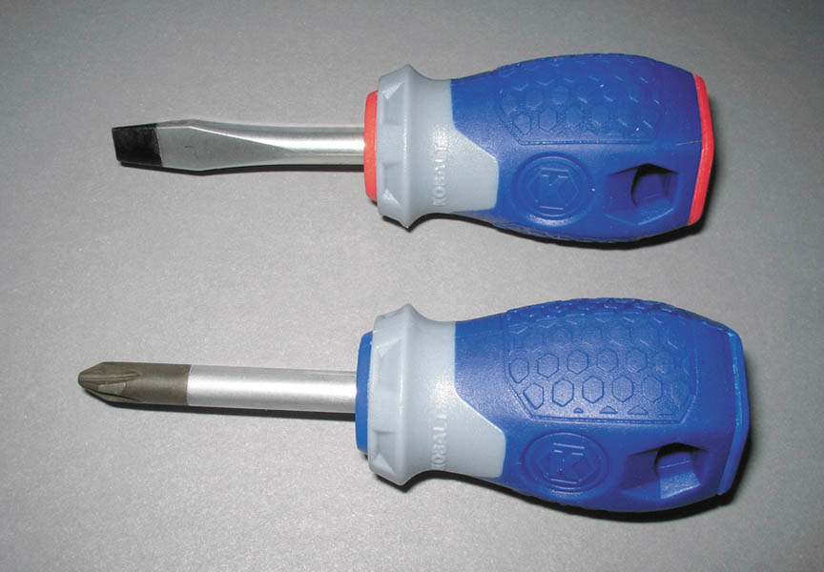
Figure 9.18 Two stubby screwdrivers that are used to access screws that have limited space above. A straight blade is on top and a #2 Phillips screwdriver is on the bottom

Slide 30
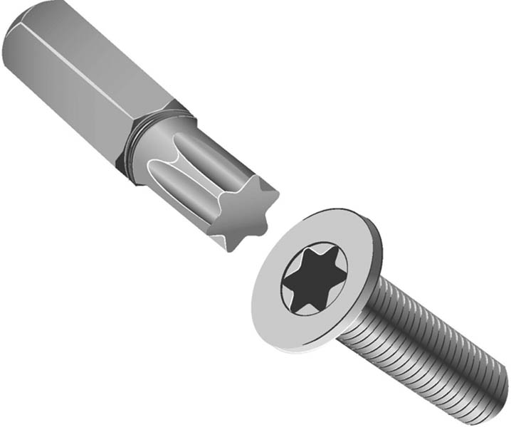
Figure 9.19 A Torx bit and fastener

Slide 31
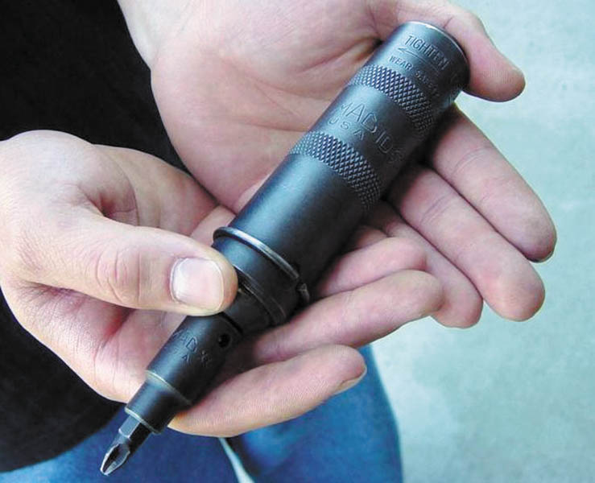
Figure 9.20 An impact screwdriver used to remove slotted or Phillips head fasteners that cannot be broken loose using a standard screwdriver

Slide 32
QUESTION 2: ?
Which type of screwdriver requires the use of a hammer or
mallet?

Slide 33
ANSWER 2:
An impact screwdriver.

Slide 34
HAMMERS AND MALLETS
Used to force objects together or apart.
Sized by the weight of the head of the hammer and the length of the handle.
Should be cleaned after use.
Should not be exposed to extreme conditions
Follow manufacturers recommended practices and procedures.

Slide 35
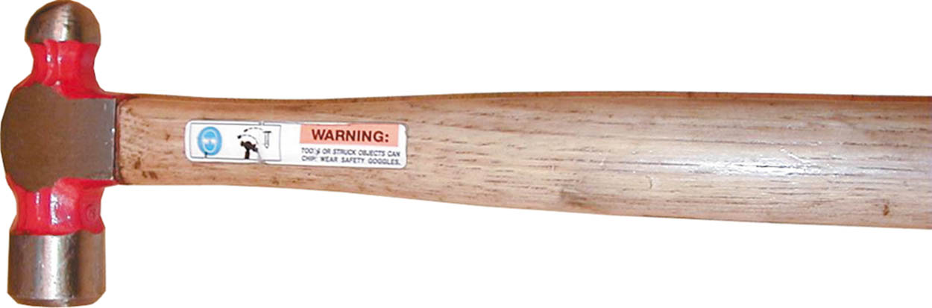
Figure 9.21 A typical ball-peen hammer

Slide 36
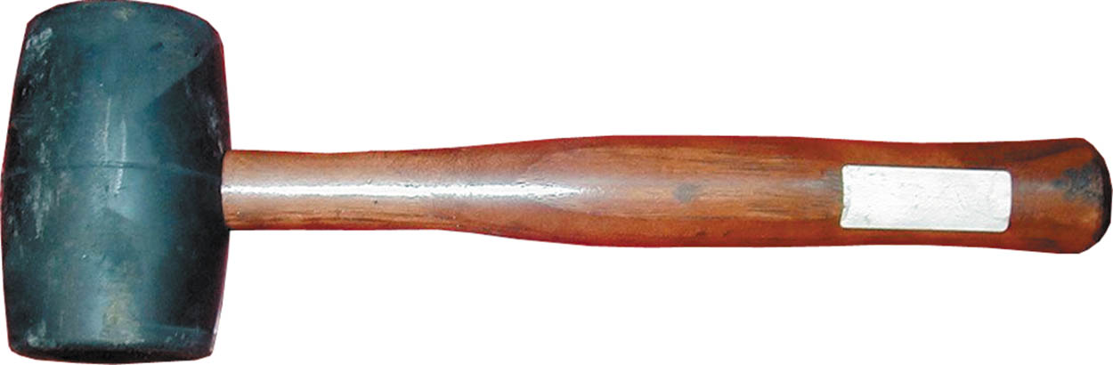
Figure 9.22 A rubber mallet is used to deliver a force to an object without harming the surface

Slide 37
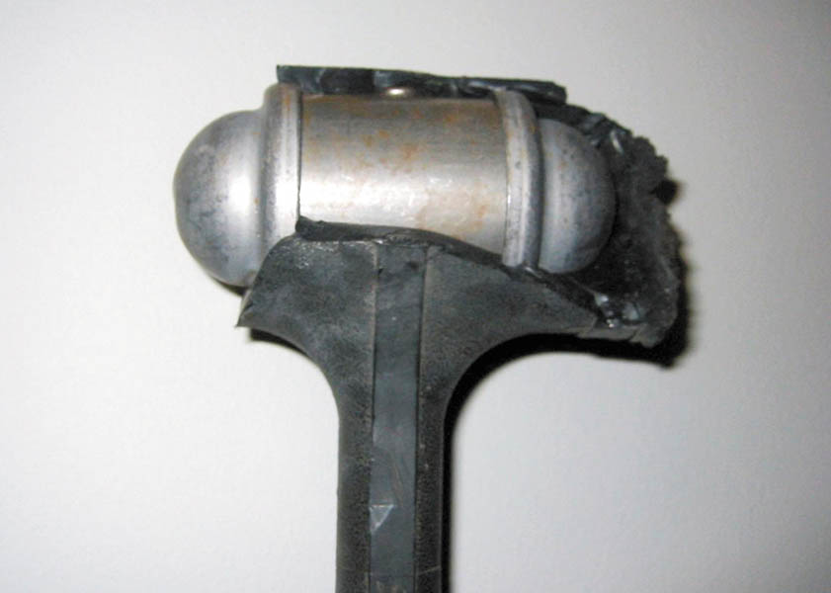
Figure 9.23 A dead-blow hammer that was left outside in freezing weather. The plastic covering was damaged, which destroyed this hammer. The lead shot is encased in the metal housing and then covered

Slide 38
PLIERS
Pliers are capable of holding, twisting, bending, and cutting objects and are an extremely useful classification of tools.
Types of pliers
Slip joint
Multi-groove adjustable
Lineman’s
Diagonal
Needle-nose
Locking
Snap-ring
.

Slide 39
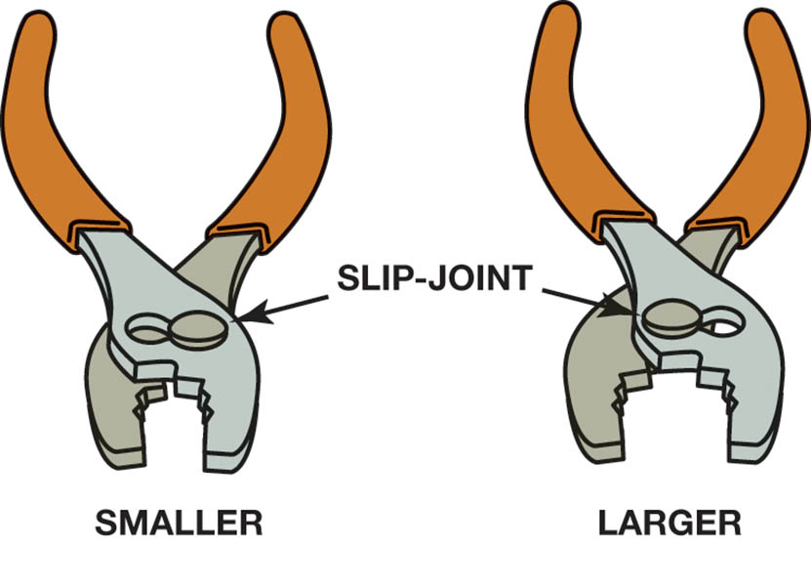
Figure 9.24 Typical slip-joint pliers, which are also common household pliers. The slip joint allows the jaws to be opened to two different settings

Slide 40
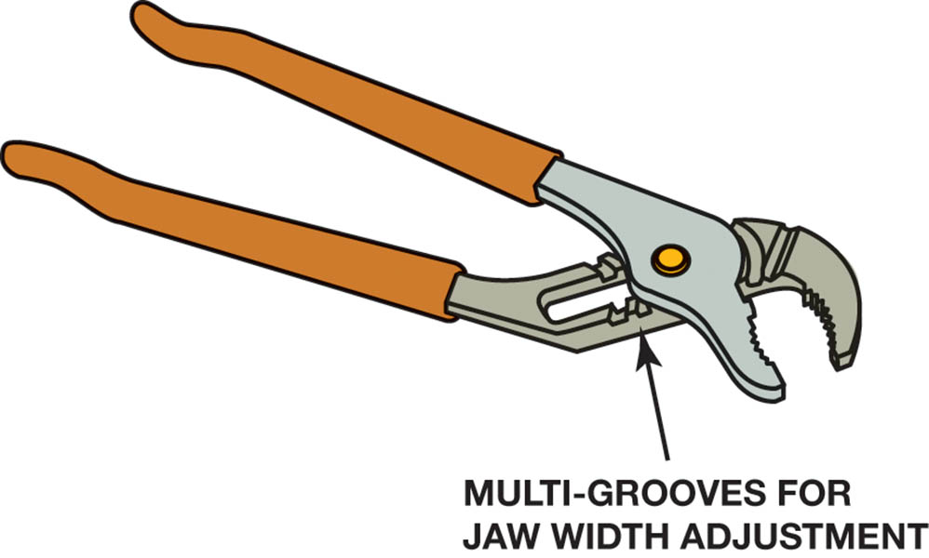
Figure 9.25 Multigroove adjustable pliers are known by many names, including the trade name Channel Locks

Slide 41
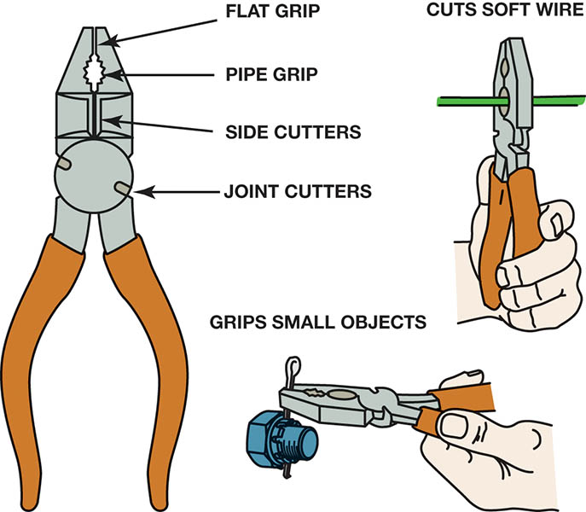
Figure 9.26 A linesman’s pliers are very useful because they can help perform many automotive service jobs

Slide 42
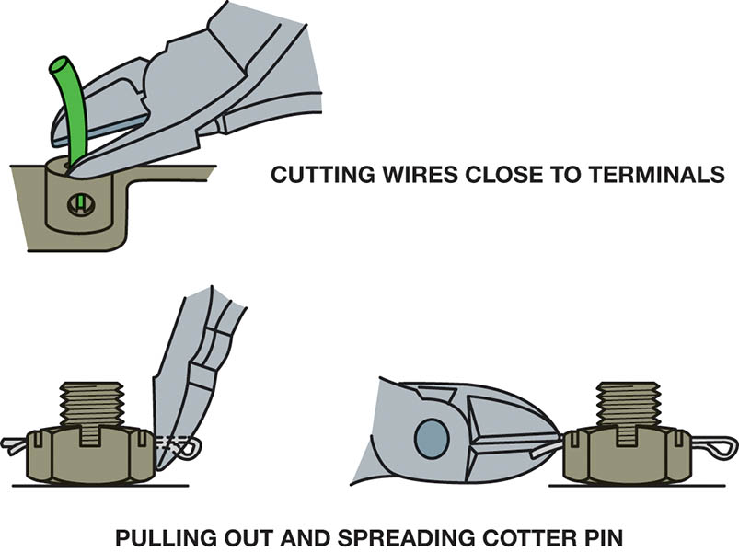
Figure 9.27 Diagonal-cut pliers are another common tool that has many names

Slide 43
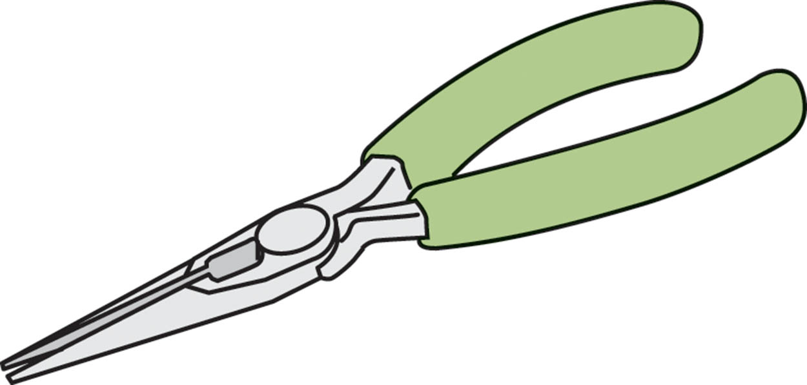
Figure 9.28 Needle-nose pliers are used where there is limited access to a wire or pin that needs to be installed or removed

Slide 44

Figure 9.29 Locking pliers are best known by their trade name Vise-Grip®

Slide 45
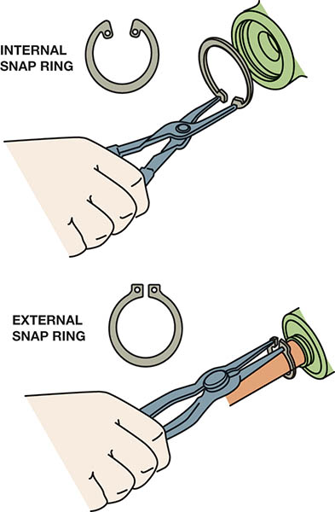
Figure 9.30 Snap-ring pliers are also called lock-ring pliers and are designed to remove internal and external snap rings (lock rings)

Slide 46
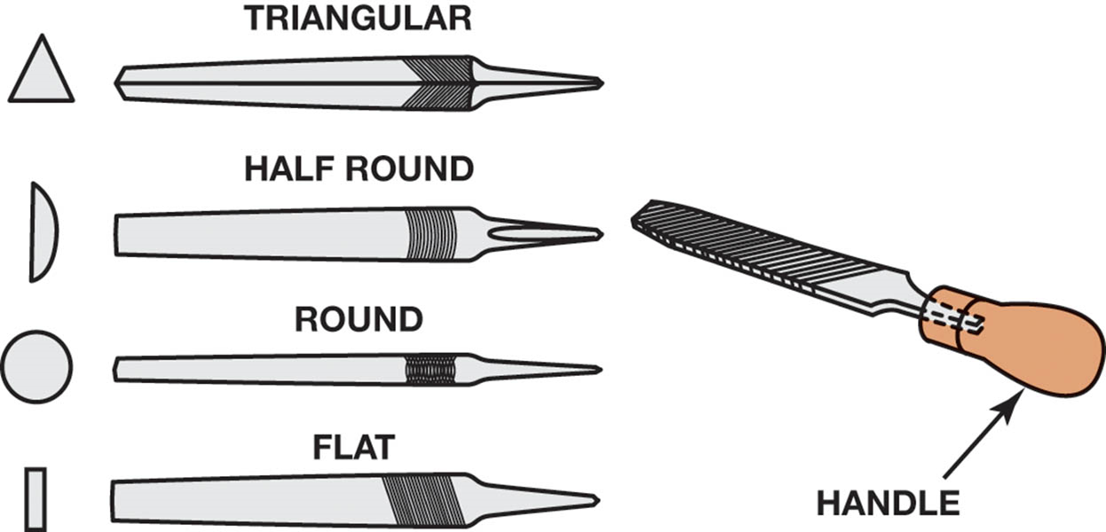
Figure 9.31 Files come in many different shapes and sizes. Never use a file without a handle

Slide 47
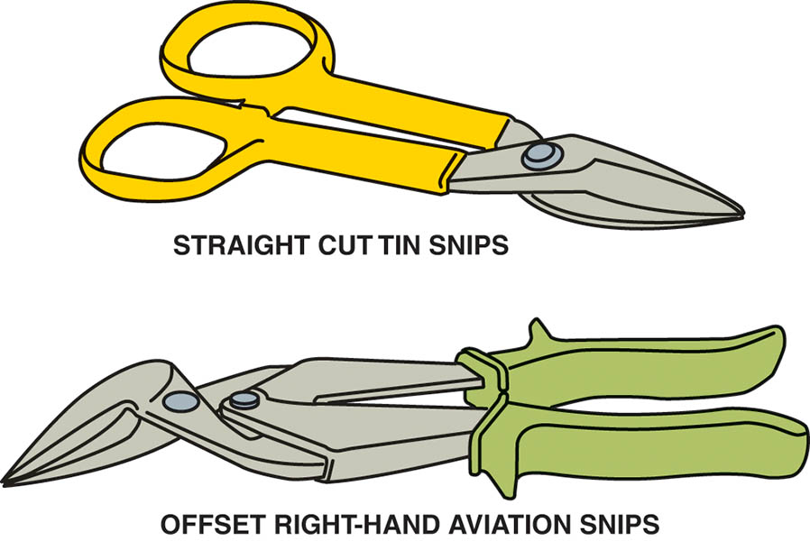
Figure 9.32 Tin snips are used to cut thin sheets of metal or carpet

Slide 48
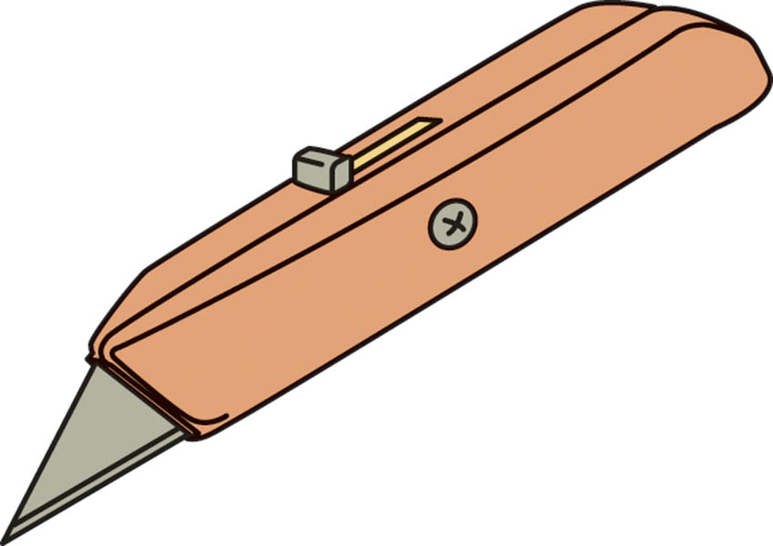
Figure 9.33 A utility knife uses replaceable blades and is used to cut carpet and other materials

Slide 49
PUNCHES AND CHISELS
Punch: A small diameter steel rod that is used to drive a pin out that is used to retain two components.
Chisel: A straight, sharp cutting end that is used for cutting off rivets or to separate two pieces of an assembly.
Always wear eye protection when using a punch or a chisel

Slide 50
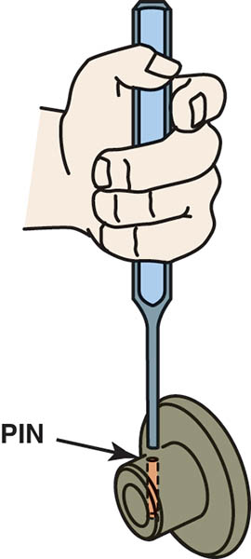
Figure 9.34 A punch used to drive pins from assembled components. This type of punch is also called a pin punch

Slide 51
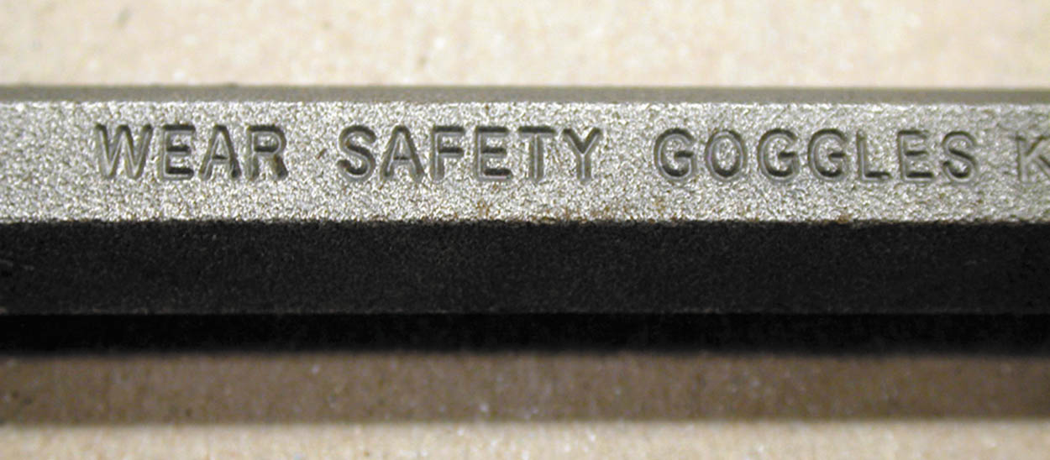
Figure 9.35 Warning stamped in the side of a punch warning that goggles should be worn when using this tool. Always follow safety warnings

Slide 52
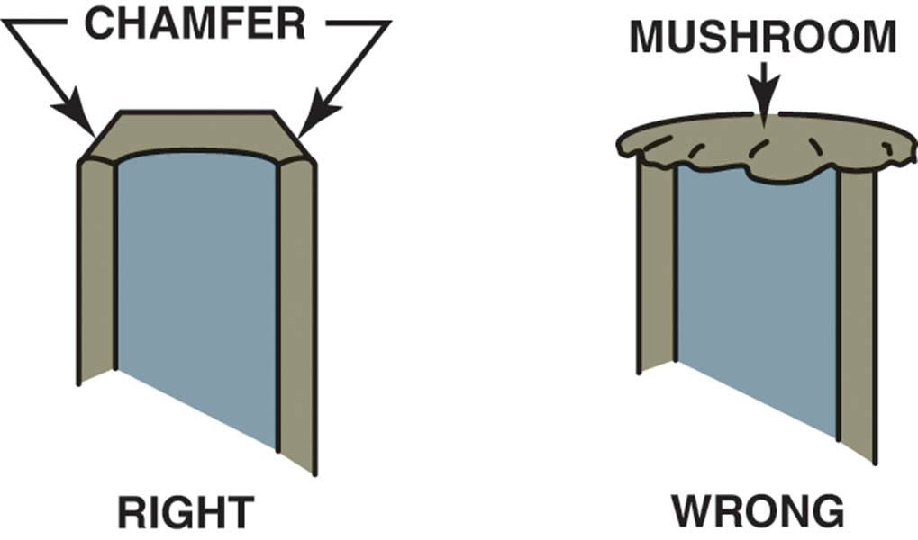
Figure 9.36 Use a grinder or a file to remove the mushroom material on the end of a punch or chisel

Slide 53
REMOVERS
Tools used to remove damaged fasteners.
Not normally needed during routine service.
Classified as:
Stud Removers
Nut splitters
Screw extractors

Slide 54
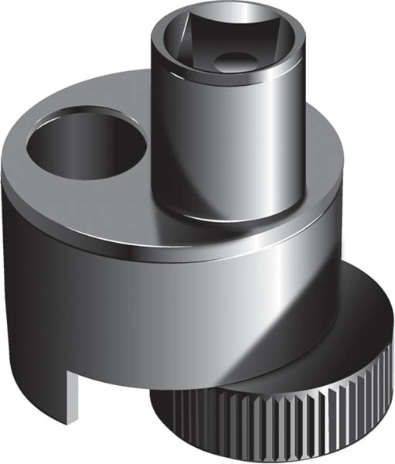
Figure 9.37 A stud remover uses an offset serrated wheel to grasp the stud so it will be rotated when a ratchet or breaker bar is used to rotate the assembly

Slide 55
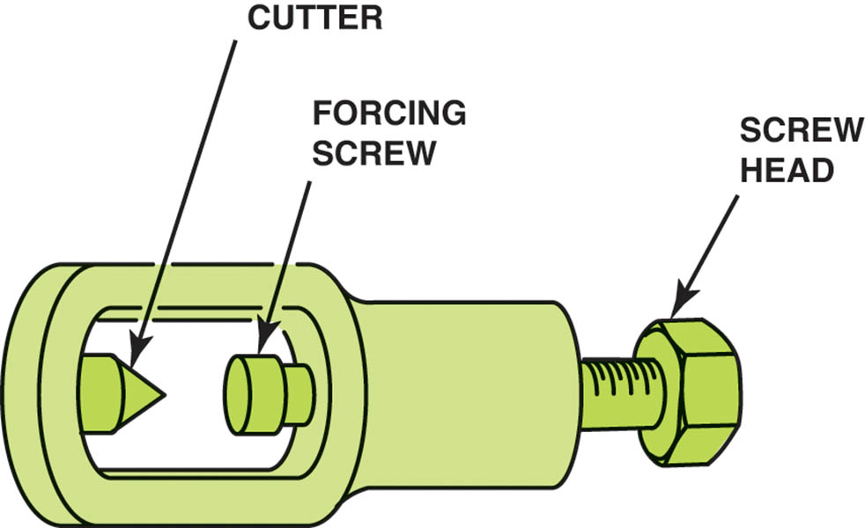
Figure 9.38 A nut splitter is used to split a nut that cannot be removed. After the nut has been split, a chisel is then used to remove the nut

Slide 56
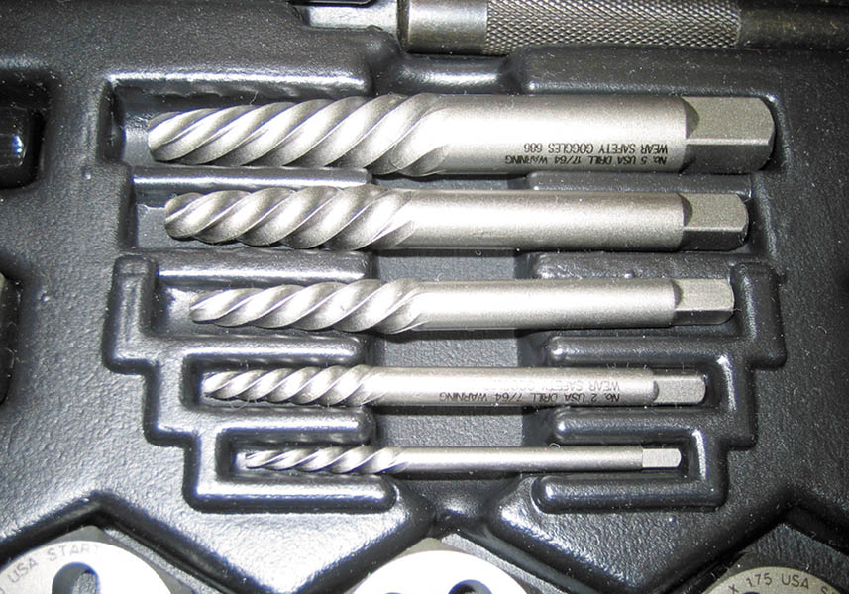
Figure 9.39 A set of bolt extractors, commonly called easy outs

Slide 57
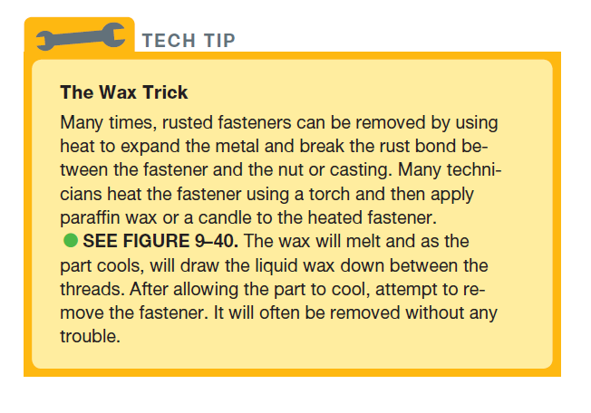
TECH TIP

Slide 58
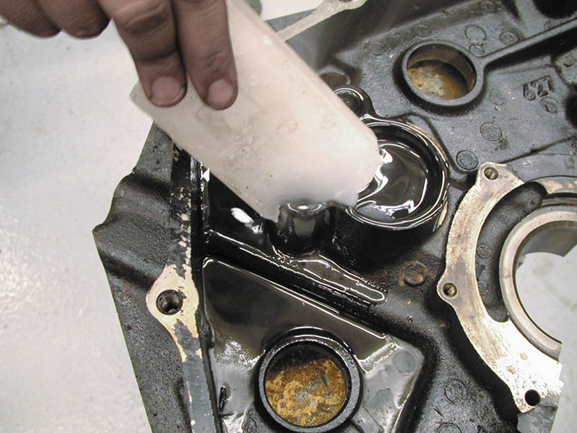
Figure 9.40 Removing plugs or bolts is easier if the plug is first heated to a cherry red color, using a torch, and then applying wax. During cooling, the wax flows in between the threads, making it easier to remove

Slide 59
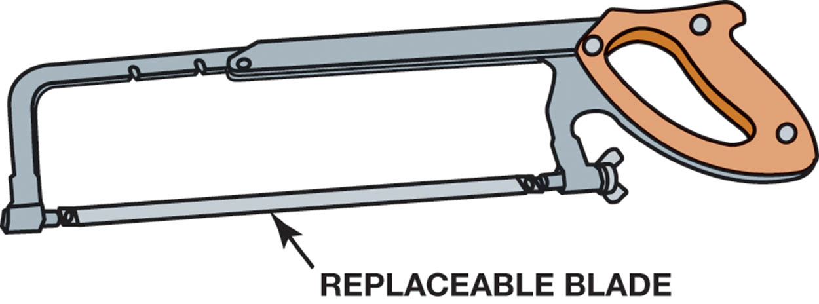
Figure 9.41 A typical hacksaw that is used to cut metal. If cutting sheet metal or thin objects, a blade with more teeth should be used

Slide 60
BASIC HAND TOOL SET
Includes Hand tools are used to turn fasteners (bolts, nuts, and screws).
Specialty tools are not included.
Different requirements for a beginning technician than a master technician.
Typically includes lockable tool storage.

Slide 61
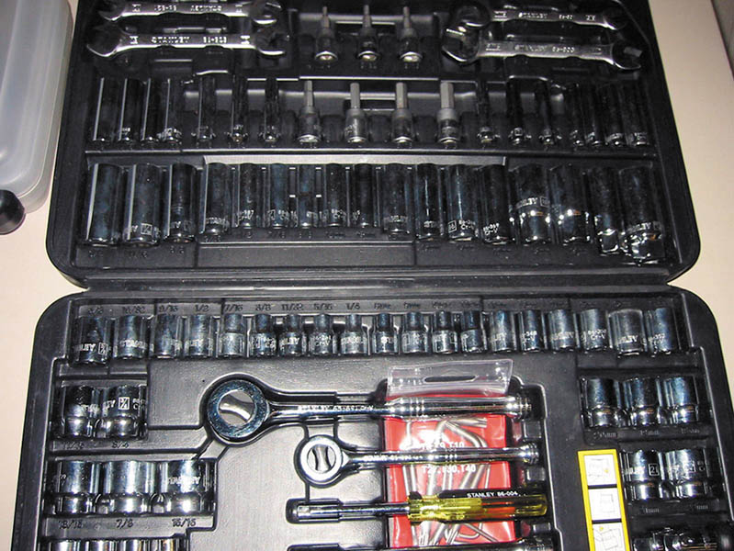
Figure 9.42 A typical beginning technician tool set that includes the basic tools to get started

Slide 62
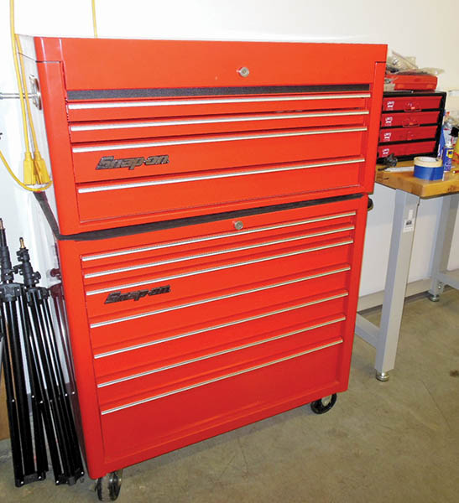
Figure 9.43 A typical 40 inch wide top and bottom professional tool box

Slide 63
SPECIALTY TOOLS
Tools other than basic hand tools that most technicians own that are task specific:
Seal pullers and drivers
Test lights
Soldering guns
Wire strippers
Wire crimpers
Multimeter

Slide 64
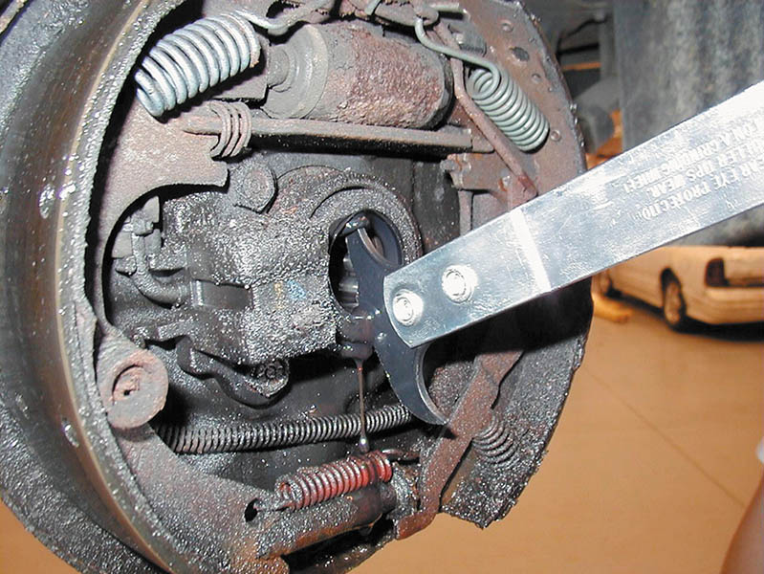
Figure 9.44 A seal puller being used to remove a seal from a rear axle

Slide 65
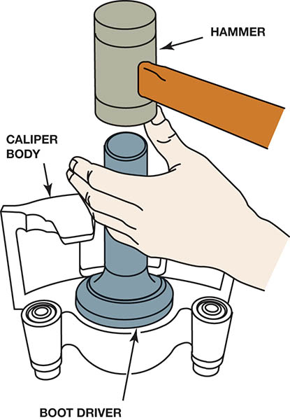
Figure 9.45 A seal driver or installer is usually aluminium and is designed to seat the seal

Slide 66
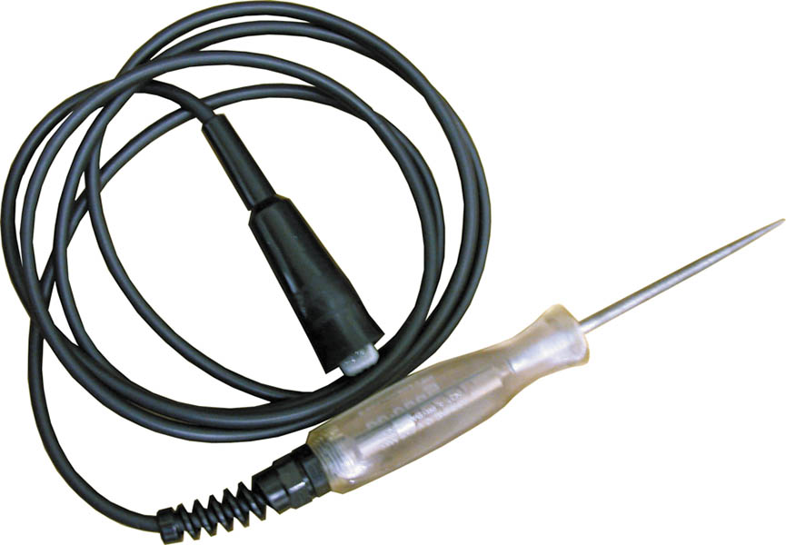
Figure 9.46 A typical 12-volt test light

Slide 67
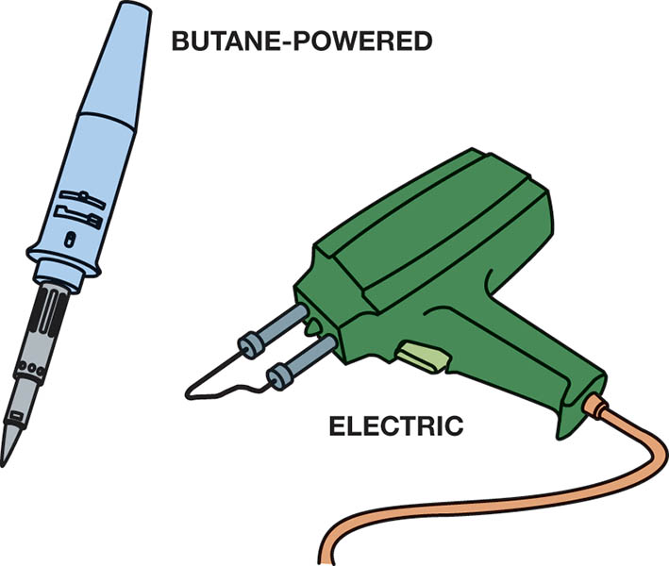
Figure 9.47 An electric soldering gun used to make electrical repairs. Soldering guns are sold by the wattage rating. The higher the wattage, the greater amount of heat created. Most solder guns used for automotive electrical work usually fall within the 60 to 160 watt range

Slide 68
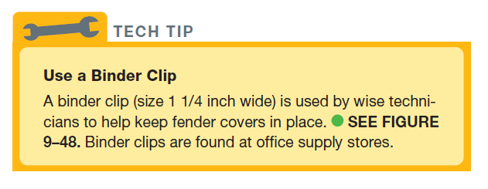
TECH TIP

Slide 69

Figure 9.48 A binder clip being used to keep a fender cover from falling

Slide 70
QUESTION 3: ?
What tool would be useful when repairing a broken wire?

Slide 71
ANSWER 3:
Soldering gun.

Slide 72
SAFETY TIPS FOR USING HAND TOOLS
Pull a wrench towards you.
Keep all hand tools clean.
Use a six-point socket or wrench to break a fastener loose.
Use a box-end wrench for torque and an open-end wrench for speed.
Replace any tool that is damaged or worn.

Slide 73
HAND TOOL MAINTENANCE
Clean tools after use.
Keep tools separated.
Line the drawers of the tool box.
Remove the tension from the torque wrench after use.
Secure the tool box.

Slide 74

Copyright

