Slide 1

Automotive Technology Principles, Diagnosis, and Service
Sixth Edition
Chapter 88
Catalytic Converters
Copyright © 2018, 2015, 2011 Pearson Education, Inc. All Rights Reserved

Slide 2
LEARNING OBJECTIVES
88.1 Explain the purpose, function, construction, and operation of catalytic converters.
88.2 Describe catalytic converter performance in OBD-II vehicles.
88.3 Discuss the diagnosis and replacement of catalytic converters.

Slide 3
CATALYTIC CONVERTERS (1 OF 3)
Purpose and Function
  A catalytic converter is an aftertreatment device used to reduce exhaust emissions outside of the engine.
Catalytic Converter Construction
  Most catalytic converters are constructed of a ceramic material in a honeycomb shape with square openings for the exhaust gases.
  The substrate is then coated with a porous aluminum material called the washcoat.
  The catalytic materials are then applied on top of the washcoat.

Slide 4
CATALYTIC CONVERTERS (2 OF 3)
Catalytic Converter Operation
  The converter substrate contains small amounts of rhodium, palladium, and platinum.
  These elements act as catalysts.
  The converter should have a 14.7:1 air-fuel ratio, but can use a mixture that varies slightly.
Converter Light-Off Temperature
  The converter must be heated to its light-off temperature of close to 500°F (260°C) before it begins working.

Slide 5
CATALYTIC CONVERTERS (3 OF 3)
Converter Usage
  A catalytic converter must be located as close as possible to the exhaust manifold to work effectively.
  Some vehicles have used a small, quick heating oxidation converter, called a pre-converter or a pup (mini) converter, that connects directly to the exhaust manifold outlet.
OBD-II Catalytic Converter Performance
  The PCM determines if the catalytic converter is ready for testing based on specific conditions, which may vary by vehicle make, model, and year.

Slide 6
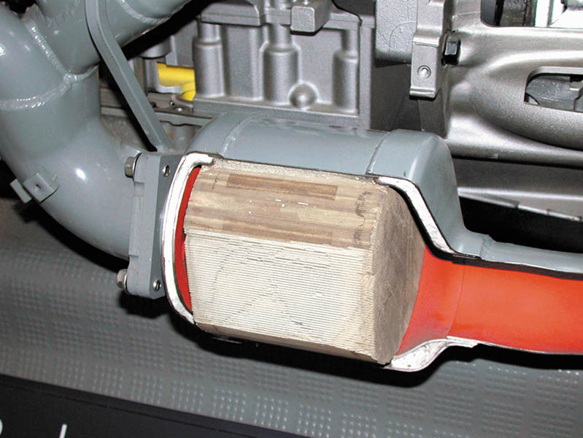
Figure 88.1 Most catalytic converters are located as close to the exhaust manifold as possible, as seen in this display of a Chevrolet Corvette

Slide 7
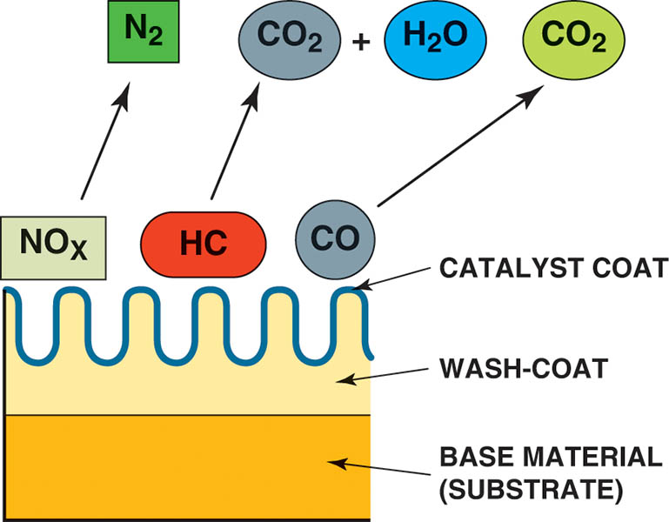
Figure 88.2 The base material, called the substrate, is used to support the wash coat, which is a porous material that is used to hold the catalyst materials

Slide 8
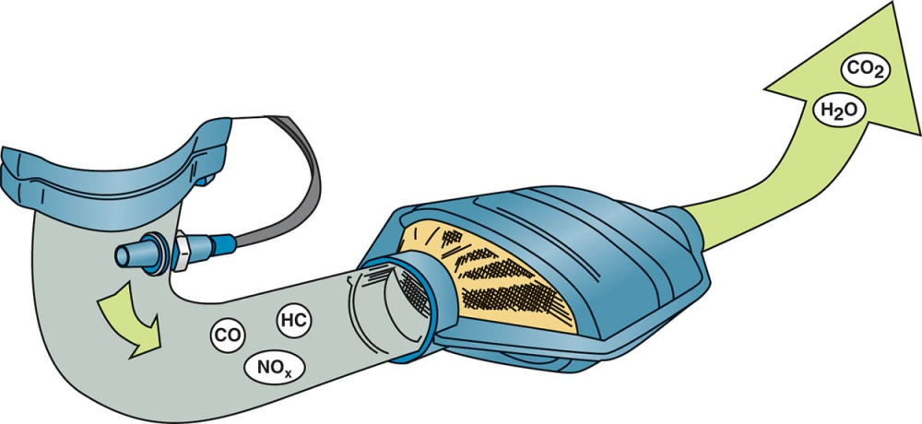
Figure 88.3 The three-way catalytic converter first separates the NO_{x} into nitrogen and oxygen and then converts the HC and CO into harmless water (H₂O) and carbon dioxide (CO₂). The nitrogen (N) passes through the converter and exits the tailpipe and enters the atmosphere, which is about 78% nitrogen

Slide 9
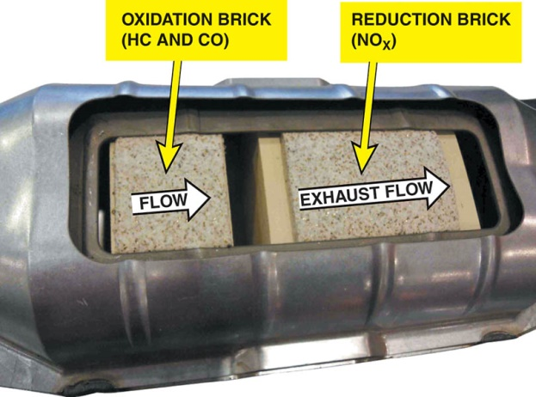
Figure 88.4 The small oxidation section of the converter helps build heat for the reduction section to reduce NO_{x} emissions in the rear brick on most newer vehicles. Older catalytic converters had the reduction brick first then the oxidation brick.

Slide 10
OBD-II CATALYTIC CONVERTER PERFORMANCE
When the three-way converter (TWC) is operating as it should, the post converter HO2S is far less active than the pre-converter sensor.
Converter Damaging Conditions
  Contamination.
  Excessive temperatures.
  Improper air-fuel mixtures.

Slide 11
QUESTION 1: ?
What is the function of the catalytic converter?

Slide 12
ANSWER 1:
The function of the catalytic converter is to reduce exhaust emissions outside the engine.

Slide 13
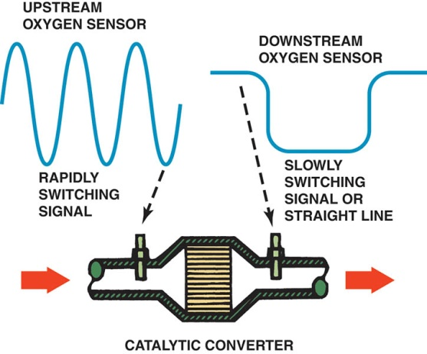
Figure 88.5 The OBD-II catalytic converter monitor compares the signals of upstream and downstream oxygen sensors to determine converter efficiency

Slide 14
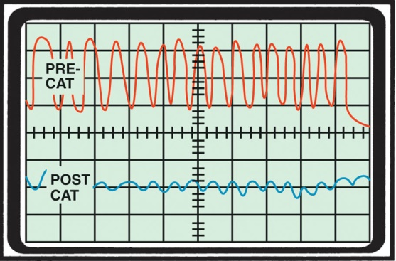
Figure 88.6 The waveform of a downstream O2S sensor from a properly functioning converter shows little, if any, activity.

Slide 15
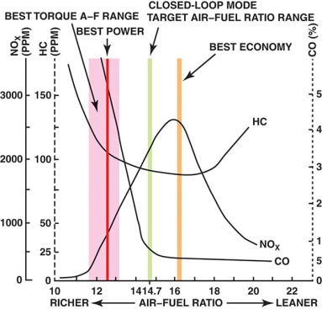
Figure 88.7 The highest catalytic converter efficiency occurs when the air-fuel mixture is about 14.7:1

Slide 16
QUESTION 2: ?
How does the engine control module monitor the performance of the catalytic converter?

Slide 17
ANSWER 2:
By monitoring the switch rate of the downstream oxygen sensor as compared to the switch rate of the upstream oxygen sensor.

Slide 18
DIAGNOSIS CATALYTIC CONVERTERS (1 OF 3)
Tap Test
  If the substrate inside the converter is broken, the converter rattles when hit. If the converter rattles, a replacement converter is required.
Testing Back Pressure with a Gauge
  Exhaust system back pressure can be measured directly by installing a pressure gauge in an exhaust opening.

Slide 19
DIAGNOSIS CATALYTIC CONVERTERS (2 OF 3)
Testing for Back Pressure Using a Vacuum Gauge
  An exhaust restriction can be tested indirectly by checking the intake manifold vacuum with the engine operating at a fast idle speed (about 2,500 RPM).
Testing a Catalytic Converter for Temperature Rise
  To test the converter, operate the engine at 2,500 RPM for at least two minutes to fully warm the converter. Measure the inlet and the outlet temperatures using an infrared pyrometer.

Slide 20
DIAGNOSIS CATALYTIC CONVERTERS (3 OF 3)
Catalytic Converter Efficiency Test
  The efficiency of a catalytic converter can be determined using an exhaust gas analyzer.

Slide 21
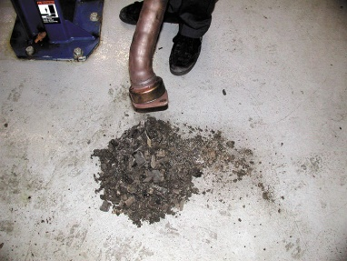
Figure 88.8 A catalytic converter that rattles when tapped was removed, and the substrate, or what was left of it, fell out. This converter has to be replaced and the root cause of why it failed found and corrected

Slide 22
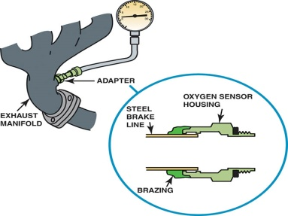
Figure 88.9 A back pressure tool can be made by using an oxygen sensor housing and epoxy or braze to hold the tube to the housing

Slide 23
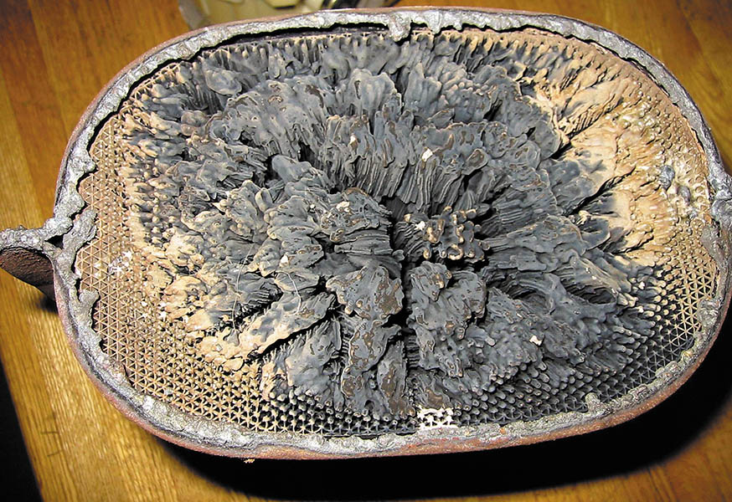
Figure 88.10 This partially melted catalytic converter tested okay at idle, but had excessive back pressure at higher engine speeds

Slide 24
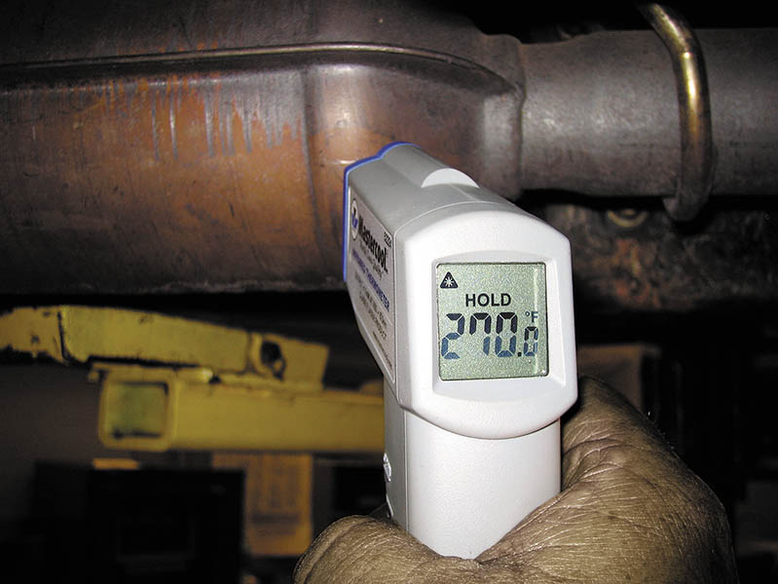
Figure 88.11 The temperature of the outlet should be at least 10% hotter than the temperature of the inlet. If a converter is not working, the inlet temperature is hotter than the outlet temperature

Slide 25
QUESTION 3: ?
How can catalytic converter be diagnosed?

Slide 26
ANSWER 3:
A tap test, a pressure test, a vacuum test, a temperature test, and an efficiency test.

Slide 27
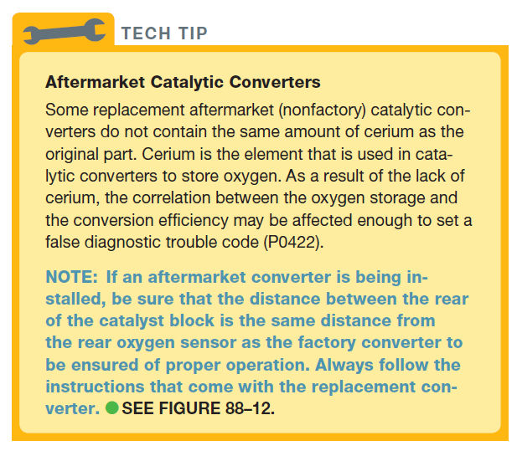
Tech Tip

Slide 28
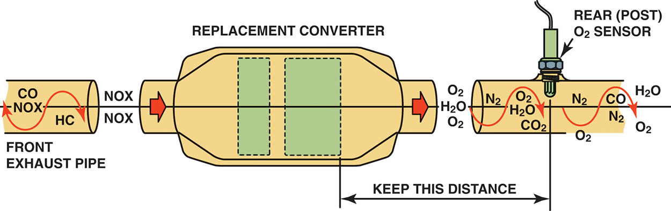
Figure 88.12 Whenever replacing a catalytic converter with a universal unit, first measure the distance between the rear brick and the center of the rear oxygen sensor. Be sure that the replacement unit is installed to the same dimension

Slide 29
CATALYTIC CONVERTER REPLACEMENT GUIDELINES
If a converter is replaced on a vehicle with less than 80,000 miles or eight years, depending on the year of the vehicle, an original equipment catalytic converter must be used as a replacement.

Slide 30
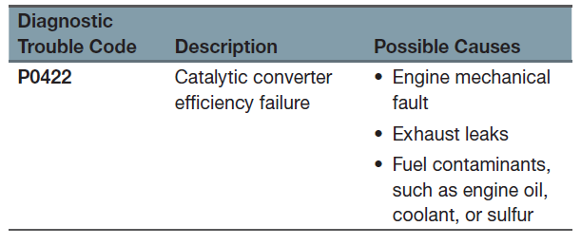
CATALYTIC CONVERTER RELATED DIAGNOSTIC TROUBLE CODES

Slide 31
Catalytic Converter Operation

Slide 32
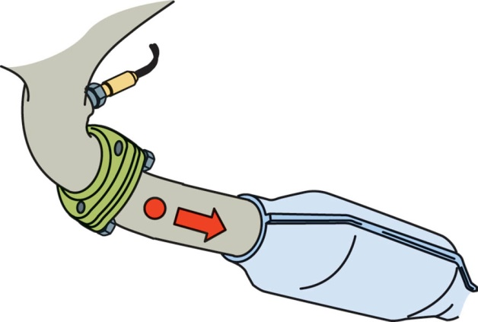
1. Carbon monoxide leaves the engine through the exhaust valve on the exhaust stroke.

Slide 33
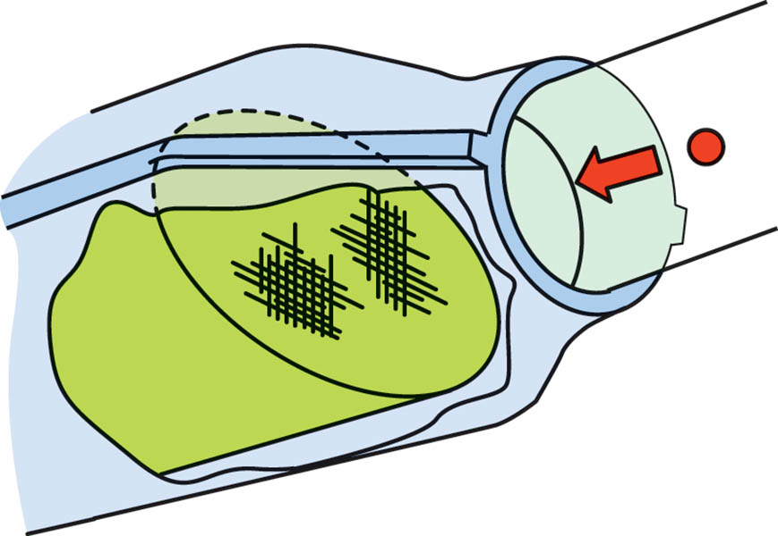
2. The CO molecule is starting to enter the converter.

Slide 34
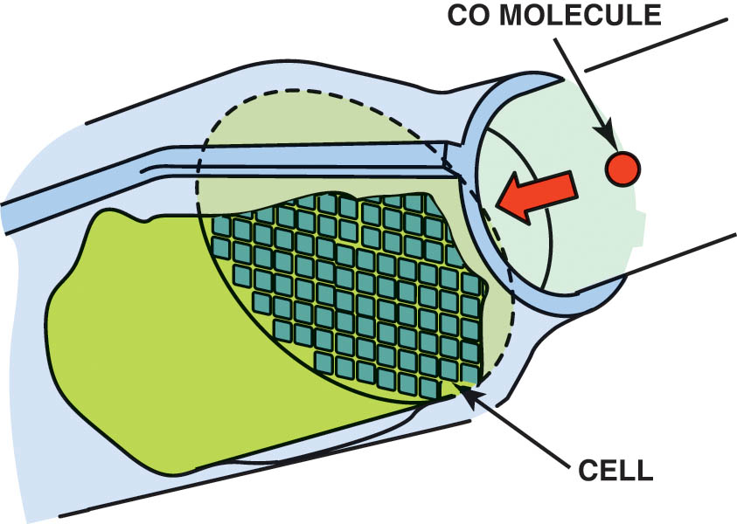
3. A CO molecule is ready to enter a cell. The number of cells ranges from 300 to 900 per sq. in. The substrate is cordierite (Mg, AL, Si) or foil-backed metal with a 0.002- to 0.006-inch (0.05- to 0.15-mm)-thick wall.

Slide 35
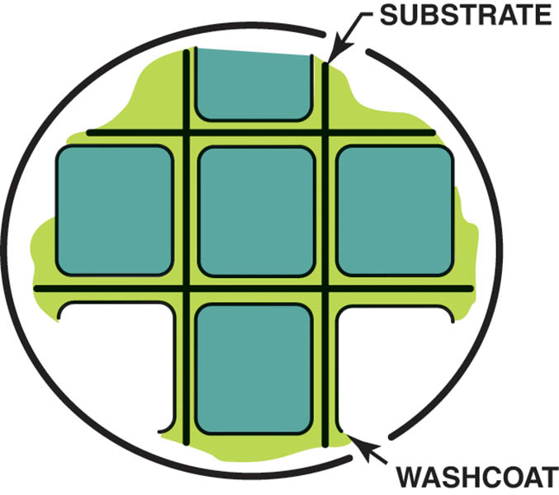
4. The CO molecule enters a cell. The substrate is coated with porous aluminum (AL2O3), called the washcoat. The catalytic material is sprayed onto the washcoat.

Slide 36
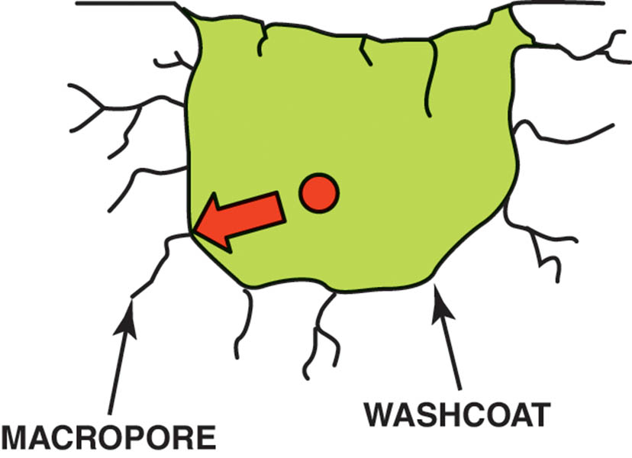
5. The CO molecule enters a micropore, which has been created in the porous washcoat.

Slide 37
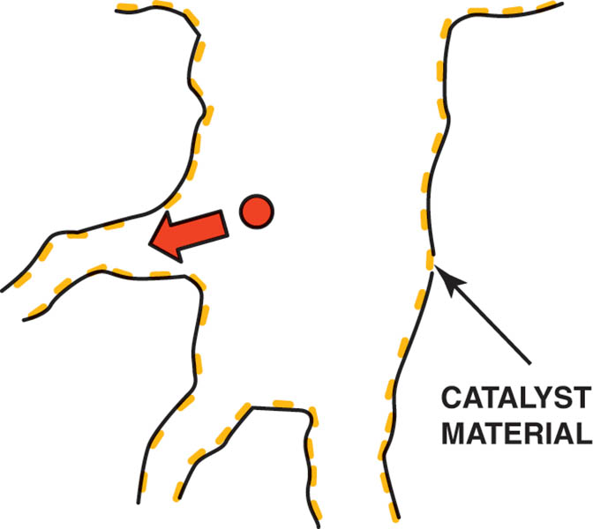
6. The CO molecule enters a smaller micropore.

Slide 38
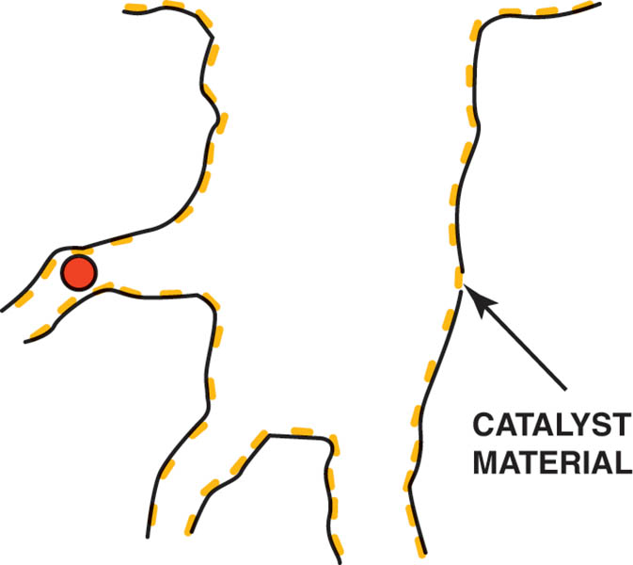
7. The CO molecule is absorbed onto a catalyst side. Only a few grams of catalyst material are applied to the washcoat

Slide 39
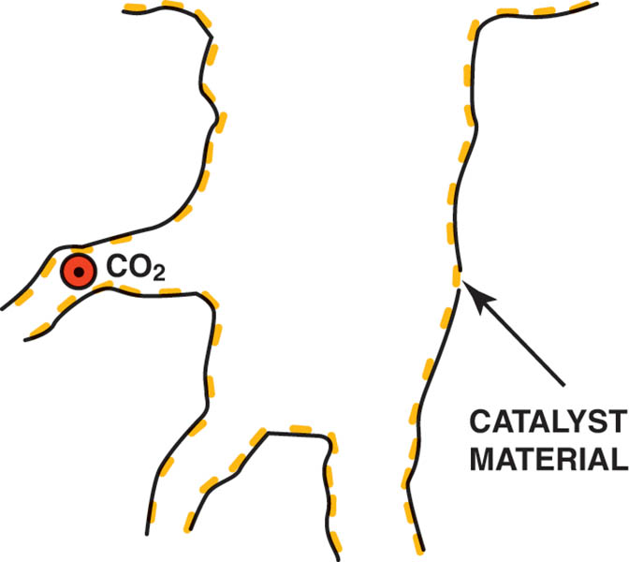
8. The CO molecule is converted to a CO2 molecule.

Slide 40
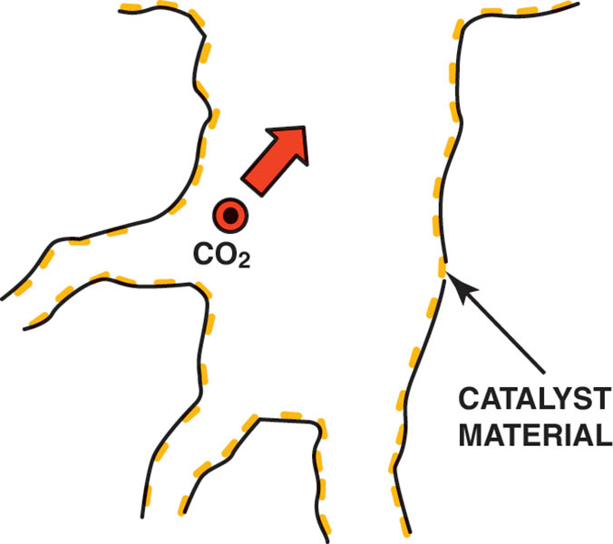
9. The CO2 molecule is exiting the small micropore.

Slide 41
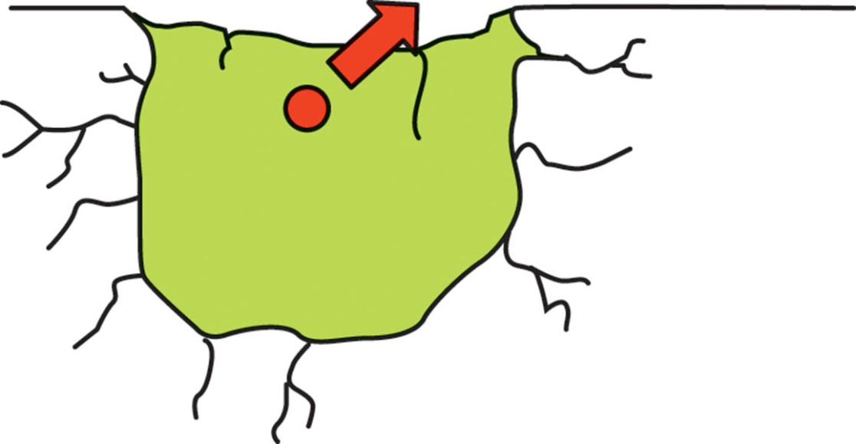
10. The CO2 molecule is exiting the larger micropore.

Slide 42
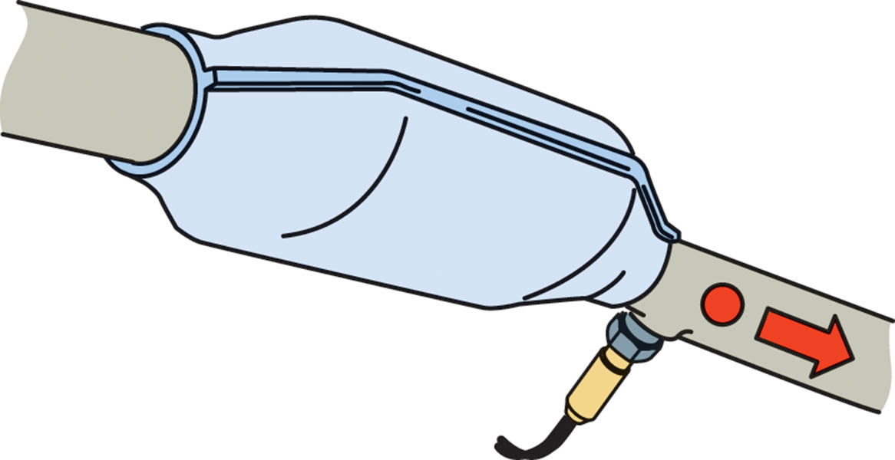
11. The CO2 molecule is exiting the converter.

Slide 43
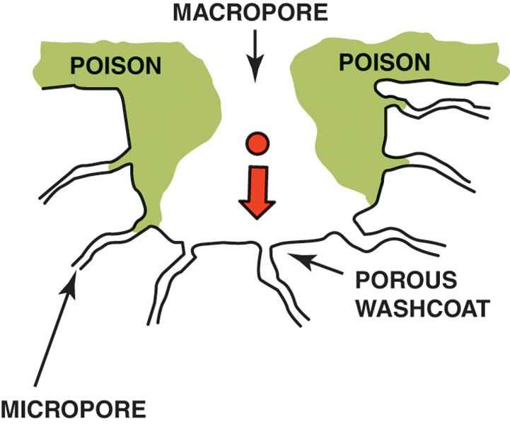
12. A poisoned converter.

Slide 44

Copyright

