Slide 1

Automotive Technology Principles, Diagnosis, and Service
Sixth Edition
Chapter 87
Positive Crankcase Ventilation and Secondary Air- Injection Systems
Copyright © 2018, 2015, 2011 Pearson Education, Inc. All Rights Reserved

Slide 2
LEARNING OBJECTIVES
87.1 Describe the purpose and function of the positive crankcase ventilation (PCV) system.
87.2 Explain the purpose and function of the secondary air-injection (SAI) system and how to diagnose faults in the system.

Slide 3
CRANKCASE VENTILATION (1 OF 2)
Purpose and Function
Positive crankcase ventilation (PCV) systems were developed to ventilate the crankcase and recirculate the vapors to the engine’s induction system so they can be burned in the cylinders.
PCV Valves
The PCV valve in most systems is a one-way valve containing a spring-operated plunger that controls valve flow rate.

Slide 4
CRANKCASE VENTILATION (2 OF 2)
Orifice Controlled Systems
The closed PCV system used on some 4-cylinder engines contains a calibrated orifice instead of a PCV valve.
Separator Systems
Turbocharged and many fuel-injected engines use an oil/vapor or oil/water separator and a calibrated orifice instead of a PCV valve.

Slide 5
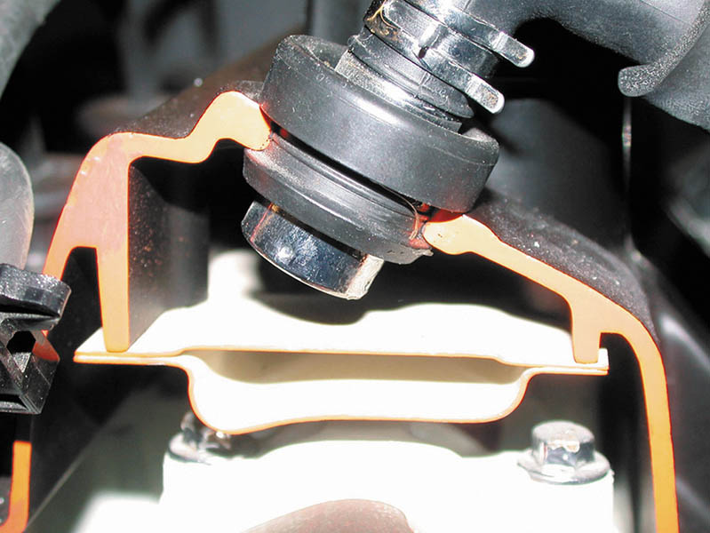
Figure 87.1 A PCV valve in a cutaway valve cover, showing the baffles that prevent liquid oil from being drawn into the intake manifold

Slide 6
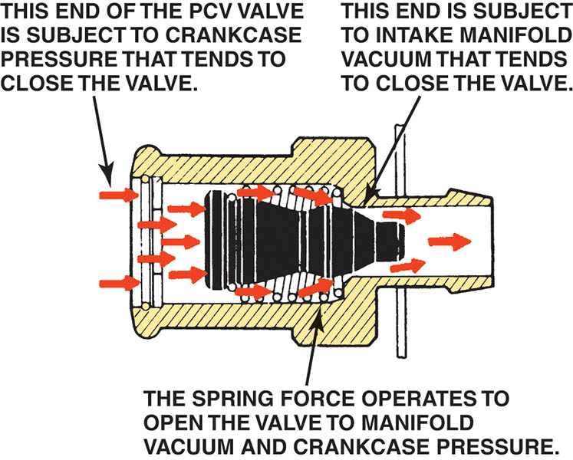
Figure 87.2 Spring force, crankcase pressure, and intake manifold vacuum work together to regulate the flow rate through the PCV valve

Slide 7
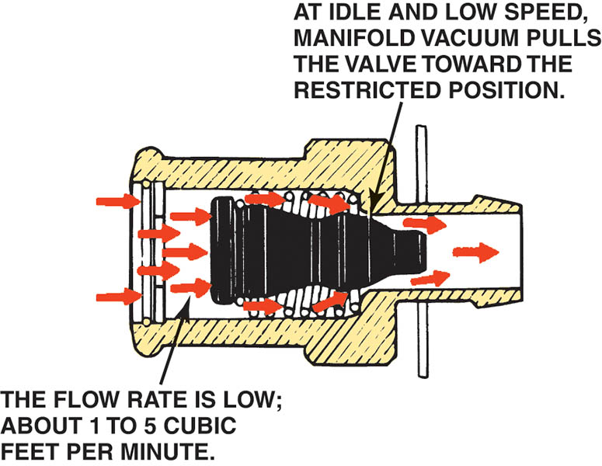
Figure 87.3 Air flows through the PCV valve during idle, cruising, and light-load conditions

Slide 8
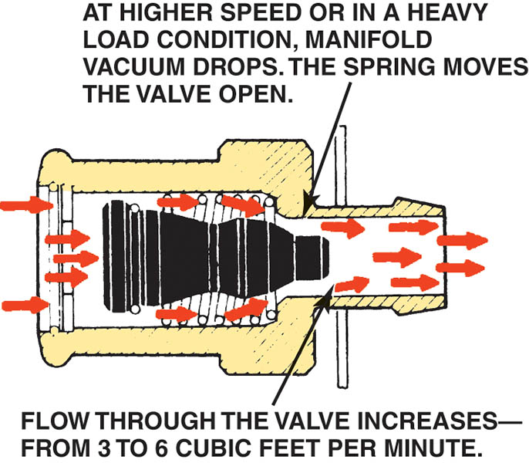
Figure 87.4 Air flows through the PCV valve during acceleration and when the engine is under a heavy load

Slide 9
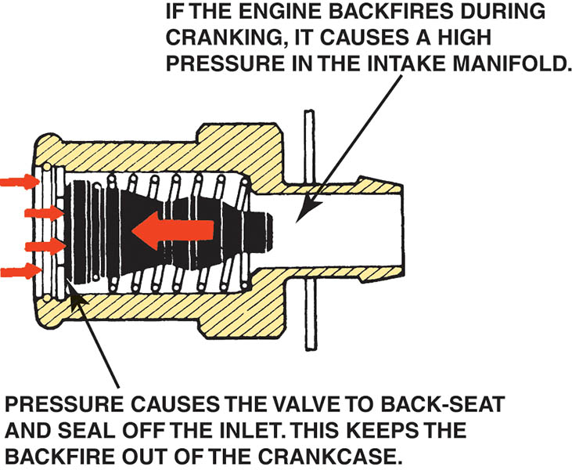
Figure 87.5 PCV valve operation in the event of a backfire

Slide 10
PCV SYSTEM DIAGNOSIS (1 OF 3)
Symptoms
Rough or unstable idle
Excessive oil consumption
Oil in the air filter housing
Oil leaks due to excessive crankcase pressure
PCV System Performance Test
A slight vacuum is created in the crankcase (usually less than 1 in. Hg if measured at the dipstick) and is also applied to other areas of the engine.

Slide 11
PCV SYSTEM DIAGNOSIS (2 OF 3)
Rattle Test
If the PCV valve does not rattle, it is definitely defective and must be replaced.
The 3X5 Card Test
Remove the oil-fill cap (where oil is added to the engine) and start the engine.
Hold a 3 × 5 card over the opening (a dollar bill or any other piece of paper can be used for this test):
If the PCV system, including the valve and hoses, is functioning correctly, the card should be held down on the oil-fill opening by the slight vacuum inside the crankcase.

Slide 12
PCV SYSTEM DIAGNOSIS (3 OF 3)
Snap-Back Test
The proper operation of the PCV valve can be checked by placing a finger over the inlet hole in the valve when the engine is running and removing the finger rapidly.
Crankcase Vacuum Test
The PCV system can be checked by testing for a weak vacuum at the oil dipstick tube using an inches-of-water manometer or gauge.
PCV Monitor
Starting with 2004 and newer vehicles, all vehicle PCMs monitor the PCV system for proper operation as part of the OBD-II system.

Slide 13
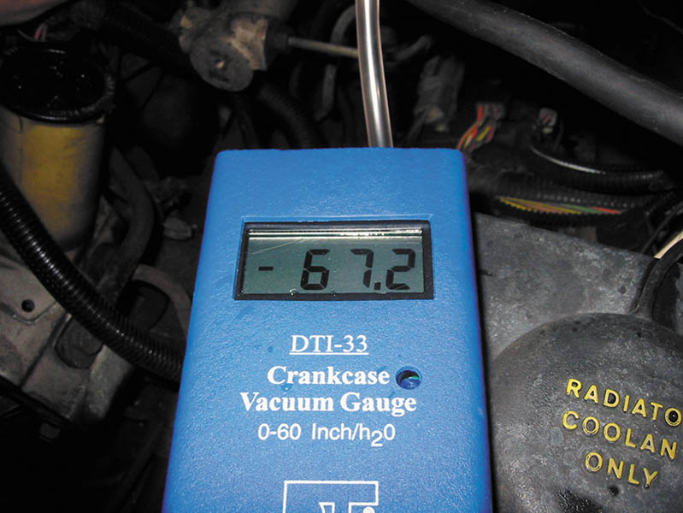
Figure 87.6 Using a gauge that measures vacuum in units of inches of water to test the vacuum at the dipstick tube, being sure that the PCV system is capable of drawing a vacuum on the crankcase (28 inches H₂O = 1 PSI, or about 2 in. Hg of vacuum)

Slide 14
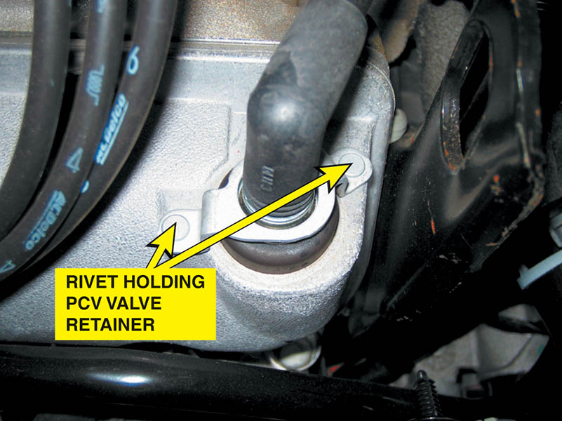
Figure 87.7 Most PCV valves used on newer vehicles are secured with fasteners, making it more difficult to disconnect, and thereby less likely to increase emissions

Slide 15
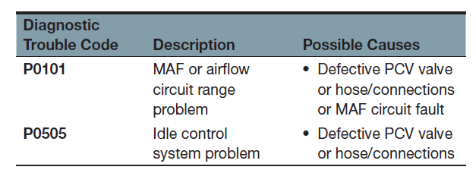
PCV RELATED DIAGNOSTIC TROUBLE CODES

Slide 16
QUESTION 1: ?
What emissions does a PCV valve control?

Slide 17
ANSWER 1:
Excessive crankcase Hydrocarbons (HC).

Slide 18
SECONDARY AIR-INJECTION SYSTEM (1 OF 3)
Purpose and Function
The secondary air-injection (SAI) system provides the air necessary for the oxidizing process either at the exhaust manifold or inside the catalytic converter.
Parts and Operation
The system pulls fresh air in through an external filter and pumps the air under slight pressure to each exhaust port through connecting hoses or a manifold.

Slide 19
SECONDARY AIR-INJECTION SYSTEM (2 OF 3)
Air Distribution Manifolds and Nozzles
Air is delivered to the exhaust system in one of two ways:
An external air manifold, or manifolds, distributes the air through injection tubes with stainless-steel nozzles.
An internal air manifold distributes the air to the exhaust ports near each exhaust valve through passages cast in the cylinder head or the exhaust manifold.

Slide 20
SECONDARY AIR-INJECTION SYSTEM (3 OF 3)
Exhaust Check Valves
All air-injection systems use one or more one-way check valves to protect the air pump and other components from reverse exhaust flow.
Belt-Driven Air Pumps
The belt-driven air pump uses a centrifugal filter just behind the drive pulley.
Electric Motor-Driven Air Pumps
Generally used only during cold engine operation and is computer controlled.

Slide 21
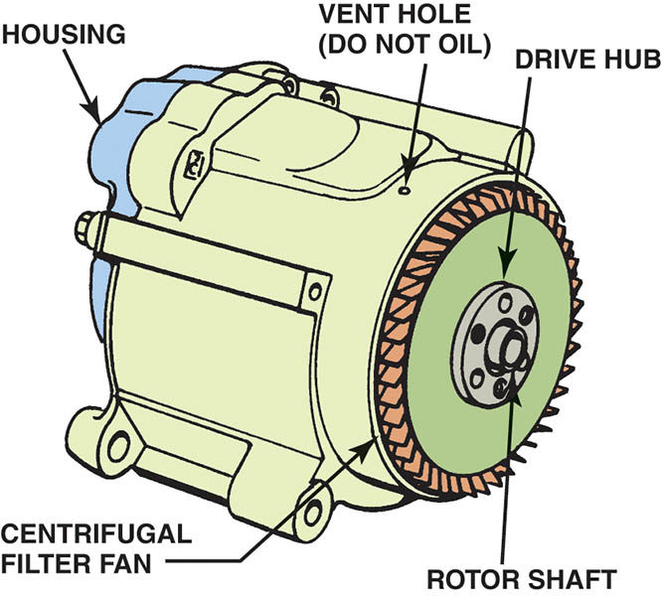
Figure 87.8 A typical belt-driven AIR pump. Air enters through the revolving fins behind the drive pulley. The fins act as an air filter because dirt is heavier than air and, therefore, the dirt is deflected off of the fins at the same time air is being drawn into the pump

Slide 22
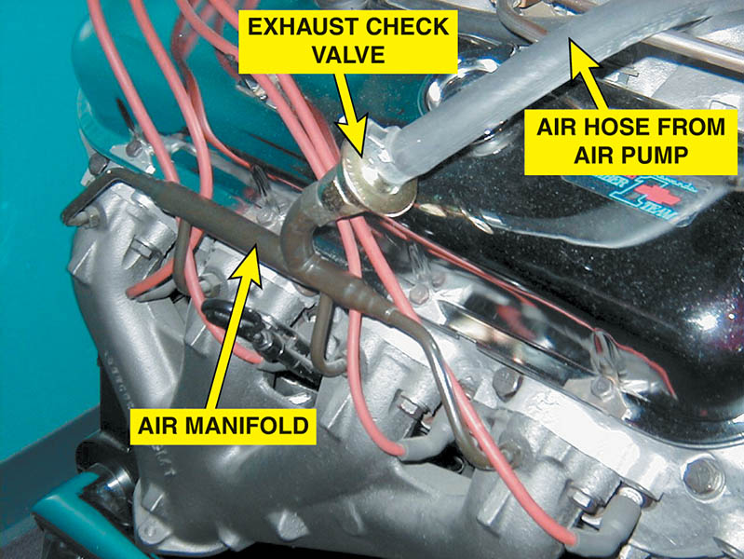
Figure 87.9 The external air manifold and exhaust check valve on a restored muscle car engine

Slide 23
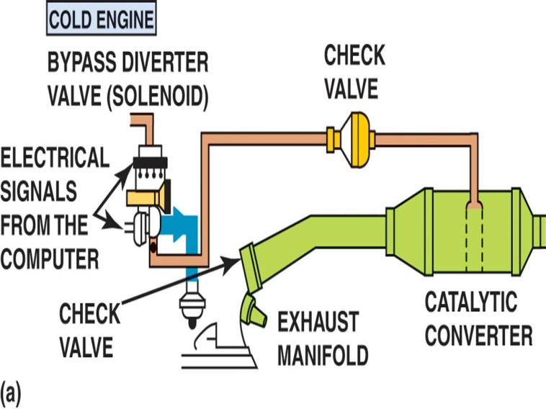
Figure 87.10 (a) When the engine is cold and before the oxygen sensor is hot enough to achieve closed loop, the airflow from the air pump is directed to the exhaust manifold(s) through the one-way check valves, which keep the exhaust gases from entering the switching solenoids and the pump itself

Slide 24
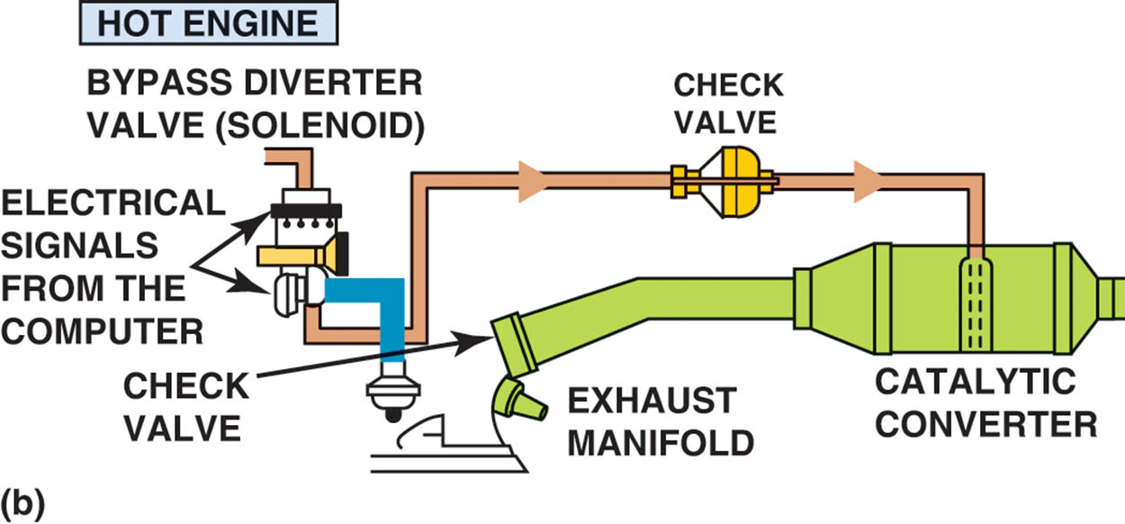
Figure 87.10 (b) When the engine achieves closed loop, the air is directed to the catalytic converter

Slide 25
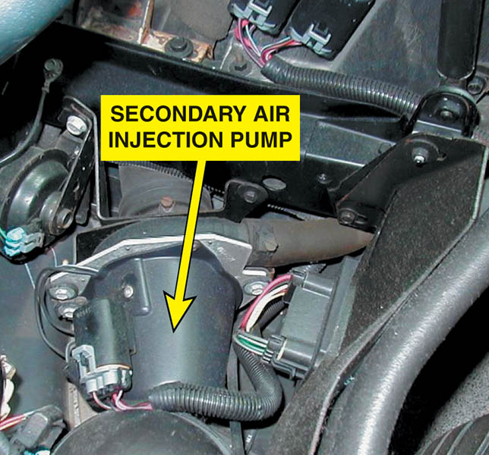
Figure 87.11 A typical electric motor–driven SAI pump. This unit is on a Chevrolet Corvette and only works when the engine is cold

Slide 26
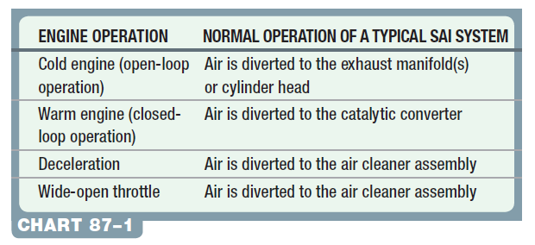
SECONDARY AIR-INJECTION SYSTEM DIAGNOSIS (1 OF 2)
Symptoms
The air pump system should be inspected if an exhaust emissions test failure occurs.

Slide 27
SECONDARY AIR-INJECTION SYSTEM DIAGNOSIS (2 OF 2)
Visual Inspection
Carefully inspect all parts of the SAI system for holes or other physical damage.
Four-Gas Exhaust Analysis
An SAI system can be tested using an exhaust gas analyzer.
Verify O2 values as the system is enabled and disabled.

Slide 28
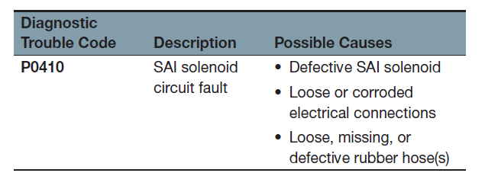
SAI-RELATED DIAGNOSTIC TROUBLE CODES

Slide 29
QUESTION 2: ?
What is the purpose of the air-injection pump?

Slide 30
ANSWER 2:
The secondary air-injection (SAI) system provides the air necessary for the oxidizing process either at the exhaust manifold or inside the catalytic converter.

Slide 31

Copyright

