Slide 1

Automotive Technology Principles, Diagnosis, and Service
Sixth Edition
Chapter 86
Exhaust Gas Recirculation System
Copyright © 2018, 2015, 2011 Pearson Education, Inc. All Rights Reserved

Slide 2
LEARNING OBJECTIVES
86.1 Discuss the purpose and function of exhaust gas recirculation (EGR) systems.
86.2 Explain the strategies to monitor onboard diagnostics generation II (OBD-II) exhaust gas recirculation (EGR) systems.
86.3 Explain how to diagnose a defective EGR system.

Slide 3
EXHUAT GAS RECIRCULATION SYSTEMS (1 OF 5)
Introduction
Exhaust gas recirculation (EGR) is an emission control system that lowers the amount of nitrogen oxides (NOx) formed during combustion.
NOx Formation
Nitrogen (N2) and oxygen (O2) molecules bond to form NOx (NO, NO2) when combustion flame front temperatures exceed 2,500°F (1,370°C).

Slide 4
EXHUAT GAS RECIRCULATION SYSTEMS (2 OF 5)
Controlling NOx
The EGR system routes small quantities, usually between 6% and 10%, of exhaust gas into the intake manifold.
The result is a lower peak combustion temperature.
EGR System Operation
Typically only used when the engine is above idle.
Not used at idle, during warm-up, and at wide-open throttle.

Slide 5
EXHUAT GAS RECIRCULATION SYSTEMS (3 OF 5)
Positive and Negative Back Pressure EGR Valves
Positive back pressure EGR valves require a positive back pressure in the exhaust system.
Negative back pressure EGR valves react to a low-pressure pulse created by the exhaust valve, by closing a small internal valve, which allows the EGR valve to be opened by vacuum.
Computer Controlled EGR Systems
Most vehicles today use the powertrain control module (PCM) to operate the EGR system.

Slide 6
EXHUAT GAS RECIRCULATION SYSTEMS (4 OF 5)
EGR Valve Position Sensors
A linear potentiometer on the top of the EGR valve stem indicates valve position to the PCM.
Digital EGR Valves
The digital EGR valve consists of three solenoids controlled by the powertrain control module (PCM).
Each solenoid controls a different size orifice in the base.
It can produce any of seven different flow rates.

Slide 7
EXHUAT GAS RECIRCULATION SYSTEMS (5 OF 5)
Linear EGR
A linear EGR valve contains a pulse-width modulated solenoid to precisely regulate exhaust gas flow and a feedback potentiometer that signals the PCM regarding the actual position of the valve.

Slide 8

Figure 86.1 Nitrogen oxides (NOx) create a red-brown haze that often hangs over major cities

Slide 9
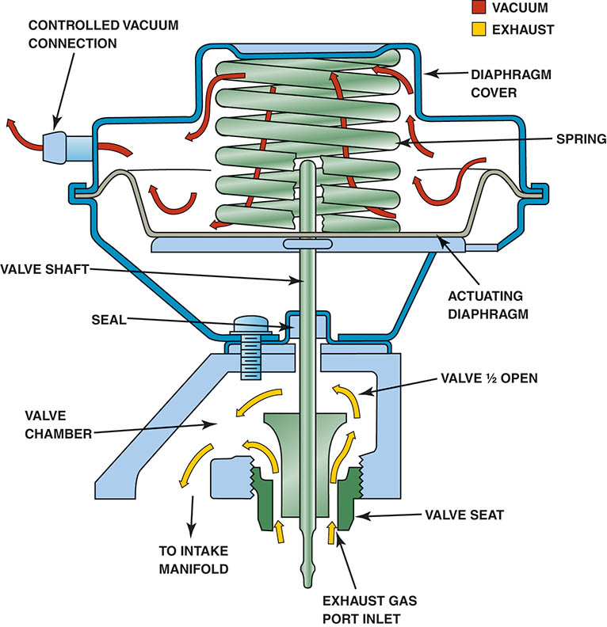
Figure 86.2 When the EGR valve opens, the exhaust gases flow through the valve and into passages in the intake manifold

Slide 10
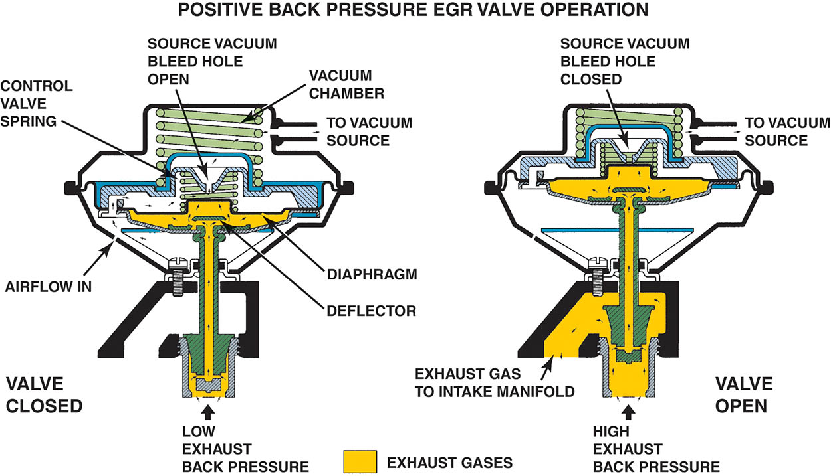
Figure 86.3 Back pressure in the exhaust system is used to close the control valve, allowing engine vacuum to open the EGR valve

Slide 11
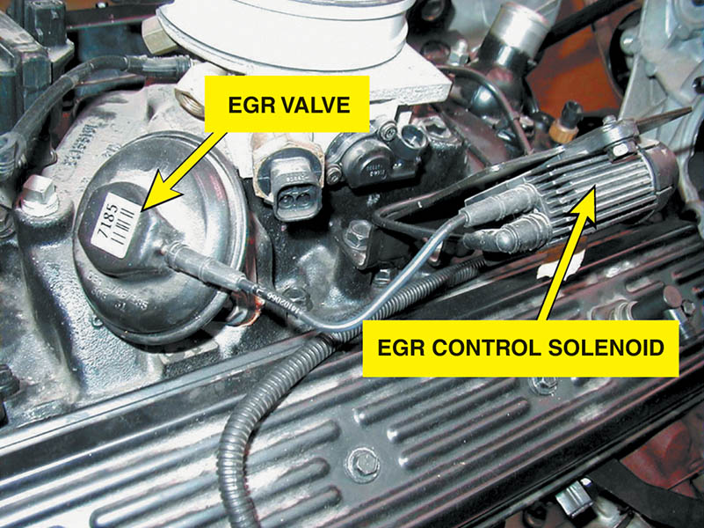
Figure 86.4 Typical vacuum-operated EGR valve. The operation of the valve is controlled by the PCM by pulsing the EGR control solenoid on and off

Slide 12
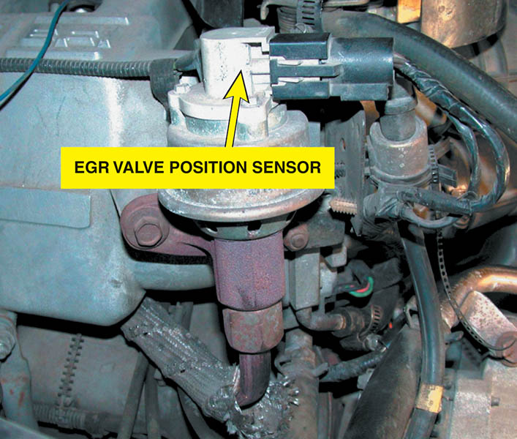
Figure 86.5 An EGR valve position sensor on top of an EGR valve

Slide 13
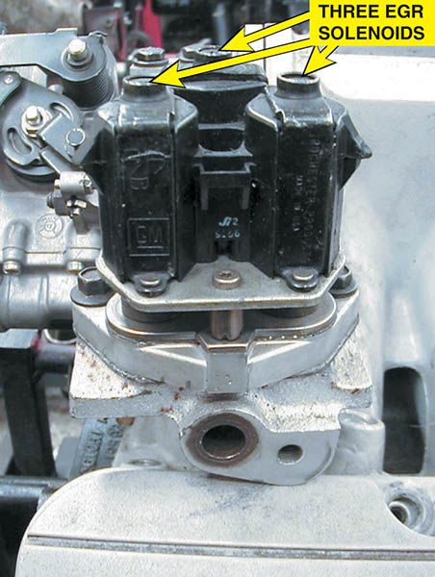
Figure 86.6 Digital EGR valve as used on some older General Motors engines

Slide 14
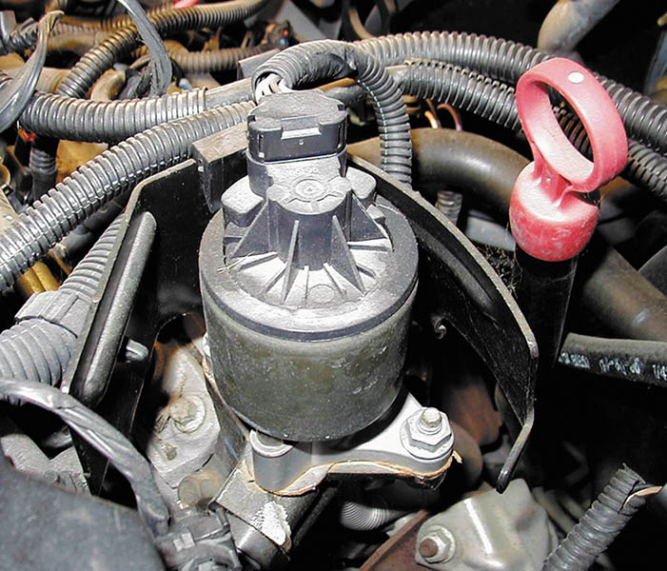
Figure 86.7 A General Motors linear EGR valve

Slide 15
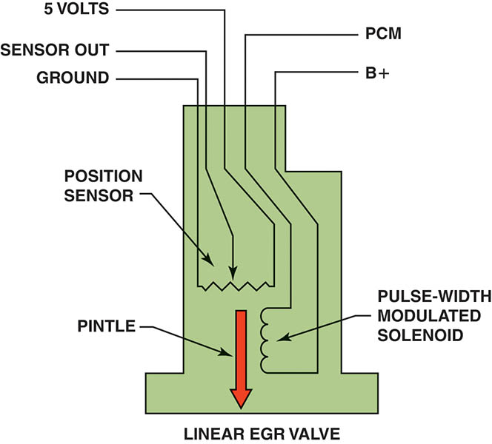
Figure 86.8 The EGR valve pintle is pulse-width modulated and a three-wire potentiometer provides pintle-position information back to the PCM

Slide 16
QUESTION 1: ?
What is the purpose of an EGR system?

Slide 17
ANSWER 1:
To reduce combustion temperatures and lower NOx tailpipe emissions.

Slide 18
OBD-II EGR MONITORING STRATEGIES
Purpose and Function
The PCM monitors the system and alerts the driver and the technician if an emission system is malfunctioning.
Monitoring Strategies
Some vehicle manufacturers, such as Chrysler, monitor the difference in the exhaust oxygen sensor’s voltage activity as the EGR valve opens and closes.
Most Fords use an EGR monitor test sensor called a delta pressure feedback EGR (DPFE) sensor.
Many vehicle manufacturers use the manifold absolute pressure(MAP) sensor as the EGR monitor on some applications.

Slide 19
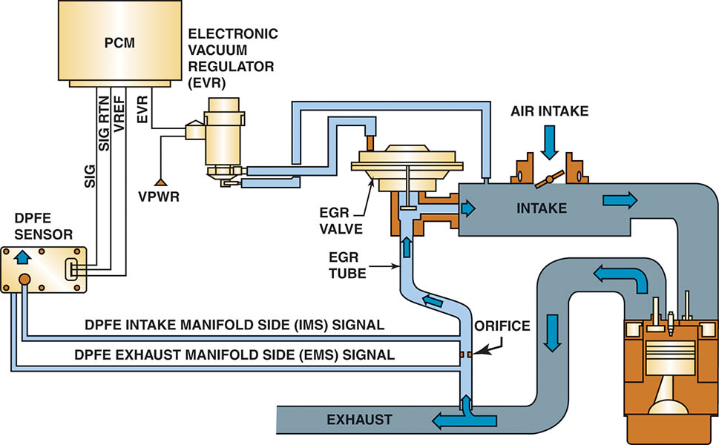
Figure 86.9 A typical Ford DPFE sensor and related components

Slide 20
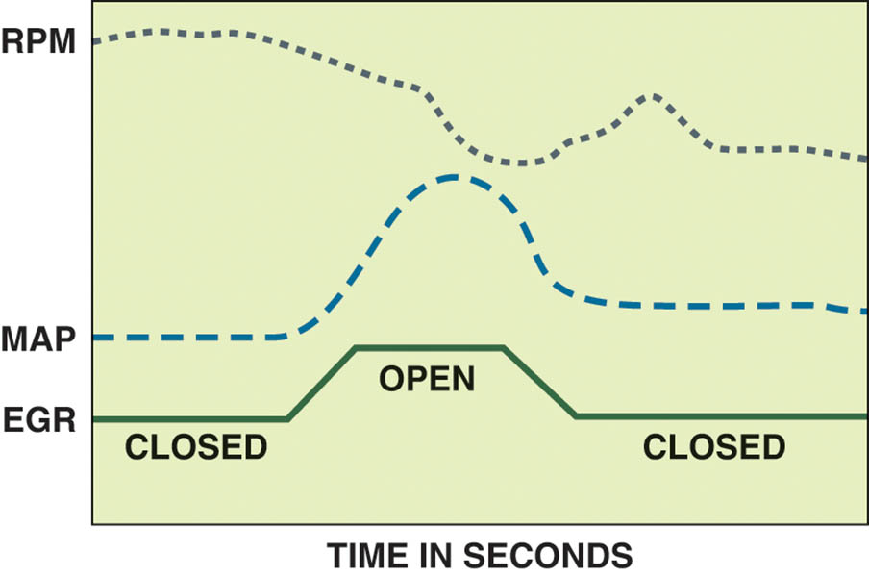
Figure 86.10 An OBD-II active test. The PCM opens the EGR valve and then monitors the MAP sensor and/or engine speed (RPM) to verify that it meets acceptable values

Slide 21
DIAGNOSING A DEFECTIVE EGR SYSTEM (1 OF 2)
Symptoms
Detonation (spark knock or ping) during acceleration or during cruise (steady-speed driving)
Excessive oxides of nitrogen (NOx) exhaust emissions
Rough idle or frequent stalling
Poor performance/low power, especially at low engine speed

Slide 22
DIAGNOSING A DEFECTIVE EGR SYSTEM (2 OF 2)
EGR Testing Procedures
Check the vacuum diaphragm of the EGR valve to see if it can hold vacuum.
Apply vacuum from a hand-operated vacuum pump and check for proper operation.
Monitor engine vacuum drop.

Slide 23
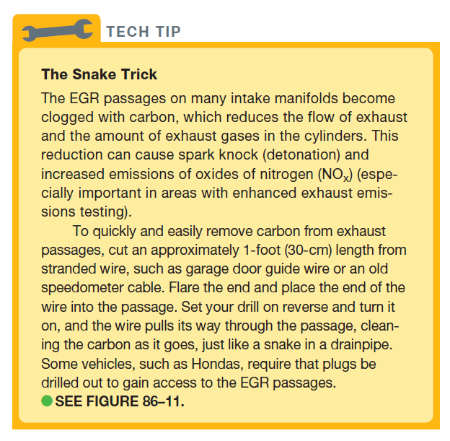
Tech Tip

Slide 24
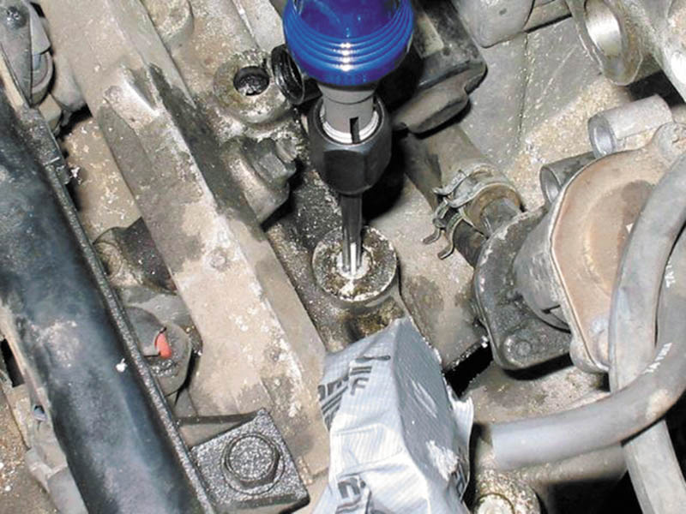
Figure 86.11 Removing the EGR passage plugs from the intake manifold on a Honda

Slide 25
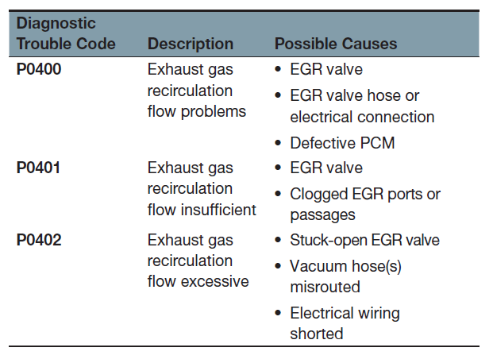
EGR RELATED OBD-II DIAGNOSTIC TROUBLE CODES

Slide 26
QUESTION 2: ?
What are the symptoms of a defective EGR system?

Slide 27
ANSWER 2:
Rough idle, spark knock, poor performance, and frequent stalling.

Slide 28

Copyright

