Slide 1

Automotive Technology Principles, Diagnosis, and Service
Sixth Edition
Chapter 85
Evaporation Emission Control Systems
Copyright © 2018, 2015, 2011 Pearson Education, Inc. All Rights Reserved

Slide 2
LEARNING OBJECTIVES
85.1 Explain the operation of an evaporative emission control system and compare enhanced and non-enhanced evaporative control (EVAP) systems.
85.2 Discuss leak detection pump systems and onboard refueling vapor recovery, and explain how to diagnose the EVAP system.
85.3 Discuss the functions of an evaporative system monitor.

Slide 3
EVAPORATIVE EMISSION CONTROL SYSTEM (1 OF 2)
Purpose and Function
The purpose of the evaporative emission control system is to trap and hold gasoline vapors, also called volatile organic compounds (VOCs).
Common Components
Most EVAP fuel tank filler caps have a built-in pressure-vacuum relief valve.

Slide 4
EVAPORATIVE EMISSION CONTROL SYSTEM (2 OF 2)
EVAP System Operation
The canister is filled with activated charcoal granules that can hold up to one-third of their own weight in fuel vapors.
During engine operation, stored vapors are drawn from the canister into the engine through a hose connected to the throttle body.
The PCM controls when the canister purges on most engines.

Slide 5
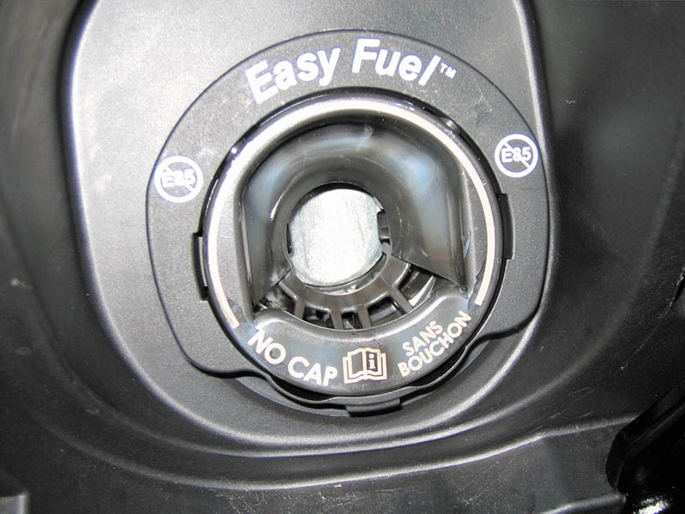
Figure 85.1 A capless system from a Ford does not use a replaceable cap; instead, it is spring-loaded closed.

Slide 6
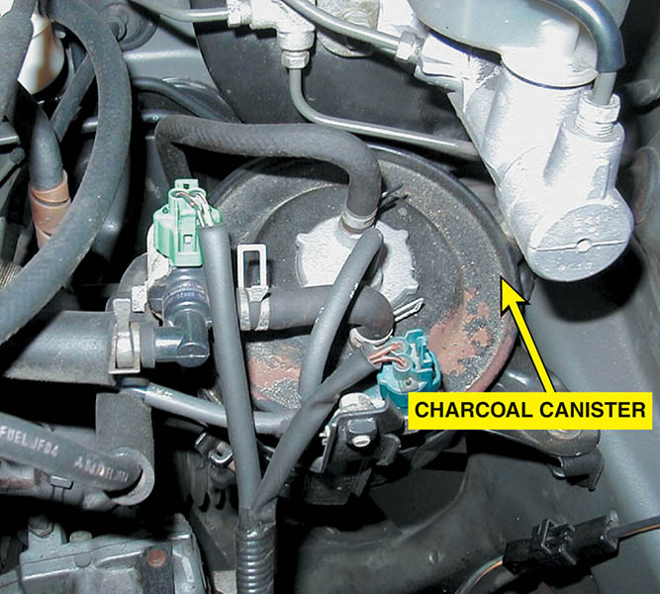
Figure 85.2 A charcoal canister can be located under the hood or underneath the vehicle.

Slide 7
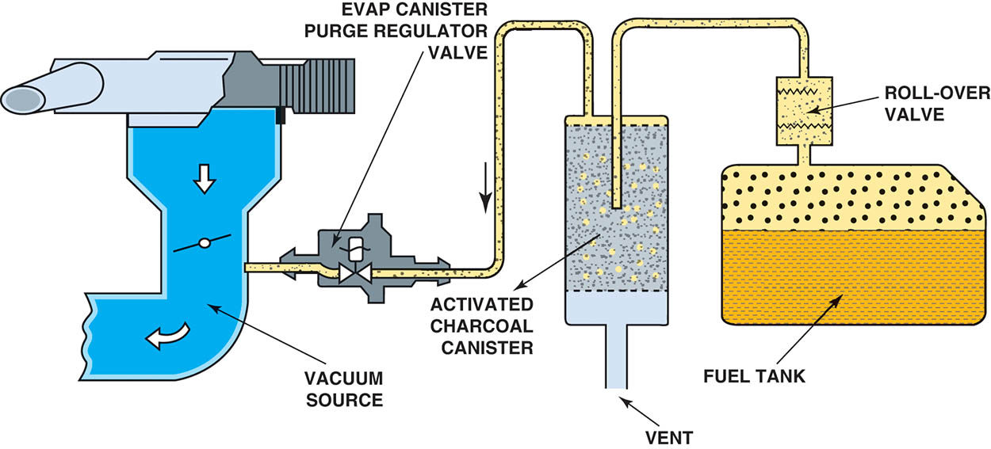
Figure 85.3 The EVAP system includes all of the lines, hoses, and valves, plus the charcoal canister.

Slide 8
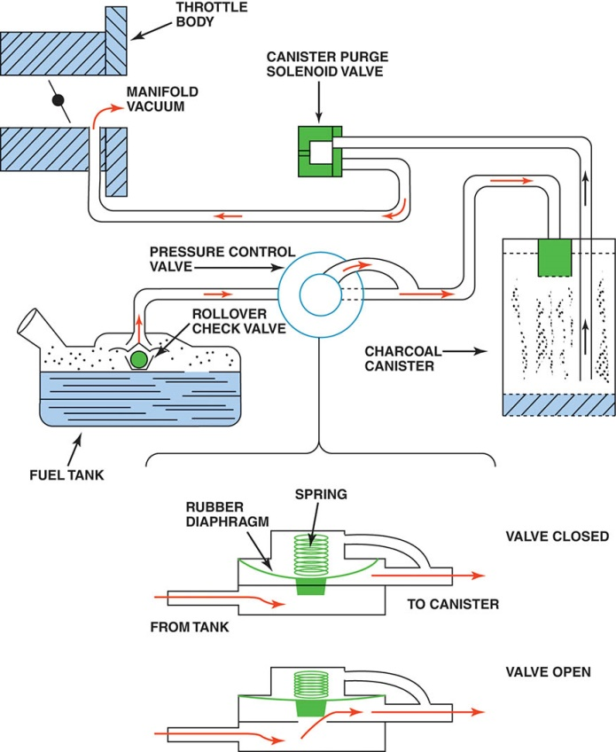
Figure 85.4 A typical EVAP system. Note that when the computer turns on the canister purge solenoid valve, manifold vacuum draws any stored vapors from the canister into the engine. Manifold vacuum also is applied to the pressure control valve.

Slide 9
QUESTION 1: ?
What is the purpose of the evaporative system?

Slide 10
ANSWER 1:
To trap and hold gasoline vapors.

Slide 11
NONENHANCED EVAPORATIVE CONTROL SYSTEMS
This term refers to evaporative systems that had limited diagnostic capabilities.
This system does not check for leaks.
The PCM also has the capability of monitoring the integrity of the purge solenoid and circuit.
Non-enhanced EVAP systems use either a canister purge solenoid or a vapor management valve to control purge vapor.

Slide 12
ENHANCED EVAPORATIVE CONTROL SYSTEMS (1 OF 2)
Background
The systems on models produced between 1996 and 2000 must be able to detect a leak as small as 0.040 inches in diameter.
Beginning in the model year 2000, the enhanced systems started a phase-in of 0.020-inch diameter leak detection.
All vehicles built after 1995 have enhanced EVAP systems with the ability to detect purge flow and system leakage.

Slide 13
ENHANCED EVAPORATIVE CONTROL SYSTEMS (2 OF 2)
Vent Valve
The canister vent valve is a normally open valve and is closed only when commanded by the PCM during testing of the system.
Purge Valve
The canister purge valve, also called the canister purge (CANP) solenoid, is normally closed and is pulsed open by the PCM during purging.

Slide 14
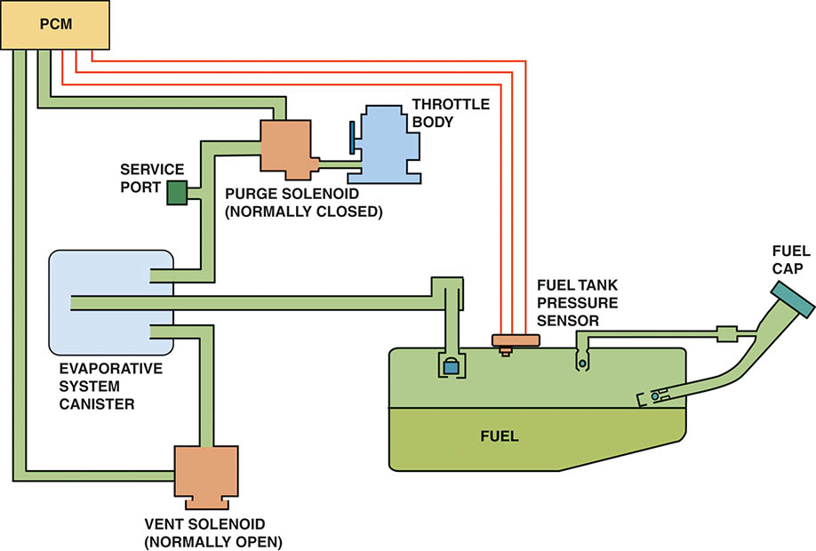
Figure 85.5 An enhanced EVAP system is able to perform system and leak detection diagnosis

Slide 15
LEAK DETECTION PUMP
Operation
The purge solenoid is normally closed.
The vent valve in the LDP is normally open. Filtered fresh air is drawn through the LDP to the canister.
The LDP uses a spring attached to a diaphragm to apply pressure (7.5 in. H2O) to the fuel tank (during pump period).
The PCM monitors the LDP switch that is triggered if the pressure drops in the fuel tank.
The shorter the pump period, the larger the leak. The longer the pump period, the smaller the leak.

Slide 16
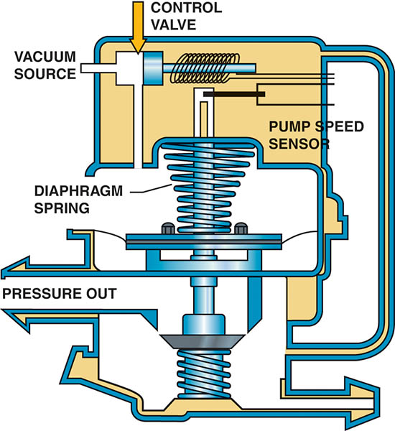
Figure 85.6 A leak detection pump (LDP) used on some Chrysler and other vehicles to pressurize (slightly) the fuel system to check for leaks

Slide 17
ONBOARD REFUELING VAPOR RECOVERY
Purpose and Function
Prevent fuel vapors from escaping to the atmosphere during refueling.
Operation
This reduced-size filler tube creates an aspiration effect, which tends to draw outside air into the filler tube.
During refueling, the fuel tank is vented to the charcoal canister.

Slide 18
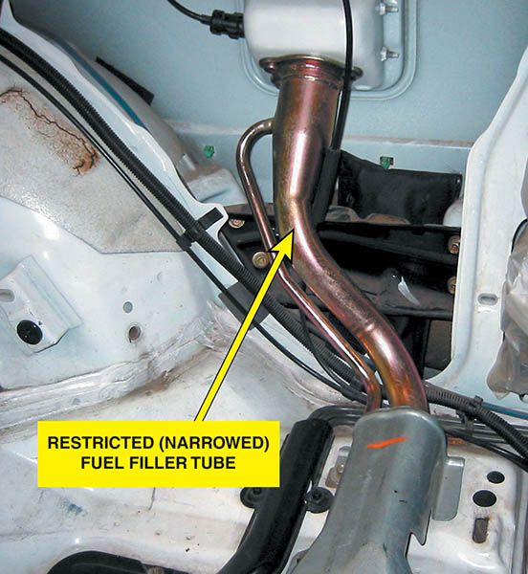
Figure 85.7 A restricted fuel fill pipe shown on vehicle with the interior removed

Slide 19
QUESTION 2: ?
What is the purpose of the ORVR system?

Slide 20
ANSWER 2:
To prevent gasoline vapors from escaping to the atmosphere during refueling.

Slide 21
DIAGNOSING THE EVAP SYSTEM
Symptoms
Common engine performance problems that can be caused by a fault in this system include the following:
Poor fuel economy.
Poor performance.
Locating Leaks in the System
Smoke machine testing.
Nitrogen gas pressurization.

Slide 22
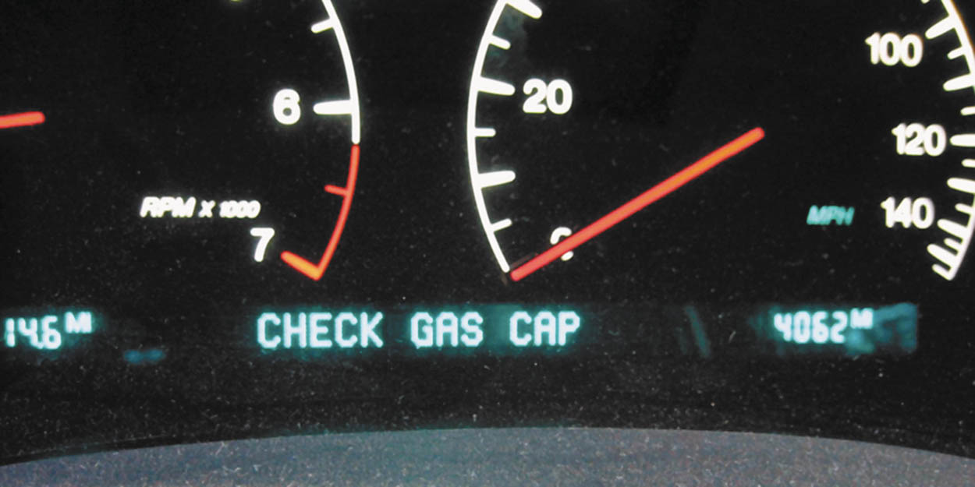
Figure 85.8 Some vehicles display a message if an evaporative control system leak is detected that could be the result of a loose gas cap

Slide 23
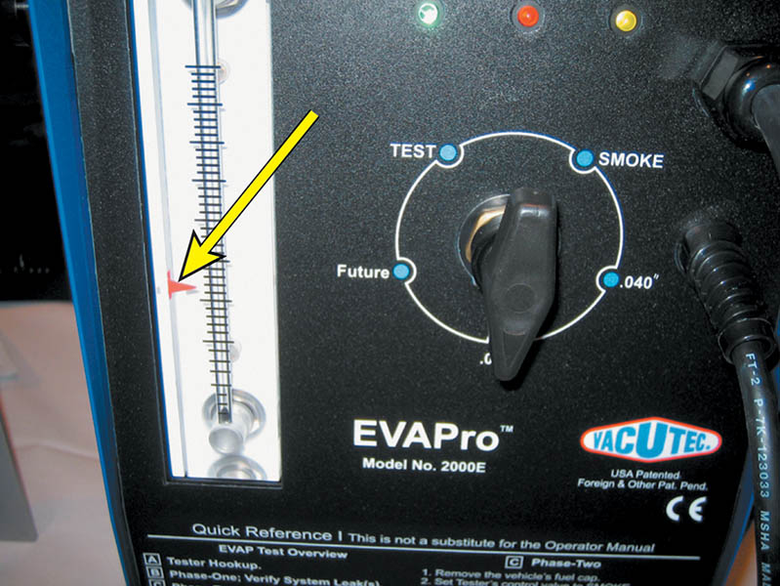
Figure 85.9 To test for a leak, this tester was set to the 0.020-inch hole and turned on. The ball rose in the scale on the left, and the red arrow was moved to that location.

Slide 24
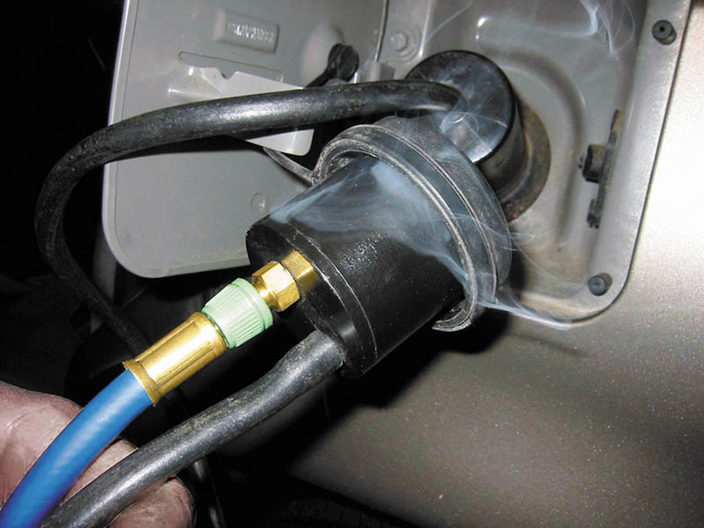
Figure 85.10 This unit is applying smoke to the fuel tank through an adapter, and the leak was easily found to be the gas cap seal

Slide 25
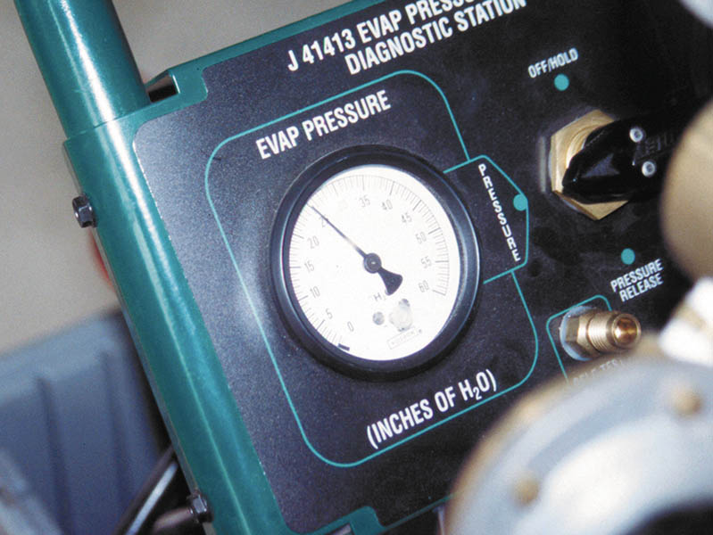
Figure 85.11 An emission tester that uses nitrogen to pressurize the fuel system

Slide 26
EVAPORATIVE SYSTEM MONITOR
OBD-II Requirements
OBD-II computer programs not only detect faults, but also periodically test various systems and alert the driver before emissions-related components are harmed by system faults.
Pressurized Test Method
The pressure in the system is monitored by a fuel tank pressure sensor when the monitor is in progress.
Engine-Off Natural Vacuum Test Method
A sealed system will draw into a slight vacuum as the tank cools. The PCM monitors the change after the vehicle has been shut off.

Slide 27
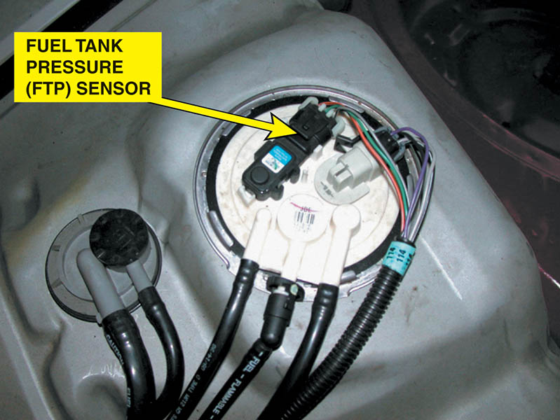
Figure 85.12 The fuel tank pressure sensor (black unit with three wires) looks like a MAP sensor and is usually located on top of the fuel pump module (white unit)

Slide 28

Figure 85.13 A tank car was cleaned using steam, and then both the bottom drain and the top vent were closed. The next day, the tank had collapsed because of the air pressure difference when the inside cooled. The higher outside air pressure caused the tank to collapse

Slide 29
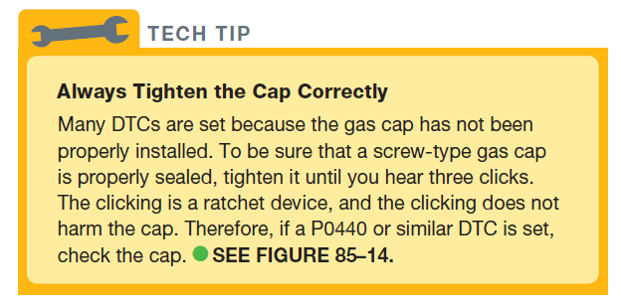
Tech Tip

Slide 30
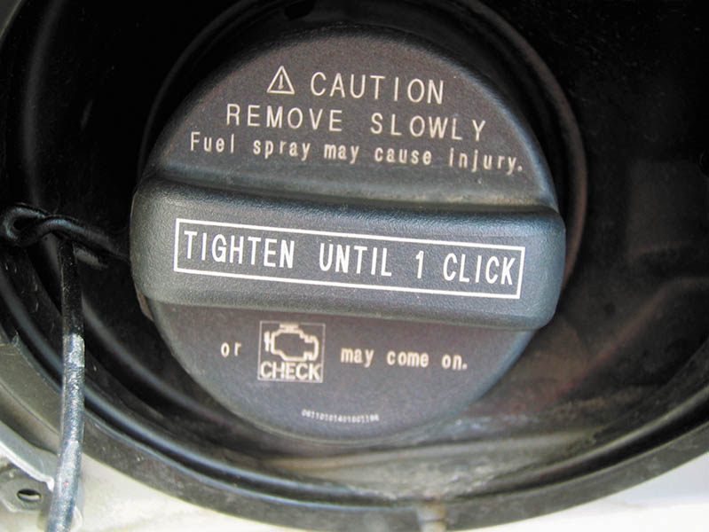
Figure 85.14 This Toyota cap warns that the check engine light comes on if not tightened until one click

Slide 31
TYPICAL EVAP MONITOR (1 OF 2)
The PCM runs the EVAP monitor when the following enable criteria are met:
Barometric pressure (BARO) greater than 70 kPa (20.7 in. Hg or 10.2 PSI)
Intake air (IAT) and coolant temperature (ECT) between 39°F and 86°F (4°C to 30°C) at engine start-up
ECT and IAT within 3°F of each other at engine start-up
Fuel level within 15% to 85%
Throttle position (TP) sensor between 9% and 35%

Slide 32
TYPICAL EVAP MONITOR (2 OF 2)
Running the EVAP Monitor
Four tests are performed during a typical EVAP monitor. A DTC is assigned to each test:
Weak vacuum test (P0440–large leak).
No flow during purging (P0441–no flow during purging).
Small leak test (P0442–small leak).
Excess vacuum test (P0446).

Slide 33
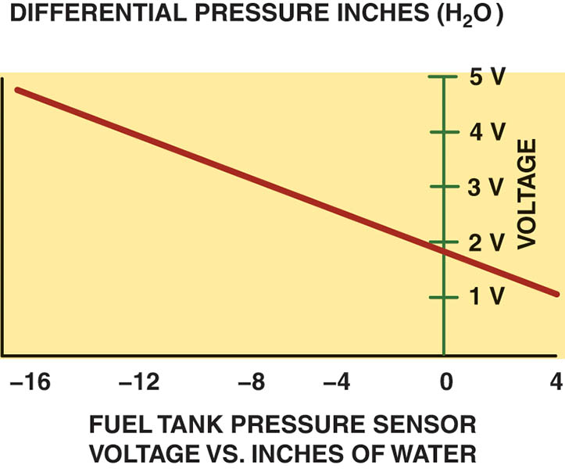
Figure 85.15 To easily check the fuel tank pressure sensor, remove the cap, and the sensor should read about 1.7 volts

Slide 34
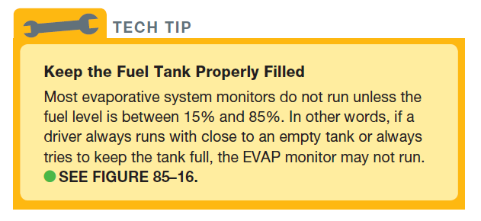
TECH TIP

Slide 35
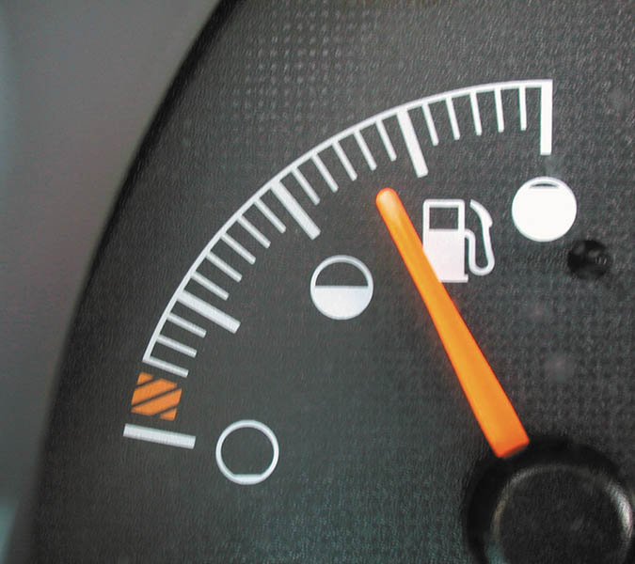
Figure 85.16 The fuel level must be above 15% and below 85% before the EVAP monitor runs on most vehicles

Slide 36
QUESTION 3: ?
What are the two OBD-II test methods used when testing evaporative systems?

Slide 37
ANSWER 3:
A pressurized test and engine-off natural vacuum.

Slide 38

Copyright

