Slide 1

Automotive Technology Principles, Diagnosis, and Service
Sixth Edition
Chapter 82
Electronic Throttle Control System
Copyright © 2018, 2015, 2011 Pearson Education, Inc. All Rights Reserved

Slide 2
LEARNING OBJECTIVES (1 of 2)
82.1 Explain how an electronic throttle-control system works.
82.2 Explain how the position of the accelerator pedal is detected in an electronic throttle-control system.
82.3 List the parts of a typical electronic throttle control system.

Slide 3
LEARNING OBJECTIVES (2 of 2)
82.4 Describe how to diagnose faults in an electronic throttle control system.
82.5 Explain how to service an electronic throttle system.
82.6 This chapter will help prepare for ASE content area “E” (Computerized Engine Controls Diagnosis and Repair).

Slide 4
ELECTRONIC CONTROL (ETC) SYSTEM
Advantages of ETC
Eliminates the mechanical throttle cable
Eliminates the need for cruise control actuators and controllers.
Helps reduce engine power for traction control (TC) and electronic stability control (ESC) systems.
Eliminates the need for an idle air control valve.
Parts Involved
Accelerator pedal position sensor (APPS), Throttle positon sensor (TPS), servo motor, and control unit.

Slide 5
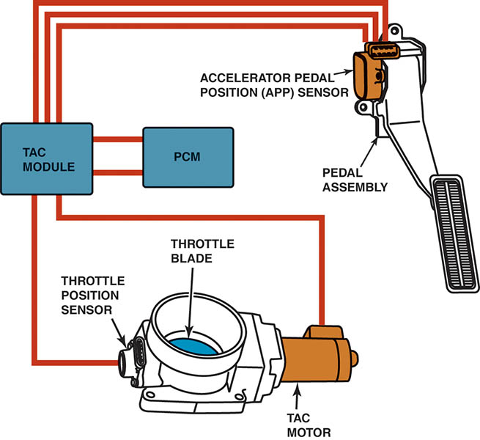
Figure 82.1 The throttle pedal is connected to the accelerator pedal position (APP) sensor. The electronic throttle body includes a throttle position sensor to provide throttle angle feedback to the vehicle computer. Some systems use a Throttle Actuator Control (TAC) module to operate the throttle blade (plate).

Slide 6
QUESTION 1: ?
What parts can be deleted if an engine uses an electronic throttle
control (ETC) system instead of a conventional accelerator
pedal and cable to operate the throttle valve?

Slide 7
ANSWER 1:
Accelerator cable, cruise actuator, idle air control valve.

Slide 8
NORMAL OPERATION OF THE ETC SYSTEM
These normal conditions include:
The engine may not increase above idle speed when depressing the accelerator pedal when the gear selector is in PARK or Neutral.
While accelerating rapidly, there is often a slight delay before the engine responds.
While at cruise speed, the accelerator pedal may or may not cause the engine speed to increase if the accelerator pedal is moved slightly.

Slide 9
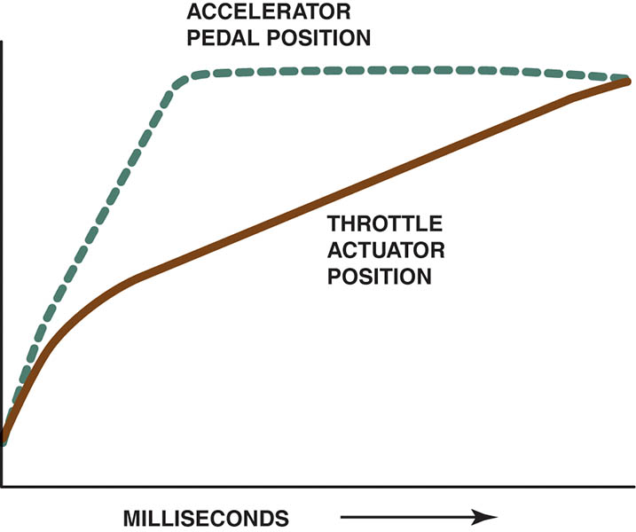
Figure 82.2 The opening of the throttle plate can be delayed as long as 30 milliseconds (0.030 sec) to allow time for the amount of fuel needed to catch up to the opening of the throttle plate.

Slide 10
ACCELERATOR PEDAL POSITION SENSOR
Cable Operated System
Uses a cable attached to the accelerator pedal to operate the APP sensor located under the hood.
Two Sensors
The accelerator pedal position sensor (mounted on the pedal assembly) uses two, and sometimes three, separate sensors, which act together to give accurate accelerator pedal position information to the controller, but also are used to check that the sensor is working properly.

Slide 11
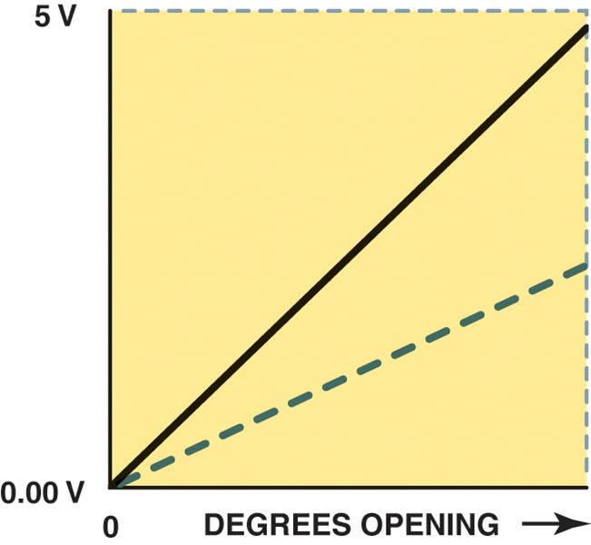
Figure 82.3 A typical accelerator pedal position (APP) sensor, showing two different output voltage signals that are used by the PCM to determine accelerator pedal position. Two (or three in some applications) are used as a double check because this is a safety-related sensor.

Slide 12
THROTTLE BODY ASSEMBLY
Throttle Plate and Spring
The throttle plate is held slightly open by a concentric clock spring.
Electronic Throttle Body Motor
The throttle plate is held slightly open by a concentric clock spring.
The throttle plate motor is driven by a bidirectional pulse-width modulated (PWM) signal from the PCM or electronic throttle control module using an H-bridge circuit.

Slide 13
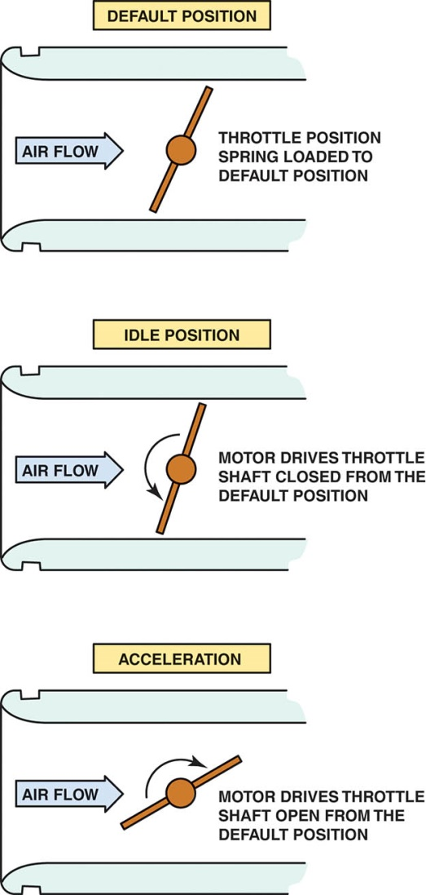
Figure 82.4 The default position for the throttle plate is in slightly open position. The servomotor then is used to close it for idle and open it during acceleration.

Slide 14
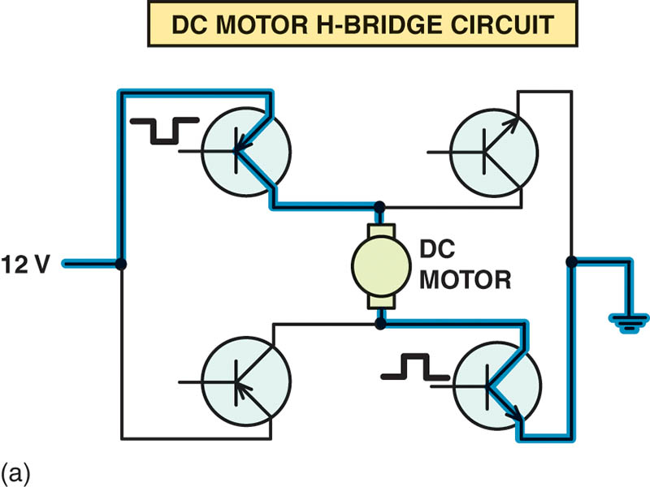
Figure 82.5 (a) An H-bridge circuit is used to control the direction of the DC electric motor of the electronic throttle control unit.

Slide 15
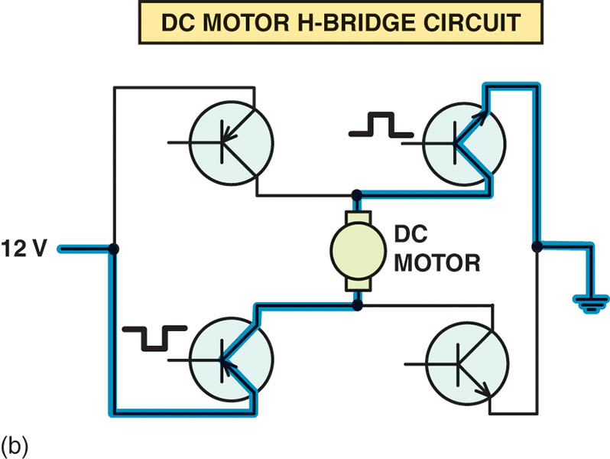
Figure 82.5 (b) To reverse the direction of operation, the polarity of the current through the motor is reversed.

Slide 16
THROTTLE POSITION (TP) SENSOR
Two TP sensors are used in the throttle body assembly to provide TP signals to the PCM.
Two sensors are used as a fail-safe measure and for diagnosis.
There are two types of TP sensors used in electronic throttle control systems:
Potentiometers
Hall-effect

Slide 17
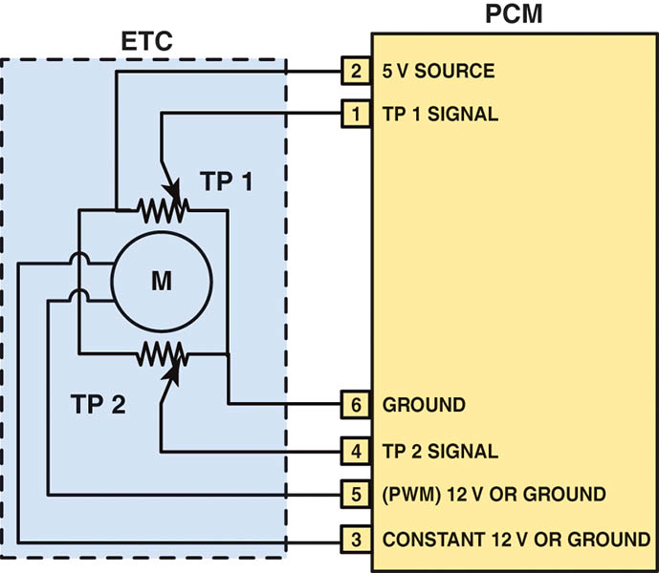
Figure 82.6 Schematic of a typical electronic throttle control (ETC) system. Note that terminal #5 is always pulse-width modulated and that terminal #3 is always constant, but both power and ground are switched to change the direction of the motor.

Slide 18
QUESTION 2: ?
What two types of throttle position sensors are used?

Slide 19
ANSWER 2:
Potentiometer and Hall-effect.

Slide 20
DAIGNOSIS OF ELECTRONIC THROTTLE CONTROL SYSTEMS (1 OF 3)
Fault Mode
The limp home mode is also called the “fail-safe mode” and indicates the following actions performed by the PCM:
Engine speed is limited to the default speed (about 1,200 to 1,600 RPM).
There is slow or no response when the accelerator pedal is depressed.
The cruise control system is disabled.
A diagnostic trouble code (DTC) is set.
An ETC warning lamp on the dash lights.

Slide 21
DAIGNOSIS OF ELECTRONIC THROTTLE CONTROL SYSTEMS (2 OF 3)
Vacuum Leaks
The ETC system simply moves the throttle, as needed, to achieve the proper idle speed to compensate for the leak.
Diagnostic Procedure
If a fault occurs in the ETC system, check service information for the specified procedure to follow for the vehicle being checked.

Slide 22
DAIGNOSIS OF ELECTRONIC THROTTLE CONTROL SYSTEMS (3 OF 3)
Scan Tool Data
APP-indicated angle.
TP-desired angle.
TP-indicated angle.
TP sensors 1 and 2.

Slide 23
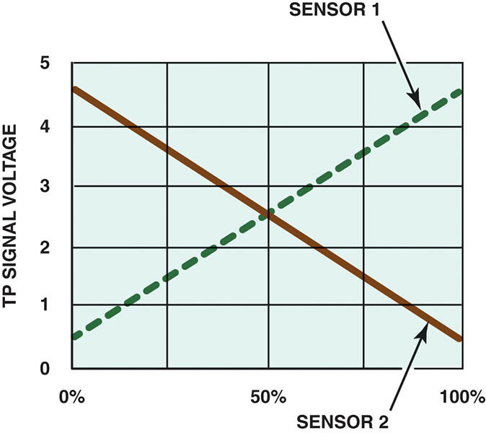
Figure 82.7 The two TP sensors used on the throttle body of an electronic throttle body assembly produce opposite voltage signals as the throttle is opened. The total voltage of both combined at any throttle plate position is 5 volts.

Slide 24
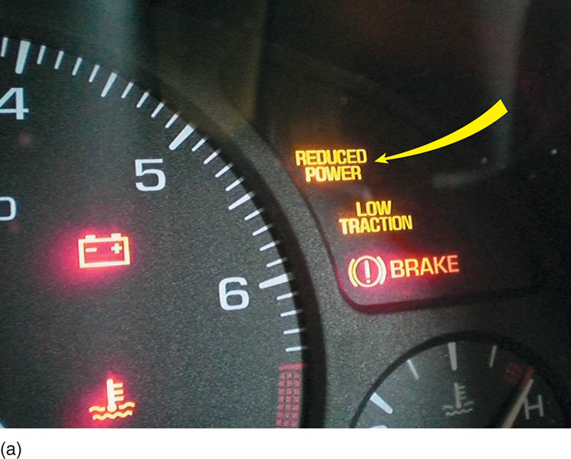
Figure 82.8 (a) A “reduced power” warning light indicates a fault with the electronic throttle control system on some General Motors vehicles.

Slide 25
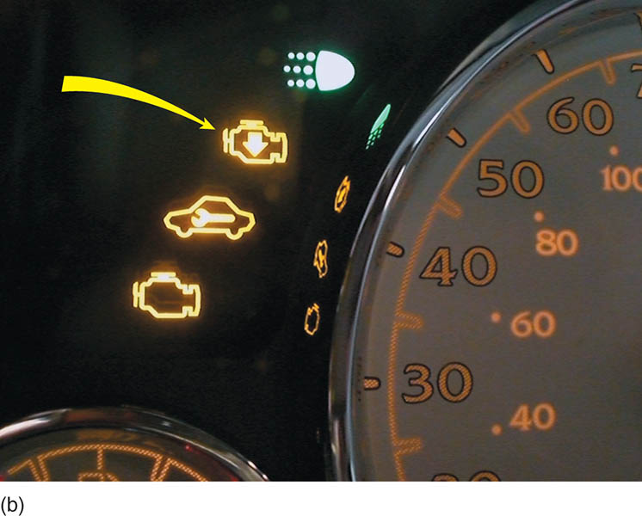
Figure 82.8 (b) A symbol showing an engine with an arrow pointing down is used on some General Motors vehicles to indicate a fault with the electronic throttle control system.

Slide 26
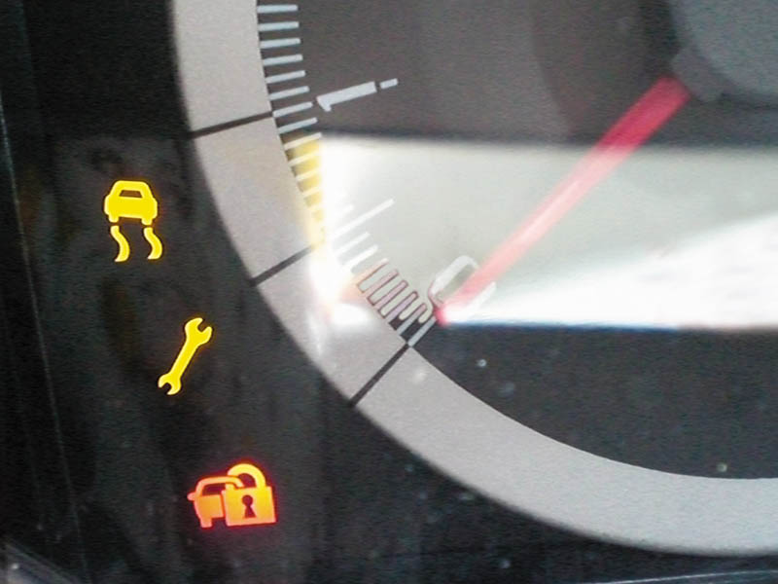
Figure 82.9 A wrench symbol warning lamp on a Ford vehicle. The symbol can also be green.

Slide 27
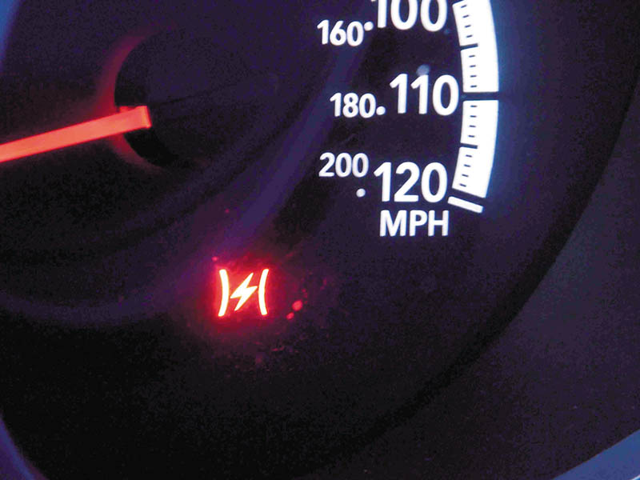
Figure 82.10 A symbol used on a Chrysler vehicle indicating a fault with the electronic throttle control.

Slide 28
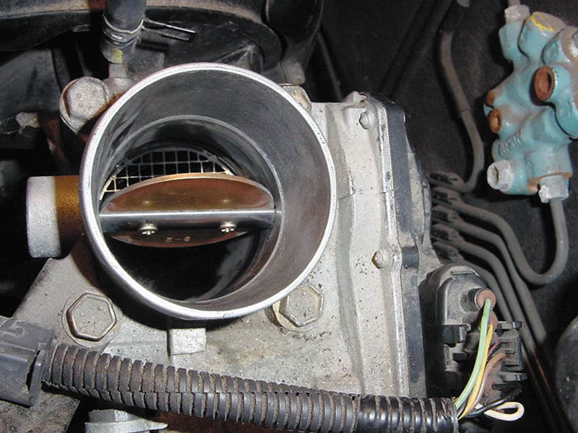
Figure 82.11 The throttle plate stayed where it was moved, which indicates that there is a problem with the electronic throttle body control assembly.

Slide 29
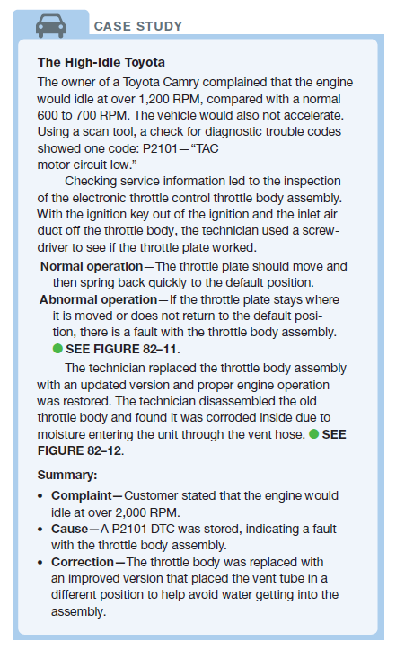
CASE STUDY

Slide 30
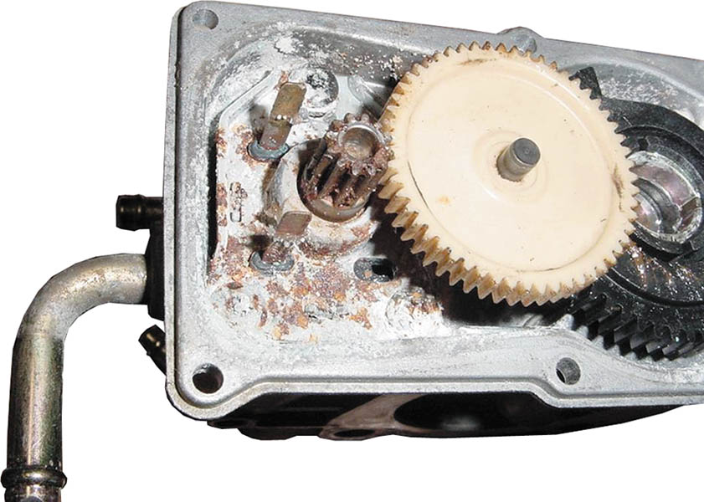
Figure 82.12 A corroded electronic throttle control assembly shown with the cover removed.

Slide 31
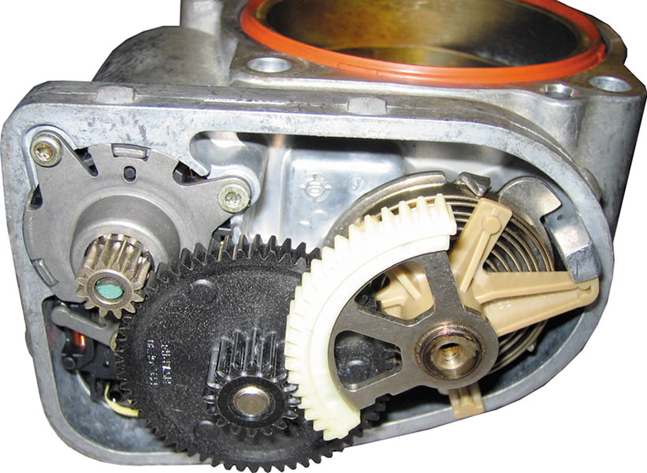
Figure 82.13 Notice the small motor gear on the left drives a larger plastic gear (black), which then drives the small gear in mesh with the section of a gear attached to the throttle plate. This results in a huge torque increase from the small motor and helps explain why it could be dangerous to insert a finger into the throttle body assembly.

Slide 32
ECT THROTTLE FOLLOWER TEST
Test can be performed on some Chrysler vehicles.
To perform this test, use the “throttle follower test” procedure as shown on the scan tool. An assistant is needed to check that the throttle plate is moving as the accelerator pedal is depressed.

Slide 33
SERVICING ELECTRONIC THROTTLE SYSTEMS (1 OF 2)
ETC-Related Performance Issues
Lower than normal idle speed
Rough idle
Engine stalls when coming to a stop (called a coast-down stall)
Throttle Body Cleaning Procedure
Remove the air inlet hose from the throttle body
Spray throttle body cleaner onto a shop cloth.
Use the shop cloth to remove the varnish and carbon deposits from the throttle body housing and throttle plate.

Slide 34
SERVICING ELECTRONIC THROTTLE SYSTEMS (2 OF 2)
Throttle Body Relearn Procedure
A typical throttle body relearn procedure includes:
Turn the ignition on (engine off) for 30 seconds.
Turn the ignition off and wait 30 seconds.
Start the engine and the idle learn procedure should cause the engine to idle at the correct speed.
Other vehicles may require the use of a scan tool.

Slide 35
QUESTION 3: ?
What three ECT performance related conditions might indicate a need for throttle body cleaning?

Slide 36
ANSWER 3:
Rough idle, lower than normal idle speed, and engine stalling.

Slide 37

Copyright

