Slide 1

Automotive Technology Principles, Diagnosis, and Service
Sixth Edition
Chapter 80
Fuel Injection Components and Operation
Copyright © 2018, 2015, 2011 Pearson Education, Inc. All Rights Reserved

Slide 2
LEARNING OBJECTIVES (1 of 2)
80.1 List components of electronic fuel-injection systems.
80.2 Explain how air intake is measured in fuel-injection systems.
80.3 Describe how throttle-body injection and port fuel-injection systems work.
80.4 Discuss the function of the fuel-pressure regulator and describe a vacuum-biased fuel-pressure regulator.

Slide 3
LEARNING OBJECTIVES (2 of 2)
80.5 Describe returnless fuel systems.
80.6 Describe how fuel injectors function and describe central port injection.
80.7 Explain modes of fuel-injection system operation.
80.8 Explain how idle speed is controlled.
80.9 This chapter will help prepare for Engine Repair (A8) ASE certification test content area “C” (Fuel, Air Induction, and Exhaust Systems Diagnosis and Repair).

Slide 4
ELECTRONIC FUEL INJECTION OPERATION (1 OF 2)
Electronic fuel-injection systems use the computer to control the following operation of fuel injectors.
Most electronic fuel-injection systems share the following:
Electric fuel pump
Fuel-pump relay
Fuel-pressure regulator
Fuel-injector nozzle or nozzles

Slide 5
ELECTRONIC FUEL INJECTION OPERATION (2 OF 2)
Most electronic fuel-injection systems use the PCM to control the following aspects of their operation:
Pulsing the fuel injectors on and off.
Operating the fuel-pump relay circuit.
There are two types of electronic fuel-injection systems:
Throttle-body-injection (TBI) type.
Port fuel-injection type.

Slide 6
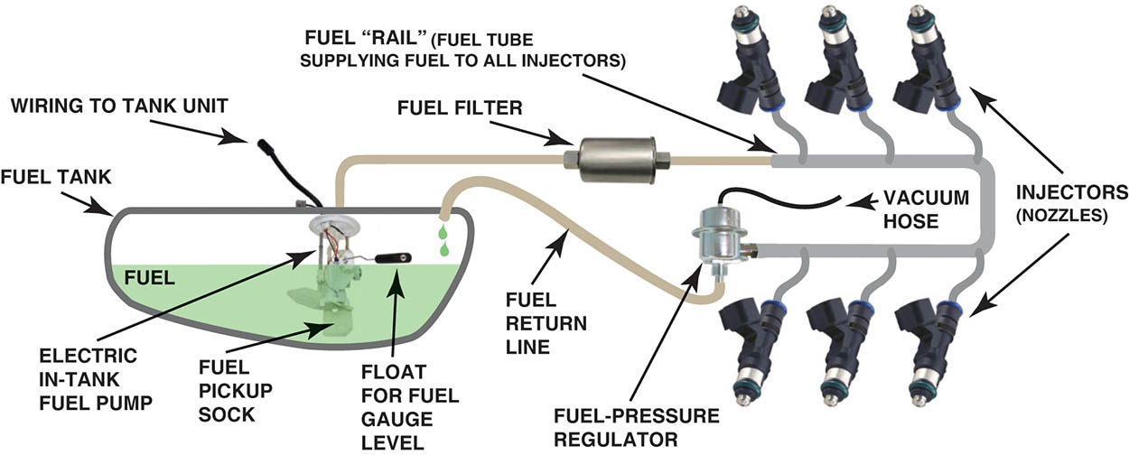
Figure 80.1 Typical port fuel-injection system, indicating the location of various components. The computer does not control fuel pressure, but does control the operation of the electric fuel pump (on most systems) and the pulsing on and off of the injectors.

Slide 7
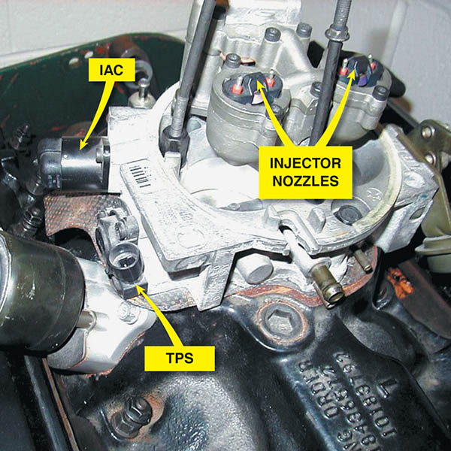
Figure 80.2 A dual-nozzle TBI unit on a Chevrolet 5.0 L V-8 engine. The fuel is squirted above the throttle plate where the fuel mixes with air before entering the intake manifold.

Slide 8
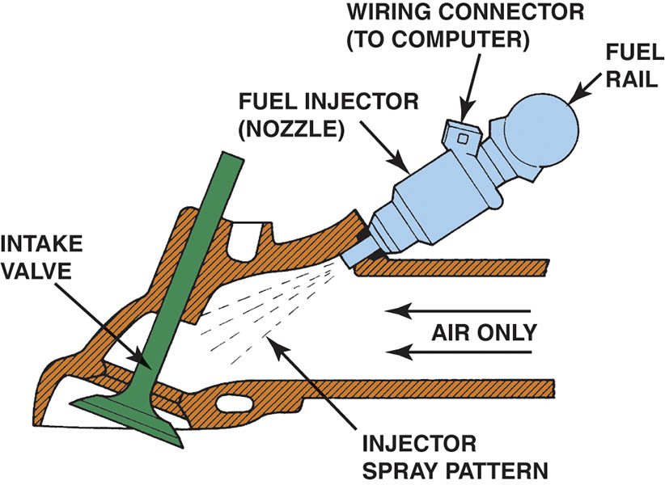
Figure 80.3 A typical port fuel-injection system squirts fuel into the low pressure (vacuum) of the intake manifold, about 3 inches (70 to 100 mm) from the intake valve.

Slide 9
SPEED DENSITY FUEL INJECTION
The speed-density method calculates the amount of fuel required by the from sensors, such as the following:.
MAP sensor.
Throttle position (TP)
Temperature sensors (coolant and Intake air).
Oxygen sensor voltage (O2S)
Adaptive memory

Slide 10
MASS AIRFLOW FUEL INJECTION SYSTEMS
The formula used by fuel-injection systems that use a mass airflow (MAF) sensor to calculate the injection base pulse width is:
Injector pulse width = airflow/RPM
The formula is modified by other sensor values, such as:
Throttle position
Engine coolant temperature
Barometric pressure
Adaptive memory

Slide 11
QUESTION 1: ?
What are the two basic methods used for measuring the amount of air the engine is breathing in?

Slide 12
ANSWER 1:
Mass airflow and speed density.

Slide 13
THROTTLE BODY INJECTION
The computer controls injector pulses in one of two ways:
Synchronized
Non-synchronized
If the system uses a synchronized mode, the injector pulses once for each distributor reference pulse.
In a non-synchronized system, the injectors are pulsed once during a given period (which varies according to calibration) completely independent of distributor reference pulses.

Slide 14
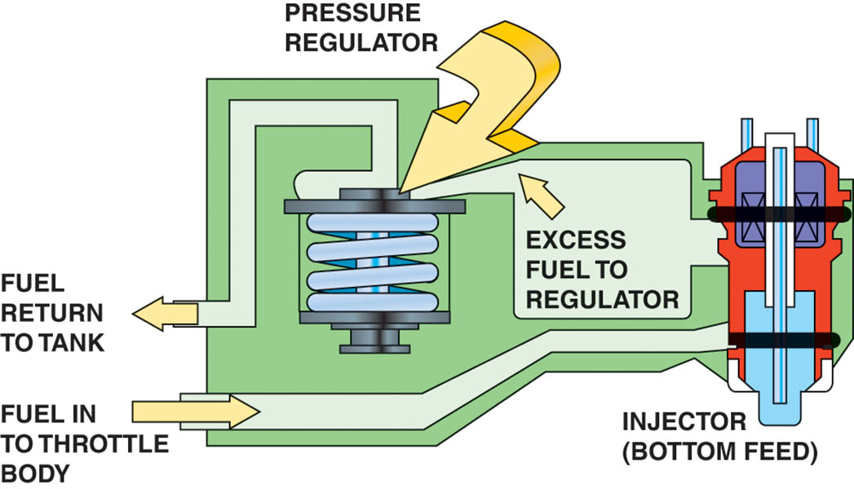
Figure 80.4 The tension of the spring in the fuel-pressure regulator determines the operating pressure on a throttle-body fuel-injection unit.

Slide 15
PORT FUEL INJECTION (1 OF 2)
The advantages of port fuel-injection design also are related to characteristics of intake manifolds:
Fuel distribution is equal to all cylinders because each cylinder has its own injector.
The fuel is injected almost directly into the combustion chamber.
The intake manifold can sized and shaped to achieve specific engine performance characteristics.

Slide 16
PORT FUEL INJECTION (2 OF 2)
Domestic systems use one of three ways to trigger the injectors:
Grouped Double Fire
Two equalized groups of injectors.
Simultaneous Double Fire
All injectors are fired at the same time.
Sequential
The firing of the injectors according to engine firing order.

Slide 17
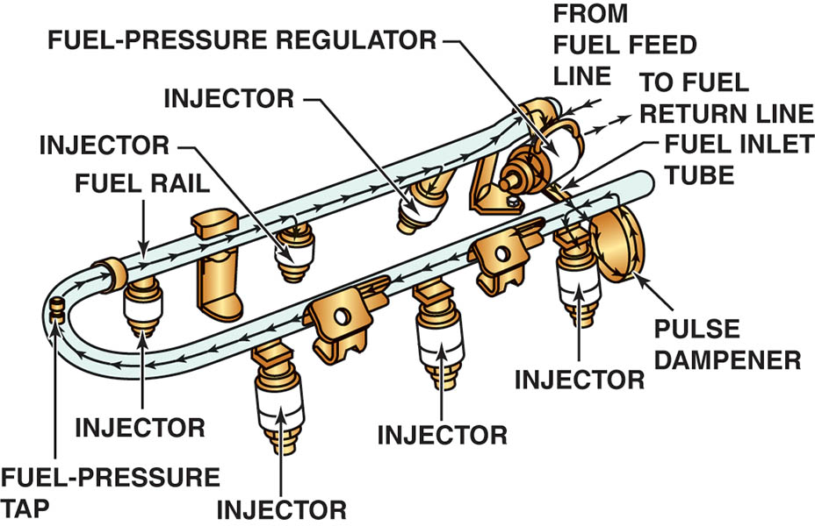
Figure 80.5 The injectors receive fuel and are supported by the fuel rail. A pulse damper is used to help reduce noise caused by the pressure changes in the fuel rail during injector pulsing operation.

Slide 18
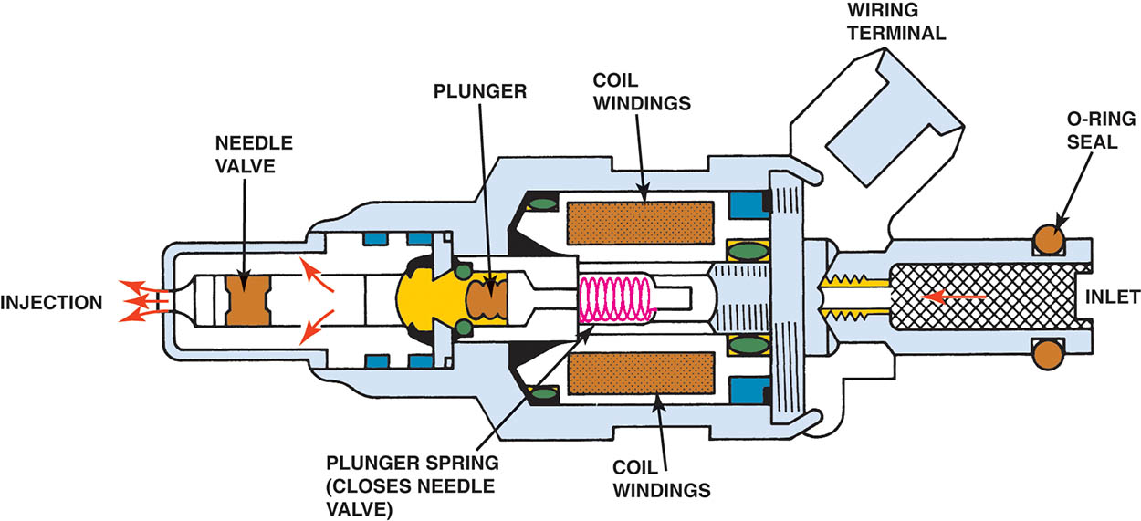
Figure 80.6 Cross section of a typical port fuel-injection nozzle assembly. These injectors are serviced as an assembly only; no part replacement or service is possible, except for replacement of external O-ring seals.

Slide 19
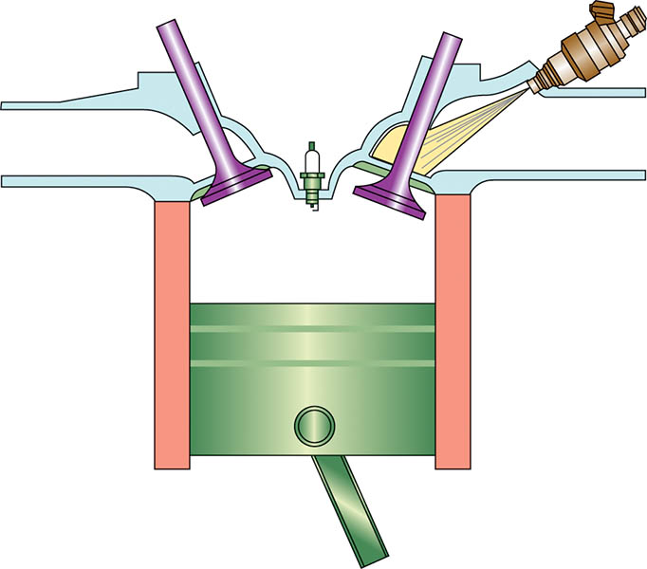
Figure 80.7 Port fuel injectors spray atomized fuel into the intake manifold about 3 inches (75 mm) from the intake valve.

Slide 20
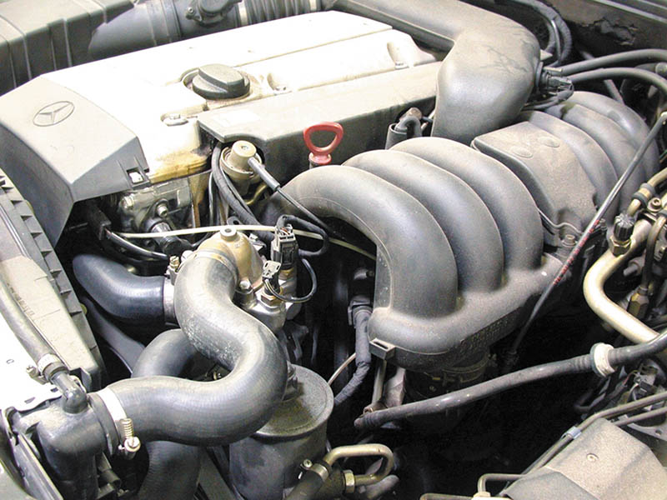
Figure 80.8 A port fuel-injected engine that is equipped with long, tuned intake-manifold runners.

Slide 21
FUEL PRESSURE REGULATOR
Purpose and Function
The pressure regulator and fuel pump work together to maintain the required pressure drop at the injector tips.
Operation
The fuel pressure is modulated by a combination of spring pressure and manifold vacuum acting on the diaphragm.

Slide 22
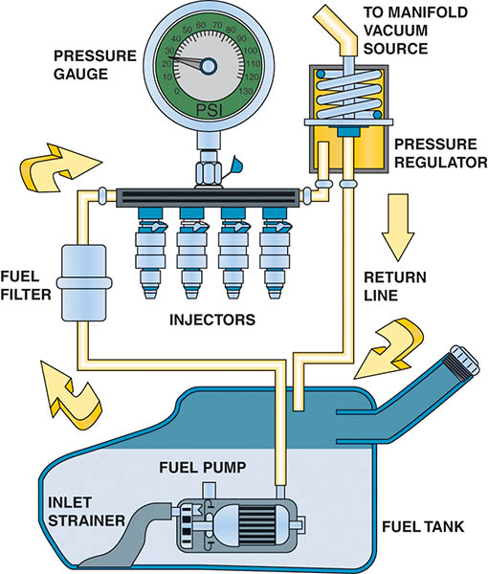
Figure 80.9 A typical port fuel-injected system showing a vacuum-controlled fuel-pressure regulator.

Slide 23
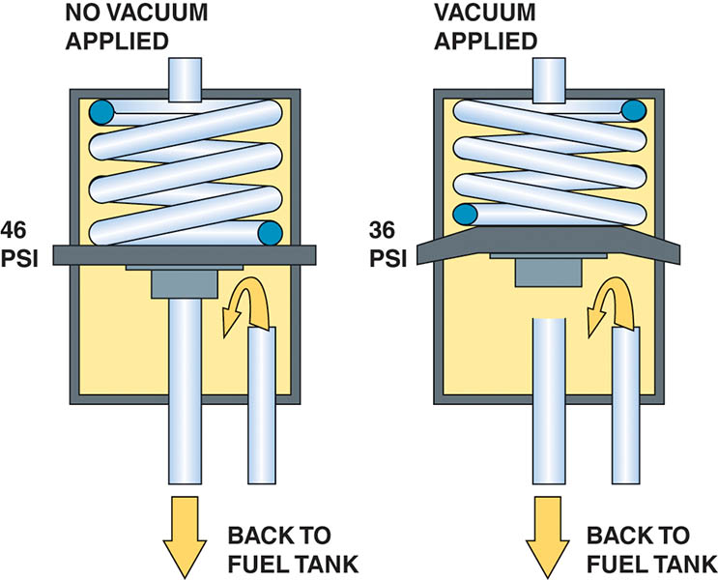
Figure 80.10 A typical fuel-pressure regulator that has a spring that exerts 46 pounds of force against the fuel.

Slide 24
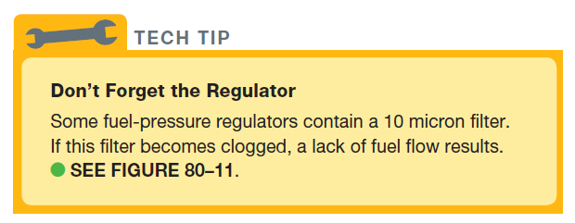
Tech Tip

Slide 25
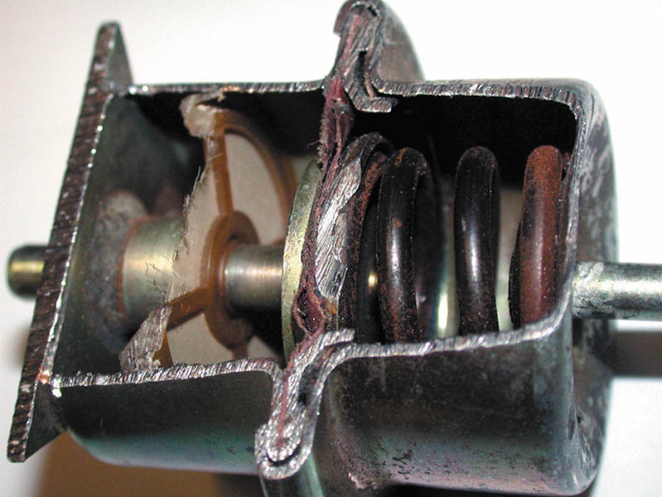
Figure 80.11 A lack of fuel flow could be due to a restricted fuel-pressure regulator. Notice the fine screen filter. If this filter becomes clogged, higher than normal fuel pressure occurs.

Slide 26
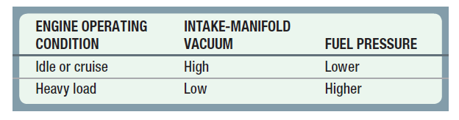
VACUUM-BIASED FUEL PRESSURE REGULATOR
The primary reason why many port fuel-injected systems use a vacuum-controlled fuel-pressure regulator is to ensure that there is a constant pressure drop across the injectors.

Slide 27
QUESTION 2: ?
What is the purpose of the vacuum-controlled (biased) fuel pressure
regulator?

Slide 28
ANSWER 2:
Adjust fuel pressure so there is a constant pressure drop across the injectors.

Slide 29
ELECTRONIC RETURNLESS FUEL SYSTEM
The power driver contains a high-current transistor that controls the pump speed using pulse width modulation (PWM).
Fuel pressure at the rail is sensed by a pressure transducer.

Slide 30
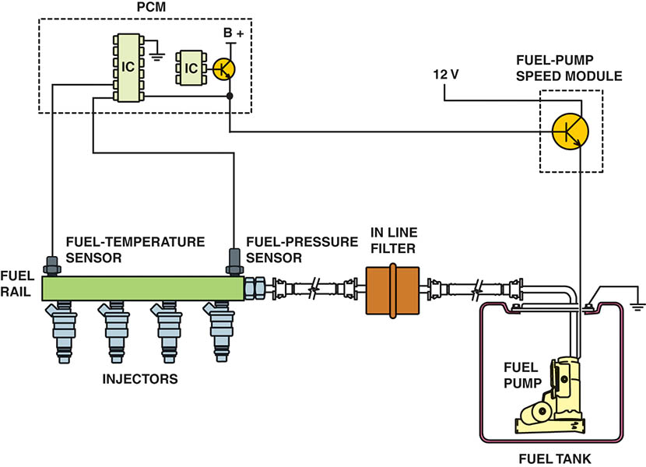
Figure 80.12 The fuel pressure sensor and fuel temperature sensor are often constructed together in one assembly to help give the PCM the needed data to control the fuel-pump speed.

Slide 31
MECHANICAL RETURNLESS FUEL SYSTEM
This system has a bypass regulator to control rail pressure that is located in close proximity to the fuel tank.
Fuel is sent by the in-tank pump to a chassis mounted inline filter with excess fuel returning to the tank through a short return line.
The system employs a constant rail pressure.

Slide 32
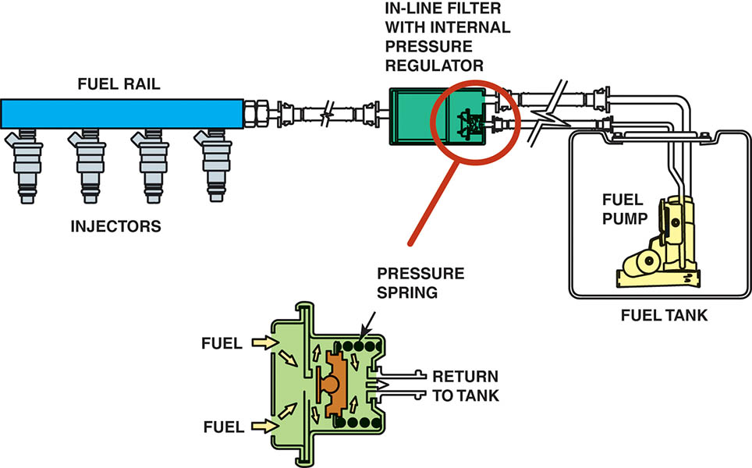
Figure 80.13 A mechanical returnless fuel system. The bypass regulator in the fuel tank controls fuel line pressure.

Slide 33
DEMAND DELIVERY SYSTEM (DDS)
A fuel pump and a low-cost, high-performance bypass regulator are used within the appropriate fuel sender.
The system provides a precise quantity of fuel into the rail as consumed by the engine.

Slide 34
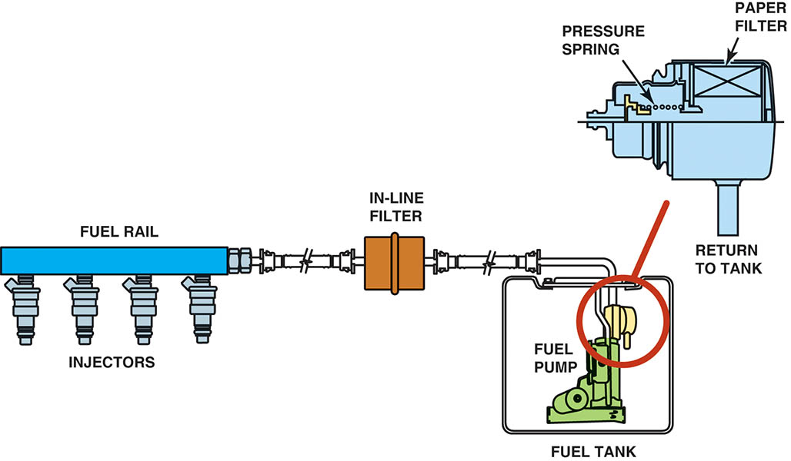
Figure 80.14 A demand delivery system uses a fuel-pressure regulator attached to the fuel pump assembly inside the fuel tank.

Slide 35
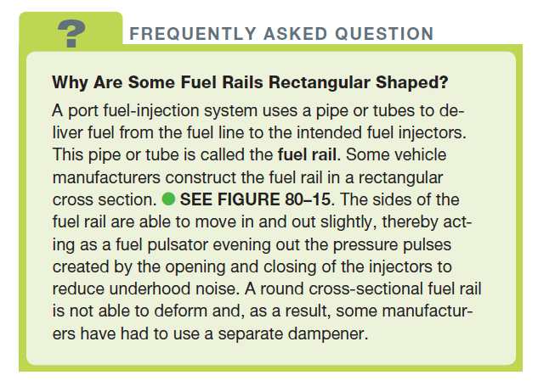
FREQUENTLY ASKED QUESTION

Slide 36
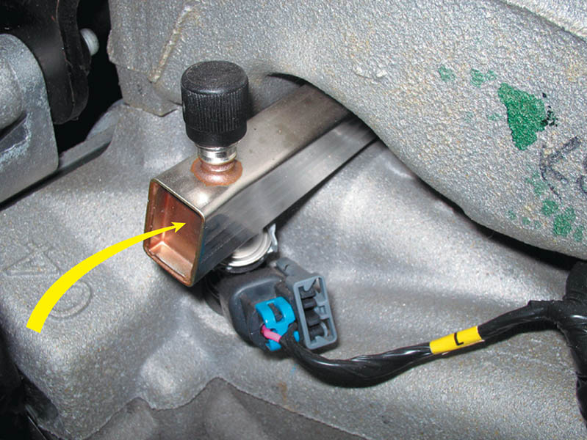
Figure 80.15 A rectangular-shaped fuel rail is used to help dampen fuel system pulsations and noise caused by the injectors opening and closing.

Slide 37
FUEL INJECTORS
This electromagnetic device contains an armature and a spring-loaded needle valve or ball valve assembly.
The injector opens the same amount each time it is energized.
The amount of fuel injected depends on the length of time the injector remains open.

Slide 38
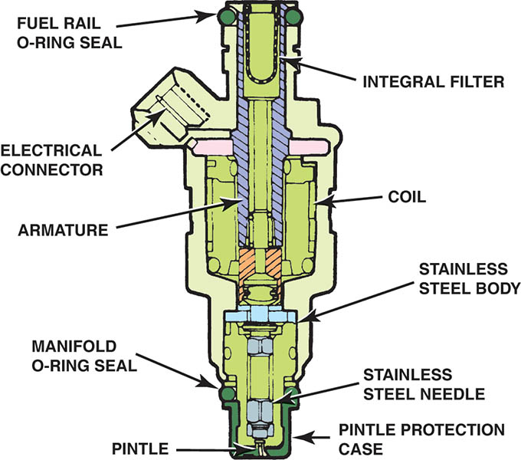
Figure 80.16 A multiport fuel injector. Notice that the fuel flows straight through and does not come in contact with the coil windings.

Slide 39
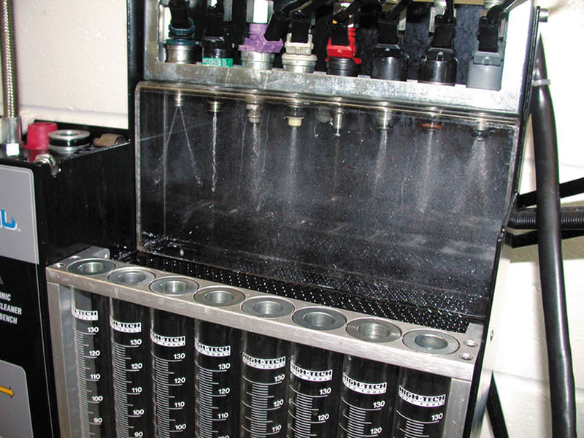
Figure 80.17 Each of the eight injectors shown are producing a correct spray pattern for the applications. While all throttle-body injectors spray a conical pattern, most port fuel injections do not.

Slide 40
CENTRAL PORT INJECTION
A cross between port fuel injection and throttle-body injection, CPI was introduced in the early 1990s by General Motors. The CPI assembly consists of a single fuel injector, a pressure regulator, and six poppet nozzle assemblies with nozzle tubes.
When the injector is energized, fuel flows through the nozzle tubes to each poppet nozzle.
The increased pressure causes each poppet nozzle ball to also lift from its seat, allowing fuel to flow from the nozzle.

Slide 41
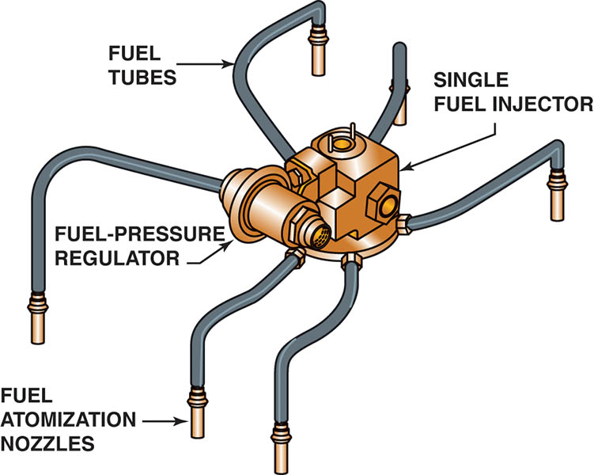
Figure 80.18 A central port fuel-injection system.

Slide 42
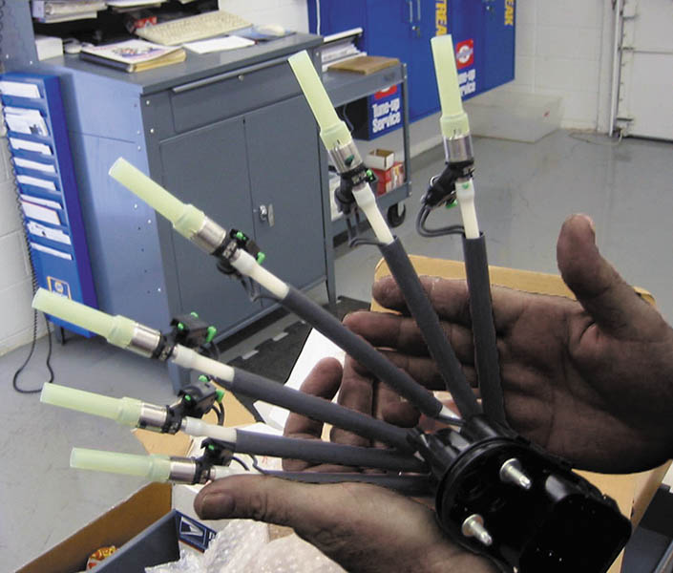
Figure 80.19 A factory replacement unit for a CSFI unit that has individual injectors at the ends that go into the intake manifold instead of poppet valves.

Slide 43
FUEL INJECTION MODES OF OPERATION (1 OF 4)
All fuel-injection systems are designed to supply the correct amount of fuel under a wide range of engine operating conditions.
Starting Mode
When the ignition is turned to the start (on) position, the engine cranks and the PCM energizes the fuel-pump relay and pulses the injectors based on engine speed and coolant temperature.

Slide 44
FUEL INJECTION MODES OF OPERATION (2 OF 4)
Clear Flood Mode
When the PCM detects that the engine speed is low (usually below 600 RPM) and the throttle-position (TP) sensor voltage is high (WOT), the injector pulse width is greatly reduced or even shut off entirely, depending on the vehicle.
Open-Loop Mode
The PCM determines injector pulse width without feedback from the oxygen sensor.

Slide 45
FUEL INJECTION MODES OF OPERATION (3 OF 4)
Closed-Loop Mode
Is used to modify the base injector pulse width as determined by feedback from the oxygen sensor.
Acceleration Enrichment Mode
The PCM then supplies a longer injector pulse width and may even supply extra pulses to supply the needed fuel for acceleration.

Slide 46
FUEL INJECTION MODES OF OPERATION (4 OF 4)
Deceleration Enleanment Mode
The injector may be shut off entirely for a short time and then pulsed on enough to keep the engine running.
Fuel Shutoff Mode
Besides shutting off fuel entirely during periods of rapid deceleration, PCM also shuts off the injector when the ignition is turned off to prevent the engine from continuing to run.

Slide 47
IDLE CONTROL
Purpose and Function
In a non-electronic throttle control system the idle speed is controlled by using an air bypass control unit.
The IAC is computer-controlled, and is either a solenoid-operated valve or a stepper motor that regulates the airflow around the throttle.
Stepper Motor Operation
Stepper motors are direct-current motors that move in fixed steps or increments from de-energized (no voltage) to fully energized (full voltage).

Slide 48
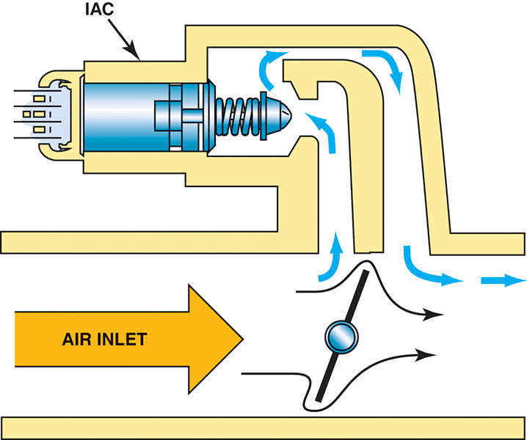
Figure 80.20 The small arrows indicate the air bypassing the throttle plate in the closed throttle position. This air is called minimum air. The air flowing through the IAC is the airflow that determines the idle speed.

Slide 49
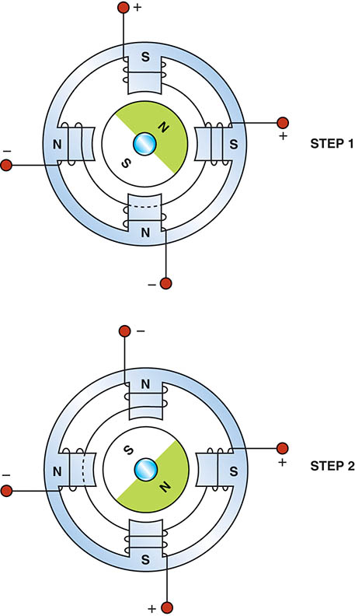
Figure 80.21 Most stepper motors use four wires, which are pulsed by the computer to rotate the armature in steps.

Slide 50
QUESTION 3: ?
What are the two types of IAC motors?

Slide 51
ANSWER 3:
Solenoid and stepper motor.

Slide 52

Copyright

