Slide 1

Automotive Technology Principles, Diagnosis, and Service
Sixth Edition
Chapter 8
Fasteners and Thread Repair
Copyright © 2018, 2015, 2011 Pearson Education, Inc. All Rights Reserved

Slide 2
LEARNING OBJECTIVES (1 of 2)
8.1 Identify bolts and explain the strength ratings of threaded fasteners.
8.2 Discuss the purpose of nuts, taps, dies, thread pitch gauges, screws, and washers.
8.3 Discuss how snap rings and clips are used.

Slide 3
LEARNING OBJECTIVES (2 of 2)
8.4 Explain how to avoid broken fasteners.
8.5 Compare the different types of thread repair inserts.

Slide 4
THREADED FASTENERS ( 1of 2)
Cap Screws
Fastener that is threaded into a casting.
Technician refers to as a bolt.
Stud
A short rod with threads on both ends.
Crest
Outside edge of the threads where a measurement is made.

Slide 5
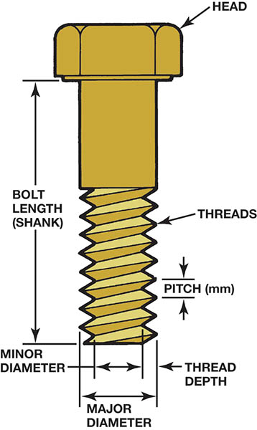
Figure 8.1 The dimensions of a typical bolt showing where sizes are measured. The major diameter is called the crest

Slide 6
THREADED FASTENERS (2 of 2)
Fraction Threads
Measured Unified National Course
Measured Unified National Fine
Pitch
Standard combinations of sizes and numbers of threads per inch.

Slide 7
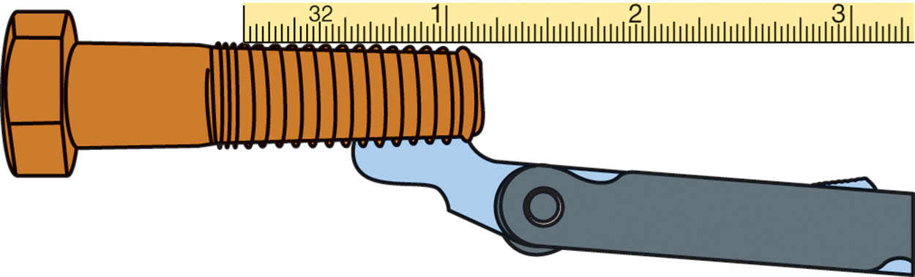
Figure 8.2 Thread pitch gauge used to measure the pitch of the thread. This bolt has 13 threads to the inch

Slide 8
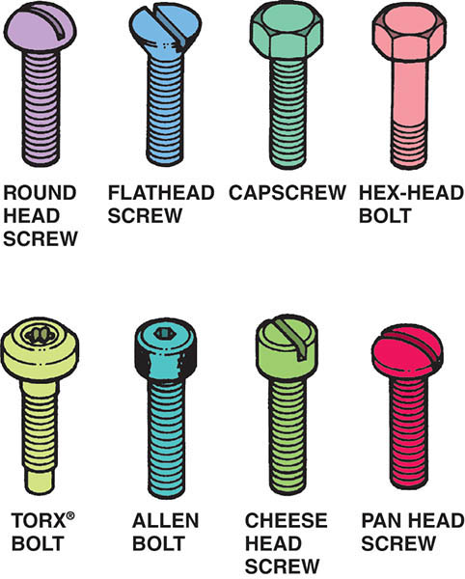
Figure 8.3 Bolts and screws have many different heads which determine what tool must be used

Slide 9
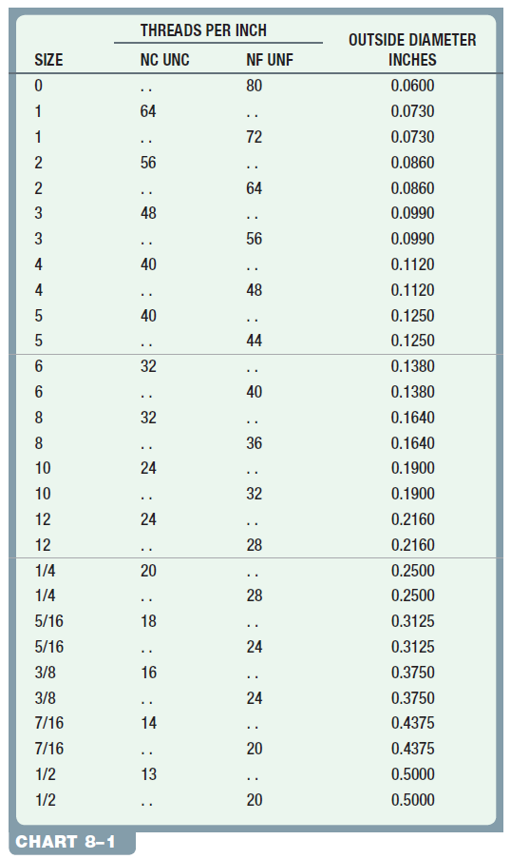
Chart 8.1 The American national system is one method of sizing fasteners.

Slide 10
METRIC BOLTS
Identified my the “M” designation
Diameter in millimeters (mm) across the crest
The distance in millimeters between the threads (pitch)
Example: M8 X 1.5

Slide 11
QUESTION 1: ?
What is the difference between a bolt and a stud?

Slide 12
ANSWER 1:
A stud is a short rod with threads on both ends.

Slide 13
GRADES OF BOLTS
The strength or classification of the bolt.
Bolt heads are marked to indicate grade.
Metric bolts have a decimal number to indicate grade.
Higher grades have threads that are rolled instead of cut.

Slide 14
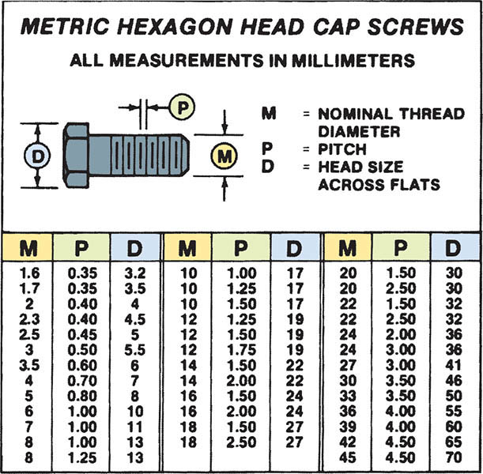
Figure 8.4 The metric system specifies fasteners by diameter, length, and pitch

Slide 15
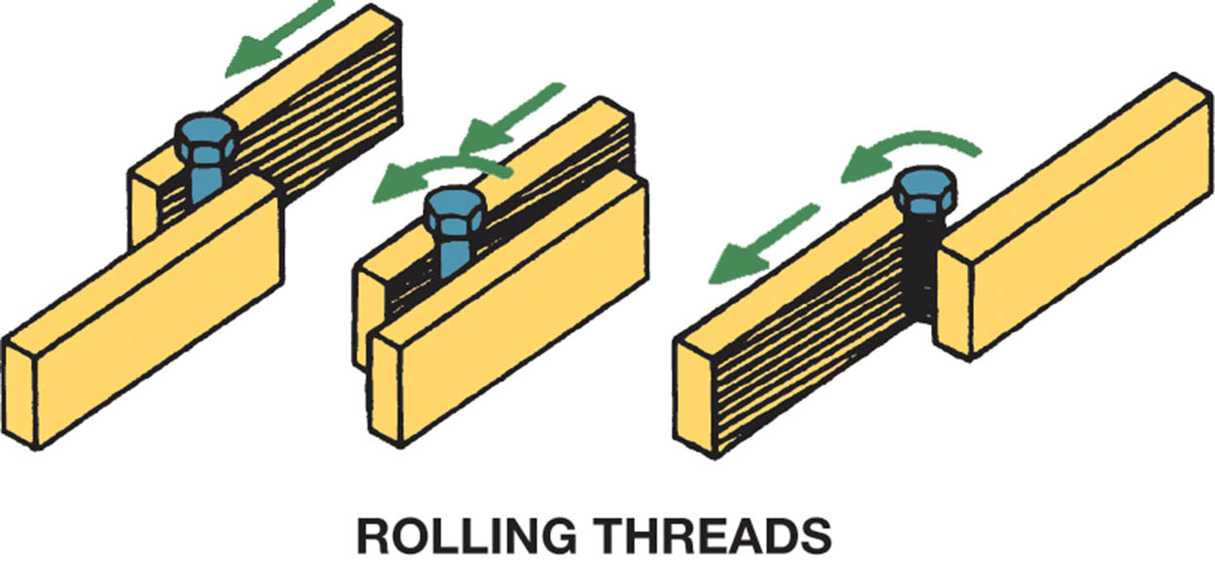
Figure 8.5 Stronger threads are created by cold-rolling a heat-treated bolt blank instead of cutting the threads using a die

Slide 16
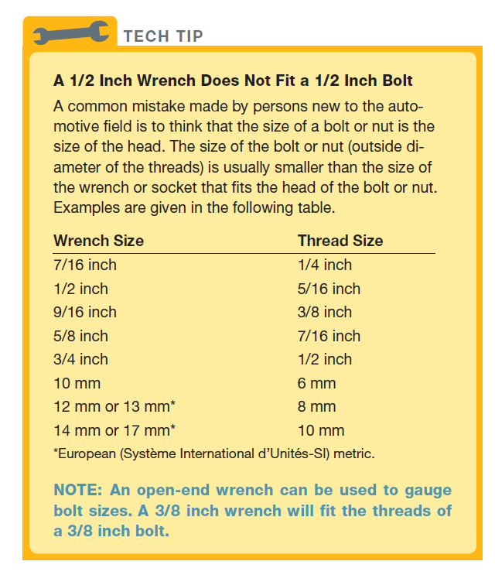
Tech Tip

Slide 17
TENSILE STRENGTH
The maximum stress under tension (lengthwise force) without causing a failure.
Specified in pounds per square inch (PSI)
Fractional fasteners use raised marks on head to identify tensile strength.
Metric fasteners use a number to idicate property class.

Slide 18
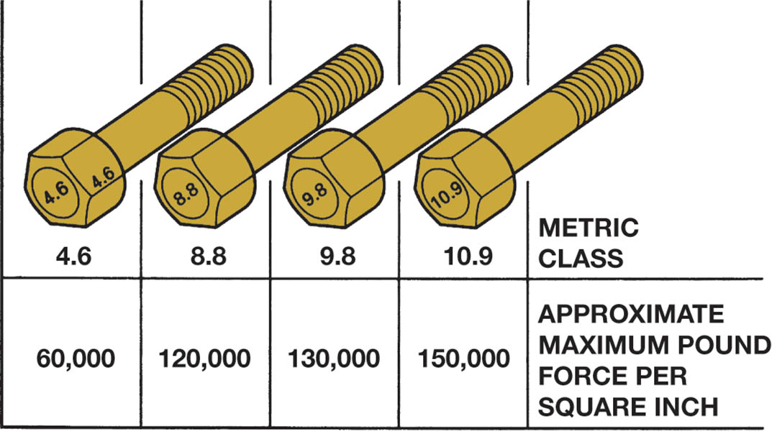
Figure 8.6 Metric bolt (cap screw) grade markings and approximate tensile strength

Slide 19
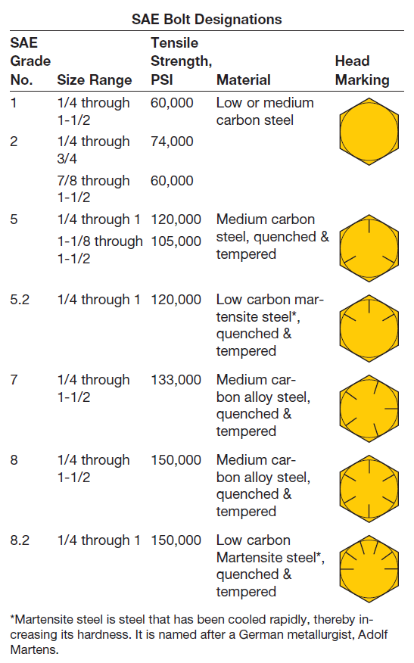
SAE bolt tensile strength designations.

Slide 20
QUESTION 2: ?
What is meant by the grade of a threaded fastener?

Slide 21
ANSWER 2:
The strength or classification of the bolt.

Slide 22
NUTS
Used on cap screws.
Metric nuts marked with dimples to show strength.
Some use interference fit to hold torque.
May be coupled with a washer to hold torque.
Some nuts require the use of thread locker.
.

Slide 23
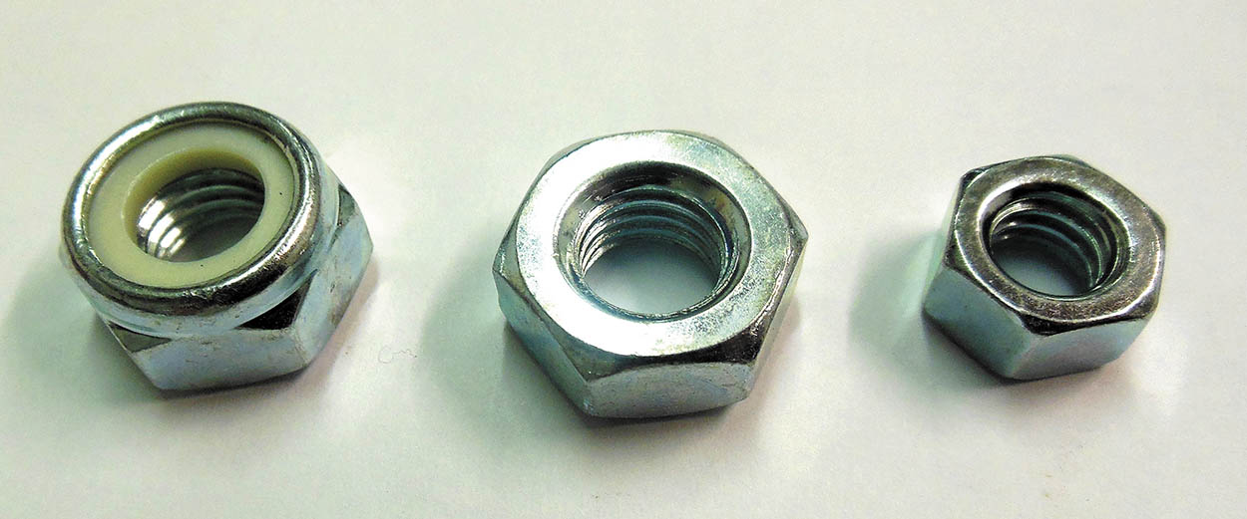
Figure 8.7 Types of lock nuts. On the left, a nylon ring; and the other two use a distorted shape to keep the nut from loosening

Slide 24
TAP AND DIES
Taps are used to cut threads in holes.
Dies are used to cut threads on round studs or rods.
Fractional and metric sizes

Slide 25
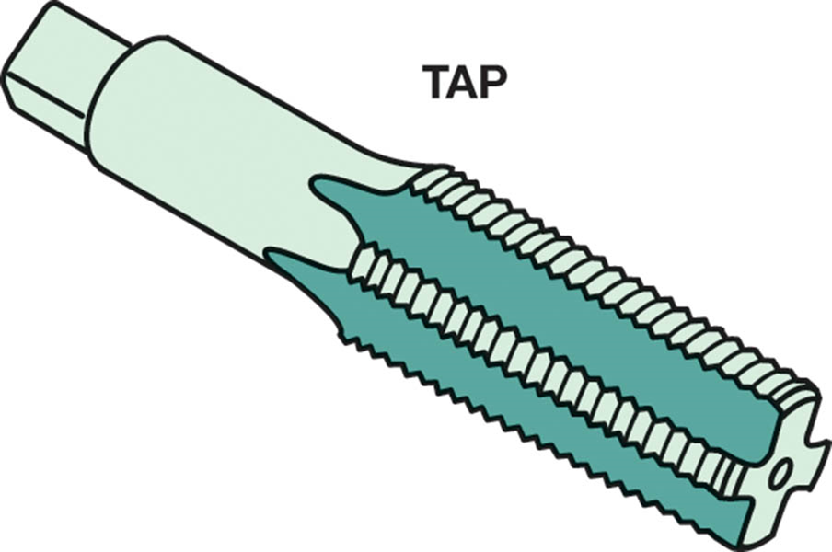
Figure 8.8 A typical bottoming tap used to create threads in holes that are not open, but stop in a casting, such as an engine block

Slide 26
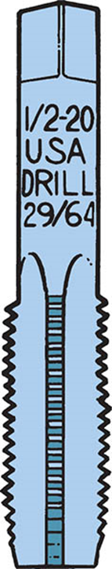
Figure 8.9 Many taps, especially larger ones, have the tap drill size printed on the top

Slide 27
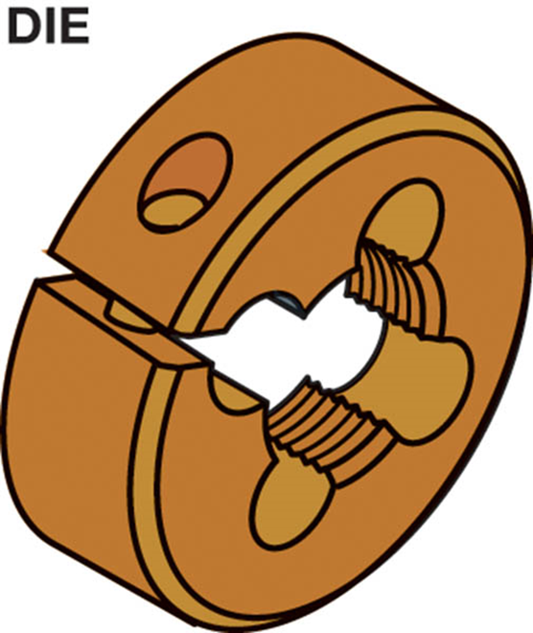
Figure 8.10 A die is used to cut threads on a metal rod

Slide 28
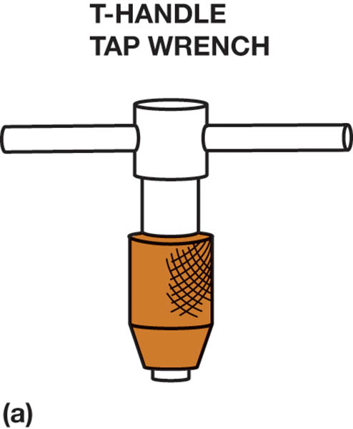
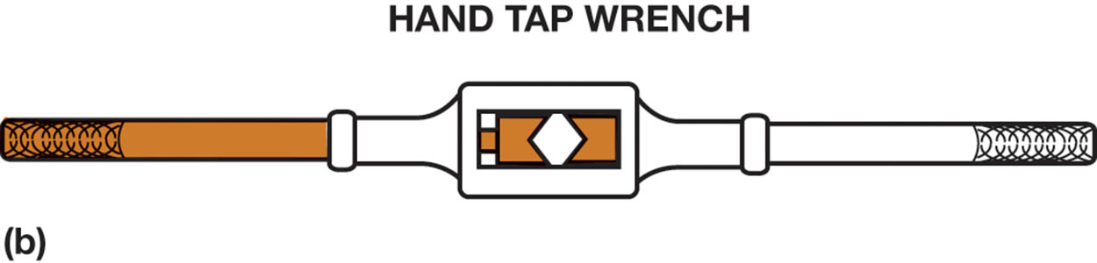
Figure 8.11 (a) A T-handle is used to hold and rotate small taps. (b) A tap wrench is used to hold and drive larger taps

Slide 29
THREAD PITCH GAUGE
A hand tool with the thread pitch on a blade.
Used to determine the thread pitch of a fastener.
Metric and fractional tools.

Slide 30
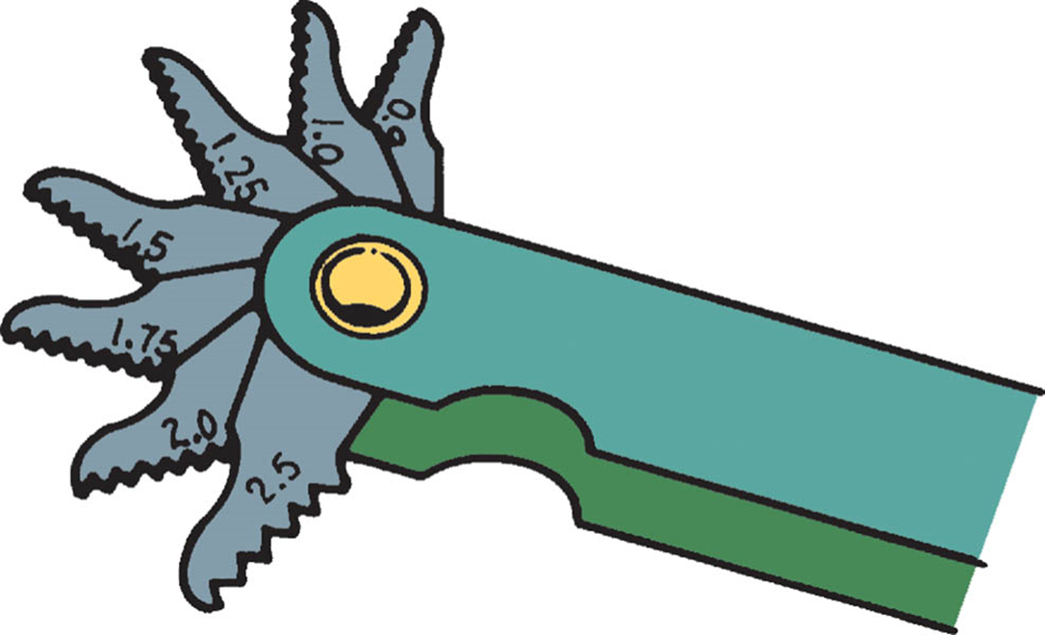
Figure 8.13 A typical metric thread pitch gauge

Slide 31
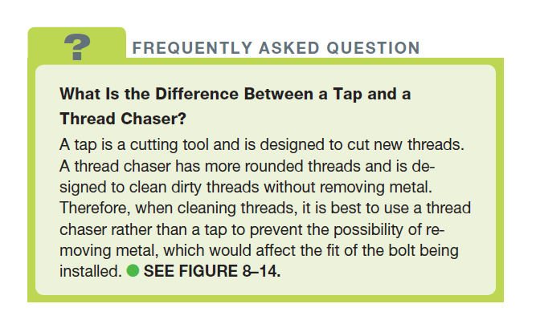
FREQUENTLY ASKED QUESTION

Slide 32
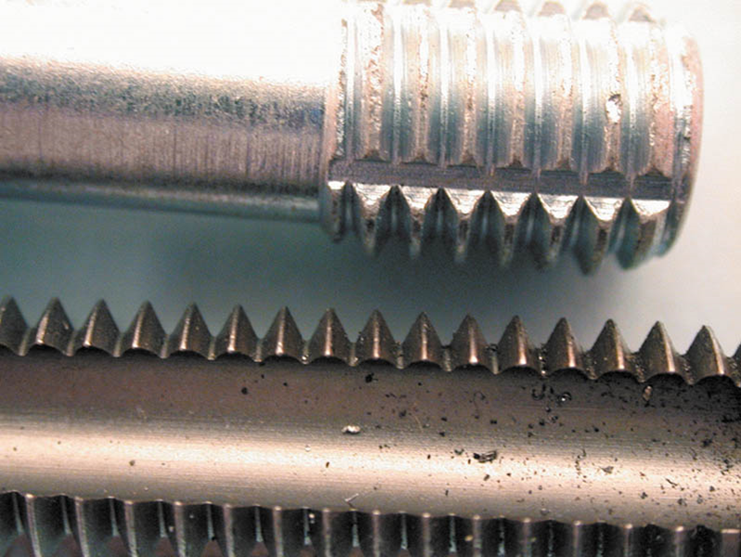
Figure 8.14 A thread chaser is shown at the top compared to a tap on the bottom. A thread chaser is used to clean threads without removing metal

Slide 33
Sheet Metal Screws
Fully threaded screws with a point.
Sometimes referred to as “self tapping”.
Used in fenders, trim and door trim panels.
Sized according to their major thread diameter.

Slide 34
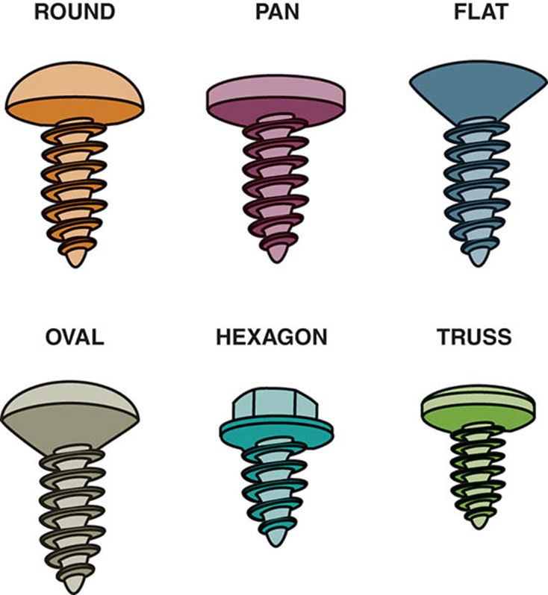
Figure 8.15 Sheet metal screws come with many head types

Slide 35
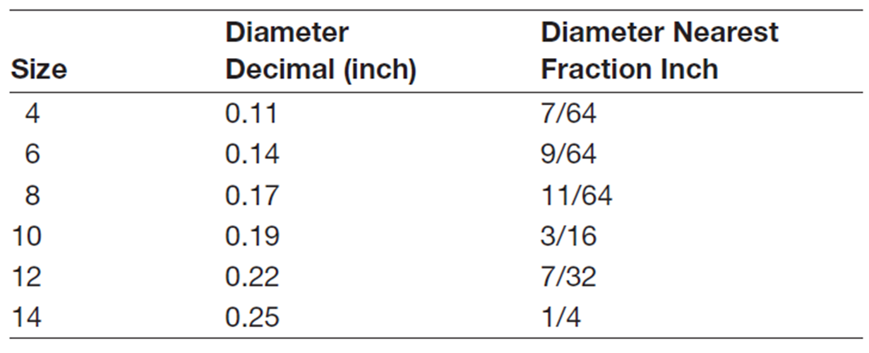
Fractional screw sizes

Slide 36
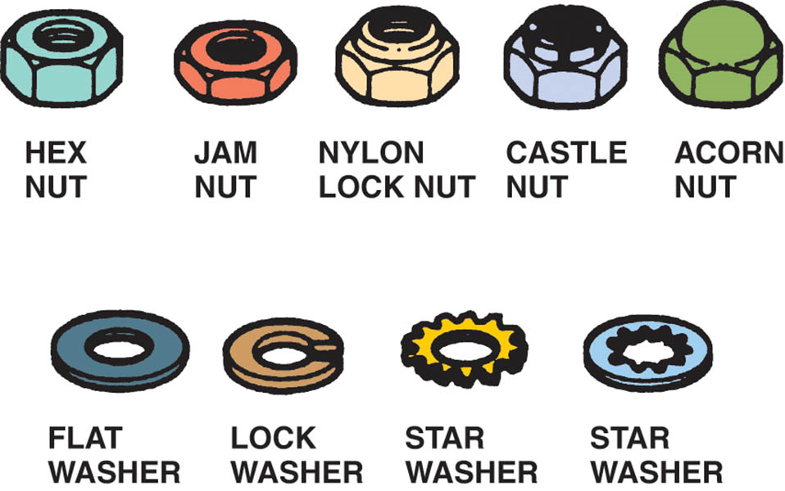
Figure 8.16 Various types of nuts (top) and washers (bottom) serve different purposes and all are used to secure bolts or cap screws

Slide 37
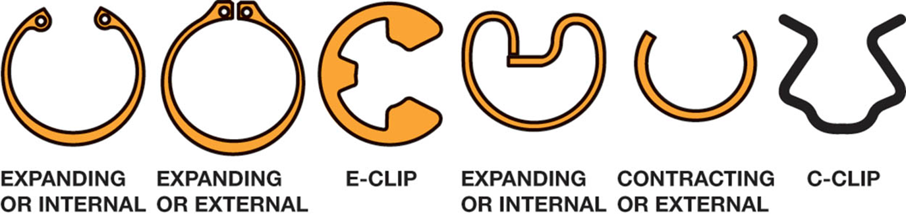
Figure 8.17 Some different types of snap rings. An internal snap ring fits inside of a housing or bore, into a groove. An external snap ring fits into a groove on the outside of a shaft or axle. An E-clip fits into a groove in the outside of a shaft. A C-clip shown is used to retain a window regulator handle on its shaft

Slide 38
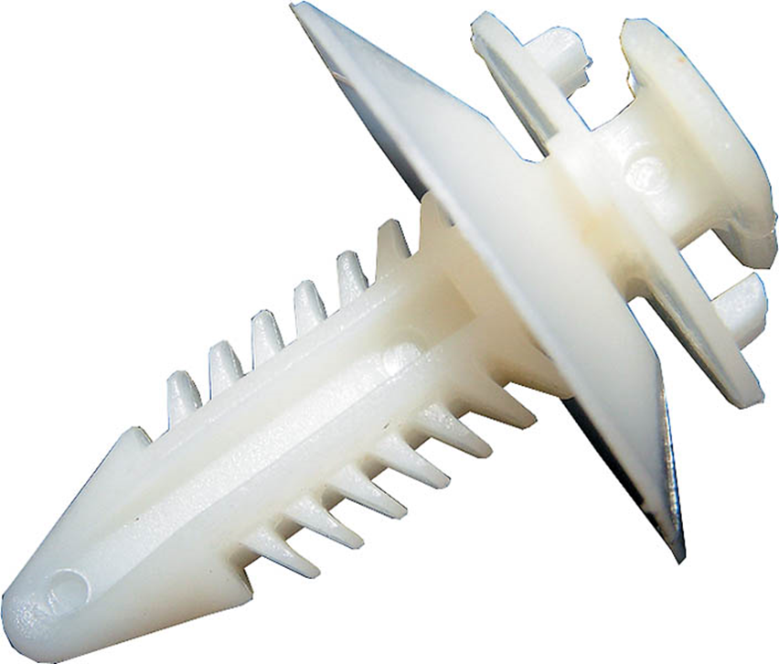
Figure 8.18 A typical door panel retaining clip

Slide 39
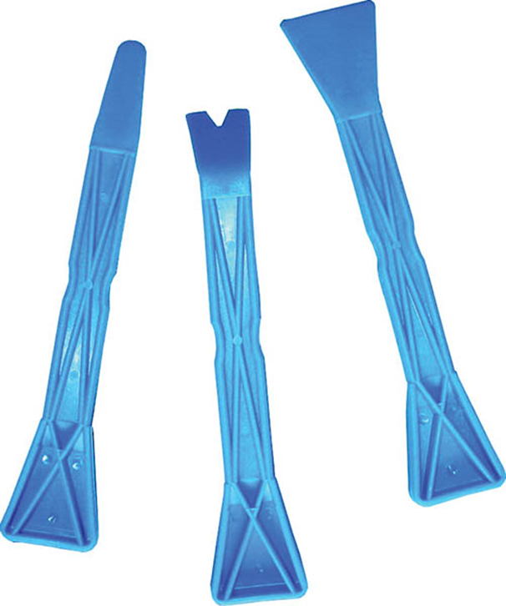
Figure 8.19 Plastic or metal trim tools are available to help the technician remove interior door panels and other trim without causing harm

Slide 40
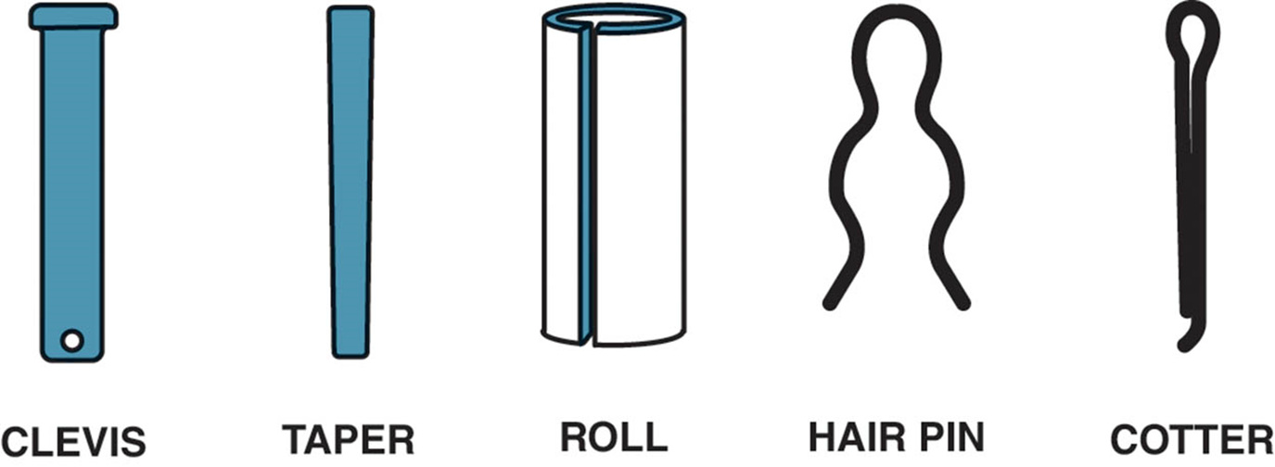
Figure 8.20 Pins come in various types

Slide 41
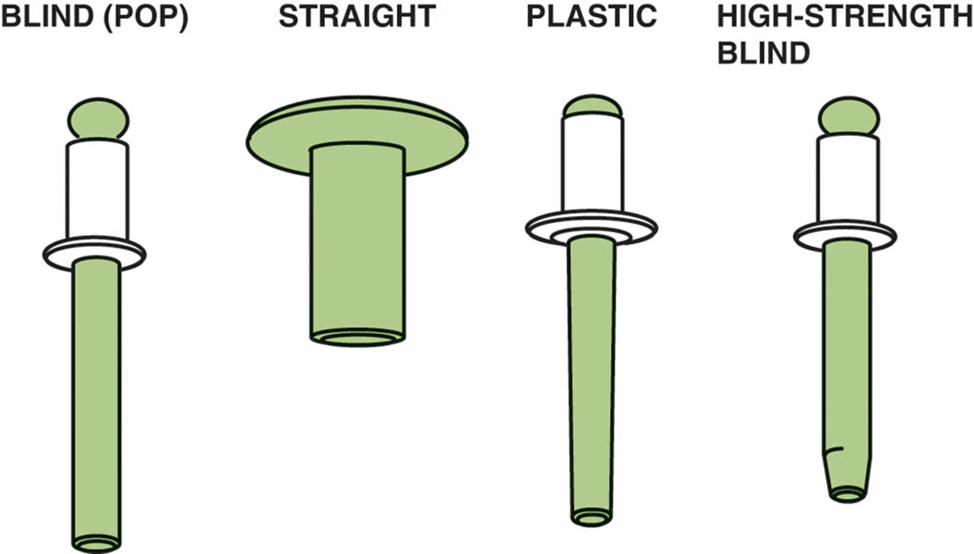
Figure 8.21 Various types of rivets

Slide 42
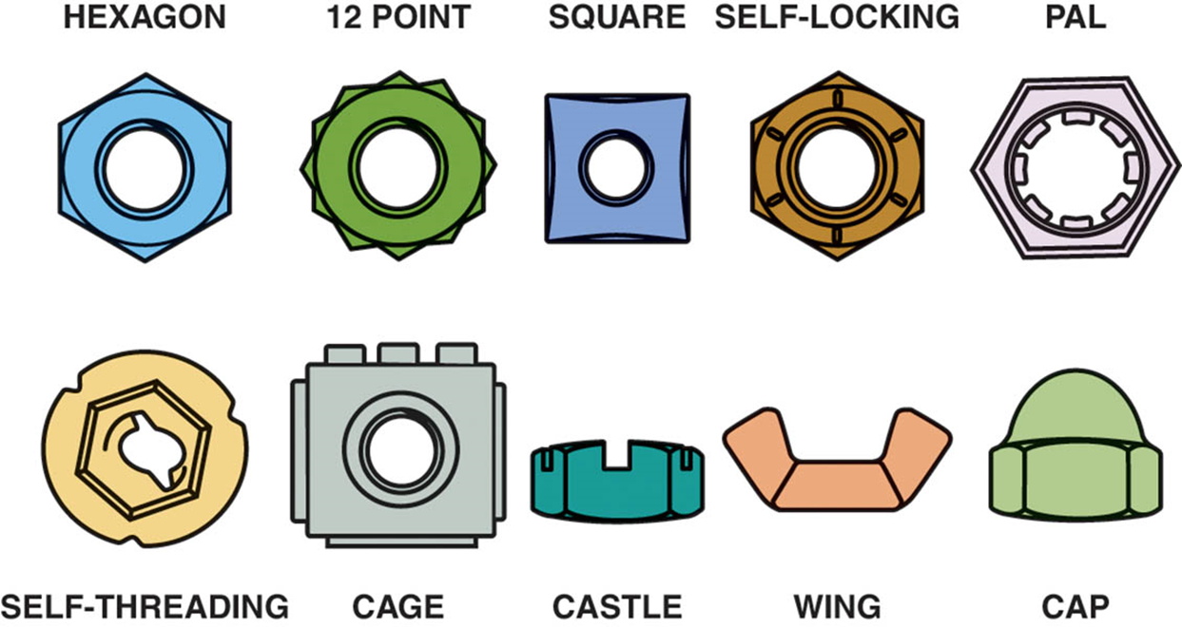
Figure 8.22 All of the nuts shown are used by themselves except for the pal nut, which is used to lock another nut to a threaded fastener so they will not be loosened by vibration

Slide 43
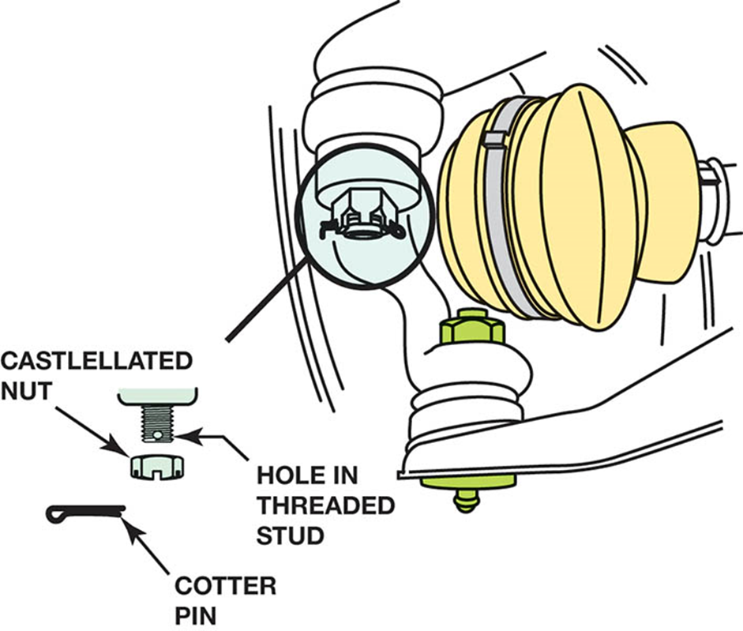
Figure 8.23 A castellated nut is locked in place with a cotter pin

Slide 44
BROKEN FASTENER REMOVAL
Try not to force fastener and damage head.
Try tightening in slightly to break corrosion.
Strike with a punch and a dead blow hammer to break corrosion.
Threads may be left-handed.
Use penetrating oil.
Properly tighten the fastener.

Slide 45
THREAD REPAIR INSERTS
Used to replace original threaded hole.
Original hole must be enlarged and tapped.
Insert restores holes to the original size.
Many types of inserts:
Threaded inserts
Self-tapping inserts
Solid bushing inserts
Key-locking inserts

Slide 46
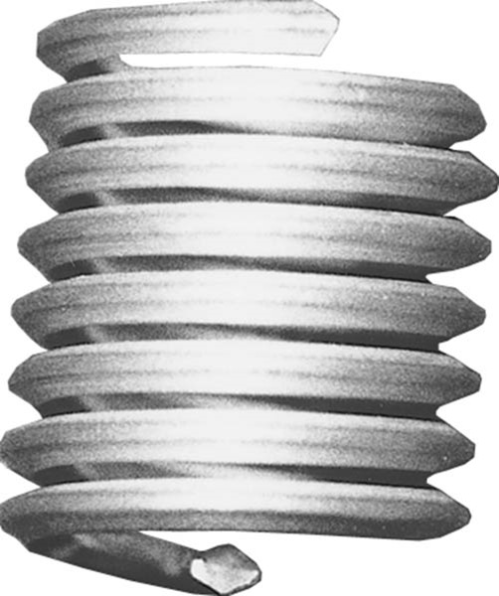
Figure 8.24 Helical inserts look like small, coiled springs. The outside is a thread to hold the coil in the hole, and the inside is threaded to fit the desired fastener

Slide 47
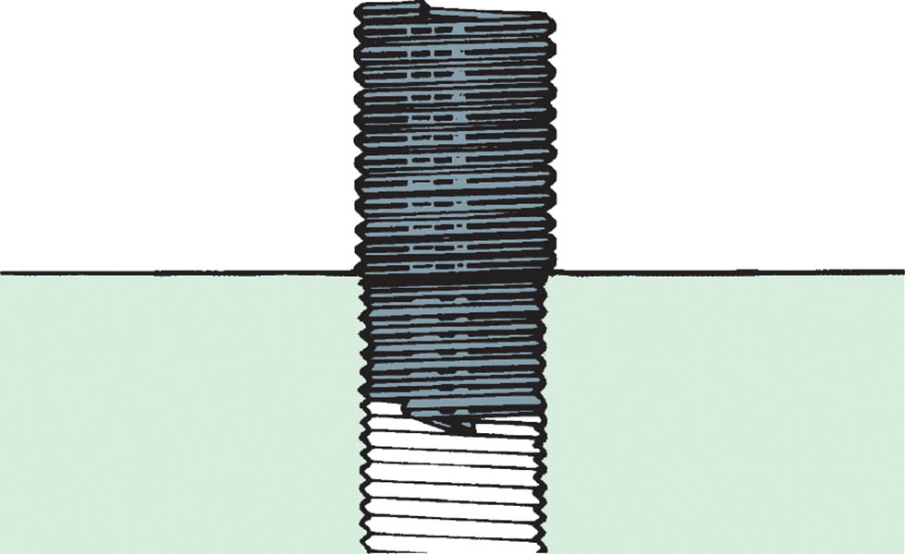
Figure 8.25 The insert provides new, stock-size threads inside an oversize hole so that the original fastener can be used

Slide 48
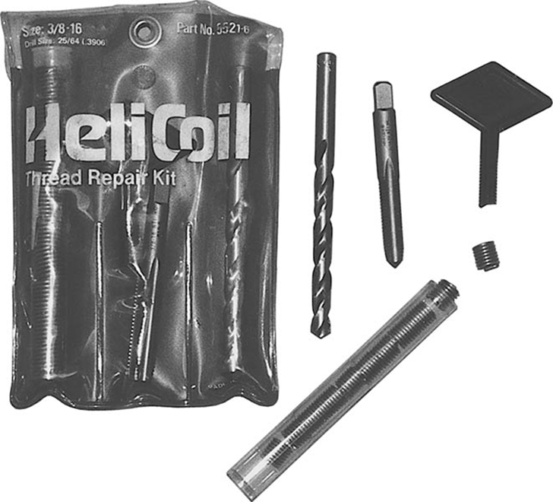
Figure 8.26 Heli-Coil® kits, available in a wide variety of sizes, contain everything needed to repair a damaged hole back to its original size

Slide 49
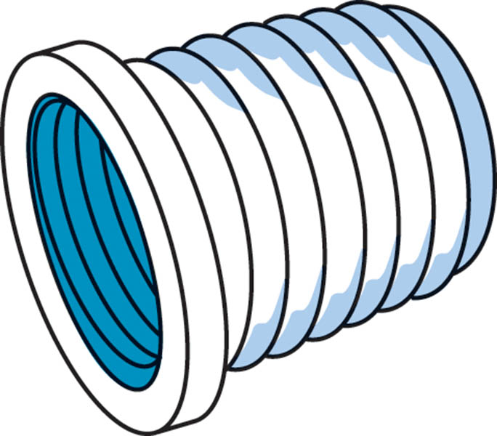
Figure 8.27 This solid-bushing insert is threaded on the outside, to grip the workpiece. The inner threads match the desired bolt size

Slide 50
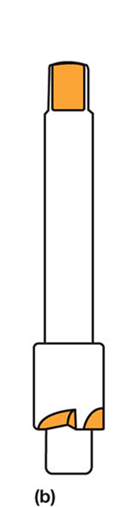
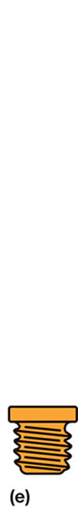
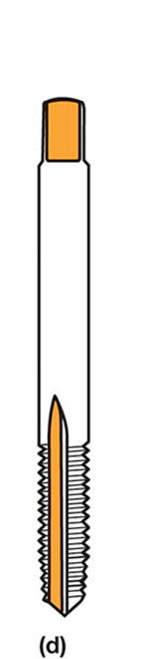
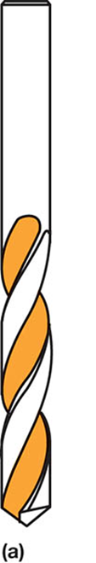
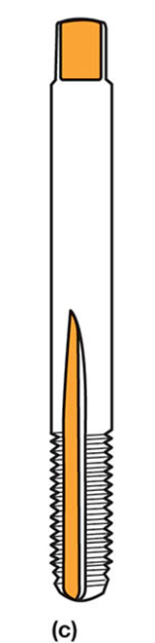
Figure 8.28 A Timesert® kit includes the drill (a), the recess cutter (b), a special tap (c), the installer (d), and the Timesert® threaded bushing (e)

Slide 51
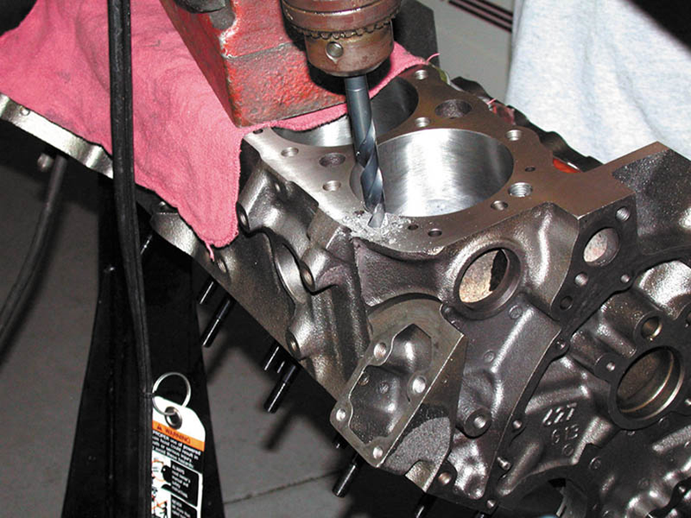
Figure 8.29 Drill out the damaged threads with the correct bit

Slide 52
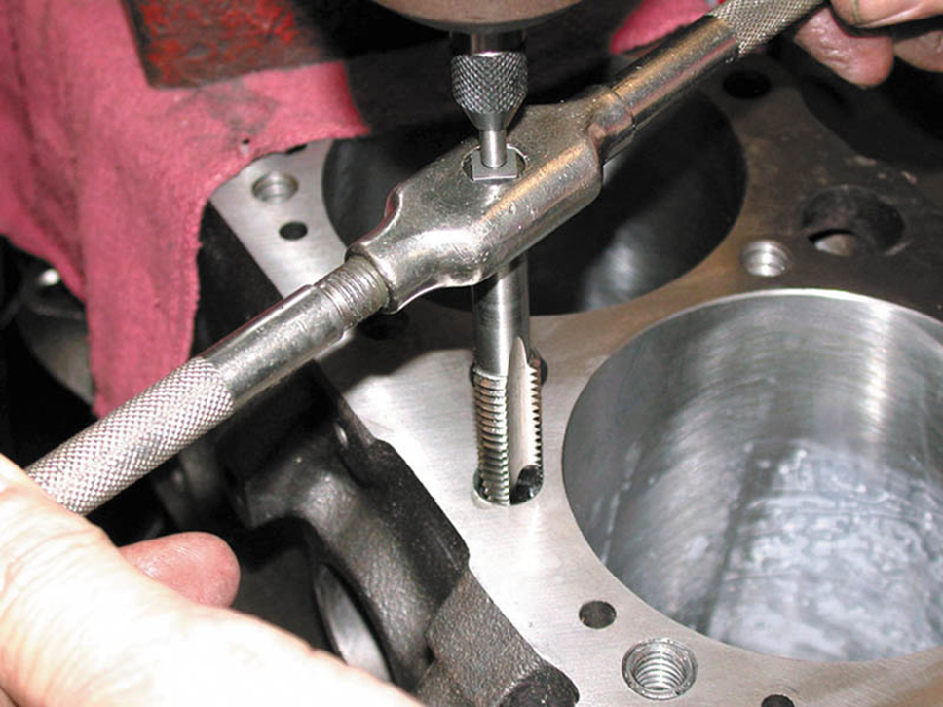
Figure 8.30 Use a special tap for the insert

Slide 53
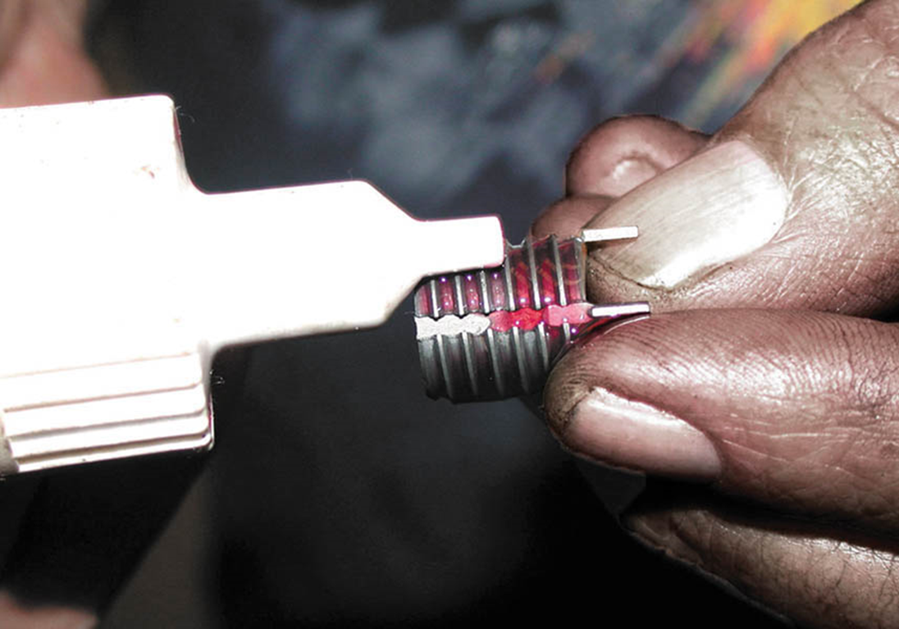
Figure 8.31 Put some thread-locking compound on the insert

Slide 54
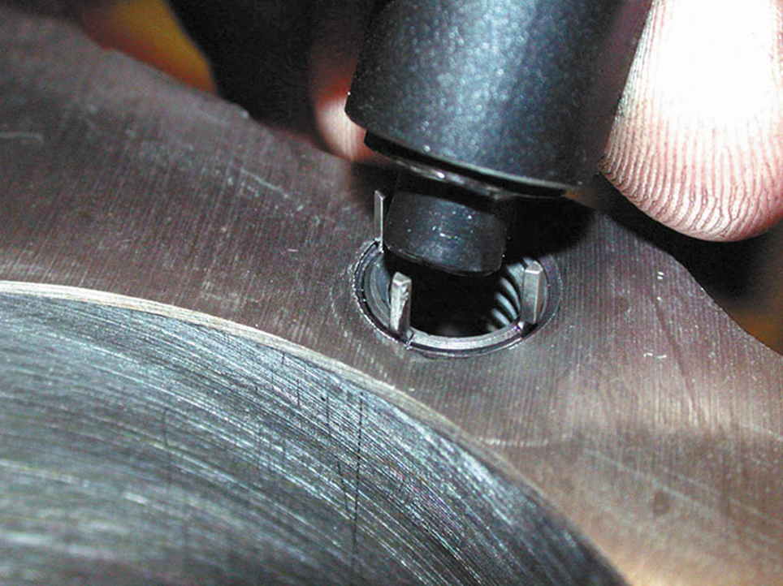
Figure 8.32 Use the driver to drive the keys down flush with the surface of the workpiece

Slide 55
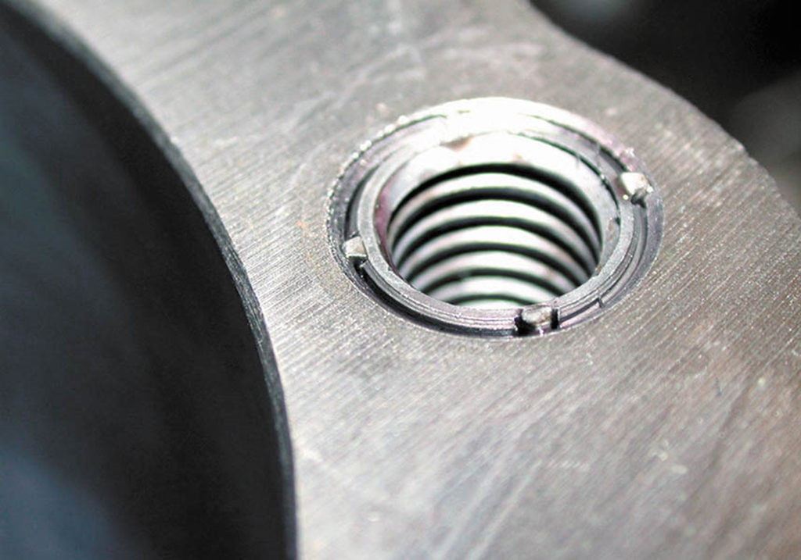
Figure 8.33 The insert and insert locks should be below the surface of the workpiece

Slide 56
QUESTION 3: ?
How are threaded inserts installed?

Slide 57
ANSWER 3:
Use the mandrel to screw the insert into the tapped hole.

Slide 58

Copyright

