Slide 1

Automotive Technology Principles, Diagnosis, and Service
Sixth Edition
Chapter 79
Fuel Pumps, Lines, and Filters
Copyright © 2018, 2015, 2011 Pearson Education, Inc. All Rights Reserved

Slide 2
LEARNING OBJECTIVES (1 of 2)
79.1 List components of the fuel delivery system and explain the role of fuel tanks.
79.2 Discuss rollover leakage prevention devices.
79.3 Discuss the different types of fuel lines.
79.4 Explain the different types of electric fuel pumps.

Slide 3
LEARNING OBJECTIVES (2 of 2)
79.5 Describe the purpose of fuel filters.
79.6 Describe how to test and replace fuel pumps.
79.7 This chapter will help prepare for Engine Repair (A8) ASE certification test content area “C” (Fuel, Air Induction, and Exhaust Systems Diagnosis and Repair).

Slide 4
FUEL DELIVERY SYSTEM
Fuel delivery (and return) systems use many if not all of the following components:
  Fuel storage tank, filler neck, and gas cap
  Fuel tank pressure sensor
  Fuel pump
  Fuel filter(s)
  Fuel delivery lines and fuel rail
  Fuel-pressure regulator
  Fuel return line (if equipped with a return-type fuel delivery system)

Slide 5
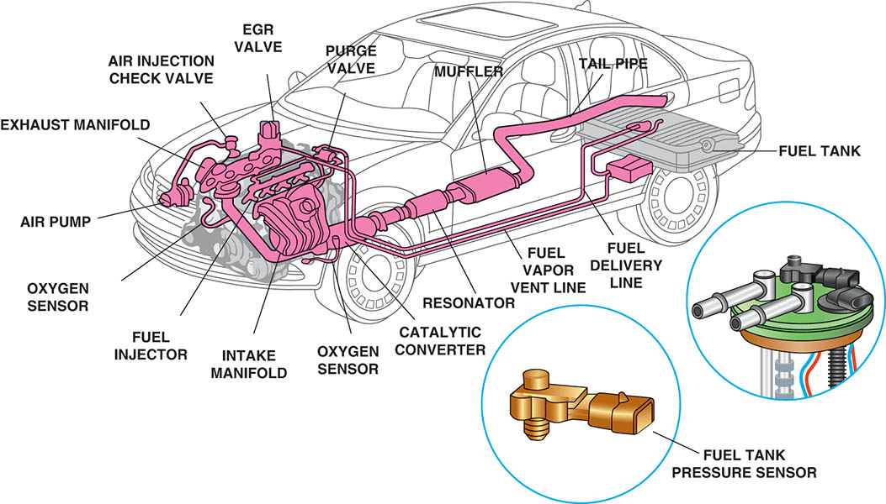
Figure 79.1 The fuel system includes many separate parts and components, including the fuel tank, fuel pump, and lines, as well as the fuel tank pressure sensor used to measure the pressure inside the fuel tanks, used by the evaporative fuel control system.

Slide 6
FUEL TANKS (1 OF 3)
A vehicle fuel tank is made of corrosion-resistant steel or polyethylene plastic.
Regardless of size and shape, all fuel tanks incorporate most, if not all, the following features:
  Inlet or filler tube through which fuel enters the tank
  Filler cap with pressure holding and relief features
  An outlet to the fuel line leading to the fuel pump or fuel injector
  Fuel pump mounted within the tank
  Tank vent system
  Fuel pickup tube and fuel level sending unit

Slide 7
FUEL TANKS (2 OF 3)
Tank Location and Mounting
  Most vehicles use a horizontally suspended fuel tank.
  Fuel tanks are located there so that frame rails and body components protect the tank in the event of a crash.
Filler Tubes
  Fuel enters the tank through a large tube extending from the tank to an opening on the outside of the vehicle.
  Onboard refueling vapor recovery (ORVR) systems were added to the filler neck to reduce evaporative emissions.

Slide 8
FUEL TANKS (3 OF 3)
Pressure-Vacuum Filler Cap
  The safety cap must seal the system, and release excess pressure or excess vacuum.
Fuel Pickup Tube
  The fuel pickup tube is usually a part of the fuel sender assembly or the electric fuel pump assembly and contains the tank sock.
Tank Venting Requirements
  An EVAP system vents gasoline vapors from the fuel tank directly to a charcoal-filled vapor storage canister.

Slide 9
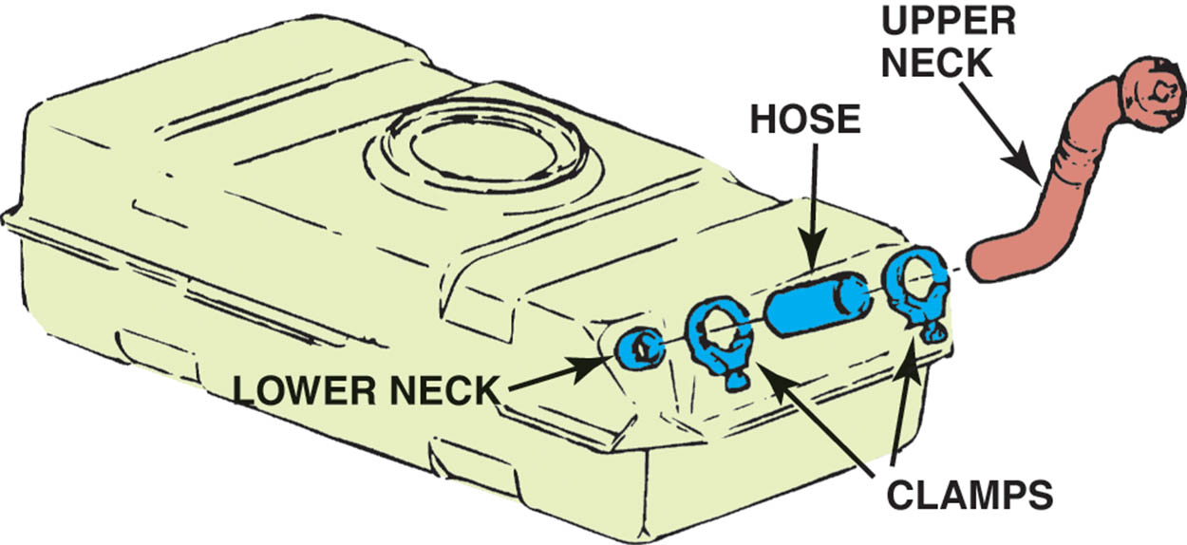
Figure 79.2 A three-piece filler tube assembly.

Slide 10
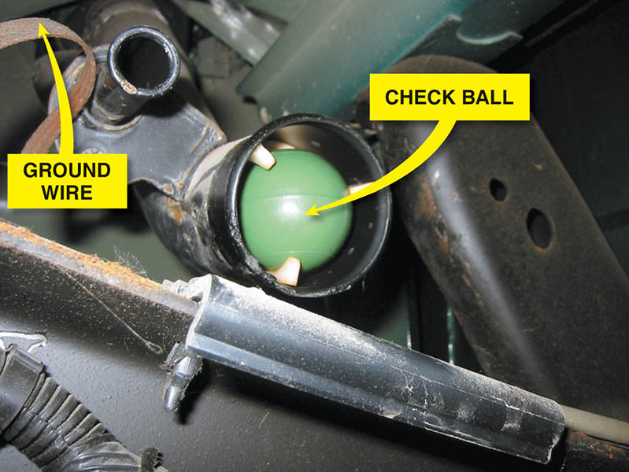
Figure 79.3 A view of a typical filler tube with the fuel tank removed. Notice the ground strap used to help prevent the buildup of static electricity as the fuel flows into the plastic tank. The check ball looks exactly like a ping-pong ball.

Slide 11
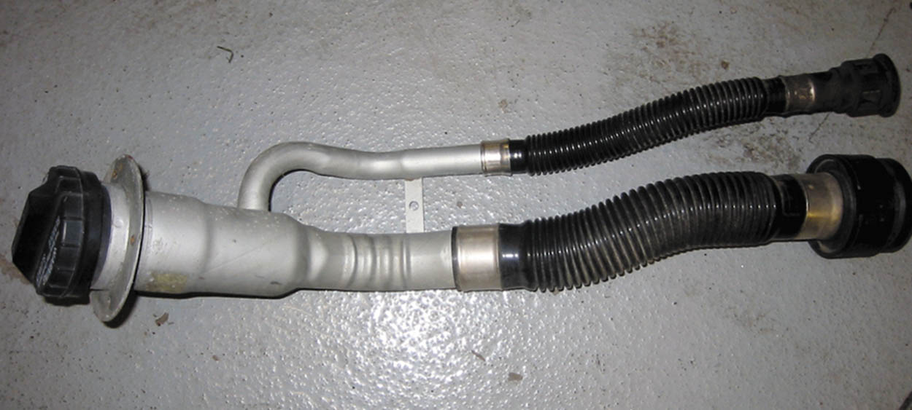
Figure 79.4 Vehicles equipped with onboard refueling vapor recovery usually have a reduced-size fill tube.

Slide 12
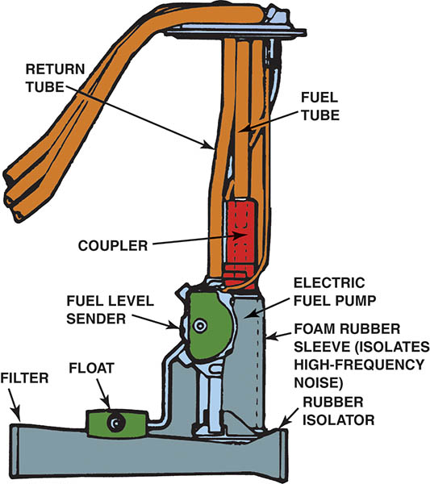
Figure 79.5 The fuel pickup tube is part of the fuel sender and pump assembly.

Slide 13
ROLLOVER LEAK PROTECTION
All vehicles have one or more devices to prevent fuel leaks in case of vehicle rollover or a collision in which fuel may spill.
A basic one-way check valve may be installed in any number of places between the fuel tank and the engine.
Some vehicles use devices to ensure that the fuel pump shuts off when an accident occurs.

Slide 14
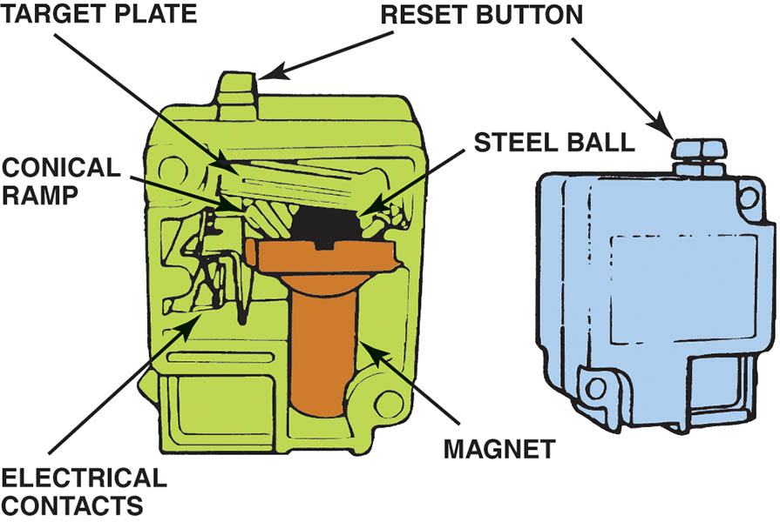
Figure 79.6 Ford uses an inertia switch to turn off the electric fuel pump in case of an accident.

Slide 15
FUEL LINES (1 OF 3)
Fuel and vapor lines made of steel, nylon tubing, or fuel-resistant rubber hoses connect the parts of the fuel system.
Depending on their function, fuel and vapor lines may be either rigid or flexible.
The design of the line is dependent on the pressure it must carry.

Slide 16
FUEL LINES (2 OF 3)
Rigid Lines
  All fuel lines fastened to the body, frame, or engine are made of seamless steel tubing.
Flexible Lines
  Most fuel systems use synthetic rubber hose sections where flexibility is needed.
Fuel Line Mounting
  Fuel supply lines from the tank to a throttle body or fuel rail are routed to follow the frame along the underbody of the vehicle.

Slide 17
FUEL LINES (3 OF 3)
Fuel Injection Lines
  Hoses used for fuel-injection systems are made of materials with high resistance to oxidation and deterioration.
Fuel-Injection Fittings and Nylon Lines
  Because of their operating pressures, fuel-injection systems often use special kinds of fittings to ensure leak proof connections.
  Unlocking the special fittings typically requires special tools.

Slide 18
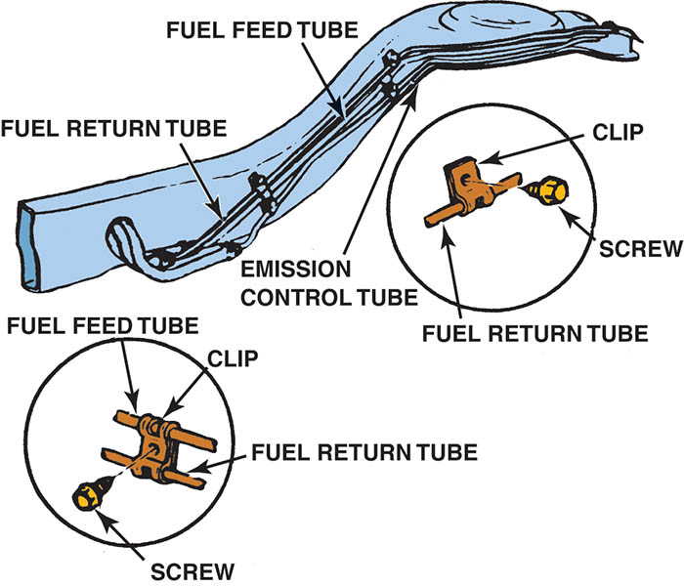
Figure 79.7 Fuel lines are routed along the frame or body and secured with clips.

Slide 19
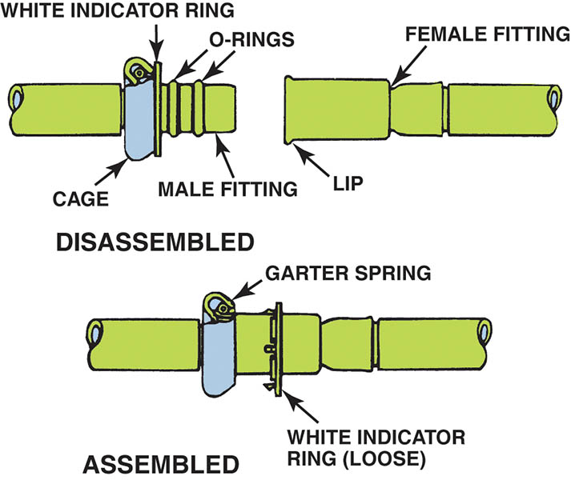
Figure 79.8 Some Ford metal line connections use spring-locks and O-rings.

Slide 20
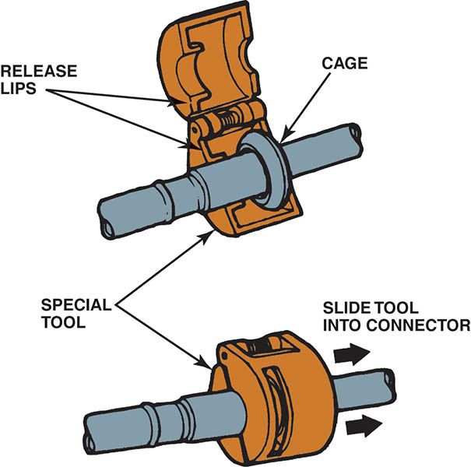
Figure 79.9 Ford spring-lock connectors require a special tool for disassembly.

Slide 21
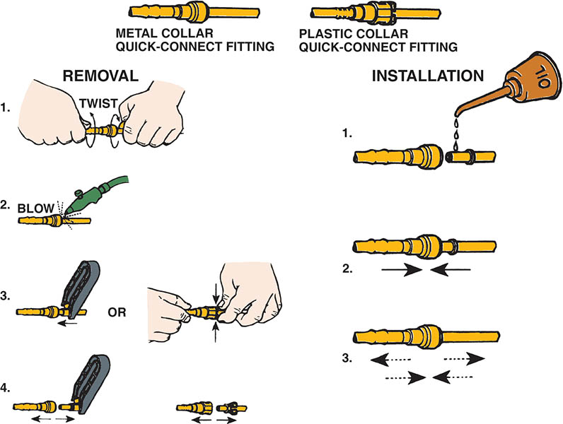
Figure 79.10 Typical quick-connect steps.

Slide 22
ELECTRIC FUEL PUMPS (1 OF 4)
Positive Displacement Pump
  A positive displacement pump is a design that forces everything that enters the pump to leave the pump.
  When the maximum volume has been reached, the supply port closes and the discharge opens.
  A fuel outlet check valve closes to maintain fuel pressure when the pump shuts off.

Slide 23
ELECTRIC FUEL PUMPS (2 OF 4)
Hydrokinetic Flow Pump Design
  This design of pump rapidly moves the fuel to create pressure.
  A turbine pump is the most common
  These units use an impeller that accelerates the fuel particles before actually discharging
  A typical electric fuel pump used on a fuel-injection system delivers about 40 to 50 gallons per hour or 0.6 to 0.8 gallons per minute at a pressure of 70 to 90 PSI.

Slide 24
ELECTRIC FUEL PUMPS (3 OF 4)
Modular Fuel Sender Assembly
  The modular fuel sender consists of a fuel level sensor, a turbine pump, and a jet pump.
  The reservoir dampens fuel slosh to maintain a constant fuel level available to the pump.
Electric Pump Control Circuits
  Fuel-pump circuits are typically controlled by the fuel-pump relay.
  The pump is energized at key on and then again once a “tach” signal is received.

Slide 25
ELECTRIC FUEL PUMPS (4 OF 4)
Pump Pulsation Dampening
  An accumulator in the system to reduce pressure pulses and noise.
Variable Speed Pumps
  Pump speed and pressure can be regulated by controlling the voltage supplied to the pump with a resistor switched into the circuit, or by using a separate fuel pump driver module to supply a pulse-width modulated (PWM) voltage to the pump.

Slide 26
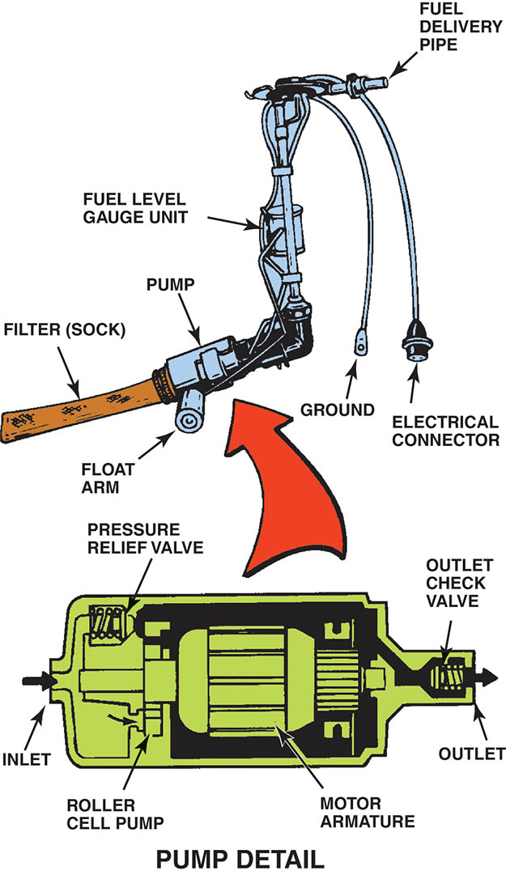
Figure 79.11 A roller cell-type electric fuel pump.

Slide 27
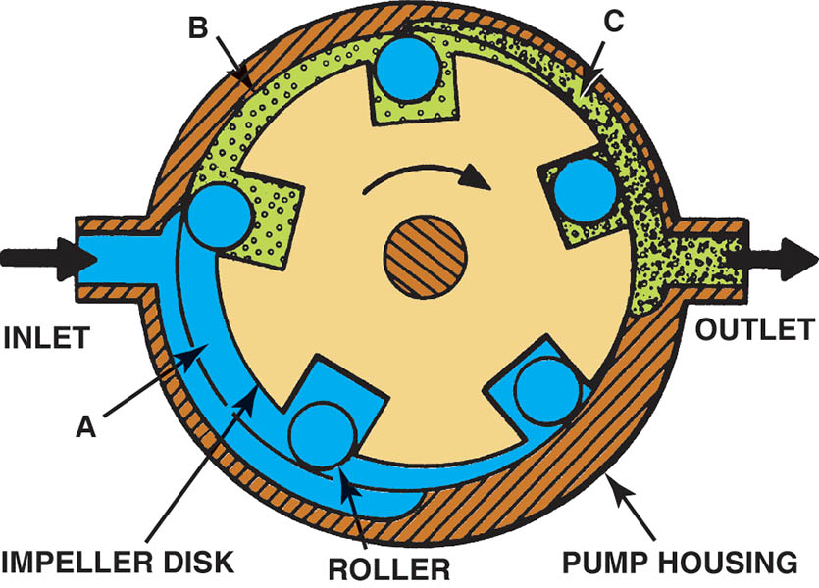
Figure 79.12 The pumping action of an impeller or rotary vane pump.

Slide 28
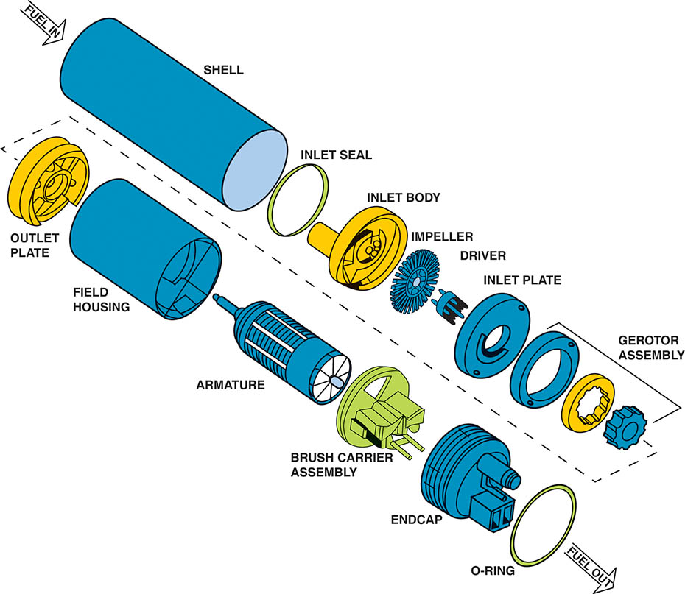
Figure 79.13 An exploded view of a gerotor electric fuel pump.

Slide 29
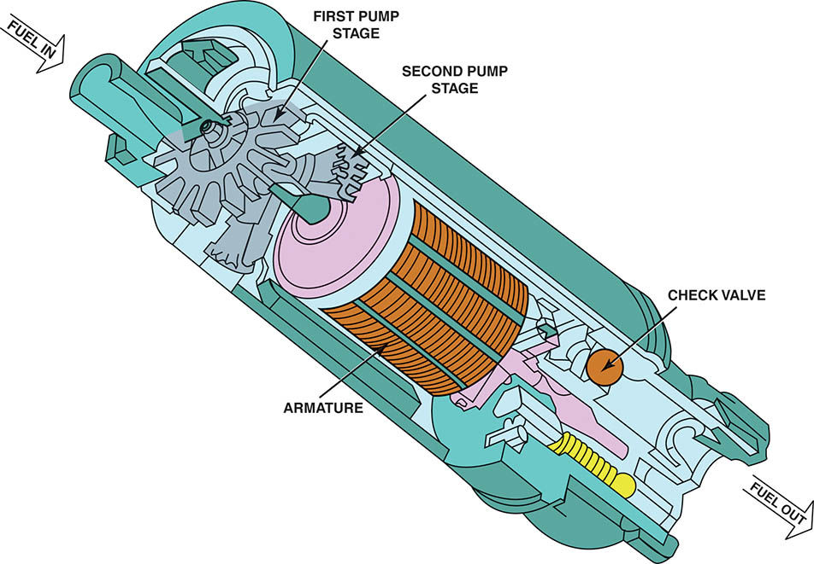
Figure 79.14 A cutaway view of a typical two-stage turbine electric fuel pump.

Slide 30
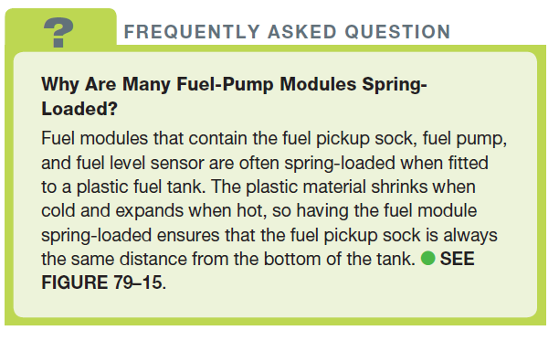
FREQUENTLY ASKED QUESTION

Slide 31
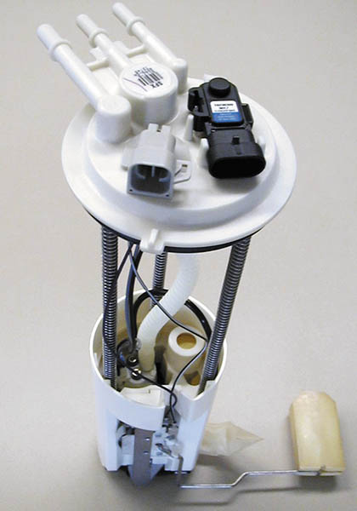
Figure 79.15 A typical fuel-pump module assembly, which includes the pickup strainer and fuel pump, as well as the fuel-pressure sensor and fuel level sensing unit.

Slide 32
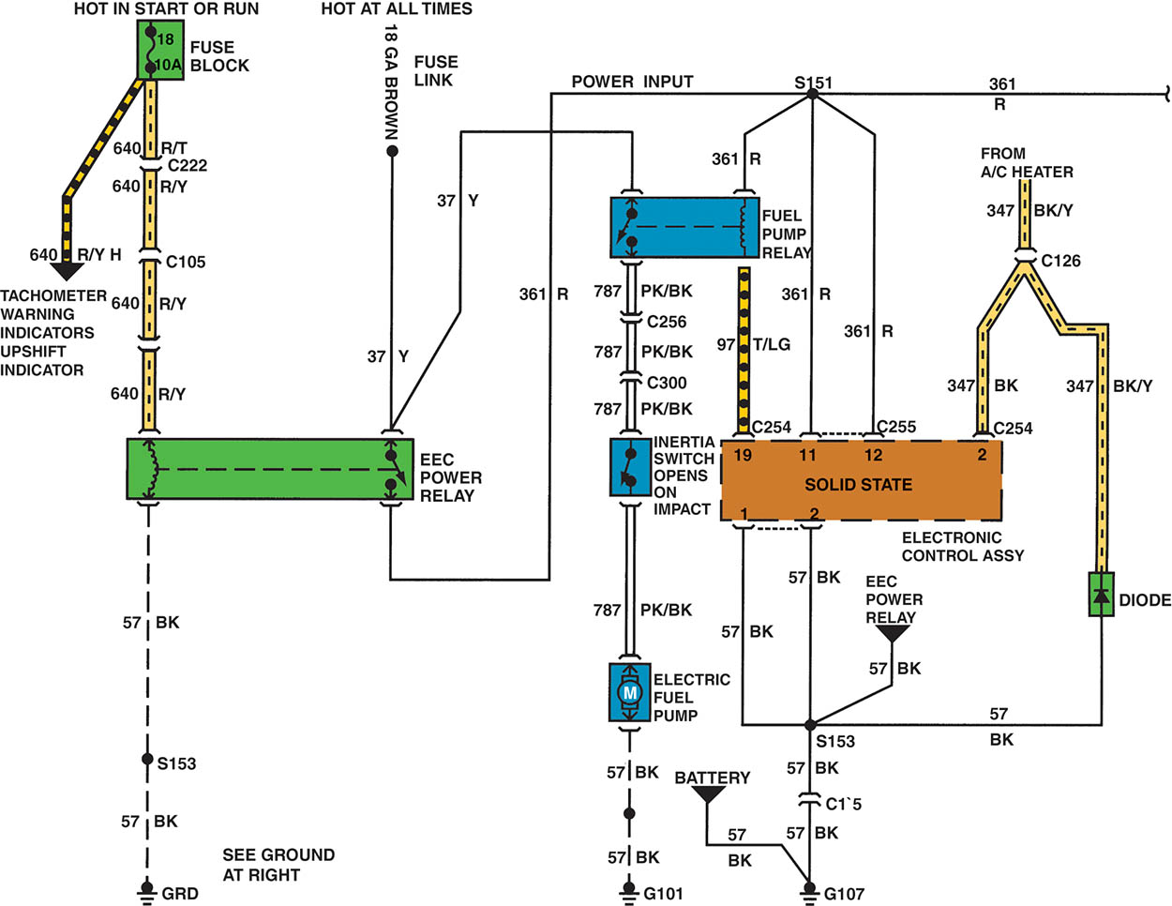
Figure 79.16 A schematic showing that an inertia switch is connected in series between the fuel-pump relay and the fuel pump.

Slide 33
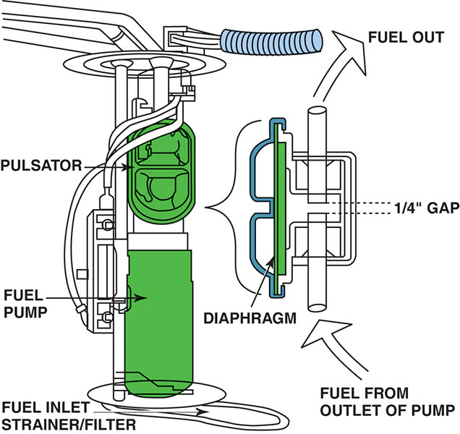
Figure 79.17 A typical fuel pulsator used mostly with roller vane-type pumps to help even out the pulsation in pressure that can cause noise.

Slide 34
QUESTION 1: ?
What are the two most common types of electric fuel pumps?

Slide 35
ANSWER 1:
Positive displacement and hydrokinetic flow.

Slide 36
FUEL FILTERS
Fuel filters remove dirt, rust, water, and other contamination from the gasoline before it can reach the fuel injectors.
Fuel filters should be replaced according to the vehicle manufacturer’s recommendations
Returnless-type fuel-injection system usually use filters that are part of the fuel pump assembly and do not have any specified service interval.

Slide 37
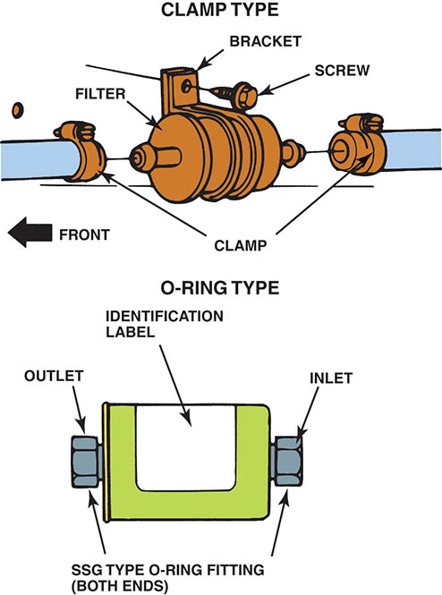
Figure 79.18 Inline fuel filters are usually attached to the fuel line with screw clamps or threaded connections. The fuel filter must be installed in the proper direction or a restricted fuel flow can result.

Slide 38
QUESTION 2: ?
Where are fuel filters typically located in the system?

Slide 39
ANSWER 2:
In the fuel tank and in-line.

Slide 40
FUEL PUMP TESTING (1 OF 2)
Testing Fuel Pump Pressure
  To measure fuel-pump pressure, locate the Schrader valve and attach a fuel-pressure gauge.
  Cycle the key to on to actuate the fuel pump.
Rest Pressure Test
  If the fuel pressure is acceptable, then check the system for leakdown.
  The pressure should not drop for 5 minutes.

Slide 41
FUEL PUMP TESTING (2 OF 2)
Dynamic Pressure Test
  To test the pressure dynamically, start the engine.
  If the pressure is vacuum referenced, then the pressure should change when the throttle is cycled.
Testing Fuel Pump Volume
  Sufficient fuel capacity (flow) should be at least 2 pints (1 liter) every 30 seconds or 1 pint in 15 seconds.

Slide 42
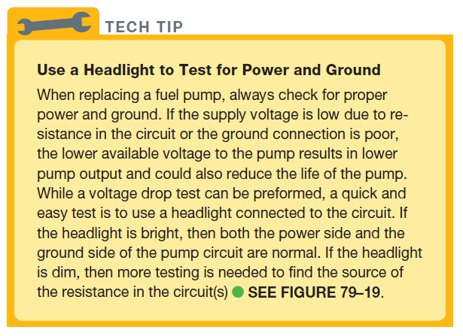
Tech Tip

Slide 43
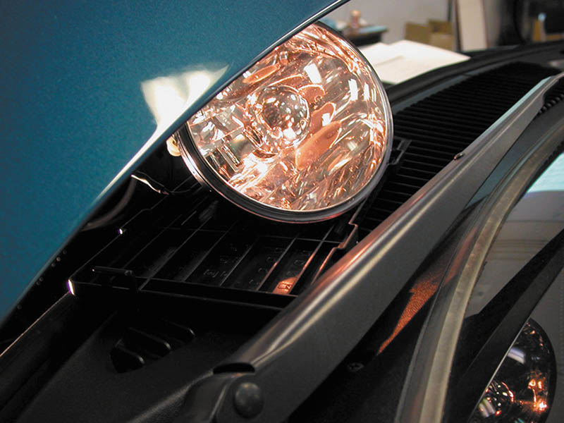
Figure 79.19 A dim headlight indicates excessive resistance in fuel pump circuit.

Slide 44
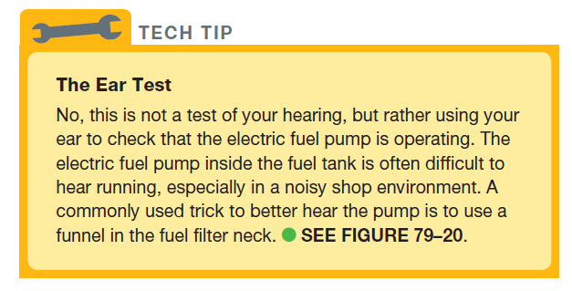
TECH TIP

Slide 45
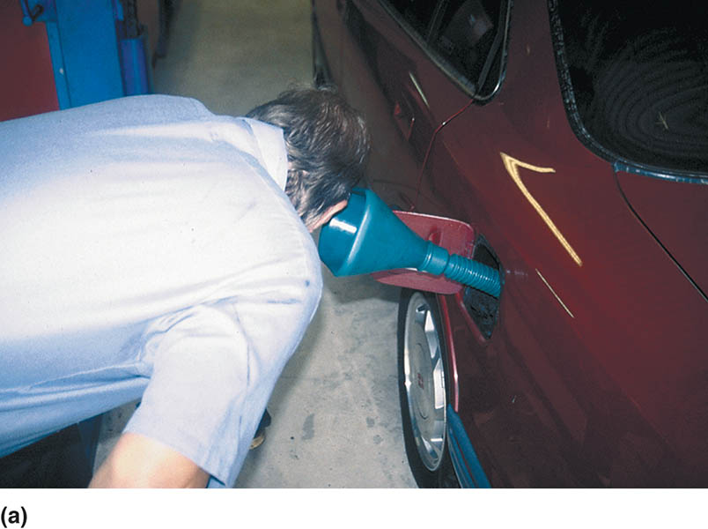
Figure 79.20 (a) A funnel helps in hearing if the electric fuel pump inside the gas tank is working.

Slide 46
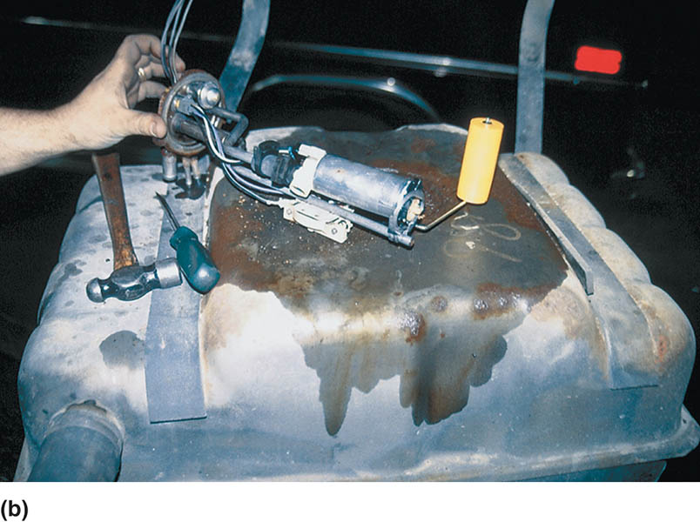
Figure 79.20 (b) If the pump is not running, check the wiring and current flow before going through the process of dropping the fuel tank to remove the pump.

Slide 47
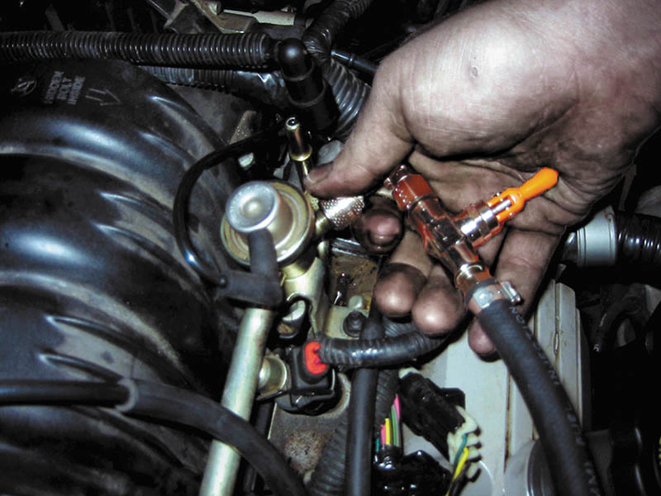
Figure 79.21 The Schrader valve on this General Motors 3800 V-6 is located next to the fuel-pressure regulator.

Slide 48
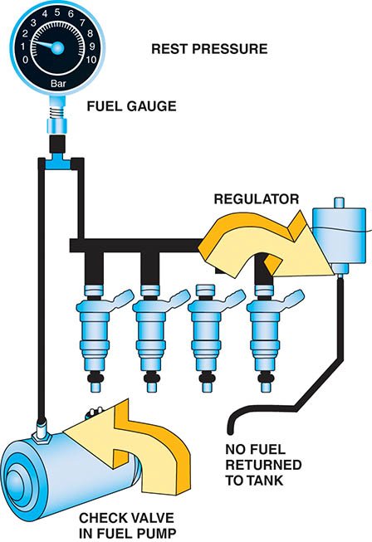
Figure 79.22 The fuel system should hold pressure if the system is leak free.

Slide 49
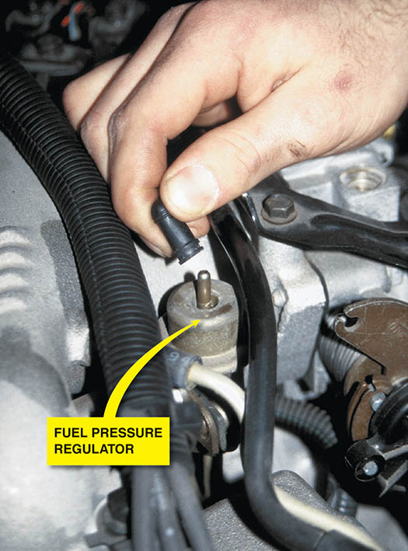
Figure 79.23 If the vacuum hose is removed from the fuel-pressure regulator when the engine is running, the fuel pressure should increase. If it does not increase, then the fuel pump is not capable of supplying adequate pressure or the fuel-pressure regulator is defective. If gasoline is visible in the vacuum hose, the regulator is leaking and should be replaced.

Slide 50
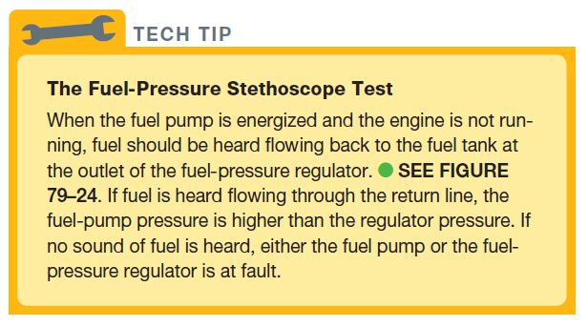
TECH TIP

Slide 51
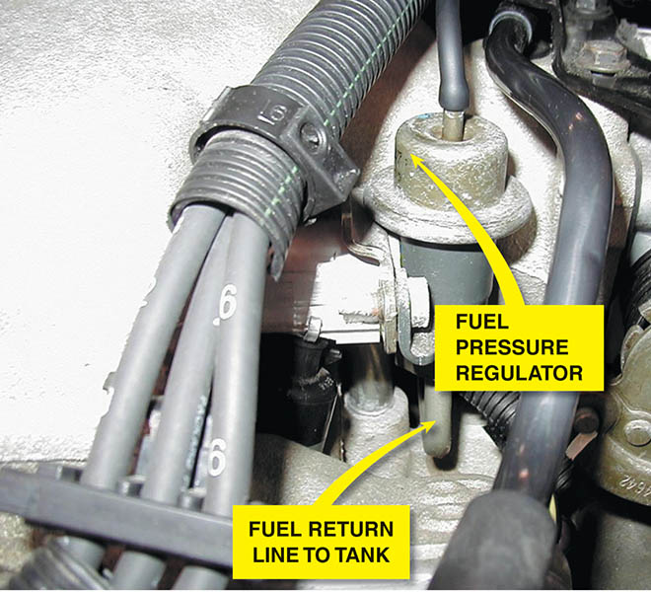
Figure 79.24 Fuel should be heard returning to the fuel tank at the fuel return line if the fuel pump and fuel-pressure regulator are functioning correctly.

Slide 52
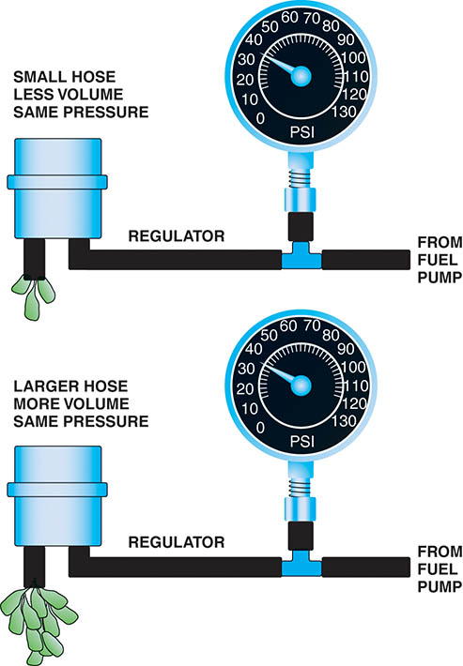
Figure 79.25 A fuel-pressure reading does not confirm that there is enough fuel volume for the engine to operate correctly.

Slide 53
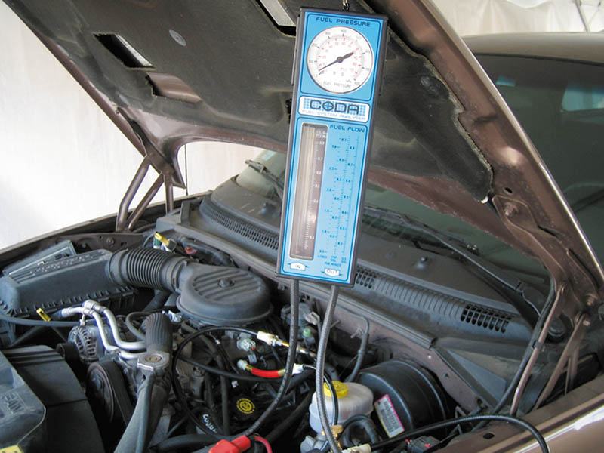
Figure 79.26 A fuel system tester connected in series in the fuel system so all of the fuel used flows through the meter, which displays the rate of flow and the fuel pressure.

Slide 54
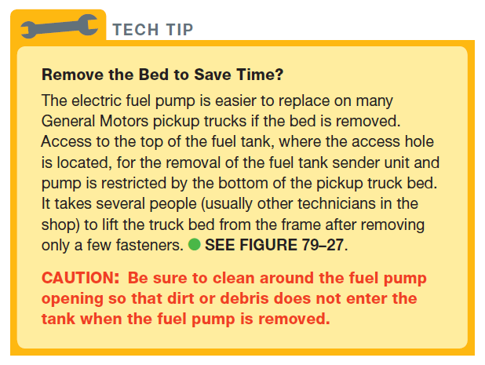
TECH TIP

Slide 55
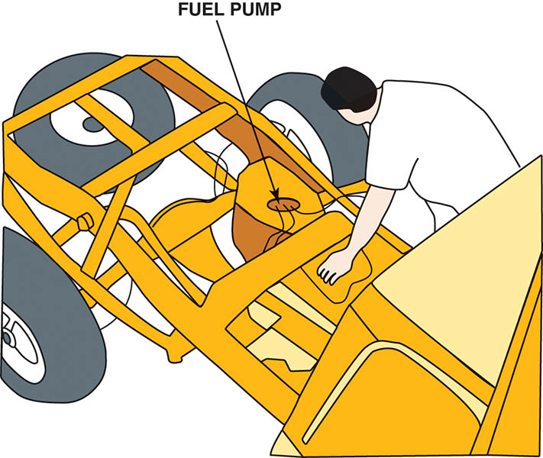
Figure 79.27 Removing the bed from a pickup truck makes gaining access to the fuel pump a lot easier.

Slide 56
QUESTION 3: ?
What are three ways to test the fuel pump.

Slide 57
ANSWER 3:
Rest pressure test, dynamic pressure test, and volume test.

Slide 58
FUEL PUMP CURRENT DRAW TEST
This test is most often performed by connecting a digital multimeter set to read DC amperes and test the current draw.
Compare the reading to factory specifications.

Slide 59
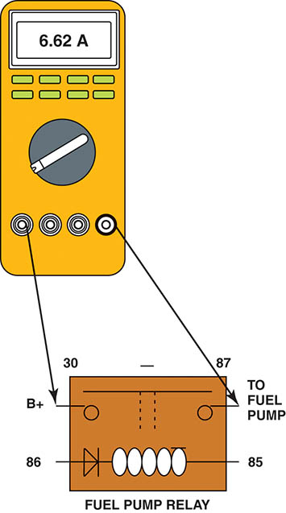
Figure 79.28 Hookup for testing fuel-pump current draw on any vehicle equipped with a fuel-pump relay.

Slide 60
FUEL PUMP REPLACEMENT
The following recommendations should be followed whenever replacing an electric fuel pump:
  The fuel-pump strainer (sock) should be replaced with the new pump.
  If the original pump had a deflector shield, it should always be reinstalled.
  Always check the interior of the fuel tank for evidence of contamination or dirt.
  Check that the wiring and electrical connectors are clean and tight.

Slide 61

Copyright

