Slide 1

Automotive Technology Principles, Diagnosis, and Service
Sixth Edition
Chapter 76
MAP/BARO Sensors
Copyright © 2018, 2015, 2011 Pearson Education, Inc. All Rights Reserved

Slide 2
LEARNING OBJECTIVES (1 of 2)
76.1 Discuss the variations in pressure that can occur within an engine.
76.2 Discuss how MAP sensors work.
76.3 Discuss the PCM uses for the MAP sensor.
76.4 Describe how the BARO sensor is used to test altitude.

Slide 3
LEARNING OBJECTIVES (2 of 2)
76.5 List the methods for testing MAP sensors and describe the symptoms of a failed MAP sensor.
76.6 This chapter will help prepare for Engine Repair (A8) ASE certification test content area “E” (Computerized Engine Controls Diagnosis and Repair).

Slide 4
AIR PRESSURE – HIGH AND LOW
Think of an internal combustion engine as a big air pump.
As a piston moves down on an intake stroke it lowers the air pressure within the engine.
The low pressure within the engine is called vacuum.
The difference in pressure between the two areas is called a pressure differential.

Slide 5
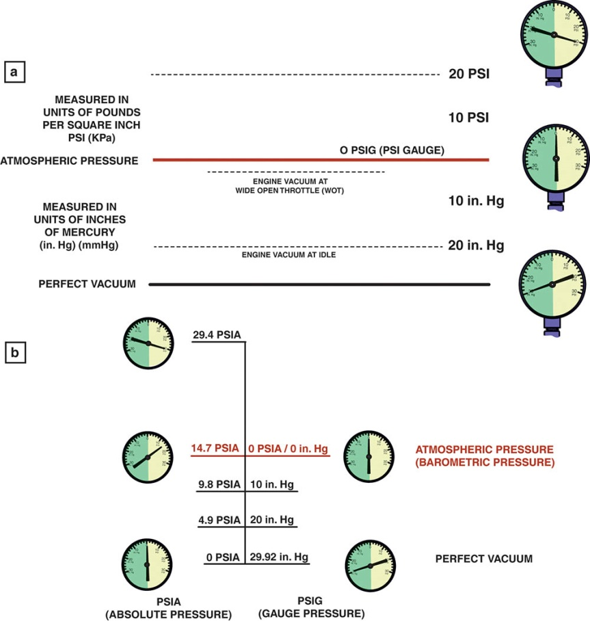
Figure 76.1 (a) As an engine is accelerated under a load, the engine vacuum drops. This drop in vacuum is actually an increase in absolute pressure in the intake manifold. A MAP sensor senses all pressures greater than that of a perfect vacuum. (b) The relationship between absolute pressure, vacuum, and gauge pressure.

Slide 6
PRINCIPLES OF PRESSURE SENSORS
To provide the computer with changing airflow information, a fuel-injection system may use the following:
Manifold absolute pressure (MAP) sensor
Manifold absolute pressure sensor plus barometric absolute pressure (BARO) sensor
Barometric and manifold absolute pressure sensors combined (BMAP)

Slide 7
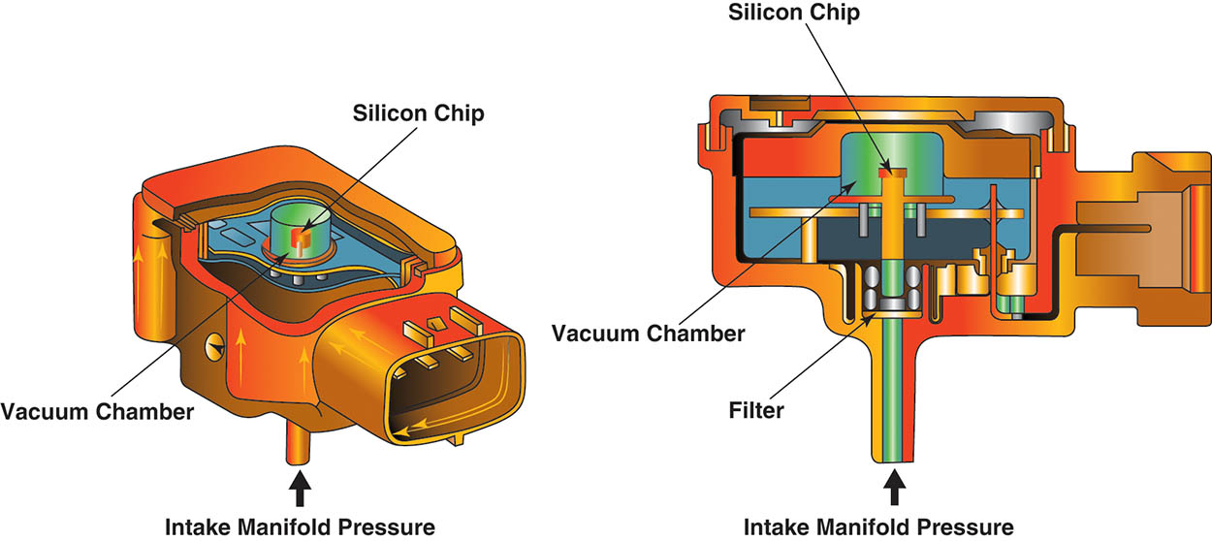
Figure 76.2 A MAP sensor compares the absolute pressure in the intake manifold to a perfect vacuum. The deflection of the silicon chip is converted to a an absolute pressure reading by the electronics in the sensor itself.

Slide 8
CONSTRUCTION OF MANIFOLD ABSOLUTE PRESSURE SENSORS
Purpose and Function
The manifold absolute pressure sensor is used by the engine computer to sense engine load.
Silicon-Diaphragm Strain Gauge MAP Sensor
There are four resistors attached to the silicon wafer, which changes in resistance when strain is applied. This a piezo resistive sensor.
Ceramic Disc MAP Sensor
This type of sensor converts manifold pressure into a capacitance discharge.

Slide 9
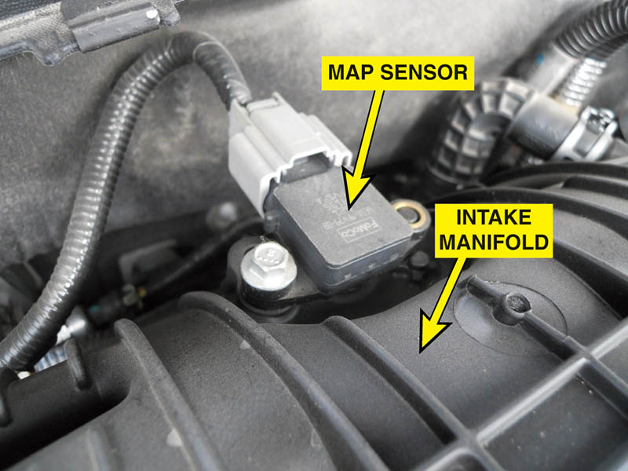
Figure 76.3 A typical MAP sensor installed in the intake manifold.

Slide 10
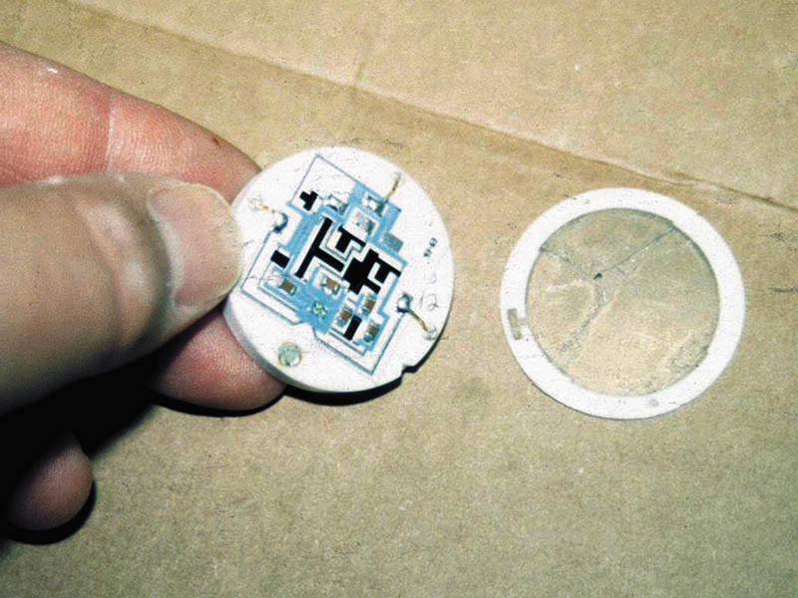
Figure 76.4 Shown is the electronic circuit inside a ceramic disc MAP sensor used on many Chrysler engines. The black areas are carbon resistors that are applied to the ceramic, and lasers are used to cut lines into these resistors during testing to achieve the proper operating calibration.

Slide 11
QUESTION 1: ?
What are two types (construction) of MAP sensors?

Slide 12
ANSWER 1:
Silicon-Diaphragm Strain Gauge MAP Sensor and Ceramic Disc MAP Sensor.

Slide 13
PCM USES OF A MAP SENSOR
The PCM uses the MAP sensor to determine the following:
The load on the engine.
Altitude, fuel, and spark control calculations.
EGR system operation.
Detect deceleration (vacuum increases).
Monitor engine condition.
Load detection for returnless-type fuel injection.
Altitude and MAP sensor values.

Slide 14
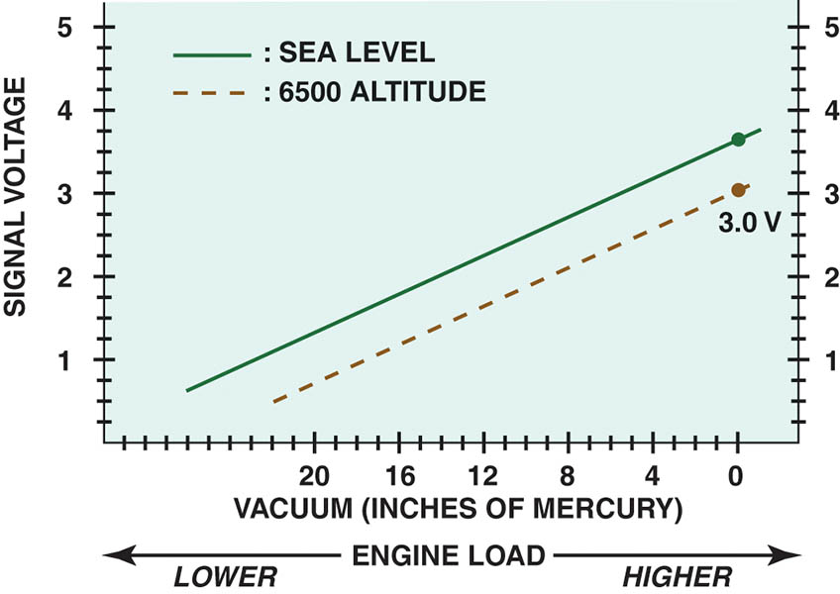
Figure 76.5 Altitude affects the MAP sensor voltage .

Slide 15
BAROMETRIC PRESSURE SENSOR
A barometric pressure (BARO) sensor is similar in design, but senses more subtle changes in barometric absolute pressure (atmospheric air pressure).
It is vented directly to the atmosphere.
Is the primary sensor used to determine altitude.

Slide 16
QUESTION 2: ?
What is the primary purpose of a barometric pressure sensor?

Slide 17
ANSWER 2:
Determine the altitude.

Slide 18
TESTING THE MAP SENSOR
Three different types of test instruments can be used to test a pressure sensor:
A digital voltmeter with three test leads connected in series.
A scope connected to the sensor output, power, and ground.
A scan tool or a specific tool recommended by the vehicle manufacturer.

Slide 19
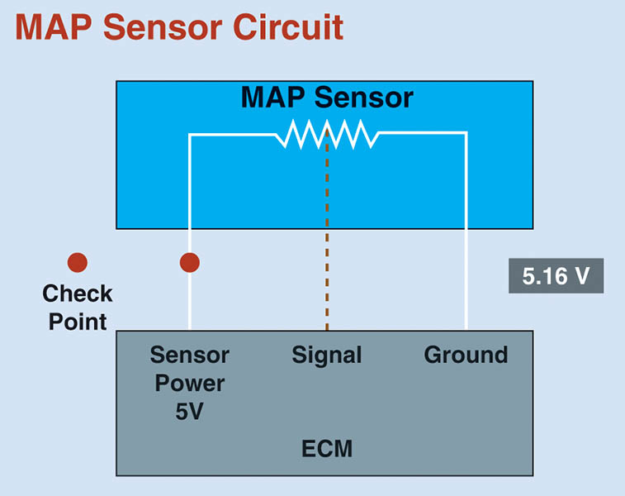
Figure 76.6 When checking a MAP sensor, first verify that the sensor is receiving a 5-volt reference voltage and then check for the output (signal) voltage.

Slide 20
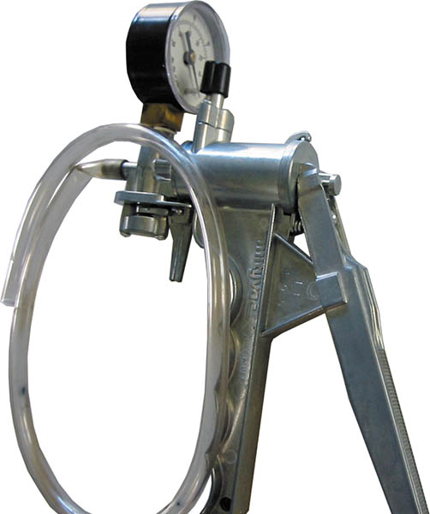
Figure 76.7 A typical hand-operated vacuum pump.

Slide 21
QUESTION 3: ?
What are three ways to test a MAP sensor?

Slide 22
ANSWER 3:
A multimeter, a scan tool, and an oscilloscope.

Slide 23

Copyright

