Slide 1

Automotive Technology Principles, Diagnosis, and Service
Sixth Edition
Chapter 75
Throttle Position (TP) Sensors
Copyright © 2018, 2015, 2011 Pearson Education, Inc. All Rights Reserved

Slide 2
LEARNING OBJECTIVES
75.1 Discuss how throttle position sensors work.
75.2. Discuss the PCM uses for the TP sensor.
75.3. Describe how to test the TP sensor using a digital multimeter and a scan tool.
75.4 This chapter will help prepare for Engine Repair (A8) ASE certification test content area “E” (Computerized Engine Controls Diagnosis and Repair).

Slide 3
THROTTLE POSITION SENSOR CONSTRUCTION
Potentiometers
  A potentiometer is a variable-resistance sensor with three terminals.
A typical sensor has three wires:
  A 5-volt reference feed wire from the computer
  Signal return (a ground wire back to the computer)
  A voltage signal wire back to the computer; as the throttle is opened, the voltage to the computer changes

Slide 4
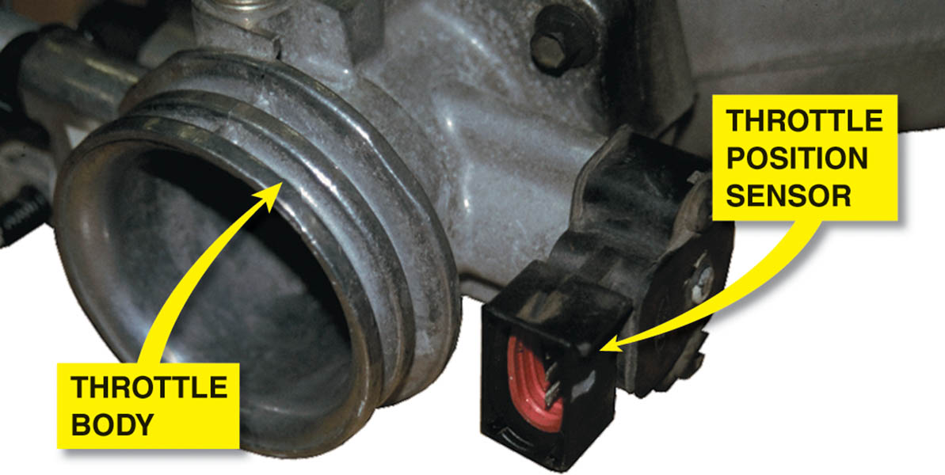
Figure 75.1 A typical TP sensor mounted on the throttle plate of this port-injected engine.

Slide 5
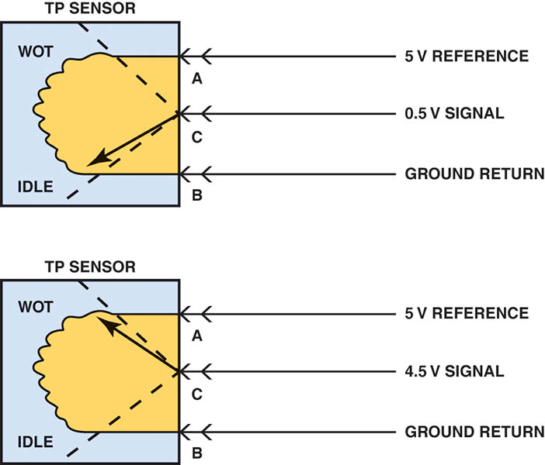
Figure 75.2 The signal voltage from a throttle position increases as the throttle is opened because the wiper arm is closer to the 5-volt reference. At idle, the resistance of the sensor winding effectively reduces the signal voltage output to the computer.

Slide 6
QUESTION 1: ?
What is the purpose of each of the three wires on a typical TP sensor?

Slide 7
ANSWER 1:
5 volt feed, ground (signal return), and signal voltage.

Slide 8
TP SENSOR COMPUTER INPUT FUNCTIONS
The computer senses any change in throttle position and changes the fuel mixture and ignition timing.
The throttle position sensor signals the PCM to pulse additional fuel from the injectors when the throttle is depressed.

Slide 9
PCM USES FOR THE TP SENSOR
The TP sensor is used by the PCM for the following reasons.
  Clear Flood Mode
  Torque Converter Clutch Engagement and Release
  Rationality Testing for MAP and MAF Sensors
  Automatic Transmission Shift Points
  Target Idle Speed (Idle Control Strategy)
  Air-Conditioning Compressor Operation
  Backs Up Other Sensors

Slide 10
TESTING THE THROTTLE POSITION SENSOR
A TP sensor can be tested using one or more of the following tools:
  A digital voltmeter with three test leads connected in series.
  A scan tool or a specific tool recommended by the vehicle manufacturer.
  An oscilloscope.

Slide 11
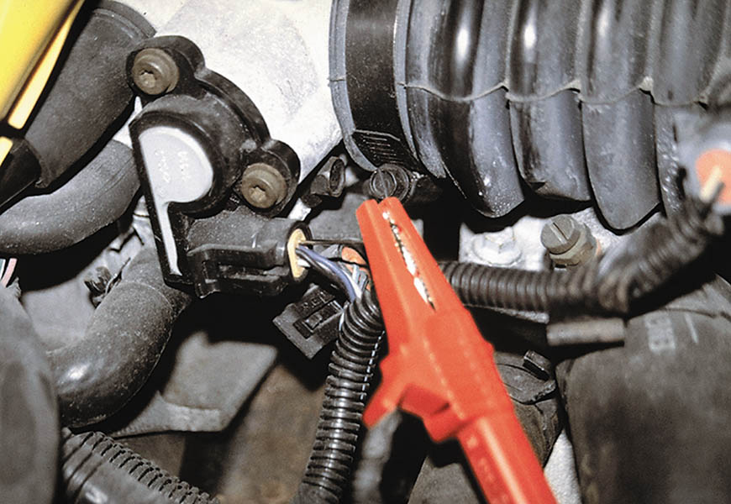
Figure 75.3 A meter lead connected to a T-pin that was gently pushed along the signal wire of the TP sensor until the point of the pin touched the metal terminal inside the plastic connector.

Slide 12
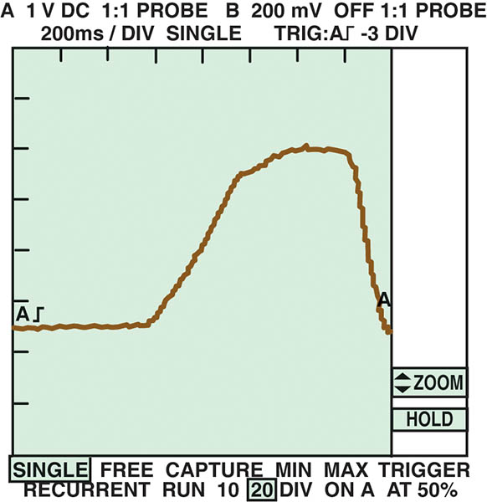
Figure 75.4 A typical waveform of a TP sensor signal as recorded on a DSO when the accelerator pedal was depressed with the ignition switch on (engine off). Clean transitions and the lack of any glitches in this waveform indicate a good sensor.

Slide 13
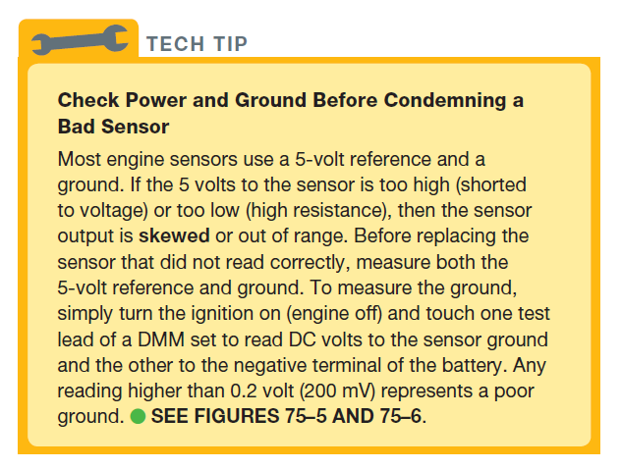
Tech Tip

Slide 14
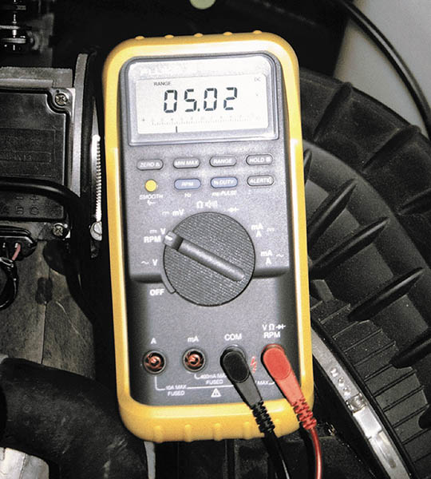
Figure 75.5 Checking the 5-volt reference from the computer being applied to the TP sensor with the ignition switch on (engine off).

Slide 15
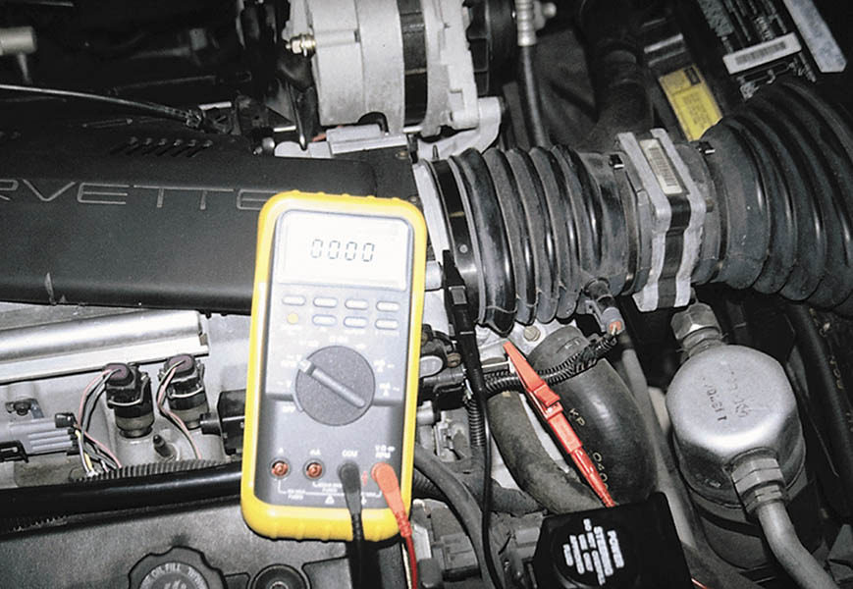
Figure 75.6 Checking the voltage drop between the TP sensor ground and a good engine ground with the ignition on (engine off). A reading of greater than 0.2 volt (200 mV) represents a bad computer ground.

Slide 16
QUESTION 2: ?
What are three ways to test a TP sensor?

Slide 17
ANSWER 2:
A multimeter, a scan tool, and an oscilloscope.

Slide 18
TESTING A TP SENSOR USINGTHE MIN/MAX FUNCTION
Many digital multimeters are capable of recording voltage readings over time and then displaying the minimum, maximum, and average readings.
To perform a MIN/MAX test of the TP sensor, manually set the meter to read higher than 4 volts.

Slide 19
TESTING THE TP SENSOR USING A SCAN TOOL
With the key on, engine off, the TP sensor voltage display should be about 0.5 volt.
Check the scan tool display for the percentage of throttle opening.
The idle air control (IAC) counts should increase as the throttle is opened and decrease as the throttle is closed.
Shut off and restart the engine. The percentage of throttle opening should return to 0%.

Slide 20

Copyright

