Slide 1

Automotive Technology Principles, Diagnosis, and Service
Sixth Edition
Chapter 74
Temperature Sensors
Copyright © 2018, 2015, 2011 Pearson Education, Inc. All Rights Reserved

Slide 2
LEARNING OBJECTIVES (1 of 2)
74.1 Describe the purpose, function, and testing of engine coolant temperature sensors.
74.2 Diagnose problems resulting from malfunctioning intake air temperature control systems.
74.3 Discuss how automatic fluid temperature sensor valves can affect transmission operation.

Slide 3
LEARNING OBJECTIVES (2 of 2)
74.4 Describe the purpose of temperature sensors for cylinder heads, engine fuel, exhaust gas recirculation, and engine oil.
74.5 This chapter will help prepare for Engine Repair (A8) ASE certification test content area “E” (Computerized Engine Controls Diagnosis and Repair).

Slide 4
ENGINE COOLANT TEMPERATURE SENSORS (1 OF 2)
Purpose and Function
A computer equipped vehicle uses the coolant temperature sensor to adjust fuel delivery, adjust ignition timing and to adjust target idle.
ECT Construction
Engine coolant temperature sensors are constructed of a semiconductor material that decreases in resistance as the temperature of the sensor increases.

Slide 5
ENGINE COOLANT TEMPERATURE SENSORS (2 OF 2)
Stepped ECT Circuits
Some vehicle manufacturers use a step-up resistor to effectively broaden the range of the ECT sensor.
When the temperature is low, usually below 120°F (50°C), the ECT sensor voltage is applied through a high-value resistor inside the PCM.
When the temperature is high, usually above 120°F (50°C), the ECT sensor voltage is applied through a much lower resistance value inside the PCM.

Slide 6
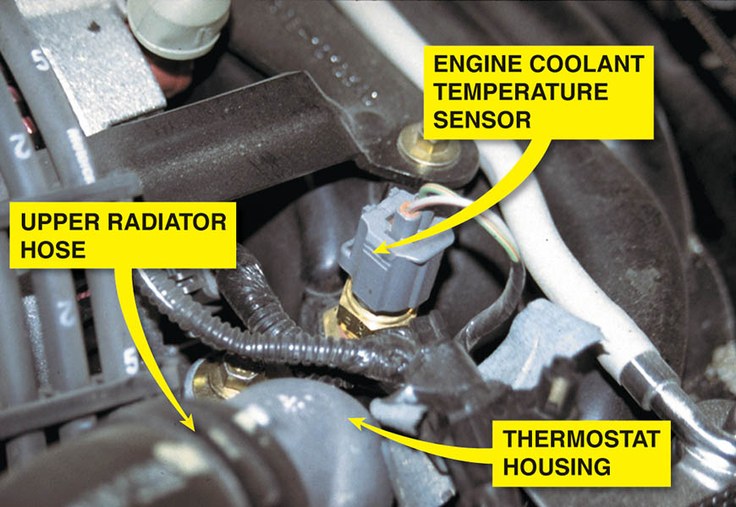
Figure 74.1 A typical engine coolant temperature (ECT) sensor. ECT sensors are located near the thermostat housing on most engines.

Slide 7
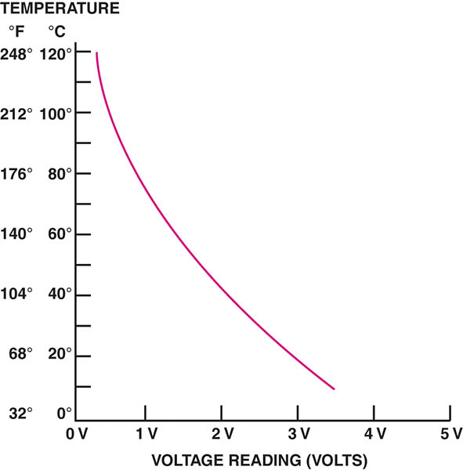
Figure 74.2 A typical ECT sensor temperature versus voltage curve.

Slide 8
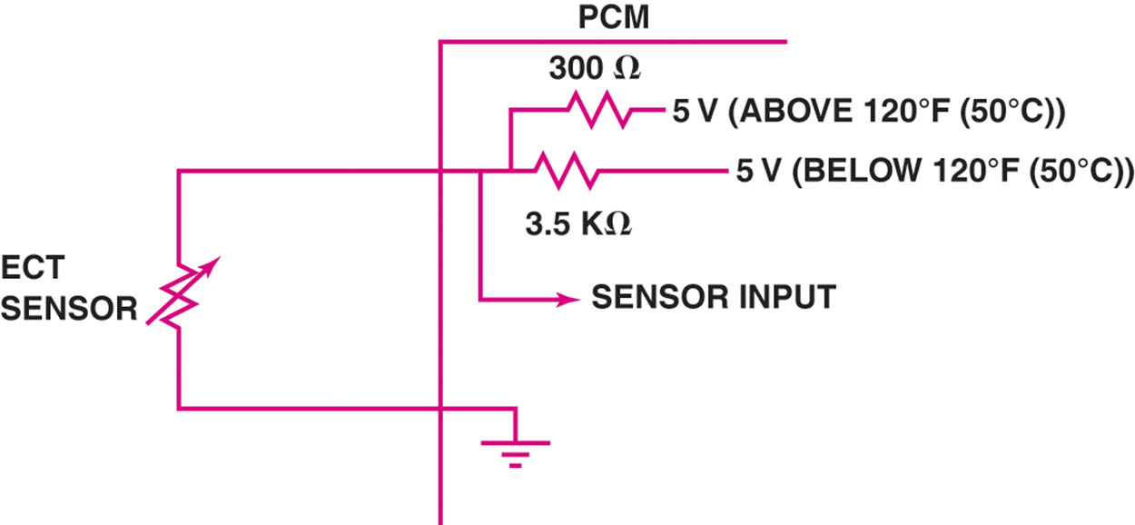
Figure 74.3 A typical two-step ECT circuit showing that when the coolant temperature is low, the PCM applies a 5-volt reference voltage to the ECT sensor through a higher resistance, compared to when the temperature is higher.

Slide 9
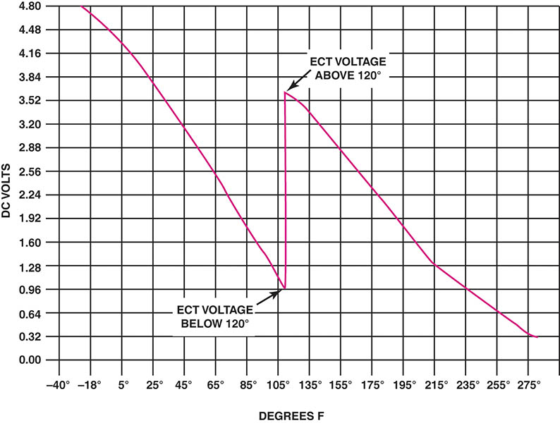
Figure 74.4 The transition between steps usually occurs at a temperature that does not interfere with cold engine starts or the cooling fan operation. In this example, the transition occurs when the sensor voltage is about 1 volt and rises to about 3.6 volts.

Slide 10
QUESTION 1: ?
What is the purpose of a stepped ECT circuit?

Slide 11
ANSWER 1:
To broaden the range of the coolant temperature sensor.

Slide 12
TESTING THE ENGINE COOLANT TEMPERATURE SENSOR
Testing the Coolant Temperature Sensor by Visual Inspection
A properly filled cooling system
Proper pressure maintained by the radiator cap
Proper antifreeze-water mix
Proper operation of the cooling fan
Testing the ECT using a multimeter
Measure the resistance and compare to a chart
Testing the ECT using a Scan Tool
Compare the displayed temperature with the actual temperature of the engine.

Slide 13
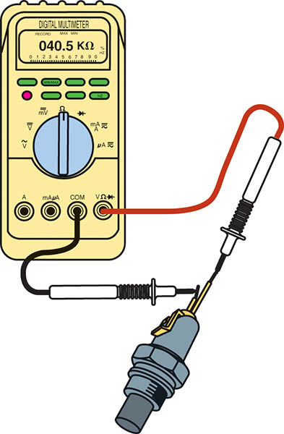
Figure 74.5 Measuring the resistance of the ECT sensor. The resistance measurement can then be compared with specifications. (Courtesy of Fluke Corporation)

Slide 14
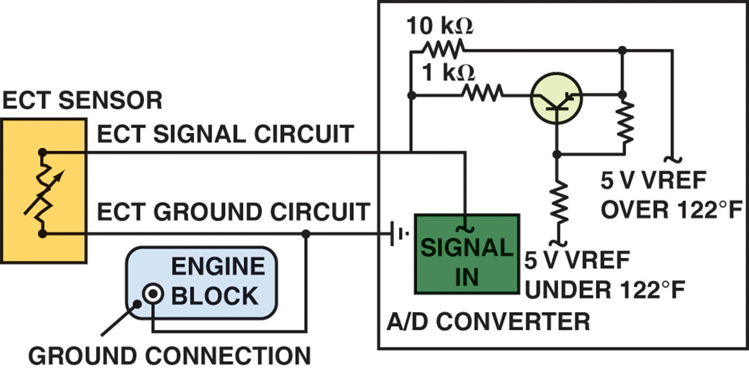
Figure 74.6 When the voltage drop reaches approximately 1.20 volts, the PCM turns on a transistor. The transistor connects a 1-kΩ resistor in parallel with the 10-kΩ resistor. Total circuit resistance now drops to around 909 ohms.

Slide 15
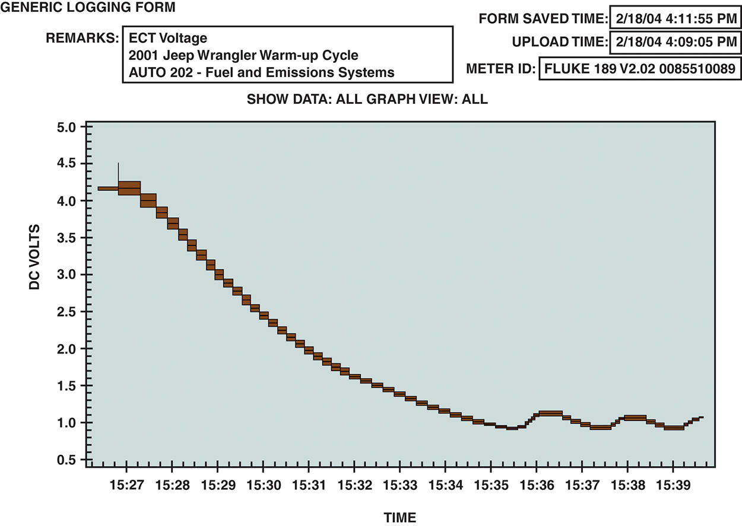
Figure 74.7 An ECT sensor being tested using a digital meter set to DC volts. A chart showing the voltage decrease of the ECT sensor as the temperature increases from a cold start. The bumps at the bottom of the waveform represent temperature decreases when the thermostat opens and is controlling coolant temperature.

Slide 16
QUESTION 2: ?
What are three ways to test an engine coolant temperature sensor?

Slide 17
ANSWER 2:
A visual inspection, with a multimeter, and with a scan tool.

Slide 18
INTAKE AIR TEMPERATURE SENSOR
Purpose and Function
The intake air temperature (IAT) sensor is a negative temperature coefficient (NTC) thermistor that decreases in resistance as the temperature of the sensor increases.
The IAT sensor is used as an input sensor by the PCM to control many functions, including:
Fuel delivery
Spark timing

Slide 19
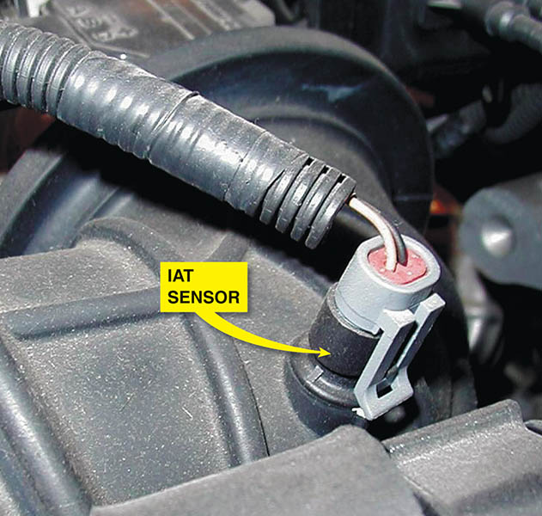
Figure 74.8 The IAT sensor on this General Motors 3800 V-6 engine is in the air passage duct between the air cleaner housing and the throttle body.

Slide 20
TESTING THE INTAKE AIR TEMPERATURE SENSOR
To diagnose the IAT sensor, follow these steps:
Perform a thorough visual inspection of the sensor and the wiring.
After the vehicle has been allowed to cool for several hours, use a scan tool, observe the IAT, and compare it to the engine coolant temperature. The two temperatures should be within 5°F of each other.
Check the voltage and compare to service specifications.

Slide 21
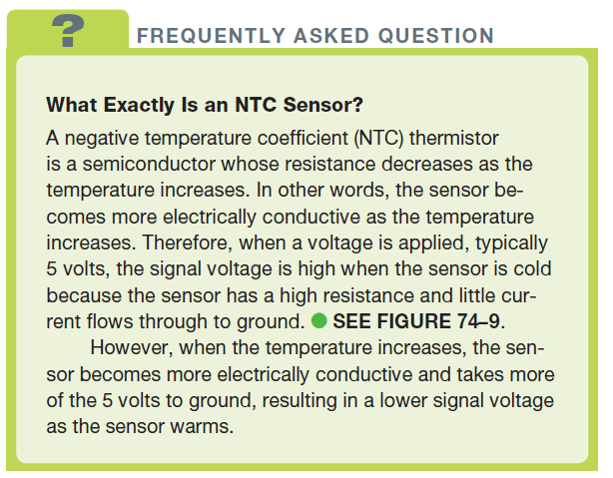
FREQUENTLY ASKED QUESTION

Slide 22
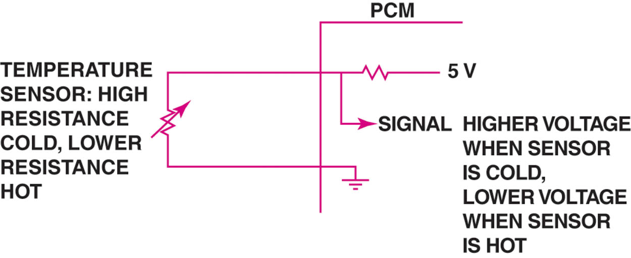
Figure 74.9 A typical temperature sensor circuit

Slide 23
TRANSMISSION FLUID TEMPERATURE SENSOR
The transmission fluid temperature signal is used by the PCM to perform certain strategies based on the temperature of the automatic transmission fluid.
Shift points may be delayed and the torque converter clutch may be inhibited in low temperatures.
In high temperatures overdrive may be inhibited and the torque converter clutch may be engaged to dissipate heat.

Slide 24
CYLINDER HEAD TEMPERATURE SENSOR
Some vehicles may use a cylinder head temperature sensor instead of, or in addition too, the engine coolant temperature sensor.
When both sensors are used, a calculation between the two is used to determine engine temperature.

Slide 25
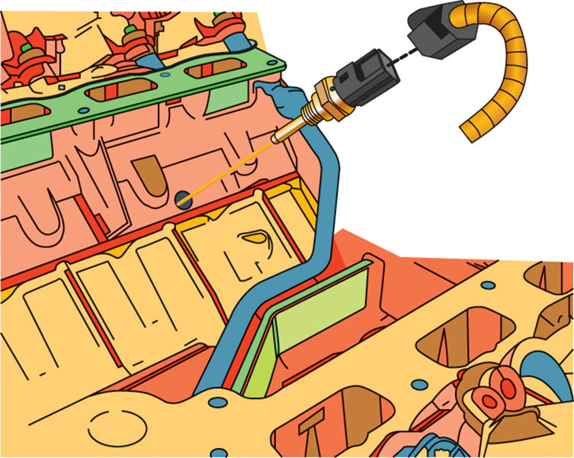
Figure 74.10 Some engines are equipped with a cylinder head temperature (CHT) sensor which is used by the PCM along with the ECT, to determine the temperature of the engine.

Slide 26
ENGINE FUEL TEMPERATURE SENSOR
Some vehicles that are equipped with an electronic returnless type of fuel injection, use an engine fuel temperature (EFT) sensor to give the PCM information regarding the temperature and, therefore, the density of the fuel.
Check service information for the exact location, if equipped, and how to test and service the sensor.

Slide 27
EXHAUST GAS RECIRCULATION (EGR) TEMPERATURE SENSOR
Some engines, such as Toyota, are equipped with exhaust gas recirculation (EGR) temperature sensors.
The PCM monitors the temperature in the exhaust passage between the EGR valve and the intake manifold.
If the temperature increases when the EGR is commanded on, the PCM can determine that the valve or related components are functioning.

Slide 28
ENGINE OIL TEMPERATURE SENSOR
Engine oil temperature sensors are used on many General Motors vehicles and are used as an input to the oil life monitoring system.
The computer program inside the PCM calculates engine oil life based on run time, engine RPM, and oil temperature.

Slide 29
QUESTION 3: ?
What is the purpose of an engine oil temperature sensor?

Slide 30
ANSWER 3:
The sensor is used as an input to determine engine oil life.

Slide 31

Copyright

