Slide 1
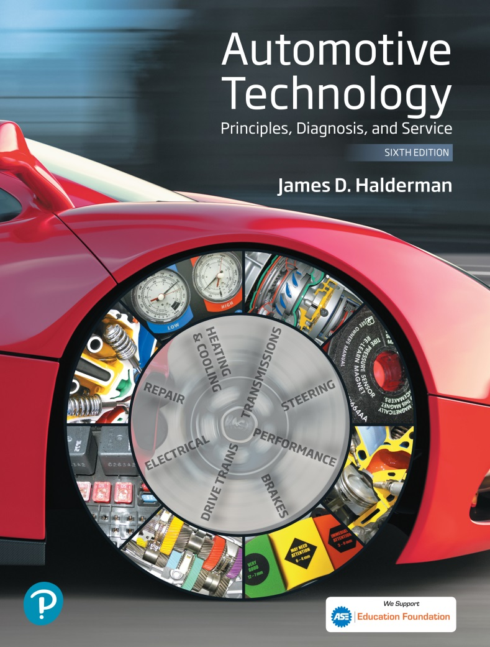
Automotive Technology Principles, Diagnosis, and Service
Sixth Edition
Chapter 73
Computer Fundamentals
Copyright © 2018, 2015, 2011 Pearson Education, Inc. All Rights Reserved

Slide 2
LEARNING OBJECTIVES
73.1 List the various parts of onboard computers.
73.2 Explain the purpose and function of onboard computers.
73.3 List to an automotive computer’s input sensors and the output devices (actuators) it controls.

Slide 3
COMPUTER FUNDAMENTALS
Purpose and Function
  Modern automotive control systems consist of a network of electronic sensors, actuators, and computer modules designed to regulate the powertrain and vehicle support systems.
Voltage Signals
  Automotive computers use voltage to send and receive information.

Slide 4
COMPUTER FUNCTIONS (1 OF 3)
Basic Functions
  Input
  Processing
  Storage
  Output
Input Functions
  The computer receives a voltage signal (input) from an input device. This may be a switch or a sensor.

Slide 5
COMPUTER FUNCTIONS (2 OF 3)
Processing
  The term processing is used to describe how input voltage signals received by a computer are handled through a series of electronic logic circuits.
Storage
  Storage is the place where the program instructions for a computer are stored in electronic memory.
  Memory includes: ROM, EEPROM, RAM, and KAM.

Slide 6
COMPUTER FUNCTIONS (3 OF 3)
Output Functions
  After the computer has processed the input signals, it sends voltage signals or commands to other devices in the system, such as system actuators.
Computer Communication
  Computers can communicate with, and control, each other through their output and input functions.
  Computers communicate with each other via high and low speed networks.

Slide 7
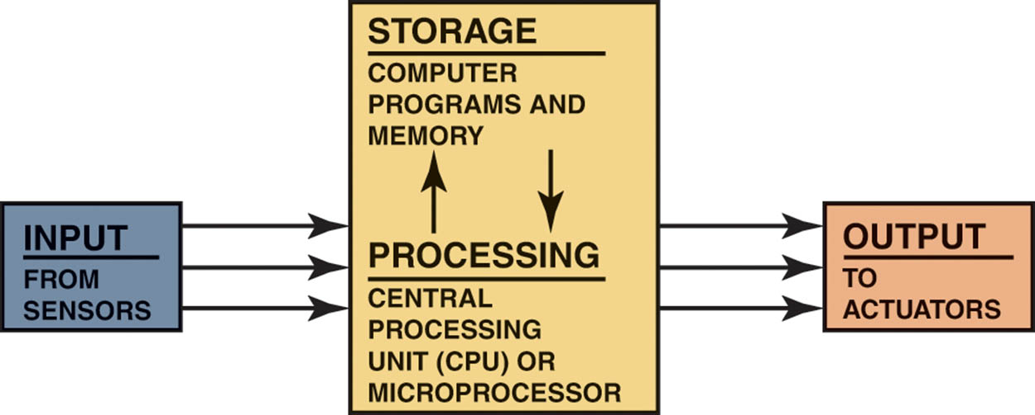
Figure 73.1 All computer systems include inputs, processing, storage, and output.

Slide 8
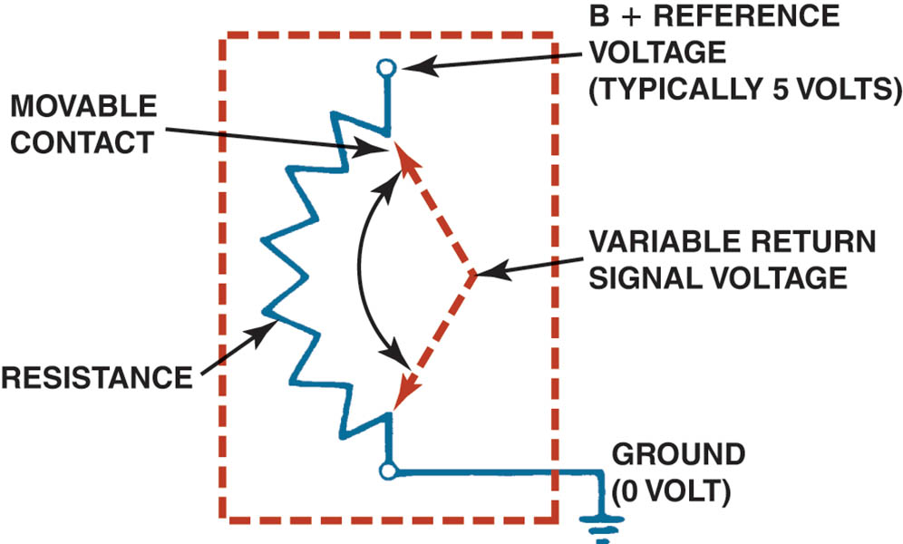
Figure 73.2 A potentiometer uses a movable contact to vary resistance and send an analog voltage right to the PCM.

Slide 9
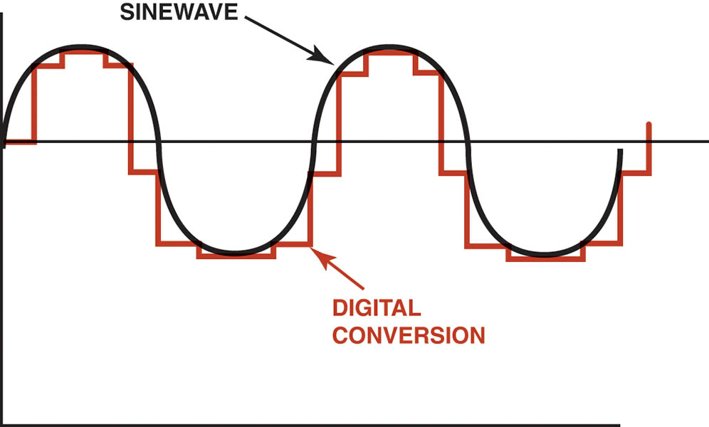
Figure 73.3 An AD converter changes analog (variable) voltage signals into digital signals that the PCM can process.

Slide 10
QUESTION 1: ?
What is the purpose of computer communication?

Slide 11
ANSWER 1:
To share information with other modules digitally.

Slide 12
DIGITAL COMPUTERS (1 OF 2)
Parts of a computer
  Central processing unit (CPU)
  Computer memory
  Computer programs
Clock Rates and Timing
  The computer’s crystal oscillator generates a steady stream of one-bit-long voltage pulses. Both the microprocessor and the memories monitor the clock pulses while they are communicating.

Slide 13
DIGITAL COMPUTERS (2 OF 2)
Computer Speeds
  The speed at which a computer operates is specified by the cycle time, or clock speed, required to perform certain measurements. Cycle time or clock speed is measured in megahertz.
Baud Rate
  The speed at which the computer transmits bits of a serial data; measured in bits per second.
Control Module Locations
  Mounted on a circuit board in a metal case.

Slide 14
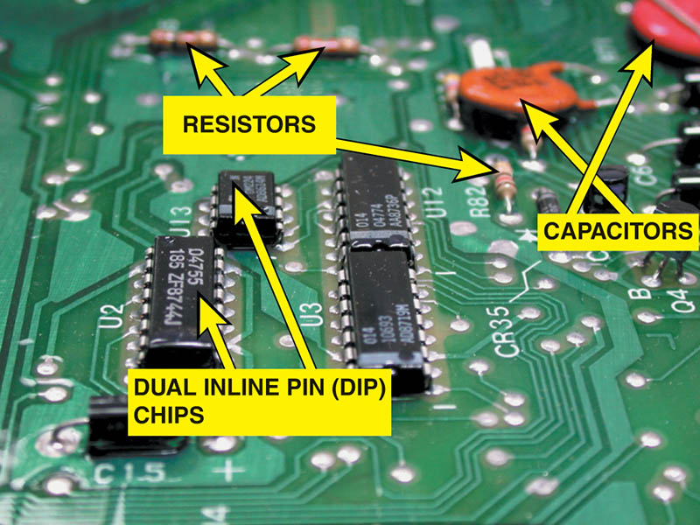
Figure 73.4 Many electronic components are used to construct a typical vehicle computer, including chips, resistors, and capacitors.

Slide 15
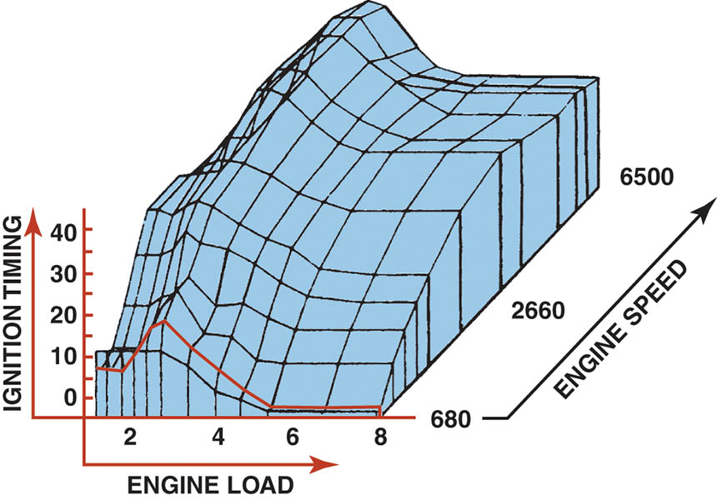
Figure 73.5 Typical engine map developed from testing and used by the vehicle computer to provide the optimum ignition timing for all engine speeds and load combinations.

Slide 16
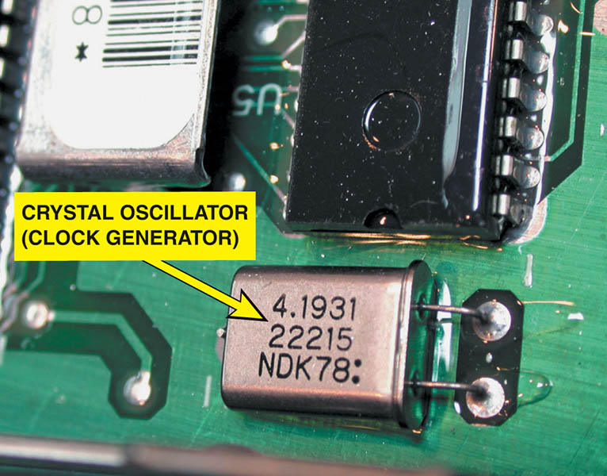
Figure 73.6 The clock generator produces a series of pulses that are used by the microprocessor and other components to stay in step with each other at a steady rate.

Slide 17
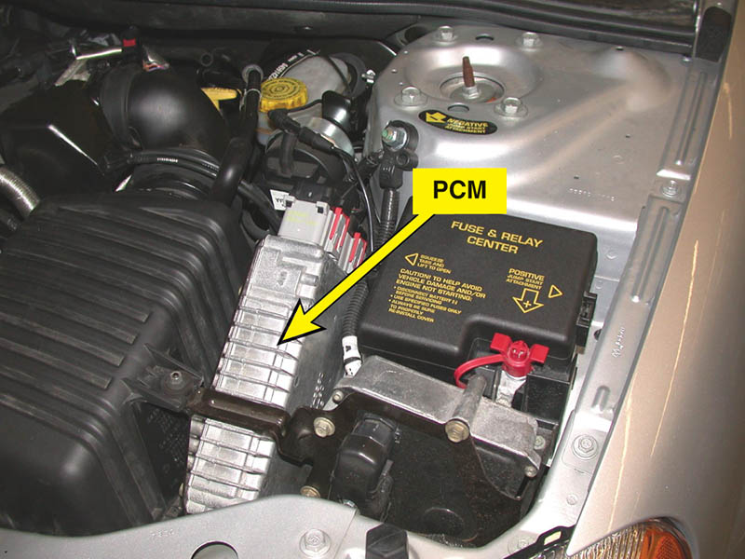
Figure 73.7 A powertrain control module (PCM) under the hood where it can be exposed to air for cooling.

Slide 18
COMPUTER INPUT SENSORS
The vehicle computer (PCM) uses signals (voltage levels) from the following sensors.
  Engine speed (revolutions per minute, or RPM) sensor
  Switches or buttons for accessory operation
  Manifold absolute pressure (MAP) sensor
  Mass airflow (MAF) sensor
  Engine coolant temperature (ECT) sensor
  Oxygen sensor (O2S)
  Throttle position (TP) sensor
  Vehicle speed (VS) sensor

Slide 19
COMPUTER OUTPUTS (1 OF 2)
The computer sends voltage signals or commands to other devices in the system, as follows:
  Operate actuators
  Network communication
Typical output devices include the following:
  Fuel Injectors
  Blower motor control
  Transmission shifting
  Idle speed control
  Evaporative emission control solenoids

Slide 20
COMPUTER OUTPUTS (2 OF 2)
Output Drivers
  Low Side Driver (LSD): provide a path to ground when energized.
  High Side Driver (HSD): provide a path to voltage when energized.
Pulse-Width Modulation
  A method of controlling an output using a digital signal. Instead of just turning devices on or off, the computer can control the amount of on-time.

Slide 21
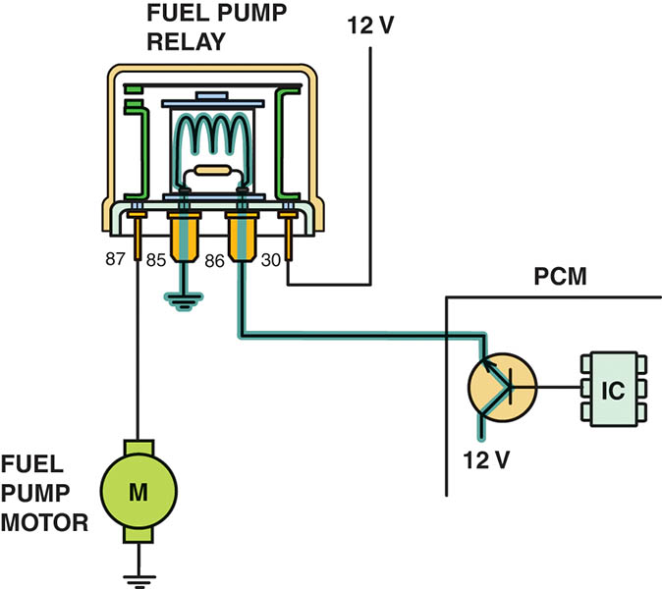
Figure 73.8 A typical output driver. In this case, the PCM applies voltage to the fuel pump relay coil to energize the fuel pump.

Slide 22
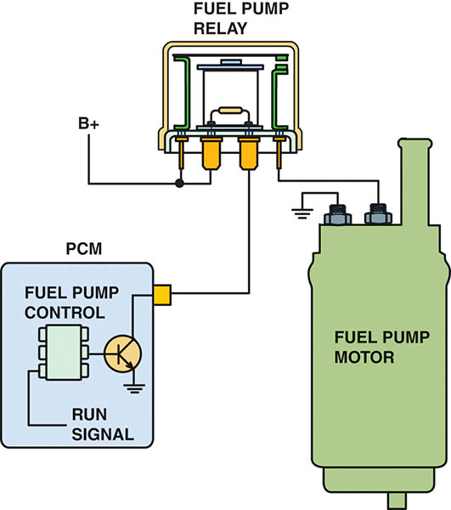
Figure 73.9 A typical low-side driver (LSD), which uses a control module to control the ground side of the relay coil.

Slide 23
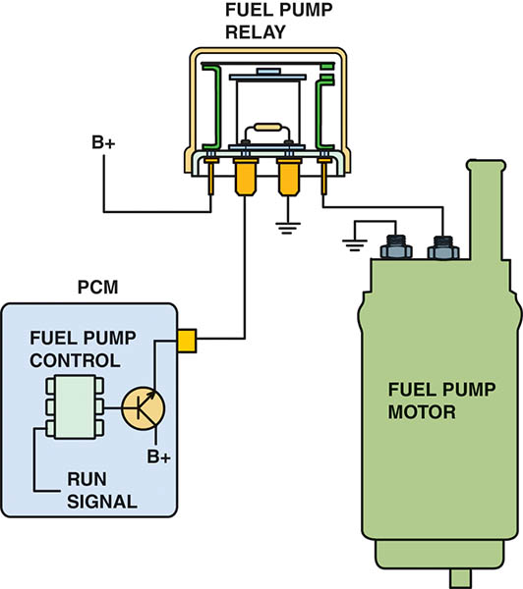
Figure 73.10 A typical module-controlled high-side driver (HSD) where the module itself supplies the electrical power to the device. The logic circuit inside the module can detect circuit faults, including continuity of the circuit, and if there is a short-to-ground in the circuit being controlled.

Slide 24
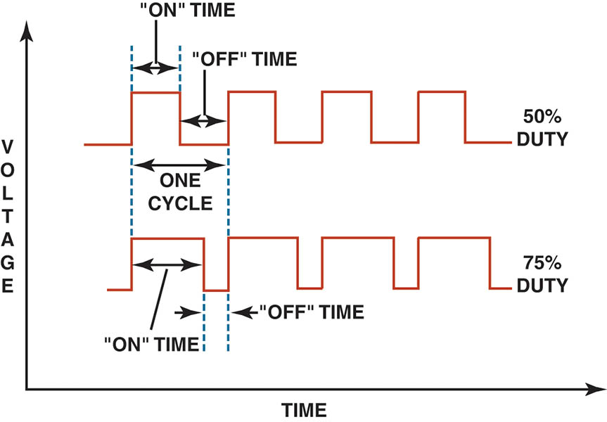
Figure 73.11 Both the top and bottom pattern have the same frequency. However, the amount of on-time varies. Duty cycle is the percentage of the time during a cycle that the signal is turned on.

Slide 25
QUESTION 2: ?
What is a low-side driver (LSD)?

Slide 26
ANSWER 2:
A digital device that completes a path to ground when energized.

Slide 27
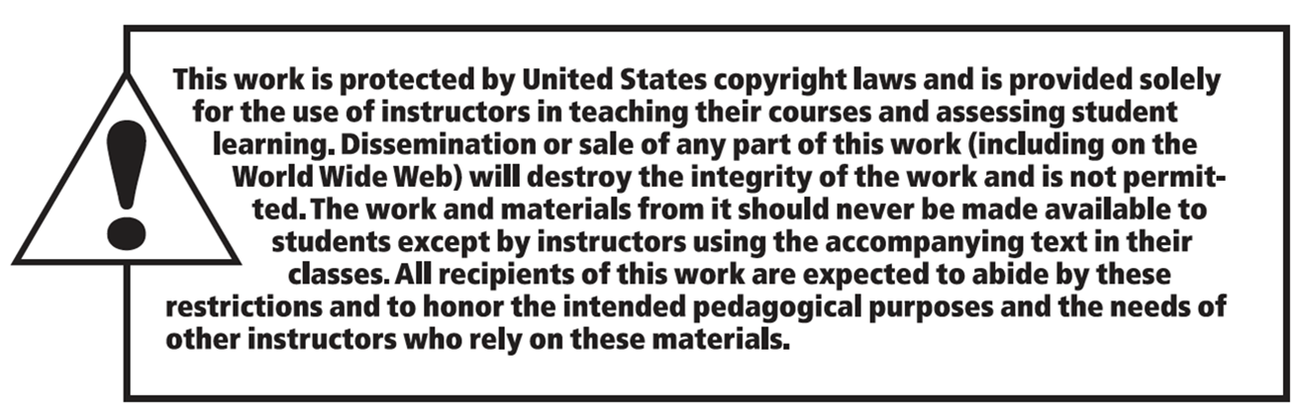
Copyright

