Slide 1
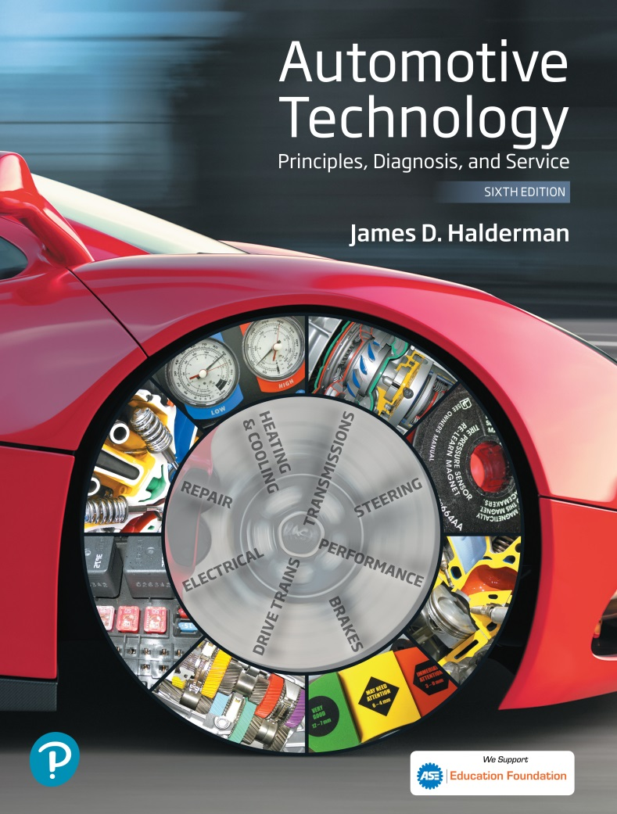
Automotive Technology Principles, Diagnosis, and Service
Sixth Edition
Chapter 72
Ignition System Diagnosis and Service
Copyright © 2018, 2015, 2011 Pearson Education, Inc. All Rights Reserved

Slide 2
LEARNING OBJECTIVES (1 of 2)
72.1 Describe the procedure used to check for spark.
72.2 Diagnose ignition system-related problems.
72.3 Inspect and test ignition coils, magnetic sensors, and Hall-effect sensors.
72.4 Discuss what to inspect and look for during a visual inspection of the ignition system.
72.5 Describe how to test for poor performance and for a no-start condition.

Slide 3
LEARNING OBJECTIVES (2 of 2)
72.6 Explain how to verify the distributor position.
72.7 Inspect and test secondary ignition system circuit and components.
72.8 Discuss the purpose and function of ignition timing and spark advance.
72.9 Describe how to test the ignition system using an oscilloscope.
72.10 This chapter will help prepare for Engine Repair (A8) ASE certification test content area “B” (Ignition System Diagnosis and Repair).

Slide 4
CHECKING FOR SPARK
In the event of a no-start condition, check for secondary voltage out of the ignition coil or to the spark plugs.
Install a spark tester, and crank the engine.
Typical causes of a no-spark (intermittent spark) condition include the following:
Weak ignition coil, low or no voltage to coil, open coil wire or plug, defective pickup coil and defective module.

Slide 5
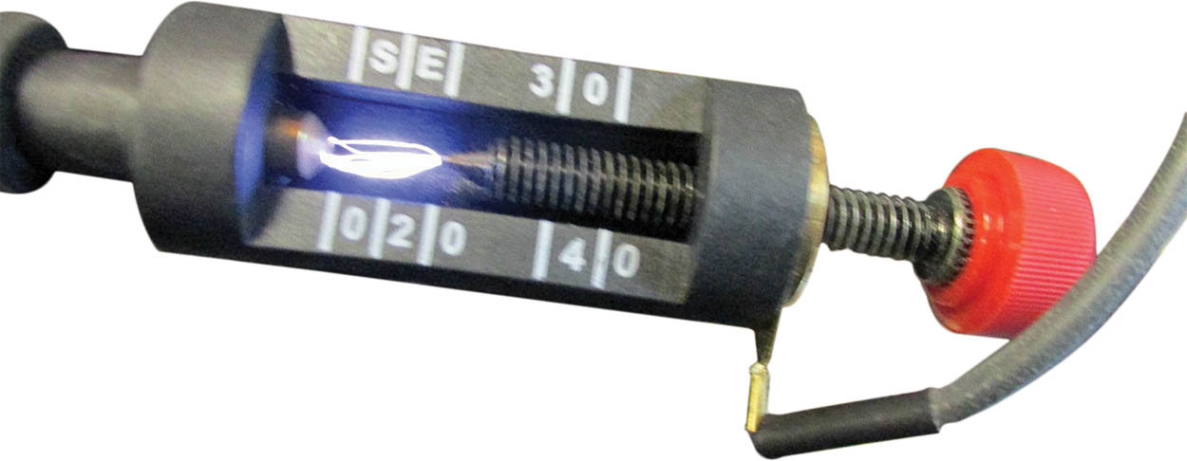
Figure 72.1 A spark tester looks like a regular spark plug with an alligator clip attached to the shell. This tester has a specified gap that requires at least 25,000 volts (25 kV) to fire

Slide 6
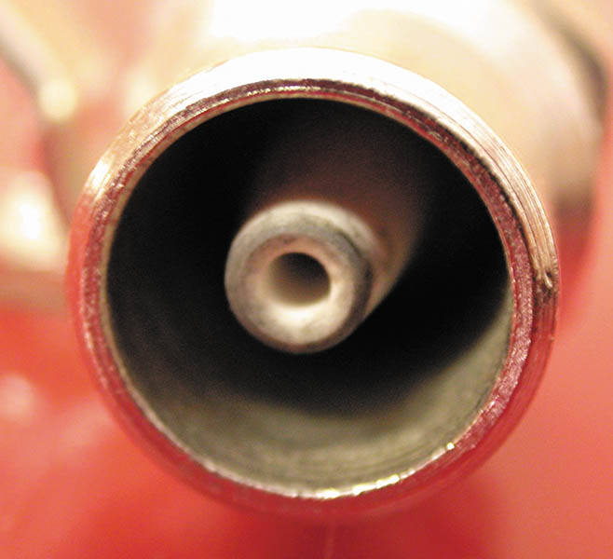
Figure 72.2 A close-up showing the recessed center electrode on a spark tester. It is recessed 3/8 inch into the shell and the spark must then jump another 3/8 inch to the shell for a total gap of 3/4 inch

Slide 7
QUESTION 1: ?
Why should a spark tester be used to check for spark, rather than a standard spark plug?

Slide 8
ANSWER 1:
The spark must jump across a larger gap to more effectively test the system.

Slide 9
ELECTRONIC IGNITION TROUBLESHOOTING PROCEDURE
Turn the ignition on (engine off) and, using either a voltmeter or a test light, test for battery voltage available at the positive terminal of the ignition coil.
Connect the voltmeter or test light to the negative side of the coil and crank the engine. The voltmeter should fluctuate or the test light should blink, indicating that the primary coil current is being turned on and off.

Slide 10
IGNITION COIL TESTING USING AN OHMMETER
To test the primary coil winding resistance:
Set the meter to read low ohms.
Measure the resistance between the positive terminal and the negative terminal of the ignition coil.
To test the secondary coil winding resistance:
Set the meter to read kilohms (kΩ).
Measure the resistance between either primary terminal and the secondary coil tower.

Slide 11
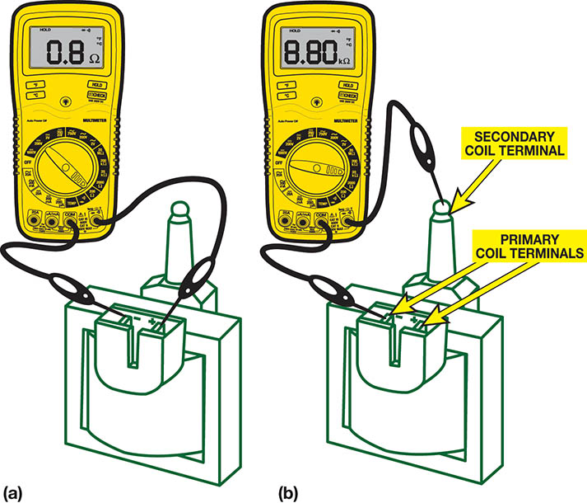
Figure 72.3 (a) Set the digital meter to read ohms and measure between the two primary terminals of the coil. Most coils are less than one ohm

Slide 12
Figure 72.3 (b) To measure the secondary winding, connect one meter lead to one of the primary terminals and the other to the secondary terminal

Slide 13
TESTING MAGNETIC SENSORS
Magnetic sensors must be tested to see if they stick to iron or steel, indicating that the magnetic strength of the sensors is okay.
The sensor can be tested using a digital meter set to read AC volts.

Slide 14
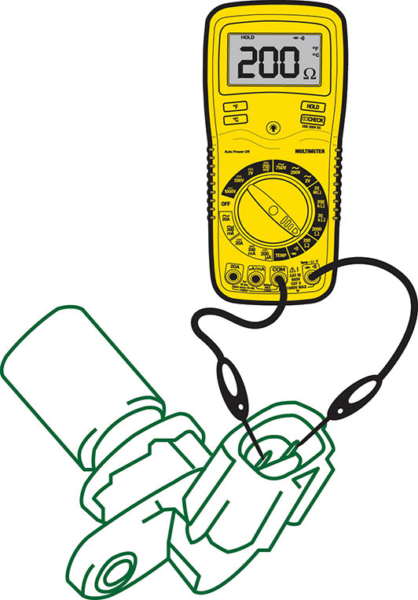
Figure 72.4 Measuring the resistance of a magnetic crankshaft position (CKP) sensor using an ohmmeter

Slide 15
QUESTION 2: ?
How is a magnetic sensor tested for resistance and AC voltage output?

Slide 16
ANSWER 2:
A digital multimeter can be used to measure resistance of the sensor and the AC voltage output.

Slide 17
TESTING HALL-EFFECT SENSORS
Using a digital voltmeter, check for the presence of changing voltage (pulsed on and off or digital DC) when the engine is being cranked.
The best test is to use an oscilloscope and observe the waveform.

Slide 18
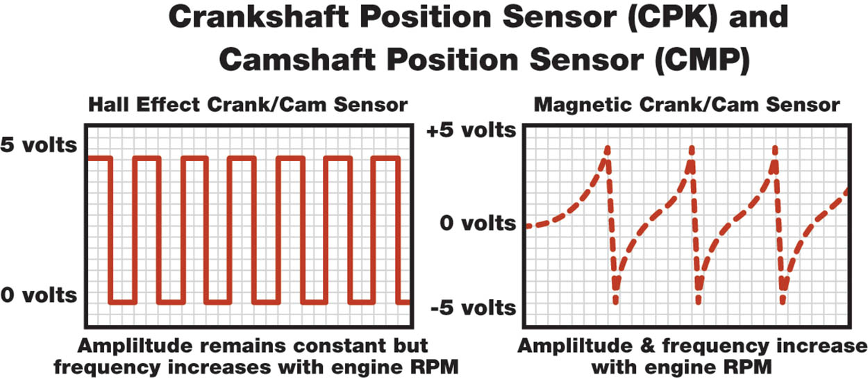
Figure 72.5 A Hall Effect sensor produces a square waveform, whereas a magnetic sensor produces an analog waveform, when viewed on scope

Slide 19
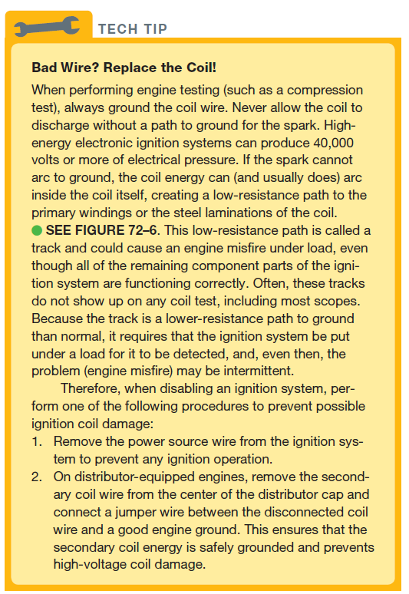
Tech Tip

Slide 20
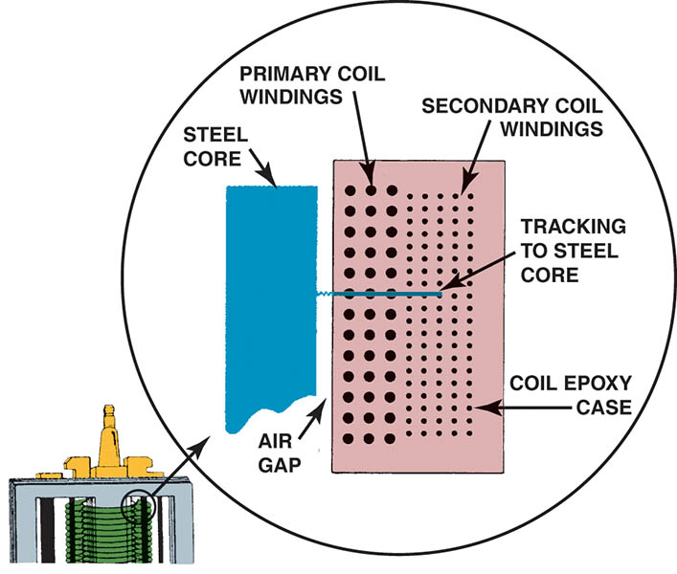
Figure 72.6 A track inside an ignition coil is not a short, but rather it is a low-resistance path or hole that has been burned through from the secondary wiring to the steel core

Slide 21
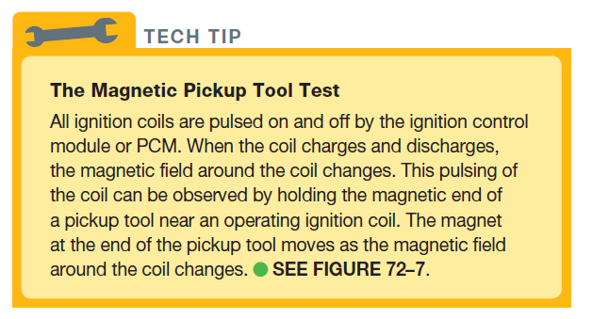
TECH TIP

Slide 22
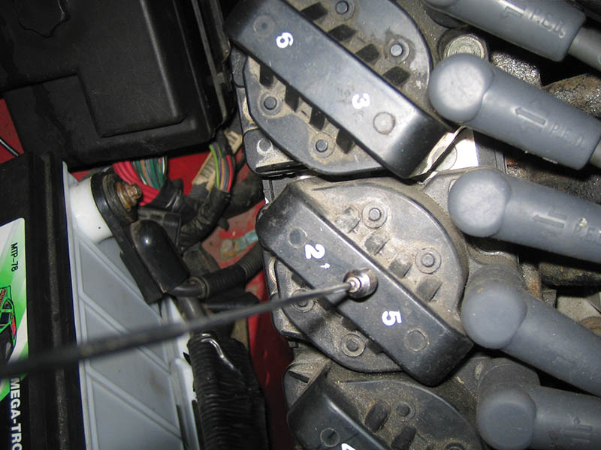
Figure 72.7 If the coil is working, the end of the magnetic pickup tool moves with the changes in the magnetic field around the coil

Slide 23
IGNITION SYSTEM DIAGNOSIS USING VISUAL INSPECTION
Check all spark plug wires for proper routing.
Check that all spark plug wires are securely attached.
Check that all spark plug wires are clean and free from excessive dirt or oil.
Remove the distributor cap and carefully check the cap and distributor rotor for faults.
Remove the spark plugs and check for excessive wear or other visible faults.

Slide 24
TESTING FOR POOR PERFORMANCE
Many diagnostic equipment manufacturers offer methods for testing distributorless ignition systems on an oscilloscope.
A simple method of testing distributorless (waste-spark systems) ignition with the engine off involves removing the spark plug wires (or connectors) from the spark plugs (or coils or distributor cap) and installing short lengths (2 inches) of rubber vacuum hose in series.

Slide 25
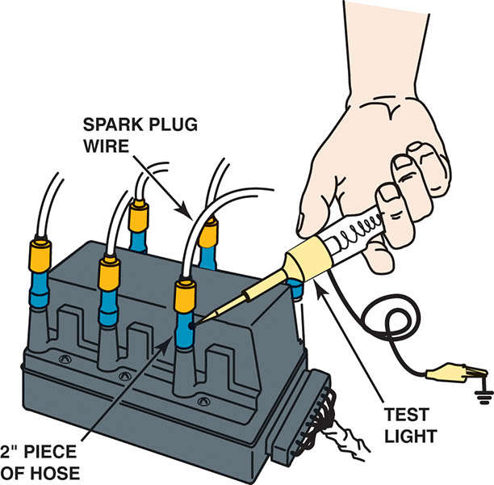
Figure 72.8 Using a vacuum hose and a grounded test light to ground one cylinder at a time on a DIS. This works on all types of ignition systems and provides a method for grounding out one cylinder at a time without fear of damaging any component.

Slide 26
DISTRIBUTOR INDEXING
A few engines using a distributor also use it to house a camshaft position (CMP) sensor.
One purpose of this sensor is to properly initiate the fuel-injection sequence.
A miss-indexed distributor may cause: surging, light bucking, or intermittent engine misfire.
Always use the factory procedure as stated in service information to properly index the distributor.

Slide 27
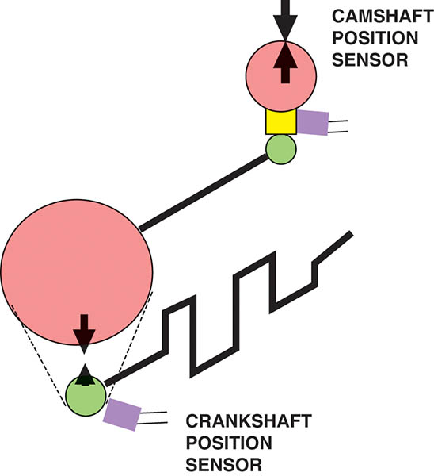
Figure 72.9 The relationship between the crankshaft position (CKP) sensor and the camshaft position (CMP) sensor is affected by wear in the timing gear and/or chain

Slide 28
SECONDARY IGNITION INSPECTION
Distributor Cap and Rotor
Inspect a distributor cap for cracks, carbon tracks, and corrosion.
COP and Waste Spark Inspection
Look for evidence of carbon track or heat-related faults to the plug boot.
Spark Plug Wire Inspection
Spark plug wires should be visually inspected for cuts or defective insulation and checked for resistance with an ohmmeter.

Slide 29
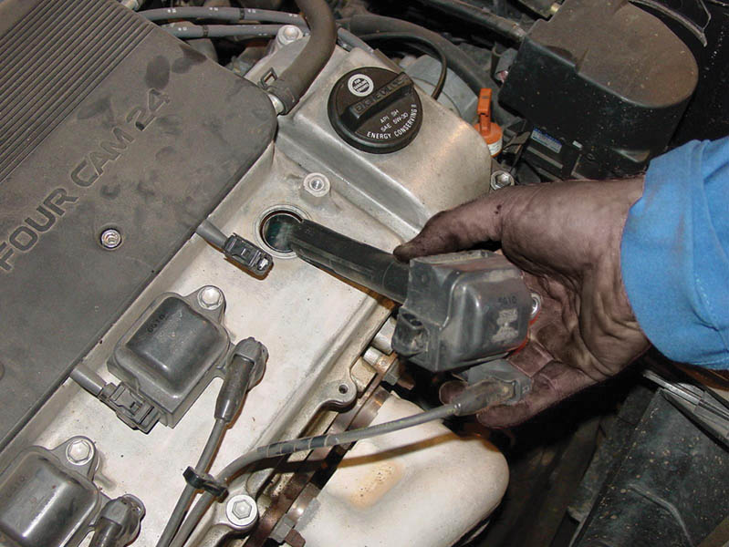
Figure 72.10 When checking a coil-on-plug (COP) assembly, check that the primary and secondary wiring looks normal and that the coil is not discolored from arcing or corrosion

Slide 30
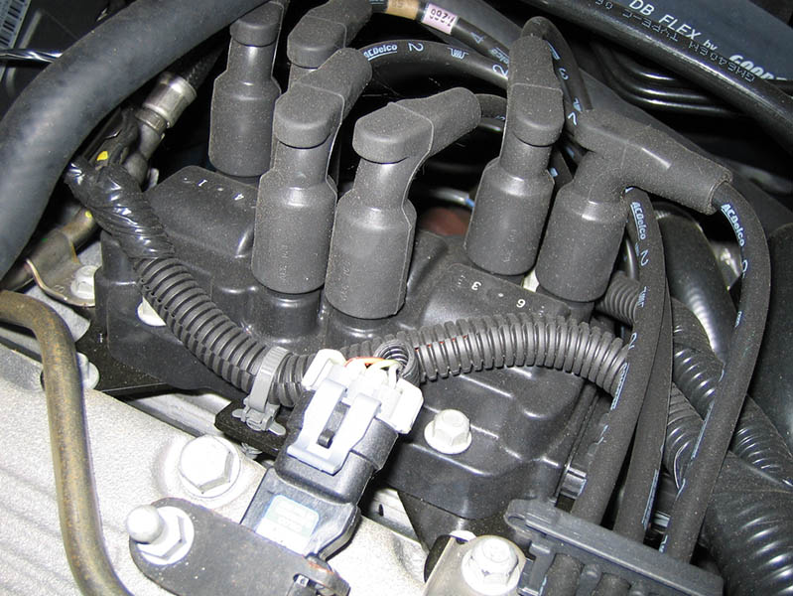
Figure 72.11 When checking a waste spark-type ignition system, check that the secondary wires are attached to the correct coil terminal and that the wiring is correctly routed to help avoid cross-fire

Slide 31
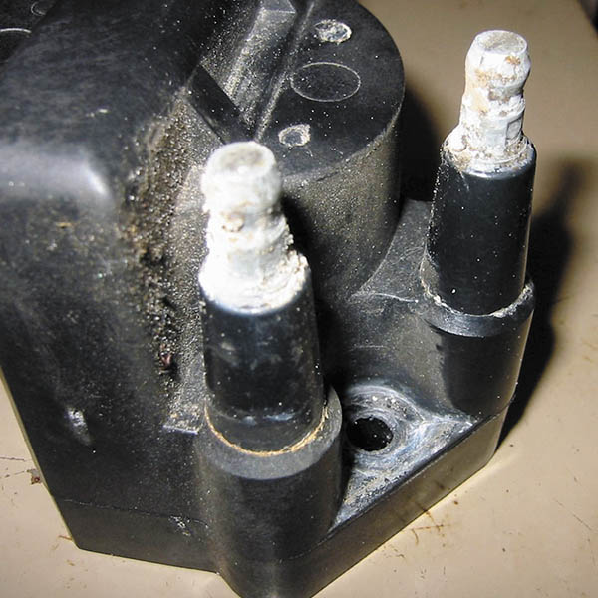
Figure 72.12 Corroded terminals on a waste-spark coil can cause misfire diagnostic trouble codes to be set

Slide 32
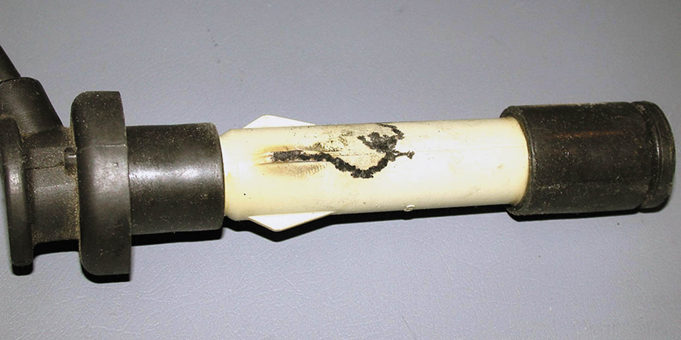
Figure 72.13 This spark plug boot on an overhead camshaft engine has been arcing to the valve cover, causing a misfire to occur

Slide 33
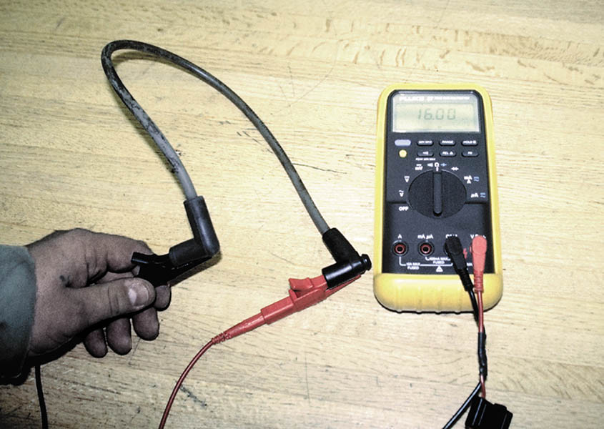
Figure 72.14 Measuring the resistance of a spark plug wire with a multimeter set to the ohms position. The reading of 16.03 kΩ (16.030 ohms) is okay because the wire is about 2-feet long. High-resistance spark plug wires can cause an engine misfire.

Slide 34
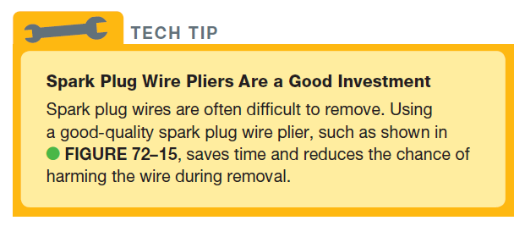
TECH TIP

Slide 35
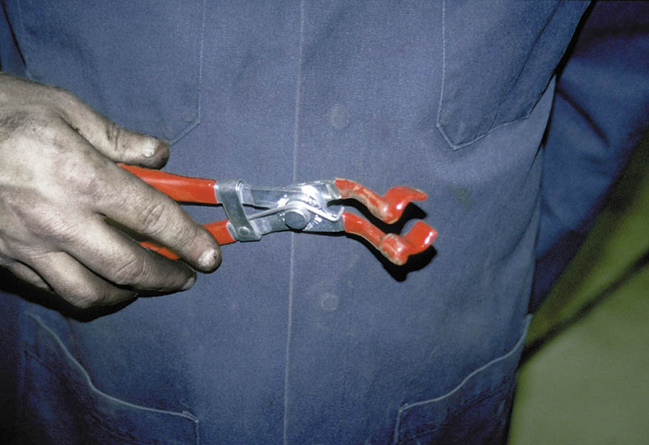
Figure 72.15 Spark plug wire boot pliers is a handy addition to any tool box

Slide 36
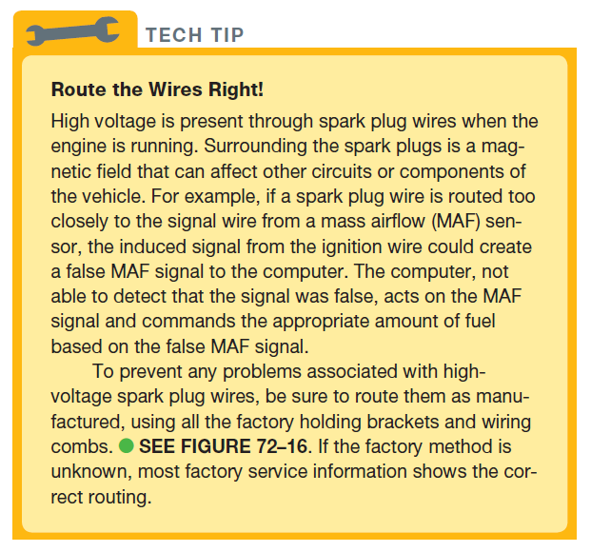
TECH TIP

Slide 37
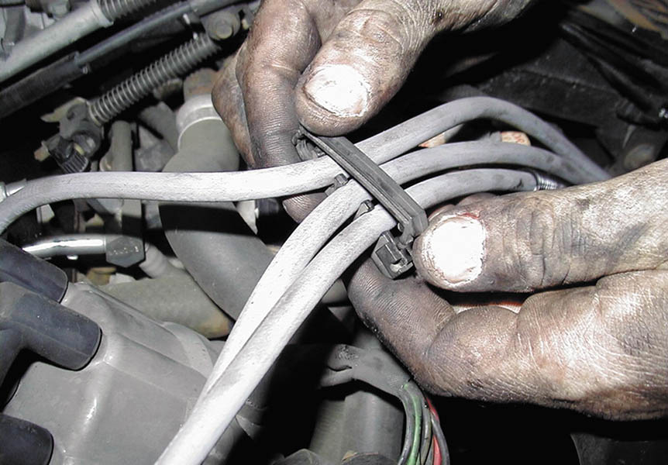
Figure 72.16 Always take the time to install spark plug wires back into the original holding brackets (wiring combs)

Slide 38
SPARK PLUG SERVICE
The Need for Service
Spark plugs should be inspected and replaced every 20,000 to 100,000 miles depending on the vehicle.
Spark Plug Inspection
Carbon fouling
Oil fouling
White coolant deposits
When installing spark plugs, always use the correct tightening torque.

Slide 39
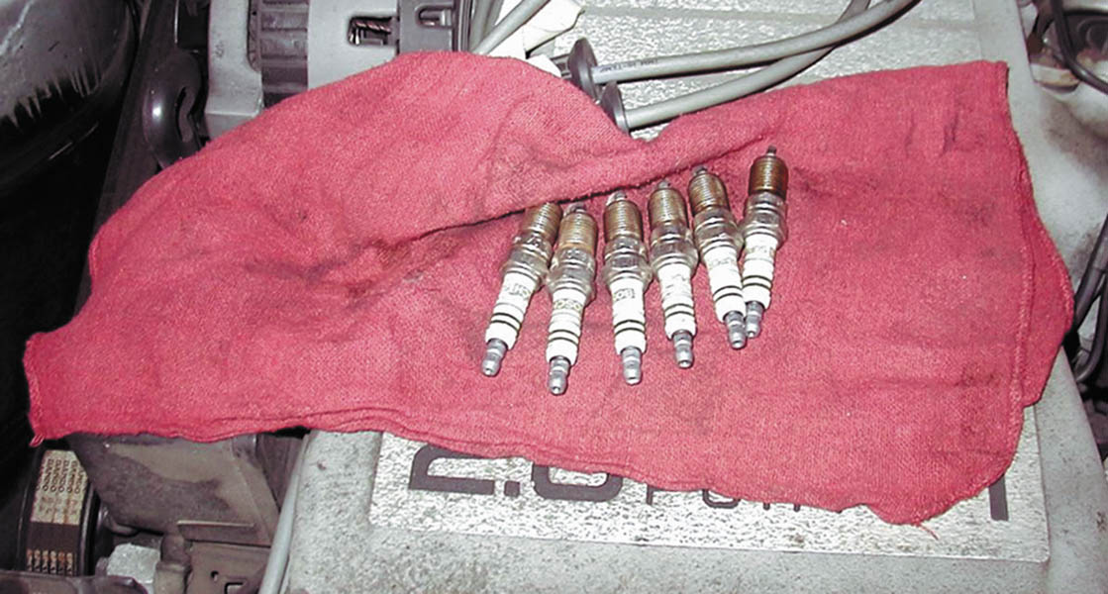
Figure 72.17 When removing spark plugs, it is wise to arrange them so that they can be compared and any problem can be identified with a particular cylinder

Slide 40
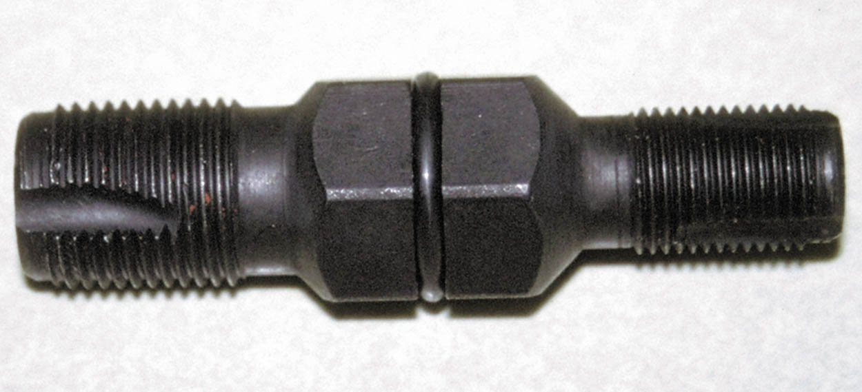
Figure 72.18 A spark plug thread chaser is a low-cost tool that hopefully is not used often, but is necessary to use to clean the threads before new spark plugs are installed.

Slide 41
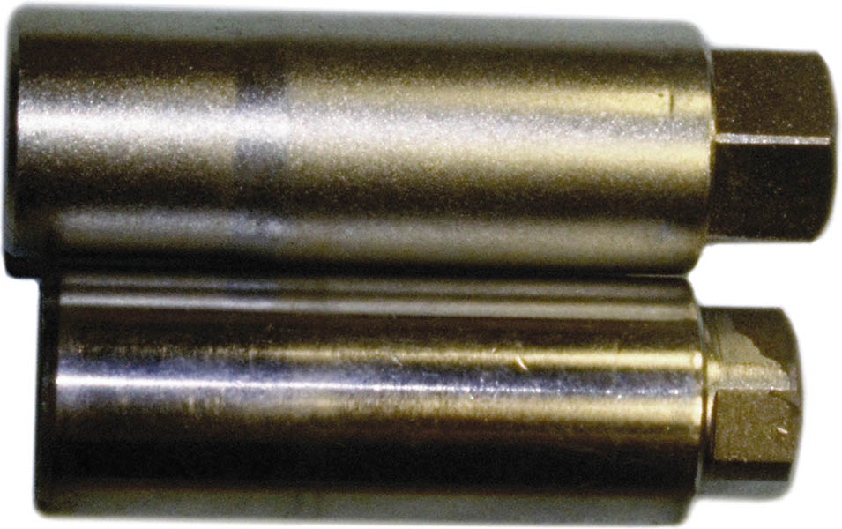
Figure 72.19 Since 1991, General Motors engines have been equipped with slightly (1/8 inch or 3 mm) longer spark plugs. This requires that a longer spark plug socket be used to prevent the possibility of cracking a spark plug during installation.

Slide 42
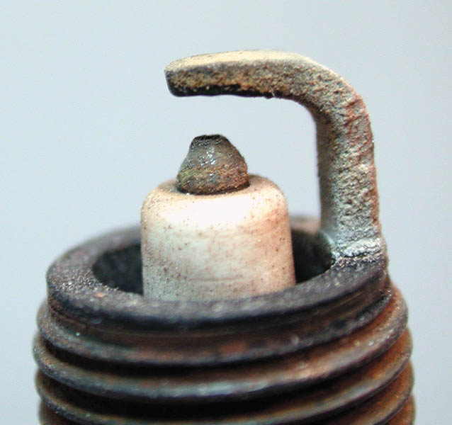
Figure 72.20 A normally worn spark plug that has a tapered platinum-tipped center electrode

Slide 43
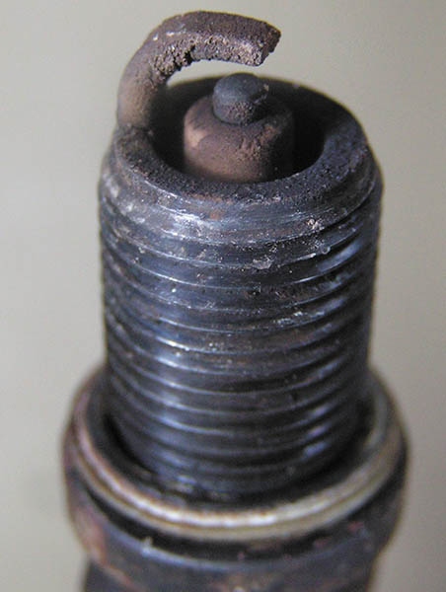
Figure 72.21 A worn spark plug showing fuel and/or oil deposits

Slide 44
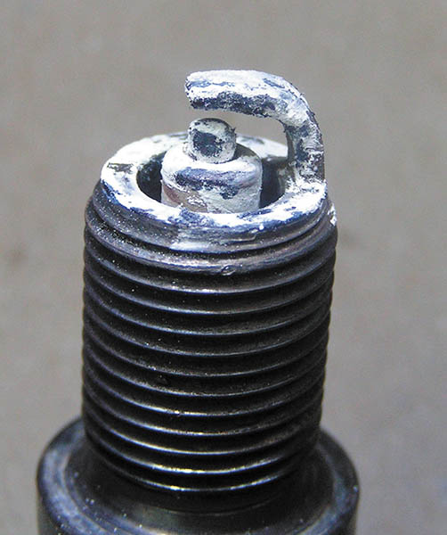
Figure 72.22 A spark plug from an engine that had a blown head gasket. The white deposits could be from the additives in the coolant.

Slide 45
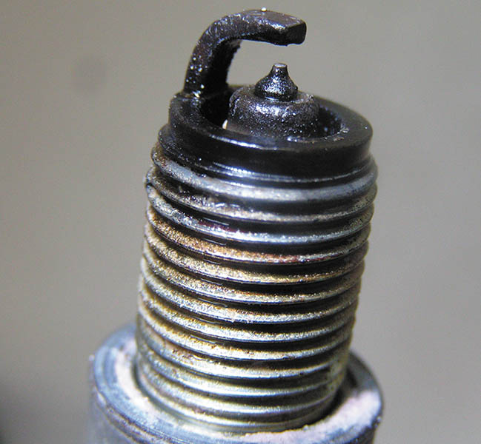
Figure 72.23 A platinum-tipped spark plug that is fuel soaked, indicating a fault with the fuel system or the ignition system causing the spark plug to not fire.

Slide 46
QUICK AND EASY SECONDARY IGNITION TESTS
Following are some quick and easy secondary ignition tests:
If any spark is visible or a “snapping” sound is heard, the location should be closely inspected and the defective parts replaced.
For intermittent problems, use a spray bottle to apply a water mist to the spark plugs, distributor cap, and spark plug wires.

Slide 47
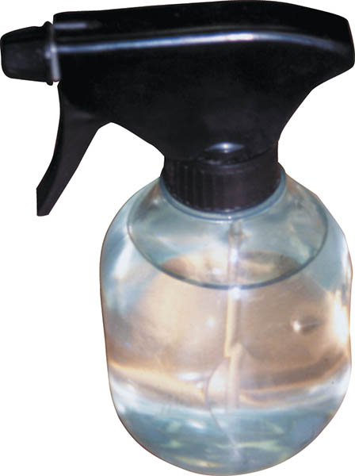
Figure 72.24 A water spray bottle is an excellent diagnostic tool to help find an intermittent engine misfire caused by a break in a secondary ignition circuit component.

Slide 48
IGNITION TIMING
Purpose
Ignition timing refers to when the spark plug fires in relation to piston position.
Checking Ignition Timing
To be assured of the proper ignition timing, follow exactly the timing procedure indicated on the underhood vehicle emission control information (VECI) decal.
The ignition timing cannot be adjusted on waste-spark and COP ignition systems.

Slide 49
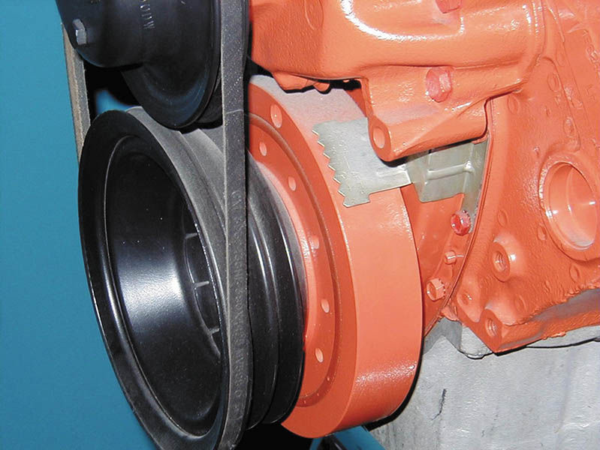
Figure 72.25 Typical timing marks. The numbers of the degrees are on the stationary plate and the notch is on the harmonic balancer

Slide 50
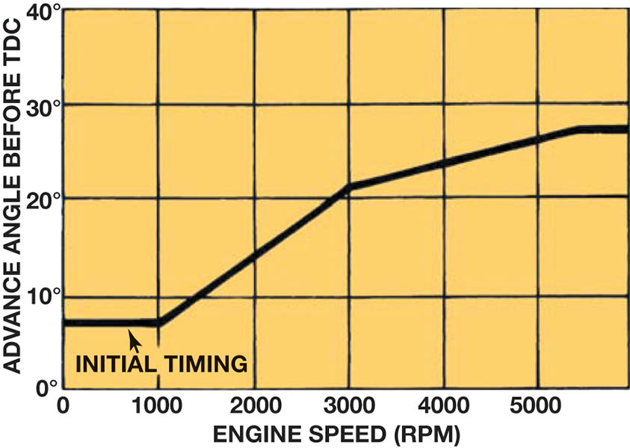
Figure 72.26 The initial (base) timing is where the spark plug fires at idle speed. The PCM then advances the timing based primarily on engine speed

Slide 51
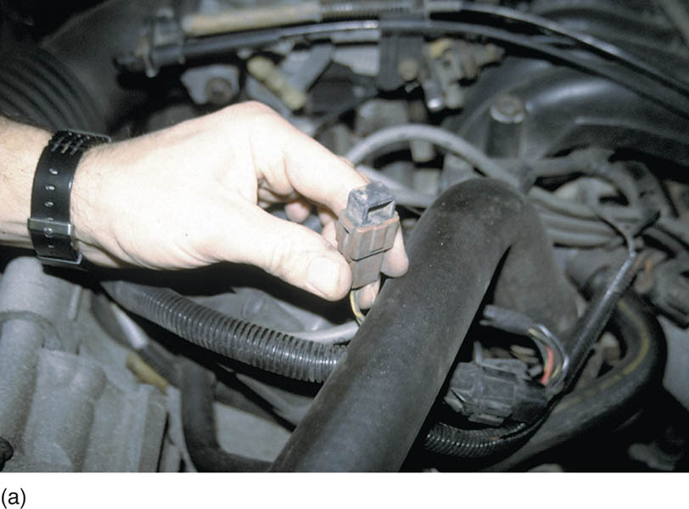
Figure 72.27 (a) Typical SPOUT connector as used on many Ford engines equipped with distributor ignition (DI)

Slide 52
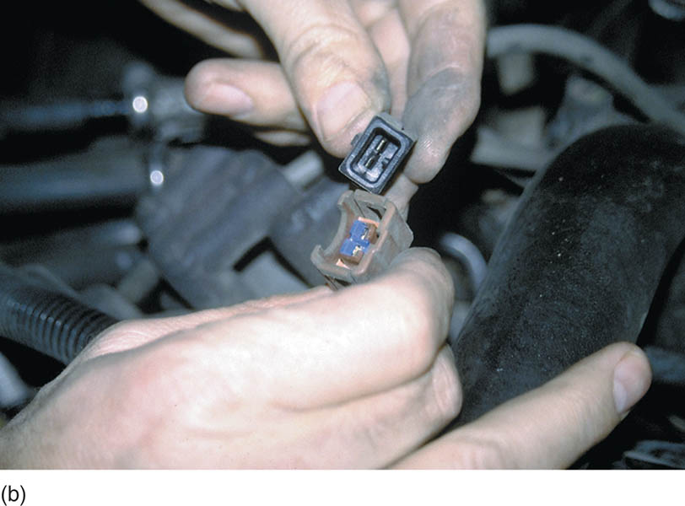
Figure 72.27 (b) The connector must be opened (disconnected) to check and/or adjust the ignition timing. On DIS/EDIS systems, the connector is called SPOUT/SAW (spark output/spark angle word)

Slide 53
SCOPE-TESTING THE IGNITION SYSTEM (1 OF 6)
Any automotive scope with the correct probes or adapters show an ignition system pattern.
Firing Line
The leftmost vertical (upward) line is called the firing line.
Spark Line
The spark line is a short horizontal line immediately after the firing line.

Slide 54
SCOPE-TESTING THE IGNITION SYSTEM (2 OF 6)
Intermediate Oscillations
The intermediate oscillations follow the spark line, and are also called the “ringing” of the coil as it is pulsed.
Transistor-On Point
When the transistor turns on an electronic system, the coil is being charged.
Dwell Section
Dwell is the amount of time that the current is charging the coil from the transistor-on point to the transistor-off point.

Slide 55
SCOPE-TESTING THE IGNITION SYSTEM (3 OF 6)
Pattern Selection
Superimposed
Raster (stacked)
Display (parade)
Reading the Scope on Display (Parade)
The firing lines should all be 5 to 15 kV in height and be within 3 kV of each other.

Slide 56
SCOPE-TESTING THE IGNITION SYSTEM (4 OF 6)
Reading the Spark Lines
The spark lines should be level and one-fourth as high as the firing lines (1.5 to 2.5 kV, but usually less than 2 kV).
Spark Line Slope
An upward-sloping spark line can indicate a lean air–fuel mixture.
A downward sloping spark line is finding ground through deposits.

Slide 57
SCOPE-TESTING THE IGNITION SYSTEM (5 OF 6)
Reading the Intermediate Section
The intermediate section should have three or more oscillations (bumps) for a correctly operating ignition system.
Electronic Ignition and the Dwell Section
Many EI systems also produce a “hump” in the dwell section, which reflects a current-limiting circuit in the control module.
Dwell Variation (Electronic Ignition)
Typically caused by a worn mechanical component.

Slide 58
SCOPE-TESTING THE IGNITION SYSTEM (6 OF 6)
Coil Polarity
If the pattern is upside down, the primary wires on the coil may be reversed, causing the coil polarity to be reversed.
Acceleration Check
All firing lines should rise evenly
If the firing lines on one or more cylinders fail to rise, this indicates fouled spark plugs.
Rotor Gap Voltage
The normal rotor gap voltage is 3 to 7 kV

Slide 59
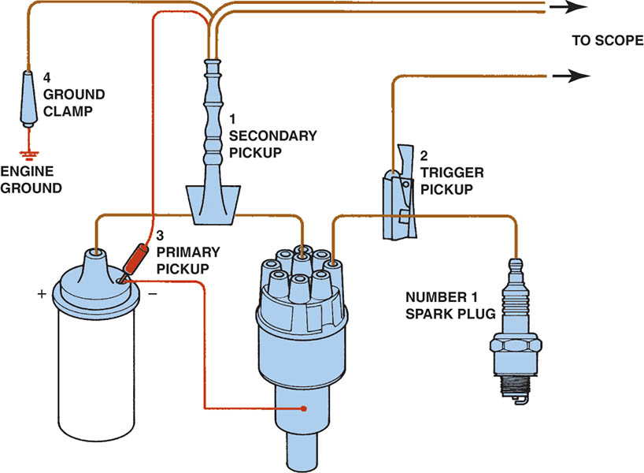
Figure 72.28 Typical engine analyzer hookup that includes a scope display. (1) Coil wire on top of the distributor cap if integral type of coil; (2) number 1 spark plug connection; (3) negative side of the ignition coil; (4) ground (negative) connection of the battery

Slide 60
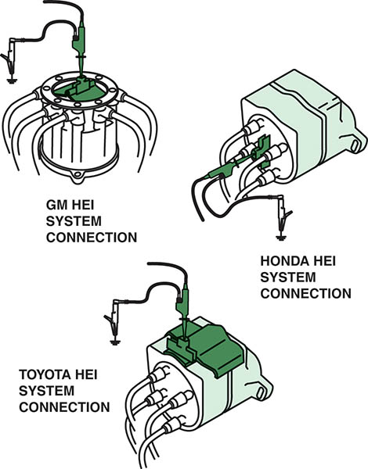
Figure 72.29 Clip-on adapters are used with an ignition system that uses an integral ignition coil

Slide 61
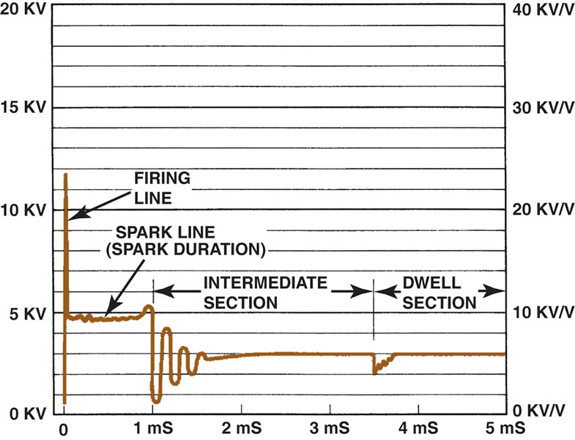
Figure 72.30 Typical secondary ignition oscilloscope pattern

Slide 62
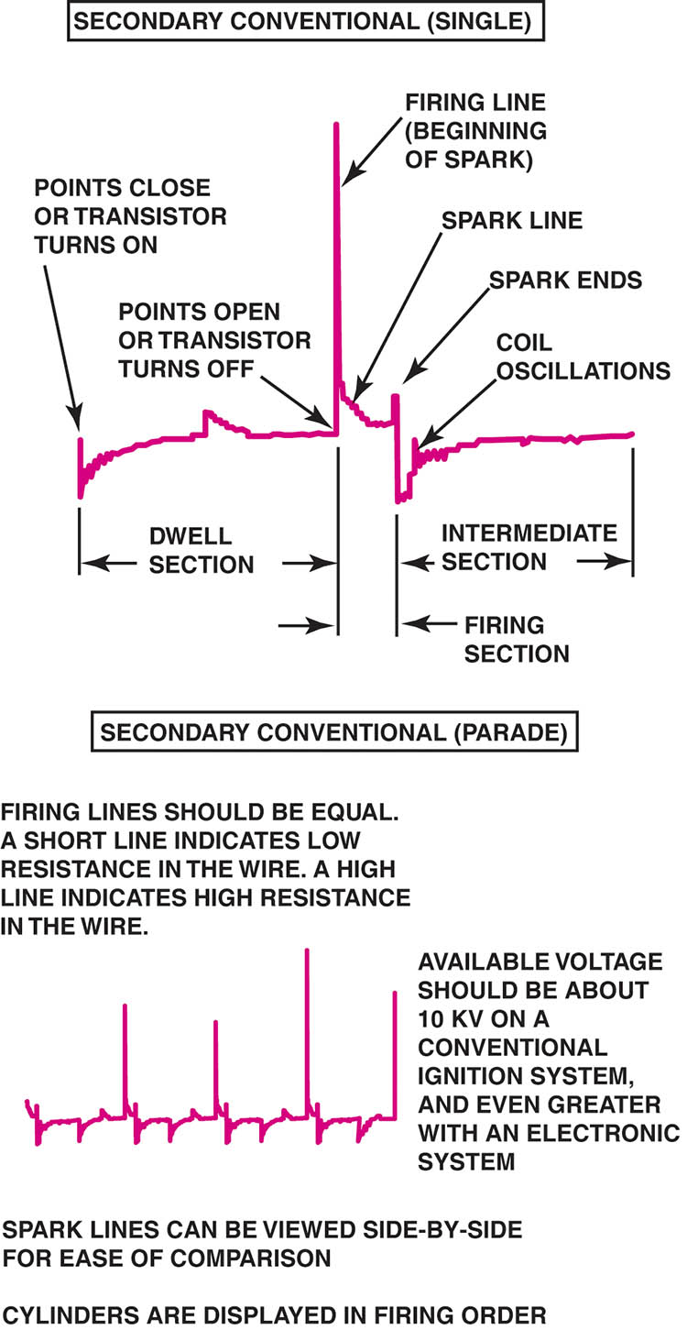
Figure 72.31 A single cylinder is shown at the top and a four cylinder engine at the bottom

Slide 63
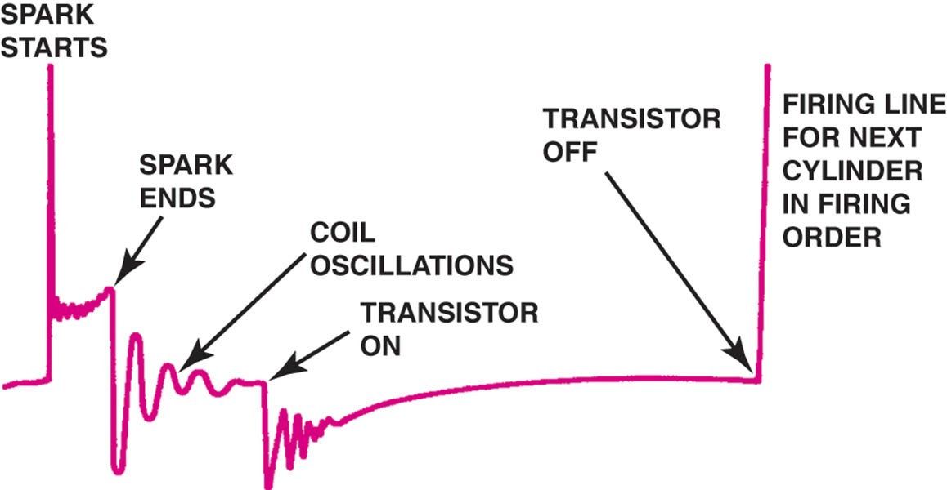
Figure 72.32 Drawing shows what is occurring electrically at each part of the scope pattern

Slide 64
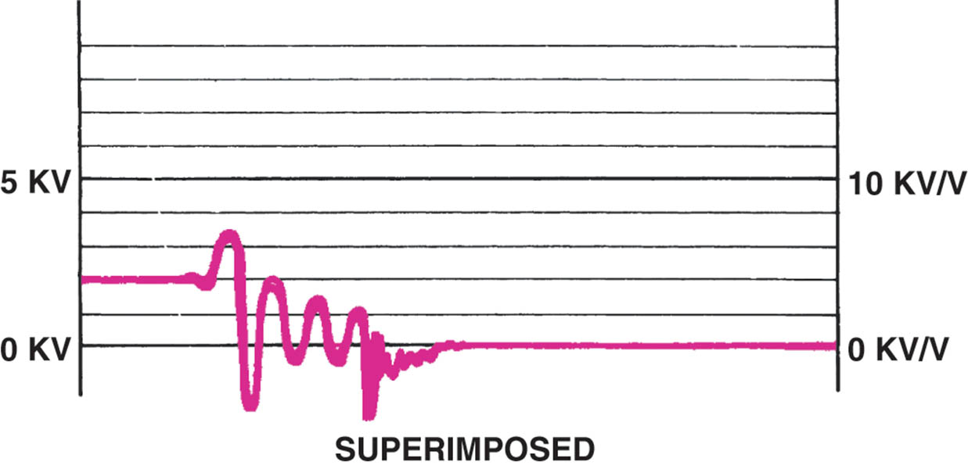
Figure 72.33 Typical secondary ignition pattern. Note the lack of firing lines on superimposed pattern

Slide 65
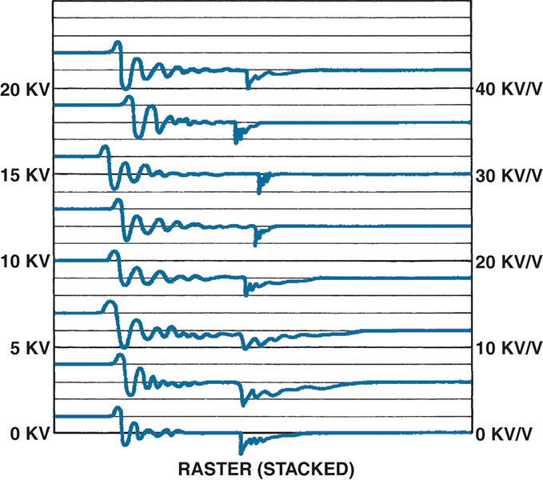
Figure 72.34 Raster is the best scope position to view the spark lines of all the cylinders to check for differences. Most scopes display the cylinder 1 at the bottom. The other cylinders are positioned by firing order above cylinder 1

Slide 66
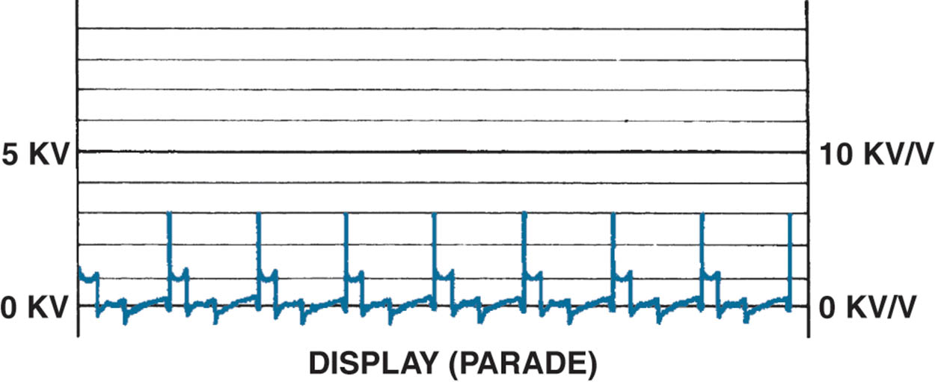
Figure 72.35 Display is the only position to view the firing lines of all cylinders. Cylinder 1 is displayed on the left (except for its firing line, which is shown on the right). The cylinders are displayed from left to right by firing order

Slide 67
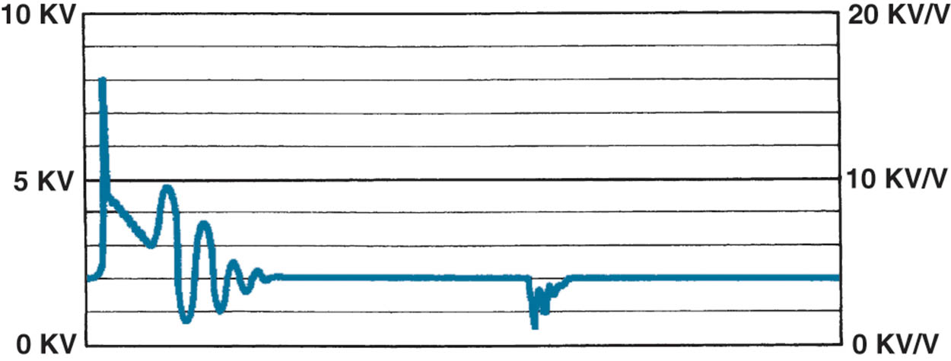
Figure 72.36 A downward-sloping spark line usually indicates high secondary ignition system resistance or an excessively rich air–fuel mixture

Slide 68
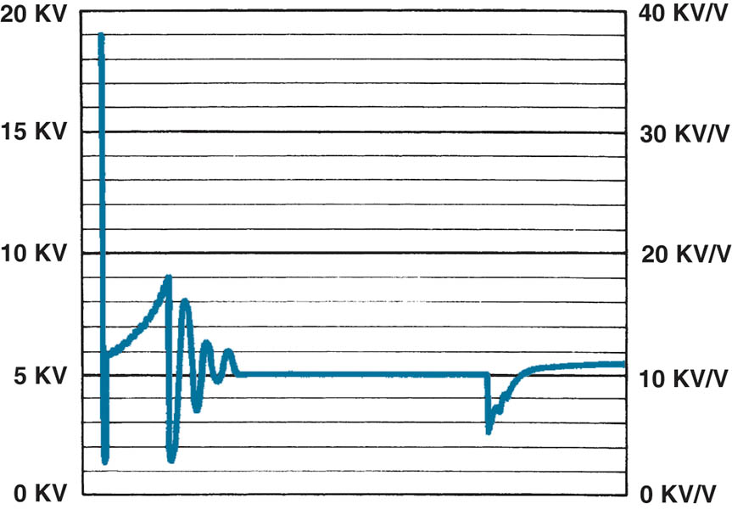
Figure 72.37 An upward-sloping spark line usually indicates a mechanical engine problem or a lean air–fuel mixture

Slide 69
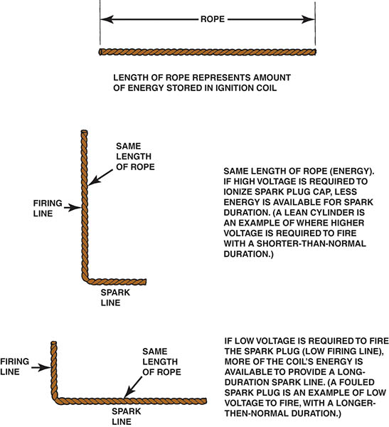
Figure 72.38 The relationship between the height of the firing line and length of the spark line can be illustrated using a rope. Because energy cannot be destroyed, the stored energy in an ignition coil must dissipate totally, regardless of engine operating conditions

Slide 70
QUESTION 3: ?
What are the sections of a secondary ignition scope pattern?

Slide 71
ANSWER 3:
Firing line, spark line, intermediate section, and dwell section.

Slide 72
SCOPE TESTING A WASTE-SPARK IGNITION SYSTEM
A handheld digital storage oscilloscope can be used to check the pattern of each individual cylinder.
Some larger scopes are able to display both power and waste-spark waveforms.
Because the waste spark does not require as high a voltage level as the cylinder on the power stroke, the waste form is normally lower.

Slide 73
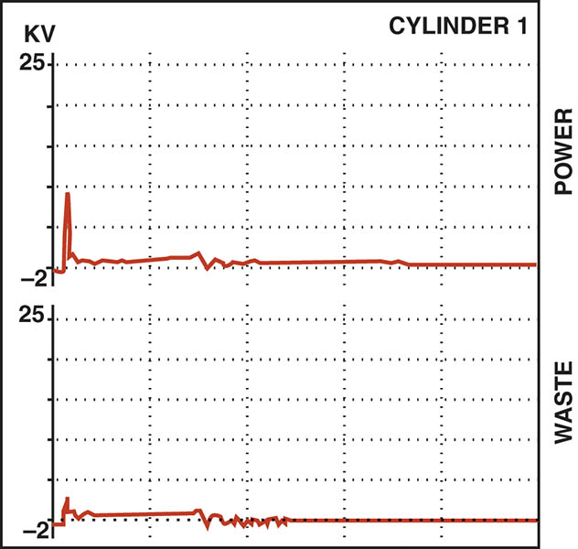
Figure 72.39 A dual-trace scope pattern showing both the power and the waste spark from the same coil (cylinders 1 and 6). Note that the firing line is higher on the cylinder that is under compression (power); otherwise, both patterns are almost identical

Slide 74
SCOPE-TESTING A COIL-ON-PLUG IGNITION SYSTEM
Each individual coil can be shown on a scope and, using the proper cables and adapters.
Always follow the scope equipment manufacturer’s instructions.
Normal ignition patterns may vary based on manufacturer system designs.

Slide 75
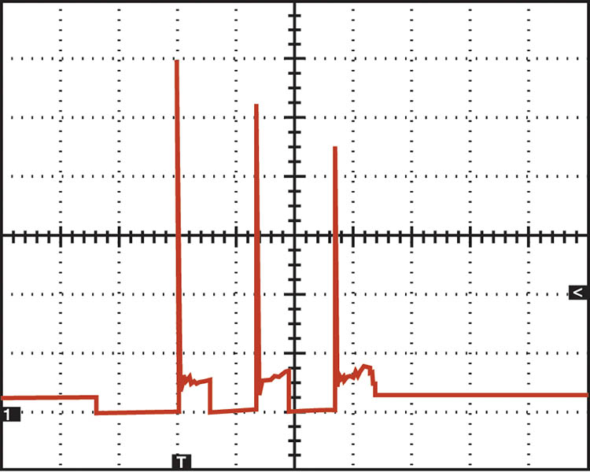
Figure 72.40 A secondary waveform of a Ford 4.6 liter V-8, showing three sparks occurring at idle speed

Slide 76

Copyright

