Slide 1
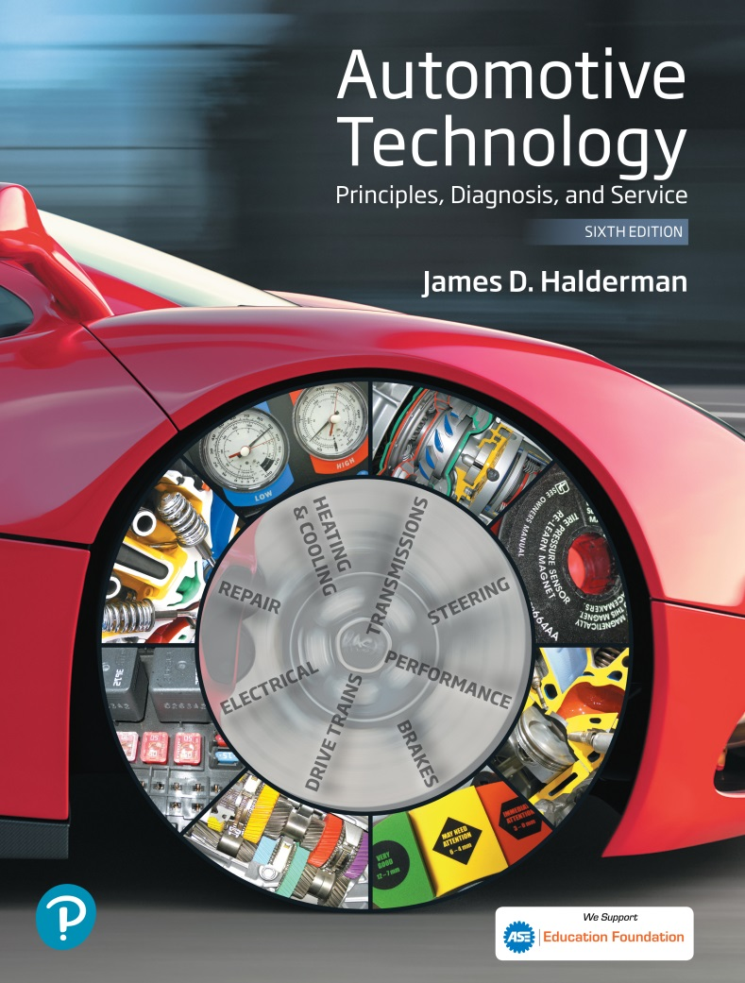
Automotive Technology Principles, Diagnosis, and Service
Sixth Edition
Chapter 71
Ignition System Components and Operation
Copyright © 2018, 2015, 2011 Pearson Education, Inc. All Rights Reserved

Slide 2
LEARNING OBJECTIVES (1 of 2)
71.1 Explain how the ignition system and ignition coils work.
71.2 Discuss crankshaft position sensor and pickup coil operation.
71.3 Describe the operation of distributor ignition.
71.4 Describe the operation of waste-spark and coil-on-plug ignition systems.

Slide 3
LEARNING OBJECTIVES (2 of 2)
71.5 Discuss ignition control circuits, compression-sensing and ion-sensing ignition, ignition timing, knock sensors, and spark plugs.
71.6 This chapter will help prepare for Engine Repair (A8) ASE certification test content area “B” (Ignition System Diagnosis and Repair).

Slide 4
IGNITION SYSTEMS
Purpose and Function
The ignition system includes components and wiring necessary to create and distribute a high voltage (up to 40,000 volts or more) and send to the spark plug.
Background
Before the mid-1970s, ignition systems used a mechanically opened set of contact points to make and break the electrical connection to ground.
Since the mid-1970s, ignition systems have used sensors, such as a pickup coil and reluctor (trigger wheel), to trigger or signal an electronic module.

Slide 5
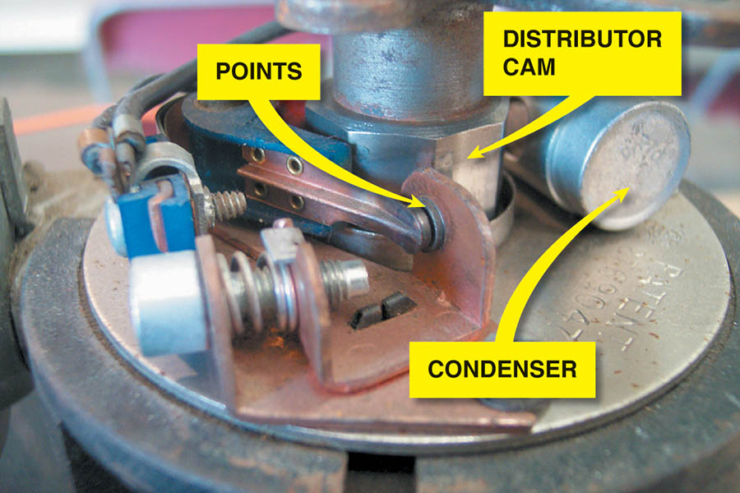
Figure 71.1 A point-type ignition system showing the distributor cam, which opens the points

Slide 6
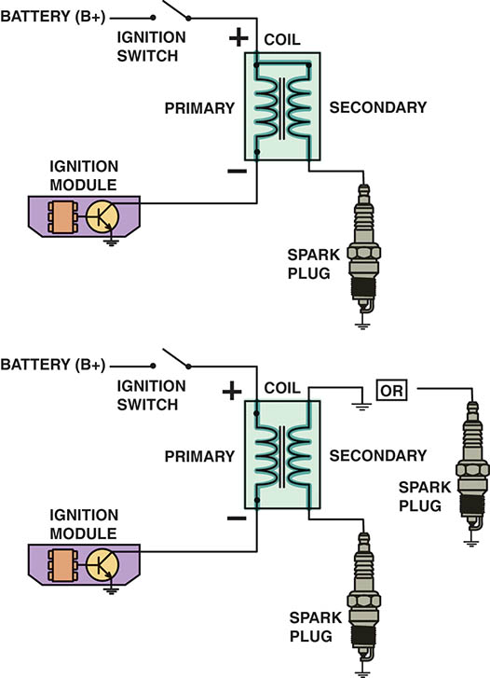
Figure 71.2 Some ignition coils are electrically connected, called married (top figure), whereas others use separate primary and secondary windings, called divorced (lower figure).

Slide 7
IGNITION SYSTEM OPERATION
All ignition systems apply voltage close to battery voltage (12 volts) to the positive side of the ignition coil and pulse the negative side to ground.
When the coil negative lead is grounded, the primary (low-voltage) circuit of the coil is complete and a magnetic field is created around the coil windings.
When the circuit is opened, the magnetic field collapses and induces a high-voltage spark in the secondary winding of the ignition coil.

Slide 8
IGNITION COILS (1 OF 4)
Purpose and Function
The coil creates a high-voltage spark by electromagnetic induction.
Coil Construction
The center of an ignition coil contains a core of laminated soft iron (thin strips of soft iron)
Surrounding the laminated core are the secondary windings
Surrounding the secondary windings are the primary windings.

Slide 9
IGNITION COILS (2 OF 4)
Self-Induction
When current starts to flow into a coil, an opposing current is created in the windings of the coil. This opposing current generation is caused by self-induction and is called inductive reactance.
Mutual Induction
The current flowing in one coil winding induces a voltage in the adjacent coil winding when a change occurs.

Slide 10
IGNITION COILS (3 OF 4)
How Ignition Coils Create 40,000 Volts
All ignition systems use electromagnetic induction to produce a high-voltage spark from the ignition coil.
The magnetic field in an ignition coil is produced by current flowing through the primary windings of the coil.
When the primary coil winding ground return path connection is opened, the magnetic field collapses and induces a voltage of 250 to 400 volts in the primary winding of the coil and a high-voltage (20,000 to 40,000 volts) low amperage (20 to 80 mA) current in the secondary coil windings.

Slide 11
IGNITION COILS (4 OF 4)
Primary Ignition Circuit
Battery, Ignition switch
Primary windings of coil
Pickup coil ( cranks sensor)
Ignition module (Igniter)
PCM
Secondary Ignition Circuit
Secondary windings of coil
Distributor cap and rotor (if the vehicle is so equipped)
Spark plug wires and Spark plugs

Slide 12
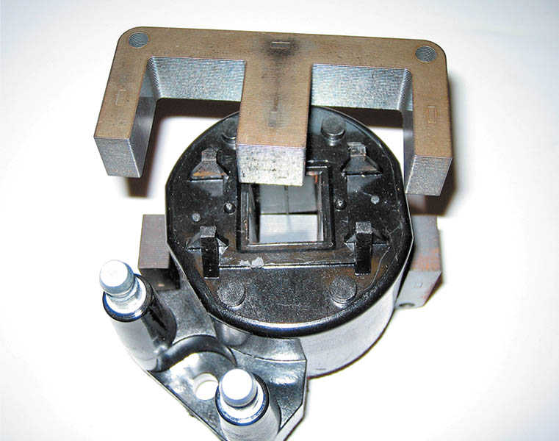
Figure 71.3 The steel lamination used in an E coil helps increase the magnetic field strength, which helps the coil produce higher energy output for a more complete combustion in the cylinders

Slide 13
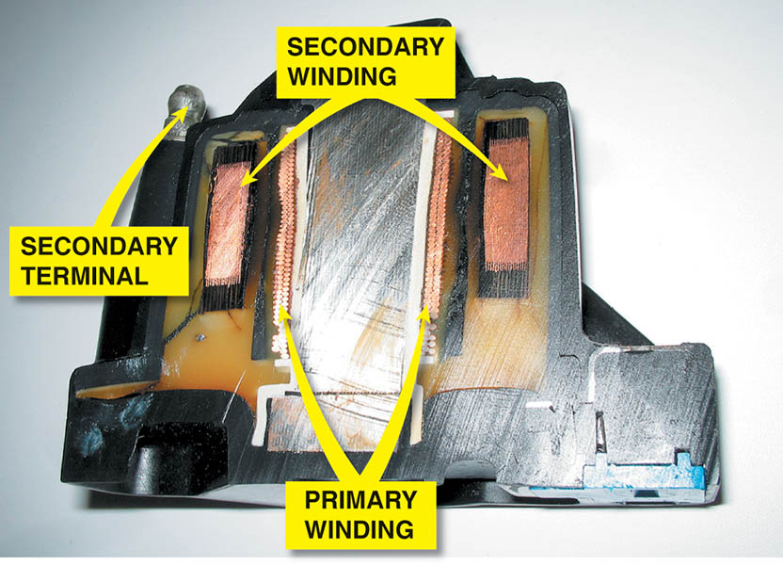
Figure 71.4 The primary windings are inside the secondary windings on this General Motors coil

Slide 14
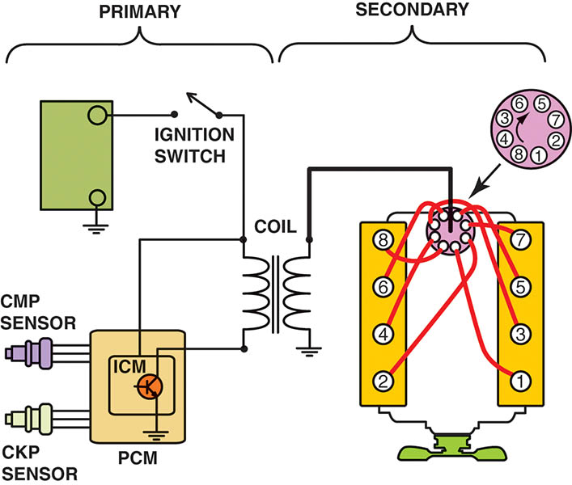
Figure 71.5 The primary ignition system is used to trigger and, therefore, create the secondary (high-voltage) spark from the ignition coil

Slide 15
QUESTION 1: ?
What are the components of the secondary ignition circuit?

Slide 16
ANSWER 1:
The secondary side of the coil, the cap and rotor (if used), the spark plug wires and the spark plugs.

Slide 17
IGNITION SWITCH AND TRIGGERING
The turning on and off of the primary circuit is called switching.
The unit that does the switching is an electronic switch, such as a power transistor.
The power transistor can be located in any of the following locations:
In the powertrain control module (PCM)
In the ICM
Part of the coil-on-plug assembly

Slide 18
PRIMARY CIRCUIT OPERATION
The following are used as crankshaft position (CKP) sensors or camshaft position (CMP) sensors.
A Hall-effect switch uses a stationary sensor and rotating trigger wheel (shutter).
A magnetic sensor uses the changing strength of the magnetic field surrounding a coil of wire to signal the module and computer.

Slide 19
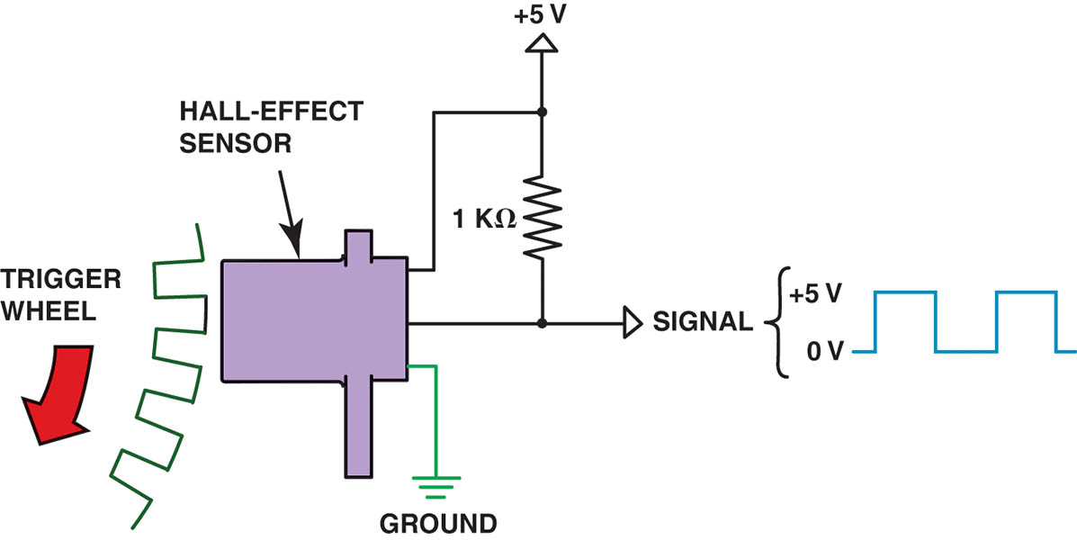
Figure 71.6 A Hall-effect sensor produces a digital on-off voltage signal whether it is used with a blade or a notched wheel

Slide 20
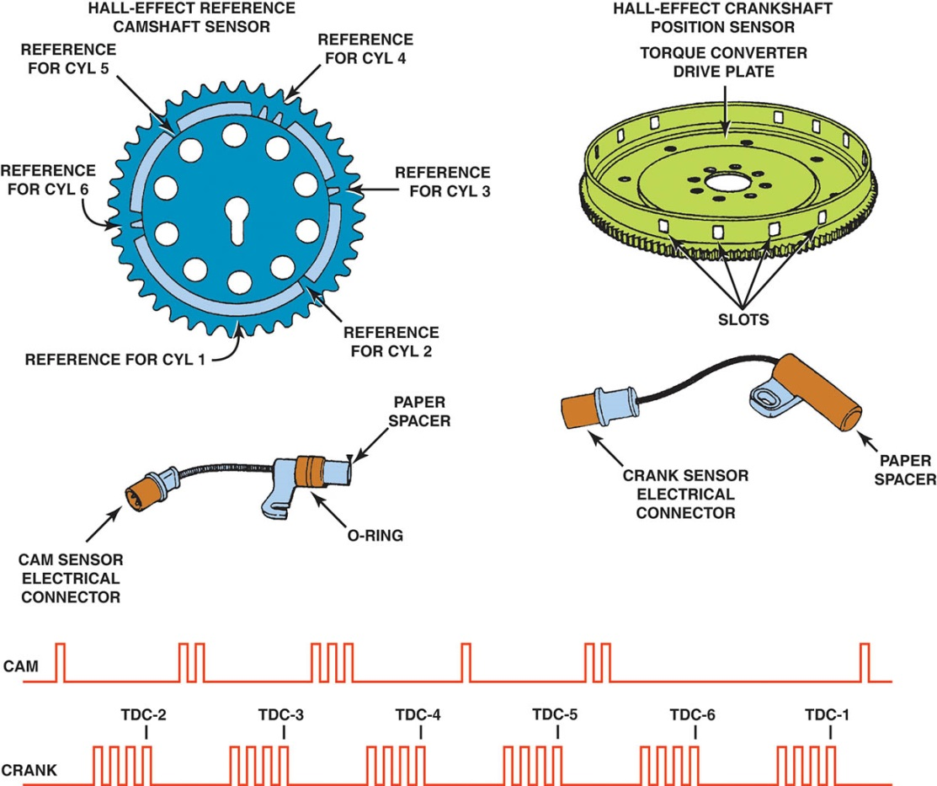
Figure 71.7 This Hall-effect camshaft reference sensor and crankshaft position sensor have an electronic circuit built in that creates a 0- to 5-volt signal, as shown at the bottom. These Hall-effect sensors have three wires: a power supply (8 volts) from the computer (controller); a signal (0 to 5 volts); and a signal ground

Slide 21
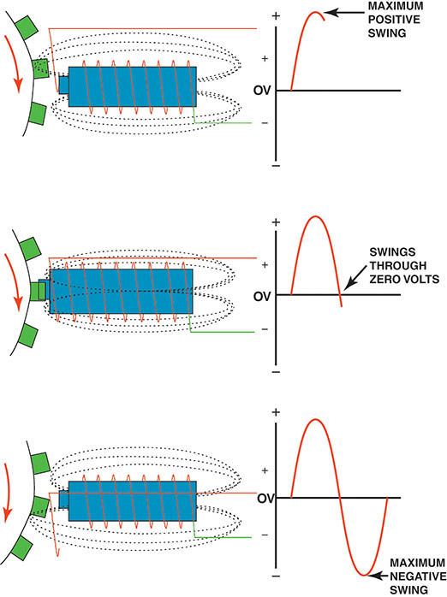
Figure 71.8 A magnetic sensor uses a permanent magnet surrounded by a coil of wire. The notches of the crankshaft (or camshaft) create a variable magnetic field strength around the coil.

Slide 22
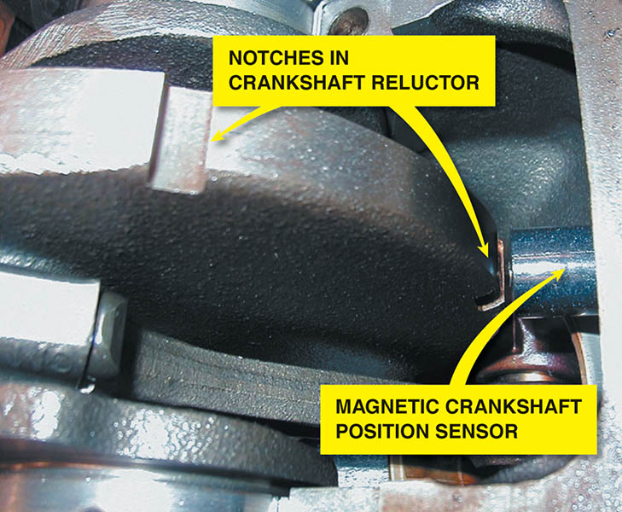
Figure 71.9 A typical magnetic crankshaft position sensor

Slide 23
QUESTION 2: ?
What are the two type of crankshaft sensors?

Slide 24
ANSWER 2:
Hall-effect and magnetic sensors.

Slide 25
DISTRIBUTOR IGNITION SYSTEMS (1 OF 2)
Purpose and Function
To distribute the high voltage spark from the ignition coil to the spark plugs located at each cylinder.
To provide a method for switching the primary ignition circuit, first using mechanical points and later using a sensor.
The distributor is driven by a gear from the end of the camshaft inside the engine that rotated at the same speed as the camshaft, which is half crankshaft speed.

Slide 26
DISTRIBUTOR IGNITION SYSTEMS (2 OF 2)
Distributor Cap and Rotor
The high-voltage pulse from the ignition coil enters the distributor cap and is sent to the individual spark plug wires by the rotating rotor.
Firing Order
Firing order means the order that the spark is distributed to the correct spark plug at the right time.

Slide 27
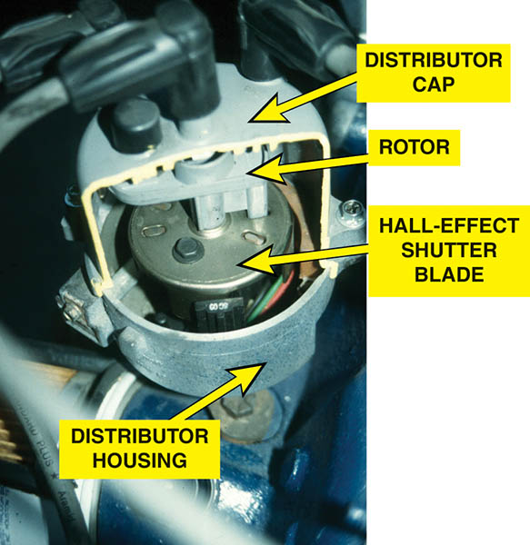
Figure 71.10 A cutaway of a Ford distributor showing the Hall-effect shutter blade that is used to trigger the ignition control module and the rotor.

Slide 28
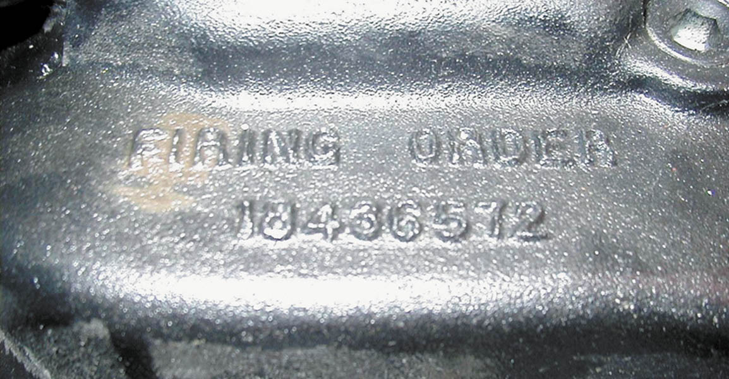
Figure 71.11 The firing order is cast or stamped on the intake manifold on most engines that have a distributor ignition

Slide 29
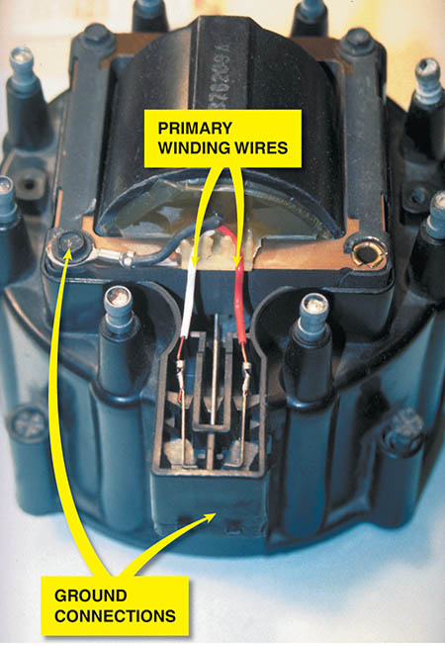
Figure 71.12 A typical General Motors HEI coil installed in the distributor cap. When the coil or distributor cap is replaced, check that the ground clip is transferred from the old distributor cap to the new. Without proper grounding, coil damage is likely.

Slide 30
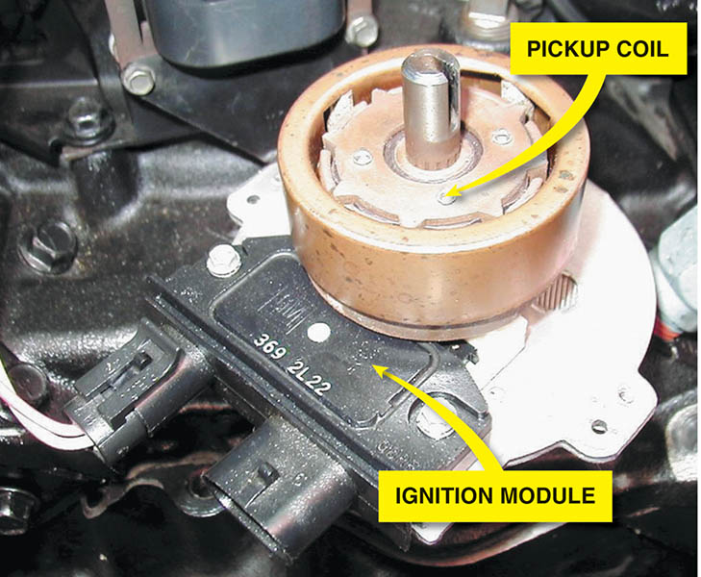
Figure 71.13 This distributor ignition system uses a remotely mounted ignition coil

Slide 31
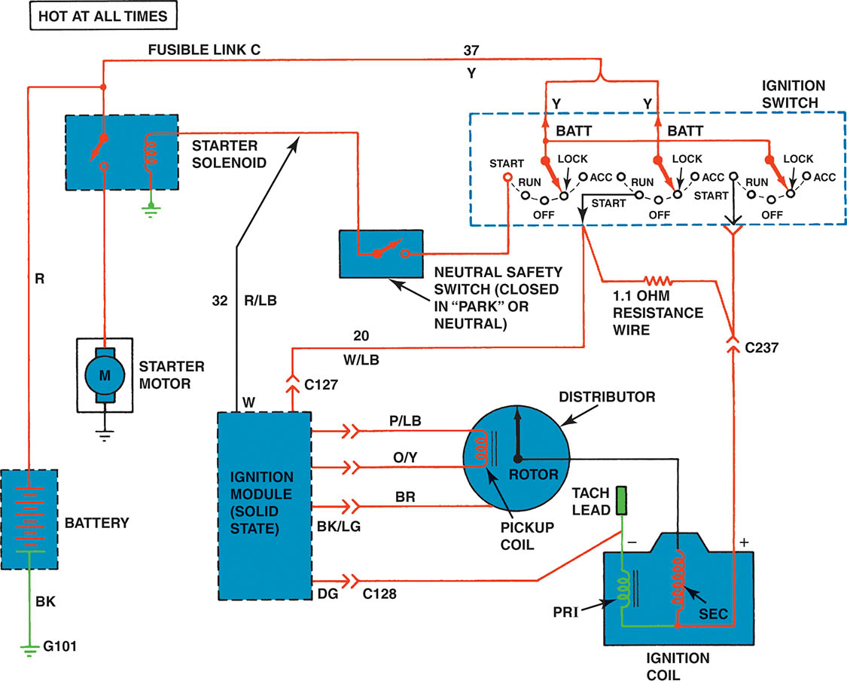
Figure 71.14 Wiring diagram of a typical Ford electronic ignition

Slide 32
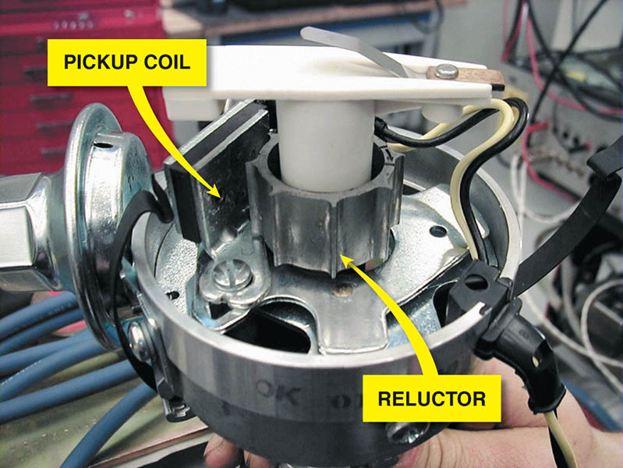
Figure 71.15 A Chrysler electronic ignition distributor. This unit is equipped with a vacuum advance mechanism that advances the ignition timing under light engine load conditions

Slide 33
WASTE-SPARK IGNITION SYSTEMS
Waste-spark ignition is another name for distributorless ignition system (DIS) or electronic ignition (EI).
Each end of the secondary winding is connected to a cylinder exactly opposite the other in the firing order, which is called a companion (paired) cylinder.
This means that both spark plugs fire at the same time (within nanoseconds of each other).

Slide 34
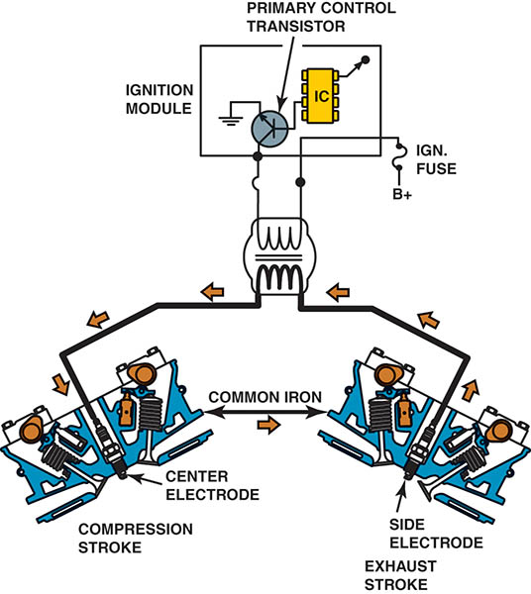
Figure 71.16 A waste-spark system fires one cylinder while its piston is on the compression stroke and into paired or companion cylinders while it is on the exhaust stroke.

Slide 35
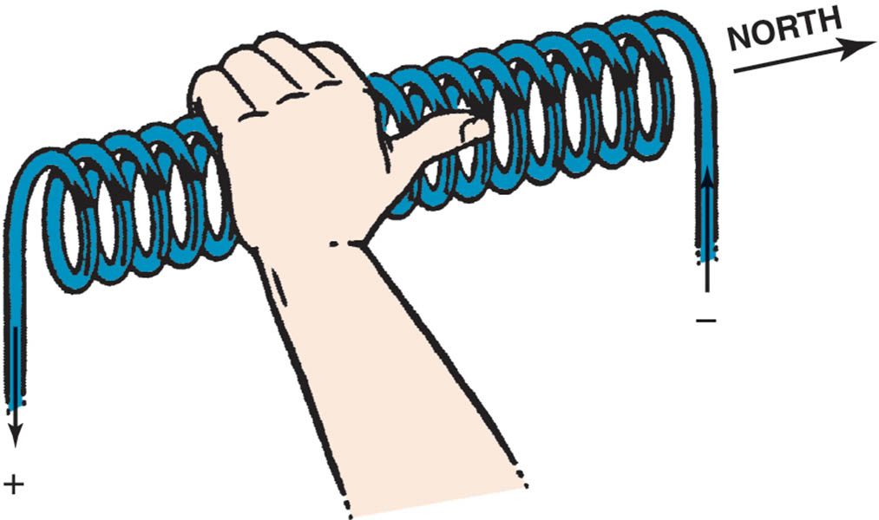
Figure 71.17 The left-hand rule states that if a coil is grasped with the left hand, the fingers point in the direction of current flow and the thumb points toward the north pole

Slide 36
COIL-ON-PLUG IGNITION
Coil-on-plug (COP) ignition uses one ignition coil for each spark plug.
There are two basic types of COP ignition:
Two-wire —This design uses the vehicle computer to control the firing of the ignition coil.
Three-wire —This design includes an ignition module at each coil.
Compression-Sensing Ignition
Uses the voltage required to fire the cylinders to determine cylinder position.

Slide 37
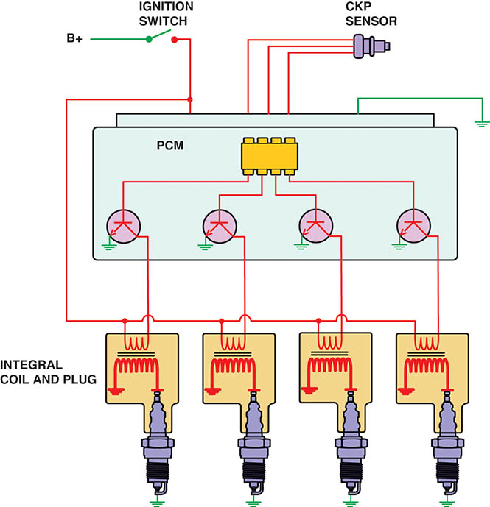
Figure 71.18 A typical two-wire coil-on-plug ignition system showing the triggering and the switching being performed by the PCM from input from the crankshaft position sensor

Slide 38
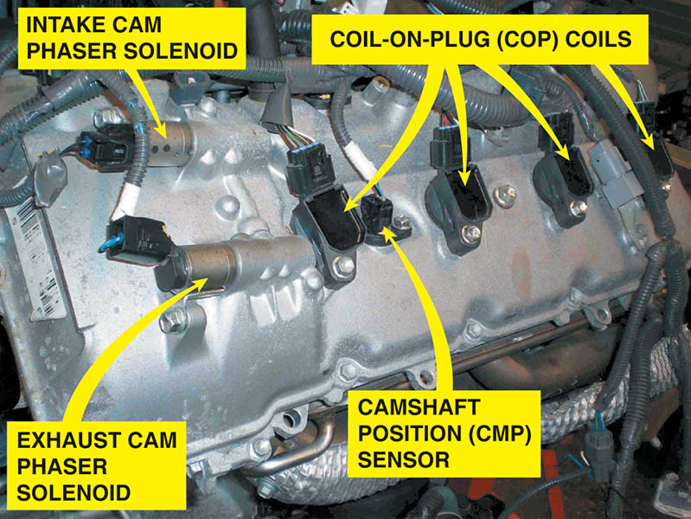
Figure 71.19 An overhead camshaft engine equipped with variable valve timing on both the intake and exhaust camshafts and coil-on-plug ignition

Slide 39
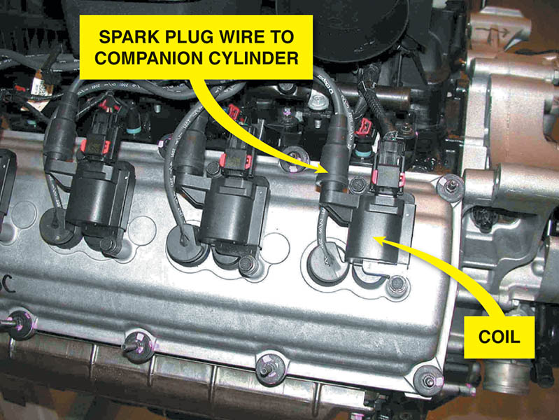
Figure 71.20 Chrysler Hemi V-8 that has two spark plugs per cylinder. The coil on top of one spark fires that plug plus, through a spark plug wire, fires a plug in the companion cylinder

Slide 40
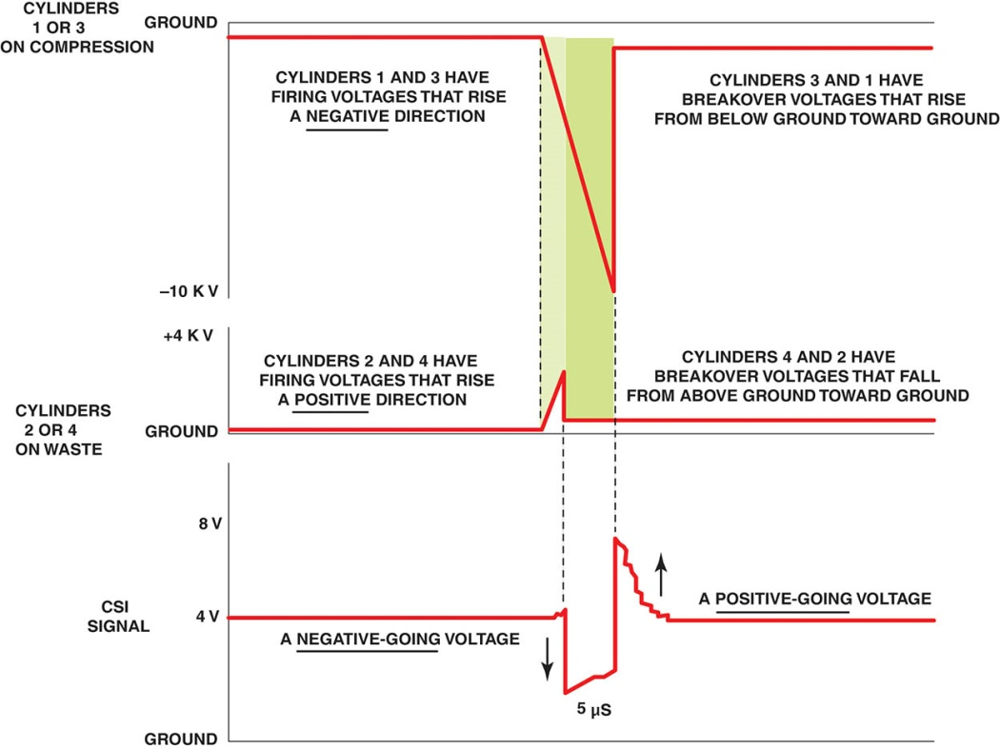
Figure 71.21 The slight (5 microsecond) difference in the firing of the companion cylinders is enough time to allow the PCM to determine which cylinder is firing on the compression stroke.

Slide 41
IGNITION CONTROL CIRCUITS (1 OF 2)
Ignition control (IC) is the OBD-II terminology for the output signal from the PCM to the ignition system that controls engine timing.
The ignition control signal is usually a digital output that is sent to the ignition system as a timing signal.
This signal controls the duration of the primary current flow in the coil, which is referred to as the dwell.

Slide 42
IGNITION CONTROL CIRCUITS (2 OF 2)
Bypass Ignition Control
A bypass-type ignition control means that the engine starts using the ignition module for timing control and then switches to the PCM for timing control after the engine starts.
Up-Integrated Ignition Control
In this type of ignition control all timing functions are interpreted in the PCM.
Most COP and waste-spark systems use this control system.

Slide 43
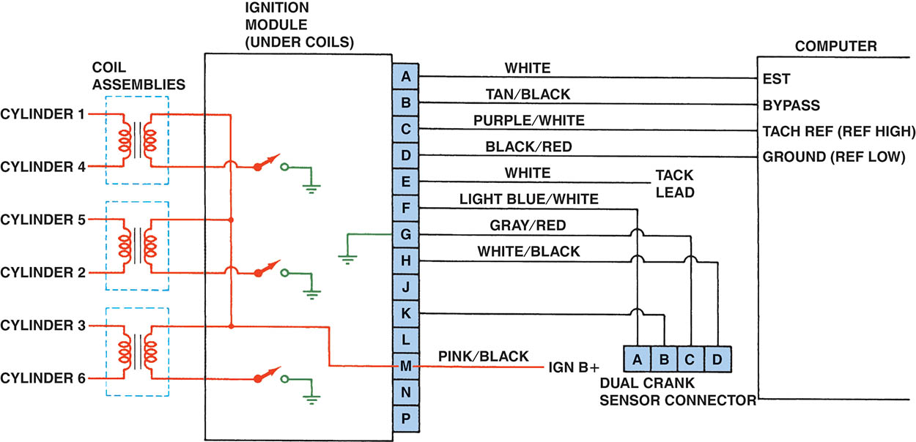
Figure 71.22 Typical wiring diagram of a V-6 distributorless (direct fire) ignition system

Slide 44
ION-SENSING IGNITION
In an ion-sensing ignition system, the spark plug itself becomes a sensor.
The purpose of this sensor includes:
Misfire detection
Knock detection
Ignition timing control
Exhaust gas recirculation (EGR) control
Air-fuel control on a per cylinder basis

Slide 45
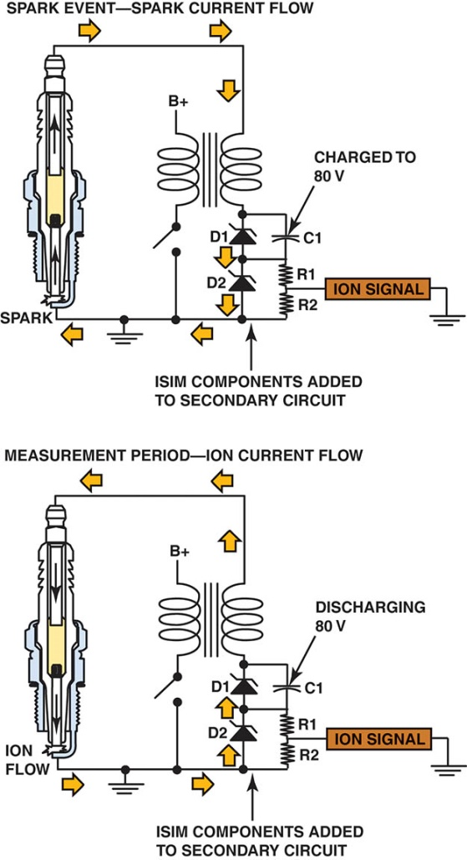
Figure 71.23 A DC voltage is applied across the spark plug gap after the plug fires and the circuit can determine if the correct air–fuel ratio was present in the cylinder and if knock occurred

Slide 46
IGNITION TIMING
The Need for Spark Advance
Ignition timing refers to when the spark plug fires in relation to piston position.
As the engine rotates faster, the spark plug firing event must occur sooner.
Initial Timing
If the engine is equipped with a distributor, it may be possible to adjust the base or the initial timing.
Ignition timing does change as the timing chain or gear wears.

Slide 47
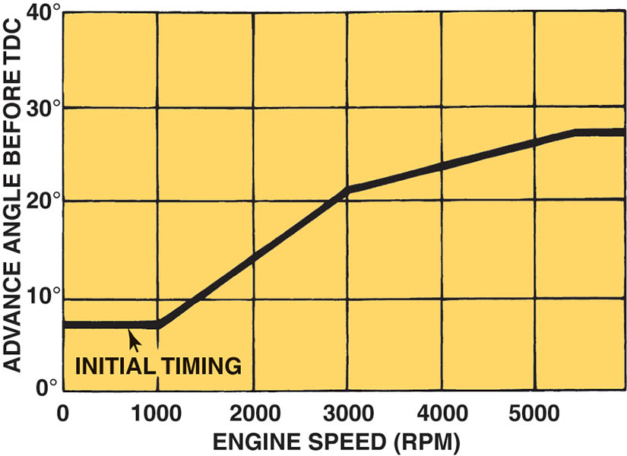
Figure 71.24 The initial timing is where the spark plug fires at idle speed. The computer then advances the timing based on engine speed and other factors

Slide 48
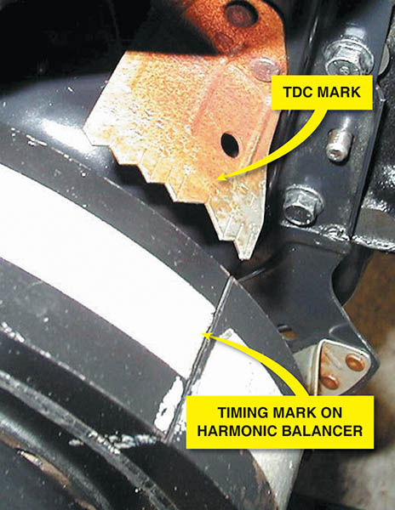
Figure 71.25 Ignition timing marks are found on the harmonic balancers that are equipped with distributor ignition

Slide 49
KNOCK SENSORS
Knock sensors are used to detect abnormal combustion.
Inside the knock sensor is a piezoelectric element that generates a voltage when pressure or a vibration is applied to the unit.
Diagnosing the Knock Sensor
A scan tool is used to read diagnostic trouble codes and check the functionality of the knock sensor.

Slide 50
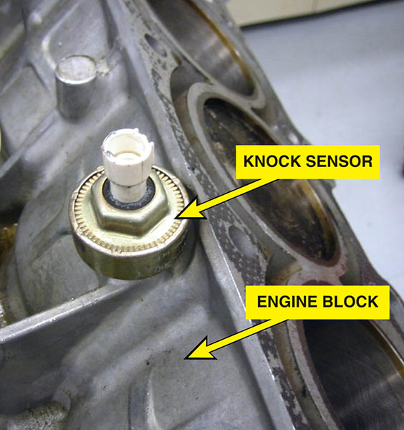
Figure 71.26 A knock sensor that is used by the powertrain control module (PCM) to detect engine detonation

Slide 51
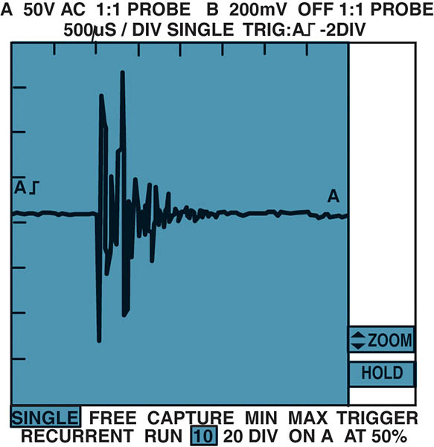
Figure 71.27 A typical waveform from a knock sensor during a spark knock event.

Slide 52
QUESTION 3: ?
What is the purpose of the knock sensor?

Slide 53
ANSWER 3:
To detect abnormal combustion.

Slide 54
SPARK PLUGS
Spark plugs are classified by reach, heat range and type of seat.
Resistor Spark Plugs
Includes a resistor in the center electrode, which helps to reduce electromagnetic noise.
Platinum Spark Plugs
A small amount of the precious metal platinum welded onto each electrode.
Iridium Spark Plugs
A small amount of iridium welded onto the tip of a small center electrode.

Slide 55
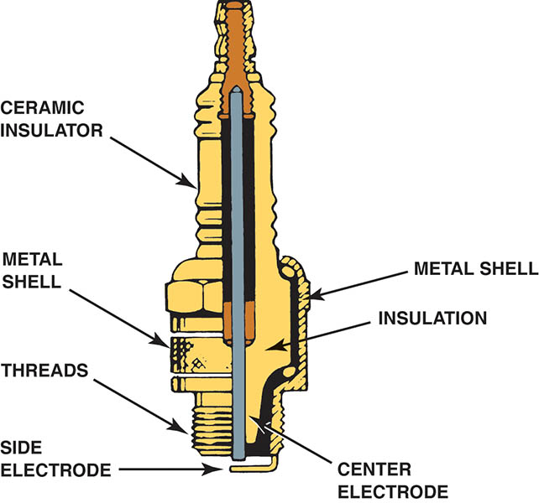
Figure 71.28 Parts of a typical spark plug

Slide 56
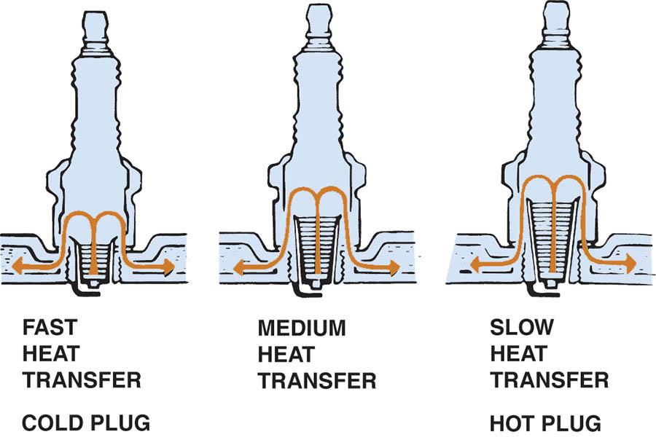
Figure 71.29 The heat range of a spark plug is determined by the distance the heat has to flow from the tip to the cylinder head

Slide 57

Copyright

