Slide 1

Automotive Technology Principles, Diagnosis, and Service
Sixth Edition
Chapter 70
Diesel and Biodiesel Fuels
Copyright © 2018, 2015, 2011 Pearson Education, Inc. All Rights Reserved

Slide 2
LEARNING OBJECTIVES
70.1 Explain diesel fuel specifications and API gravity.
70.2. List the advantages and disadvantages of biodiesel.
70.3. Explain E-diesel specifications.

Slide 3
DIESEL FUEL (1 OF 4 )
Features of Diesel Fuel
Diesel fuel contains 12% more heat energy than the same amount of gasoline.
The fuel in a diesel engine is not ignited with a spark, but is ignited by the heat generated by high compression.
Diesel Fuel Requirements
Cleanliness
Low-temperature fluidity
Cloud point

Slide 4
DIESEL FUEL (2 OF 4 )
Cetane Number
The cetane number is a measure of the ease with which the fuel can be ignited.
The cetane rating of diesel fuel should be between 45 and 50.
Sulphur Content
Federal regulations on sulfur content require less than 15 parts per million (PPM).
Diesel Fuel Color
Used to identify on-road versus off-road use.

Slide 5
DIESEL FUEL (3 OF 4 )
Grades of Diesel Fuel
Grade #1: This grade of diesel fuel has the lowest boiling point and the lowest cloud and pour points, as well as a lower BTU content.
Grade #2: This grade has a higher boiling point, cloud point, and pour point as compared with grade #1. It is most commonly used.
Diesel Fuel Specific Gravity Testing
The density or specific gravity of diesel fuel is measured in units of API gravity.

Slide 6
DIESEL FUEL (4 OF 4 )
Diesel Fuel Heaters
Diesel fuel heaters, either coolant or electric, help prevent power loss and stalling in cold weather. The heater is placed in the fuel line between the tank and the primary filter to keep the fuel from gelling.
Ultra-Low-Sulphur Diesel Fuel
Diesel engines manufactured to 2007 or newer standards must use ultra-low-sulfur diesel fuel (ULS D) containing less than 15 parts per million of sulfur compared to the older, low sulfur specification of 500 PPM.

Slide 7
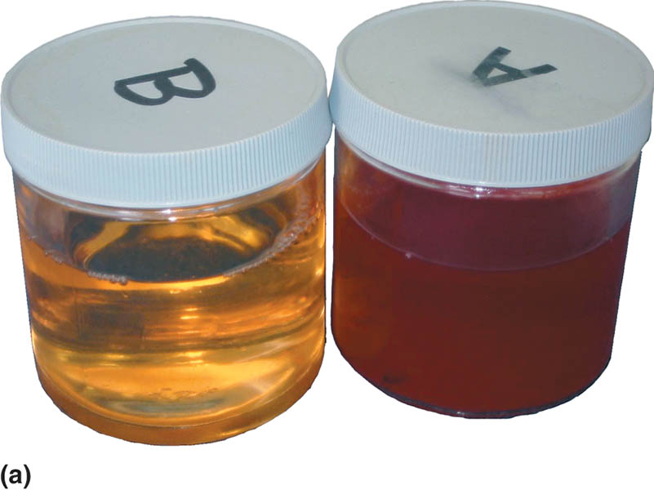
Figure 70.1 (a) Regular diesel fuel on the left has a clear or greenish tint, whereas fuel for off-road use is tinted red for identification

Slide 8
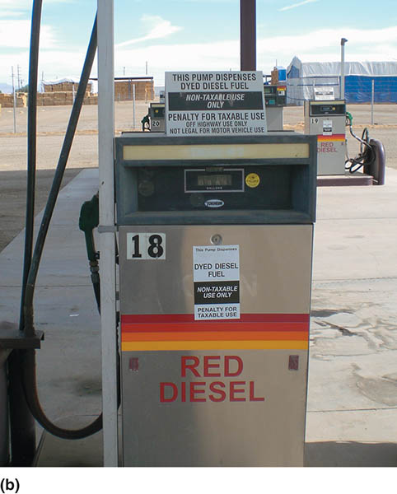
Figure 70.1(b) A fuel pump in a farming area that clearly states the red diesel fuel is for off-road use only (non-taxed)

Slide 9

Figure 70.2 Testing the API viscosity of a diesel fuel sample using a hydrometer

Slide 10
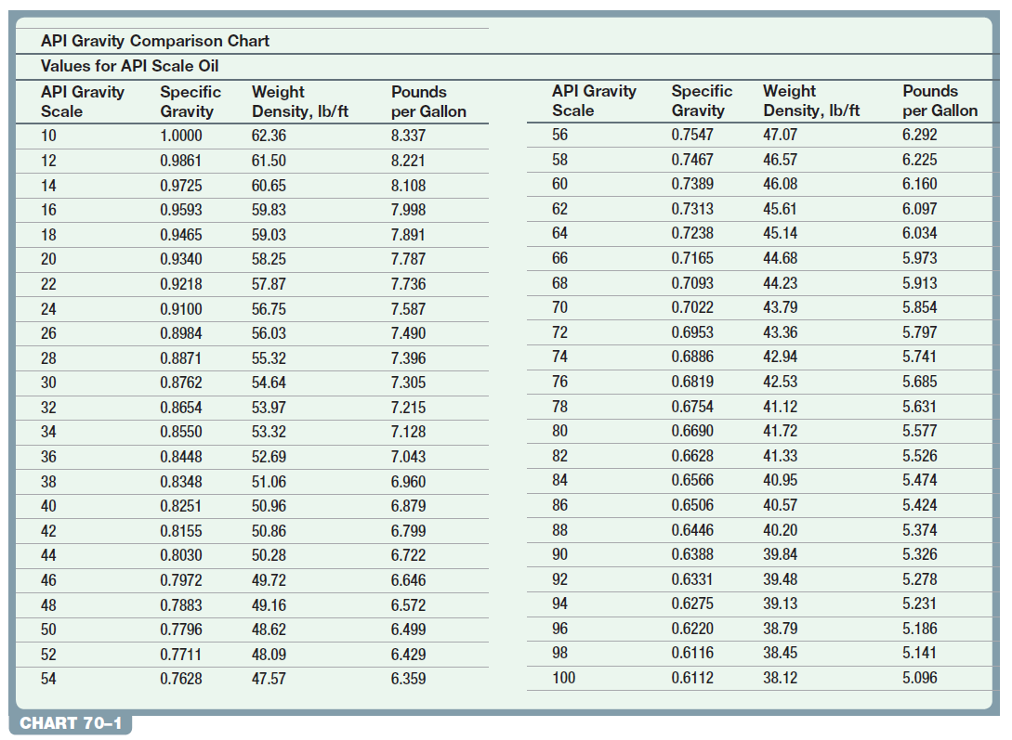

Slide 11
QUESTION 1: ?
What is the cetane number?

Slide 12
ANSWER 1:
The cetane number is a measure of the ease with which the fuel can be ignited.

Slide 13
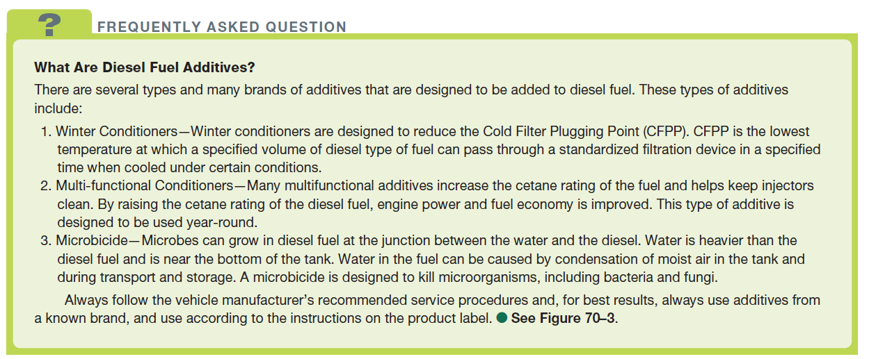
FREQUENTLY ASKED QUESTION

Slide 14
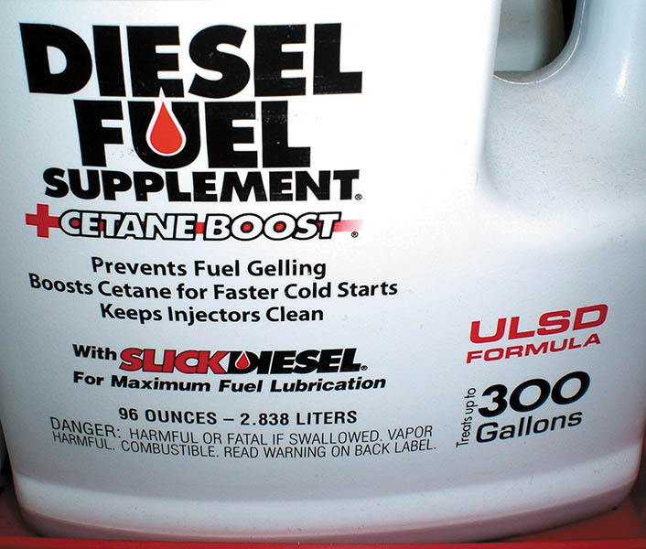
Figure 70.3 Many diesel fuel additives increase the cetane rating, which results in improved fuel economy

Slide 15
BIODIESEL
Definition of Biodiesel
Biodiesel is defined as mono-alkyl esters of long-chain fatty acids derived from vegetable oils or animal fats that conform to ASTM D6751 specifications for use in diesel engines.
Biodiesel Blends
Biodiesel blends are denoted as “BXX” with “XX” representing the percentage of biodiesel contained in the blend (i.e., B20 is 20% biodiesel, 80% petroleum diesel).

Slide 16
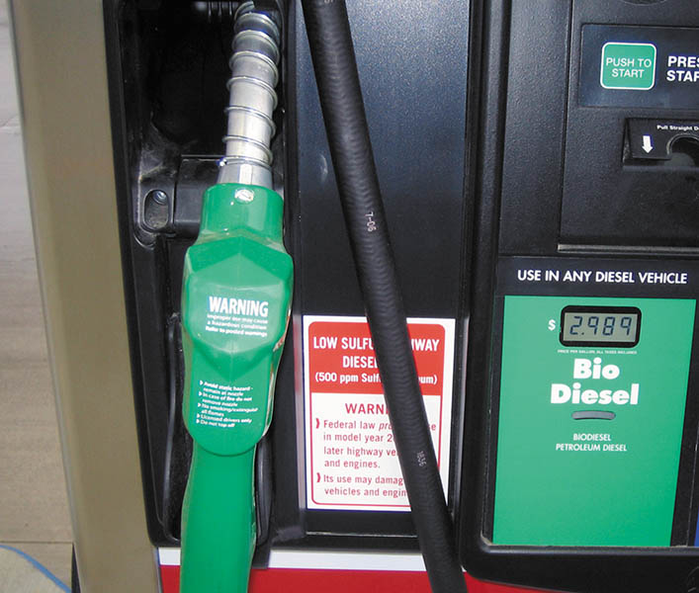
Figure 70.4 A pump decal indicating that the biodiesel fuel is ultra-low-sulfur diesel (ULSD) and must be used in 2007 and newer diesel vehicles

Slide 17
E-DIESEL FUEL
Definition of E-Diesel
E-diesel, also called diesohol outside of the United States, is standard No. 2 diesel fuel that contains up to 15% ethanol.
Cetane Rating of E-Diesel
Adding 15% ethanol lowers the cetane number.

Slide 18
QUESTION 2: ?
What does the 20 in B20 represent?

Slide 19
ANSWER 2:
The percentage of biodiesel used in the blend.

Slide 20

Copyright

