Slide 1

Automotive Technology Principles, Diagnosis, and Service
Sixth Edition
Chapter 7
Environmental and Hazardous Materials
Copyright © 2018, 2015, 2011 Pearson Education, Inc. All Rights Reserved

Slide 2
LEARNING OBJECTIVES
7.1 Identify hazardous waste materials in accordance with federal and state laws.
7.2. Discuss asbestos hazards and asbestos handling guidelines.
7.3. Explain the storage and disposal of brake fluid, used oil, coolants, lead-acid batteries, used tires, and air-conditioning refrigerant oil.
7.4 Explain the characteristics of hazardous solvents, fuel safety and storage, and airbag handling.

Slide 3
HAZARDOUS WASTE
Definition of Hazardous Waste
chemicals, or components, that the shop no longer needs that pose a danger to the environment and people if they are disposed of in ordinary garbage cans or sewers.
Personal Protective Equipment (PPE)
protective clothing and equipment detailed in the right-to know laws.

Slide 4
FEDERAL AND STATE LAWS (1 of 2)
Occupational Safety and Health Act
Creates safety and healthful working conditions through information, research, education, training and enforcement of standards developed under the act.
Environmental Protection Agency (EPA)
Publishes a list of hazardous materials that is included in the Code of Federal Regulations (CFR)
Right-To-Know Laws
Employees have a right to know when the materials they use at work are hazardous.
Includes Safety Data Sheets (SDS)

Slide 5
FEDERAL AND STATE LAWS (2 of 2)
Resource Conservation and Recovery Act
This law states that hazardous material users are responsible for hazardous materials to their grave.
Lockout/Tagout
This law states that hazardous material users are responsible for hazardous materials.
Clean Air Act
Regulates Air Conditioning refrigerant and the technicians who work on the systems.

Slide 6
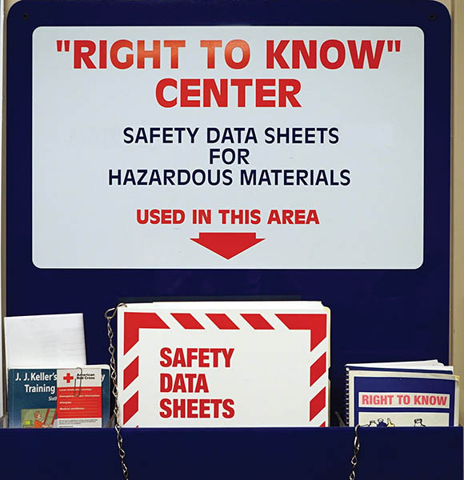
Figure 7.1 Safety Data Sheets (SDS) should be readily available for use by anyone in the area who may come into contact with hazardous materials

Slide 7
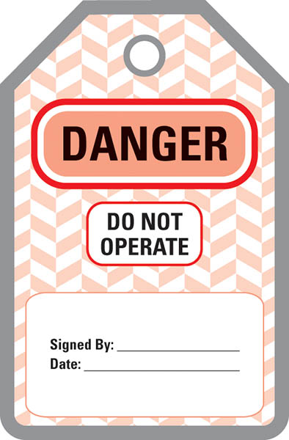
Figure 7.2 Tag that identifies the electrical power has been removed and service work is being done

Slide 8
ASBESTOS HAZARDS
Asbestosis: Scar tissue in the lungs that causes shortness of breath.
Asbestos OSHA Standards: limits exposure to less than 0.2 fibers per cubic centimeter (cc) as determined by an air sample.
Handling Guidelines:
HEPA Vacuum
Solvent Spray
Proper disposal of used shoes and pads

Slide 9
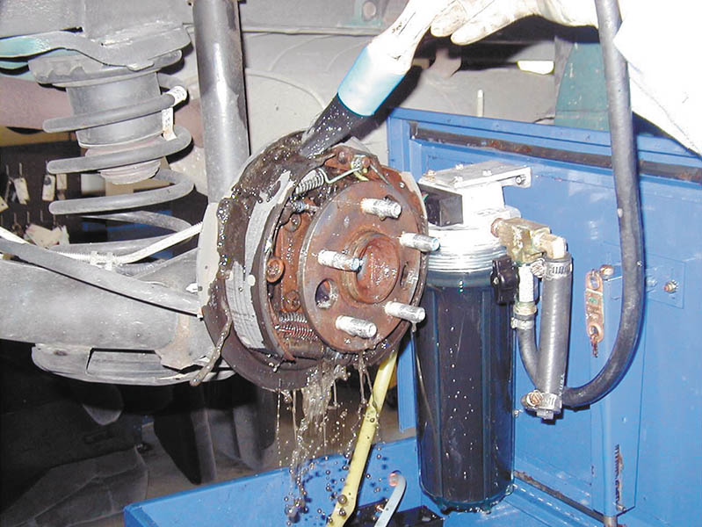
Figure 7.3 All brakes should be moistened with water or solvent to help prevent brake dust from becoming airborne

Slide 10
USED BRAKE FLUID
Collect brake fluid in a container clearly marked for that purpose.
Use only an authorized waste receiver for its disposal.
Do not mix used brake fluid with used engine oil.
Do not pour brake fluid down the drain.

Slide 11
USED OIL (1 of 2)
Used Oil: Any petroleum-based or synthetic oil that has been used.
Origin: Must have been refined from crude oil or made from synthetic materials.
Use: Oils used as lubricants, hydraulic fluids, and heat transfer fluids are considered used oil.
Contaminates: Physical or chemical impurities

Slide 12
USED OIL (2 of 2)
Storage and Disposal
Shipped offsite for recycling.
Burned onsite or offsite in an EPA-approved heater.
Used Oil Filter Disposal
Gravity drain for 12 hours.
Dismantle and hot drain.
Send for recycling

Slide 13
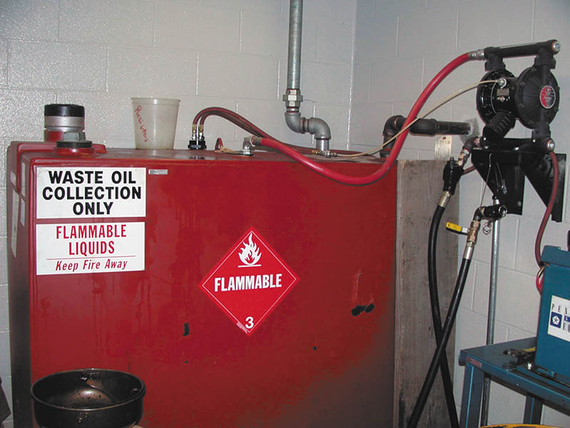
Figure 7.4 A typical aboveground oil storage tank

Slide 14
QUESTION 1: ?
How should used engine oil be disposed?

Slide 15
ANSWER 1:
Shipped offsite for recycling or burned in an EPA-approved heater.

Slide 16
COOLANT DISPOSAL
Used antifreeze may be hazardous due to dissolved metals from the engine and other components of the cooling system.
Coolant should be disposed of according to state and local regulations.

Slide 17
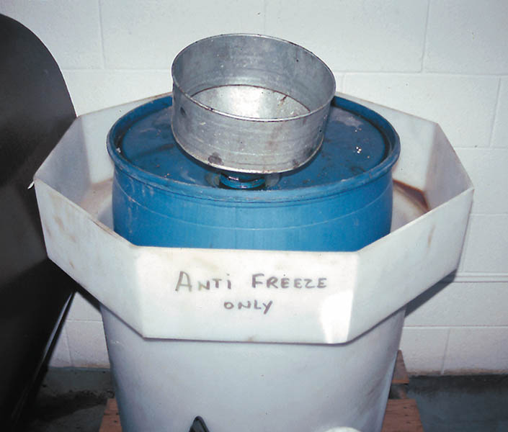
Figure 7.5 Used antifreeze coolant should be kept separate and stored in a leak-proof container until it can be recycled or disposed of according to federal, state, and local laws. Note that the storage barrel is placed inside another container to catch any coolant that may spill out of the inside barrel

Slide 18
USED TIRE DISPOSAL
Tires can be retreaded.
Tires can be shredded into asphalt.
Tires can be burned in cement kilns.
A registered scrap tire handler should be used for transport.

Slide 19
AIR-CONDITIONING REFRIGERANT OIL DISPOSAL
May contain dissolved refrigerant.
Must be separated from other oil waste.
Must be sent to a licensed hazardous waste disposal company.
.

Slide 20
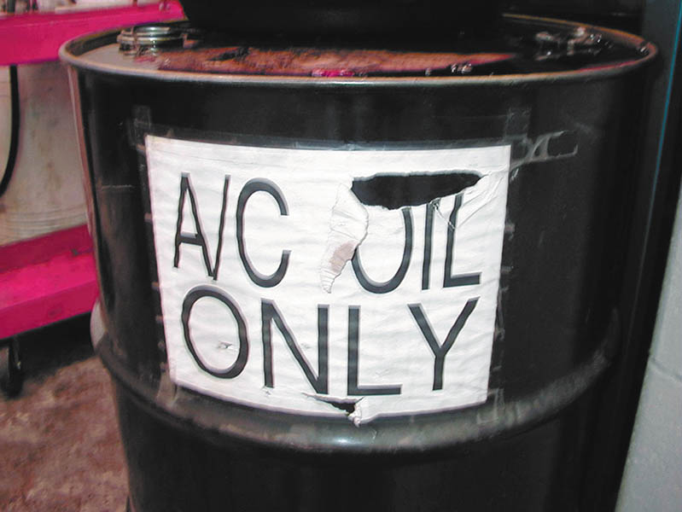
Figure 7.6 Air-conditioning refrigerant oil must be kept separated from other oils because it contains traces of refrigerant and must be treated as hazardous waste

Slide 21
LEAD-ACID BATTERY WASTE
Battery disposal according to the Battery Council International (BCI) rules.
Disposal prohibited in landfills or incinerators.
Retailers must display the universal recycling symbol and the their specific requirements for accepting used batteries.
Battery electrolyte contains sulfuric acid and is very corrosive.
Batteries contain lead which is highly poisonous.
Improperly disposed batteries can cause health and environmental concerns.

Slide 22
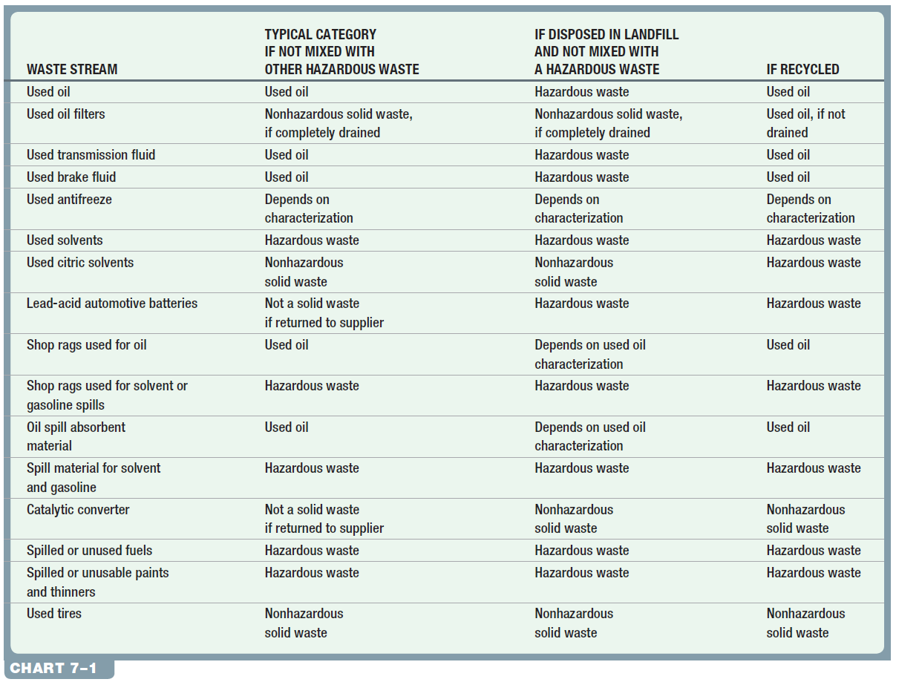
Chart 7.1 Typical waste materials generated at auto repair shops and typical category (hazardous or nonhazardous) by disposal method.

Slide 23
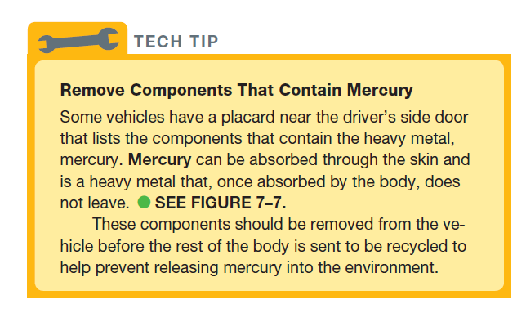
TECH TIP

Slide 24
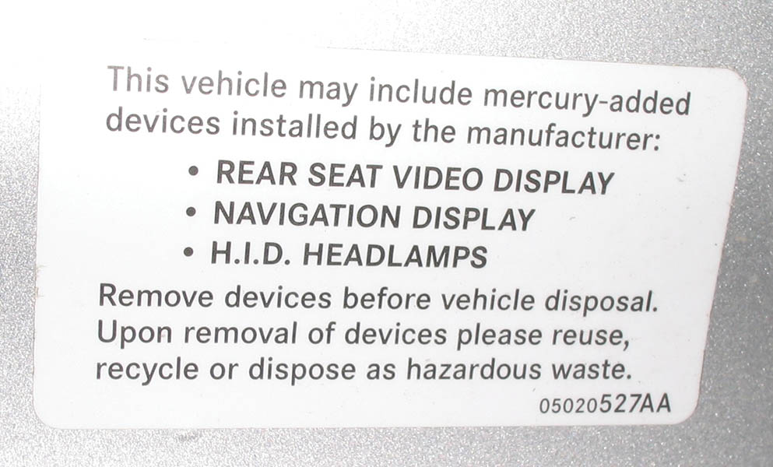
Figure 7.7 Placard near driver’s door, including what devices in the vehicle contain mercury

Slide 25
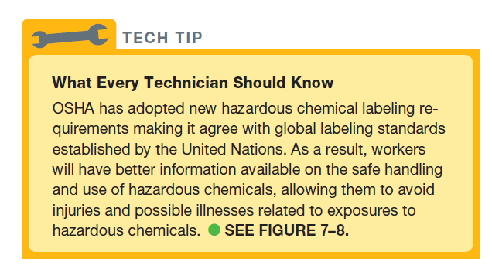
Tech Tip

Slide 26
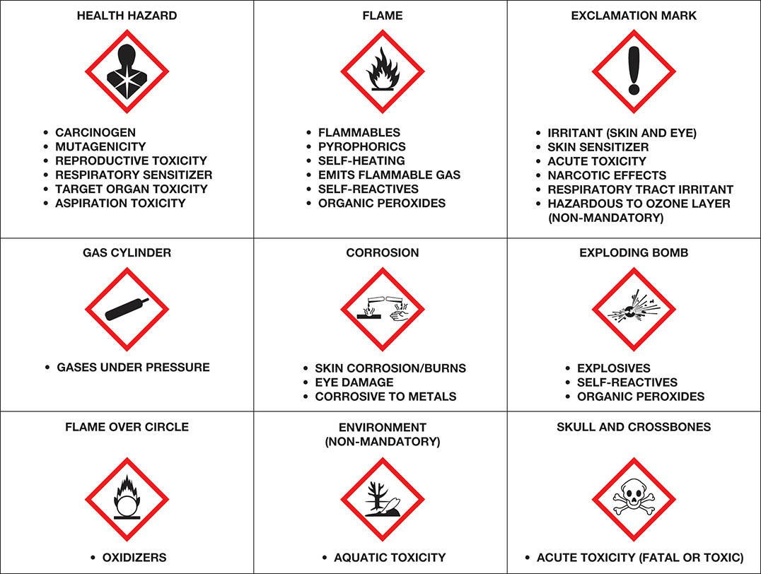
Figure 7.8 The OSHA global hazardous materials labels

Slide 27
SOLVENTS (1 of 2)
Effects of chemical poisoning
Headache
Nausea
Drowsiness
Lack of coordination
Unconsciousness

Slide 28
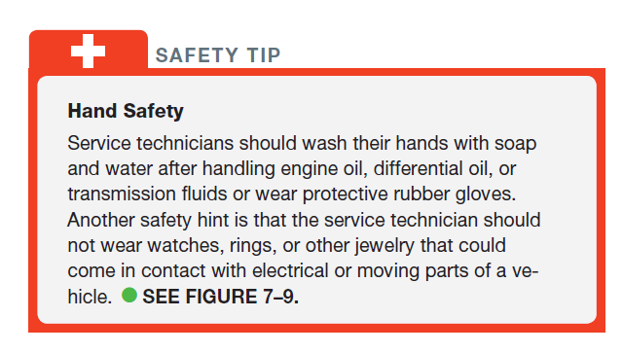
SAFETY TIP

Slide 29
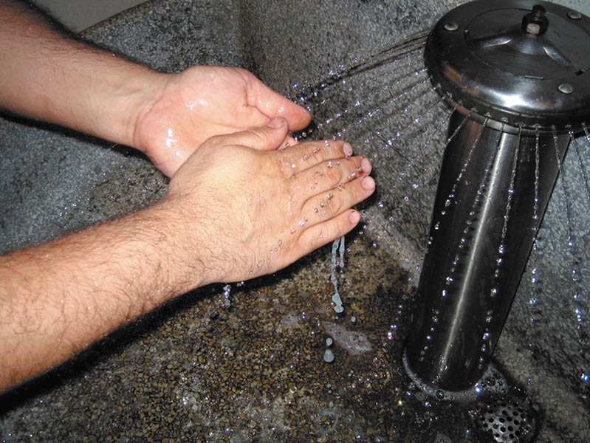
Figure 7.9 Washing hands and removing jewelry are two important safety habits all service technicians should practice

Slide 30
SOLVENTS (2 of 2)
Hazardous Solvents
Flammable solvents must be stored in a fireproof storage cabinet.
Used Solvents
Containers should be clearly labeled as Hazardous Waste.
Labels not required for parts washers.
Used solvents not counted towards monthly hazardous waste output.

Slide 31
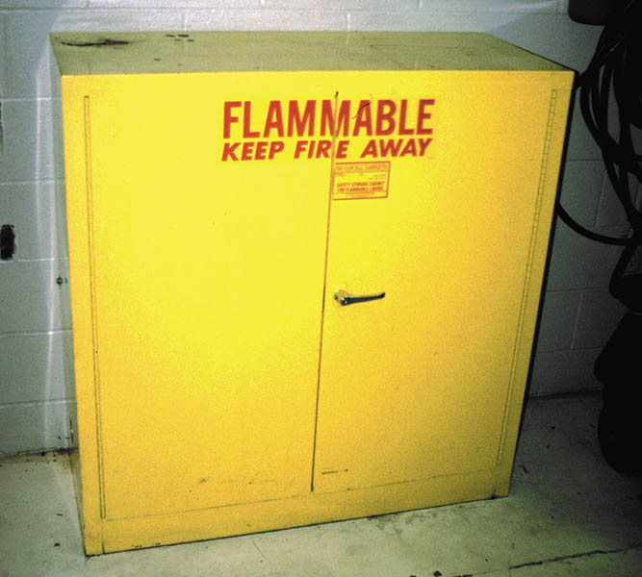
Figure 7.10 Typical fireproof flammable storage cabinet

Slide 32
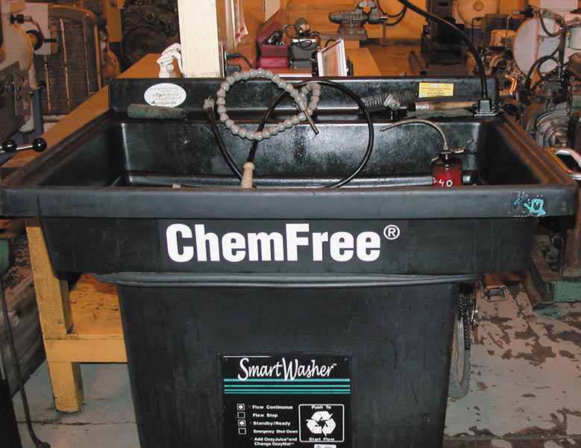
Figure 7.11 Using a water-based cleaning system helps reduce the hazards from using strong chemicals

Slide 33
FUEL SAFETY AND STORAGE
Use storage containers that have flash arresting screens.
Use only a red approved container.
Do not fill storage container full.
Never leave gasoline container open.
Never use gasoline as a cleaning agent.
Connect a ground strap when transferring fuel.

Slide 34
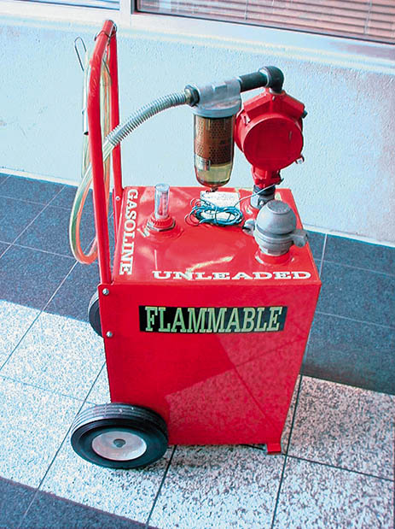
Figure 7.12 This red gasoline container holds about 30 gallons of gasoline and is used to fill vehicles used for training

Slide 35
QUESTION 2: ?
What color container should be used to store gasoline?

Slide 36
ANSWER 2:
Red.

Slide 37
AIR BAG HANDLING
Disable the air bag if you are working in an area where it might discharge.
Deploy an unused air bag before disposing.
Do not expose an air bag to heat or fire.
Carry the air bag pointed away from you.
Wear protective gloves when handling a deployed air bag.
Wash your hands after handling a deployed air bag.

Slide 38
QUESTION 3: ?
What precautions should be taken when handling a deployed air bag?

Slide 39
ANSWER 3:
Wear gloves and wash your hands when the complete.

Slide 40
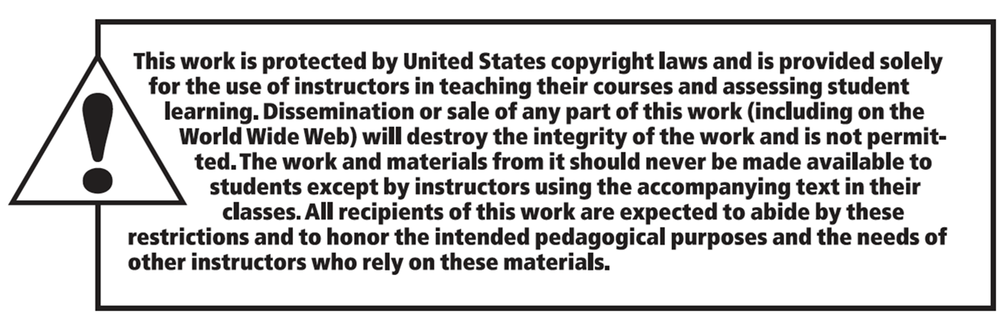
Copyright

