Slide 1

Automotive Technology Principles, Diagnosis, and Service
Sixth Edition
Chapter 68
Gasoline
Copyright © 2018, 2015, 2011 Pearson Education, Inc. All Rights Reserved

Slide 2
LEARNING OBJECTIVES (1 of 2)
68.1 Explain the chemical composition of gasoline and the process of refining gasoline.
68.2 Discuss how volatility affects driveability.
68.3 Describe the gasoline combustion process, normal versus abnormal combustion, and octane ratings and requirements.

Slide 3
LEARNING OBJECTIVES (2 of 2)
68.4 Discuss the benefits of using gasoline additives, blending gasoline, and reformulating gasoline.
68.5 Describe the procedure to test gasoline for alcohol content.
68.6 List gasoline recommendations for maintaining proper engine operation and minimizing fuel costs.
This chapter will help prepare for Engine Repair (A8) ASE certification test content area “A” (General Engine Diagnosis).

Slide 4
GASOLINE
Definition
  Gasoline is a term used to describe a complex mixture of various hydrocarbons refined from crude petroleum oil for use as a fuel in engines.
Chemical Composition
  Methane, Ethane, Propane, Butane, Pentane, Hexane, Heptane, Octane; depending on the number of carbon atoms.

Slide 5
REFINING (1 OF 2)
Types of Crude Oil
  Thin crude oil – called high gravity crude.
  Thick crude oil – called low gravity crude.
  Low Sulphur crude – called sweet crude.
  High Sulphur crude – called sour crude.
Distillation
  The crude is separated into different products by boiling

Slide 6
REFINING (2 OF 2)
Cracking
  Cracking is the process where hydrocarbons with higher boiling points could be broken down (cracked) into lower boiling hydrocarbons by treating them to very high temperatures.
  Instead of high heat, today cracking is performed using a catalyst and is called catalytic cracking.
  Hydrocracking is similar to catalytic cracking in that it uses a catalyst, but the catalyst is in a hydrogen atmosphere.

Slide 7
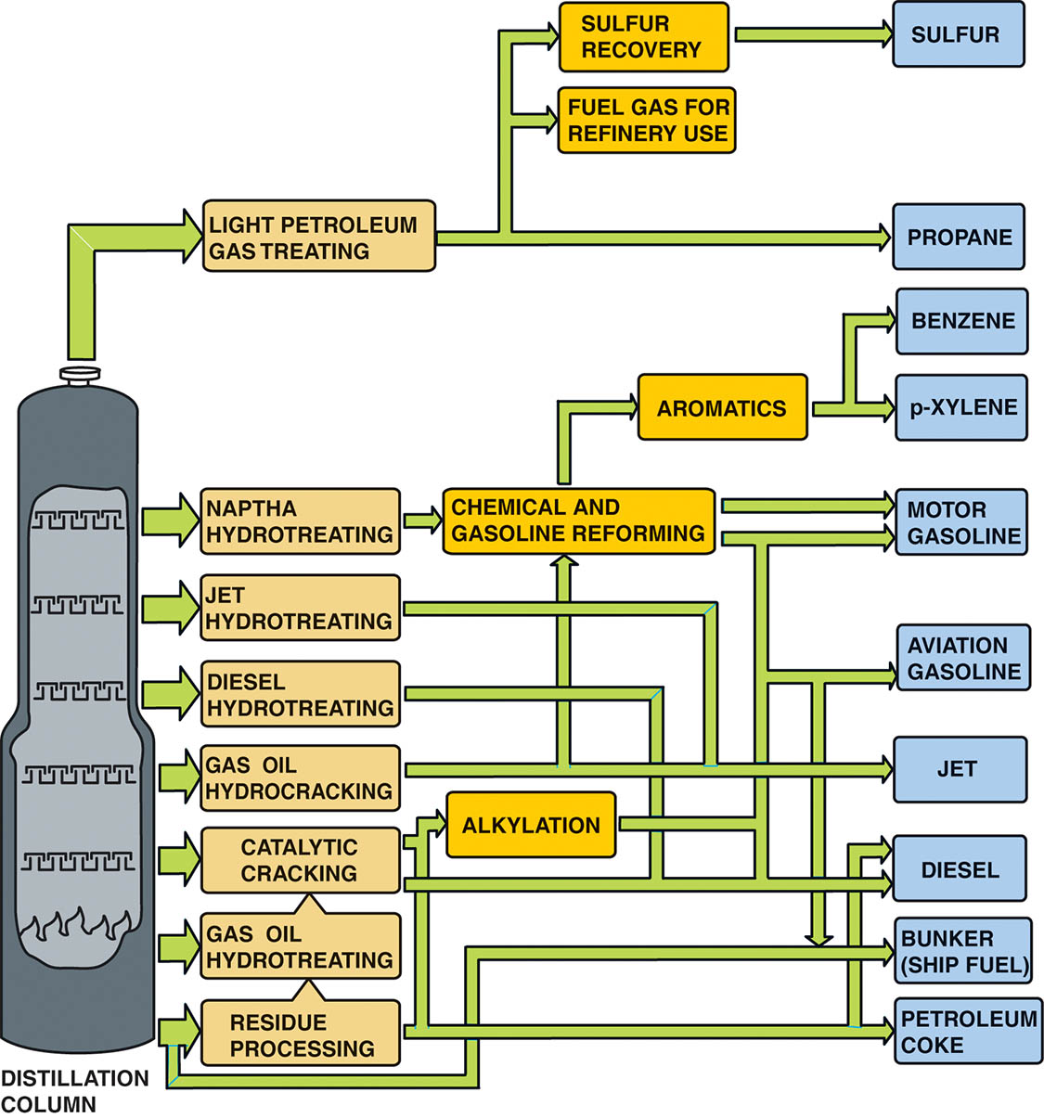
Figure 68.1 The crude oil refining showing most of the major steps and processes

Slide 8
VOLATILITY (1 OF 2)
Definition of Volatility
  Volatility describes how easily the gasoline evaporates (forms a vapor).
Reid Vapor Pressure (RVP)
  Reid vapor pressure (RVP) is the pressure of the vapor above the fuel when the fuel is at 100°F (38°C).
Seasonal Blending
  The adjustment of the RVP according to the season to match the vaporization rate with the temperature and improve starting.

Slide 9
VOLATILITY (2 OF 2)
Distillation Curve
  Another method of classifying gasoline volatility is the distillation curve
Driveability Index
  To predict cold weather driveability, an index was created called the driveability index, also called the distillation index (DI).
Volatility Related Problems
  Incorrect RVP can cause rough idle, stalling, hesitation on acceleration, and surging.

Slide 10
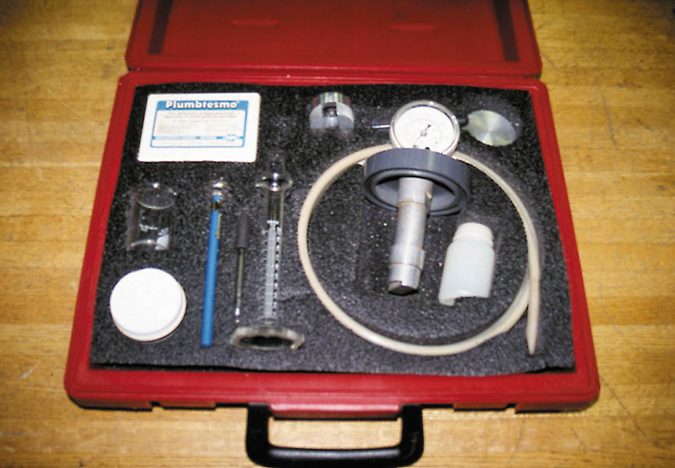
Figure 68.2 A gasoline testing kit, including an insulated container where water at 100°F (38°C) is used to heat a container holding a small sample of gasoline. The reading on the pressure gauge is the Reid vapor pressure (RVP)

Slide 11
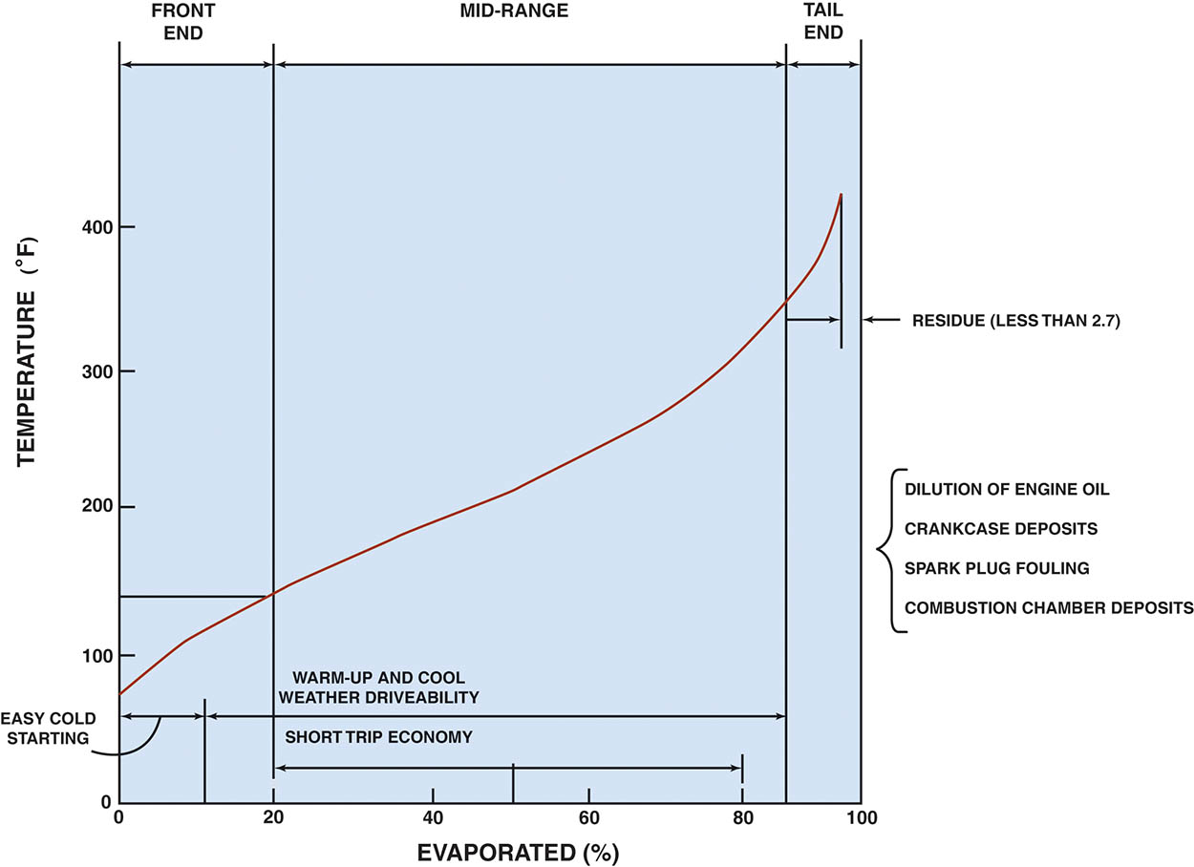
Figure 68.3 A typical distillation curve. Heavier molecules evaporate at higher temperatures and contain more heat energy for power, whereas the lighter molecules evaporate easier for starting

Slide 12
QUESTION 1: ?
What is Reid Vapor pressure?

Slide 13
ANSWER 1:
  Reid vapor pressure (RVP) is the pressure of the vapor above the fuel when the fuel is at 100°F (38°C).

Slide 14
GASOLINE COMBUSTION PROCESS (1 OF 2)
Chemical reactions
  The combustion process involves the chemical combination of oxygen (O2) from the air (about 21% of the atmosphere) with the hydrogen and carbon from the fuel.
Heat Energy
  The heat produced by the combustion process is measured in British thermal units (BTUs). One BTU is the amount of heat required to raise one pound of water one Fahrenheit degree.

Slide 15
GASOLINE COMBUSTION PROCESS (2 OF 2)
Air-Fuel Ratios
  The air–fuel ratio is the proportion by weight of air and gasoline that the injection system mixes, as needed, for engine combustion.
Stoichiometric Air-Fuel Ratio
  The ideal mixture or ratio (approximately 14.7 to 1) at which all of the fuel combines with all of the oxygen in the air and burns completely is called the stoichiometric ratio, a chemically perfect combination.

Slide 16
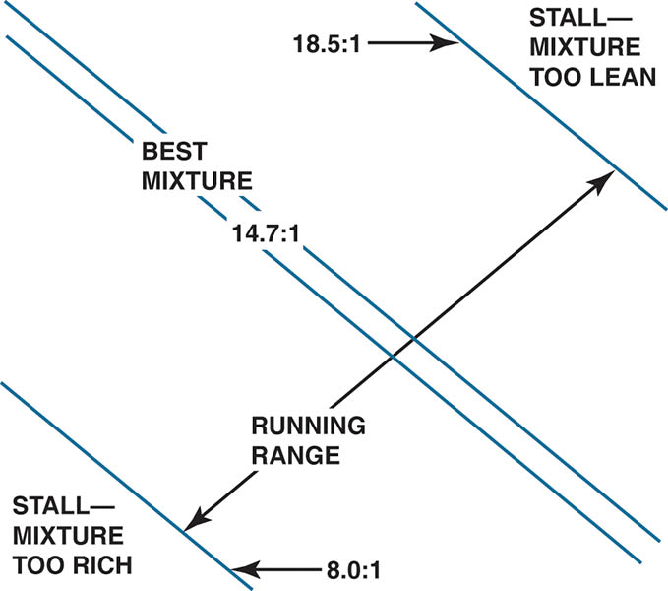
Figure 68.4 An engine does not run if the air–fuel mixture is either too rich or too lean

Slide 17
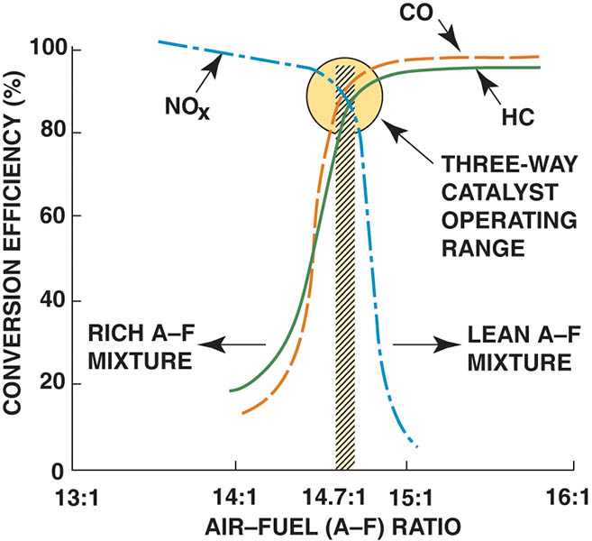
Figure 68.5 A three-way catalytic converter operates most efficiently when the air–fuel ratio is between 14.65 to 1 and 14.75 to 1

Slide 18
QUESTION 2: ?
What is stoichiometric ratio?

Slide 19
ANSWER 2:
An air/furl mixture of approximately 14.7:1.

Slide 20
NORMAL AND ABNORMAL COMBUSTION
Normal Combustion
  Normal combustion occurs smoothly and progresses across the combustion chamber from the point of ignition.
Abnormal Combustion
  Engine knock (also called detonation, spark knock, or ping) is a metallic noise an engine makes, usually during acceleration, resulting from abnormal or uncontrolled combustion inside the cylinder.

Slide 21
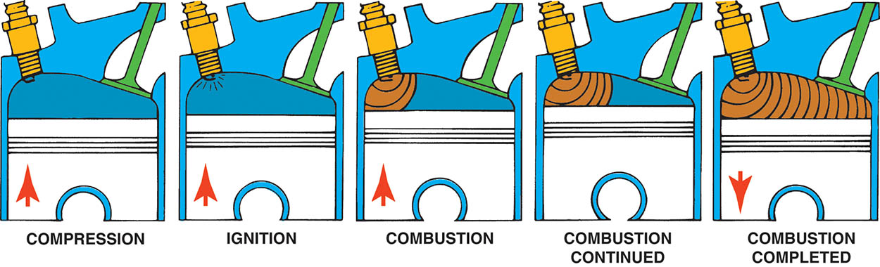
Figure 68.6 Normal combustion is a smooth, controlled burning of the air–fuel mixture

Slide 22
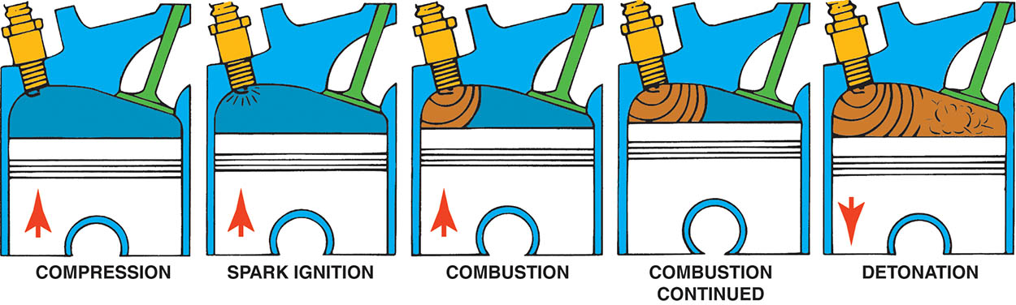
Figure 68.7 Detonation is a secondary ignition of the air–fuel mixture. It is also called spark knock or pinging

Slide 23
OCTANE RATINGS
The two basic methods used to rate gasoline for antiknock properties (octane rating) are the research method and the motor method.
The octane rating posted on pumps in the United States is the average of the two methods and is referred to as (R + M) / 2.

Slide 24
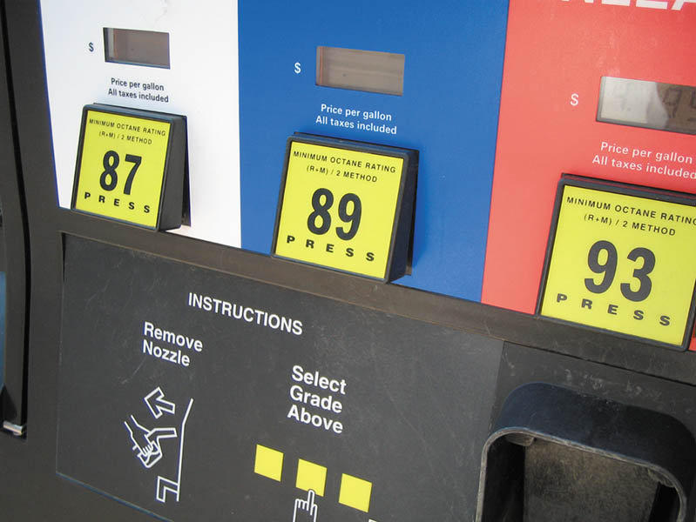
Figure 68.8 A pump showing regular with a pump octane of 87, plus rated at 89, and premium rated at 93. These ratings can vary with brand, as well as in different parts of the country

Slide 25
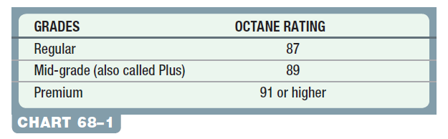
Chart 68-1 Typical octane ratings for gasoline in most parts of the country.

Slide 26
HIGH-ALTITUDE OCTANE REQUIREMENTS
The octane rating of fuel does not need to be as high because the engine cannot take in as much air.
In mountainous areas, gasoline (R + M) / 2 octane ratings are two or more numbers lower than normal (according to the SAE, about one octane number lower per 1,000 feet or 300 meters in altitude).

Slide 27
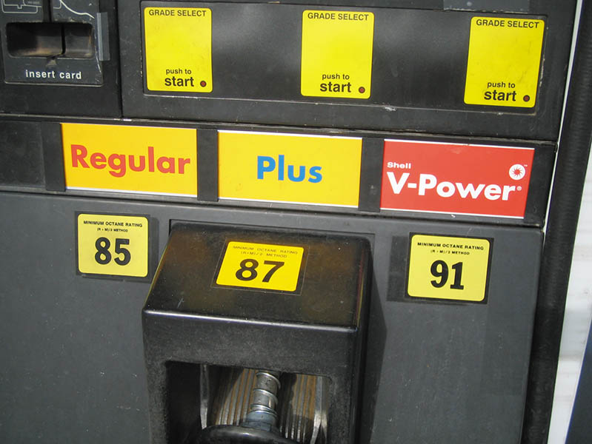
Figure 68.9 The posted octane rating in most high-altitude areas shows regular at 85 instead of the usual 87

Slide 28
QUESTION 3: ?
Why does the octane level in gasoline vary with altitude?

Slide 29
ANSWER 3:
At higher altitude the air is less dense.

Slide 30
GASOLINE ADDITIVES (1 OF 2)
Dye
  Dye is usually added to gasoline at the distributor to help identify the grade and/or brand of fuel.
Octane Improver Additives
  Aromatic hydrocarbons (hydrocarbons containing the benzene ring), such as xylene and toluene
  Alcohols, such as ethanol (ethyl alcohol), methanol (methyl alcohol), and tertiary butyl alcohol (TBA)
  Metallic compounds, such as methylcyclopentadienyl manganese tricarbonyl (MMT)

Slide 31
GASOLINE ADDITIVES (2 OF 2)
Oxygenated Fuel Additives
  Methyl Tertiary Butyl (MTBE) – Now phased out due to health concerns.
  Tertiary-Amyl Methyl Ether (TAME) - An oxygen atom bonded to two carbon atoms and is added to gasoline to provide oxygen to the fuel.
  Ethanol (Ethyl Alcohol) – The addition of ethanol at a rate of 10% adds 3.5% oxygen by weight

Slide 32
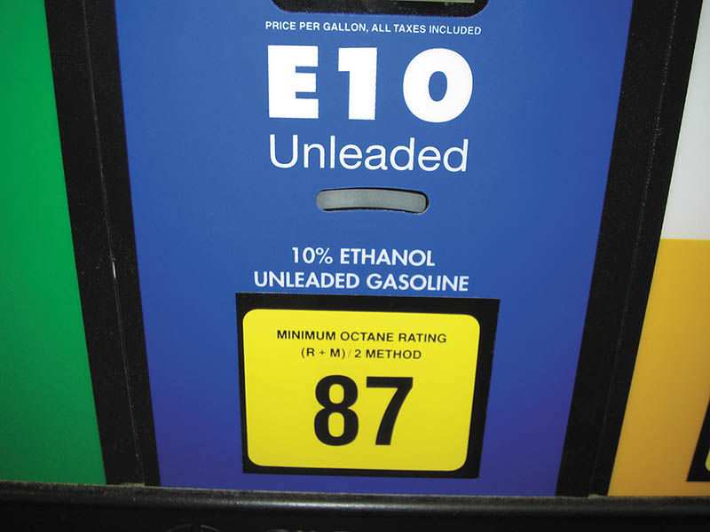
Figure 68.10 E10 is 10% ethanol and 90% gasoline

Slide 33
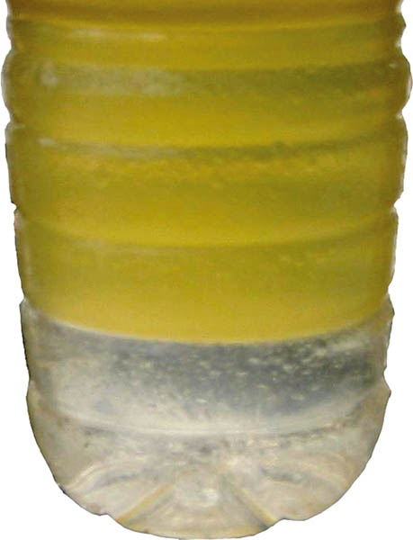
Figure 68.11 A container with gasoline containing alcohol. Notice the separation line where the alcohol-water mixture separated from the gasoline and sank to the bottom

Slide 34
GASOLINE BLENDING
Inline Blending: Gasoline and ethanol are mixed in a storage tank or in the tank of a transport truck while it is being filled.
Sequential Blending: At the terminal a measured amount of ethanol is added to the tank truck followed by a measured amount of gasoline.
Splash Blending: Splash blending can be done at the retail outlet or distributor and involves separate purchases of ethanol and gasoline.

Slide 35
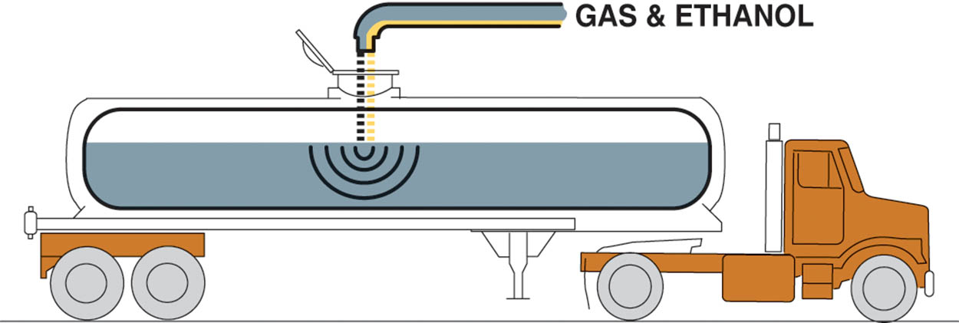
Figure 68.12 In-line blending is the most accurate method for blending ethanol with gasoline because computers are used to calculate the correct ratio

Slide 36
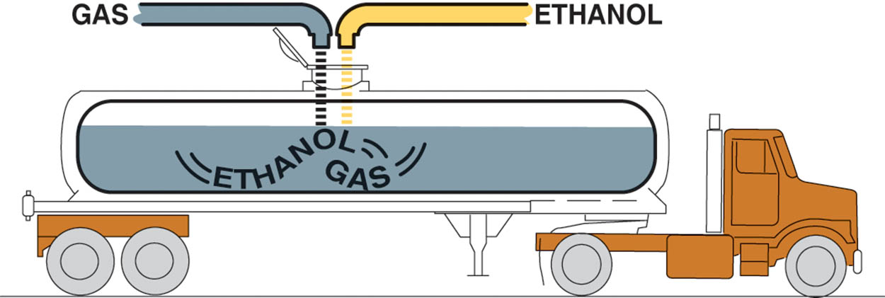
Figure 68.13 Sequential blending uses a computer to calculate the correct ratio as well as the prescribed order in which the products are loaded

Slide 37
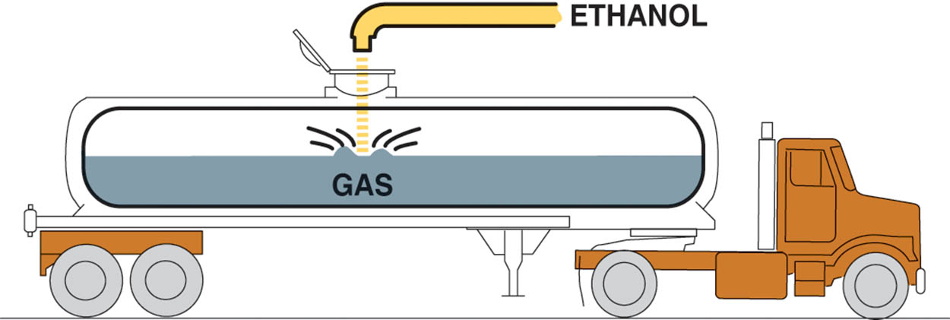
Figure 68.14 Splash blending occurs when the ethanol is added to a tanker with gasoline and is mixed as the truck travels to the retail outlet

Slide 38
REFORMULATED GASOLINE
Reformulated gasoline (RFG) is manufactured to help reduce emissions.
  The additives contain at least 2% oxygen by weight and the additive benzene is reduced to a maximum of 1% by volume.
  Reduce light compounds such as butane and propane.
  Refineries eliminate heavy compounds with high boiling points, such as aromatics and olefins.

Slide 39
TESTING GASOLINE FOR ALCOHOL CONTENT
Pour suspect gasoline into a graduated cylinder.
Fill the graduated cylinder to the 90 mL mark.
Add 10 mL of water to the graduated cylinder
Shake vigorously the cylinder for one minute.
Let it stand for two minutes.
Take a reading at the boundary between the two liquids.
For percent of alcohol in gasoline, subtract 10 mL from the reading

Slide 40
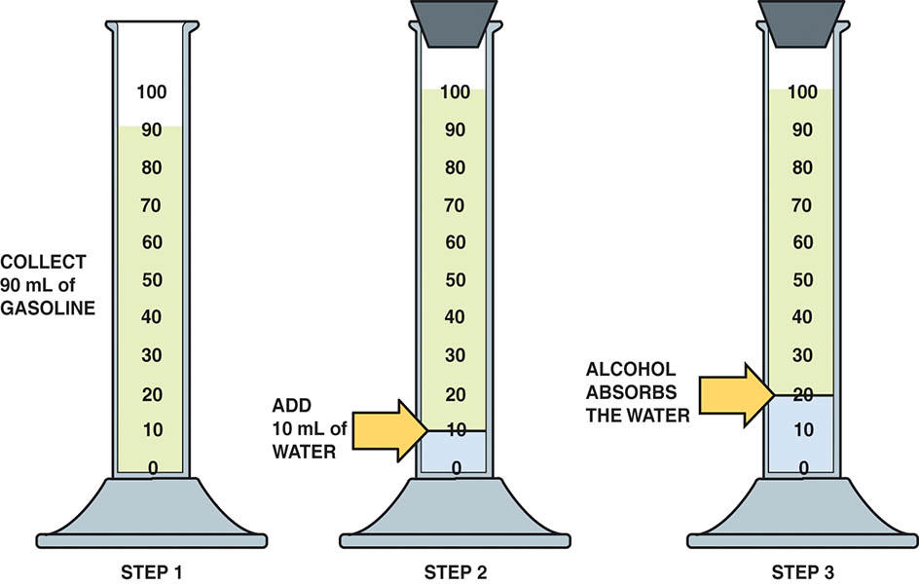
Figure 68.15 Checking gasoline for alcohol involves using a graduated cylinder and adding water to check if the alcohol absorbs the water

Slide 41
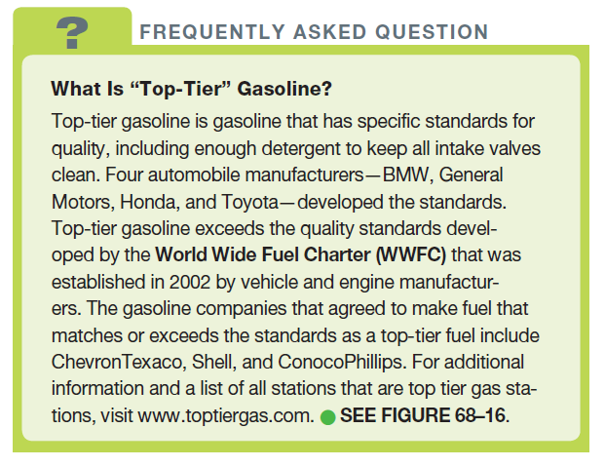
FREQUENTLY ASKED QUESTION

Slide 42
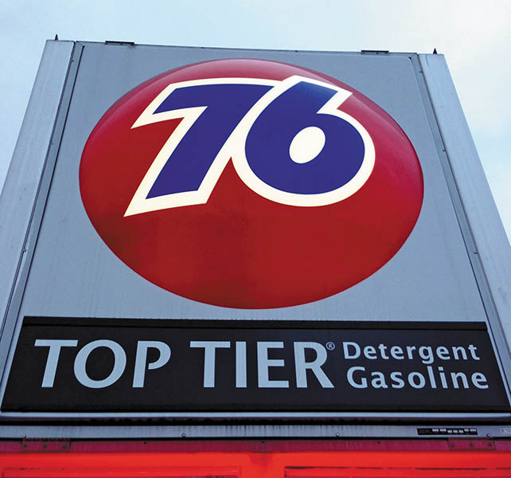
Figure 68.16 Not all top-tier gas stations mention that they are top-tier like this station. For more information and the list of top-tier gasoline stations, visit www.toptiergas.com

Slide 43
GENERAL GASOLINE RECOMENDATIONS
Purchase fuel from a busy station.
Keep the fuel tank above one-quarter full.
Do not purchase fuel with a higher octane rating than is necessary.
Do not overfill the gas tank.
Be careful when filling gasoline containers.

Slide 44
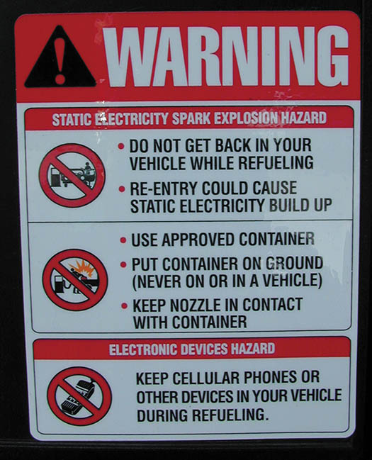
Figure 68.17 Many gasoline service stations have signs posted warning customers to place plastic fuel containers on the ground while filling.

Slide 45
TESTING FOR ALCOHOL CONTENT IN GASOLINE

Slide 46
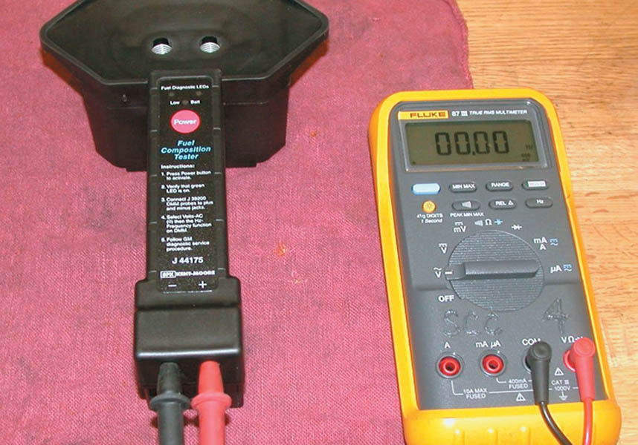
1. A fuel composition tester (SPX Kent-Moore J-44175) is the recommended tool, by General Motors, to use to test the alcohol content of gasoline.

Slide 47
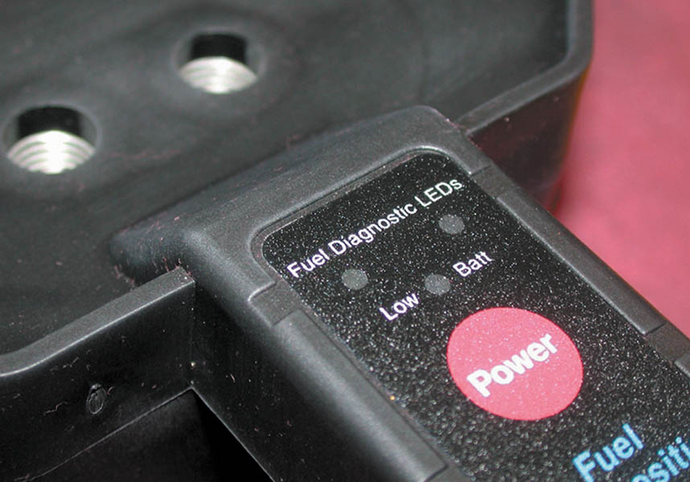
2. This battery-powered tester uses light-emitting diodes (LEDs), meter lead terminals, and two small openings for the fuel sample.

Slide 48
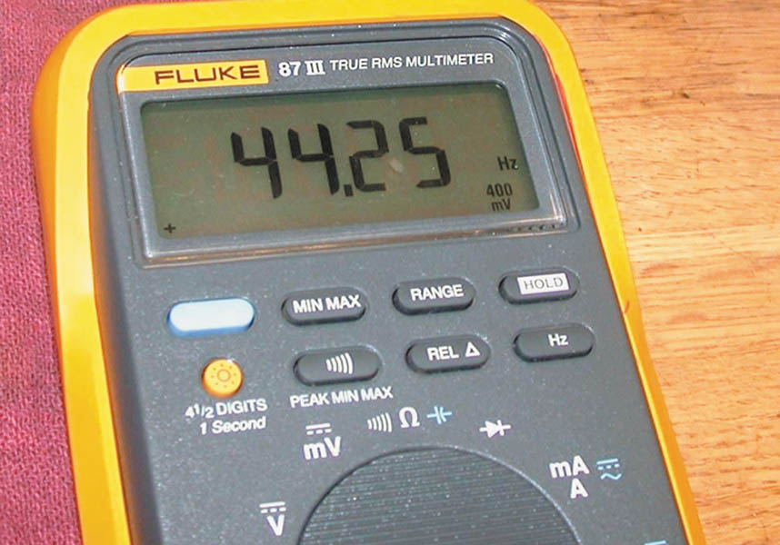
3. The first step is to verify the proper operation of the tester by measuring the air frequency by selecting AC hertz on the meter. The air frequency should be between 35 and 48 Hz.

Slide 49
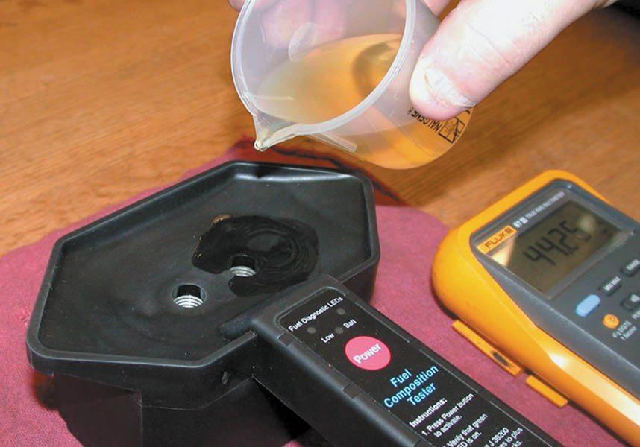
4. After verifying that the tester is capable of correctly reading the air frequency, gasoline is poured into the testing cell of the tool.

Slide 50
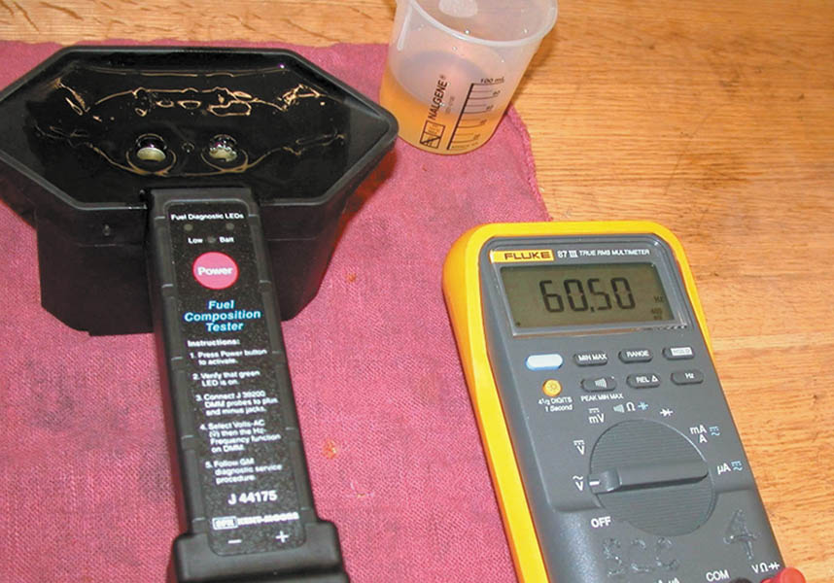
5. Record the AC frequency as shown on the meter and subtract 50 from the reading (e.g., 60.50 - 50.00 = 10.5). This number (10.5) is the percentage of alcohol in the gasoline sample.

Slide 51
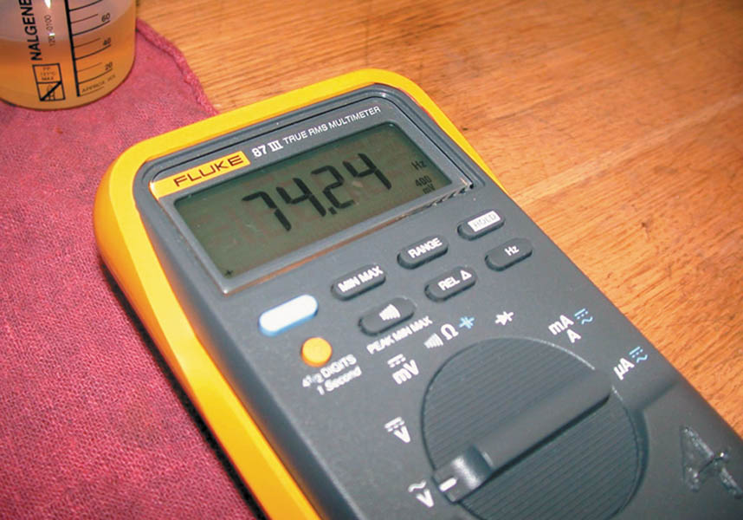
6. Adding additional amounts of ethyl alcohol (ethanol) increases the frequency reading.

Slide 52

Copyright

